Slide 1
Google’s Solution to Energy Storage: Project Malta
Amos Meeks
11/3/17
Notes:
Amos Meeks, G2, Applied Physics
Came across this through the American Energy Society Newsletter, “Energy Matters”
“The latest idea from Alphabet (Google's parent company) is a project code named Malta - the research lab is developing vats of salt and antifreeze as a system for storing renewable energy.”
Turns out there’s a paper, good topic for Journal club.

Slide 2
Why is Storage Important?
Notes:
Electricity Demand follows a sinusoidal sort of curve
Renewables are intermittent, and often don’t line up with peak demand
E.g. negative electricity prices in California
Large grid-scale Storage is necessary to help even this out
Also might want storage for day-to-day (think wind) and possibly even season-to-season variability management (solar in NE)

Slide 3
Different Kinds of Storage
Pumped Hydro
Thermal Storage
Hydrogen Storage
Electrochemical Storage
Notes:
many different kinds of grid scale storage currently in use, none of them on a wide enough scale
Pumped Hydro
Thermal, often paired with CSP
Compressed Air Energy Storage (CAES), often paired with natural gas
Hydrogen Storage
Flywheels
Electrochemical, aka batteries
Top three are generally affordable but geographically limited
Bottom three are expensive but not geographically limited

Slide 4
Source: U.S. Energy Information Administration, Preliminary Monthly Electric Generator Inventory
Notes:
Storage in the US: As of 2011 ~23 GW, 96% pumped hydro, mostly from 60s and 70s
Not really more places for pumped hydro

Slide 5
What is “Project Malta”?
T₀⁺
T₁
Notes:
“Pumped Thermal Storage”
Uses a Brayton cycle, basically used in jet or car engines
Those use combustion to add heat
Here run in storage mode to generate and store hot and cold
Then use hot and cold resevoirs to generate electricity
Explain basics of cycle
Here’s a mock up of what it might look like at scale
Currently google X has spent 2 Years of design and small scale prototyping (largely around turbine and heat exchangers),
recently publicized project and now looking for partners to create MW scale prototype.

Slide 6
Significance
Malta Estimates:
$12.7 per kWh
$600 per kW
Pumped thermal energy storage that is safe, cost competitive with pumped hydro, and can be sited anywhere, all without any significant scientific technological innovations needed, only ”21st century engineering.”
Malta?
Notes:
Compare capital costs per kW and costs per kWh
Power vs. total energy storage
Or think of need you want to fulfil (New York City?) and then how long you want to supply/time scale of demand flattening (1/2 day? 1 week?)
Best options towards lower left
Examples: Capacitors good at high power but not as good at energy storage
Hydrogen, if it were on here, would be the other extreme: good at storage but not at power
Batteries often in the middle
Best options are things like CAES or Hydro, currently constrained
What about Malta? Paper estimates better energy storage for same power cost as hydro or CAES, but not geographically constrained
Where does this estimate come from? Let’s find out
Second: http://alfin2101.blogspot.com/2011/09/state-of-art-in-energy-storage.html

Slide 7
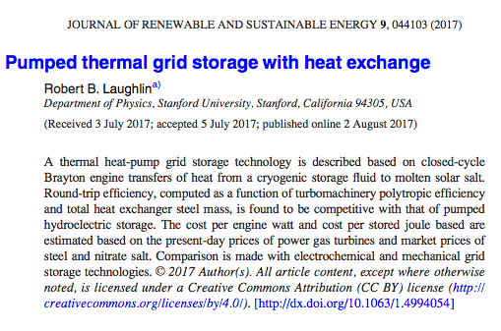
Let’s Design a Pumped Thermal Storage System!
Professor Laughlin is a theorist with interests ranging from hard-core engineering to cosmology. He is an expert in semiconductors (Nobel Prize 1998) and has also worked on plasma and nuclear physics issues related to fusion and nuclear-pumped X-ray lasers. His technical work at the moment focuses on “correlated-electron” phenomenology – working backward from experimental properties of materials to infer the presence (or not) of new kinds of quantum self-organization. He recently proposed that all Mott insulators – including the notorious doped ones that exhibit high-temperature superconductivity – are plagued by a new kind of subsidiary order called “orbital antiferromagnetism” that is difficult to detect directly. He is also the author of A Different Universe, a lay-accessible book explaining emergent law.
Notes:
This is the paper “Pumped Thermal Grid Storage with Heat Exchange”
Published in 2017 but clearly has been working on this for at least 2 years
Prof. Laughling is a nobel prize winning physicist at Stanford
Nobel Prize in 1998 for the fractional quantum hall effect
For most of the rest of this talk I’ll walk you through the paper in an effort to see where cost estimates come from

Slide 8
Optimization
1 New York City x 1 Hr =
Safety
Low Cost
High Efficiency
Energy storage, not energy conservation
In this order!
Notes:
When designing we need to establish optimization priorities
Laughlin suggests Safety, Low Cost, high Efficiency, IN THIS ORDER
Why? Energy stored can be equivalent to hiroshima bomb. Must not have explosive release
Cost is self explanatory
Efficiency only important insofar as it lowers cost, we care about affordable storage of energy, not conserving every Joule

Slide 9


Material Constraints
T₀⁺
$$η_{max}=\frac{T_{H}−T_{C}}{T_{H}}$$
$$Power∝Pressure$$
T₁
Notes:
start with what to make it out of
Optimization:
Safety: material must be very safe under high pressures and temperatures, or rather safe pressured and temps chosen to match material
Cost: Material must be cost effective and mass producible (so probably not refractory ceramics)
Efficiency maximized for high temperatures (remember Carnot)
Power maximized (and thus lower cost per power) at high pressures, more molecules flowing through system

Slide 10
Material Constraints
Creep Cliff
Stainless Steels
Proven Cycle Max Pressures ~ 10⁷ Pa
Carbon Steels
Low-Alloy Steels
T_{max} for steel ~ 850K
Maximum steel stress allowed by the 2007 ASME Boiler and Pressure Vessel Code, Part II, Section D, Tables 1A and 1B for a representative selection of steels (seamless tubing).²²The “creep cliff” at T = 873 K (600 °C) is clearly visible.
Notes:
Steel is a good material to use for cost
Steels are limited by the creep cliff
This gives us a max temperature and pressure for the system in order to ensure safety
Next question is what to use for thermal storage materials

Slide 11
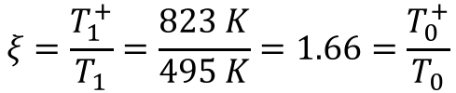
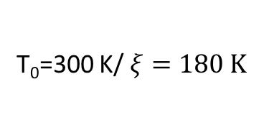
Thermal Storage Materials
T₀⁺
$$ξ=\frac{T_{1}^{+}}{T_{1}}=\frac{823 K}{495 K}=1.66=\frac{T_{0}^{+}}{T_{0}}$$
823 K
T₀⁺=300 K
T₀=300 K/ $ξ=180 K$
T₁
ΔT₁
Cold fluid must stay liquid between 300 K and 180 K. This means hydrocarbons, e.g. hexane, methanol, propylene glycol (AKA Antifreeze).
495 K
The NaNO₃/KNO₃ phase diagram, after Rogers and Janz.²⁶ The measurements of the liquidus and solidus lines are from Rogers and Janz and also Kramer and Wilson.²⁷The lines are theory due to Zhang et al.²⁸ The eutectic freezing temperature is 495 K (222 °C). The decomposition temperature is 823 K (550 °C).^{29–32}
Notes:
Solar salt a good choice for hot material, being already used for similar applications
Very stable, not very corrosive to steel
Upper temp limited by decomposition at 823 K, matches well with steel temp limitations
Lower temp limited by eutectic freezing temp, 495 K
This gives us a ratio Xi between T1 and T1+
Cold side must have same ratio, and T0+ must be at ambient to dump waste heat
Thus cold storage temp is 180 K
Need fluid that is liquid between those temps, basicall antifreeze

Slide 12
Working Fluid
Must be:
Chemically stable at 823 K
No phase transition between 180 K and 823 K (for safety!)
Cheap
Ar or N₂
Notes:
Now we have structural material and thermal storage material
This determined conditions for working fluid that actually flows through system
Any ideas for these constraints?
Best options probably Ar or N2.

Slide 13
Regeneration
Notes:
Since T1>T0+, there is some overlap where one side is trying to cool by as much as the other side tries to heat
We can thus add another heat exchanger to improve efficiency, called regeneration

Slide 14
Progress so far
Notes:
So far we have determined:
Overall cycle type
Structural materials
Hot and cold temps and storage materials
Working fluids
What is left?
Turbomachinery: compressor and turbine
Heat exchangers

Slide 15



Heat Exchangers
Minimize Cost (Steel Mass)
L is fixed to optimize turbulent heat transfer, thus M is minimized by minimizing b/a
Illustration of the shell-and-tube prototype for the heat exchanger. The number of tubes shown is N = 151. The lower right shows the case of b/a = 1.224 and d/b = 1.25. The lower left shows the case of b/a = 1.491.
$$\frac{b}{a}≈1.3$$
Notes:
Start by looking at heat exchangers
Basic design here for estimating steel amount
After doing some fluid dynamics and heat transfer that I won’t go into, you get equation for steel mass per engine power
Total length L is fixed to optimize turbulent heat transfer
Thus we want to minimize b/a, or the thickness, while still maintaining safety, so constrained by max stress under pressure and safety factor
Low temperature could be smaller than high temperature
A reasonable Estimate is around b/a = 1.3

Slide 16
Compressor and Turbine
Current efficiency and costs range from 0.3-0.6 and around $0.25/W
Custom design needed (this is what has been done the past two years)
Notes:
The compressor and turbine are more mundane
What is needed is a specially designed version of engines you can buy off the shelf. Efficiency and cost unlikely to vary dramatically
Custom turbine design seems to be much of what they’ve done in the past two years

Slide 17


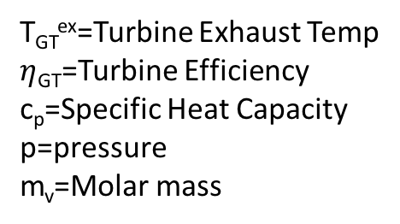
Putting it all together: Costs
T_{GT}^{ex}=Turbine Exhaust Temp
$η$_{GT}=Turbine Efficiency
c_{p}=Specific Heat Capacity
p=pressure
m_{v}=Molar mass
Turbine Cost Scaled by System Size
Total Heat Exchanger
Steel Cost
Energy extraction
efficiency
Material Costs per Energy Storage Size
Notes:
Let’s put it all together to estimate costs
Two equations, cost per kilowatt (E dot) and cost per kWh (E)
Power cost assumed to be dominated by turbine cost and heat exchanger steel cost
Energy cost assumed to be dominated by thermal storage fluids
Ask to list out assumptions in these?

Slide 18
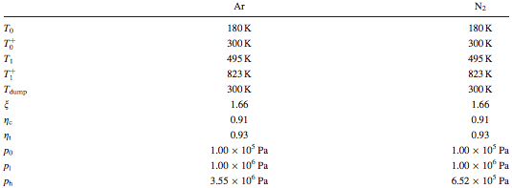
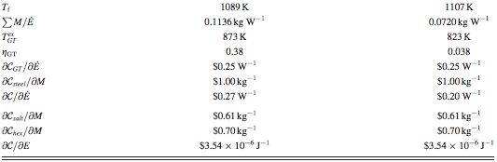
Cost Numbers
$3.54x10⁶ J⁻¹ = $12.7 per kWh
Notes:
So now we can plug all of our numbers in and see what comes out
Solid line is direct estimate here
Dotted lines are with $0.35/W more, based on converting a $0.24/W turbine to a full $0.6/W power plant
Slope is the cost per kWh, $12.7

Slide 19
Other Project Costs
Source: EIA “Capital Cost Estimates for Utility Scale Electricity Generating Plants “ https://www.eia.gov/analysis/studies/powerplants/capitalcost/pdf/capcost_assumption.pdf
Notes:
Is that $0.35/W a reasonable amount to add to make up for all of the other costs?
Here is capital cost data far two similar projects
A conventional gas fired power plant and a battery storage facility
We estimated mechanical costs, which tend to be about half of total costs. $0.35/W is roughly double, so it does seem feasible.
Note that we have not discussed operating costs, which are necessary to predict true lifetime value
However, these are likely to be similar to a gas power plant

Slide 20
Footprint/Layout
Illustration of a thermal storage facility footprint showing the size scales involved. The parameters are those of Tables IV and V. The power is 2.5 × 10⁸ W. The storage time is 24 h. The working fluid is Ar. The circles are oil depot storage tanks 14.0 meters tall and 30.0 m in radius.⁷⁹ The two hatched ones are for the nitrate salt (one each for two salt tanks in Figs. 1 and 7). The remaining four blue ones are for hexane. The heat exchanger units are cylinders of 20 m long and 2 m radius, ganged in parallel. The turbomachinery is too compact to be drawn meaningfully in this diagram, but the turbine, compressor, and generator together are about the size of one heat exchanger unit. The energy stored per unit of footprint is 2.5 × 10⁸ J m⁻² or about 2–10 times the typical pumped hydroelectric storage value, reckoned from the upper reservoir area.⁸¹ For reasons of minimizing mechanical load cycling on the tanks, a realistic design would probably store the hot and cold salt in the same tank with a thermal barrier between them and similar to hexane, thus halving the number of tanks. The entire facility would also likely be underground, for thermal insulation reasons in the case of the tanks and for safety reasons in the case of the heat exchangers.
Notes:
Here’s what a 250 MW (~1/10 Boston area), 24hr plant would look like for the given estimates.
300 m by 300 m, 14 m tall
Realistically probably underground for safety reasons

Slide 21
Discussion
Are these cost estimates reasonable? What assumptions and approximations go into them?
If there’s nothing really new or innovative, why hasn’t this been done already?

