Slide 1
Industrial Sector End-Use Energy
HEJC December 3rd, 2015
Lauren Kuntz

Slide 2
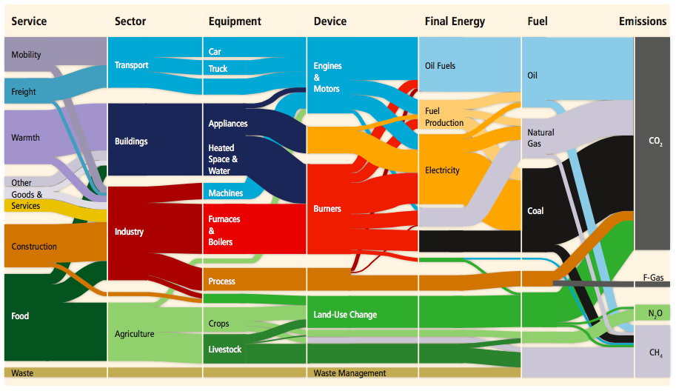
Notes:
Create all the physical products in our lives
30% of global emissions (40% if don’t count land-use) -> Mostly due to material processing (turning resources (oil, ore, biomass)/scrap into useful materials
Industry mainly construction, food are the services they provide, emissions largely just 3 categories: burners, process, machines
70% of total final energy use is fossil fuels in industry, but distribution widely dependent on sector

Slide 3
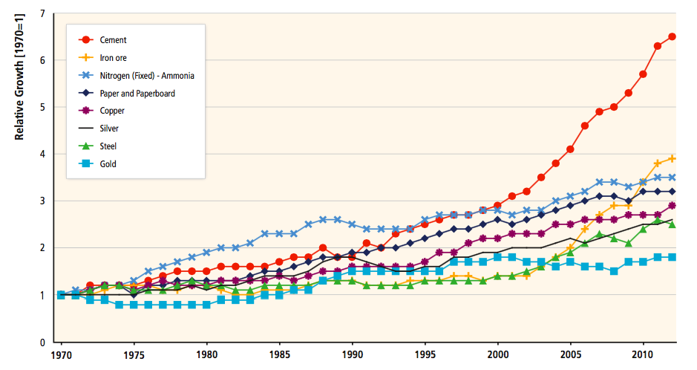
Notes:
Growth of Production in different industries
Part of huge increase due to urbanization (need to build) and globalization of industry – can trade more easily throughout the production process
Over 80% of increase in production since 1990 from China, India, and other developing Asian nations

Slide 4
Top Producers of Energy Intensive Industrial Goods
Iron Ore
China | 43%
Australia | 18%
Brazil | 13%
Steel
China | 48%
Japan | 7%
US | 6%
Cement
China | 63%
India | 7%
US | 2%
Ammonia
China | 32%
India | 9%
Russia | 7%
Notes:
Almost all steel produced in China used in mainland china (46% of global steel use, 48% of production)

Slide 5
Emissions (13.14 GtCO₂)
Direct - 5.27 GtCO₂
Process – 2.59 GtCO₂
Indirect – 5.25 GtCO₂
Process Emissions Breakdown
Notes:
Indirect = Electricity + Heat

Slide 6
Direct and Process CO₂ Emissions
Notes:
Iron and Steel, Cement, and Chemicals make up nearly ¾ of emissions

Slide 7
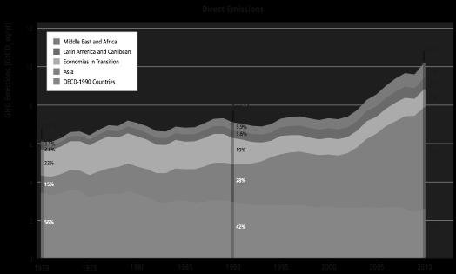
Notes:
Growth in Emissions largely driven from Asian

Slide 8
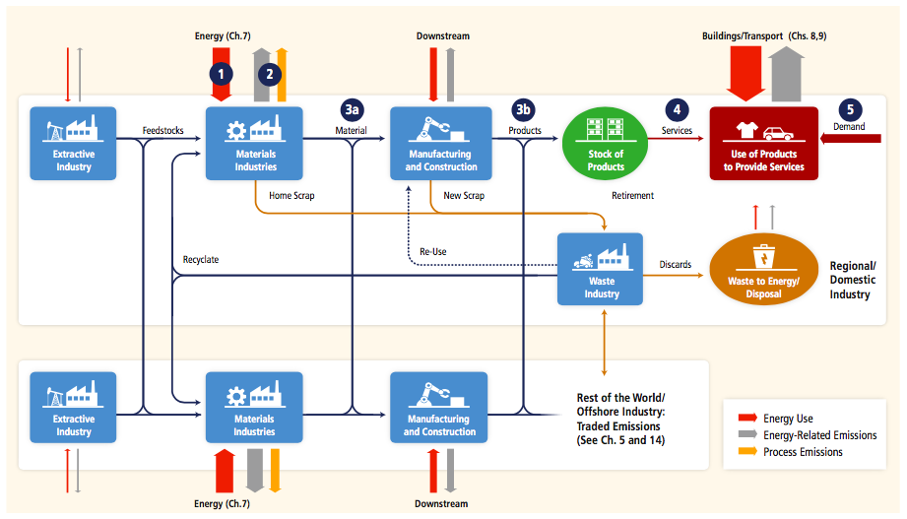
General Emission Reduction Strategies
Notes:
Energy Efficiency (Energy use = drive chemical reactions, create heat, mechanical work; thermo limits, but can improve)
Emissions Efficiency (Fuel switching, CCS)
A. Material Efficiency in Manufacturing (reducing losses in stamping/shaping, reusing old material)
B. Material Efficiency in Product Design (may products could be 1/3 lighter without loss of performance, substitution – hard due to levels of material needed)
Product-Service Efficiency (car sharing, higher building occupancy, food waste)
Service Demand Sector (use less things)
After that – Waste Industry Recycle, Re-Use, or Discard (avoids need to create material from scratch – a lot less energy. Not always enough, and not always the best quality)

Slide 9
General Emission Reduction Challenges
Capital Stock Turnover Time
Global Market Structure
Limited Knowledge Sharing
Energy Subsidies
Notes:
Using best available technology in the 5 biggest energy sectors in industry (chemicals, iron/steel, cement, pulp/paper, and aluminium) would reduce industrial energy use by 13% (emissions by 12%)

Slide 10
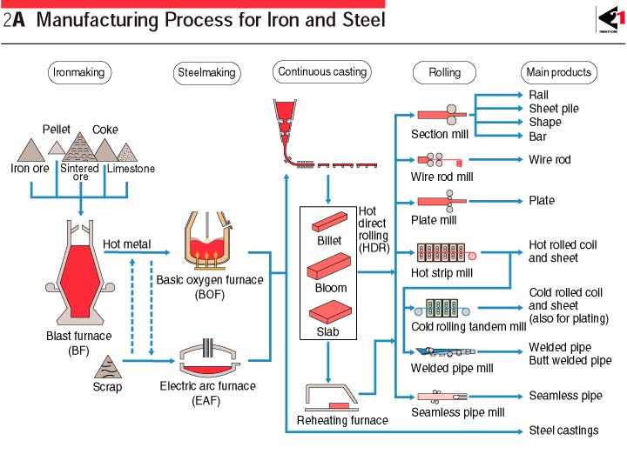
Iron and Steel
Notes:
Fe2O3 (Ironore) + 3CO (from coke) -> 3CO2 + 2 Fe (Pure Iron)

Slide 11
Iron and Steel - Technological Options
Dominant Technologies
  Blast Furnace/Basic Oxygen Furnace (13-14 GJ/tonne)
  Scrap/Electric Arc Furnace (4-6 GJ/tonne)
New Technology Options
  Direct Iron Reduction
  Smelting Reduction
  Coke Replacement with Charcoal or Waste Plastic
  Carbon Capture and Sequestration
Notes:
Coal based DRI – remove need for coke (but need more coal, and energy efficiency depends on use of reuse of residual gas)
Natural Gas based DRI – Natural gas made into H2 and CO
DRI needs more electricity for EAC
Smelting reduction – much reduction takes place in a liquid iron bath (can use low quality coal instead of coke – save energy/emissions from coking process)

Slide 12
Iron and Steel - Material Flow
Notes:
Availability + Recycling Rate – 26% is lost as process scrap (eliminating this would reduce emissions 16% for the iron/steel sector)
Better materials (allow for less to be used – although not always the case with cars)
30% of all steel produced in 2008 could be re-used in the future, but steel is cheaper than labor (amplified by tax policies) – economically drives material inefficiency to minimize labor costs
Commercial buildings in developed world built with 2x steel required by safety codes.
Extending building life would also help

Slide 13
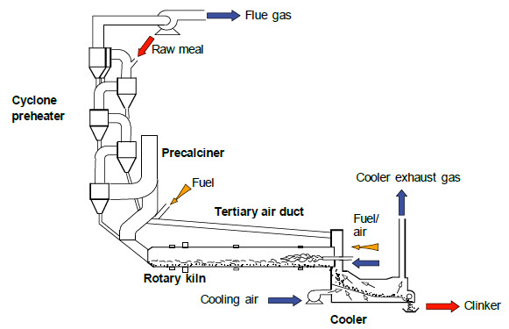
Cement
Notes:
Much lower energy intensity per tonne than steel and aluminum, but volume of production is much higher – demand dominated by construction
Limestone, clay, sand = feedstock (give lime, silica, alumina, and iron) -> clinker; add gypsum and grind for cement

Slide 14
Cement
Notes:
Heat with coal, natural gas, oil to temperatures of 2000 C
Calcination: CaCO3 -> CaO + CO2 (limestone -> lime + carbon dioxide)
Adding preheaters and precalciners can increase efficiency substantially

Slide 15
Cement – Technological Options
Notes:
Thermodynamic limit of minimum energy: 1.8 GJ/t clinker for dry limestone feedstock
Emissions highly dependent of system and fuel used

Slide 16
Cement – Technological Options
Notes:
Thermodynamic limit of minimum energy: 1.8 GJ/t clinker for dry limestone feedstock
Using best available technology could save 21% of energy consumption – although need to rebuild (can’t easily retrofit) and plant lasts 50 years
In US, half of plants built since 1980, 22% in 70s, 16% in 60s, 10% before 60s

Slide 17
Cement – Technological Options
Notes:
Capital stock in Europe new that US, less room for improvement

Slide 18
Cement – Technological Options
Clinker Substitute
  Fly-Ash
  Blast Furnace Slag
  Pozzolana
Fuel Substitution
Cement Alternatives
Carbon Capture and Sequestration
Notes:
Availability for blending limited (also can’t have long distance transport)
Waste fuels (clinker/limestone act as gas cleaning agents) – tires, wood, plastics, chemicals, municipal solid waste
Some plants have 100% substitution
Hard to recycle/reuse – best to expand building life

Slide 19
Chemicals
Largest energy user in industrial sector – 10% of global energy use, 7% of global CO₂ emissions
Emissions dominated by:
  Ethylene
  Ammonia
  Nitric Acid
  Adipic Acid and Caprolactam (used in plastics)
  Fertilizer
  Synthetic Fibers

Slide 20
Chemicals – Technological Options
Process integration and process intensification
Combined heat and power
Membranes
Bio-based Chemicals/Plastics
Carbon Capture and Storage
Notes:
Integration/intensification – using waste heat, using by-products more efficiently
CHP faces barriers: emission limits/tax rates and feed-in tariffs
Bio-based: use natural polymers, use monomers, and polymerize them, produce from micro-organisms
Plant lifetime = 60 years, average age of capital stock in Europe/N America ~20 years, China ~ 10 years

Slide 21
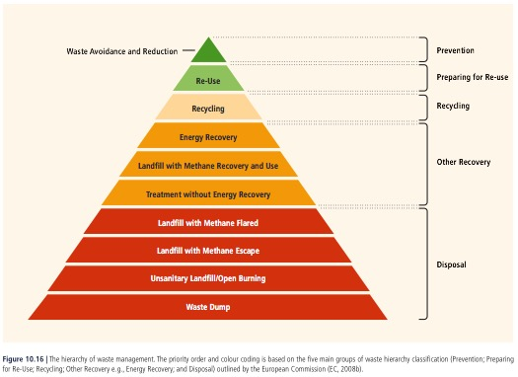
Waste Management
Notes:
Energy Recovery from Waste – MSW largely biogenic/petrochemical compounds are C and H; mostly combusted on moving grate; need to pay attention to air pollution
Landfill Methane Recovery – of methane generated only 10% captured at sanitary landfills (capture efficiencies only about 50%, up to 95% possible)
Landfill Aeration – introduce ambient air to promote biological processes to limit methane release

Slide 22
