Slide 1
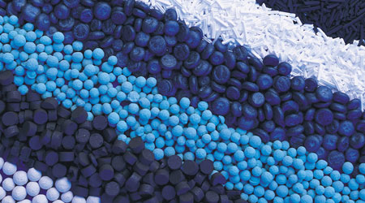
Industrial Catalysis
How Dirt and Sand Catalyze Some of the Most Important Transformations
Justin J. Teesdale
Harvard Energy Journal Club
September 29th, 2017

Slide 2
Industrial (Petro)Chemical Energy Use
In 2014,
  Total Primary Energy Supply (TPES) = 155,000 TWh (560 EJ)
International Energy Agency (IEA) (2011). Key world energy statistics-2011.
International Energy Agency (IEA) (2007). Tracking Industrial Efficiency and CO₂ Emisssions-2007.

Slide 3
Industrial (Petro)Chemical Energy Use
In 2014,
  Total Primary Energy Supply (TPES) = 155,000 TWh (560 EJ)
Industry uses ~20% of the TPES
International Energy Agency (IEA) (2011). Key world energy statistics-2011.
International Energy Agency (IEA) (2007). Tracking Industrial Efficiency and CO₂ Emisssions-2007.

Slide 4
Industrial (Petro)Chemical Energy Use
In 2014,
  Total Primary Energy Supply (TPES) = 155,000 TWh (560 EJ)
Industry uses ~20% of the TPES
Chemical and Petrochemical (30%)
Iron and Steel (20%)
Non-ferrous metals and minerals (10%)
Paper, pulp, and print (5%)
Food and tobacco
International Energy Agency (IEA) (2011). Key world energy statistics-2011.
International Energy Agency (IEA) (2007). Tracking Industrial Efficiency and CO₂ Emisssions-2007.

Slide 5
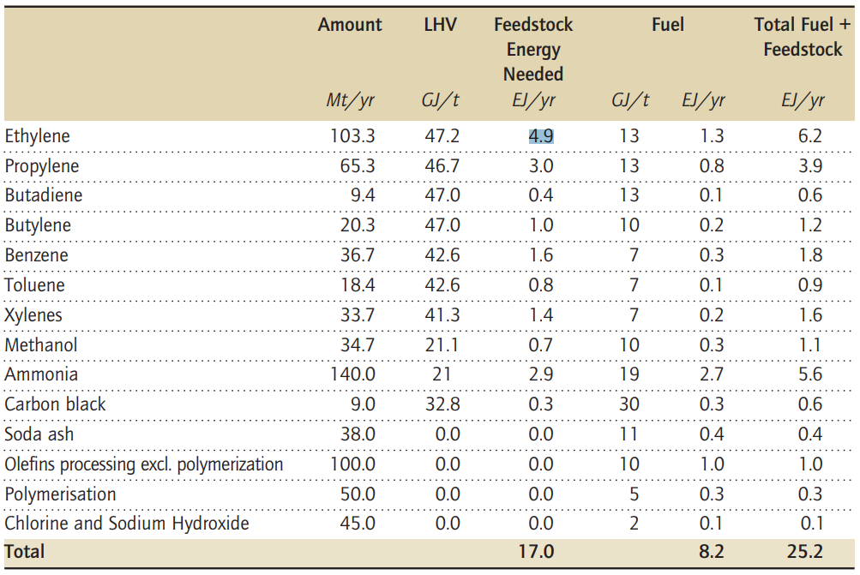
Importance of Catalysis in Industry (2004)
International Energy Agency (IEA) (2007). Tracking Industrial Efficiency and CO₂ Emisssions-2007.

Slide 6
Importance of Catalysis in Industry (2004)
All products of steam cracking and other high T/high P processes that don’t involve catalysts
International Energy Agency (IEA) (2007). Tracking Industrial Efficiency and CO₂ Emisssions-2007.

Slide 7
Importance of Catalysis in Industry (2004)
All products of steam cracking and other high T/high P processes that don’t involve catalysts
Involves supported metal oxide catalysts
International Energy Agency (IEA) (2007). Tracking Industrial Efficiency and CO₂ Emisssions-2007.

Slide 8
Importance of Catalysis in Industry (2004)
All products of steam cracking and other high T/high P processes that don’t involve catalysts
Involves supported metal oxide catalysts
Methanol and Ammonia production utilizes 1.4 % of TPES
International Energy Agency (IEA) (2007). Tracking Industrial Efficiency and CO₂ Emisssions-2007.

Slide 9
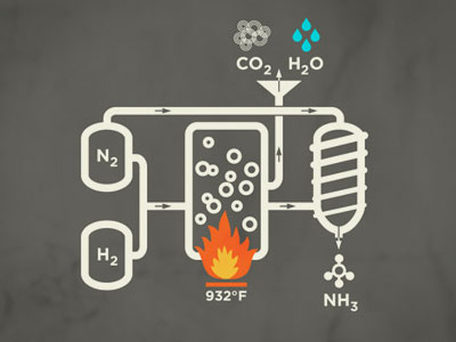
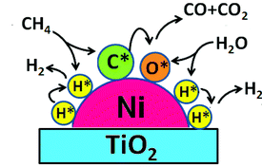
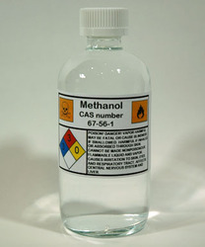
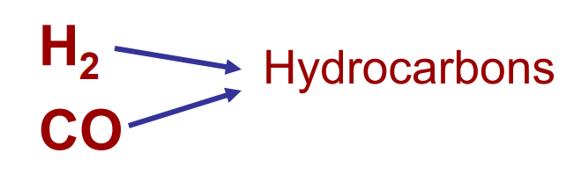
Steam Reforming of Methane and Water-Gas Shift (WGS)
Haber-Bosch Process
Methanol Production
Fischer-Tropsch Process

Slide 10
Steam Reforming: Stats
Responsible for almost 95% of annual production of hydrogen
US DOE (2013). Report of the Hydrogen Production Expert Panel.

Slide 11
Steam Reforming: Stats
Responsible for almost 95% of annual production of hydrogen
~ 50 million tons of hydrogen produced annually (worldwide)
US DOE (2013). Report of the Hydrogen Production Expert Panel.

Slide 12
Steam Reforming: Stats
Responsible for almost 95% of annual production of hydrogen
~ 50 million tons of hydrogen produced annually (worldwide)
Primarily used immediately in petroleum industry for the synthesis of other chemicals and ammonia
Largest production of any chemical in industry on a per mole basis by a large margin
US DOE (2013). Report of the Hydrogen Production Expert Panel.

Slide 13
Steam Reforming: The Setup
ECN (2004). On the Catalytic Aspects of Steam-Methane Reforming.

Slide 14
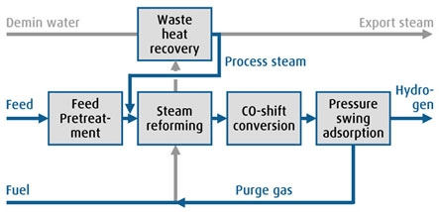
Steam Reforming: The Setup
ECN (2004). On the Catalytic Aspects of Steam-Methane Reforming.

Slide 15
Steam Reforming: The Setup
Overall process 50-80% efficient, but highly dependent on plant design
ECN (2004). On the Catalytic Aspects of Steam-Methane Reforming.

Slide 16
Steam Reforming: Reaction Conditions
Mix of steam and methane pass over catalyst @ 700-1000 °C and 3-25 bar
Catalyst typically metal supported on a high surface area material (silica, Al₂O₃, MgO, etc)
ECN (2004). On the Catalytic Aspects of Steam-Methane Reforming.

Slide 17
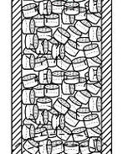
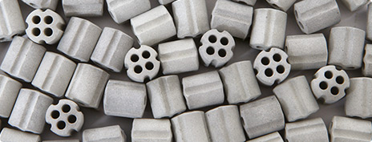
Steam Reforming: Reaction Conditions
Mix of steam and methane pass over catalyst @ 700-1000 °C and 3-25 bar
Catalyst typically metal (nickel) supported on a high surface area material (silica, Al₂O₃, MgO, etc)
Most of this chemistry was developed in 1960s and is still being employed today
ECN (2004). On the Catalytic Aspects of Steam-Methane Reforming.

Slide 18
Steam Reforming: Catalyst Design
Target: New catalysts that can operate at lower temperatures

Slide 19
Steam Reforming: Catalyst Design
Target: New catalysts that can operate at lower temperatures
Typically employing the same catalyst (Mn/Fe/Co/Ni) but with more sophisticated/expensive supports

Slide 20
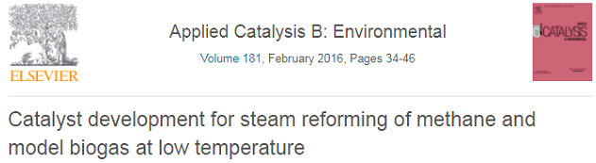
Steam Reforming: Catalyst Design
Target: New catalysts that can operate at lower temperatures
Typically employing the same catalyst (Mn/Fe/Co/Ni) but with more sophisticated/expensive supports
Ni on La₂O₃–ZrO₂–CeO₂ support/promoter can go as low as 400 °C

Slide 21
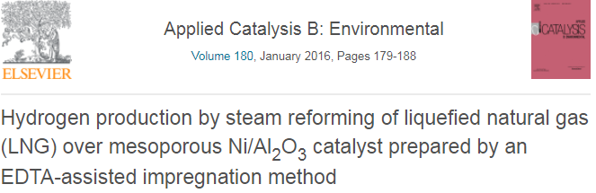
Steam Reforming: Catalyst Design
Target: New catalysts that can operate at lower temperatures
Typically employing the same catalyst (Mn/Fe/Co/Ni) but with more sophisticated/expensive supports
Ni on La₂O₃–ZrO₂–CeO₂ support/promoter can go as low as 400 °C
Preventing catalyst degradation (sintering) via different metal precursors (affects particle size and spacing)

Slide 22
Steam Reforming of Methane and Water-Gas Shift (WGS)
Haber-Bosch Process
Methanol Production
Fischer-Tropsch Process

Slide 23
Haber-Bosch: Stats
Responsible for 1-1.5% of annual energy consumption
~ 140 million tons of ammonia produced annually (worldwide)
USGS (2017). Minerals commodity Summaries–Nitrogen (fixed)–Ammonia 2017.
Smil, Vaclav World Agriculture, 2011, 2, 9-13.

Slide 24
Haber-Bosch: Stats
Responsible for 1-1.5% of annual energy consumption
~ 140 million tons of ammonia produced annually (worldwide)
88% of produced ammonia used for the synthesis of fertilizers
USGS (2017). Minerals commodity Summaries–Nitrogen (fixed)–Ammonia 2017.
Smil, Vaclav World Agriculture, 2011, 2, 9-13.

Slide 25
Haber-Bosch: Stats
Responsible for 1-1.5% of annual energy consumption
~ 140 million tons of ammonia produced annually (worldwide)
88% of produced ammonia used for the synthesis of fertilizers
Quadrupling of arable land on ice-free continents. At 1900 level production, to produce 2011 quantity of ammonia would require ~50% of total land on ice-free continents (as opposed to 15% now).
USGS (2017). Minerals commodity Summaries–Nitrogen (fixed)–Ammonia 2017.
Smil, Vaclav World Agriculture, 2011, 2, 9-13.

Slide 26
Haber-Bosch: Stats
Responsible for 1-1.5% of annual energy consumption
~ 140 million tons of ammonia produced annually (worldwide)
88% of produced ammonia used for the synthesis of fertilizers
Quadrupling of arable land on ice-free continents. At 1900 level production, to produce 2011 quantity of ammonia would require ~50% of total land on ice-free continents (as opposed to 15% now).
USGS (2017). Minerals commodity Summaries–Nitrogen (fixed)–Ammonia 2017.
Smil, Vaclav World Agriculture, 2011, 2, 9-13.

Slide 27
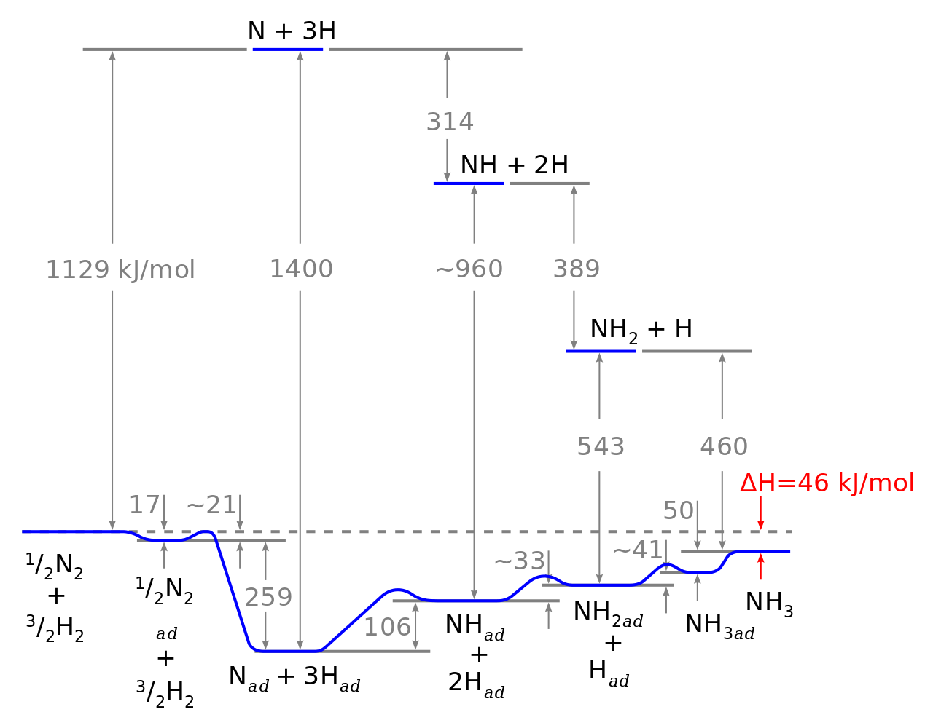
Haber-Bosch: Stats
Energy-intensive process because N₂ is extremely inert
Quadrelli, E. A. Chem. Soc. Rev. 2014, 43, 547.

Slide 28
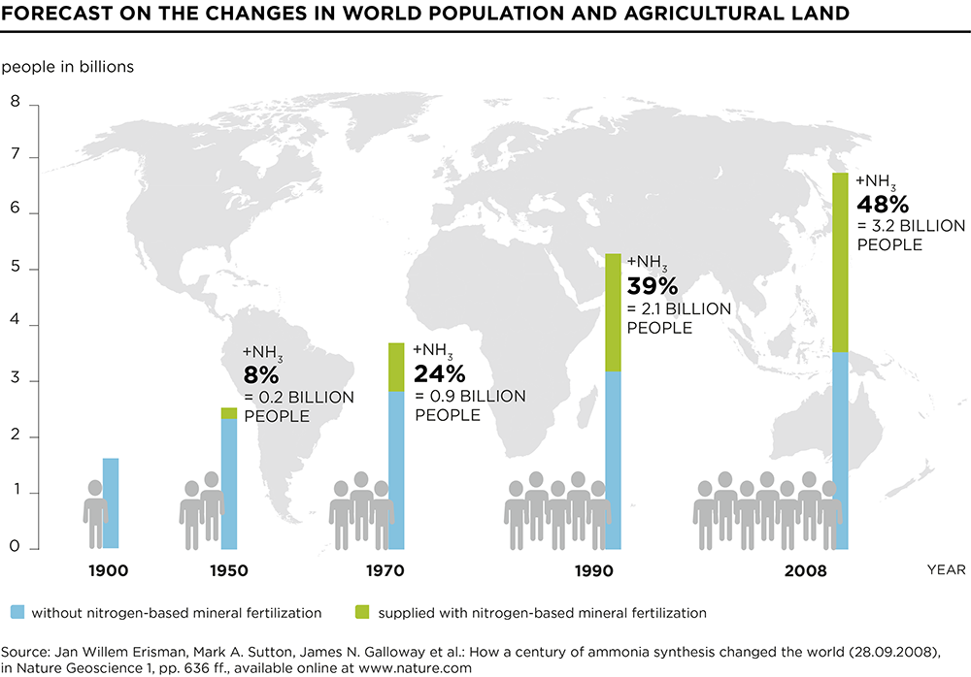
Haber-Bosch: Stats
Responsible for 1-1.5% of annual energy consumption
~ 140 million tons of ammonia produced annually (worldwide)
88% of produced ammonia used for the synthesis of fertilizers
Quadrupling of arable land on ice-free continents. At 1900 level production, to produce 2011 quantity of ammonia would require ~50% of total land on ice-free continents (as opposed to 15% now).

Slide 29
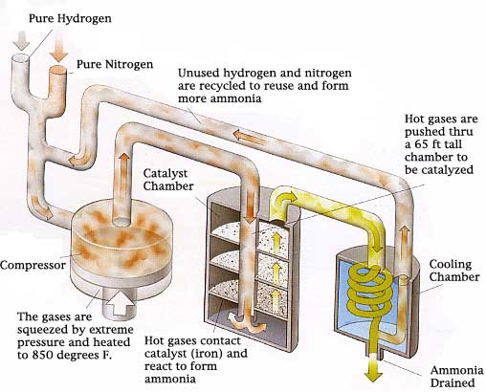
Haber-Bosch: The Setup
Notes:
200 atm in catalyst chamber

Slide 30
Haber-Bosch: The Setup
Haber-Bosch benefitted from 100 years of optimization, as a result efficiencies are typically >95%
Notes:
200 atm in catalyst chamber

Slide 31
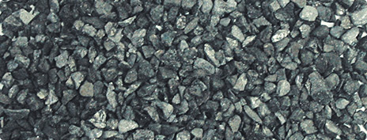
Haber-Bosch: What’s the catch?
Catalyst is simply metallic iron doped with potassium (K₂O) and supported on either silica or alumina
DOE Roundtable Report (2016). Sustainable Ammonia Synthesis

Slide 32
Haber-Bosch: What’s the catch?
Catalyst is simply metallic iron doped with potassium (K₂O) and supported on either silica or alumina
The energy intensive components are the heat and pressure necessary in the steam reformer to produce pure H₂ to be fed into Haber-Bosch reactor
DOE Roundtable Report (2016). Sustainable Ammonia Synthesis

Slide 33
Haber-Bosch: What’s the catch?
Catalyst is simply metallic iron doped with potassium (K₂O) and supported on either silica or alumina
The energy intensive components are the heat and pressure necessary in the steam reformer to produce pure H₂ to be fed into Haber-Bosch reactor
Also heat and pressure necessary for the Haber-Bosch reactor
DOE Roundtable Report (2016). Sustainable Ammonia Synthesis

Slide 34
Haber-Bosch: What’s the catch?
Catalyst is simply metallic iron doped with potassium (K₂O) and supported on either silica or alumina
The energy intensive components are the heat and pressure necessary in the steam reformer to produce pure H₂ to be fed into Haber-Bosch reactor
Also heat and pressure necessary for the Haber-Bosch reactor
Significant cost to achieve high purity H₂ and N₂ as O₂, CO, CO₂, and other oxygen containing compounds poison the catalyst
DOE Roundtable Report (2016). Sustainable Ammonia Synthesis

Slide 35
Haber-Bosch: What’s the catch?
Catalyst is simply metallic iron doped with potassium (K₂O) and supported on either silica or alumina
The energy intensive components are the heat and pressure necessary in the steam reformer to produce pure H₂ to be fed into Haber-Bosch reactor
Also heat and pressure necessary for the Haber-Bosch reactor
Significant cost to achieve high purity H₂ and N₂ as O₂, CO, CO₂, and other oxygen containing compounds poison the catalyst
New catalysts must aim to operate at lower temperature and pressure and/or be more selective for N₂ conversion to NH₃.
DOE Roundtable Report (2016). Sustainable Ammonia Synthesis

Slide 36
Haber-Bosch: New Catalyst Design
Move towards more sophisticated materials and designs
Extremely high bar set by very cheap materials
Fe/K mixtures supported on carbon nanotubes
Giddey, S. Int. J. Hydrog. Energy, 2013, 38, 14576.

Slide 37
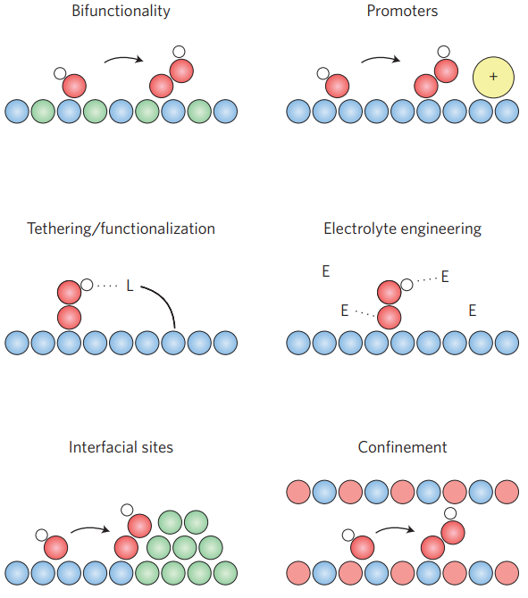
Haber-Bosch: New Catalyst Design
Jaramillo, T. F. Nat. Mater. 2017, 16, 70.

Slide 38
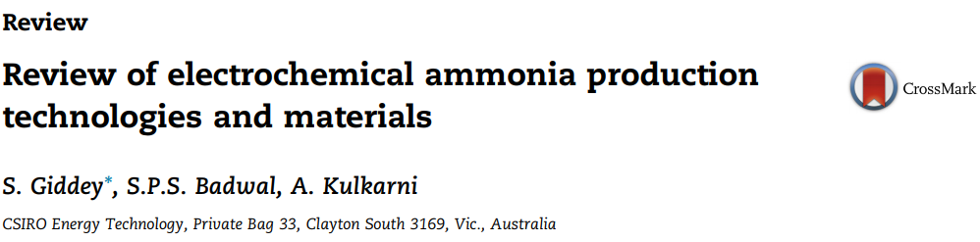
Haber-Bosch: New Catalyst Design
Move towards more sophisticated materials and designs
Extremely high bar set by very cheap materials
Fe/K mixtures supported on carbon nanotubes
Using ruthenium/activated carbon-based catalysts
Giddey, S. Int. J. Hydrog. Energy, 2013, 38, 14576.

Slide 39
Haber-Bosch: New Catalyst Design
Move towards more sophisticated materials and designs
Extremely high bar set by very cheap materials
Fe/K mixtures supported on carbon nanotubes
Using ruthenium/activated carbon-based catalysts
Improving steam reforming efficiency or replacing it entirely
Giddey, S. Int. J. Hydrog. Energy, 2013, 38, 14576.

Slide 40
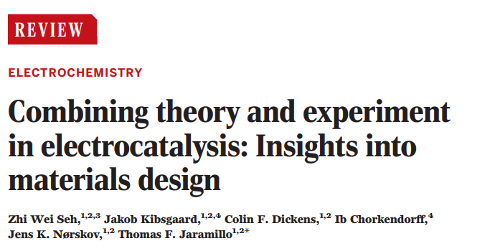
Haber-Bosch: New Catalyst Design
Move towards more sophisticated materials and designs
Fe/K mixtures supported on carbon nanotubes
Using ruthenium/activated carbon-based catalysts
Improving steam reforming efficiency or replacing it entirely
Jaramillo, T. F. Science 2017, 355, 146.

Slide 41
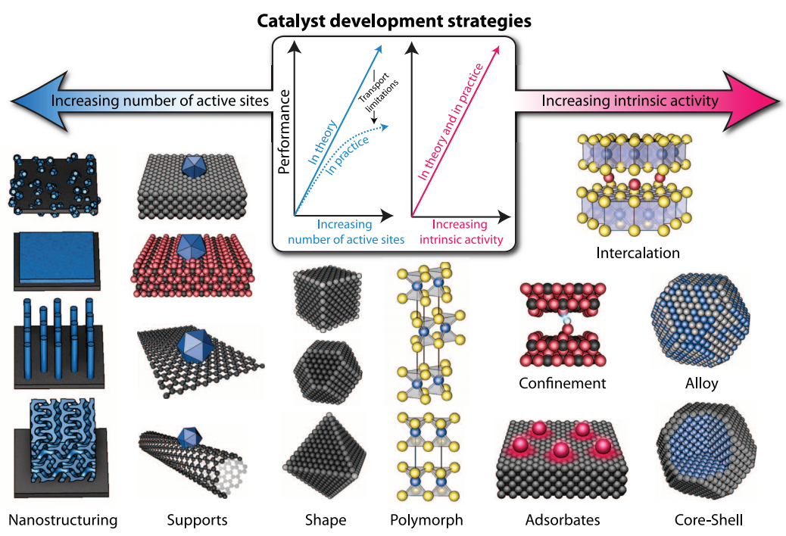
Haber-Bosch: New Catalyst Design
Jaramillo, T. F. Science 2017, 355, 146.

Slide 42
Steam Reforming of Methane and Water-Gas Shift (WGS)
Haber-Bosch Process
Methanol Production
Fischer-Tropsch Process

Slide 43
Methanol: Stats
40% of methanol is converted to formaldehyde
International Energy Agency (IEA) (2007). Tracking Industrial Efficiency and CO₂ Emisssions-2007.

Slide 44
Methanol: Stats
40% of methanol is converted to formaldehyde
Remaining methanol is used in the synthesis of fine chemicals or as a fuel additive
International Energy Agency (IEA) (2007). Tracking Industrial Efficiency and CO₂ Emisssions-2007.

Slide 45
Methanol: Stats
40% of methanol is converted to formaldehyde
Remaining methanol is used in the synthesis of fine chemicals or as a fuel additive
Responsible for ~0.4 % of world energy use
International Energy Agency (IEA) (2007). Tracking Industrial Efficiency and CO₂ Emisssions-2007.

Slide 46
Methanol: Catalyst
Industrial catalyst is an alumina pellet (Al₂O₃) coated in copper/zinc oxides
Catalyst is >99.5% efficient (not overall energy efficiency)
http://www.technology.matthey.com/article/61/3/172-182/

Slide 47
Methanol: Catalyst
Industrial catalyst is an alumina pellet (Al₂O₃) coated in copper/zinc oxides
Catalyst is >99.5% efficient (not overall energy efficiency)
Requires temperatures 400-600 °C and pressures of 40-100 atm.
Energy efficiency and cost is gated by steam reformation (H₂)
http://www.technology.matthey.com/article/61/3/172-182/

Slide 48
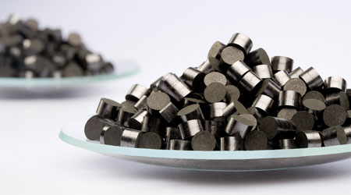
Methanol: Catalyst
Industrial catalyst is an alumina pellet (Al₂O₃) coated in copper/zinc oxides
Catalyst is >99.5% efficient (not overall energy efficiency)
Requires temperatures 400-600 °C and pressures of 40-100 atm.
Energy efficiency and cost is gated by steam reformation (H₂)
Same catalyst that was first used in 1960s
http://www.technology.matthey.com/article/61/3/172-182/

Slide 49
Methanol: Catalyst Design
Develop catalysts that operate at lower T and P or
come up with a new system entirely
Norskov, J. K. Nat. Chem. 2014, 6, 320.
Jaramillo, T. F. 2017, 5, 955.
Jaramillo, T. F. 2014, 136, 14107.

Slide 50
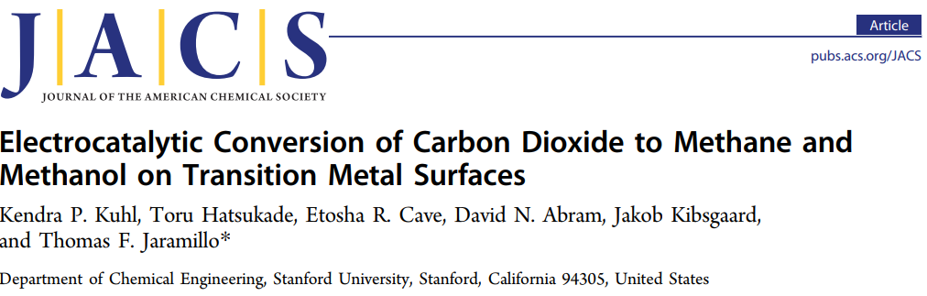
Methanol: Catalyst Design
Develop catalysts that operate at lower T and P or
come up with a new system entirely
Norskov, J. K. Nat. Chem. 2014, 6, 320.
Jaramillo, T. F. 2017, 5, 955.
Jaramillo, T. F. 2014, 136, 14107.

Slide 51
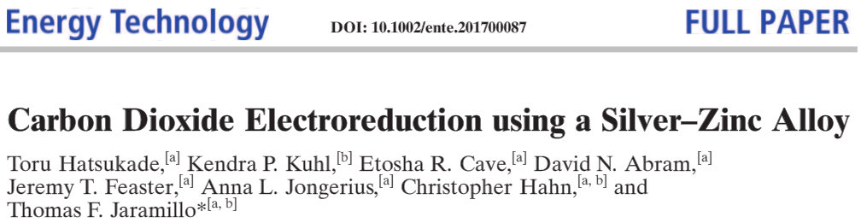
Methanol: Catalyst Design
Develop catalysts that operate at lower T and P or
come up with a new system entirely
Norskov, J. K. Nat. Chem. 2014, 6, 320.
Jaramillo, T. F. 2017, 5, 955.
Jaramillo, T. F. 2014, 136, 14107.

Slide 52
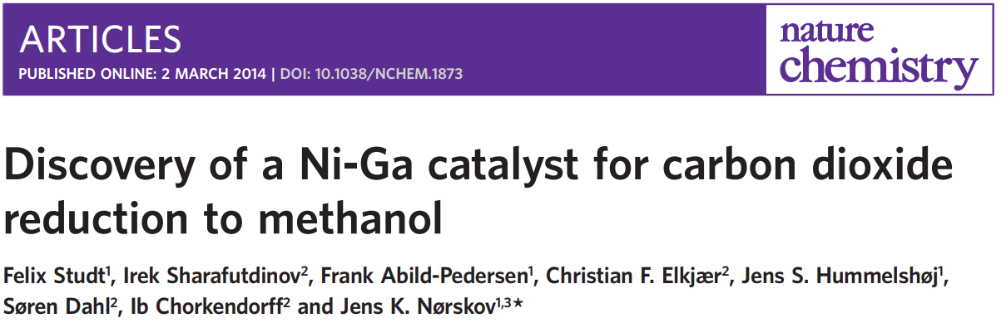
Methanol: Catalyst Design
Develop catalysts that operate at lower T and P or
come up with a new system entirely
Norskov, J. K. Nat. Chem. 2014, 6, 320.
Jaramillo, T. F. 2017, 5, 955.
Jaramillo, T. F. 2014, 136, 14107.

Slide 53
Steam Reforming of Methane and Water-Gas Shift (WGS)
Haber-Bosch Process
Methanol Production
Fischer-Tropsch Process

Slide 54
Fischer-Tropsch: Stats
Discovered in 1925 by Franz Fischer and Hans Tropsch
Syngas heated over a catalyst bed (typically Fe or Co) at 25 atm and either 230 °C (LTFT) or 320 °C (HTFT)
Klerk, A. Green Chem. 2008, 10, 1249.

Slide 55
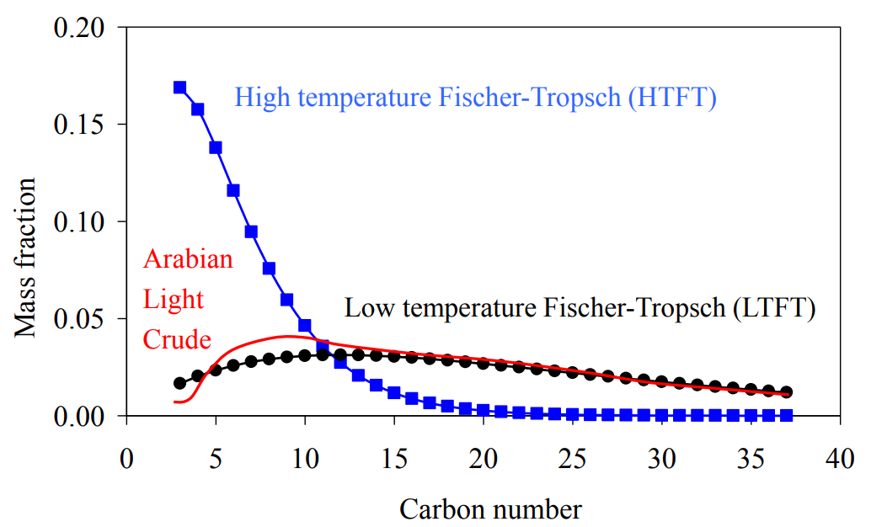
Fischer-Tropsch: Stats
Discovered in 1925 by Franz Fischer and Hans Tropsch
Syngas heated over a catalyst bed (typically Fe or Co) at 25 atm and either 230 °C (LTFT) or 320 °C (HTFT)
Klerk, A. Green Chem. 2008, 10, 1249.

Slide 56
Fischer-Tropsch: Stats
Viability heavily depends on crude oil prices, as a result, there are very few plants in operation
Klerk, A. Green Chem. 2008, 10, 1249.

Slide 57
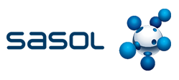


Fischer-Tropsch: Stats
Viability heavily depends on crude oil prices, as a result, there are very few plants in operation
South African company that does coal-to-liquids
Gas-to-liquids (GTL) facility in Malaysia
X-to-liquids (XTL) facility in Australia
Klerk, A. Green Chem. 2008, 10, 1249.

Slide 58
Fischer-Tropsch: Stats
Viability heavily depends on crude oil prices, as a result, there are very few plants in operation
South African company that does coal-to-liquids
Gas-to-liquids (GTL) facility in Malaysia
X-to-liquids (XTL) facility in Australia
Difficult to pin down overall energy efficiency due to variability in plant design and catalyst employed
Also challenging due to significantly less data
Klerk, A. Green Chem. 2008, 10, 1249.

Slide 59
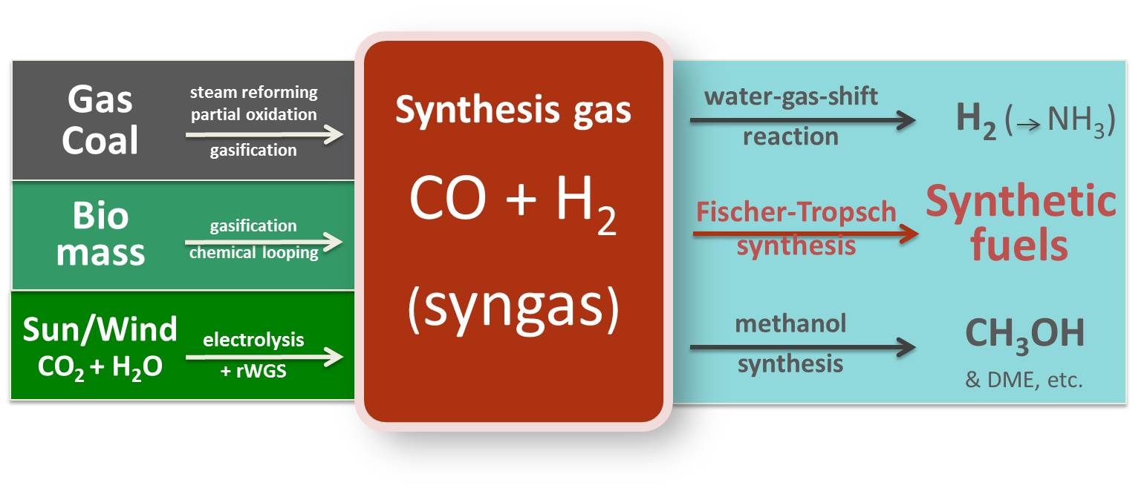
Fischer-Tropsch: Why we care
Provides security in gasoline/diesel sector
Requires a supply of syngas which can be generated from multiple sources
http://www.syngaschem.com/

Slide 60
Fischer-Tropsch: Catalyst Design
Very similar to catalysts developed for methanol production
The low selectivity catalysts are typically sold as FT catalysts

Slide 61
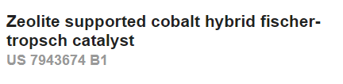



Fischer-Tropsch: Catalyst Design
Very similar to catalysts developed for methanol production
The low selectivity catalysts are typically sold as FT catalysts
Big area of research in industry (Chevron)
…..and also in academia

Slide 62
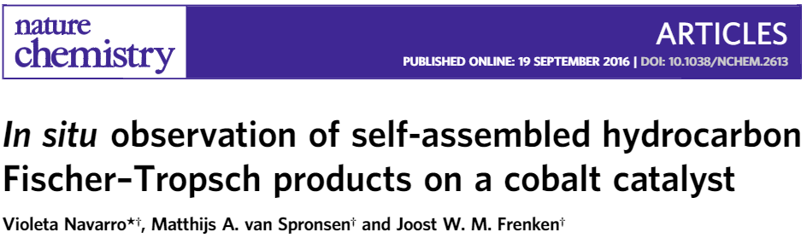
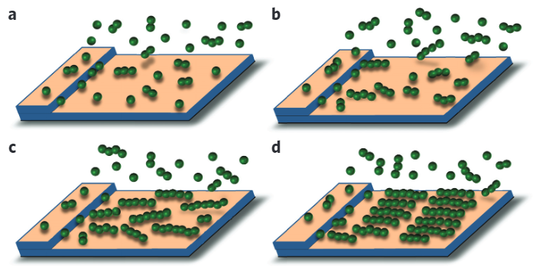
Fischer-Tropsch: Catalyst Design
Navarro, V. Nat. Chem. 2016, 8, 929.

Slide 63
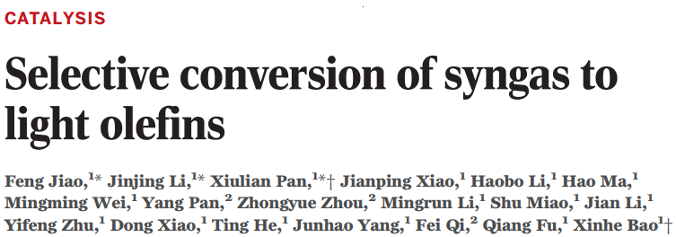
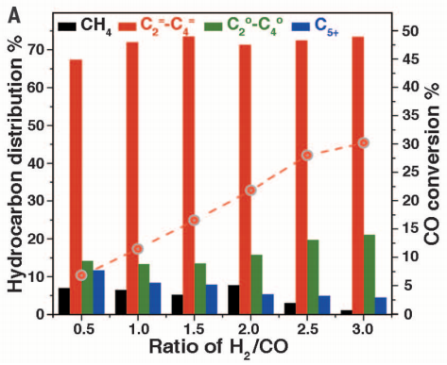
Jiao, F.; Li, J.; Pan, X. Science 2016, 351, 1065.

Slide 64
Summary and Outlook
Steam Reforming of Methane and Water-Gas Shift (WGS)
Haber-Bosch Process
Methanol Production
Fischer-Tropsch Process

Slide 65
Summary and Outlook
Steam Reforming of Methane and Water-Gas Shift (WGS)
Haber-Bosch Process
Methanol Production
Fischer-Tropsch Process
Major Challenges
Efficiency improvements or new method for H₂
Better catalysts for Haber-Bosch and Fischer-Tropsch (syngas generation)

Slide 66
Summary and Outlook
Steam Reforming of Methane and Water-Gas Shift (WGS)
Haber-Bosch Process
Methanol Production
Fischer-Tropsch Process
Major Challenges
Efficiency improvements or new method for H₂
Better catalysts for Haber-Bosch and Fischer-Tropsch (syngas generation)
How do we do these processes as we move away from fossil fuels?

