Slide 1
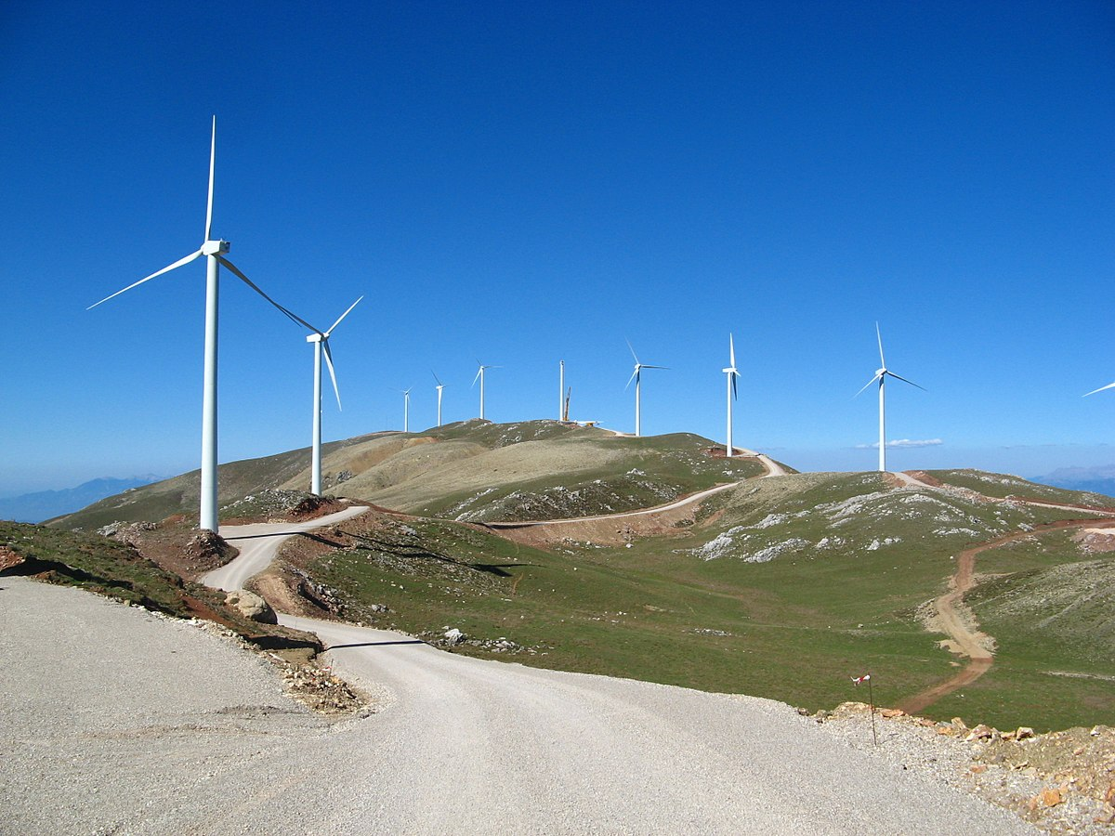
High Altitude Wind
Justin J. Teesdale

Slide 2
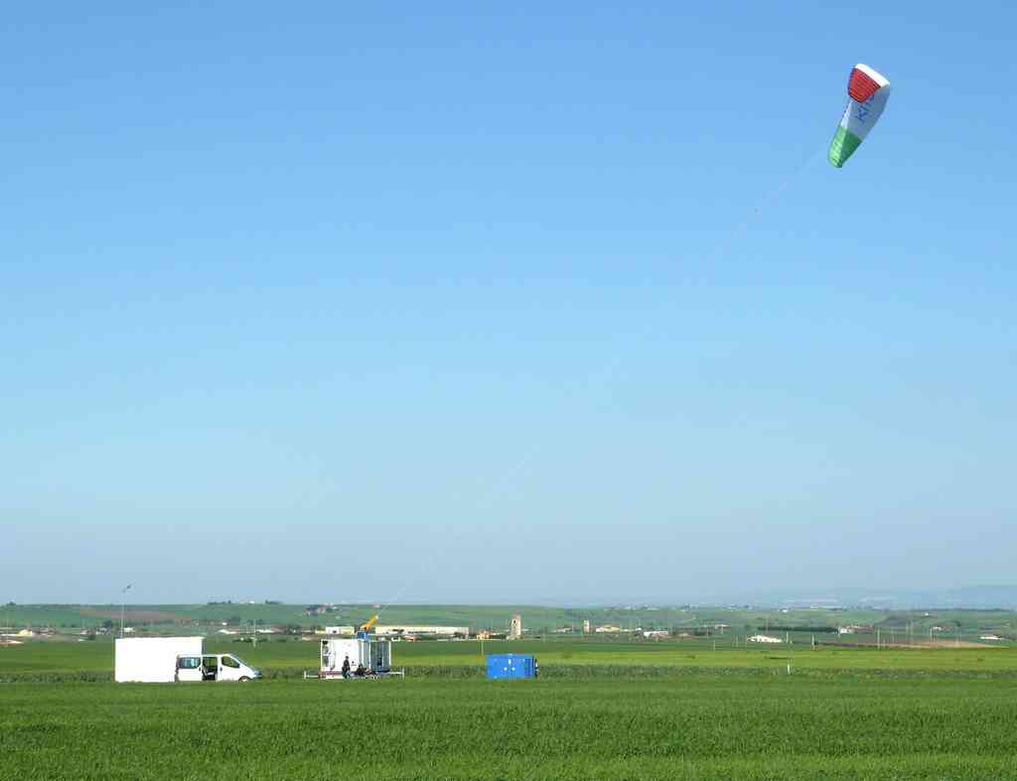
Altitude ≠ Elevation

Slide 3
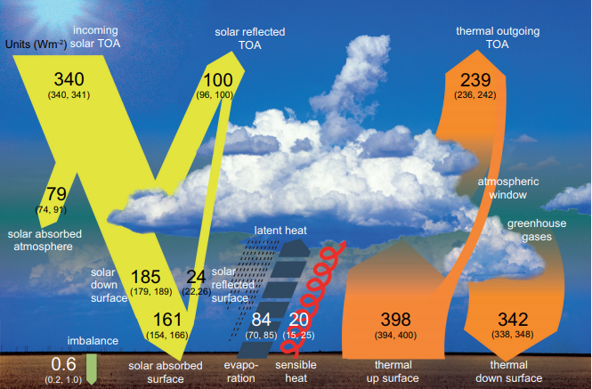
Wind Energy: Crude Analysis
50,000 TW transmitted via natural convection
~60 TW ultimately wind kinetic energy near land
~2-6 TW are economically feasible for extraction
IPCC Fifth Assessment Report, Technical Report
UN World Energy Assessment: 2004 Update

Slide 4
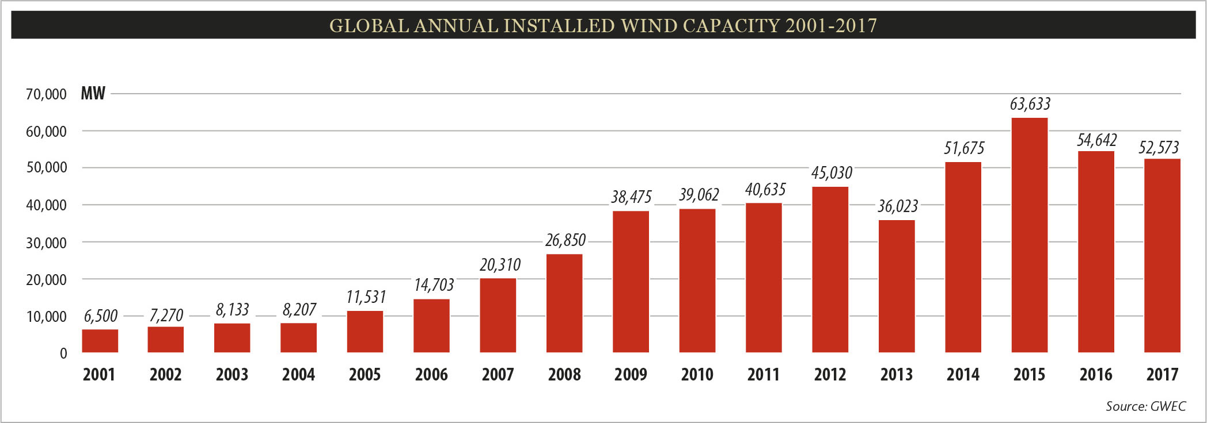
Wind Energy: Crude Analysis
Factoring in a capacity factor of 0.30, we install ~15 GW_{e} per year
http://gwec.net/global-figures/graphs/

Slide 5
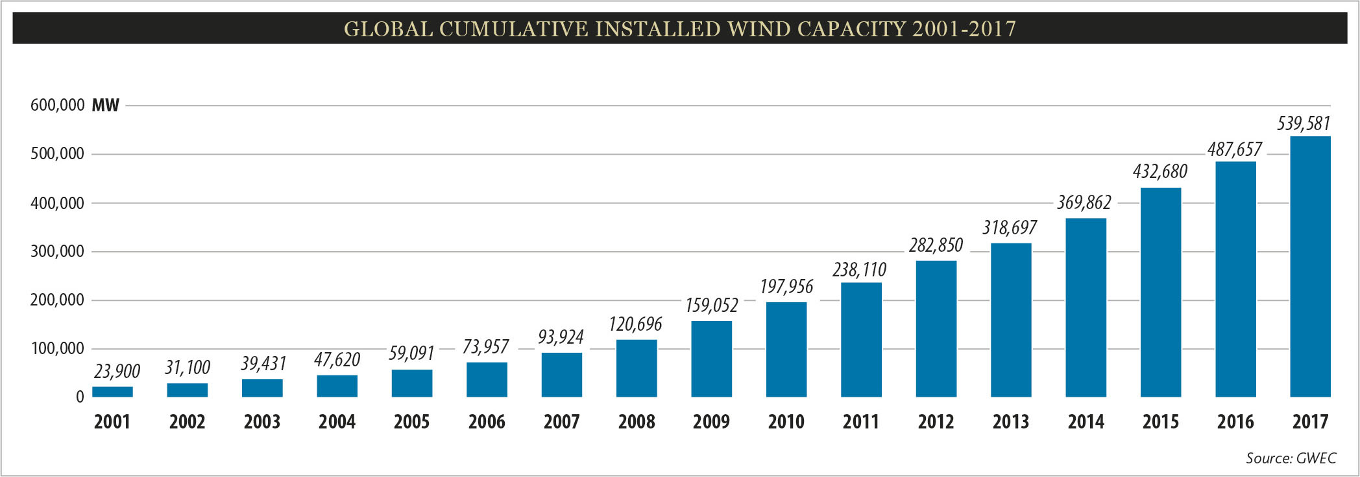
Wind Energy: Crude Analysis
Factoring in a capacity factor of 0.30, we have roughly 161 GW_{e} from wind
At a rate of 15 GW_{e}/yr, we’re on track for wind to account for 641 GW_{e} in 2050
Can we get more wedges?
http://gwec.net/global-figures/graphs/

Slide 6
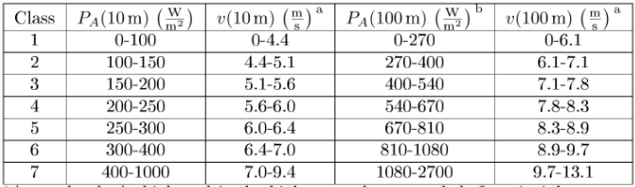
Classification of Wind
Most wind turbines access winds in the 5-9 m/s range.
IEEE Trans. Energy Conv. 2007, 22, 136.

Slide 7
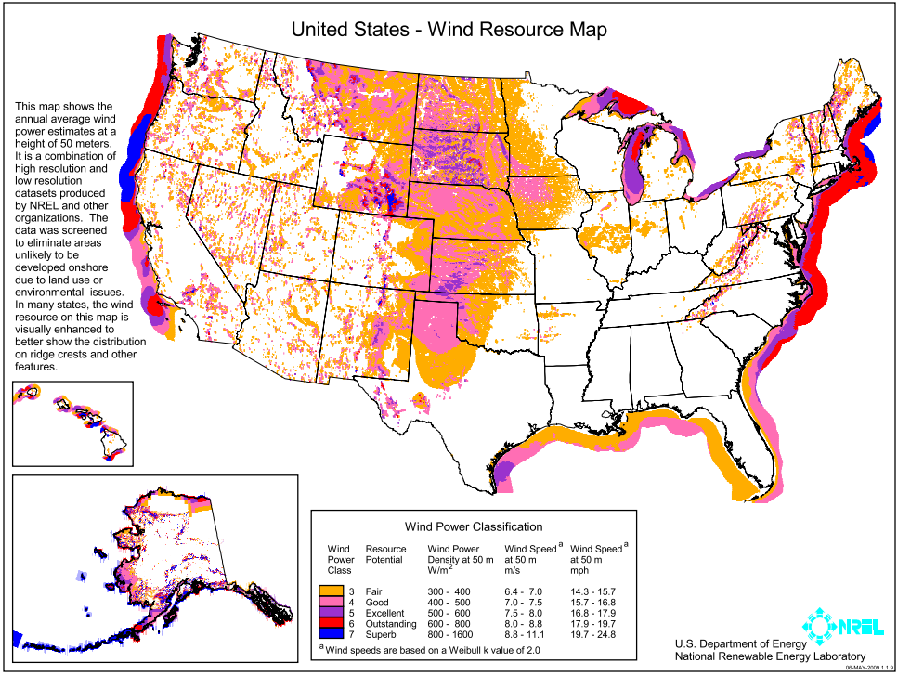
Theoretical Application
Areal Power Density (P_{A}) = ¹/₂ρν³
Highest wind speeds exist in jet streams (~6-11 km above surface)
IEEE Trans. Energy Conv. 2007, 22, 136.

Slide 8
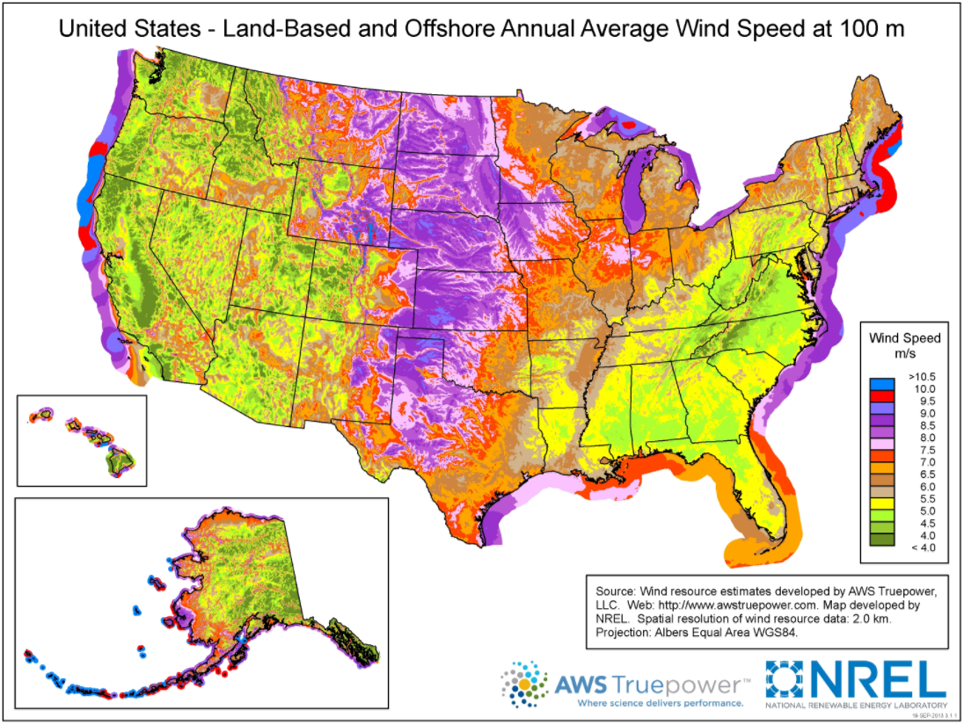
Theoretical Application
Areal Power Density (P_{A}) = ¹/₂ρν³
Highest wind speeds exist in jet streams (~6-11 km above surface)
IEEE Trans. Energy Conv. 2007, 22, 136.

Slide 9
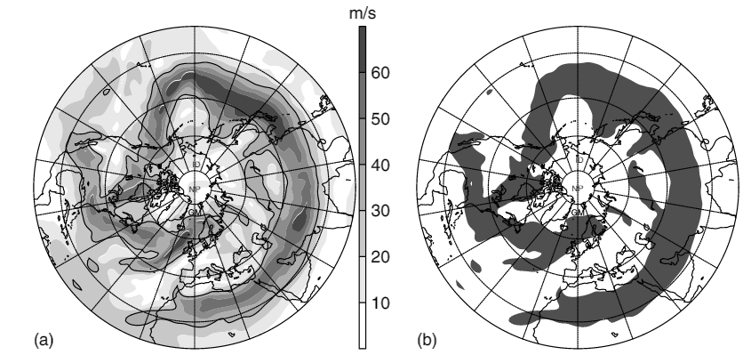
Theoretical Application
Areal Power Density (P_{A}) = ¹/₂ρν³
Highest wind speeds exist in jet streams (~6-11 km above surface)
IEEE Trans. Energy Conv. 2007, 22, 136.

Slide 10
Theoretical Application
Areal Power Density (P_{A}) = ¹/₂ρν³
Highest wind speeds exist in jet streams (~6-11 km above surface)
At this altitude, winds are much more consistent, with capacity factors expected to be > 80%.
IEEE Trans. Energy Conv. 2007, 22, 136.

Slide 11
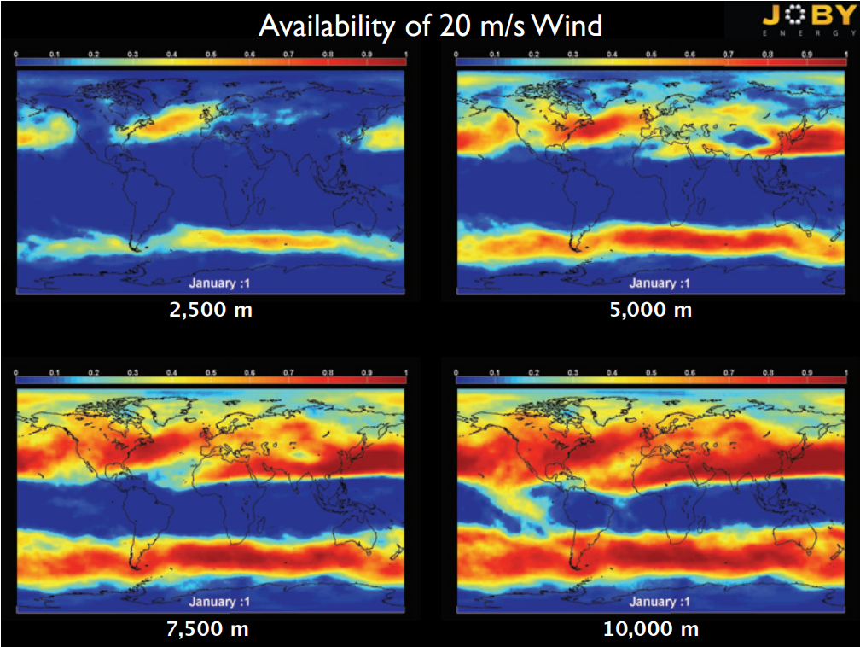
Altitude ≠ Elevation
Notes:
20 m/s ~ 45 MPH

Slide 12
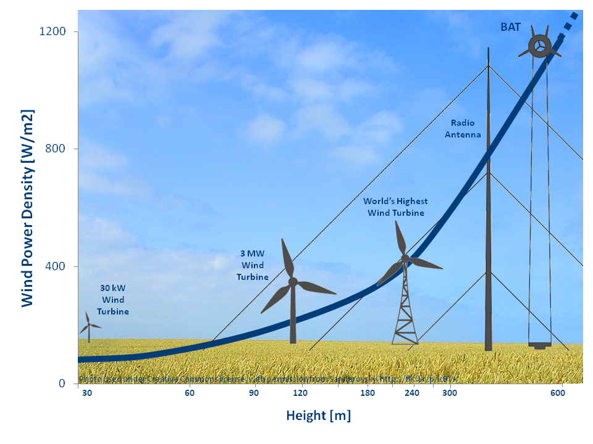
P_{A} = ¹/₂ρν³
http://www.altaeros.com/energy.html

Slide 13
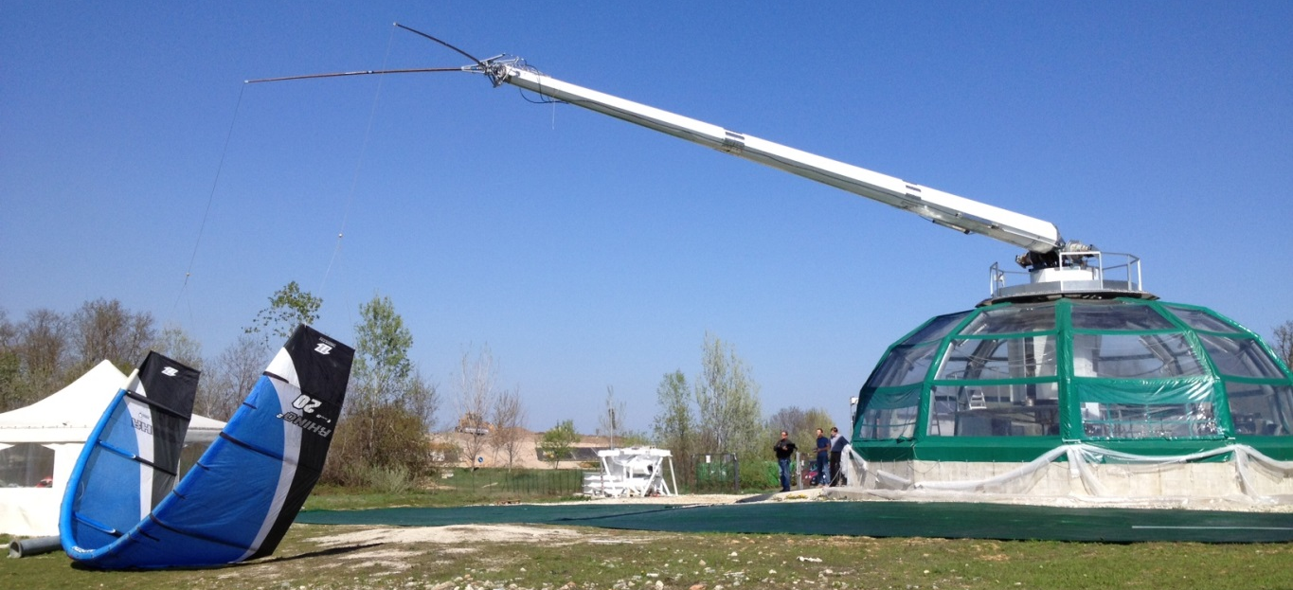
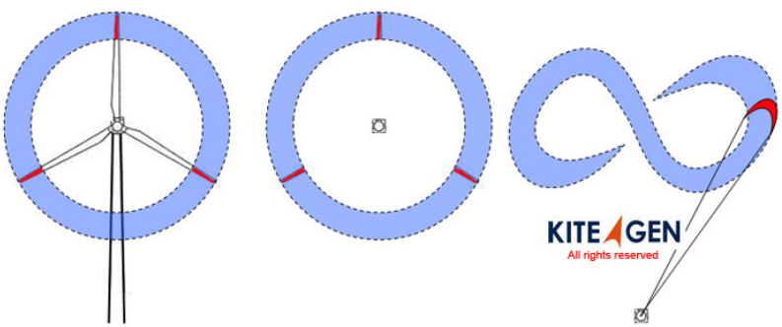
Directly analogous to wind-surfing.
Kinetic energy of kite converted to shaft work at the tether point.
“Same power as a wind turbine with 10% of the materials”
Strategy 1: Cheap Kites
http://www.kitegen.com/en/products/stem/

Slide 14
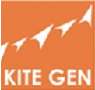
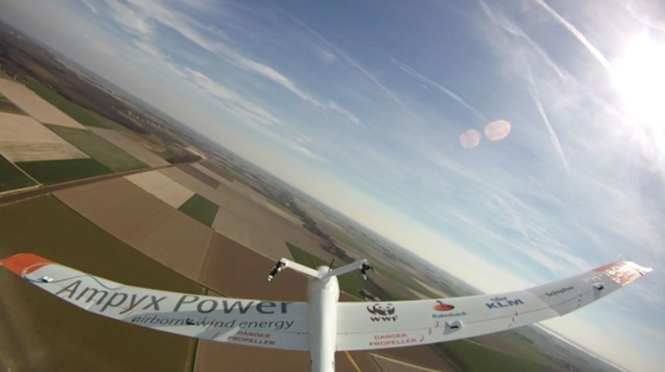



“Successful test of 3 MW rigging system”
Kites typically fly between 800-1000 meters high
In March 2017, published the completion of a large scale composites factory to produce kites en masse.
Strategy 1: Status
Largest scale: 300 kW
Aircraft typically fly between 100-500 meters high
Just started development of autopilot system
Largest scale: 60 kW, 800 m
Design similar to KiteGen. 2018 prototype to test 250 kW. Targeting more dispatchable units.
Plans for a 500 kW setup.
Equity from Shell, Schlumberger among others.

Slide 15
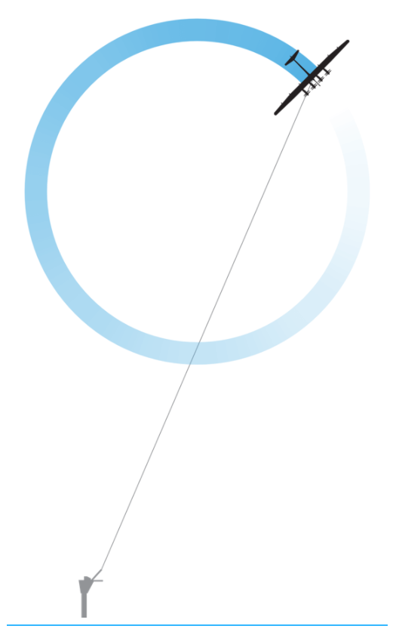
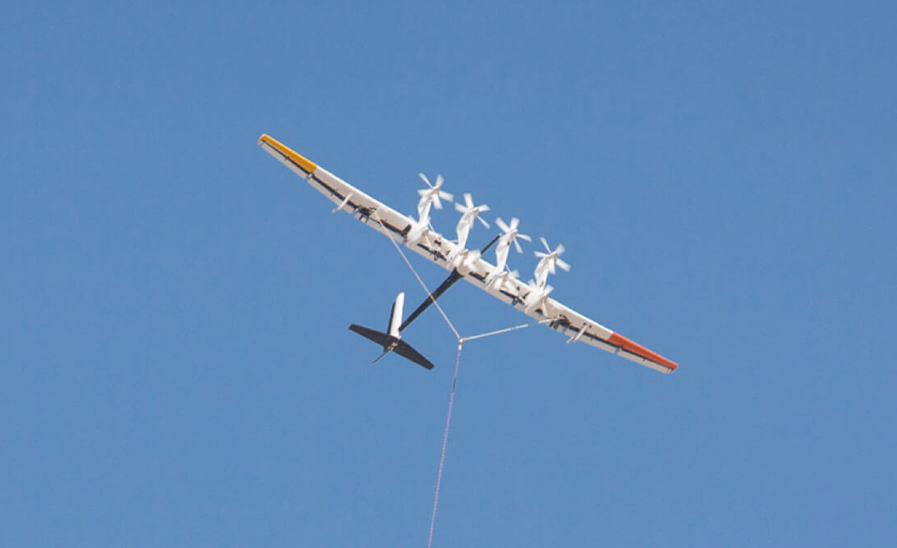
Generators are mounted to aircraft.
Electricity is transmitted through conductive tether.
Strategy 2: Really Expensive Kites
https://x.company/makani/technology/

Slide 16
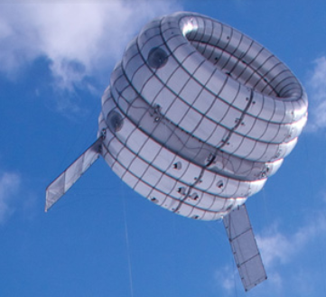

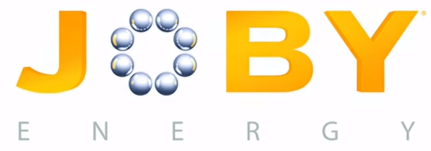



Small turbine supported by aerostat.
Tested up to 100 m, “rated for 300 m”.
$7 million in funding granted in 2017 for research in the BAT, and into telecomm services.
Strategy 2: Status
https://www.greentechmedia.com/articles/read/a-beginners-guide-to-the-airborne-wind-turbine-market#gs.JAUcOic

Slide 17
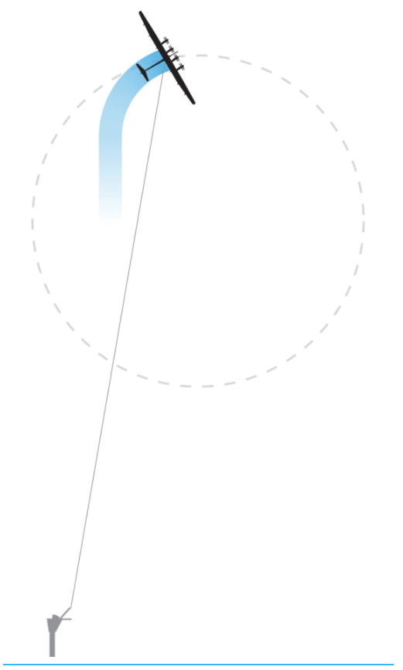
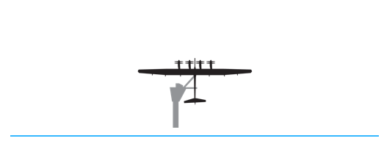
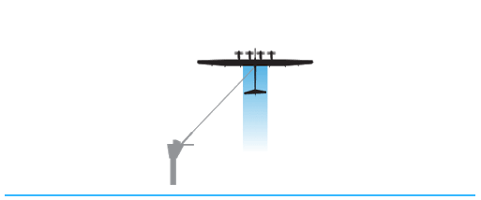
Initially, electricity supplied to reach optimal altitude.
Once correct amount of lift achieved via wind, crosswinds spin the turbine blades/generator shaft
Makani
https://x.company/makani/technology/

Slide 18
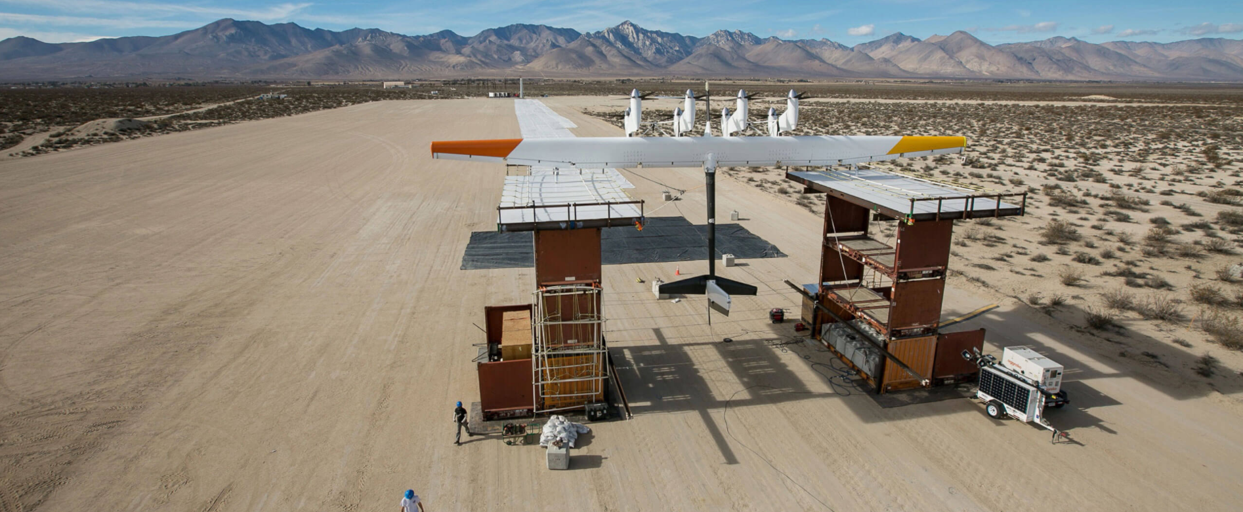
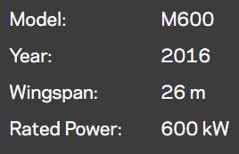
Makani
Reported to have received $500 million when acquired by X, but no status reports following acquisition.
No reported data on wind -> electricity efficiency, only generator efficiency (>96%).
https://x.company/makani/technology/

Slide 19
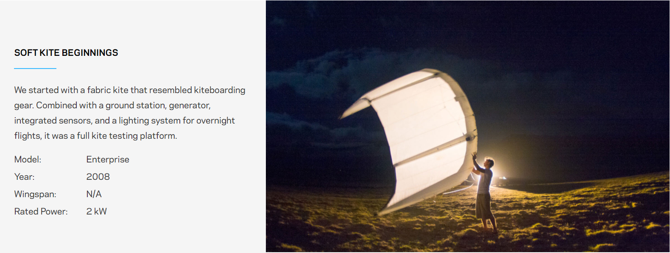
Makani
https://x.company/makani/journey/

Slide 20
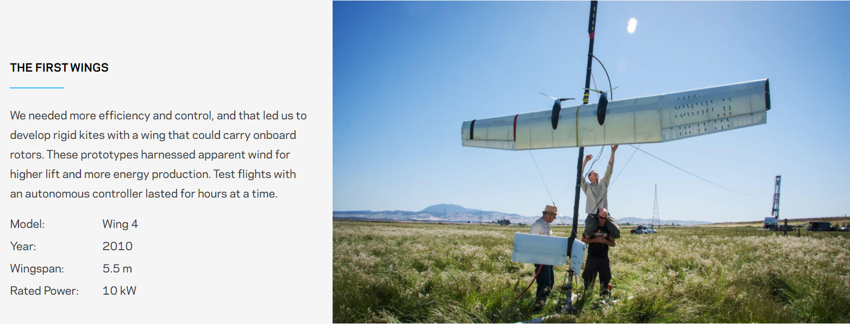
Makani
https://x.company/makani/journey/

Slide 21
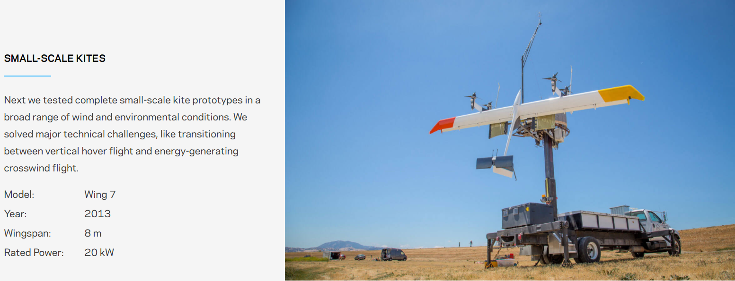
Makani
https://x.company/makani/journey/

Slide 22
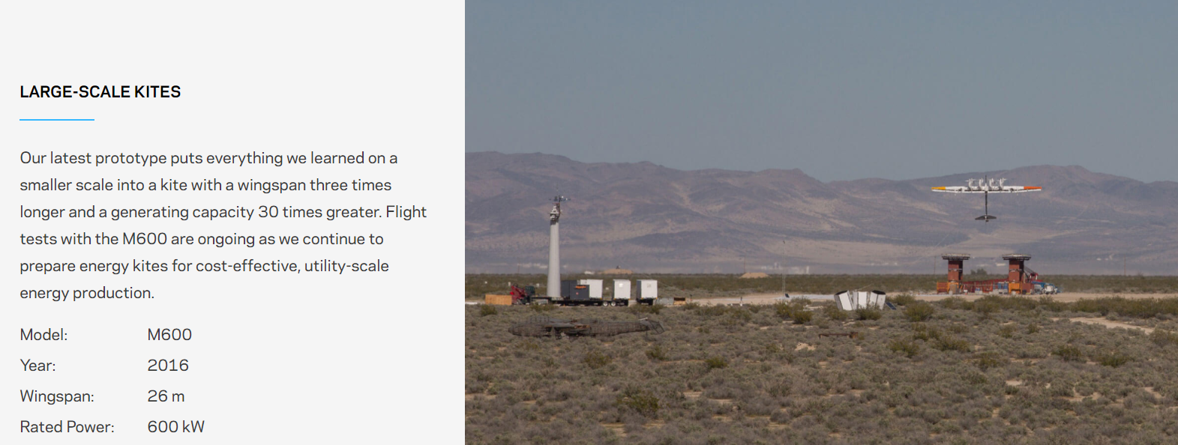
Makani
https://x.company/makani/journey/

Slide 23
Makani
https://youtu.be/An8vtD1FDqs
https://x.company/makani/journey/

Slide 24
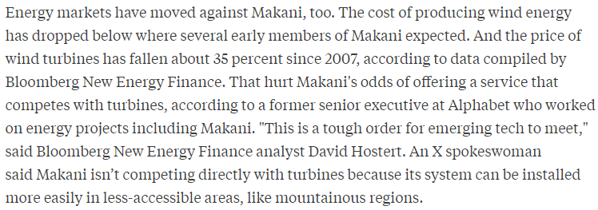
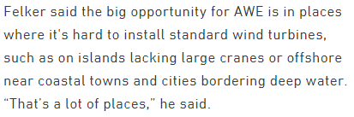
Makani Gossip
https://www.greentechmedia.com/articles/read/alphabet-remains-committed-to-makani-wind#gs.Kf4WYnI
https://www.bloomberg.com/news/articles/2017-08-04/alphabet-s-green-energy-ambitions-hit-turbulence

Slide 25
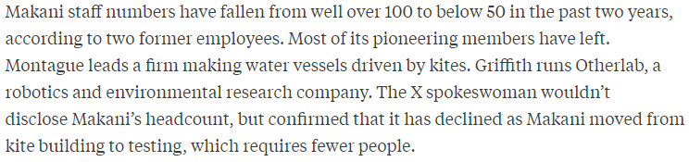
Makani Gossip
https://www.greentechmedia.com/articles/read/alphabet-remains-committed-to-makani-wind#gs.Kf4WYnI
https://www.bloomberg.com/news/articles/2017-08-04/alphabet-s-green-energy-ambitions-hit-turbulence

Slide 26
High(er) Altitude Wind
These technologies are not really high altitude wind harvesting techs in the way in which it was previously envisioned (<1000 m vs. 10,000+ m).
However, these technologies do provide a nice foundation for actual jet stream technology.
https://www.greentechmedia.com/articles/read/alphabet-remains-committed-to-makani-wind#gs.Kf4WYnI
https://www.greentechmedia.com/articles/read/joby-energy-the-tale-of-a-high-flying-entrepreneur#gs.2XGYAbs

Slide 27
High(er) Altitude Wind
These technologies are not really high altitude wind harvesting techs in the way in which it was previously envisioned (<1000 m vs. 10,000+ m).
However, these technologies do provide a nice foundation for actual jet stream technology.
Major challenge: transmission of energy from aircraft to tether point. Most startups are already limited by strength, lifetime, drag, and cost of tether materials.
https://www.greentechmedia.com/articles/read/alphabet-remains-committed-to-makani-wind#gs.Kf4WYnI
https://www.greentechmedia.com/articles/read/joby-energy-the-tale-of-a-high-flying-entrepreneur#gs.2XGYAbs

Slide 28
High(er) Altitude Wind
These technologies are not really high altitude wind harvesting techs in the way in which it was previously envisioned (<1000 m vs. 10,000+ m).
However, these technologies do provide a nice foundation for actual jet stream technology.
Major challenge: transmission of energy from aircraft to tether point. Most startups are already limited by strength, lifetime, drag, and cost of tether materials.
Slightly less major challenge: Need dedicated airspace for these devices which limits other air traffic or the location where these devices can be places.
https://www.greentechmedia.com/articles/read/alphabet-remains-committed-to-makani-wind#gs.Kf4WYnI
https://www.greentechmedia.com/articles/read/joby-energy-the-tale-of-a-high-flying-entrepreneur#gs.2XGYAbs

Slide 29
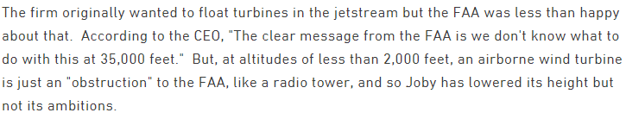
High(er) Altitude Wind
These technologies are not really high altitude wind harvesting techs in the way in which it was previously envisioned (<1000 m vs. 10,000+ m).
However, these technologies do provide a nice foundation for actual jet stream technology.
Major challenge: transmission of energy from aircraft to tether point. Most startups are already limited by strength, lifetime, drag, and cost of tether materials.
Slightly less major challenge: Need dedicated airspace for these devices which limits other air traffic or the location where these devices can be places.
https://www.greentechmedia.com/articles/read/alphabet-remains-committed-to-makani-wind#gs.Kf4WYnI
https://www.greentechmedia.com/articles/read/joby-energy-the-tale-of-a-high-flying-entrepreneur#gs.2XGYAbs

Slide 30
Airborne Wind Generation
The field seems to now have branded their tech as airborne wind generators (AWG), with the goal of targeting markets where cost of traditional wind-based energy generation is high.
https://www.greentechmedia.com/articles/read/alphabet-remains-committed-to-makani-wind#gs.Kf4WYnI
https://www.bloomberg.com/news/articles/2017-08-04/alphabet-s-green-energy-ambitions-hit-turbulence

Slide 31
Airborne Wind Generation
The field seems to now have branded their tech as airborne wind generators (AWG), with the goal of targeting markets where cost of traditional wind-based energy generation is high.
Potential markets:
Unstable/uneven ground such as mountainous regions or offshore sites
https://youtu.be/tx0ugnc5j-g
https://www.greentechmedia.com/articles/read/alphabet-remains-committed-to-makani-wind#gs.Kf4WYnI
https://www.bloomberg.com/news/articles/2017-08-04/alphabet-s-green-energy-ambitions-hit-turbulence

Slide 32
Airborne Wind Generation
The field seems to now have branded their tech as airborne wind generators (AWG), with the goal of targeting markets where cost of traditional wind-based energy generation is high.
Potential markets:
Unstable/uneven ground such as mountainous regions or offshore sites
Locations where it is cost intensive to have turbine components (tower, turbine blades, etc) shipped/constructed, such as small islands.
https://www.greentechmedia.com/articles/read/alphabet-remains-committed-to-makani-wind#gs.Kf4WYnI
https://www.bloomberg.com/news/articles/2017-08-04/alphabet-s-green-energy-ambitions-hit-turbulence

Slide 33
Airborne Wind Generation
The field seems to now have branded their tech as airborne wind generators (AWG), with the goal of targeting markets where cost of traditional wind-based energy generation is high.
Potential markets:
Unstable/uneven ground such as mountainous regions or offshore sites
Locations where it is cost intensive to have turbine components (tower, turbine blades, etc) shipped/constructed, such as small islands.
Makani is planning to move to Hawaii to test their M600 (600 kW) design in areas closer to populated locations and also potentially to test arrays.
https://www.greentechmedia.com/articles/read/alphabet-remains-committed-to-makani-wind#gs.Kf4WYnI

