Slide 1
Muni's and Microgrids - public power and community electricity distribution in Massachusetts
Erik Van Vlack
HEJC Journal Club
4/10/2020

Slide 2
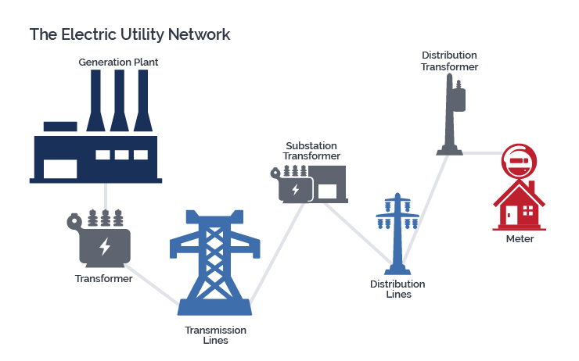
How does electricity get to you?
https://www.giud.com/about-us/electric-generation

Slide 3
Ownership Models of Electricity Distribution

Slide 4


Ownership Models of Electricity Distribution
Investor Owned Utilities

Slide 5



Ownership Models of Electricity Distribution
Investor Owned Utilities
State Power Authorities

Slide 6
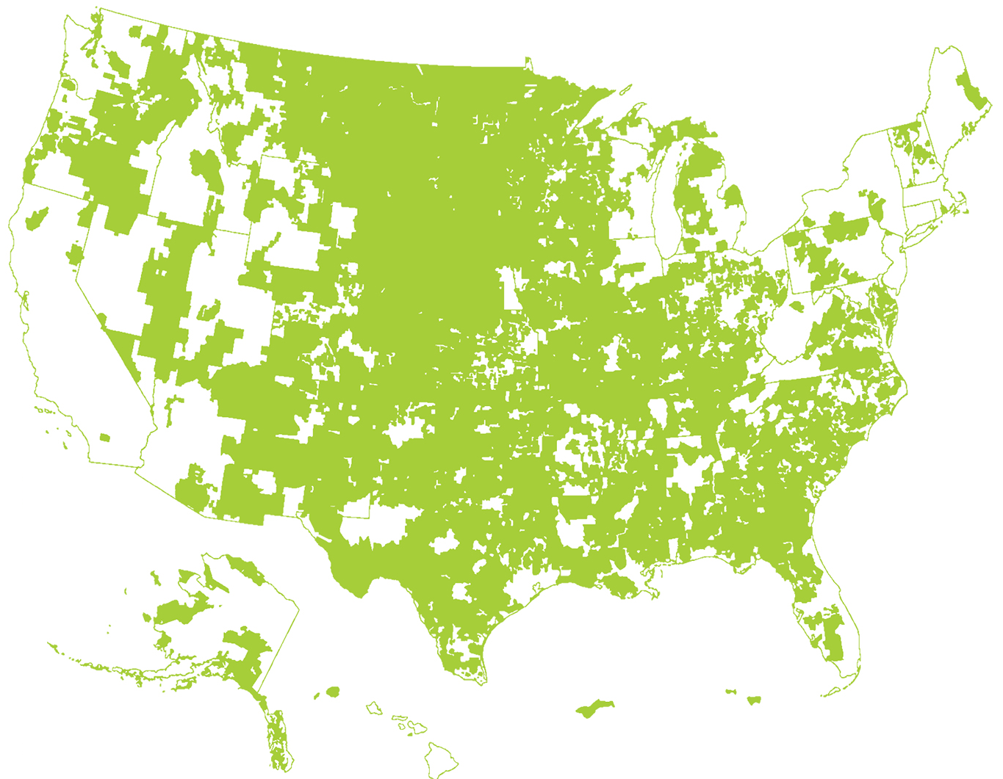

Ownership Models of Electricity Distribution
Investor Owned Utilities
State Power Authorities
Cooperatives

Slide 7

Ownership Models of Electricity Distribution
Investor Owned Utilities
State Power Authorities
Cooperatives
Municipally owned Utilities

Slide 8
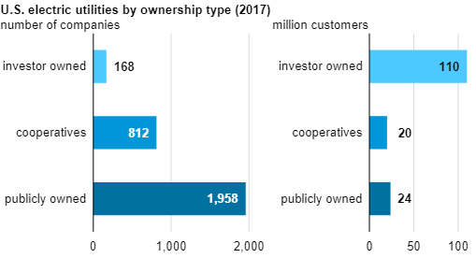
Ownership models of Electricity Distribution
Investor Owned Utilities
State Power Authorities
Cooperatives
Municipally Owned Utilities

Slide 9
Who Owns Electricity Distribution in MA?
Investor Owned Utilities – Eversource, National Grid, UNITIL
State Power Authorities
Cooperatives
Municipally Owned Utilities – 41 Municipal Light Plants (MLPs), 50 municipalities

Slide 10
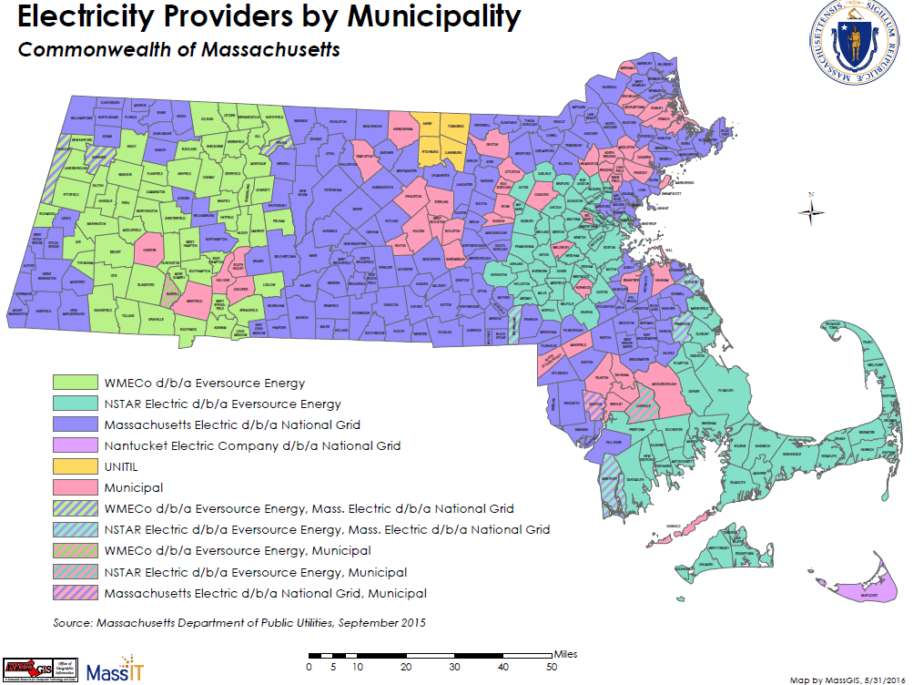
Who Owns Electricity Distribution in MA?

Slide 11
MA’s Municipal Light Plants
Managed by the town (mayor or selectmen or municipal light board)
Purchase electricity wholesale off the market or generate it themselves.
  MA Ratepayers served by MLP’s pay ~30% less on average
Faster emergency response, locally customized services

Slide 12
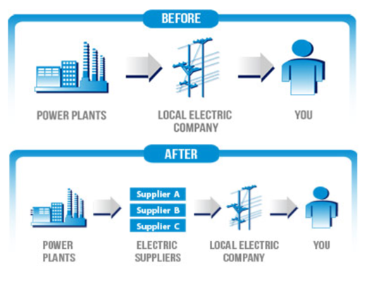
Utilities Deregulation Prevents an IOU Vertical Monopoly
www.starionenergy.com

Slide 13
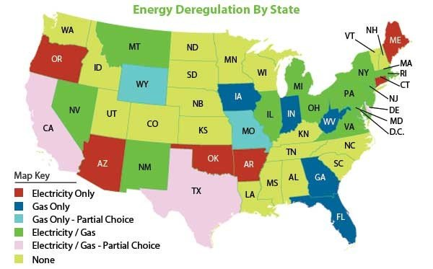
(as of Nov 2019)
paylesspower.com

Slide 14
Utilities Deregulation Prevents an IOU Vertical Monopoly
www.starionenergy.com

Slide 15






Utilities Deregulation Prevents an IOU Vertical Monopoly
Production
Distribution

Slide 16
Deregulation Does Not Apply to Municipal Light Plants
MLPs can make their own power for local distribution or buy/sell on power markets
www.publicpower.org

Slide 17
Why don’t more towns have MLPs?
No new Municipal Light Plants since 1926
Massachusetts state law gives IOUs a veto power over selling their facilities

Slide 18
Why don’t more towns have MLPs?
No new Municipal Light Plants since 1926
Massachusetts state law gives IOUs a veto power over selling their facilities
Watch this space: Legislation proposed to reintroduce public utilities ownership
  H 3893 – create a task force to recommend a course of action by 2026
  H 2914 – Allow municipalities to establish microgrids and use locally procured energy within a IOU’s territory

Slide 19
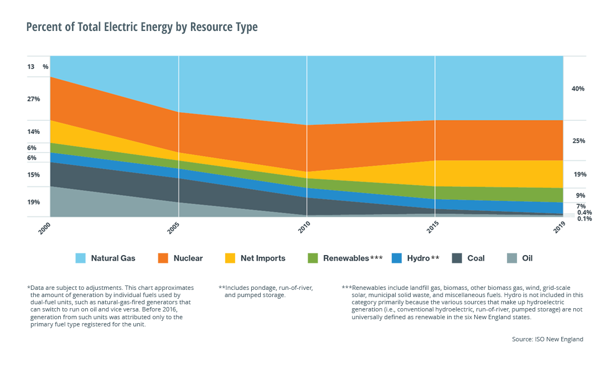
Natural gas remains the major source of electricity in New England

Slide 20
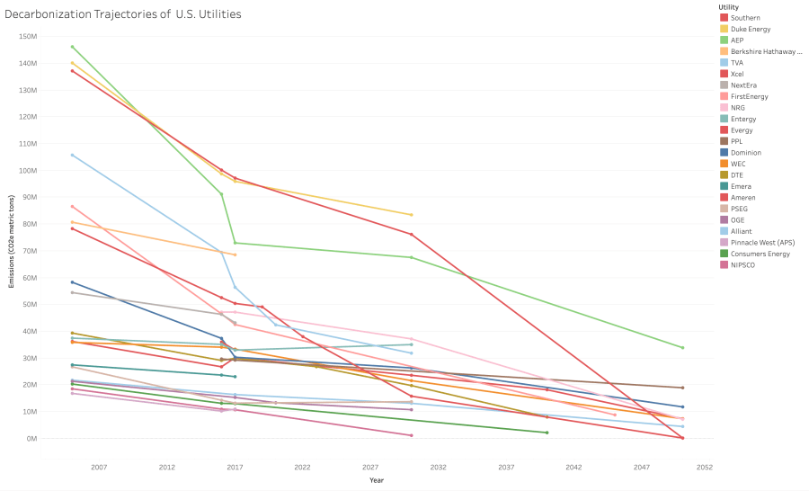
IOUs are not on track to meet decarbonization goals
https://www.energyandpolicy.org/utility-carbon-targets/

Slide 21
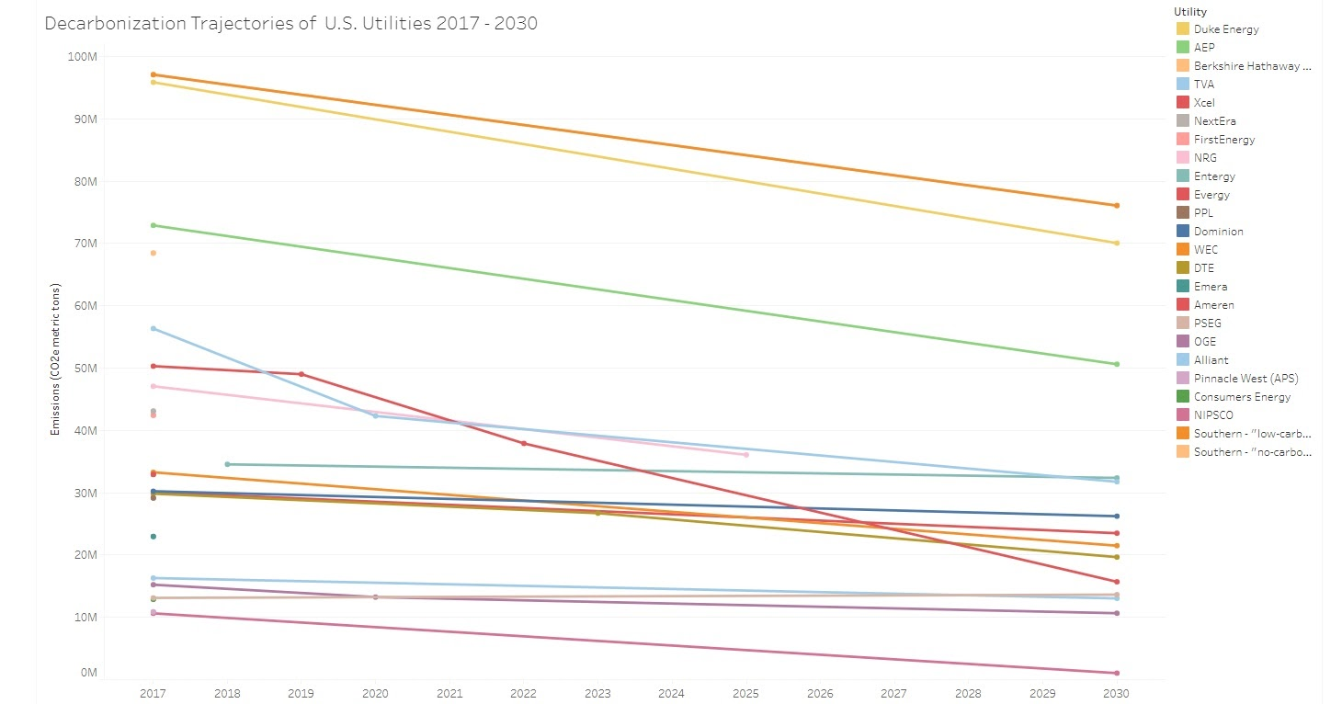
IOUs are not on track to meet decarbonization goals
https://www.energyandpolicy.org/utility-carbon-targets/

Slide 22
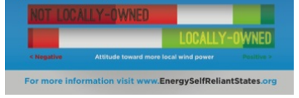
Is public power Greener?
Nationwide, public power has decarbonized faster (33% reduction in emissions vs 24% from 2005-2017)
In MA, MLPs renewables research can also improve self-sufficiency

Slide 23
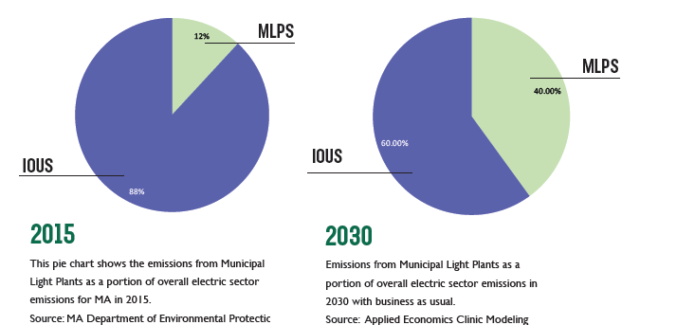
Some MA municipalities dodge green initiatives
Not held to the Renewable Portfolio Standard (RPS) or the Clean Energy Standard (CES)
Source:MCAN MLP Report Card, 2017

Slide 24
Making MLPs Greener
Concord, Belmont, and Chicopee have all published climate energy plans involving their MLP
  Concord – 100% carbon free by 2021
  Belmont – voluntarily meet CEP, 80% greenhouse gas reduction by 2050
  Chicopee – highest energy efficiency score
  Hingham – already 100% carbon free (since 2017)
Legislation proposed to hold MLPs to higher standards
  H 2836 requires MLPs to purchase 100% renewables by 2045, prioritizes local and community ownership of energy generation
Source:MCAN MLP Report Card, 2017

Slide 25
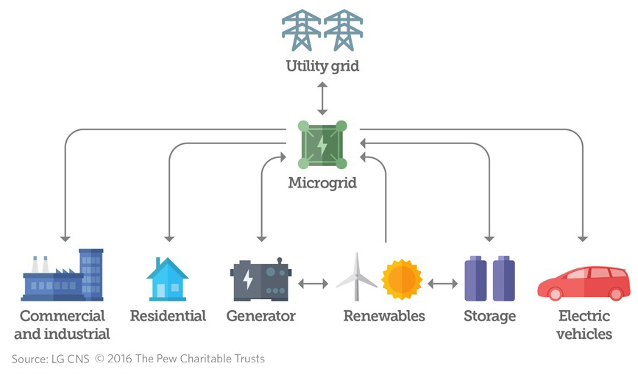
Microgrids

Slide 26
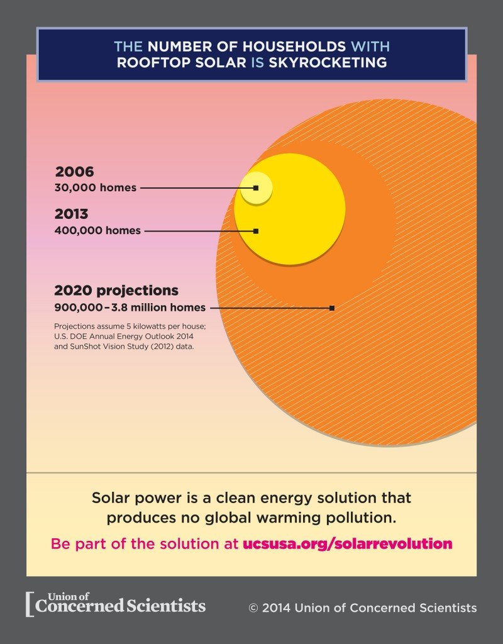
Green Advantages of Community Microgrids
Source: Union of Concerned Scientists

Slide 27

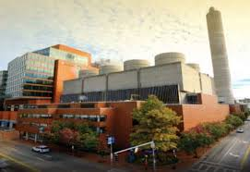
Who can own a microgrid?

Slide 28
What’s next for microgrids?
Community distributed microgrid development is ongoing in the greater Boston area
Microgrid Design Toolkit by Sandia National Labs
  https://energy.sandia.gov/download-sandias-microgrid-design-toolkit-mdt/
  Used to develop the backup power system for Hoboken, NJ

