Slide 1
Fantastic microbes and how to use them:
Is bioeconomy the way out?
Piyush Nanda HEJC 22nd April, 2022

Slide 2
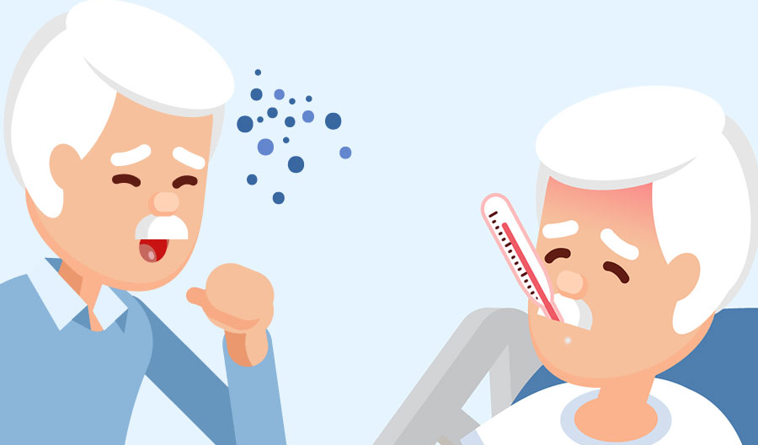
Type to enter a caption.

Slide 3
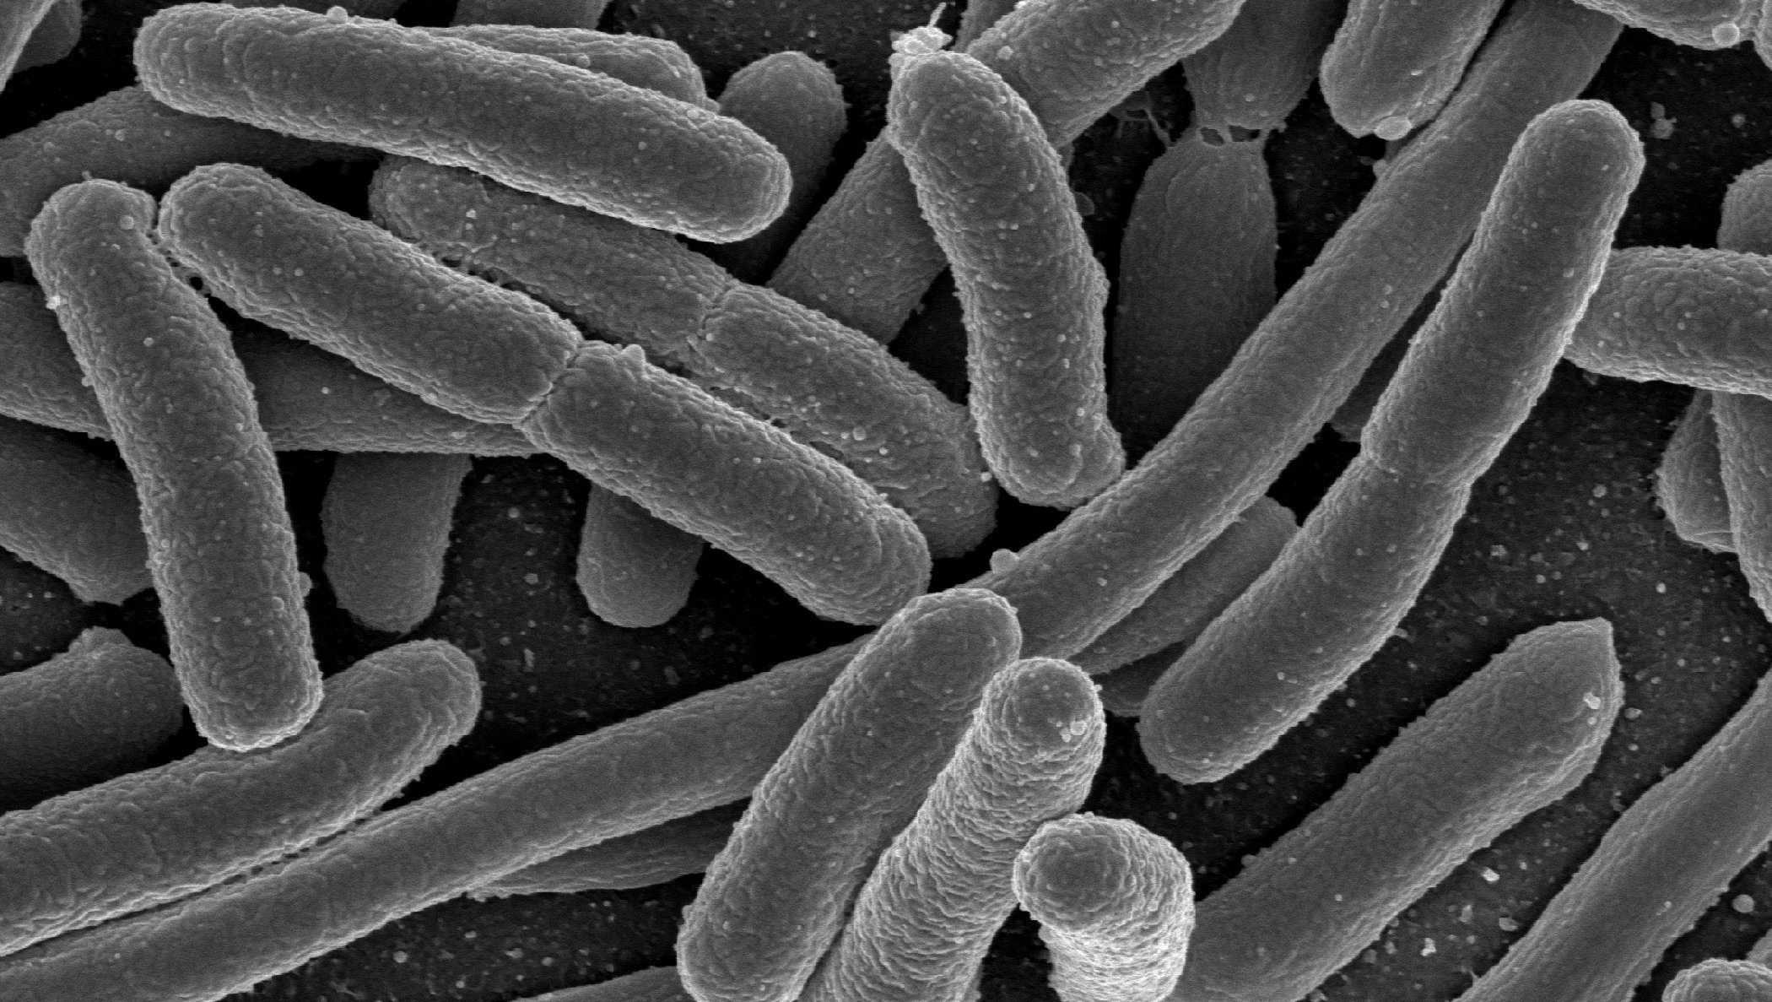
Type to enter a caption.

Slide 4
~2000 reactions
~1800 metabolites
Type to enter a caption.

Slide 5

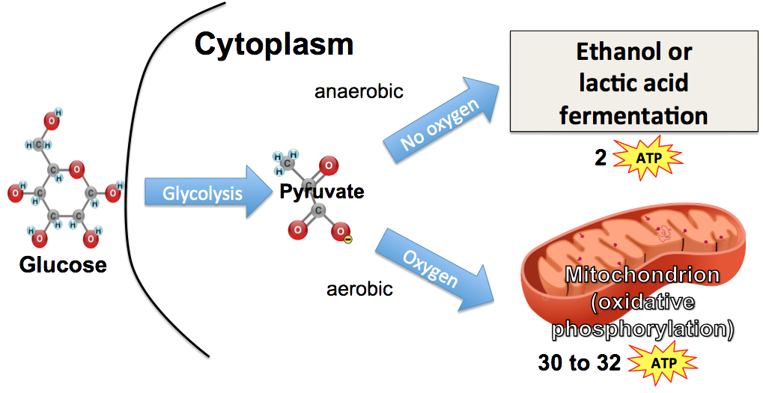
Type to enter a caption.
Type to enter a caption.

Slide 6
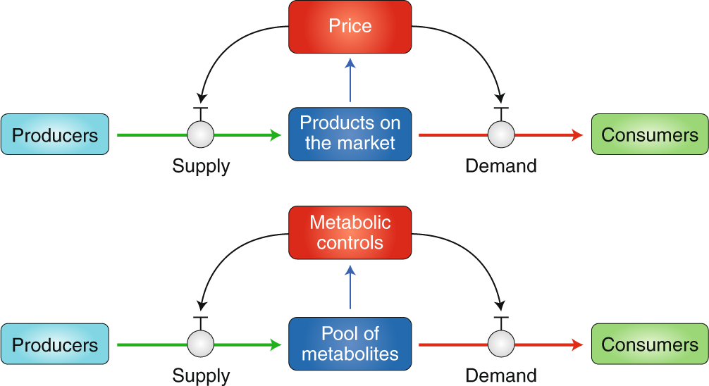
Type to enter a caption.
Type to enter a caption.

Slide 7
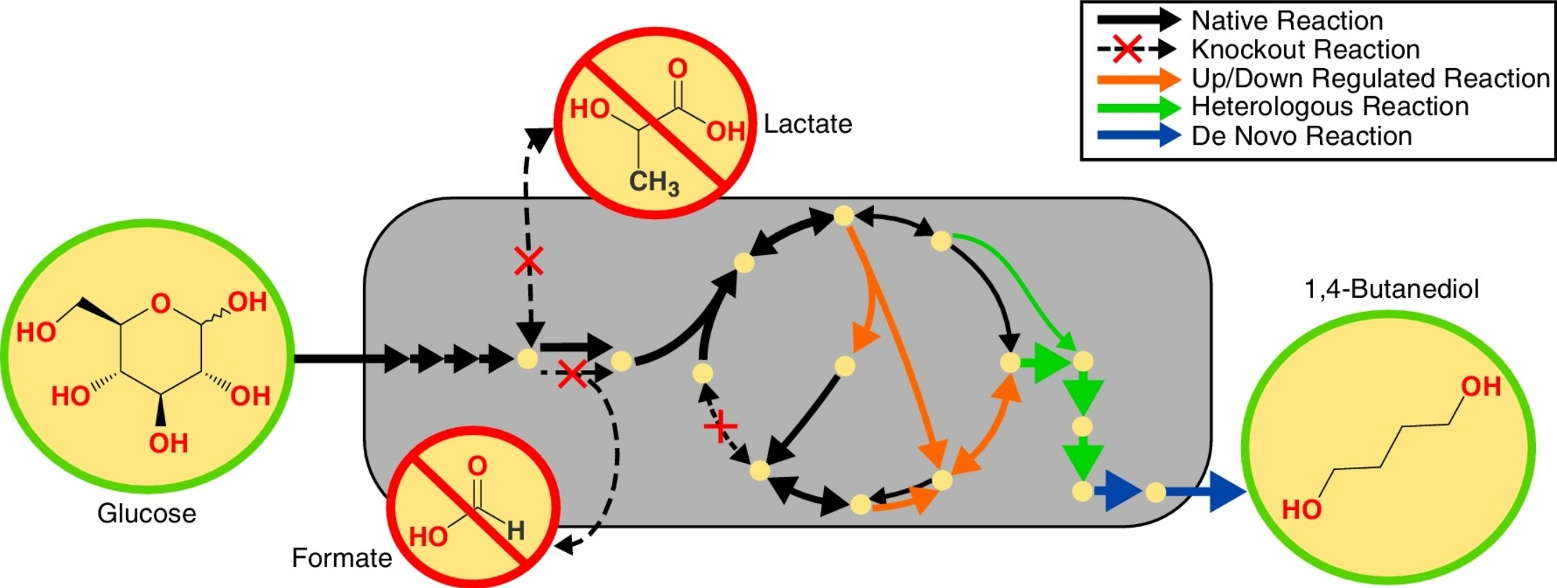
Type to enter a caption.

Slide 8
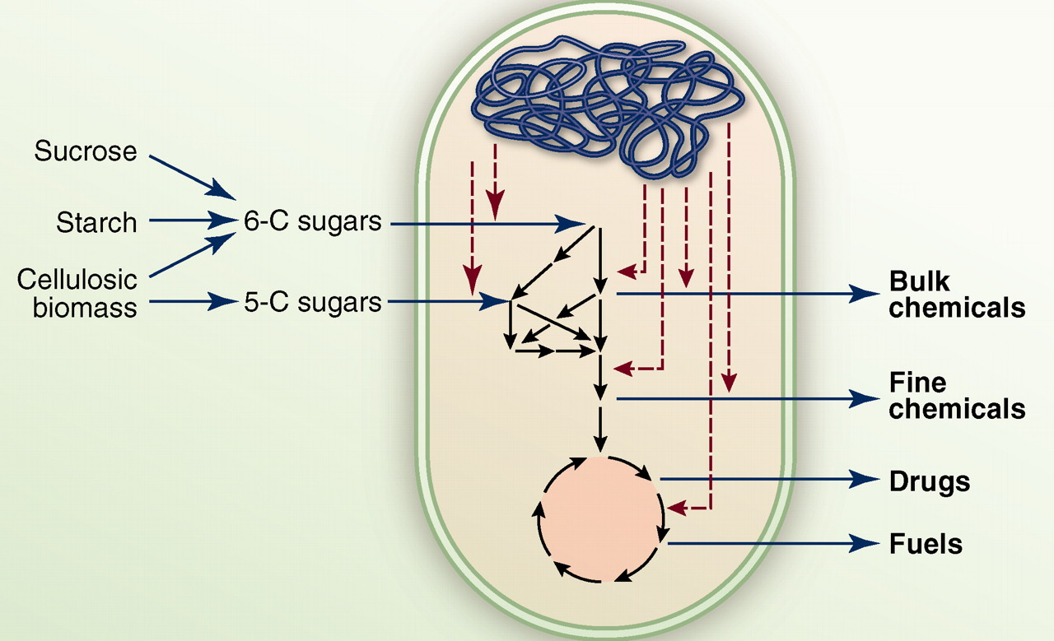
Type to enter a caption.

Slide 9
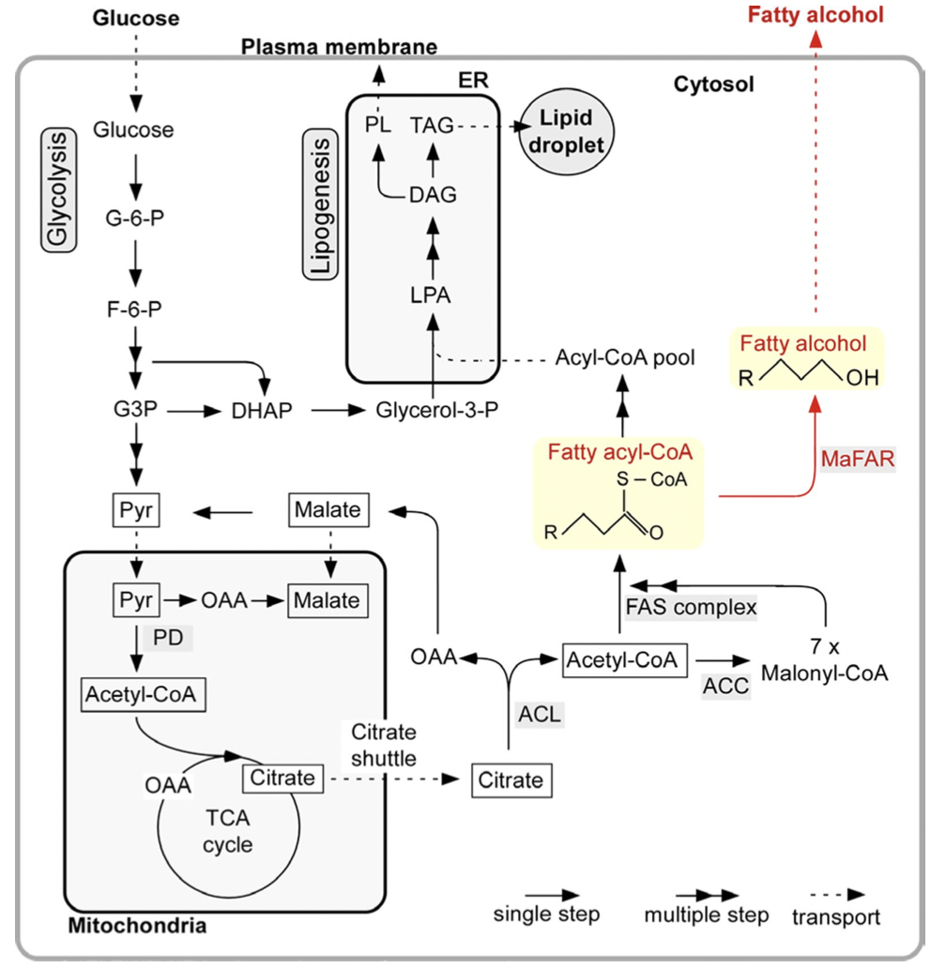
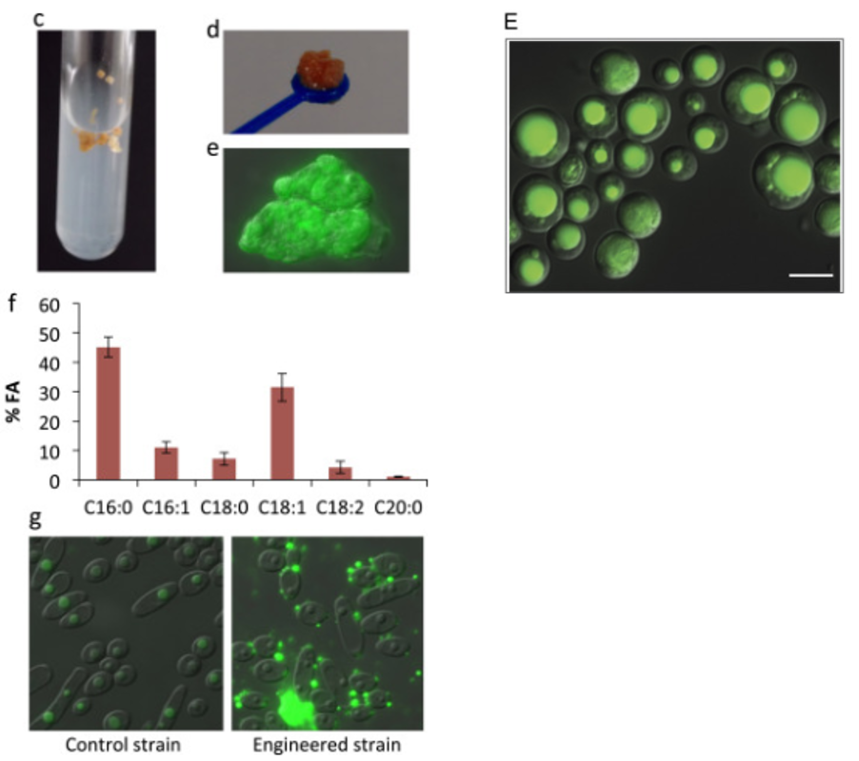
Fatty Acid production using microbes
Ledesma et al. (2016), Metab. Engg.
Wang et al. (2016), Biotech. Biofuels.

Slide 10
Isobutanol production using microbes
Valine
Isobutanol
Essential Amino Acid
Looks boring
Is it there in Vanilla?
Drop in fuel
Obtained from petroleum
Used in chemical industry

Slide 11
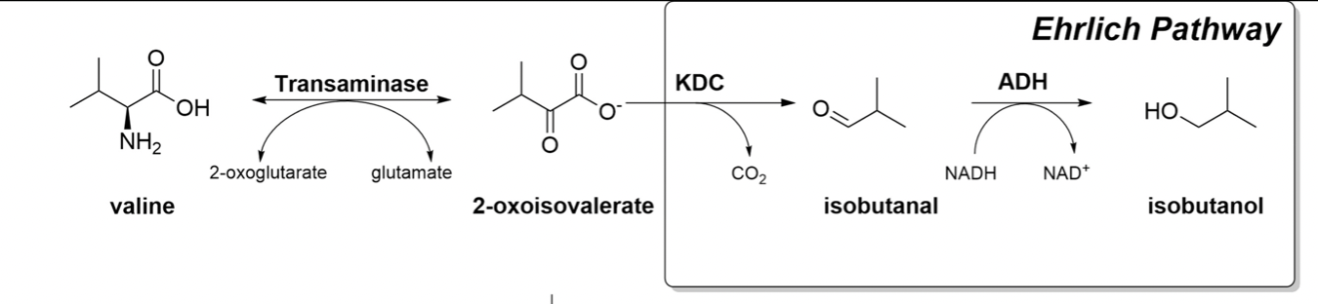
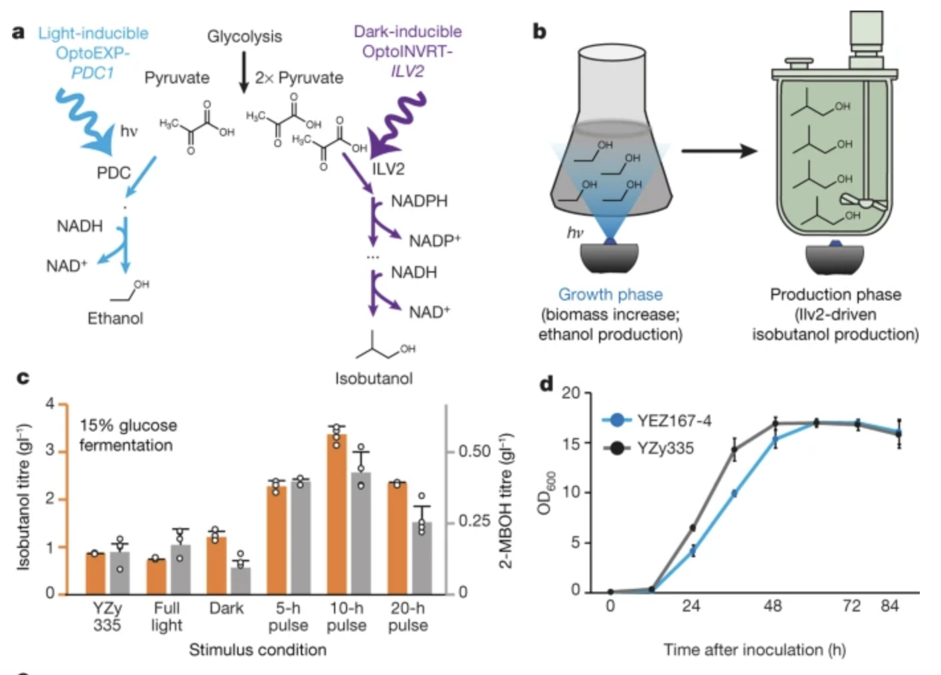
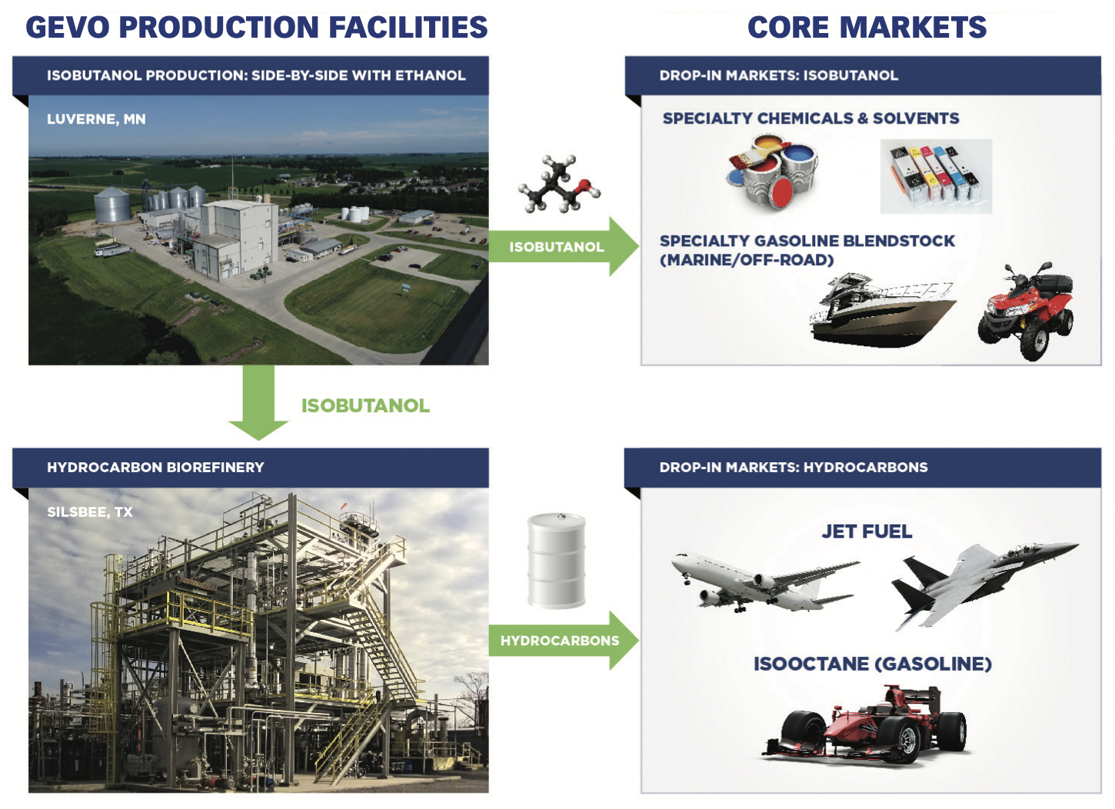
Isobutanol production using microbes
Solomon et al. (2016), Metab. Engg. Comm.
Zhao et al. (2018), Nature

Slide 12
Anti-malarial drug: Artemisinin
In Yeast
Artemisinin
Potent Anti-Malarial Drug
2015 Nobel Prize

Slide 13
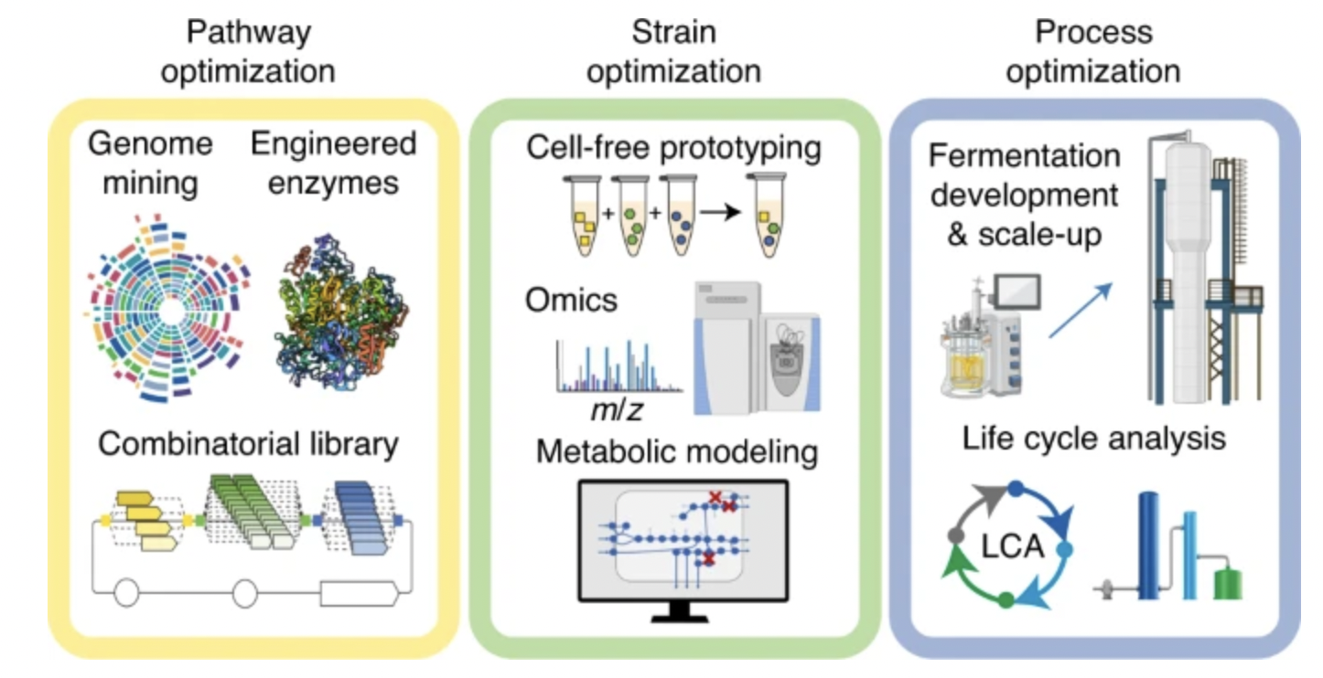
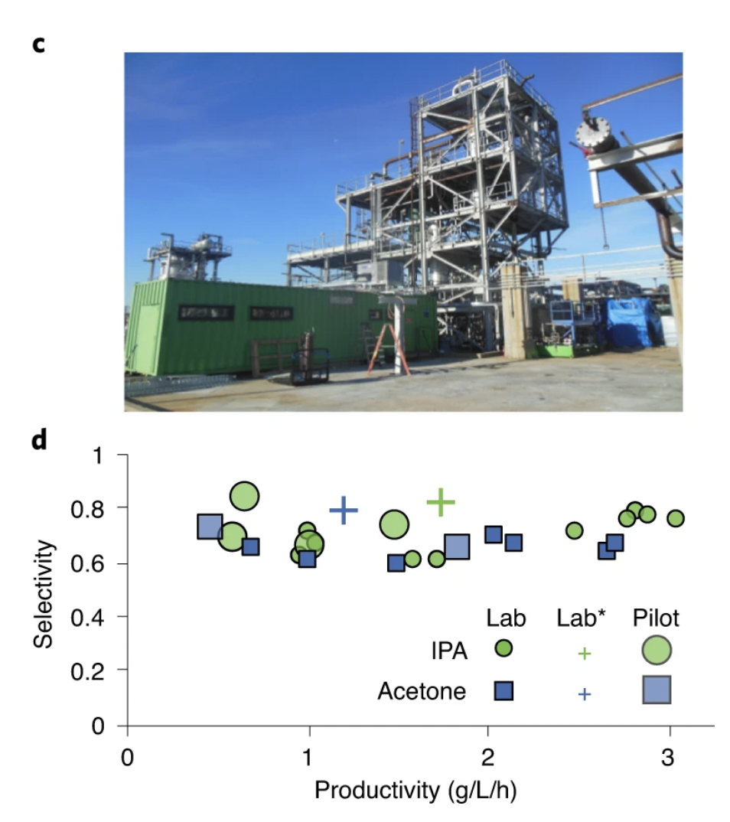
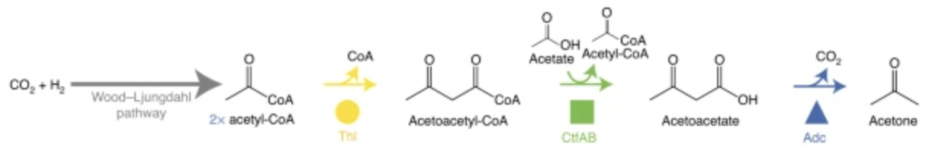
Acetone production using microbes
Isopropanol
Acetone
UD 5 billion market
~5 % CAGR
Non-renewable sources
UD 3 billion market
~8 % CAGR
Non-renewable sources
Liew et al. (2022), Nature Biotech

Slide 14
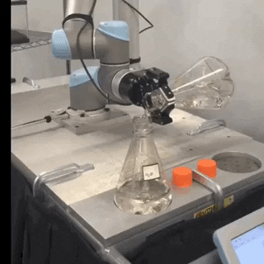
The way forward
Lab automation
Discover new friends
Computational Tools

