Slide 1
Nuclear Alchemy: The Real Magic Behind the Philosopher’s Stone
HEJC
March 4, 2022
Eric Fell

Slide 2
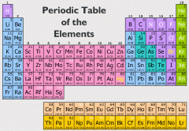
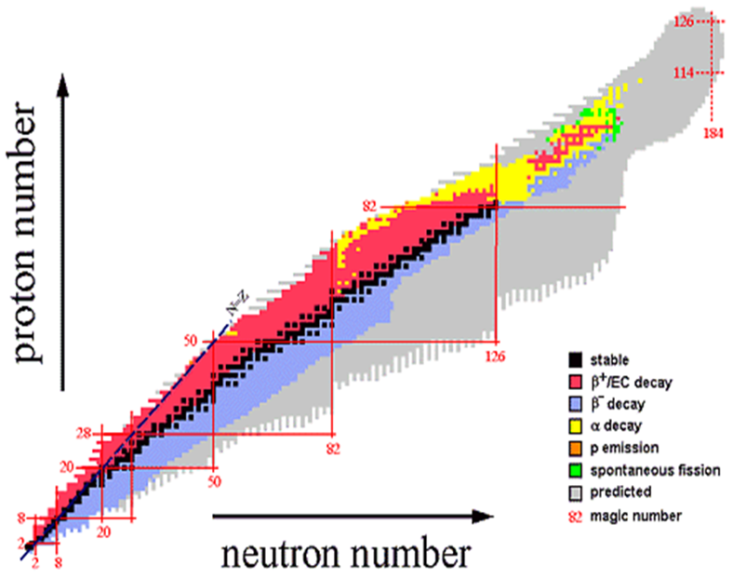
Fundamentals of nuclear reactions
All elements have isotopes, large range of stabilities
Radioactive decay occurs in unstable isotopes, resulting in spontaneous emission of particles and/or electromagnetic radiation
Repulsive force between protons must be balanced by a strong attractive force for nuclei stability
http://fys246.nuclear.lu.se/topics.asp

Slide 3
Barriers in nuclear reactions
Charged particles must overcome electrostatic potential energy barrier for nuclear reactions to occur
  Barrier scales with Z, on the order of a few MeV per proton pair
  abundance of charged reactants (e.g. protons in elements)
  Can overcome barrier with kinetic energy, propelled by electromagnetic fields of an accelerator etc.
Neutral particles have no electrostatic potential barrier
  Neutrons require less kinetic energy to initiate nuclear reactions
  Free neutron is short lived (lifetime ~15 min), therefore source is required for any use of neutrons

Slide 4
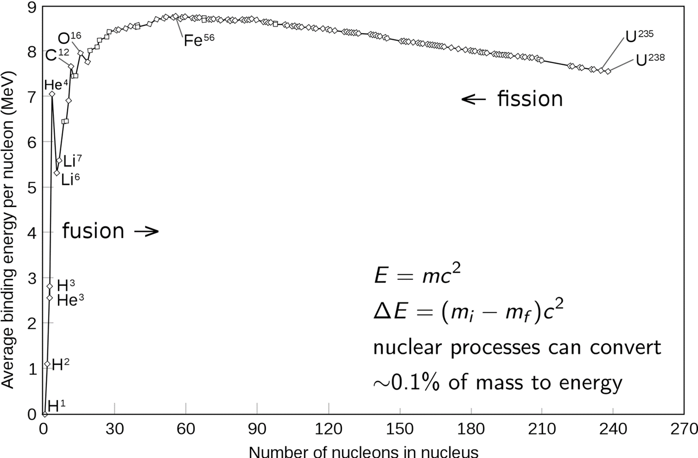
Binding energy
Nuclear transmutations release energy equal to the difference between binding energy of nuclei in final and initial states

Slide 5
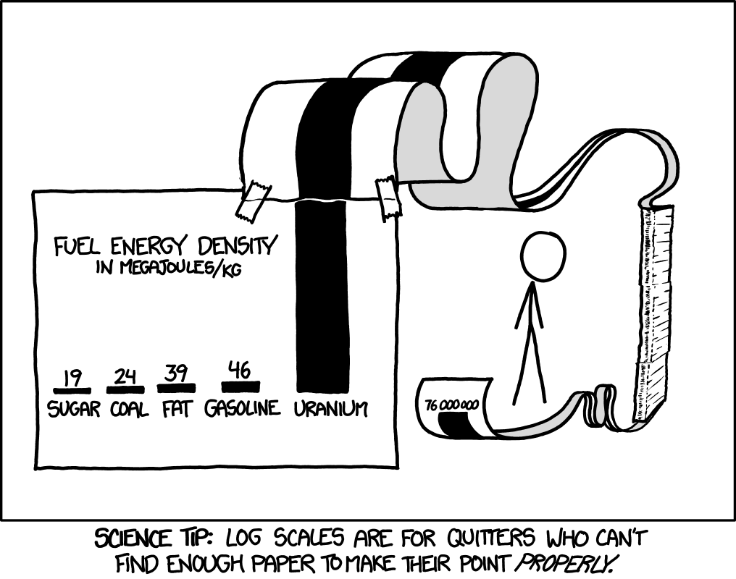

Mass-energy equivalence
$$E_{0}=mc^{2}$$
Energy of nuclear decay comes from mass conversion, on the energy scale of MeV (1.6⨯10⁻¹³ J) released for every nuclear reaction

Slide 6
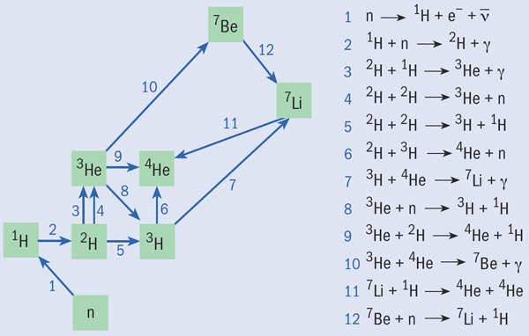
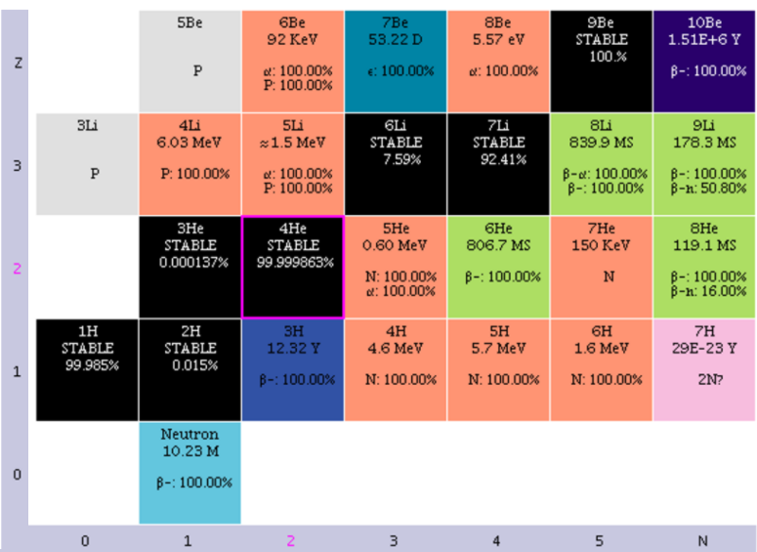
Natural transmutations:
Big Bang nucleosynthesis
Stars can bridge these gaps by the triple alpha process (3 Heliums → carbon)
Stability gaps @ mass 5 and 8
https://physicsworld.com/a/testing-the-elements-of-the-big-bang/
Results in large abundance of hydrogen and helium
# protons
# neutrons

Slide 7
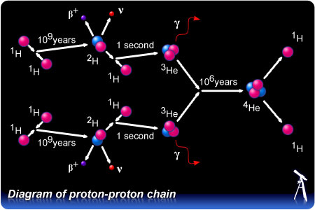
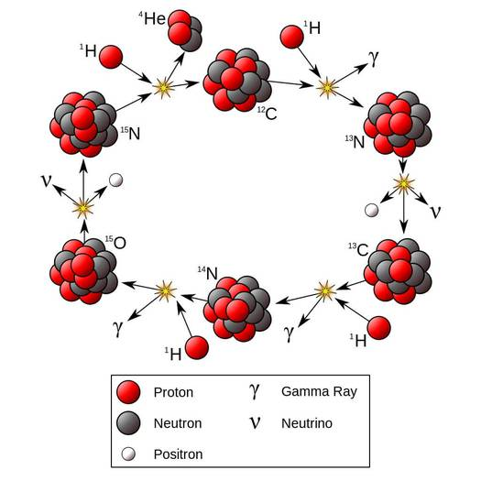
Natural transmutations:
Star burning, pp chain to CN cycle
In our Sun, majority of fusion reaction is “burning” hydrogen→helium
@ ~616 Mt/s of H
start
Younger stars are also enriched in heavier elements produced from explosive death of older stars
→ now opens up the C-N cycle
https://physicsfeed.com/post/cno-cycle/

Slide 8
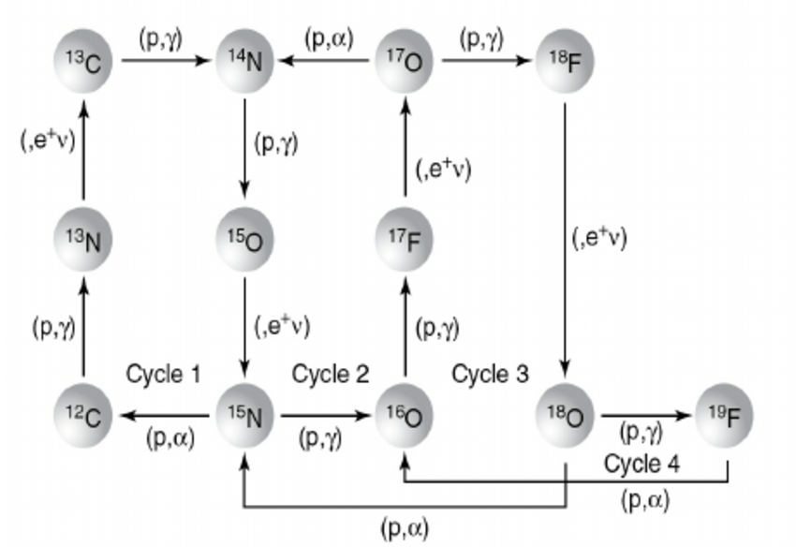
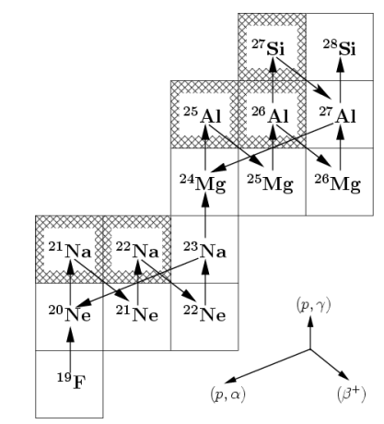
Natural transmutations:
Heavier element formation
CN cycle
Full CNO cycle
Ne-Na and Mg-Al cycles
Older stars
Hotter temperatures required for heavier element formation
Notes:
Continue up to iron

Slide 9
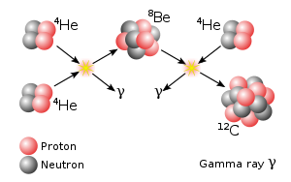
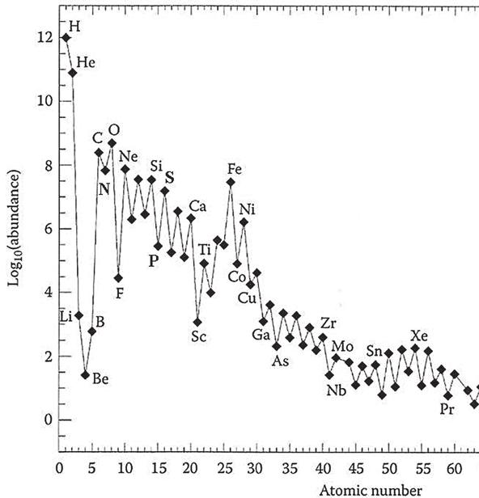
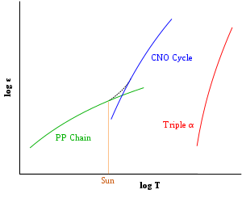

Natural transmutations:
Death (of) star
At some point, all hydrogen in star has been converted to helium and ashes of cycles (e.g. CNO)
Core contracts, heats up, helium burning begins →triple alpha process
-Bridges stability gap @masses 5 and 8,
-Isotopes with mass 5-11 are not made in stars
~reverse process
(Energy output)
p-¹¹B fusion
→ 3α + energy
https://en.wikipedia.org/wiki/CNO_cycle
Notes:
Cosmic ray spallation of nitrogen,carbon,oxygen possibly responsible for these low abundance elements

Slide 10
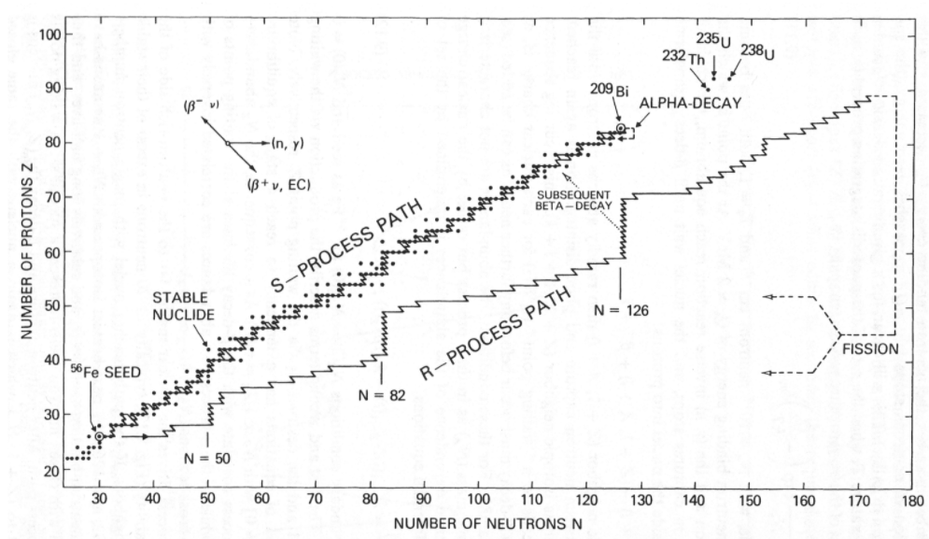
Natural transmutations:
Stellar nucleosynthesis
Other processes able to create heavy elements, path depends on reaction rate (number of available neutrons) vs beta decay rate
Stellar nucleosynthesis accounts for all naturally occurring elements in the universe, from carbon to uranium

Slide 11
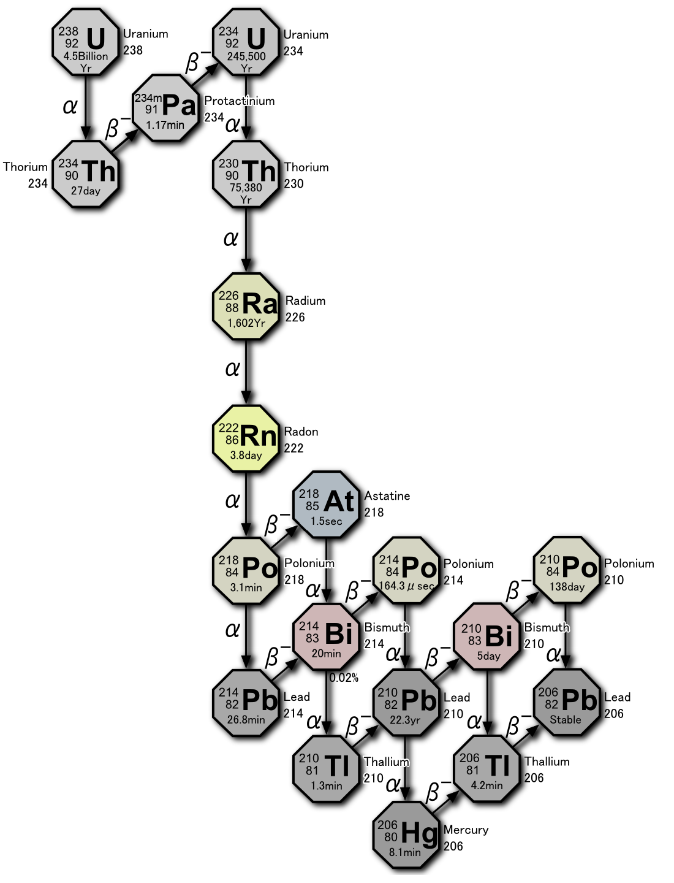
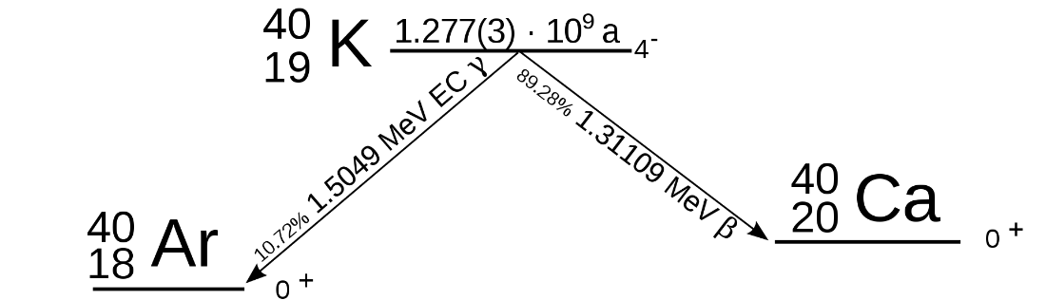
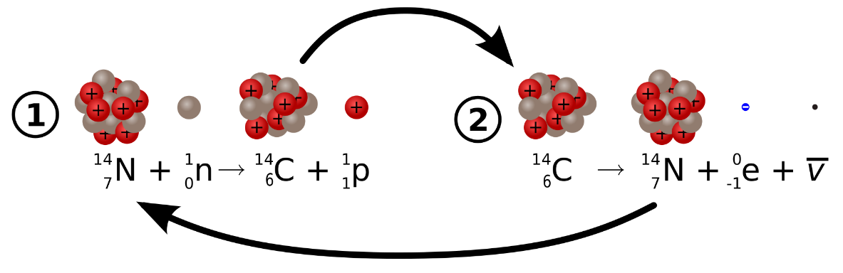
Natural transmutations:
Here on Earth
Uranium-238
Potassium-40
Largest source of radioactivity in humans
(4300 disintegrations per second)
Primordial nuclides
Carbon-14
t_{1/2} = 5730 yrs
https://en.wikipedia.org/wiki/Decay_chain

Slide 12

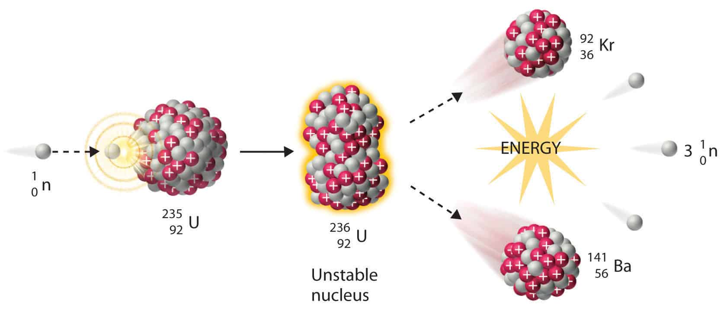
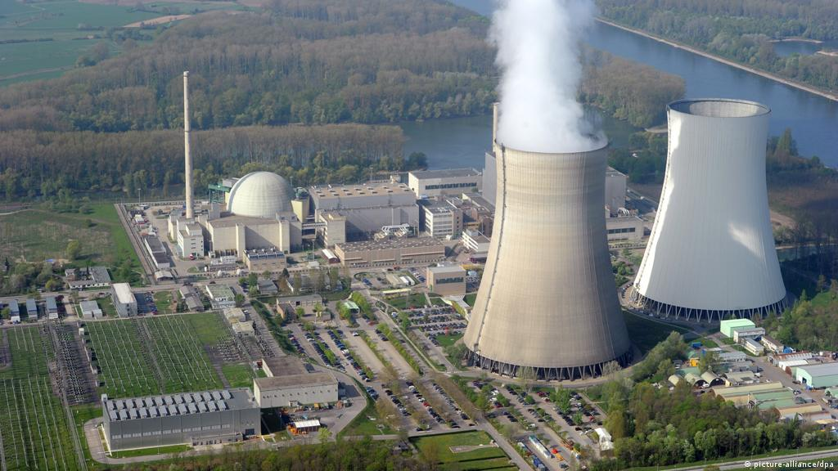
The beginnings of artificial transmutations
1917-1925, Ernest Rutherford performs the first artificial nuclear transmutation
Typically requires high-velocity bombarding particle → needs particle accelerator
1938, Hahn and Meitner discover nuclear fission of uranium

Slide 13
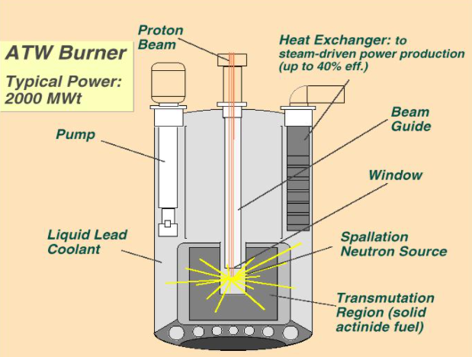
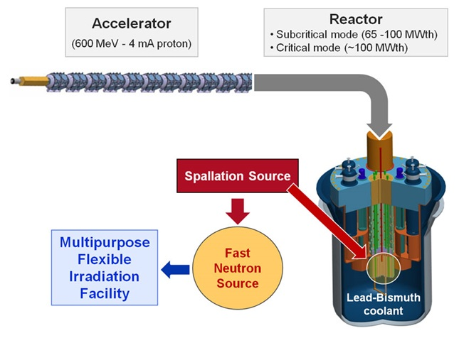
MYRRHA:
Multipurpose hYbrid Research Reactor for High-tech Applications
And to dust you shall return…
Nuclear waste transmutation
Accelerator driven systems, fast neutron spectrum research reactor
Can operate in sub-critical and critical modes
Fast protons spallate high-Z target, creates lots of neutrons
http://www.chm.bris.ac.uk/webprojects2002/crabb/modern.html
Pb-Bi eutectic is used as a coolant and liquid heavy metal target
Mixed plutonium-uranium oxide fuel (MOX)
Applications
  Waste transmutation
  Neutron irradiated silicon
  Radioisotope production
  Materials research
http://myrrha.sckcen.be/
Notes:
Belgium k=0.95

Slide 14
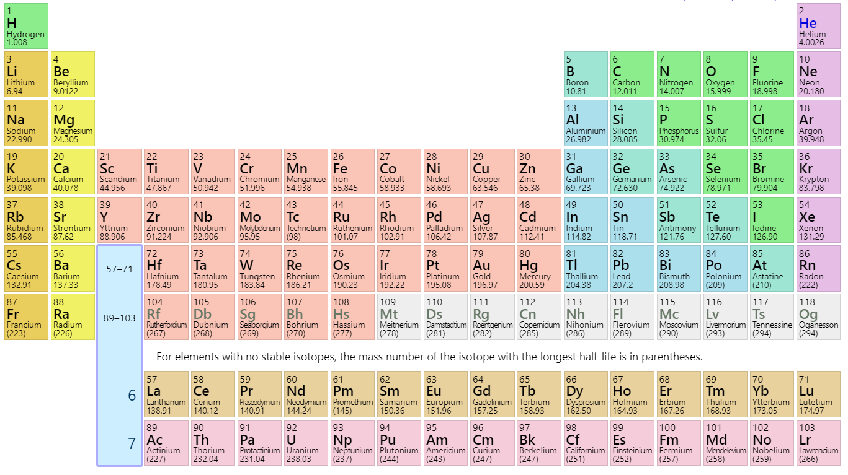
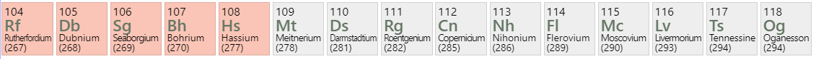

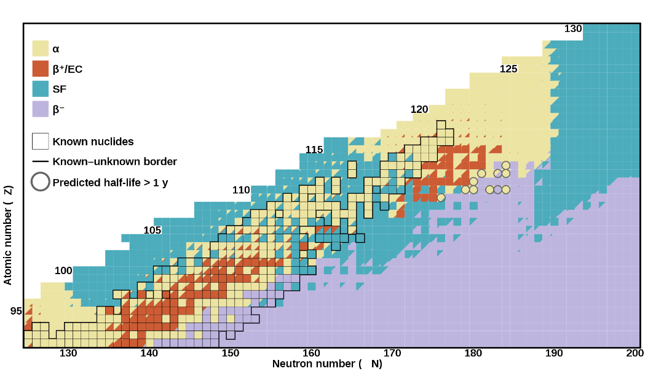

Playing Mendeleev:
The superheavy elements
1964
1970
1984
1994
1996
1999
2000
2002
1968
1976
1982
1994
2003
2003
2010
Initial creation/discovery has occurred at:
-Joint Institute for Nuclear Research. Dubna, Russia
-GSI Helmholtz Centre for Heavy Ion Research. Darmstadt, Germany
-Lawrence Berkeley/Livermore National Labs. California
-RIKEN. Tokyo, Japan
Heavy-ion accelerator bombards lead target with Ni nuclei
The most stable of the superheavies have half-lives ~10 min
The elements you’ve never heard of (because they don’t exist):
Ununennium (Z=119)
Unbibium (Z=122)
Unbihexium (Z=126)
Attempt: 1971 @CERN
https://en.wikipedia.org/wiki/Darmstadtium

Slide 15
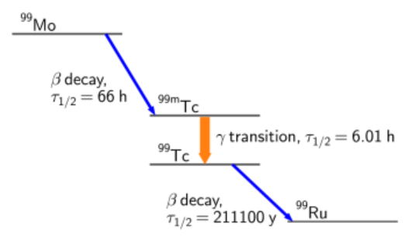

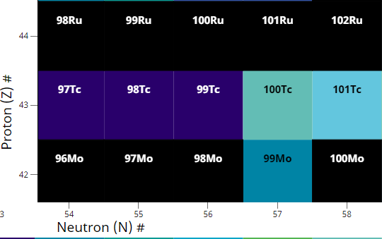
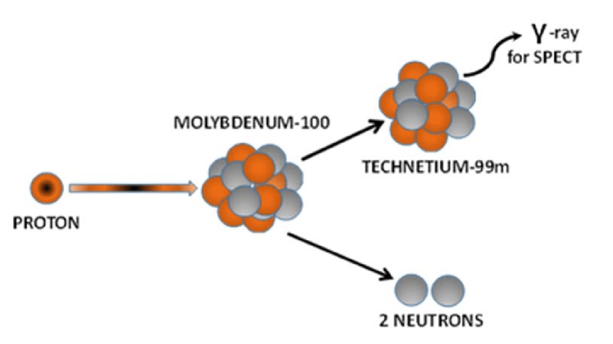
Artificial Transmutations:
Medical Isotopes
Over 80% of nuclear medical imaging uses technetium-99m
  >30 million procedures per year
  t_{1/2} = 6 hrs, gamma-emitter easily detected, eliminated from body within days
Bombard ⁹⁸Mo with neutrons in nuclear reactor
Nuclear snakes and ladders
Alternative: bombard ¹⁰⁰Mo with proton beam from accelerator
Notes:
98Mo has 24% natural abundance, 100Mo has ~10% (both are stable)
~99% of world’s supply of 99Mo from 5 reactors (Canada, Belgium, Netherlands, South Africa, Australia

Slide 16

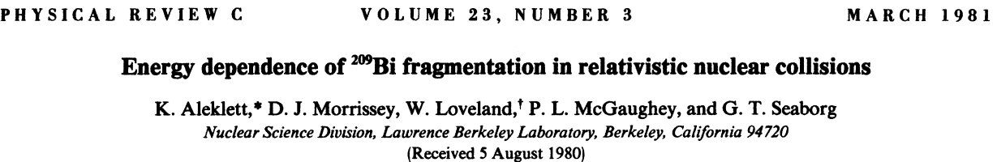
“Cheap” elements to precious metals:
The real Philosopher’s stone
1980, Glenn Seaborg transmutes thousands of bismuth-209 atoms into gold isotopes (radioactive)
Estimated cost of “quadrillions of dollars per ton”
Desired Element (current price) | Starting Element (current price) | How?
Ruthenium ($17,000/kg) | Molybdenum ($40/kg) | ¹⁰⁰Mo + n →…¹⁰¹Ru
Rhodium ($643,000/kg) | Ruthenium ($17,000/kg) | ¹⁰²Ru + n→…¹⁰³Rh
Rhenium ($100,000/kg) | Tungsten ($30/kg) | ¹⁸⁶W + n→…¹⁸⁷Re

Slide 17
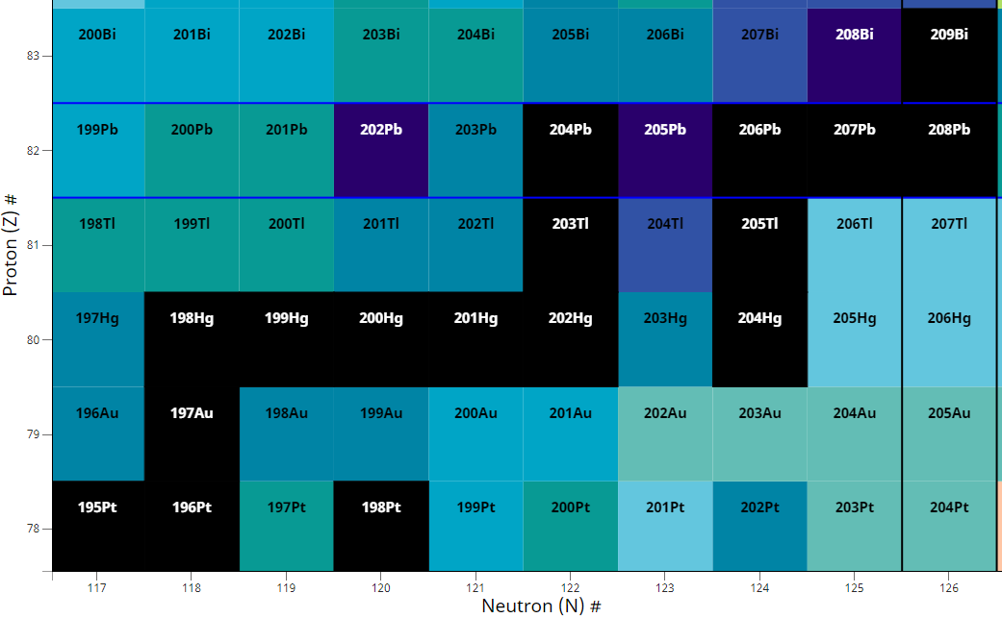
So you want to turn lead mercury into gold?
¹⁹⁶Hg + (slow) n → ¹⁹⁷Hg →EC→¹⁹⁷Au
¹⁹⁸Hg + (fast) n → ¹⁹⁷Hg →EC→¹⁹⁷Au
# protons
Spallate ¹⁹⁸Hg with proton beam
Spallate ²⁰⁹Bi with ¹²C beam
(Seaborg method, only makes radioactive Au isotopes)
# neutrons
Example calculation shows it would take ~10,000 TWh to “create” 1 kg gold with a particle accelerator (~40% of US annual primary energy consumption)

Slide 18

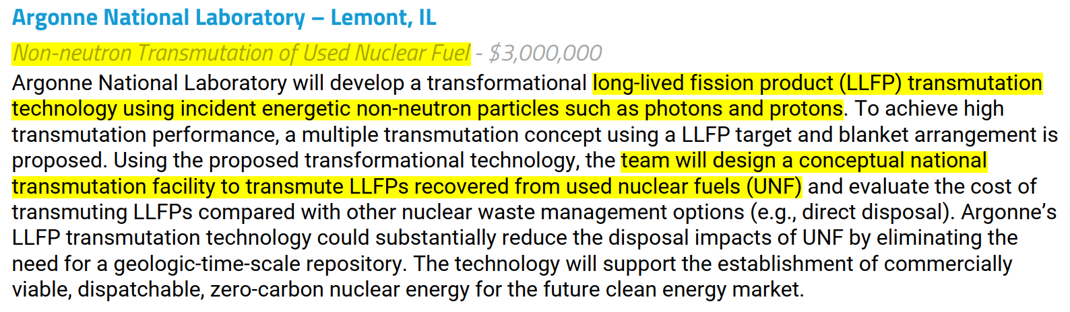
Current interest in waste transmutation
https://arpa-e.energy.gov/document/open-2021-project-descriptions

Slide 19
More references
Choppin, Liljenzin, Rydberg, Ekberg, Radiochemistry and Nuclear Chemistry
Rolfs, Rodney, Cauldrons in the Cosmos
Chart of Nuclides
World Nuclear Association
IEA nuclear
EIA nuclear

Slide 20
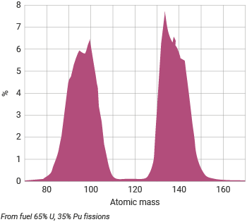
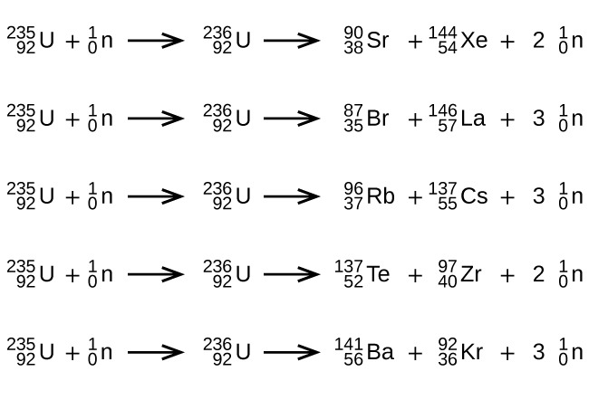
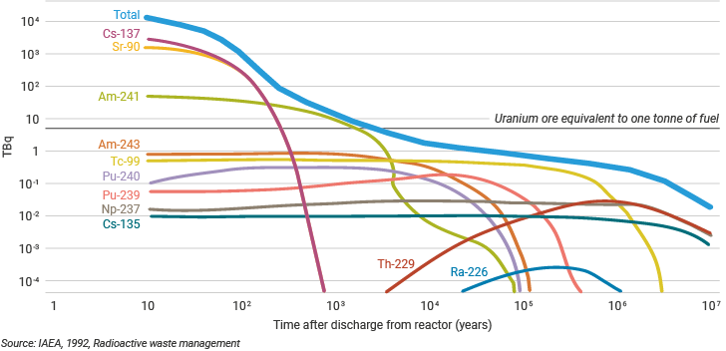
Fission waste
Distribution of fission products
Possible fissions
Activity of high-level waste from one tonne of used fuel
https://www.world-nuclear.org/information-library/nuclear-fuel-cycle/introduction/physics-of-nuclear-energy.aspx

