Slide 1


Resource Recovery from Human Waste:
An overview of nutrient flows and some technologies to recover them
“One person’s trash is another one’s treasure.”
Kindle Williams
Manthiram Lab
Harvard Energy Journal Club
30 April 2021

Slide 2
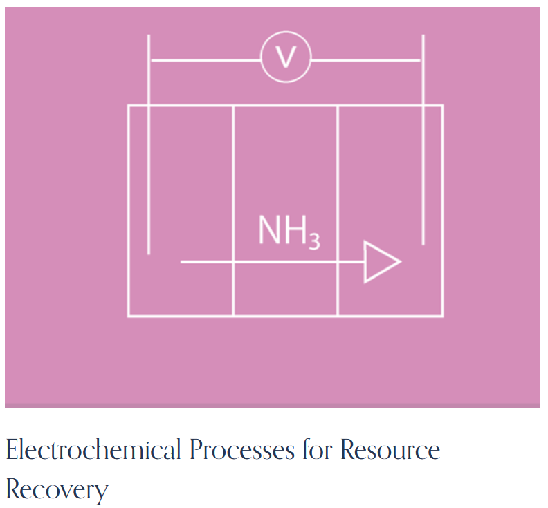
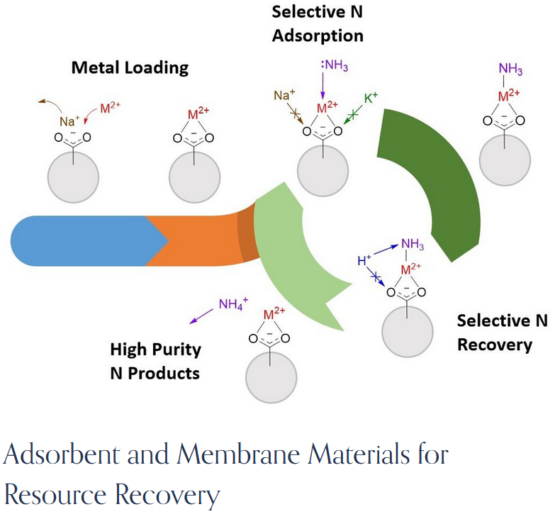

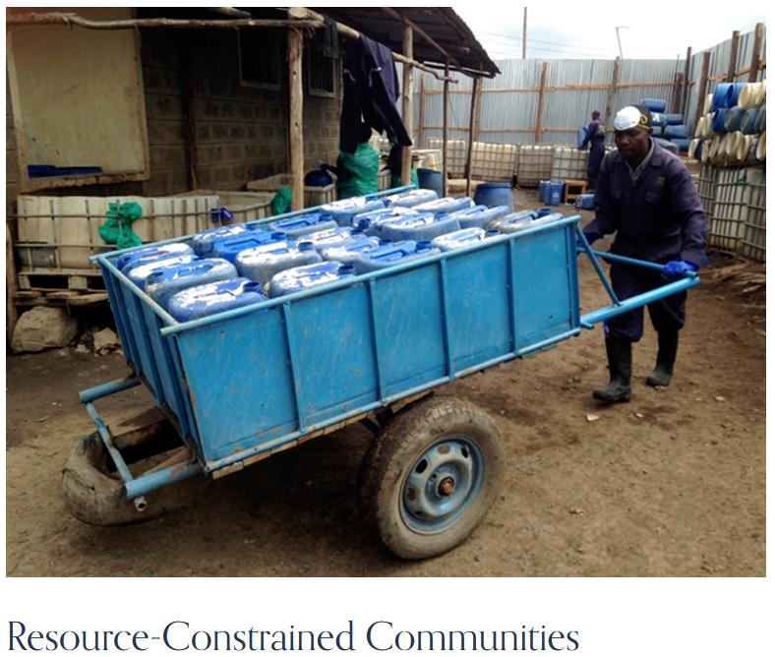
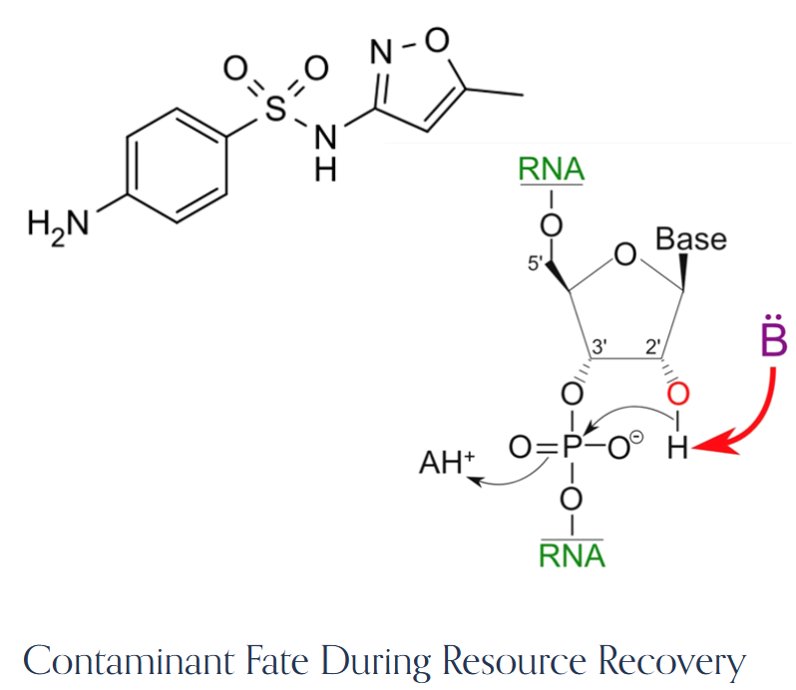
Inspiration for this talk: Prof. William Tarpeh, Stanford ChemE/EnvE
tarpehlab.com

Slide 3


Resource Removal vs. Resource Recovery
Resource Removal:
  Focus on taking something OUT of a waste stream.
  Maybe that thing has a negative impact if not removed.
    e.g.: pathogens
Resource Recovery:
  Focus on MAKING USE of a component in a waste stream
  Allows for waste monetization
  Adds value

Slide 4
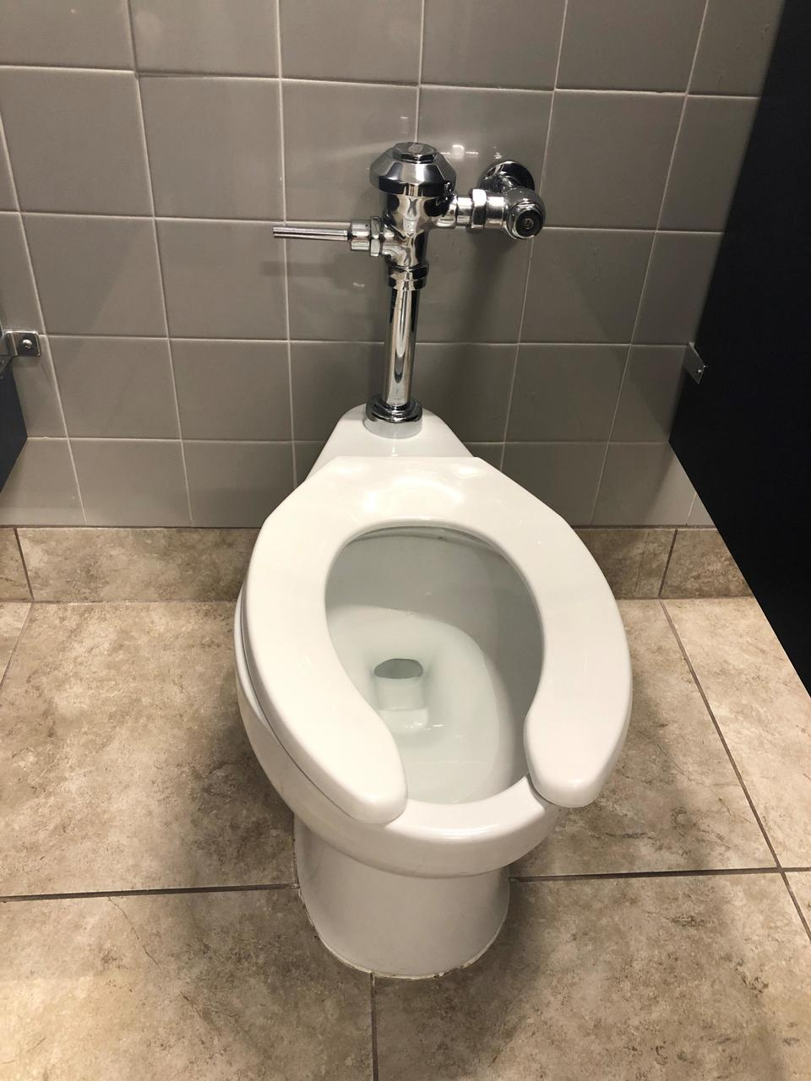
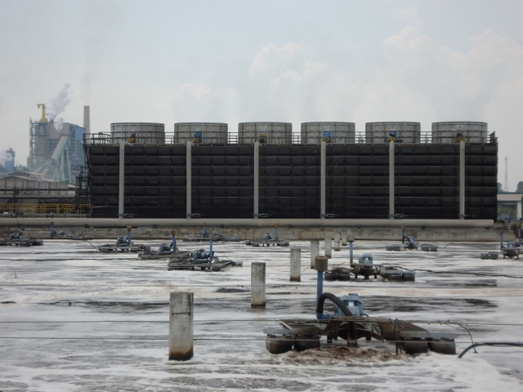
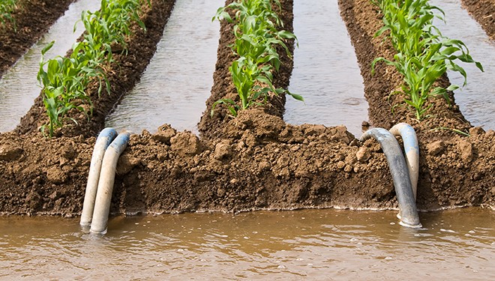
Definitions: Wastewater
What kind of crap will we be talking about today?
https://wpde.com/news/local/abc-15-special-report-flushing-away-bad-bathroom-habits
https://www.aireo2.com/en/markets-2/industrial/pulp-and-paper/
https://flores.unu.edu/en/news/news/safe-use-of-wastewater-in-agriculture-in-practice.html
Industrial wastewater (pulp & paper, mine drainage, …)
Human excrement (urine + feces)
Agricultural runoff
“Sustainable sanitation” / “Ecological sanitation” ideas
Notes:
Industrial wastewater
Pulp and paper:
S + base to pulp, so this becomes waste as well
Lots of chlorinated effluent from bleach
Much organic waste
Ag runoff
Around 20% of applied N runs off
Contains N, P, K, pesticides, metals…
“Ecosan” folks focus specifically on reuse to agriculture. This is not necessarily sustainable.

Slide 5

Composition of human waste
Solids:
  126 g/person/day
  pH ~6.6
  75% water; solids 84-93% organic
    25-54% bacterial biomass
    2-25% protein/nitrogenous matter
    25% carbohydrate/undigested plant matter
    2-15% fats
    Small amounts of…
      Ca₃(PO₄)₂
      FePO₄
      Epithelial cells
      Mucus/intestinal secretions
  Worms & their eggs can also exist in fecal matter. Because of direct handling of untreated waste for ag, Helminthiasis affects ~1.5 BILLION people worldwide.
Rose, Parker, Jefferson, Cartmell, Critical Reviews in Environmental Science and Technology 45(17), 1827-1879, 2015.

Slide 6
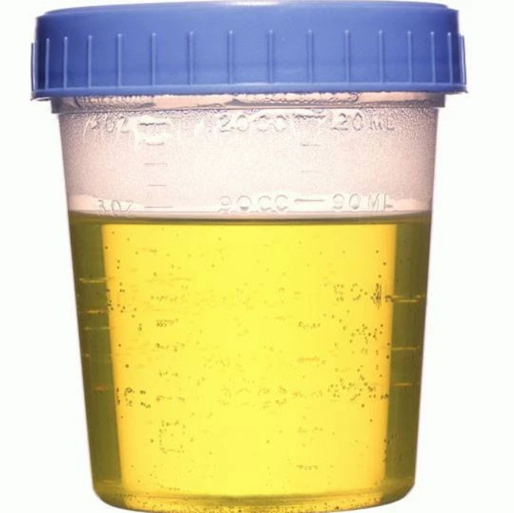
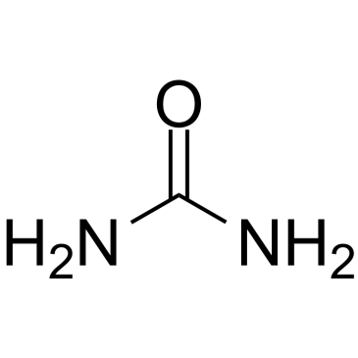
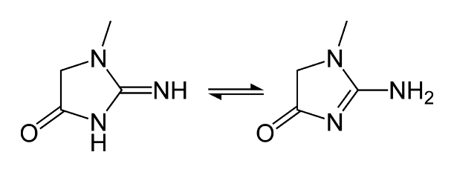
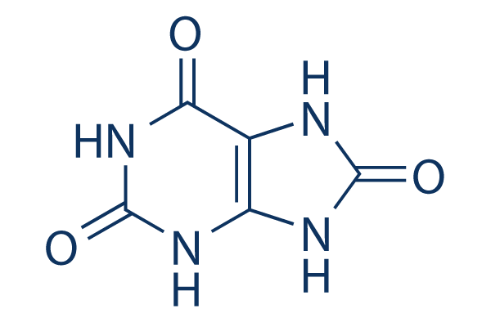
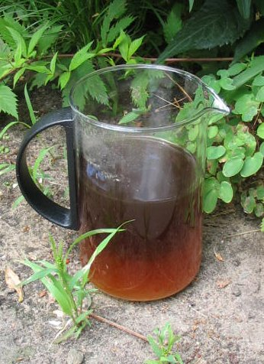
Composition of human waste
Liquids (urine):
  1.4 L/person/day
  pH ~6.2
  91-96% water; 59 g solids/person/day
    2% Urea
    0.1% Creatinine
    0.03% Uric acid
    Cl⁻, Na⁺, K⁺, SO₄²⁻, NH₄⁺, PO₄³⁻
    Small amounts of…
      Organic acids
      Pharmaceuticals
  Makes up 1% of urban wastewater volume but contains 70% of the N
  Urea naturally decomposes to ammonia + CO₂
https://www.mountainside-medical.com/products/urine-specimen-cup-sterile
Wikipedia (“Lant”)
von Münch, Winker, Technology review of urine diversion components. Deutsche Gesellschaft für Internationale Zusammenarbeit (GIZ) GmBH, 2011.
Notes:
Enzyme urease catalyzes:
Urea + water -> CO2 + 2 Ammonia
Historically, urine used:
As direct fertilizer w/ water dilution
Cleaning agent / teeth whitening
Urine -> straw -> age -> wash -> collect -> dry -> KNO3, a.k.a. saltpeter or gunpowder

Slide 7
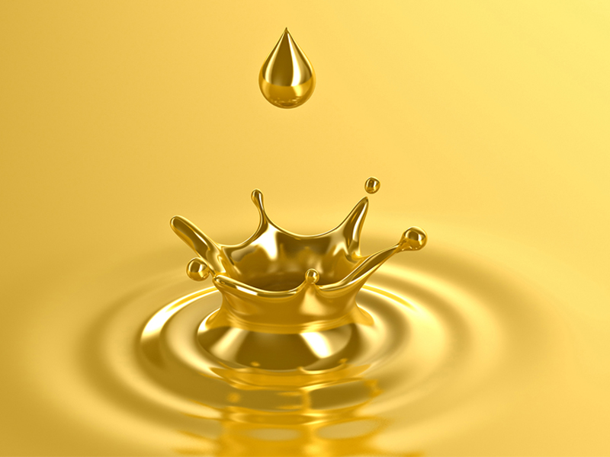

Composition of human waste
Solids
  Contain most of waste C
  Pathogens, trace metals
Liquids
  Contain most of waste P, N, other nutrients
  Not sterile, but minimal pathogens; few trace metals
Despite containing the majority of waste nutrients and posing a lower biological hazard, urine is under-utilized relative to biosolids, especially in developed countries.

Slide 8
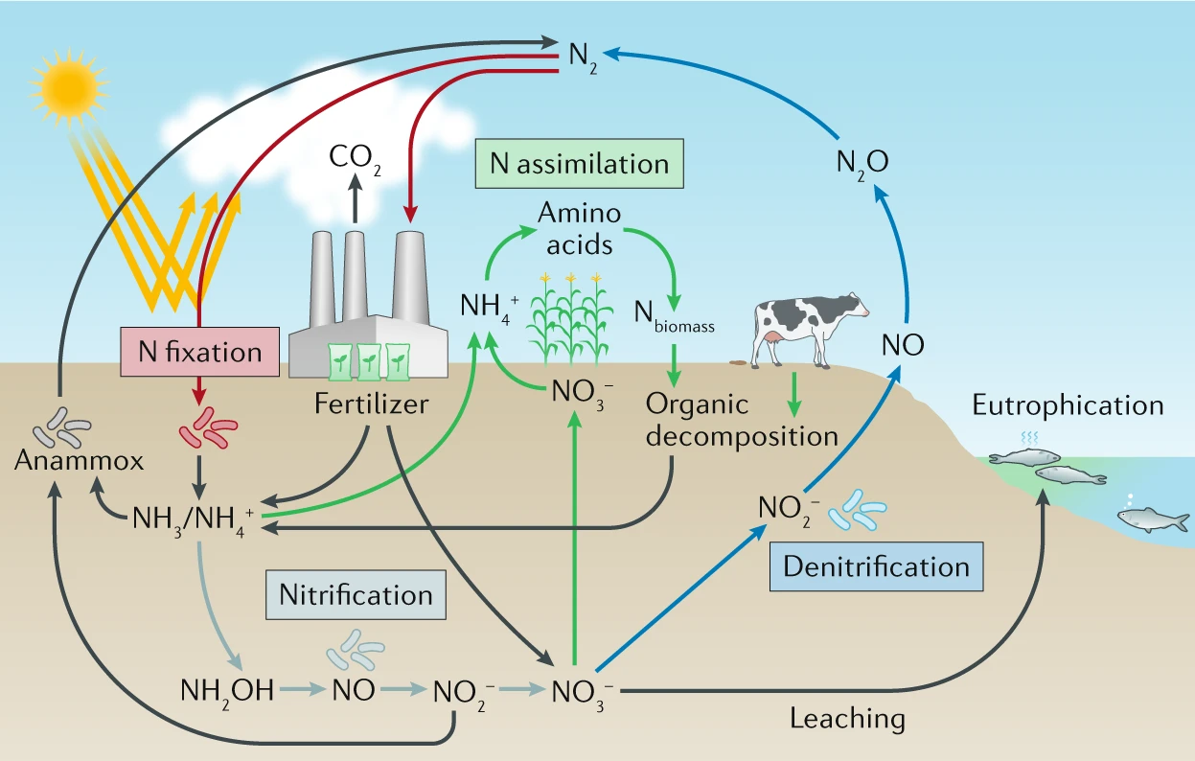
Chemical cycles: Nitrogen
Zeng, Priest, Wang, Wu, Small Methods 4 (12), 2020.
Notes:
Focus on the fact that it’s not a closed loop. We’re losing N to pollution all the time.
Eutrophication:
- Increased nutrients (P + nitrate) -> increased biomass -> decreased biodiversity -> hypoxia
Volatile NOx emissions from FF combustion have led to more N content in precipitation; this has begun to disrupt ecosystems (e.g. southern CA cacti don’t need much N -> invasive species which do need N now entering)

Slide 9
Chemical cycles: Nitrogen
N₂ (~4×10⁹ Gt)
H-B also contributes ~1.5% of global CO₂ emissions.
Bio N fixation + lightning
~200 Gt
Waste-water treatment
Haber-Bosch
~100 Gt
Denitrification + annamox
~240 Gt
Recovering all active N from human urine
would offset about 1/3 of global ammonia demand.
Humans have thrown the N cycle out of balance, leading to pollution
Active Nitrogen (NH₄⁺, NO₃⁻, NO₂⁻, …)
Figure adapted from Prof. Will Tarpeh’s talk on Tuesday
Numbers: https://slidetodoc.com/ecologywhere-do-i-fit-in-o-study-of/ & Ch. 5 of Environmental Science by Dalhousie Univ.
Notes:
We also make a bit of NOx from fossil fuel combustion, which leads to an increase in N content in rain

Slide 10
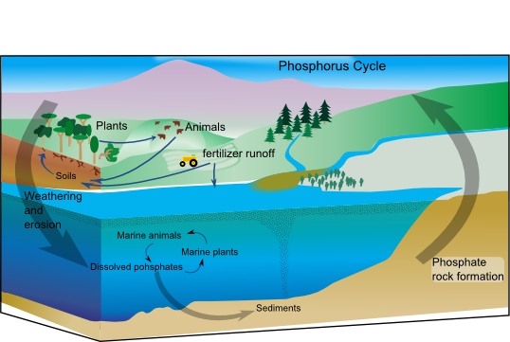
Chemical cycles: Phosphorus
Unlike many resources, P rarely volatilizes
It is, however, a finite resource
  “Peak Phosphorus” debate
Human activity has increased P cycle fluxes 4x
Capture of human excrement could
supply ~22% of global P demand
Phosphorus is also a pollutant, but perhaps more urgently, it might be running out.
Image: Wikipedia (“Phosphorus Cycle”)
Mihelcic, Fry, Shaw, Chemosphere 84(6), 832-839, 2011.
Notes:
Peak P – 2030? Much later?
Morocco/Western Sahara notable for having something like 90% of the world’s phosphate rock

Slide 11
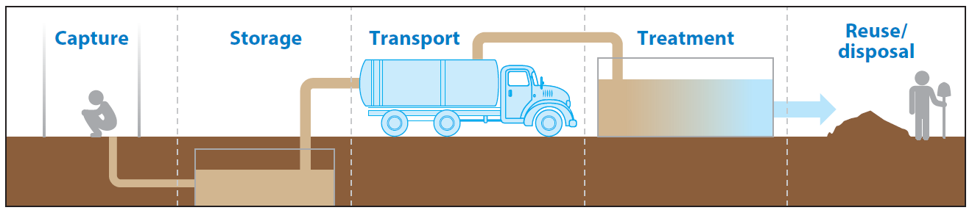
What happens to human waste today?
“Sanitation Service Chain”
2/3 of all human waste is unsafely disposed of
  4+ BILLION people w/o safely managed sanitation
  As of 2015, ~892 Million engage in open defecation (OD)
  Fundamentally a public health problem
Large disparities between high-income countries (HICs) and low- and middle-income countries (LMICs)
  Mid-1800s was time for heavy investment in centralized waste treatment infrastructure
  Large capital investments = large inertia
    Easier (and necessary) to innovate in LMICs
Hyun, … , Ray, Annual Reviews of Environment and Resources 44, 287-318, 2019.
Notes:
Percentages of sewage treated by global region: https://wriorg.s3.amazonaws.com/s3fs-public/uploads/table_1.jpg
90% NA
66% Eur
35% Asia
14% SA/Carib
<1% Afr

Slide 12
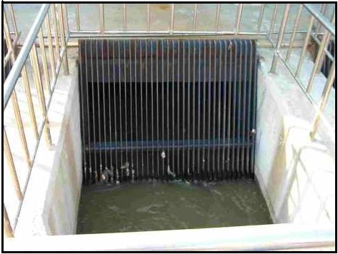
U.S. wastewater treatment: A journey through the sewers
Source: domestic + municipal wastewater, some industrial wastewater (usually pre-treated), sometimes urban runoff/stormwater
Steps:
  Pretreatment: bar screen to remove trash, tree limbs, grit, etc.
    Coagulation & flocculation reagents added
AmritaLearning.com

Slide 13
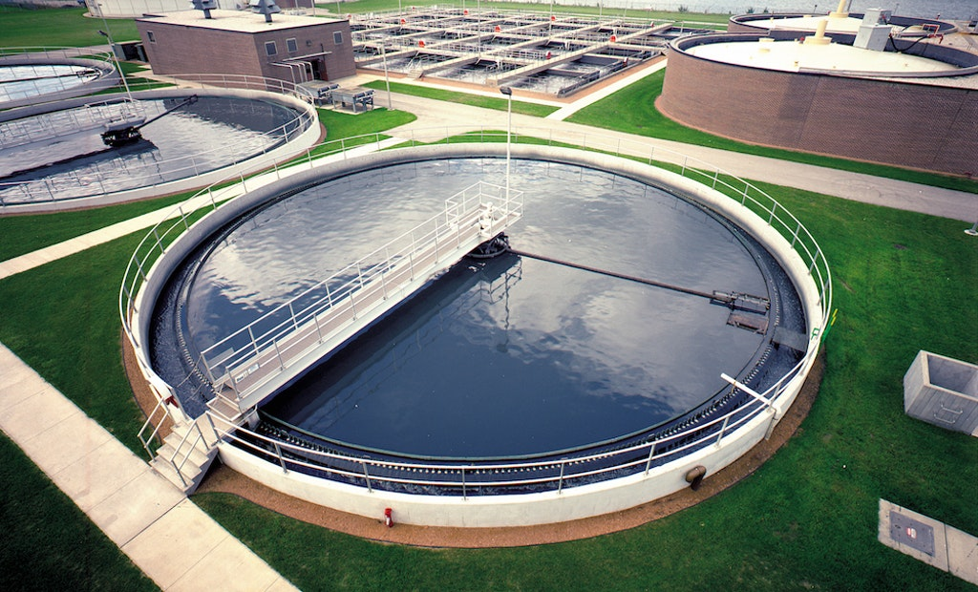
U.S. wastewater treatment: A journey through the sewers
Source: domestic + municipal wastewater, some industrial wastewater (usually pre-treated), sometimes urban runoff/stormwater
Steps:
  Pretreatment: bar screen to remove trash, tree limbs, grit, etc.
    Coagulation & flocculation reagents added
  Primary treatment: settling; solid/liquid seps
    Clarifiers skim fat off top, gather sludge on bottom
https://www.tpomag.com/online_exclusives/2017/04/optimize_your_clarifier_for_biological_phosphorus_removal_002y7

Slide 14
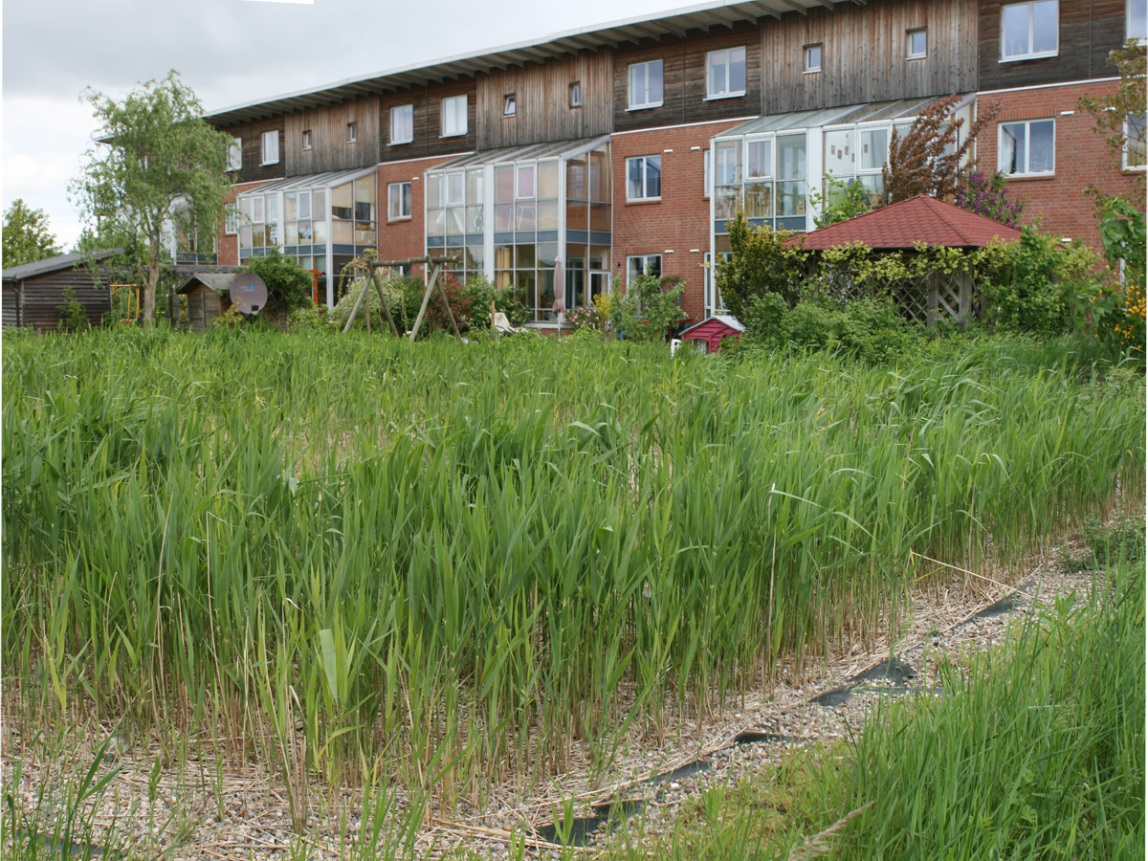
U.S. wastewater treatment: A journey through the sewers
Source: domestic + municipal wastewater, some industrial wastewater (usually pre-treated), sometimes urban runoff/stormwater
Steps:
  Pretreatment: bar screen to remove trash, tree limbs, grit, etc.
    Coagulation & flocculation reagents added
  Primary treatment: settling; solid/liquid seps
    Clarifiers skim fat off top, gather sludge on bottom
  Secondary treatment: remove dissolved/suspended biological matter
    Microbes do the work
Wikipedia (“Constructed Wetland”)
Notes:
This is sometimes also done in a clarifier
Fixed-film/attached growth vs. suspended growth

Slide 15
U.S. wastewater treatment: A journey through the sewers
Source: domestic + municipal wastewater, some industrial wastewater (usually pre-treated), sometimes urban runoff/stormwater
Steps:
  Pretreatment: bar screen to remove trash, tree limbs, grit, etc.
    Coagulation & flocculation reagents added
  Primary treatment: settling; solid/liquid seps
    Clarifiers skim fat off top, gather sludge on bottom
  Secondary treatment: remove dissolved/suspended biological matter
    Microbes do the work
  Tertiary treatment: chemical treatment/filtration
    N removal: Nitrification + Denitrification
    P removal: bioorganisms and/or chemical precipitation
    Disinfection: Ozone, active chlorine, UV light
NH₄⁺
Nitrify
NO₃⁻
De-nitrify
N₂

Slide 16
U.S. wastewater treatment: A journey through the sewers
Source: domestic + municipal wastewater, some industrial wastewater (usually pre-treated), sometimes urban runoff/stormwater
Steps:
  Pretreatment: bar screen to remove trash, tree limbs, grit, etc.
    Coagulation & flocculation reagents added
  Primary treatment: settling; solid/liquid seps
    Clarifiers skim fat off top, gather sludge on bottom
  Secondary treatment: remove dissolved/suspended biological matter
    Microbes do the work
  Tertiary treatment: chemical treatment/filtration
    N removal: Nitrification + Denitrification
    P removal: bioorganisms and/or chemical precipitation
    Disinfection: Ozone, active chlorine, UV light
  4th stage (rare): removal of pharmaceuticals, household chemicals, pesticides, etc.
    Activated carbon filtration
    Enzyme treatment (microbial fuel cells)

Slide 17
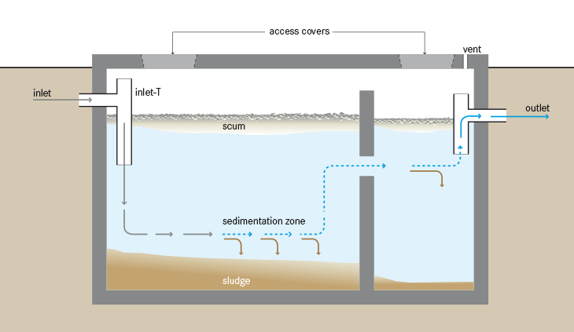
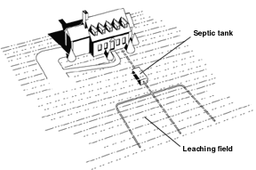
U.S. wastewater treatment: What about folks who are “off-grid”?
20% of households in the U.S. use a septic tank
Similar principle but just Primary Treatment & distributed
Wikipedia (“Septic tank”)
Notes:
Common in rural/suburban U.S. and rural Europe

Slide 18
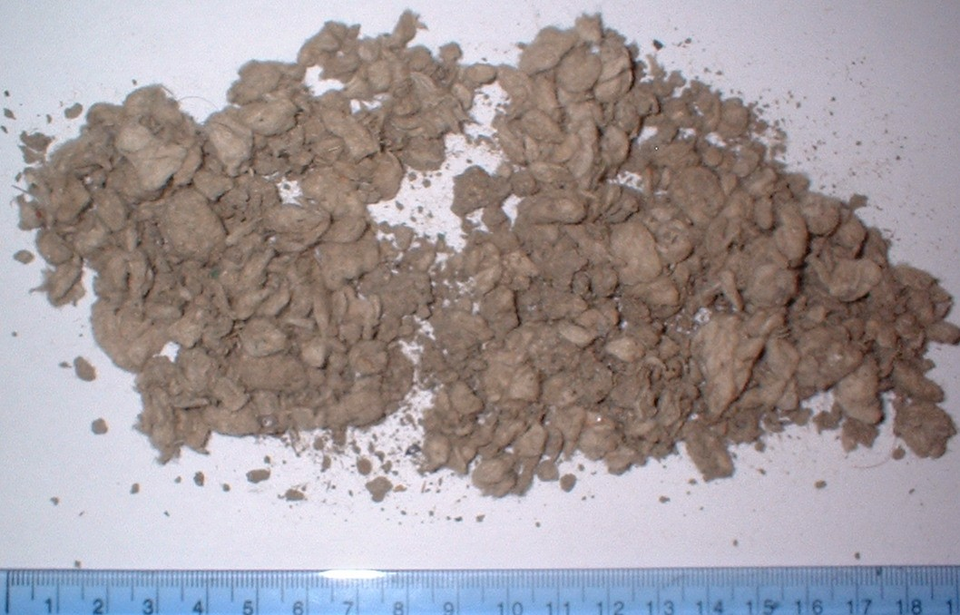
What we already recover well: solids
Steps in biosolids processing:
  Thicken
  De-water (centrifuge/filter press)
    Liquids sometimes gathered for struvite
  Digest
    Large scale: anaerobic
      Slow but produces methane
    Mid scale: aerobic
      Lower capital cost, higher operating
      costs; produces CO₂
    Small scale: compost
      Mix with other biosolids
Then add to agricultural soil, incinerate, or landfill
Wikipedia (“Sewage sludge treatment”)
Notes:
Struvite from de-watering sold in Canada as “Crystal Green” fertilizer

Slide 19
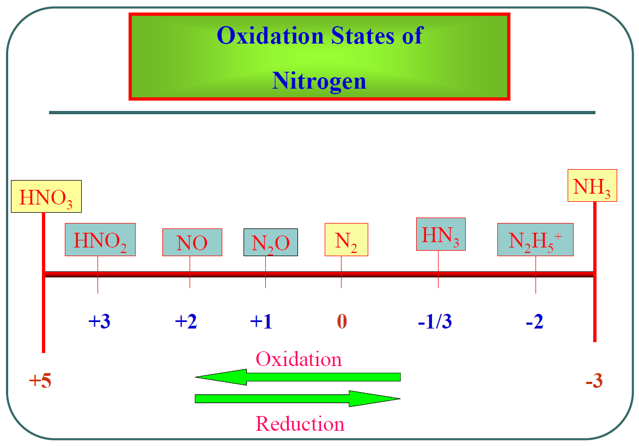
What we don’t recover well: liquids (N, P)
Nitrification/denitrification is very inefficient
  Traverses thermodynamic landscape
Much waste treatment (e.g. septic) doesn’t even get this far
Dilution (energy intensity) is a major problem
Denitrification
Nitrification
By the time we’re ready to re-apply N to soil, we’ve returned to where we started!
chem.tamu.edu
Haber-Bosch

Slide 20
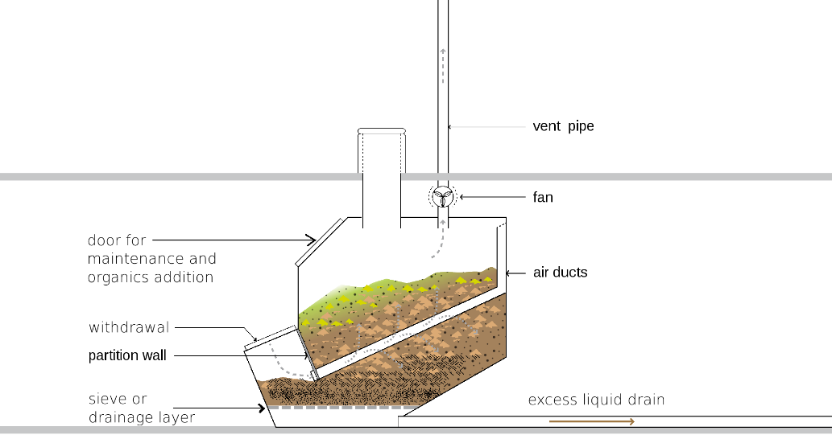
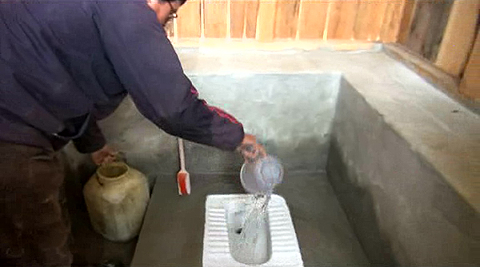
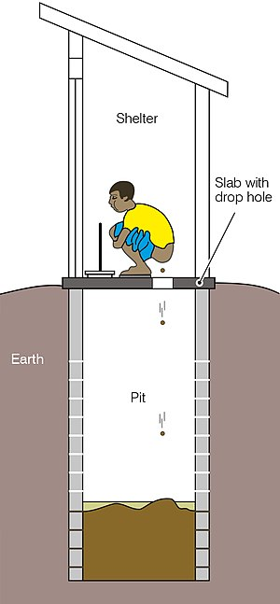
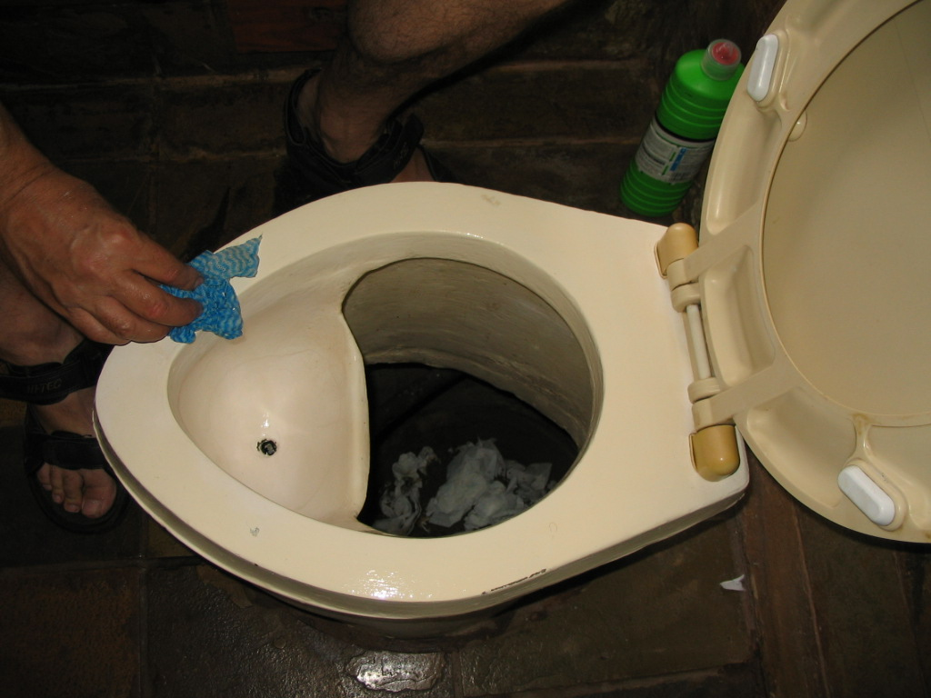
Source-separation & dry urine collection allows us to directly process urine
Other types of waste treatment more commonly used in LMICs…
Dry toilets: Composting
Pour-flush toilets
Wikipedia (“Pit latrine”)
Wikipedia (“Composting toilet”)
http://www.bbs.bt/news/?p=93609
Dry toilets: Urine-diverting
By SuSanA Secretariat - Cleaning a urine-diverting dry toilet (UDDT) in Johannesburg
Uploaded by Elitre, CC BY 2.0, https://commons.wikimedia.org/w/index.php?curid=22164302
Dry toilets: Pit latrine
Notes:
High-temperature treatment required to remove pathogens from solids (e.g. Helminth eggs)

Slide 21
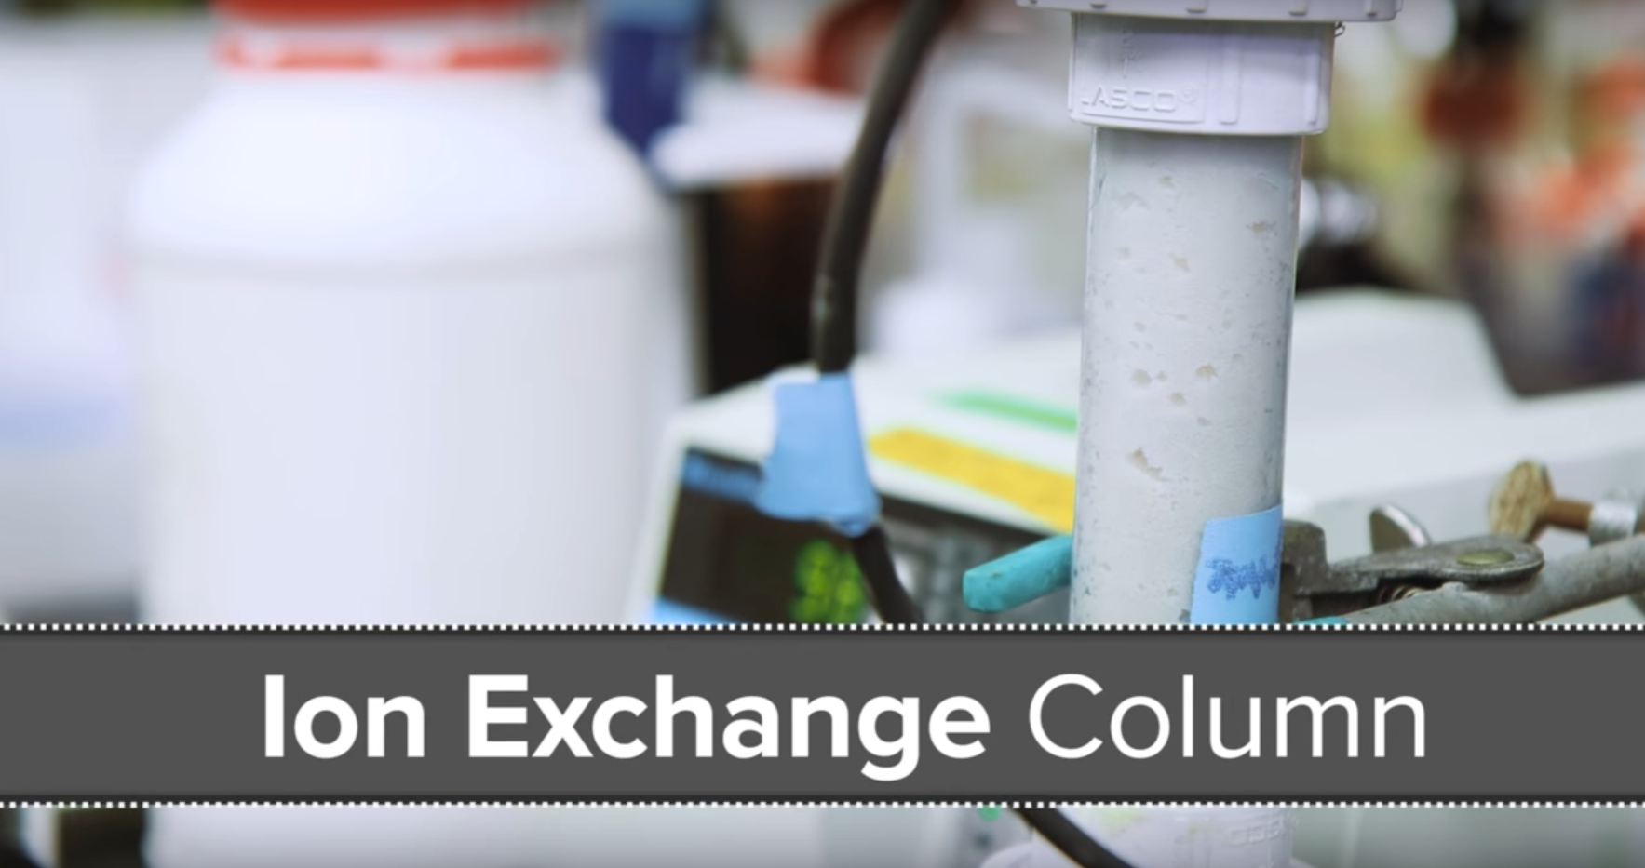
Technologies for N recovery from urine: adsorption
An established method for separation of ionic species
Adsorb NH₃ to acid sites of ion exchange resin
Recover with acid flush
In some cases, can apply the adsorbent directly to agricultural soil
Seeker: “How your pee could help billions of people.”
https://www.youtube.com/watch?v=eQV2bOYXbKc
Notes:
Natural zeolites w/ adsorbed N can be applied to soil

Slide 22
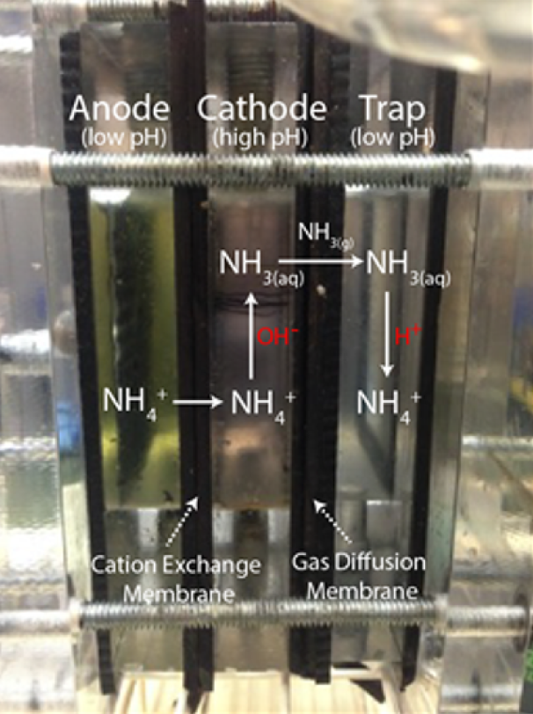


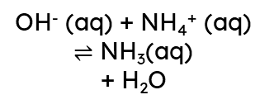

Technologies for N recovery from urine: electrochemical stripping
Beginning to overtake static-adsorptive processes in promise
Benefits from conductivity of source-separated urine
Play with pH
V
Anode chamber (low pH)
Cathode chamber (high pH)
NH₃(g)
Trap chamber
(low pH)
NH₄⁺ (aq)
OH⁻ (aq) + NH₄⁺ (aq) $⇌$ NH₃(aq)
+ H₂O
NH₃(aq) + H⁺(aq) $⇌$ NH₄⁺(aq)
OER:
$$2H_{2}O⇌O_{2}+4H^{+}+4e^{−}$$
HER:
$$2H_{2}O+2e^{−}⇌H_{2}+2{OH}^{−}$$
Cation exchange membrane
Gas permeable membrane
Urine
Adapted & taken from Tarpeh et al., Environ. Sci. Technol. 52, 1453-1460, 2018.
Notes:
Removal and recovery efficiencies for this process can be upwards of 90%

Slide 23
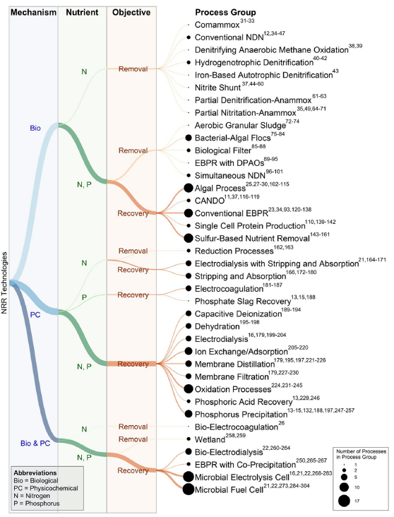
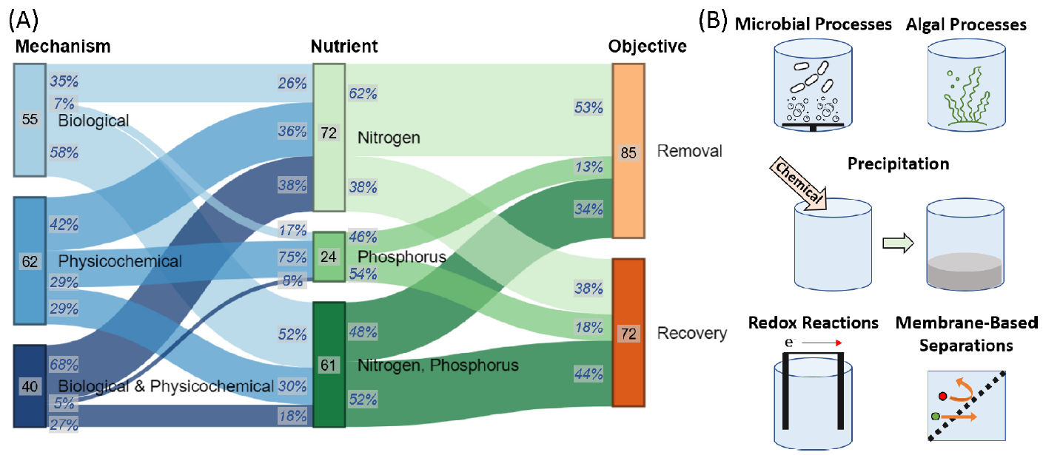
Technologies for N/P recovery from urine: others
Combined adsorption + EChem regeneration
Biological vs. Physicochemical
Kogler, … , Tarpeh, ACS EST Engg. 1(4), 662-684, 2021.

Slide 24
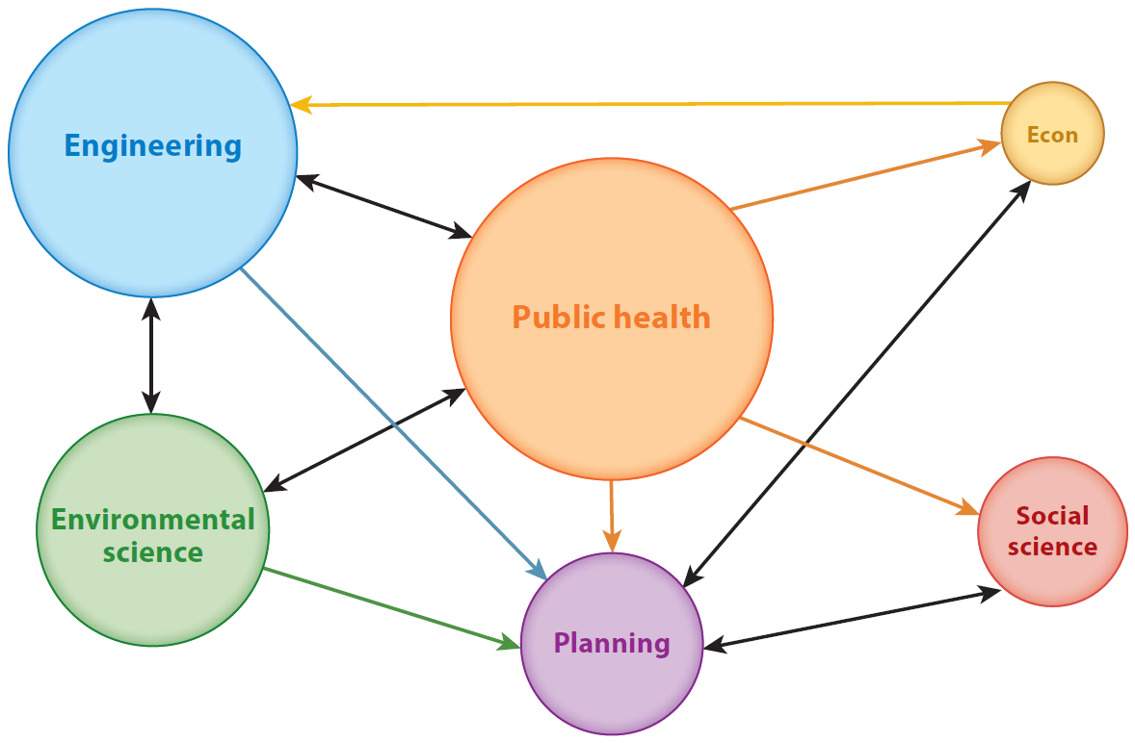
Zooming back out: the engineering/environmental perspective of sanitation
Resource efficiency & pollution just some of many things to think about within sanitation
Hyun, … , Ray, Annual Reviews of Environment and Resources 44, 287-318, 2019.

Slide 25
The place of waste treatment innovation in the global economy
High-income nations = slow to change (large investments)
Low/middle-income nations = rapidly improving sanitation, can quickly adopt tech
What works in one place doesn’t necessarily work in all
Hyun, … , Ray, Annual Reviews of Environment and Resources 44, 287-318, 2019.

Slide 26
What should we chat about?
Contact me:
Kindle Williams
kindlew@mit.edu
Thanks for listening!

Slide 27
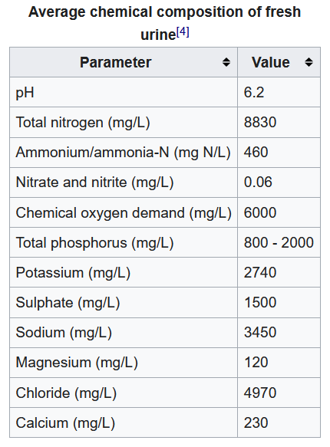
Composition of human waste
Liquids (urine):
von Münch, Winker, Technology review of urine diversion components. Deutsche Gesellschaft für Internationale Zusammenarbeit (GIZ) GmBH, 2011.

Slide 28
References
Broader societal picture of sanitation: C. Hyun, Z. Burt, Y. Crider, K. L. Nelson, C. S. S. Prasad, S. D. G. Rayasam, W. A. Tarpeh, and I. Ray. “Sanitation for Low-Income Regions: A Cross-Disciplinary Review,” Annual Review of Environment and Resources (2019). https://doi.org/10.1146/annurev-environ-101718-033327
Tech review: A. Kogler, M. Farmer, J. Simon, S. Tilmans, G. Wells, W. A. Tarpeh. “A systematic evaluation of emerging wastewater nutrient removal and recovery technologies to inform practice and advance resource efficiency,” ACS ES&T Engineering (Accepted Feb 2021). https://doi.org/10.1021/acsestengg.0c00253
Deeper into techs: W. A. Tarpeh, X. Chen. “Making wastewater obsolete: Selective separations to enable circular water treatment,” Environmental Science and Ecotechnology (2021). https://doi.org/10.1016/j.ese.2021.100078
Electrochemical stripping: W. A. Tarpeh, J. M. Barazesh, T. Y. Cath, K. L. Nelson. “Electrochemical Stripping to Recover Nitrogen from Source-Separated Urine,” Environmental Science & Technology (2018). https://doi.org/10.1021/acs.est.7b05488
Adsorption: W. A. Tarpeh, K. M. Udert, K. L. Nelson. “Comparing ion exchange adsorbents for nitrogen recovery from source-separated urine,” Environmental Science & Technology (2017). https://doi.org/10.1021/acs.est.6b05816
For an overview of the Tarpeh Lab’s publications, please see: https://www.tarpehlab.com/publications

Slide 29
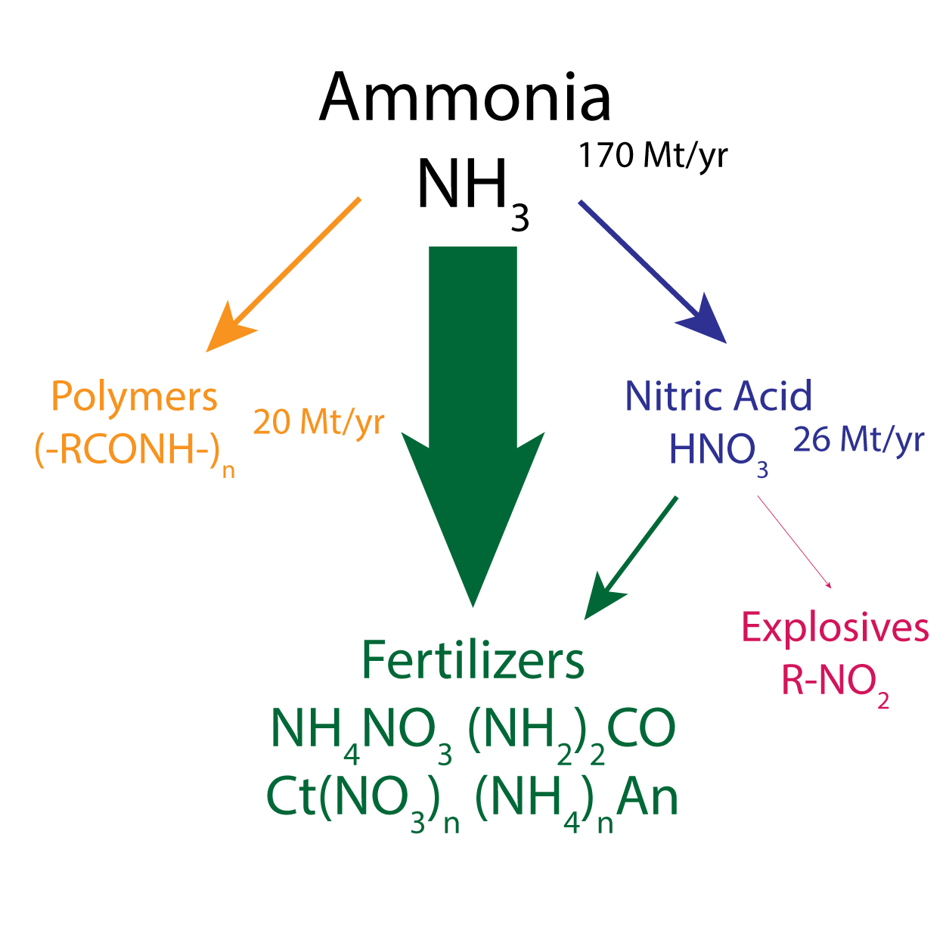
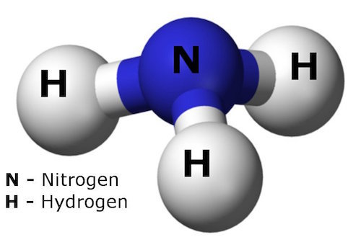
Ammonia uses by humans
Scheme: Nik Lazouski

Slide 30
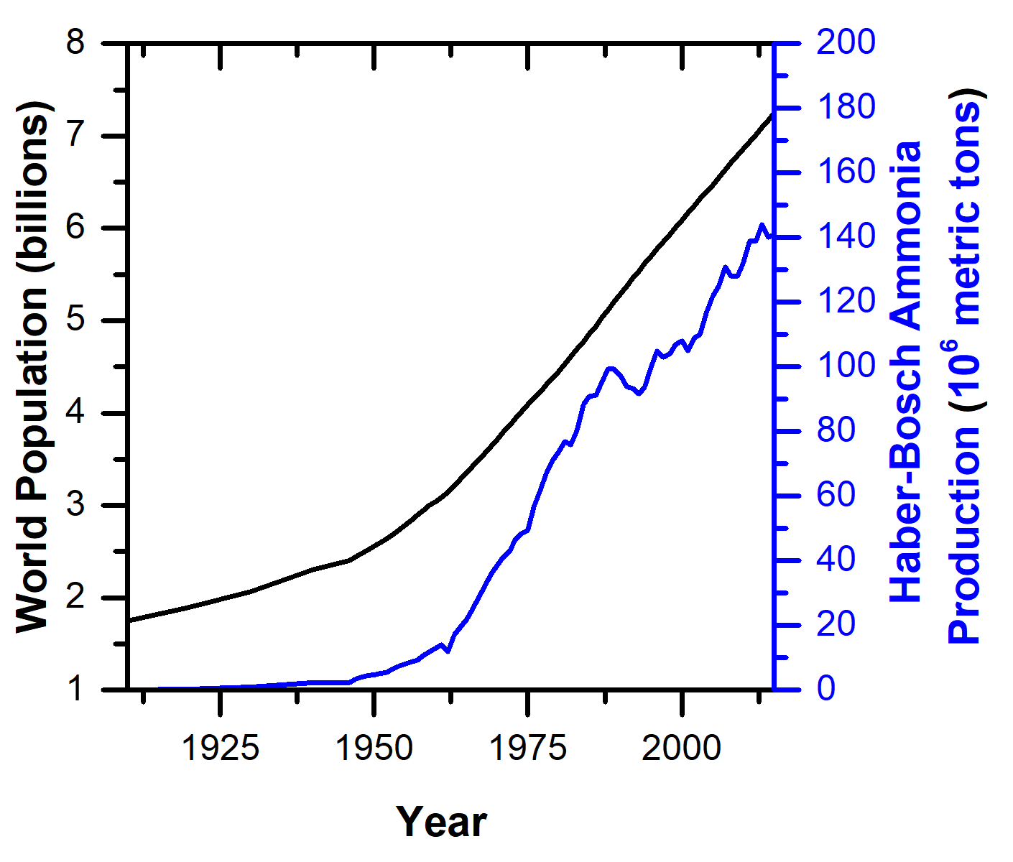
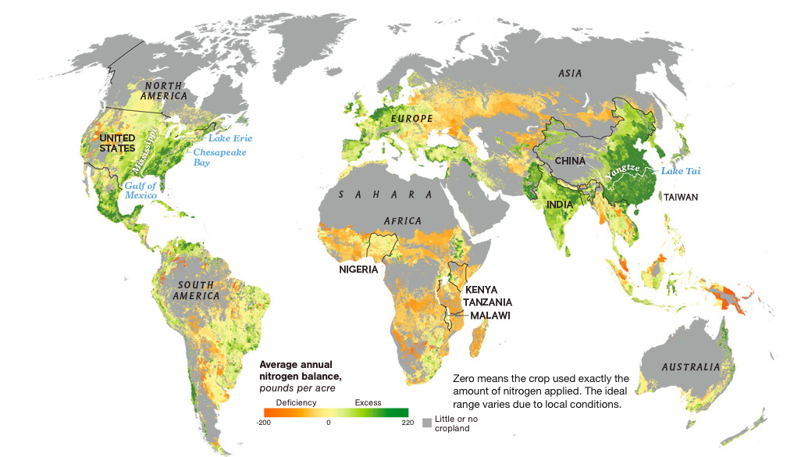
Fertilizers support the global population

Slide 31
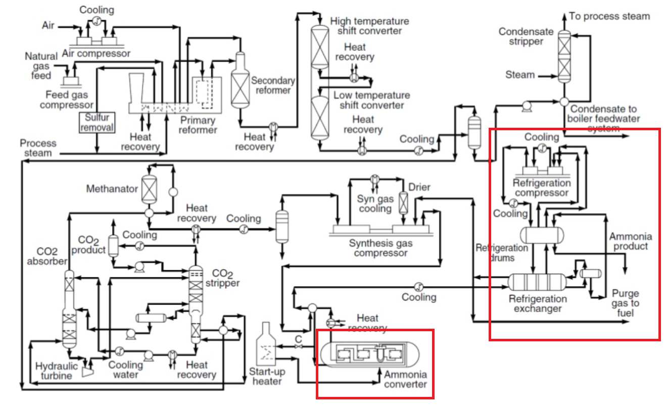


The current process: Haber-Bosch
Only economically viable at large scales
  ~3000 ton/day
Centralized production
Large capital cost
  $1B+ per plant
Out of reach for many less-wealthy economies
$$CH_{4}+{2H}_{2}O→CO_{2}+{3H}_{2}$$
1.9-9 ton CO₂/ton NH₃
>450 million tons CO₂/yr
$$N_{2}+3H_{2}→2NH_{3}$$
Ahmad, S. ud D. 2015

Slide 32
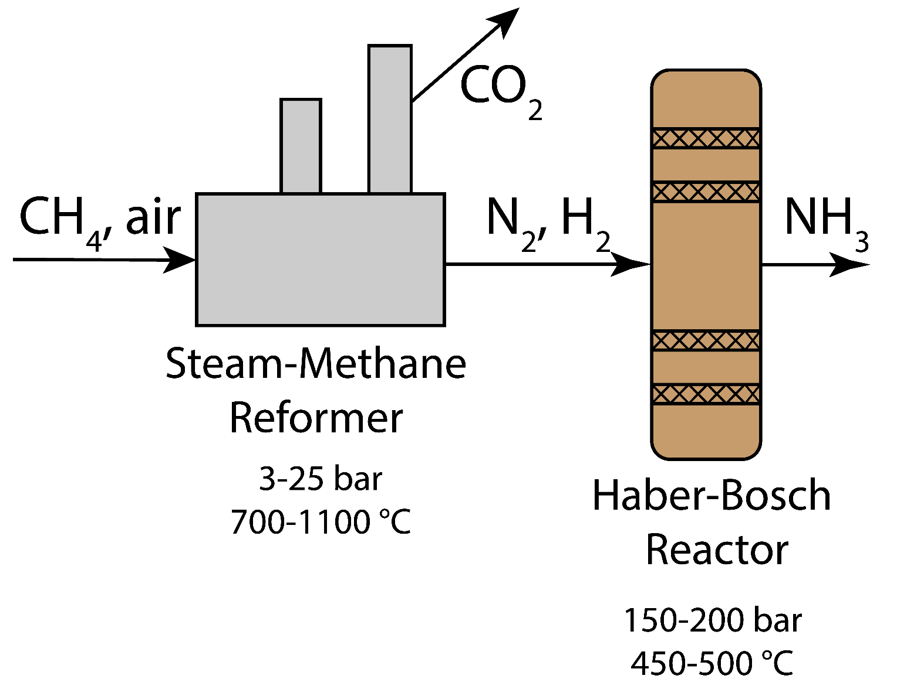
Two components: H₂ production and ammonia synthesis
“Colors” of H₂:
  Grey
  Blue
  Green
  Turquoise
Haber-Bosch
Plasma-based approaches
Electrochemical approaches
1: Hydrogen Production
2: Ammonia Synthesis
scale match
Notes:
Note: almost half of industrially produced H2 goes to ammonia synthesis.

Slide 33
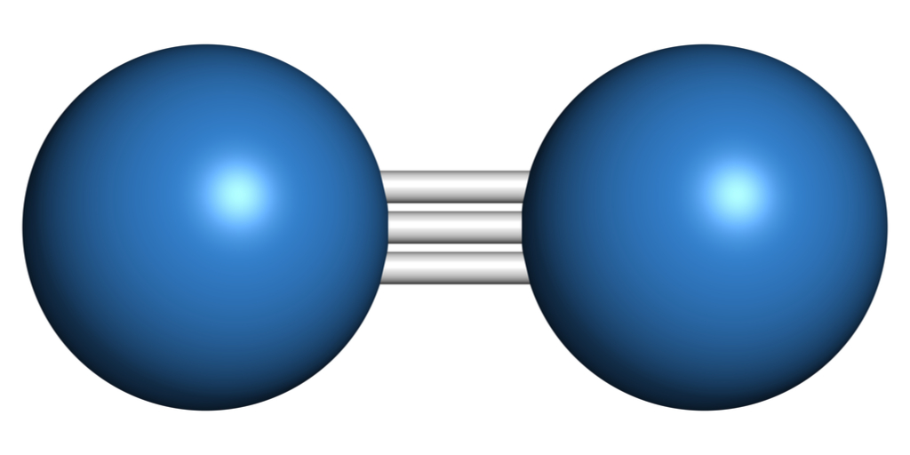
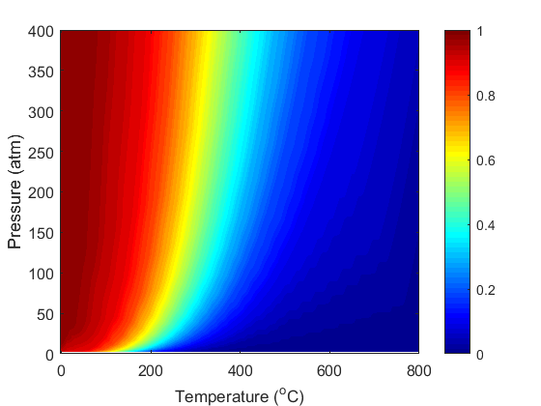
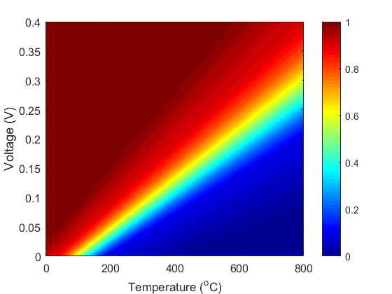
Ammonia synthesis: thermodynamics & kinetics
¹/₂ N₂ + ³/₂ H₂ → NH₃
Hard to break the N₂ triple bond
Thermochemical
Conversion
Electrochemical
X
At ambient pressure (1 atm):
X
X > 99%
Voltage also improves kinetics, so can operate at lower temperature
X <20%
Higher pressures to achieve reasonable conversions
Apply voltage to increase conversion
Higher temperatures to achieve reasonable rates
Z. J. Schiffer and K. Manthiram Joule 1 10-14 (2017).

Slide 34
How does this fit into the big picture of sustainability?
Nitrogen cycle
  Inherent N losses to soil during fertilization
  N oxides are also greenhouse gases
Distributed fert. production could help with slower fert. application
  Less runoff

