Slide 1
Overcoming the photovoltaic efficiency limit
Dr. Michael Purdy
Postdoctoral research fellow
Liu group

Slide 2
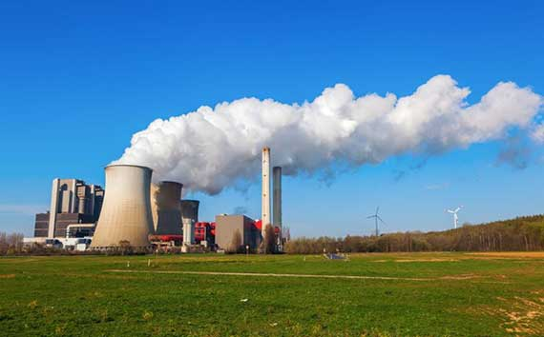

Fossil fuels
Fossil fuels sources dwindling
Fossil fuels are accessible and cheap
Renewable energy technologies need to be economically competitive

Slide 3
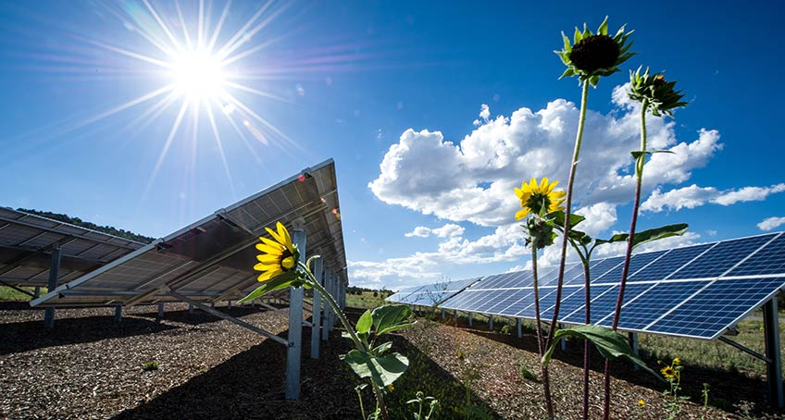
Photovoltaics
Semiconductor technology that converts solar energy into electrical energy
40 % annual growth in global photovoltaic capacity from 2000-2015
Highest performing Si-based PV device currently has an efficiency of 26.5 %

Slide 4
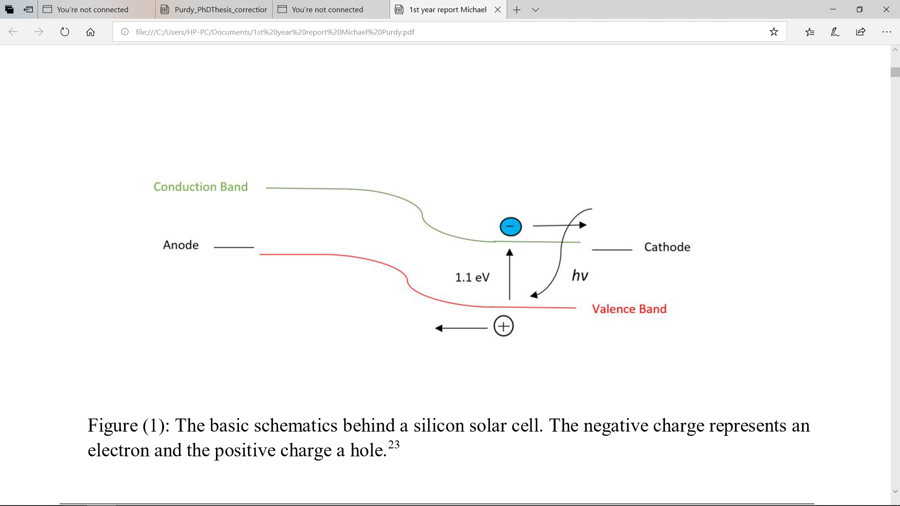
How photovoltaics work

Slide 5
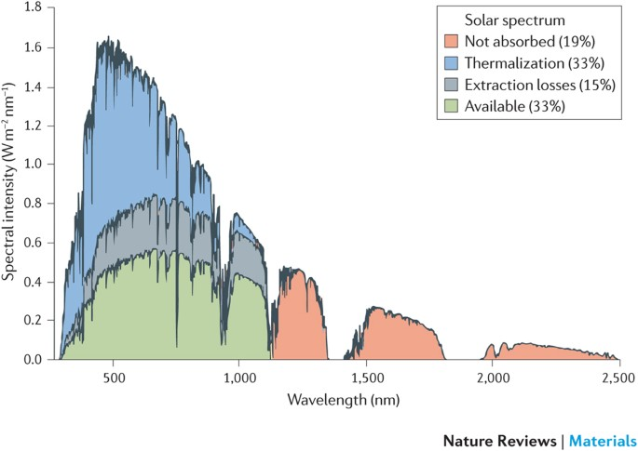
Shockley - Queisser limit
Efficiency of PV devices cannot exceed 29%
Majority of energy lost via thermalisation
Overcoming thermalisation losses could lead to an efficiency increase to 40 %
Rao, A.; Friend, R. H. Harnessing Singlet Exciton Fission To Break the Break the Shockley-Queisser Limit. Nat. Rev. Mat. 2017, 2, 17063

Slide 6
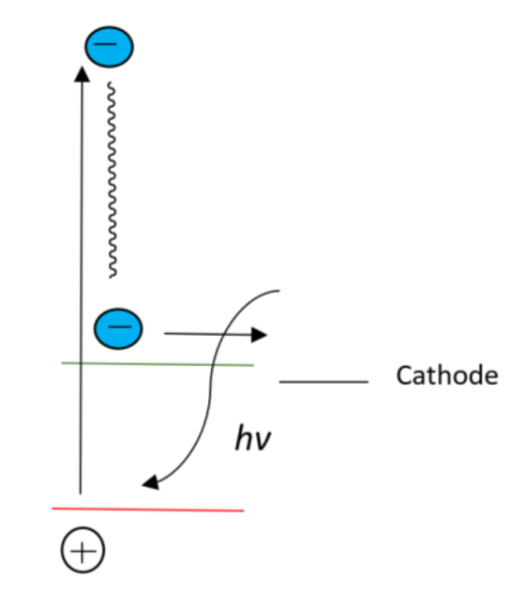
Thermalisation losses
Excess energy from > 1.1 eV photon lost via vibration decay
How can we overcome these losses and utilise higher energy photons?
Thermalisation losses
Conduction band
Valence band

Slide 7
Singlet fission
Excited state electron multiplication process
Triplets > 1.1 eV could be harnessed by silicon
Use a singlet fission organic chromophore to on top of silicon to harvest higher energy photons

Slide 8
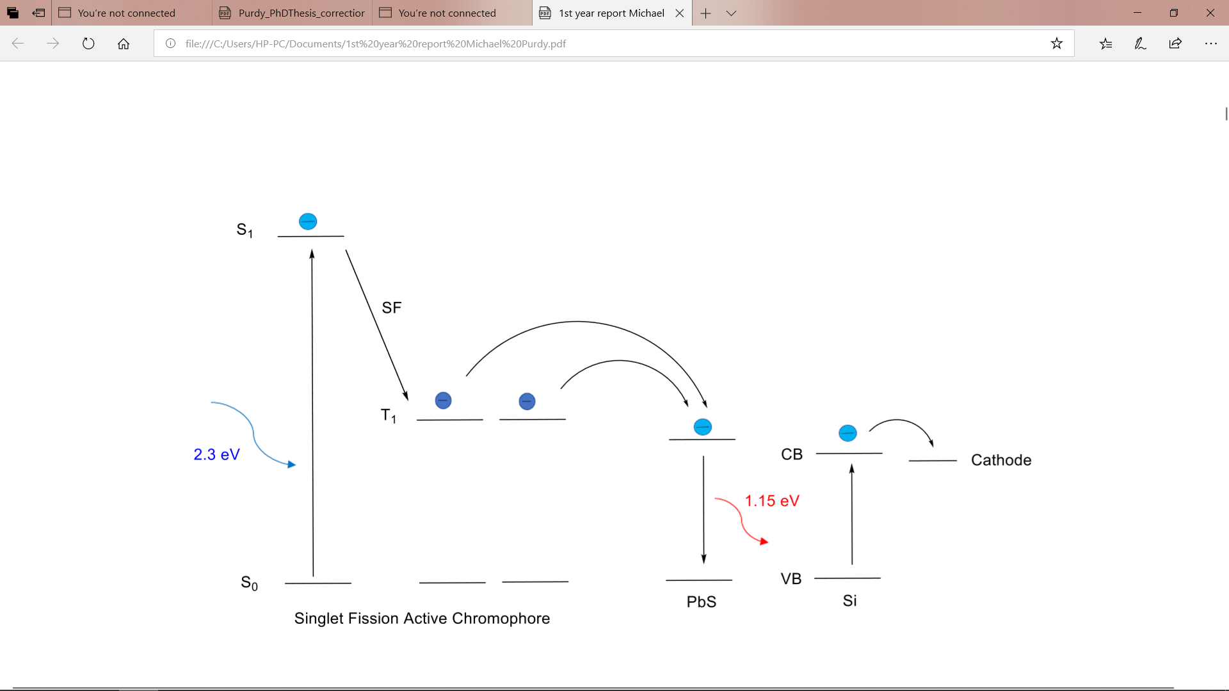
Singlet fission solar cell
Organic – inorganic exciton transfer is difficult
Quantum dots accept the triplet

Slide 9
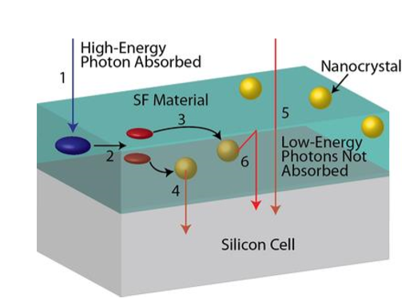
Photon multiplier technology
Currently being developed at University of Cambridge
Research led by Professor Hugo Bronstein and Professor Akshay Rao

Slide 10
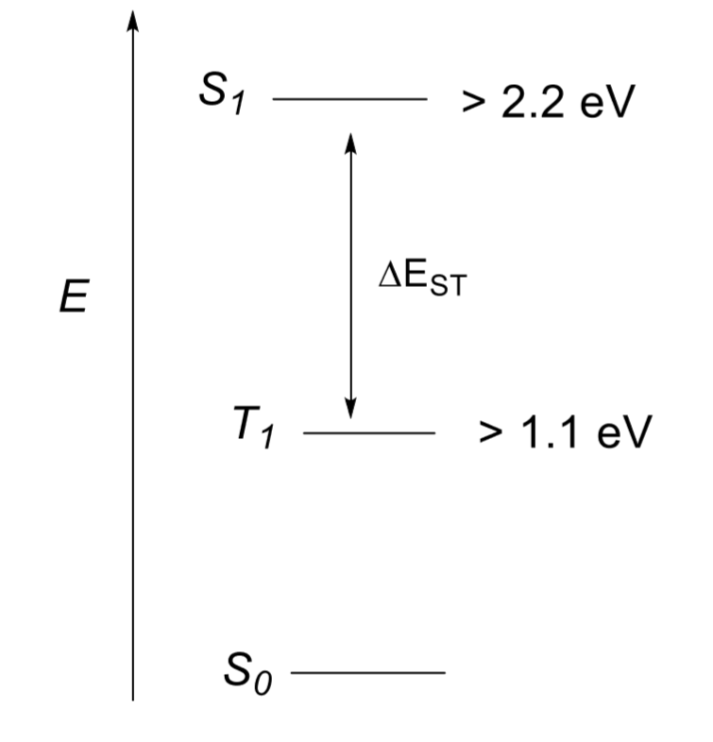
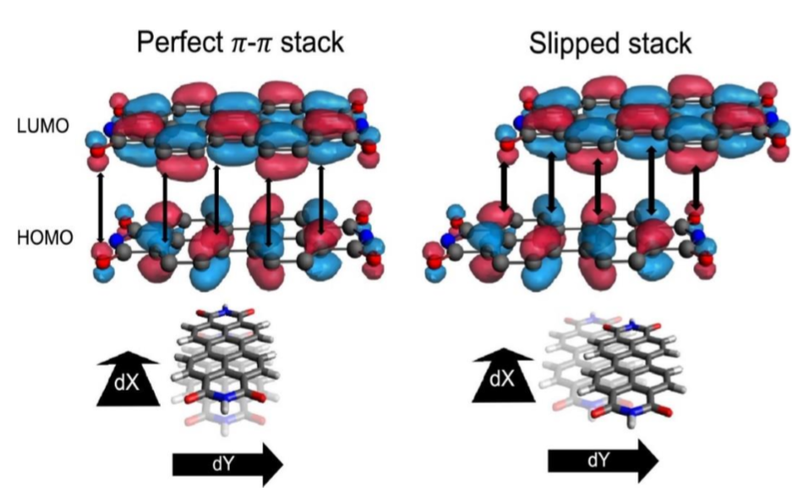
Limitations to technology
Strict energetic requirements 2E(T₁) < E(S₁)
E(T₁) > 1.1 eV
Solid state interactions tuned
Stability

Slide 11
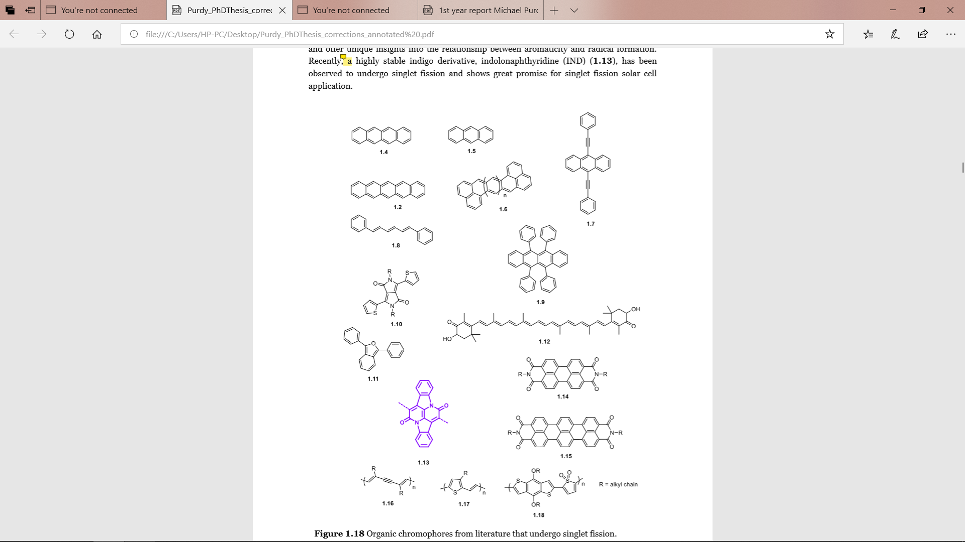
Current materials
No organic material yet satisfies all the requirements

Slide 12
Nearly there
Energy level alignment ✓
Triplet energy ~ 1.1 eV ✓
Photostability✓
Purdy, M. et al. Aza-Cibalackrot: Turning on Singlet Fission Through Crystal Engineering. J. Am. Chem. Soc. 145, 10712–10720 (2023)

Slide 13
Beyond singlet fission
Multijunction cells
Light concentration
Photon upconversion
Purely organic solar cells

Slide 14
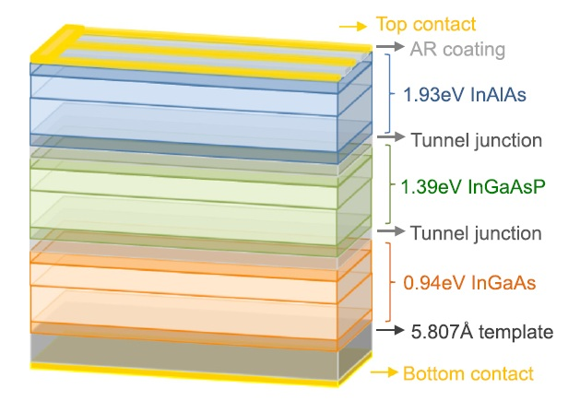
Multijunction cells
A series of photovoltaic cells that absorb different photon energies
Take full advantage of the solar spectrum
Three layers can reach 48 %
Very expensive

Slide 15
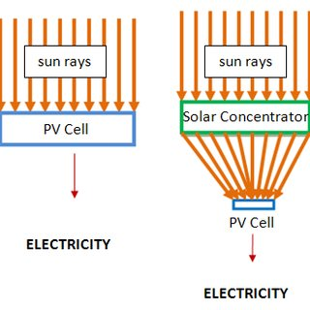
Light concentration
Intensity of 1.1 eV photons can be concentrated using mirrors
Can lead to overheating which can reduce efficiency
Efficiency could be raised to 37 %

Slide 16
Photon upconversion
Opposite to singlet fission
Two low energy photons that can’t be utilised by PV are combined
No device has been developed yet

Slide 17
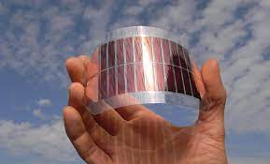
Purely organic solar cells
Alternative strategy is too remove silicon and only use organics
Plastic solar cells been manufactured

Slide 18
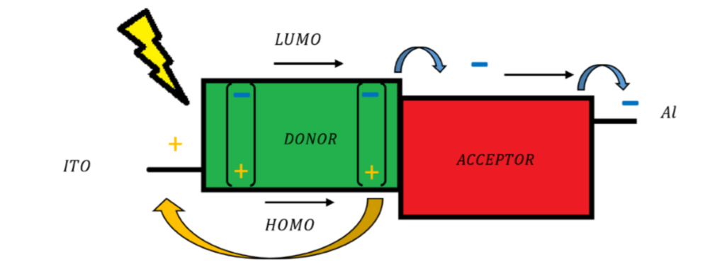
How they work

Slide 19

Advantages over silicon
Flexible and cheap
Solar windows
Conductive paint
Strong light absorbers

Slide 20
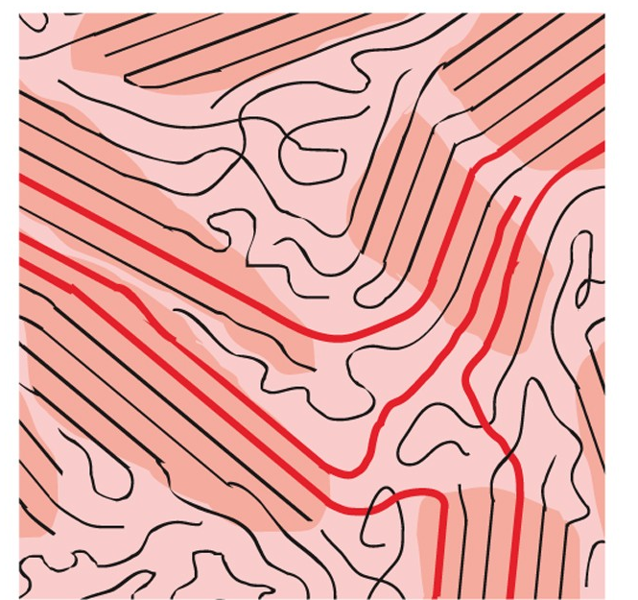
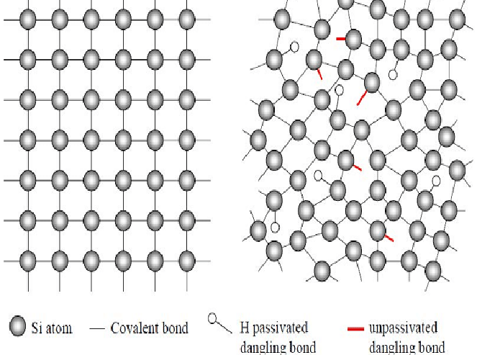
Disadvantages
Maximum efficiency ~ 20 %
Less easily transport charges

Slide 21
Conclusions
Silicon is a robust and reliable photovoltaic material
Efficiency limit must be overcome in an economically sustainable way
Organic solar cells show potential for future application

