Slide 1
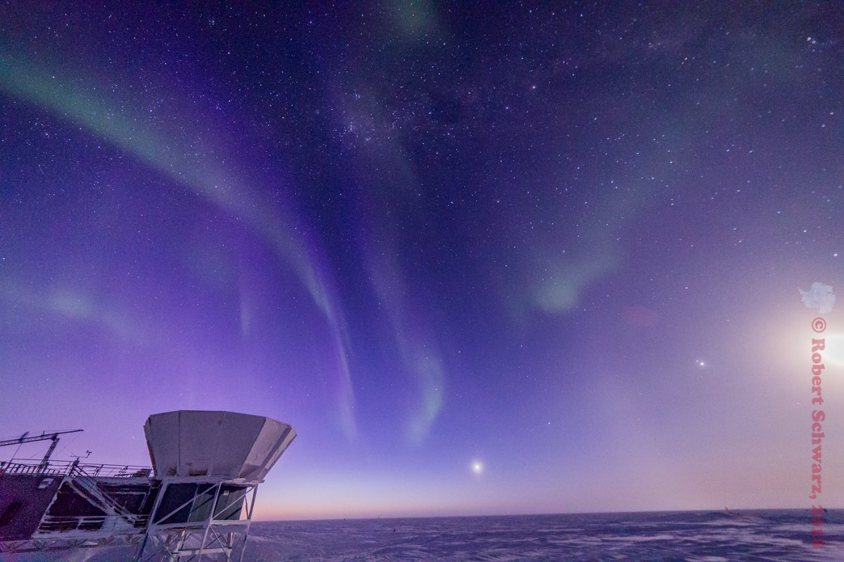
Energy Efficiency and Challenges in Antarctica
Tyler St Germaine
HEJC 2018-11-01

Slide 2
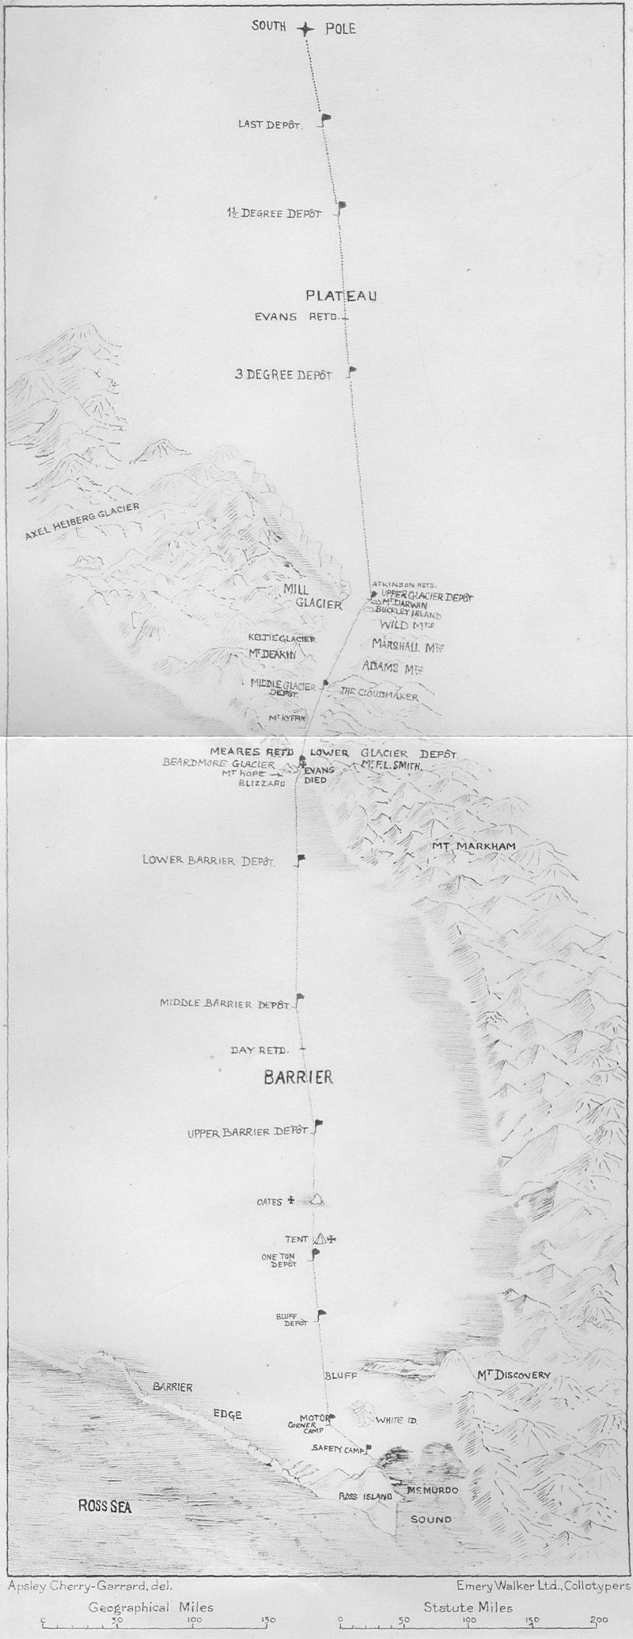
A Brief History of Antarctica
No proof of any sightings before 1820.
  650 CE, supposed existence of some “Terra Australis”
Ernest Shackleton in 1903-1904 expeditions:
  First to traverse Ross Ice Shelf
  First to traverse Trans-Antarctic Mountains
  First to reach polar plateau
  Tried and failed to reach South Pole, 97 miles away
Roald Amundsen vs Robert Scott, race to the South Pole
  Scott: “The Pole. Yes, but under very different circumstances from those expected ... Great God! This is an awful place and terrible enough for us to have laboured to it without the reward of priority…”
Most research stations established 1950 & later

Slide 3
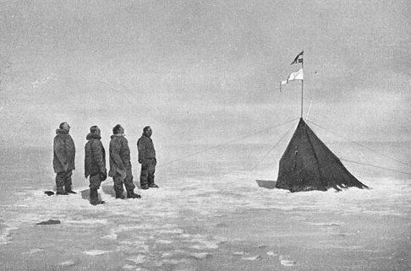
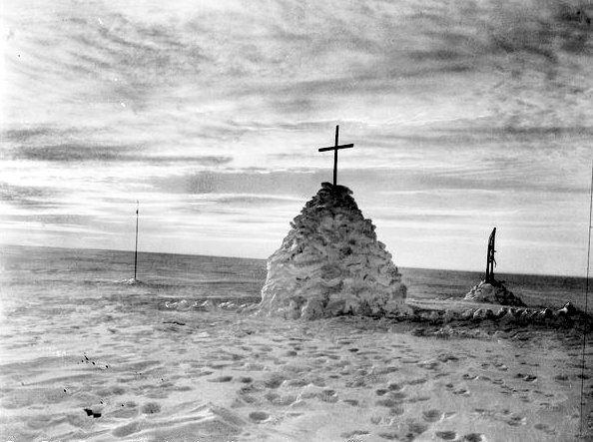
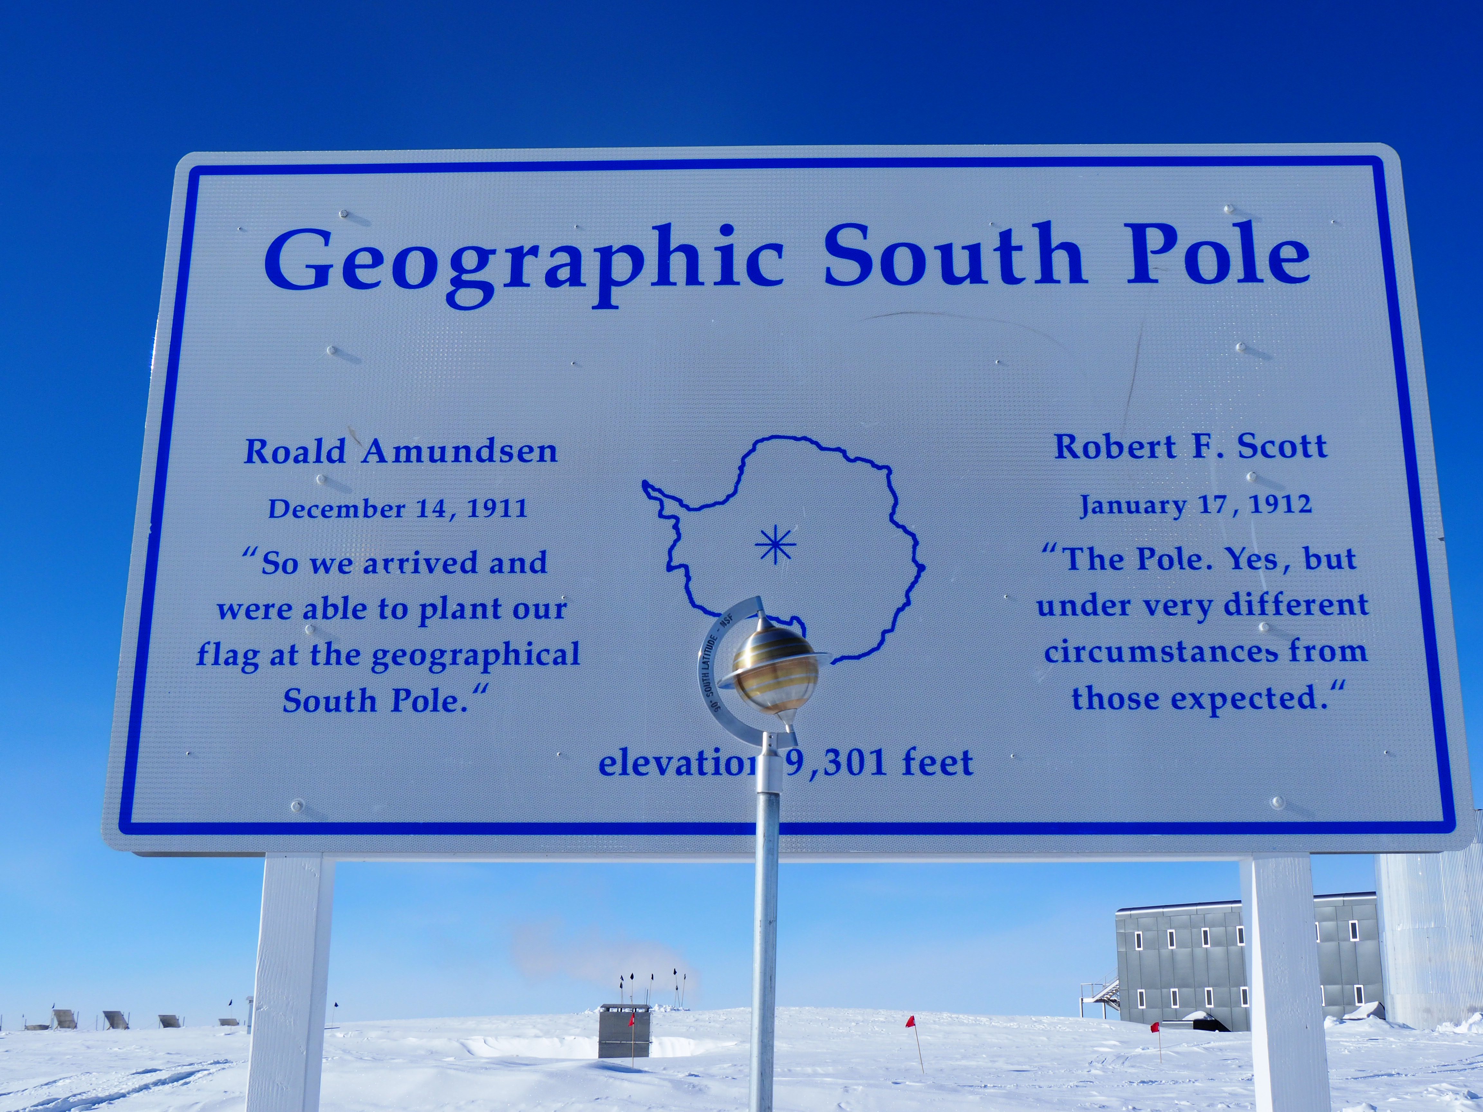
1st place: Roald Amundsen
2nd place: Robert F. Scott

Slide 4
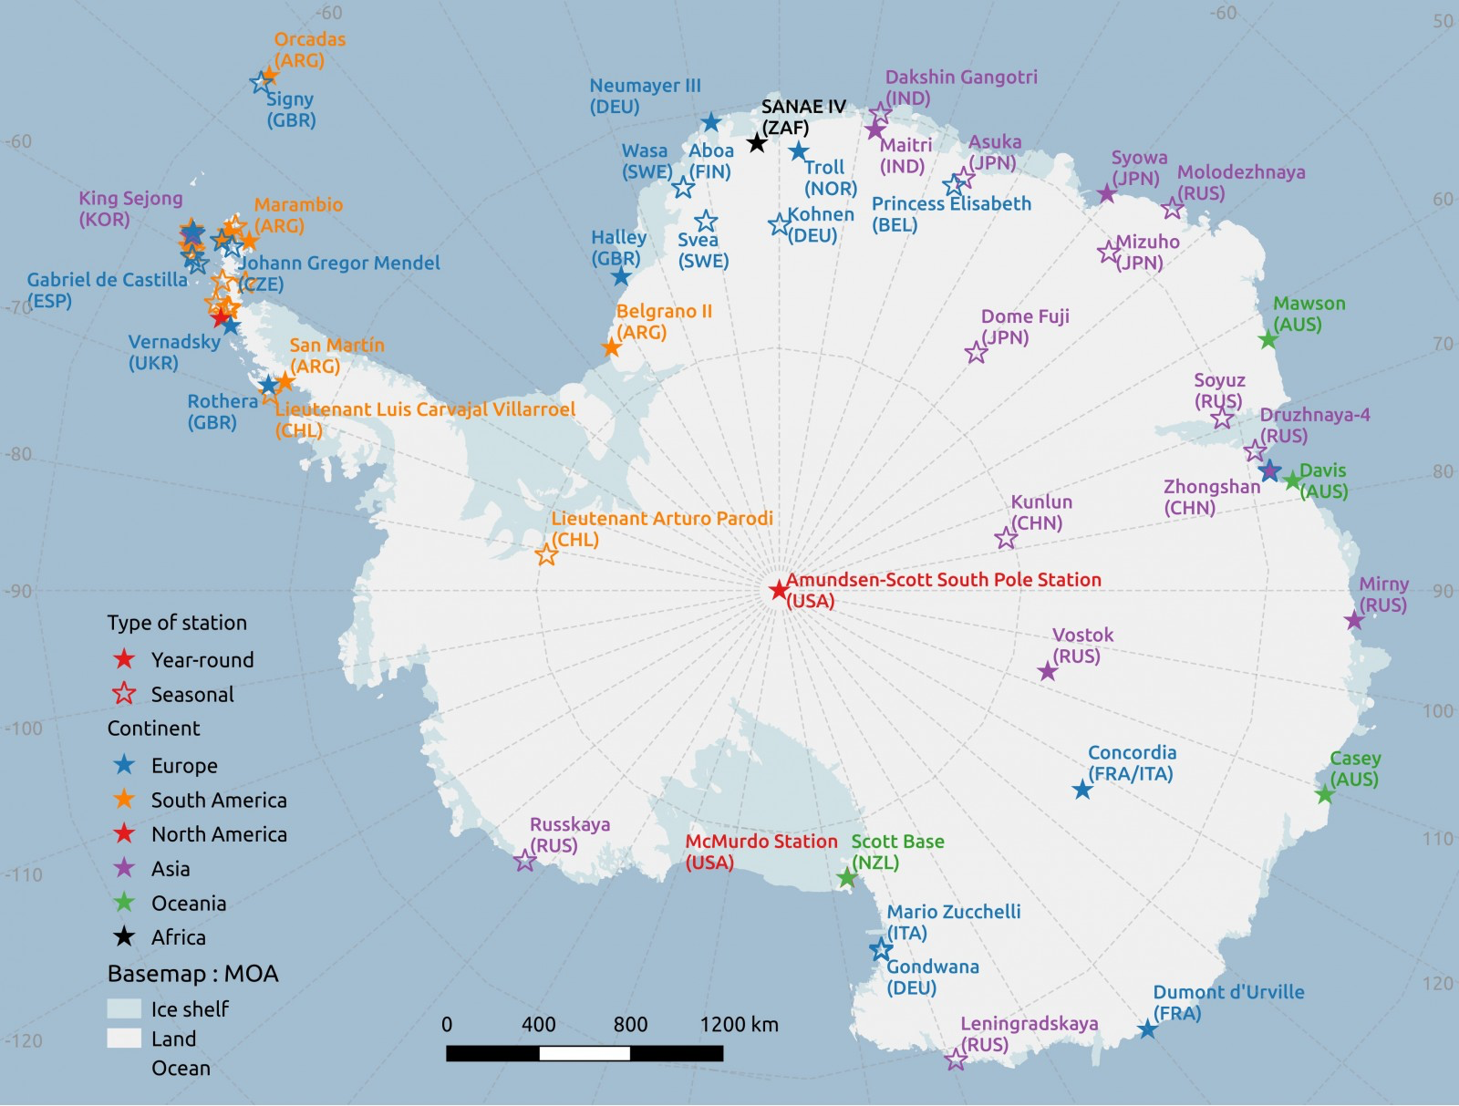

Slide 5
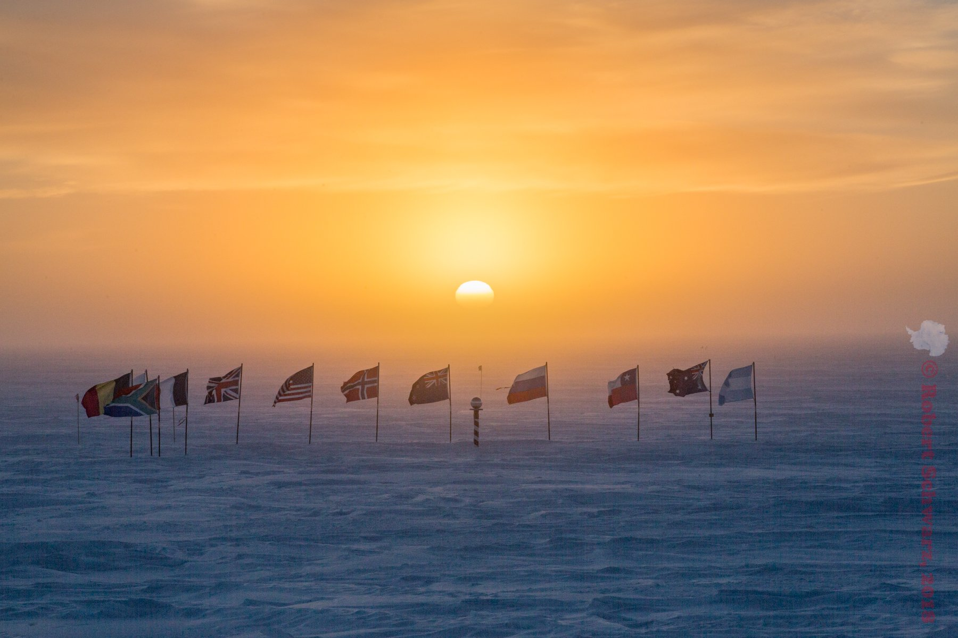
Antarctic Treaty
Originally signed by 12 countries in 1959, now up to 53

Slide 6
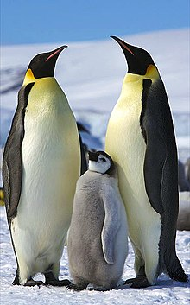
Antarctic Treaty
Peaceful purposes only. No military activity or weapon testing.
Freedom of scientific investigation.
No territorial claims.
No nuclear explosions or disposal of nuclear waste.
All treaty observers have free access to any station / part of the continent.
Other agreements based on preserving the ecosystem
  Convention for Conservation of Antarctic Seals
  Convention for Conservation of Antarctic Marine Living Resources
  Protocol on Environmental Protection to the Antarctic Treaty
    No mining except for scientific purposes!
No other regulation as to how a country operates its stations.

Slide 7
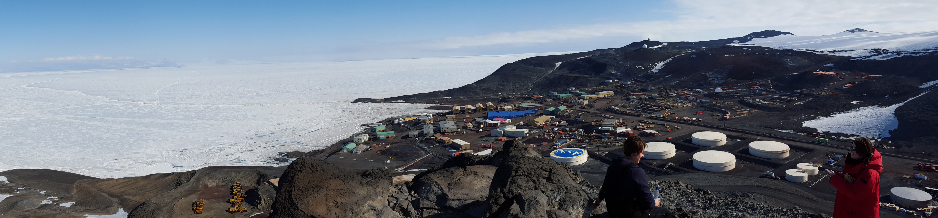
About the Ice – Environmental Conditions
It’s cold.
  Winter lasts ~9 months and averages -10º F / -20º C on the coast, -80º F / -60º C inland
  Coldest temperature reached is -128 F / -89º C
It’s dry.
  It is a desert with only 8” annual precipitation on the coast, as low as 0.3 mm inland
It’s windy.
  Strong katabatic winds off the polar plateau.

Slide 8
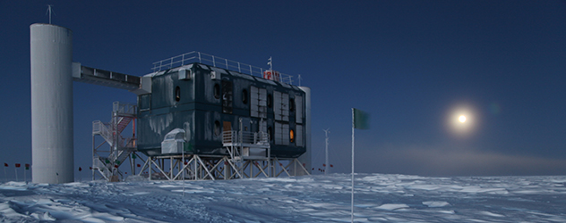
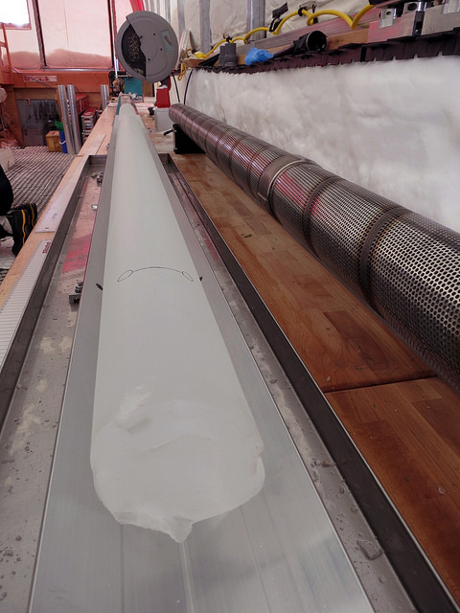
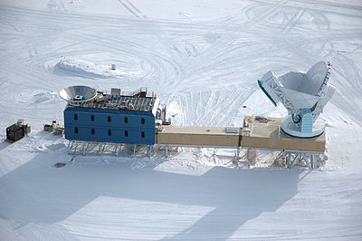
About the Ice – Science
IceCube Neutrino Observatory
Astrophysics and geospace sciences
Biology, Ecology
Earth Sciences
Glaciology
Ocean and Atmospheric Sciences
Climate Change
Education and Outreach
SPIce Core
BICEP/Keck and South Pole Telescope

Slide 9
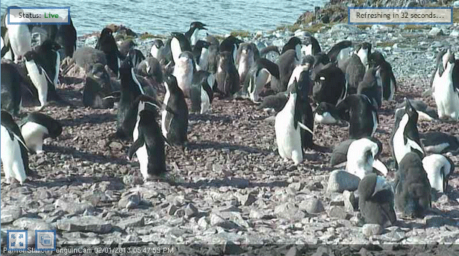
Torgersen Island Penguin Cam!
http://pal.lternet.edu/education/webcams
(active during breeding season Oct-Apr)

Slide 10
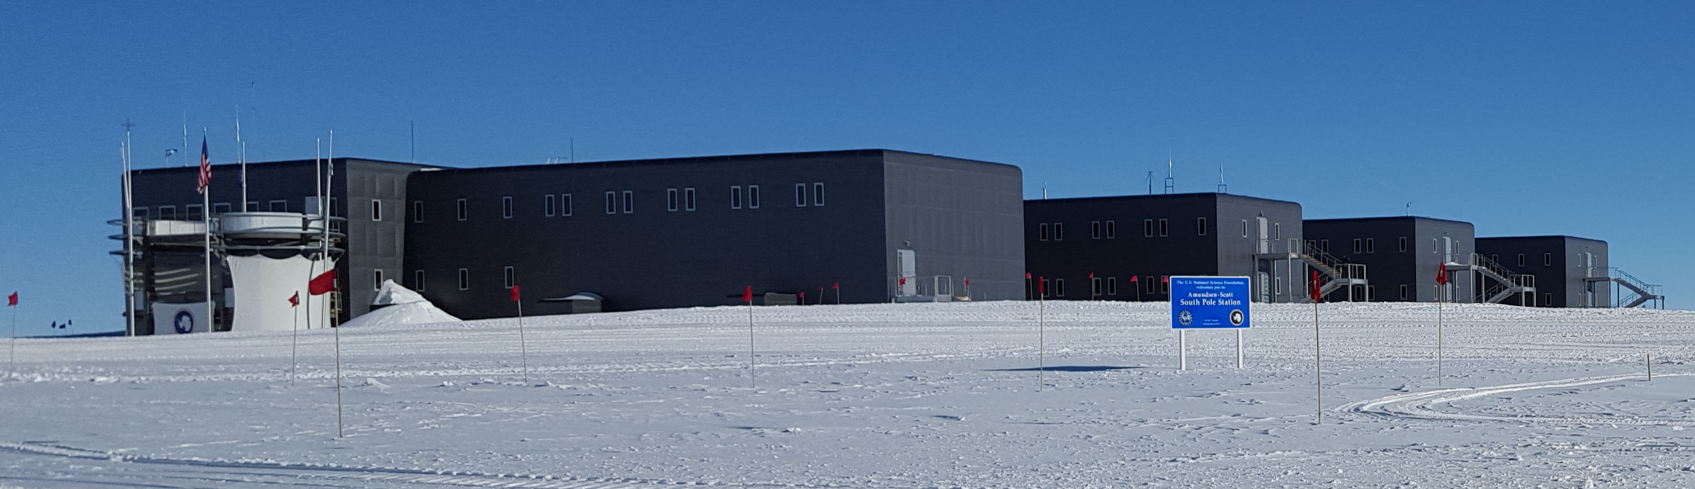
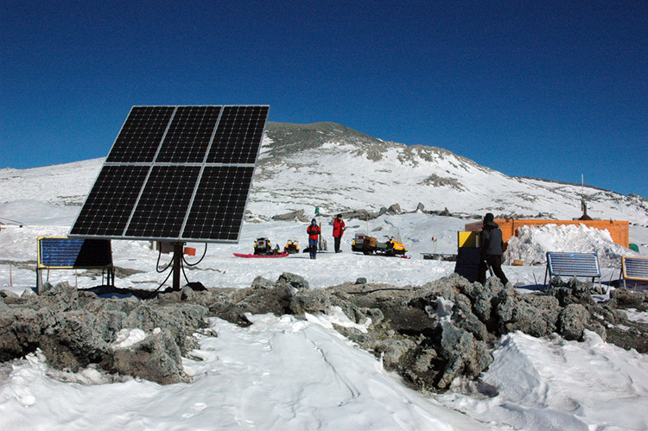
About the Ice – Research Stations
~4000 people on continent in summer, ~1000 in winter.
Permanent research stations
Field camps

Slide 11
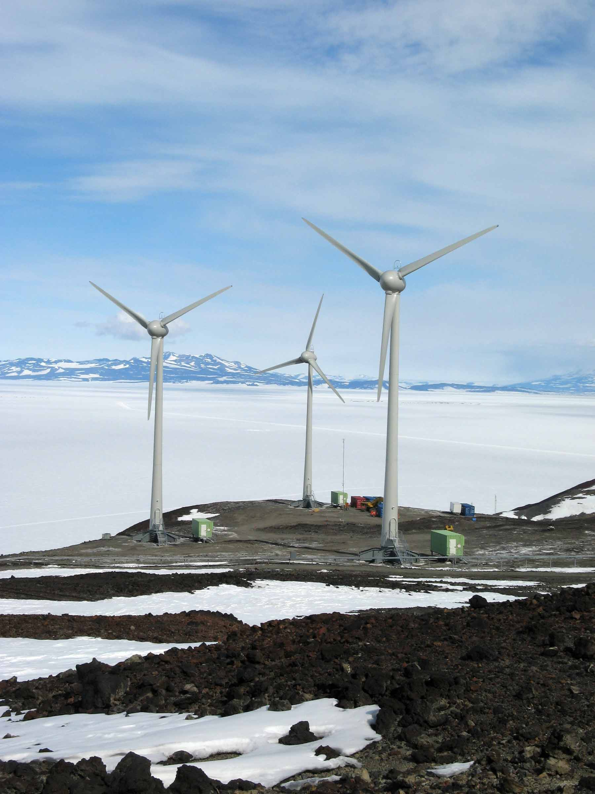
Energy Efficiency at Permanent Stations
Energy needs:
  Scientific equipment
  Lighting
  Space heating
  Water pumping & purification
  Waste management
Current energy sources
  Fossil fuel-based generators
  Fuel also used for aircrafts/vehicles
  Renewables: wind and solar
Challenges for renewables
  Solar: sun only up ~3 months
  Wind: infrastructure

Slide 12
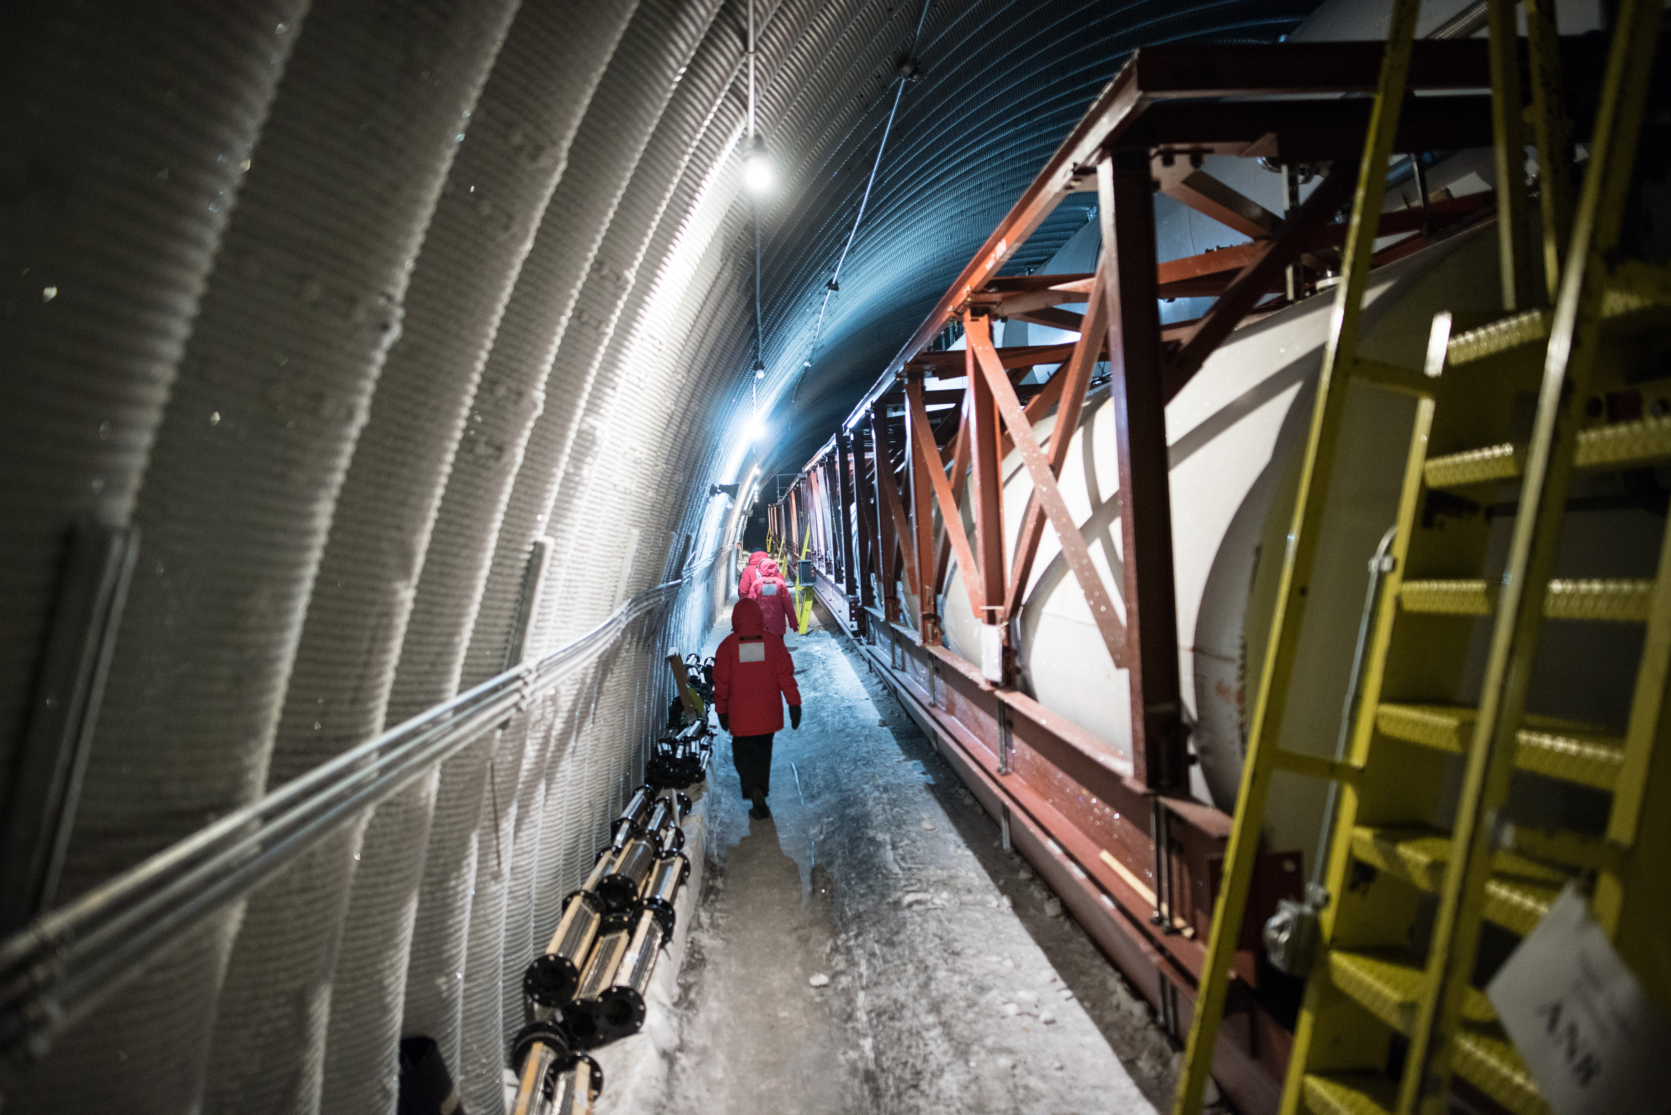
Energy Efficiency at Permanent Stations
Up until recently, the only way to get fuel to South Pole Station is via C-130
  Makes fuel SEVEN times more expensive than at McMurdo
Fuel now delivered via South Pole Traverse
Marion Dierickx

Slide 13
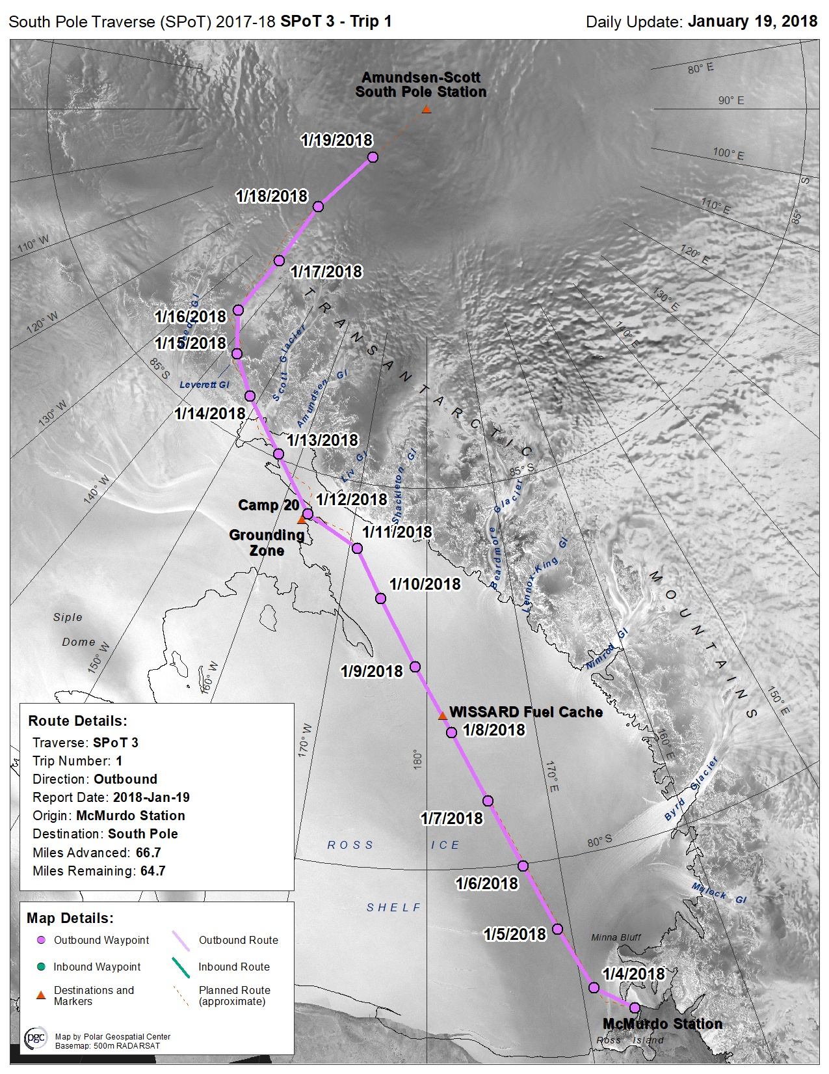
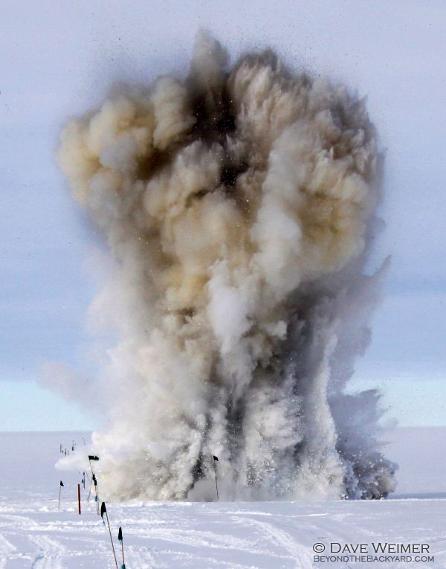
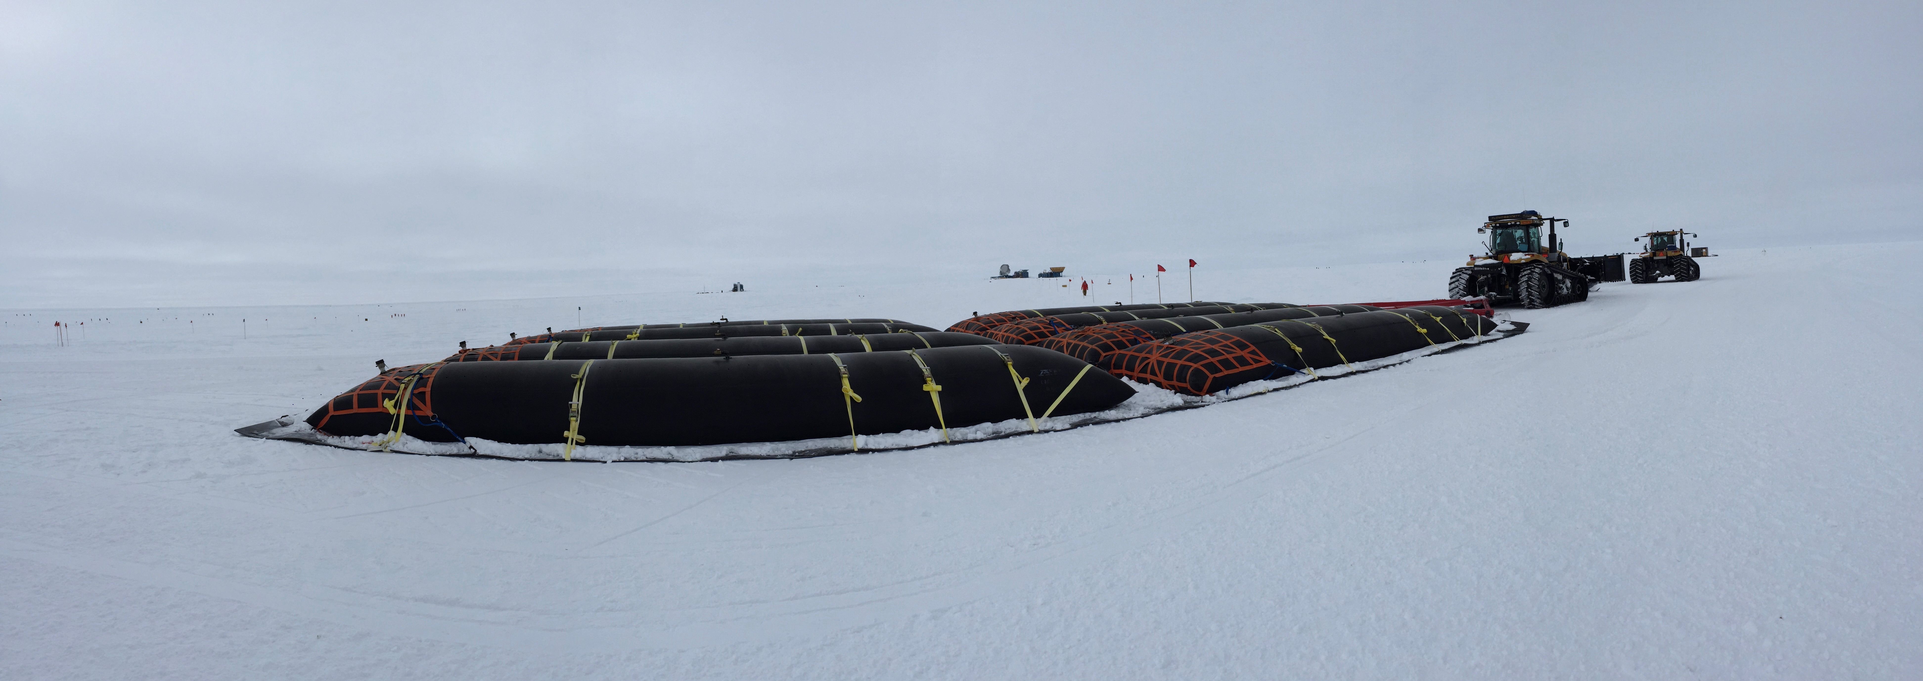
South Pole Traverse
Photos: Marion Dierickx , South Pole Traverse team

Slide 14
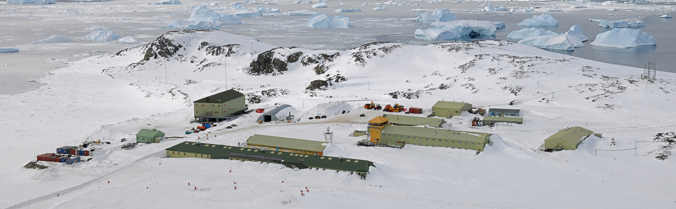
Energy Efficiency at Permanent Stations
Other easy ways to increase efficiency:
  Enchanced insulation
  Improved boilers
  Design buildings to minimize snow drift
  Heat exchange system to recycle waste heat
  Limits on power and water usage
  Staff education and encouragement of behavioral change
Rothera station (UK) redesigned buildings to minimize snow accumulation
Photo: British Antarctic Survey

