Slide 1

Overview of the
U.S. Department of Energy
Energy Journal Club
John Hensley
10-27-2017
Notes:
Motivation…
Agenda: overview, budget, some politics

Slide 2

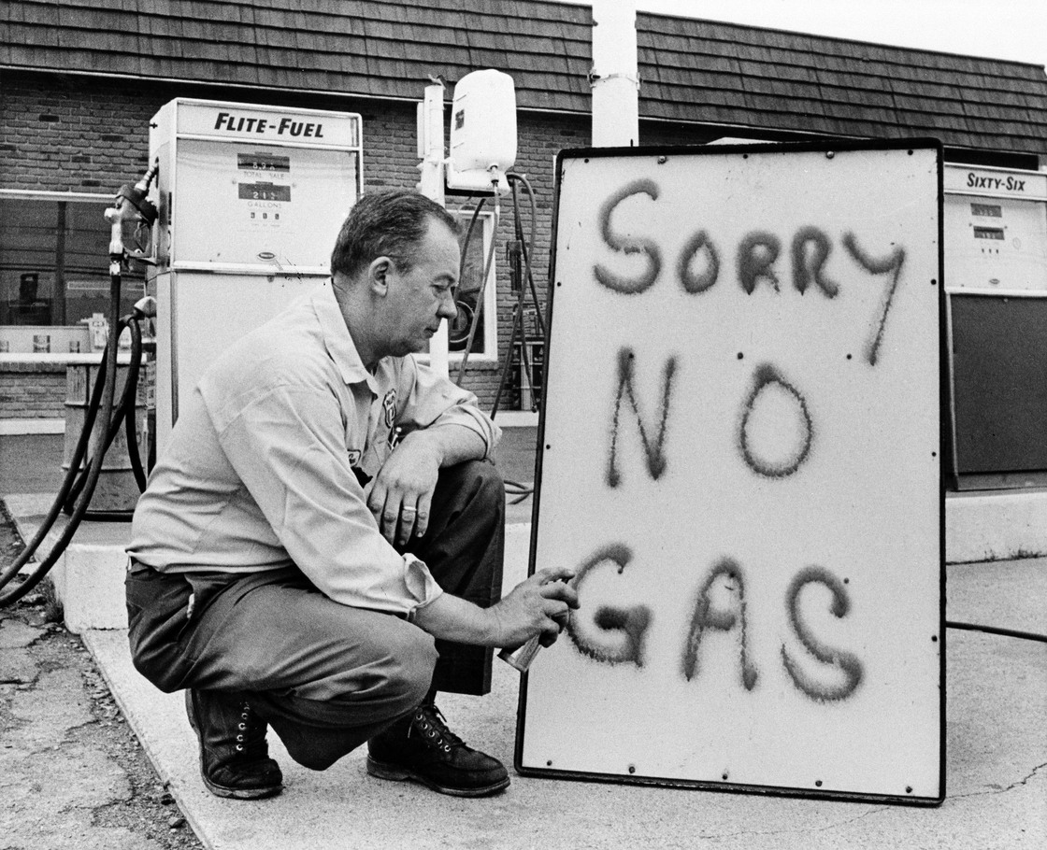
A brief history
The Manhattan Project (1940s)
The Cold War (1947-1991)
OPEC oil embargo (1973-1974)
Energy Department founded 1977
Notes:
Manhattan project dedicated to research on the nuclear bomb
1950s and 1960s: development of nuclear power, nuclear weapons, nuclear security...
1977: Energy Department founded
Consolidated the Federal Energy Administration, the Energy Research and Development Administration, the Federal Power Commission
1970s: focus on energy regulation and development
1980s: cold war continues (focus on nuclear development)
1990s: cleanup of our nuclear nuclear weapons complex, stewardship
History shows that the DOE’s primary focus is on security, thru the lens of energy and nuclear

Slide 3
Primary responsibilities
The mission of the Energy Department is to ensure America’s security and prosperity by addressing its energy, environmental and nuclear challenges through transformative science and technology solutions.
Nuclear security
Energy & basic science research
Energy supply security
$$
Notes:
A lot of diplomacy happens in the DOE (nuclear intelligence, working with other countries with nukes…)
For example, the Iran Nuclear Deal was mostly orchestrated at the DOE
Security in the form of: stewardship of nuclear weapons stockpile, safety from nuclear threats, environmental cleanup
17 national labs, leads a lot of research in both basic science and in energy and nuclear (largest federal supporter)
In decreasing proportion of total budget (see later slides)

Slide 4

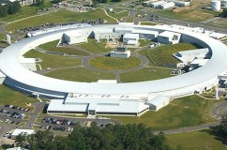
Basic facts
Cabinet-level department
13,000 employees
17 national labs, 80+ total facilities

Slide 5
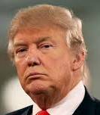
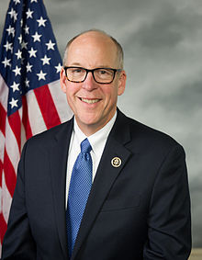
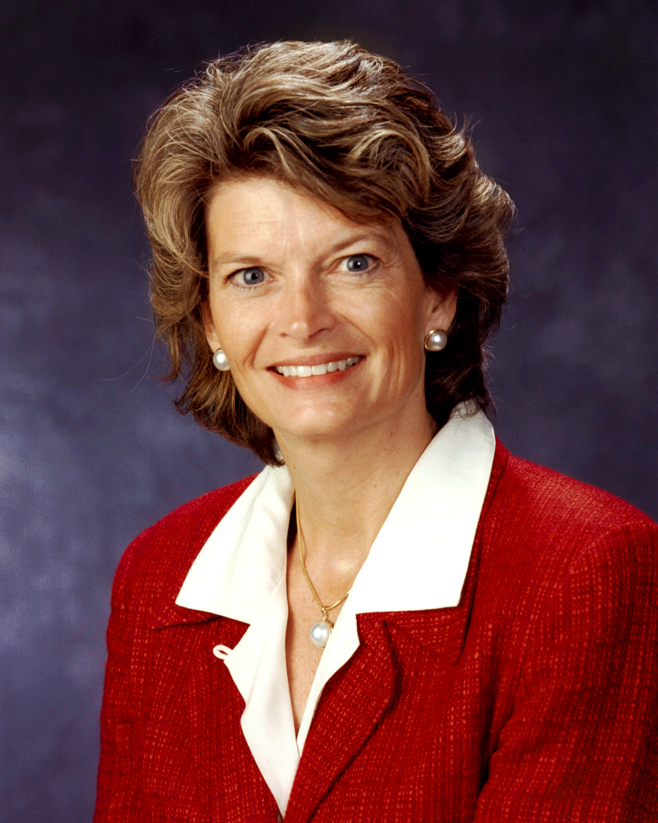

External oversight and influence
Industry? Wealthy individuals? Lobbies?
H.O.R. Committee on Energy & Commerce
(31 R, 24 D)
Senate Committee on Energy & Nat. Resources (12 R, 11 D)
Other departments (e.g., State, Defense)
Notes:
committees: mostly about legislation that would affect the DOE, but also some investigations, require a budget request to congress (for approval)…
In the HOR, the committee has more power compared to the floor than in the senate
Senate: slight majority by republicans, with Alaska senator as chair (moderate)
HOR: significant majority by republicans, with Oregon rep as chair (moderate) and Texas rep as vice chair
The secretary works closely with defense, state (due to huge influence of nuclear)
Because it is in the cabinet, the DOE thru the secretary of energy directly influenced by trump and his agenda
Lobbies, wealthy individuals, industry play a direct role in influencing DOE through $$, advising…

Slide 6
Internal structure
Advisory Boards & Councils
Secretary
FERC
Deputy Secretary
Inspector General
Nuclear Security Office
Science & Energy Office
Management & Performance Office
Public affairs, finance, power administration…
Defense, security, infrastructure, project management, counter-terrorism…
Energy reliability, energy management, science
Notes:
Secretary + deputy secretary; analogous to pres and vp. Chosen by Trump administration
Activities broken down into offices, which are generally administered by officials. Chosen by presidential administration.
OTHER
FERC: electricity, pipeline, and oil/gas regulator. Funded by DOE but independently operated.
Inspector general: audits and reporting on activities, including to congress. Also funded by DOE.
Advisory boards and councils: in the past, it was made up of lots of academics. Probably now has lots of industry, or perhaps academics in different fields, due to change in political climate. Appointed by secretary.
AB & C have the ability to shape actions and policies of DOE within context of laws made by congress.
Essentially, all the high level admin is chosen by the current president.

Slide 7
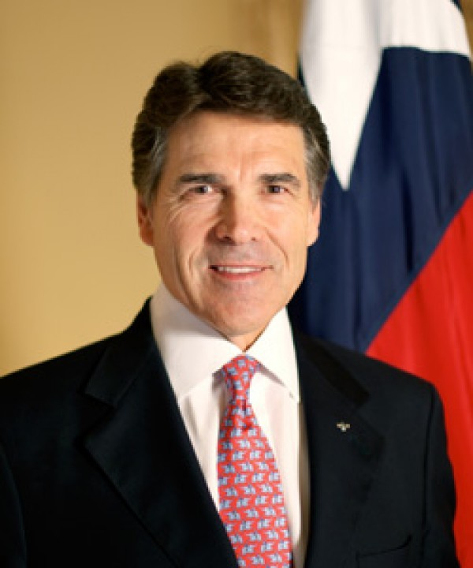
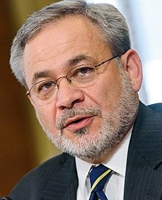
Current leadership
Secretary
Rick Perry
Deputy Secretary
Dan Brouillette
Notes:
Rick Perry background:
Texas A&M grad in agricultural sciences (Obama’s previous secretaries: nuclear physicists, nobel prize winner)
Governor of texas – 15 years (longest of anyone). Previous secretaries (1 dem, 1 rep) are saying that he will do a good job because he’s used to running a bureaucracy
Dan Brouillette background:
University of Maryland, army
2003-2004: Experience as chief of staff of energy/commerce committee
VP at Ford
Louisiana’s State Mineral and Energy Board
9 children
Difference in leadership strategies:
Obama has two nuclear physicists running the DOE – scientific expertise
Trump has two people with business, policy backgrounds (similar to Bush administration – bureaucratic expertise)

Slide 8
How else has the changing political climate affected the structure and operations of the D.O.E.?

Slide 9
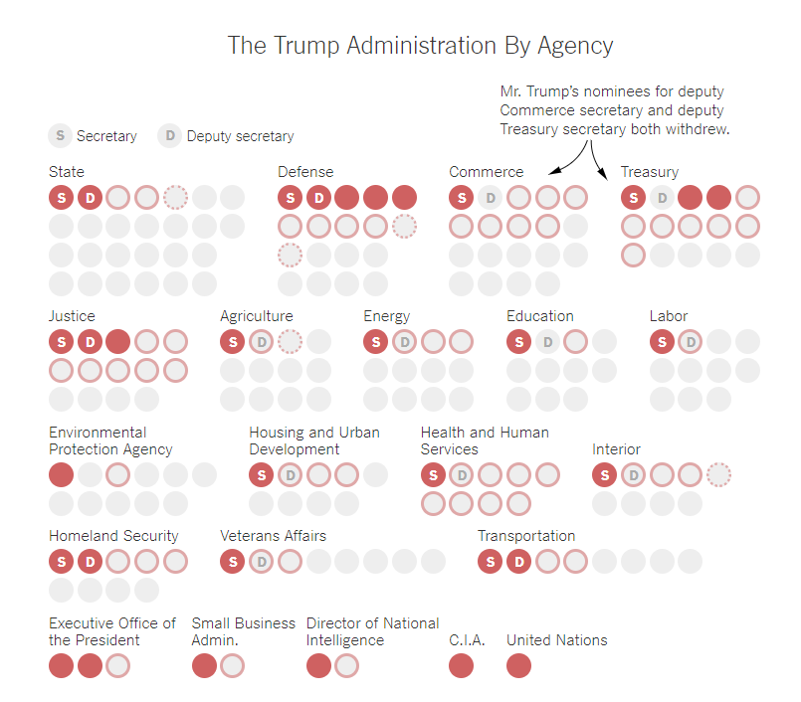
Vacancies in the White House
High ranking positions filled in each department (as of 07/17/17).
Deputy secretary of D.O.E. confirmed since then.
https://www.nytimes.com/interactive/2017/07/17/us/politics/trump-appointments.html
Notes:
Shows the confirmed (red), filled (red outline), planned (dotted), and vacant leading positions in each agency
President nominates a person, who fills in, and then is confirmed by the senate.
From July: only difference now is that the energy deputy secretary has been confirmed
President Trump shows no interest in filling many of the positions, he finds them to be unnecessary
In DOE, a lot of these positions are under secretaries that lead the offices, and they have specific roles and could conceivably manage billions of $$
In state department, this may have more consequences; for example, there’s no ambassador to south korea

Slide 10
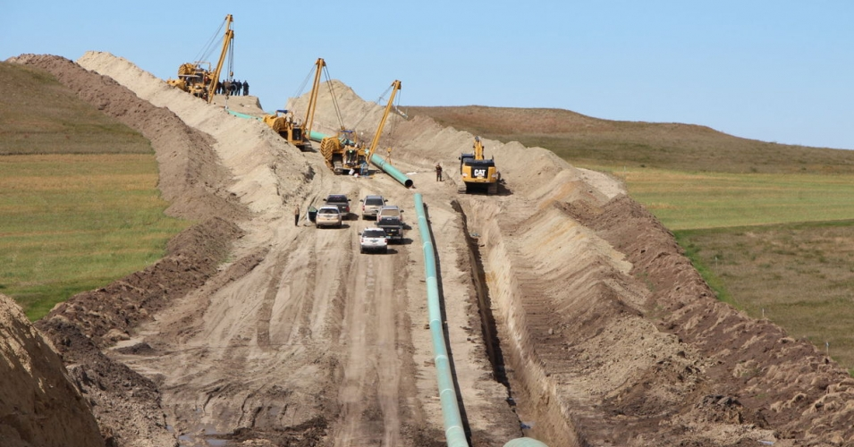

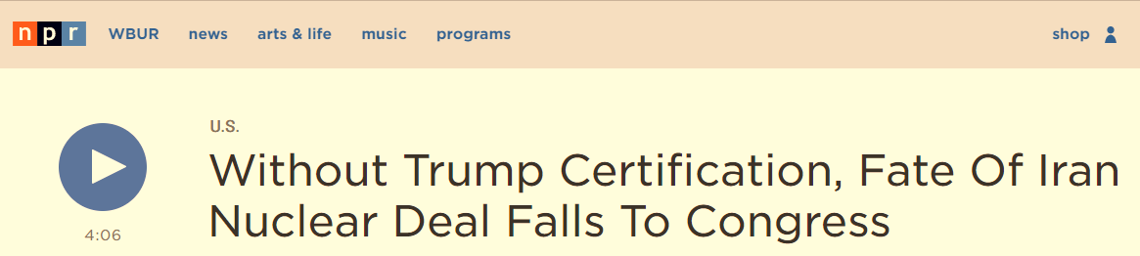
Direct impacts of political change
Policy and regulation
But the scientists weren’t fired. Is there a way they could they be affected?
The budget

Slide 11
How is a federal budget enacted?
Proposal submitted by President
Committees on the Budget pass resolutions
Appropriations Committees specify/edit breakdown of $ through appropriation bills
Congress passes appropriation bill
President signs appropriation bill
Ideally completed by F.Y. start (Oct. 1)
Proposal
Appropriation bill
F.Y. budget
Notes:
President, in collaboration with DOE (and other potential actors) propose a budget, usually by February
Committees in congress “approve,” edit, and suggest a more precise breakdown of the budget (which can involve shifting large amounts of money)
Resolution : total amount of money allocated
Appropriation : breakdown of total amount
President signs again, hopefully before the fiscal year starts
To the best of my knowledge, we are still in the appropriation phase, but not sure

Slide 12
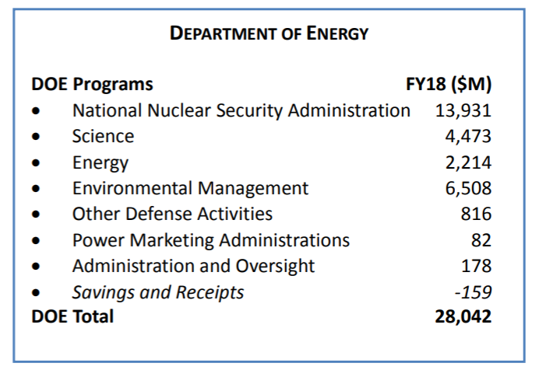
F.Y. 2018 budget proposal
(introduced May 2017)
https://energy.gov/sites/prod/files/2017/05/f34/FY2018BudgetinBrief_3.pdf
Notes:
Budget is a good proxy for the commitment of the DOE to each of its functions
Look how much money has to go into environmental management every year! (6.5 billion)
Science means science research, basically. Almost 4.5 billion dollars goes there every year. Energy also largely research, and then also other activities. Probably a good chunk of our funding comes from there.

Slide 13
How do I get a sense of what’s underlying the budget proposal?

Slide 14
Let’s look at the historical record
Compared to the F.Y. 2017 budget, the President’s proposal recommended the following
Funding for science research
Funding for energy research
Env. mgmt. of nuclear activities
Weapons activity support
Total proposed cost:
-$874 million
-$2.2 billion (HALF)
remains constant
+$920 million
-$2.7 billion
Notes:
Remember, these were proposed by trump, not actual.
Put up the most staggering or interesting differences.
Some interesting line items that were neglected: Indian reservation electrification loan, nuclear waste disposal grant for Yucca mountain, other nuclear waste (total $120 million) grants
Some interesting large increases in money: grants given to organizations that are helping out economically distressed areas: Appalachia, Mississippi river delta, Alaska, new England…

Slide 15
Didn’t you say something about Congress revising the budget proposal?

Slide 16
F.Y. 2018 Appropriation Bills
(introduced July 2017)
Values in $ billions
Line item | ’18 Proposal | ’18 Appropriations |  | ’17 Budget
 |  | H.O.R. | Senate
Science funding | 4.5 | (+0.9) 5.4 | (+1.1) 5.6 | 5.4
Renewables funding | 0.6 | (+0.5) 1.1 | (+1.3) 1.9 | 2.1
Nuclear & fossil funding | 1 | (+0.5) 1.5 | (+0.5) 1.5 | 1.7
Weapons | 10.2 | 10.2 | (-0.2) 10 | 9.3
Total | 27.8 | 29.9 | 32 | 30.5
https://www.congress.gov/congressional-report/115th-congress/senate-report/132/1
https://www.congress.gov/congressional-report/115th-congress/house-report/230/1
Notes:
Senate is more generous than house, which could reflect the longer experience and closer parity between houses
Hits still taken – renewable funding increased dramatically (40% over 1-2 years, under Obama) and so probably some republicans want to cut back
HOR budget still lower than in 2017
HOR and senate have to agree about appropriations

Slide 17
What comes next?
Congress now finalizes one appropriation bill
The joint appropriation bill must then pass
(1) senate
(2) house
(3) president
Remember: The process happens again next year

Slide 18
It might be interesting to think about what influences our politicians.
Re-election
Consensus of voter base
Personal beliefs and values
What my political allies think
Money (i.e., campaign financing)
…
Notes:
http://www.rollcall.com/issues/57_100/bradford-fitch-what-really-motivates-members-congress-212660-1.html

Slide 19
What are some examples of ways of tapping into the motivations of our politicians?

Slide 20
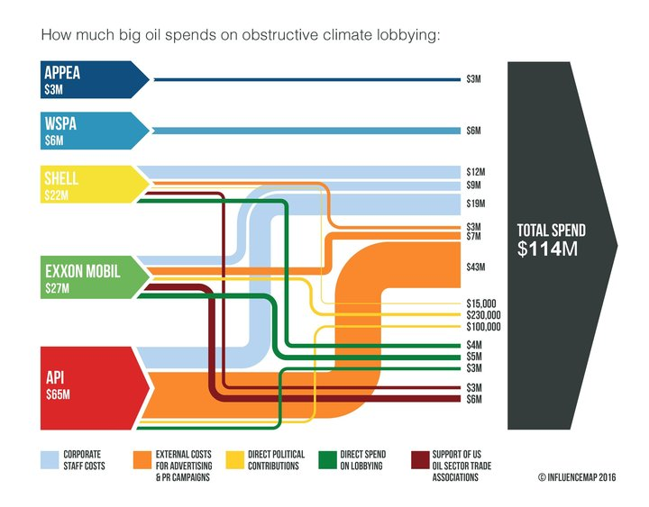
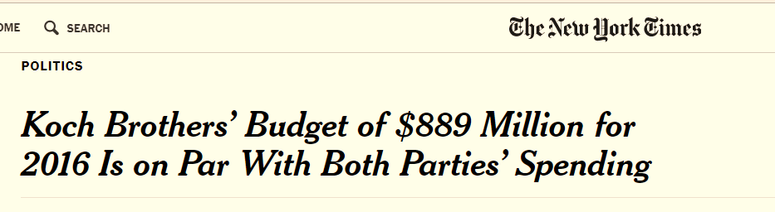
Money
Notes:
Industry provides money to lobbies or in direct campaign contributions
Lobbies generally in turn provide money for campaign contributions
Wealthy individuals like the Koch brothers provide money for campaign contributions
So then our politicians have the advertising for re-election

Slide 21
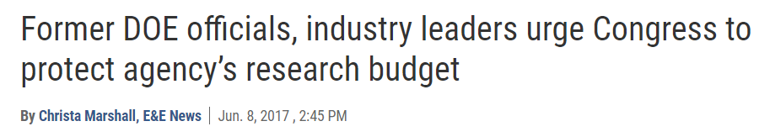
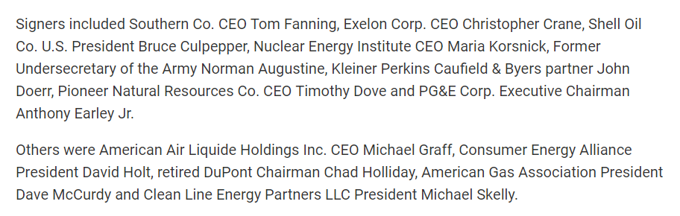
Politicians listen to industry
(Oil and gas benefits from science too)
Notes:
Letter signed by former officials and industry
Fracking was one case of where research was helpful for industry, used as an example
Industry has ACCESS:
Politicians would take the opinion of industry – influences voter base, money, lobbies…maybe helps them see a different side of how a budget could influence something they care about
The appropriation bill seems to show that congress listened

Slide 22
Correlations between background and political decision-making
Notes:
Murkowski: Alaska native, cares about oil and environment
Greg Walden: Oregon native, generally favors oil, but also is big on preserving wildlife, natural resources, forests
Rick Perry: Texas native, oil is one of primary industries there
Dan Brouillette: history in the automotive and oil industries
Tapping into their personal values and what influences the places they come from may help you make compromises…

Slide 23
Revisiting the mission statement
The mission of the Energy Department is to ensure America’s security and prosperity by addressing its energy, environmental and nuclear challenges through transformative science and technology solutions.
Are we ensuring our security and prosperity?
Are we addressing our (long term) energy challenges?
Are we supporting transformative solutions?

