Slide 1

China Energy Landscape
Mandy Liu, Eliza Spear
11/15/2018

Slide 2

Overview
China energy usage summary
Energy policy of China
Energy future of China & the changing world

Slide 3
China energy usage summary
https://www.iea.org/weo/china/

Slide 4
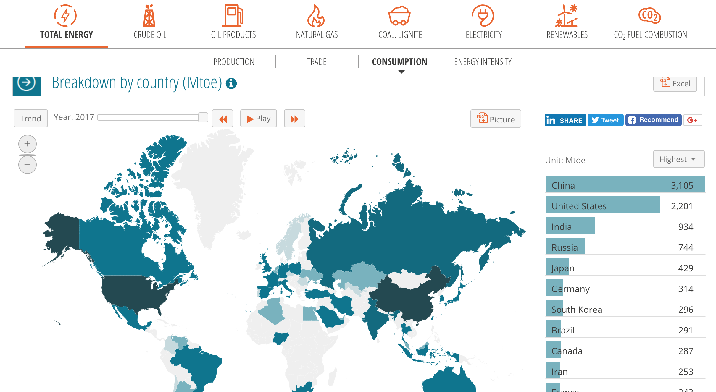
China: The largest energy consumer and producer in the world
Mtoe: million tonnes of oil equivalent, 1 Mtoe = 1.16 × 10¹⁰ Kwh
yearbook.enerdata.net/
Notes:
Eliza

Slide 5
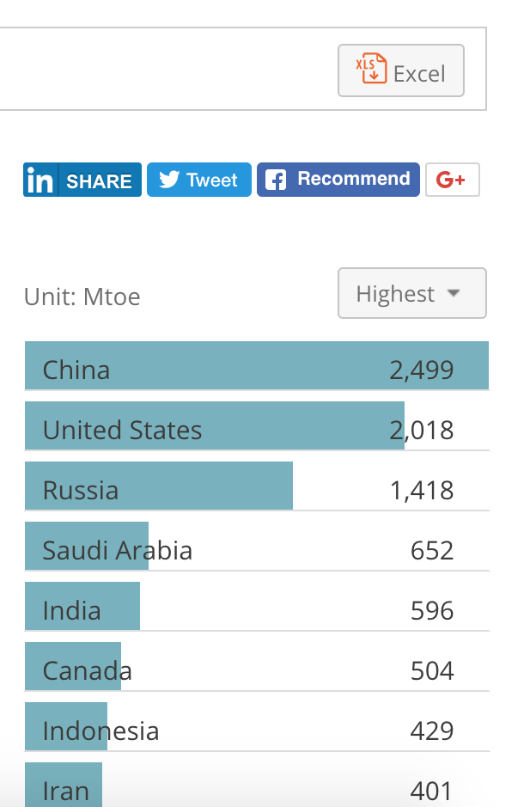
China: The largest energy consumer and producer in the world
Production
Mtoe: million tonnes of oil equivalent, 1 Mtoe = 1.16 × 10¹⁰ Kwh
yearbook.enerdata.net/
Notes:
Eliza

Slide 6
Ultrafast and energy-intensive growth
Ultrafast economic growth, coupled with energy consumption and CO₂ emission
https://www.flickr.com/photos/eiagov/43568277842/
http://www.climatechangenews.com/2017/03/31/chinese-co2-emissions-really-peaked/
Notes:
Eliza

Slide 7
Severe pollution
Air pollution
“Beijing air pollution can be deadlier than 40 cigarettes”
https://www.inverse.com/article/32209-air-pollution-smog-beijing-china-cigarettes-unhealthy

Slide 8
Severe pollution
Major fires at national granaries in Northeastern China
Land
Water
“If you think China’s air is bad, you should see the water.”
http://finance.qq.com/zt2013/cjgc/zcl.htm
https://www.revealnews.org/article-legacy/chinas-other-pollution-problem-its-soil/
https://www.businessinsider.com/china-water-air-pollution-facts-2015-11?r=UK&IR=T

Slide 9
Imbalanced energy structure
A quick formula to pollution: imbalanced energy structure + poorly regulated industrial practices
Primary Energy sources
Secondary Energy sources
A secondary energy source need to be made from a primary source.
/yearbook.enerdata.net/

Slide 10
Imbalanced energy structure
Secondary Energy sources
A secondary energy source need to be made from a primary source.
Primary Energy sources
Input to Refineries
# 2 in the world
2/3 of the #1 country (United States)
Consumption
# 1 in the world
3.5 times of the #2 country (India)
Consumption
# 1 in the world
1.5 times of the #2 country (United States)
Is the electricity in China really “clean”?
Consumption
# 2 in the world
2/3 of the #1 country (United States)
Consumption
# 2 in the world
1/3 of the #1 country (United States)
/yearbook.enerdata.net/

Slide 11
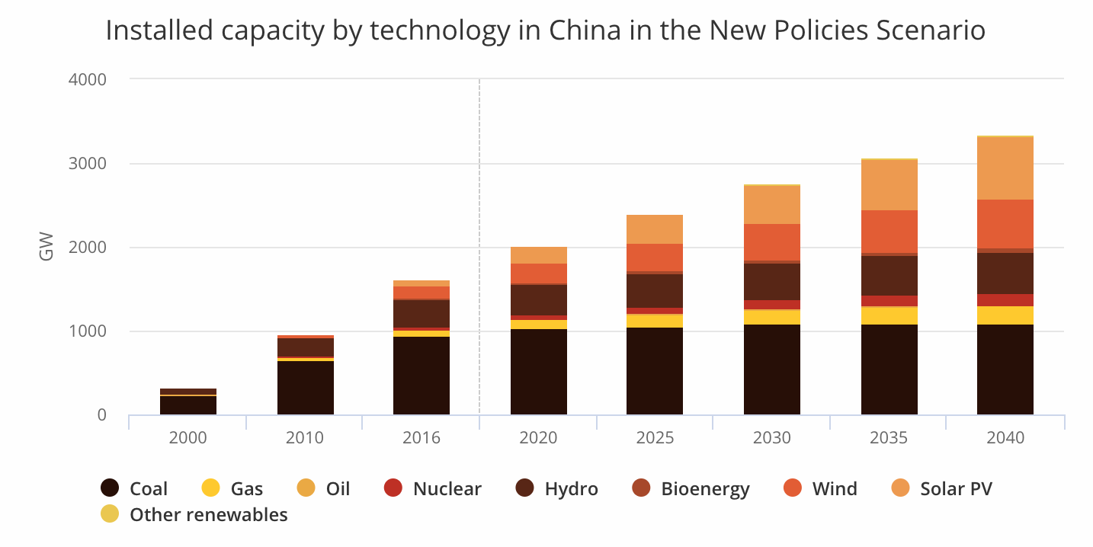
Imbalanced Energy Structure
China’s coal obsession
Installed Capacity by Energy Sources
https://www.iea.org/weo/china/

Slide 12
Imbalanced Energy Structure
China’s coal obsession
America’s oil obsession
Installed Capacity by Energy Sources
A 14-year-long oil spill in the Gulf of Mexico
https://www.washingtonpost.com/national/health-science/a-14-year-long-oil-spill-in-the-gulf-of-mexico-verges-on-becoming-one-of-the-worst-in-us-history/2018/10/20/f9a66fd0-9045-11e8-bcd5-9d911c784c38_story.html?utm_term=.56169a87b56e
https://www.iea.org/weo/china/

Slide 13

Hydropower boom in 2009
Three Gorges Dam holds world record for hydroelectric gravity dam
Displaced 1.2 million people, flooded 1,300 + villages
Might have permanently changed the ecosystem
https://www.internationalrivers.org/campaigns/three-gorges-dam
https://www.nytimes.com/2007/11/19/world/asia/19dam.html

Slide 14
Something is going on …
Peaked?
Peaked?
Current Installed Capacity by Energy Sources
Fast diversification?

Slide 15
Energy policy in China: the game changer?
Google images
National People’s Congress
Xi might stay in power after term limit was abolished
Notes:
Eliza

Slide 16
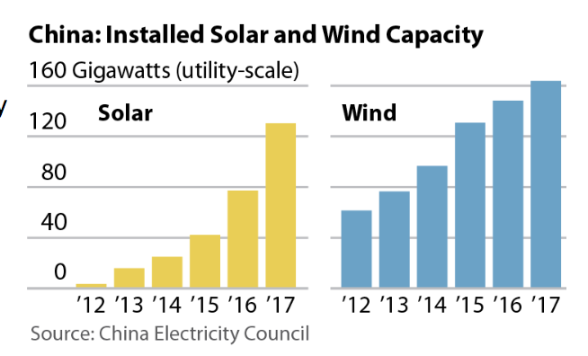
Change energy structure
http://ieefa.org/ieefa-china-a-sea-change-in-energy-policy/
Notes:
Eliza

Slide 17
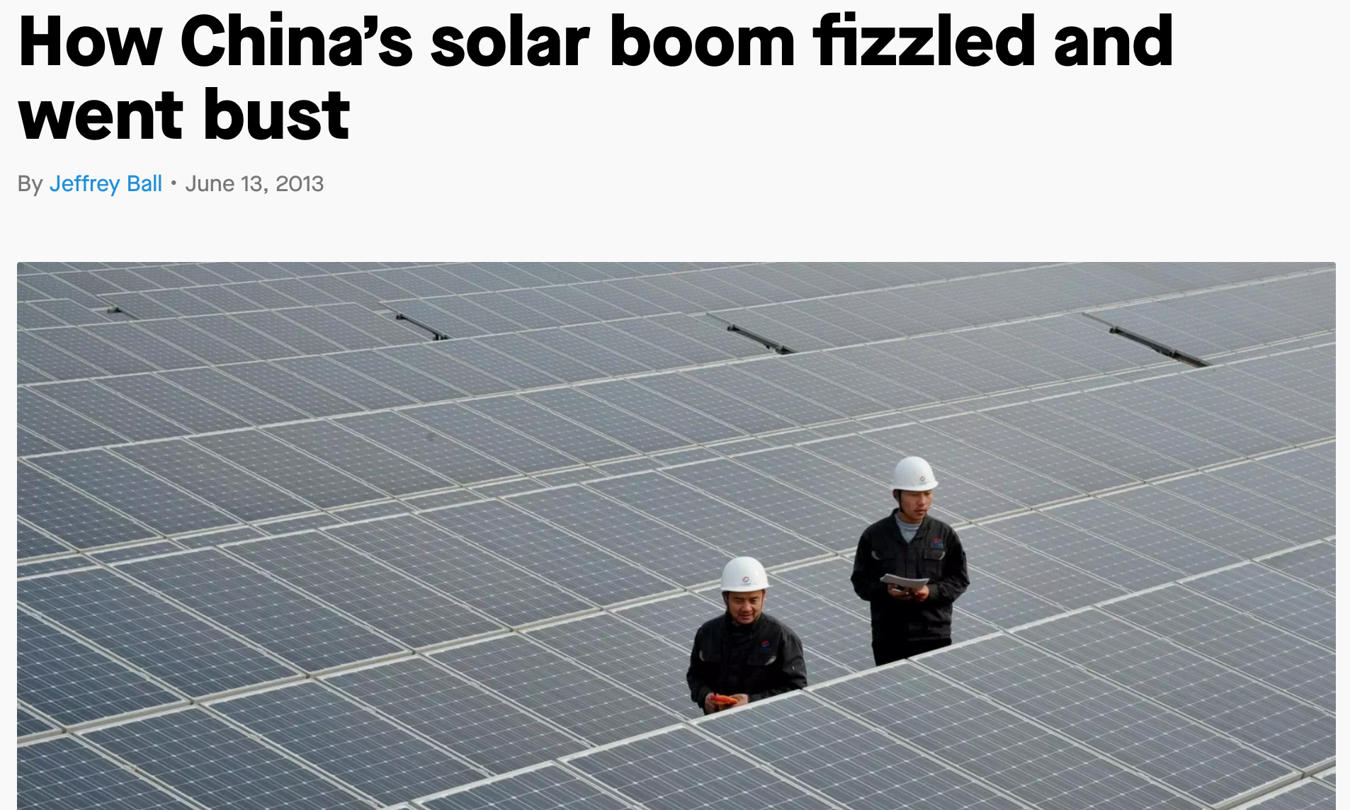
Case study: Boom and bust of photovoltaics in China
Renewable energy industries
Boom:
  Western countries curtail solar spending
  Initial backings from government and banks across China
Bust
  More competition from Western countries
  Shrinking market/demand could no longer match the sharp production increase
https://qz.com/93368/how-chinas-solar-boom-fizzled-and-went-bust/

Slide 18
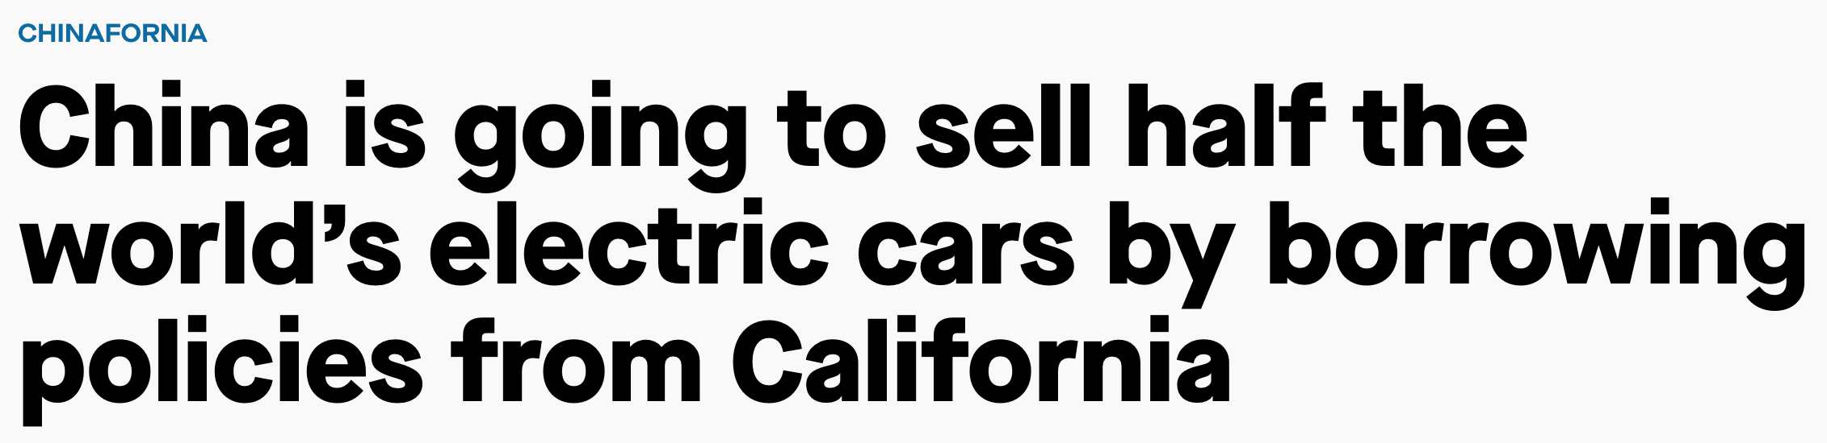
Aggressive policy support on electrical vehicles
Subsidies to both production and consumption ends
  Zero Emission Vehicle Program (automaker credit system)
  Lift plate registration limitations
Potential backfire:
  Primary energy structure needs to be fixed first
  Could be another photovoltaics industry
IEA Global EV Outlook 2017
https://qz.com/1286376/china-is-going-to-sell-half-the-worlds-electric-cars-by-borrowing-policies-from-california/

Slide 19
Energy future of China & the changing world

Slide 20
Steps forward
China to launch its own moon to save energy
Illumination satellites planned by Chengdu City
Reflective coating to harvest energy from the space
Eight times lighter than the moon
Replace conventional street lamps
Save electricity bill
https://www.businesstoday.in/current/world/china-to-launch-its-own-moon-in-the-sky-to-save-energy-light-up-streets/story/285859.html
Notes:
Eliza

Slide 21
China as global leader in combatting climate change?
Dark green: members (regional)
Light green: prospective members (regional)
Dark blue: members (non-regional)
Light blue: prospective members (non-regional)
Asia infrastructure investment bank (AIIB)
Back funding institution of the infrastructure network
One belt, one road
To form infrastructure network and promote energy technology input
http://www.thesmithsophian.com/from-china-hoax-to-china-legend-will-china-be-the-next-global-leader-on-climate-change/
https://www.forbes.com/sites/wadeshepard/2017/07/15/the-real-role-of-the-aiib-in-chinas-new-silk-road/#1c0445df7472
Notes:
Eliza

Slide 22
Crazy Rich Asians?
Movie vs. Reality
Can China stay rich?

Slide 23

Steps backward
“Catching tiger and hidden flies in China’s energy sector”
Nur Bekri, head of the National Energy Administration, was under investigation for suspicious graft.
Officials from China’s oil and coal sector has been among the most high-profile corruption cases
State-owned energy sector produces the largest number of officials and managers under investigation

Slide 24
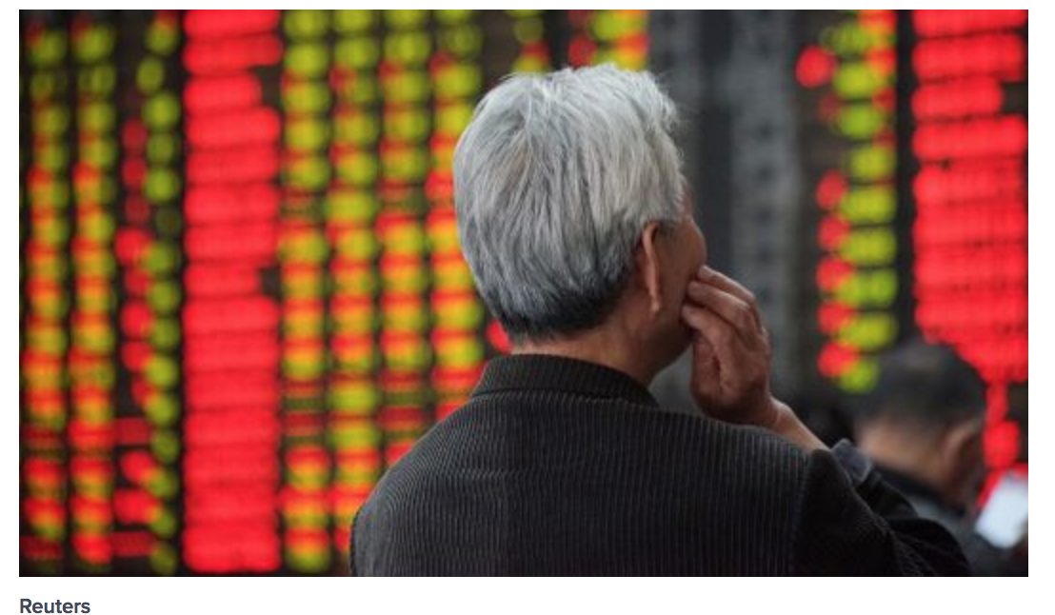
Dangers: trade war
China places tariffs on the natural gas sector
China stocks plunges with heavy selling in the energy sector
https://foreignpolicy.com/2018/09/24/trumps-trade-war-with-china-could-hit-energy-exports/
https://www.cnbc.com/2018/10/18/china-stocks-plunge-amidheavy-selling-in-the-energy-sector-and-growing-worries-about-the-economy.html

Slide 25

Conclusion
China is the largest energy producer and consumer in the world and its energy-related actions can have a large impact on the world.
In the past 5-10 years, China has substantially diversified its energy profile, with the aid of aggressive energy policy
However, the future of China’s energy landscape remains unclear, given the instability factors globally.

Slide 26

Questions?
Thank you!

