Slide 1
Breakthrough Energy: Where Billionaires Invest in the Future
Harvard Energy Journal Club
4/27/2018
Andrew Wong

Slide 2
Breakthrough Energy
“The goal of Breakthrough Energy is to make sure that everyone on the planet can enjoy a good standard of living, including basic electricity, healthy food, comfortable buildings, and convenient transportation, without contributing to climate change. Our strategy links cutting-edge, government-funded research to patient, risk-tolerant capital so that more clean energy innovations get to market faster”
http://www.b-t.energy/ventures/

Slide 3
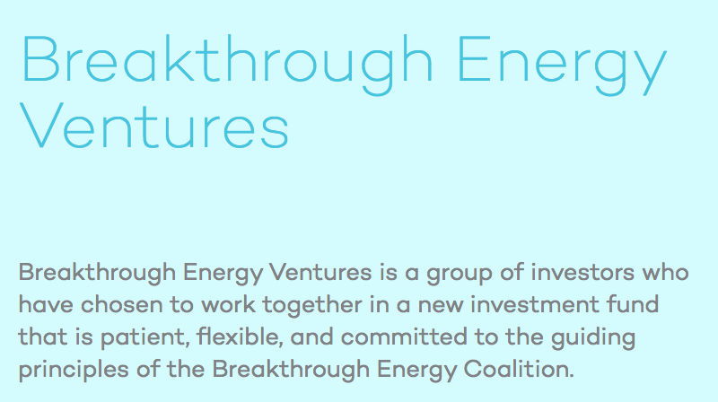
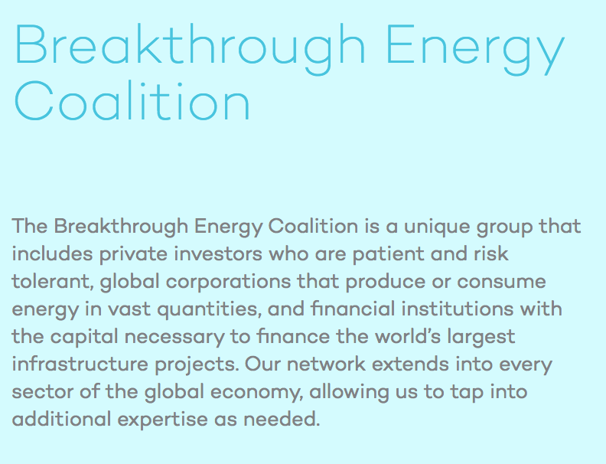
http://www.b-t.energy/

Slide 4
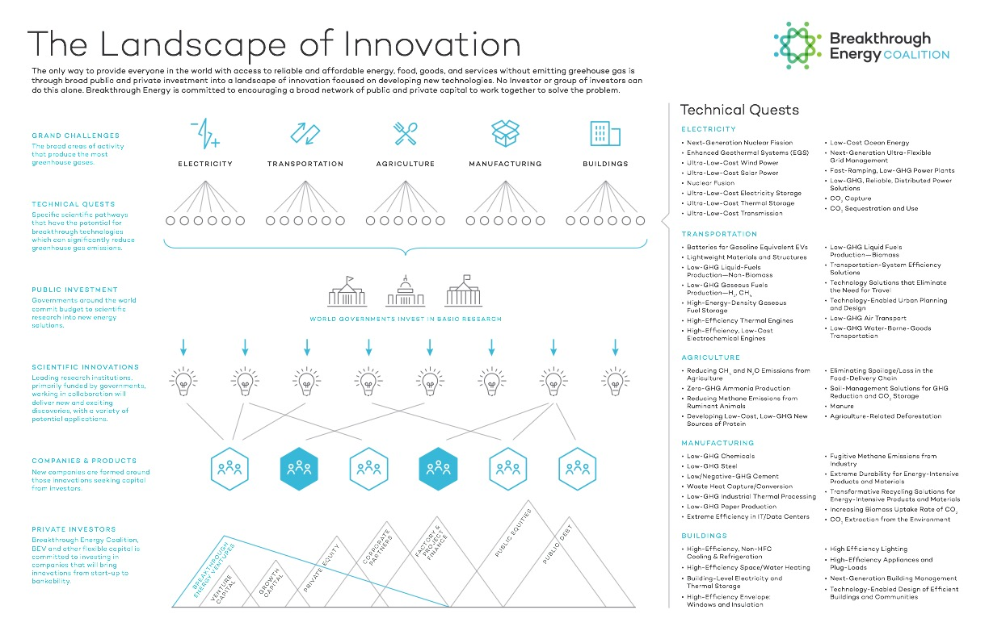
http://www.b-t.energy/landscape/

Slide 5

















Breakthrough Energy Coalition: Companies & Institutions
Energy Impact Partners
http://www.b-t.energy/coalition/who-we-are/
Notes:
Breakthrough Energy Ventures
Purdue Ventures
E-leaf (Energy Impact Partners) – investment company
Virgin Group
Energy Impact Partners – British Multinational VC
Wheatsheaf Group – Agricultural development and investment
BNP Parbais - Banking
ARC – African Rainbow Capital – investment mining
ARM – African Rainbow Minerals – mining company in South Africa
Oil and Gas Climate Initiative (OGCI) – 10 oil and gas companies grouped to lower GHG – have climate investment fund
Total Group – 4th largest oil and gas company
Reliance Industries Ltd. – Indian conglomerate holding company (many sectors)
General Electric – multinational conglomerate
Microsoft – software
SAP SE - software
National Grid – British multinational electricity and gas utility
Engie – energy services
University of California - education

Slide 6
Breakthrough Energy Coalition: Individuals (all, *partner company, +board)
Mukesh Ambani*+ – Chairman & Managing Director – Reliance Industries Limited (India)
John Arnold+ (BEC co-chair) – Laura & John Arnold Foundation (USA)
Marc Benioff – Founder, Chairman & CEO – Salesforce.com (USA)
Jeff Bezos+ – Founder & CEO – Amazon (USA)
HRH Prince Alwaleed bin Talal+ – Chairman – Alwaleed Philanthropies (Saudi Arabia)
Michael Bloomberg+ – CEO – Bloomberg LP (USA)
Richard Branson+ – Founder – Virgin Group (UK)
Ray Dalio+ – Founder – Bridgewater Associates (USA)
Aliko Dangote – Founder & Chief Executive – Dangote Group (Nigeria)
John Doeer+ – Chairman – Kleiner Perkins Caulfield & Byers (USA)
Bill Gates*+ (BEC co-chair) – Bill & Melinda Gates Foundation (USA)
Reid Hoffman+ – co-founder – LinkedIn (USA)
Chris Hon+ – Founder – The Children’s Investment Fund (UK)
Vinod Khosla+ – Founder – Khosla Ventures (USA)
Jack Ma+ – Executive Chairman – Alibaba Group (China)
Dustin Moskovitz & Cari Tuna+ – Co-founders – Good Ventures (USA)
Patrice Motsepe*+ – Founder & Executive Chairman – African Rainbow Minerals (South Africa)
Xavider Niel+ – Founder – Iliad Group – (France)
Hasso Plattner*+– Co-founder – SAP SE (Germany)
Julian Robertson+ – Founder & Chairman – Tiger Management (USA)
Neil Shen – Founding Managing Partner – Sequoia Capital China (China)
Nat Simons & Laura Baxter Simons*+ – Co-founders – Prelude Ventures (USA)
Masayoshi Son+ – Founder, Chairman & CEO – SoftBank Group Corp. (Japan)
George Soros – Chairman – Soros Fund Management LLC (USA)
Tom Steyer – Businessman, Philanthropist, President – NextGen Climate (USA)
Ratan Tata – Chairman Emeritus – Tata Sons (India)
Megan Whitman – CEO – Hewlett Packard Enterprise (USA)
Ms. Zhang Xin & Mr. Pan Shiyi+ – Co-founder & CEO, SOHO Chairman – SOHO China (China)
Mark Zuckerberg & Dr. Priscilla Chan – Founder, Chairman & CEO – Facebook/Pediatrician & CEO – The Primary School (USA)
http://www.b-t.energy/coalition/who-we-are/

Slide 7
Breakthrough Energy Coalition: Individuals (partner company)
Mukesh Ambani* – Chairman & Managing Director – Reliance Industries Limited (India)
Bill Gates* (BEC co-chair) – Bill & Melinda Gates Foundation (USA)
Patrice Motsepe* – Founder & Executive Chairman – African Rainbow Minerals (South Africa)
Hasso Plattner* – Co-founder – SAP SE (Germany)
http://www.b-t.energy/coalition/who-we-are/

Slide 8
Breakthrough Energy Coalition: Individuals (select)
John Arnold (BEC co-chair) – Laura & John Arnold Foundation (USA)
Marc Benioff – Founder, Chairman & CEO – Salesforce.com (USA)
Jeff Bezos – Founder & CEO – Amazon (USA)
HRH Prince Alwaleed bin Talal – Chairman – Alwaleed Philanthropies (Saudi Arabia)
Michael Bloomberg – CEO – Bloomberg LP (USA)
Ray Dalio – Founder – Bridgewater Associates (USA)
Reid Hoffman – co-founder – LinkedIn (USA)
Jack Ma – Executive Chairman – Alibaba Group (China)
Ratan Tata – Chairman Emeritus – Tata Sons (India)
Mark Zuckerberg & Dr. Priscilla Chan – Founder, Chairman & CEO – Facebook/Pediatrician & CEO – The Primary School (USA)
http://www.b-t.energy/coalition/who-we-are/

Slide 9
Breakthrough Energy Coalition: Individuals (by country)
Neil Shen – Founding Managing Partner – Sequoia Capital China (China)
Jack Ma – Executive Chairman – Alibaba Group (China)
Ms. Zhang Xin & Mr. Pan Shiyi – Co-founder & CEO, SOHO Chairman – SOHO China (China)
Xavider Niel – Founder – Iliad Group – (France)
Hasso Plattner* – Co-founder – SAP SE (Germany)
Ratan Tata – Chairman Emeritus – Tata Sons (India)
Mukesh Ambani* – Chairman & Managing Director – Reliance Industries Limited (India)
Masayoshi Son – Founder, Chairman & CEO – SoftBank Group Corp. (Japan)
Aliko Dangote – Founder & Chief Executive – Dangote Group (Nigeria)
HRH Prince Alwaleed bin Talal – Chairman – Alwaleed Philanthropies (Saudi Arabia)
Patrice Motsepe* – Founder & Executive Chairman – African Rainbow Minerals (South Africa)
Richard Branson – Founder – Virgin Group (UK)
Chris Hon – Founder – The Children’s Investment Fund (UK
John Arnold (BEC co-chair) – Laura & John Arnold Foundation (USA)
Marc Benioff – Founder, Chairman & CEO – Salesforce.com (USA)
Jeff Bezos – Founder & CEO – Amazon (USA)
Michael Bloomberg – CEO – Bloomberg LP (USA)
Ray Dalio – Founder – Bridgewater Associates (USA)
John Doeer – Chairman – Kleiner Perkins Caulfield & Byers (USA)
Bill Gates* (BEC co-chair) – Bill & Melinda Gates Foundation (USA)
Reid Hoffman – co-founder – LinkedIn (USA)
Vinod Khosla – Founder – Khosla Ventures (USA)
Dustin Moskovitz & Cari Tuna – Co-founders – Good Ventures (USA)
Julian Robertson – Founder & Chairman – Tiger Management (USA)
Nat Simons & Laura Baxter Simons* – Co-founders – Prelude Ventures (USA)
George Soros – Chairman – Soros Fund Management LLC (USA)
Tom Steyer – Businessman, Philanthropist, President – NextGen Climate (USA)
Megan Whitman – CEO – Hewlett Packard Enterprise (USA)
Mark Zuckerberg & Dr. Priscilla Chan – Founder, Chairman & CEO – Facebook/Pediatrician & CEO – The Primary School (USA)
http://www.b-t.energy/coalition/who-we-are/

Slide 10
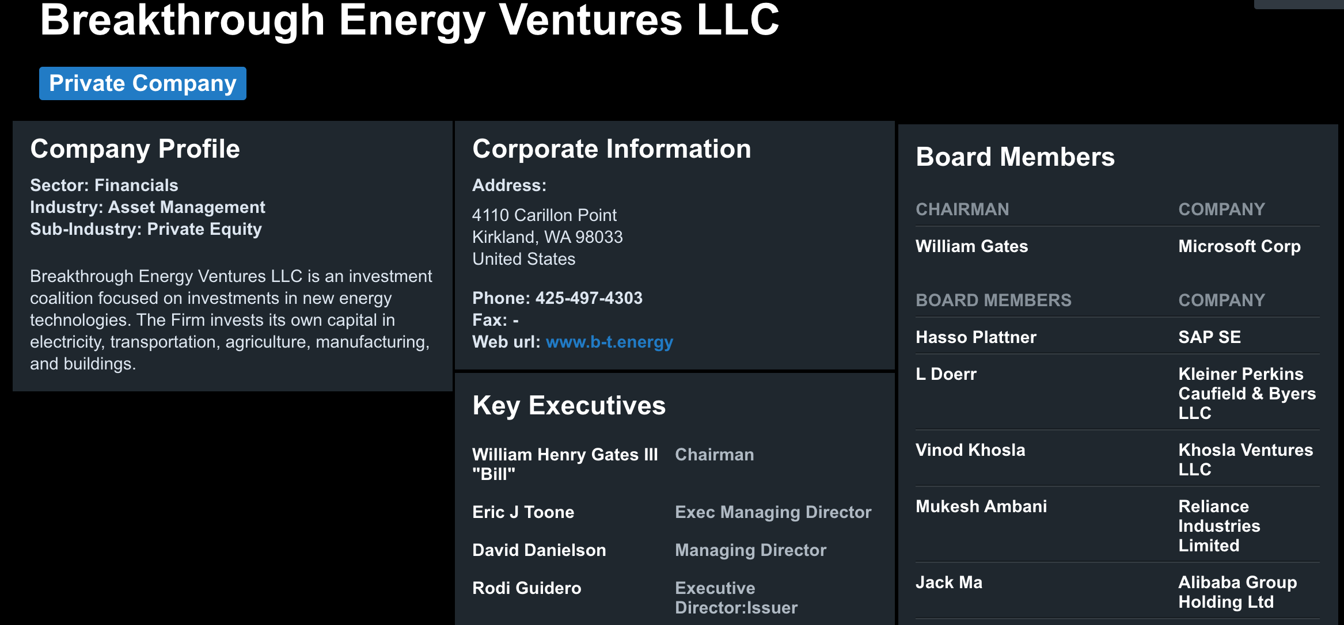
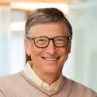
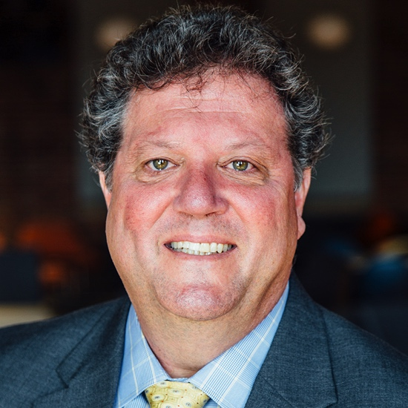
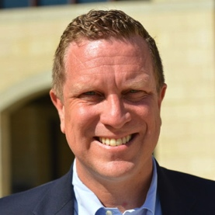
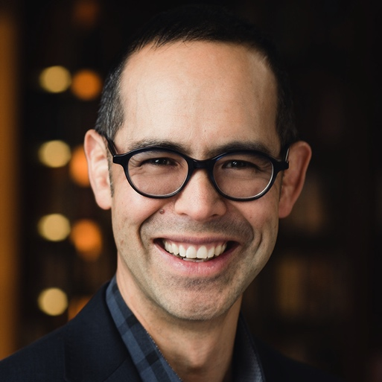
https://www.bloomberg.com/profiles/companies/1475104D:US-breakthrough-energy-ventures-llc

Slide 11
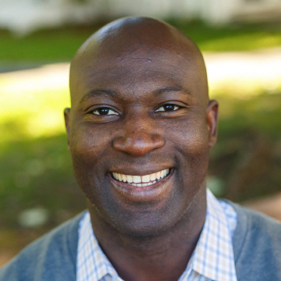
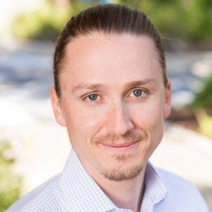

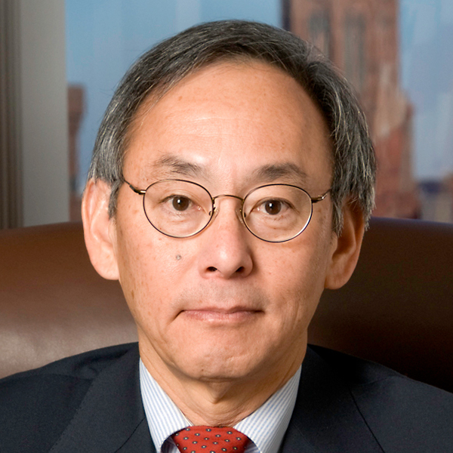
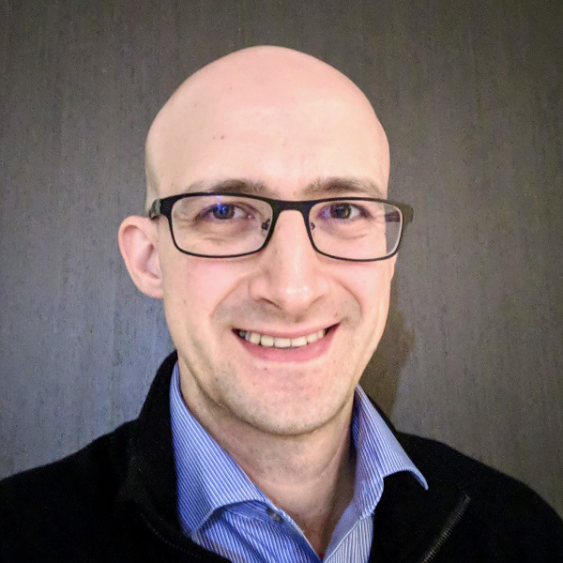
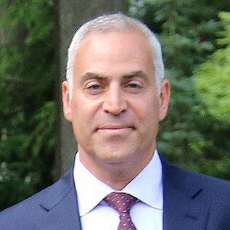
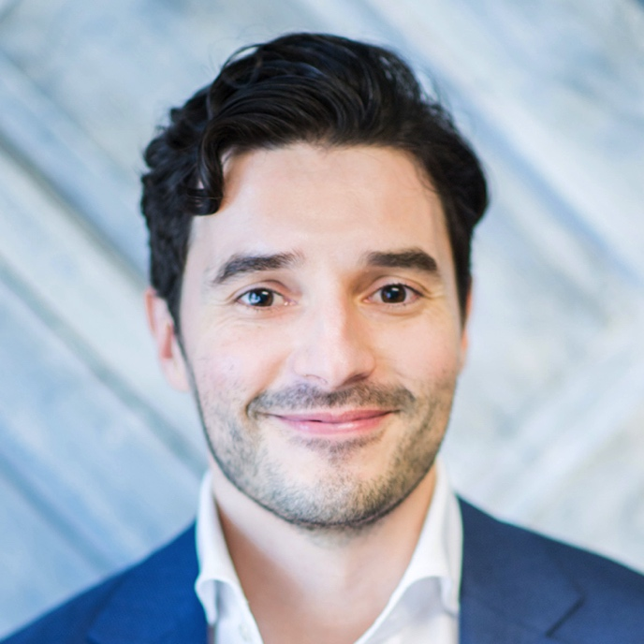
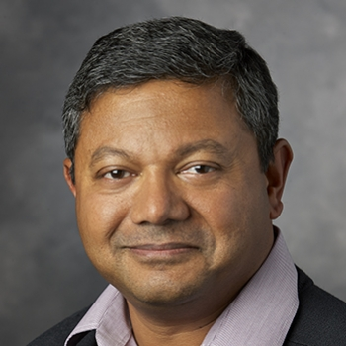
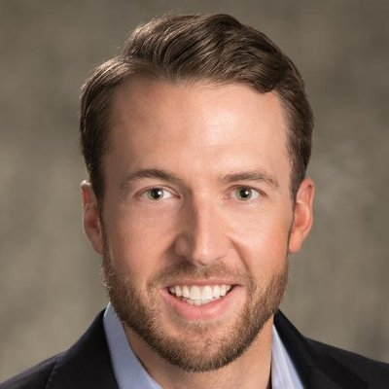
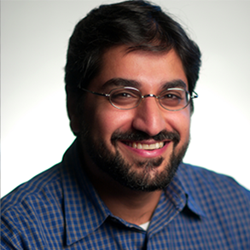
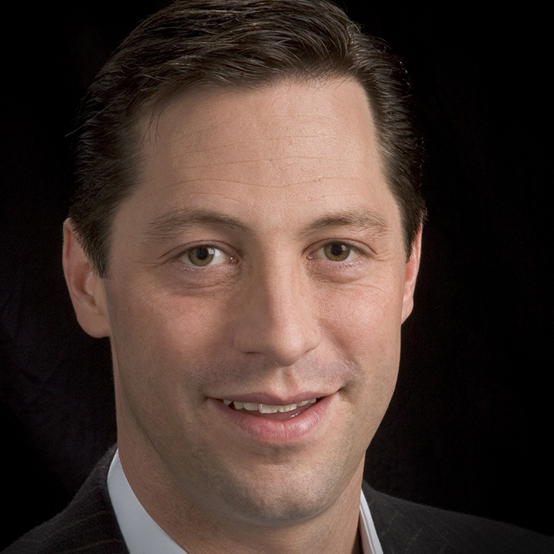
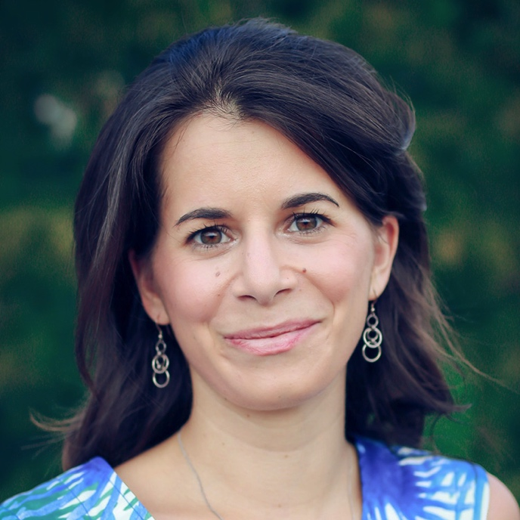
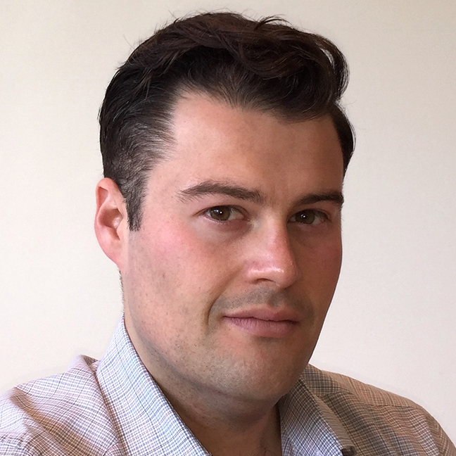
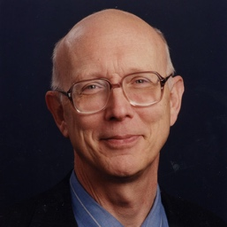
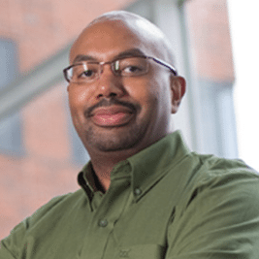
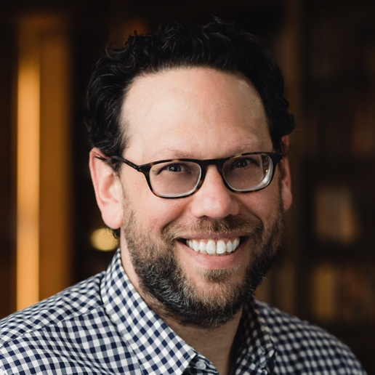
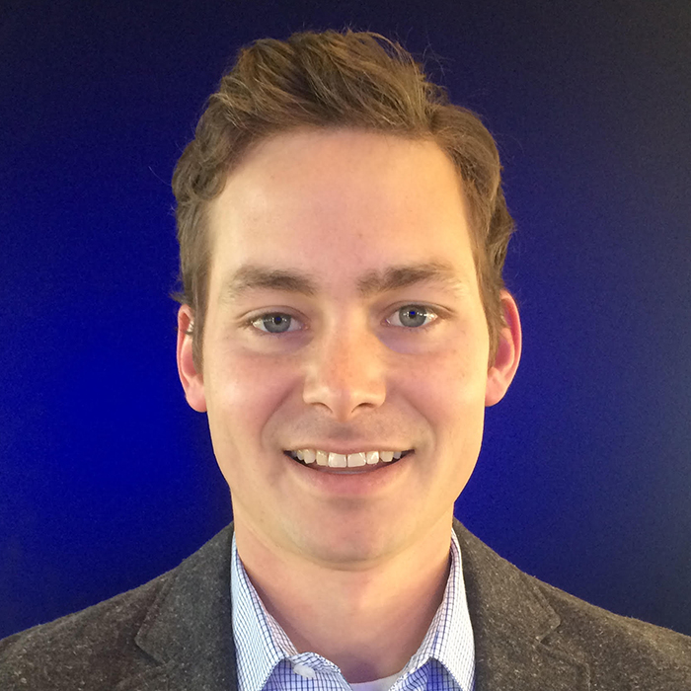
Breakthrough Energy Ventures: Team (* w/Gates Foundation)
Entrepreneurs
Finance/Investment
Professors + DOE
Bunmi Adekore
Bhargavi Chevva
P. Steven Chu
Chris Rivest
Phil Larochelle*
Christian Garcia*
P. Arun Majumdar
Adam Wallen
Joel Moxley
Rhodi Guidero*
P. Rajeev Ram
Chris Poirier
Christina Karapataki
P. Eric Toone
Cooper Rinzler
P. George Whitesides
Policy + Science
Carmichael Roberts
Jonah Goldman*
David Danielson
Peter Turner

Slide 12
3-BEV Team Members
Bhargavi Chevva
Cooper Rinzler
Carmichael Roberts

Slide 13
Multinational
Interdisciplinary
Coalition

Slide 14

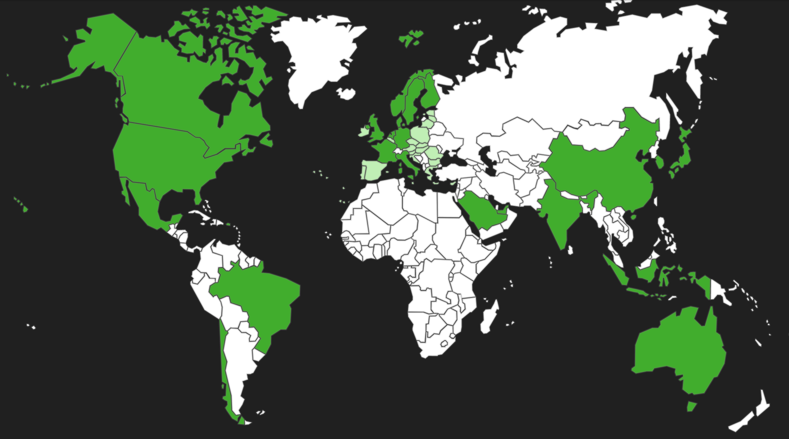

Slide 15
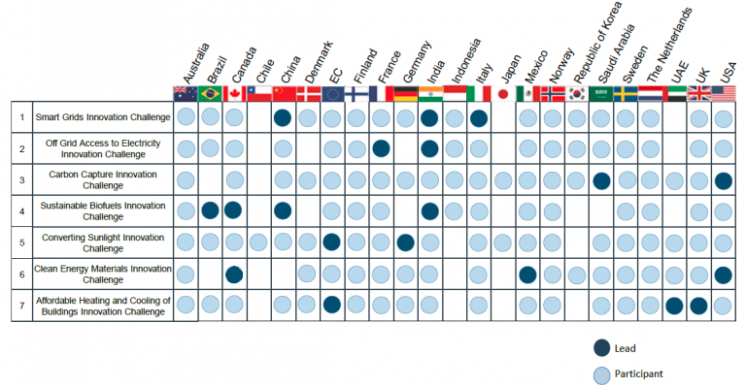

Slide 16

DOE Innovation Hubs
Critical Materials Hub
Consortium for Advanced Simulation of Light Water Reactors
Join Center for Artificial Photosynthesis
Joint Center for Energy Storage Research
Notes:
Critical Materials Hub
Consortium for Advanced Simulation of Light Water Reactors
Join Center for Artificial Photosynthesis
Joint Center for Energy Storage Research

Slide 17





BEV: Trends
Rise of very low-cost intermittent electricity
The emergence of a burgeoning middle class
Increasing urbanization
Autonomy, The Internet of Things (IOT), Distributed Everything
Ample supply of fossil resources
BEV: Investment Criteria
Climate impact
Other investors
Scientific possibility
Filling the gaps
http://www.b-t.energy/ventures/

Slide 18

Breakthrough Energy: Grand Challenges
Liquid Fuel
Grid Scale Energy Storage
Alternative Building Materials
Micro/Mini Grids
Geothermal
BEV: Initial Areas of Focus

Slide 19






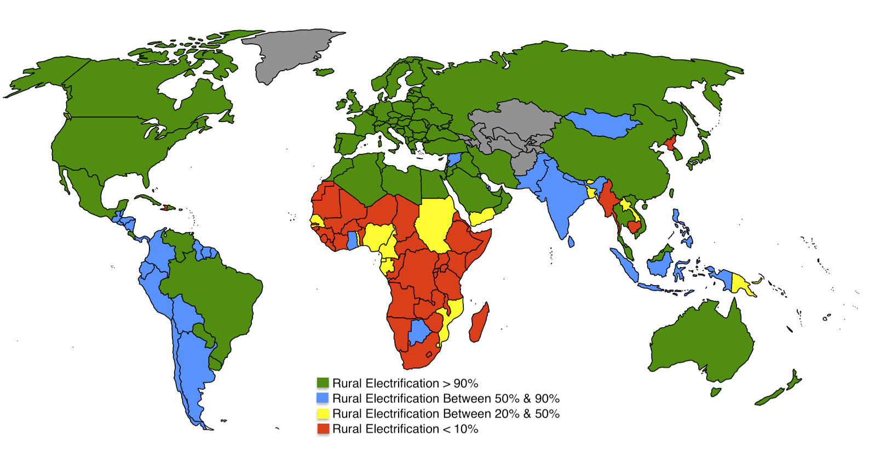










Alternative Building Materials
Geothermal
Liquid Fuels
Micro/Mini-Grids
Grid Scale Energy Storage
https://www.greentechmedia.com/articles/read/breakthrough-energy-ventures-investment-strategy#gs.Mn=JC2w
Notes:
Sakti – Dyson owns

Slide 20
Thank you
Discussion of the Grand Challenges

Slide 21
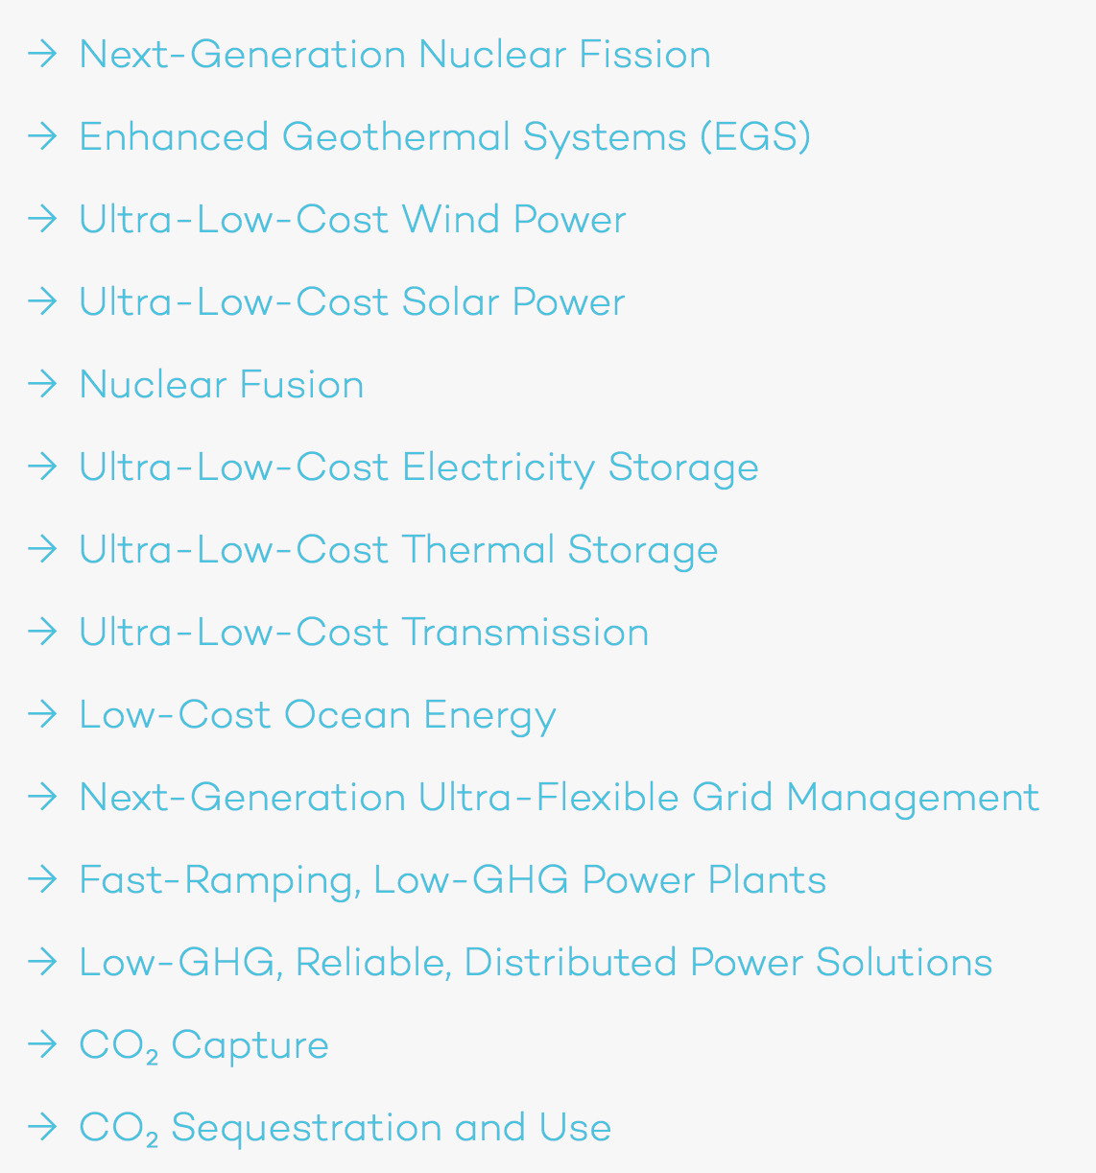
Grand Challenge: Electricity
http://www.b-t.energy/landscape/electricity/

Slide 22
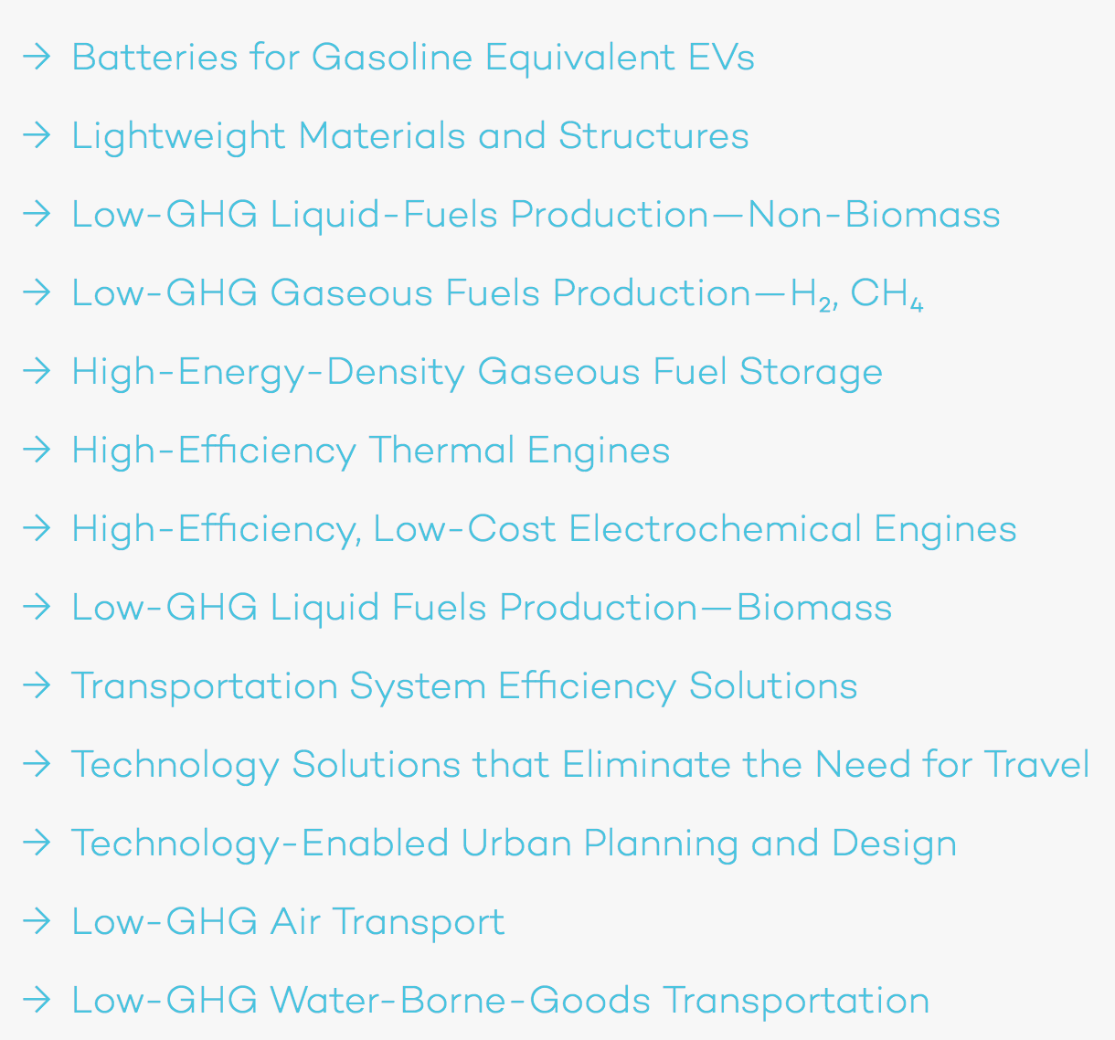
Grand Challenge: Transportation
http://www.b-t.energy/landscape/transportation/

Slide 23
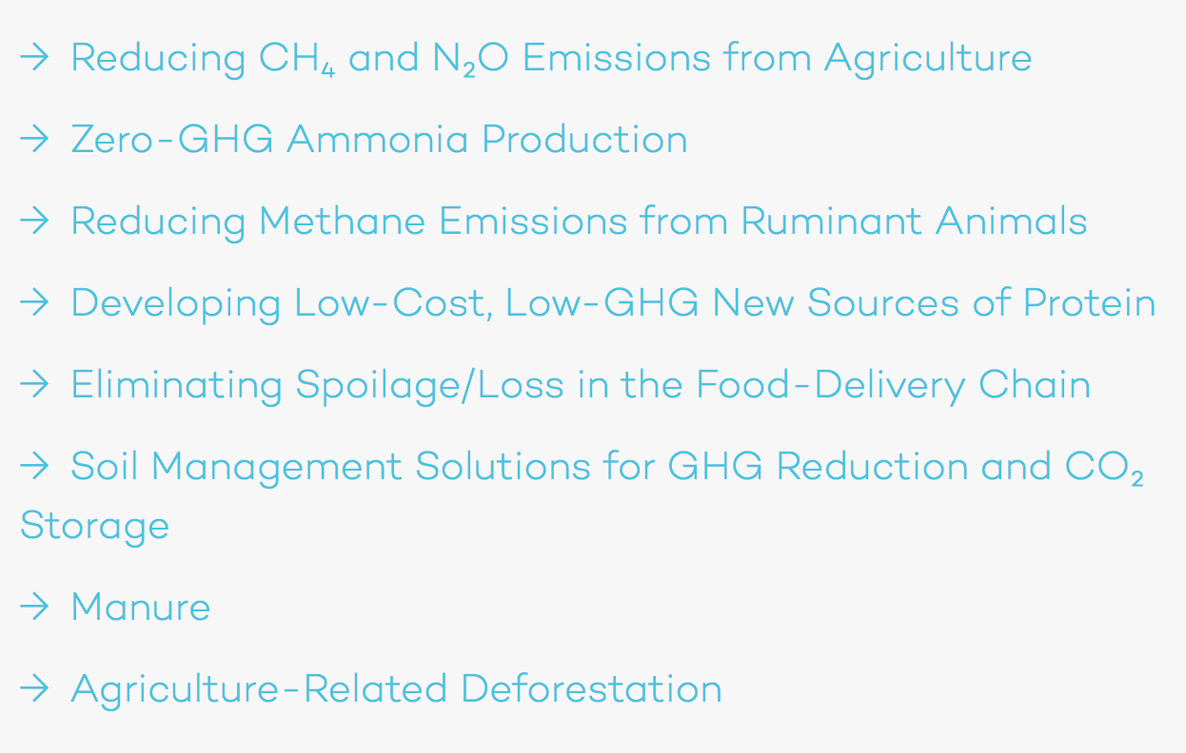
Grand Challenge: Agriculture
http://www.b-t.energy/landscape/agriculture/

Slide 24
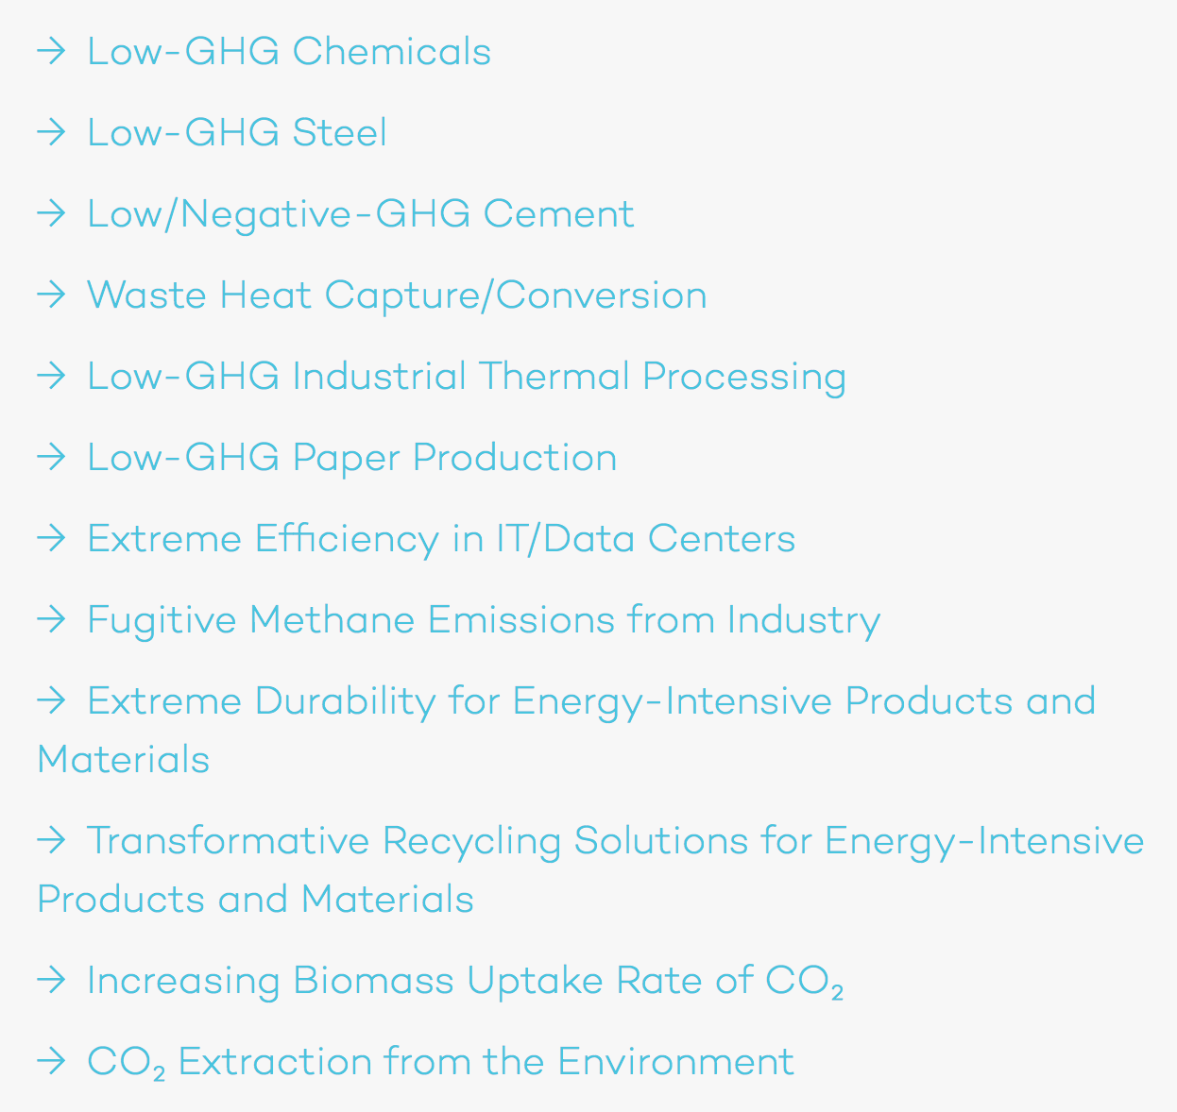
Grand Challenge: Manufacturing
http://www.b-t.energy/landscape/manufacturing/

Slide 25
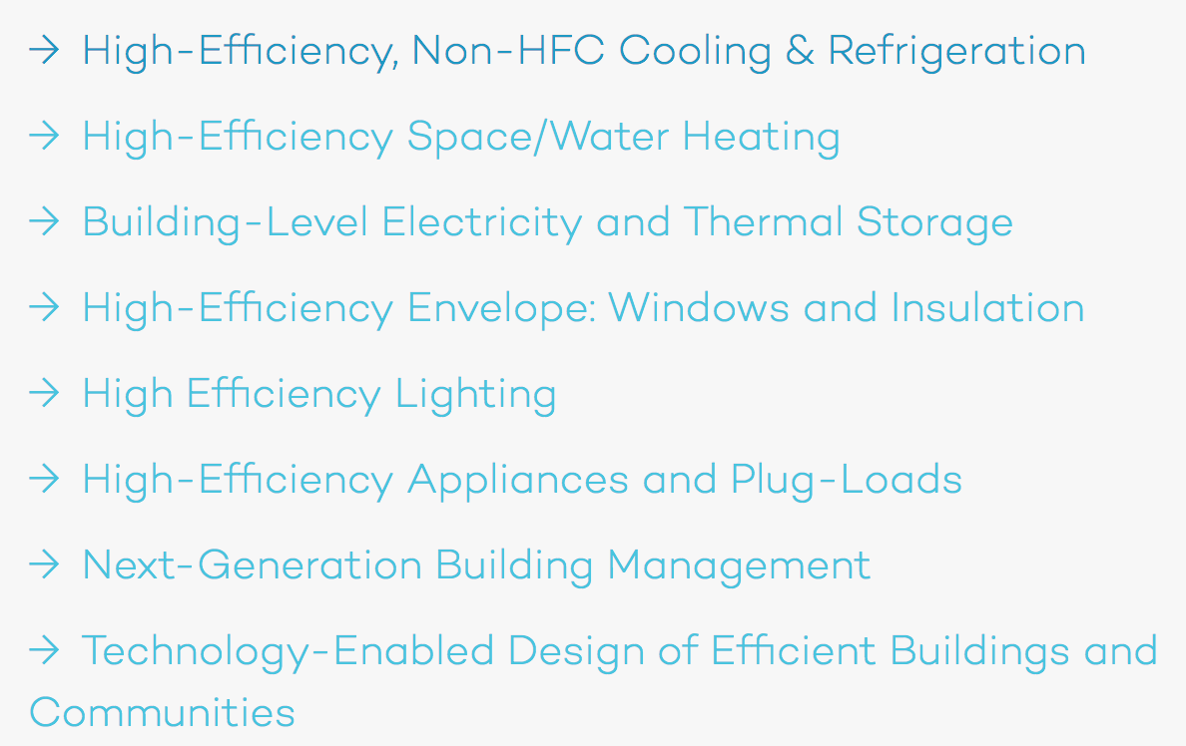
Grand Challenge: Buildings
http://www.b-t.energy/landscape/buildings/

