Slide 1
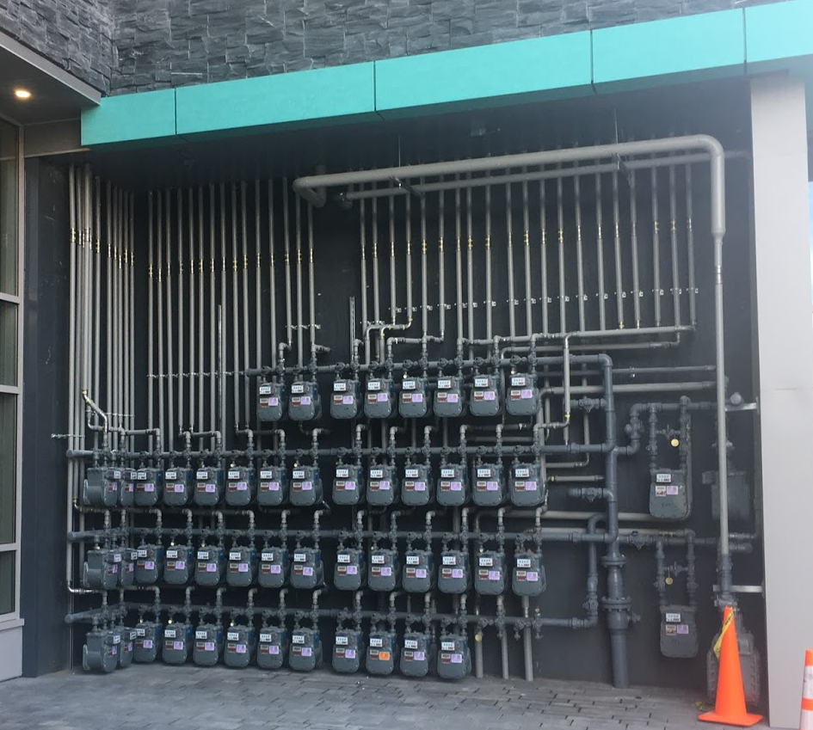
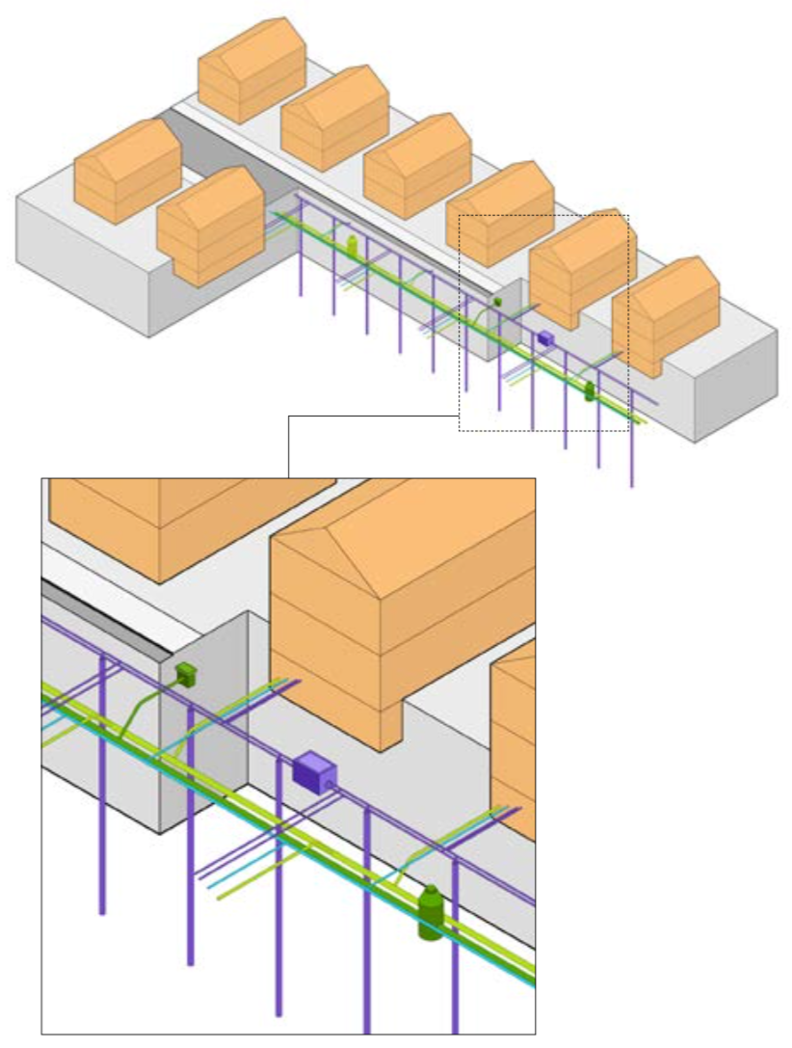
GeoMicroDistricts
Amos Meeks
Harvard Energy Journal Club
2/7/20

Slide 2
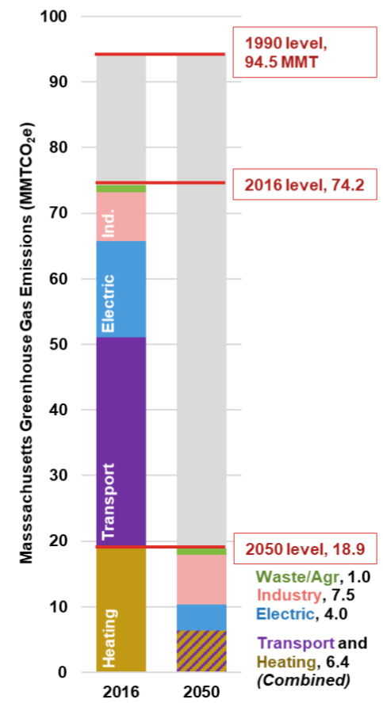
There is a legal requirement to get off fossil fuels in the next 30 years.
2018 Natural Gas Use in MA
Applied Economics Clinic Policy Brief, December 2019
Net Zero, 2050
https://www.eia.gov/dnav/ng/NG_CONS_SUM_DCU_SMA_A.htm
Notes:
Ability to balance heating and cooling loads over space and time, e.g. hocky rinks and grocery stores.

Slide 3
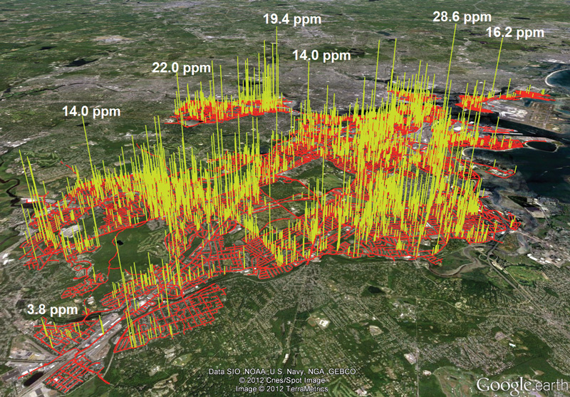
Existing natural gas infrastructure is old and leaky

Slide 4
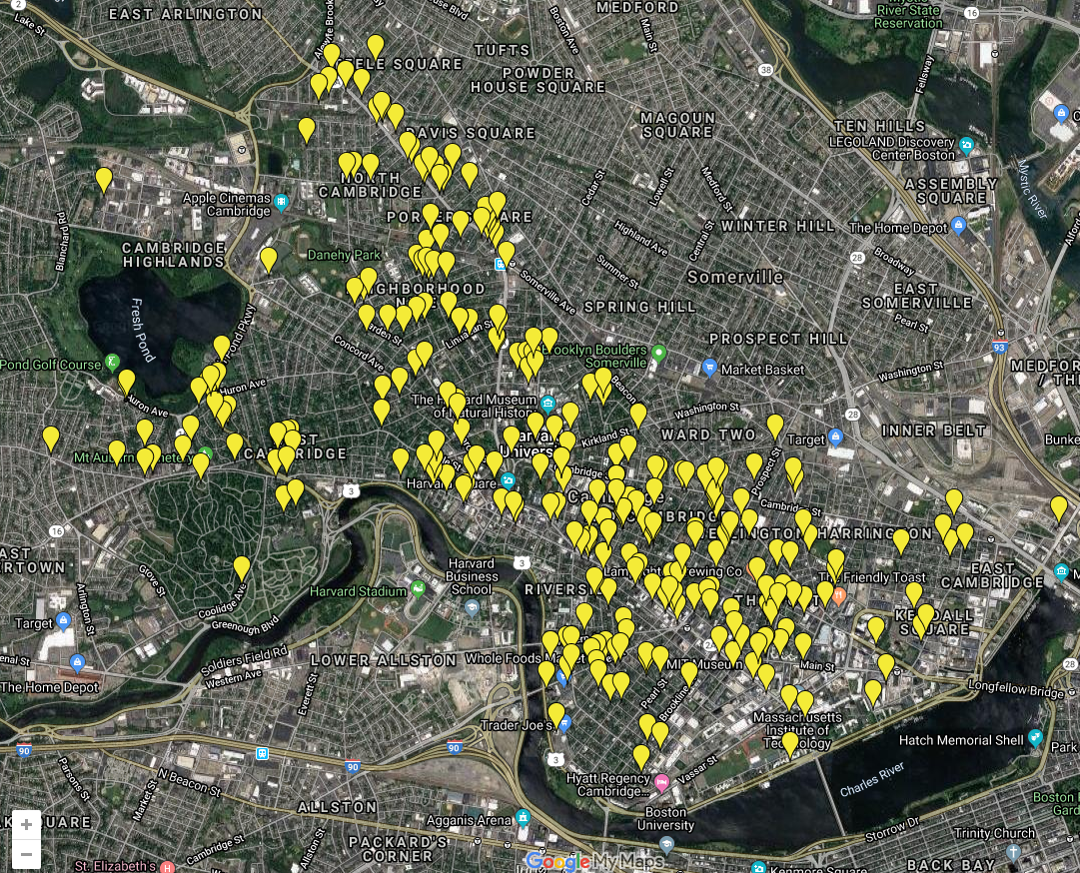

Slide 5

Estimated cost to repair: $9,000,000,000

Slide 6



Local nonprofit HEET commissioned a report to look at the idea of a GeoMicroDristrict
Notes:
HEET Budget is less than $200,000 per year.

Slide 7
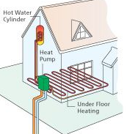
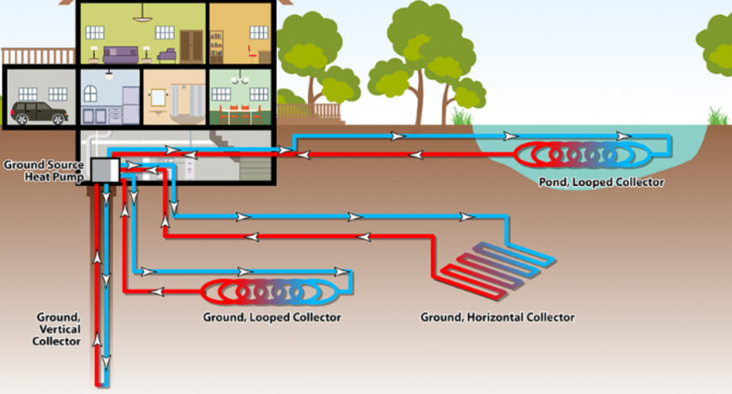
GeoMicroDistricts promise clean, utility-scale building climate control
Notes:
Caveats: Very preliminary study
Note: It would provide cooling in addition to heating! Very important as we transition from heating-dominated to cooling-dominated in the next 50 years.

Slide 8
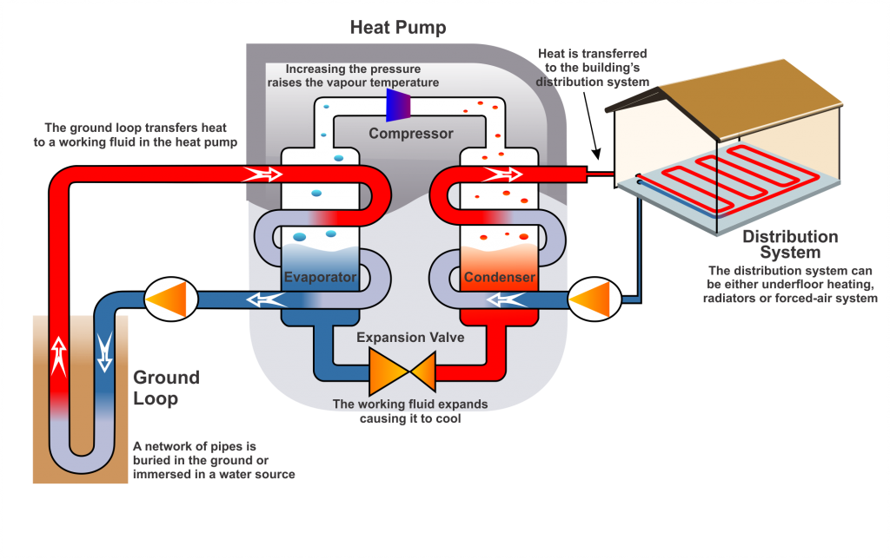
Heat pumps are just a reversible refrigeration cycle
http://tidewatermechanical.com/geothermal-heat-pumps/

Slide 9
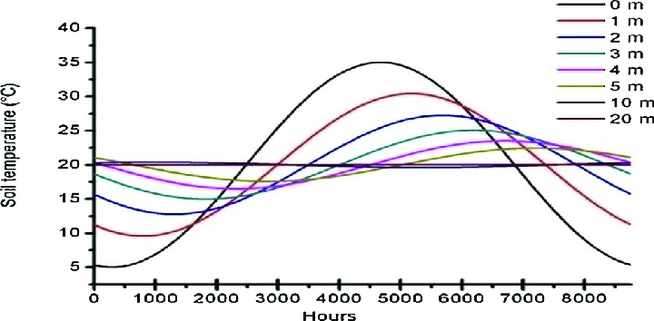
Ground provides nearly constant temperature all year
Benzaama, Mohammed-Hichem et al. (2018). Investigation of the thermal behavior of a combined geothermal system for cooling with regards to Algeria’s climate. Sustainable Cities and Society. 43. 10.1016/j.scs.2018.08.016.
Notes:
GSHP wells are usually 100 to 500 ft. Trench wells may only be a couple of meters, which provides some benefit but not nearly as much

Slide 10
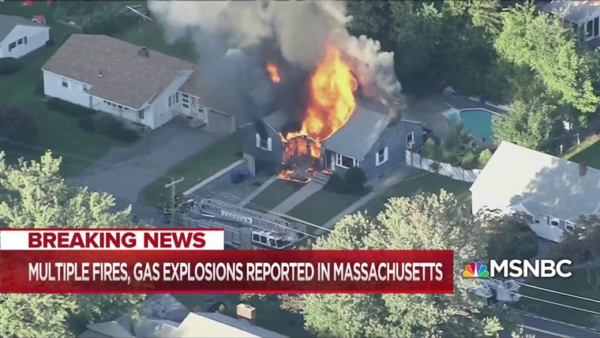
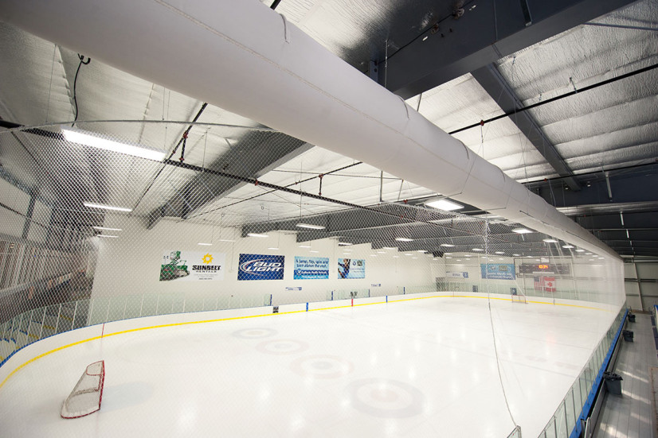
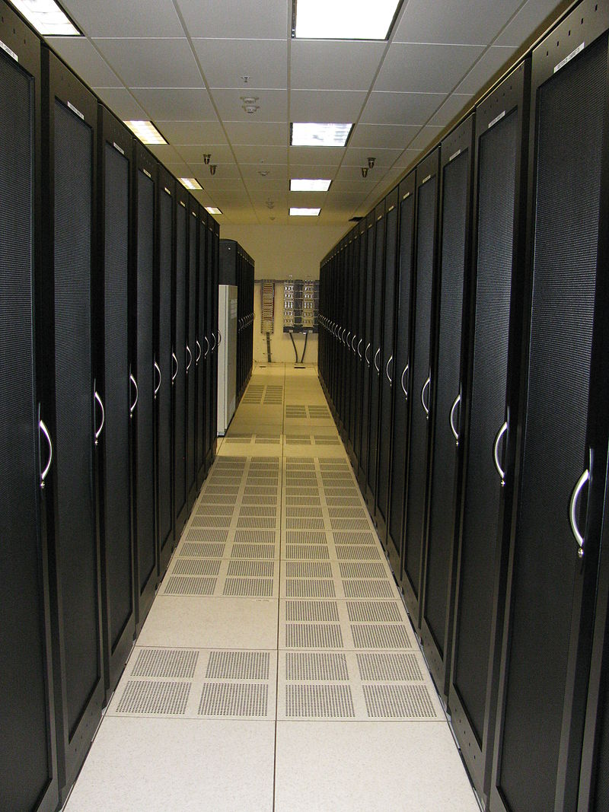
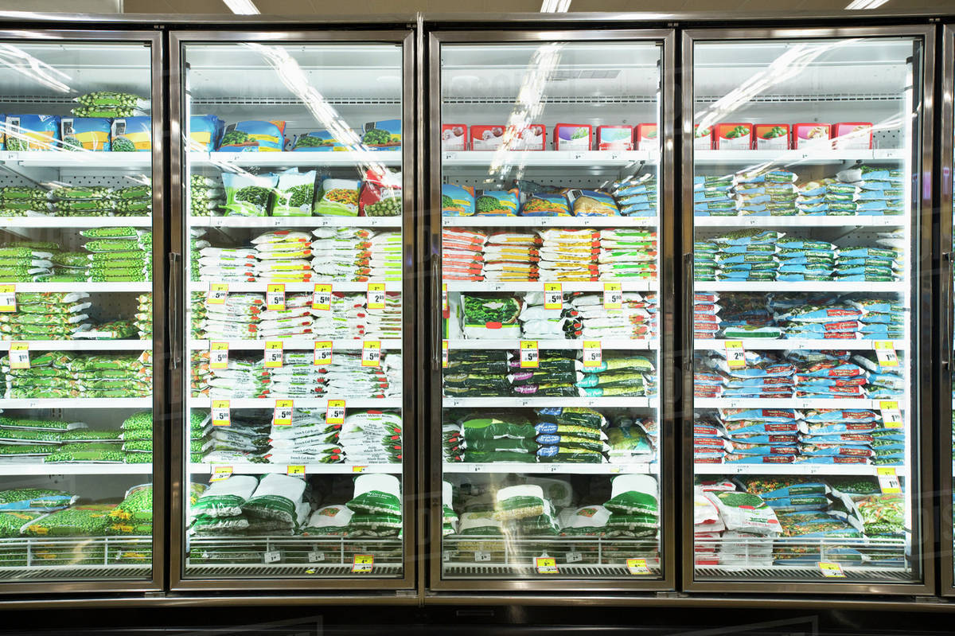
Increased Safety
Greatly reduced emissions
Capture of waste heat
Notes:
CO2 emissions only from materials and electricity
Safety
Facilitates use of waste heat from e.g. data centers, supermarkets, ice rinks, etc.

Slide 11
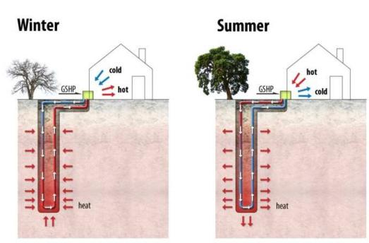
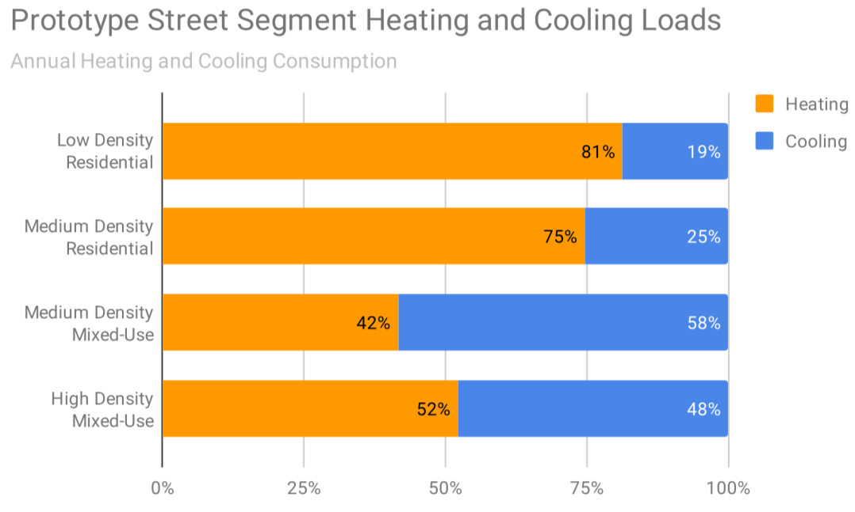
Annual heating and cooling loads must be balanced
=

Slide 12
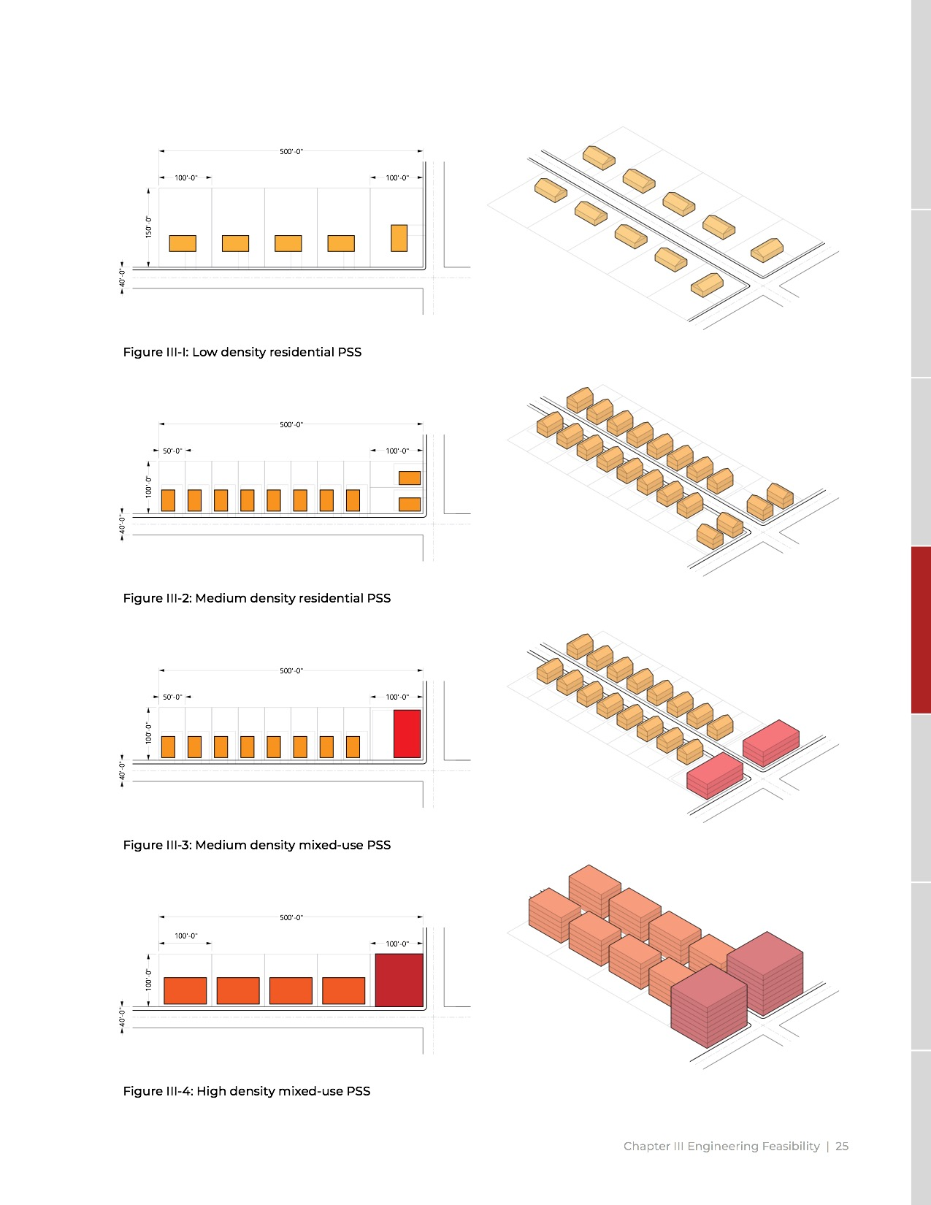
Modeling was done with four prototypical street types

Slide 13
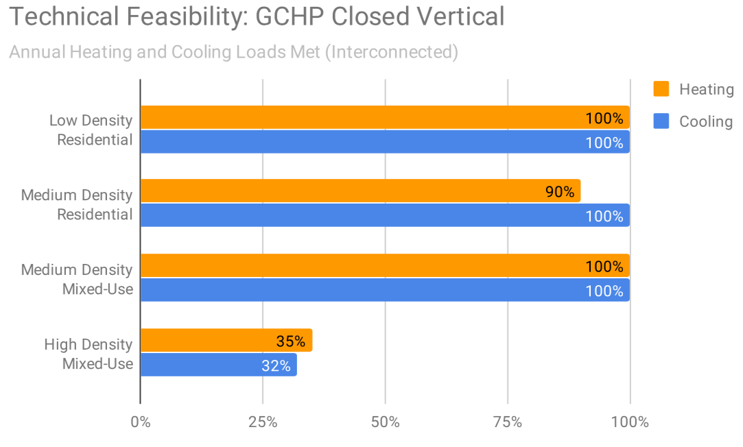
Model suggests that GMDs can meet heating and cooling loads in all cases except high-density
Notes:
Load met goes up for mixed use because of waste heat use.

Slide 14
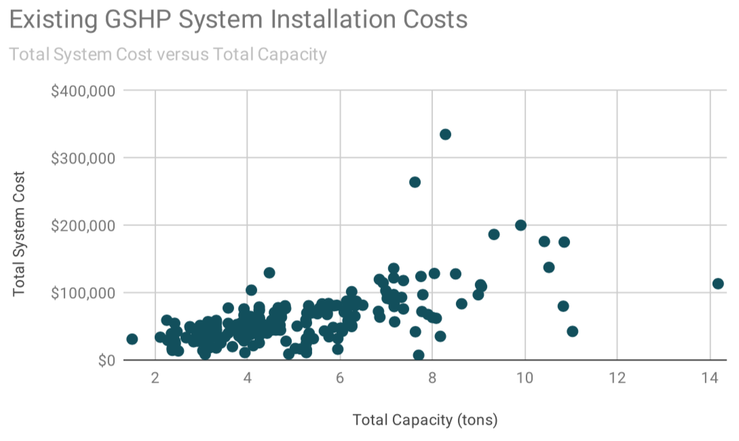
Installation costs vary but are ≈$10,000/ton
Notes:
the rate of heat transfer that results in the freezing (*or melting) of 1 short ton (2,000 lb; 907 kg) of pure ice at 0 °C (32 °F) in 24 hours. A refrigeration ton is approximately equivalent to 12,000 BTU/h or 3.5 kW. $10,000/ton ~= $3,000/kW.

Slide 15
Installation costs are dominated by borehole drilling

Slide 16
Operating costs are driven by backup heating/cooling needed for load balancing

Slide 17
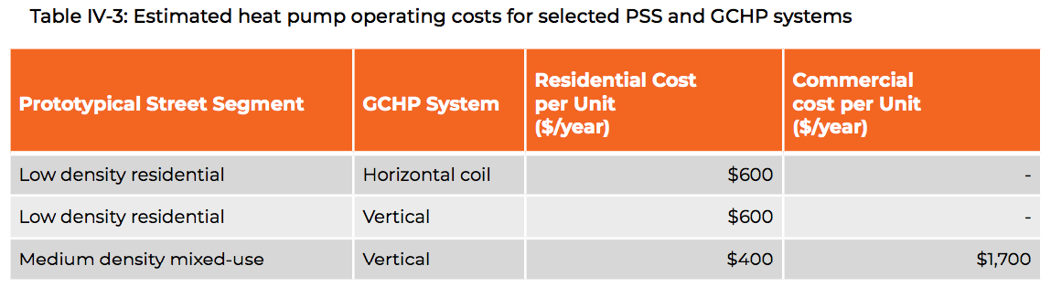
Operating costs are comparable to natural gas heating
Cost to heat the average MA home with natural gas is about $1,000/year
https://www.mass.gov/info-details/household-heating-costs

Slide 18
Total conversion costs are comparable to gas infrastructure maintenance costs
Conversion costs per building ≈$10³-10⁵
Number of buildings in MA ≈10⁶
Total conversion cost ≈$10⁹-10¹¹
Gas system maintenance costs ≈$10¹⁰
Notes:
Order 10^6 buildings in MA. Costs range from 10^3 to 10^5, so total cost range 10^9 to 10^11.

Slide 19
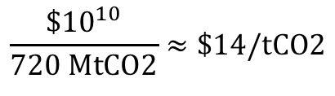
System conversion could pay for itself with a reasonable carbon price
Eventual reduction by about a factor of 10
Heating emissions currently 20 MtCO2/yr -> Reduction of 18 MtCO2/yr
$$\frac{\${10}^{10}}{720 MtCO2}≈\$14/tCO2$$
Assuming 40 year lifetime: 40 yrs* 18 MtCO2/yr = 720 MtCO2
Notes:
Heating ~20 MTCO2/yr. Lifetime ~40 years, so 800 MTCO2. Lets say this reduces emissions by an order of magnitude, so about 720 MTCO2. Let’s say cost is about $10^10. That’s about $10^1/tCO2 -> Reasonable! Sugggests that carbon abatement alone could pay for the transition, even without accounting for the needed benefits of heating and cooling.

Slide 20
GMD will be tested in MA in the next few years
Jan 3 2020: Eversource submitted a rate case to do three pilots over three years. Currently in review by the MA DEP, up to 8 months.
Legislation recently passed by the state senate would specifically authorize utilities to pursue this.

Slide 21
Conclusions
Initial feasibility study suggest that the GeoMicroDistrict is a potential low-emission way to provide building climate control for reasonable cost
Questions
How to provide carbon-free heating and cooling for high-density urban centers?
How should implementation be staged and incentivized?
How to get private building owners to change (energy efficiency upgrades + heat pump installation)?

