Slide 1
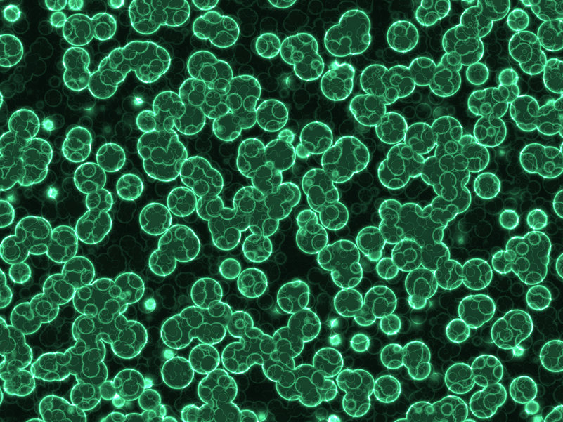
Biophotovoltaics using natural photosynthesis for direct energy production
Eliza Spear
HEJC
2021-02-19
Notes:
Image source: https://singularityhub.com/2018/06/04/how-cyanobacteria-could-help-save-the-planet/

Slide 2
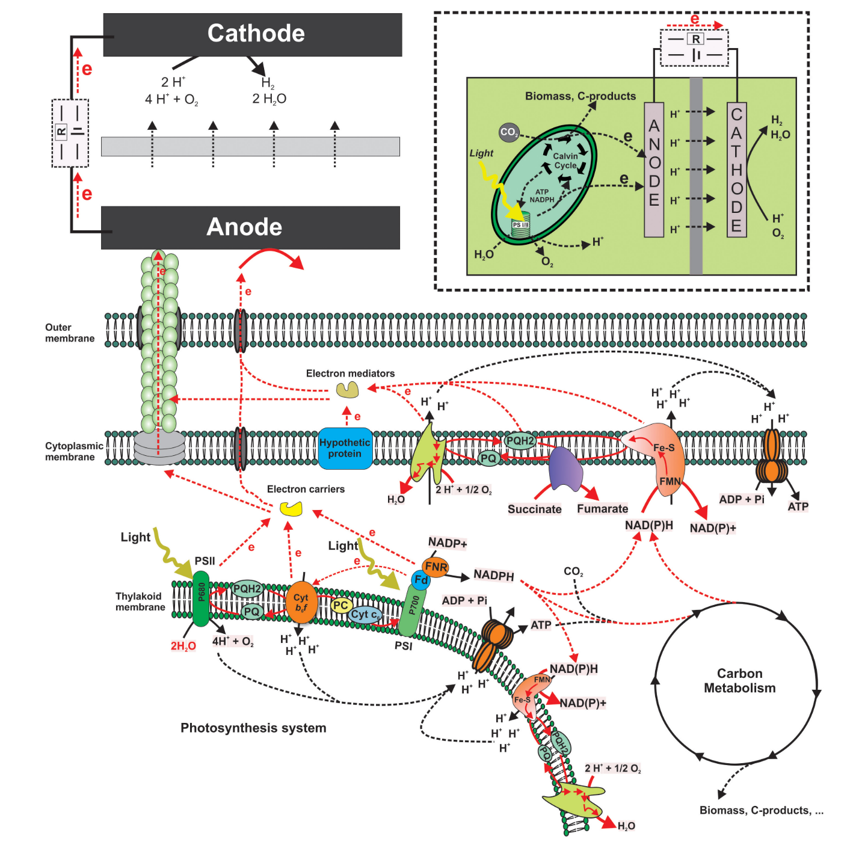
What are biophotovoltaics?
Relatively new discipline in microbial fuel cell research
Basic idea: convert light energy into electrical energy using photosynthetic microorganisms (use natural photosynthesis for direct energy production)
Water is the electron source
Tschörtner, J.; Lai, B.; Krömer, J. O. Frontiers in Microbiology 2019, 10, 866.

Slide 3
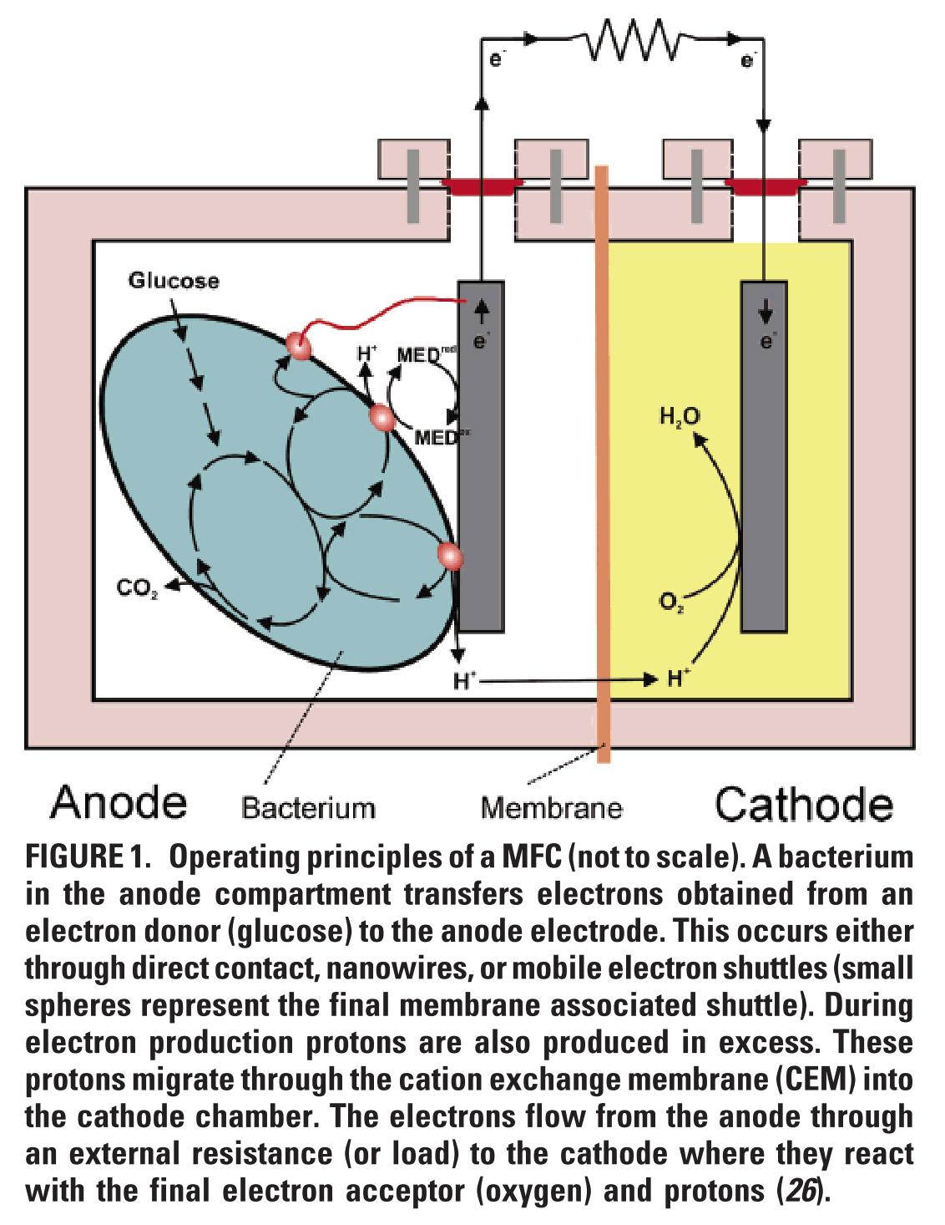
Microbial fuel cells and biophotovoltaics
Fuel cells: use metal catalysts to oxidize fuel (hydrogen, methanol)
Microbial fuel cells: use bacteria as catalysts to oxidize organic and inorganic matter (e.g. glucose) and generate current (image at right)
Biophotovoltaics: subset of microbial fuel cells where photosynthetic bacteria use light to split water
Tschörtner, J.; Lai, B.; Krömer, J. O. Frontiers in Microbiology 2019, 10, 866.

Slide 4
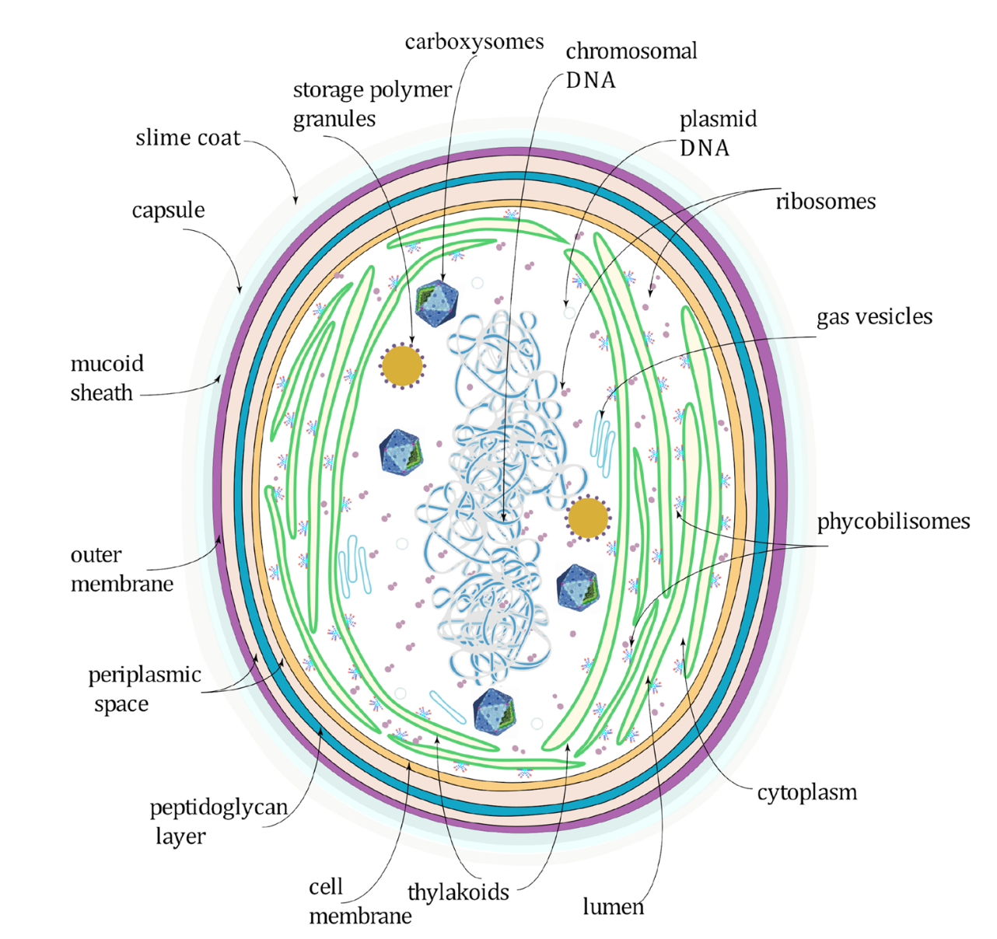
BioPV typically employ cyanobacteria
Single-celled organisms found naturally in all types of water
Perform oxygenic photosynthesis - the process that converts water and CO₂ into biomass, initiated by incoming light energy
Image: Noreña-Caro, D.; Benton, M. G. Journal of CO₂ Utilization 2018, 28, 335.

Slide 5
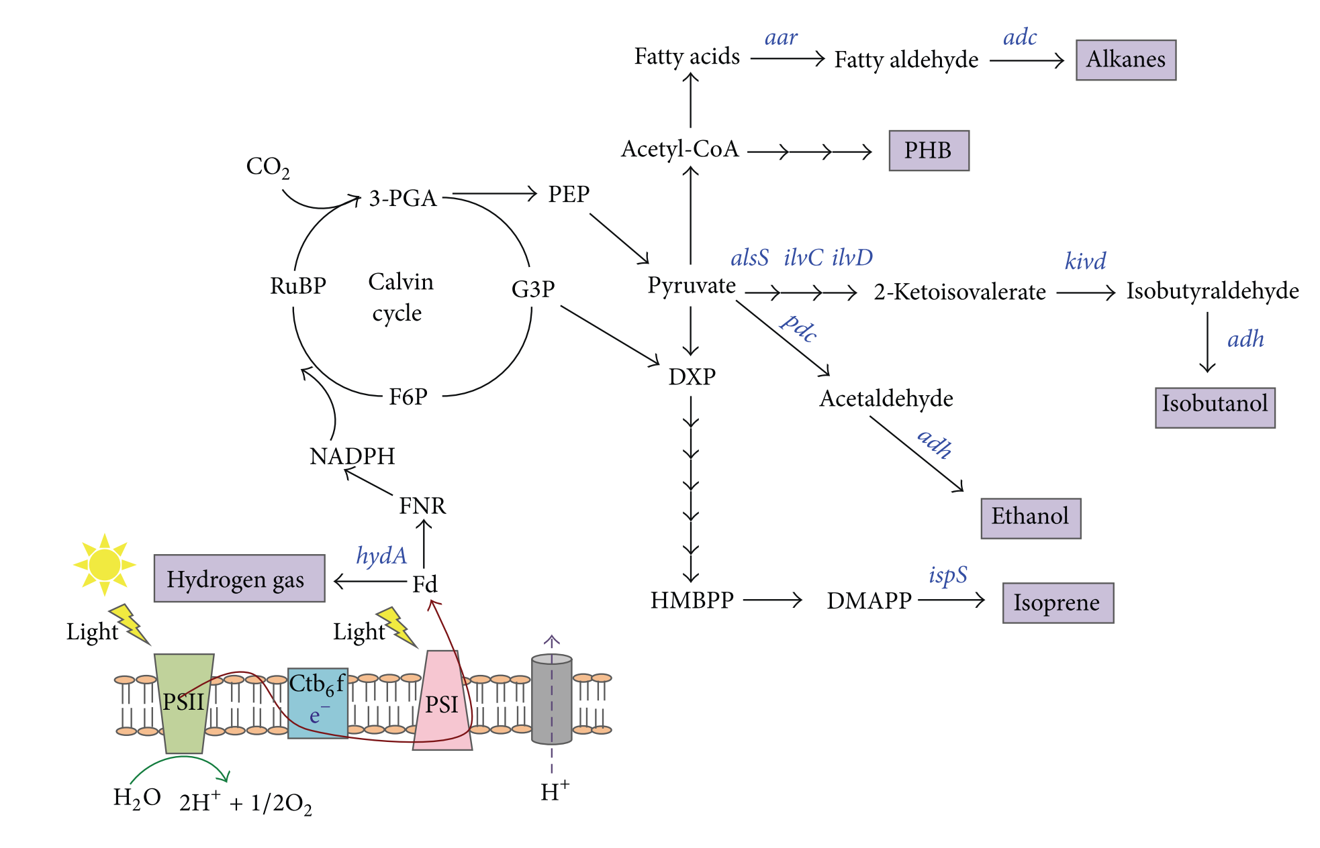
Cyanobacteria can also be used to directly convert CO₂ to various biofuels
Lau, N.-S. et al. BioMed Research International 2015, 754934.

Slide 6
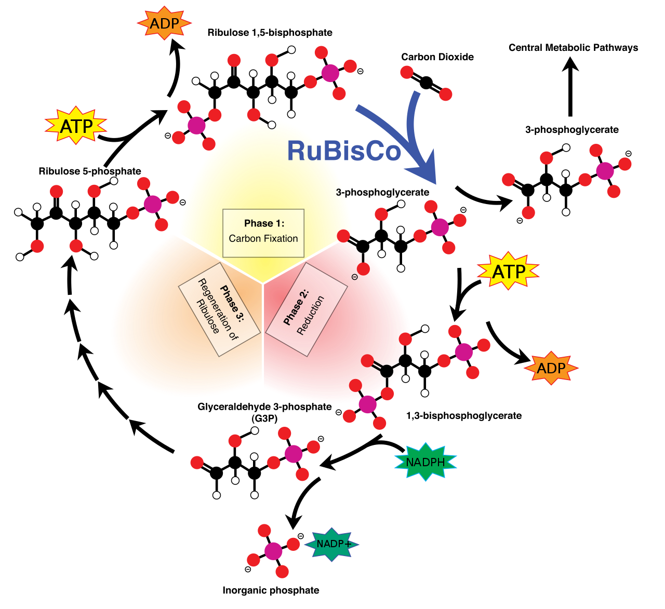
Carbon fixation via the Calvin Cycle
Image: https://en.wikipedia.org/wiki/Calvin_cycle

Slide 7
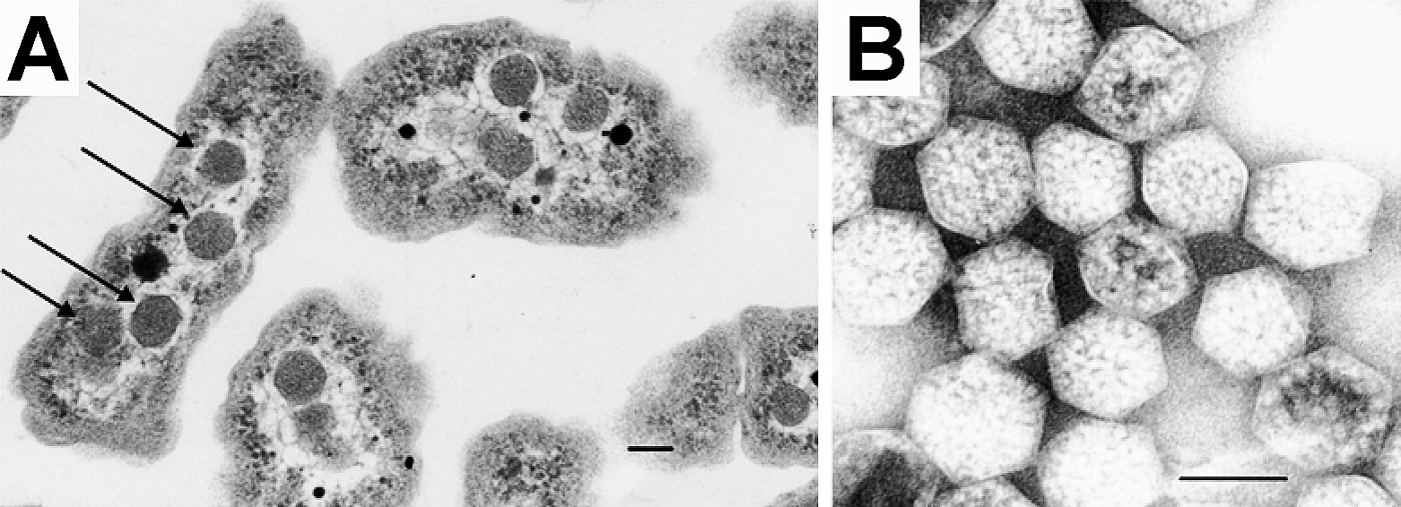
Carbon fixation via the Calvin Cycle
In cyanobacteria, RuBisCo is located in carboxysomes (shown), which concentrate CO₂ to improve efficiency
Carbonic anhydrase in the carboxysomes releases CO₂ from bicarbonate (HCO₃⁻)
https://en.wikipedia.org/wiki/Photosynthesis; Image: https://en.wikipedia.org/wiki/Carboxysome

Slide 8
Electron transfer pathways in cyanobacteria
The protein complexes and electron mediator molecules involved in the PETC (photosynthetic electron transport chain) are in thylakoids, a membrane system in the cytoplasm
carboxysome
thylakoid
Tschörtner, J.; Lai, B.; Krömer, J. O. Frontiers in Microbiology 2019, 10, 866.
Protein complexes:
  Photosystems I and II (PSI, PSII)
  Cytochrome b₆f (Cyt b₆f)
  ATPsynthase (proton gradient driven; does not participate in PETC)
Electrons are passed from PSII via Cyt b6f and PSI to NADP⁺, with the help of several soluble electron carrier molecules and ferrodoxin NADP oxidreductase (FNR)

Slide 9
Why bioPV, and why cyanobacteria?
“More complicated systems are less efficient: energy is lost each time the electron is passed between carrier molecules, and the system must expend energy to maintain itself.
However, a complicated system such as a bacterial cell has the advantage that it can assemble and repair itself, and the ability to store metabolites may allow power generation in the dark.
For this reason, most work in this field has been based on cyanobacteria (oxygenic photosynthetic bacteria, ‘blue-green algae’), as they have a comparatively simple internal structure. In these organisms, the thylakoid membranes where charge separation occurs are directly exposed to the cytoplasm, and the organism is enclosed by a typical Gram-negative cytoplasmic membrane/cell wall/outer membrane arrangement (Figure 1).
Cyanobacterial metabolism is well studied, and genetic manipulation of many species (e.g. Synechocystis sp. PCC 6803) is well established”
Bradley, R. W. et al. Biochem. Soc. Trans. 2012, 40, 1302.

Slide 10
Getting electrons from cyanobacteria
Cyanobacteria use the electrons generated with the energy of incoming photons to fix carbon and to grow.
For cyanobacteria, excretion of electrons (to the anode) would be wasteful.
In order to make cyanobacteria useful organisms for direct production of electrical current, we need to understand:
  How electrons are transferred from the cell to the anode
  What intracellular electron-transfer pathways take electrons to their point of exit
  How electron flux out of the cell can be improved so that the full light-harvesting potential of the organism can be exploited
Bradley, R. W. et al. Biochem. Soc. Trans. 2012, 40, 1302.
Tschörtner, J.; Lai, B.; Krömer, J. O. Frontiers in Microbiology 2019, 10, 866.

Slide 11
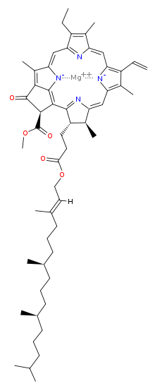
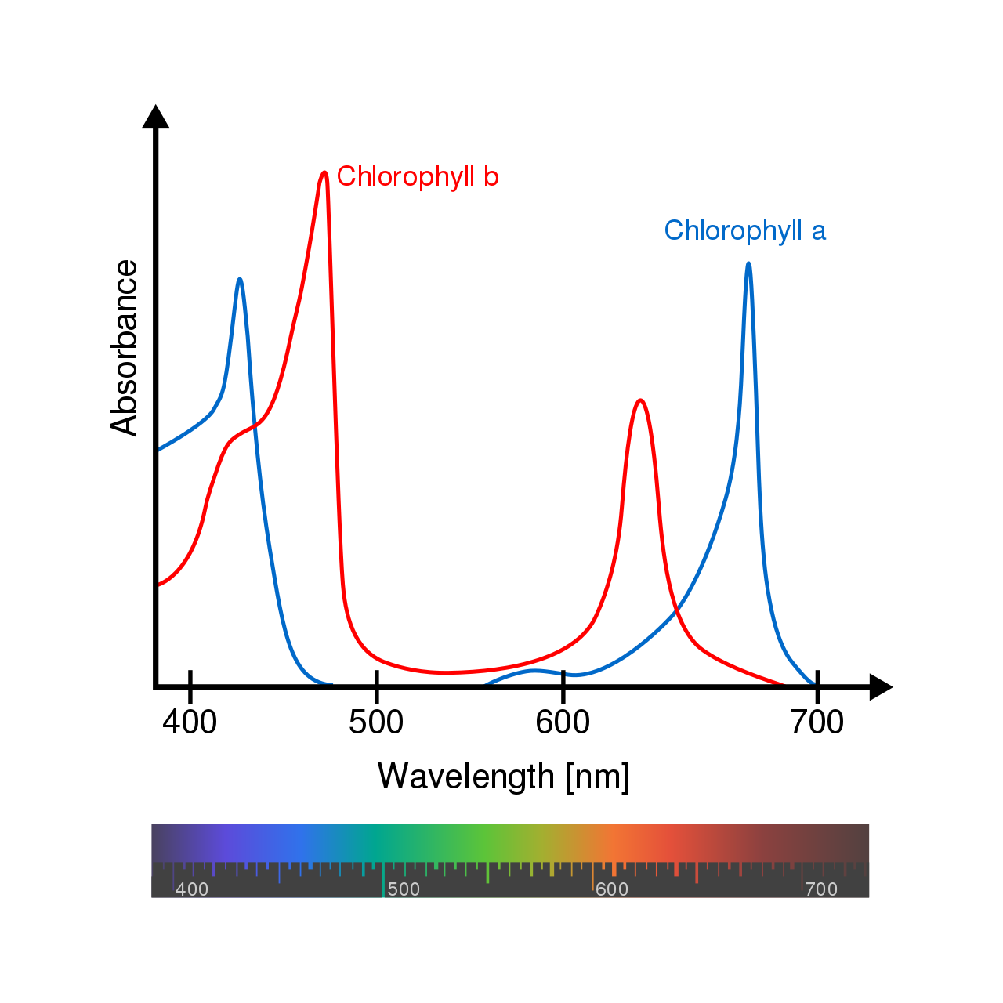
Cyanobacteria contain chlorophyll a
Chlorophyll a is present in photosystems I and II (PSI, PSII); called P680 and P700
P680 and P700 are the primary electron donors to the electron transport chain
Chlorophyll a
https://en.wikipedia.org/wiki/Chlorophyll_a
Protein complexes:
  Photosystems I and II (PSI, PSII)
  Cytochrome b₆f (Cyt b₆f)
  ATPsynthase (proton gradient driven; does not participate in PETC)
Electrons are passed from PSII via Cyt b6f and PSI to NADP⁺, with the help of several soluble electron carrier molecules and ferrodoxin NADP oxidreductase (FNR)

Slide 12
Photocurrent generating capacity of cyanobacteria is ~1 pA/cell
Photosynthetic oxygen evolution rates of cyanobacteria are ~500 μmol of O₂ per mg of chlorophyll per h
Equivalent to current production of 50 mA/mg of chlorophyll
Assuming ~2×10⁻¹⁴ g of chlorophyll per cell, this would be 1 pA/cell (10⁻¹² A)
Chlorophyll a
Bradley, R. W. et al. Biochem. Soc. Trans. 2012, 40, 1302.
Protein complexes:
  Photosystems I and II (PSI, PSII)
  Cytochrome b₆f (Cyt b₆f)
  ATPsynthase (proton gradient driven; does not participate in PETC)
Electrons are passed from PSII via Cyt b6f and PSI to NADP⁺, with the help of several soluble electron carrier molecules and ferrodoxin NADP oxidreductase (FNR)

Slide 13
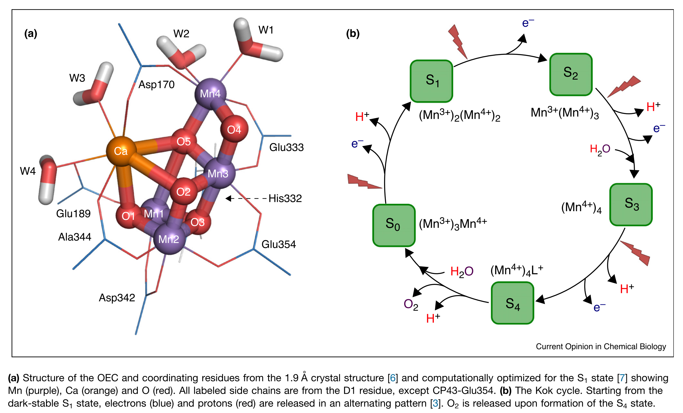
The Oxygen Evolving Complex (OEC) uses energy from absorbed photons to split water
4 photons are required to split 2 H₂O, yielding 4 electrons, which are passed to PSII
Vogt, L. et al. Current Opinion in Chemical Biology 2015, 25, 152.

Slide 14
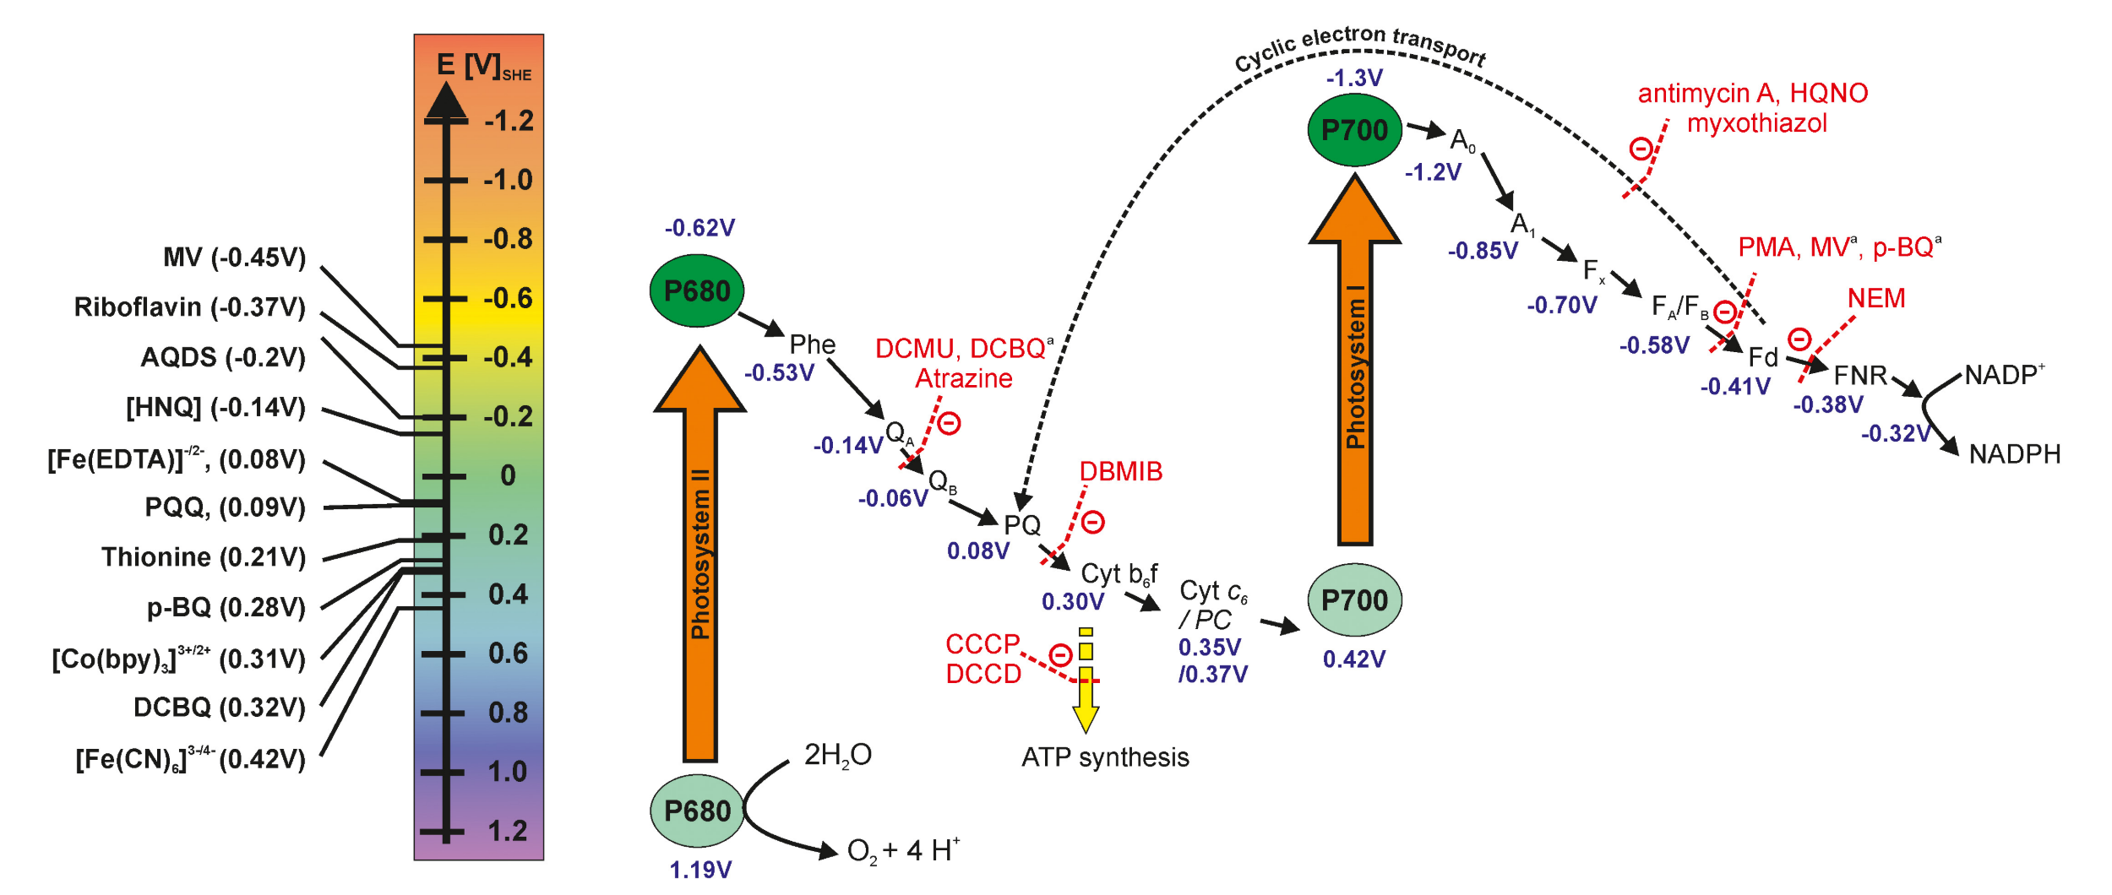
Z-scheme of the photosynthetic electron transport chain
Electron transfer inhibitors shown in red
(OEC)
Potential Mediators
These molecules can be used to remove electrons from the cyanobacteria
Proton buildup in the thylakoid lumen drives ATP synthesis
Tschörtner, J.; Lai, B.; Krömer, J. O. Frontiers in Microbiology 2019, 10, 866.

Slide 15
Electron transfer from the photosystem to the electrode is not well understood
Some current is observed without any mediators, even in “planktonic” systems
Photosynthetic and respiratory electron transport chains (PETC, RETC) may be electron sources
  (1) Light Reactions - illumination activates photosynthesis and the photosynthetic electron transport chain (PETC)
    ATP and NADPH, which are formed in the light reactions, are used to fix carbon in the Calvin cycle
  (2) Dark Reactions - in the dark, current decreases but is still above the abiotic baseline; “dark currents” are attributed to the breakdown of endogenously stored carbohydrates, which were synthesized using the electrons and energy generated from photosynthesis; can be considered “delayed photo current”
Tschörtner, J.; Lai, B.; Krömer, J. O. Frontiers in Microbiology 2019, 10, 866.

Slide 16
Device design
Two chamber
Electrodes in separate chambers, separate by a proton exchange membrane
Pros: keeps electron mediators interacting only with the working electrode and the biomass
Cons: membranes increase resistance and suffer from degradation, clogging, fouling
Single chamber
Biofilms or microorganisms are immobilized on the anode, so that chamber separation isn’t necessary; current dominant device structure in the literature
Pros: simpler
Cons: unclear whether these operate by direct electron transfer to the anode, or if the organisms release compounds that act as mediators
Tschörtner, J.; Lai, B.; Krömer, J. O. Frontiers in Microbiology 2019, 10, 866.

Slide 17
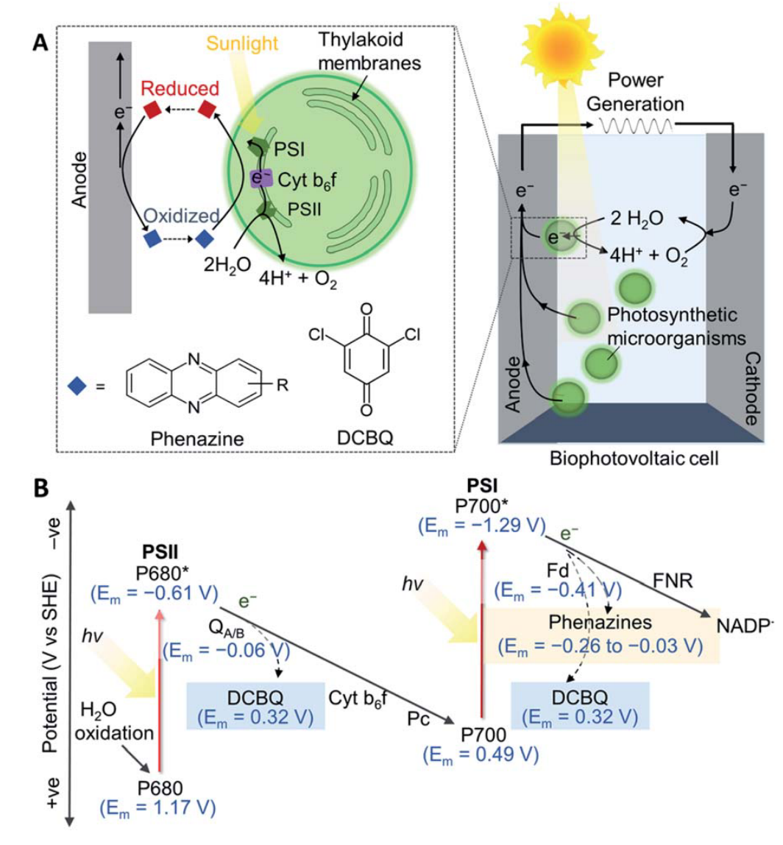
Electrode and electrolyte materials
Anode
Many materials have been tested; for single chamber biofilm-type devices, must design the anode to be a good surface for biofilm growth and for charge transfer, often a porous material (no consensus on best material)
Examples: ITO coatings on various porous surfaces, ITO inverse opals, polyaniline on FTO/glass, carbon paper, stainless steel, polypyrrole
Cathode
Facilitates reduction of oxygen to water; typically platinum
Electrolyte
Alkaline pH facilitates CO₂ concentrating, improves biomass build-up
Salt-tolerant/marine cyanobacteria have an advantage (happy in artificial seawater)
Tschörtner, J.; Lai, B.; Krömer, J. O. Frontiers in Microbiology 2019, 10, 866.

Slide 18
Mediators
Mediators, e.g. phenazine and DCBQ (a quinone), can shuttle electrons from the bacterium to the anode
(B) shows the energetic landscape of the electron transport chain
Dashed arrows represent points from which electrons can be intercepted by DCBQ and phenazines
Transport by DCBQ comes with a cost of ~700 mV; alternate mediators with more negative reduction potentials (e.g. phenazines) are desired
Clifford, E. R. et al. Chem. Sci. 2021, Advance Article ﻿https://doi.org/10.1039/d0sc05655c.

Slide 19
Mediators
Concerns with mediators include:
Figuring out the appropriate concentration w.r.t. biomass
Toxicity to the cyanobacteria
Sustainability/cost issues with scale-up
Bradley, R. W. et al. Biochem. Soc. Trans. 2012, 40, 1302.
Clifford, E. R. et al. Chem. Sci. 2021, Advance Article ﻿https://doi.org/10.1039/d0sc05655c.

Slide 20
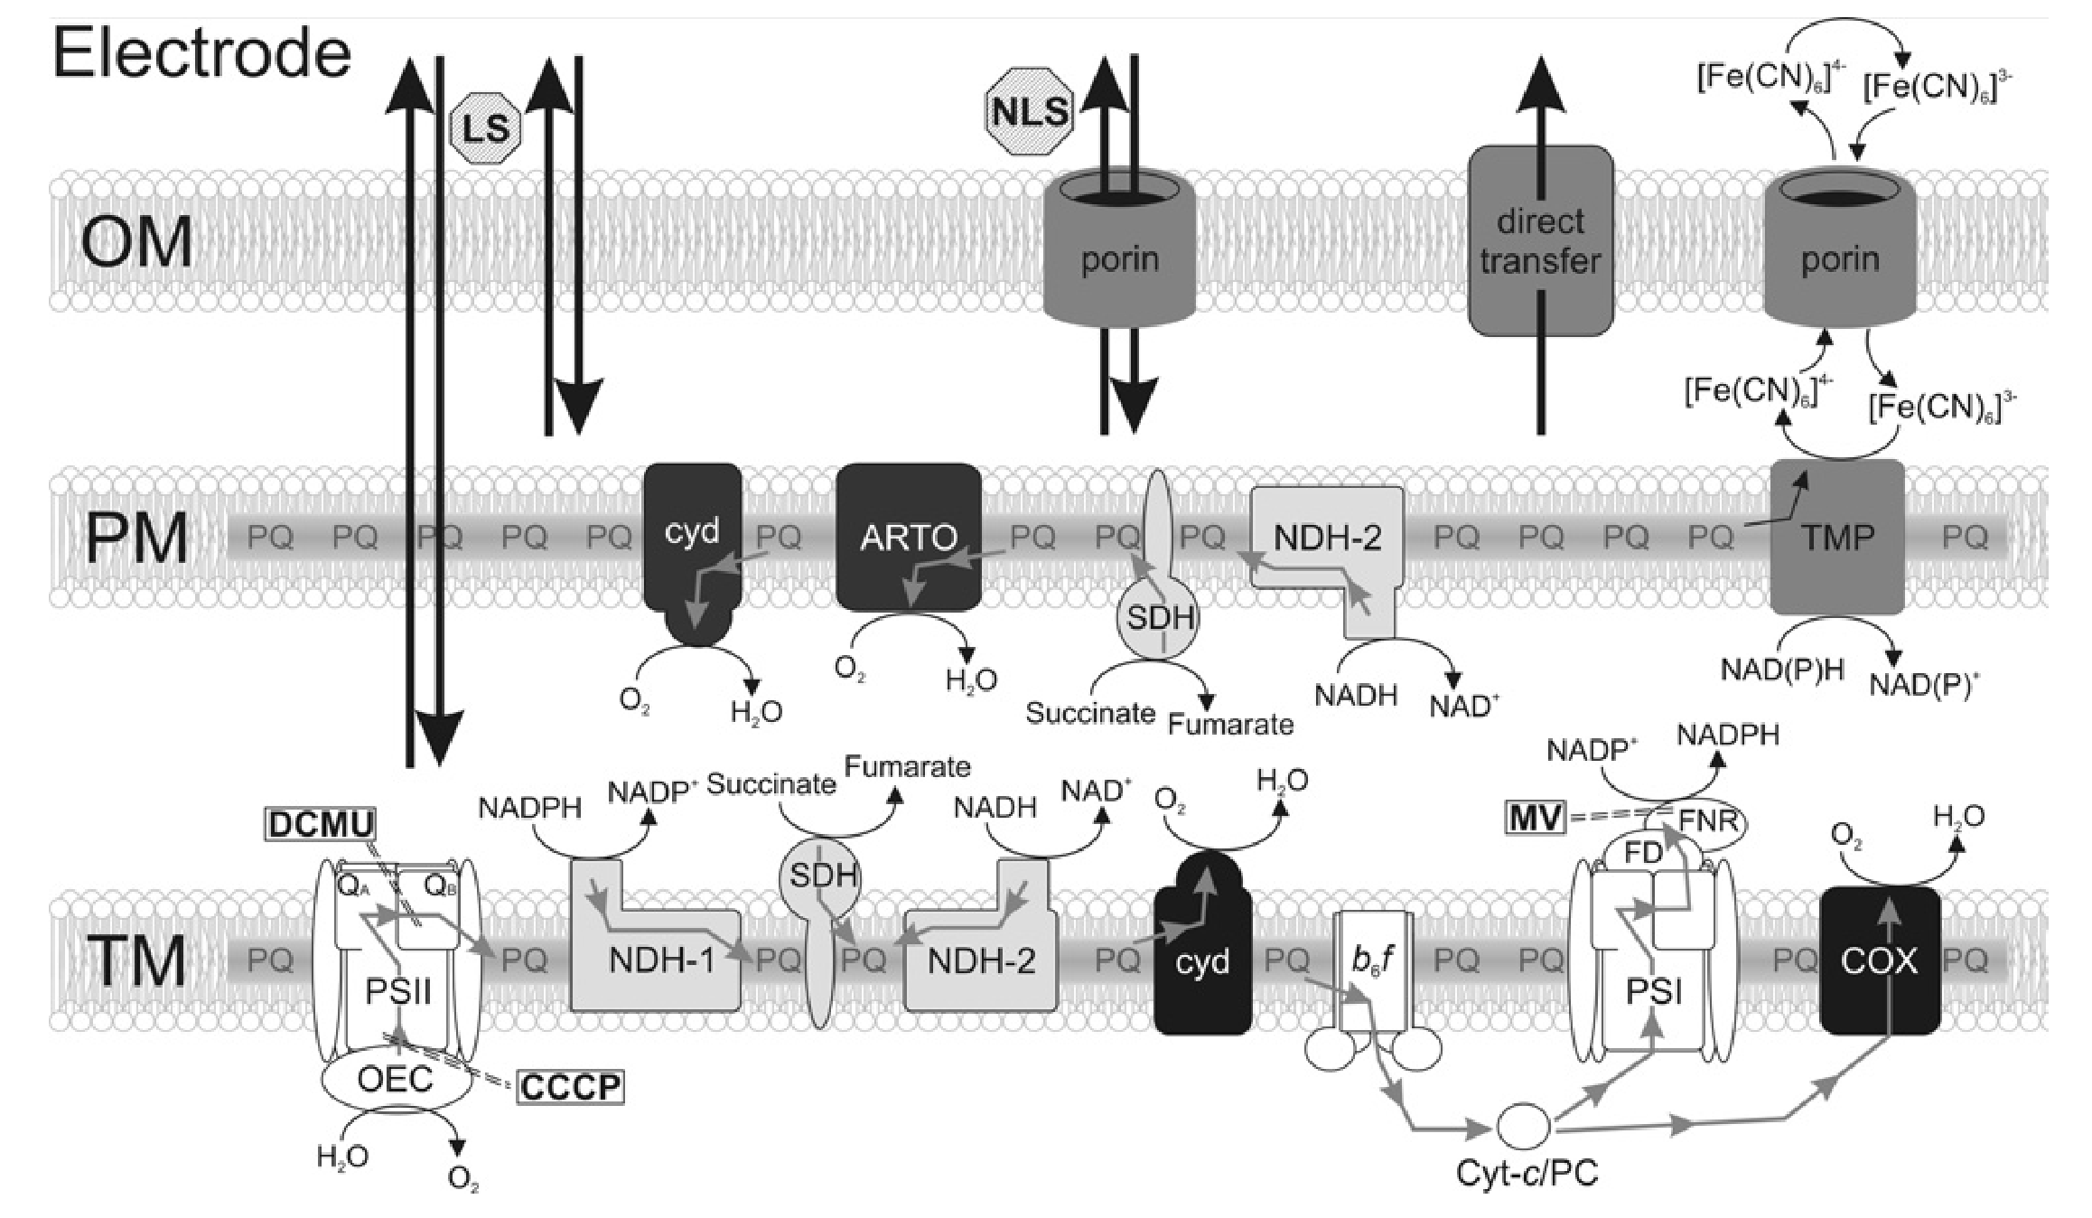
Cyanobacterial membrane and mediators
lipid-soluble mediator
non-lipid-soluble mediator
outer membrane
cytoplasmic
membrane
thylakoid
membrane
Gray arrows show electron flow
Inhibitors shown in boxes (DCMU, CCCB, MV)
Proteins associated with: photosynthesis (white), respiration (light gray), terminal oxidases (black), other (dark gray)
Bradley, R. W. et al. Biochem. Soc. Trans. 2012, 40, 1302.

Slide 21
Cyanobacterial membrane, mediators, and inhibitors
lipid-soluble mediator
non-lipid-soluble mediator
outer membrane
cytoplasmic
membrane
thylakoid
membrane
Genetic modification could enhance electron export, e.g. by:
  Removing terminal oxidases
  Reducing the capacity for biomass generation (limit CO₂ supply or down-regulate Calvin cycle components)
Bradley, R. W. et al. Biochem. Soc. Trans. 2012, 40, 1302.

Slide 22
Schematic of bioPV function
Red lines indicate hypothetical electron transfer routes
Shows both photosynthetic and respiratory ETCs (PETC and RETC)
Tschörtner, J.; Lai, B.; Krömer, J. O. Frontiers in Microbiology 2019, 10, 866.

Slide 23
Membrane structures may also facilitate electron transfer to the anode
Mediated electron transfer
Direct electron transfer from cell to anode by pili / membrane structures
Tschörtner, J.; Lai, B.; Krömer, J. O. Frontiers in Microbiology 2019, 10, 866.

Slide 24
Record bioPV performance
Highest power density reported as of 2019: 610 mW m⁻², reported 2017
Corresponds to a light-to-power efficiency of 4.01% (report that theoretical maximum in cyanobacteria is ~11%)
Anode: matrix incorporating cadmium telluride quantum dots (CdTe QD), graphene nanoplatelets, and silk-fibrin on a graphite electrode
  Silk fibrin supports biofilm growth
  Graphene nanoplatelets facilitates direct electron transfer to the anode (reduce nanocomposite band gap to 2.9 eV, decrease charge transfer resistance by ~9-fold)
  CdTe QDs “surge” PSI and PSII with desired wavelengths (650-750 nm) at a broad excitation spectrum (350-644 nm) through fluorescence resonance energy transfer (FRET)
Kaushik, S. et al. J. Mater. Chem. A 2017, 5, 7885.
Tschörtner, J.; Lai, B.; Krömer, J. O. Frontiers in Microbiology 2019, 10, 866.

Slide 25
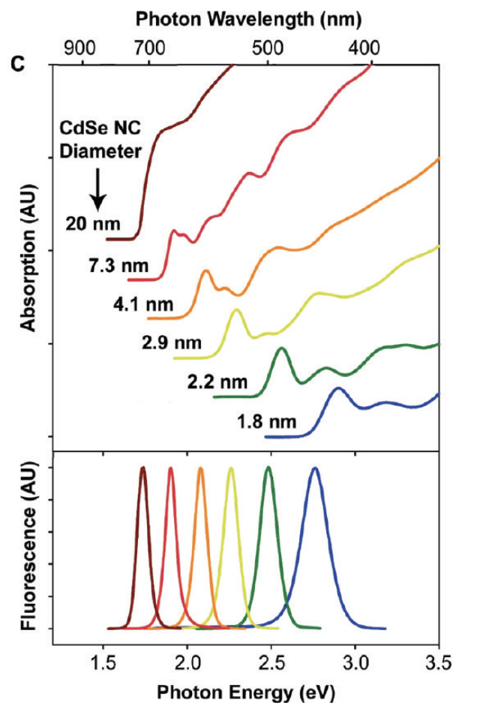
Remember chlorophyll a…
QDs are semiconducting nanomaterials which can absorb light in a wide range and have tunable and sharp emission wavelengths and good photo-stability
They use 3.8 nm CdTe QDs, which have an absorption max at 644 nm and a sharp fluorescence max at 680 nm; this is intended to deliver as many usable photons as possible to chlorophyll a
Kaushik, S. et al. J. Mater. Chem. A 2017, 5, 7885.
Smith, A.; Nie, S. Acc. Chem. Res. 2010, 43 (2), 190.
Protein complexes:
  Photosystems I and II (PSI, PSII)
  Cytochrome b₆f (Cyt b₆f)
  ATPsynthase (proton gradient driven; does not participate in PETC)
Electrons are passed from PSII via Cyt b6f and PSI to NADP⁺, with the help of several soluble electron carrier molecules and ferrodoxin NADP oxidreductase (FNR)

Slide 26
Could bioPV really be a thing?
Issues
Very low current outputs of devices
Lack of comparability and standardization of the experimental set-up hinders systematic optimization
Roy says: in photosynthetic organisms, the relevant molecules are being photolyzed often (maybe every 3 days); stability of the biological systems may be a big problem (especially if we’re stealing electrons from its usual self-repair pathways)
Scale-up really hasn’t been explored
Reasons to pay attention
“Nevertheless, the fundamental questions of redox homeostasis in photoautotrophs and the potential to directly harvest light energy from a highly efficient photosystem, rather than through oxidation of inefficiently produced biomass are highly relevant aspects of biophotovoltaics.”
Tschörtner, J.; Lai, B.; Krömer, J. O. Frontiers in Microbiology 2019, 10, 866.

Slide 27
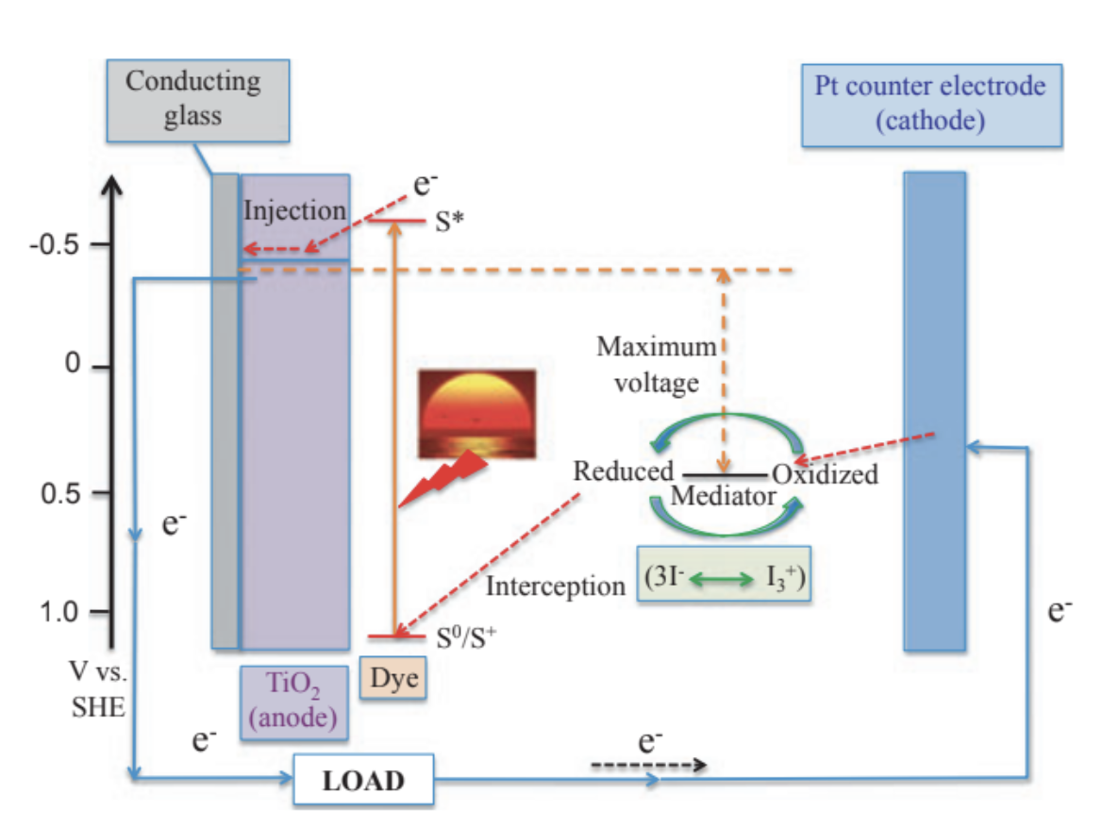
Work by Robert Niederman’s group at Rutgers
Biological dye-sensitized solar cell: the typical organic light-harvesting dye is replaced with chromatophores (bacterial photosynthetic membrane vesicles) from Rhodospirillum rubrum
Woronowicz, K. et al. Photochem Photobiol. 2012, 88 (6), 1467.

Slide 28
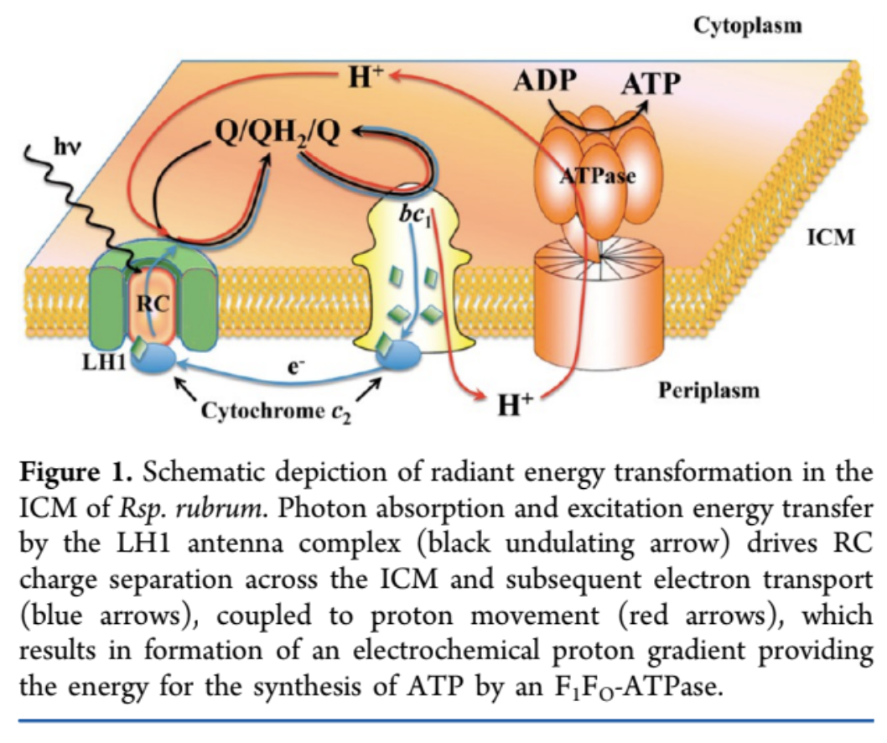
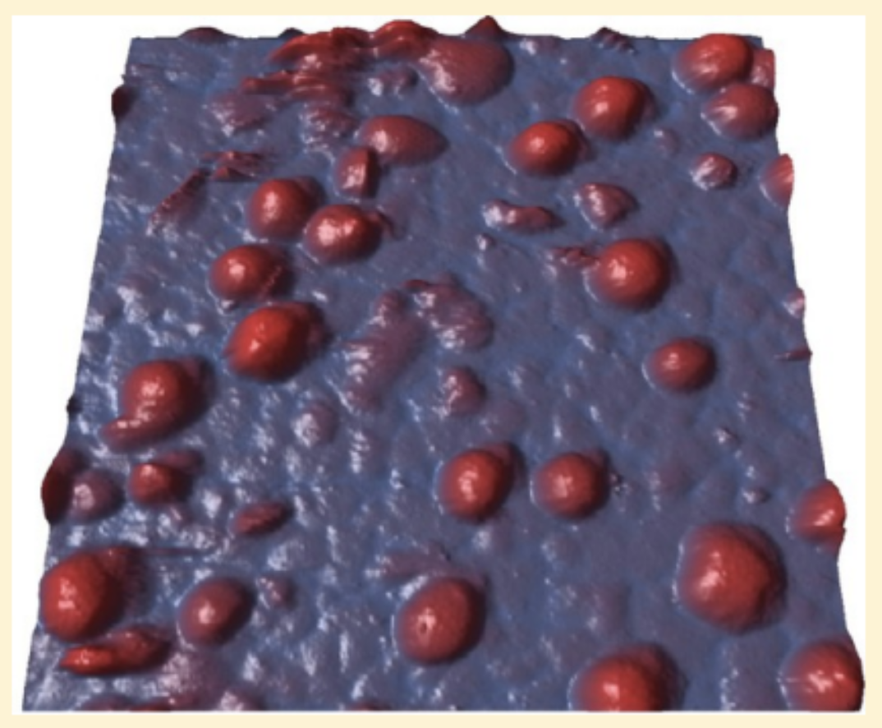
John Harrold’s work with Niederman
Investigation of the morphology, fluorescence kinetics, and photocurrent generation of Rhodospirillum rubrum chromatophores deposited directly onto a gold surface
ICM, intracytoplasmic membrane
LH1, light harvesting 1
RC, reaction center
Harrold, J. W. et al. J. Phys. Chem. B 2013, 117 (38), 11249.

Slide 29
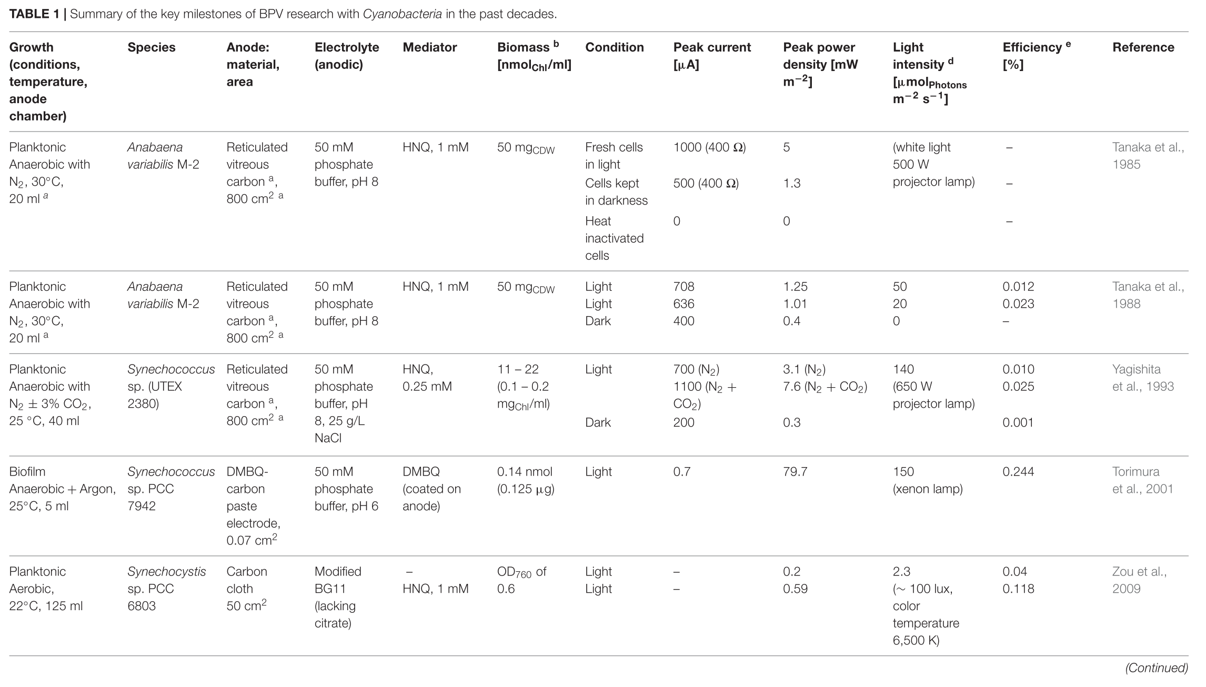
Summary of key milestones in BPV research with cyanobacteria (as of 2019) 1/6
Tschörtner, J.; Lai, B.; Krömer, J. O. Frontiers in Microbiology 2019, 10, 866.

Slide 30
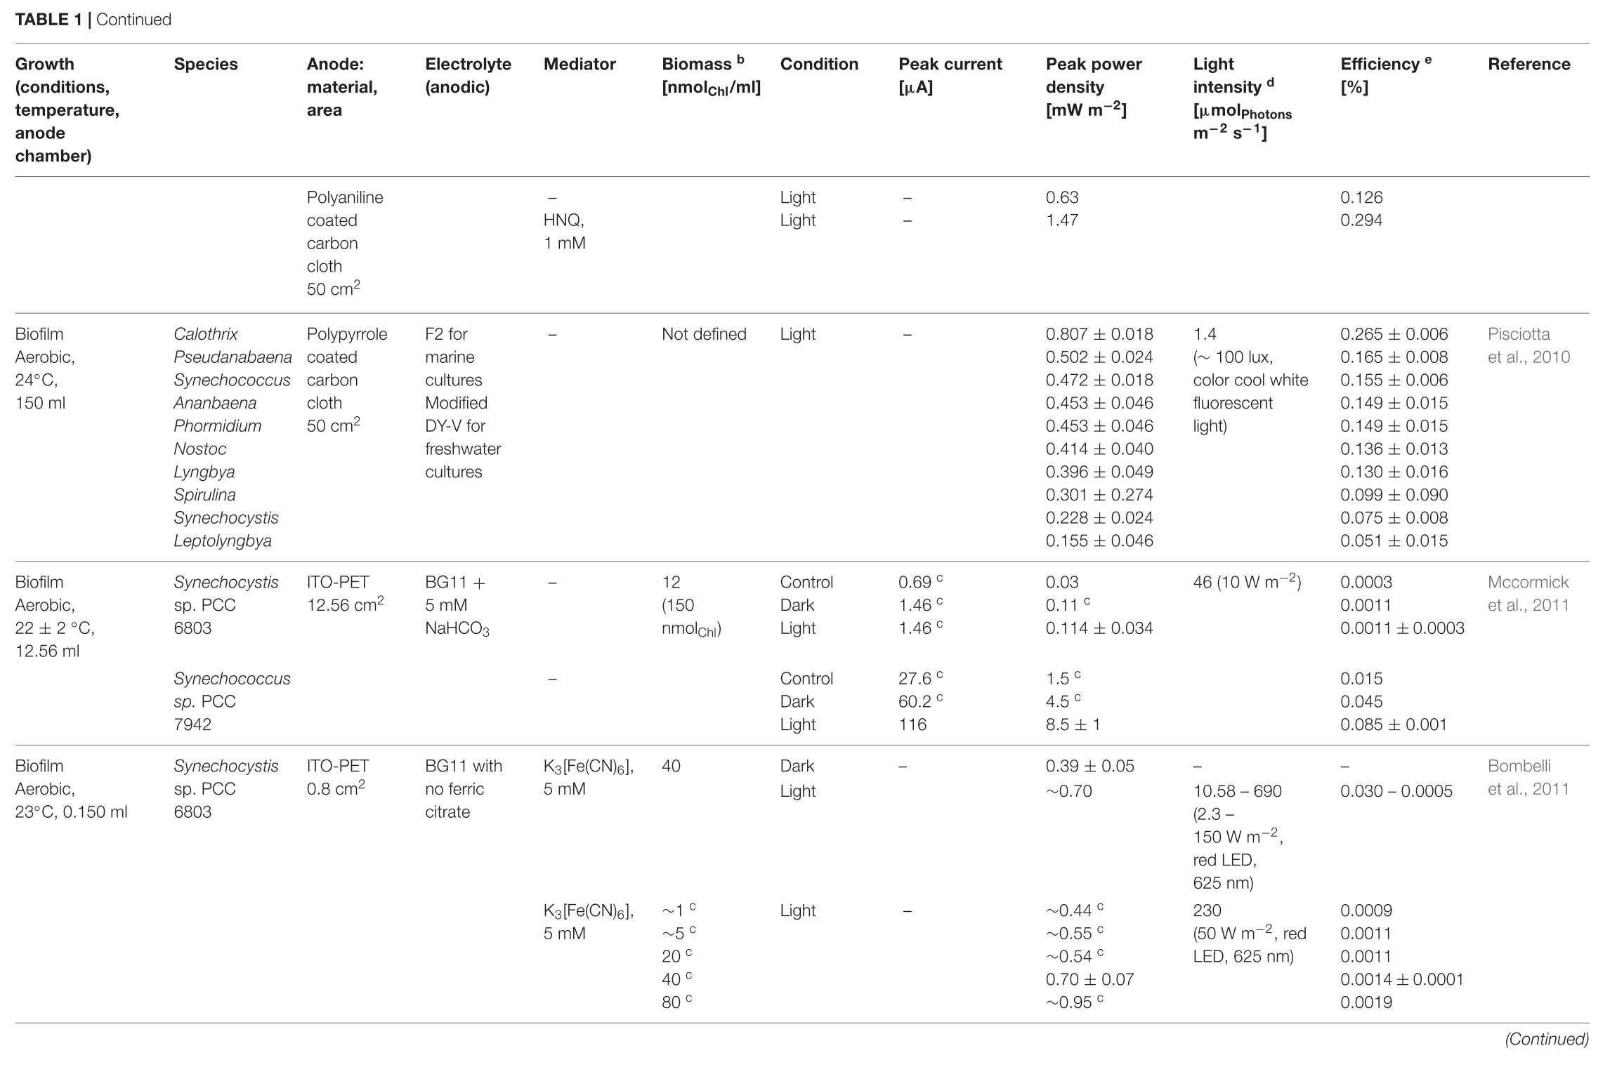
2/6
Tschörtner, J.; Lai, B.; Krömer, J. O. Frontiers in Microbiology 2019, 10, 866.

Slide 31
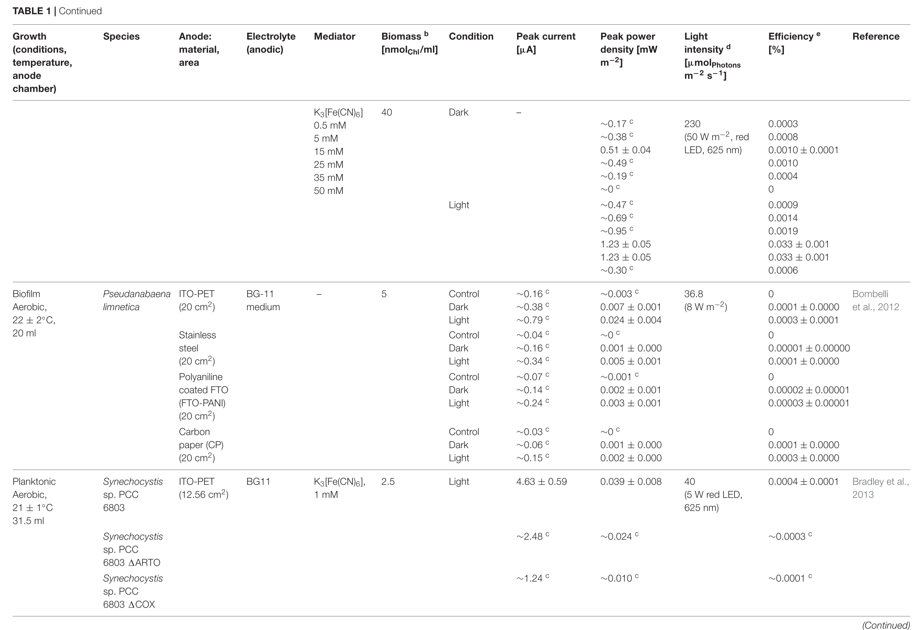
3/6
Tschörtner, J.; Lai, B.; Krömer, J. O. Frontiers in Microbiology 2019, 10, 866.

Slide 32
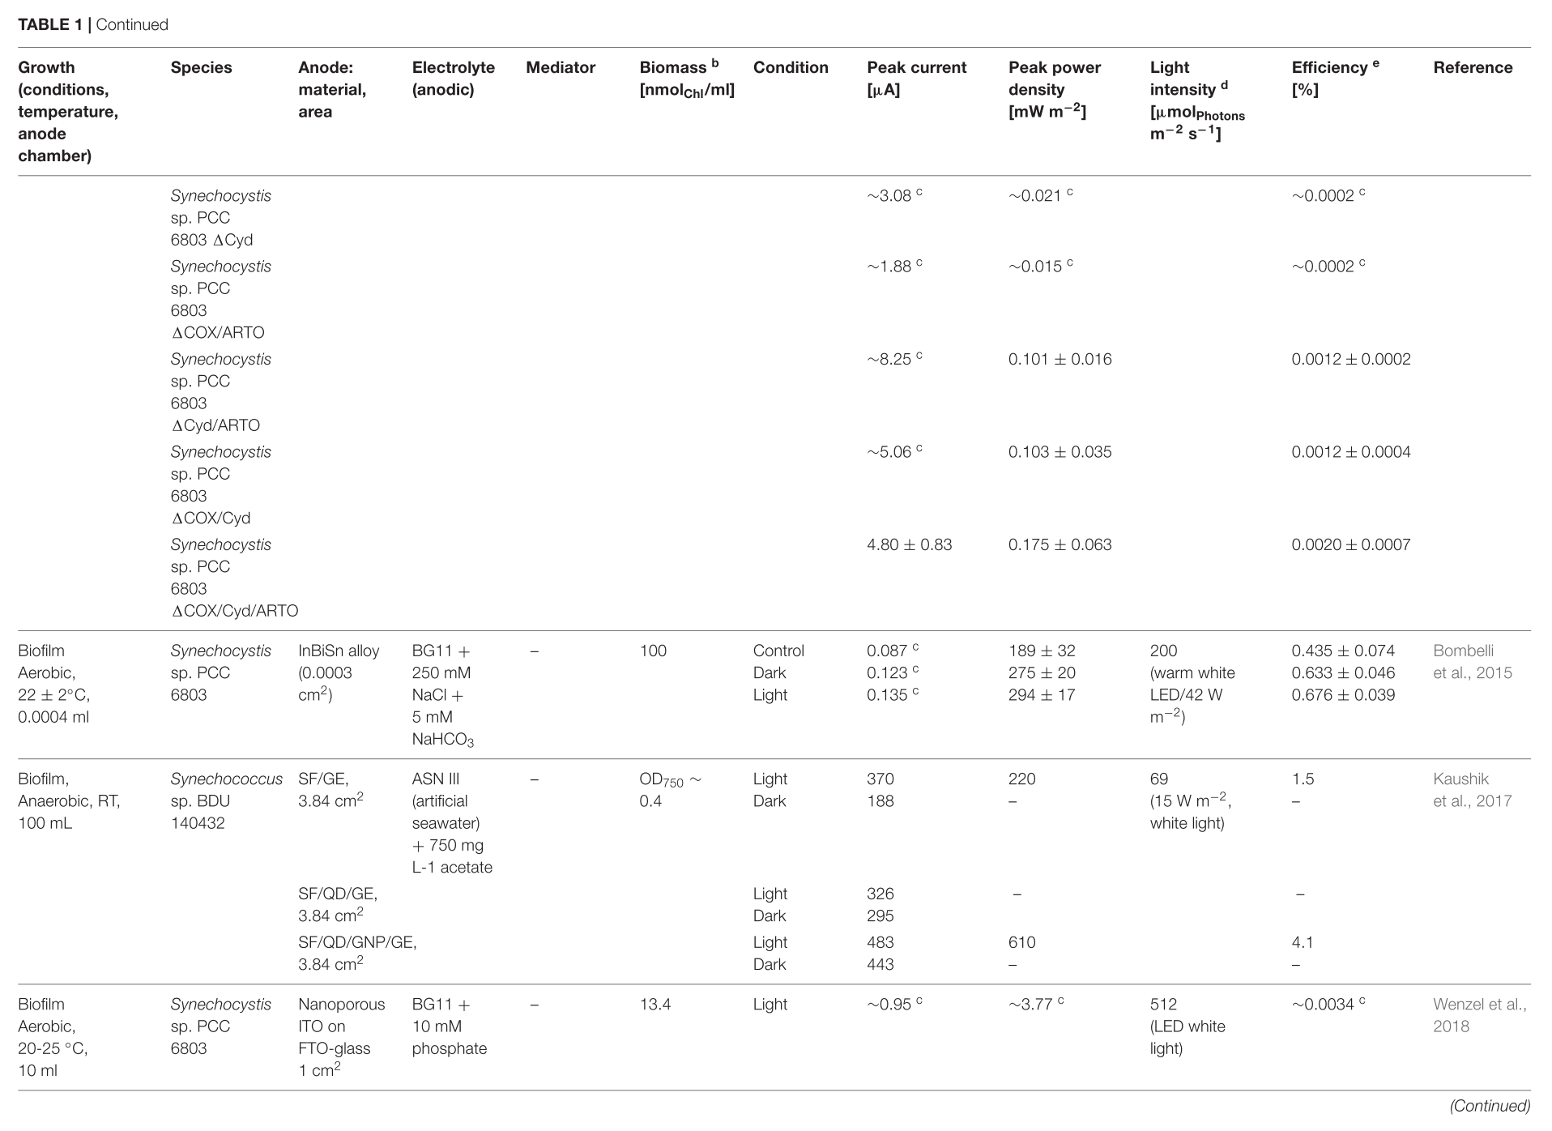
4/6
Tschörtner, J.; Lai, B.; Krömer, J. O. Frontiers in Microbiology 2019, 10, 866.

Slide 33
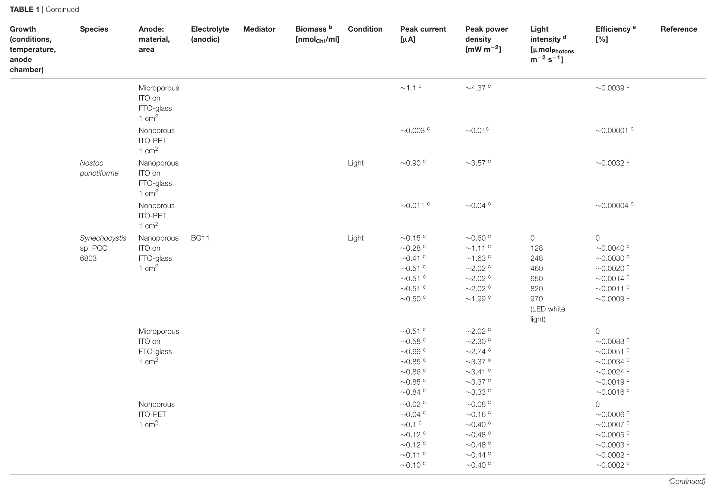
5/6
Tschörtner, J.; Lai, B.; Krömer, J. O. Frontiers in Microbiology 2019, 10, 866.

Slide 34
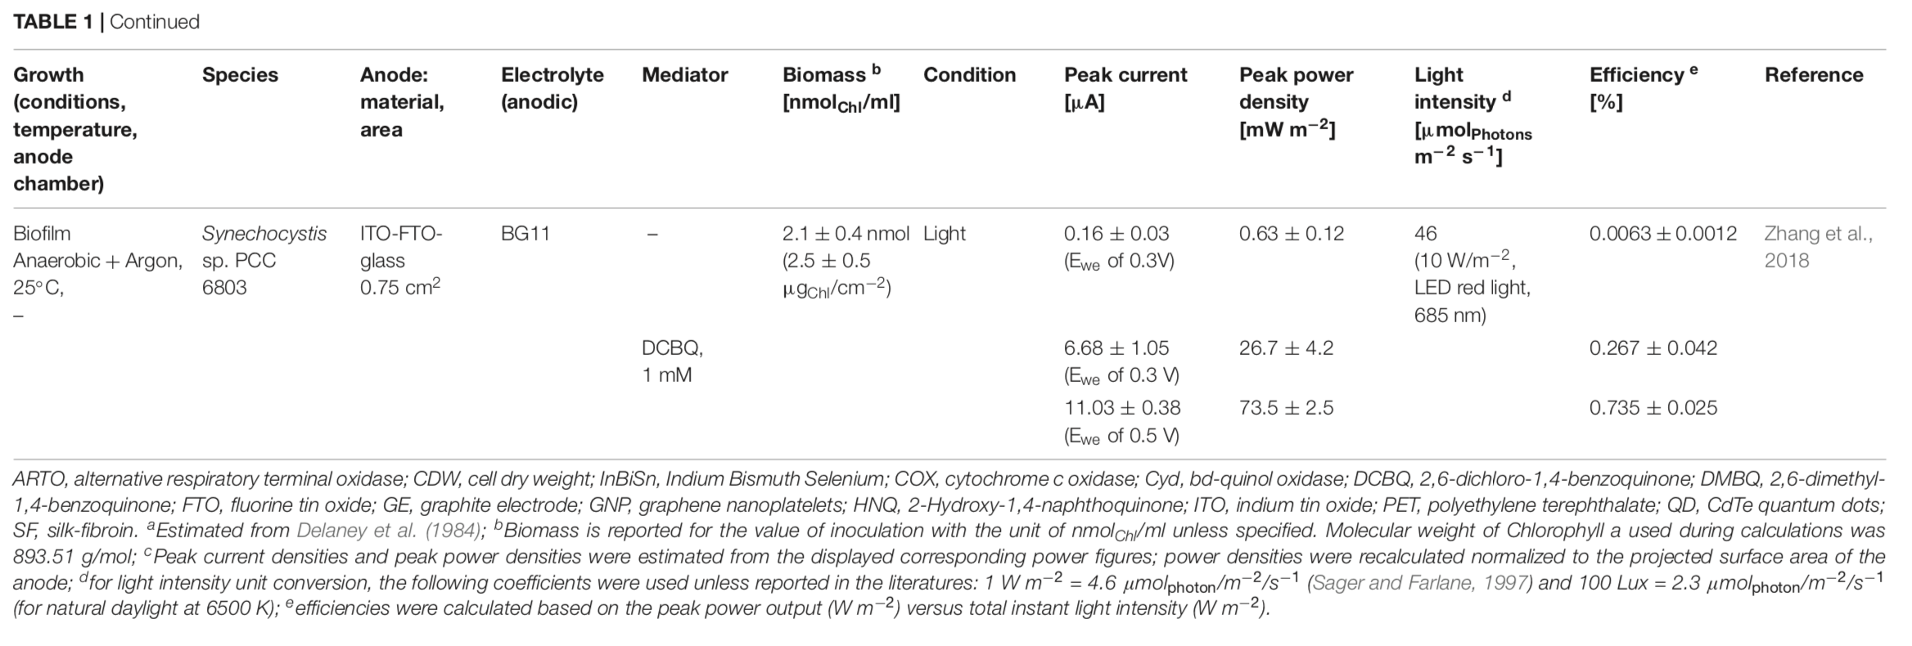
6/6
Tschörtner, J.; Lai, B.; Krömer, J. O. Frontiers in Microbiology 2019, 10, 866.

Slide 35
References
Cover image: https://singularityhub.com/2018/06/04/how-cyanobacteria-could-help-save-the-planet/
Niederman (our own John Harrold):
  Woronowicz, K. et al. Photochem Photobiol. 2012, 88 (6), 1467.
  Harrold, J. W. et al. J. Phys. Chem. B 2013, 117 (38), 11249.
Cyanobacteria in biophotovoltaics
Bradley, R. W. et al. Biological photovoltaics: intra- and extra-cellular electron transport by cyanobacteria. Biochem. Soc. Trans. 2012, 40, 1302.
Clifford, E. R. et al. Phenazines as model low-midpoint potential electron shuttles for photosynthetic bioelectrochemical systems. Chem. Sci. 2021, Advance Article ﻿https://doi.org/10.1039/d0sc05655c.
Grattieri, M. et al. Advancing the fundamental understanding and practical applications of photo-bioelectrocatalysis. Chem. Commun. 2020, 56, 8553.
Kaushik, S. et al. FRET-guided surging of cyanobacterial photosystems improves and stabilizes current in photosynthetic microbial fuel cell. J. Mater. Chem. A 2017, 5, 7885. (Record device paper)
Tschörtner, J.; Lai, B.; Krömer, J. O. Biophotovoltaics: Green Power Generation From Sunlight and Water. Frontiers in Microbiology 2019, 10, 866.
Cyanobacteria for fuel synthesis
Lau, N.-S. et al. Cyanobacteria: Photoautotrophic Microbial Factories for the Sustainable Synthesis of Industrial Products. BioMed Research International 2015, 754934.
Noreña-Caro, D.; Benton, M. G. Cyanobacteria as photoautotrophic biofactories of high-value chemicals. Journal of CO₂ Utilization 2018, 28, 335.

