Slide 1
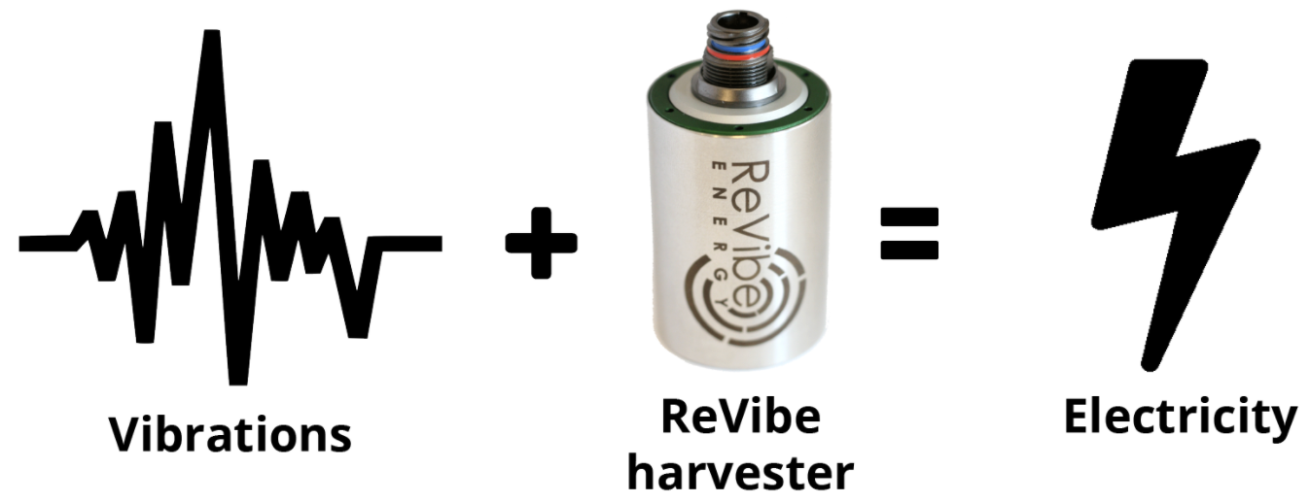
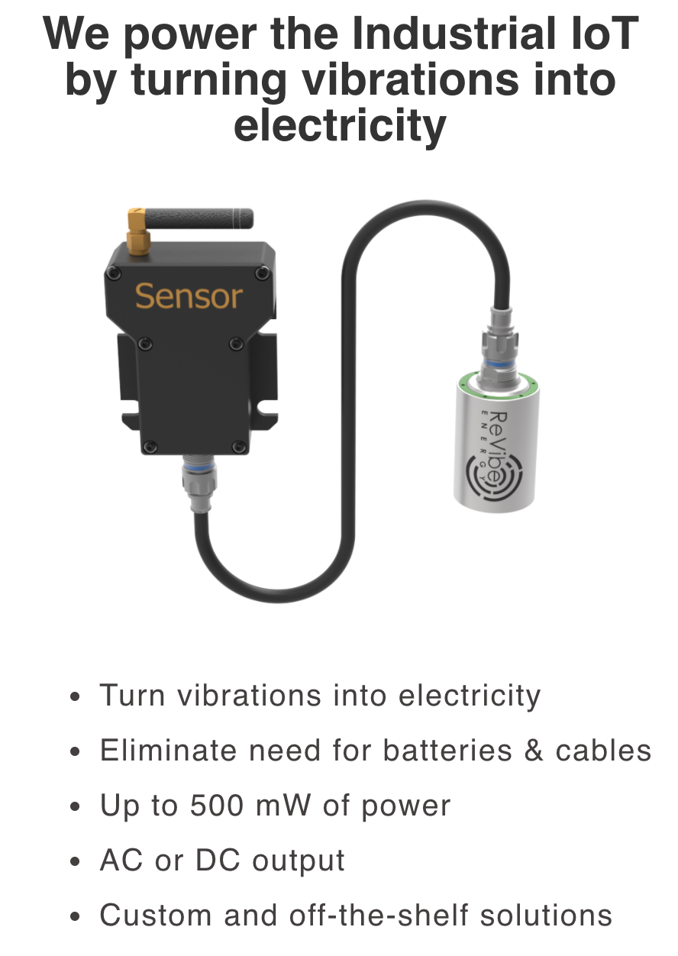
Vibrational Energy Harvesting
Eliza Kate Spear
HEJC
2020-11-20
Notes:
Images from https://revibeenergy.com/

Slide 2
Vibrational energy harvesting (VEH) converts vibrational energy to electrical energy
Vibrational energy is harvested using a transducer, which is a device that converts one form of energy to another (in this case, kinetic to electrical)

Slide 3
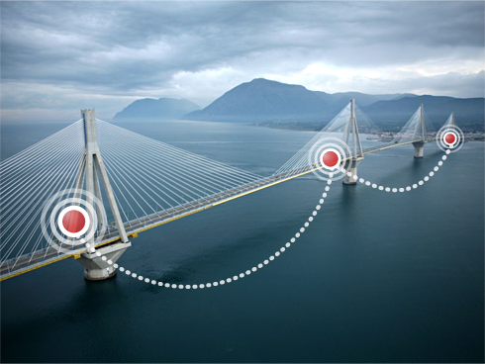
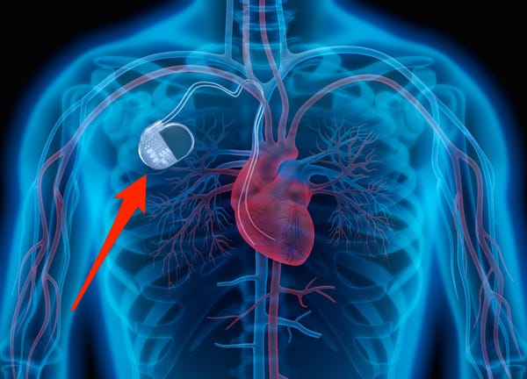
VEH is an attractive option for wireless sensor networks (WSN)
Wireless sensors generally require batteries, but replacing those batteries can be challenging, expensive, and impractical.
For some sensors, e.g. on industrial machinery or on bridges to monitor bridge health, vibrations in the sensor environment can provide enough energy to power the device.
VEH also finds application in medical devices, e.g. in pacemakers, where battery replacement necessitates surgery.

Slide 4
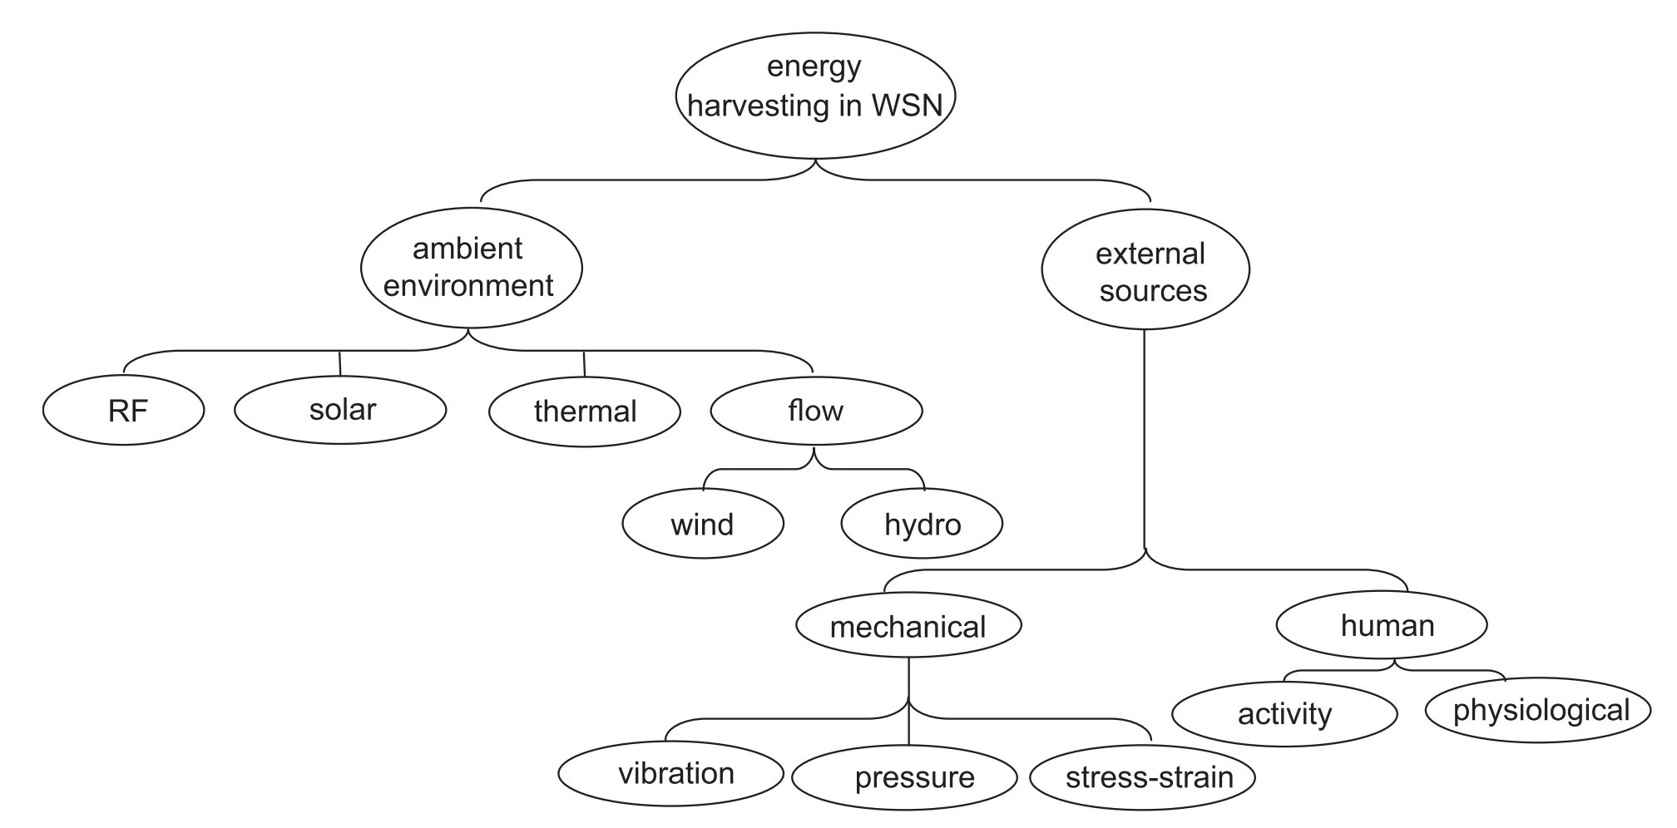
For sensors in the right environment, VEH can be a convenient choice
Wireless sensor networks have a host of energy options; specifics of the sensor environment will dictate whether VEH is appropriate.
Shaikh, F. K.; Zeadall, S. Renew. Sust. Energ. Rev. 2016, 55, 1041-1054.

Slide 5
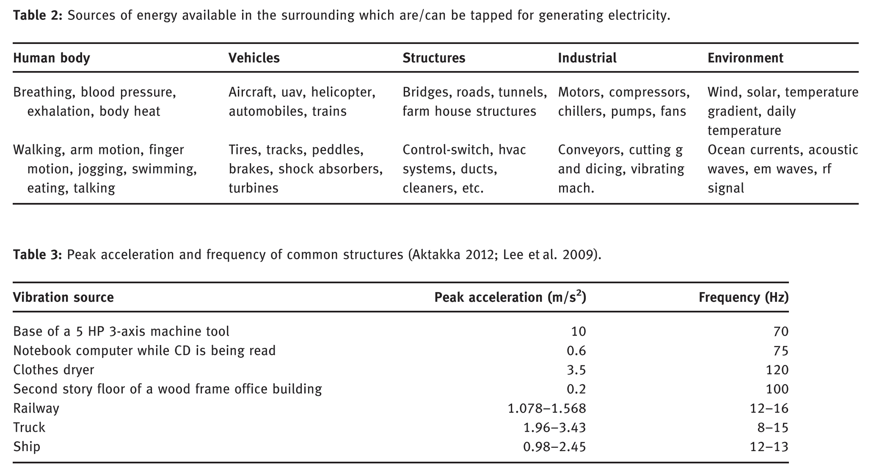
Sources of energy
Priya, S. et al. Energy Harvesting and Systems 2017, 4 (1), 3-39.

Slide 6
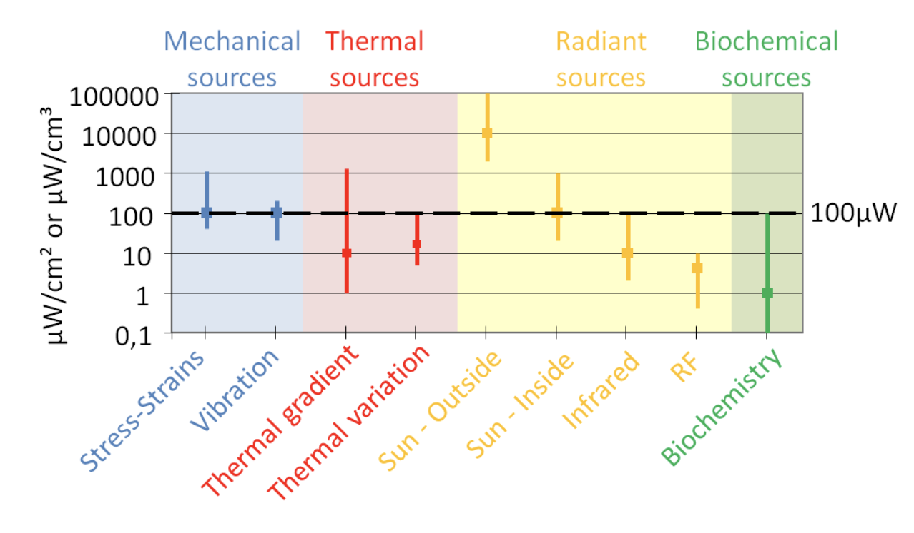
Power density of ambient energy sources
https://www.intechopen.com/books/small-scale-energy-harvesting/electrostatic-conversion-for-vibration-energy-harvesting
Notes:
https://www.intechopen.com/books/small-scale-energy-harvesting/electrostatic-conversion-for-vibration-energy-harvesting
DOI: 10.5772/51360

Slide 7
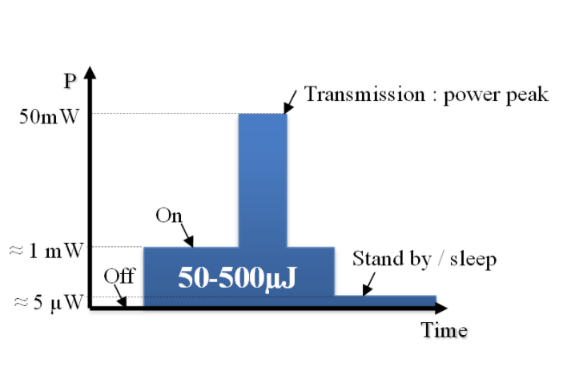
Wireless sensor node power consumption
https://www.intechopen.com/books/small-scale-energy-harvesting/electrostatic-conversion-for-vibration-energy-harvesting
Notes:
https://www.intechopen.com/books/small-scale-energy-harvesting/electrostatic-conversion-for-vibration-energy-harvesting
DOI: 10.5772/51360

Slide 8
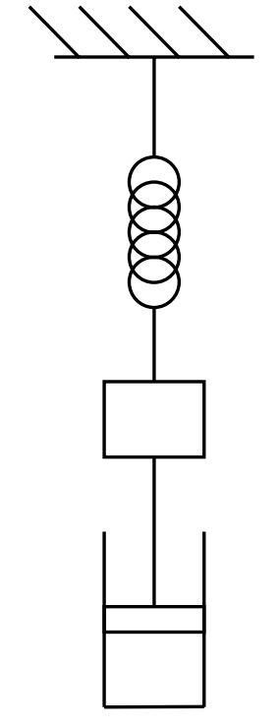
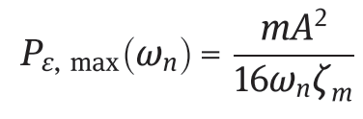
Sources of vibrational energy
Considering a simple mass-spring-damper system, maximum power can be obtained from low frequency vibrations with high acceleration
(𝜁_{m} is the mechanical damping factor)
Priya, S. et al. Energy Harvesting and Systems 2017, 4 (1), 3-39.
Notes:
https://faculty.washington.edu/seattle/physics227/reading/reading-3b.pdf

Slide 9
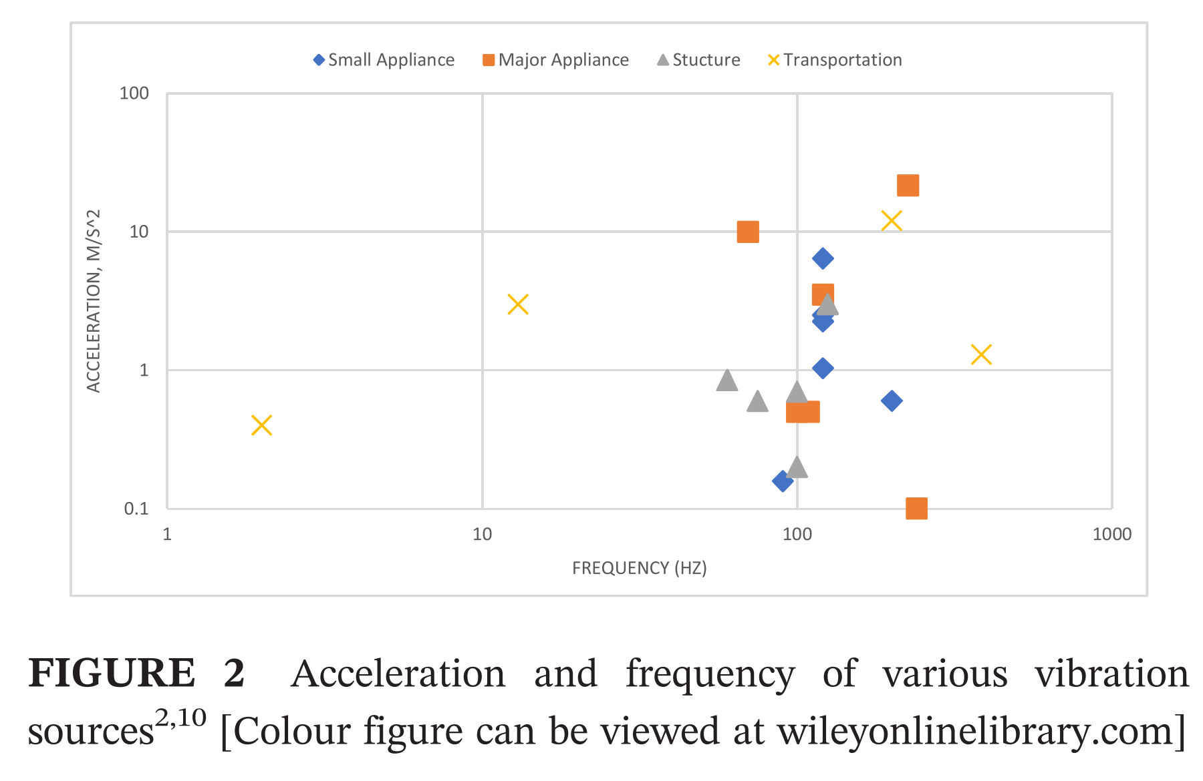
Frequency and acceleration of vibration from various sources
Acceleration (m/s²)
Frequency (Hz)
Image Source: Siang, J.; Lim, M. H.; Salman Leong, M. Int. J. Energy Res. 2018, 42, 1866-1893.

Slide 10
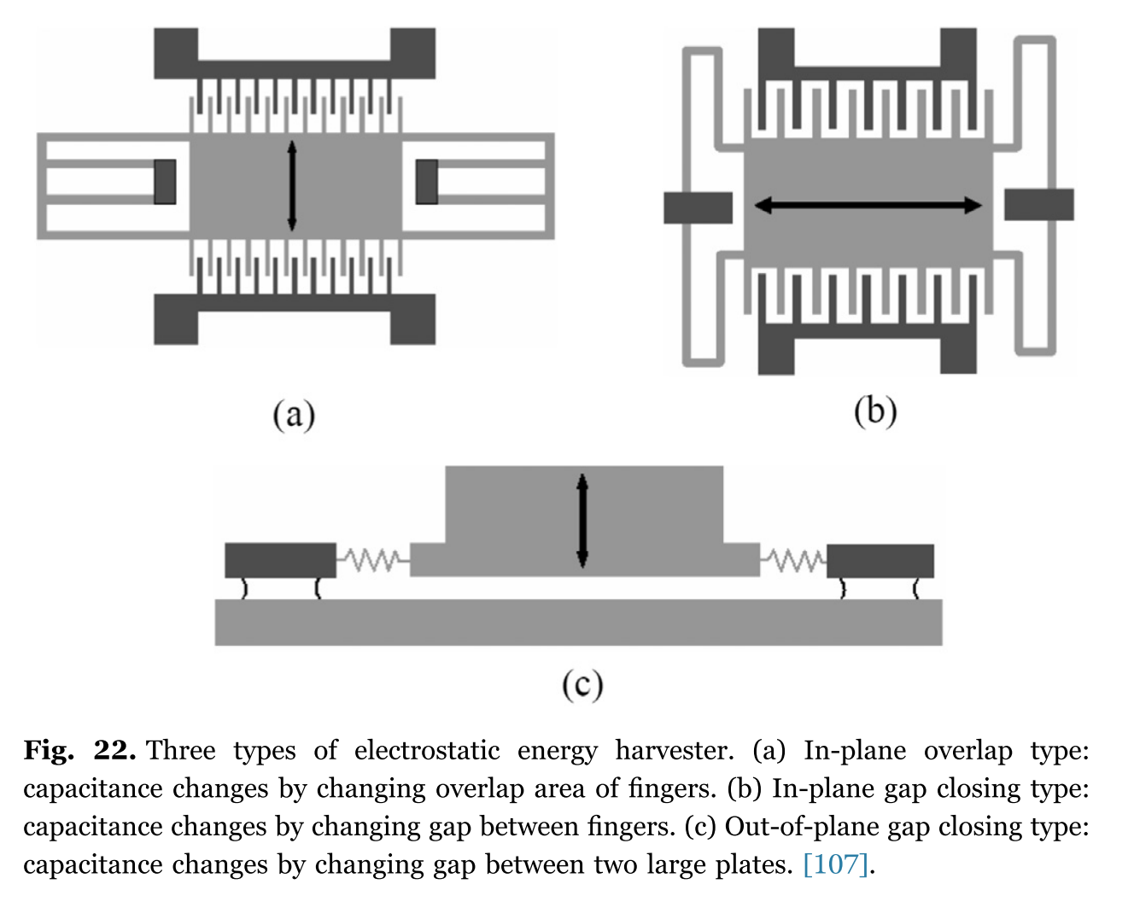
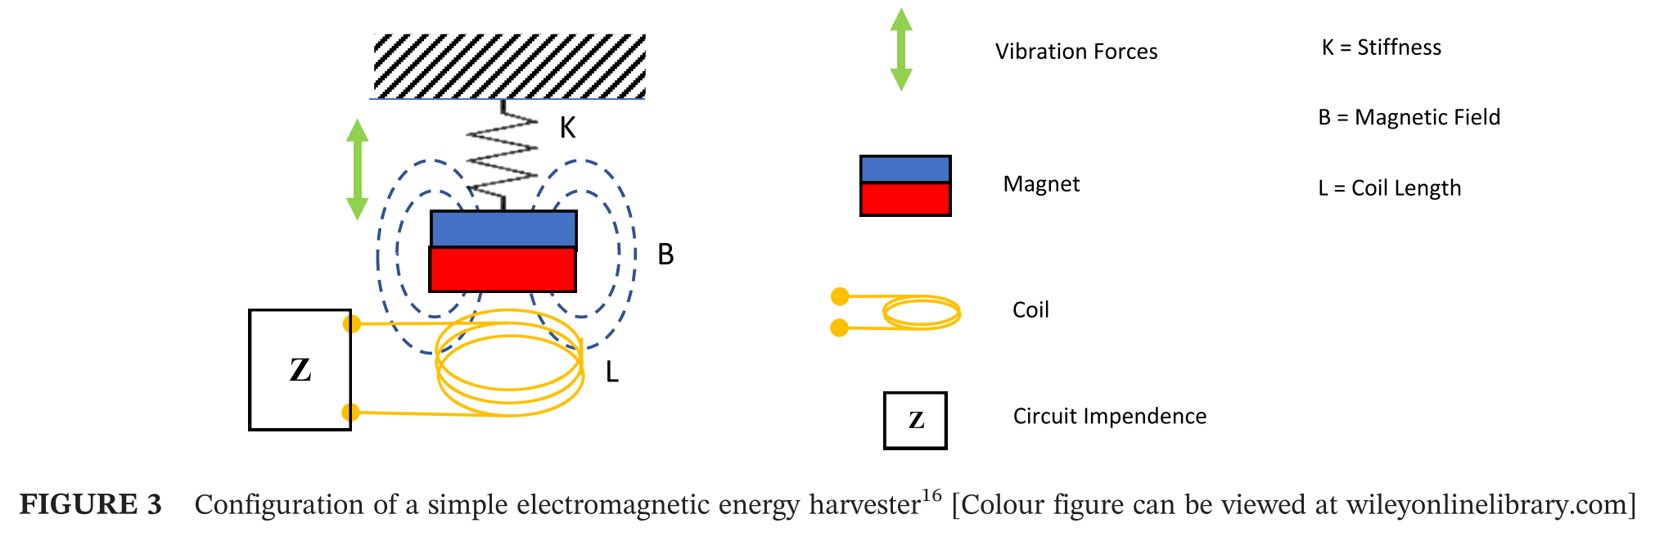
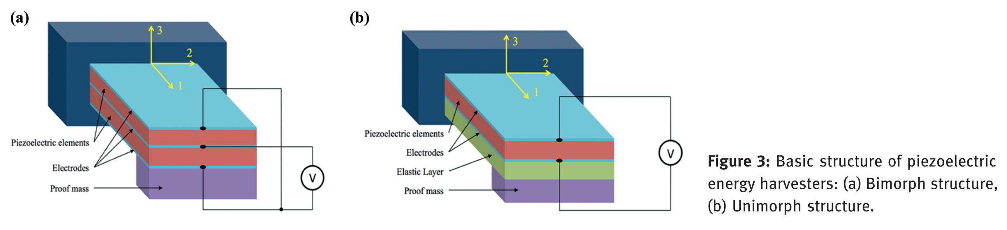
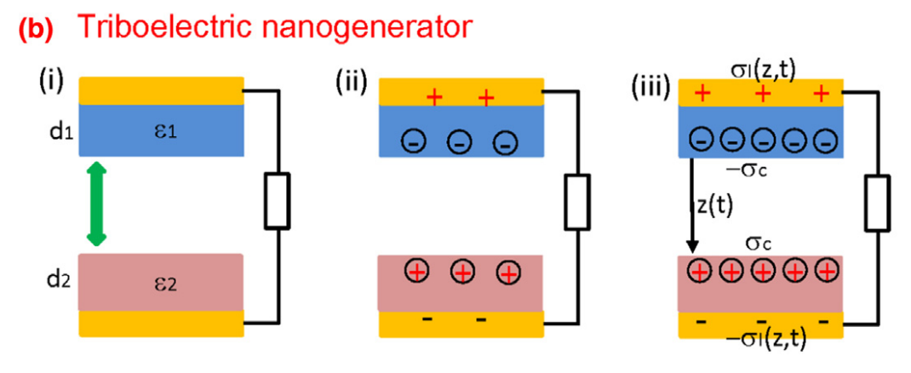
Three Main Methods of VEH
Electromagnetic
Piezoelectric
Electrostatic
capacitive
triboelectric
Additional niche methods include magnetostrictive and flexoelectric

Slide 11
Electromagnetic VEH
General Concept: vibrating magnet generates current in a conductive coil
Advantages: simple construction, high conversion efficiency
Disadvantages: low voltage compared to piezoelectric and electrostatic VEH, difficult to scale down (micro- and nano-scale coils)
Image Source: Siang, J.; Lim, M. H.; Salman Leong, M. Int. J. Energy Res. 2018, 42, 1866-1893.

Slide 12
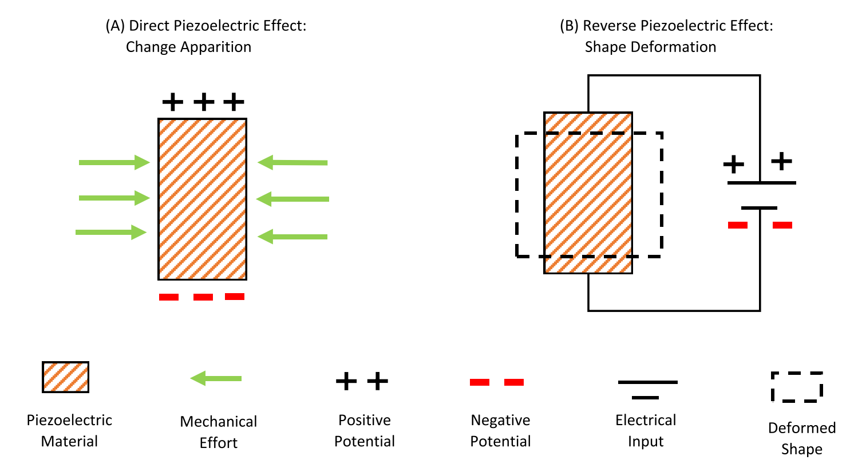
Piezoelectric VEH
The piezoelectric effect is a material property, where mechanical strain induces an electric field in the material (conversely, in the reverse piezoelectric effect, an applied electric field induces deformation)
Image Source: Shaikh, F. K.; Zeadall, S. Renew. Sust. Energ. Rev. 2016, 55, 1041-1054.

Slide 13
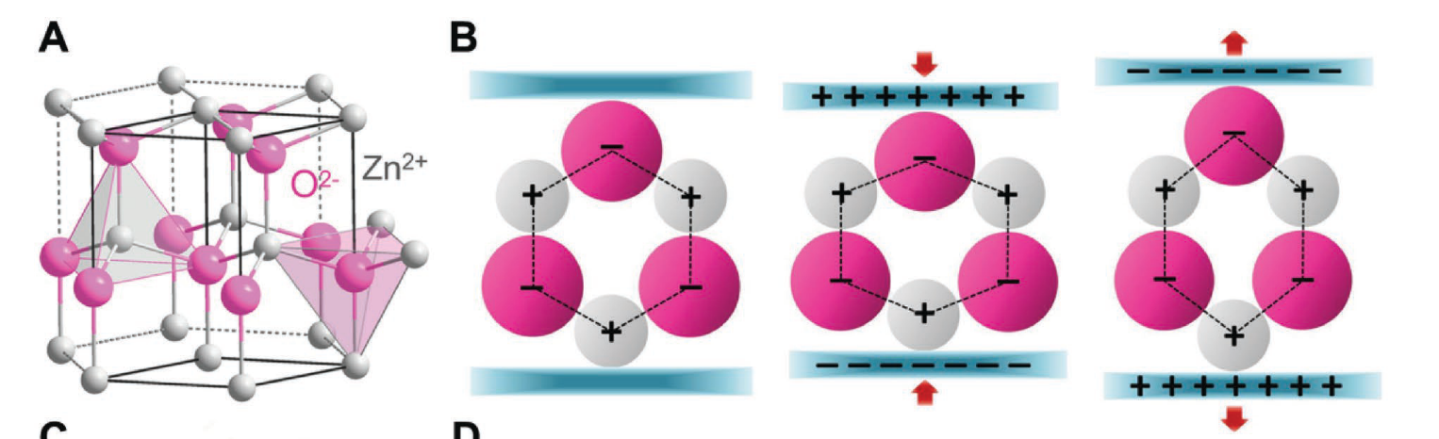
Piezoelectric VEH
Example: the piezoelectric effect in ZnO
The piezoelectric effect is a material property, where mechanical strain induces an electric field in the material
Zheng, Q. et al. Adv. Sci. 2017, 4, 1700029.

Slide 14
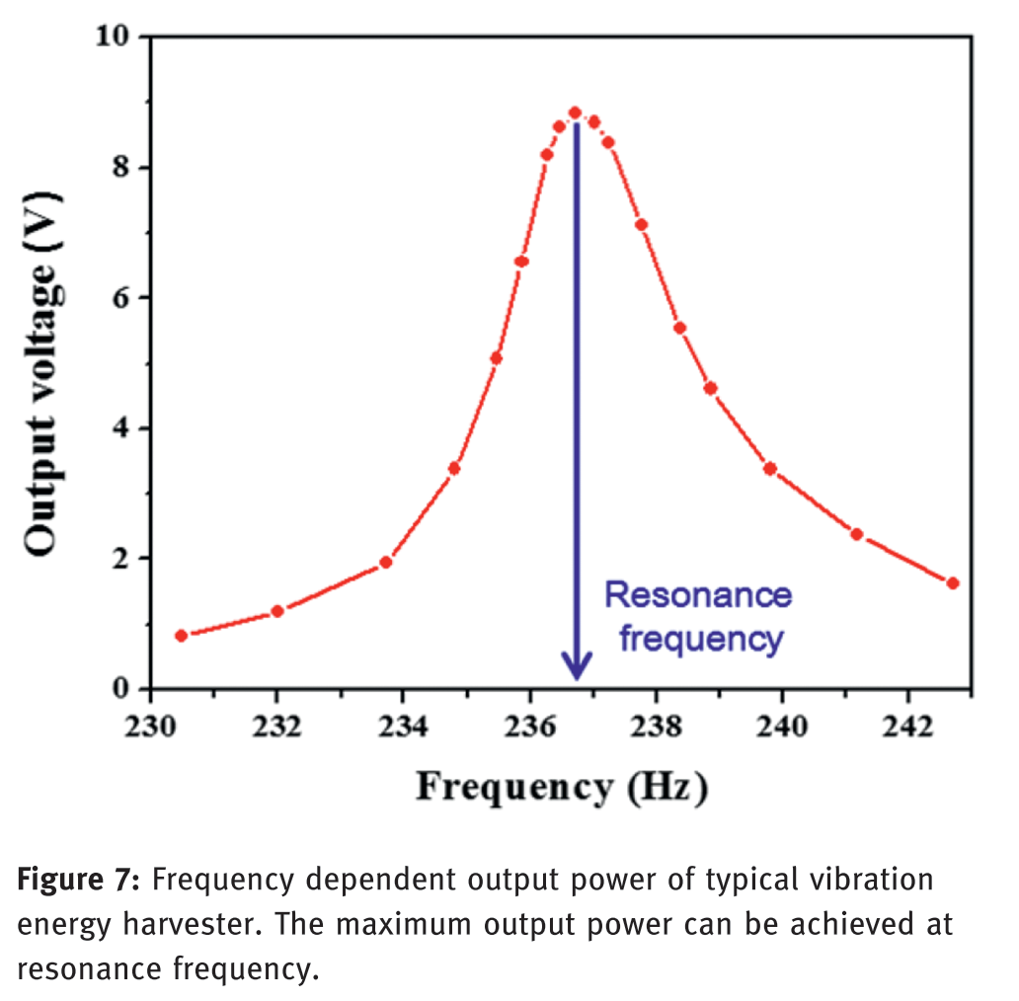
Piezoelectric VEH
Cantilever-based piezoelectric harvester design
Mass (purple) adjusts resonant frequency to the available environmental frequency
Unimorph Structure
Priya, S. et al. Energy Harvesting and Systems 2017, 4 (1), 3-39.

Slide 15
Piezoelectric VEH
Cantilever-based piezoelectric harvester design
General Concept: vibration induces a voltage across a piezoelectric material; typical piezoelectrics used are PZT (Pb(Zr,Ti)O₃) and AlN
Advantages: simple construction, can be smaller than electromagnetic VEH
Disadvantages: lifespan issues due to brittleness, depolarization of the dielectric (especially in high temperature environments)
Image Source: Priya, S. et al. Energy Harvesting and Systems 2017, 4 (1), 3-39.

Slide 16
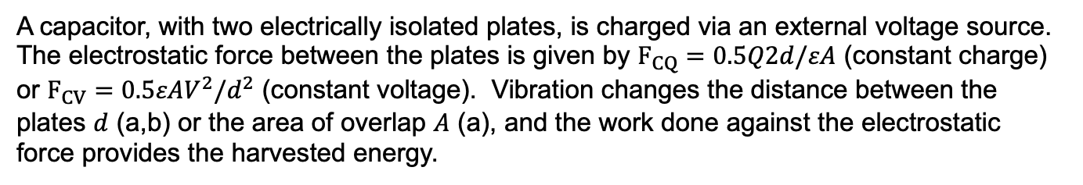
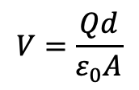
Electrostatic VEH – capacitive
In-plane overlap type
In-plane gap closing type
$$V=\frac{Qd}{ε_{0}A}$$
Out-of-plane gap closing type
A capacitor, with two electrically isolated plates, is charged via an external voltage source. The electrostatic force between the plates is given by $F_{CQ}=0.5Q2d/εA$ (constant charge) or $F_{CV}=0.5εAV^{2}/d^{2}$ (constant voltage). Vibration changes the distance between the plates $d$ (a,b) or the area of overlap $A$ (a), and the work done against the electrostatic force provides the harvested energy.
Beeby, S. P. et al. Meas. Sci. Technol., 2006, 17, R175-R195.

Slide 17
Electrostatic VEH – capacitive
General Concept: vibration either changes distance between capacitor plates or changes capacitor area
Advantages: straightforward fabrication (similar to existing MEMS components)
Disadvantages: requires an external voltage source
Beeby, S. P. et al. Meas. Sci. Technol., 2006, 17, R175-R195.
Varpula, A. et al. Sci. Rep. 2014, 4, 6799.

Slide 18
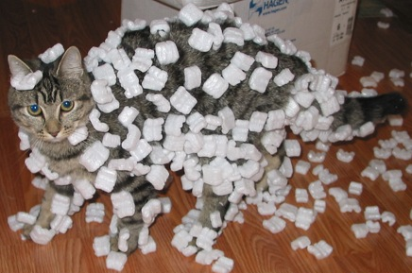
Electrostatic VEH – triboelectric
The triboelectric effect is a type of contact electrification where materials become electrically charged after they are separated from another material (e.g. static electricity)
“Triboelectric effect”, Wikipedia, accessed 2020-11-19. https://en.wikipedia.org/wiki/Triboelectric_effect

Slide 19
Electrostatic VEH – triboelectric
Two dielectrics are driven into physical contact; charges build up in the two dielectrics via the triboelectric effect (ii)
With additional cycles, further charges build up to saturation, and the resulting electrostatic field drives electrons to flow through the external load (iii)
Wang, Z. L. Mater. Today 2017, 20 (2), 74-82.

Slide 20
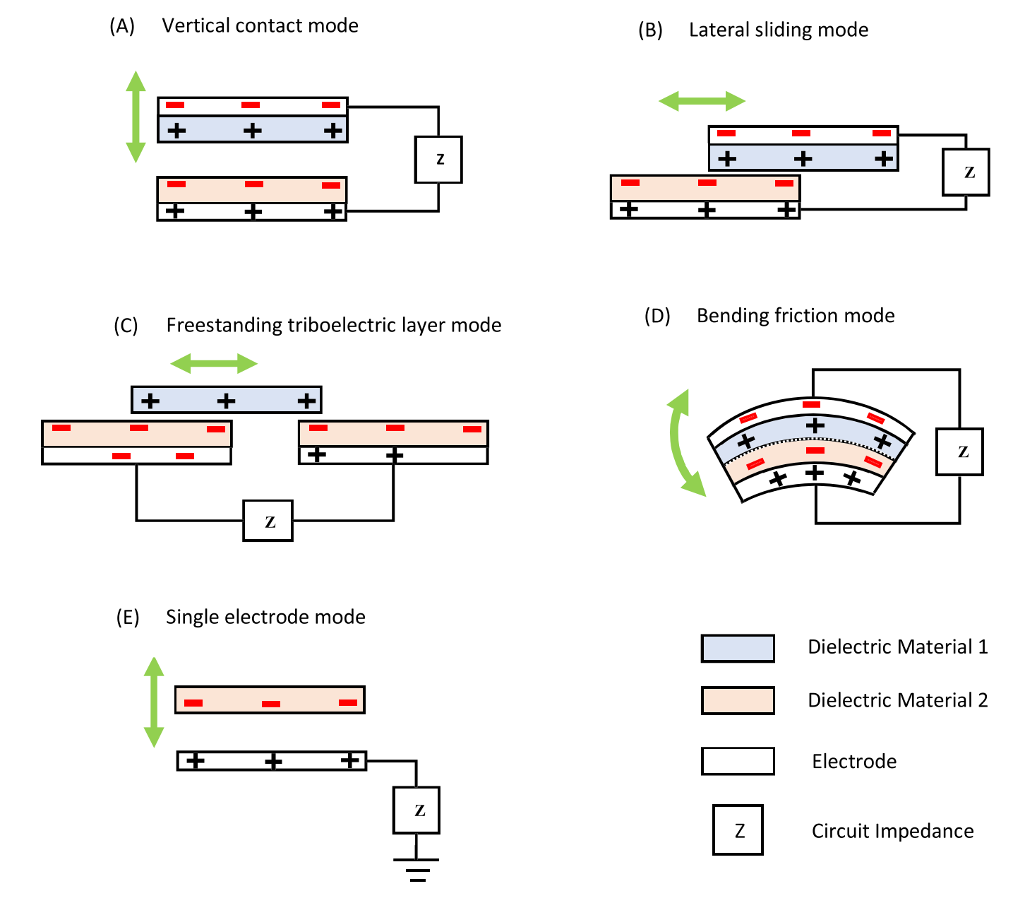
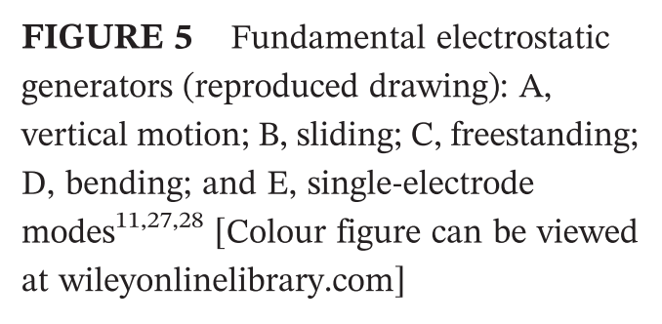
Electrostatic VEH – triboelectric
Siang, J.; Lim, M. H.; Salman Leong, M. Int. J. Energy Res. 2018, 42, 1866-1893.

Slide 21
Electrostatic VEH – triboelectric
General Concept: vibration induces contact and charge build-up via the triboelectric effect
Advantages: more mechanically robust than piezoelectric VEH
Disadvantages: low durability; high moisture environments affect device performance
Siang, J.; Lim, M. H.; Salman Leong, M. Int. J. Energy Res. 2018, 42, 1866-1893.

Slide 22
VEH Summary
Electromagnetic
Piezoelectric
Electrostatic
capacitive
triboelectric

Slide 23
VEH Summary
General Concept: vibrating magnet generates current in a conductive coil
Con: difficult to scale down to MEMS scale
Electromagnetic
General Concept: vibration induces a voltage across a piezoelectric material
Con: lifespan issues (depolarization, brittleness), temperature sensitivity
Piezoelectric
Capacitive
General Concept: vibration either changes distance between capacitor plates or changes capacitor area
Con: requires an external voltage source
Triboelectric
General Concept: vibration induces contact and charge build-up via the triboelectric effect
Con: lifespan issues, moisture sensitivity
Electrostatic

Slide 24
VEH Summary
General Concept: vibrating magnet generates current in a conductive coil
Con: difficult to scale down to MEMS scale
Electromagnetic
General Concept: vibration induces a voltage across a piezoelectric material
Con: lifespan issues (depolarization, brittleness), temperature sensitivity
Piezoelectric
Capacitive
General Concept: vibration either changes distance between capacitor plates or changes capacitor area
Con: requires an external voltage source
Triboelectric
General Concept: vibration induces contact and charge build-up via the triboelectric effect
Con: lifespan issues, moisture sensitivity
Electrostatic
Are any of these VEH systems commercially available?

Slide 25

Appear to have commercial electromagnetic VEH products available!
From their website: “If you are looking into the Internet of Things and consider costly cable installations and battery replacements to be an issue, ReVibe’s energy harvesting solutions might just be the thing for you. If vibrations, impulses or other mechanical movement is found close to the applications that needs monitoring, we can offer you a sustainable, cost-efficient and completely autonomous power source!”
https://revibeenergy.com/

Slide 26
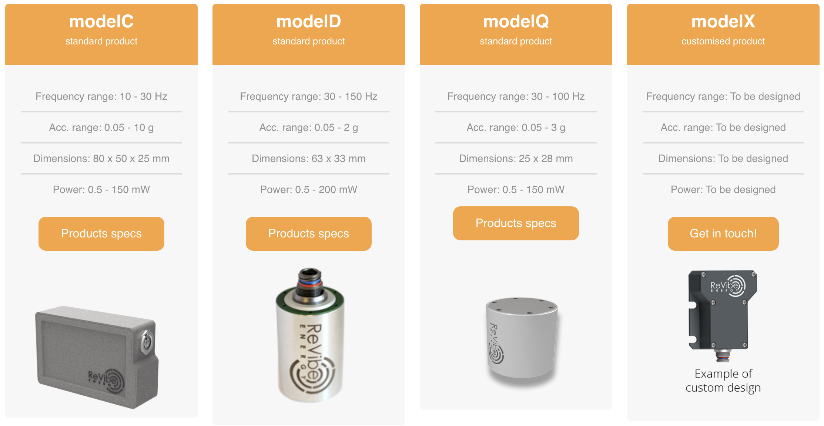
Offer three standard VEH products and customized products
€295
€645
€695
https://revibeenergy.com/

Slide 27

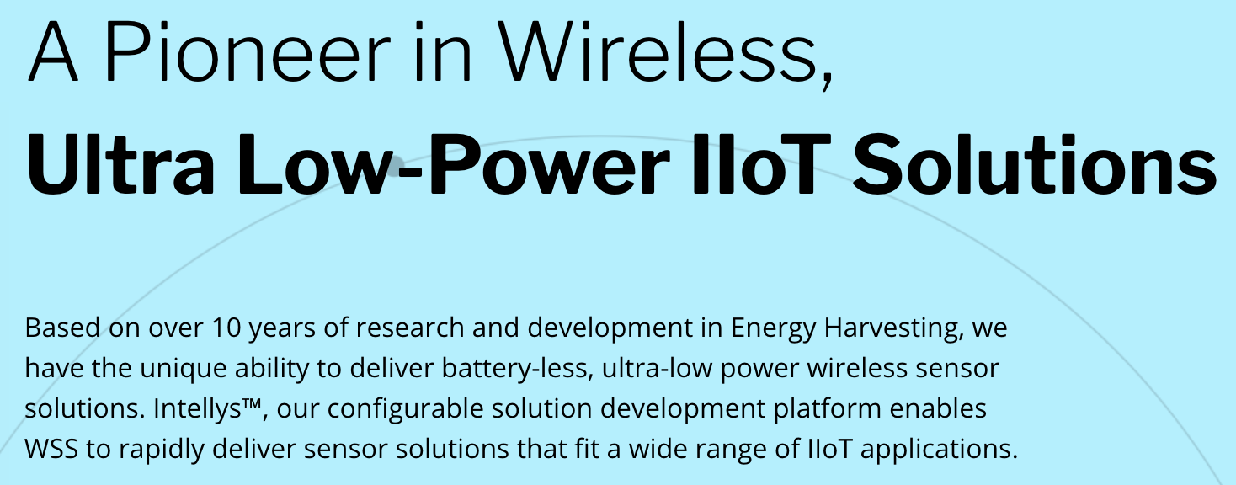
microGen Systems, Inc., founded 2010, was developing piezoelectric VEH; according to their LinkedIn page (probably last updated ~2011):
“microGen Systems, Inc., is the leading supplier of MEMS-based piezoelectric vibrational energy harvesting power generators and systems. We provide perpetual power solutions essential to the growth of the Internet of Things (IoT).”
Wireless Sensor Solutions, founded 2017, acquired microGen Systems (also in 2017):
IIOT = industrial internet of things
https://www.linkedin.com/company/microgen-systems-inc/about/ and https://www.wsstec.com/

Slide 28
Questions?

