Slide 1
Energy End-uses:
Residential and Commercial Sectors
Rupak Chakraborty
HEJC
November 19, 2015

Slide 2
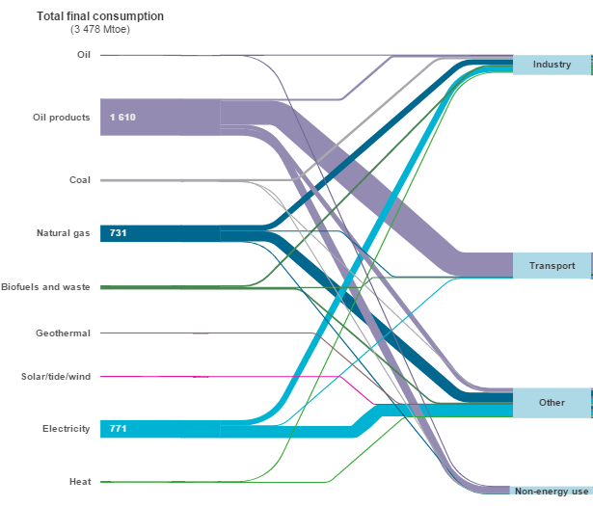
Global energy end-use
40 PWh
IEA 2013

Slide 3
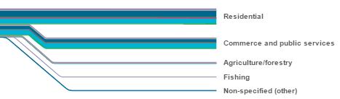
What is in “Other”?
IEA 2013
Notes:
2010 numbers:
24% for residential
8% for commercial
32% total

Slide 4
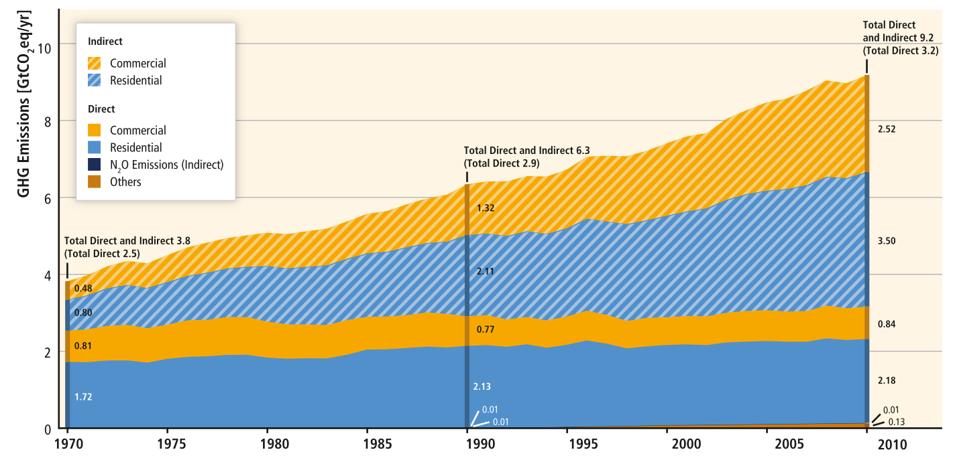
Buildings
32% of global final energy end use; 19% of all global GHG emissions
Electricity use
Fossil fuel combustion
IPCC WG3 AR5
Notes:
Most comes from indirect CO2 emissions from electricity use in buildings
Indirect emissions are growing faster than direct emissions

Slide 5
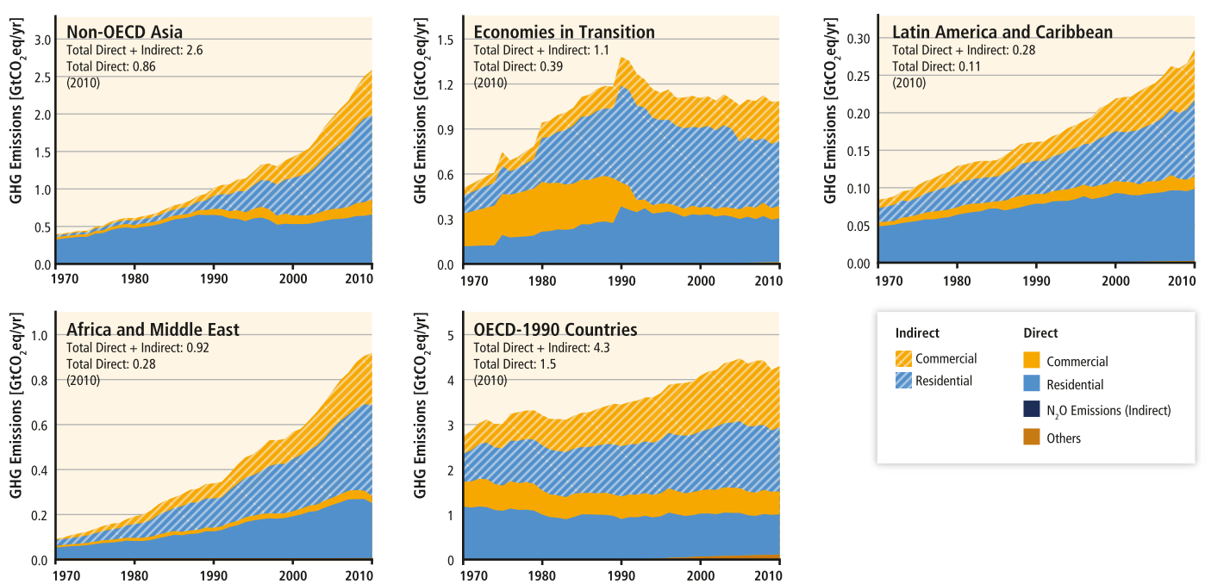
Regional emissions growth
IPCC WG3 AR5
Notes:
Growth driven by non-OECD Asia, no surprisingly

Slide 6
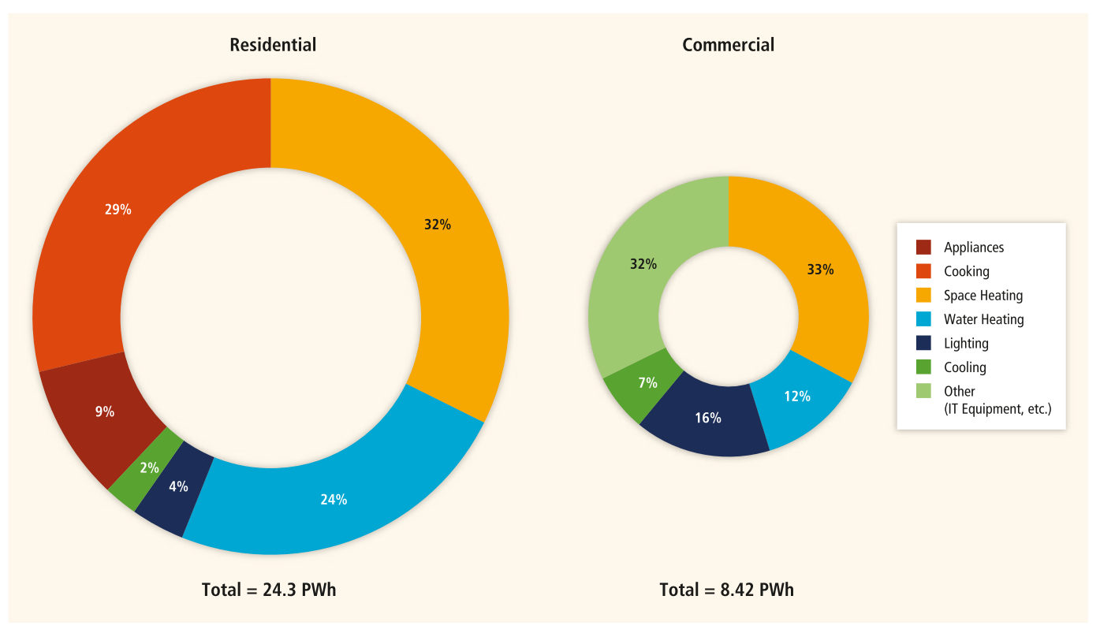
End-use breakdown
IPCC WG3 AR5
Notes:
World building final energy consumption be end-use in 2010
Most of this is thermal energy use – cooking, space heating, water heating
Cooling, suprisingly, is only a small fraction of the total energy use in these sectors

Slide 7
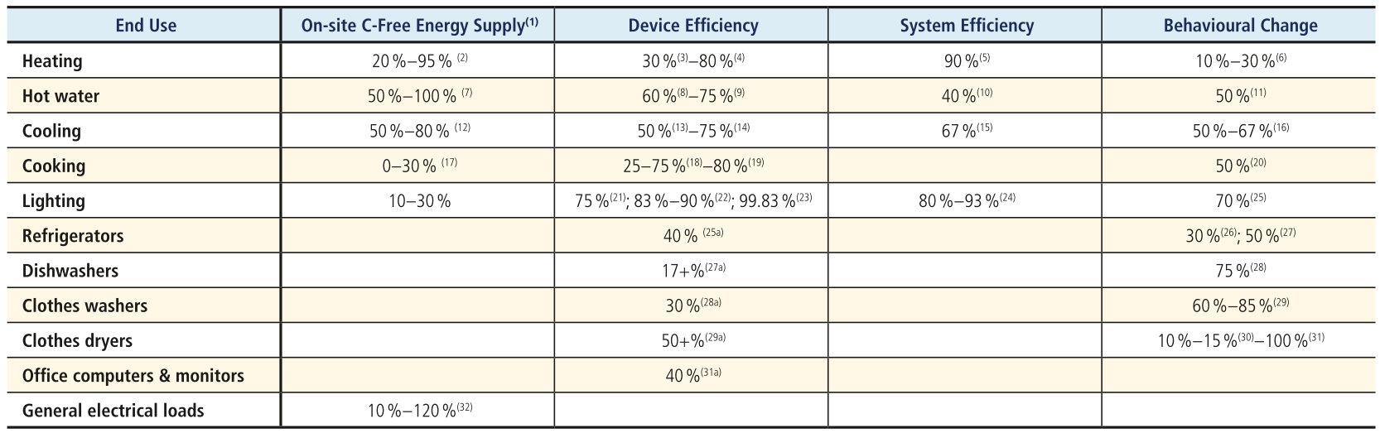
Reduction potentials
IPCC WG3 AR5

Slide 8
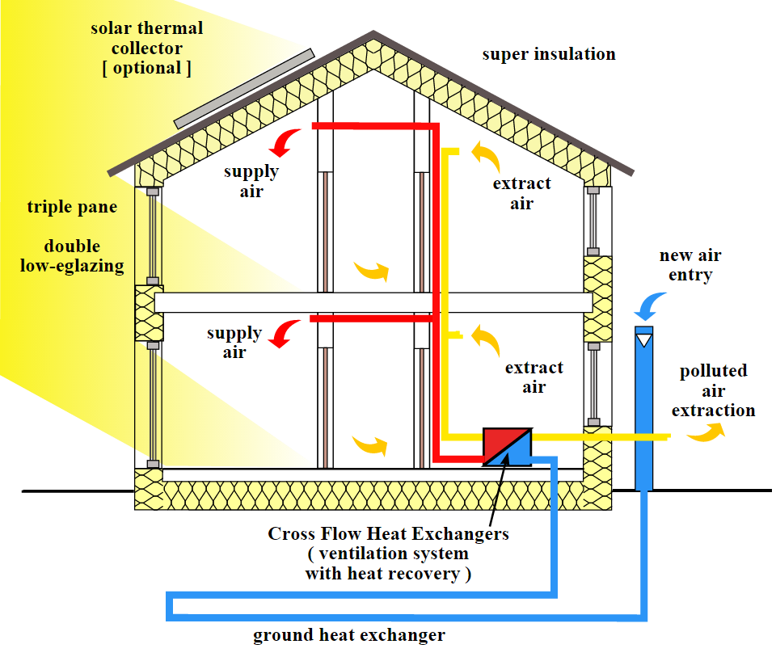
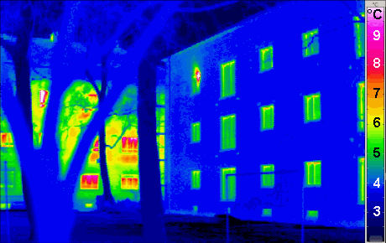
Thermal improvements: new buildings
New buildings
  Passive House Standard: 15 kWh/m²/yr for heating (60-250 typical)
Notes:
As discussed in
AR4, essential steps in the design of low-energy buildings are:
(1)
building orientation, thermal mass, and shape;
(2) high-performance
envelope specification;
(3) maximization of passive features (day-
lighting, heating, cooling, and ventilation);
(4) efficient systems meet-
ing remaining loads;
(5) highest possible efficiencies and adequate
sizing of individual energy-using devices; and
(6) proper commission-
ing of systems and devices.

Slide 9
Thermal improvements: old buildings
Comprehensive retrofits can result in 50-75% reduction
Modest insulation upgrades in developing countries can achieve reduction in heating energy by 66%

Slide 10
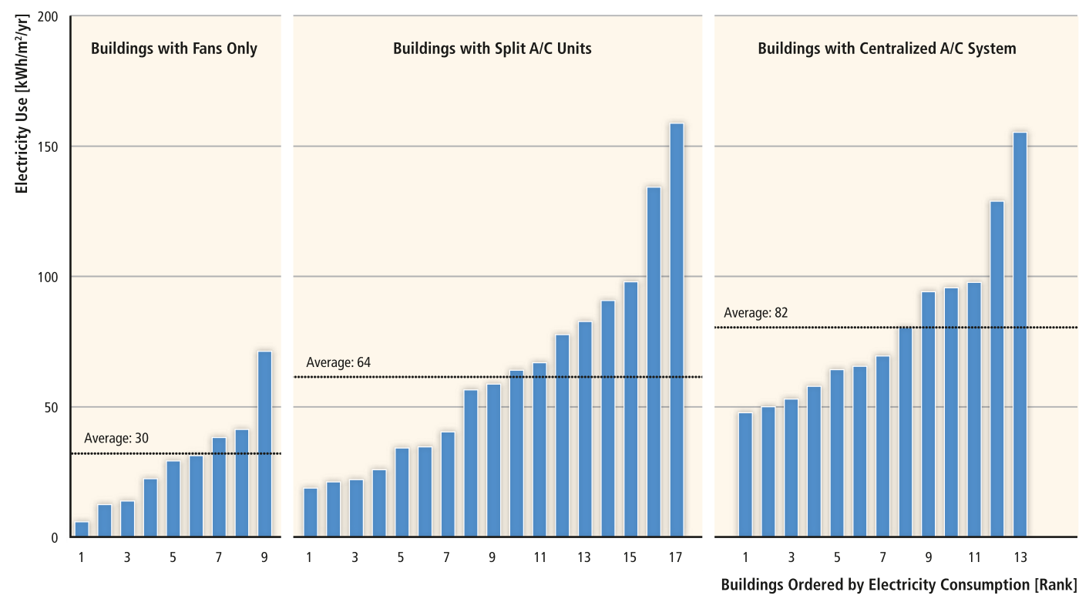
Thermal improvements: decentralized cooling
Beijing, China
IPCC WG3 AR5

Slide 11
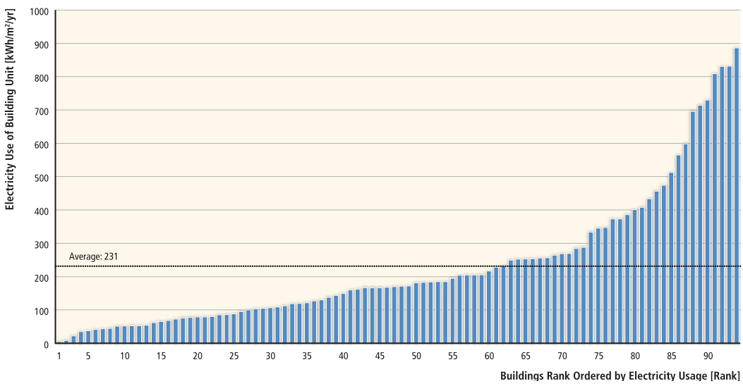
Thermal improvements: decentralized cooling
Philadelphia
IPCC WG3 AR5

Slide 12
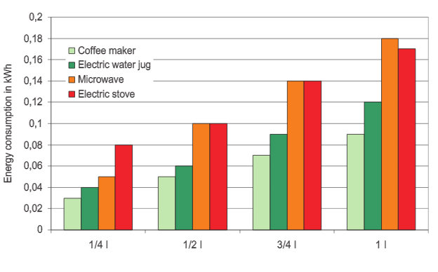
Cooking
50 % savings potential just through changing cooking practices
Oberascher et al. 2011

Slide 13
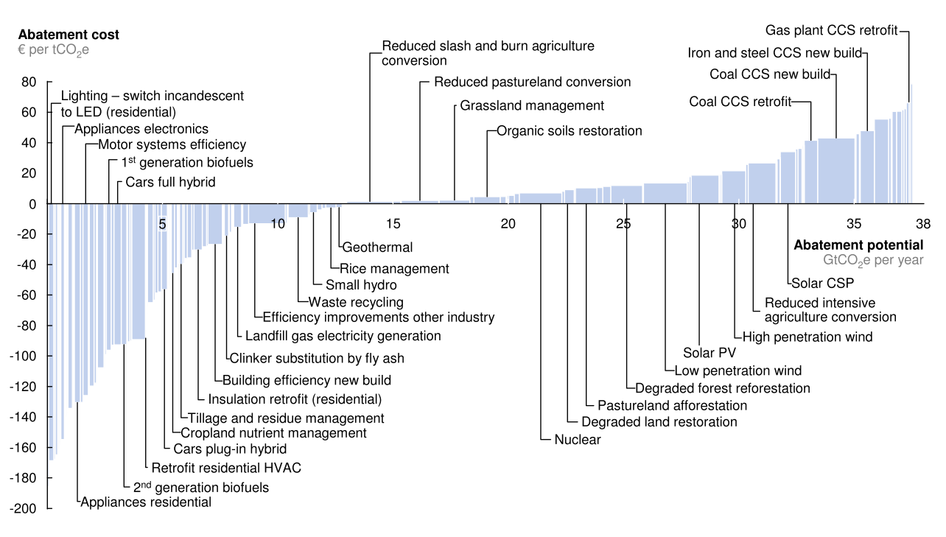
Efficiency aligned with economics?
Up-front cost
Lack of information
Principal-agent problem
Inaccurate discount rate
Unintended behavioral changes
Why aren’t these happening more frequently?
McKinsey 2010
Notes:
-often it is the rational economic choice to be energy efficient, but people discount
Lack of information:
Existence of efficient appliances or knowledge of potential savings not known
Principal agent problem
Apartment complex
Inaccurate discount rate
CAFÉ standards just make clear to the consumer
Unintended behavioral changes

Slide 14
Reduction potentials

Slide 15
Reduction potentials
2°C less
Shorter showers
Fans
Cooking practices
Turning off
No beer fridge
Fully loaded
Wash cold
Full load; air dry

Slide 16
How the digital world helps
Consumption data visibility (smart meters)
Automated hardware
  Smart thermostats/vents

Slide 17
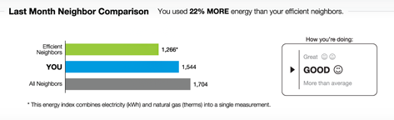

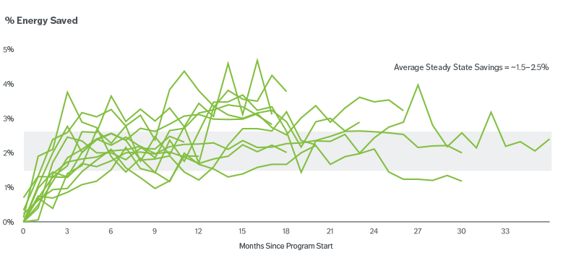
Behavioral changes…for the better
Enabled by…data utilities already had

Slide 18
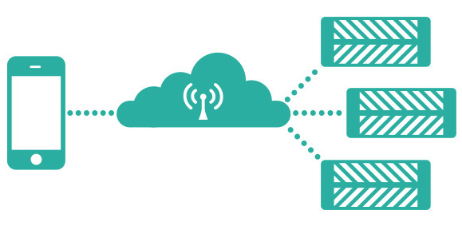
Retrofit decentralized cooling
Smart vents (Keen Home, Ecovent)

Slide 19
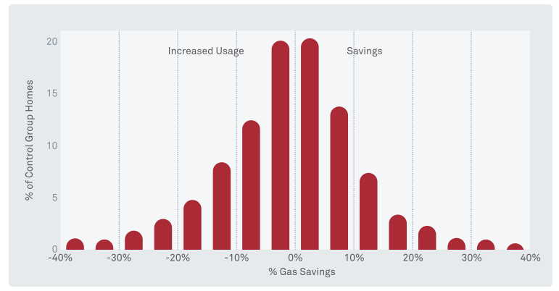
Retrofit smart thermostats: Nest

Slide 20
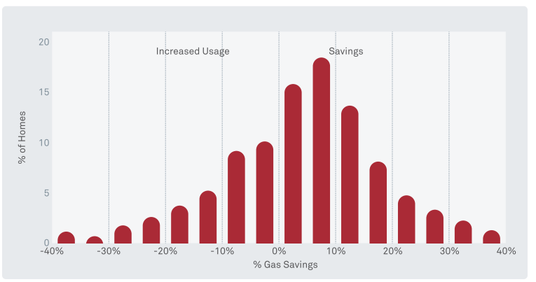
Retrofit smart thermostats: Nest

Slide 21
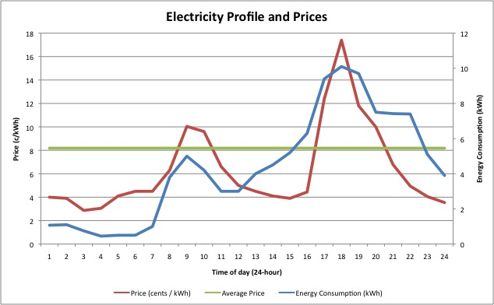
Smart meters
Smart meters record energy consumption at < 1hr intervals
Enables real-time tracking of consumption, enabling demand management

Slide 22
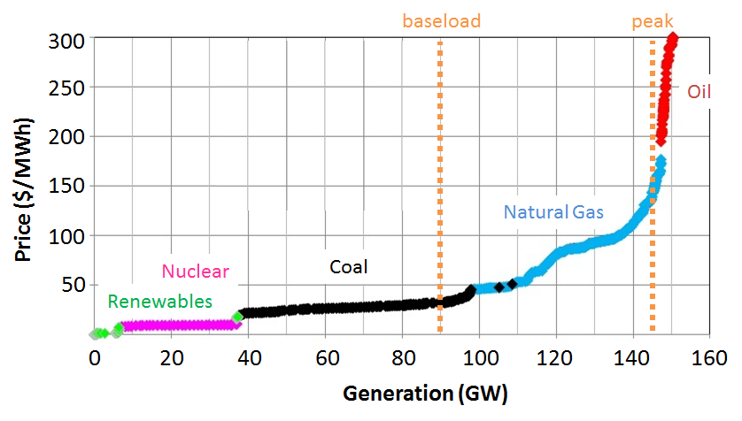
Peak demand => dirty fuels and higher price

Slide 23
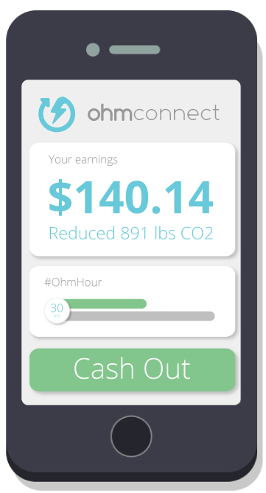
Smart meters enable demand-management
OhmConnect: notifies you during peak hours, and you get paid to turn down your AC/heat
ENERNOC and others: same for industry

Slide 24
Summary
19% of global GHG emission due to residential and commercial building use
Recent growth largely due to rising electricity consumption
Most energy use at residential and commercial level is for thermal energy
Economic incentives may align with energy efficiency, but detrimental behavioral changes must be thought through
Behavioral change is a key mitigation strategy, enabled by
  Visibility into energy consumption
  Automation of energy usage

Slide 25
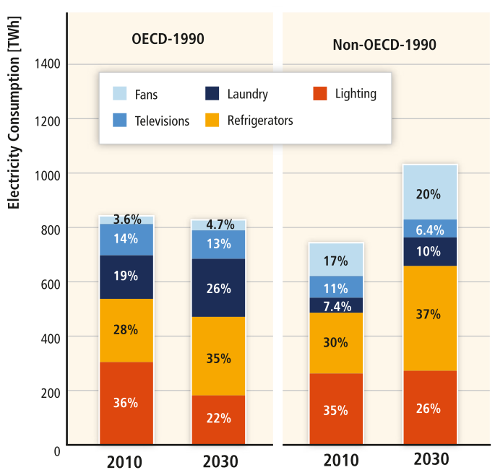
Electricity consumption
IPCC WG3 AR5

