Slide 1
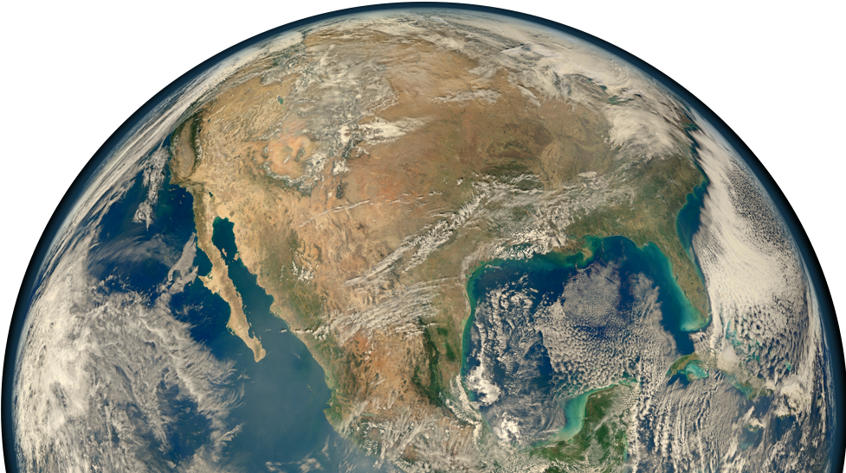
Solar Geoengineering
Harvard Energy Journal Club
September 14, 2018
Colleen Golja

Slide 2
1
Solar Geoengineering Basics
2
Current Research
a)
Laboratory Studies
Content Overview
b)
Climate Impacts
c)
In Situ Experiments
3
Discussion and Questions

Slide 3
1
Solar Geoengineering Background

Slide 4
Background: What is Solar Geo?
Notes:
-Solar geoengineering, or Solar Radiation Management (SRM), is the largescale intentional manipulation of radiative forcing to partially and temporarily reduce anthropogenic climate change
-Earth’s energy balance consists of incoming energy from the sun, balanced by outgoing long wave radiation.
-The difference between incoming and and outgoing energy is absorbed in the earth’s atmosphere and at the surface – giving rise to Earth’s Equilibrium Temperature.
-GHG’s act to force the surface to higher equilibrium temperatures by intercepting and redirecting some of earth’s outgoing longwave radiation, increasing the net downward radiative flux
-Aerosols may act on both sides of the energy balance – particles of diameter less than 1 micron are effective at scattering incoming radiation- sending some portion back to space
-particles may also act to absorb outgoing longwave radiation and heat the atmosphere around them

Slide 5
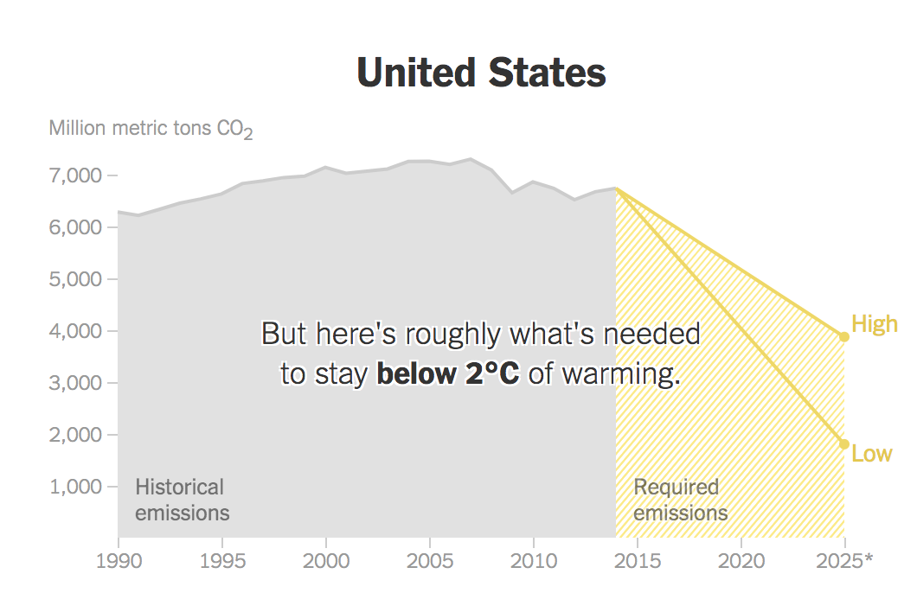
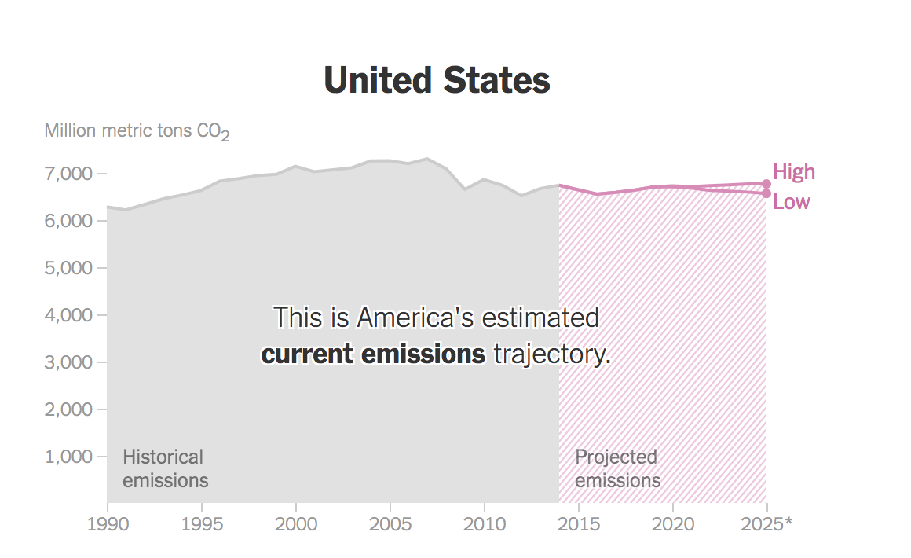
Background: Why Consider this?
Source: Plumer, Brad. 2017. “Here’s How Far the World Is From Meeting Its Climate Goals.” The New York Times, November 6, 2017, sec. Climate.

Slide 6
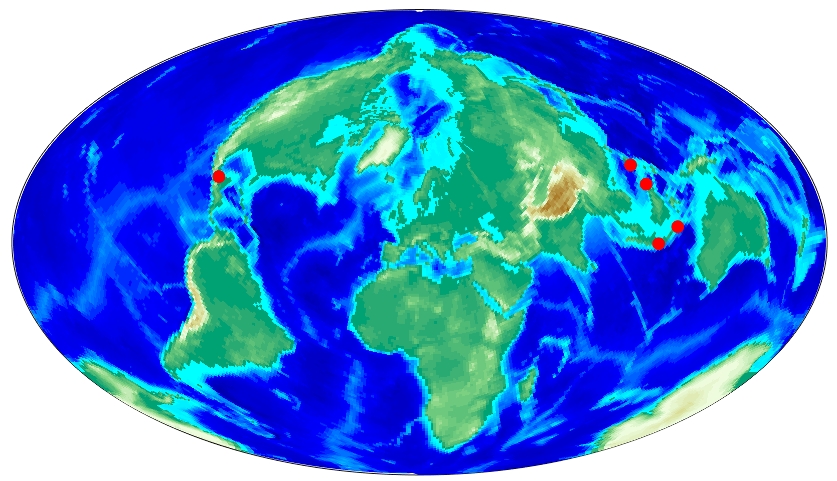
Background: Overview
Location of Notable Volcanic Events
Notes:
Pinatubo: erupted in 1991 → 17 megatons SO2 (sulfate aerosols ) , spread in 3 weeks stayed a year, increased globally averaged optical depth were 0.15 for a year Effects on climate were an observed surface cooling in the Northern Hemisphere of up to 0.5 to 0.6°C, midlatitude ozone concentrations reached their lowest levels on record during 1992-93, the Southern Hemisphere "ozone hole" increased in 1992 to an unprecedented size, and ozone depletion rates were observed to be faster than ever before recorded.
Krakatoa : 1883 – deadliest and most destructive in history : The record rainfall that hit Southern California during the “water year” from July 1883 to June 1884 – Los Angeles received 38.18 inches (969.8 mm)
El Chicon : 1982 – 8 megatons SO2
Agung: 1963, injected dust and volatiles into the stratospheric aerosol layer more directly. Analyses of magmatic volatiles indicate that the Agung eruption was proportionately richer in SO₂ and Cl than either Tambora or Krakatau
Tambora:1815, Produced the “year without a summer”
Eruptions in the tropics can lead to sulfate aerosols that are easily spread across both the northern and southern hemisphere, leading to global-scale cooling of the surface. While the surface cools, the stratosphere actually warms. Volcanoes farther away from the tropics mean more regional impacts.

Slide 7

Background: Volcanoes
HBr
SO₂
HCl
CO₂
H₂S
hv
OH
H₂SO₄
_{aerosol}
SO₂
Notes:
-Notable Gases when a volcano erupts :
HCL
HBR
SO2
CO2
H2S

Slide 8
Background: Volcanoes
HBr
SO₂
HCl
CO₂
H₂S
Loss Cycle
Cl + O₃ → ClO + O₂
ClO + O → Cl + O₂
Aerosol Catalyzed
HCl
ClNO₃
H₂SO₄
_{aerosol}
Notes:
-Notable Gases when a volcano erupts :
HCL
HBR
SO2
CO2
H2S

Slide 9


Background: Aerosol
Notes:
Aerosols are suspensions of fine solid or liquid droplets in air or gas
-Aerosols in air are typically defined as being in size range a few nm to 100 microns. As we continue – know that we will exclusively be talking about fine particles -- -coarse are larger and are often things like dust, pollen, mold, debris ash etc.
-you tend to get redder sunsets after volcanic eruptions – sulfate aerosols reflect blue/ green and at sunset the zenith angle is at it’s max and you get -- you also get clouds refracting and reflecting light through water droplets – this is an aerosol effect
-fog --> fog – often hard to see through – because as water droplets swell their cross sectional area for scattering – eventually blocking out all wavelengths →

Slide 10
Background: Materials
1). Radiative Properties
2). Chemical Properties
Incident Radiation (Visible Light)
Scattered Radiation
Involvement with catalytic destruction of ozone
hv, ClO_{x}, HO_{x}, NO_{x}
O
3
O
O
2
O
O
Incident Radiation (Long Wave IR)
= absorption
Notes:
Aerosol : a colloidal suspension of particles in a gas
-colloid meaning the particles are evenly distributed and will not settle out
Different materials exhibit different radiative properties based on size and chemical makeup
-for SRM we desire particles that are efficient scatters around 550nm (400-700 nm peak at 550 in the green ) ---scattering is maximum for a particle radius corresponding to the wavelength of radiation-----
-we also wish to minimize particle absorption of both incoming and outgoing radiation!
-Second it would be ideal if the species we choose does not participate in ozone depleting catalytic cycles
-these you can compare to green house gases which only act on outgoing IR (bc they are so small)
Rayleigh scattering – air molecules, ghgs, etc
mie scattering -= particles about same size as wavelength
You get some amount of forward scattering → fun fact this is why putting high beams on in fog sucks bc. it backwards scatters right attcha

Slide 11
Background: Materials
0.6 um
Refractive Index = 1.43 (550 nm)
OH, H₂O
S
H₂SO_{4 (aq)}
IR absorption
O
O
Participates in ozone depleting reactions
Sulfur Dioxide
Sulfate Aerosol
0.550 um
Refractive Index = 1.57 (550 nm)
CaCO_{3 (s)}
Minimized IR absorption
?
May participate in ozone depleting reactions
May serve as sink for HCl, HBr, HNO₃, and H₂SO₄
Calcite Aerosol
Keith et al. December 27, 2016
Notes:
calcite refractive index: 1.57 + 1.1 e -4 i
sulfate refractive index: 1.43 + 1 e -8 I
list index of refraction not really that high
Source: https://keith.seas.harvard.edu/files/tkg/files/keith_et_al._-_2016_-_stratospheric_solar_geoengineering_without_ozone_l.pdf

Slide 12
Background: Materials
H₂SO₄
HCl + ClNO₃
Cl₂
2 HNO₃
2HCl
H₂SO_{4 (aq)}
CaCO_{3 (s)}
Calcite Aerosol
N₂O₅ + H₂O
2HNO₃
Notes:
1). CaCO₃ + 2 HNO₃ → Ca(NO₃)₂ + H₂O + CO₂
2). CaCO₃ + H₂SO₄ → CaSO₄ + H₂O + CO₂
3). CaCO₃ + 2HCl → CaCl₂ + H₂O + CO₂

Slide 13
2
Current Research

Slide 14
Experiments Overview
Lab Studies + Observations
Inform Model Parameters
Use Model to Predict Outcomes
Test Model Assumptions

Slide 15
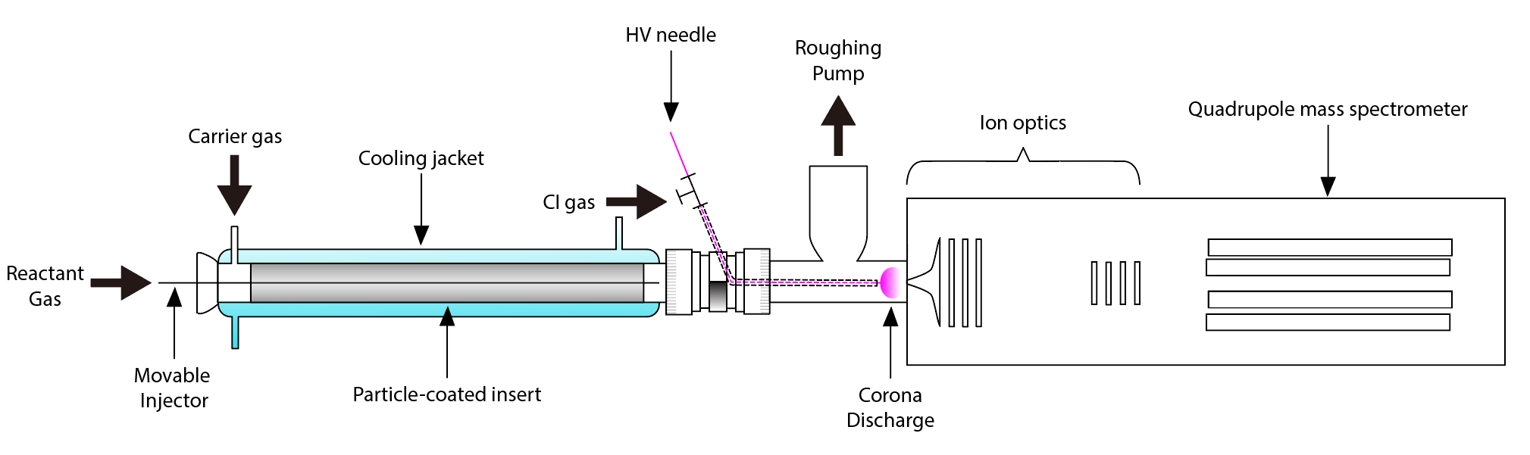
Experiments Flowtube
Variables
Output
Method
Particle types
Surface as catalyst
Flow tube-mass spectrometer
Gaseous species
(HCl, HNO₃ )
Important reaction kinetics
Particle as reactant
Chemical analysis of total uptake
Temperature
Number density
Humidity
UV radiation

Slide 16
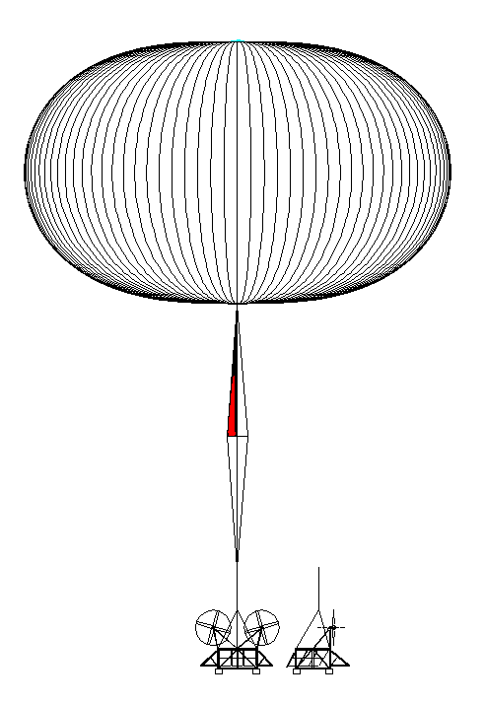
Experiments: Stratospheric Controlled Perturbation Experiment
Flight Through Plume to Collect Samples and Data
Release Solid Particles into Plume Wake
Coagulation + Chemistry
Expansion
Notes:
What is the experiment capturing – diagram of the reactions we don’t totally understand – separate sulfer rxns from calcium carbonate
Show two injection locations

Slide 17
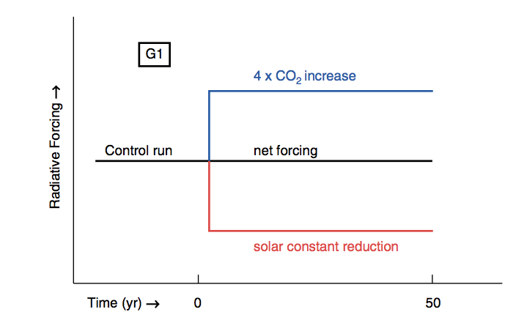
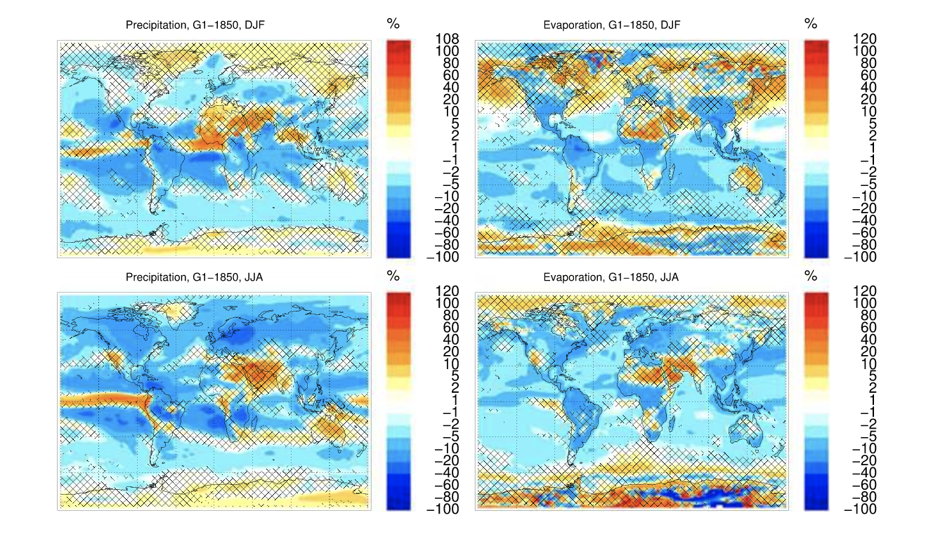
Modeling:
Hydrology under SRM
Precipitation
Evaporation
Tilmes et al, 2013
Notes:
Feedbacks associated with changes in cloud cover represent the largest uncertainty in current model representations of change:
clouds may serve to increase the albedo of the earth, reflective- but are also efficient absorbers of IR radiation
-cooling drives down evaporation which tends to decrease precipitation while increasing IR tends to increase temperature increase precip and increase evap
-model representations of these feedbacks are the largest sourch of intermodel uncertainty in the geomip G1 model – it would be interesting to understand how model parameterizatons impact the results ? So we are going to look at a). CAM a normally parameterized GCM vs. b). SP CAM – with a superparameterized cloud component
“Ensemble mean seasonal differences between G1 and 1850 experiments of (left column) precipitation and (right column) evaporation for (top row) DJF and (bottom row) JJA. All available ensemble members for each model and all years are considered. Hashed areas indicate locations where less than 75% of the models agree on the sign of change.”

Slide 18
Cloud Resolving Model
GCM Grid Box
Cloud Resolving Model
26 Vertical Layers
100 km
2 km
2 km
100 km

Slide 19
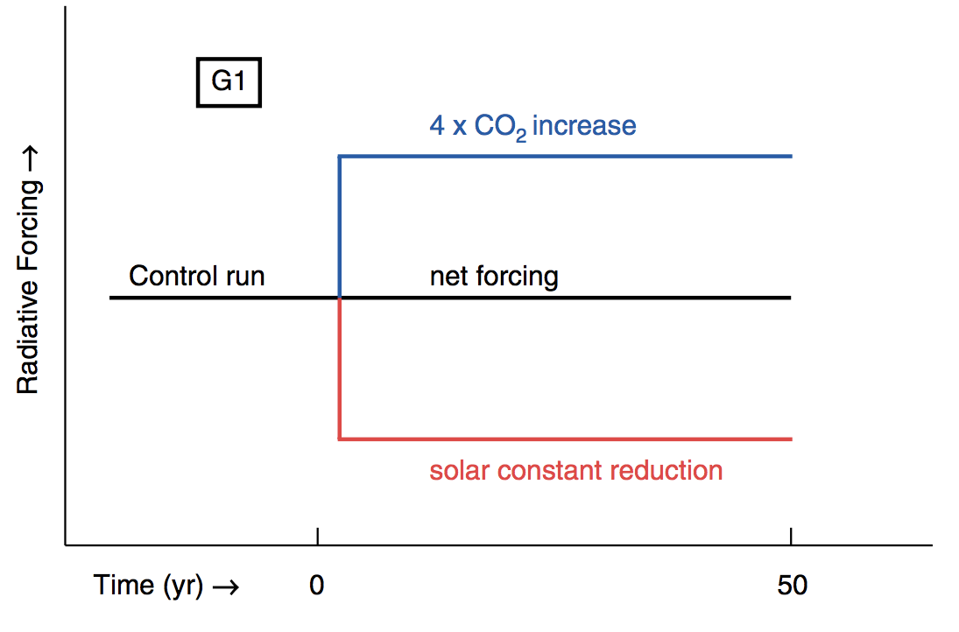
SP-CAM Proposed Scenario
Proposed
2 x CO₂ increase
net forcing
solar constant reduction
(50% offset)
(100% offset)
Compare results from :
1). CAM
2). SPCAM

Slide 20
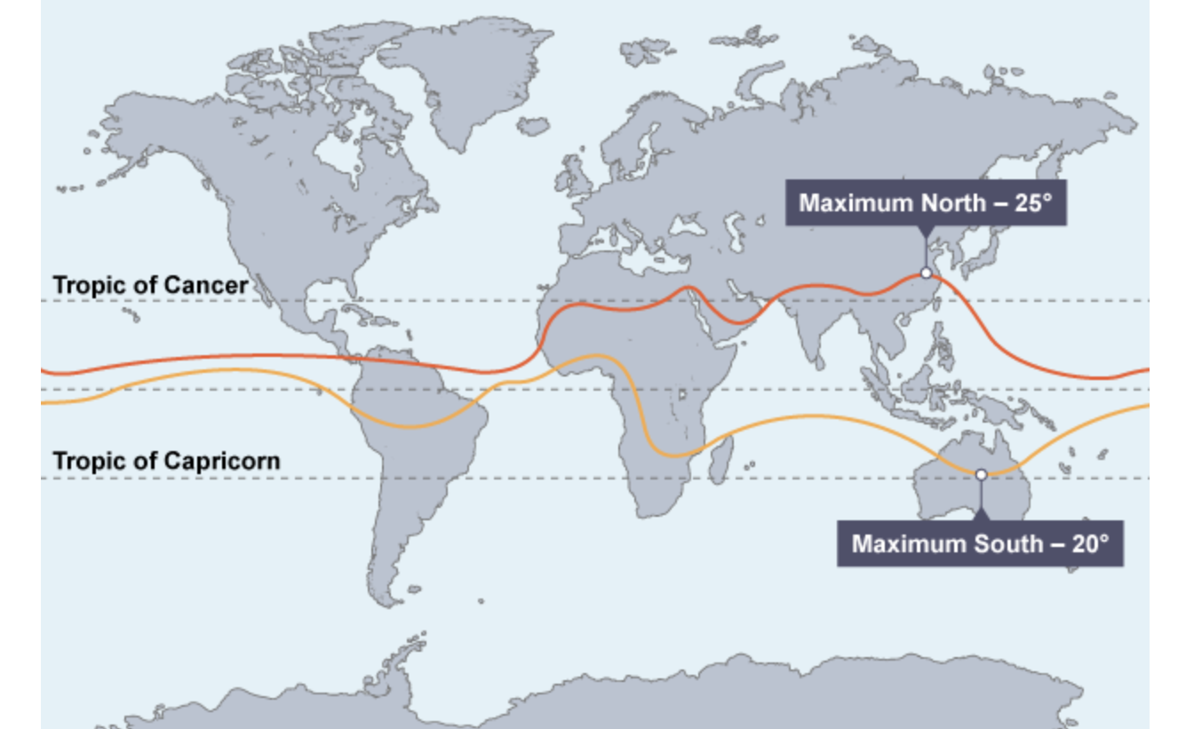
SP-CAM Regional ITCZ Migration
Location of the ITCZ
Source: “The Cause and Impact of the Intertropical Convergence Zone.” n.d. BBC Bitesize. https://www.bbc.com/bitesize/guides/z9yssbk/revision/1.
Notes:
What is the Intertropical Convergence Zone?
the itcz is a global climate feature consisting of the lower brances of the Hadley circulation cell
Lower branches of the Hadley cell bring warm, moist air masses together where they converge, rise and diverge as cooler, drier air masses aloft
Moist static energy aloft is greater than at surface, so the Hadley cell exports energy from the tropics
The ITCZ is the location of the air mass convergence
Figure: annual and seasonal mean positions of the ITCZ – far left is the winter minimum far right is summer max. geoengineering is shown in the second rows.
Important to note – that all the models represent this migration differently, but most agree that geoengineering truncates that north south traverse of the ITCZ
-why is this important – take for example the Sahel region – it relies on the northernmost rainfall carried by the ITCZ- if this water is no longer available, there is increased food security concern, and conflict concern.
How could we look at regional changes in Hadley circulation?
Stream function : it represents volumetric flux : kg / m s may provide information about changes in the Hadley location and strength and may be computed with some temporal average – say monthly !

Slide 21
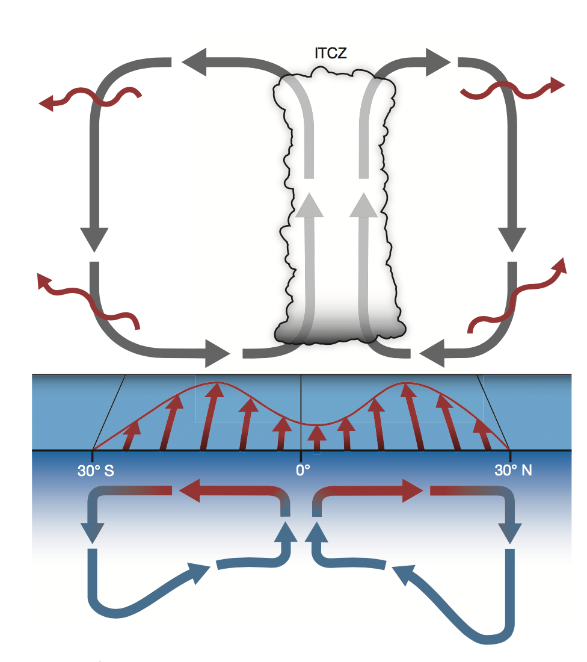
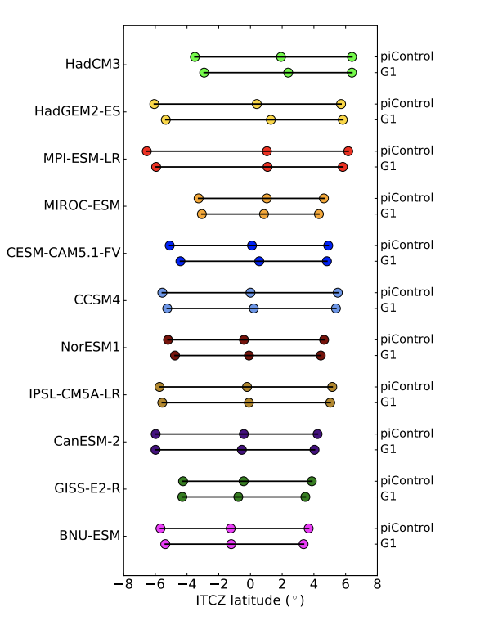
SP-CAM Regional ITCZ Migration
Location of the ITCZ
Schneider et al, 2014
Smyth et al, 2017
Notes:
What is the Intertropical Convergence Zone?
the itcz is a global climate feature consisting of the lower brances of the Hadley circulation cell
Lower branches of the Hadley cell bring warm, moist air masses together where they converge, rise and diverge as cooler, drier air masses aloft
Moist static energy aloft is greater than at surface, so the Hadley cell exports energy from the tropics
The ITCZ is the location of the air mass convergence
Figure: annual and seasonal mean positions of the ITCZ – far left is the winter minimum far right is summer max. geoengineering is shown in the second rows.
Important to note – that all the models represent this migration differently, but most agree that geoengineering truncates that north south traverse of the ITCZ
-why is this important – take for example the Sahel region – it relies on the northernmost rainfall carried by the ITCZ- if this water is no longer available, there is increased food security concern, and conflict concern.
How could we look at regional changes in Hadley circulation?
Stream function : it represents volumetric flux : kg / m s may provide information about changes in the Hadley location and strength and may be computed with some temporal average – say monthly !

Slide 22
3
Discussion Questions

Slide 23
How many people think it might happen in some form in the next 50 years ?
Is it ethical to study Solar Geoengineering? Is it ethical not to?

Slide 24
Works Cited
Dykema, J. A., D. W. Keith, J. G. Anderson, and D. Weisenstein. 2014. “Stratospheric Controlled Perturbation Experiment: A Small-Scale Experiment to Improve Understanding of the Risks of Solar Geoengineering.” Philosophical Transactions of the Royal Society A: Mathematical, Physical and Engineering Sciences 372 (2031): 20140059–20140059. https://doi.org/10.1098/rsta.2014.0059.
Keith, David W., Debra K. Weisenstein, John A. Dykema, and Frank N. Keutsch. 2016. “Stratospheric Solar Geoengineering without Ozone Loss.” Proceedings of the National Academy of Sciences 113 (52): 14910–14. https://doi.org/10.1073/pnas.1615572113.
Khairoutdinov, Marat F., and David A. Randall. 2001. “A Cloud Resolving Model as a Cloud Parameterization in the NCAR Community Climate System Model: Preliminary Results.” Geophysical Research Letters 28 (18): 3617–20. https://doi.org/10.1029/2001GL013552.
Kravitz, Ben, Alan Robock, Olivier Boucher, Hauke Schmidt, Karl E. Taylor, Georgiy Stenchikov, and Michael Schulz. 2011. “The Geoengineering Model Intercomparison Project (GeoMIP).” Atmospheric Science Letters 12 (2): 162–67. https://doi.org/10.1002/asl.316.
Kremser, Stefanie, Larry W. Thomason, Marc von Hobe, Markus Hermann, Terry Deshler, Claudia Timmreck, Matthew Toohey, et al. 2016. “Stratospheric Aerosol-Observations, Processes, and Impact on Climate: Stratospheric Aerosol.” Reviews of Geophysics 54 (2): 278–335. https://doi.org/10.1002/2015RG000511.
Li, Fuyu, Daniele Rosa, William D. Collins, and Michael F. Wehner. 2012. “‘Super-Parameterization’: A Better Way to Simulate Regional Extreme Precipitation?: SUPER PARAMETERIZATION FOR EXTREME PRECIPITATION SIMULATIONS.” Journal of Advances in Modeling Earth Systems 4 (2): n/a-n/a. https://doi.org/10.1029/2011MS000106.
Plumer, Brad. 2017. “Here’s How Far the World Is From Meeting Its Climate Goals.” The New York Times, November 6, 2017, sec. Climate.
Randall, David, Mark Branson, Minghuai Wang, Steven Ghan, Cheryl Craig, Andrew Gettelman, and James Edwards. 2013. “A Community Atmosphere Model With Superparameterized Clouds.” Eos, Transactions American Geophysical Union 94 (25): 221–22. https://doi.org/10.1002/2013EO250001.
Schneider, Tapio, Tobias Bischoff, and Gerald H. Haug. 2014. “Migrations and Dynamics of the Intertropical Convergence Zone.” Nature 513 (7516): 45–53. https://doi.org/10.1038/nature13636.
Smyth, Jane E., Rick D. Russotto, and Trude Storelvmo. 2017. “Thermodynamic and Dynamic Responses of the Hydrological Cycle to Solar Dimming.” Atmospheric Chemistry and Physics 17 (10): 6439–53. https://doi.org/10.5194/acp-17-6439-2017.
“The Cause and Impact of the Intertropical Convergence Zone.” n.d. BBC Bitesize. https://www.bbc.com/bitesize/guides/z9yssbk/revision/1.
Tilmes, Simone, John Fasullo, Jean-Francois Lamarque, Daniel R. Marsh, Michael Mills, Kari Alterskjaer, Helene Muri, et al. 2013. “The Hydrological Impact of Geoengineering in the Geoengineering Model Intercomparison Project (GeoMIP): THE HYDROLOGIC IMPACT OF GEOENGINEERING.” Journal of Geophysical Research: Atmospheres 118 (19): 11,036-11,058. https://doi.org/10.1002/jgrd.50868.

