Slide 1
Cutting the Cord: Wireless Power Transfer for Sustainable Mobility and Renewable Energy Harvesting
Kiana Amini
Harvard Energy Journal Club

Slide 2
Outline
A Brief History of Wireless Power Transfer (WPT)
Types and Working Principles of WPT
Wireless Charging Technologies for
Sustainable Mobility
Harvesting Renewable Energies

Slide 3
A Brief History …

Slide 4
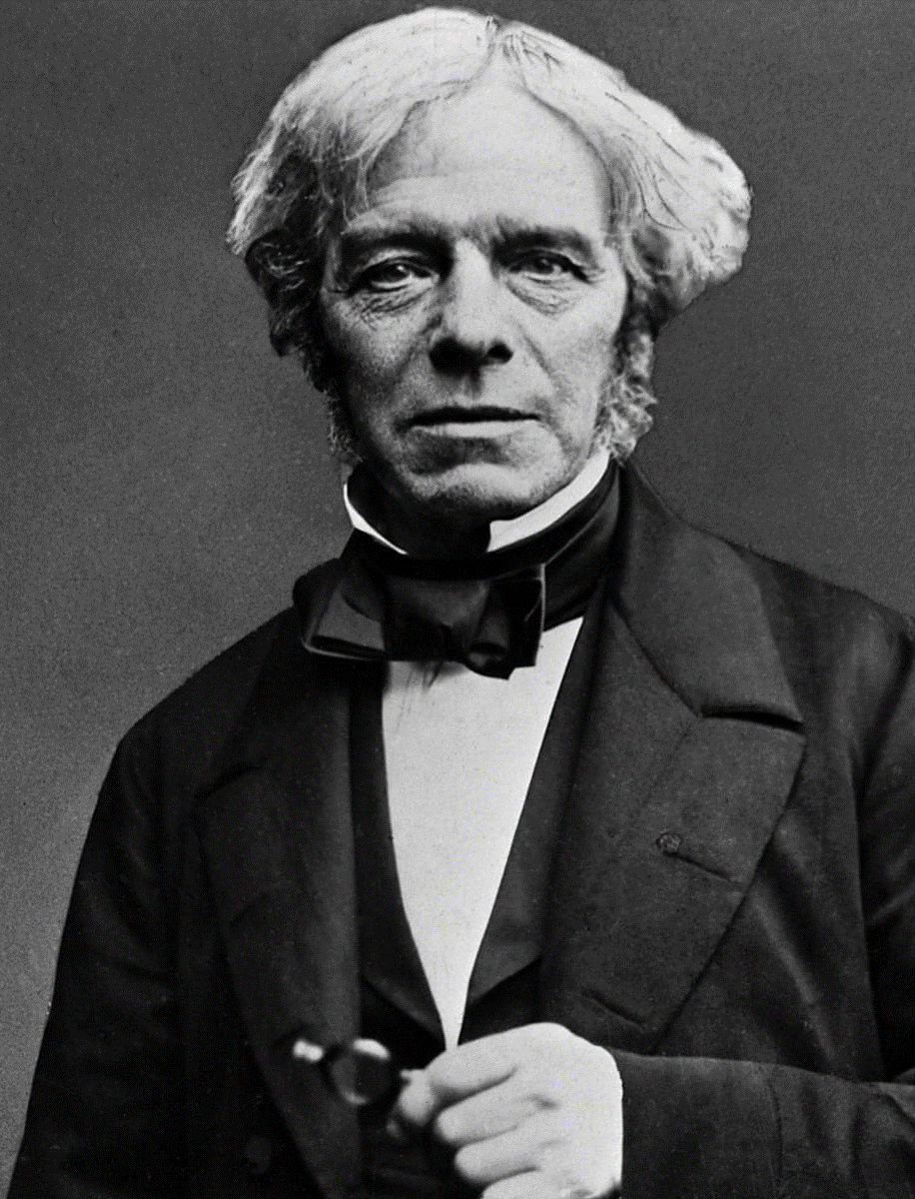
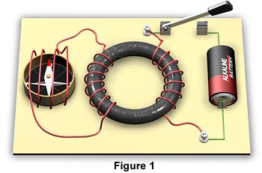
Michael Faraday’s Discovery
1831
Michael Faraday is credited for the discovery of electromagnetic induction
Electromagnetic Induction
is the production of an electromotive force across an electrical conductor in a changing magnetic field.

Slide 5
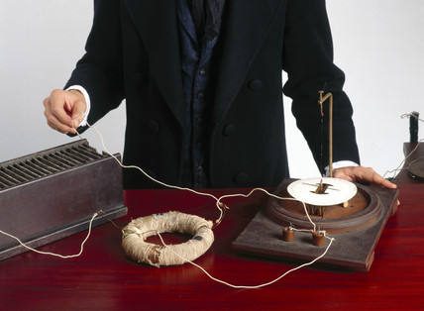
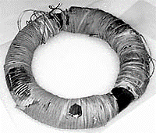
History in Pictures …
Photo of one of Michael Faraday’s original wire-coiled iron rings, courtesy of the Royal Institution, where Faraday did his experiments
© Science Museum / Science & Society Picture Library

Slide 6
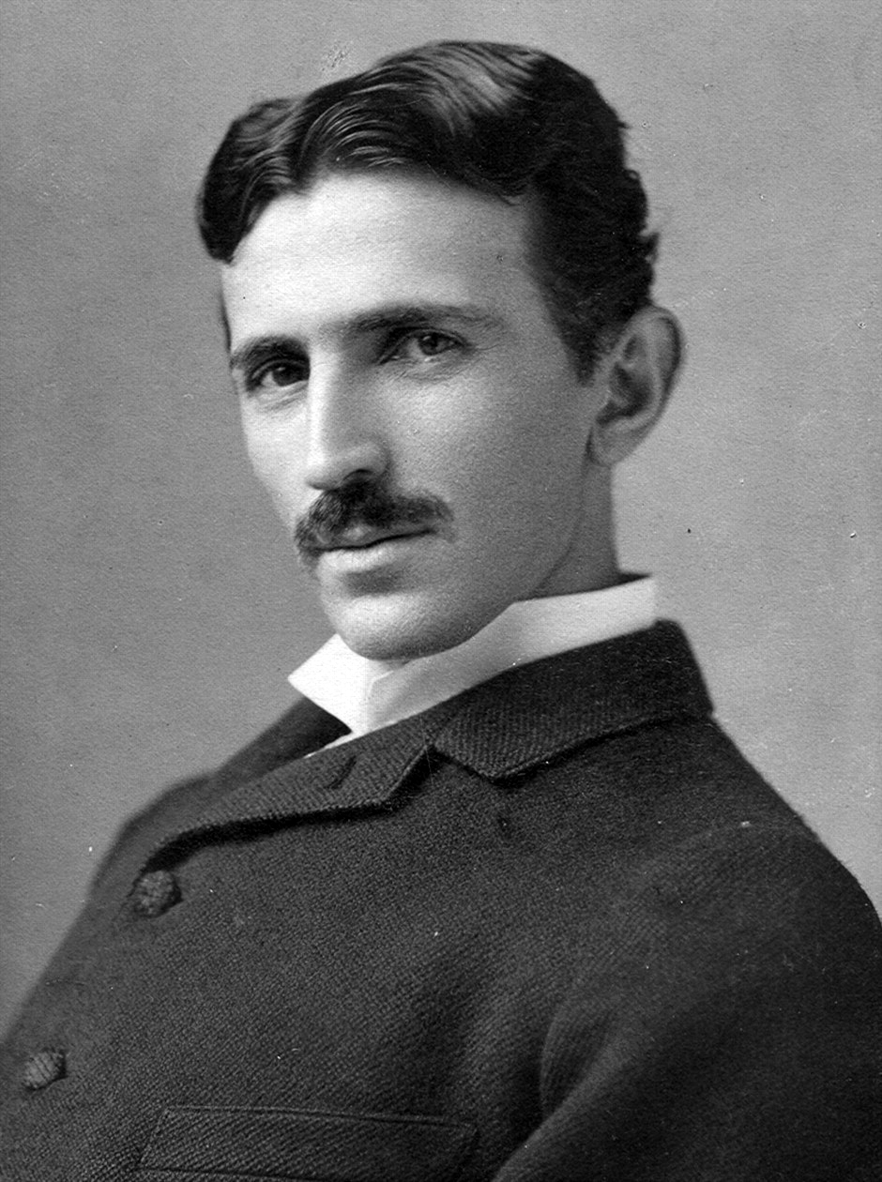
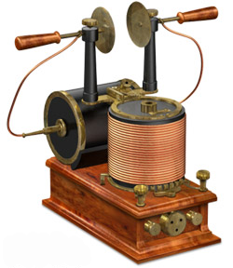
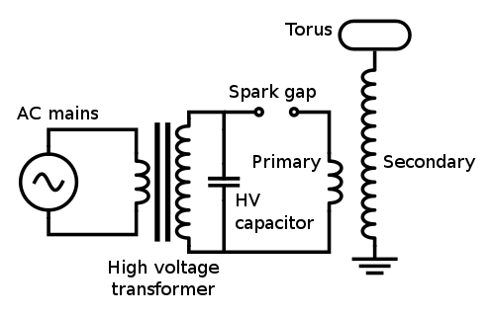
Nikola Tesla’s Invention
1891
Nikola Tesla is credited for
The invention of the
Tesla coil
Tesla Coil
Electrotherapymuseum.com

Slide 7
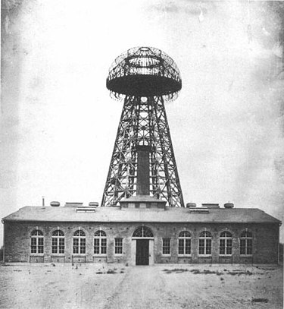
Tesla’s Vision: Powering the World Wirelessly
1904 image of Wardenclyffe Tower
Lets’ turn the Earth into a giant Tesla Coil!
Atop his tower was perched a fifty-five-ton dome of conductive metals, and beneath it stretched an iron root system that penetrated more than 300 feet into the Earth’s crust.
Pump voltage to the earth at a certain frequency!
Extract power from the ground anywhere in the world!
Notes:
By pumping voltage to the earth at a certain frequency, we could get resonance and pull power from the receiver far from the transmitter.

Slide 8
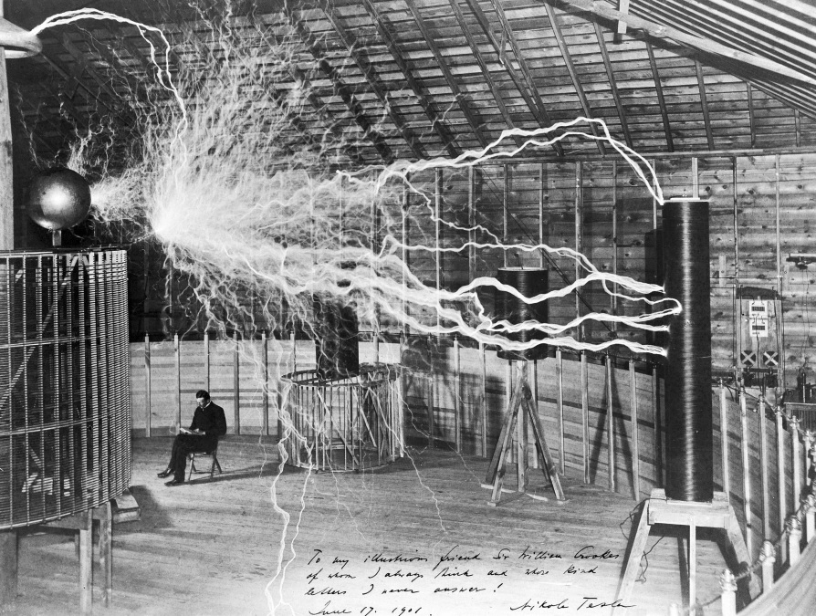
History in Pictures …
Printed in the Electrical Experimenter, February 1919
https://bigthink.com/hard-science/10-science-photos-that-made-history/

Slide 9
Types and Working Principles of Modern WPTs

Slide 10
Types of WPTs
Wireless Power Delivery Technologies
Near-Field
Far-Field
~ mm to m
~ m to km
Magnetic Field
Electric Field
Laser
Microwave
Radio
Inductive Coupling
Magnetic Resonant
Capacitive Coupling

Slide 11
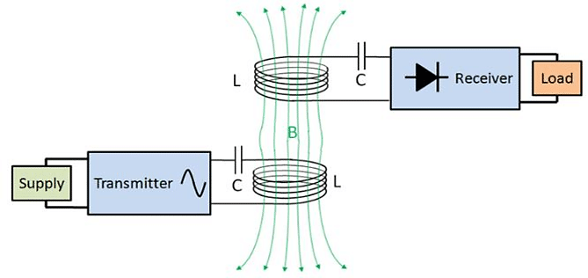
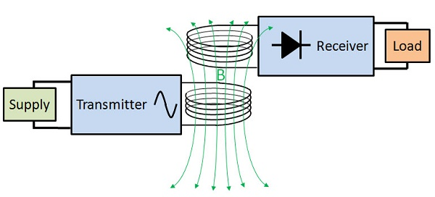
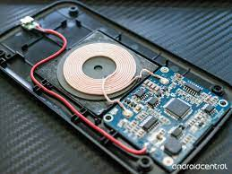
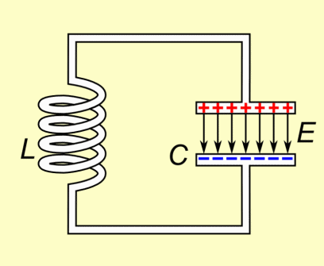
Magnetic Field WPT
Inductive Coupling
Magnetic Resonant

Slide 12
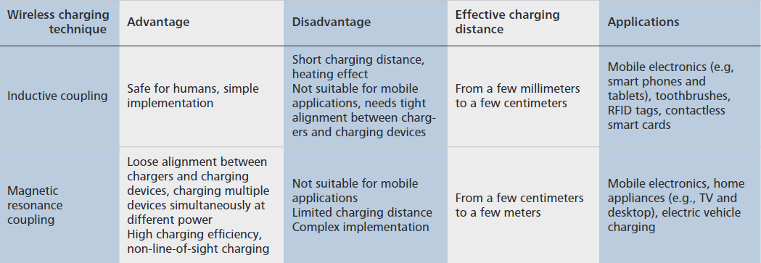
Magnetic Field WPT

Slide 13
Capacitive Coupling WPT (Electric Field)
+
-
-
+
Transfer power across metal barriers
Simplicity in design
Absence of heat generation in the wireless transmission region
X Short range (up to several mm)

Slide 14
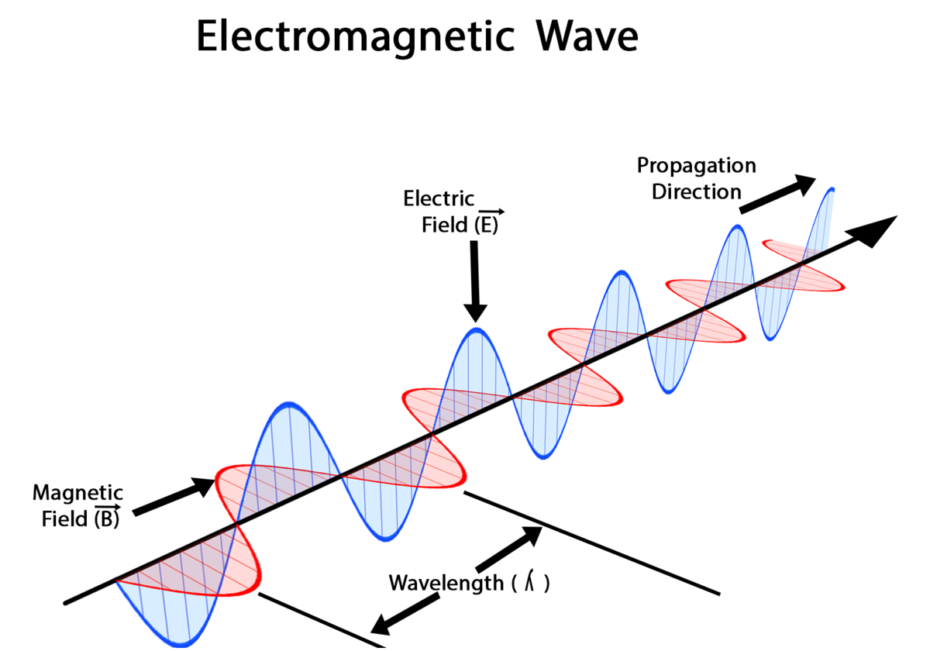
Far-Field (Electromagnetic Radiation)
* A constant line-of-sight (LoS) between the transmitter and receiver is mandatory.

Slide 15
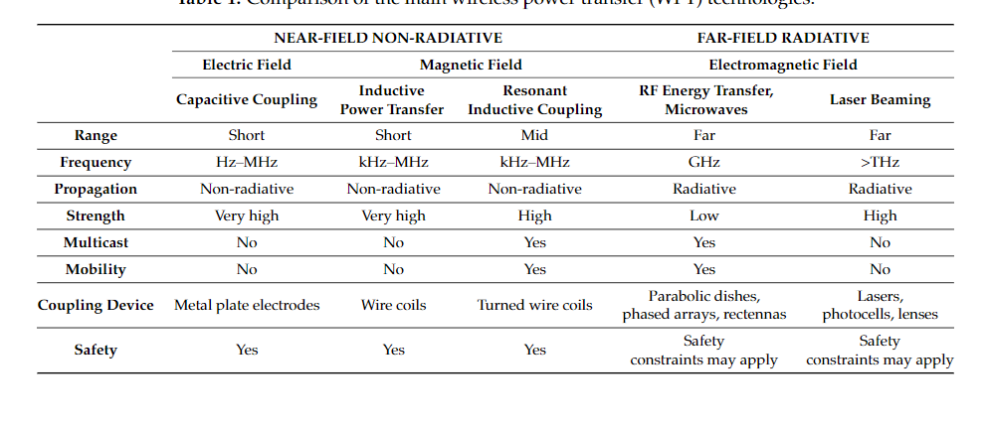
Comparison Between different WPT Methods

Slide 16
Applications:
Charging Electric Vehicles

Slide 17
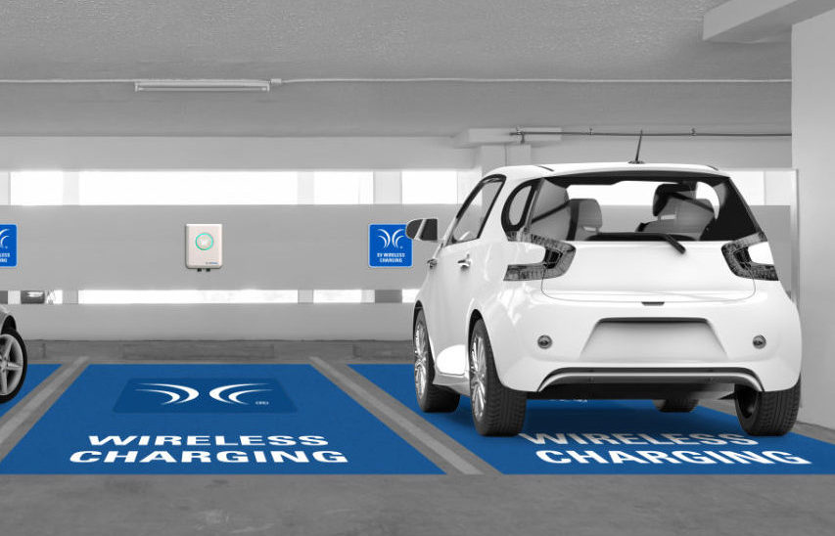
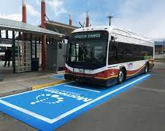
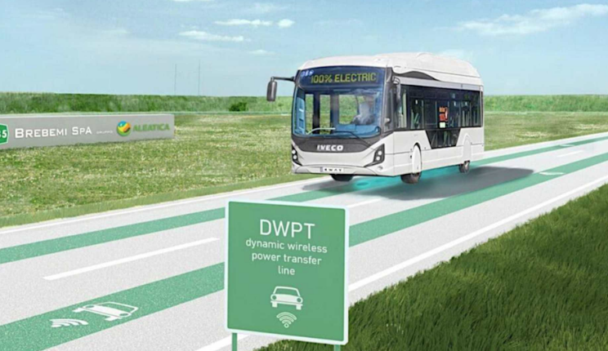
Wireless Charging Modes for Electric Vehicles
WPT modes for EVs
Static (SWPT)
Charge while vehicle is not in motion
Dynamic (DWPT)
Charge while the vehicle is moving along a WPT-enabled roadway

Slide 18
Case Study: Electric Bus Systems
Case Study: Plug-in versus WPT
67 buses operating on 21 routes
(based on 12 years of operation)
Wireless Charger (85% efficient)
Plug-in Charger (90% efficient)
67 on-WCs
428 off-WCs (60 kW each)
67 plug-in (60 kW each)
Each transit center (6 minutes)
Downtown bus stop (36 seconds per charging stop) Suburban areas (29 seconds per charging stop)
Bi, Z. K. (2015). Plug-in vs. Wireless Charging: Life Cycle Energy and Greenhouse Gas Emission Analysis of an Electric Bus System (Doctoral dissertation).

Slide 19
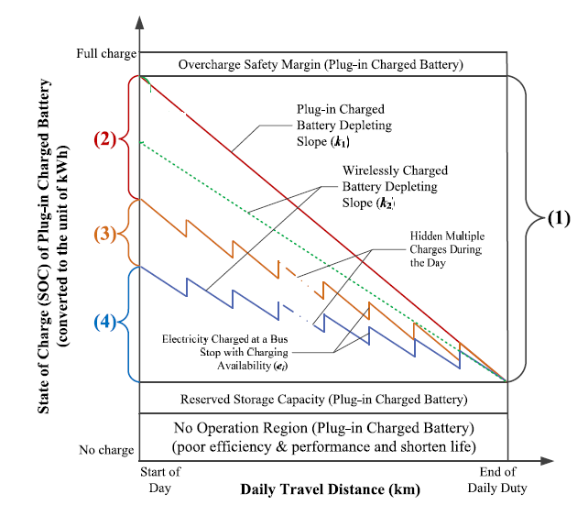
Electric Bus System: Plug-in versus SWPT
Battery downsizing calculation.
Operating Region (kWh) of plug-in charged battery;
(2) Primary capacity reduction (kWh) due to wireless charging availability;
(3) Secondary capacity reduction (kWh) due to fuel
economy improvement;
(4) Minimum electricity needed (kWh) at start of the day
for a wirelessly charged battery (not yet including its own Overcharge Safety Margin, Reserved Storage Capacity)
Bi, Z. K. (2015). Plug-in vs. Wireless Charging: Life Cycle Energy and Greenhouse Gas Emission Analysis of an Electric Bus System (Doctoral dissertation).

Slide 20
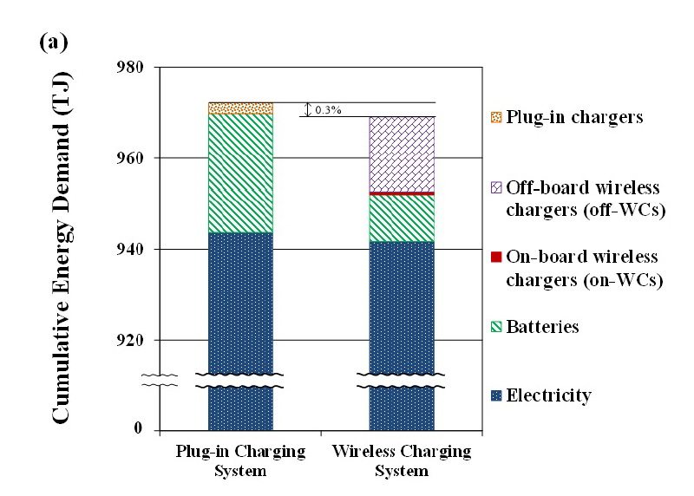
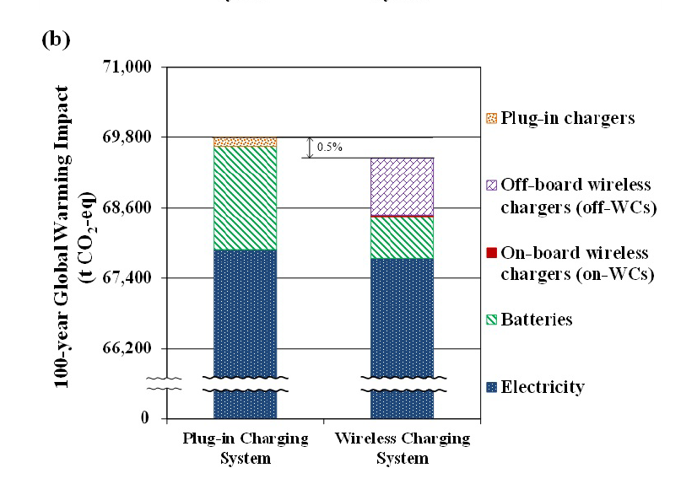
CED and GWI of Plug-in versus WPT
Bi, Z. K. (2015). Plug-in vs. Wireless Charging: Life Cycle Energy and Greenhouse Gas Emission Analysis of an Electric Bus System (Doctoral dissertation).

Slide 21
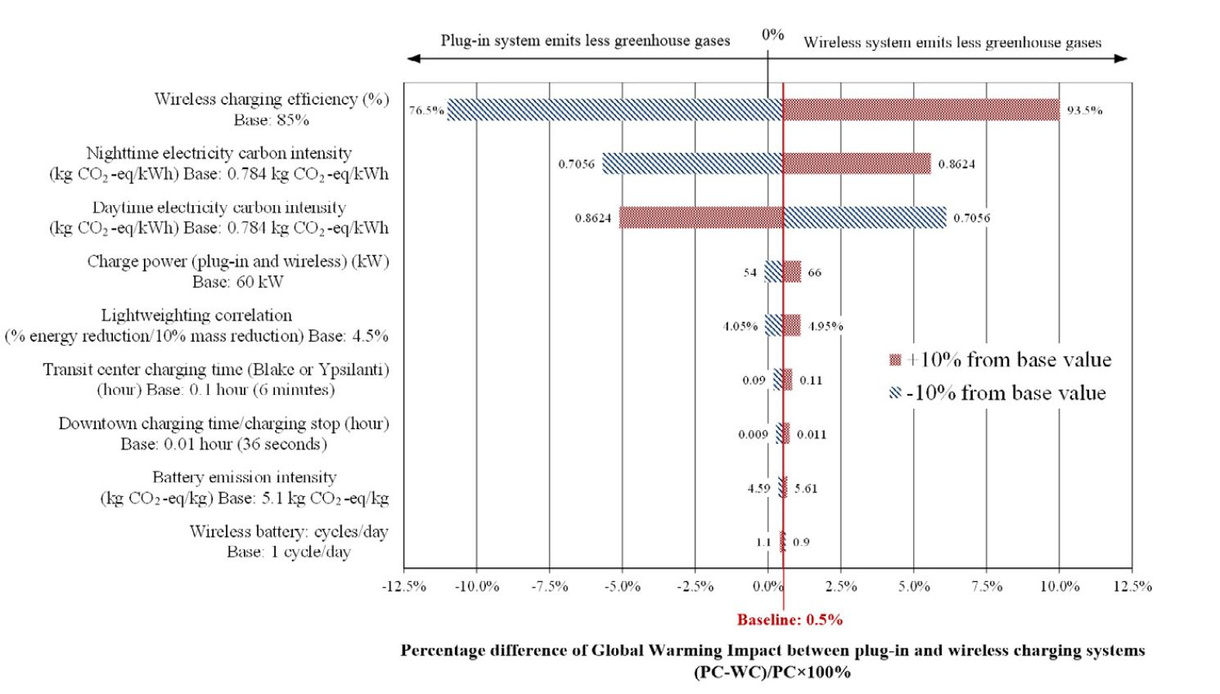
Sensitivity Analysis
Example: WPT would emit 18.6% less GHGs than the plug-in system when (simultaneously)
A wireless charging efficiency of 93.5%;
The daytime carbon intensity is 10% lower than
nighttime;
3) A charging power of 66 kW;
4) A lightweighting correlation of 4.95% fuel
reduction per 10% vehicle mass reduction,
5) A 10% longer dwell time at charging
stations in downtown and transit centers.
Bi, Z. K. (2015). Plug-in vs. Wireless Charging: Life Cycle Energy and Greenhouse Gas Emission Analysis of an Electric Bus System (Doctoral dissertation).

Slide 22
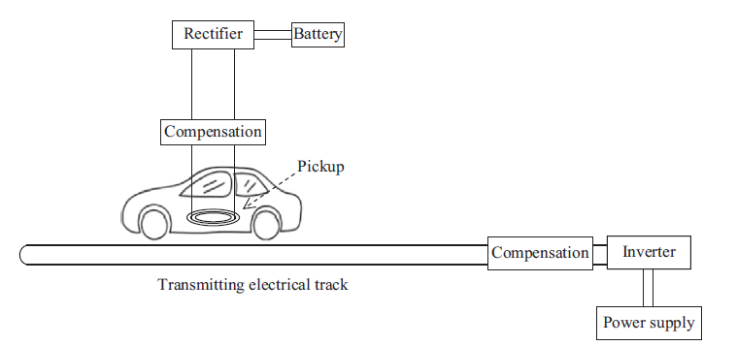
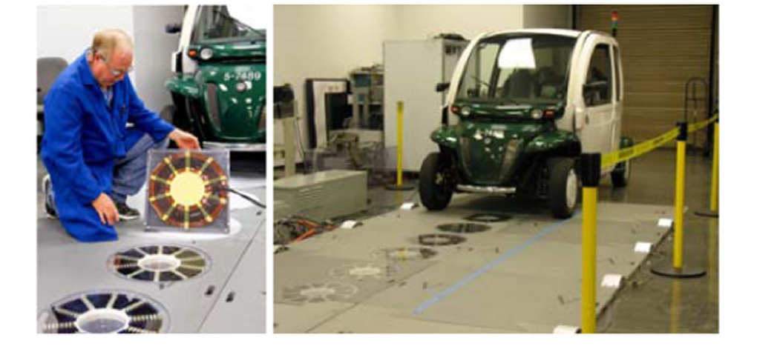
Dynamic Wireless Power Transfer (DWPT)
Dynamic charging EV system with segmented-coil track
Dynamic charging EV system with single-long-coil track

Slide 23
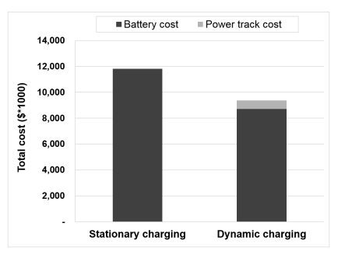
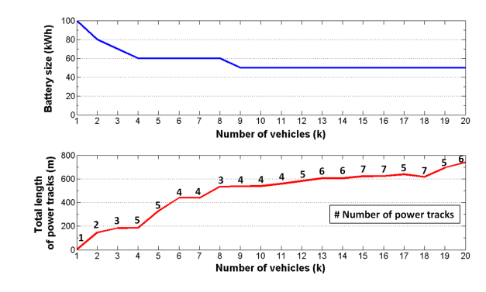
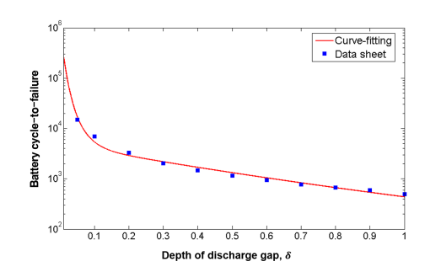
Comparison between DWPT and SWPT
By how much can dynamic charging reduce the size of an EV’s battery, compared with stationary charging?
What is the optimum battery size and power track allocation for a given route, for a dynamic charging EV system?
Total cost comparison of the stationary charging system and dynamic charging system when 18 buses are operated for 10 years

Slide 24
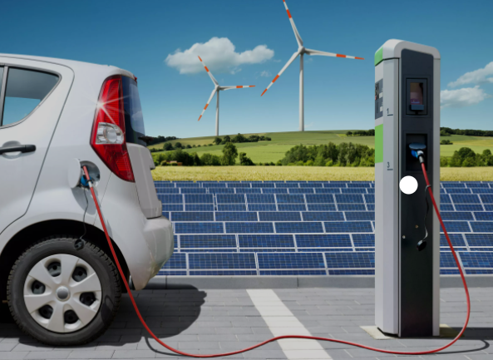
Sustainable Mobility
Vehicle-to-grid
is smart charging tech that allows car batteries to give back to the power grid. EV batteries are tools to power EVs and backup storage cells for the electrical grid.
Renewable-based EV charging station
EV charging can be paired with on-site renewable energy generation---most commonly by co-locating EVs with on-site solar energy systems,

Slide 25
Applications:
Harvesting Renewable Energies

Slide 26
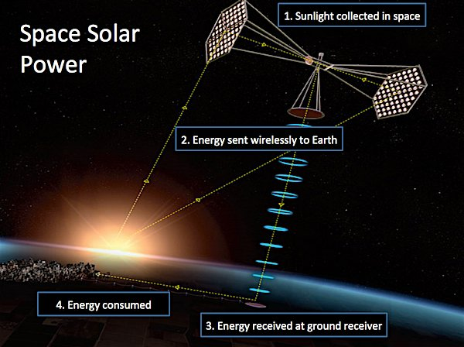
Vision
National Space Society blog
https://www.allaboutcircuits.com/news/wireless-power-transmission-of-solar-energy-from-space/

Slide 27
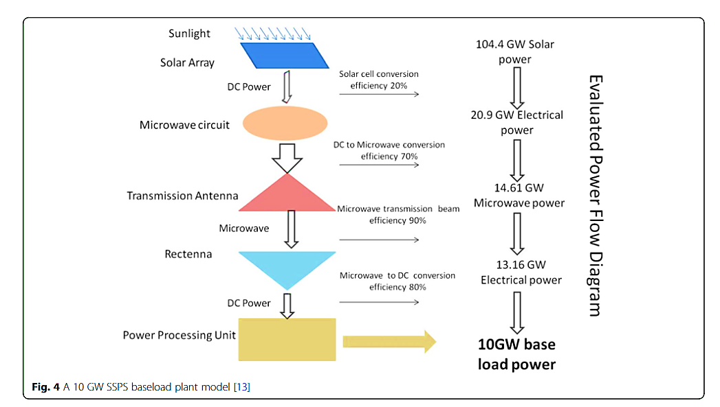
Flow Diagram of a SPACE SOLAR Power System

Slide 28
Advantages and Dangers
The solar panels on the satellite will be illuminated throughout
the year.
The amount of sunshine is about five times more than what would be
available in terrestrial locations.
The lasers or microwave systems could harm people and property as
they transmit energy back to Earth.
The cost of deploying the satellites in space is huge. It could cost about
200 million dollars to set up a 10-25 MW prototype in low Earth orbit.

Slide 29
Development Roadmap
Start with a low-power demonstration unit (less than 100KW) in the lower earth orbit to tests technologies for gravity stabilization, beam control, power transmission, and effect on ionosphere.
Launch a lower orbit 10MW prototype system. Researchers test the robotic assembly, high-power transmission, and control.
Put a pilot system in geostationary orbit where all the required technologies and operations will be tested.
Upscale to a commercial plant in geostationary orbit.
https://www.allaboutcircuits.com/news/wireless-power-transmission-of-solar-energy-from-space/

Slide 30
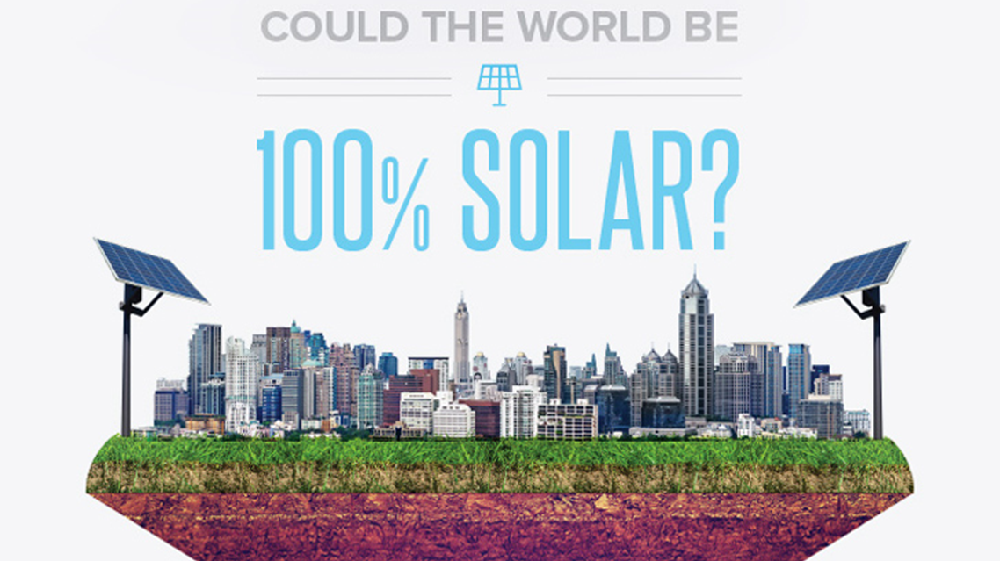

Slide 31
Thank you!

