Slide 1
Unlock
Advanced Non-intermittent Renewable Energy
Cambridge, MA. 2021

Slide 2
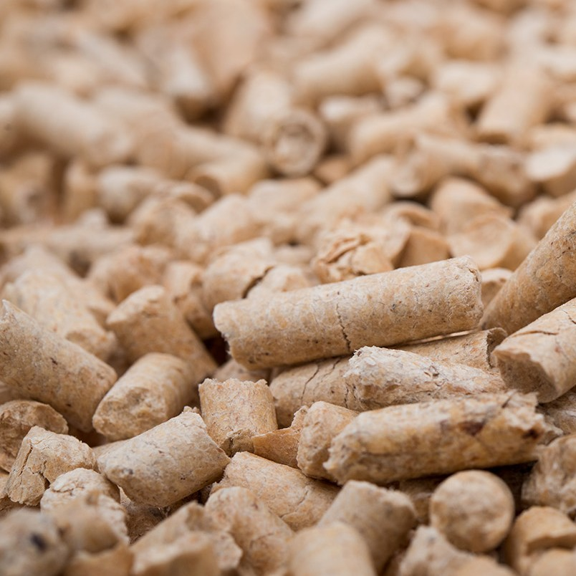
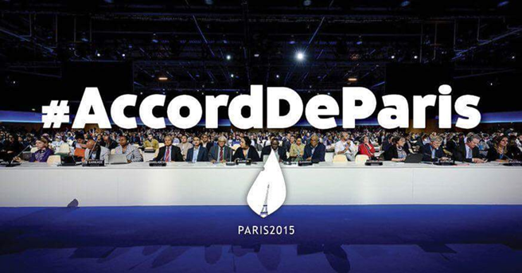
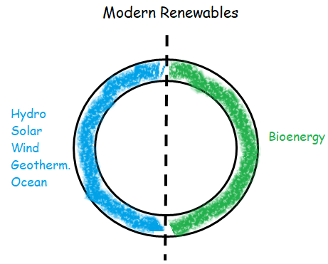
WHY ARE WOOD PELLETS SO IMPORTANT WORLDWIDE?
DECARBONIZATION
Modern sustainable bioenergy provides 50% of total renewable energy production and consumption in the world; more than 60% comes from wood pellets biofuel for heating or electricity.
SWITCHING-OFF FOSSIL FUELS
-Coal Power Plants around the world;
and/or
-Gas and Oil boilers, furnaces.
UN-REN21, (2019)
.
Notes:
Tirar

Slide 3
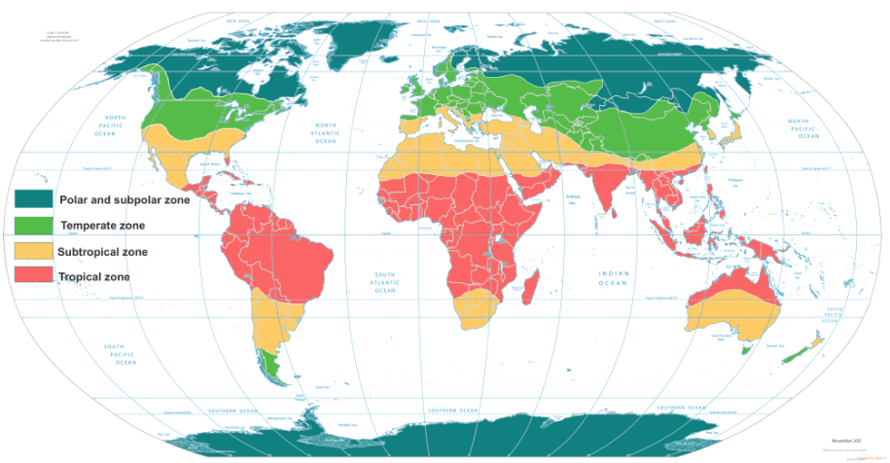
IPCC – Wood Pellets Controvertial Issue Temperade & Boreal Forests
Current Region of vast wood pellets production
Slower stock carbon cycle of woody production
15 - 30 years, reaching up to 100 years to achieve maturity
*In a few years ago generates controversial discussions that
indicate the temperate and boreal forest could store more carbon instead transformed into wood pellet
Climate Zones World Map - Rick Hansen Man In Motion Tour Map.

Slide 4
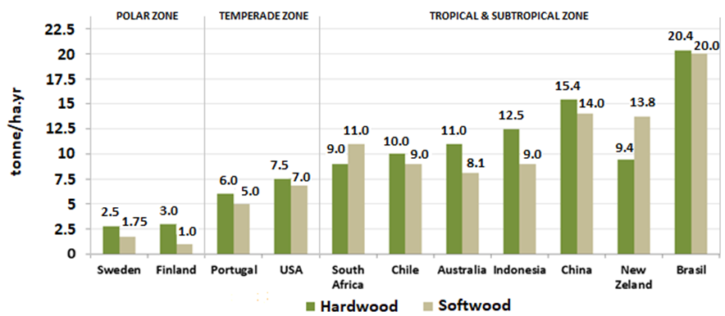
MAI in Planted Forest by climate zone Boreal, Temperade and Tropical Forest
Eucalyptus forest has the largest CO2 absorption in a short time frame.
Sustainable Eucalyptus Tropical Forest in Brazil produce more biomass than any other country worldwide
Stock carbon 3x and 6x faster than temperate and polar zone.
Eucalyptus Pine
FAO, (2001); Abraf, (2013)
.

Slide 5
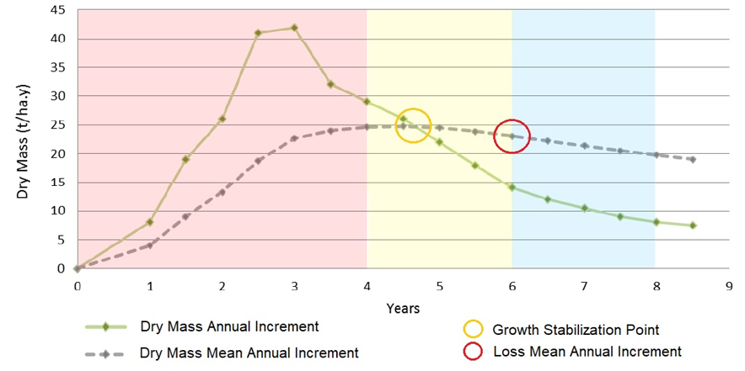
Brazilian eucalyptus forest growth stabilization.
TROPICAL
Brazilian Eucalyptus.
(forest maturity) In 5–6th-year is the max. point of forest growth.
THAN
TEMPERADE & BOREAL
Minimum.
(forest maturity) In 30–year.
Sartorio, (2014); FAO, (2001)
.

Slide 6
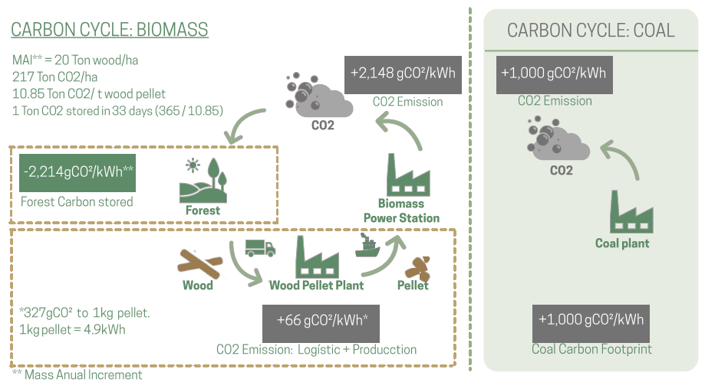
Eucalyptus wood pellets. Advanced Carbon Neutrality
CAVALETT et al., 2018; IBÁ, (2016); FAO, (2001)
.

Slide 7
TROPICAL DISADVANTAGE
Rains with high sodium chloride (NaCl)
Historically wood pellets fuel generated from sustainable tropical eucalyptus forest are banned in many countries because burning them generates harzardous emissions.
Dioxins and Organochlorides Index - highest toxicity
Climate Zones World Map - Rick Hansen Man In Motion Tour Map.
Healthy - Their toxicity levels can be lethal to humans - 1 μg/kg
Economics - Generate corrosion in power plants/boilers.

Slide 8
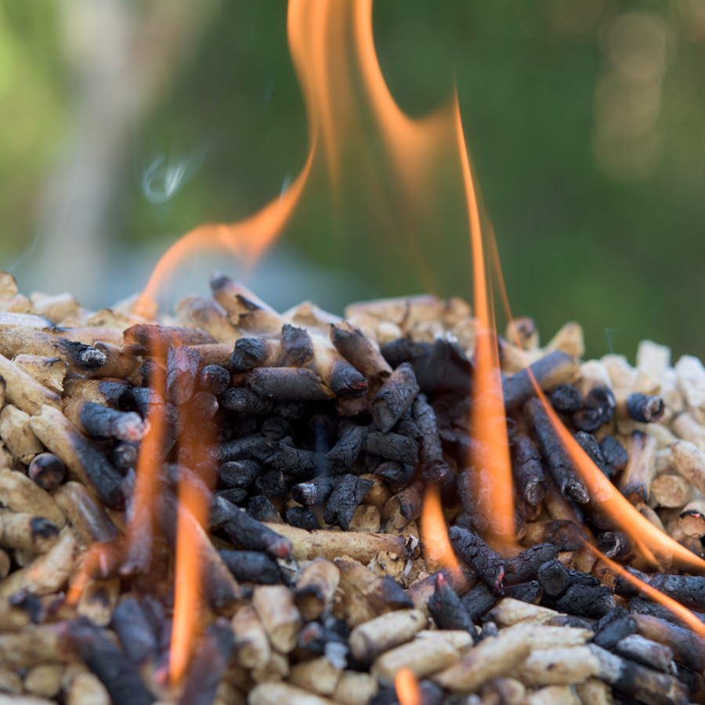
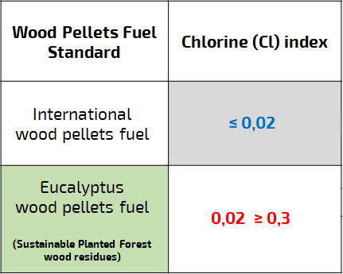
Problem
Commercial Standard – (ENplus)
ENplus, 2020.

Slide 9
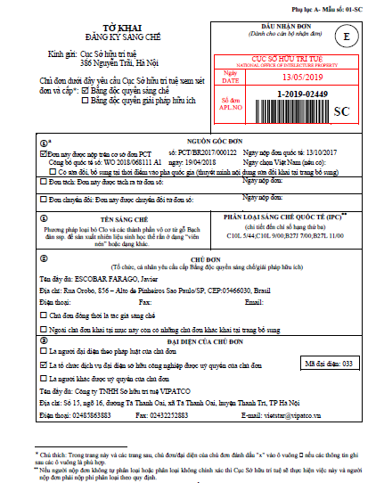
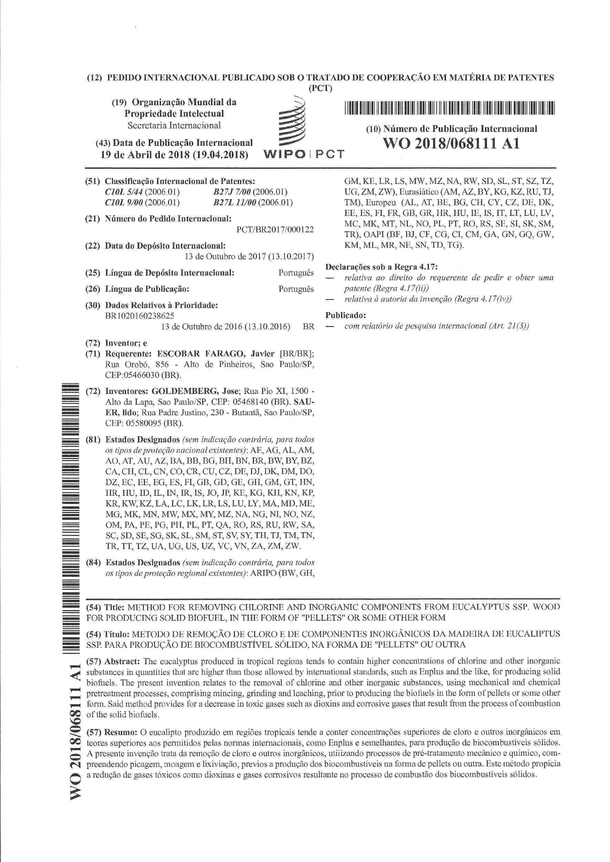
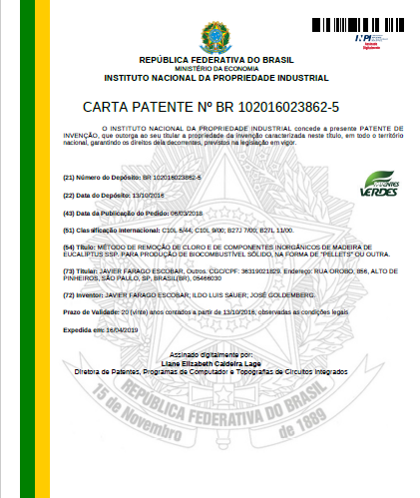
IP - TECHNOLOGICAL SOLUTION
PATENT
Method For Removing Chlorine And Inorganic Components From Eucalyptus ssp. Wood For Producing Biofuel, in the Form Of “Pellets” or Some Other Form.

Slide 10
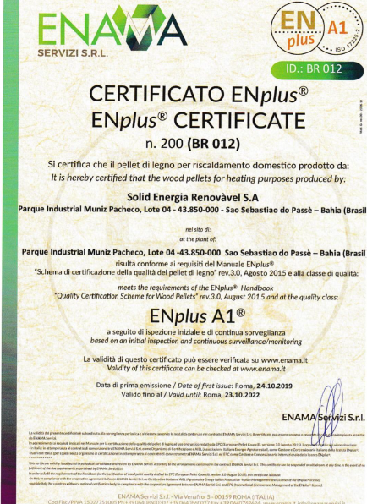
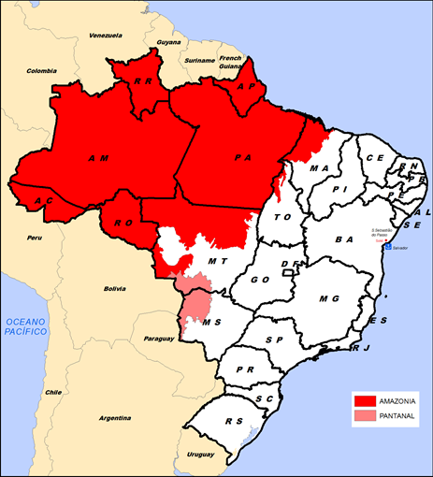
MVP Industrial & Commercial Validation
“First & Unique certified sustainable eucalyptus wood
pellet fuel in the world – “Standard Validation”
Sold 300 containers in late 2019 to European Union (Italy).
Amazon rainforest

Slide 11
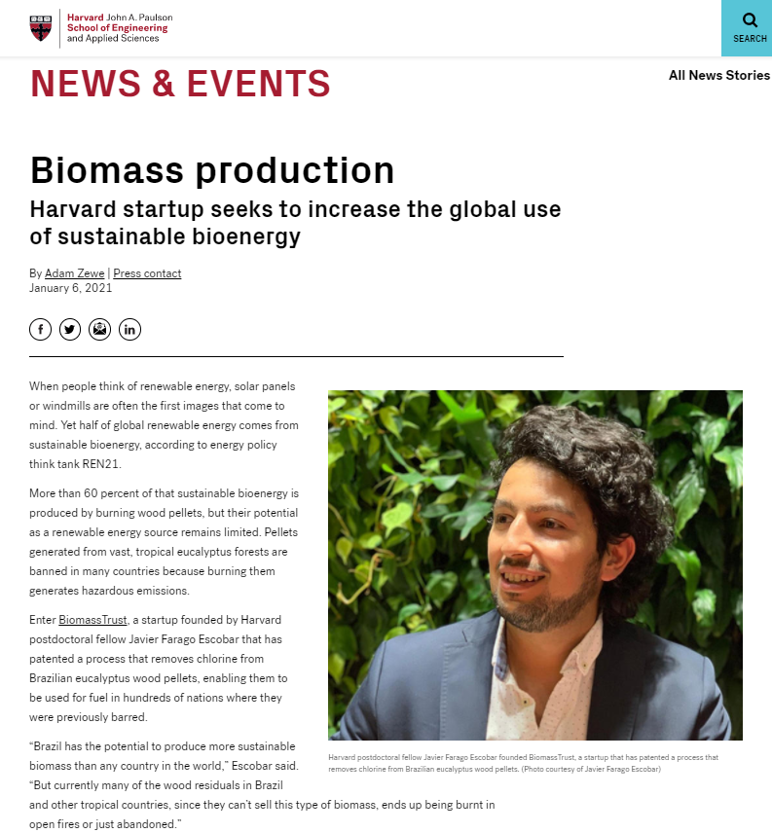
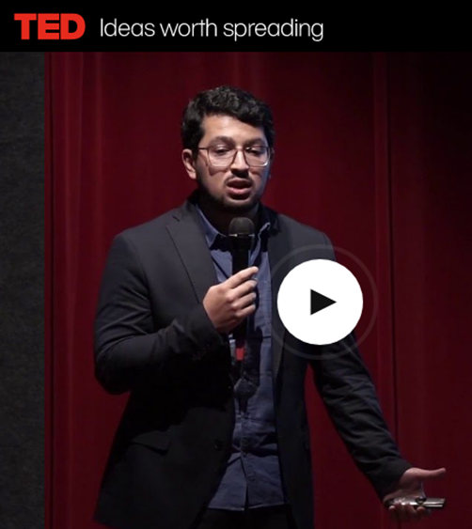
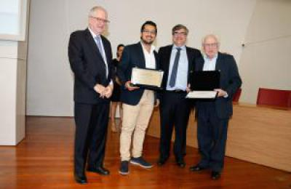
Feature story at Harvard SEAS:
Concept of BiomassTrust’s patent presented by our founder at TEDx:
Our origins after receiving “USP Outstanding Doctoral Thesis Award”:
Notes:
Tirar

Slide 12
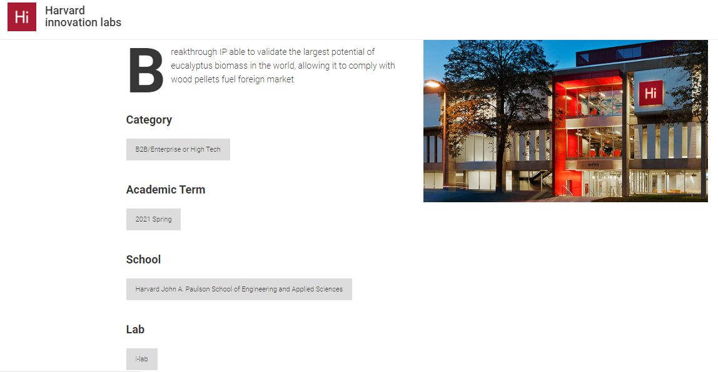
Incubated at Harvard Innovation Lab, Spring 2020 - to date
https://innovationlabs.harvard.edu/current-team/biomasstrust/
Notes:
Tirar

Slide 13
Solution
A new patented technology by BiomassTrust that removes chlorine from eucalyptus wood pellets fuel, enabling them to be used for fuel in hundreds of nations where they were previously barred. The new process will:
Open sustainable tropical biomass to export markets across the world
Unleash a supply of wood pellet at a fraction of the cost
Unlock Non-intermittent renewable energy, accelerate CO2 absorption

Slide 14
BIOMASS ASSESSMENT
* sawdust, thinning and firewood in Brazil
32-37 USD/tonne*
5 - 11 USD/tonne*
Cl
Cl
Pinus ssp. and other softwood
Eucalyptus ssp.
Image: Freepik

Slide 15
INNOVATION
* sawdust, thinning forest and firewood in Brazil
** Innovation process - final product (OPEX+CAPEX+Capital Recovery Factor)
32-37 USD/tonne*
5 - 11 USD/tonne*
1 ‎USD/tonne**
Cl
Cl
Pinus ssp. and other softwood
Eucalyptus ssp.
Image: Freepik

Slide 16
Business Model
We produce wood pellets at a fraction of the cost for the wood raw material vs competitors
Economics of Current Competitors¹
Our Economics
Raw Material Cost (per ton)
% Cost of Raw Material
% Other Costs (eg. production, shipping)
GROSS
MARGIN
Raw Material Cost (per ton)
% Cost of Raw Material
% Other Costs (eg. production, shipping)
GROSS
MARGIN
c. $35
40%
60%
13%
c. $12
c. 10%
60%
30%
¹ https://www.envivabiomass.com/wp-content/uploads/EVA-Investor-Presentation_Nov-2020.pdf
BiomassTrust Financial Analysis

Slide 17
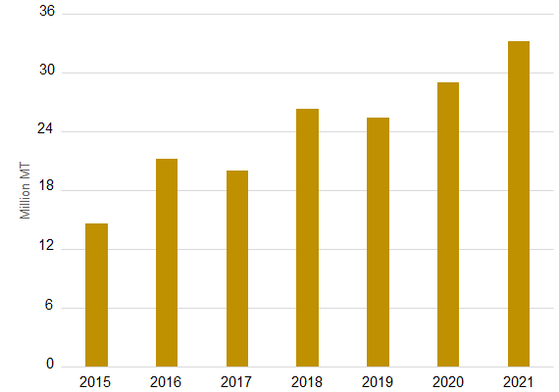
Market Size
GLOBAL WOOD PELLET CONSUMPTION¹
TOTAL ADDRESSABLE MARKET
30 + 30
CAGR 5y
c. 9%
30 Mton is the current demand for wood pellets for the European Union
30 Mton is the expected new demand for Asia in the next 20 years due to agreements to comply with climate changes initiatives
Million MT
Wood pellet fuel demand 2050 = 60 MT
Pricing per ton. = $200
Estimated TAM
$12.0 billion
¹ https://www.envivabiomass.com/wp-content/uploads/EVA-Investor-Presentation_Nov-2020.pdf

Slide 18
Market Adoption
Market is driven by global commitment to fight climate change^{1.} Our goal is to continue to close partnerships within the most committed countries across the globe. The industry standard is to close long term contracts, c. 10 years, which generates stable margins.
POLICYMAKER COMMITMENT BY COUNTRY¹
CONTRACTS / PARTNERSHIPS
COUNTRY / REGION | EST. DEMAND DUE TO POLICIES¹
JAPAN | c. 15 to 20 MT per year
EUROPEAN UNION | RED II calls for renewables to account for at least 32% of EU consumption by 2030
GERMANY | Largest user of coal in the EU with a goal to reduce the use of fossil fuels
UK | Law requires coal phase-out by 2025
NETHERLANDS | Legally binding goal to phase out of coal by 2030
Contracts are standardized in the industry
Long-term contracts (c. 10 years)
Fixed-price (with escalators), take-or-pay contracts
Fixed USD/ton denominated shipping contracts matched to length of off-contracts
¹ https://www.envivabiomass.com/wp-content/uploads/EVA-Investor-Presentation_Nov-2020.pdf

Slide 19
Competition
AFFORDABLE
N/A
╦ BiomassTrust
OTHER RENEWABLE
BIOMASS RENEWABLE
N/A
EXPENSIVE

Slide 20
Payback
Investment:
USD 18 Million
Revenue (yr):
USD 20 Million
First eucalyptus pellets factory certified for export
Production 100.000 tonne/year
Cost (yr):
USD 14 Million
Payback
3 years of operation
Phase 1 - First Unit: Largest wood pellet factory in Brazil with an annual production capacity of 100,000 tons, exploiting the potential of sustainable eucalyptus by validated patent to produce certified wood pellets A1 (ENplus A1) to export (EU or Japan). Contracts of 10 years (Take-or-pay), providing cash flow stability to the business and to investors
Phase 2 – Expansion: Implementation of three new plants, reaching 400,000 tons per year. There is existing current demand at these levels for long term contracts, and timetable for Phase 2 can be accelerated depending on access to capital and business strategy. At the end of this phase, BiomassTrust will have a sizeable asset base and we see 3 alternatives :
Initial Public Offering IPO. With 400.000 tons per year, BiomassTrust’s will already have enough size to go to the public offer (precedents already exist and trade in attractive multiples)
Sale to strategic investors (wood pellet groups already in the market, some of them have been approaching us) or to financial investors (willing to continue to expand the company in Brazil or abroad)
Maintain assets, harness hold to maturity contracted returns, and if desired expand the patent.

Slide 21
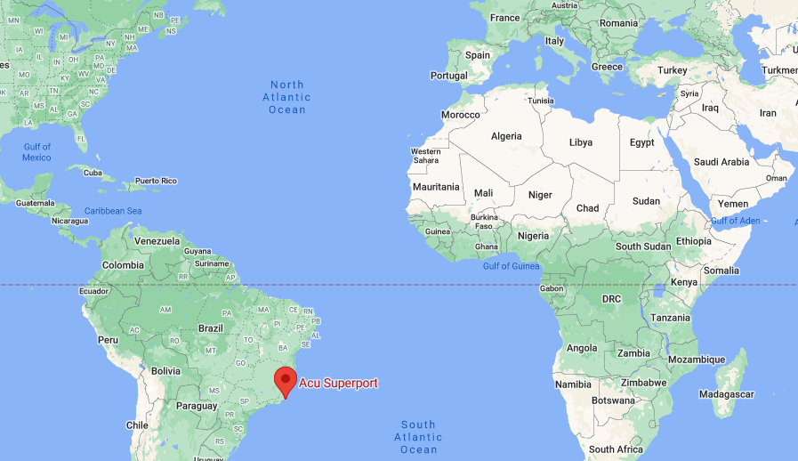
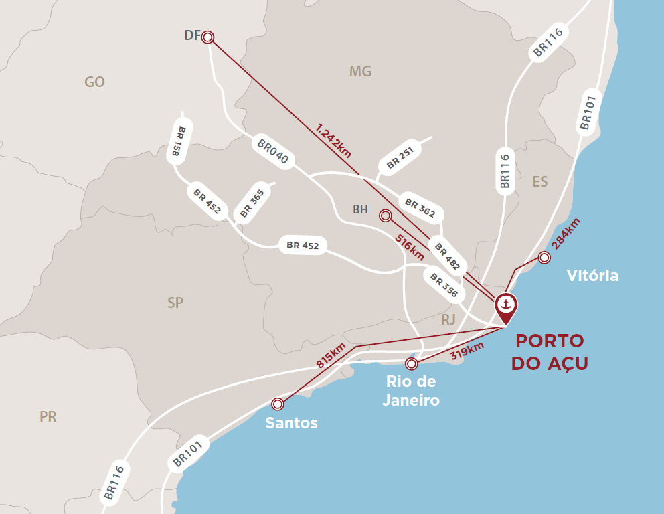
Partner
EIG Global Energy Partners is a leading provider of institutional capital to the energy sector globally.

Slide 22
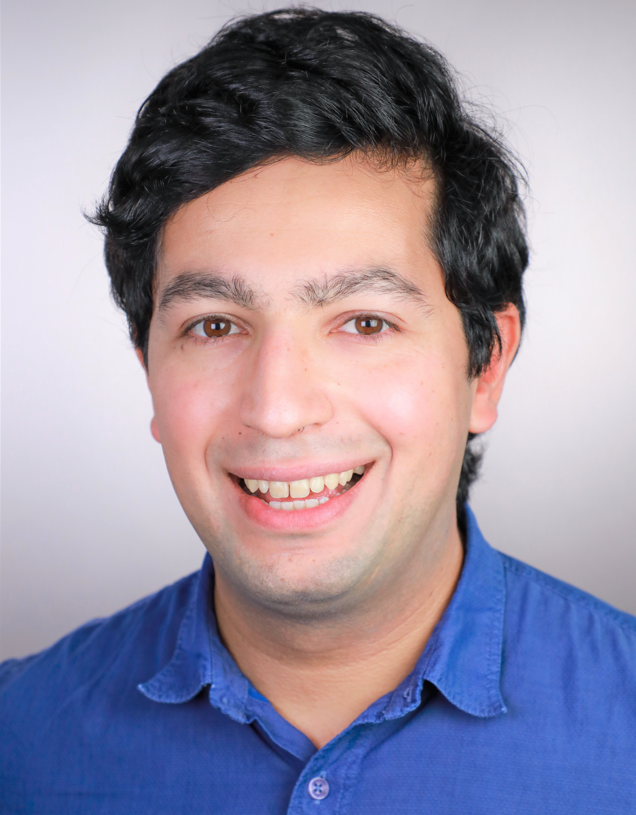
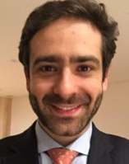
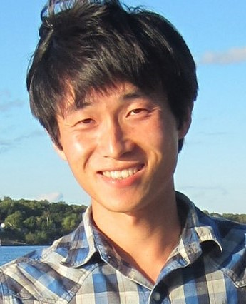
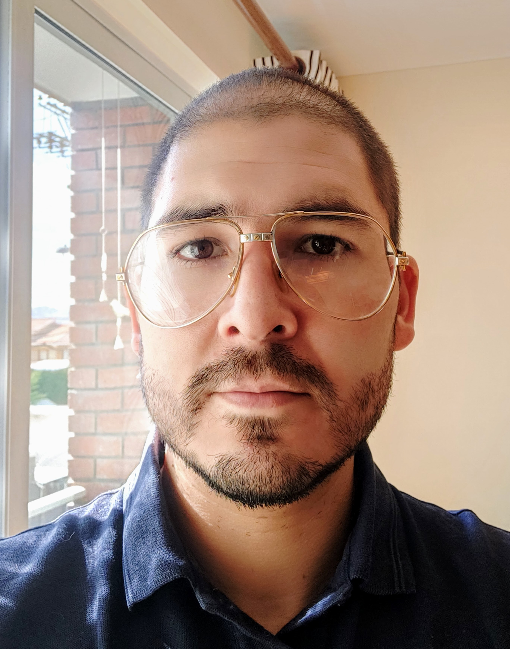
Team
Farago Escobar, Javier – (Founder – CEO)
Harvard School of Engineering & Applied Sciences, Postdoctoral Fellow 22’
Lead Brazilian Contributor in the UN Environment - Renewable Global Status Report (REN21)
Former Researcher at Brazilian Reference Centre on Biomass, and Shell Research Centre for Gas Innovation, Brazil
USP Outstanding Doctoral Thesis Award
Spark Grant by Harvard Innovation Lab
Visiting PhD. at Utrecht University; and New South Wales Government – DPI, Australia
Forestry Eng.; MSc. in Wood Technology.; PhD in Energy with highest honors from University of São Paulo
Rauter Vasconcellos, Diego – (Advisor / Financial Structuring)
Spent 20+ years helping Brazilian entrepreneurs, large corporates and state-owned companies to raise capital in the local and international markets (public and private). Extensive experience in advising complex M&A situations, as well as structuring project finance greenfield capital, including large scale wind renewable projects in Brazil
Led execution to raise and advise clients in 30+ transactions (R$ 50 billion)
Former positions at BR Partners (2013-2020), Credit Suisse Brasil (2011-2013), Bank of America Merrill Lynch (2007-2011), and ABN AMRO Bank (2002-2007).
BA degree in Business Administration from Fundação Getulio Vargas & Exchange Program @ Tulane University
Fan, Yuanchao – (Development Manager)
Harvard Center for the Environment, Solar Geoengineering Postdoctoral Fellow 22’
Expert in forests, with experience in vegetation carbon and energy cycles of ecosystems across tropical regions.
Former Researcher at the Norwegian Research Centre, and Bjerknes Centre for Climate Research in Bergen, Norway
PhD degree in Bioclimatology from the University of Göttingen
PhD degree in Functional Ecology and Agricultural Sciences from AgroParisTech
Alba Pieracci, Mike – (Project Manager)
Swiss Federal Institute of Technology - EPFL Engineering Merit Fellow 10’
Spent 06 years as a project manager in the energy sector.
Led several technical, strategic and investment operations for infrastructure construction in Latin America.
MBA from Miguel de Cervantes European University.

Slide 23
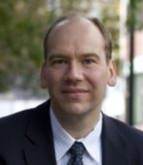
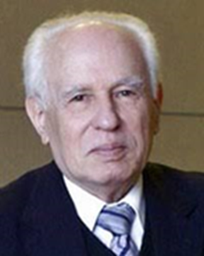
Advisors
Scot T. Martin
Academic Advisor – Harvard University / SEAS
Gordon McKay Professor of Environmental Science and Engineering and Professor of Earth and Planetary Sciences
Director of the Laboratory of Environmental Chemistry in the School of Engineering and Applied Sciences at Harvard University
Ph.D. degree in chemistry (Caltech), and B.S. degree in Chemistry at Georgetown University.
José Goldemberg
World Energy Assessment – UNDP
Worldwide heroes of the environment
Former Brazilian Minister of Science and Technology
Former Brazilian Minister of Education
Former Environment Secretary and president of State of São Paulo Energy Company
Professor from IEE/University of São Paulo. Ph.D. in Physical Science and former President at University of São Paulo.
Phil Green
Venture Program Hi-lab Advisor – Harvard Innovation Labs
Former CTO, he has built consumer mobile apps for IOS and Android
Former CEO, he built a customer base of 5,000 organizations, in 50 countries, serving over 1 million users such as Bank of America, NASA, Owens Corning, Pfizer, Kraft Foods
Boston Techstars alumnus.
MBA from HBS and graduated from Harvard College with an AB in Economics.

Slide 24
“While we are rushing to build more efficient batteries, we forget that nature already gives us wood”
Javier Farago Escobar
escobar@seas.harvard.edu

