Slide 1
Recovering
Electrochemical
Components and
Yielding
Cathodes while
Lowering
Emissions
Andrew Wong – Harvard Energy Journal Club – 3 April 2019

Slide 2
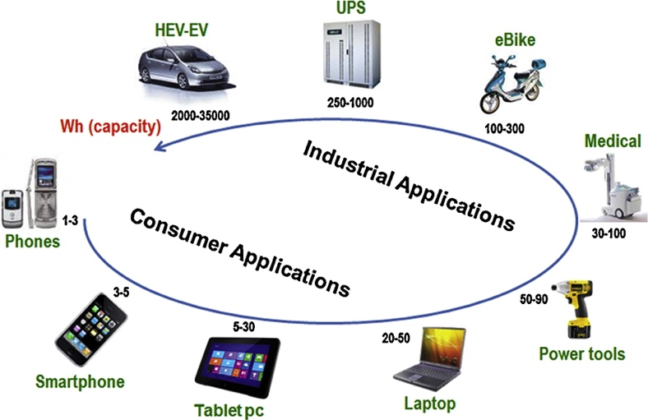
The need for better batteries
Yoo et al. Materials Today, 2014, 17, 3
DOI: 10.1016/j.mattod.2014.02.014

Slide 3
Some major battery chemistries
Alkaline batteries
Zn/KOH/MnO₂
Lead-acid
Pb/H₂SO₄/PbO₂
NiCad
Cd/KOH/Ni(OH)₂
Nickel metal hydride
MH/KOH/Ni(OH)₂
Li-ion
Anode: LiC₆ (Li, Li₁₅Si₄)
Electrolyte salts:
LiPF₆, LiBF₄, LiClO₄
Cathodes:
Li₂TiO₃ (LTO)
LiCoO₂ (LCO)
LiFePO₄ (LFP)
LiMn₂O₄ (LMO)
LiNiCoAlO₂ (NCA)
LiNiMnCoO₂ (NMC)*

Slide 4
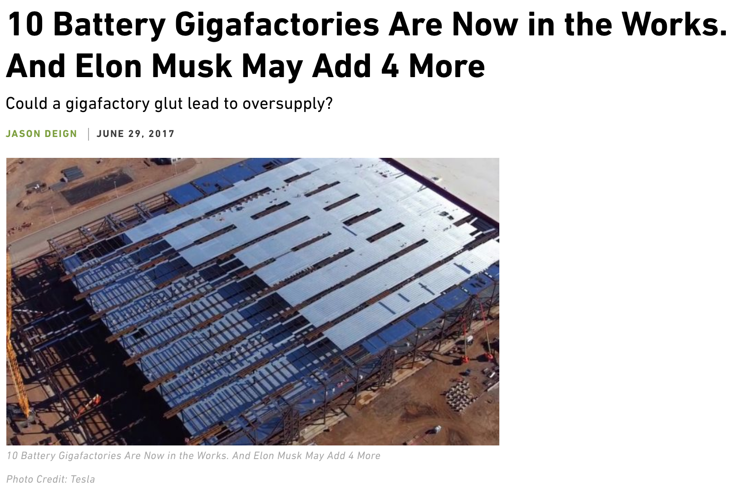
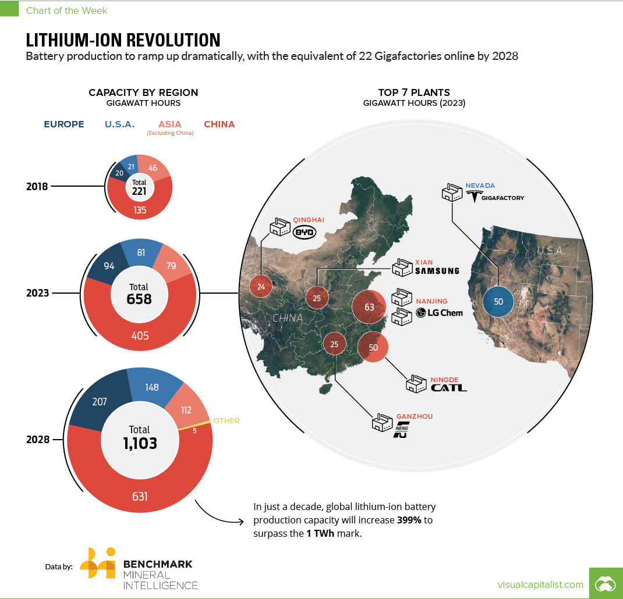
Strong Li-ion demand increase
https://www.greentechmedia.com/articles/read/10-battery-gigafactories-are-now-in-progress-and-musk-may-add-4-more
https://www.visualcapitalist.com/battery-megafactory-forecast-1-twh-capacity-2028/

Slide 5
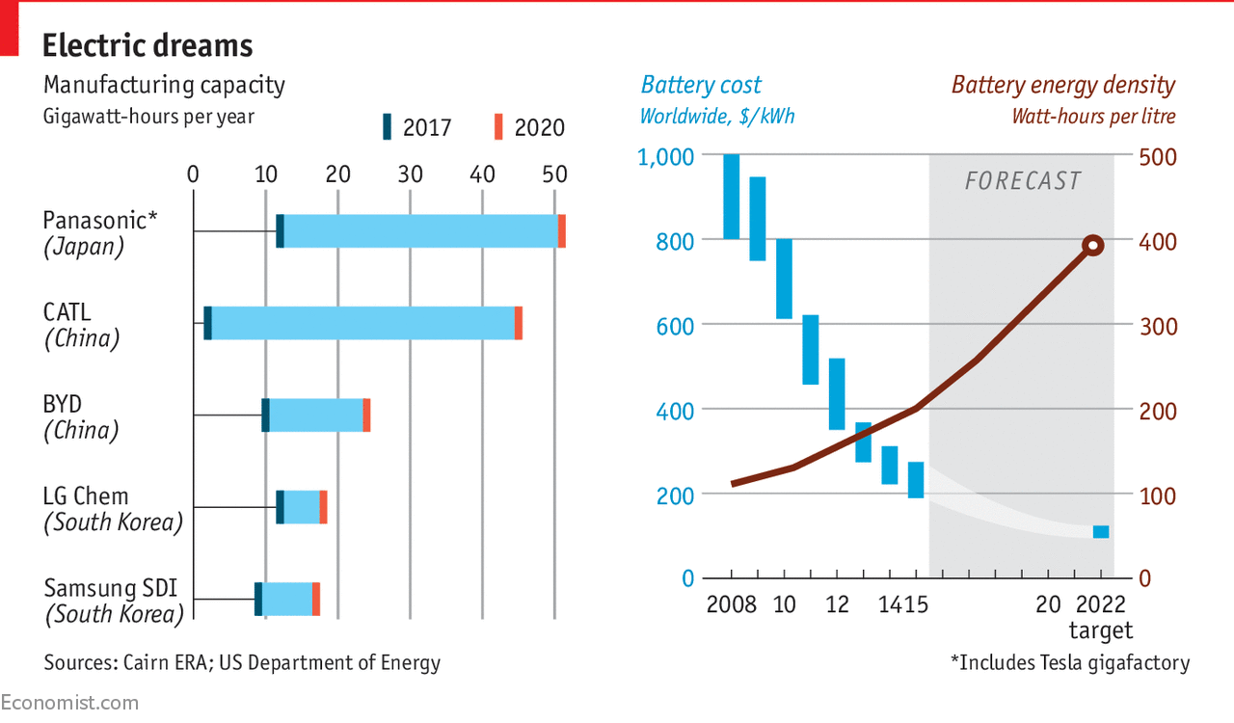
Rising production, declining cost
https://www.economist.com/graphic-detail/2017/08/14/the-growth-of-lithium-ion-battery-power

Slide 6
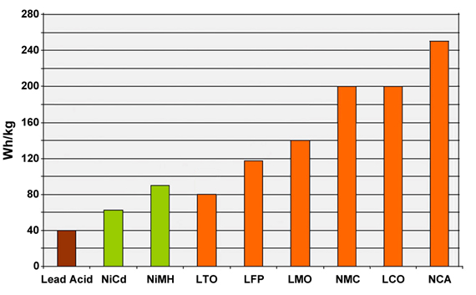
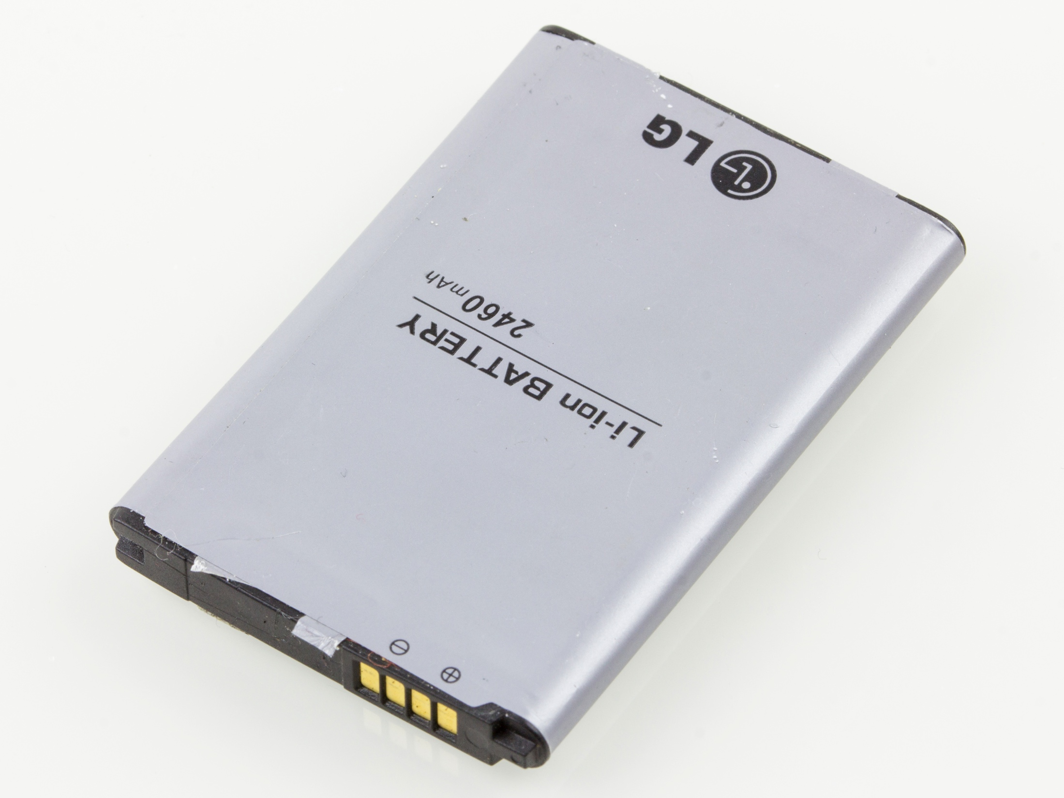
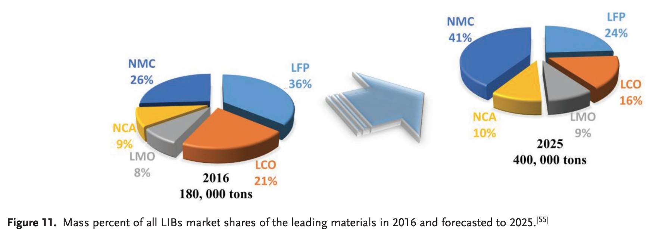
Li-ion
Li et al. Adv. Mater., 2018, 30, 1800561
DOI: 10.1002/adma.201800561
https://batteryuniversity.com/learn/article/types_of_lithium_ion

Slide 7
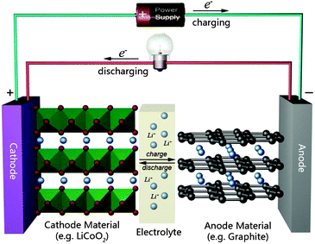
Battery operation
Liu et al. Chem. Commun., 2011,47, 1384-1404
DOI: 10.1039/c0cc03158e
https://www.energy.gov/eere/articles/how-does-lithium-ion-battery-work

Slide 8
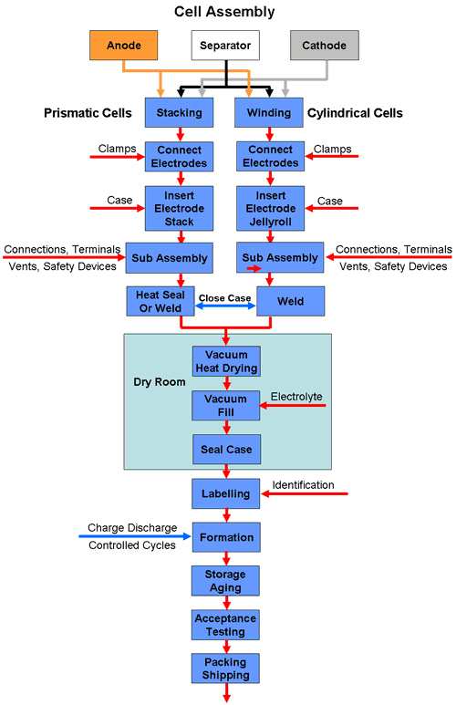
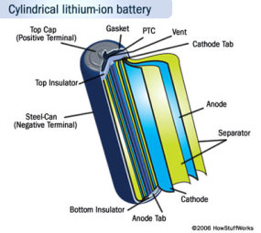
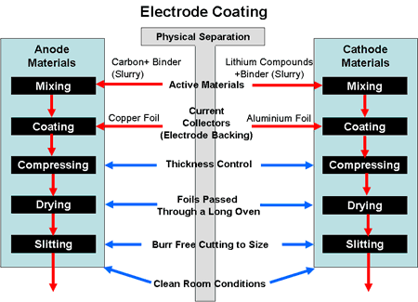
Production Process
https://www.mpoweruk.com/battery_manufacturing.htm
https://electronics.howstuffworks.com/everyday-tech/lithium-ion-battery1.htm

Slide 9
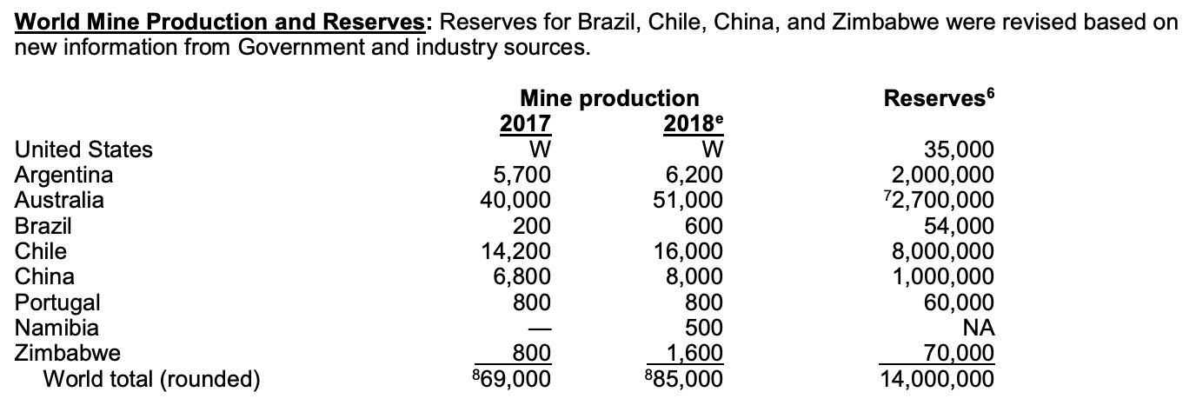
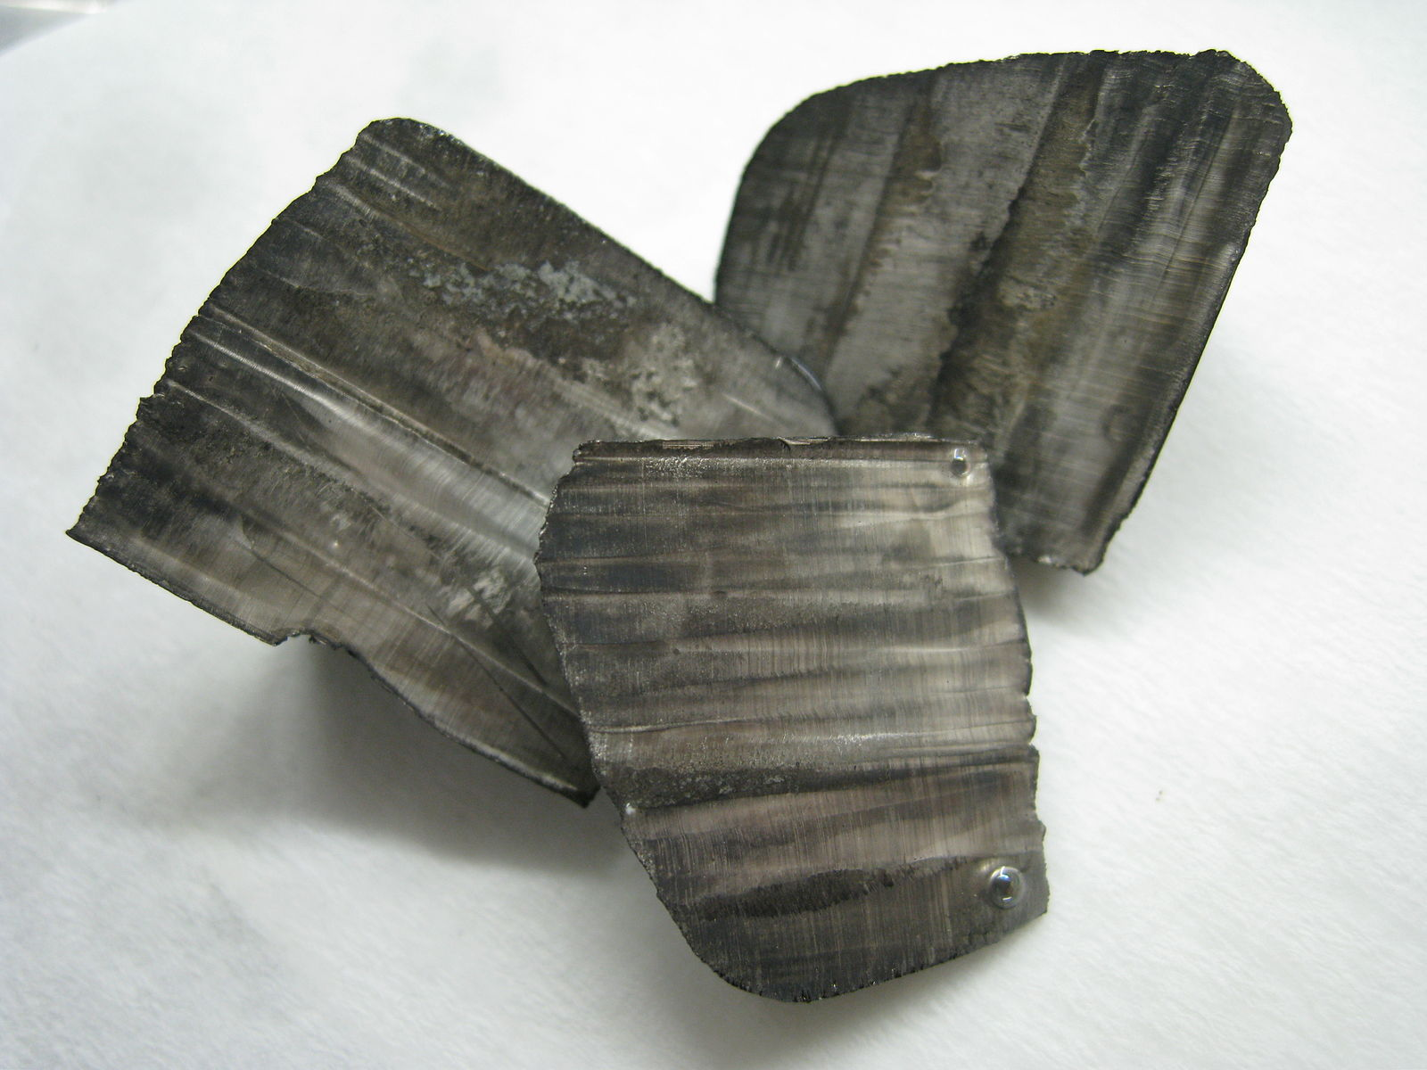
Materials sourcing: lithium
“The only lithium production in the United States was from a brine operation in Nevada.”
“Although lithium markets vary by location, global end-use markets are estimated as follows: batteries, 56%; ceramics and glass, 23%; lubricating greases, 6%;…Lithium consumption for batteries has increased significantly in recent years because rechargeable lithium batteries are used extensively in the growing market for portable electronic devices and increasingly are used in electric tools, electric vehicles, and grid storage applications.”
“Import Sources (2014–17): Argentina, 51%; Chile, 44%; China, 3%; Russia, 1%; and other, 1%.”
https://minerals.usgs.gov/minerals/pubs/commodity/lithium/mcs-2019-lithi.pdf

Slide 10
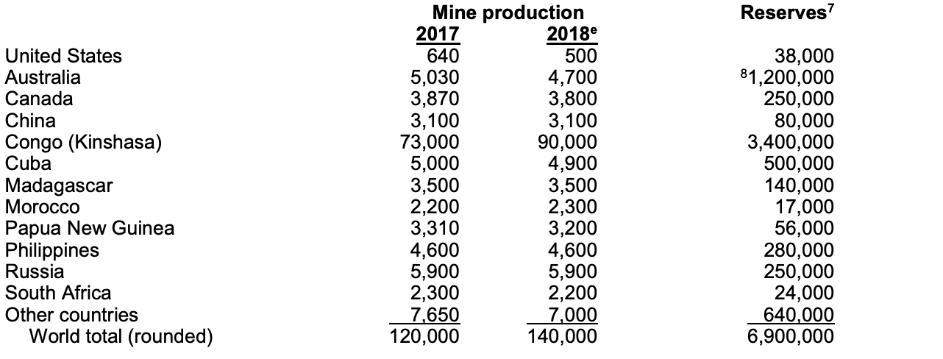
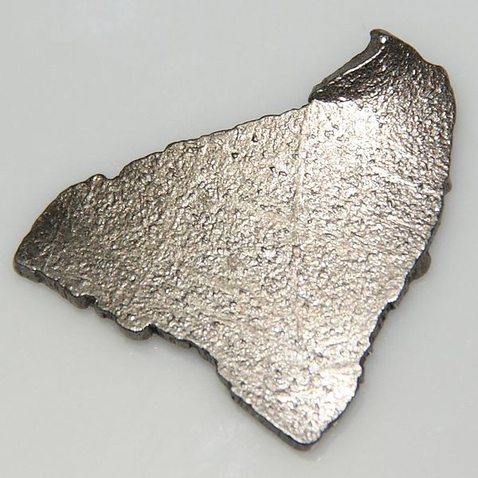
Minerals sourcing: cobalt
“About 46% of the cobalt consumed in the United States was used in superalloys, mainly in aircraft gas turbine engines;”
“Congo (Kinshasa) continued to be the world’s leading source of mined cobalt, supplying more than 60% of world cobalt mine production. China was the world’s leading producer of refined cobalt and has been a leading supplier of cobalt imports to the United States. China was the world’s leading consumer of cobalt, with more than 80% of its consumption being used by the rechargeable battery industry.”
https://minerals.usgs.gov/minerals/pubs/commodity/cobalt/mcs-2019-cobal.pdf
Notes:
8% in cemented carbides for cutting and wear-resistant applications; 15% in various
other metallic applications; and 31% in a variety of chemical applications.
Import Sources (2014–17): Cobalt contained in metal, oxide, and salts: Norway, 18%; China, 12%; Japan, 12%;
Finland, 9%; and other, 49%.
The cobalt contents of lithium-ion batteries, the leading global use for cobalt, are expected to be
reduced rather than eliminated; nickel contents of lithium-ion batteries will increase as cobalt contents decrease.

Slide 11
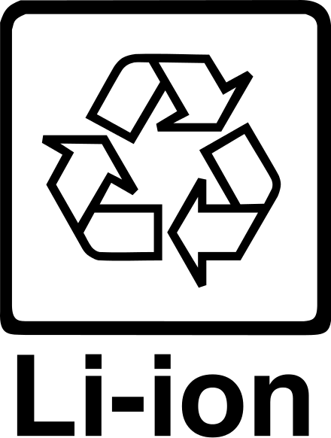
Materials recycling
Lithium: One domestic company has recycled lithium metal and lithium-ion batteries since 1992 at its facility in British Columbia, Canada. In 2015, the company began operating the first U.S. recycling facility for lithium-ion vehicle batteries in Lancaster, OH.
Cobalt: In 2018, cobalt contained in purchased scrap represented an estimated 29% of cobalt reported consumption.
Nickel: recycled nickel in all forms accounted for approximately 52% of apparent consumption.
https://minerals.usgs.gov/minerals/pubs/commodity/lithium/mcs-2019-lithi.pdf
https://minerals.usgs.gov/minerals/pubs/commodity/cobalt/mcs-2019-cobal.pdf
https://minerals.usgs.gov/minerals/pubs/commodity/nickel/mcs-2019-nicke.pdf

Slide 12
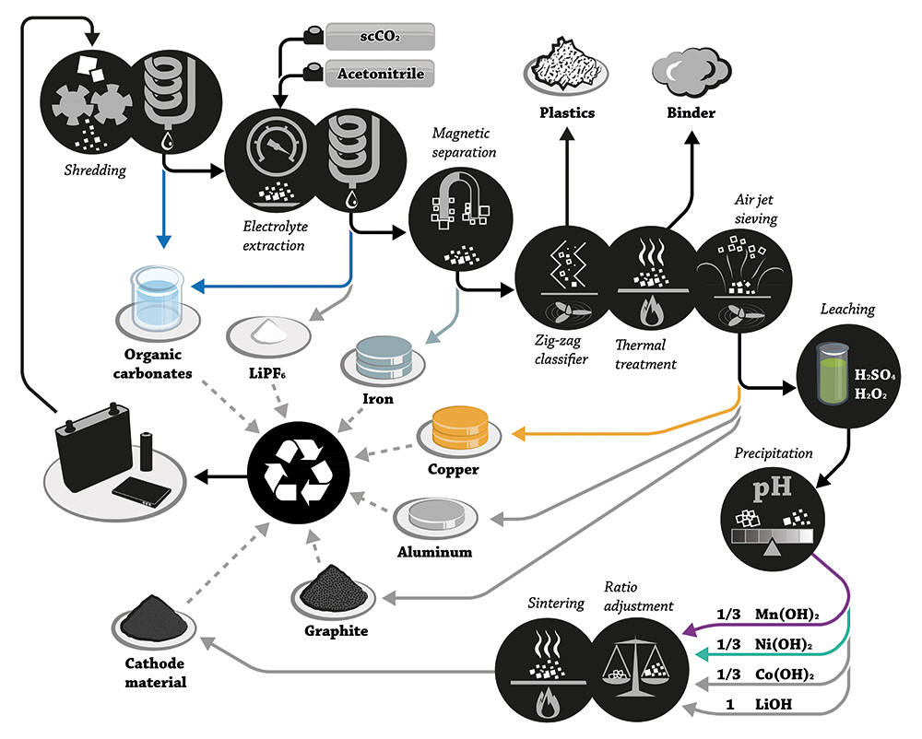
Current battery recycling process
https://www.laboratory-journal.com/science/chemistry-physics/recycling-lithium-ion-batteries
Notes:
Approximately 50% of spent lithium ion (Li-ion) battery assets are recovered and recycled in Europe, China, South Korea, and Japan. In contrast, less than 5% of all Li-ion battery assets are recycled in the US. While cobalt and lithium are thought to be the two most valuable metals found in Li-ion batteries (with consumption of both reportedly outpacing production in the past 5 years), other metals like iron, nickel, aluminum, and magnesium also have positive revenue implications when recycled. Still, the US lacks the domestic supply of both lithium and cobalt.

Slide 13
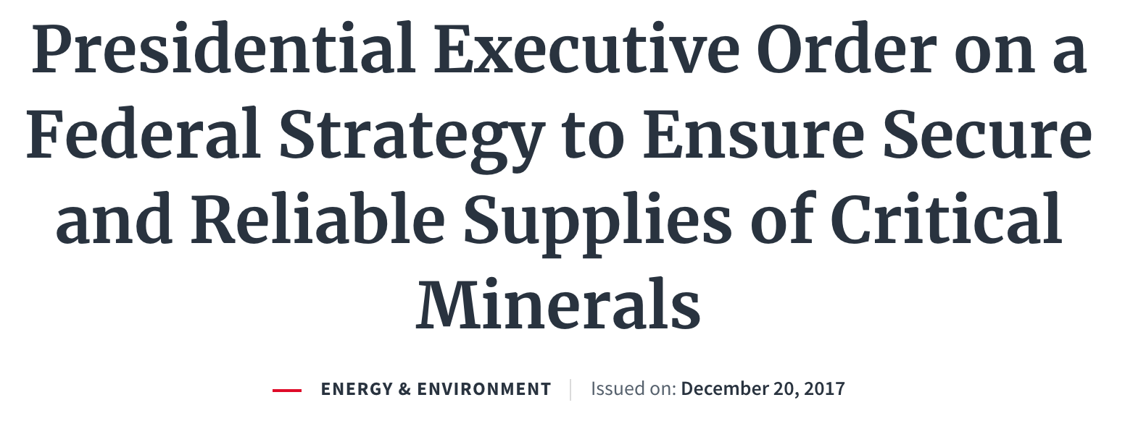
“An increase in private‑sector domestic exploration, production, recycling, and reprocessing of critical minerals…will reduce our dependence on imports, preserve our leadership in technological innovation…”
“A “critical mineral” is a mineral identified… to be (i) a non-fuel mineral or mineral material essential to the economic and national security… (ii) the supply chain of which is vulnerable to disruption, and (iii) that serves an essential function in the manufacturing of a product”
Executive Order 13817
https://www.whitehouse.gov/presidential-actions/presidential-executive-order-federal-strategy-ensure-secure-reliable-supplies-critical-minerals/

Slide 14
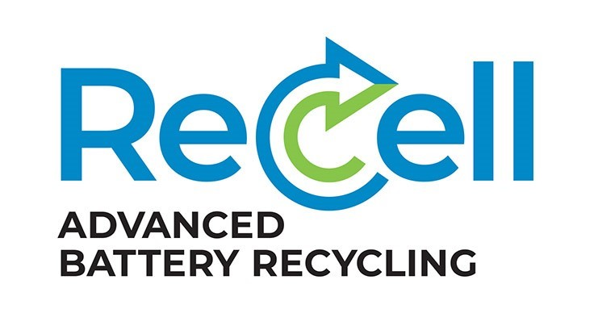
“These efforts aim to reclaim and recycle critical materials (e.g., cobalt and lithium) from lithium-based battery technology”
“The goal…to profitably capture 90% of all lithium based battery technologies…Currently…recycled at a rate of less than 5%.” “award cash prizes totaling $5.5 million”
A direct cathode recycling focus will develop recycling…without the need for costly reprocessing;
Create technologies that cost effectively recycle other battery materials
Design for recycling will develop new battery designs optimized
Modeling and analysis tools

Slide 15
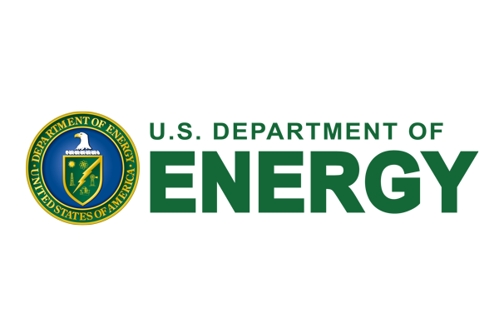
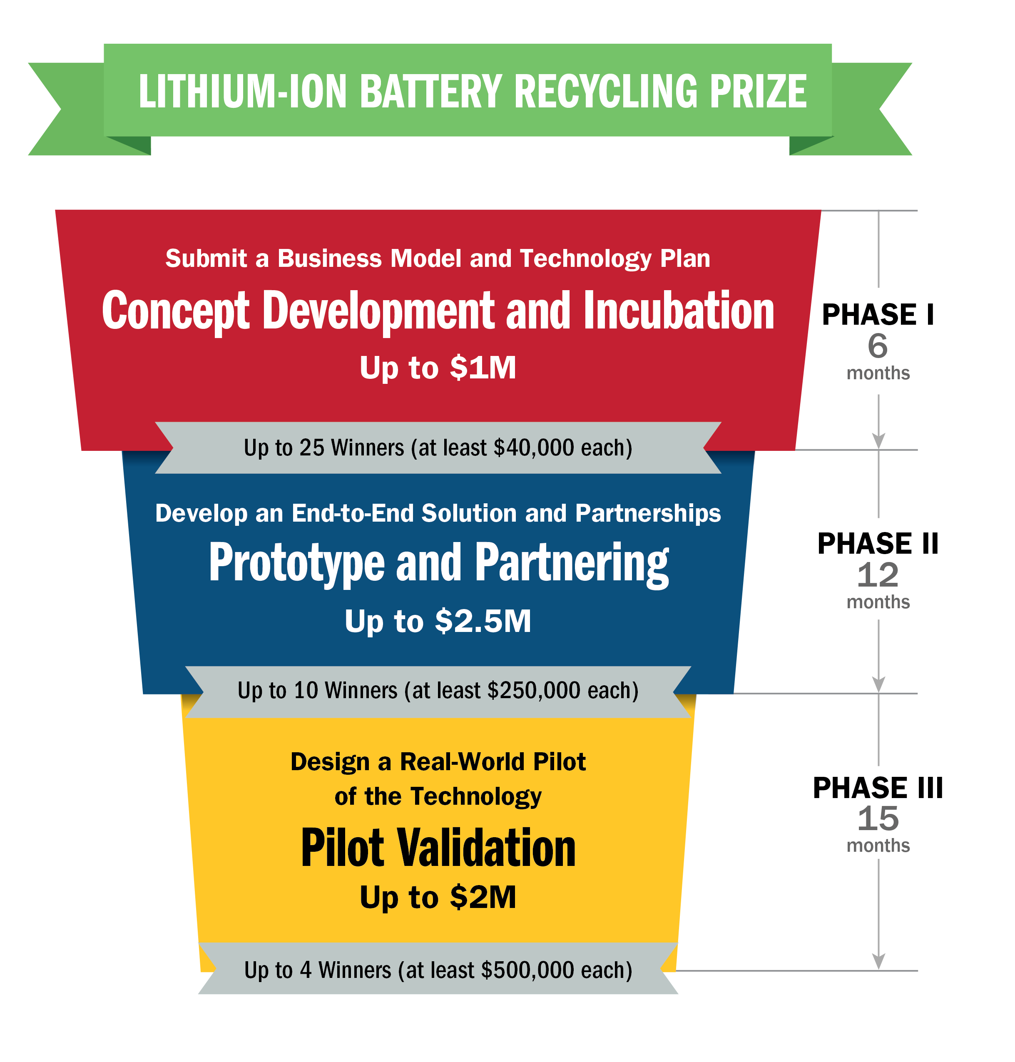
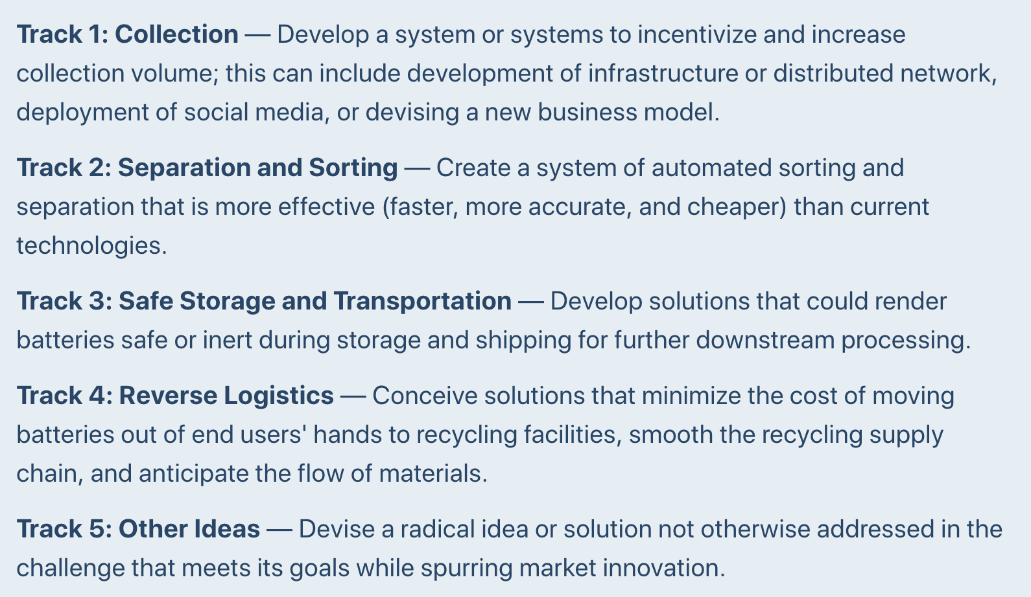
https://americanmadechallenges.org/batteryrecycling/

Slide 16
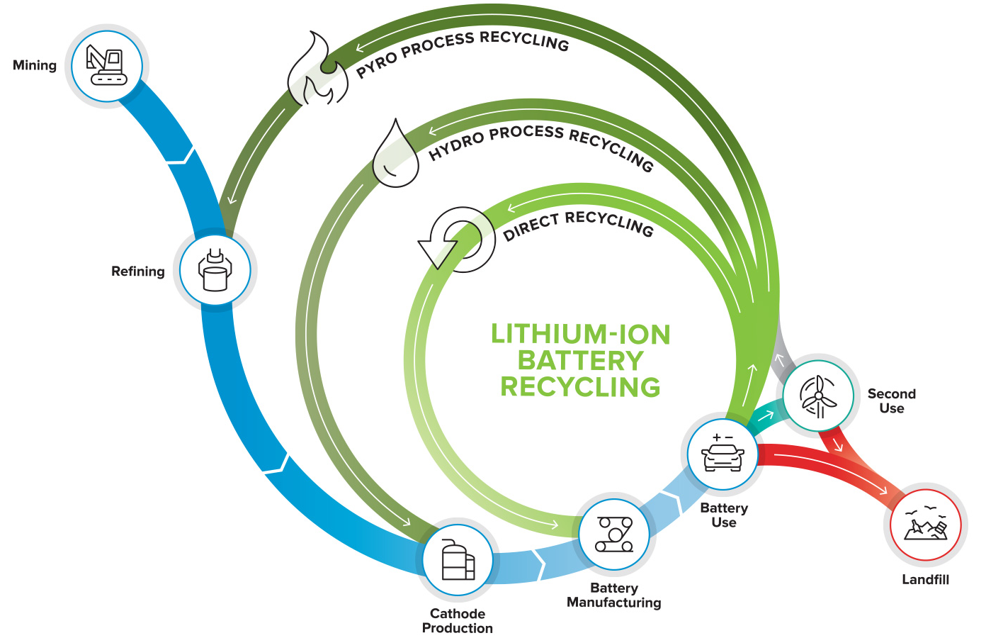

Slide 17
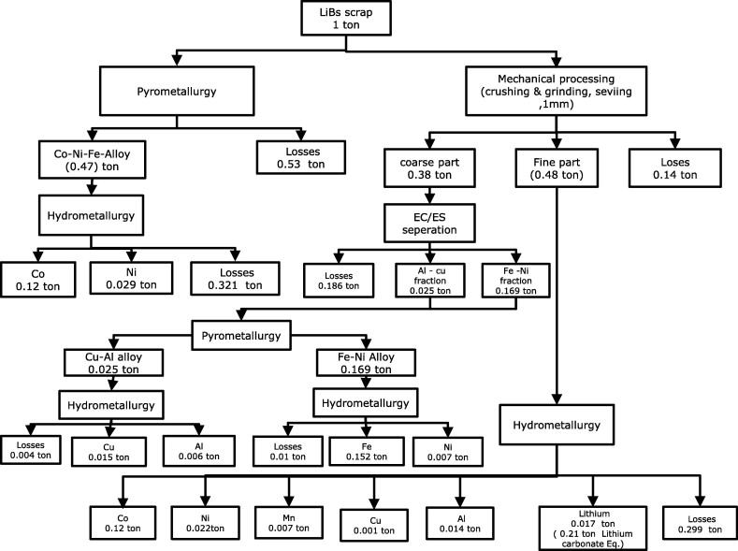
Pyrometallurgical processing
Al-Thyabat et al., Minerals Engineering, 2013, 45, 4-17
DOI: 10.1016/j.mineng.2012.12.005

Slide 18
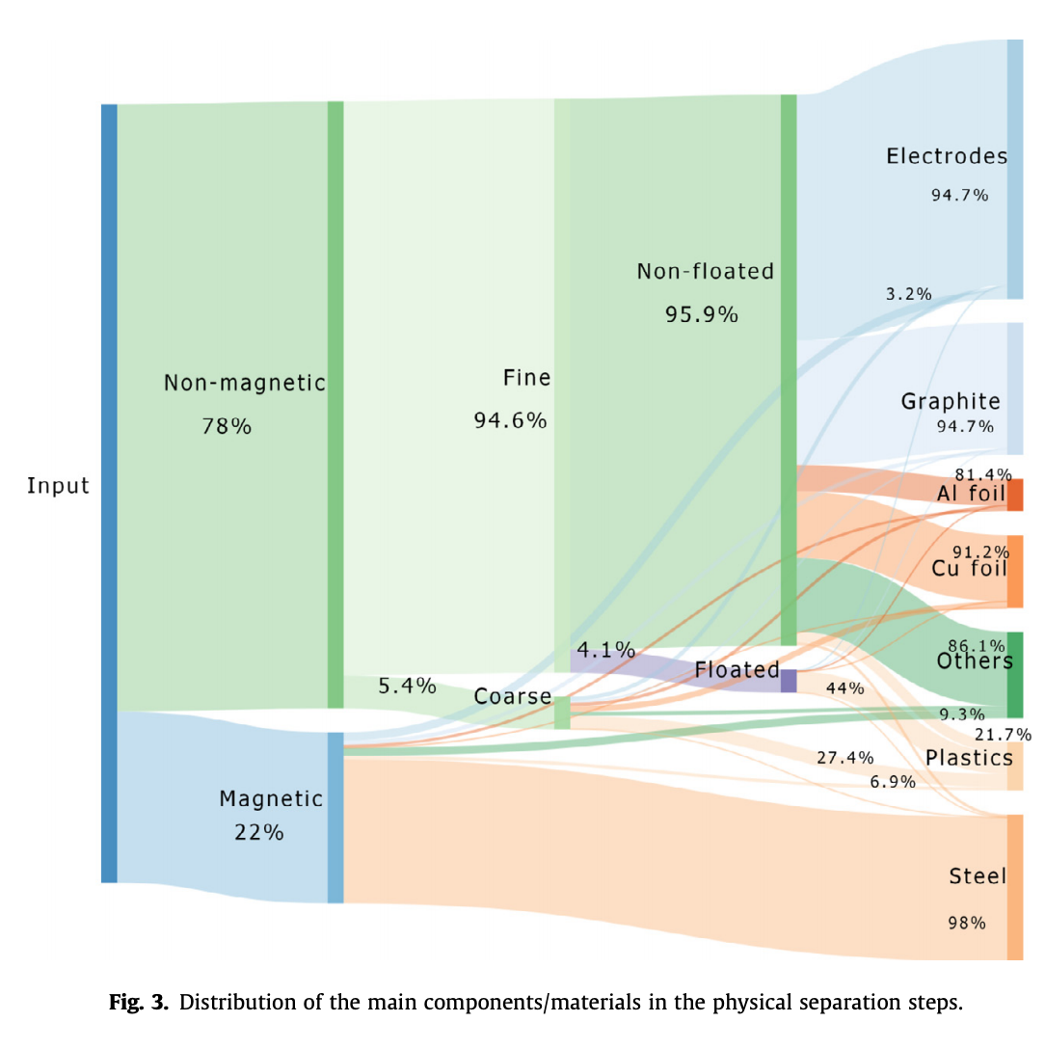
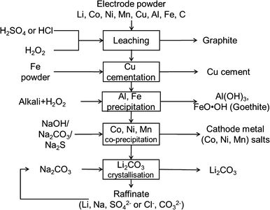
Hydrometallurgical processing
N. Vieceli et al., Waste Management 71 (2018) 350–361
DOI 10.1016/j.wasman.2017.09.032
Wang et al., J. Sustain. Metall. 2015, 1, 168–178
DOI 10.1007/s40831-015-0016-6

Slide 19
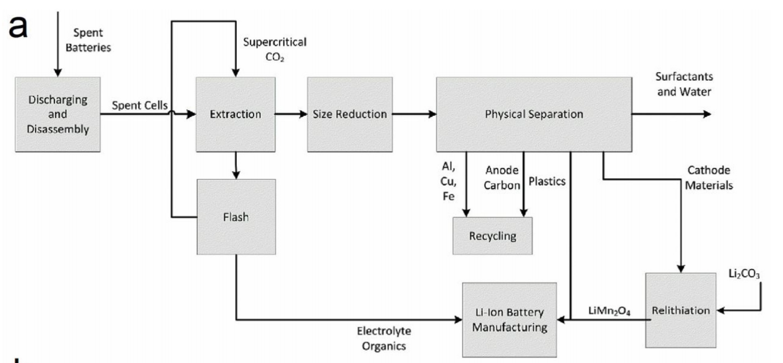
Direct cathode recovery
Huang et al., Journal of Power Sources 399 (2018) 274–286
DOI: 10.1016/j.jpowsour.2018.07.116

Slide 20
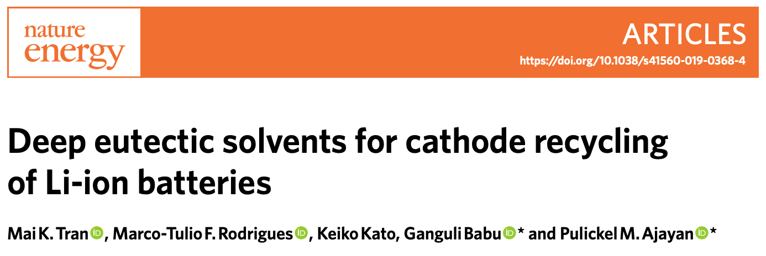
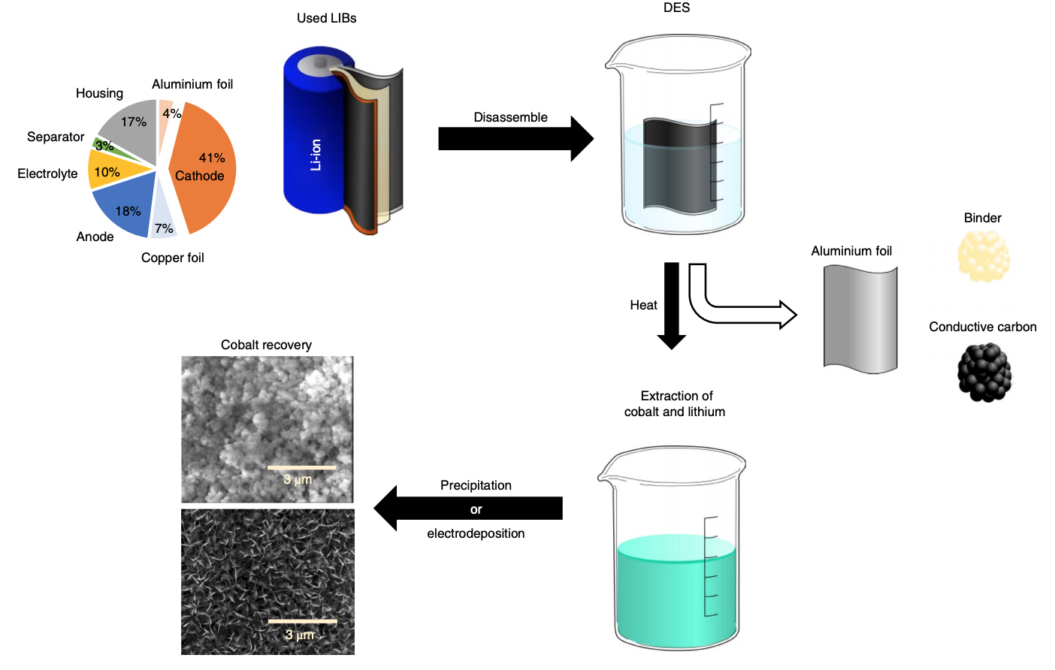
Published April 1, 2019
Deep eutectic solvent (DES) composed of choline chloride and ethylene glycol (ChCl:EG)
DOI: 10.1038/s41560-019-0368-4

Slide 21
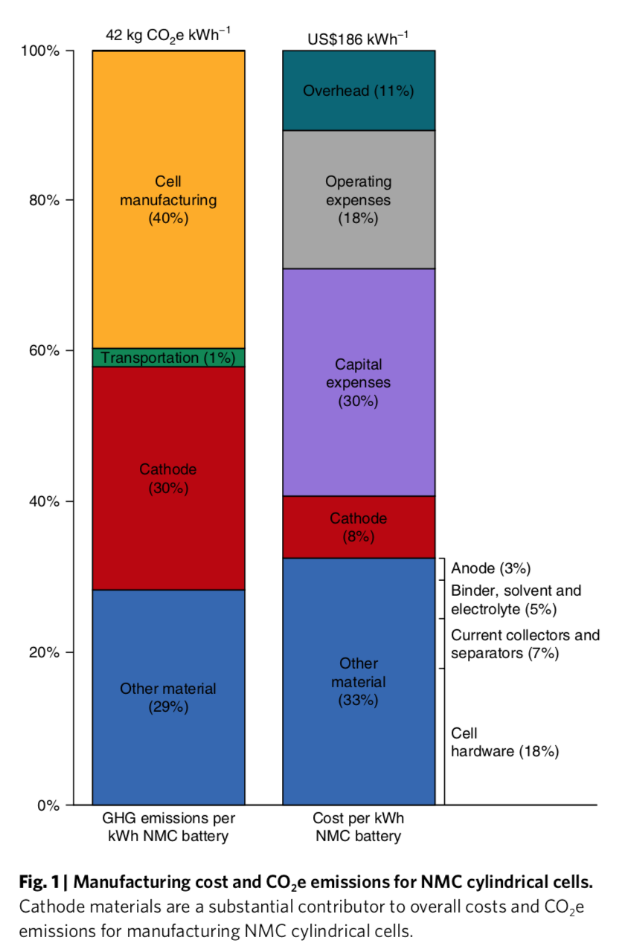
“several battery recycling processes exist, the greenhouse gas emissions impacts and economic prospects of these processes differ”
“We compare three recycling processes: pyrometallurgical and hydrometallurgical recycling processes…and direct cathode recycling”
“While pyrometallurgical and hydrometallurgical processes do not significantly reduce life-cycle greenhouse gas emis- sions, direct cathode recycling has the potential to reduce emissions and be economically competitive. Recycling policies should incentivize battery collection and emissions reductions through energetically efficient recycling processes.”
Ciez, Whitacre. Nature Sustainability, February2019, 2, 148–156
DOI: 10.1038/s41893-019-0222-5

Slide 22
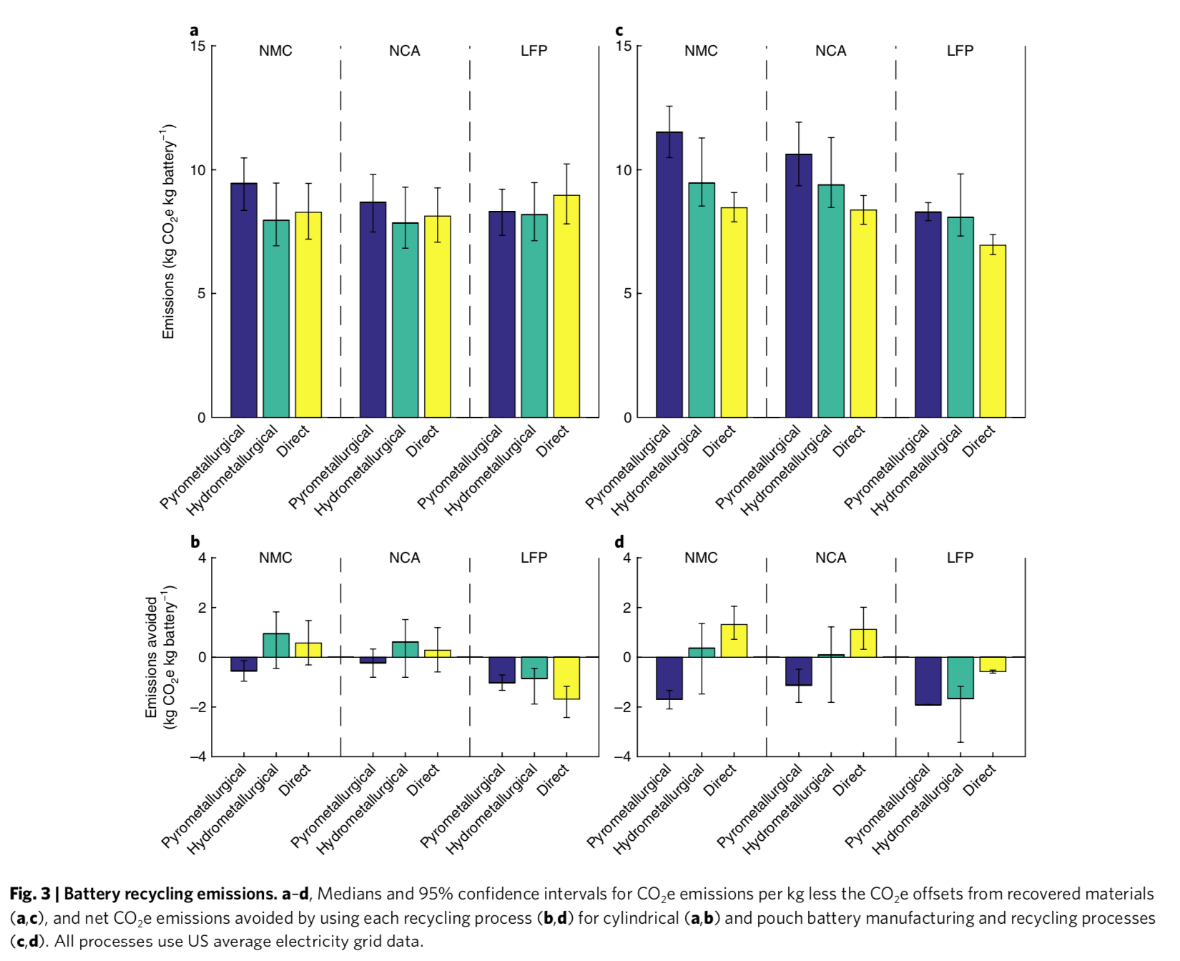
Ciez, Whitacre. Nature Sustainability, February2019, 2, 148–156
DOI: 10.1038/s41893-019-0222-5

Slide 23
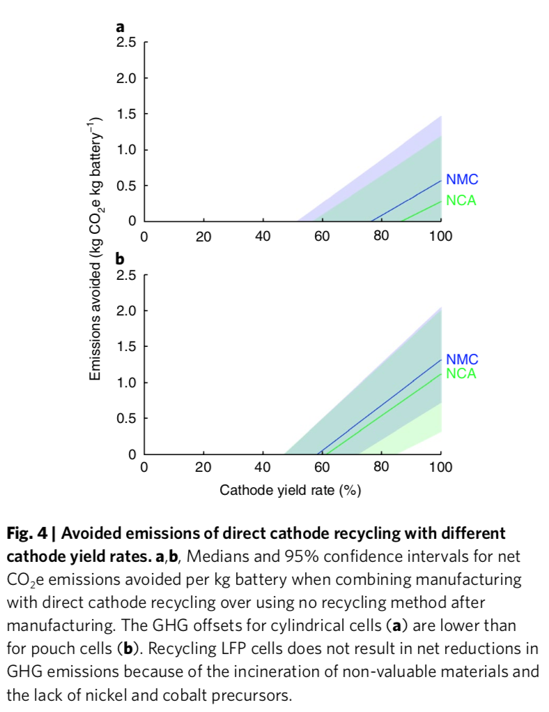
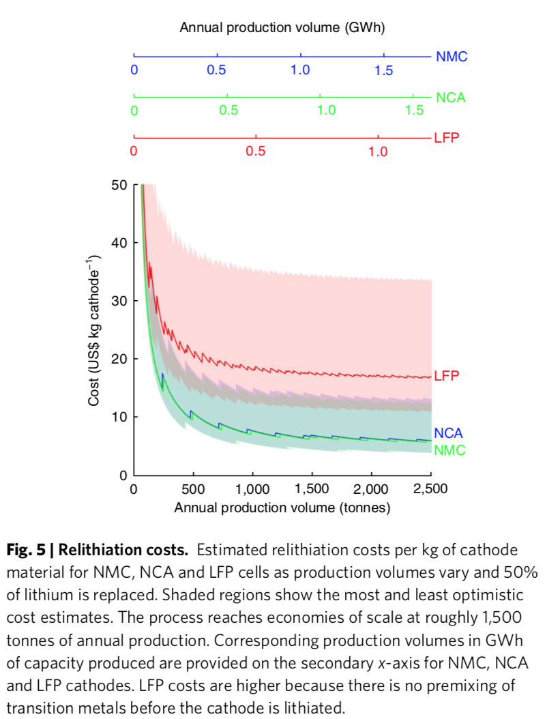
Ciez, Whitacre. Nature Sustainability, February2019, 2, 148–156
DOI: 10.1038/s41893-019-0222-5

Slide 24
Questions to discuss
What are the bottlenecks in Li-ion battery recycling?
How could/should the public sector continue to address this topic?
How might the private sector be incentivized to invest in battery recycling?
What needs to happen to make direct recycling technically and economically feasible?

Slide 25
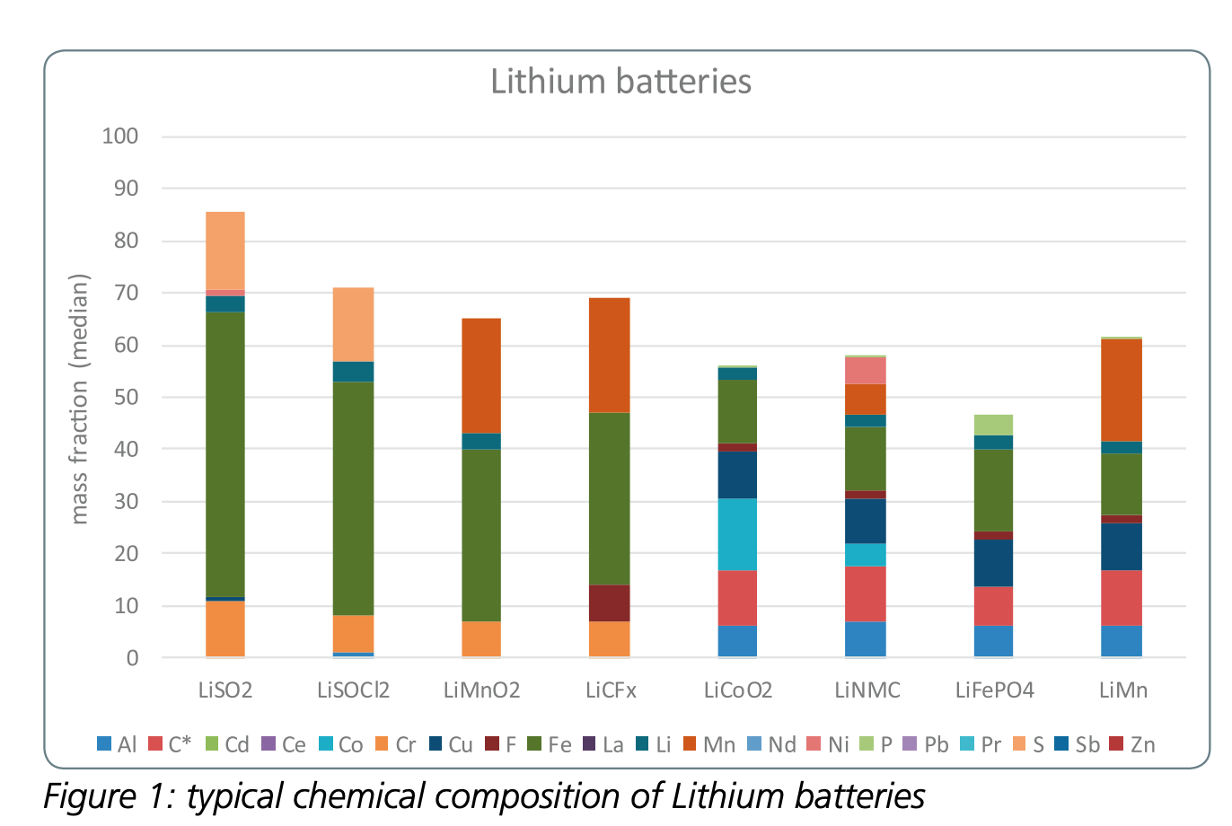
Appendix: Li-ion element breakdown
https://www.rechargebatteries.org/wp-content/uploads/2018/05/RECHARGE-The-Batteries-Report-2018-April-18.pdf

Slide 26
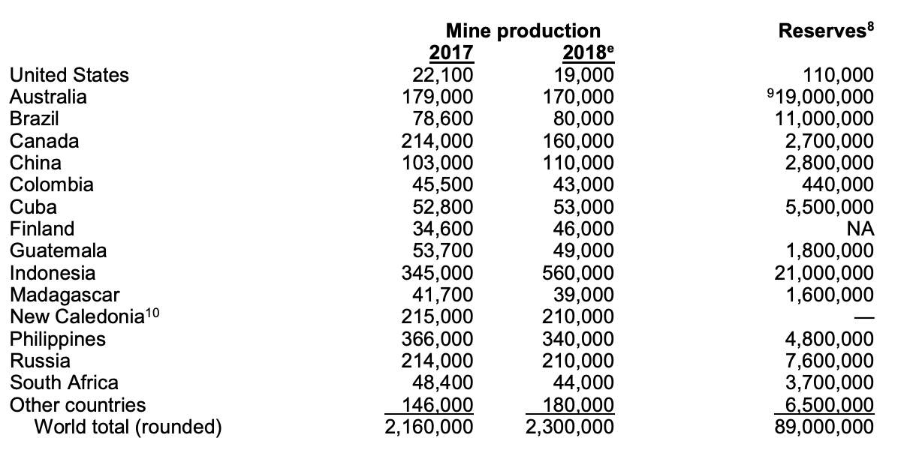
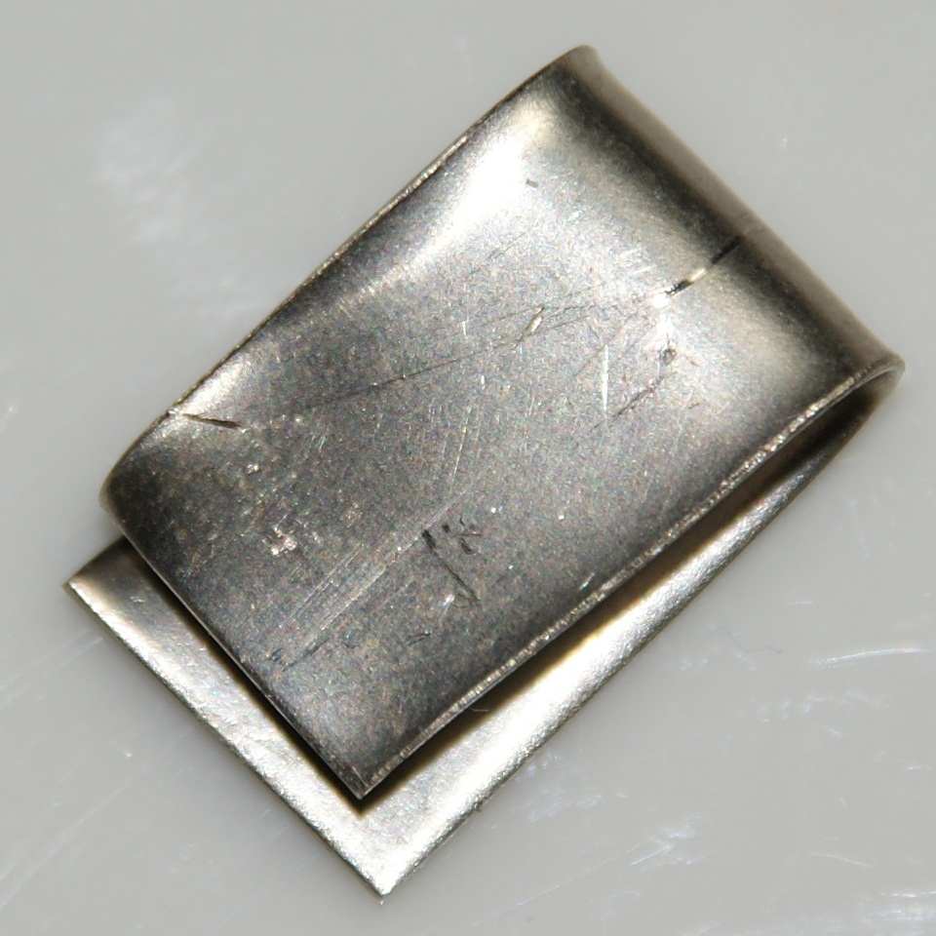
Appendix: Materials sourcing: nickel
“Approximately 47% of the primary nickel consumed went into stainless and alloy steel products, 41% into nonferrous alloys and superalloys, 7% into electroplating”
“Import Sources (2014–17): Nickel contained in ferronickel, metal, oxides, and salt: Canada, 41%; Norway, 11%;Australia, 8%; Russia, 8%; and other, 32%. Nickel-containing scrap, including nickel content of stainless steel scrap: Canada, 40%; Mexico, 28%; United Kingdom, 8%; and other, 24%."
https://minerals.usgs.gov/minerals/pubs/commodity/nickel/mcs-2019-nicke.pdf

Slide 27
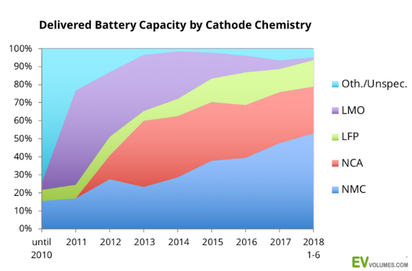
Appendix: Li-ion by chemistry
https://www.li-cycle.com/blog

Slide 28
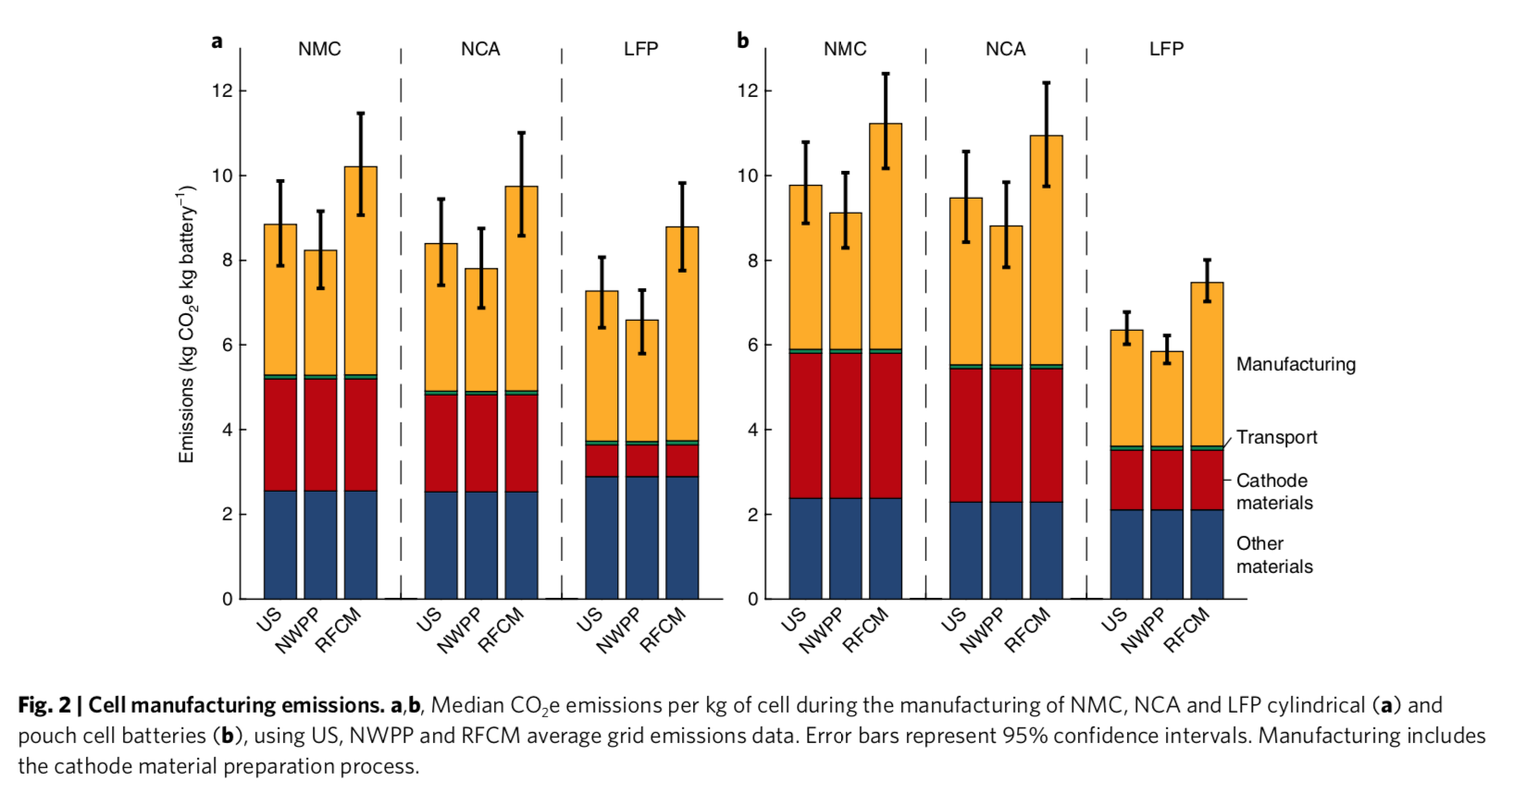
Appendix: CO₂ emissions
^{US average (US)}
low emitting grid, the Northwest Power Pool (NWPP)
higher-emitting grid, the ReliabilityFirst Corporation/Michigan (RFCM)

Slide 29
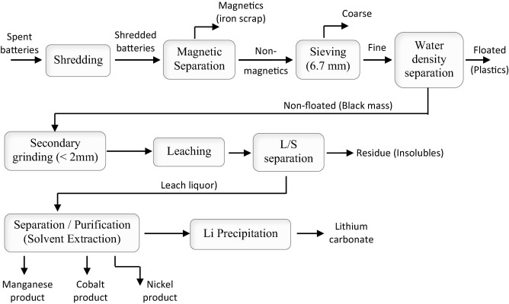
Hydrometallurgical processing
N. Vieceli et al., Waste Management 71 (2018) 350–361
DOI 10.1016/j.wasman.2017.09.032

Slide 30
Hydrometallurgical processing
https://www.researchgate.net/figure/Hydrometallurgical-model-for-recycling-lithium-battery-see-online-version-for-colours_fig1_308063762

