Slide 1
A Children’s Choice of Toy or the Next Decision in Transportation: Planes or Trains
JDS
Harvard Energy Journal Club
April 1st, 2022

Slide 2
Outline
Motivation for Evaluating Transportation Modes
History
Planes
Current Usage & Effects on Climate Change
Opportunities for Technological Improvements & Role in Reducing Carbon Emissions
Trains
Current Usage & Effects on Climate Change
Opportunities for Technological Improvements & Role in Reducing Carbon Emissions

Slide 3
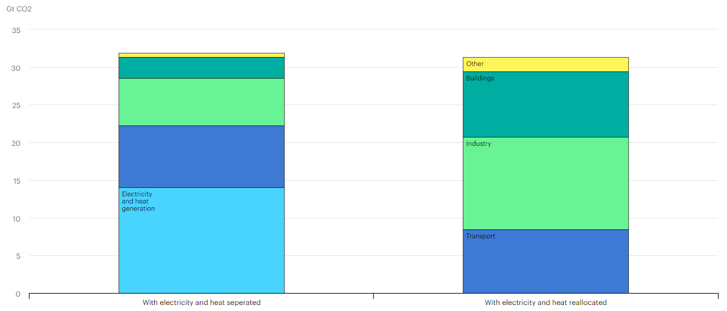
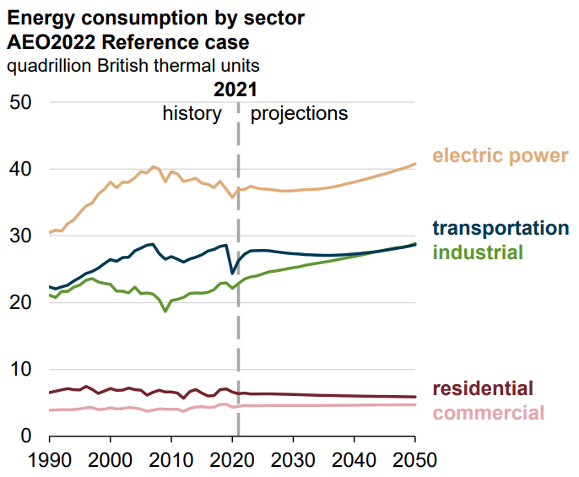
Motivation
https://www.iea.org/data-and-statistics/charts/global-co2-emissions-by-sector-2019
https://www.eia.gov/outlooks/aeo/pdf/AEO2022_ChartLibrary_full.pdf
Notes:
1st plot is in US, 2nd plot is for the world

Slide 4
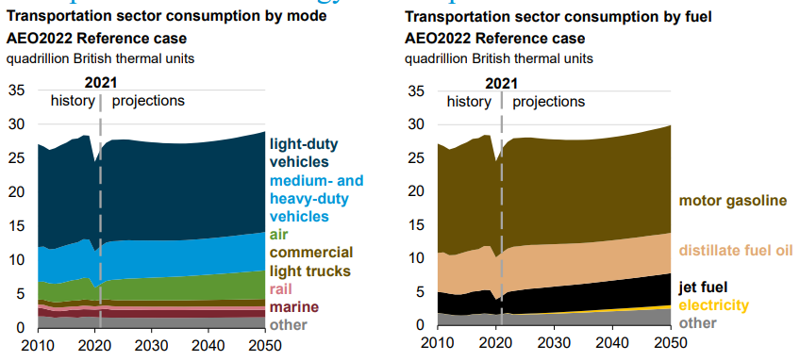
Motivation
Notes:
https://www.eia.gov/outlooks/aeo/pdf/AEO2022_ChartLibrary_full.pdf
Again, looking at the US here

Slide 5
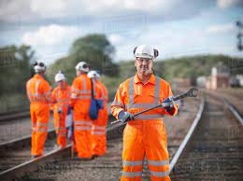
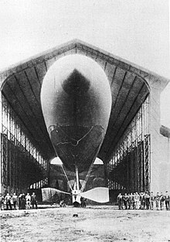
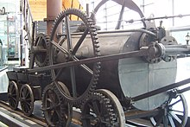
History of Planes & Trains
1804: Steam locomotive
1881: Electric tram lines
1886: Steam engine
1919: Crossing the Atlantic
1958: Boeing 707
1837: Electric locomotive
1884:
“La France” powered by flow battery
1903: Wright brothers
1939: 1st turbojet powered flight
Notes:
1825: railways built; could handle 400 passengers and go at 8 mph or 14 kph. This started “Railway Mania” stock market bubble
1837: powered by batteries; 6 tons moving at 4 mph or 6 km/h for a distance of 1.5 miles or 2.4 km. Unfortunately, destroyed by railway workers because of concerns over work
1881: By around 1900, got up to 100 mph or 160 km/h
1884: La France: 23.4 km/h (14.5 mph), range 12.2 km (7.6 mi). Powered by 435 kg ZnCl flow battery, traveled 8 km.
1886: Eole flew using a steam engine
1903: Wright brothers use gas powered engines
1919 used Rolls-Royce Engine developed for military use in WW1. Also had first international commercial flight
1939: diesel fueled engine. Speeds limited to 372 mph (598 km/h), lasted 10 minutes. Turbojet: airbreathing jet engine; gas turbine with propelling nozzle. Doesn’t have aerodynamic limitations of propellers. Flew in Heinkel He 178
1958: first widely successful commercial jet

Slide 6
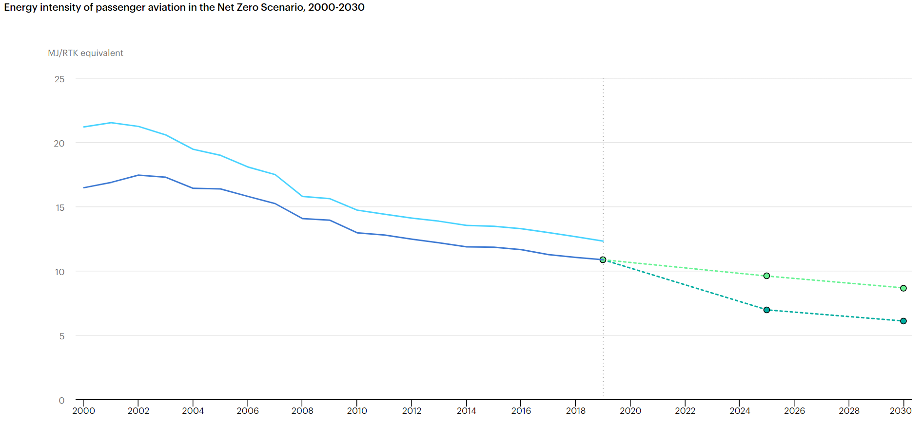
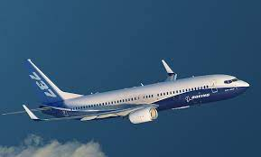
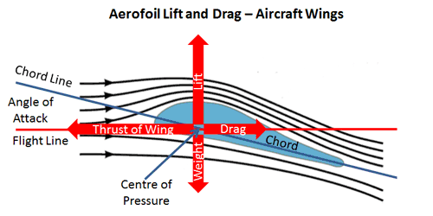
Planes Today
1% of world’s cargo
4 billion passengers a year
https://www.iea.org/reports/aviation
$p_{1}+\frac{ρv_{1}^{2}}{2}+ρgh_{1}=$ $p_{2}+\frac{ρv_{2}^{2}}{2}+ρgh_{2}$
Notes:
Carry 1% of world’s cargo and transport 4 billion passengers annually
Fuel efficiency: 70% decrease in carbon intensity per available seat-km in the last 60 years. Currently, efficiency improvements are beating industry targets but are not reaching improvements suggested by certain organizations (International Civil Aviation Organization from the UN)
https://www.mpoweruk.com/flight_theory.htm
V. Viswanathan et al., Nature 601 (2022). https://doi.org/10.1038/s41586-021-04139-1

Slide 7
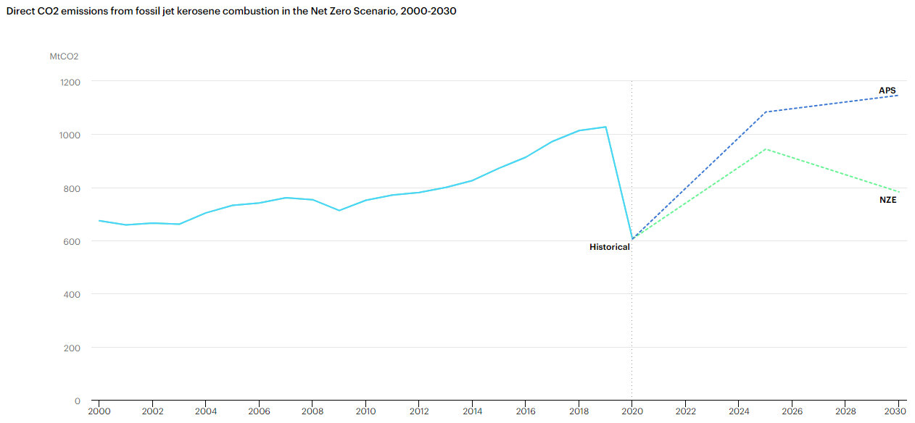
Planes Today
https://www.iea.org/reports/aviation
APS = Announced Pledges Scenario
NZE = Net Zero Emissions by 2050 Scenario
Notes:
In response to less passengers in 2020 and 2021, air cargo traffic surpassed 2020 levels by 10%
Large aircraft responsible for 95% of aviation direct emissions. At cruise, large aircraft produce less CO2 per kWh than the world’s electric grid by 20-35%

Slide 8
Future of Planes
Alternative fuels (biofuels and synthetic jet kerosene)
Currently less than 0.1% of fuel; aiming for 2% by 2025, 63% by 2050 for European Commission & 100% for USA
Twice as expensive
Electrification
Notes:
Alternative Fuels: https://www.iea.org/reports/aviation
Electrification (efficiency): V. Viswanathan et al., Nature 601 (2022). https://doi.org/10.1038/s41586-021-04139-1

Slide 9
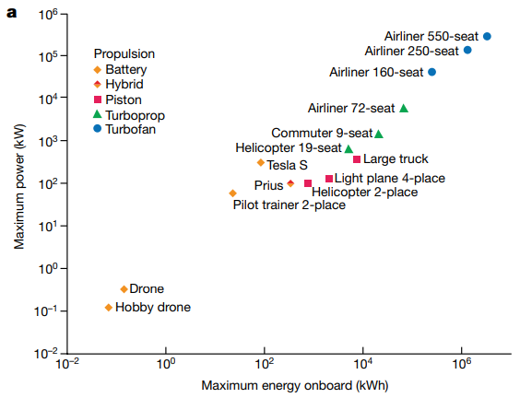
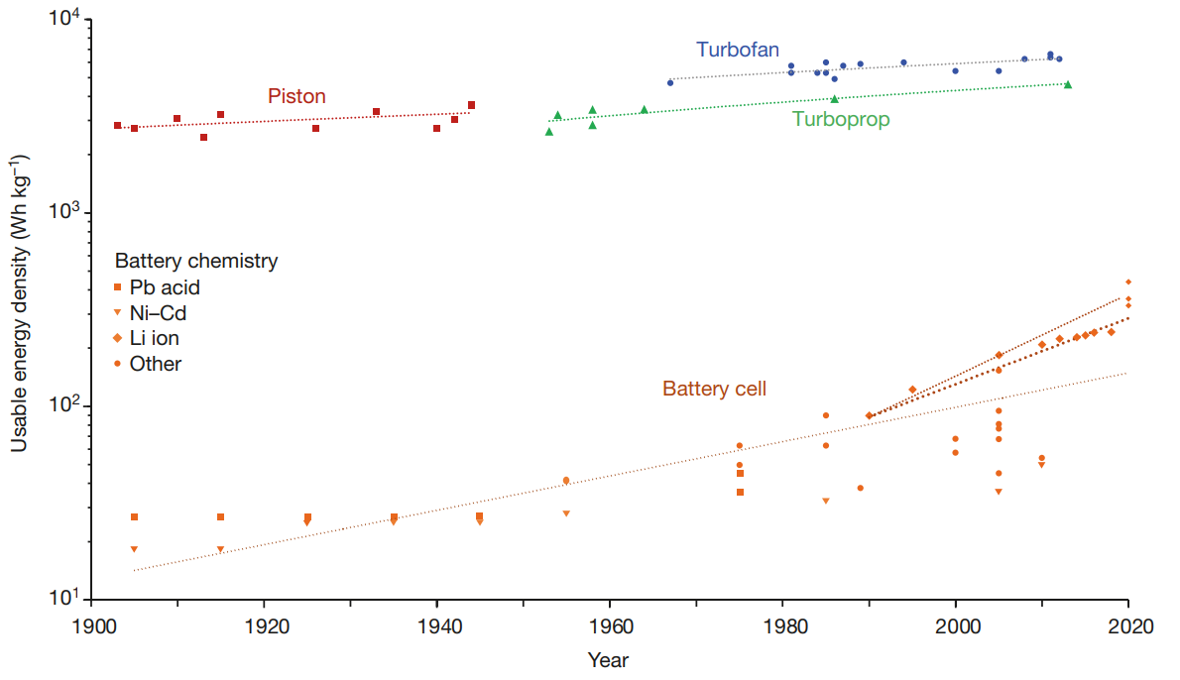
Requirements for Electrification
Fuel Cell
Li+, NiMH,
V. Viswanathan et al., Nature 601 (2022). https://doi.org/10.1038/s41586-021-04139-1. Edited.
Notes:
Alternative Fuels: https://www.iea.org/reports/aviation

Slide 10
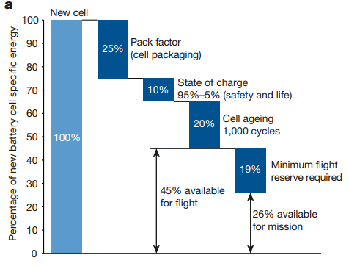
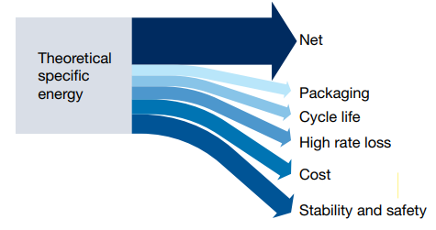
Requirements for Electrification
V. Viswanathan et al., Nature 601 (2022). https://doi.org/10.1038/s41586-021-04139-1
Notes:
Alternative Fuels: https://www.iea.org/reports/aviation
For a battery that lasts 1,000 cycles, it needs to cost $8-13 per kWh

Slide 11
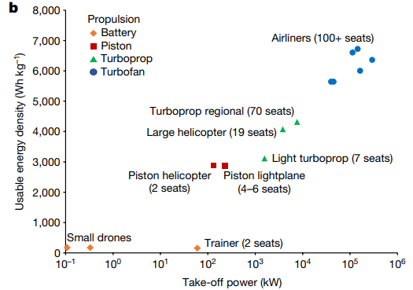
Requirements for Electrification
V. Viswanathan et al., Nature 601 (2022). https://doi.org/10.1038/s41586-021-04139-1. Edited.
Notes:
Alternative Fuels: https://www.iea.org/reports/aviation

Slide 12
Future for Electrified Flight
Electrification
Demonstrations up to 20 passengers past 100 km
Expected to be less than 1 Mm trips until 2050
Electrification vs Combustion
Energy efficiency jumps from 20-55% to 80-90%
Cost of ownership is expected to be the same
Electrical equipment and gas turbines are ~ same per kW
With superior efficiency, energy cost becomes equivalent
https://www.iea.org/reports/aviation
Sripad and Viswanathan The promise of energy-efficient battery-powered urban aircraft. PNAS 2021 Vol. 118 No. 45 e2111164118. https://doi.org/10.1073/pnas.2111164118
V. Viswanathan et al., Nature 601 (2022). https://doi.org/10.1038/s41586-021-04139-1
Notes:
Alternative Fuels: https://www.iea.org/reports/aviation

Slide 13
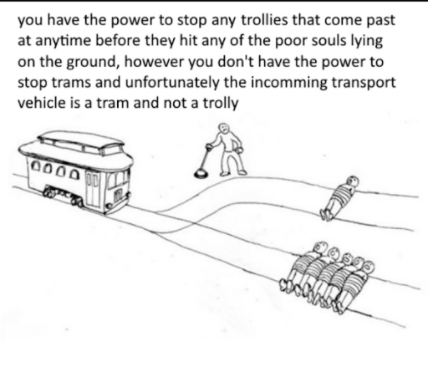
Trains Versus Everybody

Slide 14
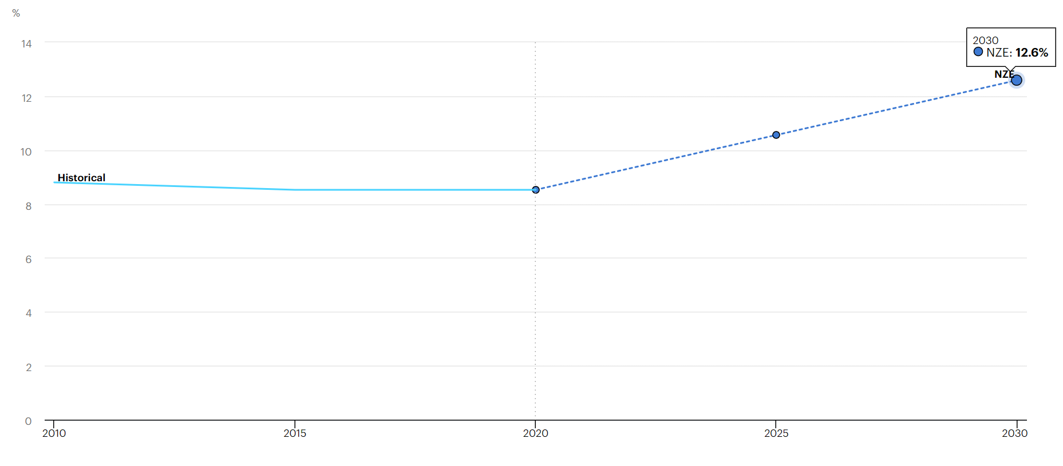
Trains Today
Share of rail travel in total passenger transport activity globally in the Net Zero Scenario, 2010-2030
NZE = Net Zero Emissions by 2050 Scenario
Notes:
Fuel efficiency: "Rail - Fuels & Technologies". IEA. 7 January 2022. Retrieved 23 January 2022.
https://www.iea.org/reports/rail (image with bars and dots: bars are GHG intensity range, dots are World average)
Despite rapid global metro and high-speed rail system expansions in the past ten years, the share of rail in passenger transport remained roughly constant at just below 10% over the past two decades.

Slide 15
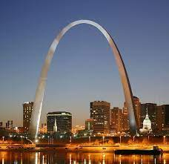
Trains vs Planes: A Case Study
Example: Chicago to St. Louis
Planes
1.25 hours, $165-350 roundtrip
Including airport time, about 3.5-4.5 hours
Car
5 hours, a tank of gas; $40? $1,000?
Train
5.25 hours, $62-$100
Notes:
https://www.nytimes.com/2019/09/20/travel/trains-airplanes.html

Slide 16
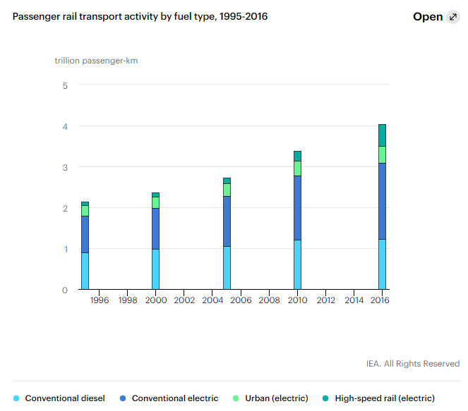
Trains Today: Increasingly Electric
Notes:
https://www.iea.org/reports/the-future-of-rail
¾ of rail transport on elect4ric trains, an increase of 60% from 2000. It’s the only widely electrified transport system today.
https://en.wikipedia.org/wiki/Electric_locomotive#:~:text=An%20electric%20locomotive%20is%20a,a%20battery%20or%20a%20supercapacitor.
Electric: pros
Regenerative braking
Quiet
Easier on tracks (lack of reciprocating parts) - > less maintenance
Power plants use
Also more efficient at burning nonrenewable sources
Can be from renewable energy sources
20% cheaper than diesel locomotives; 25-35% lower maintenance costs, 50% less operational costs
Electric: cons
High cost for infrastructure
Hard to incentivize in the US because tracks are privately owned and we STILL don’t have a carbon tax

Slide 17
Notes:
This is share of electric train activity as a percentage of total train activity.
Passenger rail networks are concentrated in a handful of regions – China, the European Union, India, Japan and Russia – that together register 90% of global passenger rail activity. Somehow, Currently, US and China make ¼ of rail freight activity. EU reduced tolls by 50% from 2020 to 2021, and they plan to double rail freight by 2050. Chile also plans to double by 2027.
Notably, passenger rail is significantly more electrified than freight pretty much everywhere.
Notably, regions with more urban rail and high-speed rail have larger shares of passenger-km from electricity

Slide 18
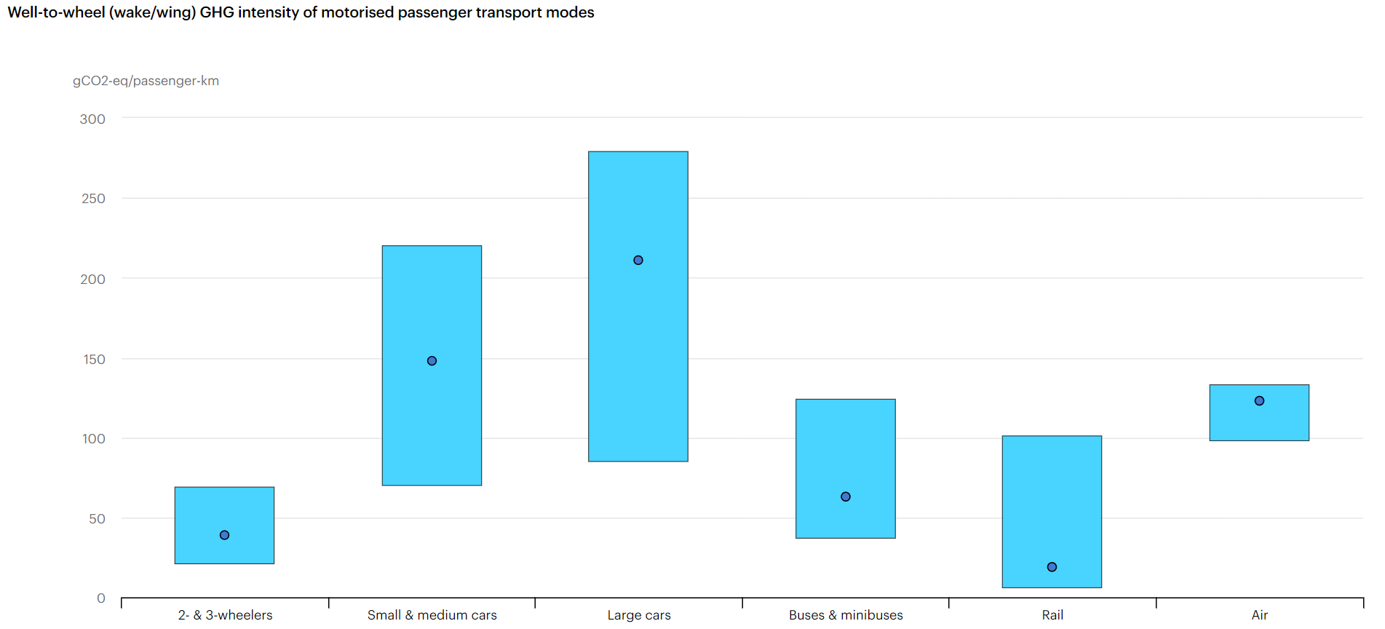
Trains Today
Bars: range of values
Dots: global average
Notes:
Fuel efficiency: "Rail - Fuels & Technologies". IEA. 7 January 2022. Retrieved 23 January 2022.
https://www.iea.org/reports/rail (image with bars and dots: bars are GHG intensity range, dots are World average)
Responsible for 9% of global motorized passenger movement and 7% of freight but only 3% ohttps://www.iea.org/reports/rail f transport energy use
12 times less energy and emits 7-11 times less GHGs per passenger-km travelled than private vehicles and airplanes. Estimated 63 g CO2 per passenger-km
oil accounted for 55% of total energy consumption in rail and powered 28% of all passenger rail transport activity in 2020.
Fuel efficiency: "Rail - Fuels & Technologies". IEA. 7 January 2022. Retrieved 23 January 2022.
https://nationalrrmuseum.org/blog/railroads-strive-to-reduce-the-carbon-footprint-and-increase-sustainability/#:~:text=They%20reduce%20greenhouse%20emissions%20by,2%25%20of%20transportation%20source%20emissions.
More fuel efficient because less friction on terrain. Also, have optimized operations by fuel management systems software on the train. Also, don’t have nearly as much stop-start idling. Additionally, have improved aerodynamics
On average, U.S. railroads move one ton of freight 479 miles on one gallon of diesel fuel. If just 10% of freight hauled by trucks moved by rail instead, fuel savings would amount to more than 1.5 billion gallons per year and annual greenhouse gases would be reduced by more than 17 million tons. This is equivalent to removing 3.2 million cars from the highways or planting 400 million trees, which Ireland plans to do by 2040.
with taxes and fees falling short of the amount required to upkeep the cost of highway maintenance caused by the damage from heavy trucks ($25 billion in private capital annually), the use of the railroad to transport more goods would be a relief to the taxpayer as well.

Slide 19
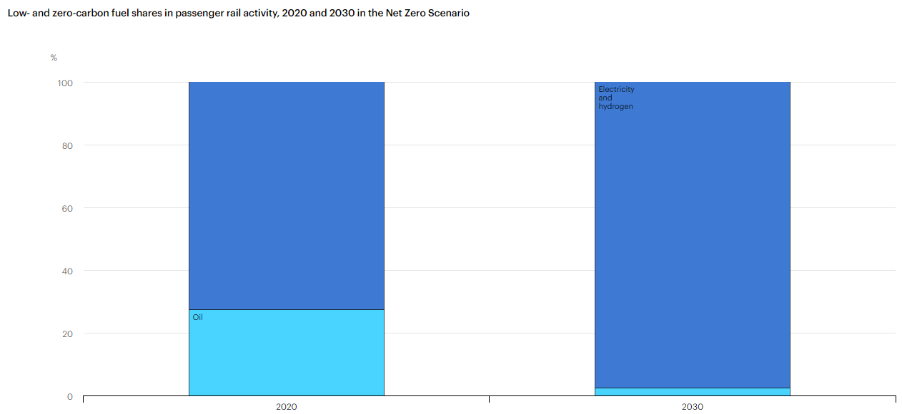
Future of Trains
Notes:
https://www.iea.org/reports/rail
Under the Net Zero Scenario, however, electricity and hydrogen sustain almost 100% of total passenger rail activity as soon as 2030.

Slide 20
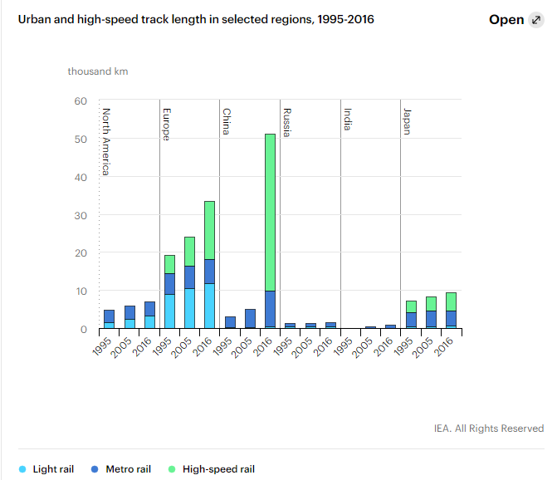
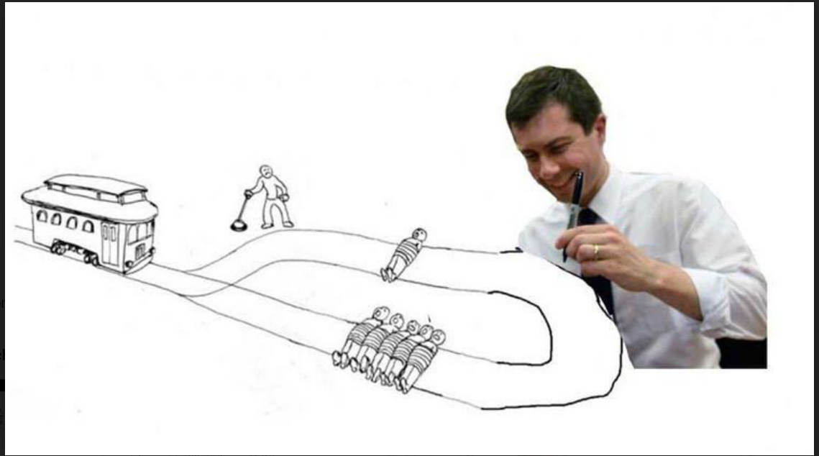
Conventional vs High-Speed Rail
Notes:
High speed: over 250 kph (155 mph)
Metro rail: high-frequency, high capacity urban rails, separated from traffic.
Light rail: Kinda like the green line but smaller

Slide 21
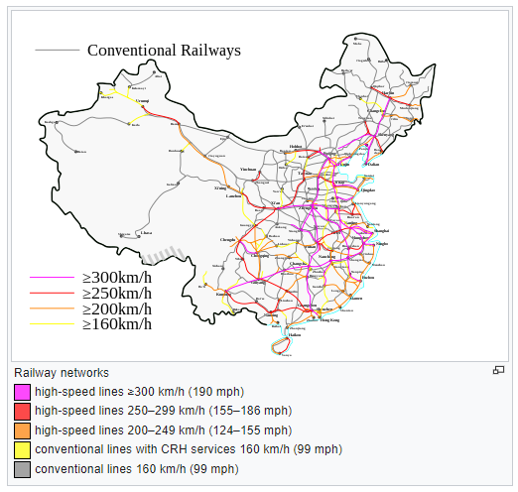
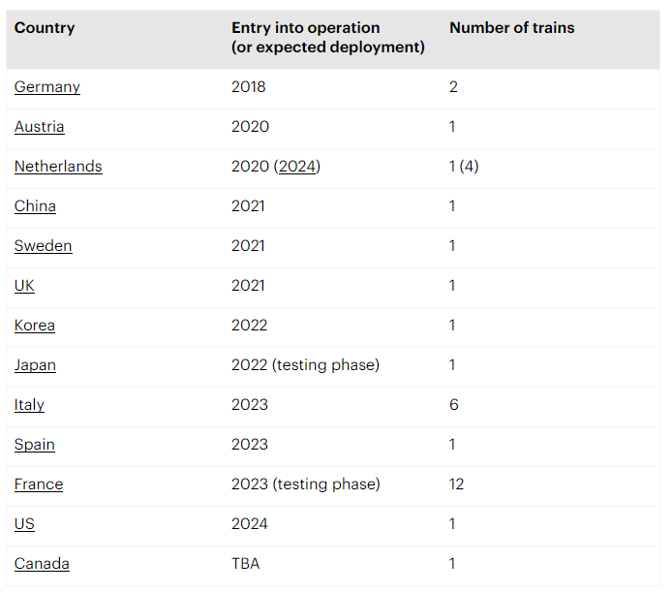
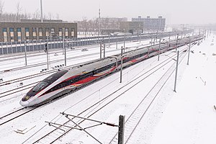
Future of Trains: China
Notes:
https://www.iea.org/reports/rail
https://en.wikipedia.org/wiki/High-speed_rail_in_China
In 2010, China had no high-speed rails. Now, China has several with 600+ billion passenger-km traveled with it each year. China actually plans to double its high speed rail in 15 years. By then, every city with more than 200,000 people will have rail line connections. Additionallly, China completed its hydrogen-fuel cell hybrid train and plans to launch its first fully electrified bullet trai

Slide 22
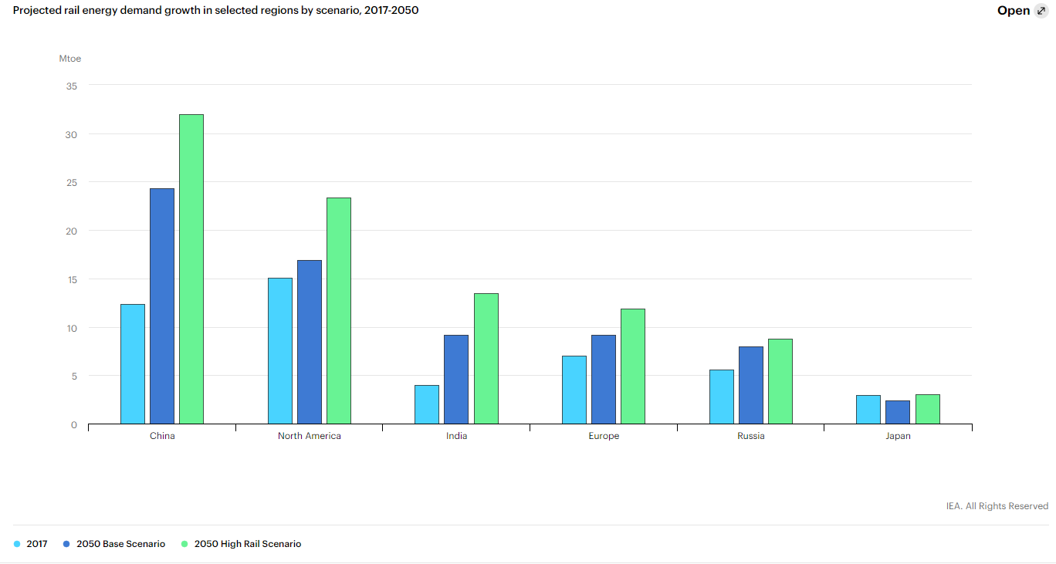
Future of Trains
Notes:
https://www.iea.org/reports/rail
https://www.iea.org/reports/the-future-of-rail
Base scenario: expectations based on announced policies, regulations, and projects
High Rail scenario: requires minimizing costs per passenger-km, maximizing revenues for rail systems, and ensuring other forms of transport pay for their infrastructure and their adverse effects (costs of repairing roads, carbon taxes, etc). Gives 42% more energy demand in rail sector by 2050 than in Base case at 2050. However, that only brings rail to 4% of total transport energy demand then.

Slide 23
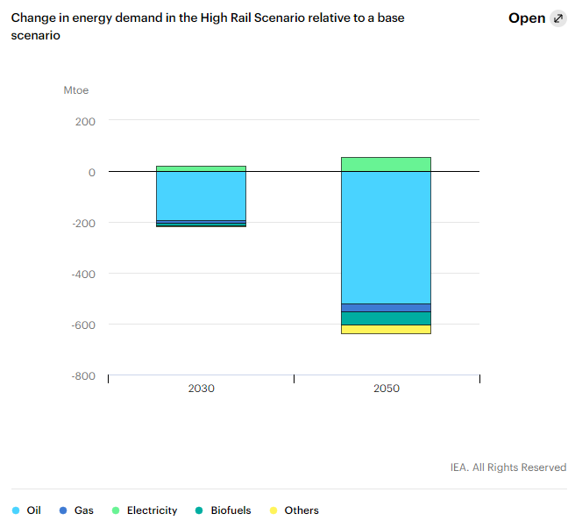
Future of Trains: High Rail Scenario
Notes:
High Rail scenario: requires minimizing costs per passenger-km, maximizing revenues for rail systems, and ensuring transport forms pay for their infrastructure and their adverse effects (costs of repairing roads, carbon taxes, etc). Gives 42% more energy demand in rail sector by 2050 than in Base case at 2050. However, that only brings rail to 4% of total transport energy demand then.

Slide 24
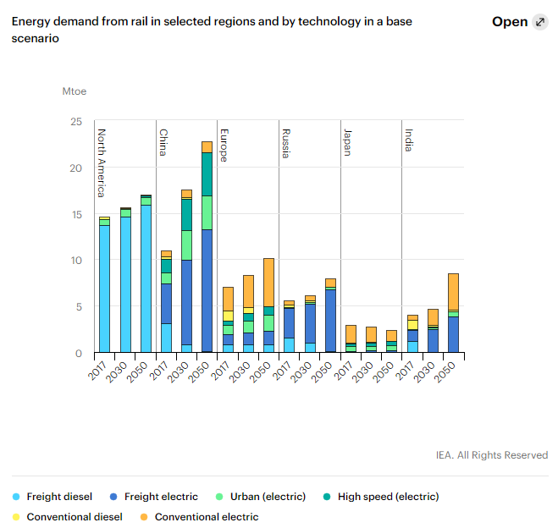
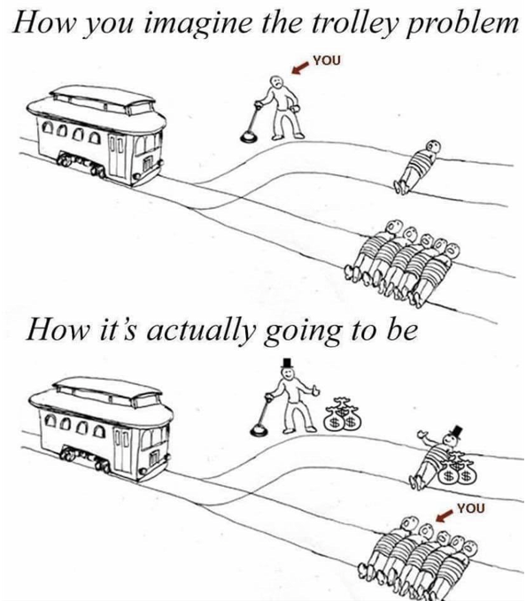
Future of Trains: Baseline Scenario
Notes:
Given that the passenger rail share in total transport activity must reach at least 13% by 2030 to achieve Net Zero aims, targeted and more ambitious government policies, along with advances in rail modernisation and digitalisation, are needed to support rapid and widespread shifts to rail.

Slide 25
Thank You! Questions??
JDs
Contact hejc for my contact info for questions

Slide 26
Motivation

Slide 27
History of Planes & Trains
1804: Steam locomotive
1881: Electric tram lines
1886: “Eole,” steam engine
1919: Crossing the Atlantic
1958: Boeing 707
1837: Electric locomotive
1884:
“La France” powered by flow battery
1903: Wright brothers use gas power
1939: 1st turbojet powered flight
Notes:
1825: railways built; could handle 400 passengers and go at 8 mph or 14 kph. This started “Railway Mania” stock market bubble
1837: powered by batteries; 6 tons moving at 4 mph or 6 km/h for a distance of 1.5 miles or 2.4 km. Unfortunately, destroyed by railway workers because of concerns over work
1881: By around 1900, got up to 100 mph or 160 km/h
1884: La France: 23.4 km/h (14.5 mph), range 12.2 km (7.6 mi). Powered by 435 kg ZnCl flow battery, traveled 8 km.
1886: Eole steam engine flew using a steam engine
1919 used Rolls-Royce Engine developed for military use in WW1. Also had first international commercial flight
1939: diesel fueled engine. Speeds limited to 372 mph (598 km/h), lasted 10 minutes. Turbojet: airbreathing jet engine; gas turbine with propelling nozzle. Doesn’t have aerodynamic limitations of propellers. Flew in Heinkel He 178
1958: first widely successful commercial jet

