Slide 1
Electrification of Ammonia Synthesis for Sustainability
Kindle Williams
Manthiram Lab
Harvard Energy Journal Club
16 October 2020

Slide 2
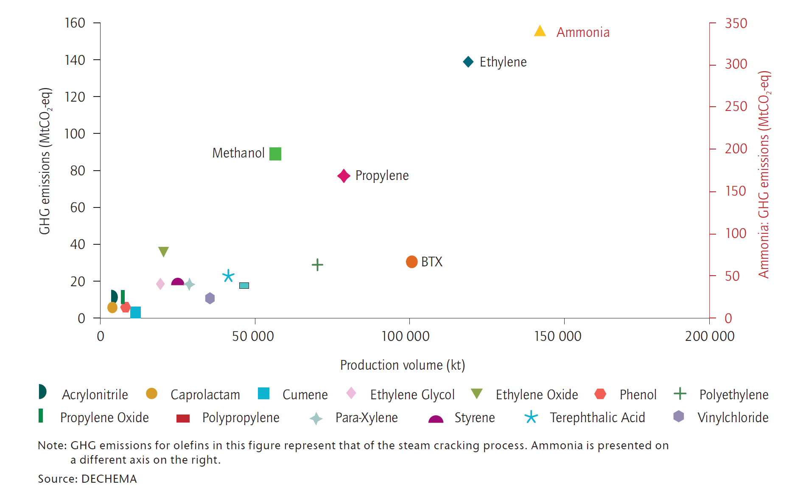
Chemical manufacturing represents a large carbon footprint
Chemical industry emits 7% of global GHG emissions
Ammonia alone represents >1% of global GHG emissions
Z. J. Schiffer and K. Manthiram Joule 1 10-14 (2017).
Notes:
Difficult to decarbonize because sometimes the emissions are associated with the chemistry of the process.

Slide 3
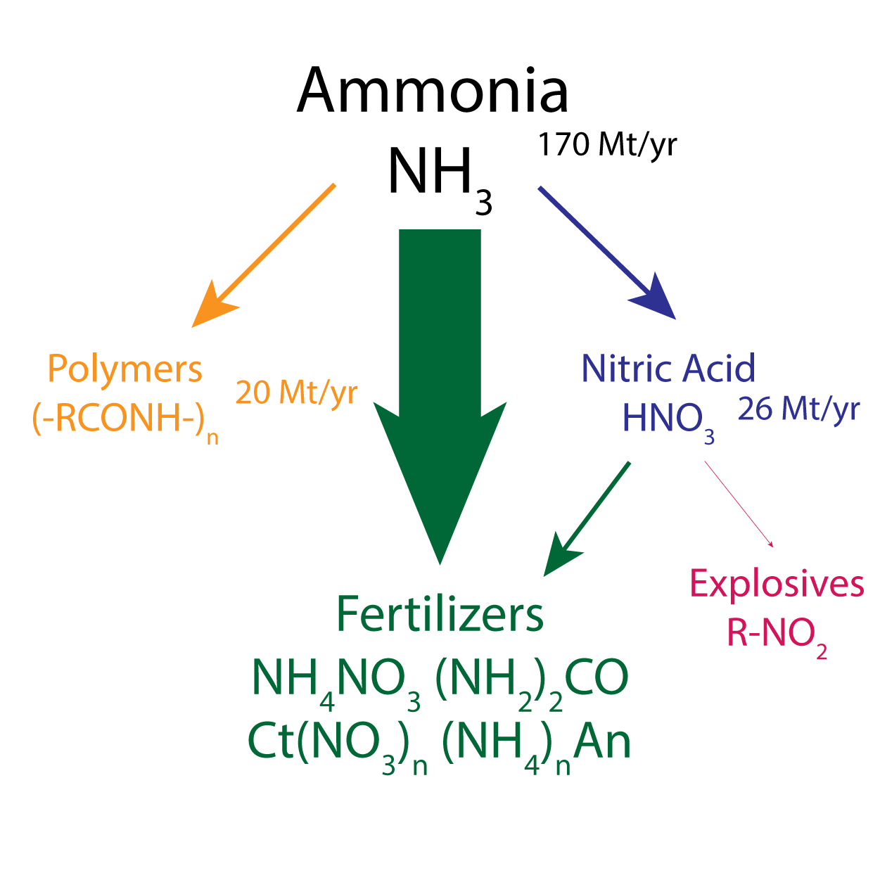
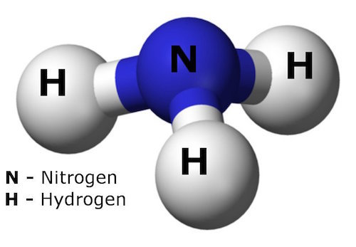
This ammonia is mostly used in fertilizers
Scheme: Nik Lazouski

Slide 4
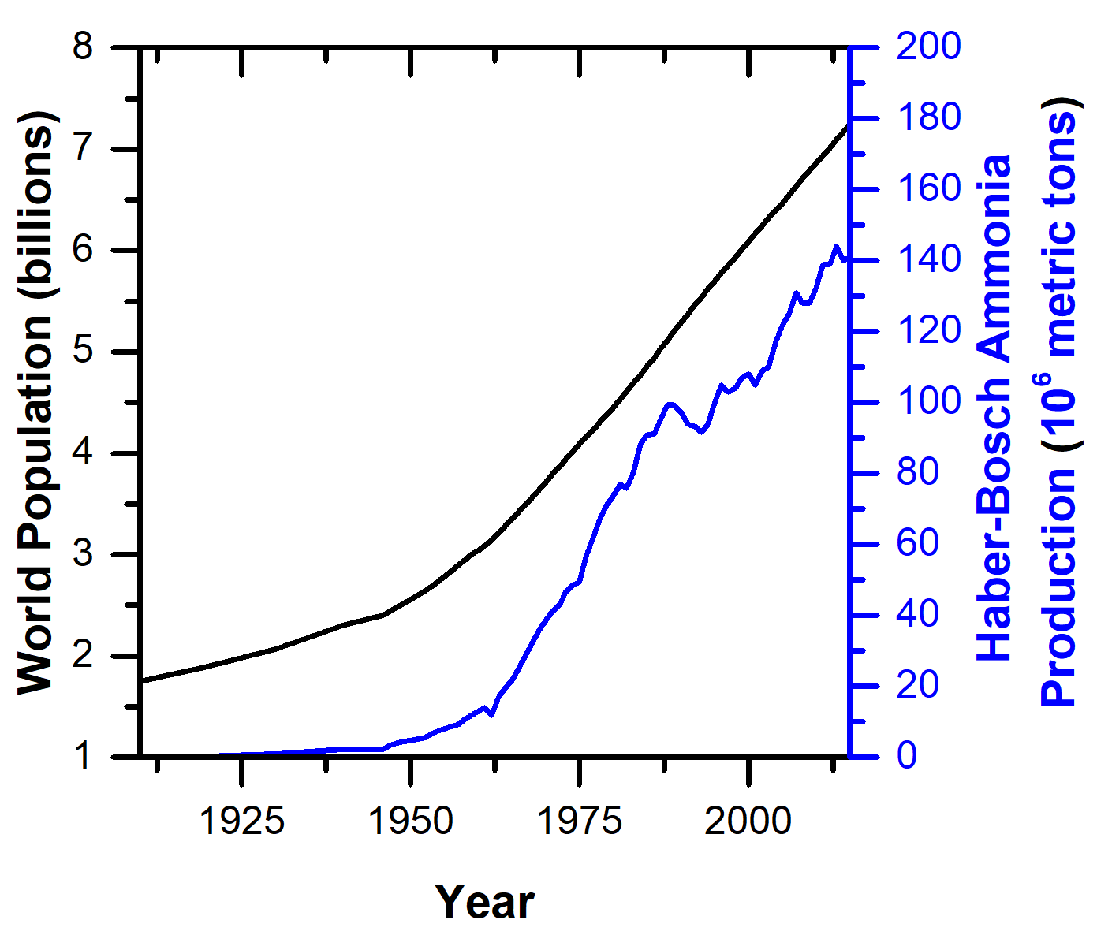
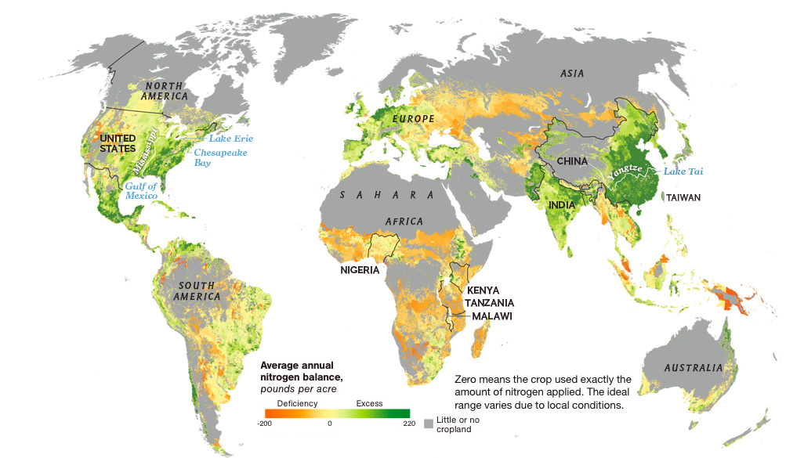
Fertilizers support the global population

Slide 5
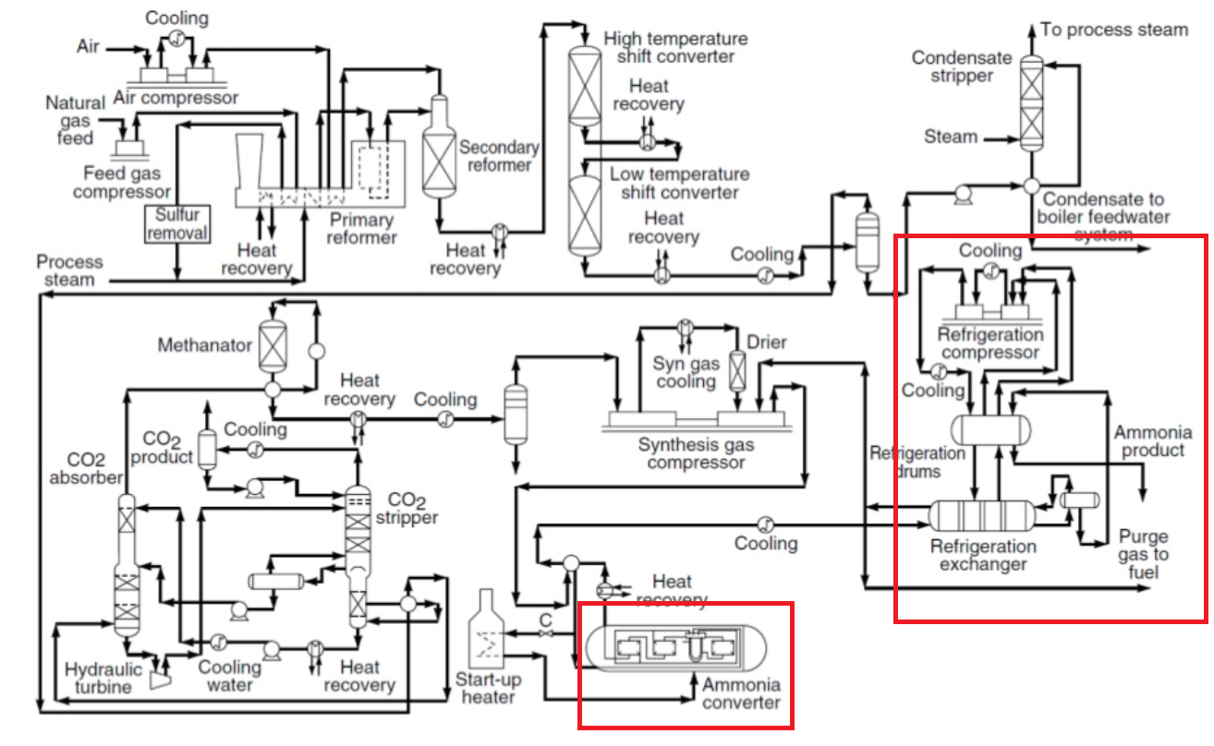
The current process: Haber-Bosch
Only economically viable at large scales
~3000 ton/day
Centralized production
Large capital cost
$1B+ per plant
Out of reach for many less-wealthy economies
$$CH_{4}+{2H}_{2}O→CO_{2}+{3H}_{2}$$
1.9-9 ton CO₂/ton NH₃
>450 million tons CO₂/yr
$$N_{2}+3H_{2}→2NH_{3}$$
Ahmad, S. ud D. 2015

Slide 6
Two components: H₂ production and ammonia synthesis
“Colors” of H₂:
Grey
Blue
Green
Turquoise
Haber-Bosch
Plasma-based approaches
Electrochemical approaches
1: Hydrogen Production
2: Ammonia Synthesis
scale match
Notes:
Note: almost half of industrially produced H2 goes to ammonia synthesis.

Slide 7
Two components: H₂ production and ammonia synthesis
“Colors” of H₂:
Grey
Blue
Green
Turquoise
Haber-Bosch
Plasma-based approaches
Electrochemical approaches
1: Hydrogen Production
2: Ammonia Synthesis
scale match
Notes:
Note: almost half of industrially produced H2 goes to ammonia synthesis.

Slide 8
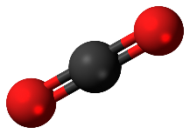
Hydrogen production: “colors”
“Colors” of H₂:
Grey/Brown
Steam-methane reforming
Coal gasification
Methane partial oxidation/ATR
$$CH_{4}+H_{2}O ⇌3H_{2}+CO$$
$$3C+O_{2}+H_{2}O ⇌H_{2}+3CO$$
$$2CH_{4}+O_{2}⇌4H_{2}+2CO$$
$$2CH_{4}+O_{2}+CO_{2}⇌3H_{2}+3CO+H_{2}O$$
$$4CH_{4}+O_{2}+2H_{2}O⇌10H_{2}+4CO$$
Water-gas Shift
$$CO+H_{2}O ⇌CO_{2}+H_{2}$$
Notes:
SMR: Ni catalyst, endothermic, 14-40 bar, 800-900 C
WGS: exothermic
ATR = autothermal reforming
Technically coal is brown hydrogen
50% SMR, 30% oil, 20% coal today

Slide 9
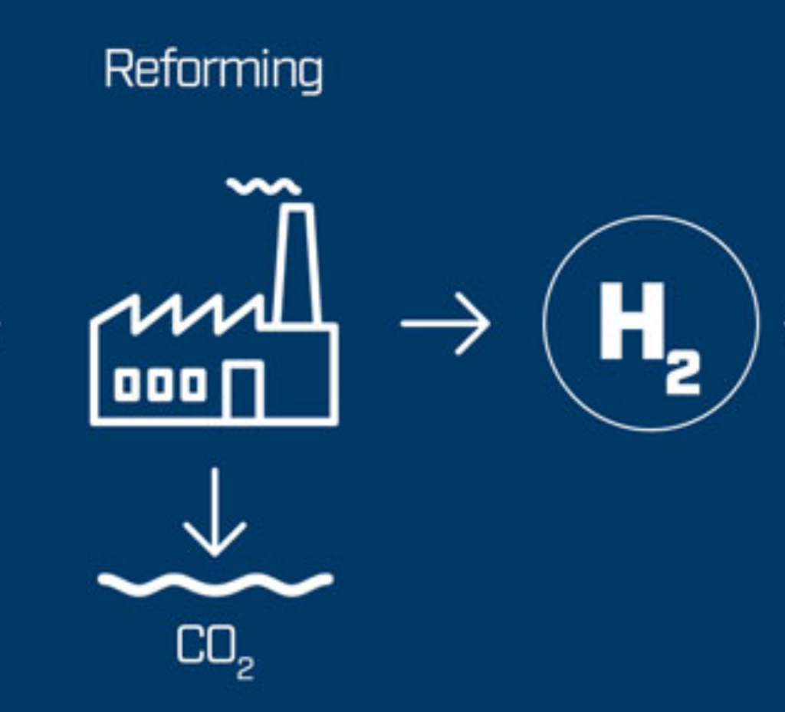
Hydrogen production: “colors”
“Colors” of H₂:
Grey/Brown
Blue (Grey/Brown + CCUS)
Image: 2B1st Consulting
Steam-methane reforming
Coal gasification
Methane partial oxidation/ATR
$$CH_{4}+H_{2}O ⇌3H_{2}+CO$$
$$3C+O_{2}+H_{2}O ⇌H_{2}+3CO$$
$$2CH_{4}+O_{2}⇌4H_{2}+2CO$$
$$2CH_{4}+O_{2}+CO_{2}⇌3H_{2}+3CO+H_{2}O$$
$$4CH_{4}+O_{2}+2H_{2}O⇌10H_{2}+4CO$$
Water-gas Shift
$$CO+H_{2}O ⇌CO_{2}+H_{2}$$

Slide 10
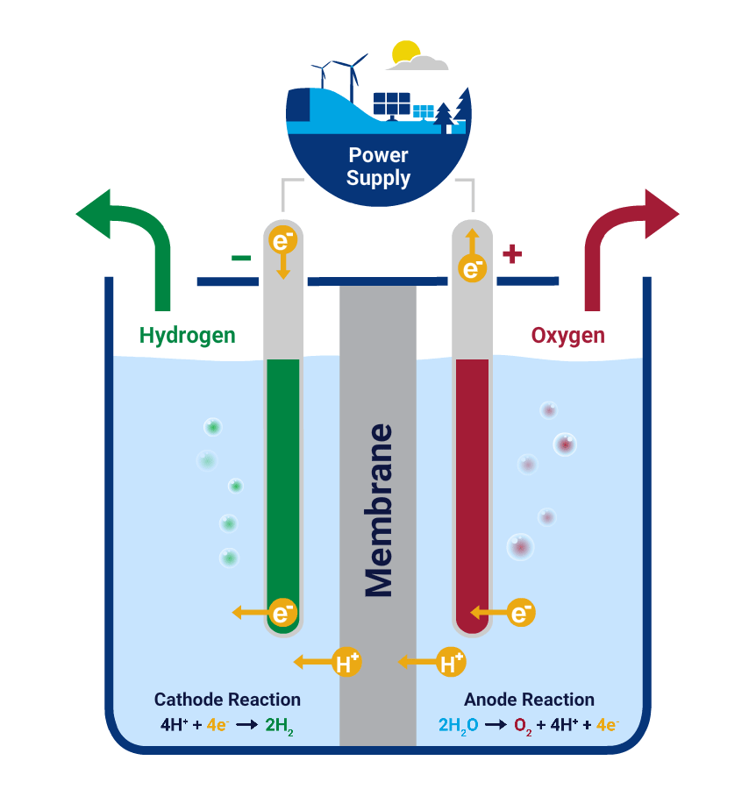
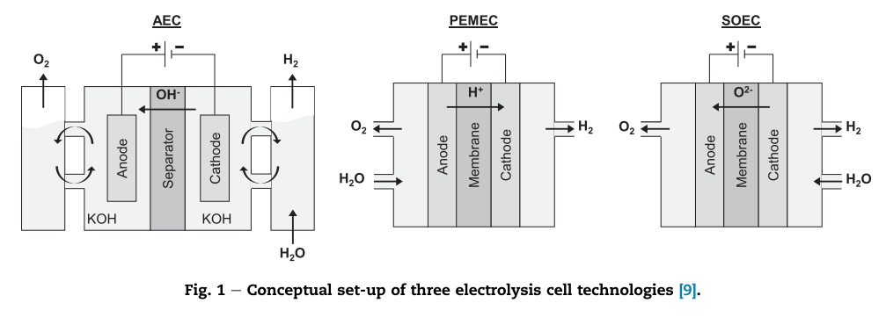
Hydrogen production: “colors”
H₂O → H₂ + ½ O₂
“Colors” of H₂:
Grey/Brown
Blue
Green
AEC (basic)
PEM (acidic)
SOEC (high-T)
Mature w/ limitations
Up-&-coming; promising
Efficient, but research phase
Note: other “green” methods that don’t involve electrolysis:
PEC
Photobiological
High-T water splitting (concentrated solar/nuclear)
Image: AleaSoft
Notes:
Alkaline electrolysis cell
Proton exchange membrane
Solid oxide electrolysis cell
https://www.nrel.gov/docs/fy10osti/72740.pdf

Slide 11
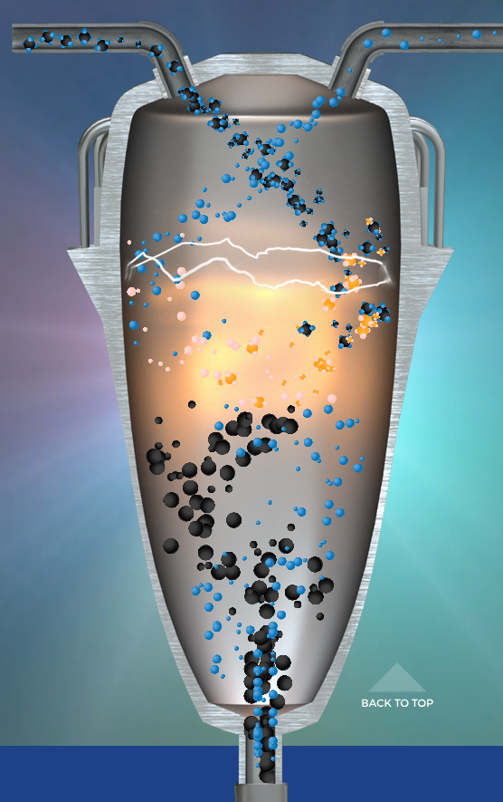
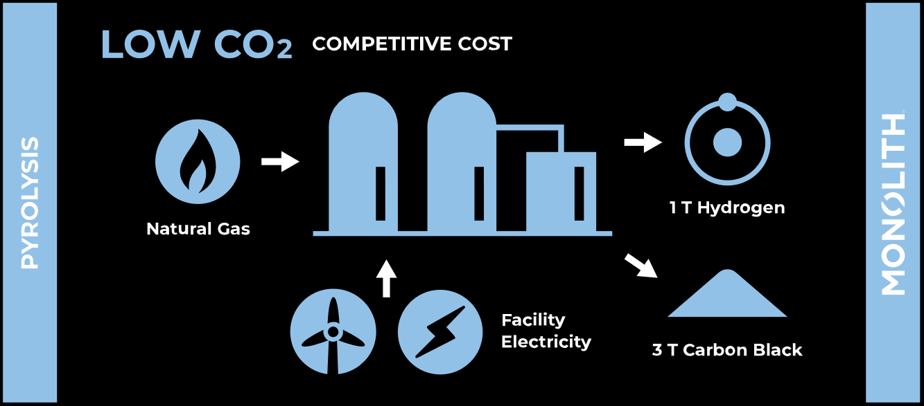
Hydrogen production: “colors”
$$CH_{4}⇌C+2H_{2}$$
“Colors” of H₂:
Grey/Brown
Blue
Green
Turquoise (i.e. “blue-green”)
Images: Monolith Materials

Slide 12
Two components: H₂ production and ammonia synthesis
“Colors” of H₂:
Grey
Blue
Green
Turquoise
Haber-Bosch
Plasma-based approaches
Electrochemical approaches
1: Hydrogen Production
2: Ammonia Synthesis
scale match
Notes:
Note: almost half of industrially produced H2 goes to ammonia synthesis.

Slide 13
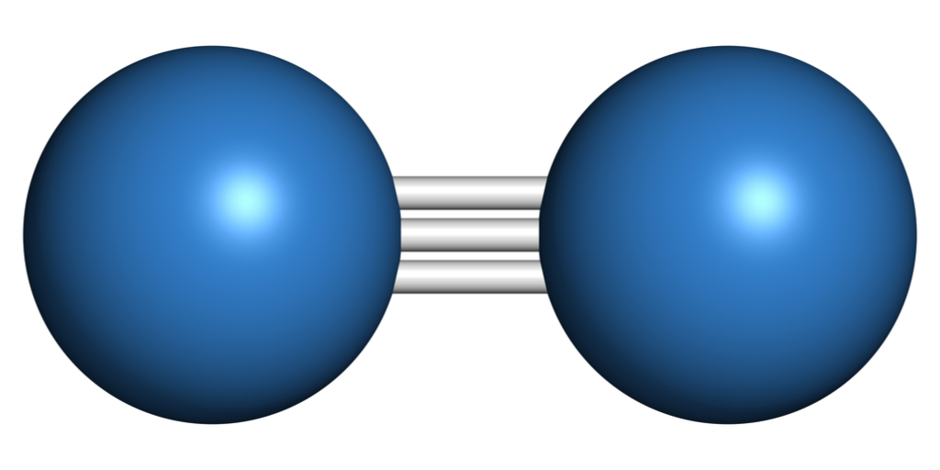
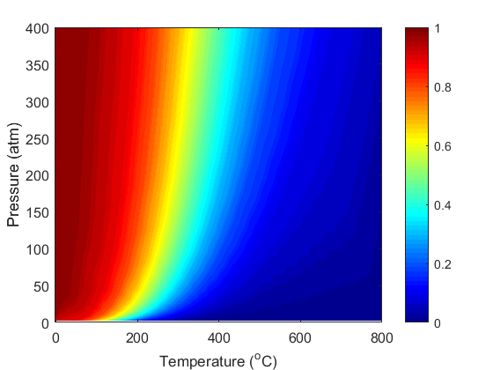
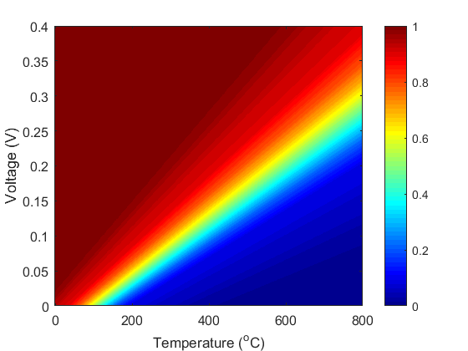
Ammonia synthesis: thermodynamics & kinetics
¹/₂ N₂ + ³/₂ H₂ → NH₃
Hard to break the N₂ triple bond
Thermochemical
Conversion
Electrochemical
X
At ambient pressure (1 atm):
X
X > 99%
Voltage also improves kinetics, so can operate at lower temperature
X <20%
Higher pressures to achieve reasonable conversions
Apply voltage to increase conversion
Higher temperatures to achieve reasonable rates
Z. J. Schiffer and K. Manthiram Joule 1 10-14 (2017).

Slide 14
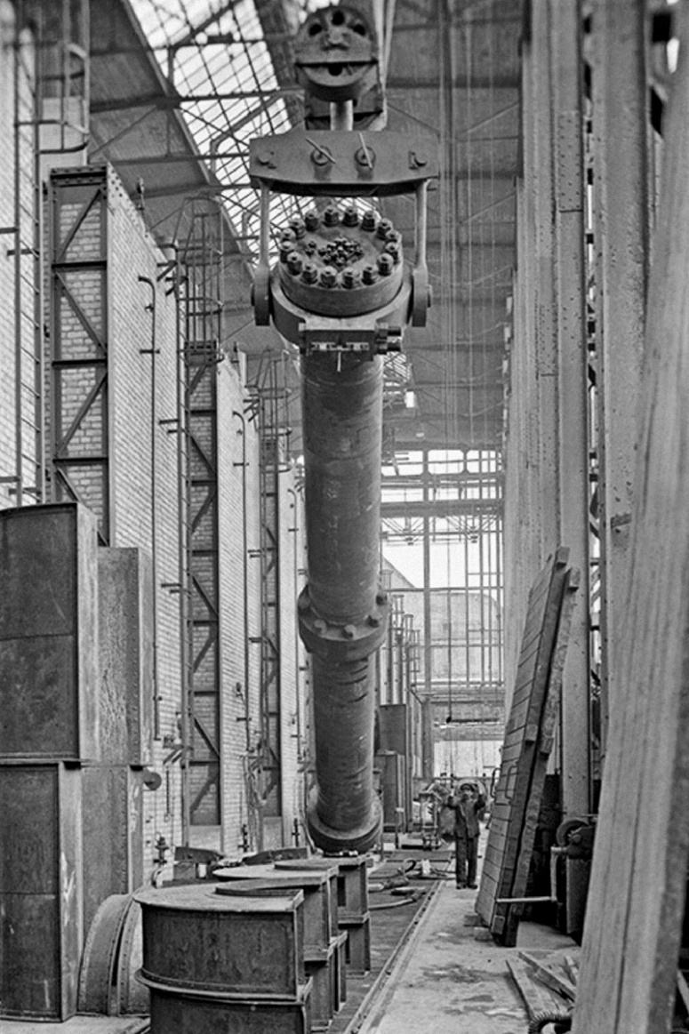
Ammonia synthesis reactors: from industrial scale to leading-edge research
Commercial:
Haber-Bosch
100+ bar, 400-500 °C
15% single-pass conversion, 97% overall conversion
Iron oxide catalyst is easily poisoned
Image: BASF

Slide 15
Ammonia synthesis reactors: from industrial scale to leading-edge research
Commercial:
Haber-Bosch
Research-stage:
Low-T/P Haber-Bosch
Using Ruthenium catalyst, can:
Improve kinetics → Lower-T operation → Lower-P operation → Decrease safety risk & lower capital cost

Slide 16
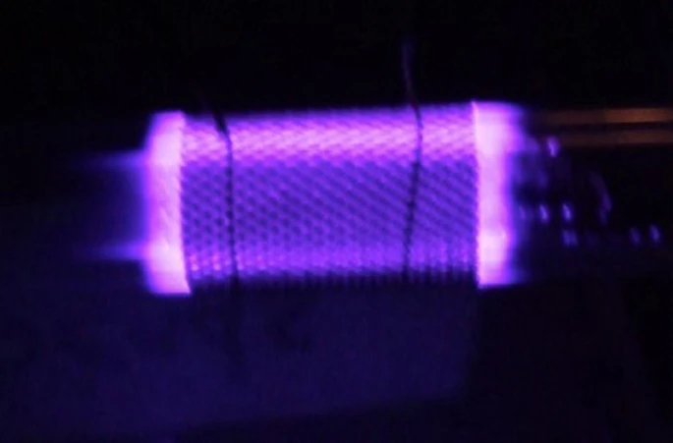
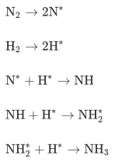
Ammonia synthesis reactors: from industrial scale to leading-edge research
Commercial:
Haber-Bosch
Research-stage:
Low-T/P Haber-Bosch
Plasma synthesis
Thermal & non-thermal plasmas
Low (~1%) efficiency because kV input required
Plasma generates radicals, which couple on a catalyst
Peng et al., J. Clean. Prod. 177, 597-609 (2018)
Whitehead, J.C. Front. Chem. Sci. Eng. 13, 264–273 (2019).
Notes:
https://www.sciencedirect.com/science/article/pii/S0959652617332195?via%3Dihub

Slide 17
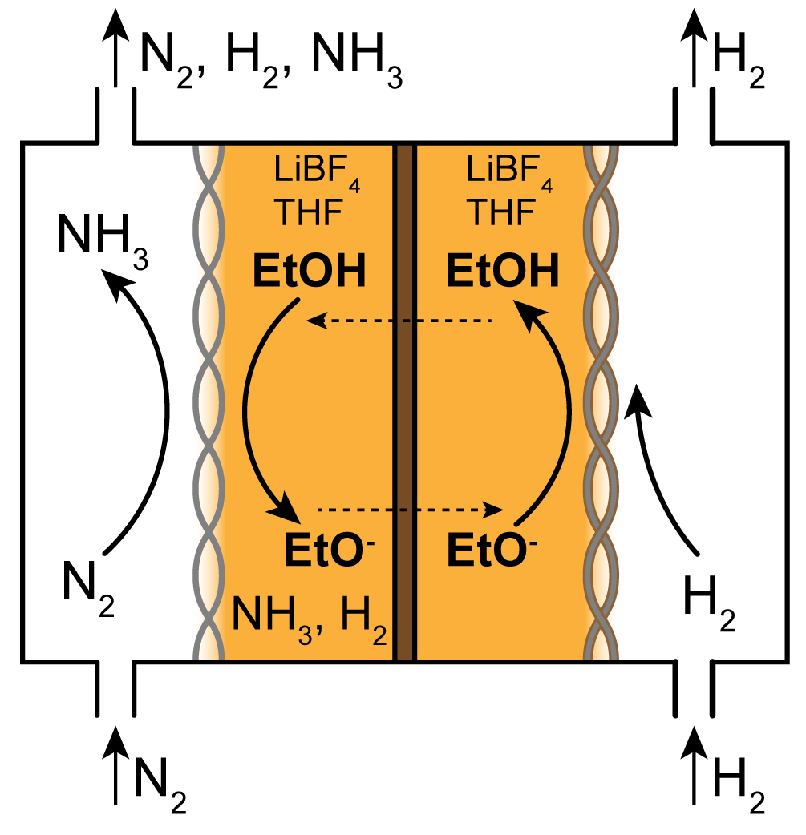
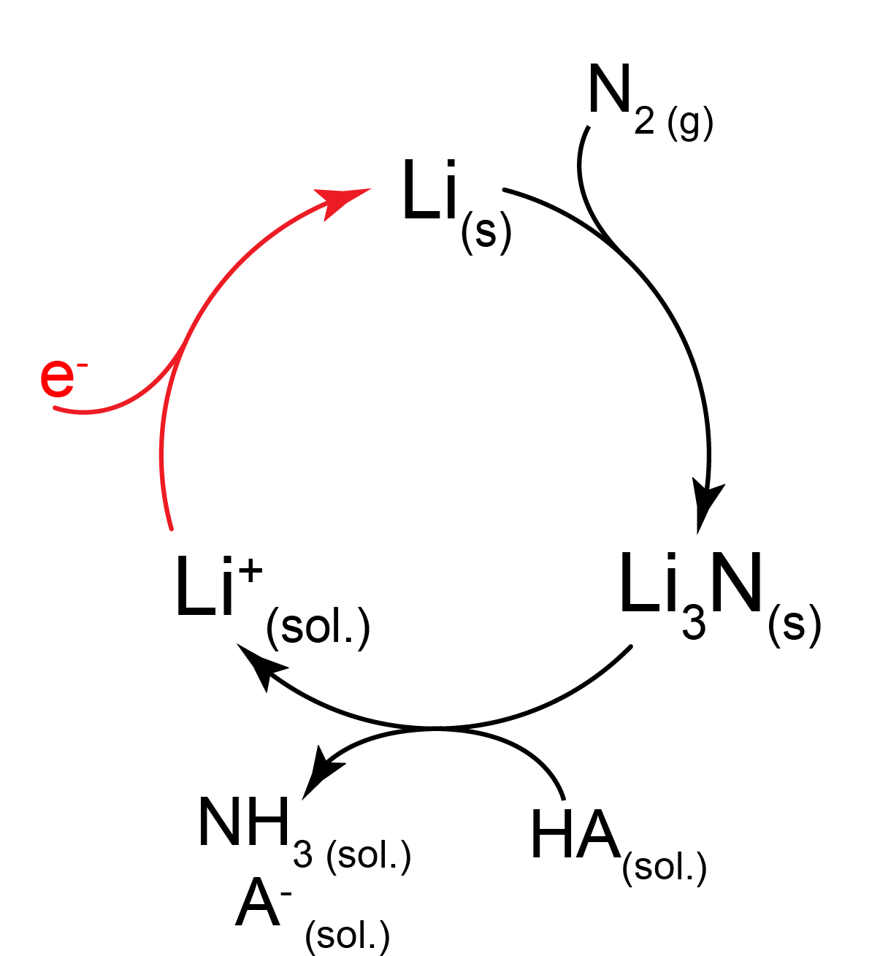
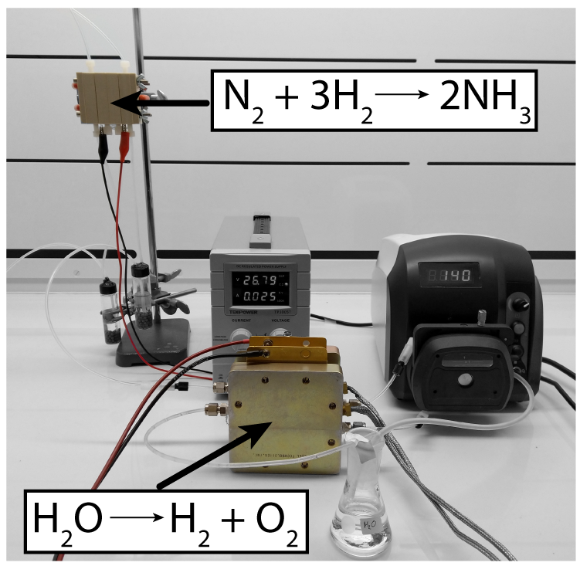
Ammonia synthesis reactors: from industrial scale to leading-edge research
Commercial:
Haber-Bosch
Research-stage:
Low-T/P Haber-Bosch
Plasma synthesis
Electrochemical
Non-aqueous, Lithium-mediated:
Aqueous:
N₂ + 3H₂O → 2NH₃ + 3/2 O₂
Generally pretty low-rate, hard to reproduce reports right now

Slide 18
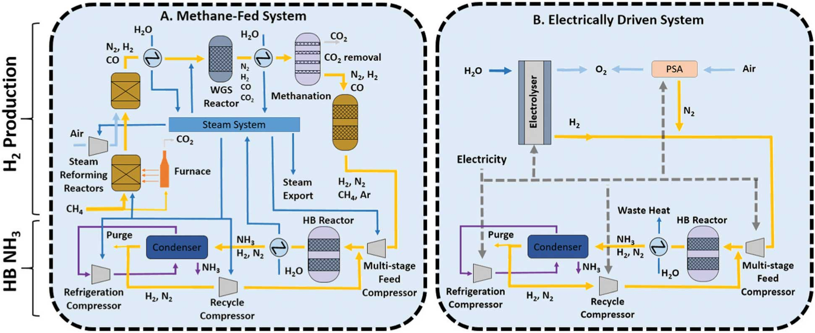
State-of-the-art vs. what is possible in the near-term
Replace the steam methane reforming/WGS with electrolyzers; add air separation; scale down H-B to match electrolyzer scale.
Smith et al., Energy Environ. Sci., 2020, 13, 331

Slide 19
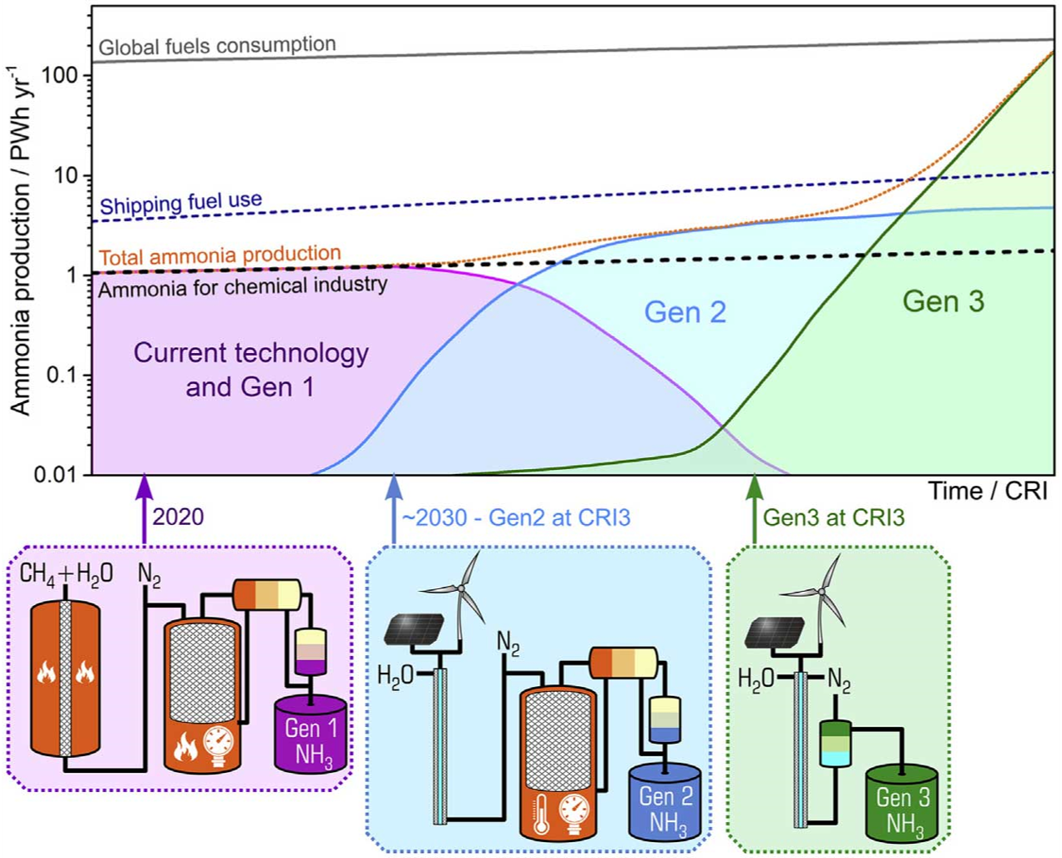
Generations of ammonia production technology

Slide 20
The bigger picture: how does this fit into existing markets/regulations?
Markets:
Agriculture (established, most of NH₃ today)
Traditional
Greenhouse
Urban
Organic
Chemical synthesis (e.g. nylon)
Refrigerants
Energy storage (growth potential)
Regulations
Organic certification?
Refrigeration
Fertilizers
Chemicals

Slide 21
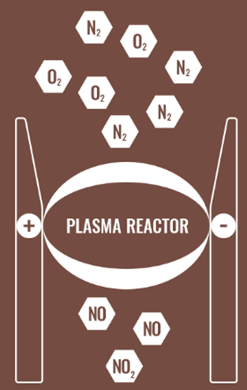
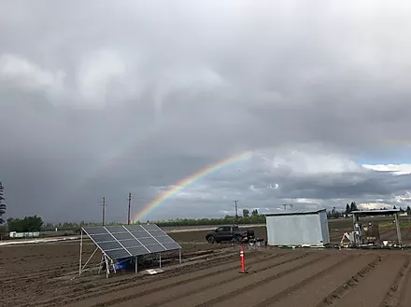
What are folks doing today? Startups:
Nitricity
Starfire Energy
Producing nitrate fertilizers at small scales
Plasma-based process: lower capital costs, high operating costs
Targeting off-grid production of fertilizer – need to pay off solar installations
Producing NH₃ at small scales
Low pressure operation – higher recycling costs, but cheaper capital than H-B
Targeting NH₃ as fuel – low margin, high product; long approach to target market
*Disclaimer: this is not exhaustive!!*

Slide 22
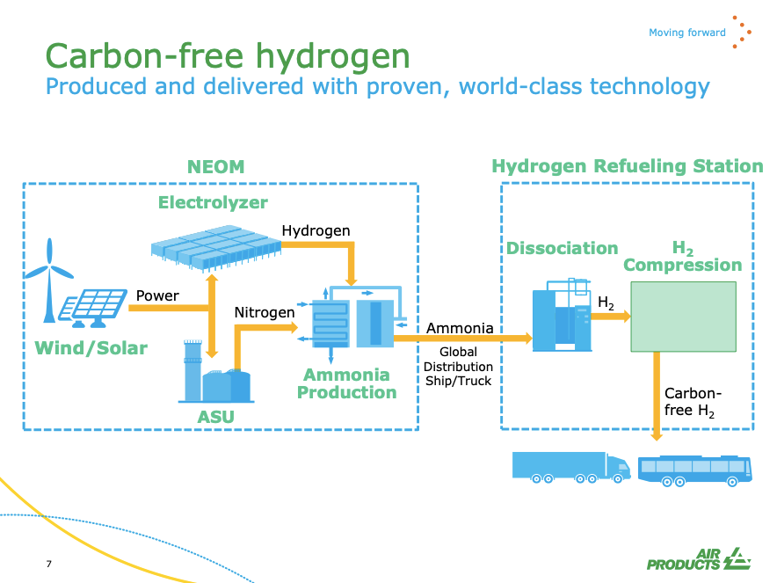
What are folks doing today? Big players:
*Disclaimer: this is not exhaustive!!*

Slide 23
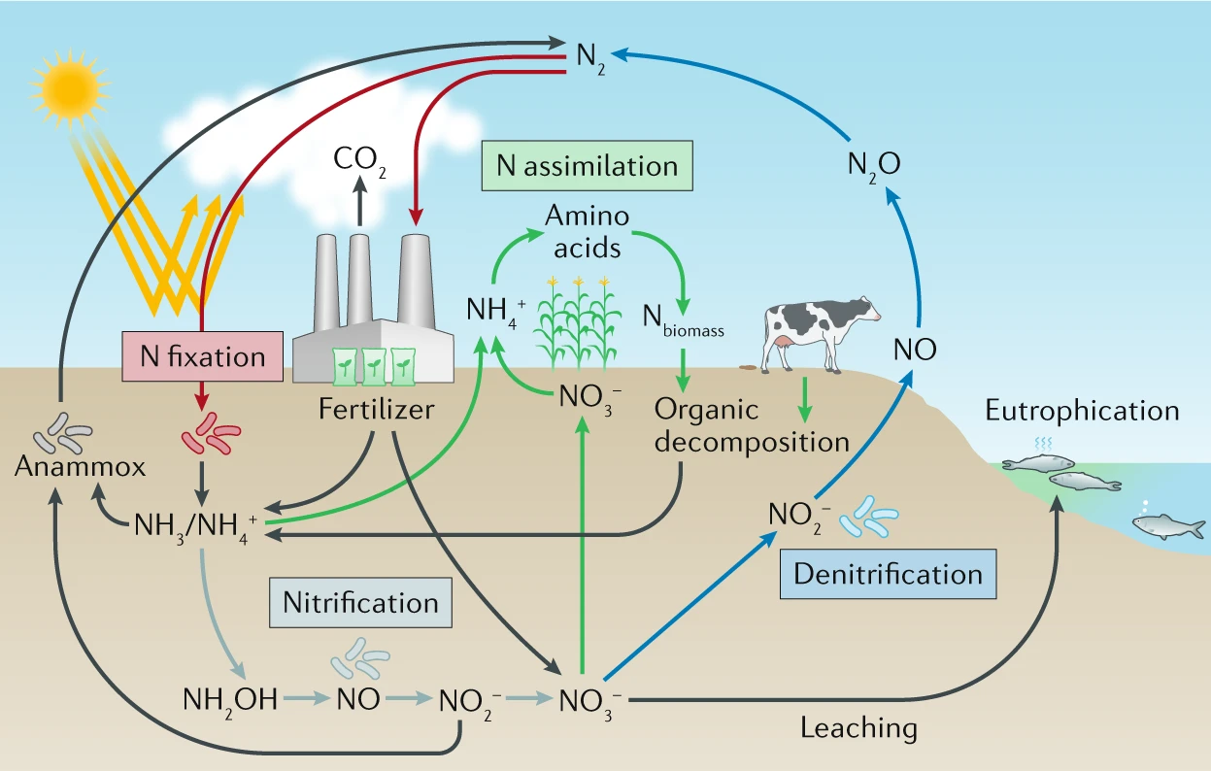
How does this fit into the big picture of sustainability?
Nitrogen cycle
Inherent N losses to soil during fertilization
N oxides are also greenhouse gases
Distributed fert. production could help with slower fert. application
Less runoff

Slide 24
Acknowledgements
Manthiram Lab
PI: Prof. Karthish Manthiram
Research/many slides: Nik Lazouski →
15.366 Climate & Energy Ventures
Contact me:
Kindle Williams
kindlew@mit.edu
Thanks for listening!

Slide 25
References
Smith et al., Energy Environ. Sci., 2020, 13, 331: https://pubs.rsc.org/en/content/articlelanding/2020/ee/c9ee02873k
Lazouski et al., Nature Catal., 2020, 3, 463-469: https://www.nature.com/articles/s41929-020-0455-8

Slide 26
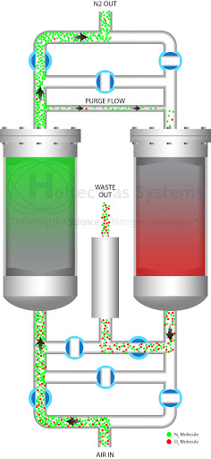
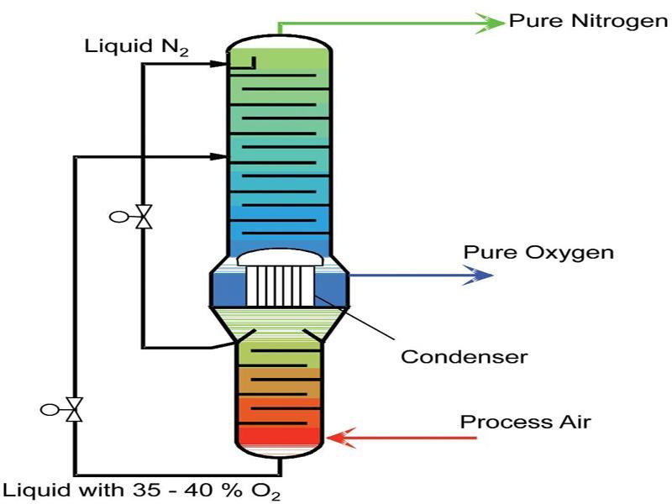
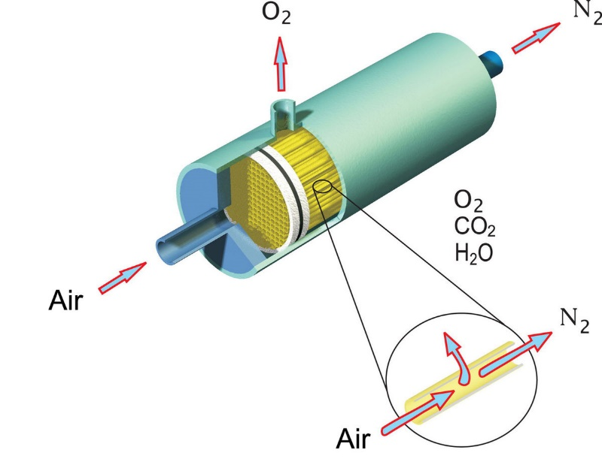
Nitrogen production comparison (slide: Nik Lazouski)
Nitrogen is produced from air when fuels burn
Three methods of air separation
Cryogenic
Large production scales
Energy intensive
Produces very pure N₂
Not intermittent
Pressure swing absorption
Can produce high purity N₂ (99.99%)
Lower flowrates
Membrane separations
Only good for moderate purity (97-99% N₂)
Can get high flowrates
Needs a large pressure drop
Scales poorly with size
Notes:
https://www.airbestpractices.com/system-assessments/air-treatmentn2/energy-costs-associated-nitrogen-specifications

