Slide 1
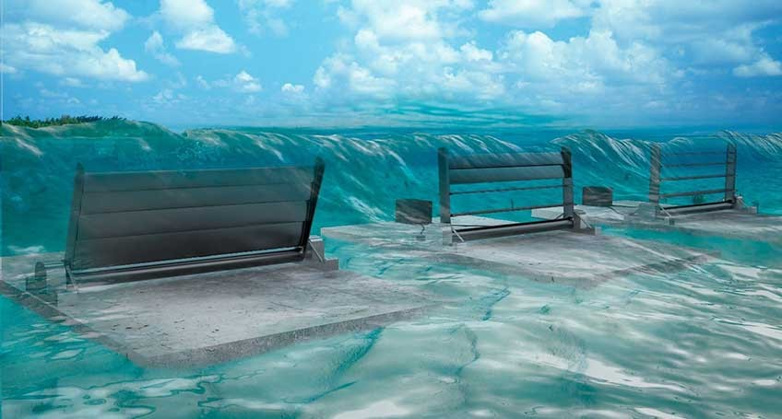
Ocean Wave and Tidal Energy
Eliza Spear
2019-10-04
HEJC

Slide 2
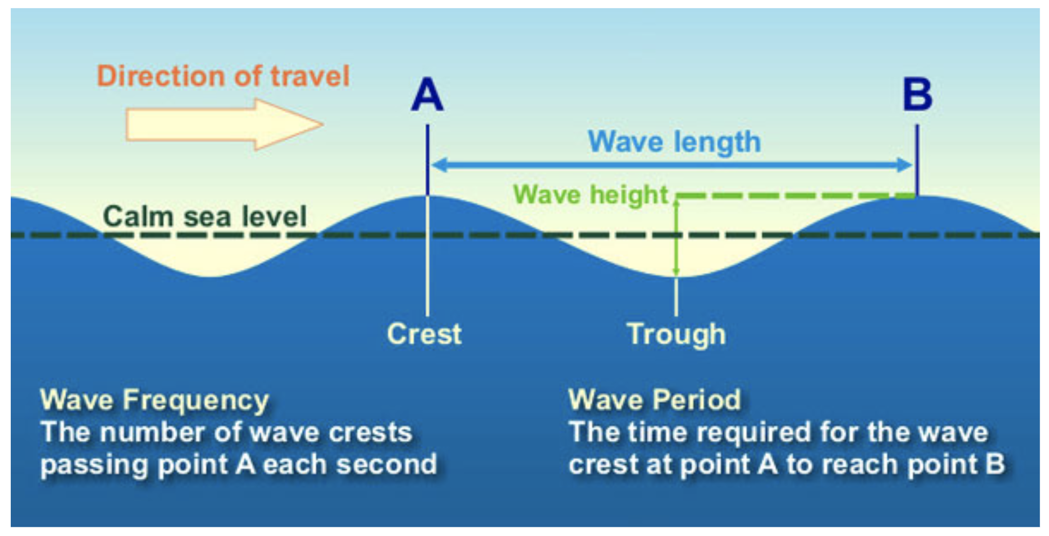
Wave Energy Basics
Where does wave energy come from?
Heat from the sun causes wind, which in turn causes waves
Wave energy can be considered “third-hand” solar energy
Wind speeds > 0.5 m/s generates waves on open water
Wind speed dictates wavelength, period
Water surface area exposed to the wind dictates amplitude
McKay, David J. C. Sustainable Energy—Without the Hot Air, UIT: Cambridge, England, 2009.
Image: https://oceanservice.noaa.gov/education/tutorial_currents/media/supp_cur03a.html

Slide 3
Wave Energy Basics
Wave power is measured in power per unit length of coastline
The fetch is the distance wind blows over the water
Wave energy should be collected in places where there is a large fetch; any interruption (e.g. islands) will absorb energy from the waves, reducing the amount of energy that can be harvested
Near coastlines, friction with the seabed reduces the energy in the waves, so deep offshore water is ideal
McKay, David J. C. Sustainable Energy—Without the Hot Air, UIT: Cambridge, England, 2009.
http://www.emec.org.uk/marine-energy/

Slide 4
U.S. Ocean Energy Projects
According to the Energy Information Administration, waves off the coast of the U.S. provide a theoretical annual energy potential of up to 2640 TWh (66% of annual U.S. electricity generation as of 2017)
Other sources predict 29,500 TWh/year available in accessible wave energy worldwide
There are many, many wave energy technologies under development, but none have been commercially successful in the U.S.
https://www.eia.gov/energyexplained/hydropower/wave-power.php
https://www.irena.org/documentdownloads/publications/wave-energy_v4_web.pdf

Slide 5
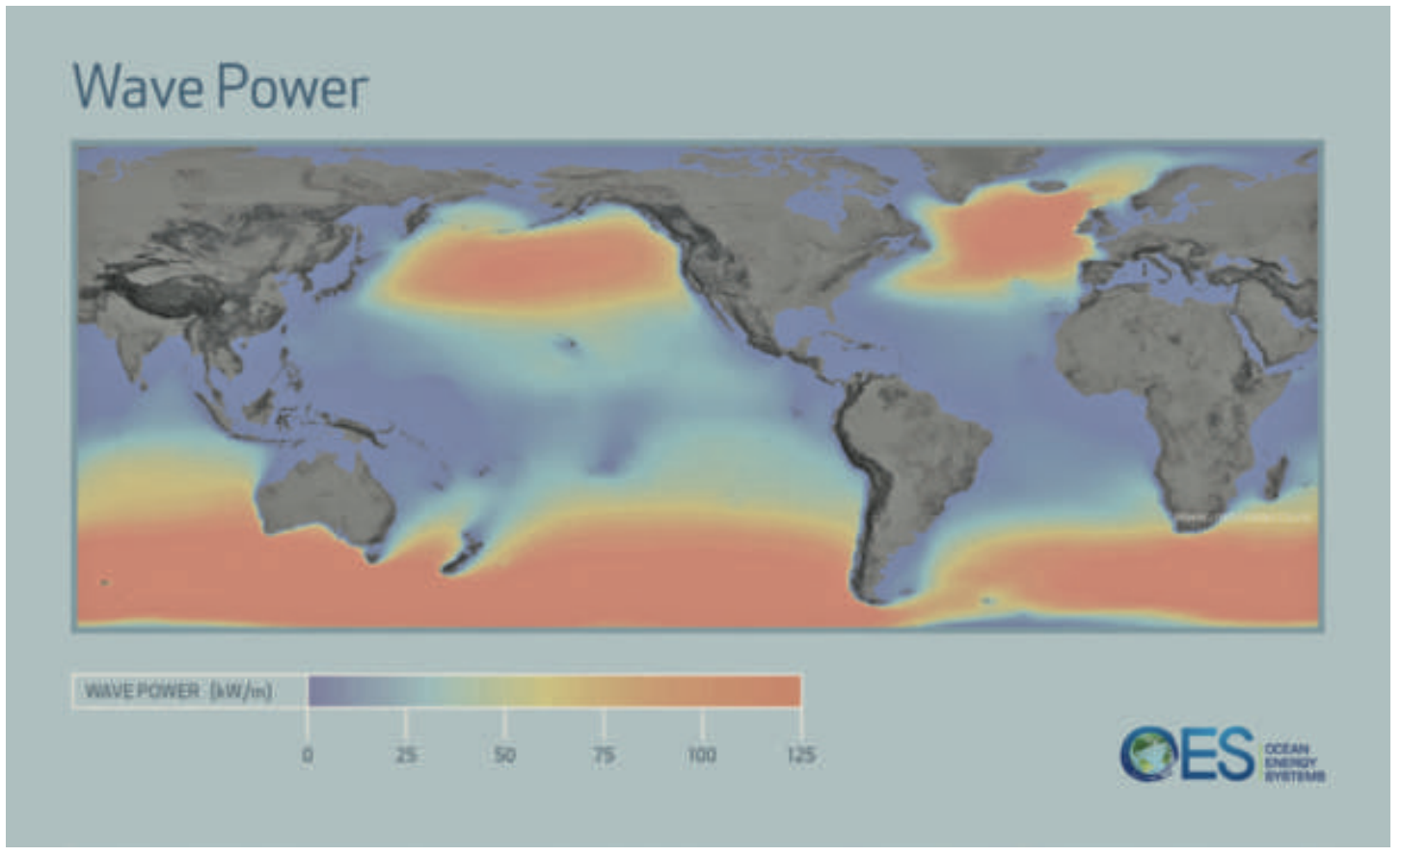
Global Annual Mean Wave Power Distribution
https://www.irena.org/documentdownloads/publications/wave-energy_v4_web.pdf

Slide 6
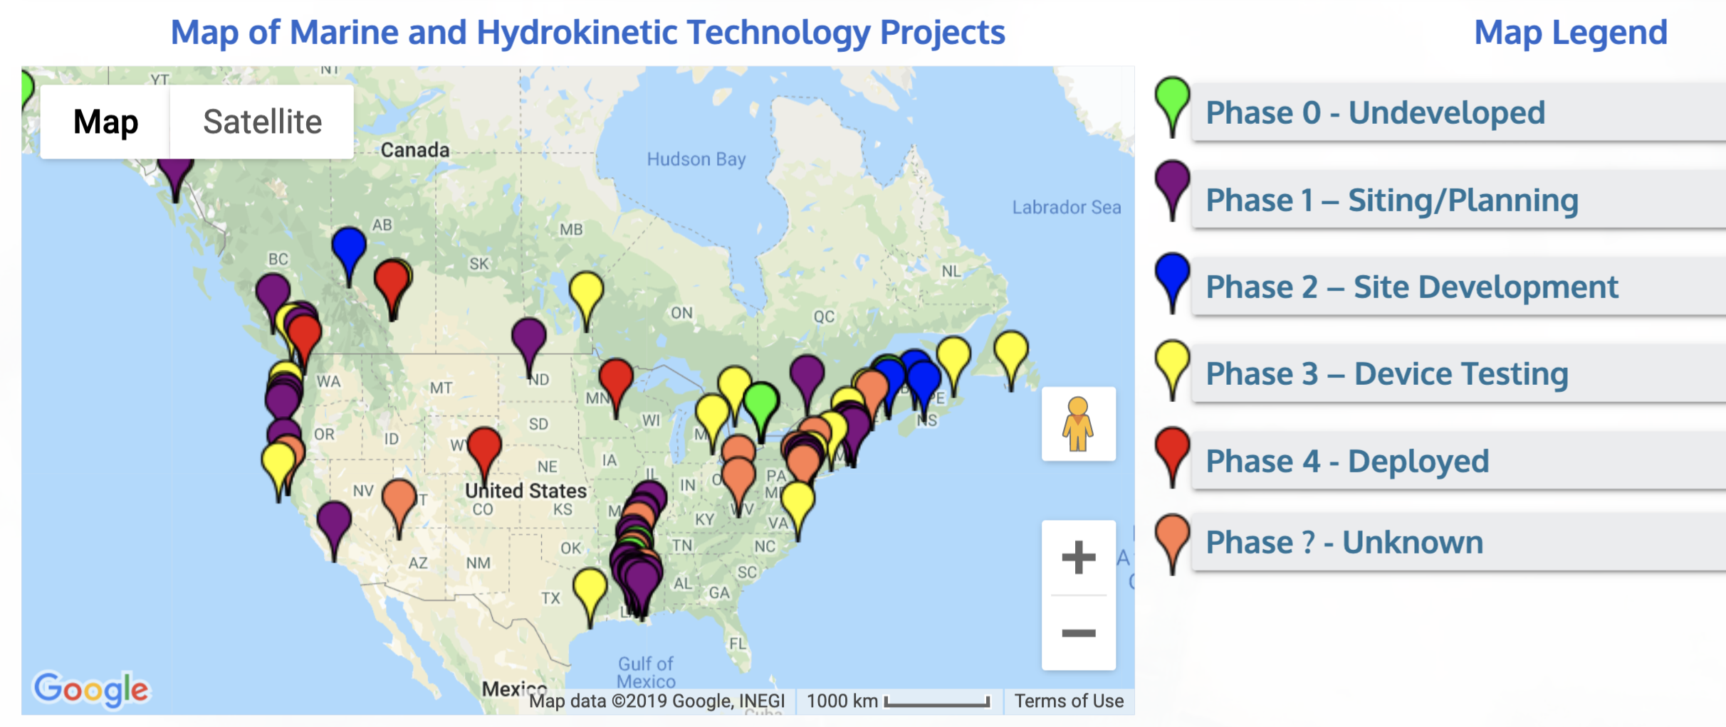
DOE’s Marine and Hydrokinetic Technology Database
The database provides information about existing projects around the world
The most mature projects in U.S. oceans are at the “Device Testing” stage
https://openei.org/wiki/Marine_and_Hydrokinetic_Technology_Database

Slide 7
Marine & Hydrokinetic Technologies
Integrity Concerns: devices must be able to withstand the impact of the water and any debris, as well as the constant exposure to salt water and marine life (example: Pelamis failure)
Environmental Concerns: devices have the potential to seriously negatively impact the ecosystem; electromagnetic fields around cables to and from underwater devices can drastically affect marine life (possible negative effects on behavior, navigation, migration, reproduction)
Advantages: marine resources are very close to many populous areas (coastal cities), and many technologies operate underwater and out of view
https://openei.org/wiki/Marine_and_Hydrokinetic_Technology_Database
https://tethys.pnnl.gov/stressor/emf

Slide 8
Marine & Hydrokinetic Technologies: Wave Devices
Point Absorber
Attenuator
Bulge Wave
Rotating Mass
Oscillating Wave Surge Converter
Submerged Pressure Differential
Oscillating Water Column
Overtopping/
Terminator Device
http://www.emec.org.uk/marine-energy/wave-devices/

Slide 9
Marine & Hydrokinetic Technologies: Tidal Devices
Horizontal Axis Turbine
Vertical Axis Turbine
Oscillating Hydrofoil
Enclosed Tips
(Venturi)
Archimedes Screw
http://www.emec.org.uk/marine-energy/tidal-devices/

Slide 10
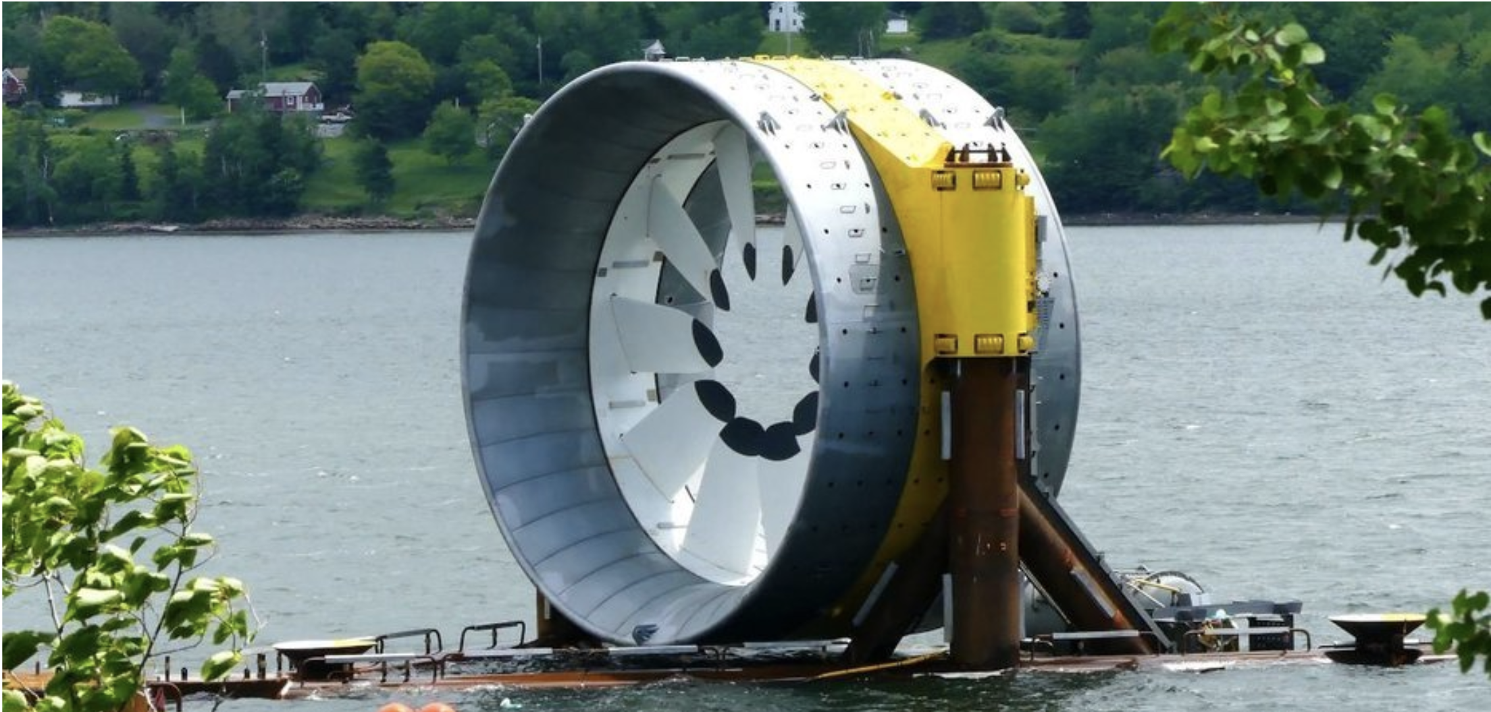
Turbines
Moving water can spin underwater turbines (can be used with ocean waves and tides, or with river currents)
https://openei.org/wiki/Marine_and_Hydrokinetic_Technology_Database
https://www.govtech.com/fs/infrastructure/Ocean-Turbines-Could-Turn-the-Tide-for-Energy-Generation.html

Slide 11
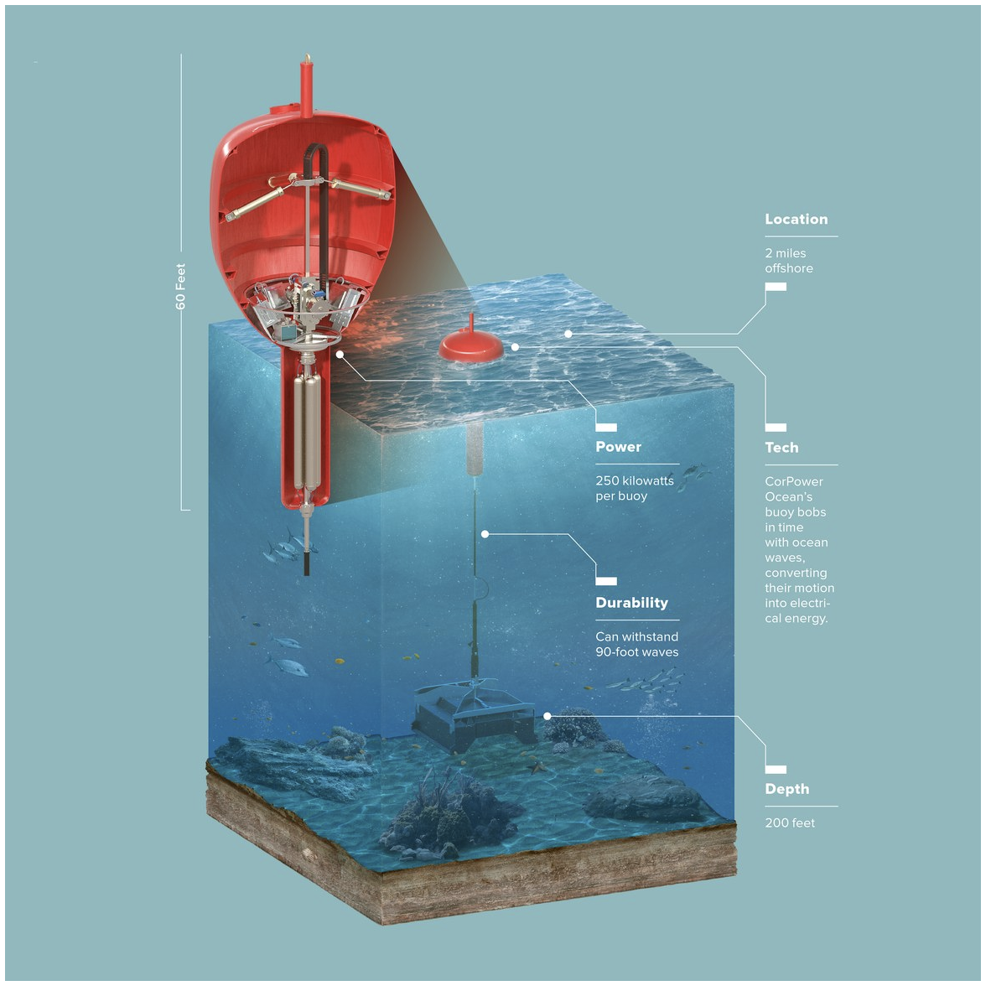
Buoys
Harness energy from wave movement (vertical rise/fall, or back/forth and side/side)
Pictured: recent design from Swedish company CorPower
https://openei.org/wiki/Marine_and_Hydrokinetic_Technology_Database
https://www.wired.com/2016/04/corpower-buoy/

Slide 12
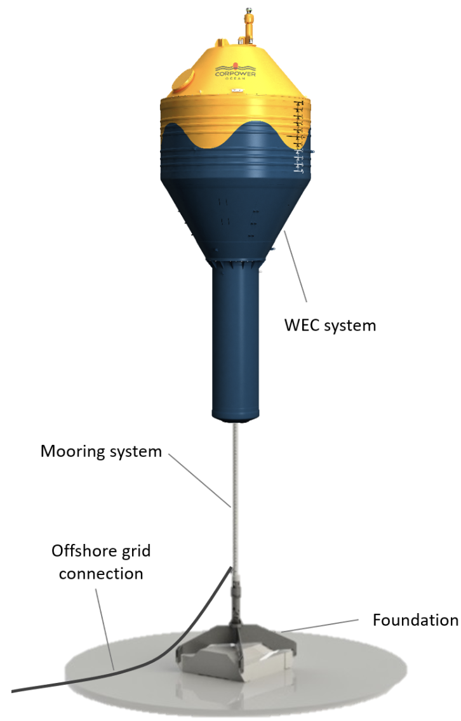
http://www.corpowerocean.com/

Slide 13
Wave Energy Converters
Fixed-bottom the venetian blind design that oscillates with water movement; inspired by wind turbine’s variable pitch, and intended to minimize device damage to increase lifetime and decrease cost
https://www.nrel.gov/news/program/2018/new-wave-energy-converter-design-inspired-by-wind-energy.html

Slide 14
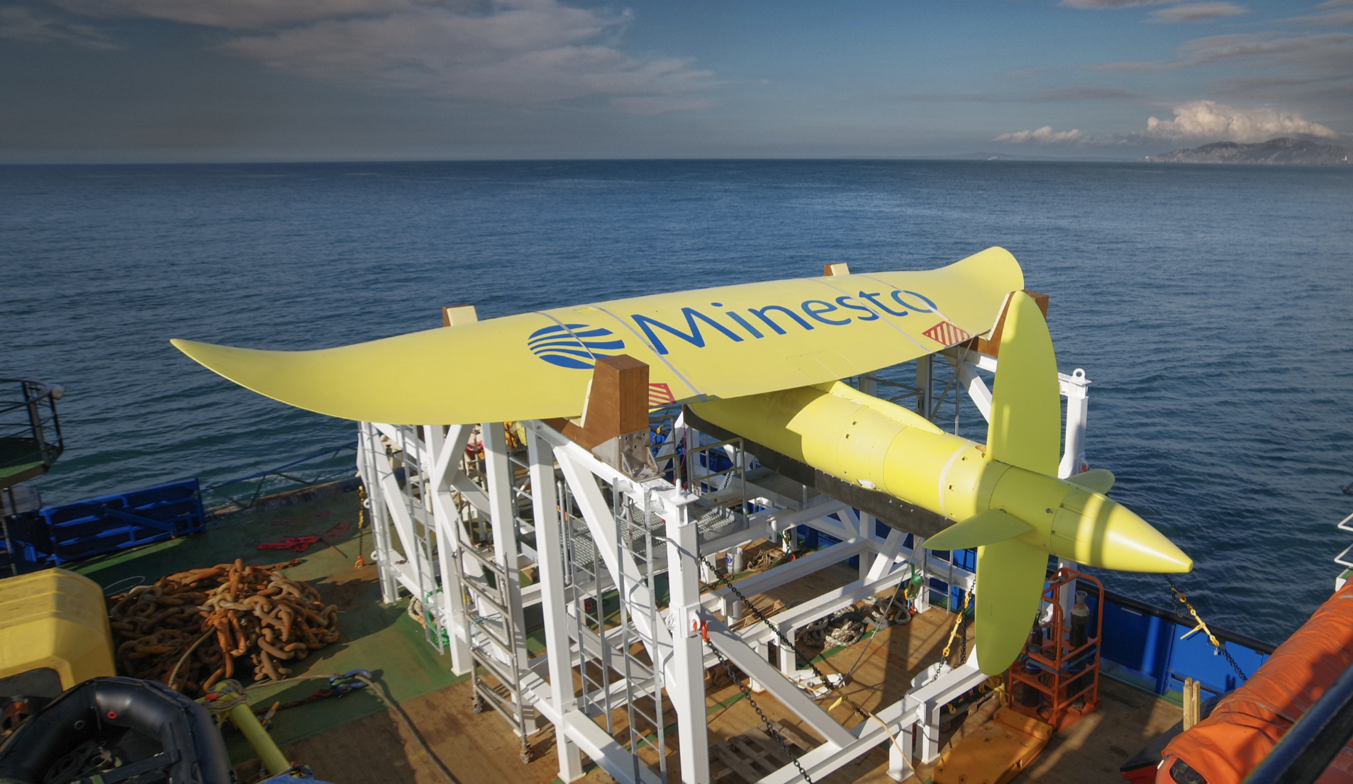
Underwater Kites
Tethered to the seafloor, ”flies” underwater like a kite so that the water velocity experienced by the onboard turbines is higher than the actual water velocity; intended to collect energy from slower-moving water (1.2-2.4 m/s, vs. 2.5+ m/s required for economical use of turbines)
https://minesto.com/ocean-energy
https://www.power-technology.com/features/underwater-kite-energy/

Slide 15
https://minesto.com/ocean-energy
https://www.power-technology.com/features/underwater-kite-energy/

Slide 16
Archimedes Screw
Helical turbine that is rotated by moving water; moves more slowly than other tidal hydrokinetic devices and so is less likely to pose a collision risk
https://tethys.pnnl.gov/technology-type/tidal
http://www.emec.org.uk/marine-energy/tidal-devices/

Slide 17
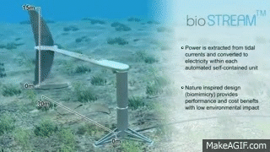
Oscillating Hydrofoil
https://giphy.com/gifs/tidal-QV7OQux2eE8dq
https://tommytoy.typepad.com/.a/6a0133f3a4072c970b0162fd2f9800970d-popup

Slide 18
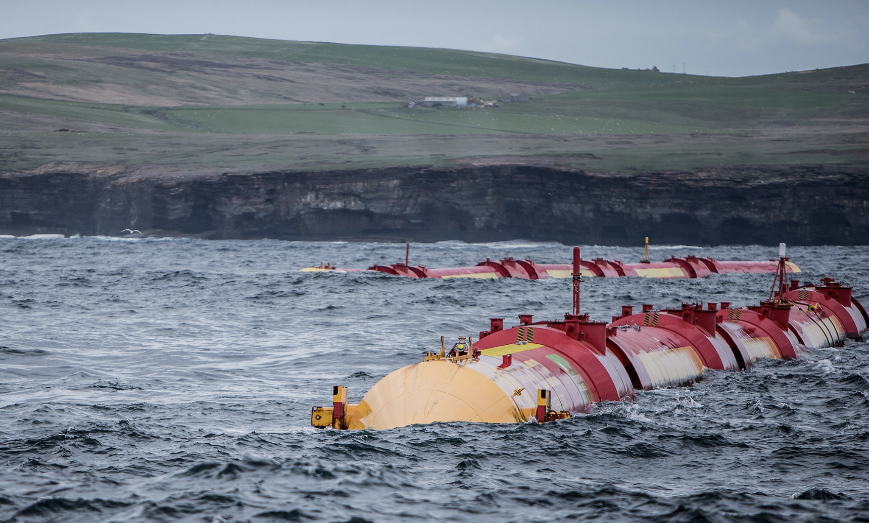
Sea Snakes
Float on the ocean surface and undulate; generate electricity from this movement
McKay, David J. C. Sustainable Energy—Without the Hot Air, UIT: Cambridge, England, 2009.
Image: https://www.flickr.com/photos/pelamiswave/14219315418/in/photostream/

Slide 19
Sea Snakes - Pelamis
The Pelamis Wave Energy Converter for deep water (about 50 m)
Comprised of “snakes”, each 100-200 m long, 3.5 m in diameter, and made of several segments
Each snake has an effective cross-section of 7 m and a maximum power output of 750 kW
A Pelamis “wavefarm” covering 1 km² (2.5 x 0.4 km), with 39 snakes arranged in 3 rows, was predicted to deliver about 10 kW/m
McKay, David J. C. Sustainable Energy—Without the Hot Air, UIT: Cambridge, England, 2009.
Image: https://en.wikipedia.org/wiki/Pelamis_Wave_Energy_Converter

Slide 20
Technology: Pelamis
Pelamis Wave Power (PWP) was founded in Edinburgh in 1988
Their first prototype was a single “snake” tested in 2004 near Orkney, Scotland, and was the first offshore wave power converter that generated electricity for a national grid
In 2008, three Pelamis units (2.25 MW) were installed 3 miles off the coast of Portugal as part of an experimental commercial project. Two months after installation, the devices were decommissioned due to leaks in the buoyancy tanks (among other technical issues); although the issues were solvable, they were too expensive and the project was not pursued
In 2010, a 750 kW Pelamis was installed and tested for 3 years
PWP went bankrupt in 2014
http://www.emec.org.uk/about-us/wave-clients/pelamis-wave-power/
https://web.archive.org/web/20090430152637/http://cleantech.com/news/3562/pelamis-starts-portugal-wave-power-farm
Image: https://en.wikipedia.org/wiki/Pelamis_Wave_Energy_Converter

Slide 21
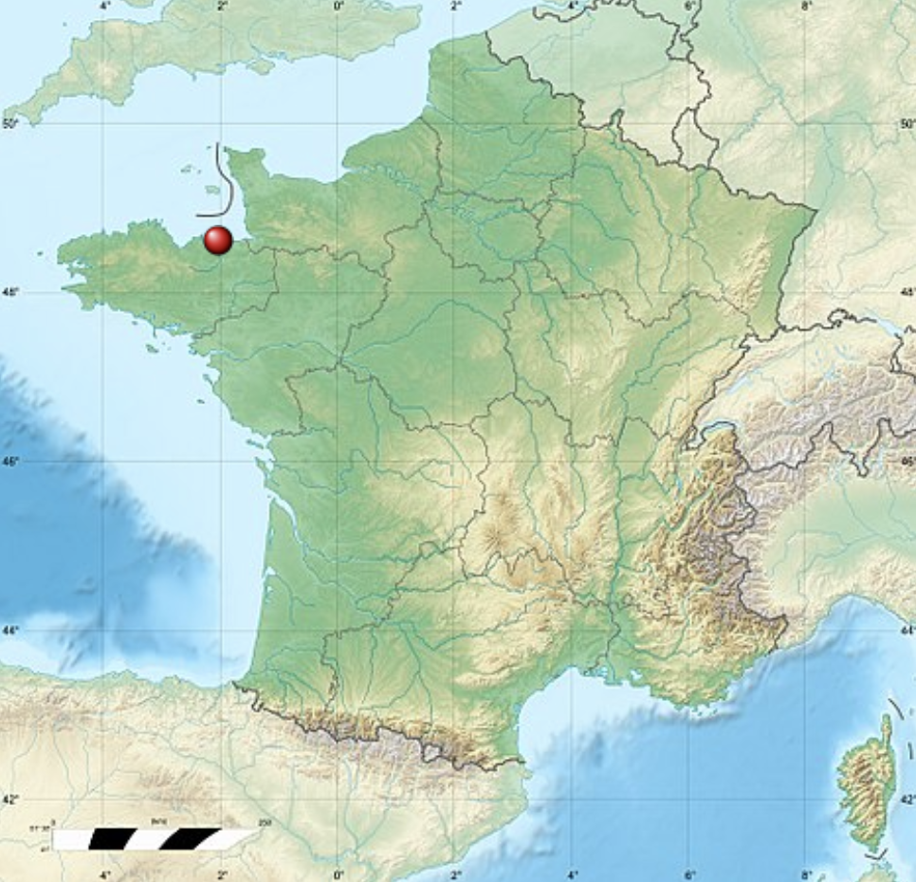
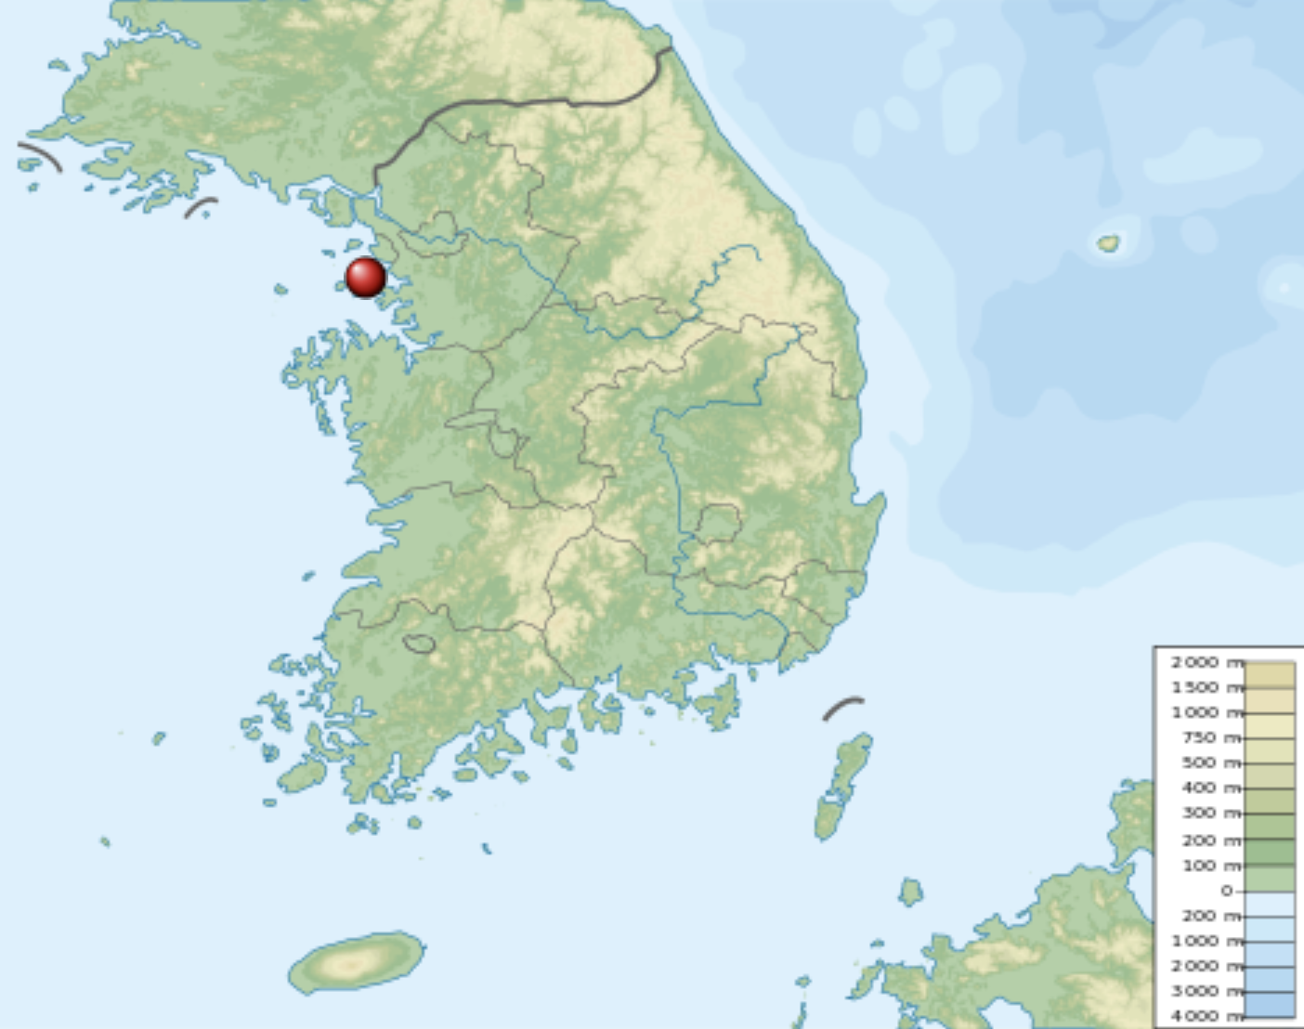
Tidal Power Plants
Tidal power plants are in operation in South Korea, France, Canada, China, England, and Russia
The world’s first tidal power plant was La Rance, a tidal barrage in Brittany, France
240 MW, since 1966
The world’s largest tidal power plant is the Sihwa Lake Tidal Power Station in Gyeonggi Province, South Korea
254 MW, since 2011
https://www.eia.gov/energyexplained/hydropower/tidal-power.php
https://tethys.pnnl.gov/annex-iv-sites/la-rance-tidal-barrage
https://tethys.pnnl.gov/annex-iv-sites/sihwa-tidal-power-plant
https://en.wikipedia.org/wiki/Sihwa_Lake_Tidal_Power_Station
https://en.wikipedia.org/wiki/Rance_Tidal_Power_Station

Slide 22
Tidal Power Plants
Both La Rance and Sihwa are tidal barrage power plants
Tidal barrages are like dams, built at the inlet of a bay to form an isolatable tidal basin
When tides rise the basin is filled, and as the tide goes down the basin empties
The water level within the basin and the flow of water in and out is controlled by sluice gates, which isolate the basin when the water level inside is at its highest and/or lowest
Tidal barrages can use both the incoming (flood tide) and outgoing (ebb tide) water flows to turn turbines and generate electricity; many use only one or the other
https://www.eia.gov/energyexplained/hydropower/tidal-power.php
https://www.irena.org/documentdownloads/publications/tidal_energy_v4_web.pdf

Slide 23
Tidal Power Plants
Tidal barrage requirements
Fluctuations in water depth must be 5+ meters
Only 40 potential sites have been located
Tidal barrage concerns
The ecosystem is seriously impacted by tidal barrage installation
Neighboring areas can also be affected by the altered tides (shoreline, tidal flats)
Water quality is negatively affected: the bay is not “flushed” as much, and the flow in and out causes turbidity
Wildlife: reduced salinity can kill fish and therefore birds and animals; fish cannot access breeding grounds
Economy: shipping routes can be affected
https://www.eia.gov/energyexplained/hydropower/tidal-power.php
https://tethys.pnnl.gov/technology-type/tidal

Slide 24
Tidal barrage using ebb tide to generate electricity
https://www.britannica.com/science/tidal-power

Slide 25
La Rance Tidal Barrage (France)
https://www.britannica.com/science/tidal-power

Slide 26
La Rance Tidal Barrage (France)
Capacity
24 turbines $×$ 10 MW each $⟶$ 240 MW capacity
Typical operating capacity of 96 MW (capacity factor ~40%), providing 600 GWh annually
Supplies 0.012% of France’s energy
Turbines (ebb & flow operation)
Bulb turbines, 5.35 m diameter, 93.75 rpm
Location
Average tidal range = 8.2 m
Basin area of 22 km²
Maximum flow rate 9,600 m³/s
https://www.britannica.com/science/tidal-power
https://www.irena.org/documentdownloads/publications/tidal_energy_v4_web.pdf

Slide 27
La Rance Tidal Barrage (France)
Environmental impact
Sedimentation and unstable salinity during the six years of construction had a major impact on marine life
Operation of the plant must be monitored to minimize its impact on the estuary ecosystem
Some species no longer live in the estuary (sand-eels, plaice), but some have returned (cuttlefish, sea bass)
Studies showed that biological diversity in the estuary was restored within 10 years, but the ecosystem is still considered fragile
https://tethys.pnnl.gov/annex-iv-sites/la-rance-tidal-barrage
https://www.britannica.com/science/tidal-power

Slide 28
Sihwa Lake Tidal Barrage (South Korea)
https://www.powermag.com/sihwa-lake-tidal-power-plant-gyeonggi-province-south-korea/

Slide 29
Sihwa Lake Tidal Barrage (South Korea)
Capacity
10 turbines $×$ 25.4 MW each $⟶$ 254 MW capacity
Provides 550+ GWh annually, at $0.02/kWh
Generates 2x per day
Turbines (ebb operation only)
Turbine/generator units, 7.5 m diameter, 64.3 rpm
Location
Artificial lake area of 43.8 km²
https://www.britannica.com/science/tidal-power
https://tethys.pnnl.gov/annex-iv-sites/sihwa-tidal-power-plant

Slide 30
Sihwa Lake Tidal Barrage (South Korea)
Origin story
The 43.8 km² man-made Sihwa Lake was constructed in 1994 for the purpose of flood mitigation and for use as a water source for irrigation, which required conversion to fresh water
“The Lake of Death”: once isolated from the ocean tides, water quality plummeted due mainly to a lack of significant freshwater inflow and contributions from industrial wastewater
A sluice was opened to allow seawater circulation, and the lake’s original purpose was abandoned; it was converted to a tidal power station in 1994
https://www.britannica.com/science/tidal-power
https://tethys.pnnl.gov/annex-iv-sites/sihwa-tidal-power-plant
https://www.powermag.com/sihwa-lake-tidal-power-plant-gyeonggi-province-south-korea/

Slide 31
In summary…
A handful of successful large-scale tidal technologies have been deployed worldwide
Environmental impacts of La Rance may have given some countries pause, and only 40 promising sites for such tidal barrage power plants have been identified
There are many, many other technologies designed to convert kinetic energy in waves and tides into electrical energy; the wide variety of wave conditions have likely led to diverse technologies and a lack of demand for any one type
https://www.irena.org/documentdownloads/publications/wave-energy_v4_web.pdf

Slide 32
Some recommended sources for future reading:
Tethys
https://tethys.pnnl.gov
European Marine Energy Center (EMEC)
http://www.emec.org.uk/
International Renewable Energy Agency (IRENA) Technology Briefs:
Tidal Energy
https://www.irena.org/documentdownloads/publications/tidal_energy_v4_web.pdf
Wave Energy
https://www.irena.org/documentdownloads/publications/wave-energy_v4_web.pdf

Slide 33
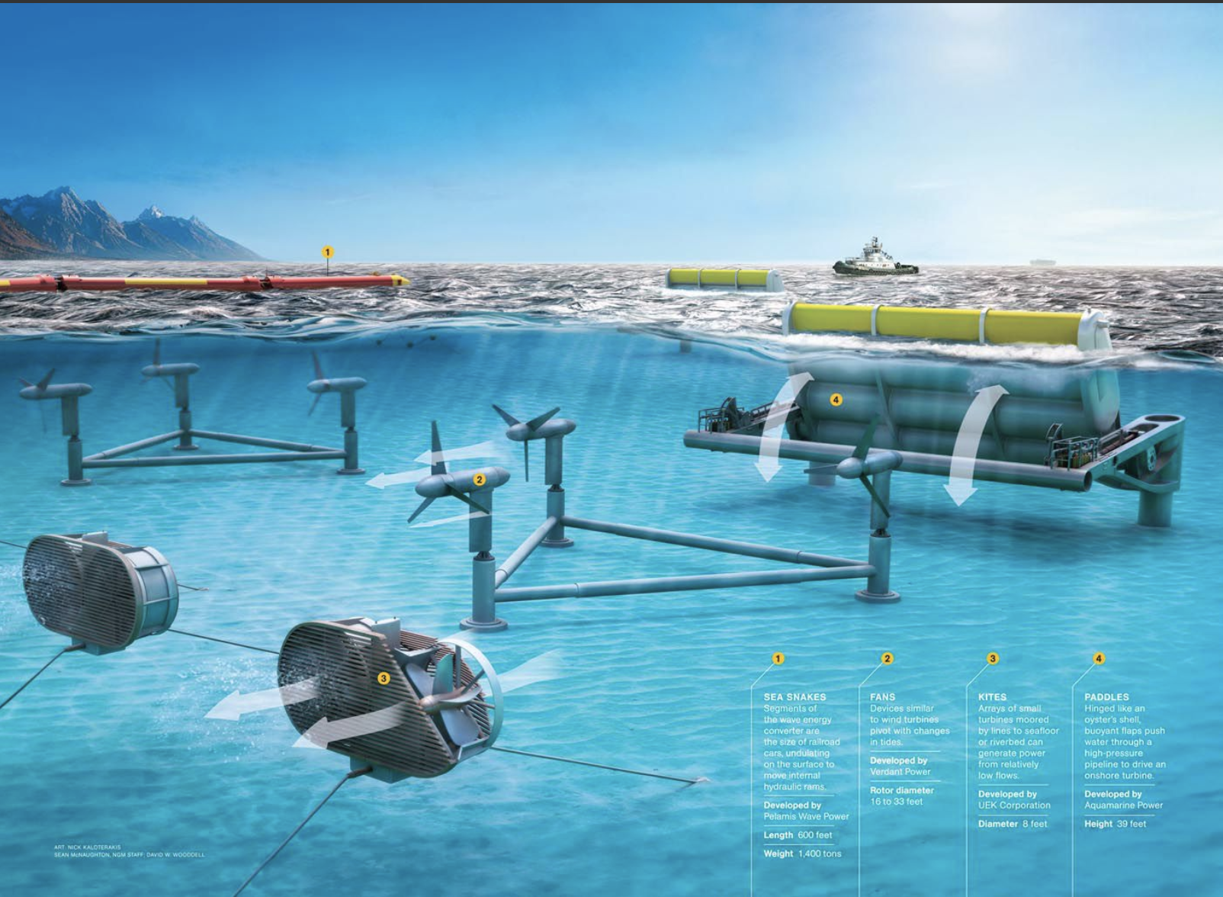
Marine & Hydrokinetic Technologies
https://www.nationalgeographic.org/encyclopedia/tidal-energy/

