Slide 1
Commercialization of Perovskite Solar Cells
HEJC March 6th, 2020
Robert Gustafson

Slide 2
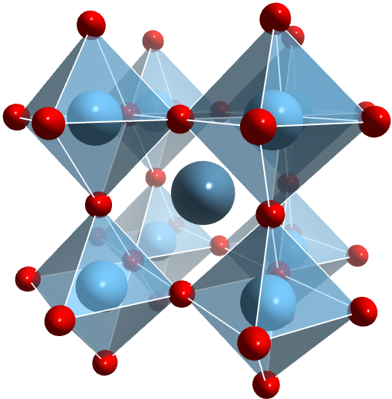
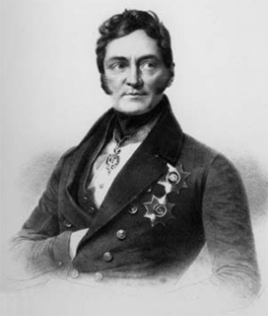
What are perovskites?
B
A
C
Lev Perovski 1792 - 1856
ABX₃

Slide 3
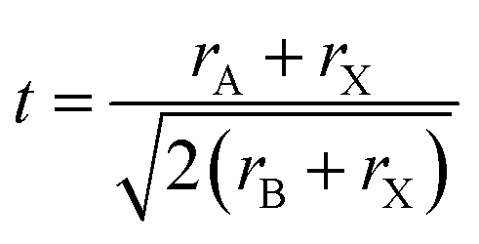
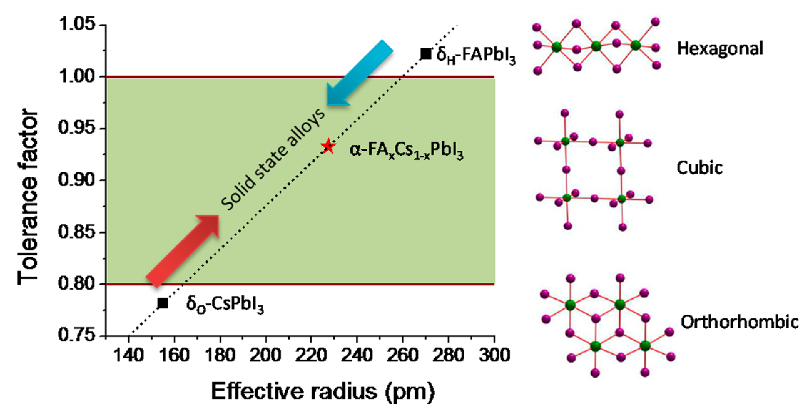
Amazingly tunable!
Li, et al, Chemistry of Materials, 28, 1 (2016)

Slide 4
1D, 2D perovskites!… not really
Energy Environ. Sci.,2018,11,234

Slide 5
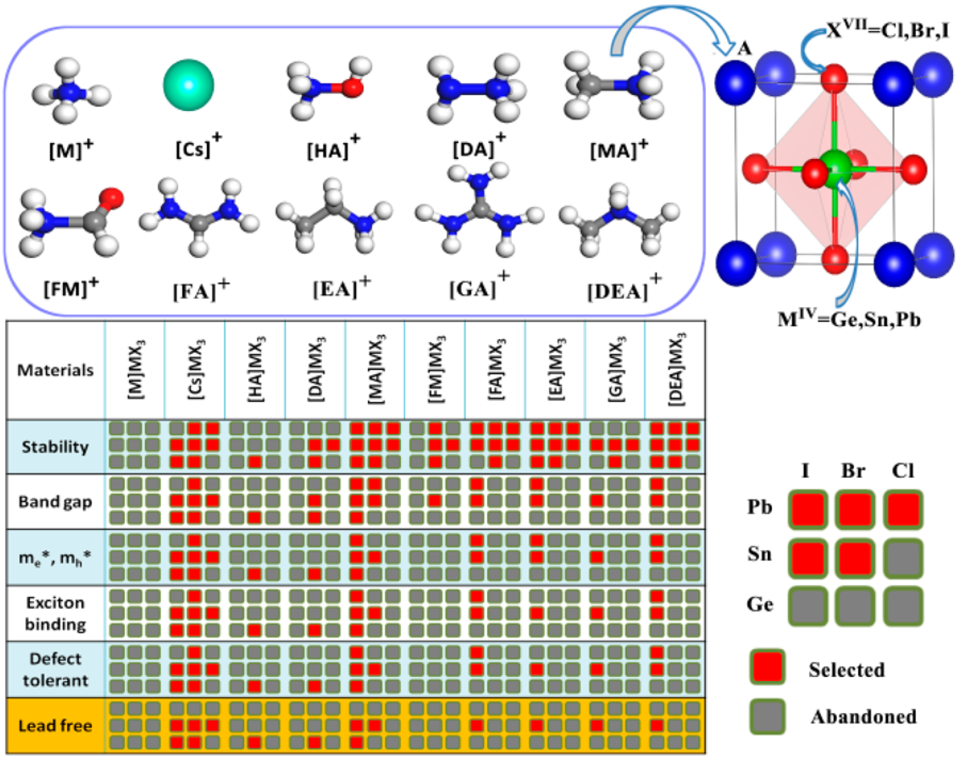
Which compositions are best?
Yang, D. et al. Chem. Mater. 2017, 29 (2)

Slide 6
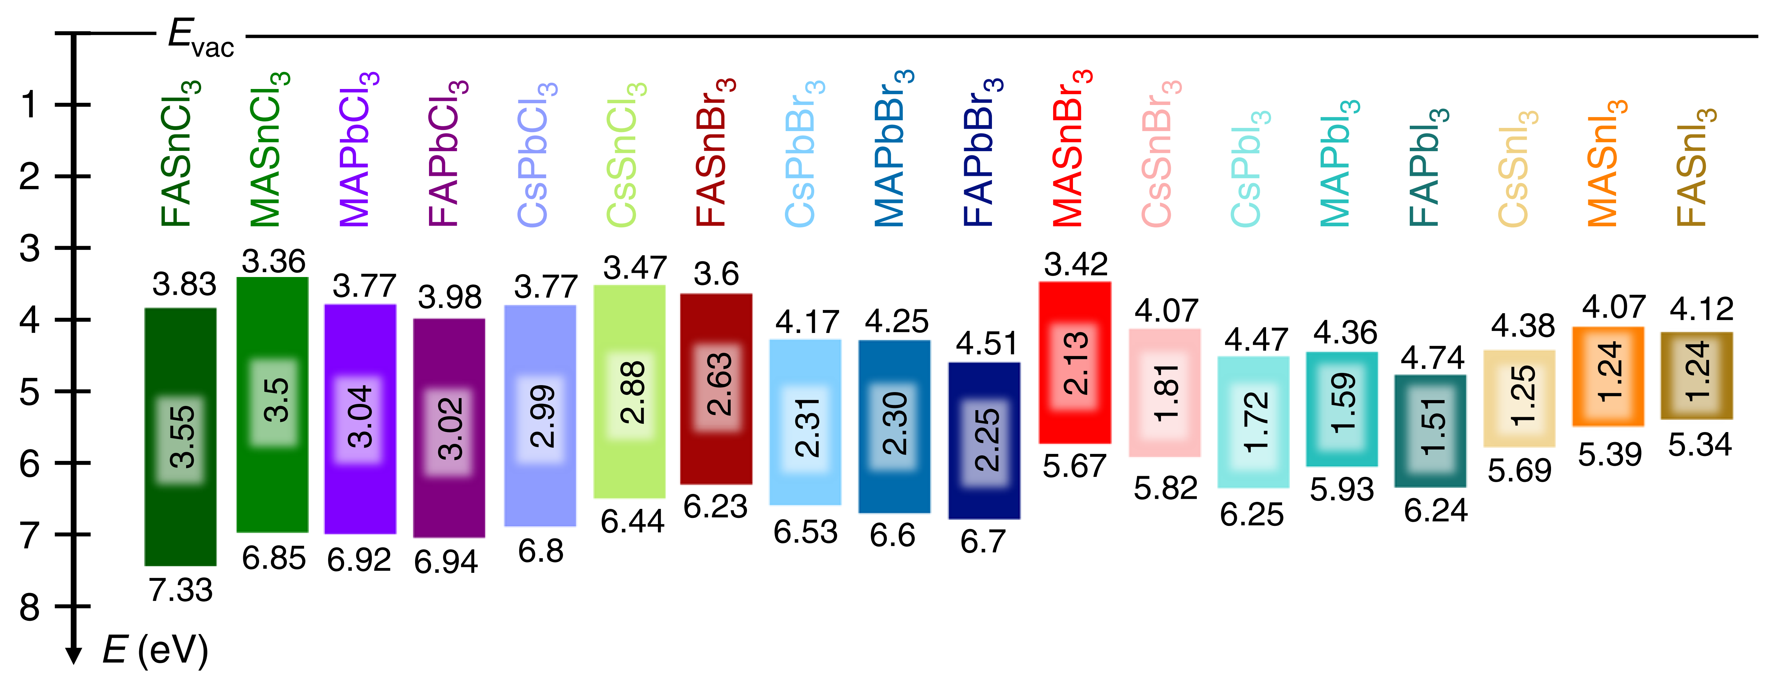
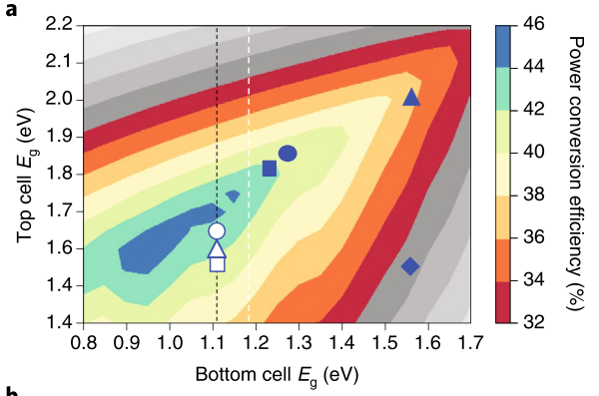
Which compositions are best?
Tao, S. et al. Nat Commun 2019, 10 (1)
Leijtens, T. et al. Nat Energy 2018, 3 (10)

Slide 7
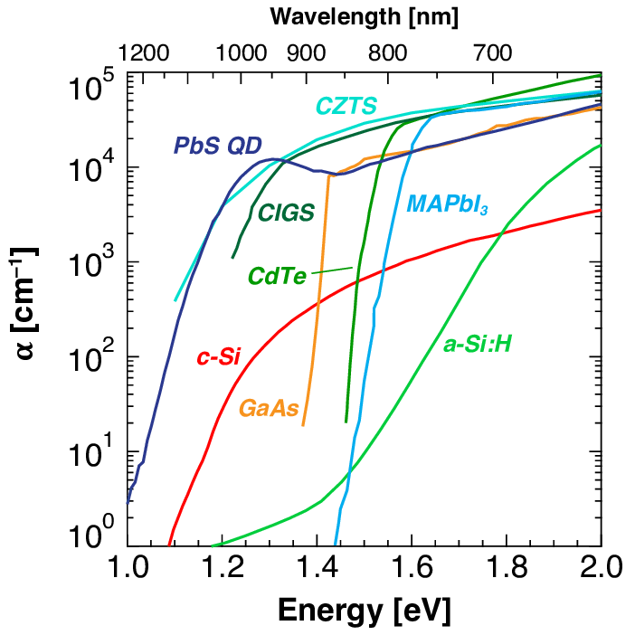
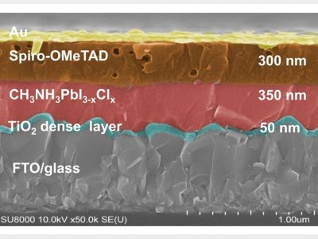
Lifting the hood on perovskite performance
High Absorption
Long diffusion lengths
Jean, J. et al. ACS Energy Letters, 2, (11)

Slide 8
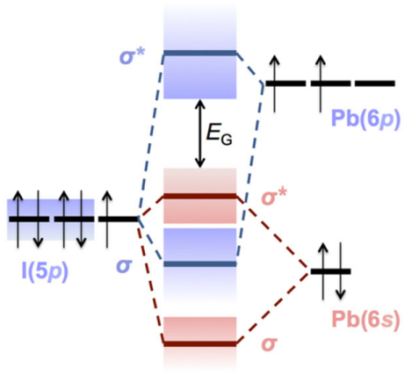
Lifting the hood on perovskite performance
Defect Tolerance
Grain Boundary Passivation
Grain Boundary
Rudd, P. N.; Huang, J. Trends in Chemistry 2019, 1 (4)

Slide 9
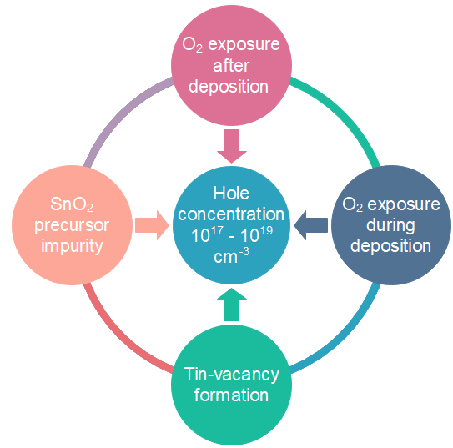
Tin-based perovskites performance lag
Poor surface coverage
Long fabrication time
Exposure during equipment transfer
Commercial SnI₂ has up to 10% SnI₄ and SnO₂
No purification practice
Trace O₂ in glovebox
Long deposition time
High pO₂ in vacuum chamber
Too rapid of crystallization
Not enough tin
Non-compact grains

Slide 10
Commercialization

Slide 11
Deposition techniques
Solution
Evaporation
(4) Angew. Chem. Int. Ed., 2018, 57, 2554-2569
Low Vacuum Vapor Transport
(6) J. Mater. Chem. A, 2017, 5, 11462-82
(5) ACS Appl. Mater. Interfaces, 2015, 7, 2708−2714

Slide 12
Current lab efficiency at 28%
100 MW production coming soon
$170 mm investment

Slide 13
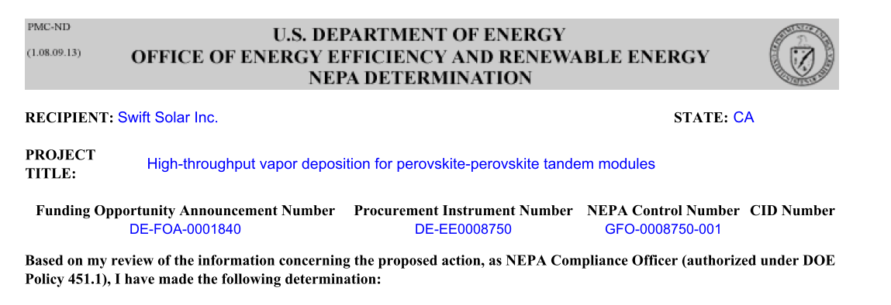
No advertised efficiency (probably 25%)
No plans for manufacturing yet
$6 mm investment
https://youtu.be/BeBvoqdXVBw?t=2

Slide 14
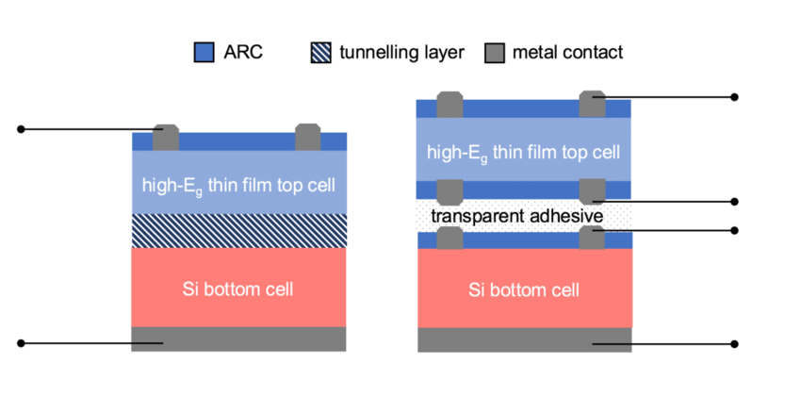
No advertised efficiency (probably 25%)
Ink-jet printing, mechanically stacked
$2.4 mm investment
Awarded: $500,000 ARPA-E grant
$250,000 DOE AMO voucher to work with NREL
$225,000 NSF SBIR to look into IoT applications

Slide 15
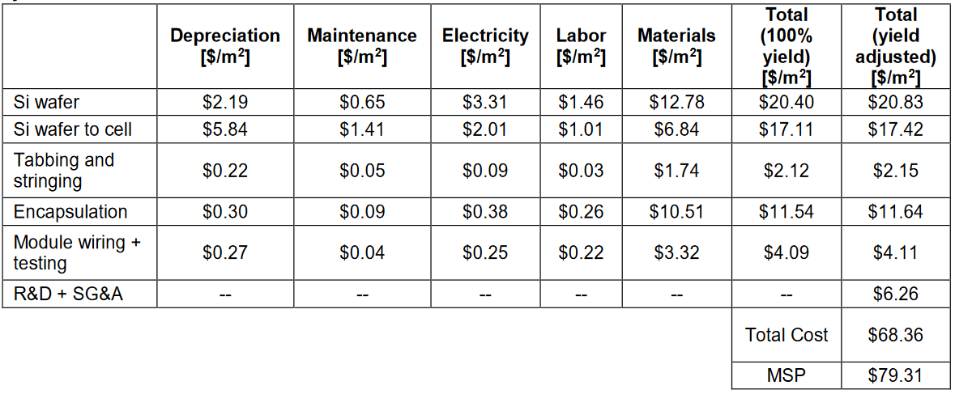
Competitive costs for mono-PERC

Slide 16
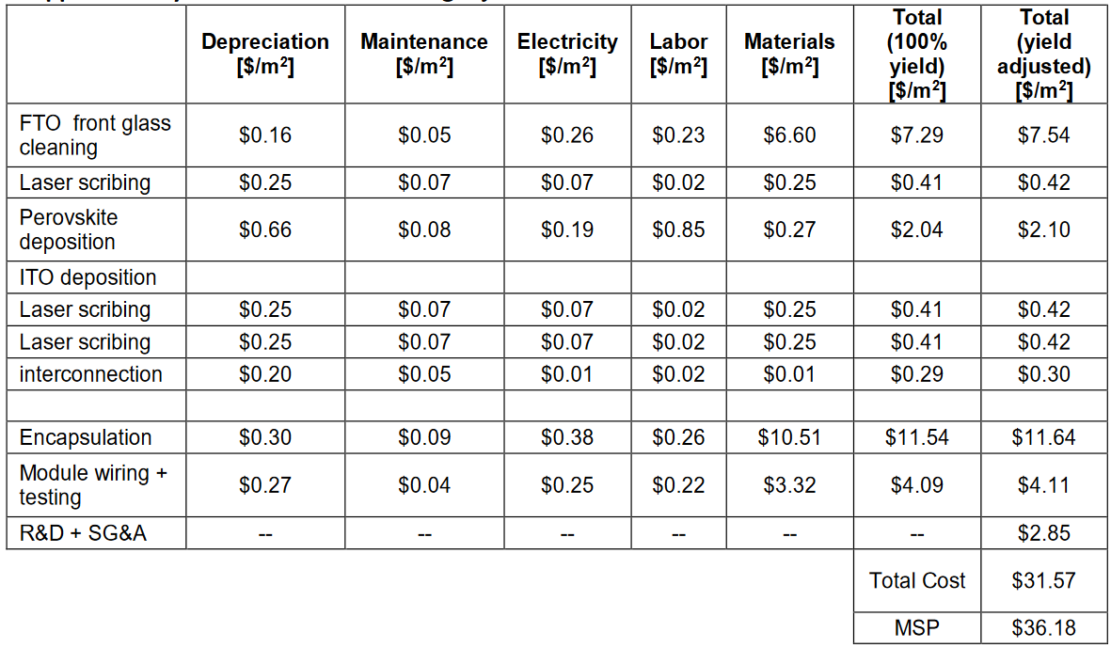
Competitive costs for single-junction PSC

Slide 17
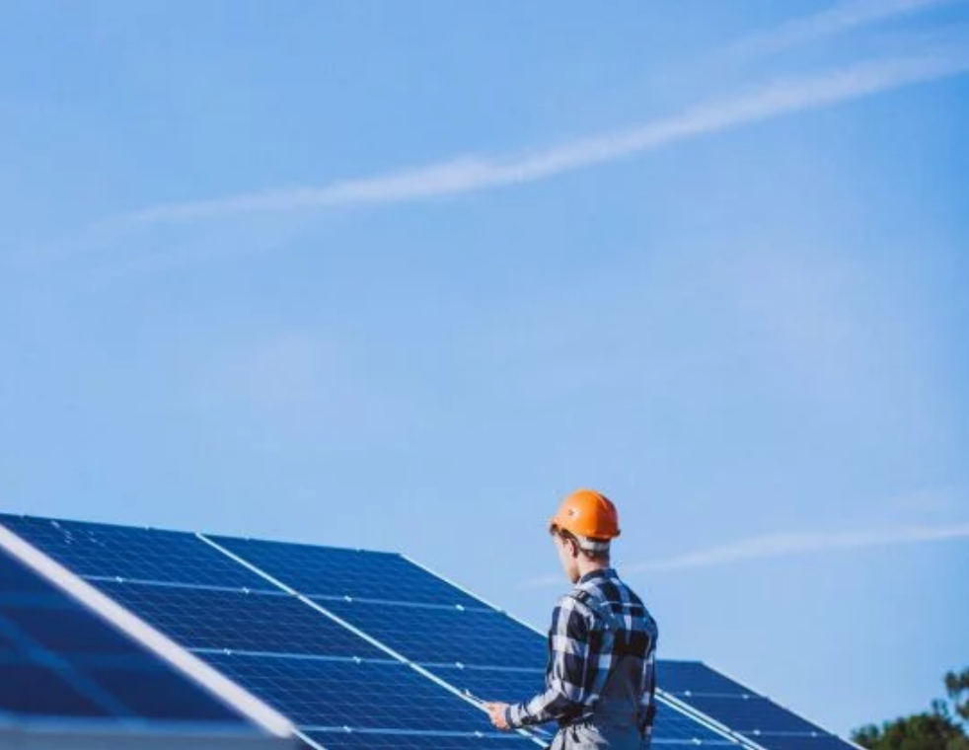
Will perovskites compete with low-cost Si solar panels?

Slide 18
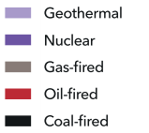
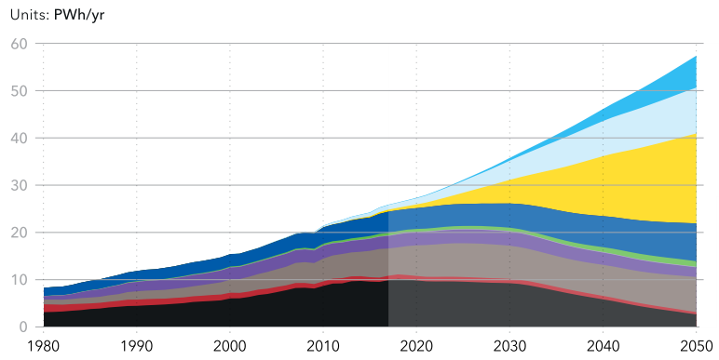
Global Electricity Demand
DNV GL, “Energy Transition Outlook 2019 Executive summary”

Slide 19
Very challenging with status quo
Huge investment:
Need > $20 bn in solar manufacturing CAPEX by 2030^{1,2}
Low margins:
Negative average median operating margin for 16+ large PV module producers over the last 4 years³
High installation costs:
Module cost of total installed cost: 32% in utility-scale markets⁴
Efficiency gains slowing:
Panel efficiencies only expected to increase 10% by 2029⁵
¹IRENA (2019), Global energy transformation: A roadmap to 2050 (2019 edition), International Renewable Energy Agency, Abu Dhabi
²Science, 2019, 364, 6443, 835-838
³Feldman and Margolis, Q1/Q2 2019 Solar Industry Update, National Renewable Energy Lab (NREL), 2019
⁴Appl. Sci., 2019, 9, 1227
⁵International Technology Roadmap for Photovoltaic (ITRPV), 10th edition, March 2019

Slide 20
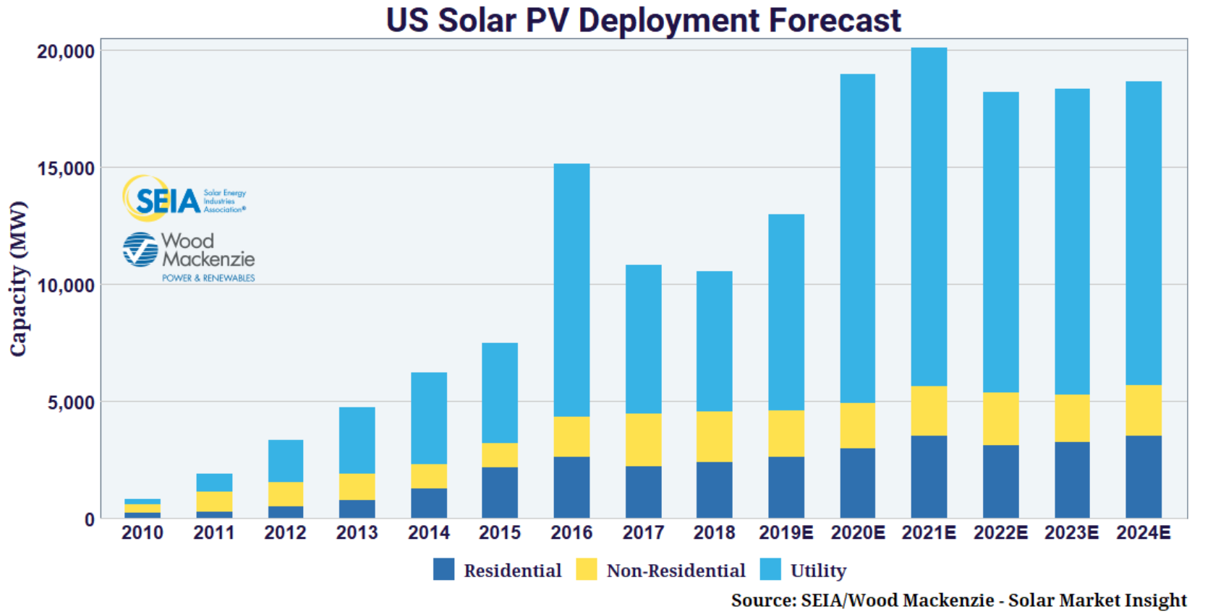
Slowing growth in the Resi sector
ITC ends

Slide 21
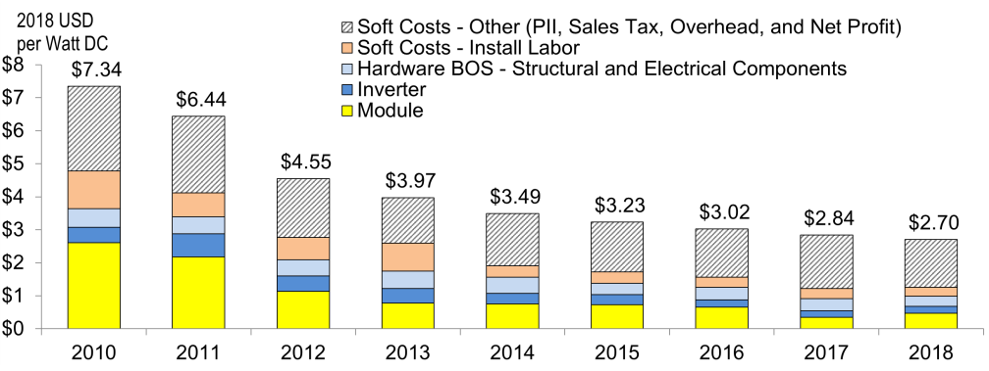
... resulting from slowing module gains
NREL “U.S. Solar Photovoltaic System Cost Benchmark: Q1 2018”

Slide 22
Prediction
“ The world will see continued deployment of silicon-based solar panels through the 2020s. Beginning in the 2030s, the market share of silicon-based solar panels will begin to cede ground to perovskites, and by the end of the 2030s, perovskites will have the dominant market share of new production with efficiencies over 30%”
- Robert Gustafson HEJC 2020

