Slide 1
Energy and THE economy
"Energy, Economics, Mechanics 101"

Slide 2
Disclaimers
This presentation : not about one specific technology.
Takes a step back to observe the impact energy → economy.
I won't be discussing opinions.
Data sources: nasa.gov, epa.gov, ourworld.org,
Jean-Marc Jancovici
The Shift Project
Pablo Servigne

Slide 3
Is climate change… real?

Slide 4
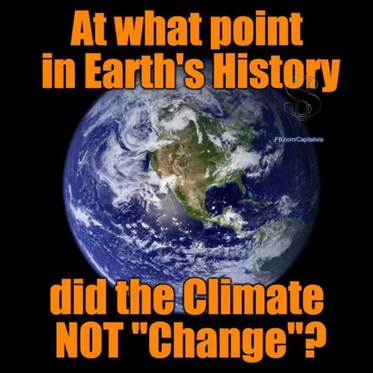
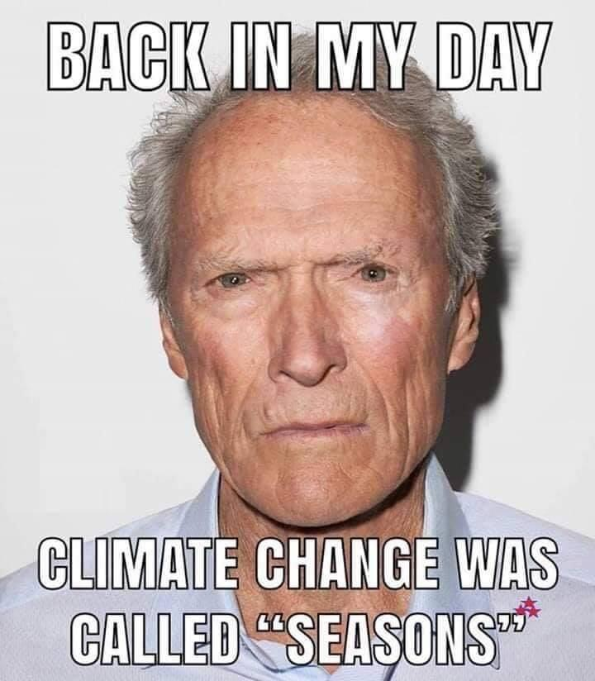
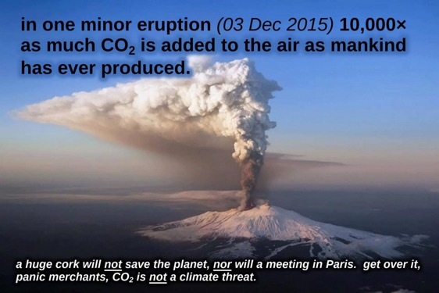
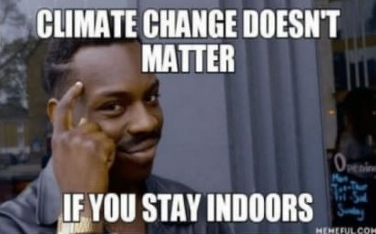
The four horsemen of Chad

Slide 5
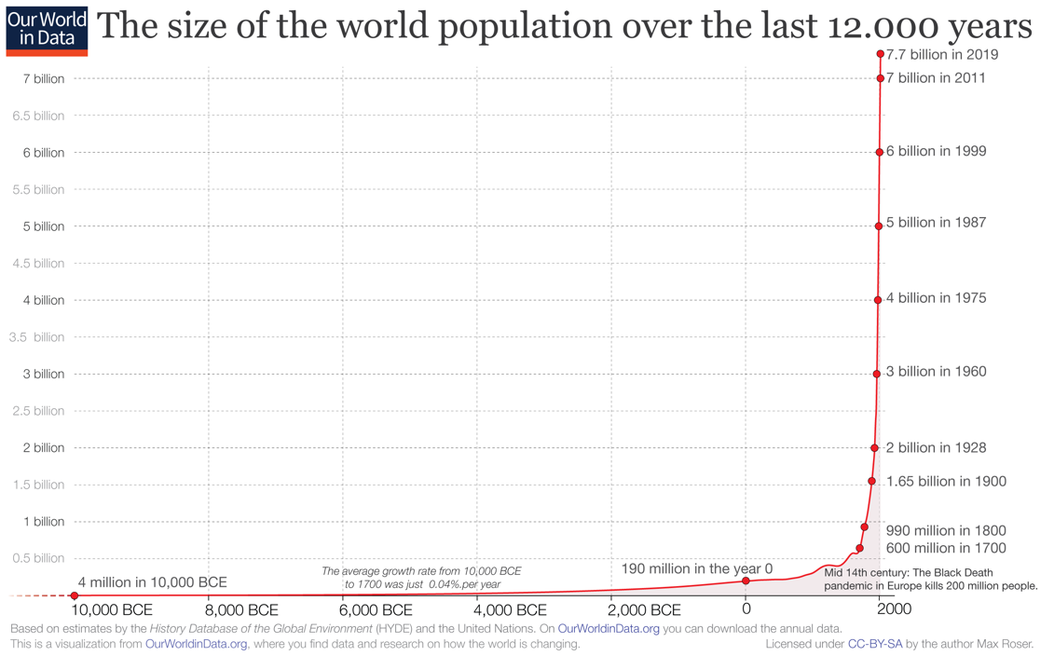
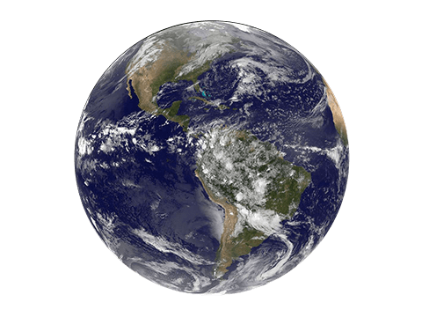
A couple facts
Settling of nomadic population: sedentarisation
Petri dish

Slide 6
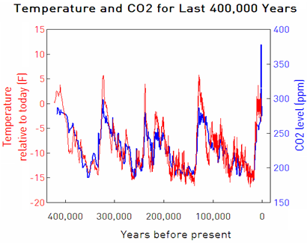
"Temperature variations is common over the years"
Data Sources for CO2: Vostok ice core, Law Dome ice core, and Mauna Loa air samples. Data Source for Temperature: Vostok ice core.

Slide 7
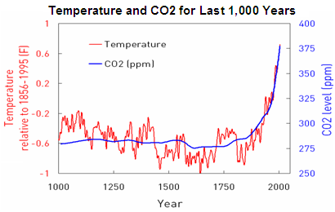
"Temperature variations is common over the years"
Data Sources for CO2: Law Dome ice core and Mauna Loa air samples. Data Source for Temperature: NOAA.
… but it'll take more than a GNUPlot graph with a 1990's colorscheme to convince an HEJC crowd

Slide 8
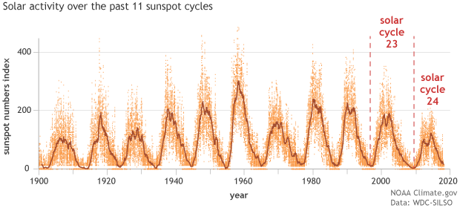
"The Earth is warming because of the sun"
A [reason] that scientists have ruled out a significant role for the Sun in global warming is that if the Sun’s energy output had intensified, we would expect all layers of Earth’s atmosphere to have warmed. But we don’t see that. Rather, satellites and observations from weather balloons show warming in the lower atmosphere (troposphere) and cooling in the upper stratosphere (stratosphere)—which is exactly what we would expect to see as a result of increasing greenhouse gases trapping heat in the lower atmosphere.
NOAA and climate.gov
Kopp, G., Krivova, N., Wu, C. J., & Lean, J. (2016). The Impact of the Revised Sunspot Record on Solar Irradiance Reconstructions. Solar Physics, 291(9–10), 2951–2965.
Aquila, V., Swartz, W. H., Waugh, D. W., Colarco, P. R., Pawson, S., Polvani, L. M., & Stolarski, R. S. (2016). Isolating the roles of different forcing agents in global stratospheric temperature changes using model integrations with incrementally added single forcings. Journal of Geophysical Research: Atmospheres, 121(13), 8067–8082.

Slide 9
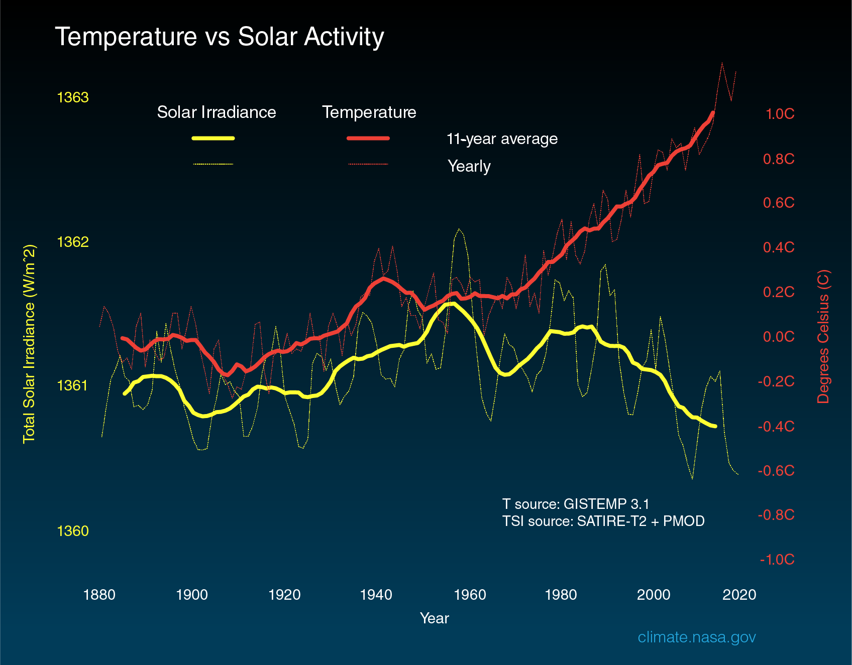
"The Earth is warming because of the sun"
The above graph compares global surface temperature changes (red line) and the Sun's energy received by Earth (yellow line) in watts (units of energy) per square meter since 1880. The lighter/thinner lines show the yearly levels while the heavier/thicker lines show the 11-year average trends. Eleven-year averages are used to reduce the year-to-year natural noise in the data, making the underlying trends more obvious.
nasa.gov

Slide 10
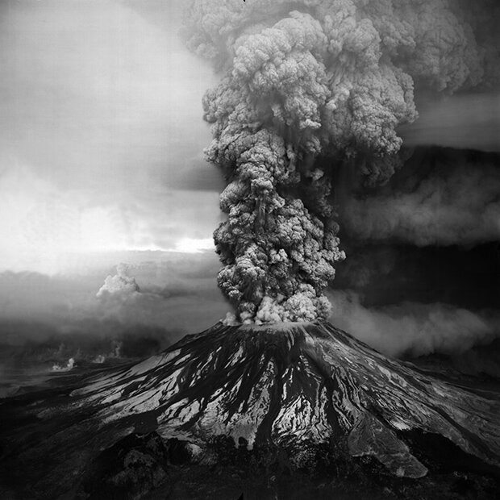
Chad :

Slide 11
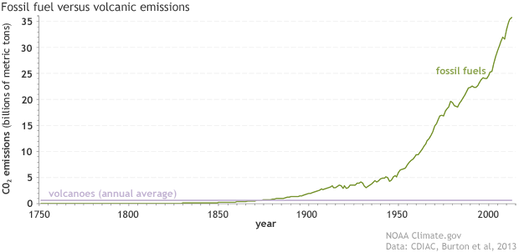
You wish.
Since the start of the Industrial Revolution, human emissions of carbon dioxide from fossil fuels and cement production (green line) have risen to more than 35 billion metric tons per year, while volcanoes (purple line) produce less than 1 billion metric tons annually
. NOAA Climate.gov graph, based on data from the Carbon Dioxide Information Analysis Center (CDIAC) at the DOE's Oak Ridge National Laboratory and Burton et al., 2013.

Slide 12
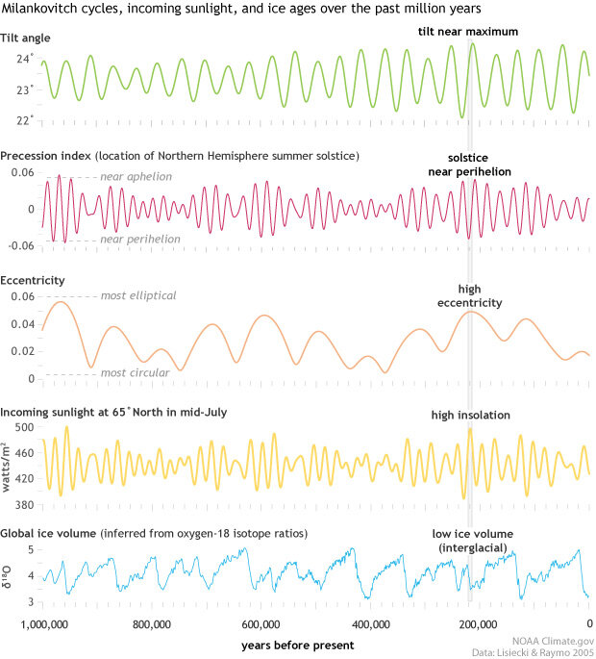
… maybe we missed something?
Maybe.
Not represented: El Nino/La Nina.
But likely not.
NOAA and climate.gov
Too many sources to add.

Slide 13
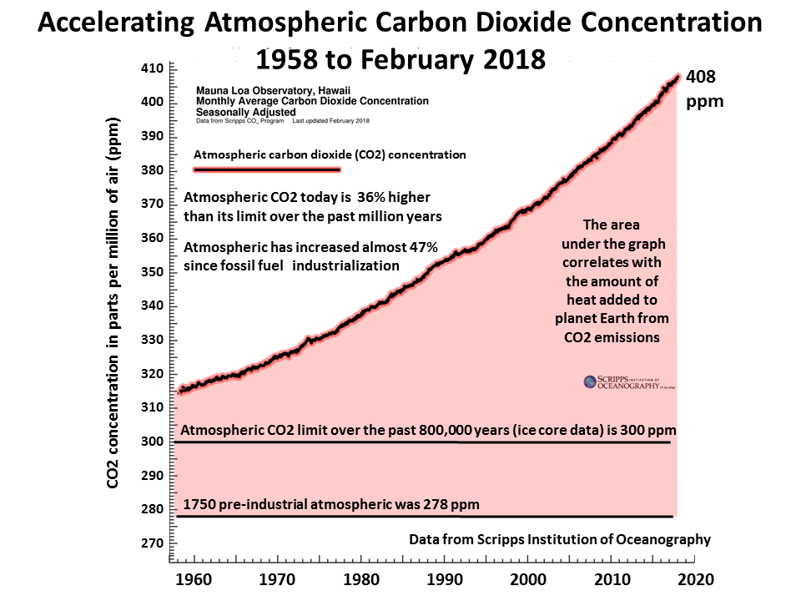
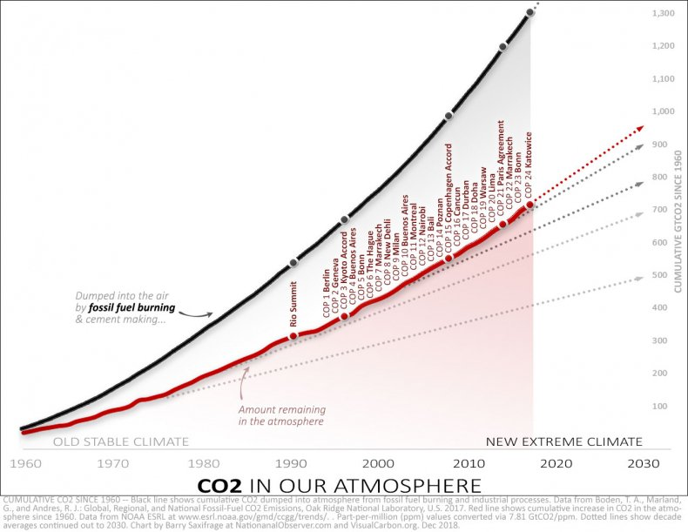
CO2 and COP

Slide 14
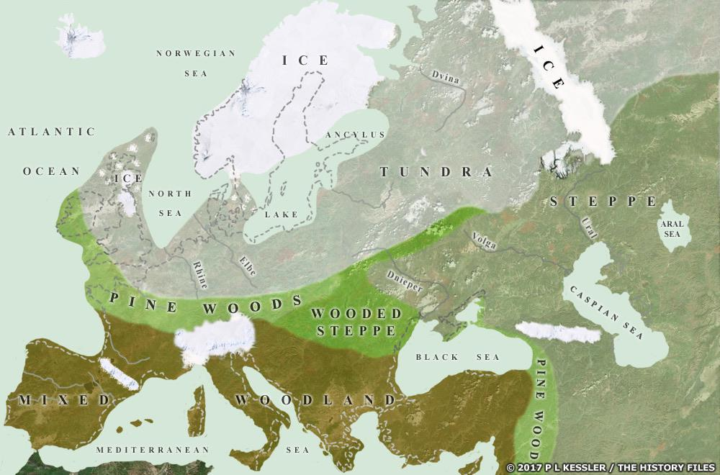
Chad's sister: "I'm not against a warmer climate in Boston"
2-mile thick
~5C difference: many of today’s countries were entirely covered by thick ice sheets for thousands of years.
Today, about three-quarters of all the world’s freshwater (14,9 million km2) is stored in glaciers, while during the last Ice Age it was about 3 times more (44,4 Million km3).
Tierney, J.E., Zhu, J., King, J. et al. Glacial cooling and climate sensitivity revisited. Nature 584, 569–573 (2020). https://doi.org/10.1038/s41586-020-2617-x

Slide 15
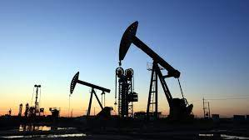
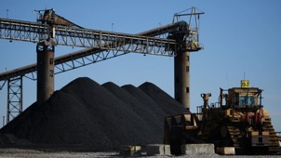
"Wasn't your talk: 'Energy and the Economy' ?"
How much is your rent? How much is your electricity bill?
= 5%
= 2%

Slide 16
Global energy consumption has never been greater than today. If that wasn't the case, today's audience would be 0.
Notes:
Misconception between energy and electricity.
Today: world's energy consumption is greater it has ever been.
If that wasn't the case, we wouldn’t be here. We would be fishing, picking up carrots in a field. We wouldn’t have time to study, go to college, go to the movie theater on Tuesday night.

Slide 17
Once upon a time: 100% renewable/sustainable.
Wind (renewable)
Linen, later : cotton
(renewable)
Water (renewable)
Wood (renewable)
Notes:
If renewable energies are so great, why did we move away from them?

Slide 18
If renewable energies are so great, why did we move away from them?

Slide 19
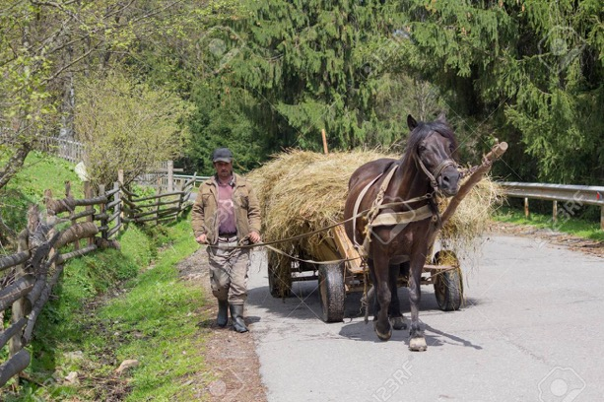
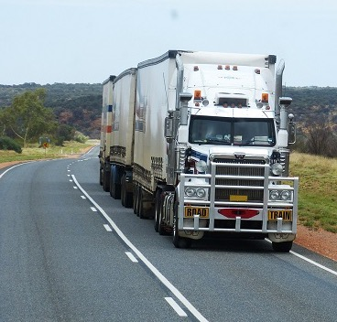
Once upon a time: 100% renewable/sustainable.

Slide 20
Once upon a time: 100% renewable/sustainable.

Slide 21
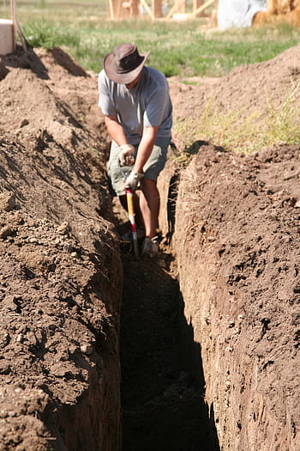
Once upon a time: 100% renewable/sustainable.

Slide 22
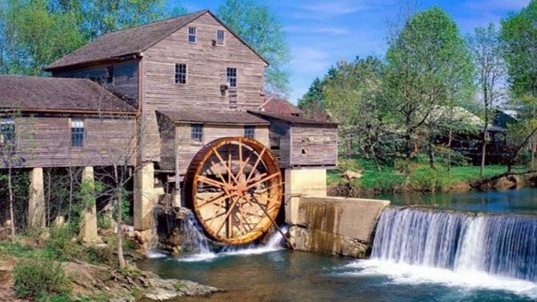
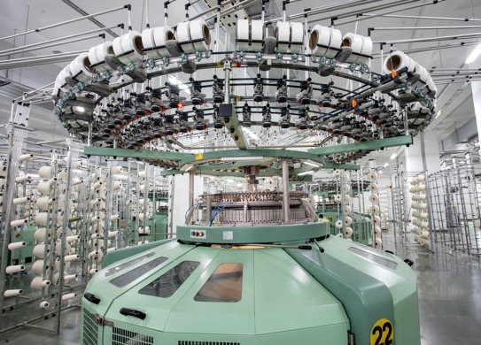
Once upon a time: 100% renewable/sustainable.
Notes:
Renewable industry became fossil industry, easier cheaper to fill up the Macys, Marshalls, Targets textile aisles.

Slide 23
For 2 centuries, we've moved away from renewable energies. Why? Were our ancestors ill-intentioned?
Reason: physics.
Fossil fuels are an abundant source of energy, easy to transport, easy to control, easy to store, able to generate power. Lots of power.
Renewable energies are diffuse, intermittent, hard to control.

Slide 24
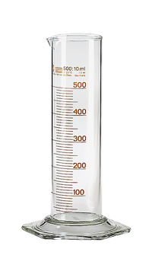
Can we explain the trend?
80 km/h (~50mph)
=
10m
3mL of oil (0.1oz)
$0.06-$0.08 per kWh w/o guarantee, $0.25-$0.50 with.
10m
$0.0015 per kWh as of Nov 9, 2021.
Guaranteed.
10m (~30 ft)
Which one is more convenient to transport, install, scale, control?
Easier to dig up oil, rather than waiting for the wind to blow.
Source: Carbone 4 (NGO)

Slide 25
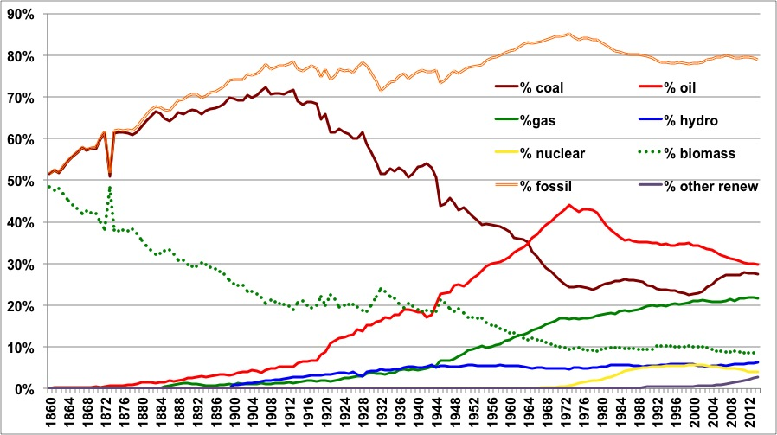
Global energy consumption per energy source
Share of fossil fuels has become clearly dominant over the last 2 centuries.
Nuclear power stopped growing after 1986, after giving a dent to global fossil fuel consumption.
Source: Shilling et al. 1977, BP Statistical Review 2015, Global Carbon Budget, JM Jancovici.

Slide 26
But why, and how did we get there?
Basic physics can provide an answer.
What is "Energy" ?
Every time something can be transformed (eg.: a velocity, a mass, a temperature), quantity of Energy involved.
Cannot transform a system without energy. Cannot deliver energy without transforming a system.
The more we use energy, the more we transform objects around us, and the more we benefit from these transformations (and the more we are exposed to the downsides of these transformations).
Immutable laws of nature: Law of Conservation of Energy = "A principle that states that a certain physical property (i.e., a measurable quantity) does not change in the course of time within an isolated physical system"

Slide 27
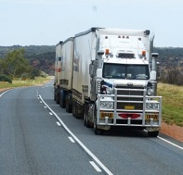
But why, and how did we get there?
Consequence: using energy implies to extract it from the environment, where it is stored, and transform it with a converter (Energy cannot be created out of nothing)
E.g: humans use biomass and convert it into heat (to maintain body temp) + a bit of work.
W + 𝛉℃ (or "𝛉℉")
To find more power, we need other converters, and the energy to power them:
+
+
+
+

Slide 28
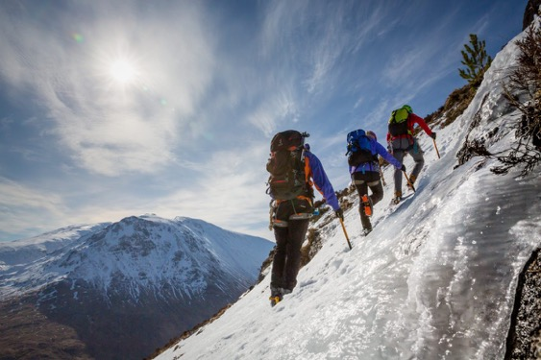
Orders of magnitude
80 kg + 10 kg (~200lbs)
x 2,000m Elevation Gains (~6,500 ft)
Mt Washington
≈ 1.8MJ, or 0.5 kWh
Every other day: 100 kWh/yr of mechanical energy
~ $200/kWh if paid minimum wage
1L of gas (~0.25 Gallon):
10 kWh of thermal energy,
2-4 kWh mechanical energy
(Carnot cycle / mech engine max yield)
Lift 6 m³ soil over 1 meter
(~ 15 T , or 33,000 lbs)
~ 0.05 kWh / day
Every other day: 10kWh/yr
~ $2000/kWh
→ 10-100 days of forced human labor
for $1 USD
"Forced" human labor provides 10-100kWh/yr
~ $0.25 USD /kWh
Notes:
A well trained
Energy provided by your body to elevate your mass against the Earth's gravitational field.
Energy is simply "mgh".
The entire audience put to work for a day = same amount of energy contained in less than a gallon of gas.

Slide 29
Orders of magnitude
Consequences:
This is the origin of:
Tertiarization of job market
Purchasing power
Industrial development
Globalization
College education
Retirement
PTOs
End of slavery in the West
~ $200/kWh if paid minimum wage
~ $0.25 USD /kWh
~ $2000/kWh
Machines have a considerably higher capacity to transform the world than humans.
Notes:
A well trained
Energy provided by your body to elevate your mass against the Earth's gravitational field.
Energy is simply "mgh".
The entire audience put to work for a day = same amount of energy contained in less than a gallon of gas.
You have machines that work for you 24/7 with no will to run away
There is no reason to use a source of energy that is considerably less efficient than machines, and which until recently was viewed as moral and positive.

Slide 30
Orders of magnitude
= mean power: 10W arms - 100W legs
=
hand blender = 300-400W
(what if you had to pay 3-4 cyclists…)
=
Vacuum cleaner = 1500W
=
x50 Average elevator motor ~5kW
=
x600 Tractor ~60kW
Rural exodus: because 100s of people replaced by tractors
Machines have a considerably higher capacity to transform the world than humans.
Notes:
When you press the button of the elevator: 50 cyclists start working for you.

Slide 31
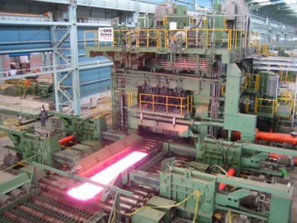
Orders of magnitude
= mean power: 10W arms - 100W legs
=
X10,000 Excavator ~ 100kW
=
X4,000 Truck ~400 kW
=
X10,000,000 Steel rolling mill ~100 MW
(1 person in Fontana, CA controls
the machine)
Machines have a considerably higher capacity to transform the world than humans.
Notes:
When you press the button of the elevator: 50 cyclists start working for you.

Slide 32
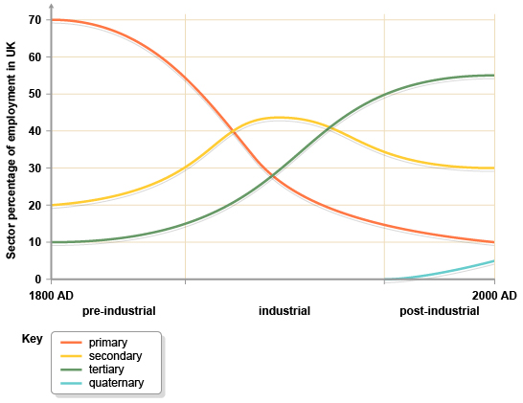
Changing employment structure over time because energy
Our primary concern: food (feed ourselves)
Before: most workers were farmers (about 2/3). Feed themselves first (subsistance farming)
As much non-farmers as there was excess of food production. 2/3 of budget was food consumption.
Source: bbc.co.uk

Slide 33
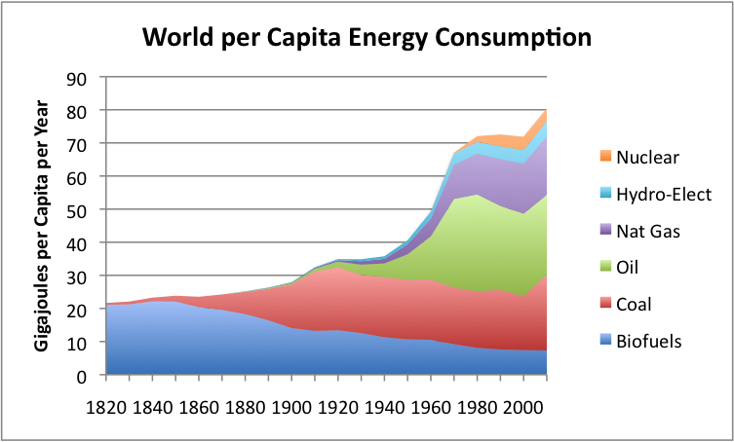
kWh: not sustainable, but it feels good
20,000 kWh per capita per year:
200 "workers" per capita
1 kWh = 3.6 MJ
20,000 kWh
kWh per capita:
1920-1940: flat
5,000 kWh
Per Capita, coal consumption has never decreased in history.
Fossil fuels = animal feed (kibble) for machines.
Oil: mostly to move around people and goods
Coal: mostly for electricity production

Slide 34
Why "Energy and the economy" ?

Slide 35
World economy in simplified terms
Renewable* resources
Non-renewable resources
W
Productive activity: either consume resources directly, or make "nice" things we it.
E.g.: iron ore-> fork.
At the beginning of times, not enough people to make dent in renewable resources (fish,…).
Studies : local shortage of flint.
*renewable over the course of a human life
14B years ago: Big Bang gave it for free
No one paid for it. Atmosphere, Oceans.. free.

Slide 36
World economy in simplified terms
Renewable* resources
Non-renewable resources
W
K
Then we discovered energy: amplifier of our capacity to take and transform.
With energy, making takes and transforms a lot more
Capital: we can set aside part of our production to increase our future production.
*renewable over the course of a human life
14B years ago: Big Bang gave it for free
No one paid for it. Atmosphere, Oceans.. free.

Slide 37
World economy in simplified terms
Renewable* resources
W
K
Non-renewable resources
Then we discovered energy: amplifier of our capacity to take and transform.
With energy, making takes and transforms a lot more
The more humans, the more we take & transform, and the less natural resources left.
*renewable over the course of a human life
14B years ago: Big Bang gave it for free
No one paid for it. Atmosphere, Oceans.. free.

Slide 38
World economy in simplified terms
W
K
Renewable* resources
Non-renewable resources
Then we discovered energy: amplifier of our capacity to take and transform.
With energy, making takes and transforms a lot more
The more humans, the more we take & transform, and the less natural resources left.
*renewable over the course of a human life
14B years ago: Big Bang gave it for free
No one paid for it. Atmosphere, Oceans.. free.
Then we have enough humans and we are so productive, that we start reducing the stock of renewable resources (eg: fish, forests,…).

Slide 39
World economy in simplified terms
W
K
Renewable* resources
Non-renewable resources
When we transform, we create byproducts (useless/undesirable)
Eg.: when flint knapping (stone tools), create stone fragments, dust…)
waste.
Stone fragments here and there: ok.
But when 7B+ people, becomes a problem because our production is consequential because it degrades the quality of remaining assets.
*renewable over the course of a human life
14B years ago: Big Bang gave it for free
No one paid for it. Atmosphere, Oceans.. free.

Slide 40
World economy in simplified terms
W
K
Renewable* resources
Non-renewable resources
Price and 𝚺 prices = GDP
When you buy something, you don't pay for materials (Nature left it there for free).
You pay: salaries of people involved + annuities on capital.
GDP is an aggregate of prices: flux coming from transformation (destruction) of natural resources.
*renewable over the course of a human life
14B years ago: Big Bang gave it for free
No one paid for it. Atmosphere, Oceans.. free.
Notes:
Note: GDP icnrease doesn’t mean we are getting richer. Getting richer means value of what you create is greater than what you've created, minus what it cost to create it (marginal cost).

Slide 41
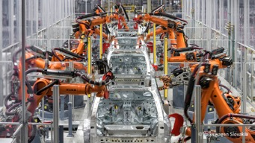
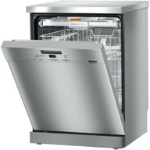
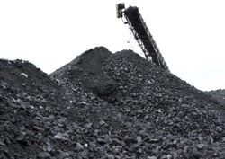
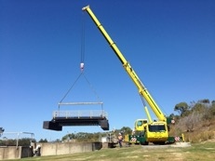
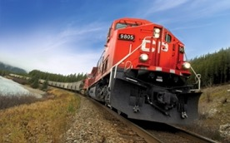
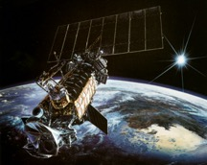
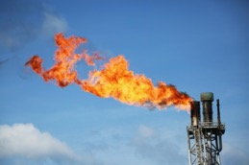
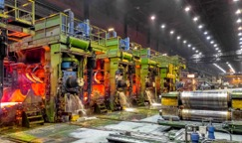
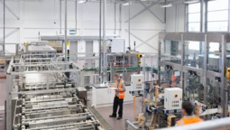
Energy = Iron Man
+
=
200 workers per capita
(~ 1k in US of A)
Without machines+energy, World's GDP would be 0.5-1% of current GDP
Notes:
Without all these machines

Slide 42
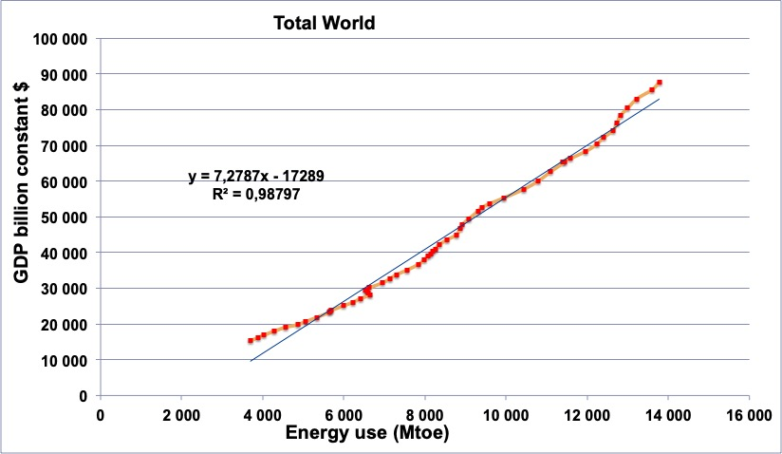
GDP = Energy
2019
1965
The Woods Hole Research Center for deforestation (through Global Carbon Budget 2013)
World Bank
From The Shift Project (JM Jancovici)

Slide 43
GDP = Energy
2019
The more machines, the more energy used, the more we produce
1965
Energy = # of machines in use.
The Woods Hole Research Center for deforestation (through Global Carbon Budget 2013)
World Bank
From The Shift Project (JM Jancovici)

Slide 44
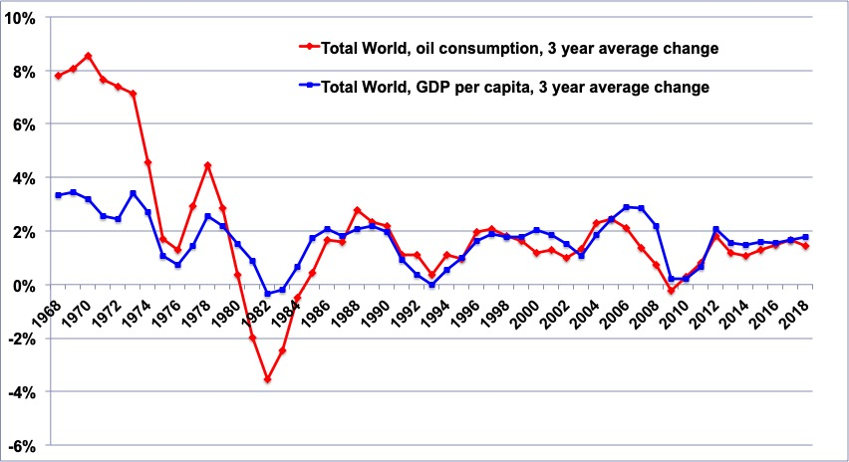
GDP = Energy
The Woods Hole Research Center for deforestation (through Global Carbon Budget 2013)
World Bank
From The Shift Project (JM Jancovici)

Slide 45
Historically, energy sources: stacked, not substituted.
Fossil = CO2

Slide 46
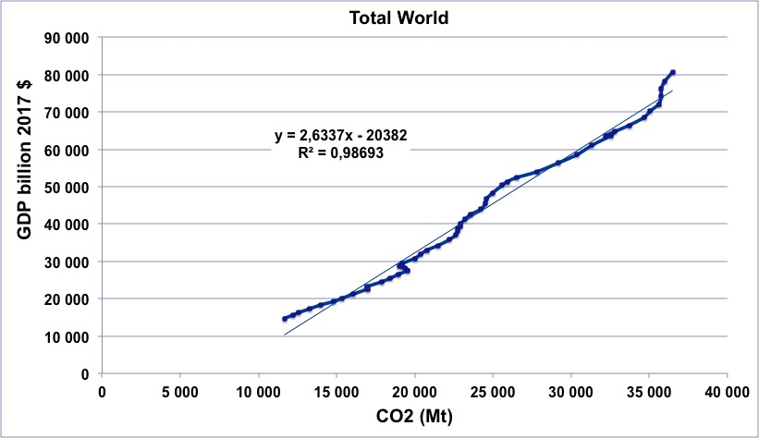
Hydro, renewables, IT "boom" have had no impact because 80% of energy still fossil fuels.

Slide 48
Never in history we've had more GDP with less CO₂. "Carbon neutral" ⇒ recession?

Slide 49
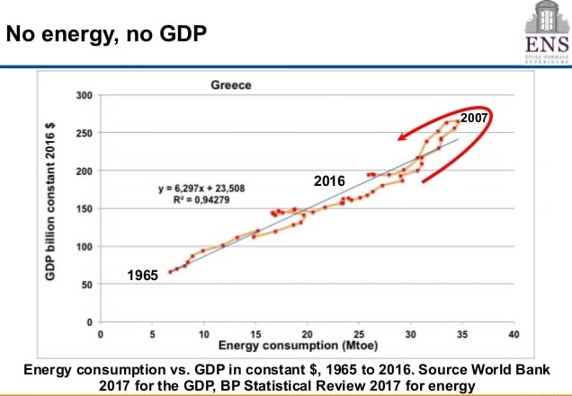
GDP adjusted

Slide 50
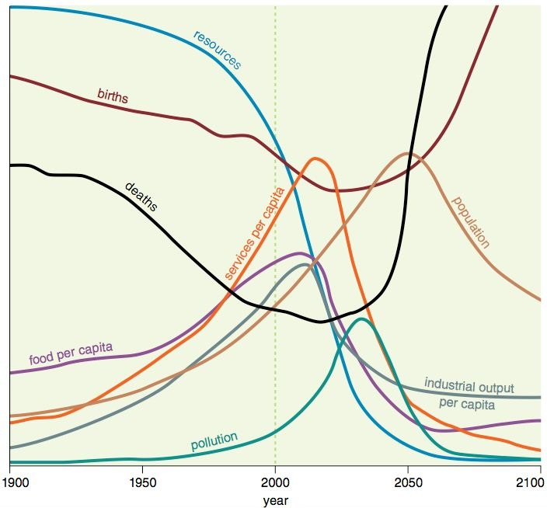
The Meadows report: 1970 (MIT)
In all scenarios, continually increasing economic output leads to collapse.

Slide 51
The End.

Slide 52
US Energy Information Administration

Slide 53
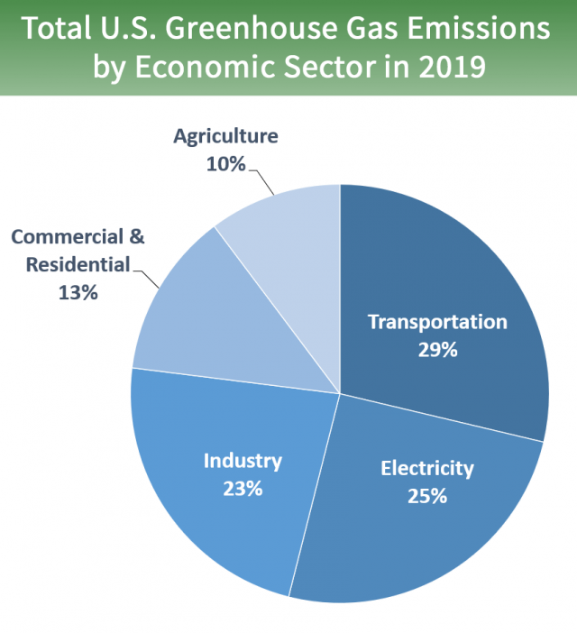
Total US Greenhouse Emissions by Economic Sectors in 2019
The transportation sector generates the largest share of greenhouse gas emissions. Greenhouse gas emissions from transportation primarily come from burning fossil fuel for our cars, trucks, ships, trains, and planes. Over 90 percent of the fuel used for transportation is petroleum based, which includes primarily gasoline and diesel
Electricity production (25 percent of 2019 greenhouse gas emissions) – Electricity production generates the second largest share of greenhouse gas emissions. Approximately 62 percent of our electricity comes from burning fossil fuels, mostly coal and natural gas
Direct emissions are produced from residential and commercial activities in a variety of ways:
Combustion of natural gas and petroleum products for heating and cooking needs emits carbon dioxide (CO₂), methane (CH₄), and nitrous oxide (N₂O). Emissions from natural gas consumption represent 80 percent of the direct fossil fuel CO₂ emissions from the residential and commercial sectors in 2019. Coal consumption is a minor component of energy use in both of these sectors.
Organic waste sent to landfills emits CH₄.
Wastewater treatment plants emit CH₄ and N₂O.
Anaerobic digestion at biogas facilities emits CH₄.
Fluorinated gases (mainly hydrofluorocarbons, or HFCs) used in air conditioning and refrigeration systems can be released during servicing or from leaking equipment.
Indirect emissions are produced by burning fossil fuel at a power plant to make electricity, which is then used in residential and commercial activities such as lighting and for appliances.
Total Emissions in 2019 = 6,558 Million Metric Tons of CO2 equivalent
epa.gov
Inventory of U.S. Greenhouse Gas Emissions and Sinks: 1990–2019.

Slide 54
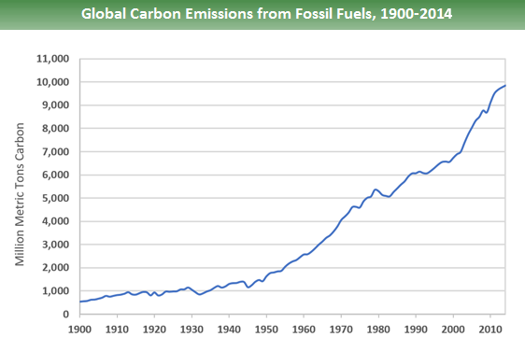
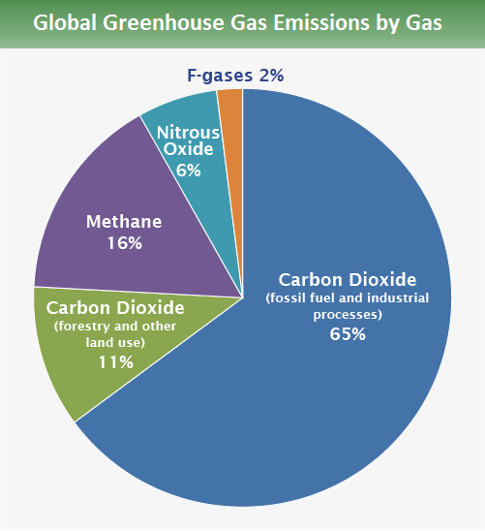
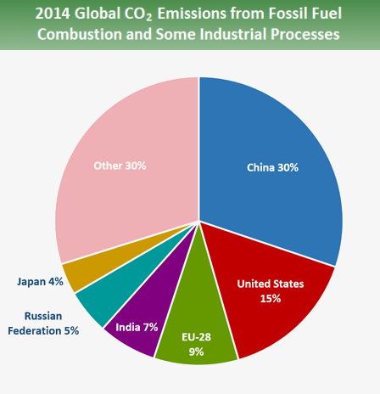
Global trends
Source: Boden, T.A., Marland, G., and Andres, R.J. (2017). Global, Regional, and National Fossil-Fuel CO2Emissions. Carbon Dioxide Information Analysis Center, Oak Ridge National Laboratory, U.S. Department of Energy, Oak Ridge, Tenn., U.S.A. doi 10.3334/CDIAC/00001_V2017.
Source: IPCC (2014)

