Slide 2
KNOCK
KNOCK
An American joke adapted with the help of Eric Fell and Ashleigh Herrera
Notes:
Who’s there
Gray hydrogen
Gray hydrogen who
….

Slide 3
Aren’t Ya (Orangeya) Glad I Didn’t Say Gray Hydrogen

Slide 4
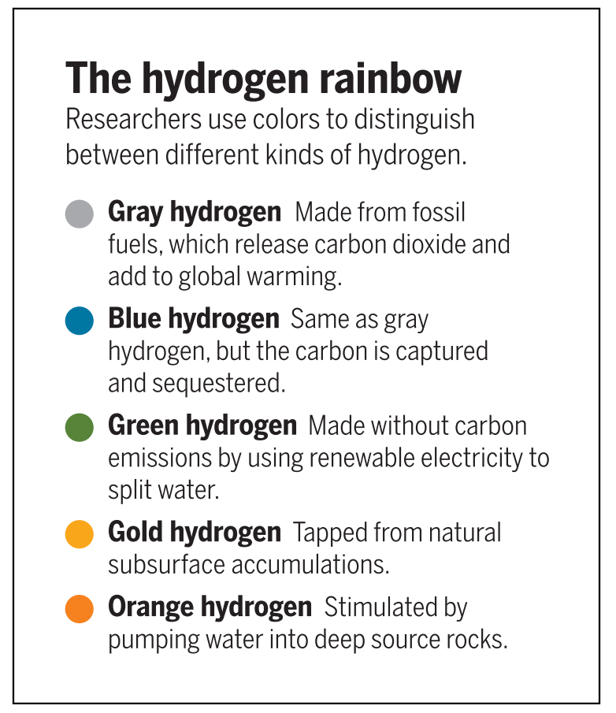
Aren’t Ya (Orangeya) Glad We Have Orange Hydrogen for the Renewable Energy Transition
Jordan D. Sosa
Harvard Energy Journal Club
December 1st, 2023
Eric Hand, Hidden Hydrogen. Science, 379 (6633), . DOI: 10.1126/science.adh1477

Slide 5
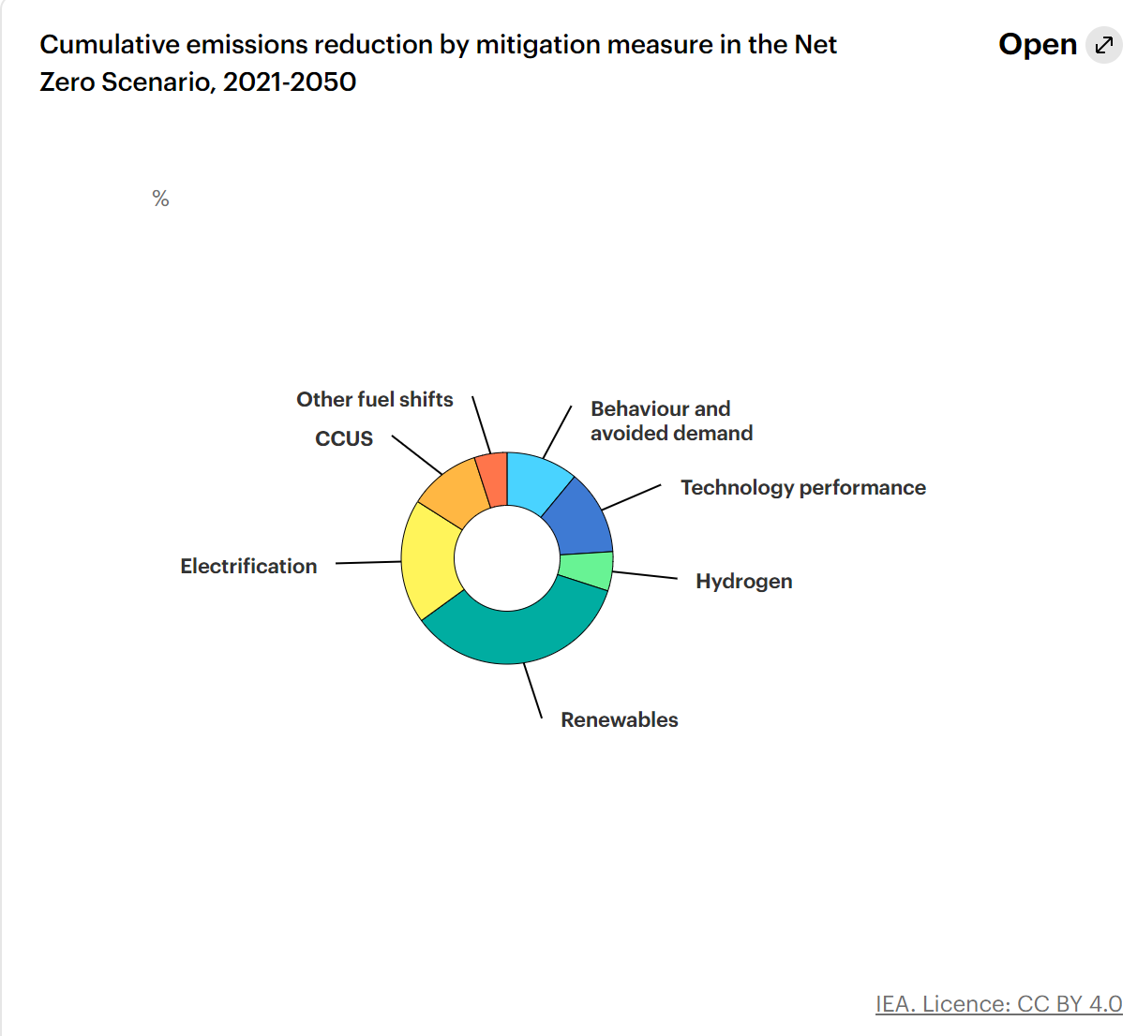

Why hydrogen?
Useful for applications that are difficult to decarbonize
  Long-haul transport, chemical processing, alloys manufacturing
Method for storing excess renewable energy
  Can last days to months
High energy density
IEA (2021), Global Hydrogen Review 2021, IEA, Paris https://www.iea.org/reports/global-hydrogen-review-2021, License: CC BY 4.0

Slide 6
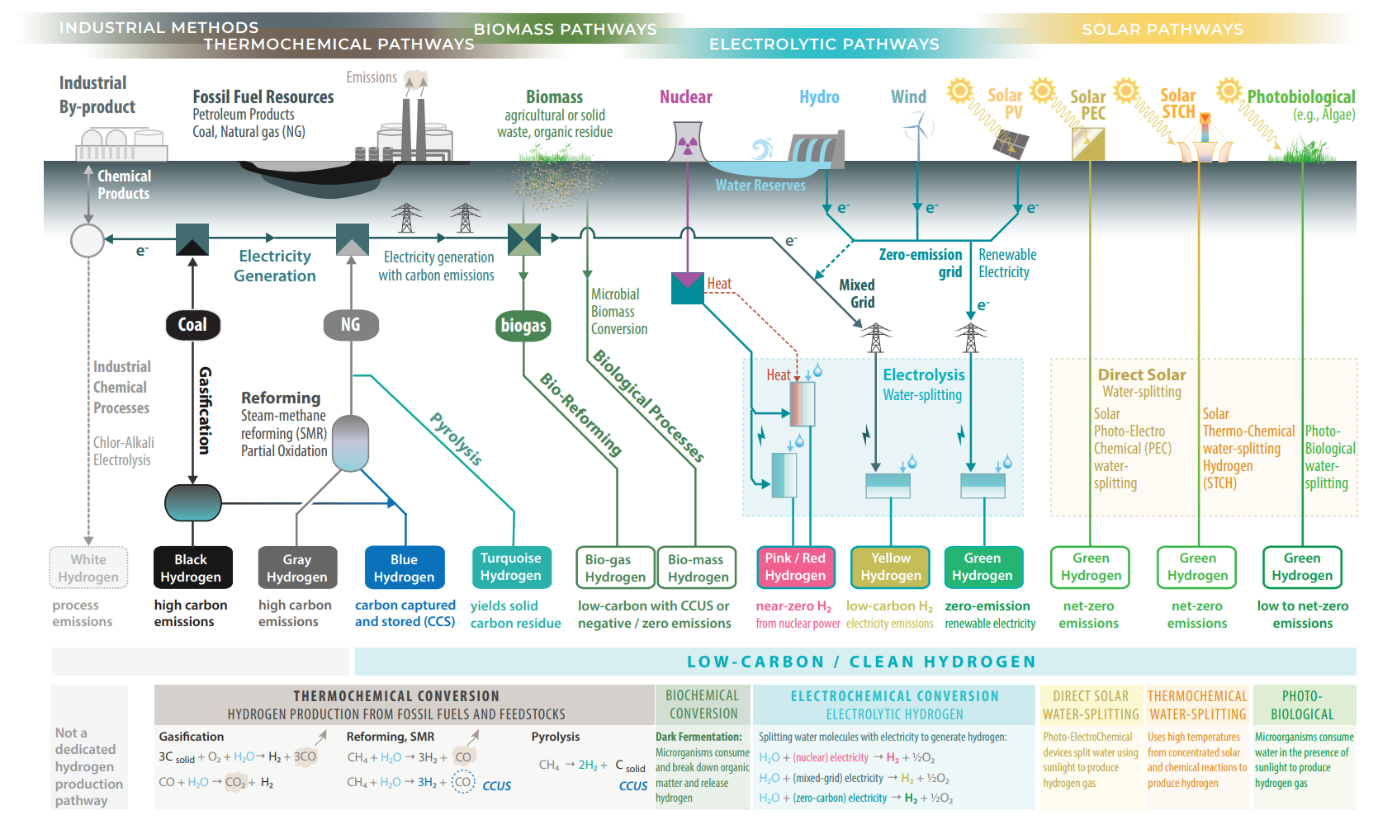
Ahmet Kusoglu 2021 Electrochem. Soc. Interface 30 44
Thanks, Tommy George, for the article!
Notes:
Gasification: Converting coal or carbonaceous mats at high temps into gases, then react w/ steam to separate the H2
SMR: 75% H2; Industrial: 2%; renewable: 0.1% (in 2021)
Yellow hydrogen can be worse than gray hydrogen if too much of electricity from inefficient nonrenewables

Slide 7
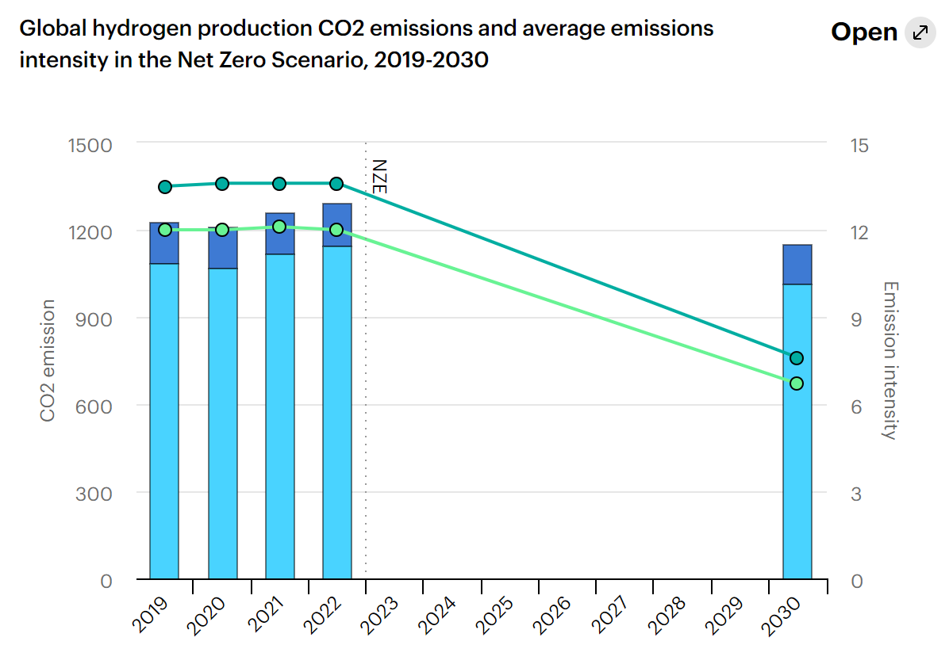
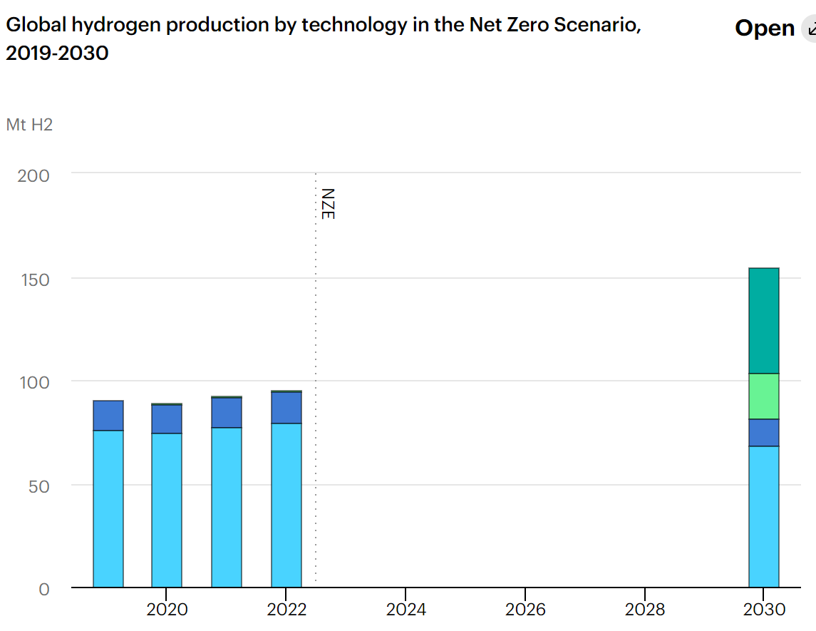
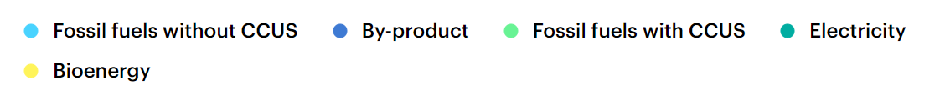
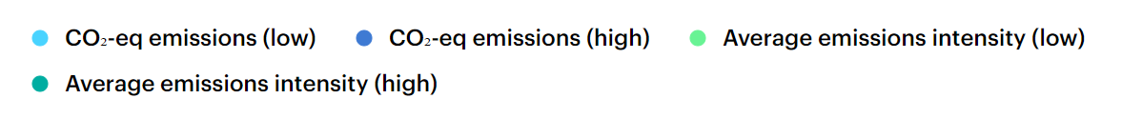
Issue: H₂ production costly, energy intensive, and/or causes emissions
including upstream and midstream emissions from fossil fuel suppl
“The range in the emissions and in the average emissions intensity reflects the different allocation methods for the by-product hydrogen production in refineries.”
IEA (2021), Global Hydrogen Review 2021, IEA, Paris https://www.iea.org/reports/global-hydrogen-review-2021, License: CC BY 4.0
Notes:
Getting on track with the NZE Scenario requires a rapid scale-up of low-emission hydrogen, with around 50 Mt of hydrogen production based on electrolysis and more than 30 Mt produced from fossil fuels with CCUS by 2030, for a total of more than 50% of hydrogen production. This will require an installed capacity of more than 550 GW of electrolysers, which in turn requires both a rapid scale-up of electrolyser manufacturing capacity (see Electrolysers page) and significant deployment of dedicated renewable capacity for hydrogen production and enhancement of the power grid. With regard to fossil fuels, by 2030 natural gas demand for hydrogen production is almost 30% higher than in 2022 in the NZE Scenario, while coal demand drops by nearly one-fifth. In both cases, newly deployed production capacity is equipped with CCUS and a fraction of existing facilities still operational in 2030 are retrofitted with CCUS.

Slide 8
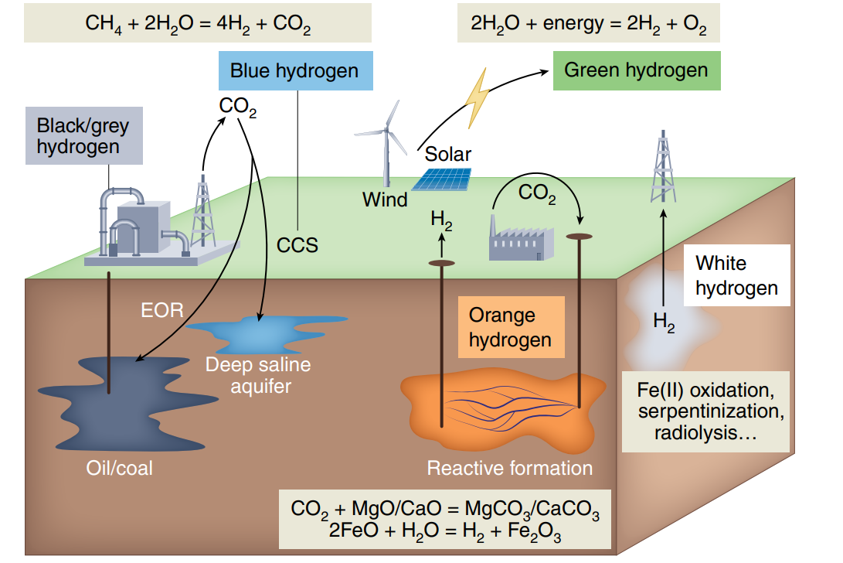
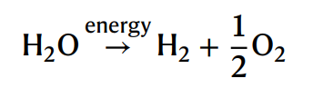
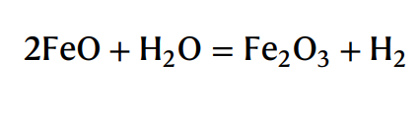
Solution: Pull H₂ from the Earth
F. Osselin et al, Orange hydrogen is the new green. Nature Geoscience, Vol. 15 (2022), pp. 765–769. https://doi.org/10.1038/s41561-022-01043-9
Notes:
Natural hydrogen commonly produced by the reduction of water to hydrogen following the anoxic and abiotic oxidation of ferrous iron to the orange-colored ferric iron
~~~~~~~~~~ Orange hydrogen ~~~~~~~~~
Difference between this and white hydrogen is the proactivity, searching
to stimulate the reaction between water and iron ores. This is done by
injecting water in situ in identified formations and collecting the
hydrogen-saturated water from wells. This approach can also be done for
iron-rich mine wastes
Example: Under ocean floor, magnesium silicate rocks with up to 10 wt %
of ferrous iron become hydrated at high temps (200-400 C) by
percolation of seawater
Example 2: Can happen at lower temps and pressure on land-based systems
Serpentinization is not the only process; it can occur anywhere
water meets reduced iron at the right temp, composition, & pressure

Slide 9
Benefits of Orange Hydrogen
The products (magnetite particles (Fe₃O₄)) used in the pharmaceutical industry
Can be created with seawater or even wastewater, making it cheaper
Also, rock formations hit with water for this may dissolve minerals that can then be extracted for further value
Very abundant: 400 Mt H₂ per year expected for NZE scenario, ore available for 100 trillion tons of H₂ (lasting us 250k years, without refreshing)
  Can get 0.1 to 3 Mt H₂ per km³*year
F. Klein, J. D. Tarnas, W. Bach, Abiotic Sources of Molecular Hydrogen on Earth. Elements, Vol. 16, pp. 19–24

Slide 10
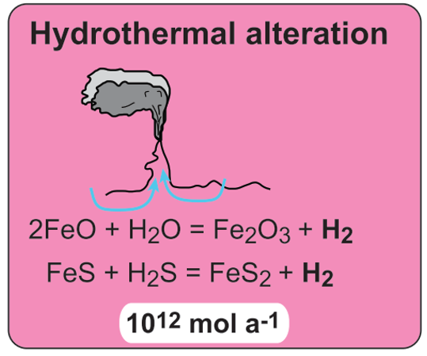

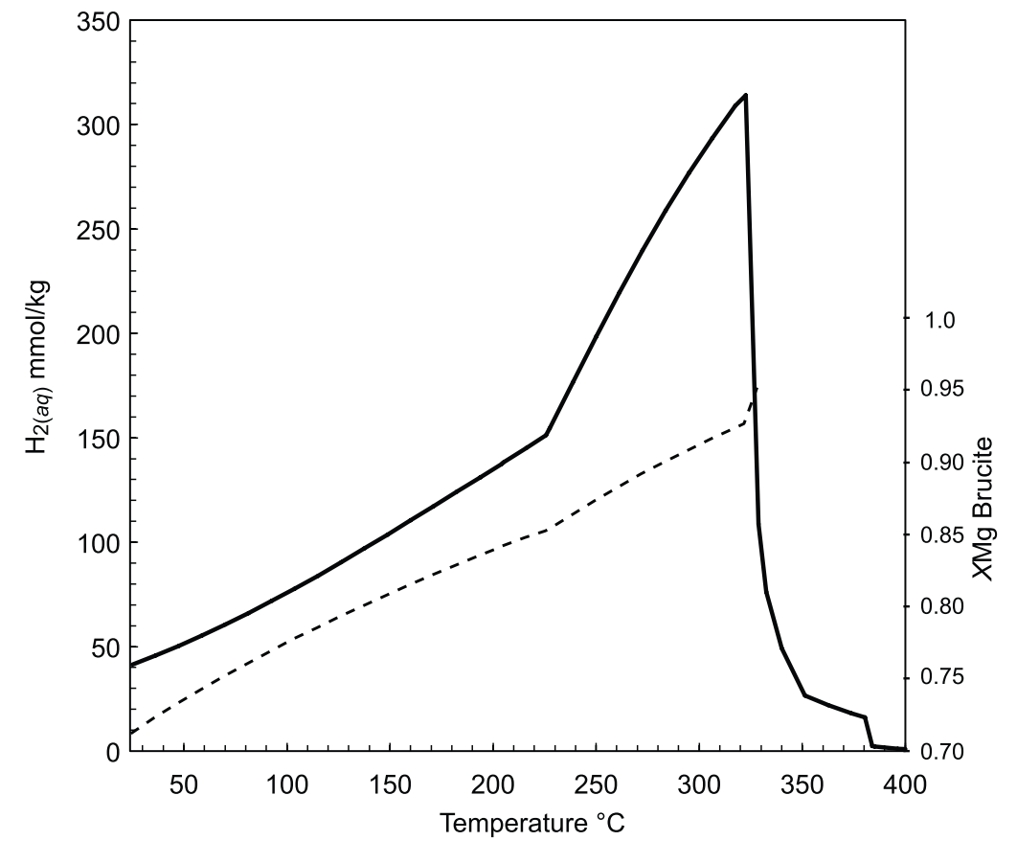

Hydrothermal H₂
Once free oxygen is consumed during percolation of water through rocks in the recharge zone
Then the oxidation of iron by oxygen-depleted water in the root zone of a hydrothermal system can generate H2 as follows:
As temperature decreases, the ferrous iron content of brucite increases, which limits the amount of H2 formation.
As temperature increases, get more olivine which limits amount of Fe(II) available for H₂ generatior
F. Klein, J. D. Tarnas, W. Bach, Abiotic Sources of Molecular Hydrogen on Earth. Elements, Vol. 16, pp. 19–24
Notes:
driven by gradients in temperature and pressure, seawater enters the oceanic basement, percolates deeper into the hot but cooling igneous rocks, increases its own temperature and then buoyantly rises back to the seafloor

Slide 11

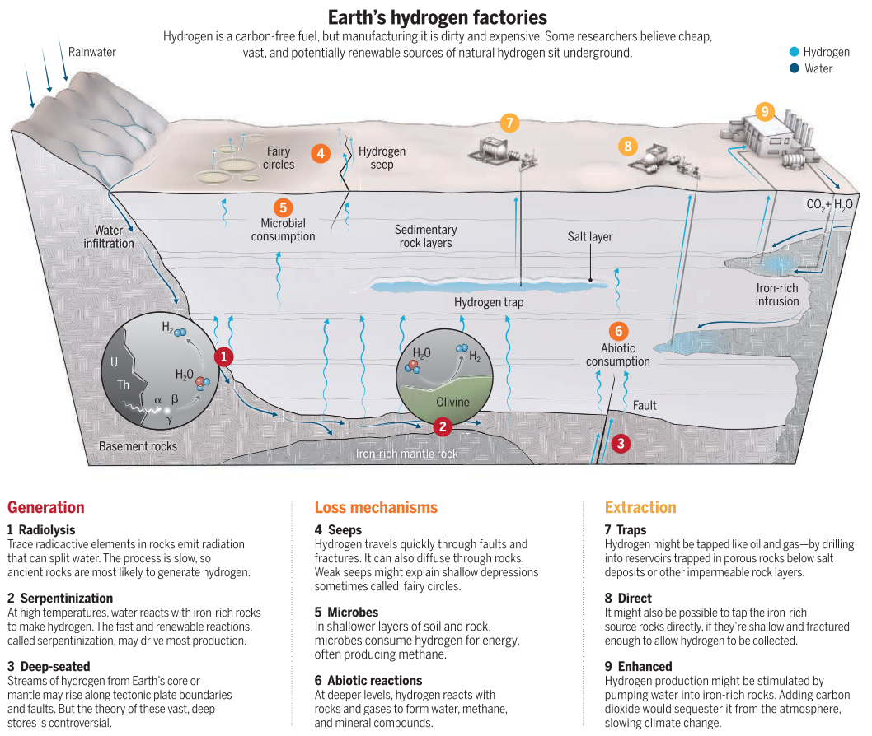
Eric Hand, Hidden Hydrogen. Science, 379 (6633), . DOI: 10.1126/science.adh1477

Slide 12

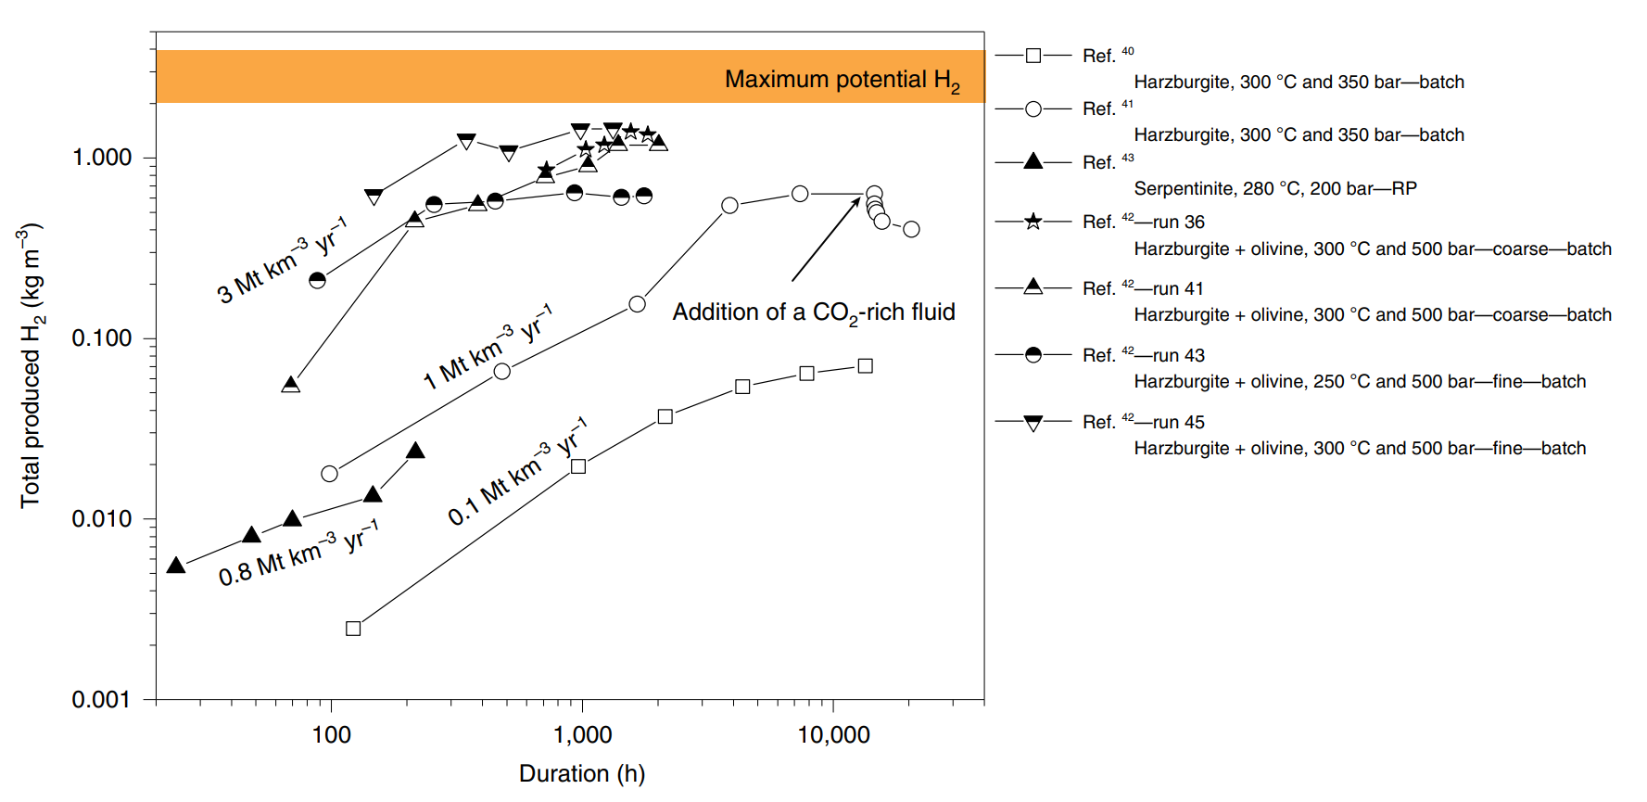
Hydrogen Production Rates
(causes precipitation & clogging)
Also can get complete carbonation in hours to days!
F. Osselin et al, Orange hydrogen is the new green. Nature Geoscience, Vol. 15 (2022), pp. 765–769. https://doi.org/10.1038/s41561-022-01043-9
Notes:
Measured hydrogen in both batch and reactive percolation experiments. In controlled conditions, the production of H2 close to the theoretical maximum. RP, reactive percolation
Lab experiments show magnesium silicates w/ CO₂ show mixture of NaHCO₃ and dissolved CO₂ can achieve complete carbonation after a few hours to a few days

Slide 13

Optimizing Rates
Carbonation rate direct function of CO₂ partial pressure, but rate of serpentinization either unaffected or slightly accelerated by CO₂ presence
  Might have to tailor concentration of CO₂ to optimize this possible tradeoff
carbonation & serpentinization strongly temp dependent
  maintaining high rate of H₂ prod and CO₂ mineralization requires careful control of downhole temperature
    luckily, very exothermic processes (get desired temp w/ self heating)
      reduces production costs, but requires careful control of injection rate
      supposedly, this heat can be extracted in geothermal-like process

Slide 14
Challenges for Orange H₂
1. Accurate description, quantification and mapping of the resource, considering iron grade of the rock formation and its technological & sociological accessibility
2. Identifying ideal pressure, temp, flow rate, fluid composition to produce H2 and carbon mineralization
  (what about energy needed to put CO2 into solution?)
  need to consider precipitation of minerals competing with carbonate precipitation, as well as influence of carbonate on oxidation of Fe
  Also need careful control of porosity to prevent clogging w/ precipitates
3. Field-scale optimization of injection and recovery
  I think we’ll be OK; let’s go Tulsa >:)

Slide 15
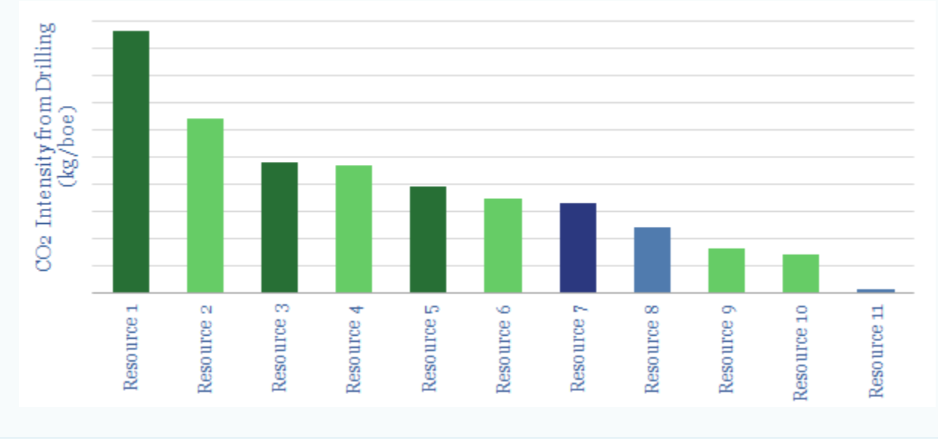
What about emissions from drilling?
Well drilling GHG intensity factor of 60.6 t CO₂ per well drilled in 2000
Compare to ~60-100 kg CO₂ / kWh for batteries
Assuming 120 MJ/kg H2, need ~18 kg H2 or ~600 kWh per well
F. Osselin et al, Orange hydrogen is the new green. Nature Geoscience, Vol. 15 (2022), pp. 765–769. https://doi.org/10.1038/s41561-022-01043-9
https://thundersaidenergy.com/downloads/co2-intensity-of-drilling-oil-wells/ Accessed Nov 30, 2023; I wouldn’t pay to get numbers; just figure
D. Tyner and M. Johnson, Emission Factors for Hydraulically Fractured Gas Wells Derived UsingWell- and Battery-level Reported Data for Alberta, Canada. Environ. Sci. Technol.2014, 48, 14772−14781. dx.doi.org/10.1021/es502815b reference for CO2 per well drilled
Report C 444 - Lithium-Ion Vehicle Battery Production – Status 2019 on Energy Use, CO2 Emissions, Use of Metals, Products Environmental Footprint, and Recycling reference for emissions per kWh of battery

Slide 16


Current Orange Hydrogen Projects
Nebraska, USA in 2019
Companies in South Africa
Company in Europe starting drilling in 2024
Eric Hand, Hidden Hydrogen. Science, 379 (6633), . DOI: 10.1126/science.adh1477

Slide 17
Summary
Hydrogen production currently very energy or emission intensive
Flooding iron ores with water may allow for massive amounts of low emission, low energy accessed hydrogen while sequestering carbon
Challenges include:
  Finding these sources of ores or hydrogen deposits
  Optimizing temperature, flow rate, and composition for orange hydrogen production
Current state: companies are actively pursuing this resource

Slide 18
Don’t Forget!
Hydrogen should not and will not take over all roles in the renewable energy transition
IEA (2021), Global Hydrogen Review 2021, IEA, Paris https://www.iea.org/reports/global-hydrogen-review-2021, License: CC BY 4.0

Slide 19
Supplemental

Slide 20
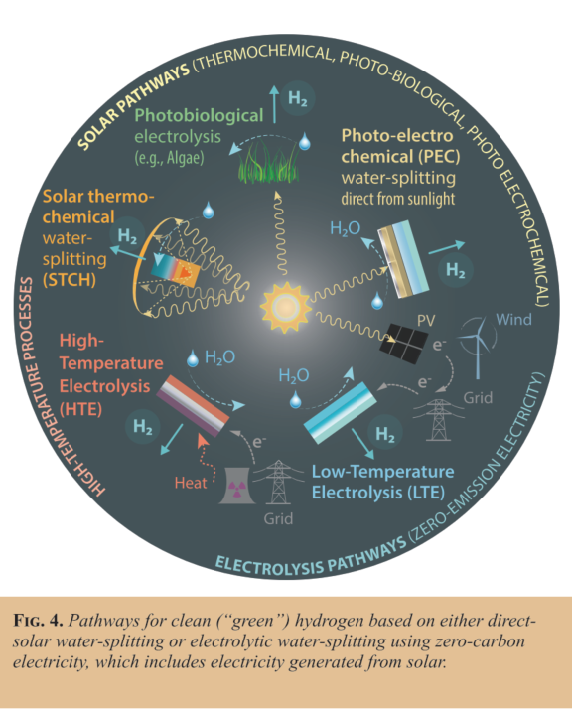
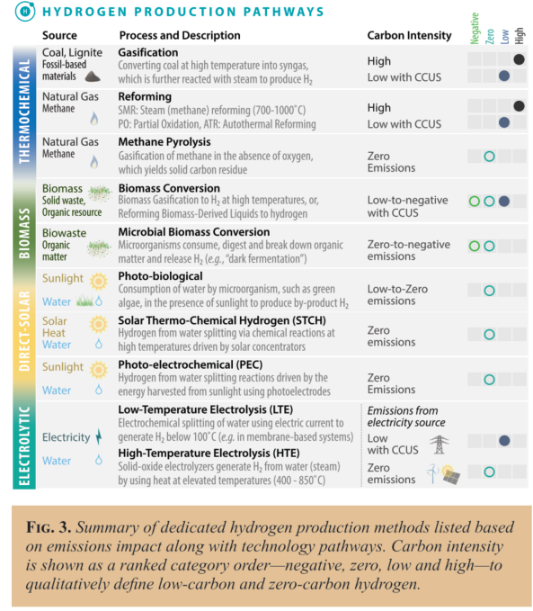
Ahmet Kusoglu 2021 Electrochem. Soc. Interface 30 44
Thanks, Tommy George, for the article!

Slide 21
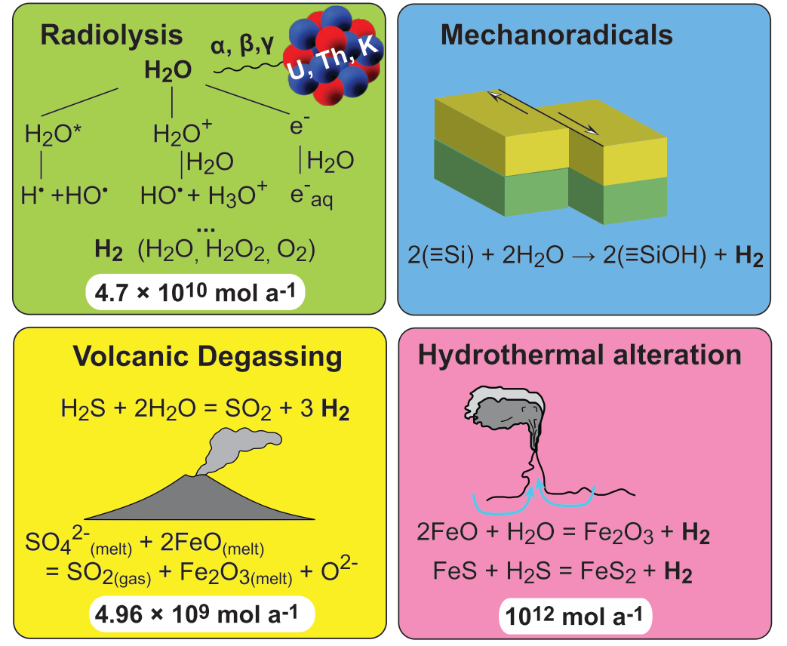
Abiotic sources of Hydrogen
F. Klein, J. D. Tarnas, W. Bach, Abiotic Sources of Molecular Hydrogen on Earth. Elements, Vol. 16, pp. 19–24
Notes:
Left numbers: Annual flux for each source

Slide 22
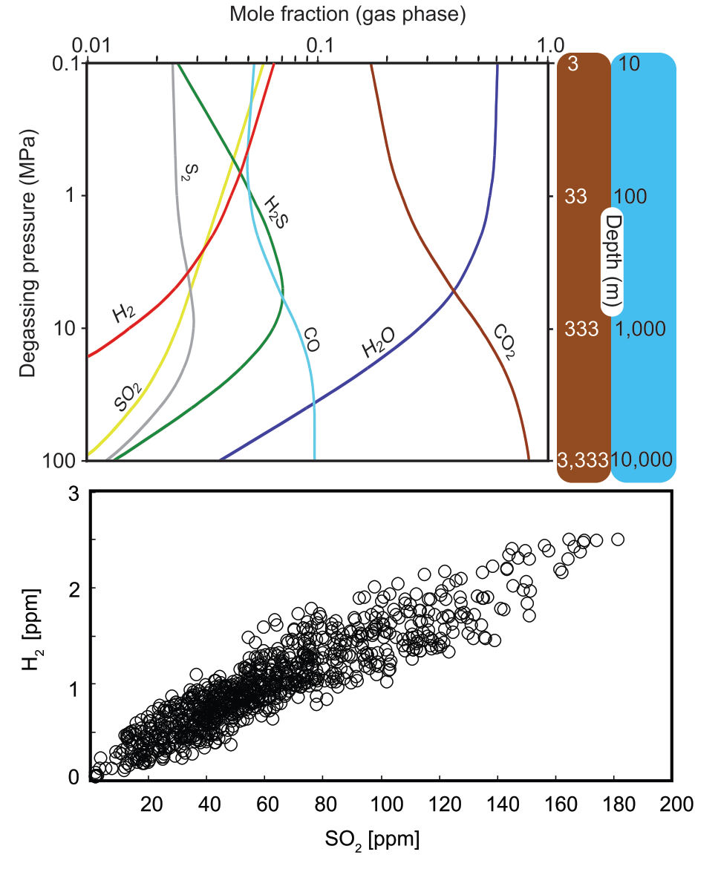
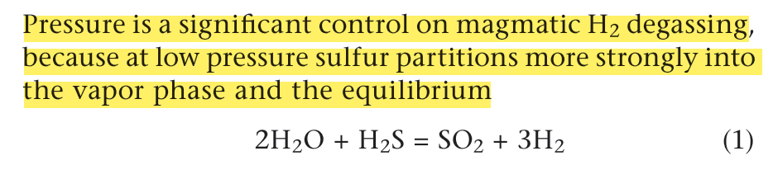
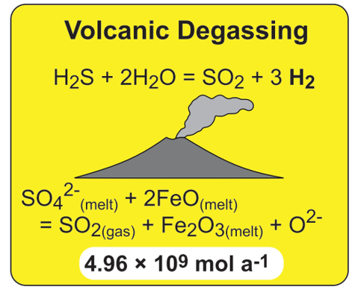
Volcanic degassing
and is shifted to the right
F. Klein, J. D. Tarnas, W. Bach, Abiotic Sources of Molecular Hydrogen on Earth. Elements, Vol. 16, pp. 19–24
Notes:
Right, top: calculated compositions of volatiles in degassing magma as a function of pressure. Degassing at
high pressure favors CO2, CO, H2O, H2S, and S2 (in order of decreasing abundance), whereas degassing at lower pressures favors H2O, CO2, H2, and SO2
Right, bottom: Graph of H2 (ppm) at Mt. Etna (Italy) showing linear correlation with SO2

Slide 23
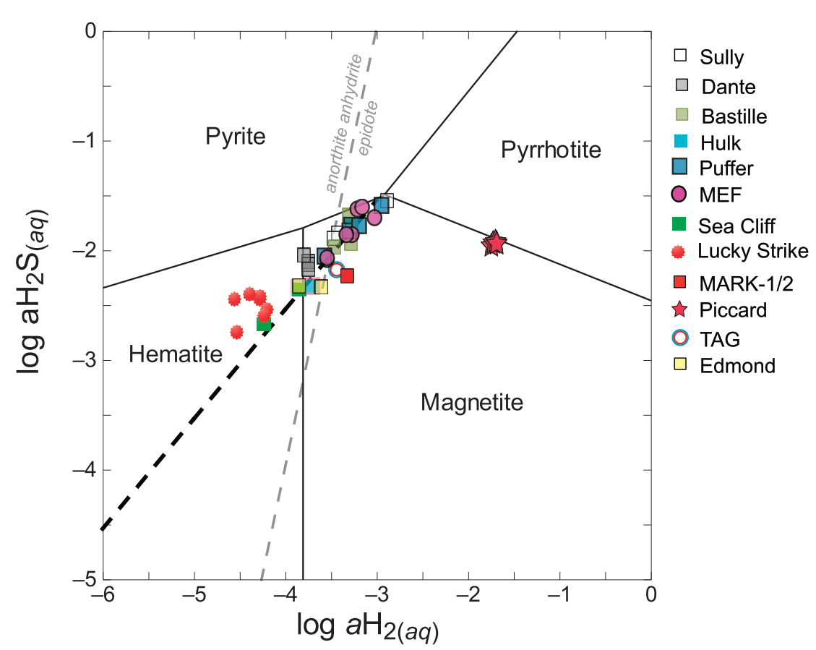
Hydrothermal H2:
Remarkable spread of H2 concentrations from Mafic rocks
Mafic rocks: where hydrothermal systems are hosted in ridge segments with robust magma supply
- Supply H2 concentrations of 0.05 to 1 mM

