Slide 1
The Role of Radiotracers in Climate Science
HEJC
November 17, 2023
Eric Fell

Slide 2
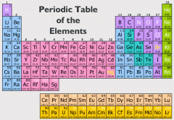
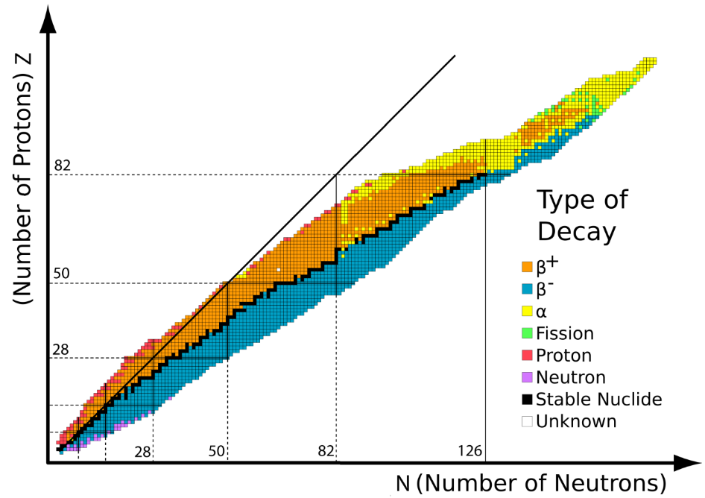
Fundamentals of nuclear reactions
All elements have isotopes, large range of stabilities
Radioactive decay occurs in unstable isotopes, resulting in spontaneous emission of particles and/or electromagnetic radiation
Repulsive force between protons must be balanced by a strong attractive force for nuclei stability

Slide 3
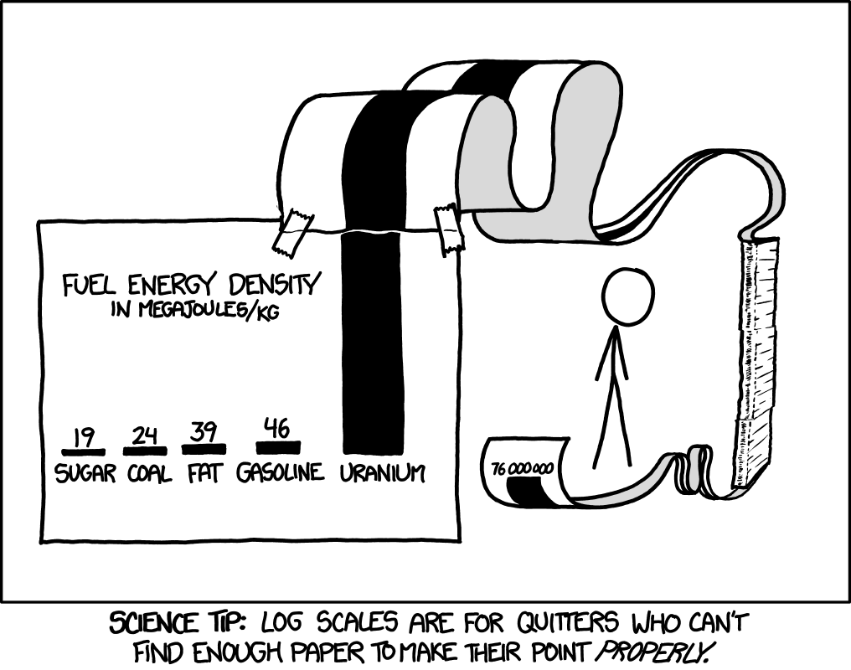

Mass-energy equivalence
$$E_{0}=mc^{2}$$
Energy of nuclear decay comes from mass conversion, on the energy scale of MeV (1.6⨯10⁻¹³ J) released for every nuclear reaction

Slide 4
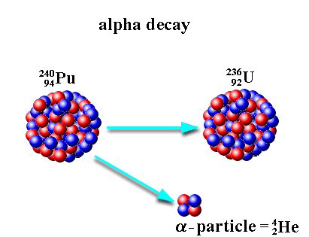
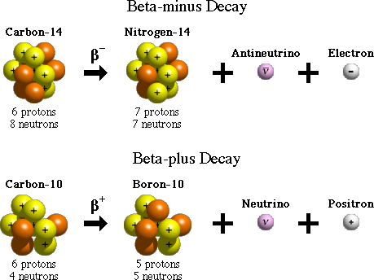
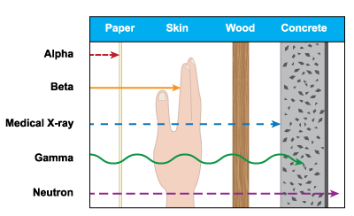
Types of nuclear decay
Other decay processes include
Gamma decay
Neutron emission
Electron capture
Internal conversion
Cluster decay / fission

Slide 5
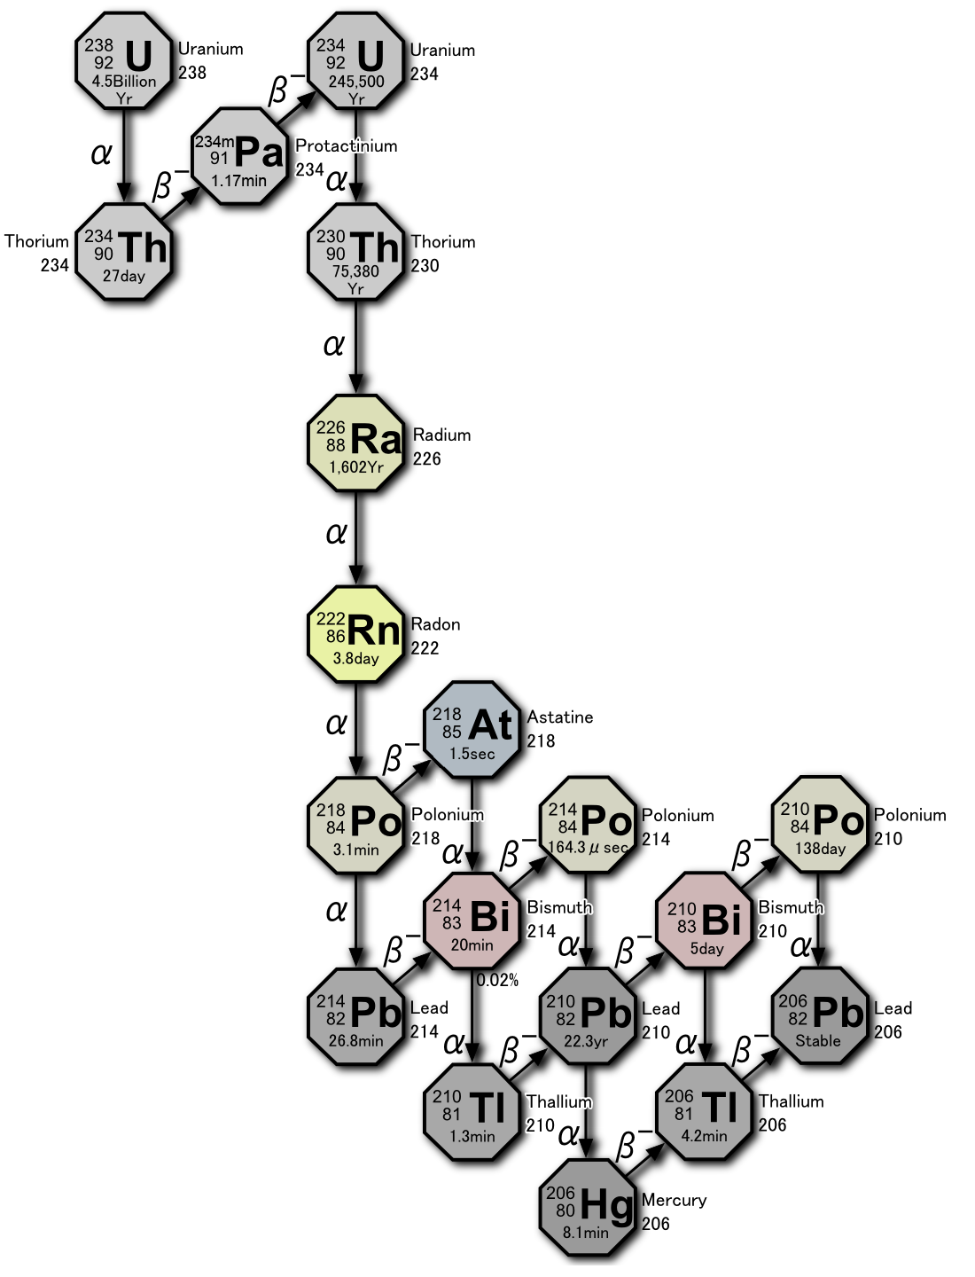
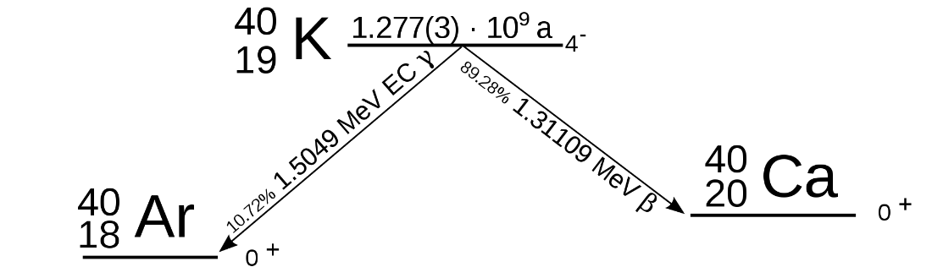
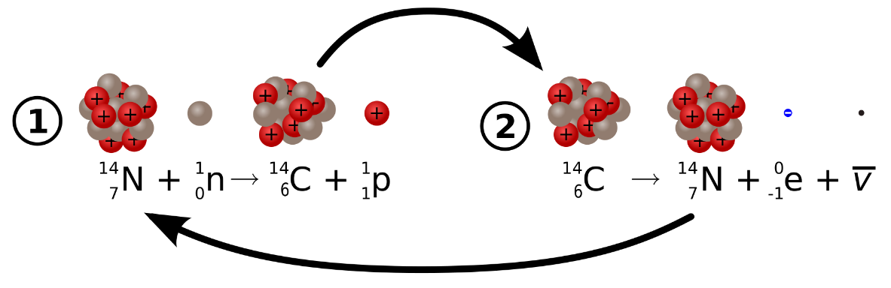
Natural radiation here on Earth
Uranium-238
Potassium-40
Largest source of radioactivity in humans
(4300 disintegrations per second)
Primordial nuclides
Carbon-14
t_{1/2} = 5730 years
https://en.wikipedia.org/wiki/Decay_chain

Slide 6
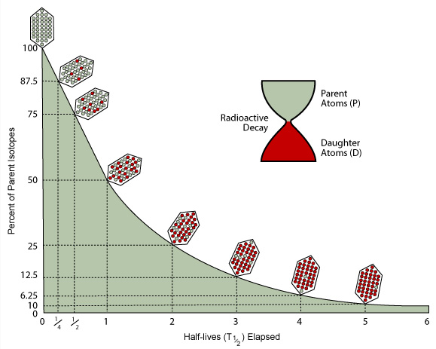
Radiometric dating
Radioactive nuclides have constant half-lives, not affected by temperature, pressure, magnetic/electric fields
Proportion of original nuclide:decay products changes in predictable way
Relative abundances of product nuclides can be used as a clock to determine when original nuclide was incorporated in a material
Age calculation makes use of first order differential equations

Slide 7
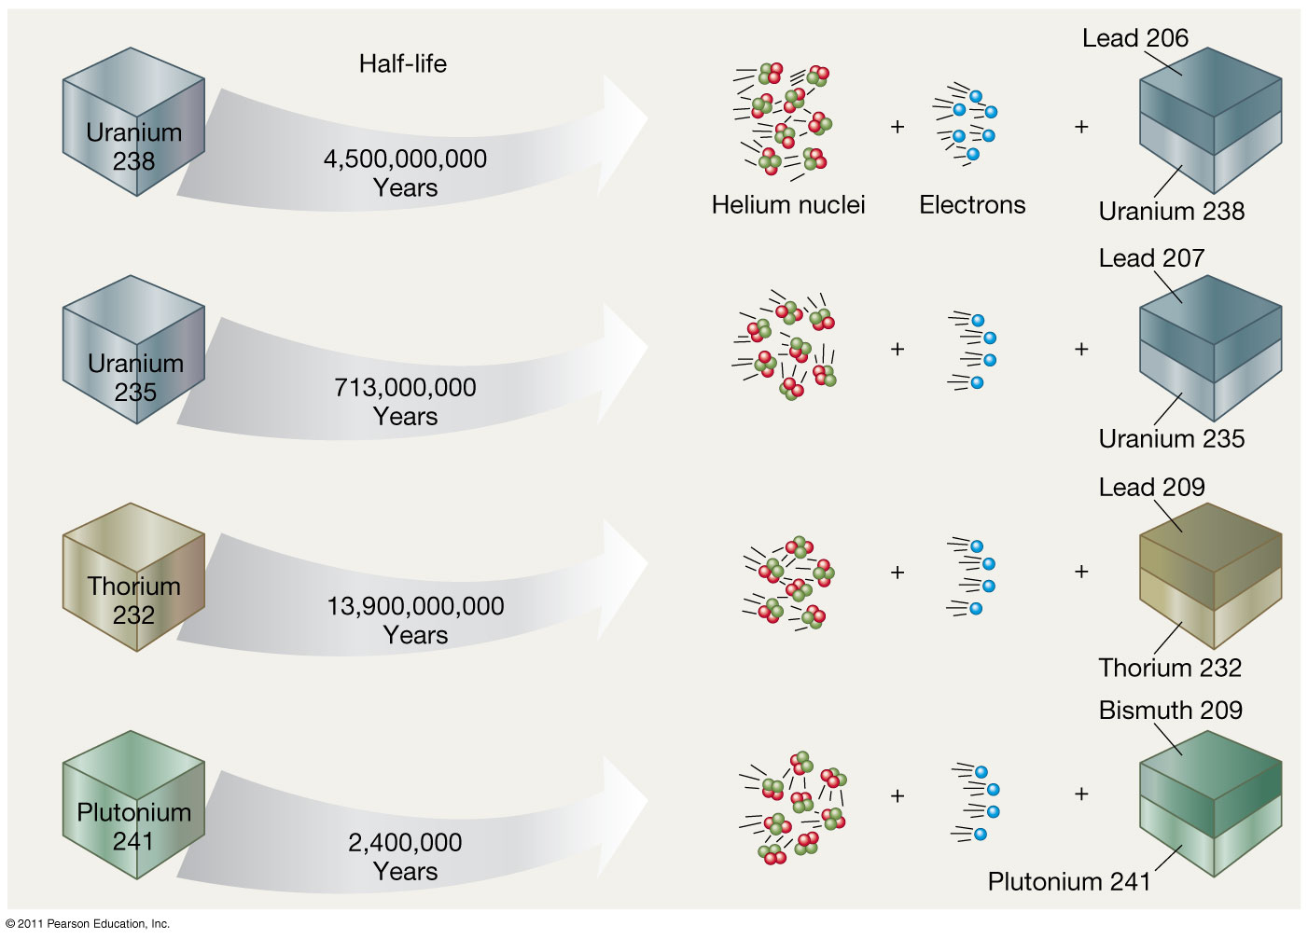
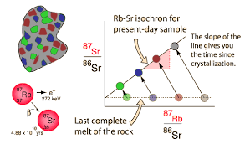
Radioisotopes for geologic timescales
Isochron dating can be used to date crystallization, metamorphism, shock events, and differentiation of precursor melts, in the history of rocks.

Slide 8
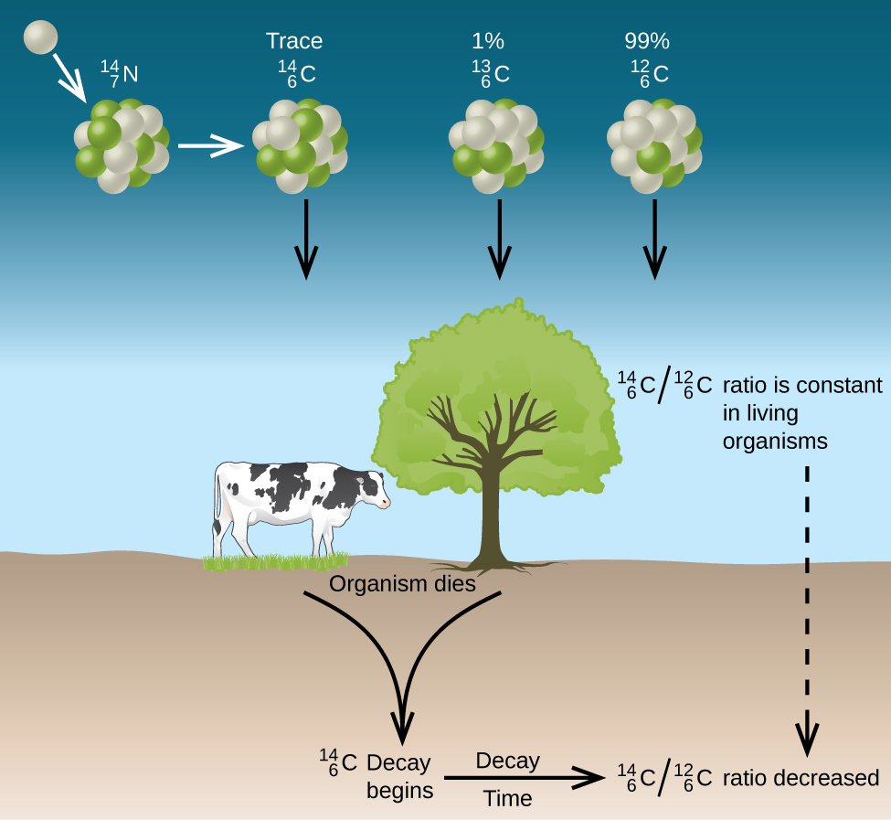
Carbon-14 dating
In the atmosphere, ¹⁴C is incorporated in ¹⁴CO₂→takes part in the global carbon cycle.
¹⁴CO₂ taken up by plants, level of ¹⁴C in plants ≈ level of ¹⁴C in atmosphere
Plants (and animals that eat them) die, no more uptake of ¹⁴C → only decrease of ¹⁴C over time due to radioactive decay
Proportion of ¹⁴C left when sample is examined gives the time elapsed since death
¹⁴C continuously created via collisions of neutrons generated by cosmic rays with nitrogen in upper atmosphere
→ near-constant ¹⁴C level on Earth (~75 tons)
Due to half life (5730 years),
dating limit is ~50-60k years

Slide 9
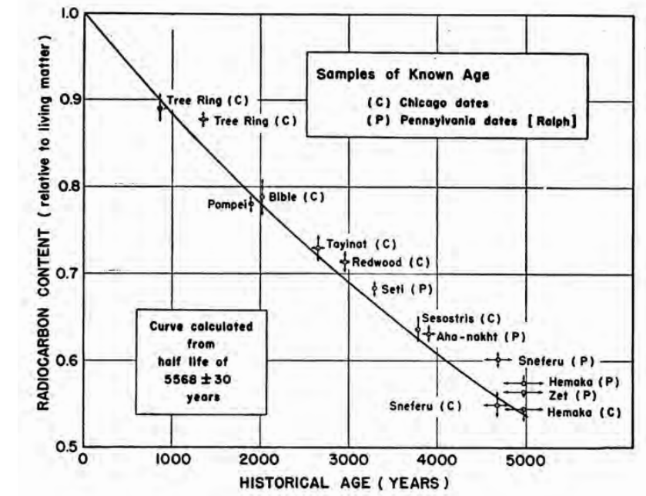
Carbon-14 dating
“Curve of Knowns”
1960 Nobel Prize in Chemistry:
Willard Libby
for his method to use carbon-14 for age determination in archaeology, geology, geophysics, and other branches of science
W.F. Libby, E.C. Anderson, J.R. Arnold, Science, 109, 227, 1949

Slide 10
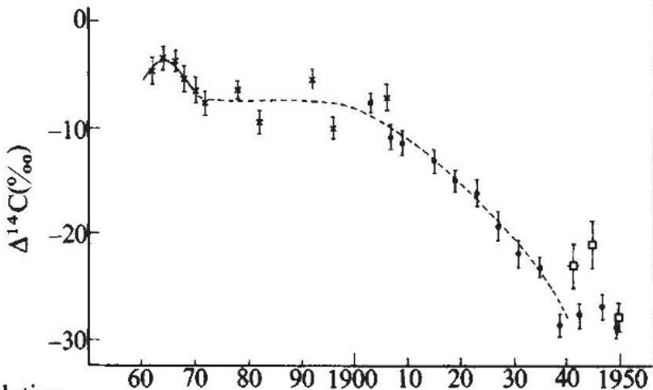
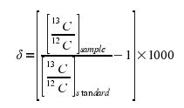
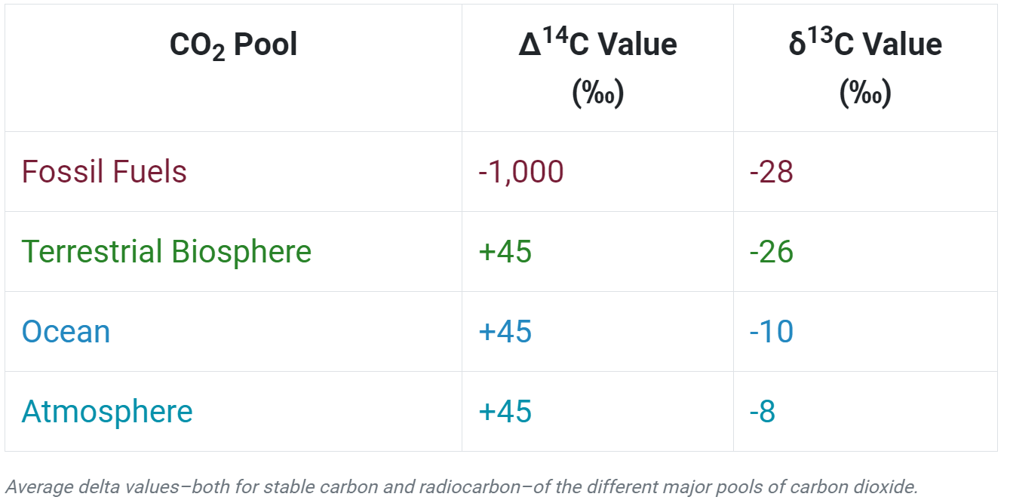
Suess effect complicates Carbon-14 measurement
Dilution of atmospheric ¹⁴CO₂ by fossil fuel derived CO₂ which doesn’t contain ¹⁴C
¹⁴C measured in tree rings
Δ¹⁴C can differentiate between CO₂ increase due to fossil fuels vs forest fires
https://gml.noaa.gov/ccgg/
P.P. Tans, A.F.M. De Jong, W.G. Mook, Nature, 280, 826, 1979

Slide 11
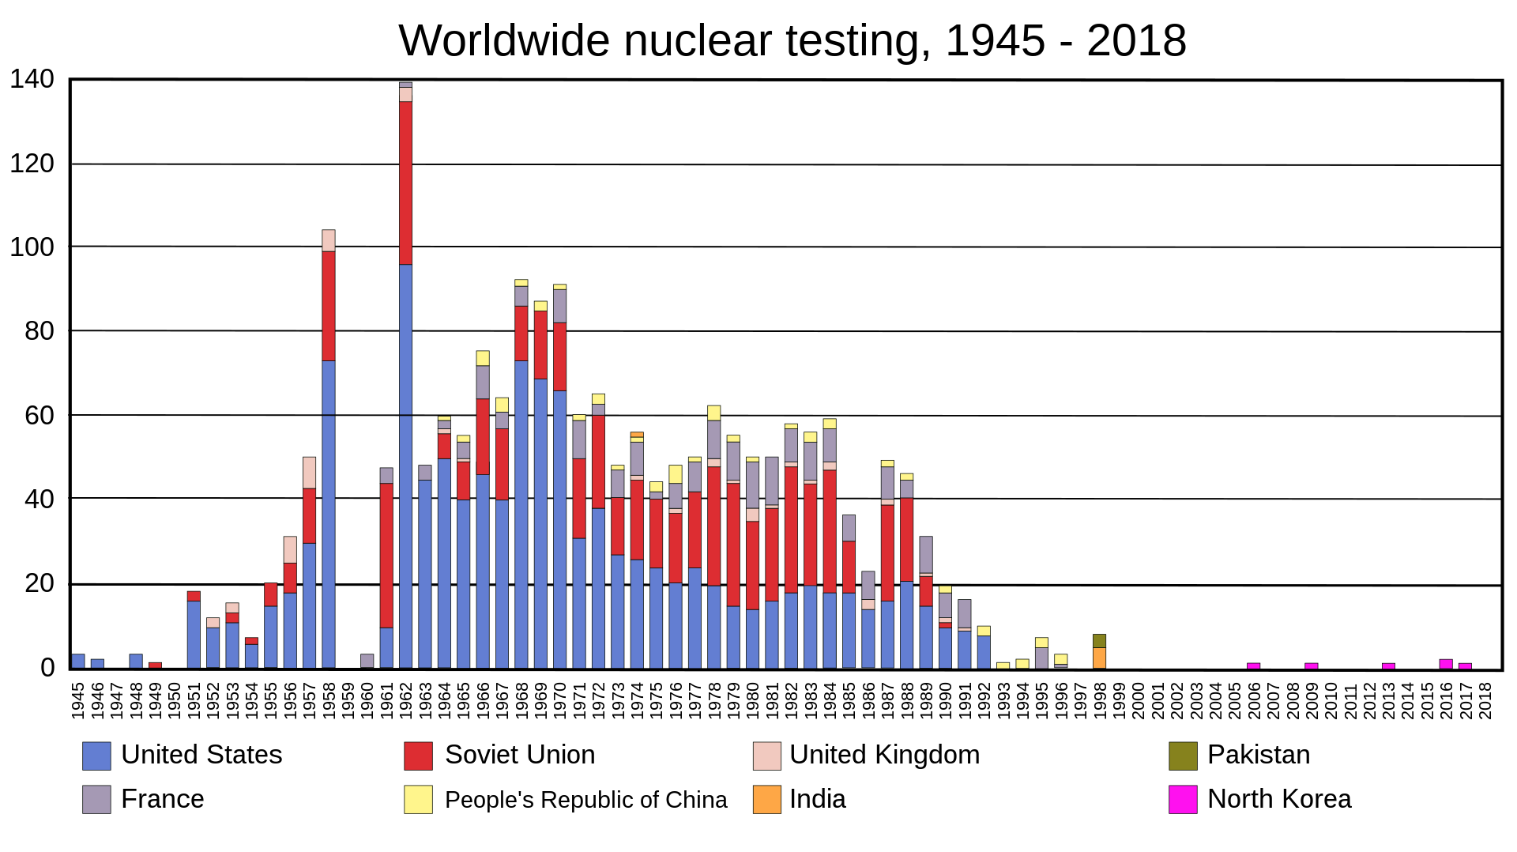
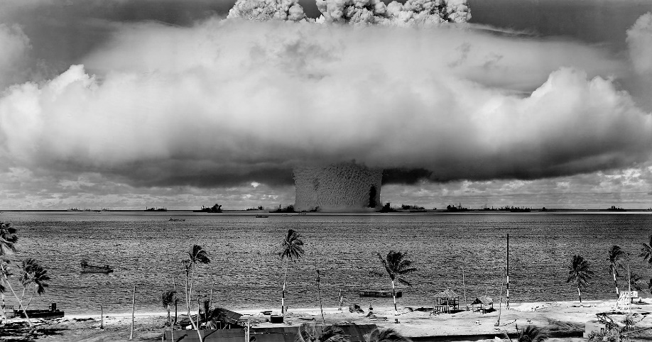
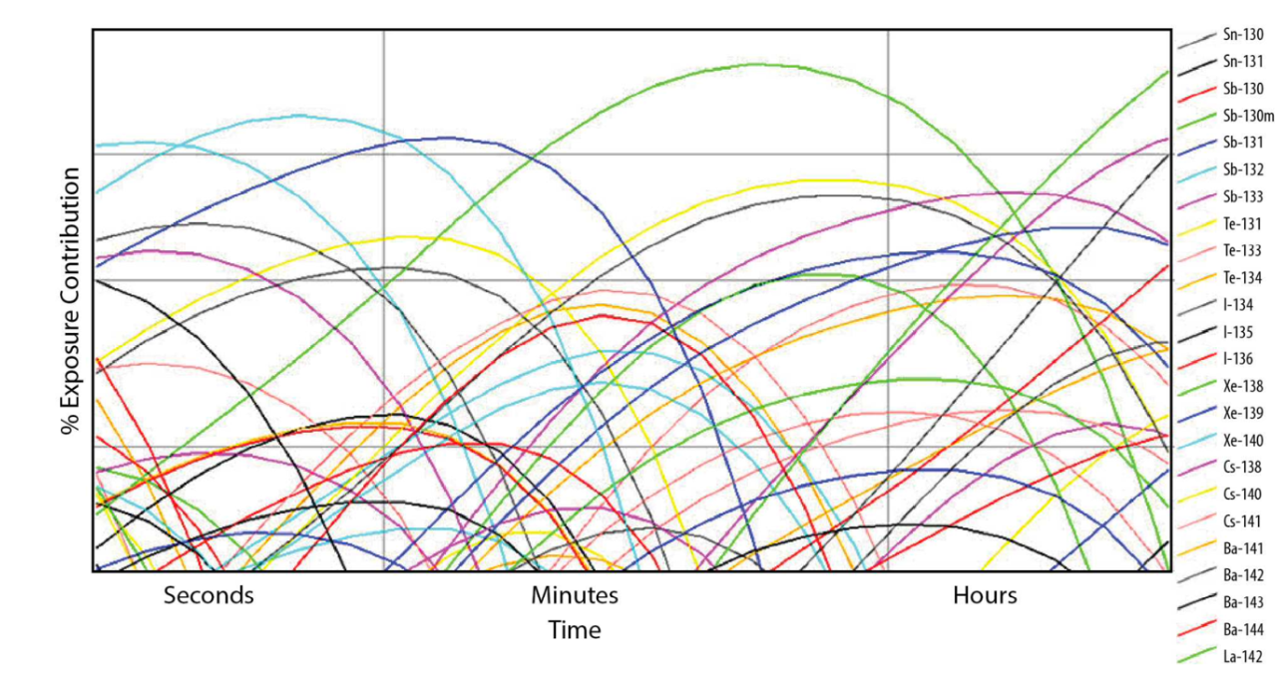
Nuclear weapons testing
First nuclear bomb, Trinity test. New Mexico, July 1945
1952, first thermonuclear bomb test (US)
1945-1963 almost 500 nuclear bomb tests worldwide
1963 US-UK-USSR sign Partial Test Ban Treaty, only allows underground tests
Nuclear fallout includes radioactive fission products and material in earth/water that becomes radioactive
→still detected at old nuclear test sites

Slide 12
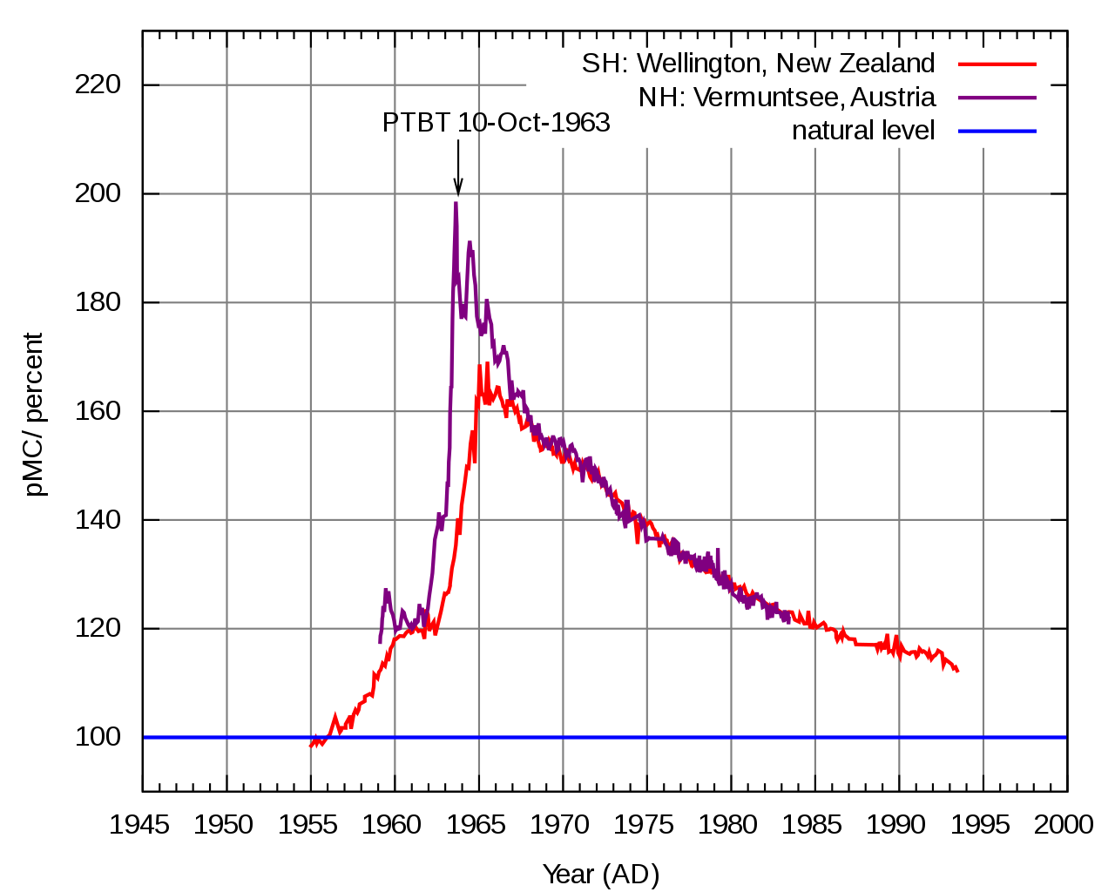
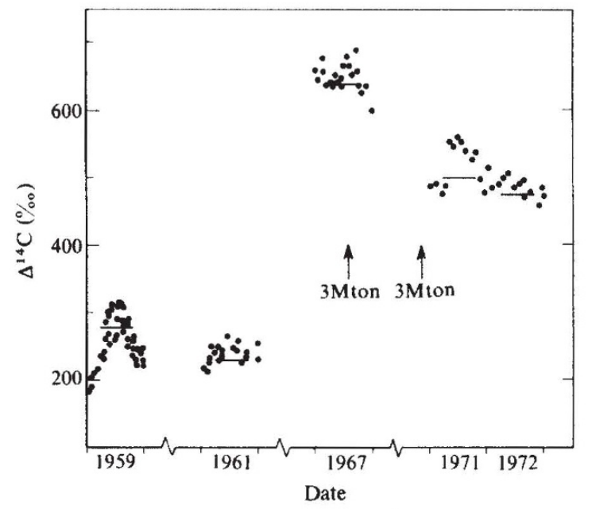
Carbon-14 “Bomb Pulse”
Nuclear testing caused rapid increase in atmospheric ¹⁴C due to neutrons from explosions colliding with ¹⁴N
Chinese thermonuclear explosions
Bomb tests also irradiated seawater forming large amounts of ³⁶Cl (T_{1/2}= 301,000 y).
³⁶Cl has atmospheric residence time ~ 2 y so can be used to indicate 1950s water in soil and ground water. Also used for geologic dating of ice and sediments.
P.P. Tans, A.F.M. De Jong, W.G. Mook, Nature, 280, 826, 1979
Notes:
pMC=percent modern carbon

Slide 13
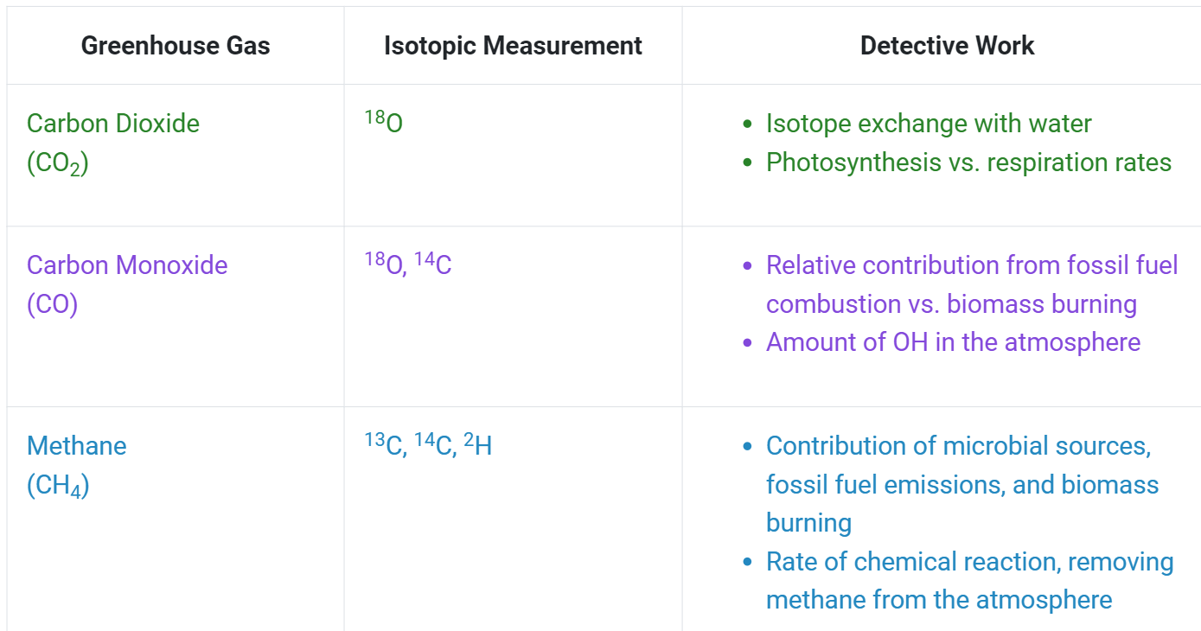
Other radiotracers used in climate research
to study air masses, vertical exchange transport, convective activity in the troposphere
⁷Be (T_{1/2}= 53 d) formed by cosmic rays hitting N, O, in stratosphere/upper troposphere
²¹⁰Pb (T_{1/2}= 22 y) formed by radioactive decay of ²²²Rn gas from Earth’s crust
(not all are radiotracers)
https://gml.noaa.gov/ccgg/isotopes/

Slide 14
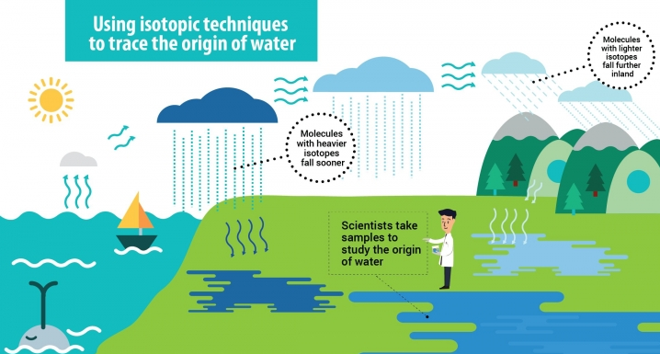
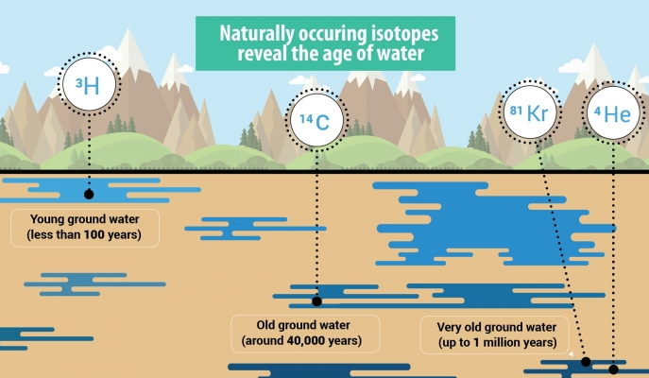



Isotope hydrology
$${}_{36}^{81}{Kr\overset{→}{229,000 yrs}{}_{35}^{81}{Br+υ_{e}}}$$
$${}_{1}^{3}{H\overset{→}{12.3 yrs}{}_{ 2}^{3}{He+e^{−}+\overline{υ_{e}}}}$$
$${}_{6}^{14}{C\overset{→}{5730 yrs}{}_{7}^{14}{N+e^{−}+\overline{υ_{e}}}}$$
https://www.iaea.org/newscenter/news/world-water-day-2018-nature-for-water
Notes:
Kr-81 formed by spallation rxns via cosmic rays

Slide 15
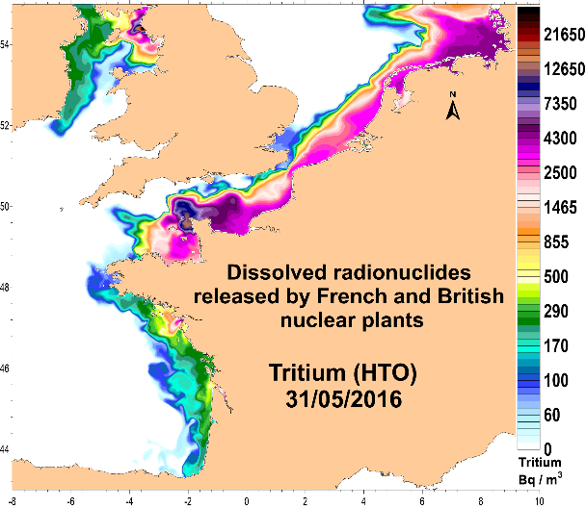
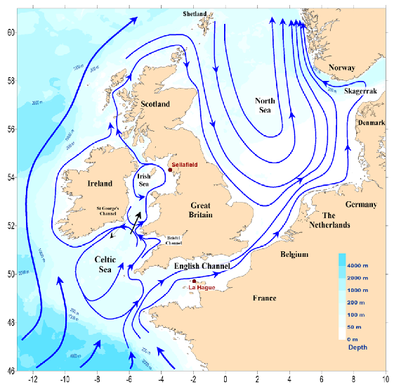
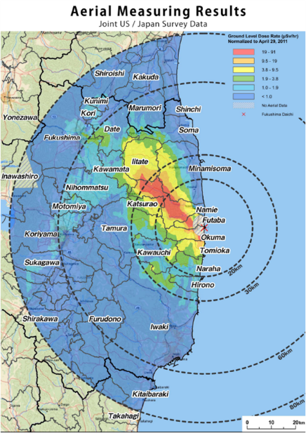
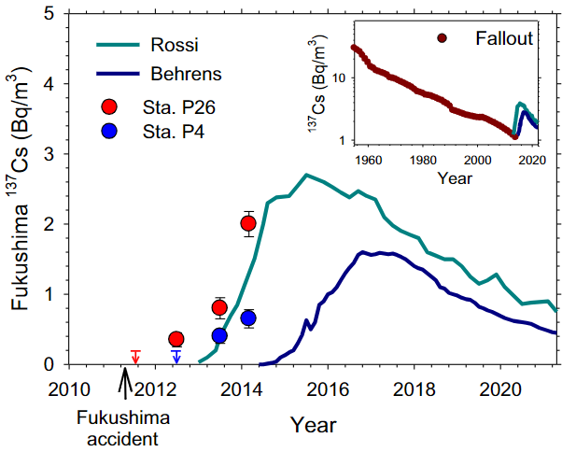
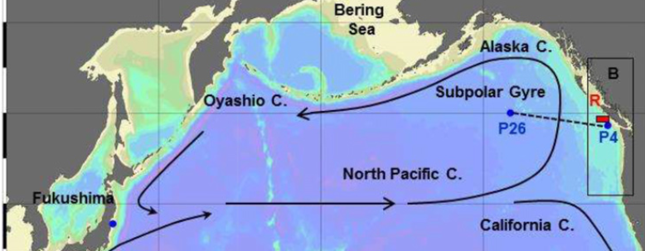
Controlled & accidental radionuclide ocean releases
Controlled releases from British & French nuclear fuel reprocessing plants
Understanding of circulation pathways and water masses transit times
P.B. du Bois et al, Water, 12, 1667, 2020
Accidental releases from Fukushima 2011 nuclear accident
Radionuclides in ocean water took ~2 y to cross the Pacific
J.N. Smith et al, PNAS, 112, 1310, 2015

Slide 16
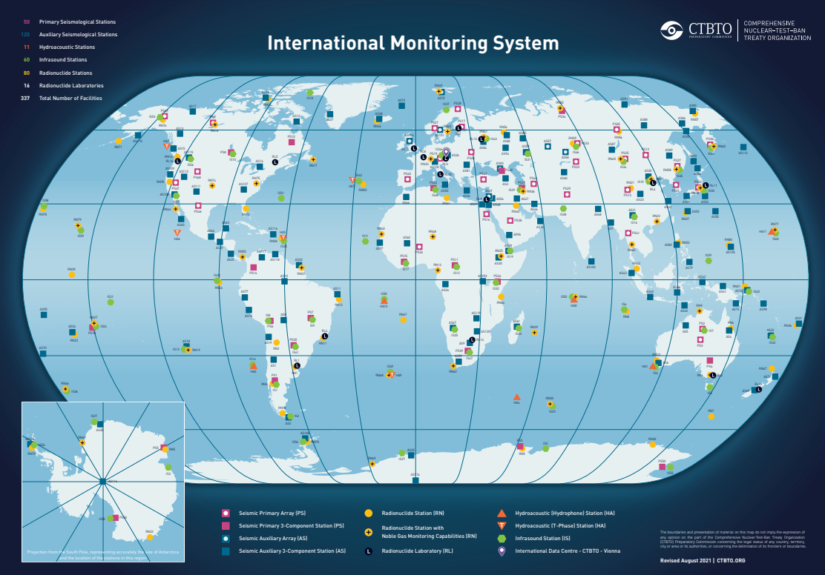
International Monitoring System
80 radionuclide stations for air-sample detection of radioactive particles
Comprehensive Nuclear-Test-Ban Treaty Organization will be tasked with verifying ban on nuclear tests, operate global monitoring systems, on-site inspections

Slide 17
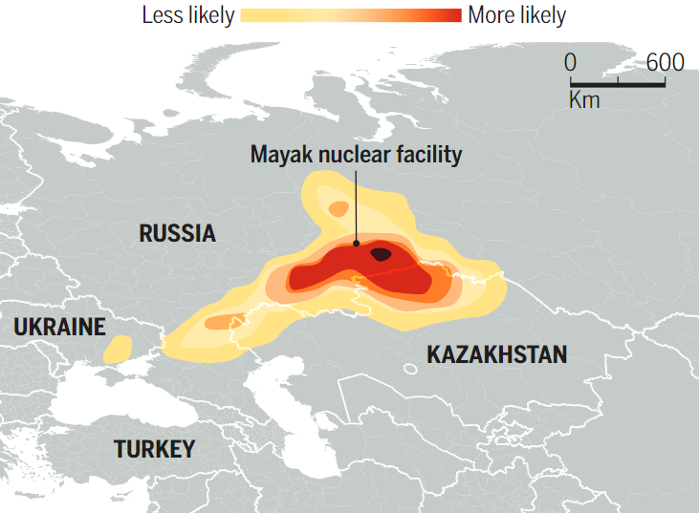
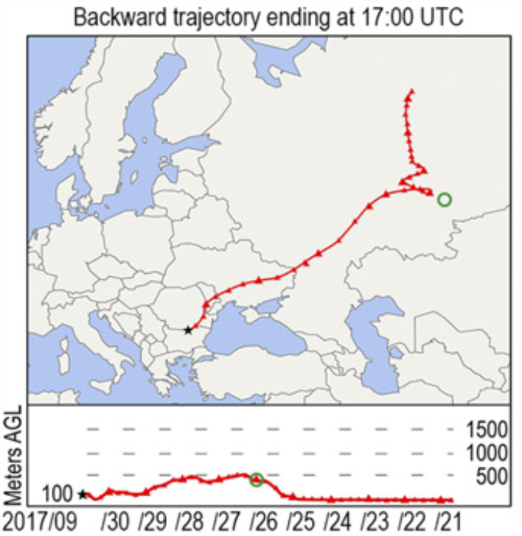
Radio-forensics: Recent atmospheric detections
October 2017, European countries detect atmospheric, high-purity radioactive ^{103,106}Ru
Lack of other detected fission products ruled out accidental release from a nuclear reactor
^{103,106}Ru is typically associated with nuclear fuel reprocessing or medical radioactive sources
Radio-forensics suggests release site was the Mayak nuclear complex in the Southern Urals
Mayak was producing ¹⁴⁴Ce source for neutrino experiment in the Gran Sasso National Lab (Italy).
¹⁰⁶Ru release would be linked to production of ¹⁴⁴Ce
2 months later, Mayak canceled the contract…
¯\_(ツ)_/¯
E. Cartlidge, Science, 359, 729, 2018
O. Masson et al., PNAS, 116, 16750, 2019
Notes:
1-4 g Ru released.
uncontrolled temperature rise during the separation of cerium from the spent fuel at Mayak might have converted some of the ruthenium in the waste to gaseous ruthenium oxide. That gas would have escaped through the facility’s filters and solidified in the cool outside air, turning into small solid oxide particles

Slide 18
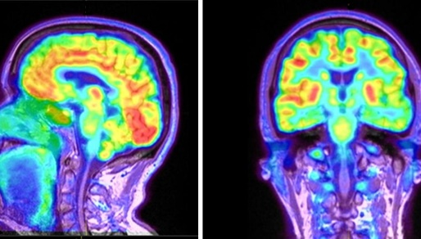
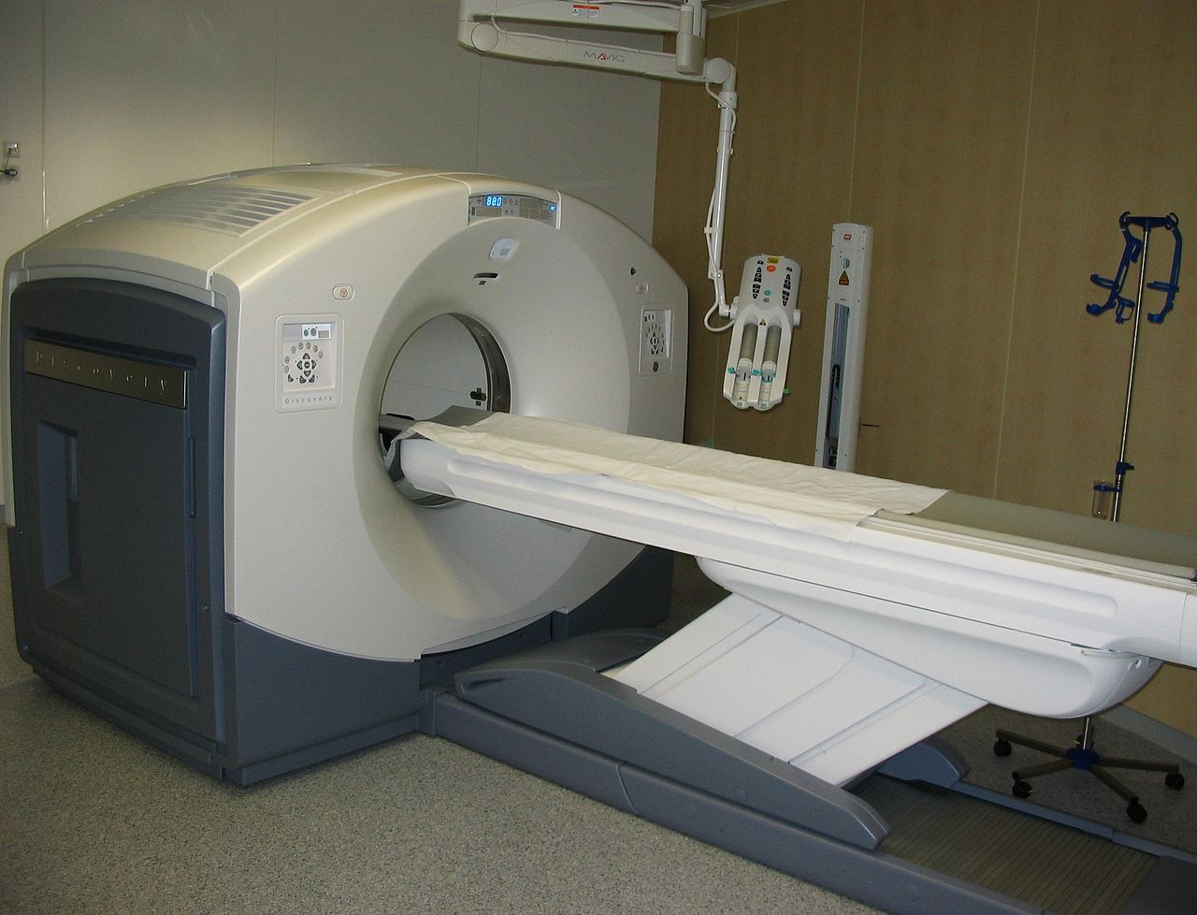
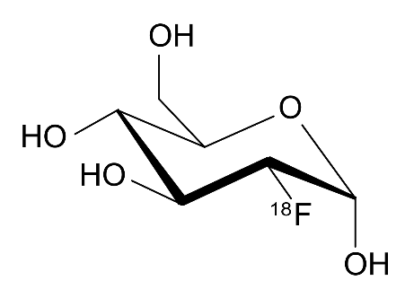
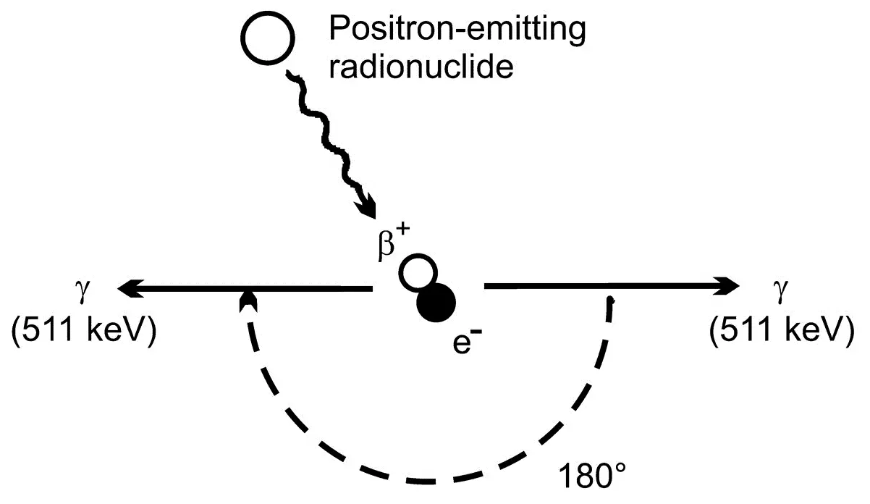


Positron emission tomography (PET scan)
(not climate science)
Uses radiotracers injected into body for medical imaging
¹⁸F-FDG for cancer detection
Na¹⁸F for bone formation
¹⁵O for blood flow
Fluorodeoxyglucose
$${}_{9}^{18}{F\overset{→}{110 min}{}_{8}^{18}{O+e^{+}+υ_{e}}}$$
$${}_{8}^{15}{O\overset{→}{2 min}{}_{7}^{15}{N+e^{+}+υ_{e}}}$$
~
Notes:
F-18 usually made via proton bombardment of O-18 in a cyclotron. Positrons interact with electrons, annihilate and two gammas emitted in opposite directions

Slide 19
More references
Choppin, Liljenzin, Rydberg, Ekberg, Radiochemistry and Nuclear Chemistry
Rolfs, Rodney, Cauldrons in the Cosmos
Chart of Nuclides
World Nuclear Association
IEA nuclear
EIA nuclear
REMM
Lingering radioactivity from bomb test sites

Slide 20
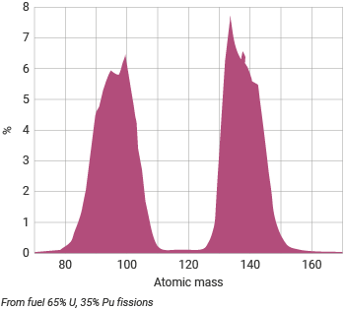
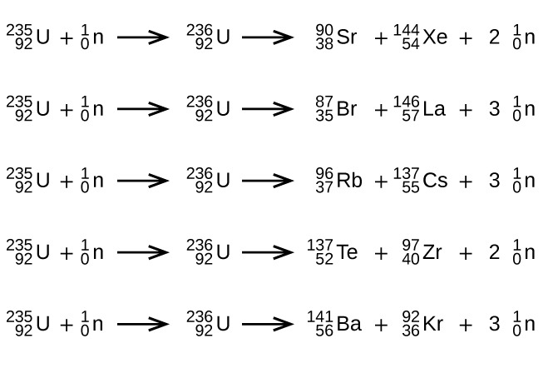
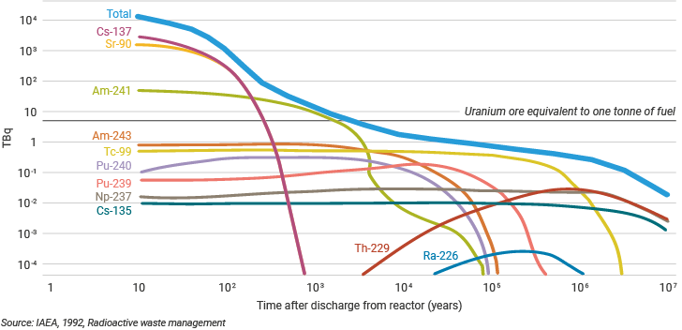
Nuclear reactor fission waste
Distribution of fission products
Possible fissions
Activity of high-level waste from one tonne of used fuel
https://www.world-nuclear.org/information-library/nuclear-fuel-cycle/introduction/physics-of-nuclear-energy.aspx

