Slide 1

Electrochemical
Wastewater
Refining
TYG HEJC
10/27/23

Slide 2
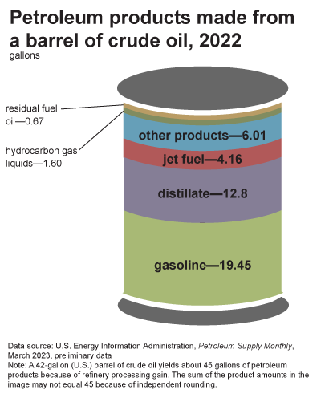
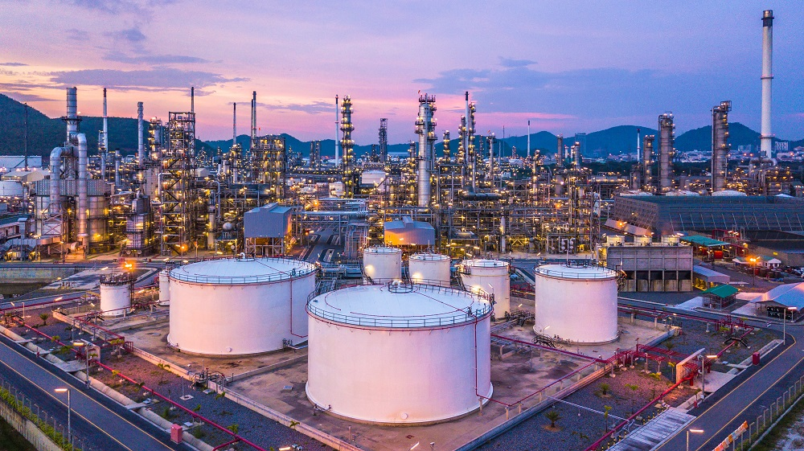
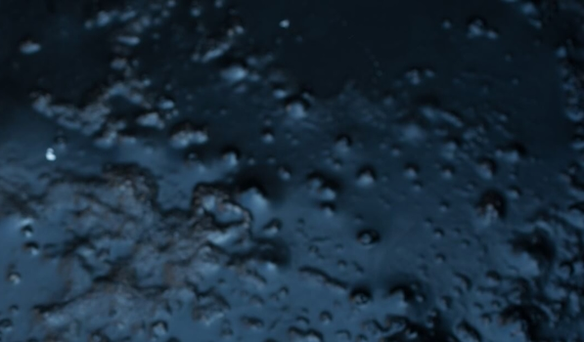
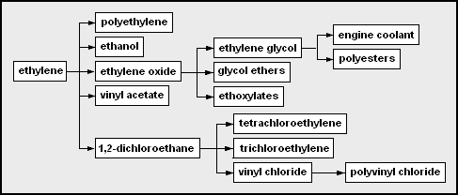
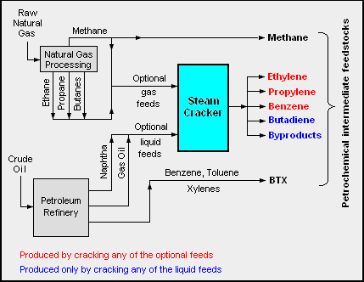
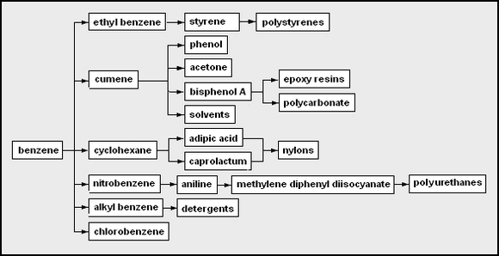
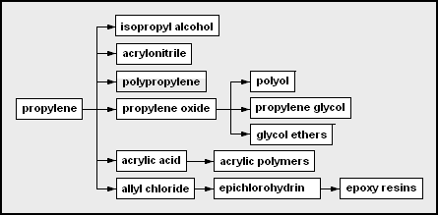
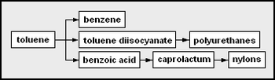
“Refining” usually means oil
https://en.wikipedia.org/wiki/Petrochemical
Notes:
Distillate is deisel and fuel oil
Centralized and LINEAR: extract, react, emit

Slide 3
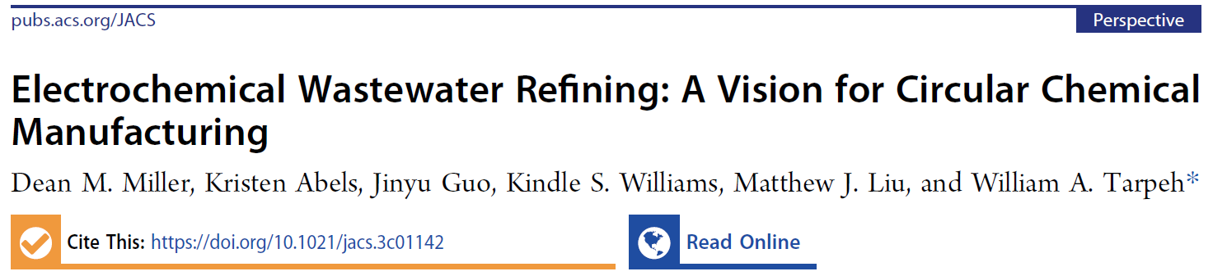

Electrochemical
wastewater refining:
Start with contaminated water,
remove the contaminants for
some use, and recover clean water!
HEJC alum!
J. Am. Chem. Soc. 2023, 145, 36, 19422–19439

Slide 4
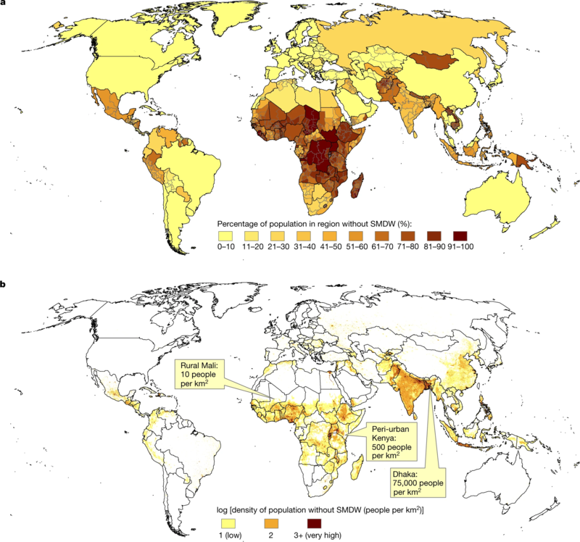
Safely
Managed
Drinking
Water:
“Located on premises, available when needed, free of contamination”
Note SMDW scarcity
in low population
density areas
https://en.wikipedia.org/wiki/Drinking_water

Slide 5
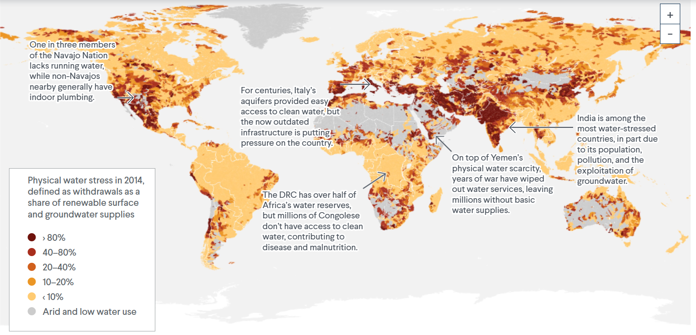
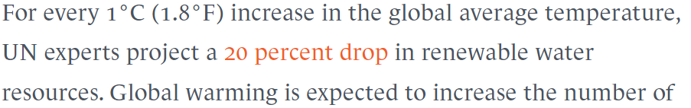
https://www.cfr.org/backgrounder/water-stress-global-problem-thats-getting-worse

Slide 6
Wastewater facts
2.2 x 10¹⁵ L wastewater discharged annually
(54 % of the volume of freshwater withdrawn)
100 moles wastewater emitted per mole CO₂ emitted
80 % of wastewater not adequately treated before discharge ☹
J. Am. Chem. Soc. 2023, 145, 36, 19422–19439

Slide 7
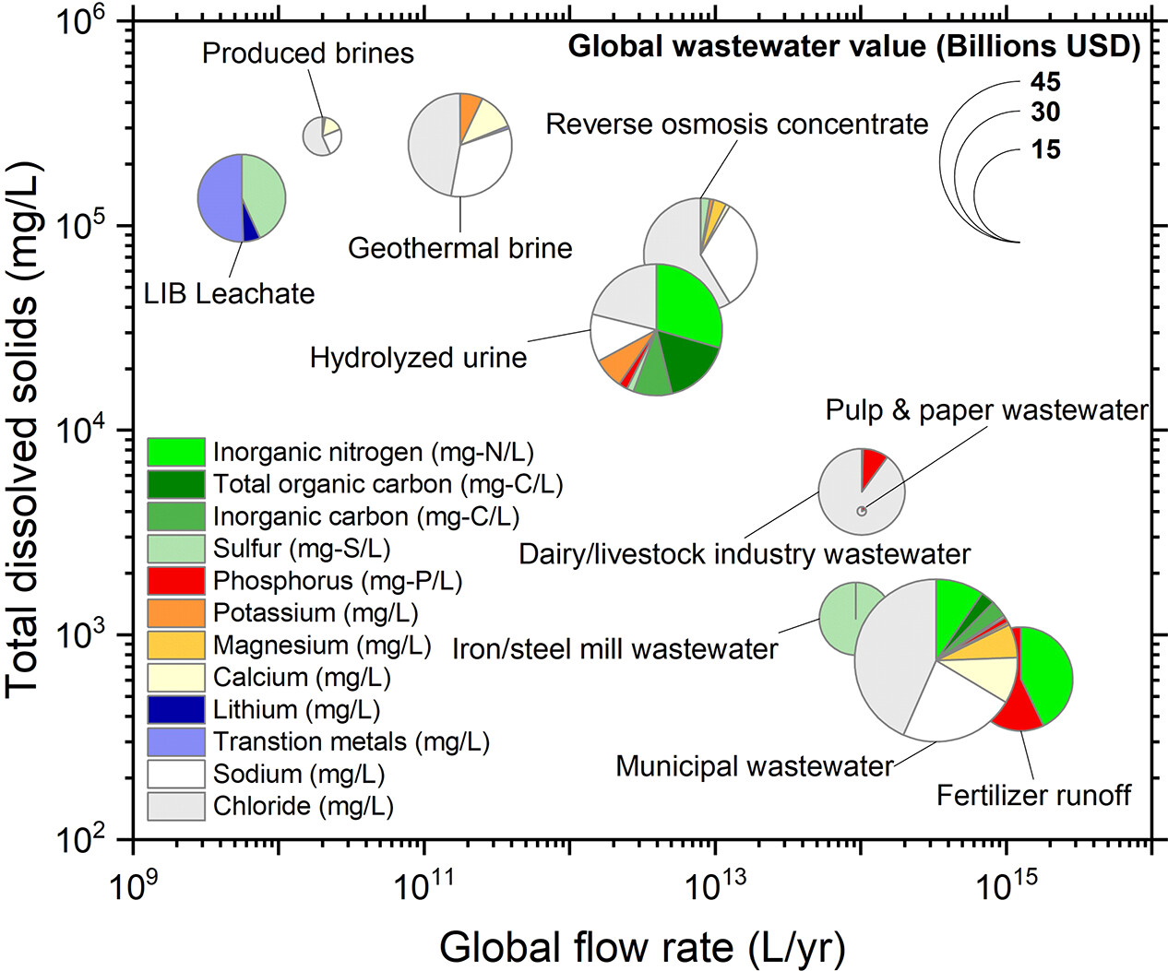
What’s in wastewater?
J. Am. Chem. Soc. 2023, 145, 36, 19422–19439
Notes:
TDS varies by orders of magnitude
about the same N in urine and fertilizer

Slide 8
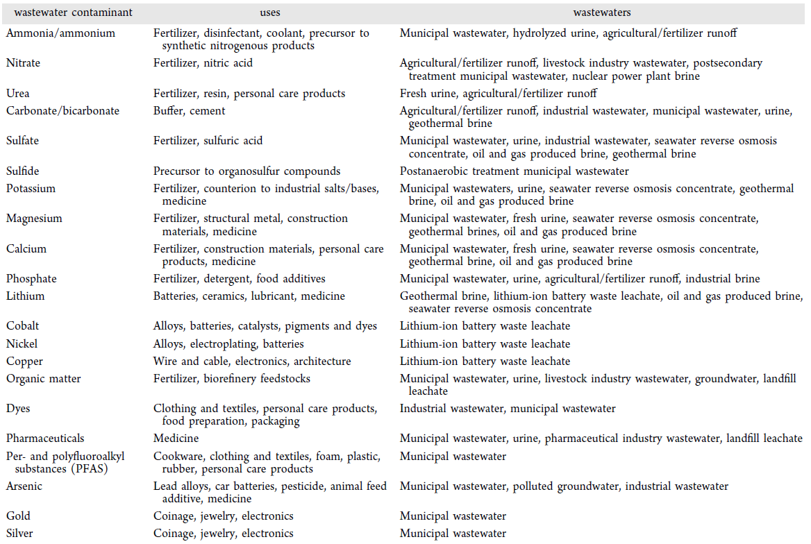
J. Am. Chem. Soc. 2023, 145, 36, 19422–19439

Slide 9
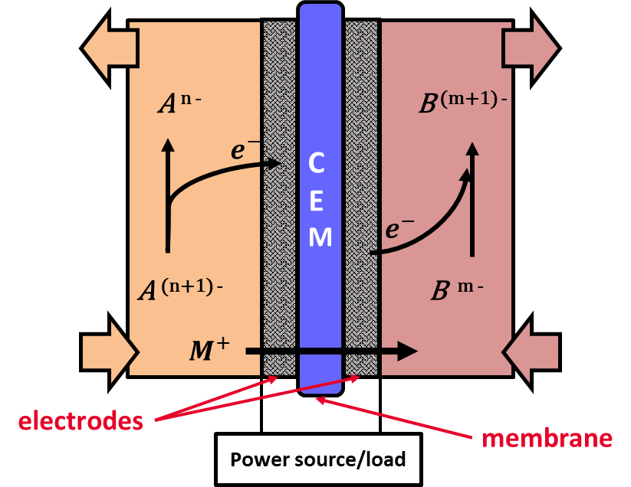
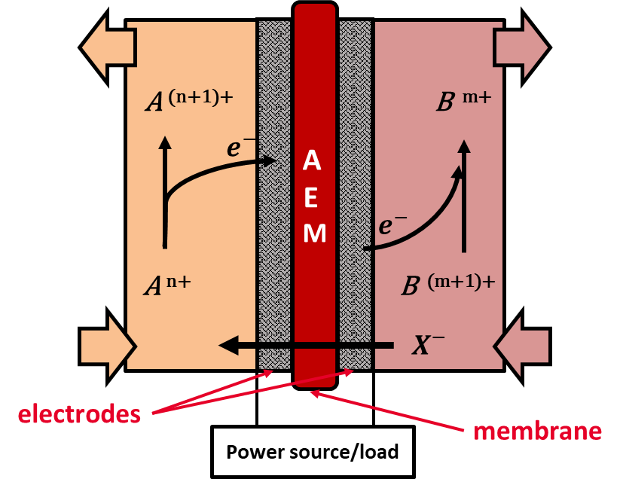
Electrochemical flow cells (general)
Modular/scalable: For distributed manufacturing to meet wastewater needs
Selective: Membranes and electrodes can select based on charge
Electrochemical reactions may be finely controlled by voltage

Slide 10
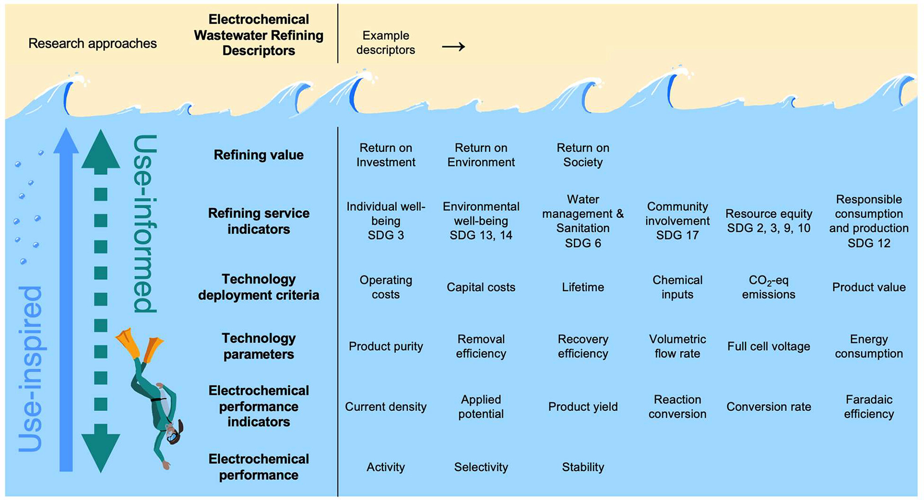
J. Am. Chem. Soc. 2023, 145, 36, 19422–19439
Notes:
Use informed considers context-specific details
Could enable communities to produce their own resources
ROI is quantitative. Need real democratic outreach, EJ framework, participatory research (?) to understand ROE and ROS
- life cycle analysis, quantitative sustainable design

Slide 11
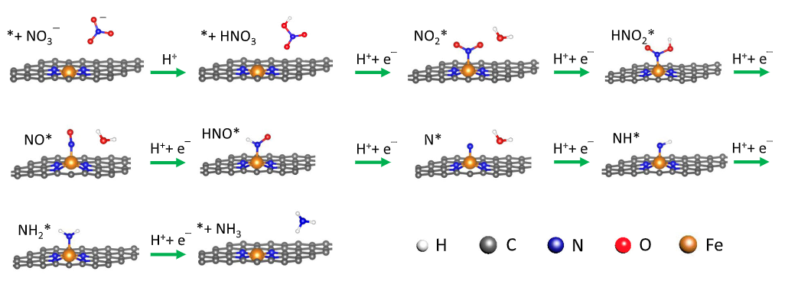
Nitrate reduction
Nitrate is the most commonly reported drinking water violation
Ammonia is a precursor to synthetic nitrogen products, especially fertilizers
Single-atom iron electrocatalyst (example)
https://doi.org/10.1038/s41467-021-23115
Notes:
It’s complicated
The mechanism depends on the surface
But also, the microenvironment matters. Local pH matters for PCET. Concentration matters (Mass transport). A need to understand in real wastewater conditions!

Slide 12
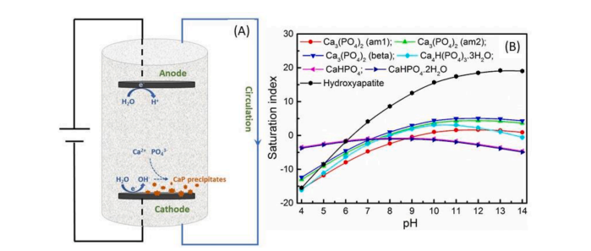
Phosphorous
Phosphorus is nonrenewable and must be mined (phosphate rocks)
It is fundamental for organisms and is used heavily in fertilizer

Slide 13
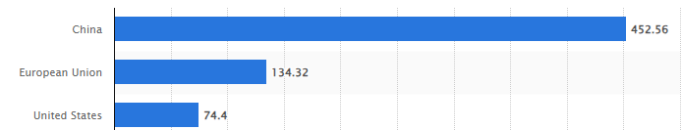

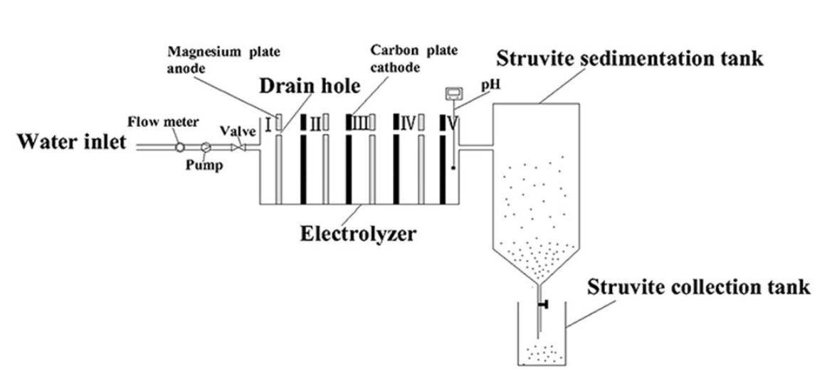

Struvite
Can precipitate struvite from waste containing phosphate and ammonium
Example:
Swine
wastewater
https://www.statista.com/statistics/263964/number-of-pigs-in-selected-countries/
Wang, F., Fu, R., Lv, H. et al. Phosphate Recovery from Swine Wastewater by a Struvite Precipitation Electrolyzer. Sci Rep 9, 8893 (2019). https://doi.org/10.1038/s41598-019-45085-3

Slide 14
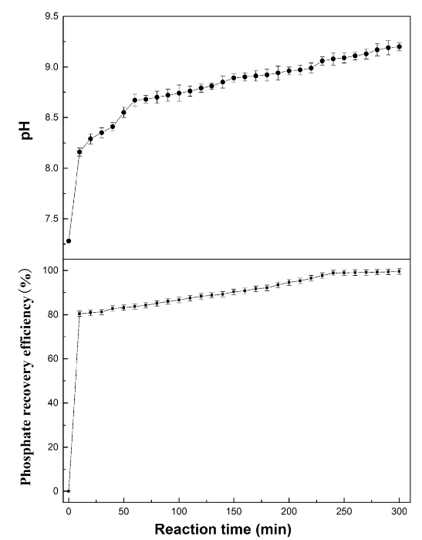
Wang, F., Fu, R., Lv, H. et al. Phosphate Recovery from Swine Wastewater by a Struvite Precipitation Electrolyzer. Sci Rep 9, 8893 (2019). https://doi.org/10.1038/s41598-019-45085-3
Notes:
Could benefit from a better understanding of reaction and microenvironment. Is nicely demo’d in real situations, though.
Also, precipitation-based reactions have challenges, like clogging, passivation, kinetics of nucleation, crystal size and regularity

Slide 15
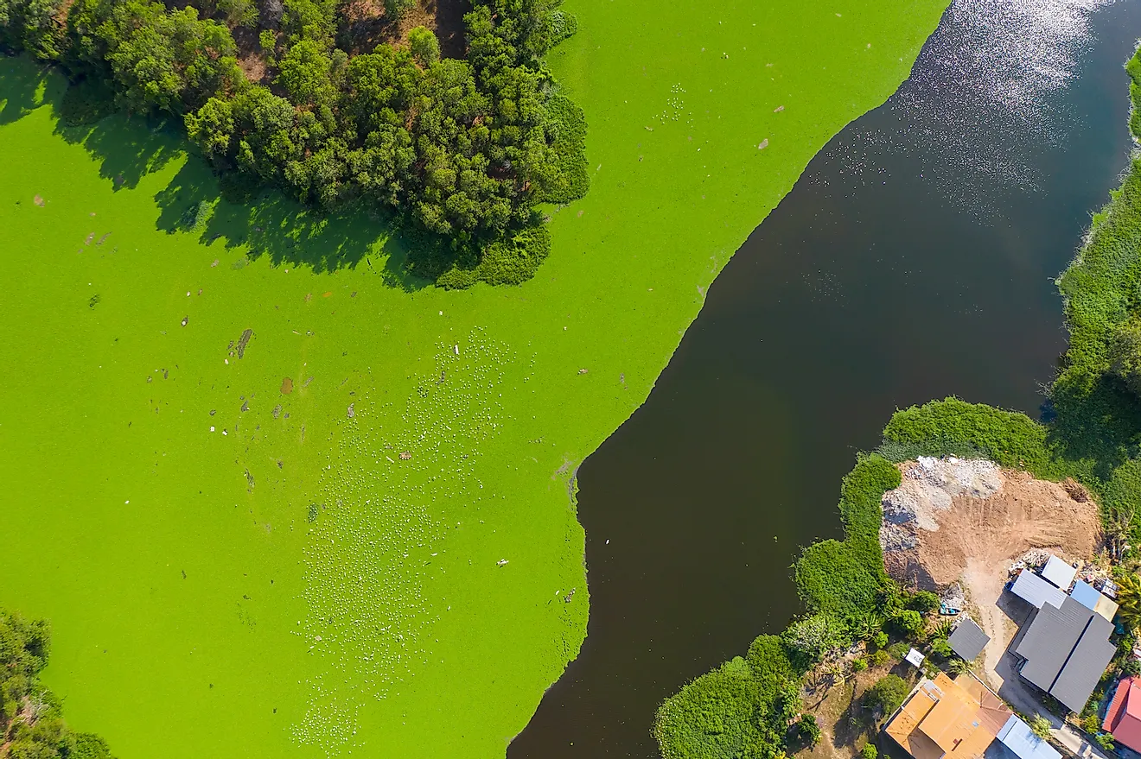
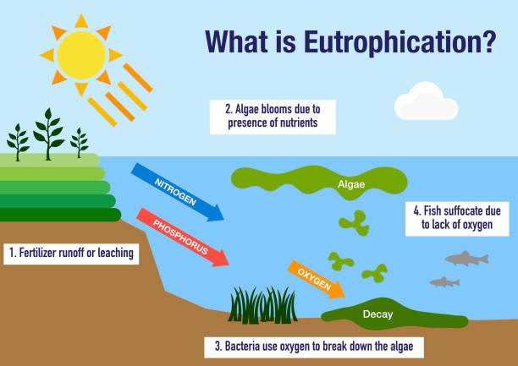

Slide 16
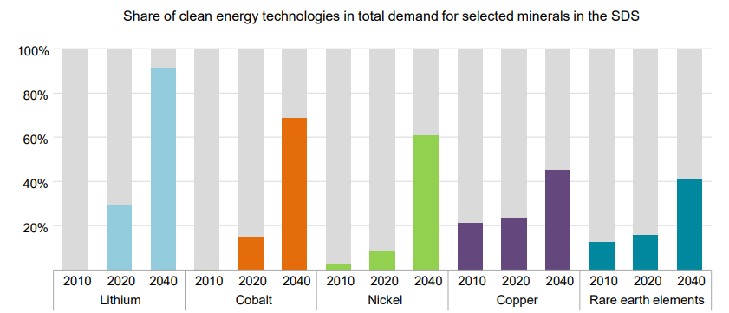
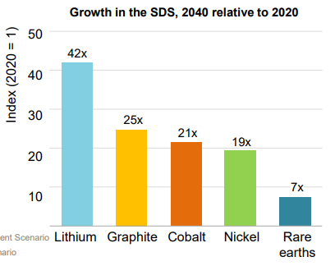
We’ll probably need a lot of lithium
https://www.igfmining.org/wp-content/uploads/2021/07/kc-micheals-iea-critical-minerals-americas-forum-2021.pdf

Slide 17
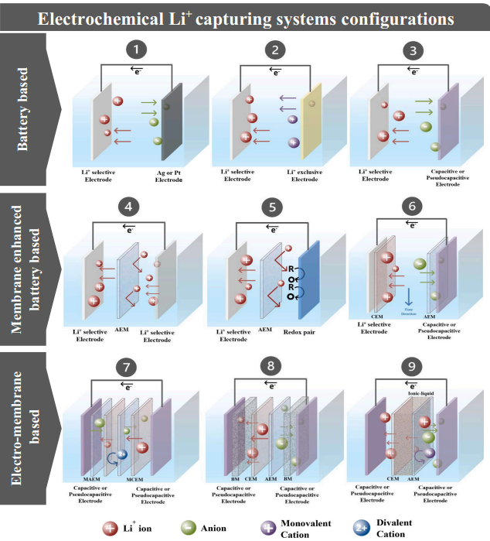
https://doi.org/10.1016/j.desal.2020.114883
Notes:
Electrode materials with selectivity at low concentration
Membrane selectivity and understanding of mechanisms, including under current (can also change current protocols, pulsed techniques, etc)

Slide 18
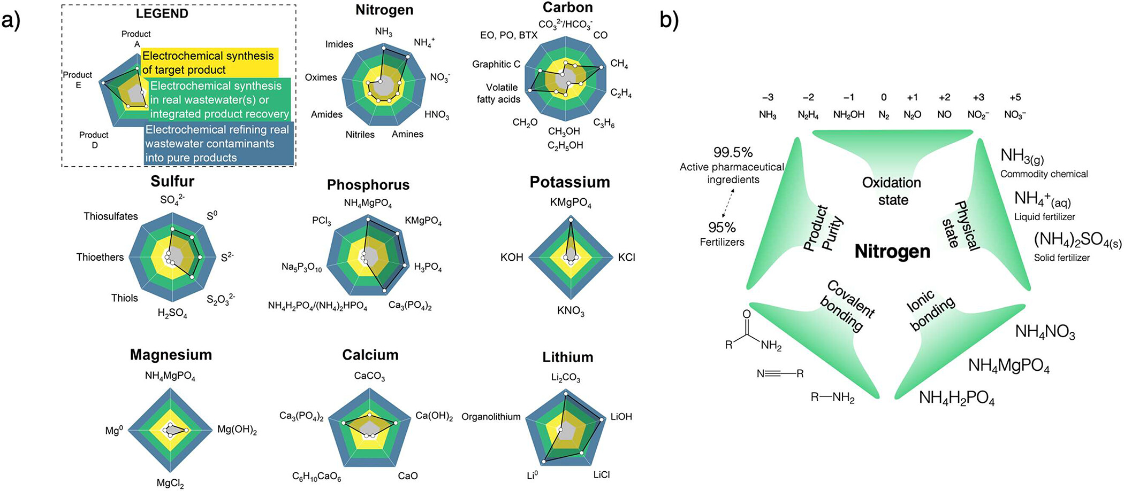
A progress
report
J. Am. Chem. Soc. 2023, 145, 36, 19422–19439
Notes:
Product requirements should be defined based on use
For example, we can make NH3, can we make solid fertilizer?
CO2RR as a model – now targeting C2 products and beyond, with double and triple CC bonds

Slide 19
How much chemical space can we reach starting from waste?
J. Am. Chem. Soc. 2023, 145, 36, 19422–19439
Notes:
Solid fertilizer for slow release, liquid for fast. What does that do to the echem reactor?
Co reduce CO2 and nitrate to make amines, etc?
Higher MW are easier to separate

Slide 20
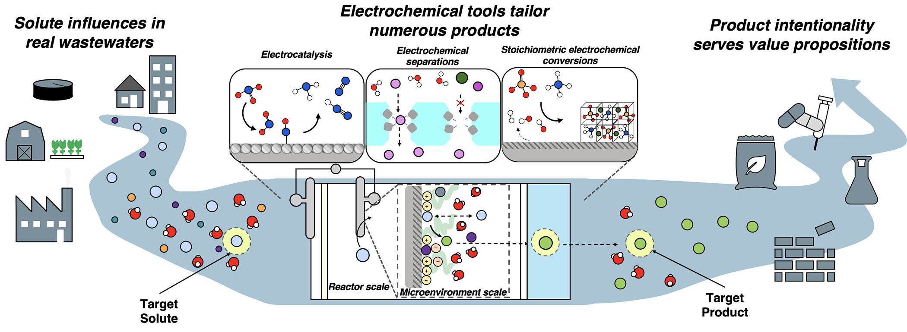
Summary and discussion
J. Am. Chem. Soc. 2023, 145, 36, 19422–19439

