Slide 1

A Presentation of Ice & Fire: Thermal Energy Storage
Dr. Mandy Liu
2023/04/28
Bye bye HEJC and Eric

Slide 2
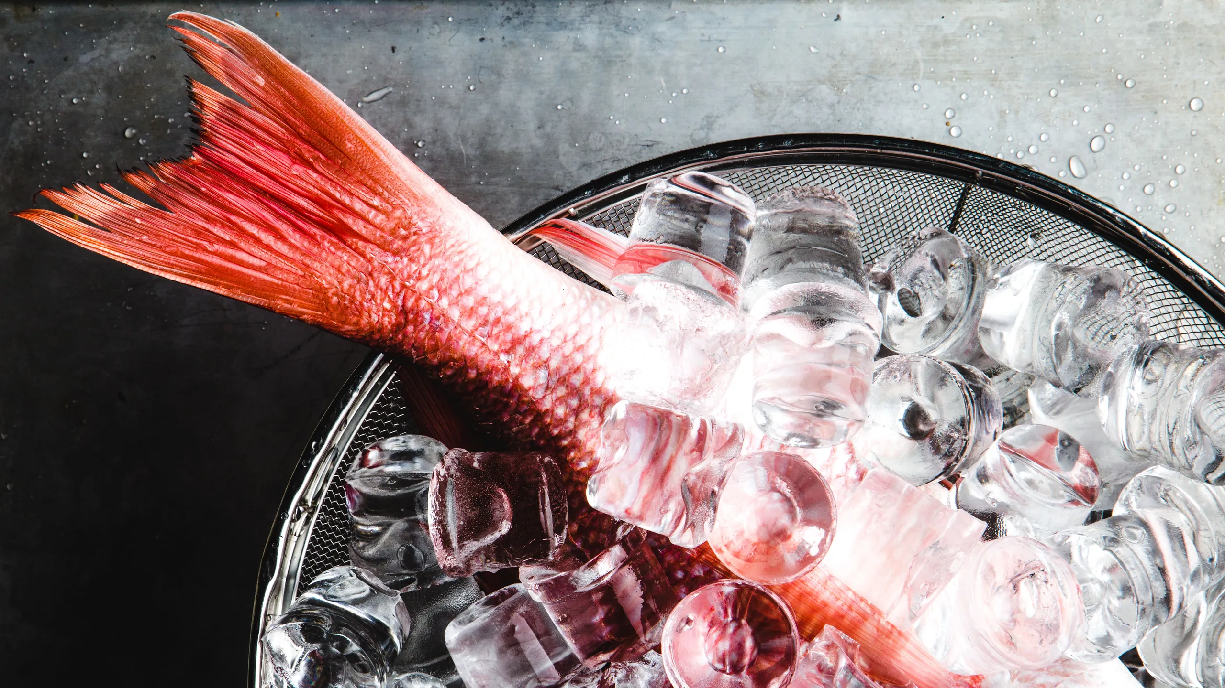
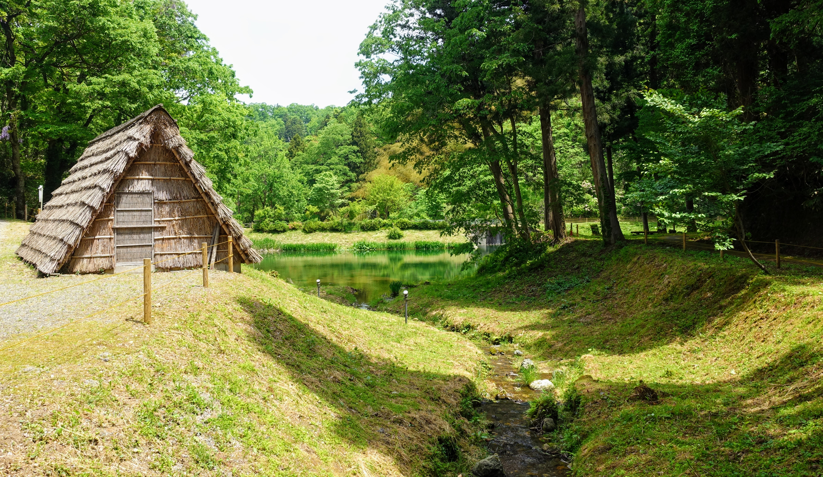
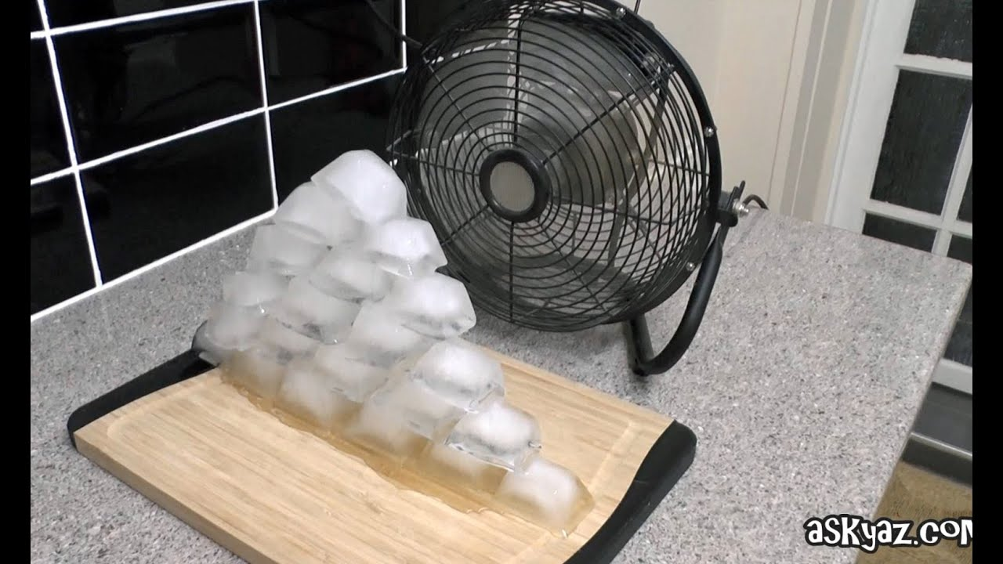
Definition & History of Thermal Energy Storage
“TES is the temporary storage of energy by heating or cooling a storage medium so that the stored energy can be used at a later time (for power generation/heating & cooling).”
storing food over ice
conditioning the room with ice & convection
European Association for Storage of Energy, 2017
Paksoy, Thermal Energy Storage for Sustainable Energy Consumption, 3–22.
IRENA, Innovation Outlook: Thermal Energy Storage, 2020

Slide 3
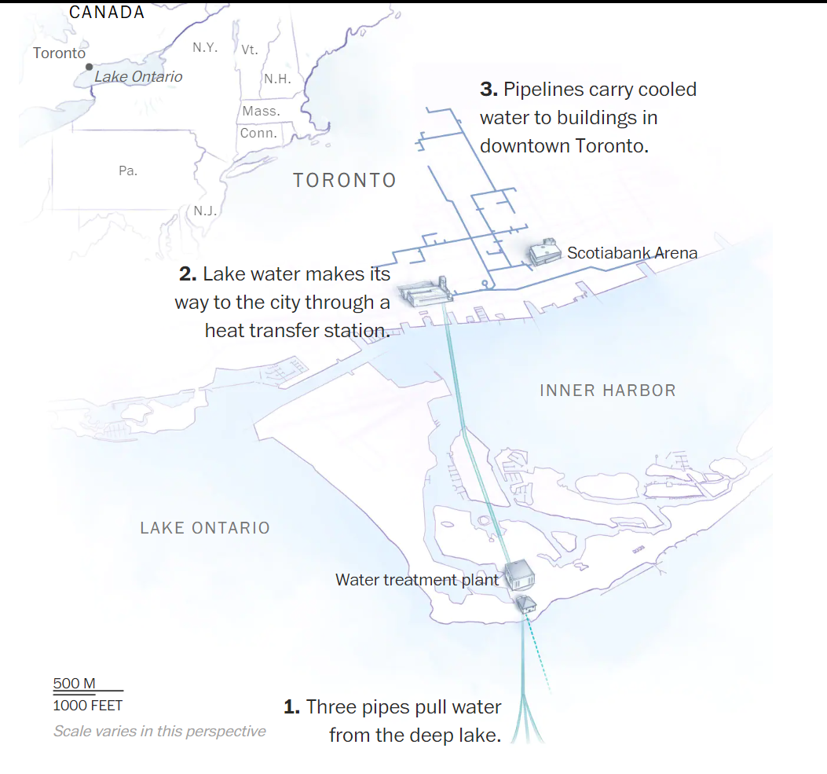
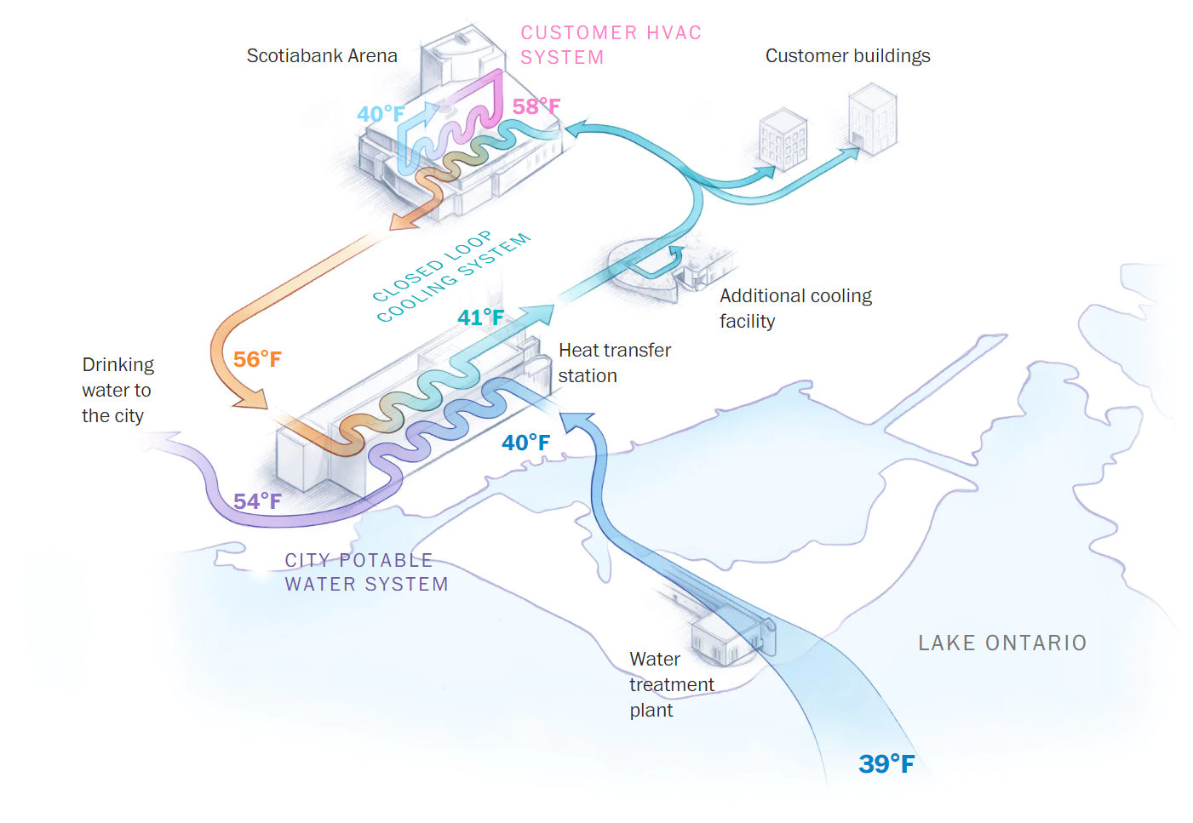
Case Studies: TES with Natural Resources
How well it works:
Saves 90 K MWh of electricity annually
  (70% of cooling demand)
Saves 220 million gallon of water
Potential pitfall:
Sensitive to global warming
Warm discharge water could lead to algae bloom
Downtown Toronto has the largest deep lake water cooling (DLWC) system in the world.
Washington Post
Notes:
https://www.washingtonpost.com/climate-solutions/interactive/2021/toronto-deep-latke-water-cooling-raptors/
https://www.google.com/search?q=Sundsvall+hospital+cooling+plant&rlz=1C1CHBF_enUS890US890&source=lnms&tbm=isch&sa=X&ved=2ahUKEwj1vZze7sj-AhU9EVkFHcgIDf4Q_AUoAnoECAEQBA&biw=1671&bih=884&dpr=1.35#imgrc=-7hYl9hCLLxW0M

Slide 4
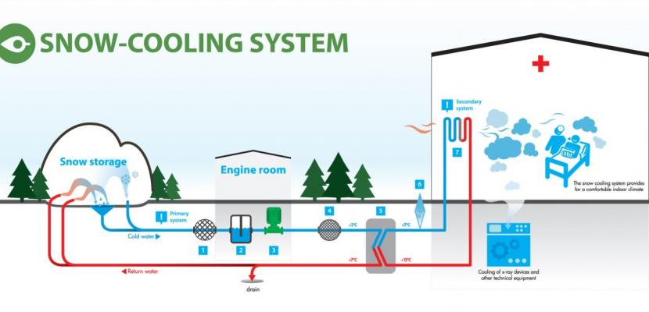
Case Studies: TES with Natural Resources
How well it works:
Saves 90% of electricity needed for cooling
  900 MWh -> 65 MWh (heat pumps)
Saves cost to deposit snow
Potential pitfall:
Sensitive to global warming
Works the best for places with long winter and peak summer cooling demand
Successful snow cooling system in Sundsvall Hospital, Sweden.
Interreg Europe
Notes:
https://www.washingtonpost.com/climate-solutions/interactive/2021/toronto-deep-latke-water-cooling-raptors/
https://www.google.com/search?q=Sundsvall+hospital+cooling+plant&rlz=1C1CHBF_enUS890US890&source=lnms&tbm=isch&sa=X&ved=2ahUKEwj1vZze7sj-AhU9EVkFHcgIDf4Q_AUoAnoECAEQBA&biw=1671&bih=884&dpr=1.35#imgrc=-7hYl9hCLLxW0M

Slide 5
TES towards clean energy transition
Key benefits: Enabler for renewable energy adaptation
Current status, market size & growth
Technology overview
  4 mechanisms
Application by Sector
  Power, heating & cooling (district & individual buildings), transport (cold chain), industry (high-temperature)
Barriers to overcome & potential solutions
IRENA, Innovation Outlook: Thermal Energy Storage, 2020
Notes:
Investment comparison: https://www.irena.org/News/pressreleases/2023/Feb/Investments-in-Renewables-Reached-Record-High-But-Need-Massive-Increase-More-Equitable-Distribution#:~:text=Despite%20reaching%20record%2Dhigh%20annual,grids)%20between%202021%20and%202030.

Slide 6
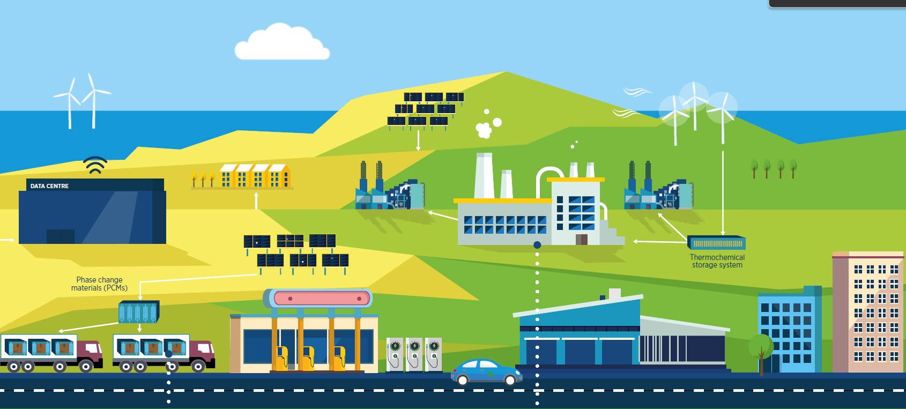
Key Benefits of TES: enabling clean energy transition
Bridge the intermittency of solar & wind, at much lower unit cost compared to Li-ion battery (some could be 60–90% cheaper).
Notes:
Investment comparison: https://www.irena.org/News/pressreleases/2023/Feb/Investments-in-Renewables-Reached-Record-High-But-Need-Massive-Increase-More-Equitable-Distribution#:~:text=Despite%20reaching%20record%2Dhigh%20annual,grids)%20between%202021%20and%202030.

Slide 7
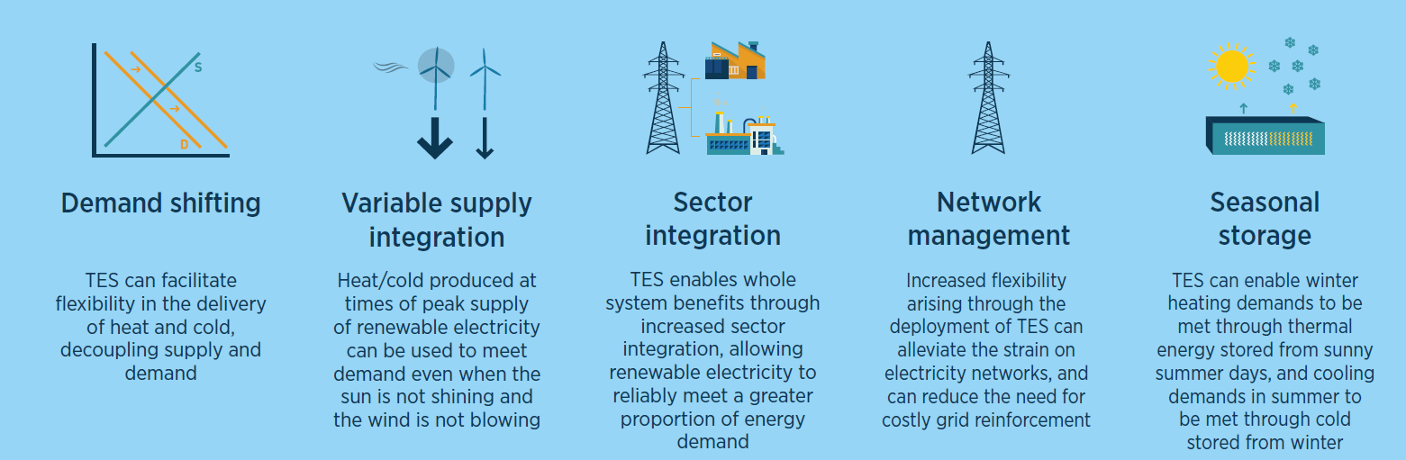
Key Benefits of TES: enabling clean energy transition
With high flexibility, TES can be the “glue” of a clean-energy society.
Notes:
Investment comparison: https://www.irena.org/News/pressreleases/2023/Feb/Investments-in-Renewables-Reached-Record-High-But-Need-Massive-Increase-More-Equitable-Distribution#:~:text=Despite%20reaching%20record%2Dhigh%20annual,grids)%20between%202021%20and%202030.

Slide 8
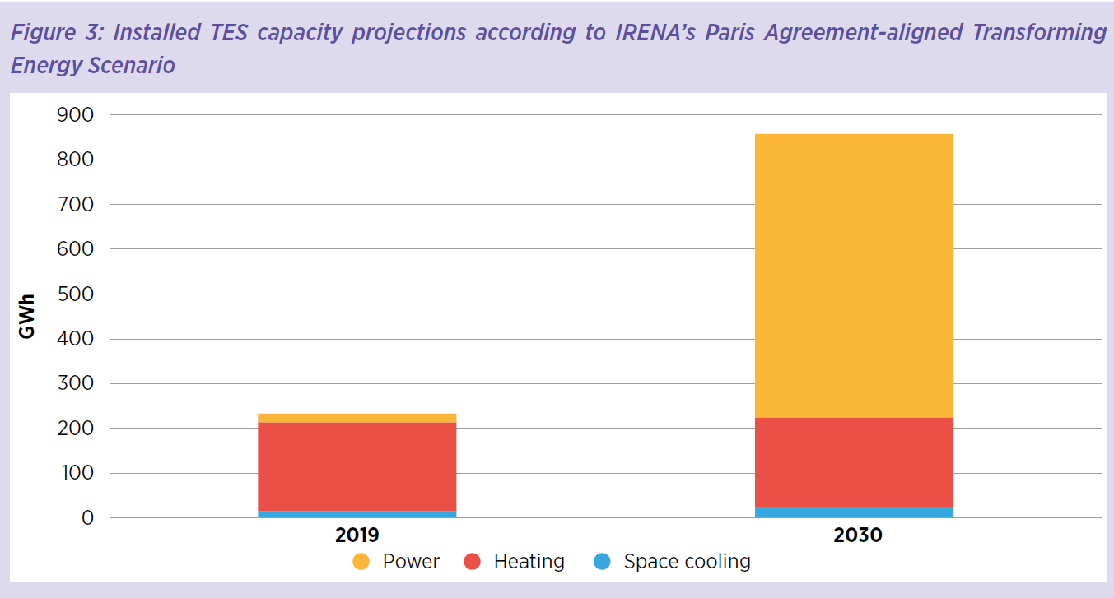
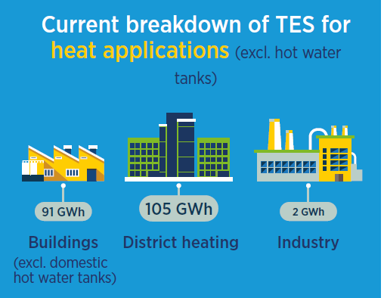
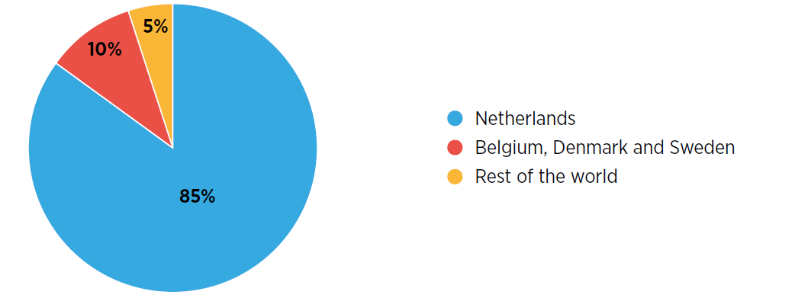
Current status & market overview
Expected to triple by 2030 (> 800 GWh)
Expected investment: $ 13-27 billion
  Global investment in renewables in 2010-2019: $ 2.5 trillion
  ATES (aquifer): some of the largest heating and cooling projects
UN Environment Programme

Slide 9
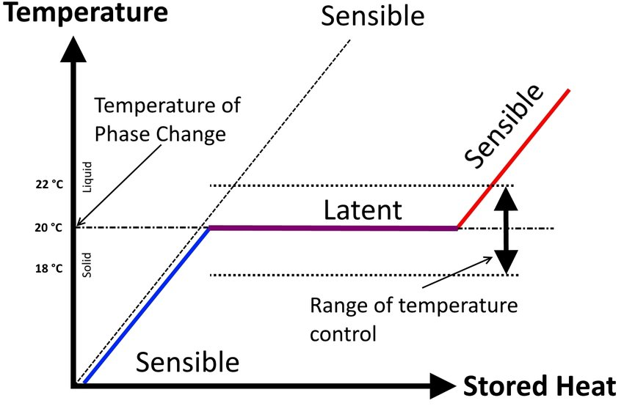
Technology Overview
4 main mechanisms: sensible, latent, thermochemical, mechanical-thermal heat storage
Sensible vs latent heat storage
Sensible heat: changing the temperature of a medium
  (water) tank TS
  solid-state TS (bricks, rocks, concretes)
Latent heat: heat change related to a phase change
  ice TS
  phase-change materials (PCM)
Energies

Slide 10
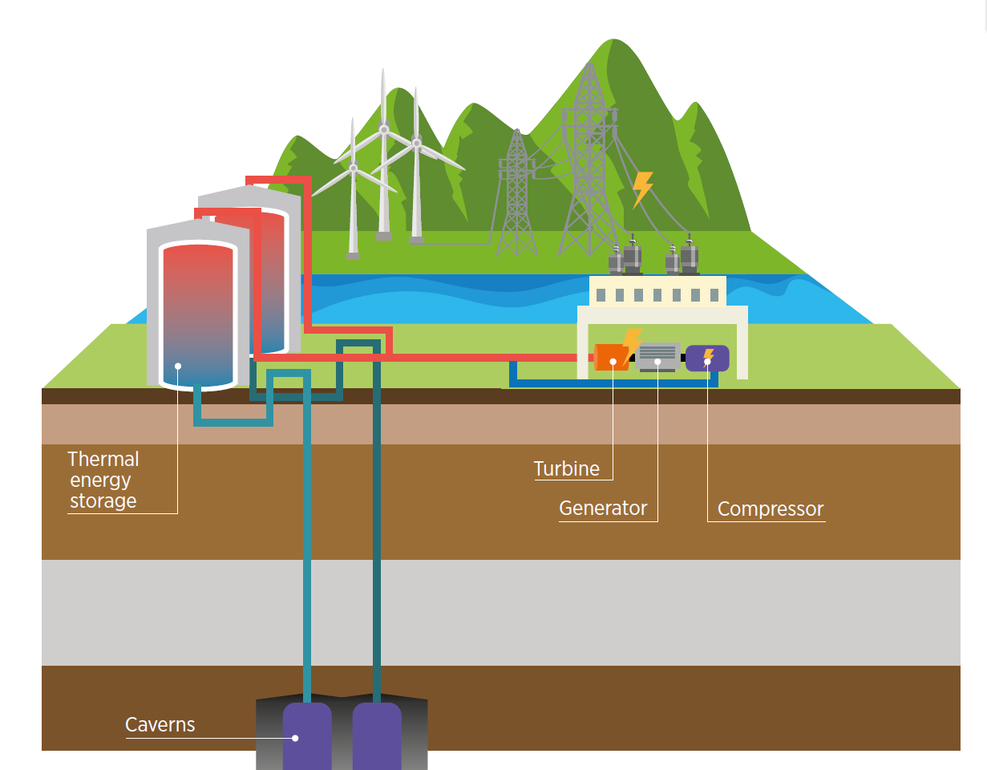
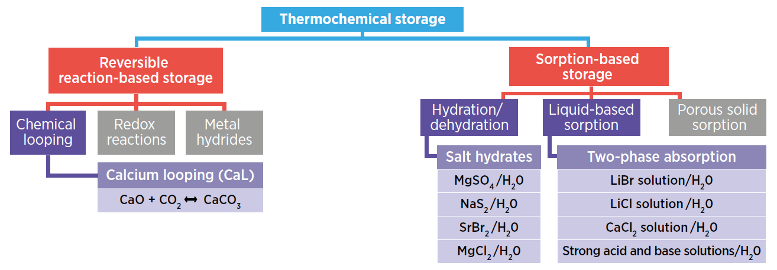
Technology Overview
4 main mechanisms: sensible, latent, thermochemical, mechanical-thermal heat storage
Thermochemical storage involves triggering chemical reactions (typically decomposition & formation), or sorption & desorption
Mechanical-thermal storage involves compressing air:
compressed air energy storage (CAES): off peak electricity used to compress air. Peak: expended air drives turbine.
Liquid air ES: air is compressed so much that it liquifies

Slide 11
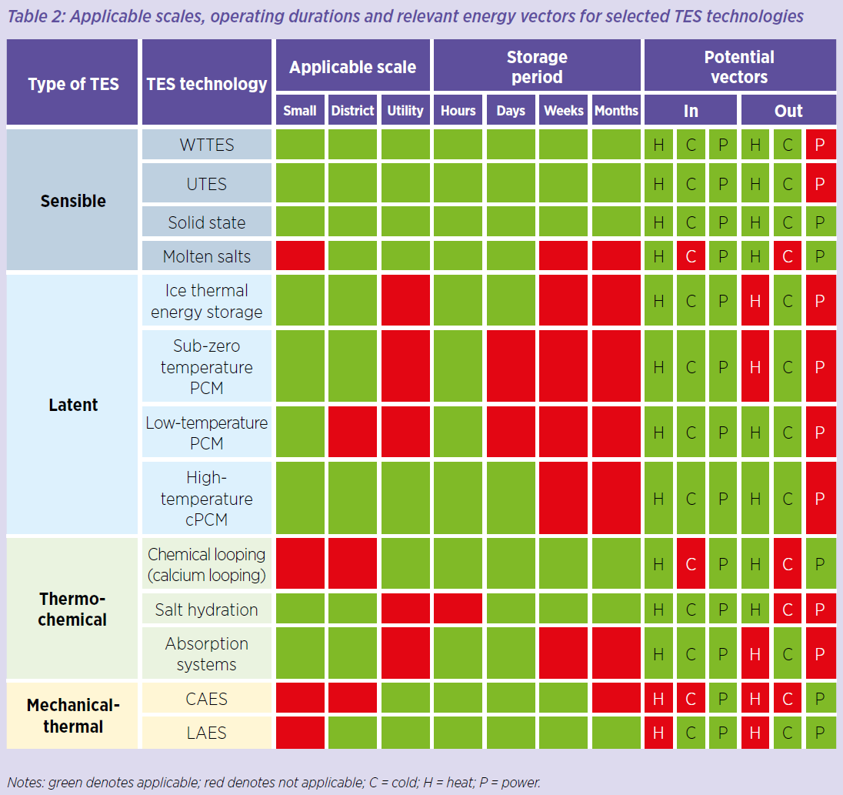
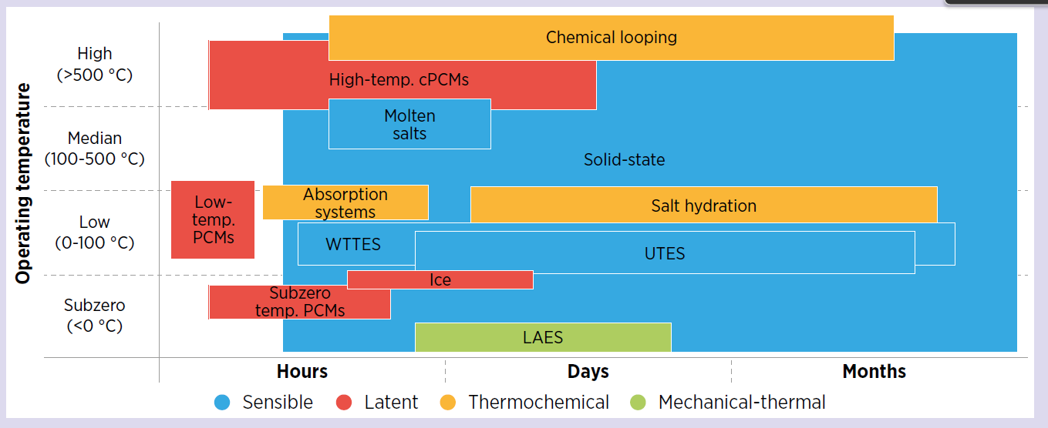
Technology Overview

Slide 12
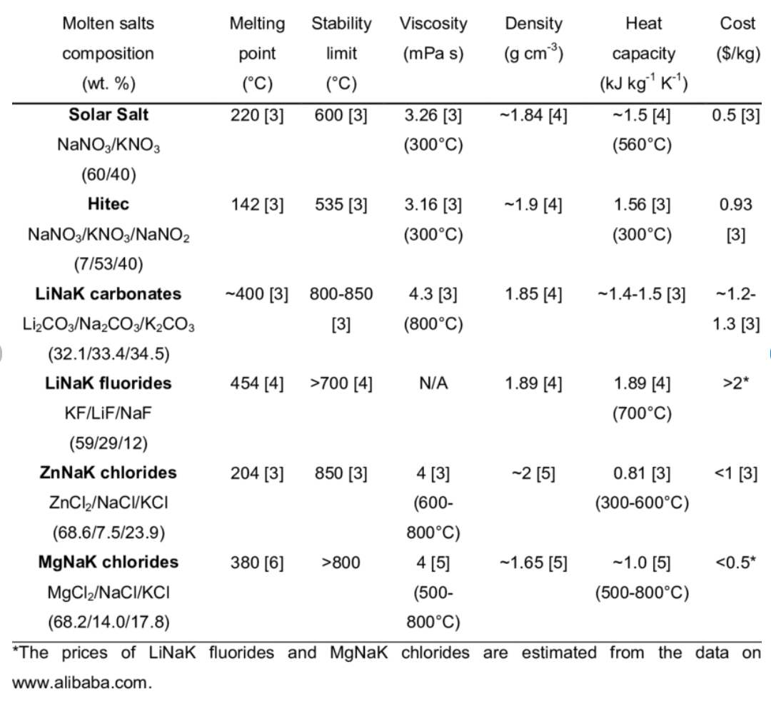
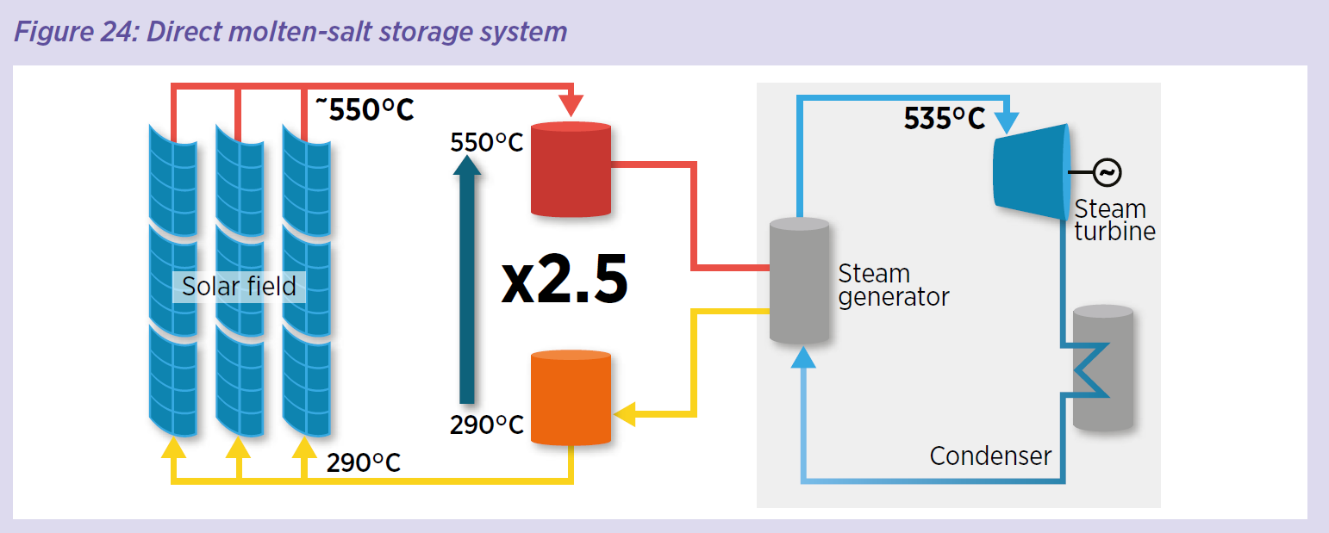
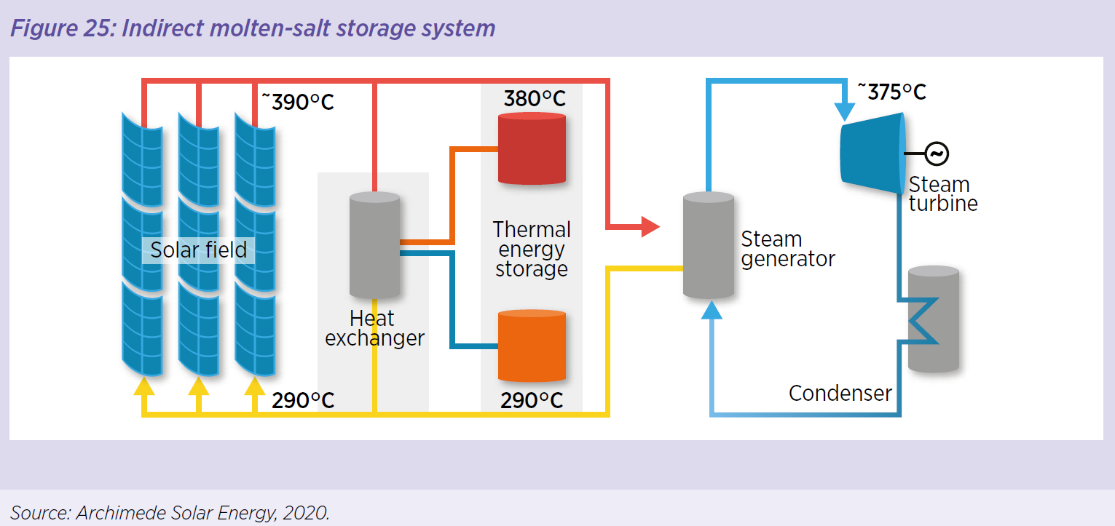
Application by sectors: Power
most common example: molten-salt @ concentrating solar plants, will be paired with 70% of CSP. Main challenge: salt freezing.
The journal of energy storage

Slide 13
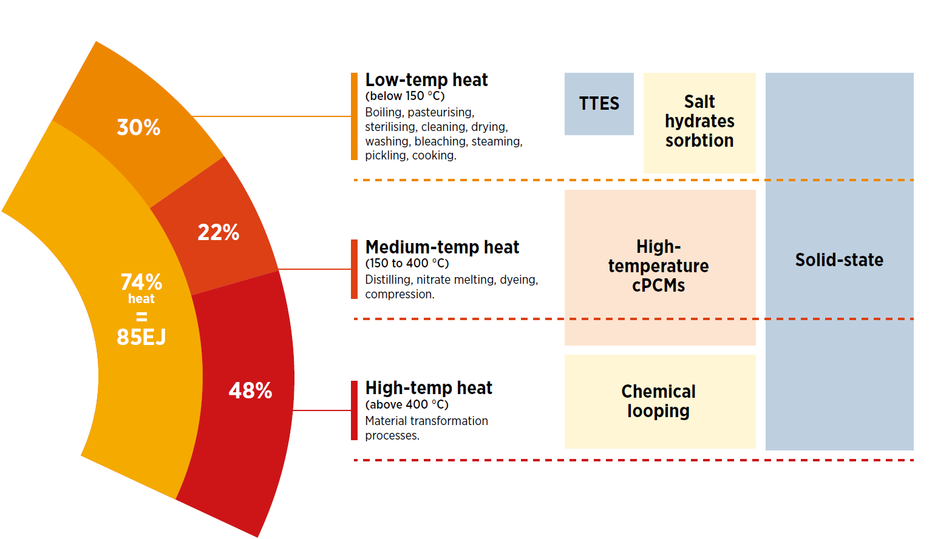
Application by sectors: Industry
Currently slowest adoption. Only water tank TS has been used for low-temperature processes

Slide 14
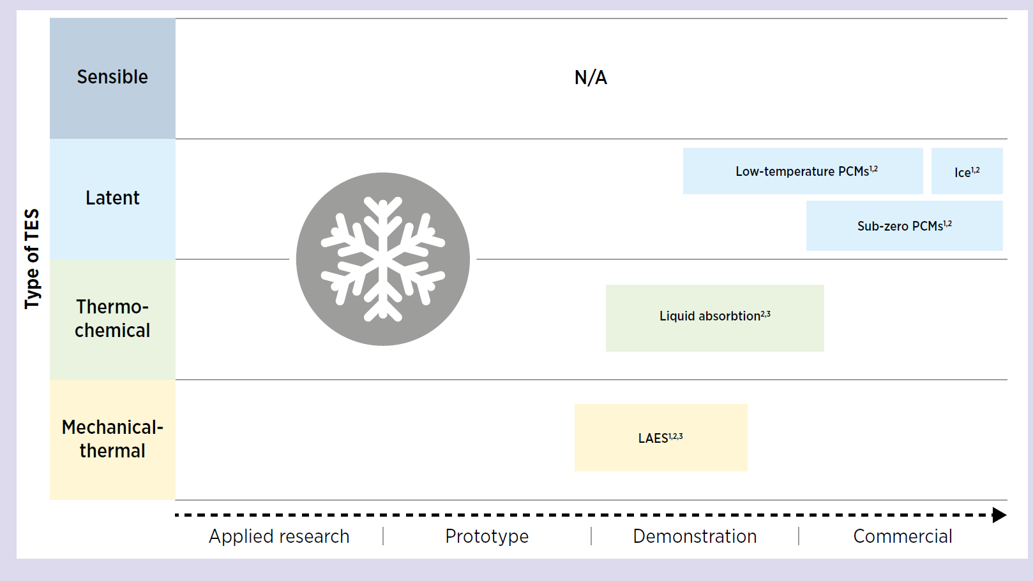
Application by sectors: Cold Chain (Transportation)
Commercial readiness of cold chain applications is pretty high.
Could help with developing countries realize off-grid solutions.

Slide 15
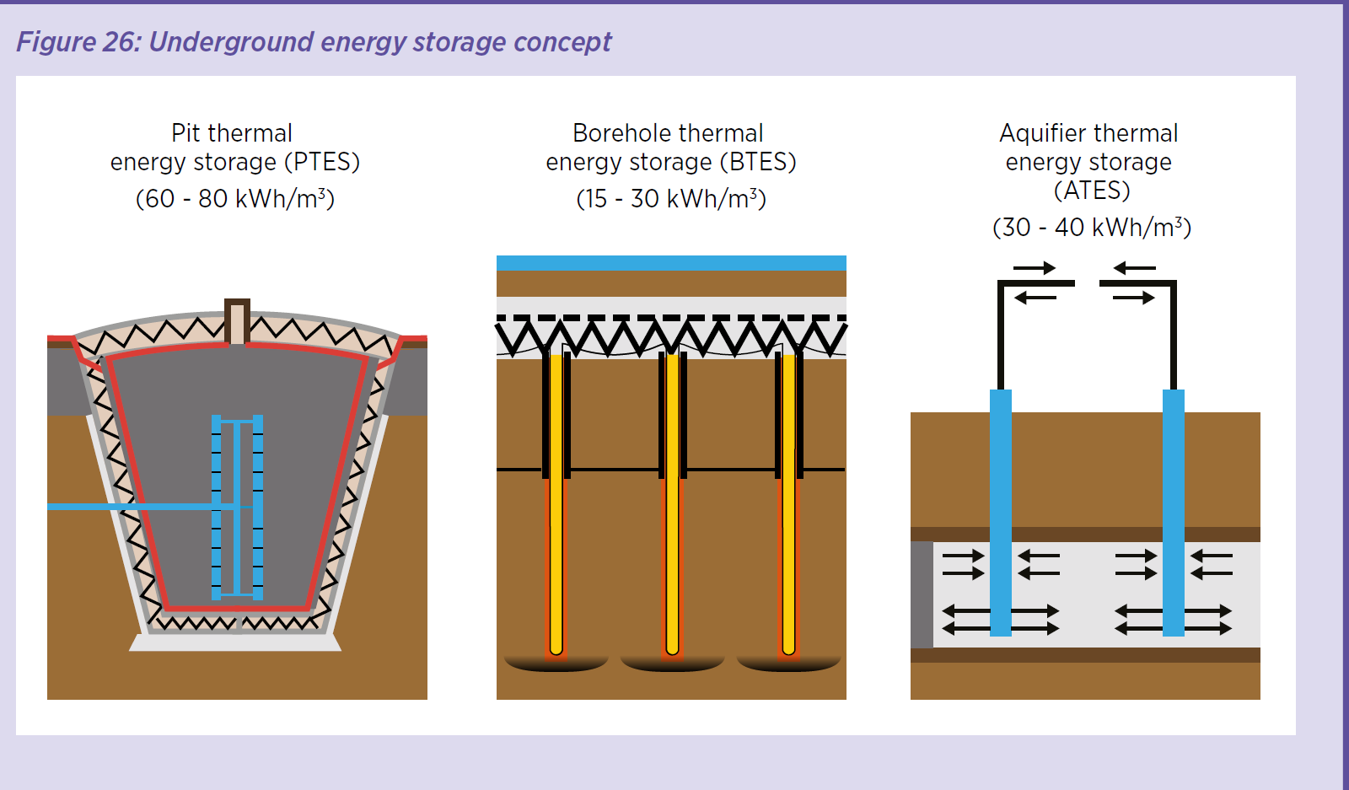
Application by sectors: district & building heating & cooling
Centralized vs individual heating & cooling system
UETS can be deployed at large scales and are commonly used for district heating & cooling.
Thermal batteries for individual buildings to provide flexibility for heat pump adoption.
Currently Water tank ES is widely used across the world

Slide 16
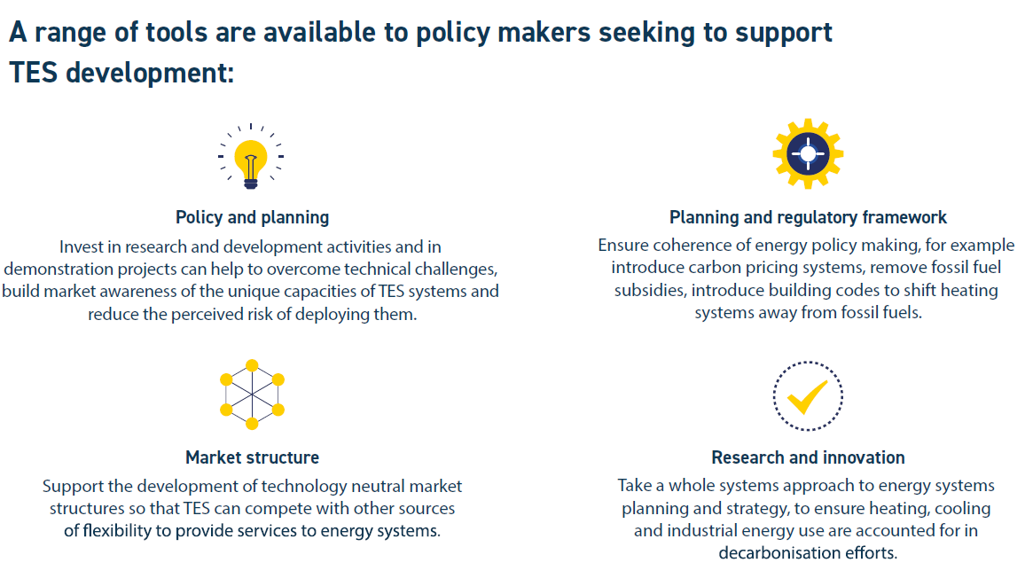
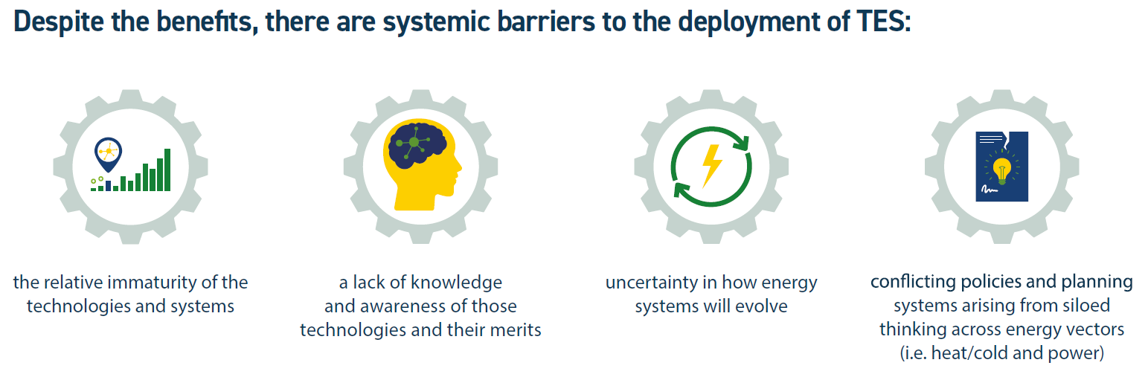
Barriers to deployment & strategies

Slide 17
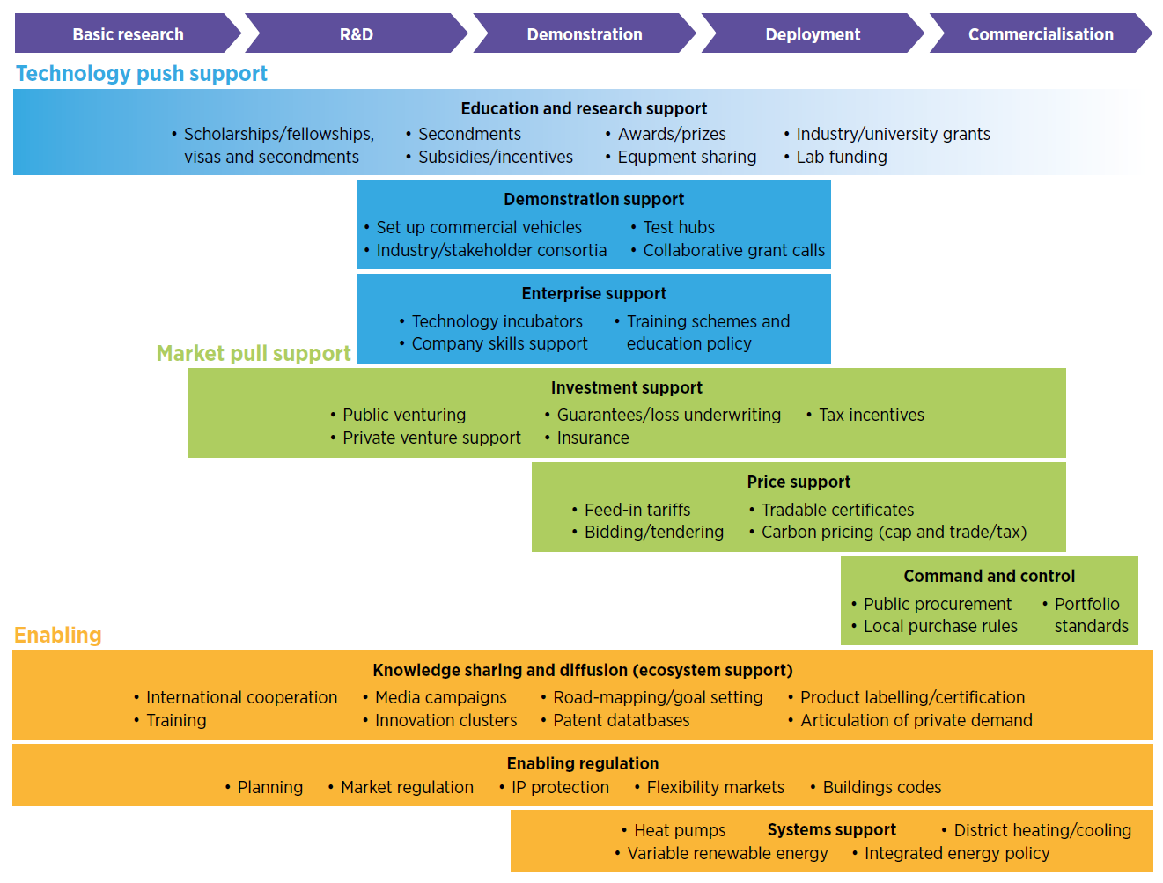
Barriers to deployment & strategies
Identify barriers and actionable for each sector

Slide 18
Thank you!
For your attention and for many great Fridays in the past 5 years ☺

