Slide 1

Can we make ammonia with
electrochemistry?
TYG HEJC
04/21/23

Slide 2
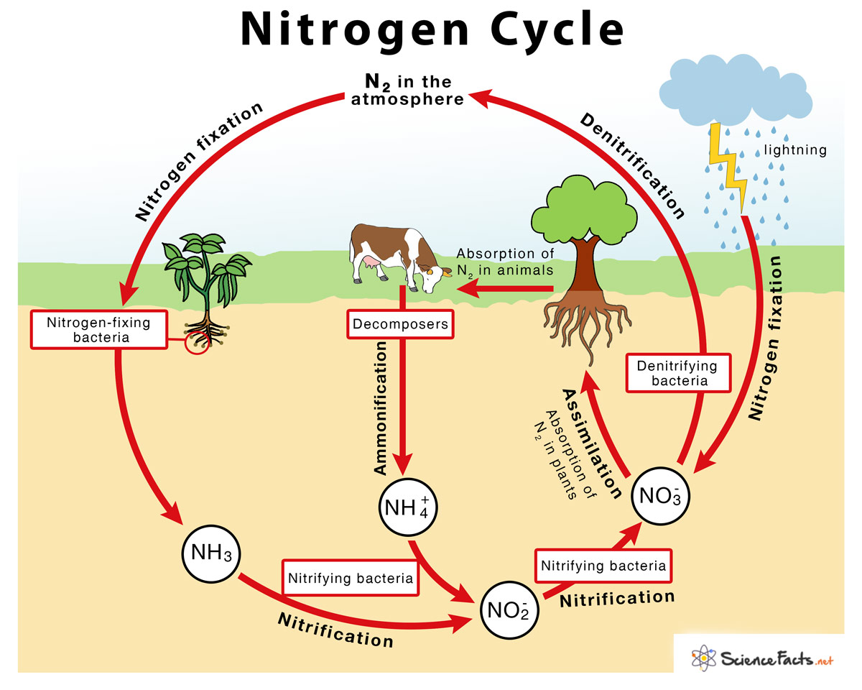
1
Notes:
Atmospheric N2 inaccessible to organisms
lightning helps atmospheric n2 and o2 react

Slide 3
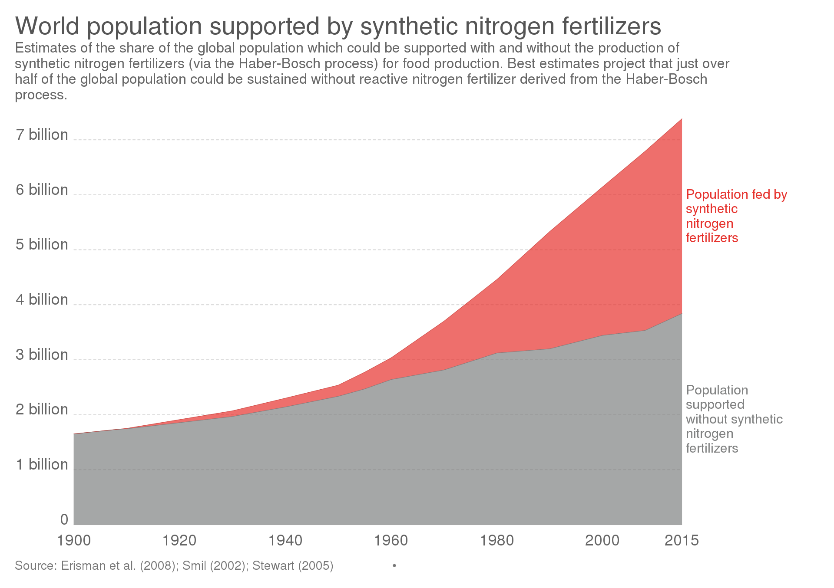
2

Slide 4
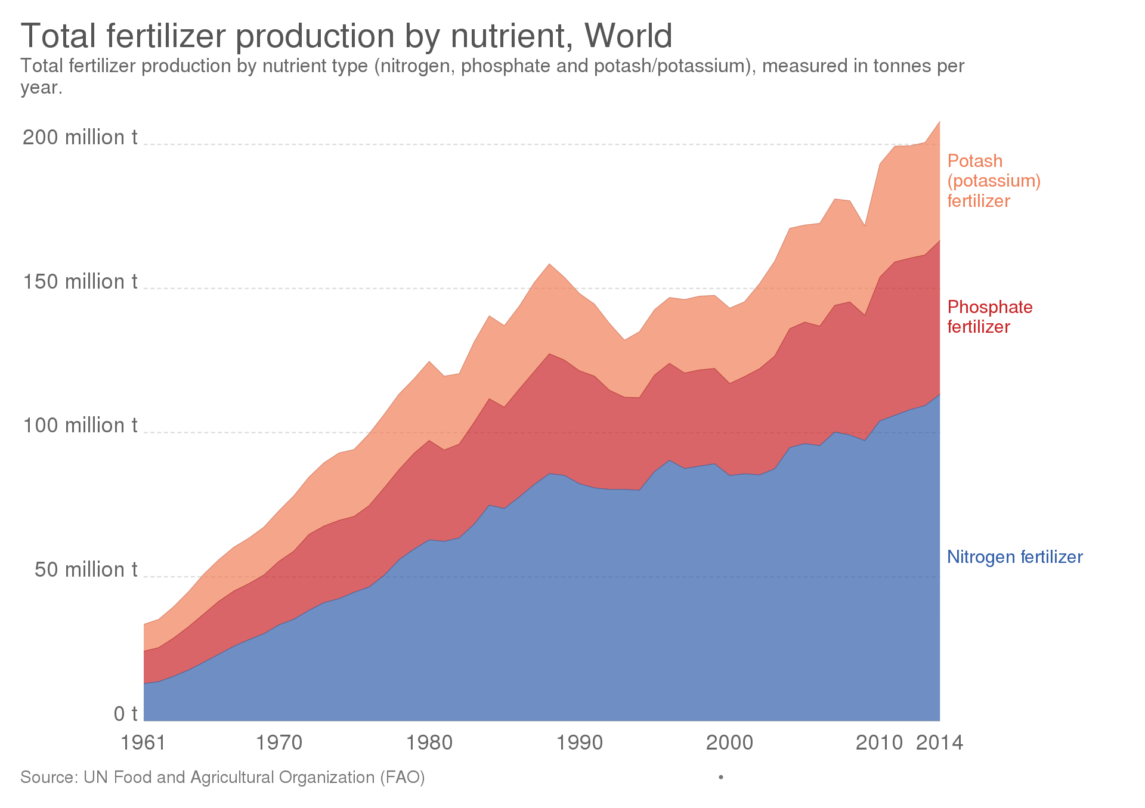
3

Slide 5
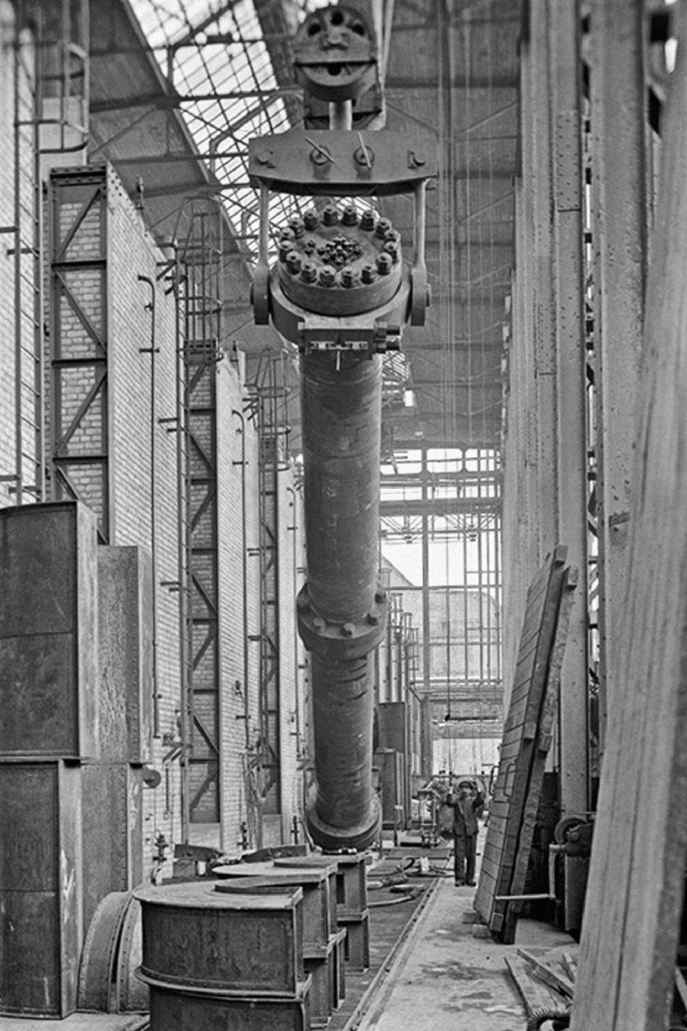


4
Industrial ammonia synthesis
$$N_{2}+3H_{2}↔2NH_{3}$$
$$∆G= ∆H −T∆S$$
The reaction is exothermic (energy-releasing) so it is favored at lower temperature
The reaction decreases the amount of gas molecules, it lowers entropy, so it is favored at
high pressure
At room temperature ammonia is favored at
equilibrium but it is slow
Industrially this reaction is done around 60-300
bar pressure and 300-500 C
Right: first reactor of BASF Oppau ammonia plant,
1913
https://en.wikipedia.org/wiki/Haber_process
Notes:
Poll the group for chem background
Ask about endo and exothermic
And entropy
Le chateleier 1884!

Slide 6
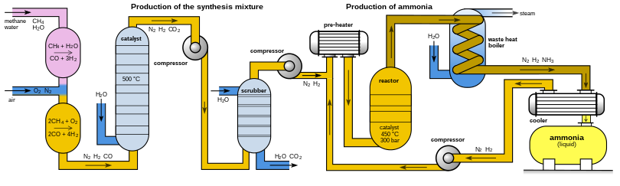
5
The Haber-Bosch process
$$N_{2}+3H_{2}↔2NH_{3}$$
Fritz Haber: chemist credited with this process (1894-1911), also developed and implemented chemical weapons
in World War 1. “During peace time a scientist belongs to the World, but during war time he belongs to his country.”
Carl Bosch: worked for BASF, made the Haber-Bosch process practical (first plant in 1913)
https://en.wikipedia.org/wiki/Haber_process

Slide 7
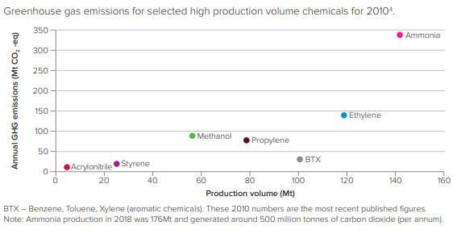
6
Ammonia is carbon intensive
https://royalsociety.org/-/media/policy/projects/green-ammonia/green-ammonia-policy-briefing.pdf

Slide 8
7
The Haber-Bosch process: energy and CO₂
“It may be that this solution is not the final one. Nitrogen bacteria teach us that Nature, with her sophisticated forms of the chemistry of living matter, still understands and utilizes methods which we do not as yet know how to imitate”
- Fritz Haber, Nobel acceptance speech
Power
Heat
Steam reforming of methane
+ water-gas shift reaction:
“grey hydrogen”
Direct CO₂
emissions
https://en.wikipedia.org/wiki/Haber_process

Slide 9
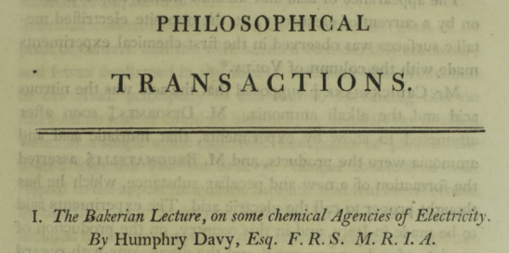
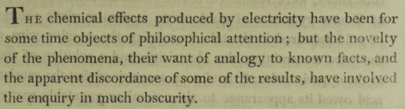
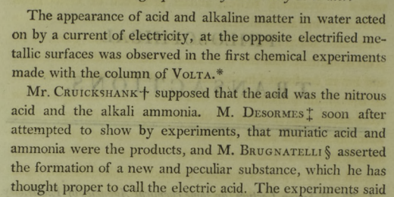
1807:
maybe…
water + current = ammonia ?
8

Slide 10
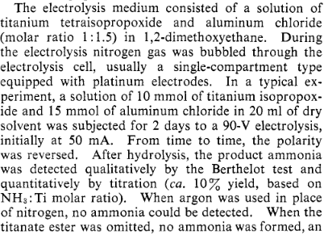
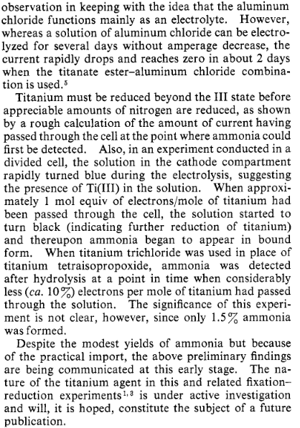
1968 JACS letter to the editor:
“Electrolytic Reduction of Molecular Nitrogen”
9
N₂
Pt
Pt
Titanium
tetraisopropoxide
Aluminum chloride
Dimethoxyethane
Eugene E. Van Tamelen and Bjorn Akermark
Journal of the American Chemical Society 1968 90 (16), 4492-4493
DOI: 10.1021/ja01018a074

Slide 11
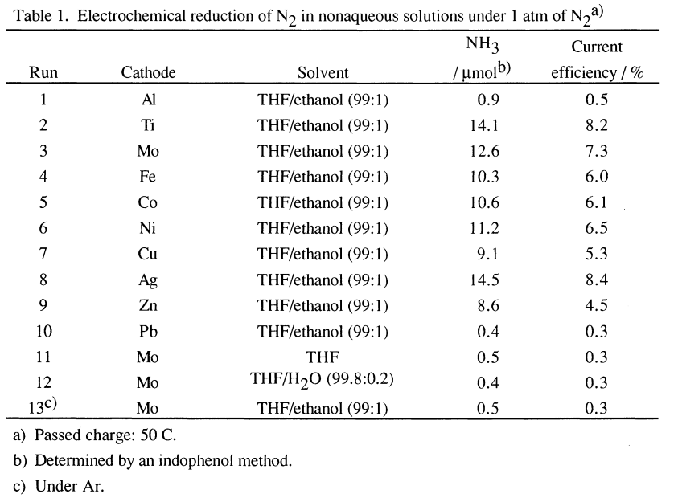
1993:
“Efficient Electrochemical Reduction of N2 to NH3 Catalyzed by Li.”
10
N₂
Cathode
(NRR)
Pt
Lithium
perchlorate
Solvent
Tsuneto, A., Kudo, A., & Sakata, T. (1993). Efficient Electrochemical Reduction of N2 to NH3 Catalyzed by Lithium. Chemistry Letters, 22(5), 851–854. doi:10.1246/cl.1993.851

Slide 12
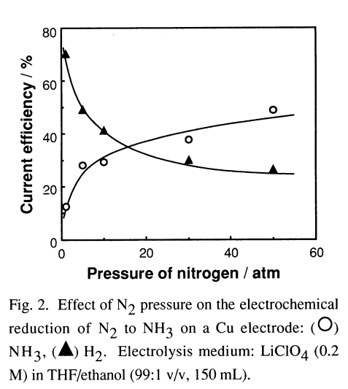
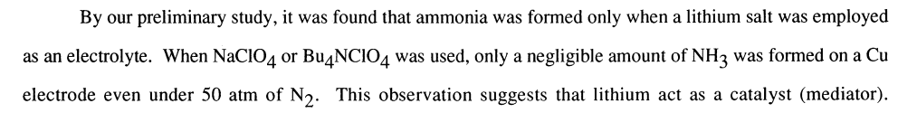
1993:
“Efficient Electrochemical Reduction of N2 to NH3 Catalyzed by Li.”
11
N₂
Mo cathode
(NRR)
Pt
Lithium
perchlorate
Solvent
Tsuneto, A., Kudo, A., & Sakata, T. (1993). Efficient Electrochemical Reduction of N2 to NH3 Catalyzed by Lithium. Chemistry Letters, 22(5), 851–854. doi:10.1246/cl.1993.851

Slide 13
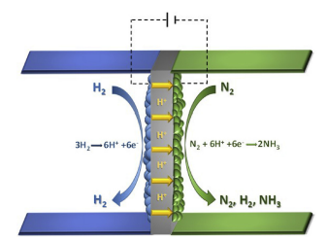
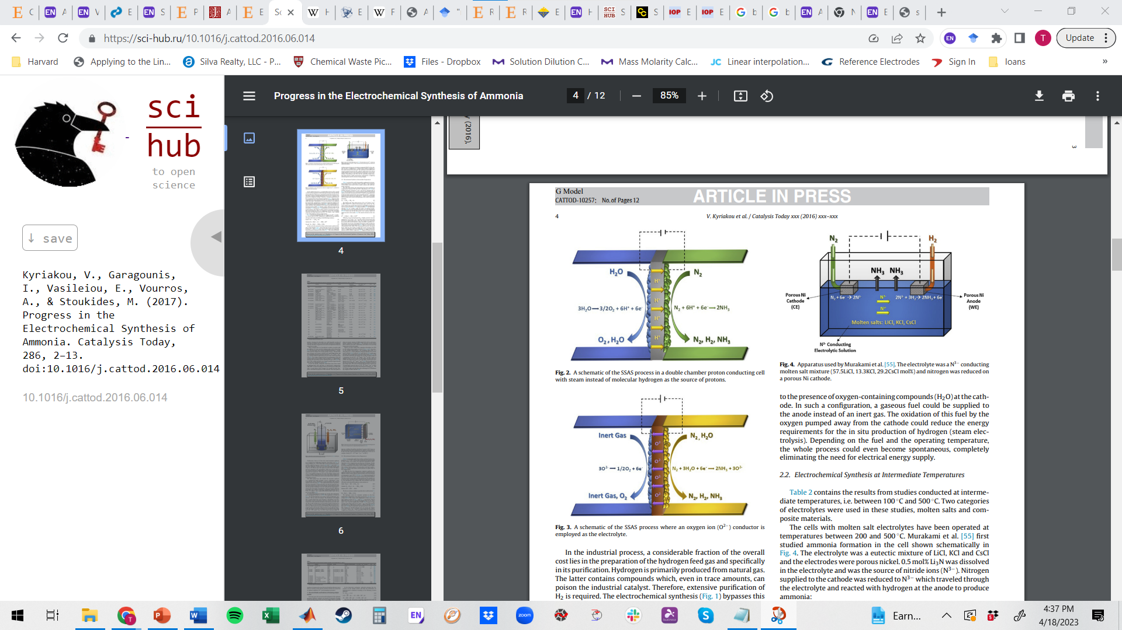
12
The 2000s:
High Temperature Solid State Reactors
Kyriakou, V., Garagounis, I., Vasileiou, E., Vourros, A., & Stoukides, M. (2017). Progress in the Electrochemical Synthesis of Ammonia. Catalysis Today, 286, 2–13. doi:10.1016/j.cattod.2016.06.014 (applies to next slide too!)
Notes:
Booost reaction rrate
poll – highest rate?

Slide 14
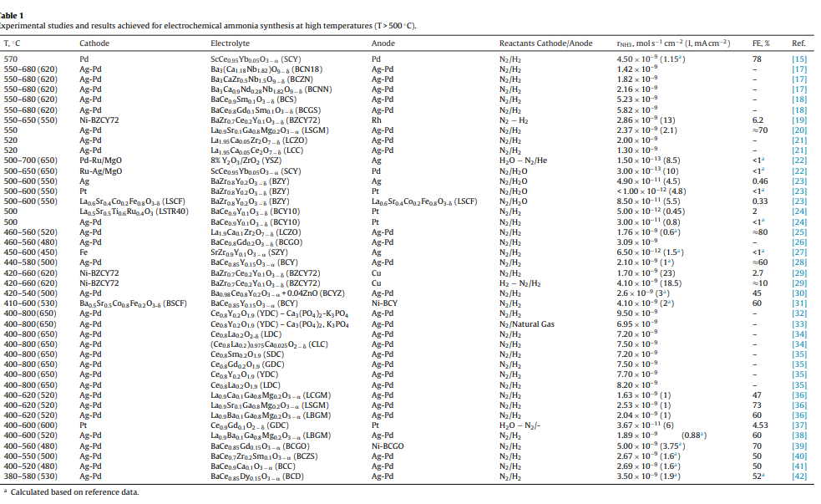
13

Slide 15
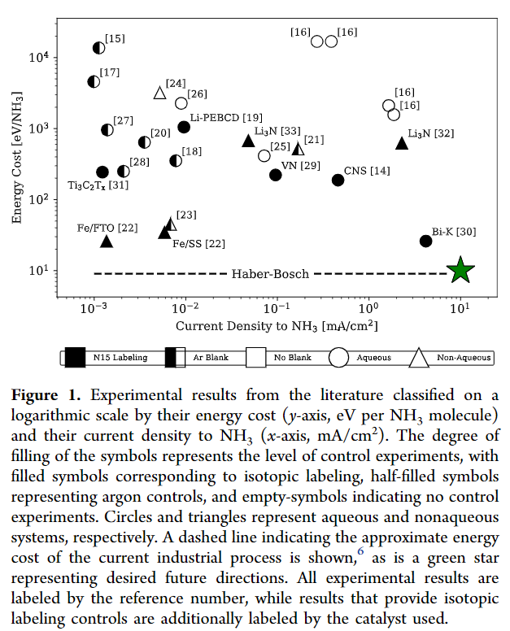
As of 2019: Energy cost is higher than Haber-Bosch
14
Aayush R. Singh, Brian A. Rohr, Michael J. Statt, Jay A. Schwalbe, Matteo Cargnello, and Jens K. Nørskov
ACS Catalysis 2019 9 (9), 8316-8324
DOI: 10.1021/acscatal.9b02245
Notes:
Note the authors question results that don’t have N15 labelling, because N is everywhere!

Slide 16
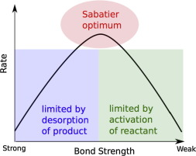
Electrocatalysis
15
reactant
product
intermediate
catalyst

Slide 17
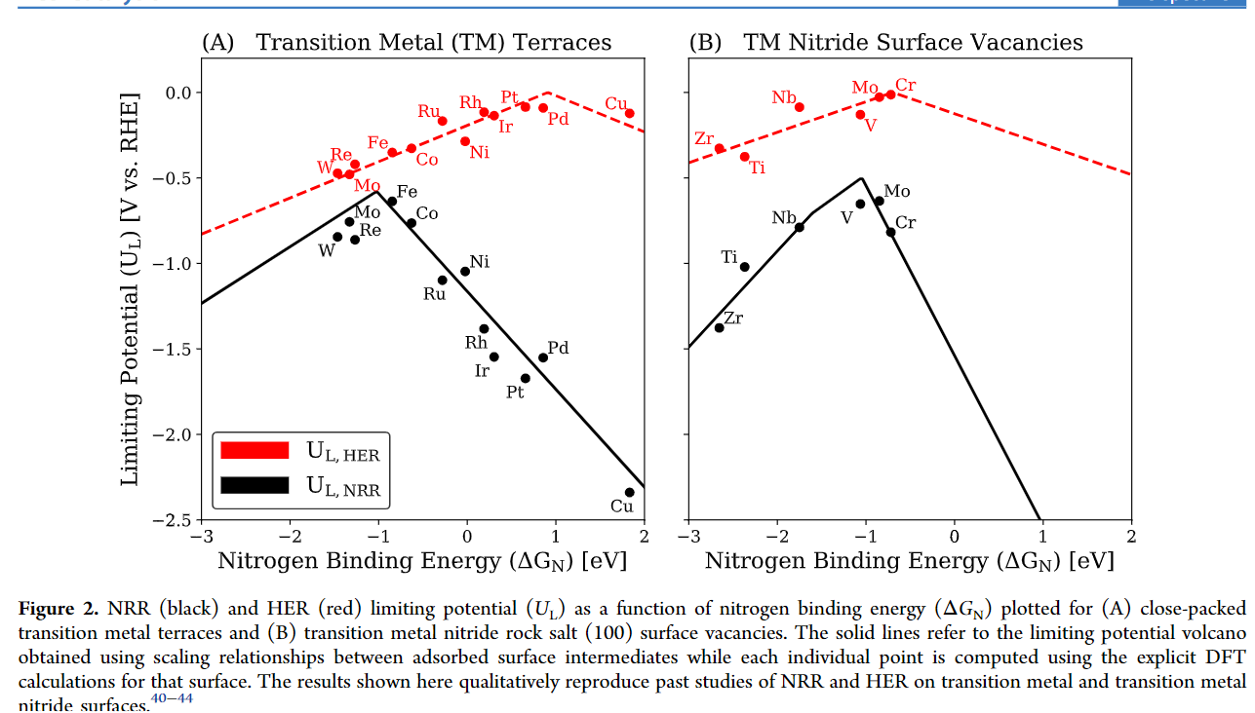
Fundamental challenge when protons are available (like water)
16
Aayush R. Singh, Brian A. Rohr, Michael J. Statt, Jay A. Schwalbe, Matteo Cargnello, and Jens K. Nørskov
ACS Catalysis 2019 9 (9), 8316-8324
DOI: 10.1021/acscatal.9b02245
More
effective
catalyst

Slide 18
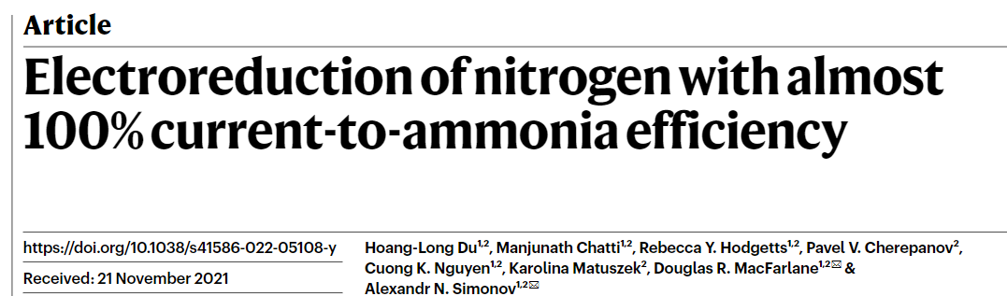

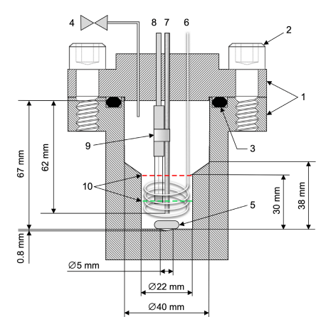
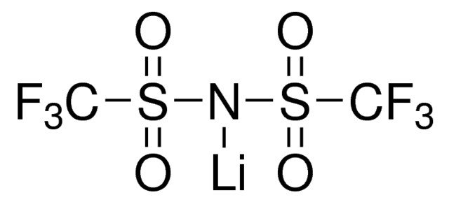
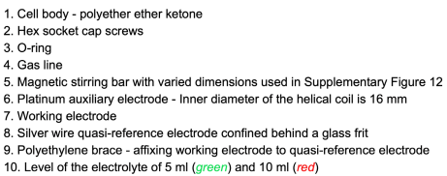
17
How can this be???
Du, HL., Chatti, M., Hodgetts, R.Y. et al. Electroreduction of nitrogen with almost 100% current-to-ammonia efficiency. Nature 609, 722–727 (2022). https://doi.org/10.1038/s41586-022-05108-y
Lithium mediated nitrogen reduction
Nitrogen pressure: 15 bar
Solvent: THF
Salt: LiTFSI
Proton carrier: ethanol
Electrode: nickel
What happens at the anode? Solvent is being oxidized…

Slide 19
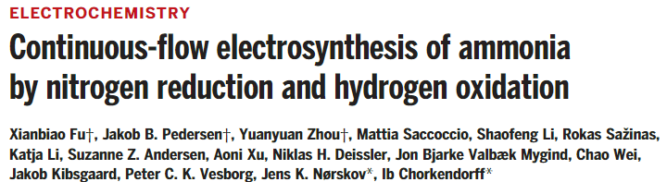
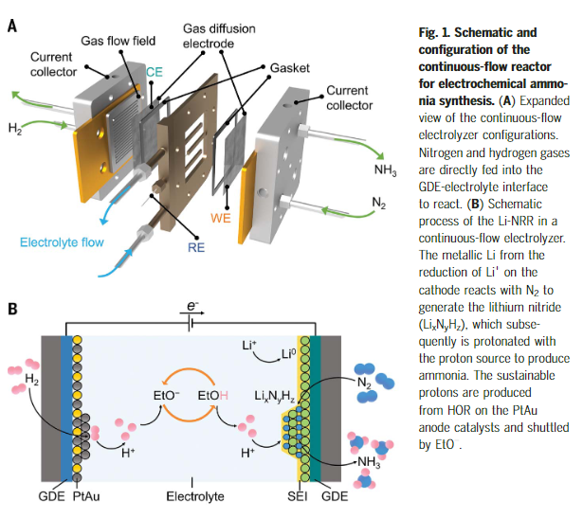
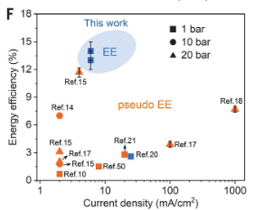
18
Lithium mediated nitrogen reduction
Faradaic efficiency: ~ 60 %
Voltage: 4-5 V
Fu et al., Science 379, 707–712 (2023)
Notes:
Gde stainless steel

Slide 20
How else can we decarbonize ammonia production?
19
Power
Heat
Steam reforming of methane
+ water-gas shift reaction:
“grey hydrogen”
Direct CO₂
emissions
https://en.wikipedia.org/wiki/Haber_process

Slide 21
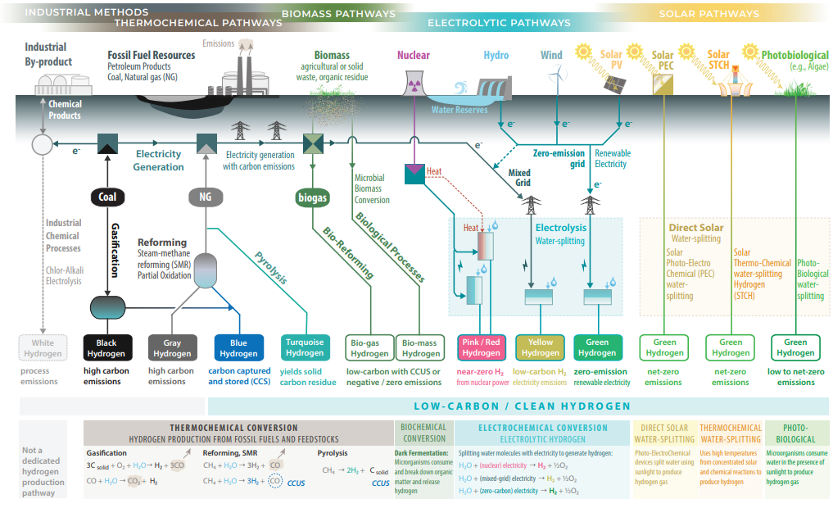
20
Ahmet Kusoglu 2021 Electrochem. Soc. Interface 30 44

Slide 22
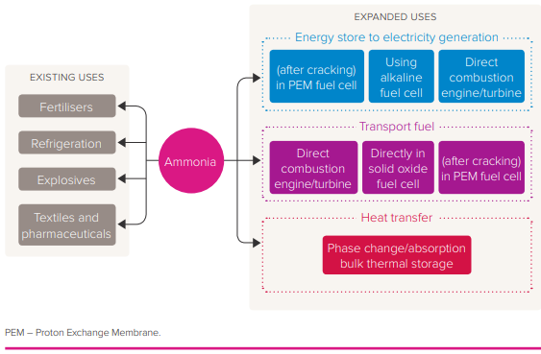
Hydrogen economy? What about… ammonia economy :o
21
https://royalsociety.org/-/media/policy/projects/green-ammonia/green-ammonia-policy-briefing.pdf

Slide 23
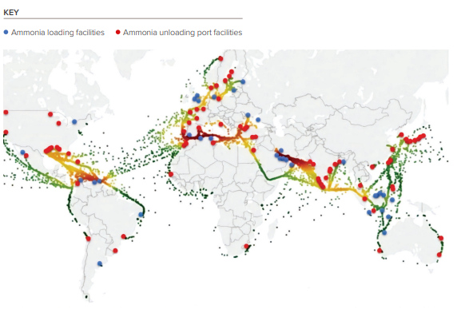
Ammonia gets around
22
https://royalsociety.org/-/media/policy/projects/green-ammonia/green-ammonia-policy-briefing.pdf

Slide 24
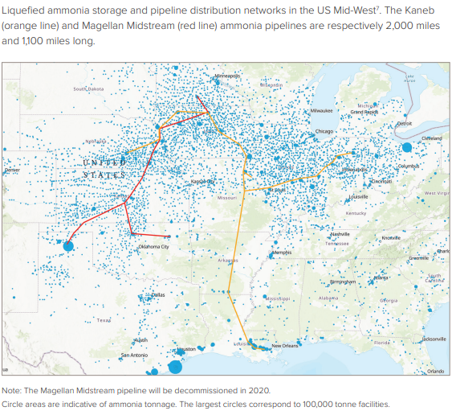
23

Slide 25
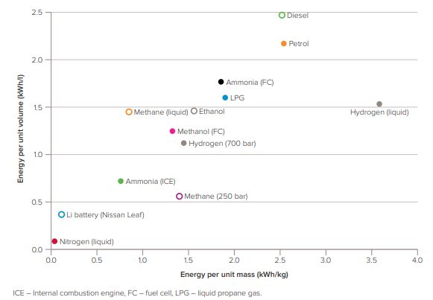
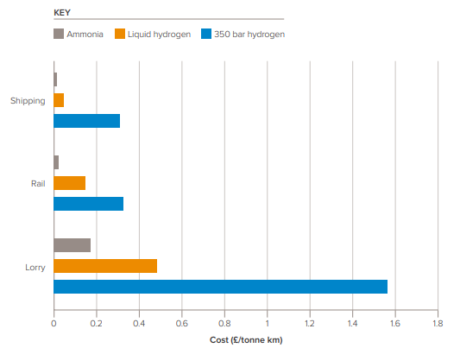
Ammonia as fuel
24
https://royalsociety.org/-/media/policy/projects/green-ammonia/green-ammonia-policy-briefing.pdf

Slide 26
But don’t forget!
25

