Slide 1
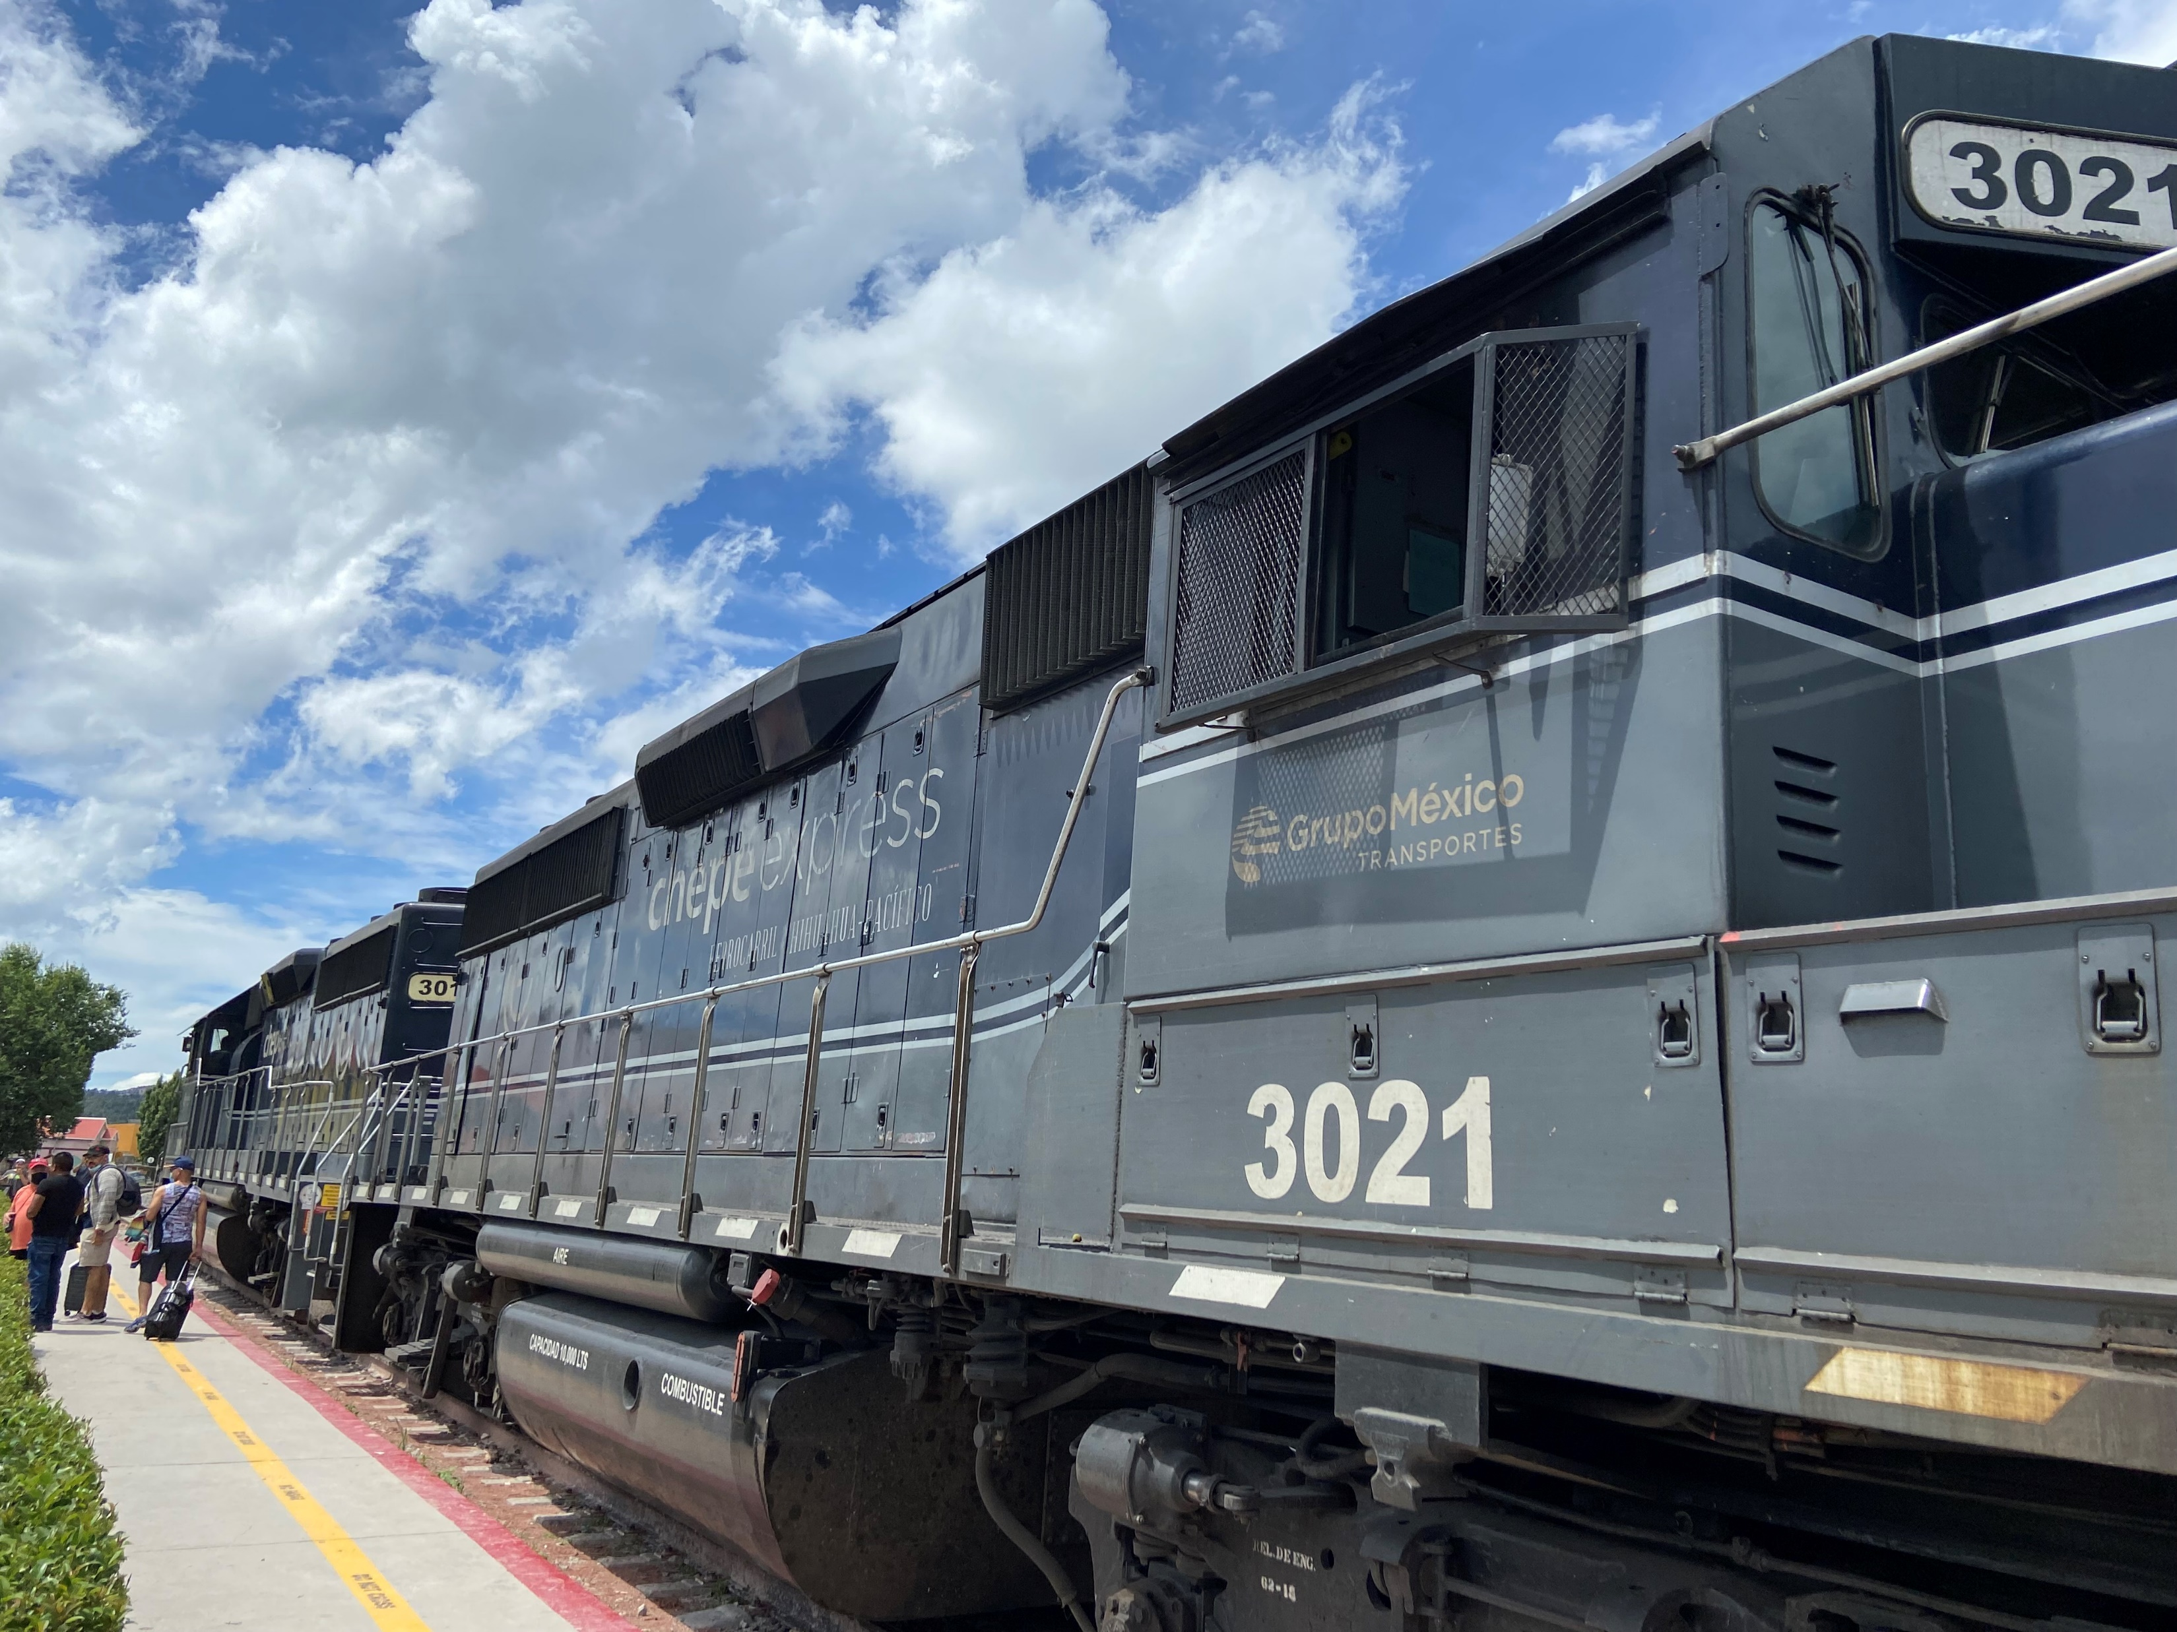
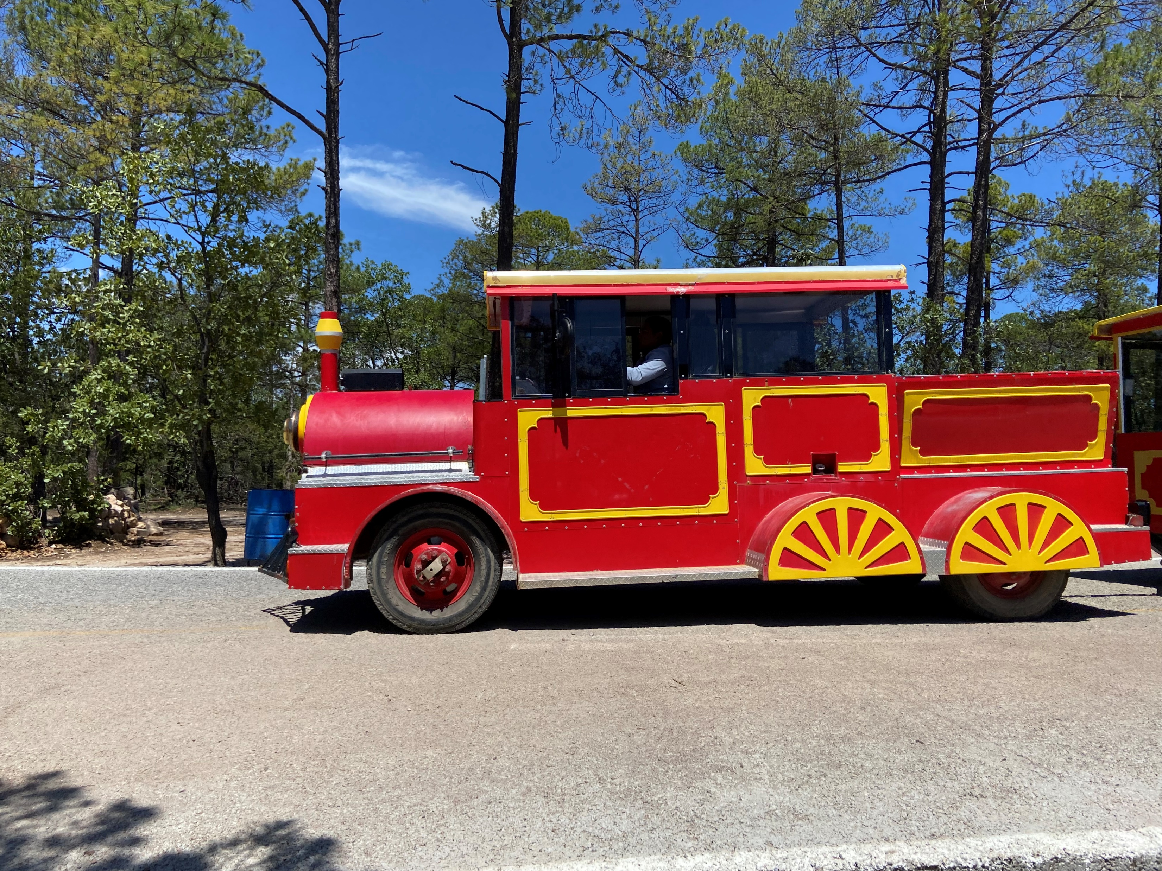
Conducting Electrons to Transport People & Cargo; How Should we Conduct Ourselves?
Harvard Energy Journal Club
Jordan D. Sosa
April 7th, 2023
Notes:
Heads up, we’re gonna be US centric

Slide 2
Outline
Motivation
Examining transportation systems: Cars, planes, & trains
  Considering emissions to create and operate
  Considering costs
Side-by-side comparison (3 slides)
Recommendations for funding (1 slide)

Slide 3
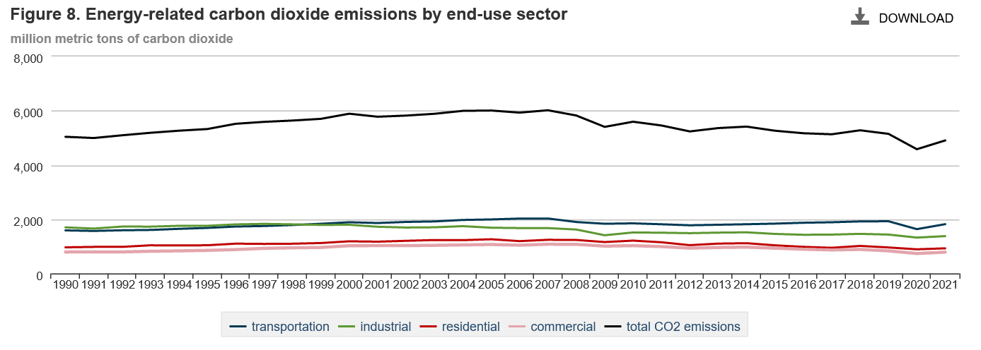
Motivation: Transportation #1 Emitter in USA
U.S. Energy-Related Carbon Dioxide Emissions, 2021 https://www.eia.gov/environment/emissions/carbon/ Accessed April 6, 2024
Notes:
Emissions increased 11% from 2020 to 2021, unsurprisingly; they are still 5% below pre-pandemic levels though!
However, increase in petroleum products, particularly in transport, accounted for over half the rise in US CO2 emissions. This can be due to people traveling again and also return to work in offices (9% increase in emissions). 27% increase came from jet fuel emissions! 7% increase from diesel

Slide 4
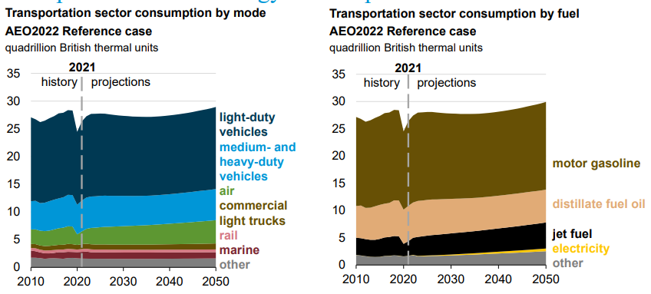
Breaking Down Transport Emissions
US Energy Information Administration, Annual Energy Outlook 2022 https://www.eia.gov/outlooks/aeo/pdf/AEO2022_ChartLibrary_full.pdf Accessed April 6, 2023
Notes:
Looks like light-duty and medium and heavy-duty vehicles cause the most pollutions. Let’s see how we can improve them!

Slide 5
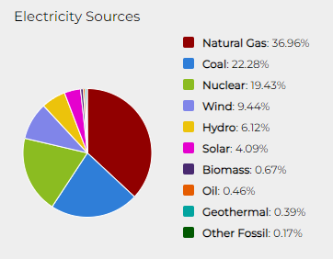
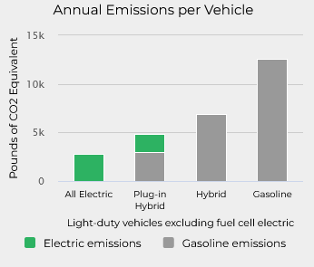
Solution: Electrify cars!
https://afdc.energy.gov/vehicles/electric_emissions.html Accessed April 6, 2023
Notes:
“If you’re a young G2 thinking about how cool EVs are, you might make a presentation showing things like these in the Fall of 2020”

Slide 6
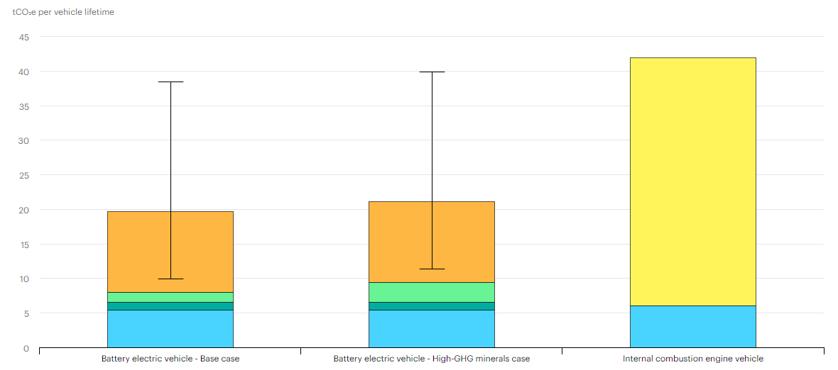

Emissions and Costs from Cars
But wait!
How much will those manufacturing emissions matter?
And how do we handle the infrastructure?
https://www.iea.org/data-and-statistics/charts/comparative-life-cycle-greenhouse-gas-emissions-of-a-mid-size-bev-and-ice-vehicle Accessed April 6, 2023

Slide 7

Emissions and Costs from Cars
$11k a year to own and operate a car
Best case, 10 tonnes CO2 per car lifetime
278 million cars registered in 2021
  Emit 2.78 Gt CO2 eq to eventually replace our cars (which last ~15 years)
  Cost of ownership is $3 trill? (something wrong here, let’s assume $300 bill)
Also, car accidents hurt A LOT of people
https://www.iea.org/data-and-statistics/charts/comparative-life-cycle-greenhouse-gas-emissions-of-a-mid-size-bev-and-ice-vehicle
https://www.forbes.com/advisor/car-insurance/car-ownership-statistics/#cost_to_own_a_car_section
Accessed April 4, 2023
Notes:
59-119 kg CO2 eq per kWh of battery energy produced
If rest of energy to run is completely clean, that’s the lower limit
Currently, it costs $11k a year to won and operate a car
Also, car accidents hurt A LOT of people
Car accidents kill more than 46k people in the US according to Annual United States Road Crash Statistics in 2022

Slide 8
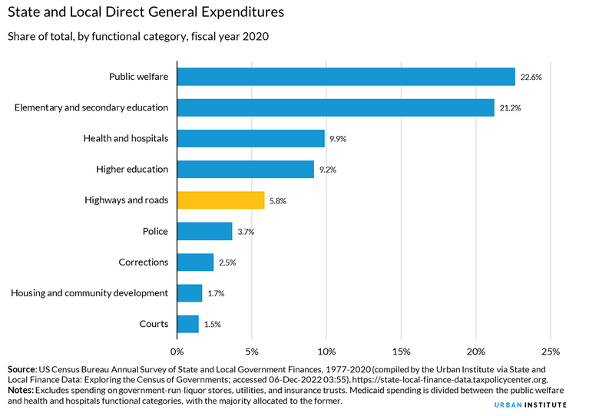
Highway Costs in the US
States and local govs spent $154b on highways;
Doesn’t include $51b from federal funding
Only 37% of that $154b comes from driving-related taxes/tolls (that means you paid for the other 67%)
https://www.urban.org/policy-centers/cross-center-initiatives/state-and-local-finance-initiative/state-and-local-backgrounders/highway-and-road-expenditures Accessed April 6, 2023
Notes:
In 2020, 43 percent of highway and road spending went toward operational costs, such as maintenance, repair, snow and ice removal, highway and traffic design and operation, and highway safety. The other 57 percent went toward capital spending, such as the construction of both highways and roads.
By the way, only 37 percent of funds from taxes or tolls associated with driving paid for these costs. The other 63% came from general funds!!!

Slide 9
So we’ve reviewed cars’ minimum emissions and current costs.
What about planes?

Slide 10
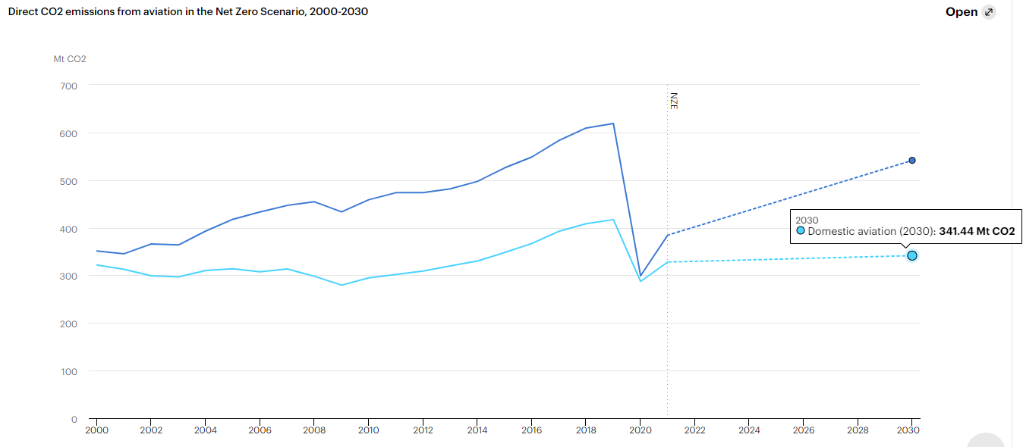
What About Planes?
11% of US emissions according to *
Plot from https://www.iea.org/reports/aviation, accessed Apr 4, 2023
*White House Fact Sheet “Biden Administration Advances the Future of Sustainable Fuels in American Aviation
Notes:
Dark blue is international aviation

Slide 11
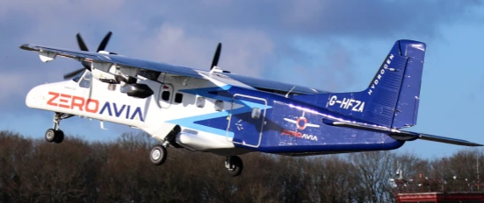
Cutting Down Emissions for Planes
Issues:
Still don’t have these biofuels we need now
Can’t store H₂ well in planes
And what about costs?
Funding for R & D:*
  Sustainable fuels to enable emissions to drop 20% by 2030 compared to business as usual
    Aiming to meet 100% of aviation fuel by 2050
  30% improvement in fuel efficiency in aircrafts
Sustainable Aviation Fuel tax credit: requires 50% reduction in lifecycle emissions*
Hydrogen aircraft**
**“Hydrogen-powered planes take off with startup’s test flight” by Casey Crownhart. MIT Technology Review, Jan 19, 2023
*White House Fact Sheet “Biden Administration Advances the Future of Sustainable Fuels in American Aviation
Notes:
MIT hydrogen aircraft: 19-seat air craft powered in part by h2 fuel cells. Made by ZeroAvia. Lasted 10 minutes. Left side engines were from H2 fuel cells and batteries; right side was kerosene
They had to remove all the seats to fit the fuel cell propulsion system (major limit: Creating lots of hydrogen at cost and storing it appropriately)

Slide 12
Emissions and Costs for Planes
Consumers spent over $76b on domestic flights in 1st 10 months of 2022 ($11b more than in 2019), & flight costs increasing*
In 2013-2017, government granted ~$3b PER YEAR on airport infrastructure**
  In 2022, we’ve started funding another 1 of $5b into airport infrastructure***
11% of emissions *V
$8b a year on Federal Aviation Administration V
“More people travel by air in the United States than on any other nation’s system but the U.S. system ranks behind other major industrialized states in performance. Its airports perform poorly on international rankings, and no U.S. airline rates among the top performing global carriers.”
- https://www.cfr.org/backgrounder/us-aviation-infrastructure Accessed April 6, 2024
*https://www.cntraveler.com/story/rising-airfare-prices-americans-spent-11-billion-domestic-flights#:~:text=While%20bookings%20for%20domestic%20flights,to%20%2465%20billion%20in%202019.
**https://www.gao.gov/products/gao-20-298
*** https://www.faa.gov/newsroom/faa-begins-investing-1b-bipartisan-infrastructure-law-funding-air-traffic-control-system
*V https://www.whitehouse.gov/briefing-room/statements-releases/2021/09/09/fact-sheet-biden-administration-advances-the-future-of-sustainable-fuels-in-american-aviation/
V https://www.cfr.org/backgrounder/us-aviation-infrastructure
Accessed April 6, 2024
Notes:
In 2013-2017 funding, it’s notable that airports spent 14 billion dollars annually for infrastructure projects
Breakdown in 2022 funding from IRA:
Reinforce Navigation, Weather & Tracking Equipment: The FAA uses a host of communications, surveillance, weather and navigation systems to guide aircraft safely. We will complete the backlog of supporting infrastructure sustainment projects to keep these systems reliable.
Power Systems: Replace underground cables, transformers, switches at airports, engine generators and fuel storage tanks that are part of primary and back-up power systems for our air traffic systems.
Enroute Flight Centers: Update and repair the country’s Air Route Traffic Control Centers that handle aircraft flying at high altitudes.
Long-Range Radars: Renovate or replace the supporting infrastructure at long-range radar sites, which are critical to tracking flights between airports.
Replace Towers: Pay for design, site evaluation and preparation for the first air traffic control towers that will be replaced over the coming years. Many of the towers selected will be located at regional and smaller airports.
Improve Towers and Approach & Departure Facilities: More than 50 percent of our towers and TRACON facilities, which handle flights entering and exiting busy airspace, are over 40 years old. Funding will pay for new elevators, plumbing systems, and supporting infrastructure.
Environmental and Safety: Remove and restore areas where we have outdated facilities or personnel safety infrastructure that is no longer used and incorporate environmental and personnel safety updates.
Personnel & Travel: Recruit and hire installation technicians and engineers needed to improve and modernize these facilities.
Facility Security: Upgrade various integrated security systems at all FAA staffed facilities. Upgrades include those for guardhouses, visitor parking, fencing, perimeter hardening, window blast protection and lighting.
Note on pop up quote: Reason performance is so bad is because the airlines become one of the most profitable investments once they started increasing fares and decreasing how much of their capacity they use (they just overfill every flight now). There are also claims that for airlines to perform better, we need to be investing MORE in airports and airline companies! (see next slide)

Slide 13
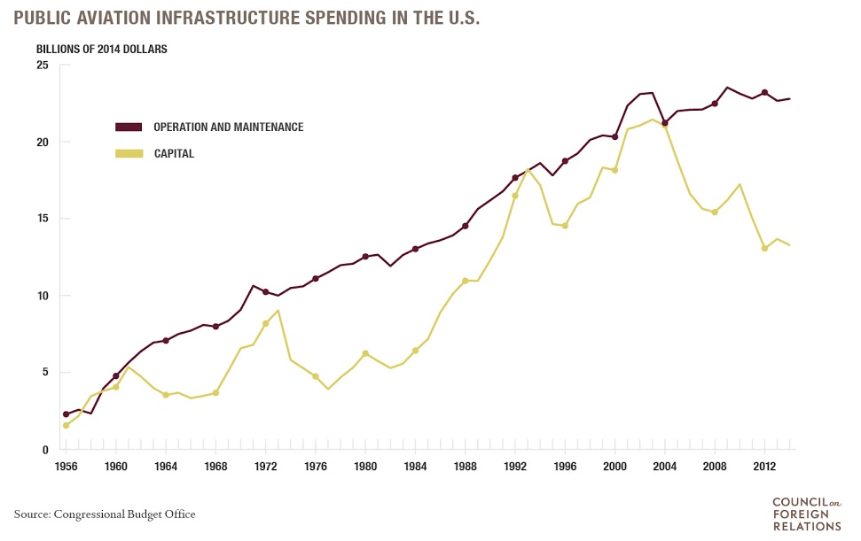
Emissions and Costs for Planes
https://www.cfr.org/backgrounder/us-aviation-infrastructure Accessed April 6, 2023
Notes:
Reasons for this decline in capital include a decline in the federal share of spending, project delays due to budgetary constraints, and the Great Recession (2007-2009)
The FAA spends over $7 billion annually on air traffic control operations, and over $1.2 billion in developing and enforcing new safety standards and aircraft certifications

Slide 14

So we’ve reviewed cars’ and planes’ minimum emissions and current costs.
What about trains?

Slide 15
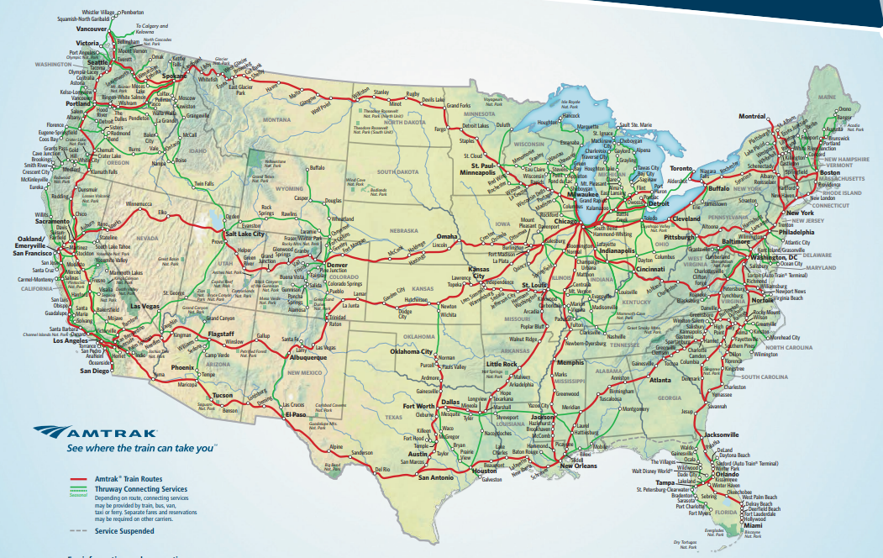
A Sad Story
The Amtrak Network in 2018
https://www.amtrak.com/content/dam/projects/dotcom/english/public/documents/Maps/Amtrak-System-Map-1018.pdf, Accessed Apr 4, 2023
By 1865, every single city in the North and Midwest were connected by railways, with over 80% of farms within 5 miles of a railway
Attempts to improve:
Obama administration: Multi-state high-speed rail, but governors stopped it
Currently: California high-speed rail
Notes:
Basically, railroads were well connected, but hard to improve standards as economic depressions kept hitting. Additionally, cars and planes showed up with massive government subsidies, while trains had heavy regulations
Cars and planes became the way to go, and many railroads were shut down. Half have shut down since the 1960s.
Car infrastructure also had socioeconomic impacts too. By building highways, governments could force minority communities that had become financially independent to have to give up their homes and spread out, so it sucks for that too.
Today, Amtrak trains now go about 110-145 mph, but often the freight tracks they use require them to go 60-80 mph. The red lines are Amtrak train routes, green lines are thruway connecting services
High speed rail in California will run at 200 mph

Slide 16
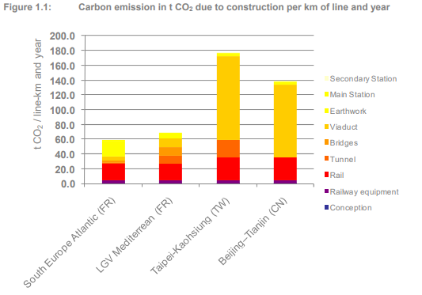
Infrastructure Emissions for Railways
Operationally:
0 CO2 emissions if sourced by renewable energy
Train cars last 50 years
Don’t require giant batteries
At worst case, that’s 0.99 Mt CO2 to build & maintain coast-to-coast railway in the US
“Carbon Footprint of High Speed Rail” Report 2011, International Union of Railways
Notes:
These numbers consider the emissions for construction of the track system and manufacturing of train cars
Calculation
Trains: Assuming highest value of 176 t CO2 per km and year, with 5,633 km, that’s 0.99 Mt CO2

Slide 17
Cost for High-Speed Rail
SF-LA route to build is about $200M per mile, spread out over ~18 years
  If we assume this value and we don’t get better at building, our coast-to-coast rail is $700 billion (over 20 years, that’s $35 bill a year)
Operations costs
  California expected to reach $1.91M per mile, which for coast-to-coast is $6.7 B per year
https://www.hoover.org/research/little-engine-couldnt-californias-high-speed-rail-costs-rise-200-million-mile
https://www.worldbank.org/en/news/press-release/2014/07/10/cost-of-high-speed-rail-in-china-one-third-lower-than-in-other-countries
Accessed April 6, 2023
Notes:
Cost is 3,500 miles * 200 = 0.7E6 mill or 700E3 mill = 700 bill
Cost for operation of 3,500 miles at 1.91 M /mile, that's $6.7 b
per year

Slide 18

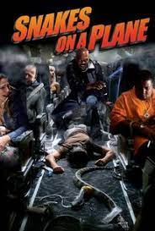

Let’s look at everything side by side

Slide 19
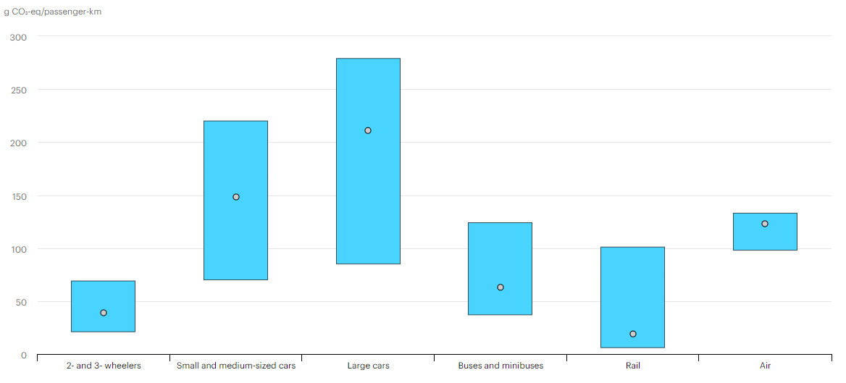
Comparing Emissions to Travel
https://www.iea.org/reports/rail
Notes:
Note that train cars are replaced every 50 years, while passenger cars are 10-20 years
According to Wikipedia, it’s

Slide 20

Car Plane Train
(manufacturing) (operation) (infrastructure)
Notes:
Emissions:
Manufacturing emissions of cars, distributed evenly over 15 years and assuming completely clean electric energy for operation
Planes: Simply operational; including in infrastructure only increases this
Trains: Infrastructure, including initial building and expected upkeep

Slide 21
Notes:
Costs:
Car infrastructure for roads (200 bill) and such + cost of ownership (300 bill we assumed)
Plane: Amount we spent on traveling last year + amount we pay from our taxes
Train: Infrastructure building distributed over 20 years + yearly maintenance + operation

Slide 22
How can we fund railroads?
Taxes (we already pay $103b for horrible car infrastructure and $8b for horrible airlines)
Capturing land value benefits to offset high capital investment costs (Idk ‘bout this)
Notes:
We already pay a shit load of our general tax funds towards highway and airport infrastructure; why not do it for rails? If we paid half of what we do for cars but for trains every year, we’d have our coast to coast train in 20 years

Slide 23

Questions?
Please enjoy this cut of the Chepe Express to Las Barrancas del Cobre
Thank you!

Slide 24
Back up stuff

Slide 25
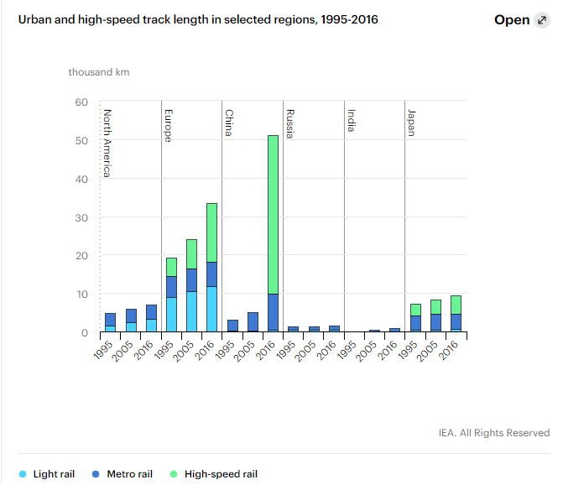
A Sad Story Continued (for US)
https://www.iea.org/reports/rail
Accessed April 6, 2023
Notes:
Metro rail cover 20,000 km, ¼ of which were installed in 2017-2021
25 countries have high-speed rail, totalling 45,000 km of track

Slide 26
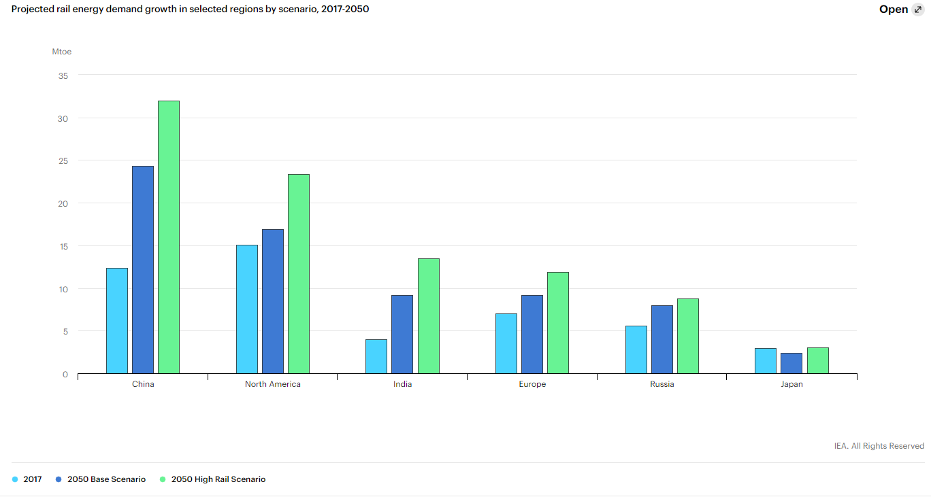
Plans for Railways & What They Could Be:
https://www.iea.org/reports/rail
Notes:
Look at that growth in China and India!

Slide 27
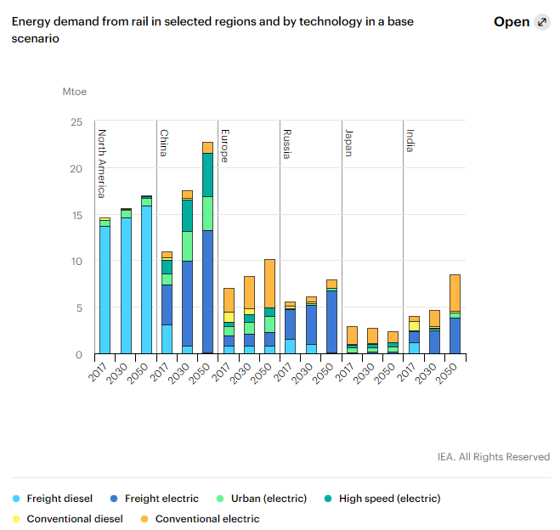
Plans for Transport:
Our trains are old and dirty!
https://www.iea.org/reports/rail Accessed April 1, 2022
Notes:
This is base scenario if we keep going the way things are

