Slide 1
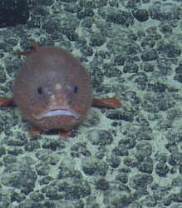
Precious metals extraction from the ocean
Manganese nodules
Sea toad
Eliza K. Spear
Harvard Energy Journal Club
Feb. 16, 2023
Notes:
Blurb: Oceans contain various desirable elements, both on the ocean floor and dissolved in the water itself. As terrestrial mines are depleted, these ocean resources are becoming more attractive and potentially cost-competitive. Deep-sea mining, which refers to mining the deep seabed for metals including nickel, cobalt, and manganese, is entering experimental stages and has raised serious environmental concerns. This talk will explore the status, pros, and cons of deep sea mining, and also discuss the viability of extracting valuable elements including lithium and uranium directly from seawater.
Image source: https://nautiluslive.org/blog/2018/10/01/mapping-clarion-clipperton-fracture-zone

Slide 2
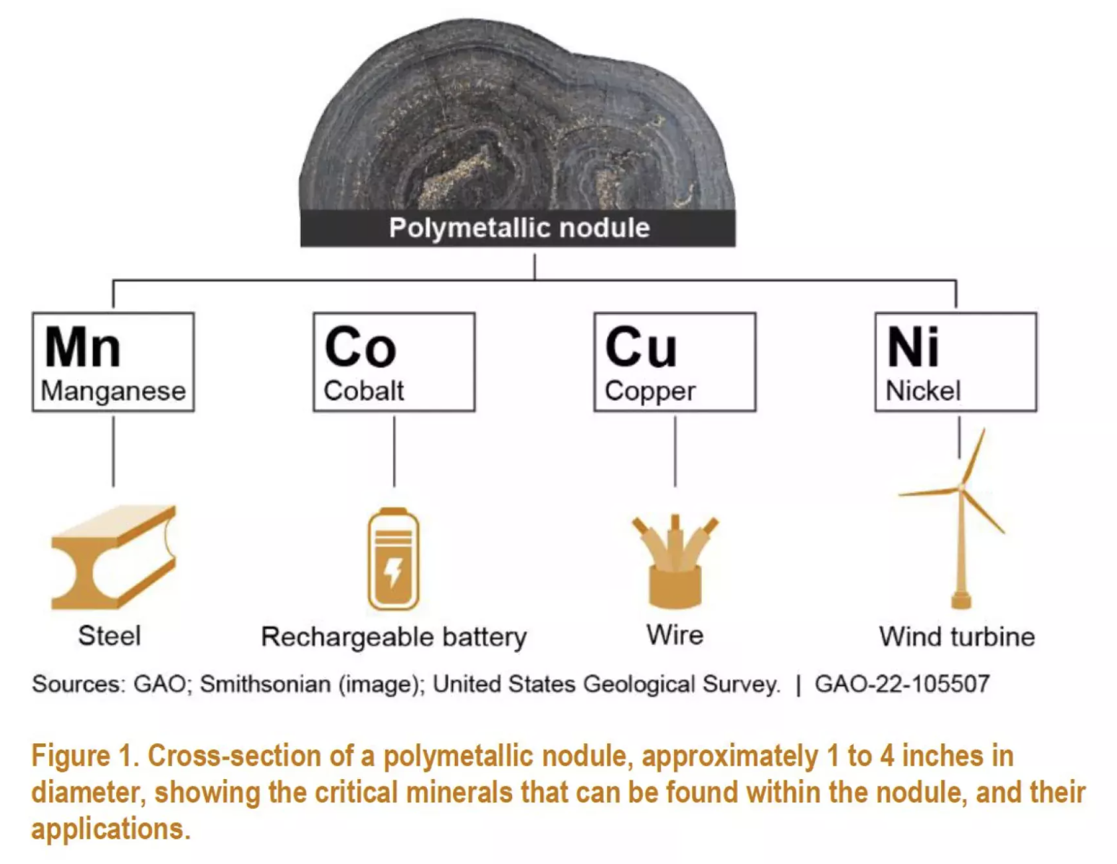
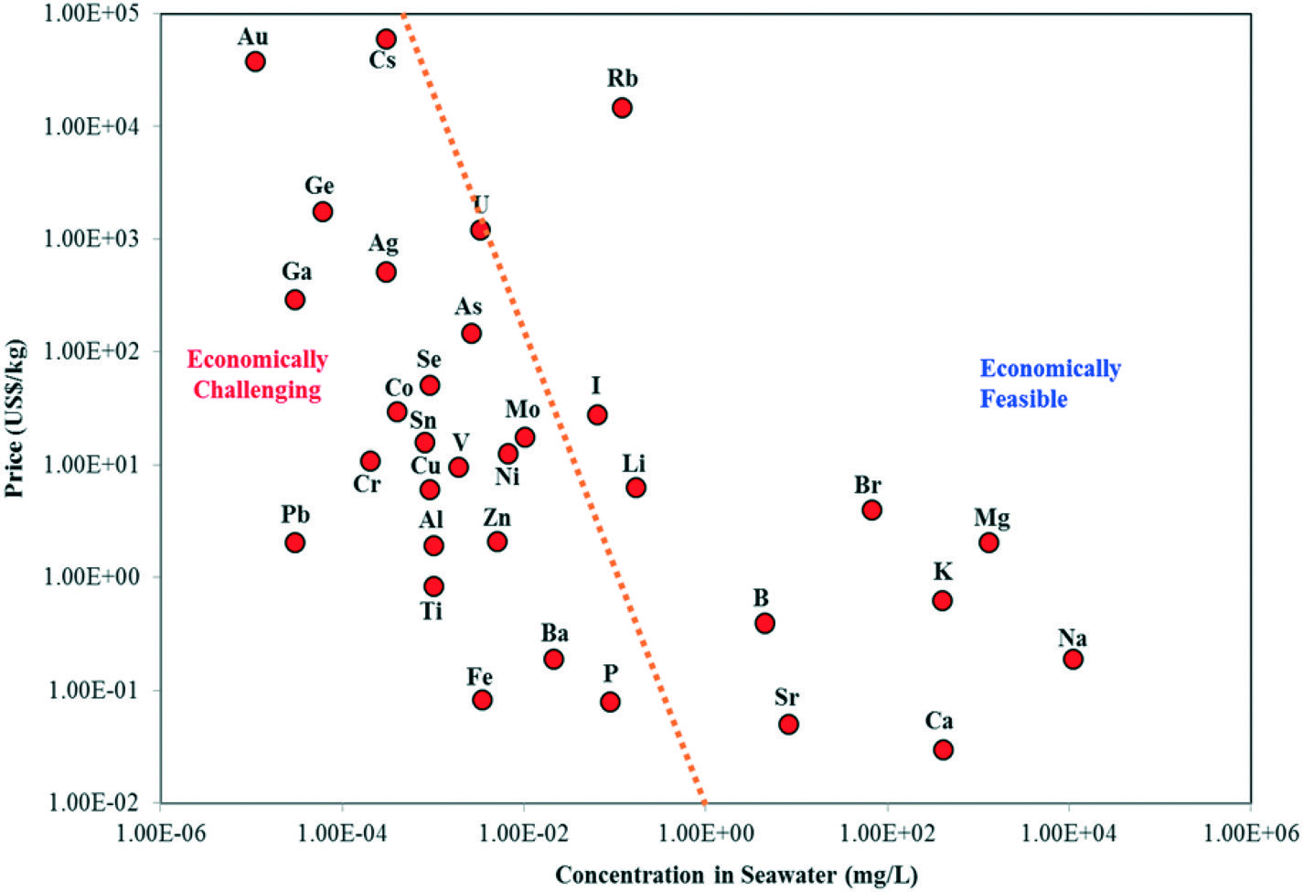
Precious metals extraction from the ocean
Deep-sea mining
Extraction from seawater
U.S. GOA, “Deep-Sea Mining Could Help Meet Demand for Critical Minerals, But Also Comes with Serious Obstacles”, Dec. 16, 2021.
P. Loganathan, G. Naidu, S. Vigneswaran. Environ. Sci.: Water Res. Technol. 2017, 3, 37

Slide 3
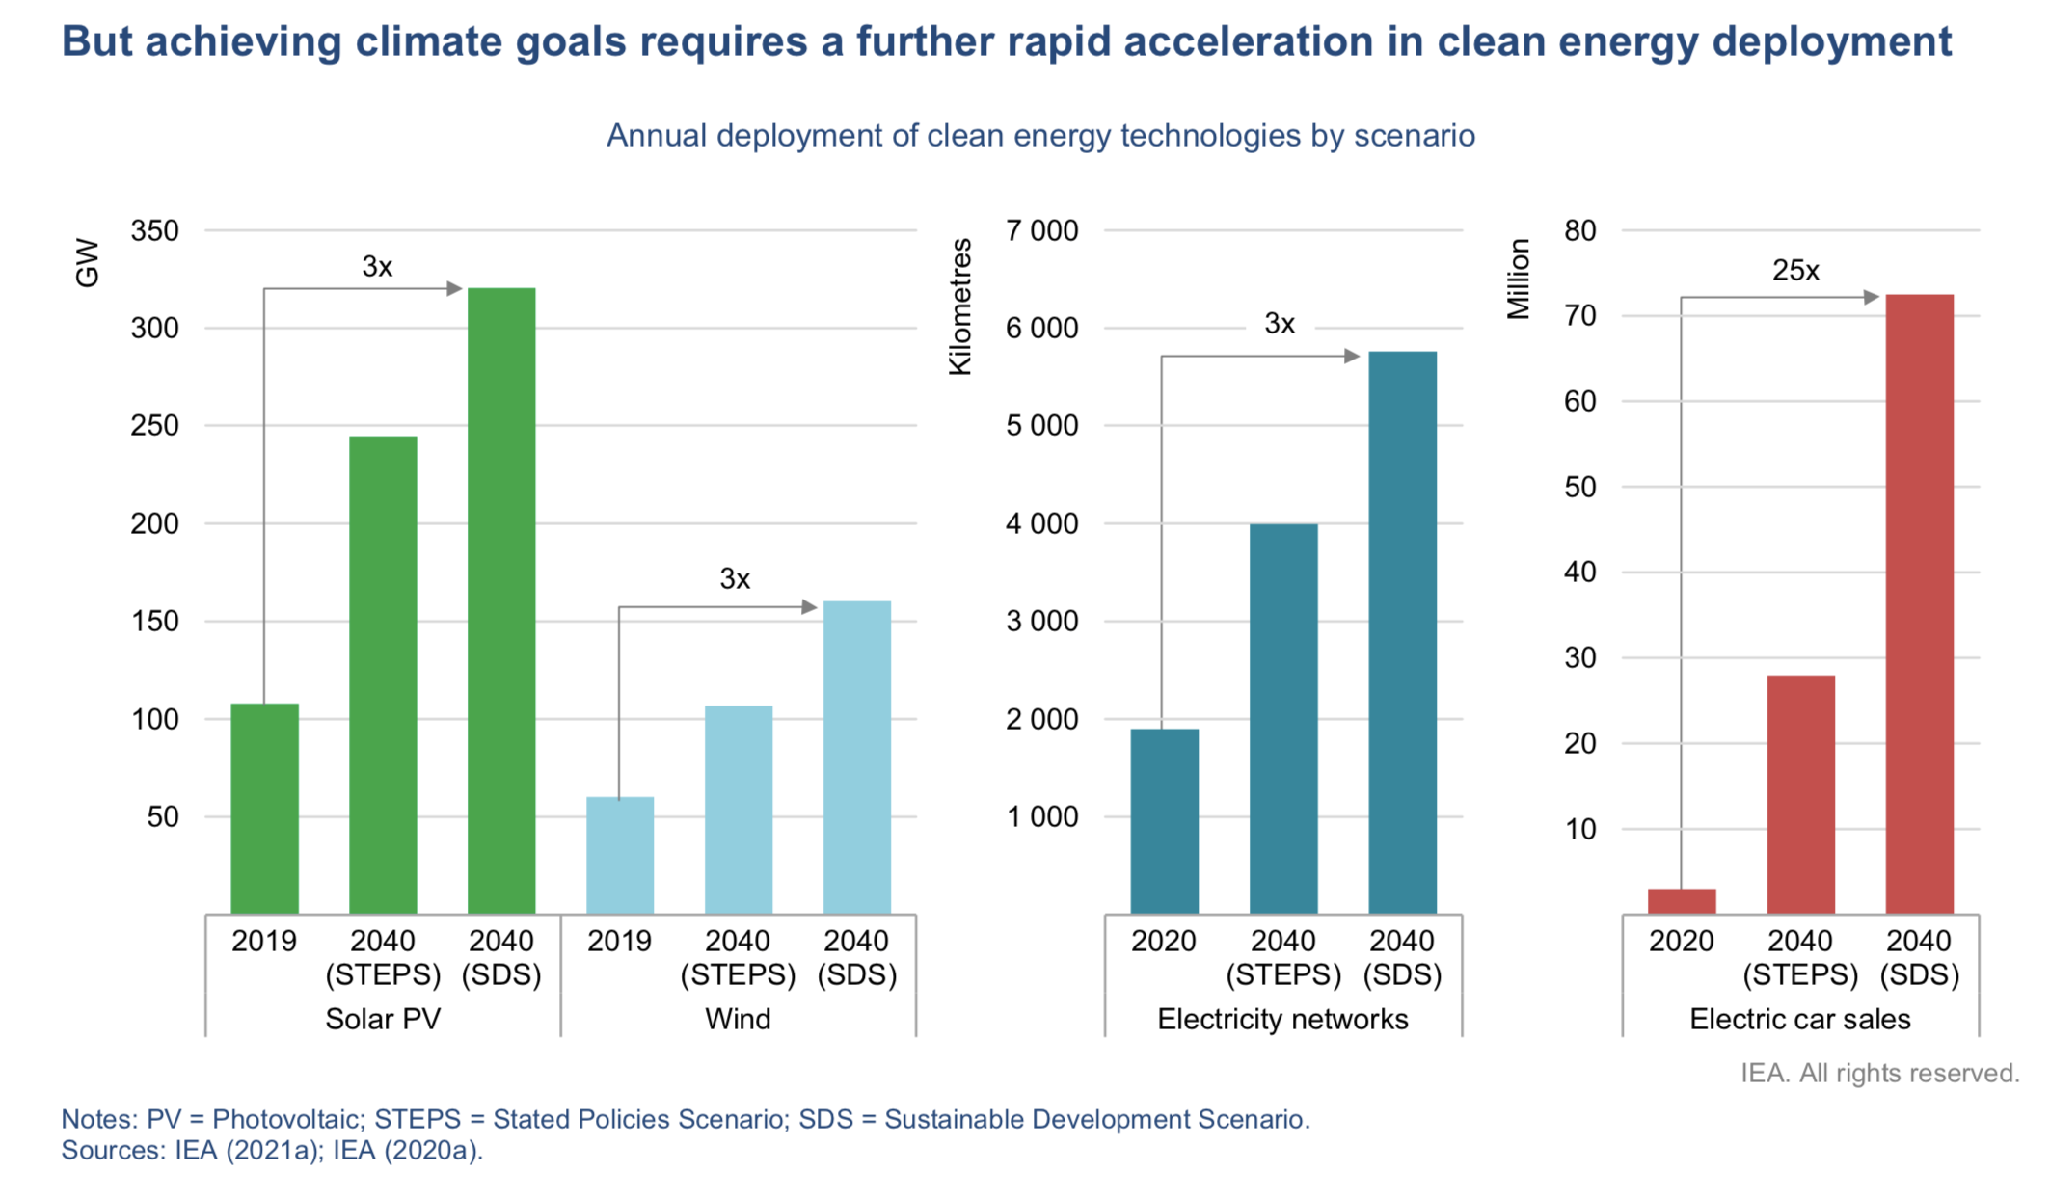
Achieving climate goals requires rapid acceleration in clean energy deployment
IEA (2021), The Role of Critical Minerals in Clean Energy Transitions, IEA, Paris.
Notes:
Nodule photo source citation: T. Peacock and M. A. Alford. The Race Is on to Mine and Protect the Deep Seafloor. Scientific American, 2018, 318 (5), 72-77.

Slide 4
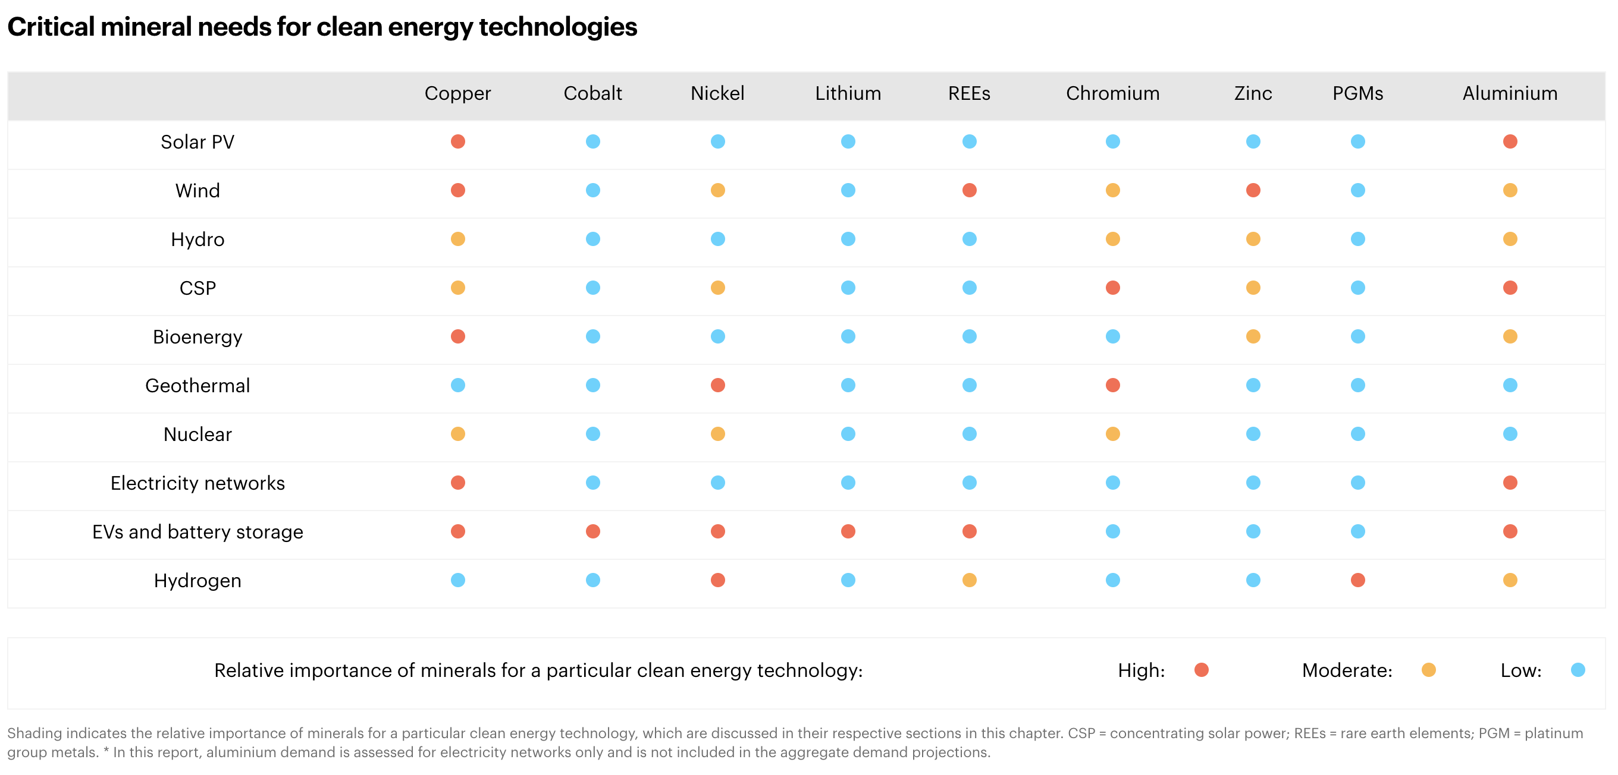
Clean energy technologies need minerals and metals
IEA (2021), The Role of Critical Minerals in Clean Energy Transitions, IEA, Paris.
Notes:
Nodule photo source citation: T. Peacock and M. A. Alford. The Race Is on to Mine and Protect the Deep Seafloor. Scientific American, 2018, 318 (5), 72-77.

Slide 5
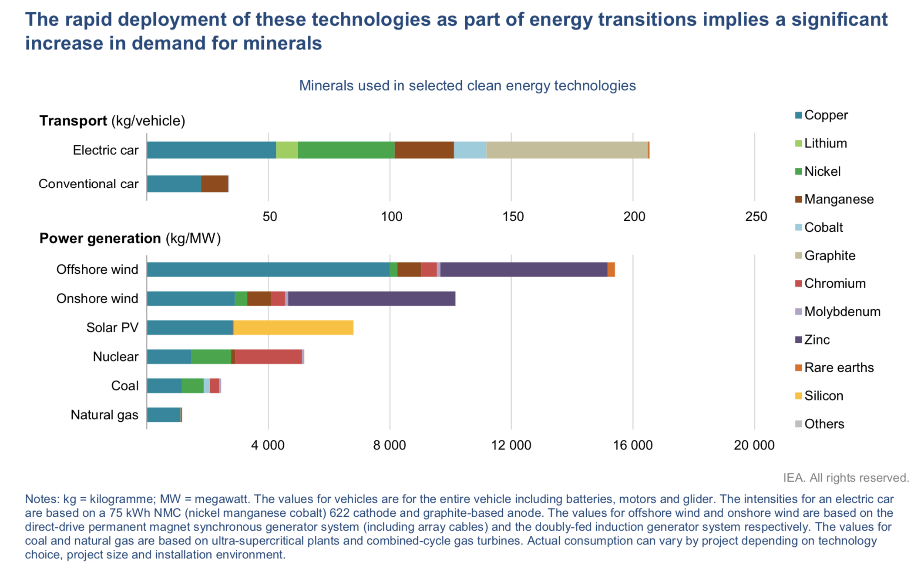
Clean energy technologies need minerals and metals
IEA (2021), The Role of Critical Minerals in Clean Energy Transitions, IEA, Paris.
Notes:
Nodule photo source citation: T. Peacock and M. A. Alford. The Race Is on to Mine and Protect the Deep Seafloor. Scientific American, 2018, 318 (5), 72-77.

Slide 6
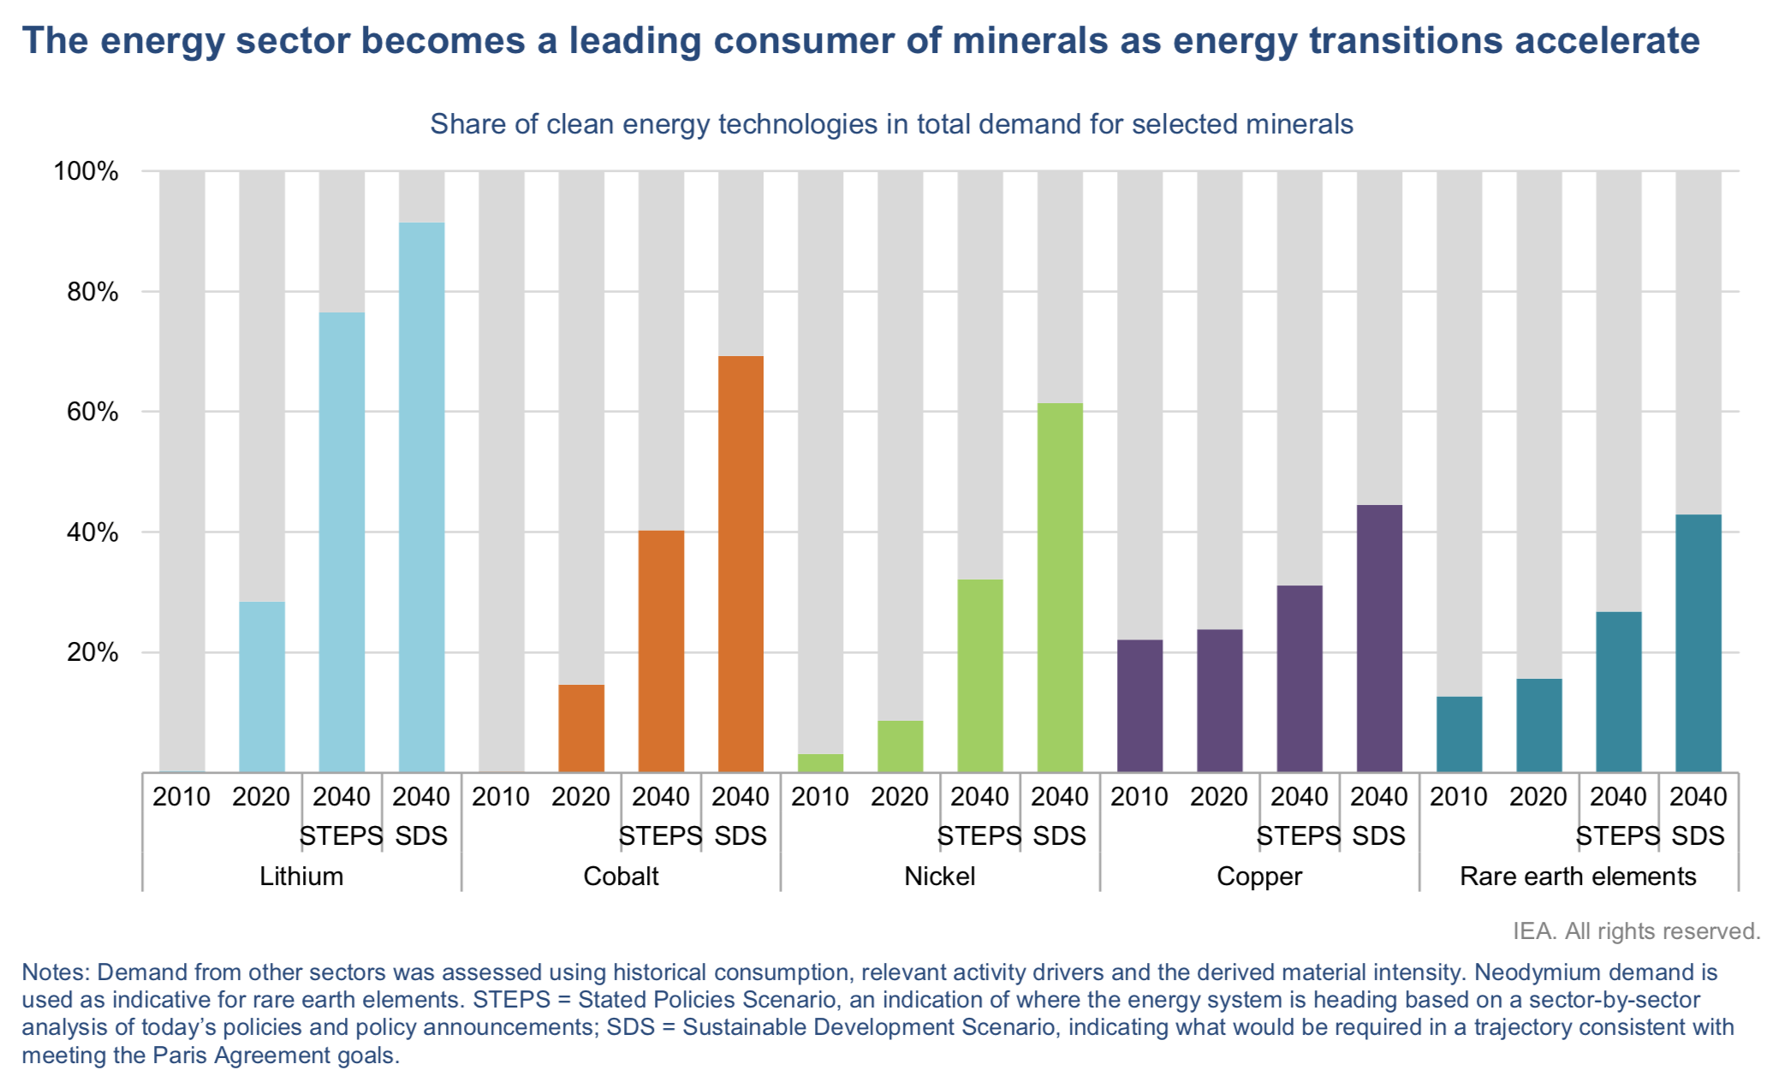
The energy sector’s demand for minerals is growing
IEA (2021), The Role of Critical Minerals in Clean Energy Transitions, IEA, Paris.
Notes:
Nodule photo source citation: T. Peacock and M. A. Alford. The Race Is on to Mine and Protect the Deep Seafloor. Scientific American, 2018, 318 (5), 72-77.

Slide 7
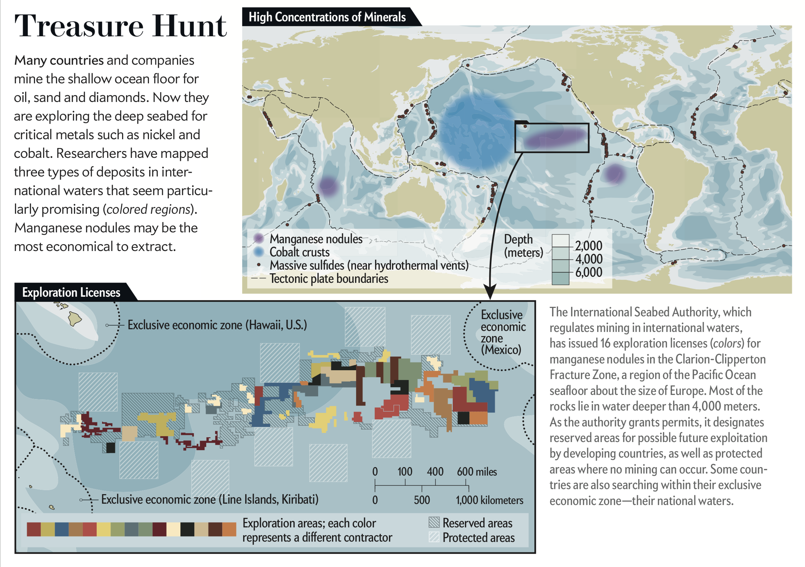
Deep-sea mining could be the answer
Materials including oil, sand, and diamonds are already mined from the shallow ocean floor.
Deep-sea mining refers to mining the deep seabed for metals including nickel, cobalt, and manganese.
Manganese/polymetallic nodules, cobalt crusts, and massive sulfides are of particular interest.
T. Peacock and M. A. Alford. The Race Is on to Mine and Protect the Deep Seafloor. Scientific American, 2018, 318 (5), 72-77.

Slide 8
Deep-sea mining could be the answer
“Deep-sea” resources are >200 m (and often >4000 m) below the ocean surface
Three major types:
Cobalt crusts
  Cobalt-rich, plus manganese, iron, copper, nickel, platinum
Massive sulfides
  Contain copper, gold, zinc, lead, barium, silver
Polymetallic nodules
  Rich in manganese, nickel, copper, cobalt, molybdenum, rare earths
  A 4.5 million km² area in the eastern Pacific Ocean is estimated to contain reserves of 274 Mt nickel and 44 Mt cobalt (greater than all terrestrial reserves)
IEA (2021), The Role of Critical Minerals in Clean Energy Transitions, IEA, Paris.
Notes:
Nodule photo source citation: T. Peacock and M. A. Alford. The Race Is on to Mine and Protect the Deep Seafloor. Scientific American, 2018, 318 (5), 72-77.

Slide 9
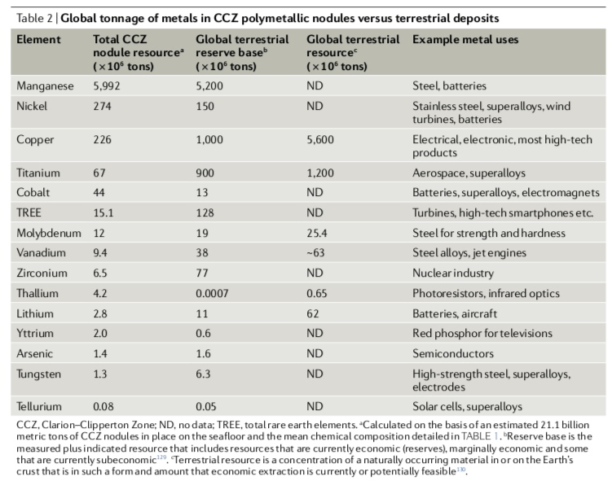
Polymetallic nodules
J. R. Hein, A. Koschinsky, T. Kuhn. Deep-ocean polymetallic nodules as a resource for critical materials. Nat. Rev. Earth Environ. 2020, 1, 158-169.
Notes:
Nodule photo source citation: T. Peacock and M. A. Alford. The Race Is on to Mine and Protect the Deep Seafloor. Scientific American, 2018, 318 (5), 72-77.

Slide 10
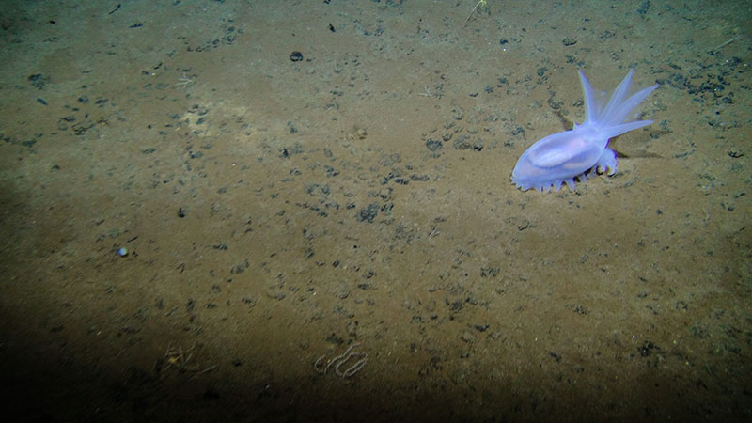
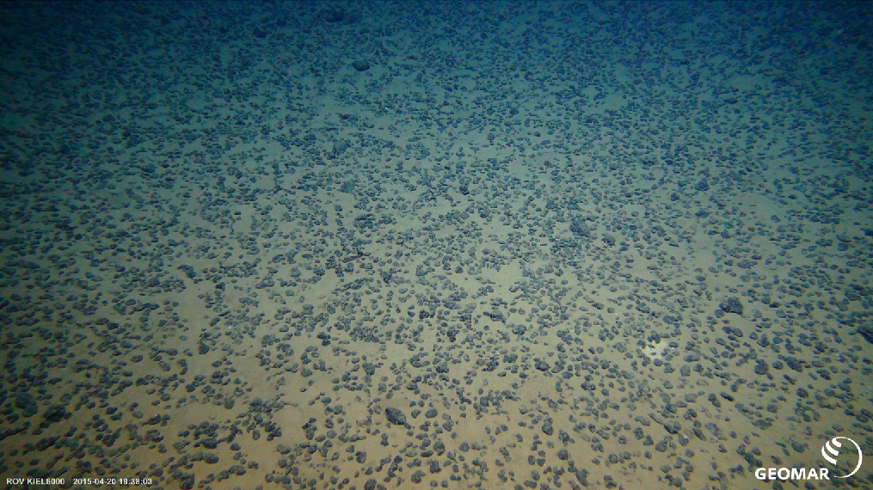
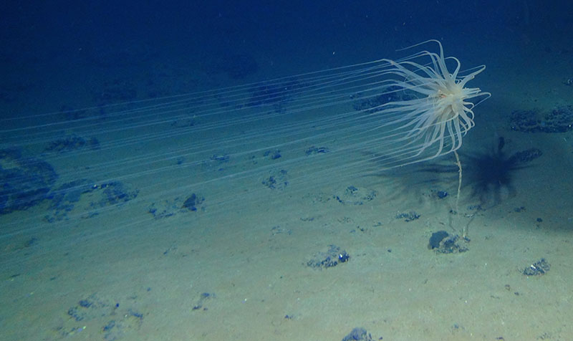
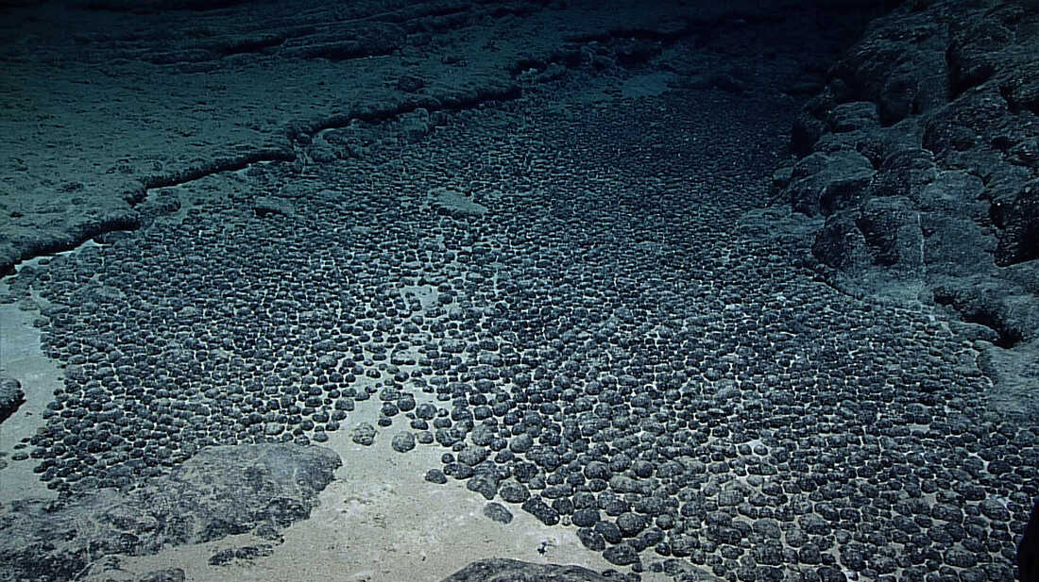
Polymetallic nodules
Notes:
Photos:
Uniform field of nodules (Geomar label): https://dsmobserver.com/2019/12/a-primer-on-polymetallic-nodule-fields/
Field of nodules: https://www.npr.org/2021/09/03/1031434711/your-next-car-may-be-built-with-ocean-rocks-scientists-cant-agree-if-thats-good
With critters (2): https://oceanexplorer.noaa.gov/explorations/18ccz/background/mining/mining.html

Slide 11
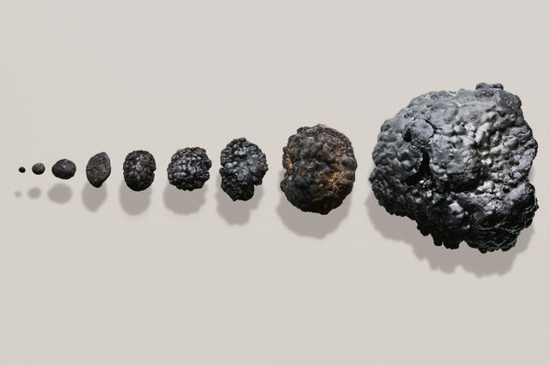
Polymetallic nodules
First discovered at 4300-5500 m depths in the 1870s
Minerals come from seawater and sediment pore water
Interest in mining nodules led to pilot mining operations in the 1960s-1970s, but ended in the early 1980s due to low metal prices
Since 2010, private companies have driven the polymetallic nodule mining industry, which is currently in experimental / pilot phases
Manganese nodules
Photo by Brett Stevens
J. R. Hein, A. Koschinsky, T. Kuhn. Deep-ocean polymetallic nodules as a resource for critical materials. Nat. Rev. Earth Environ. 2020, 1, 158-169.
Notes:
Nodule photo source citation: T. Peacock and M. A. Alford. The Race Is on to Mine and Protect the Deep Seafloor. Scientific American, 2018, 318 (5), 72-77.

Slide 12
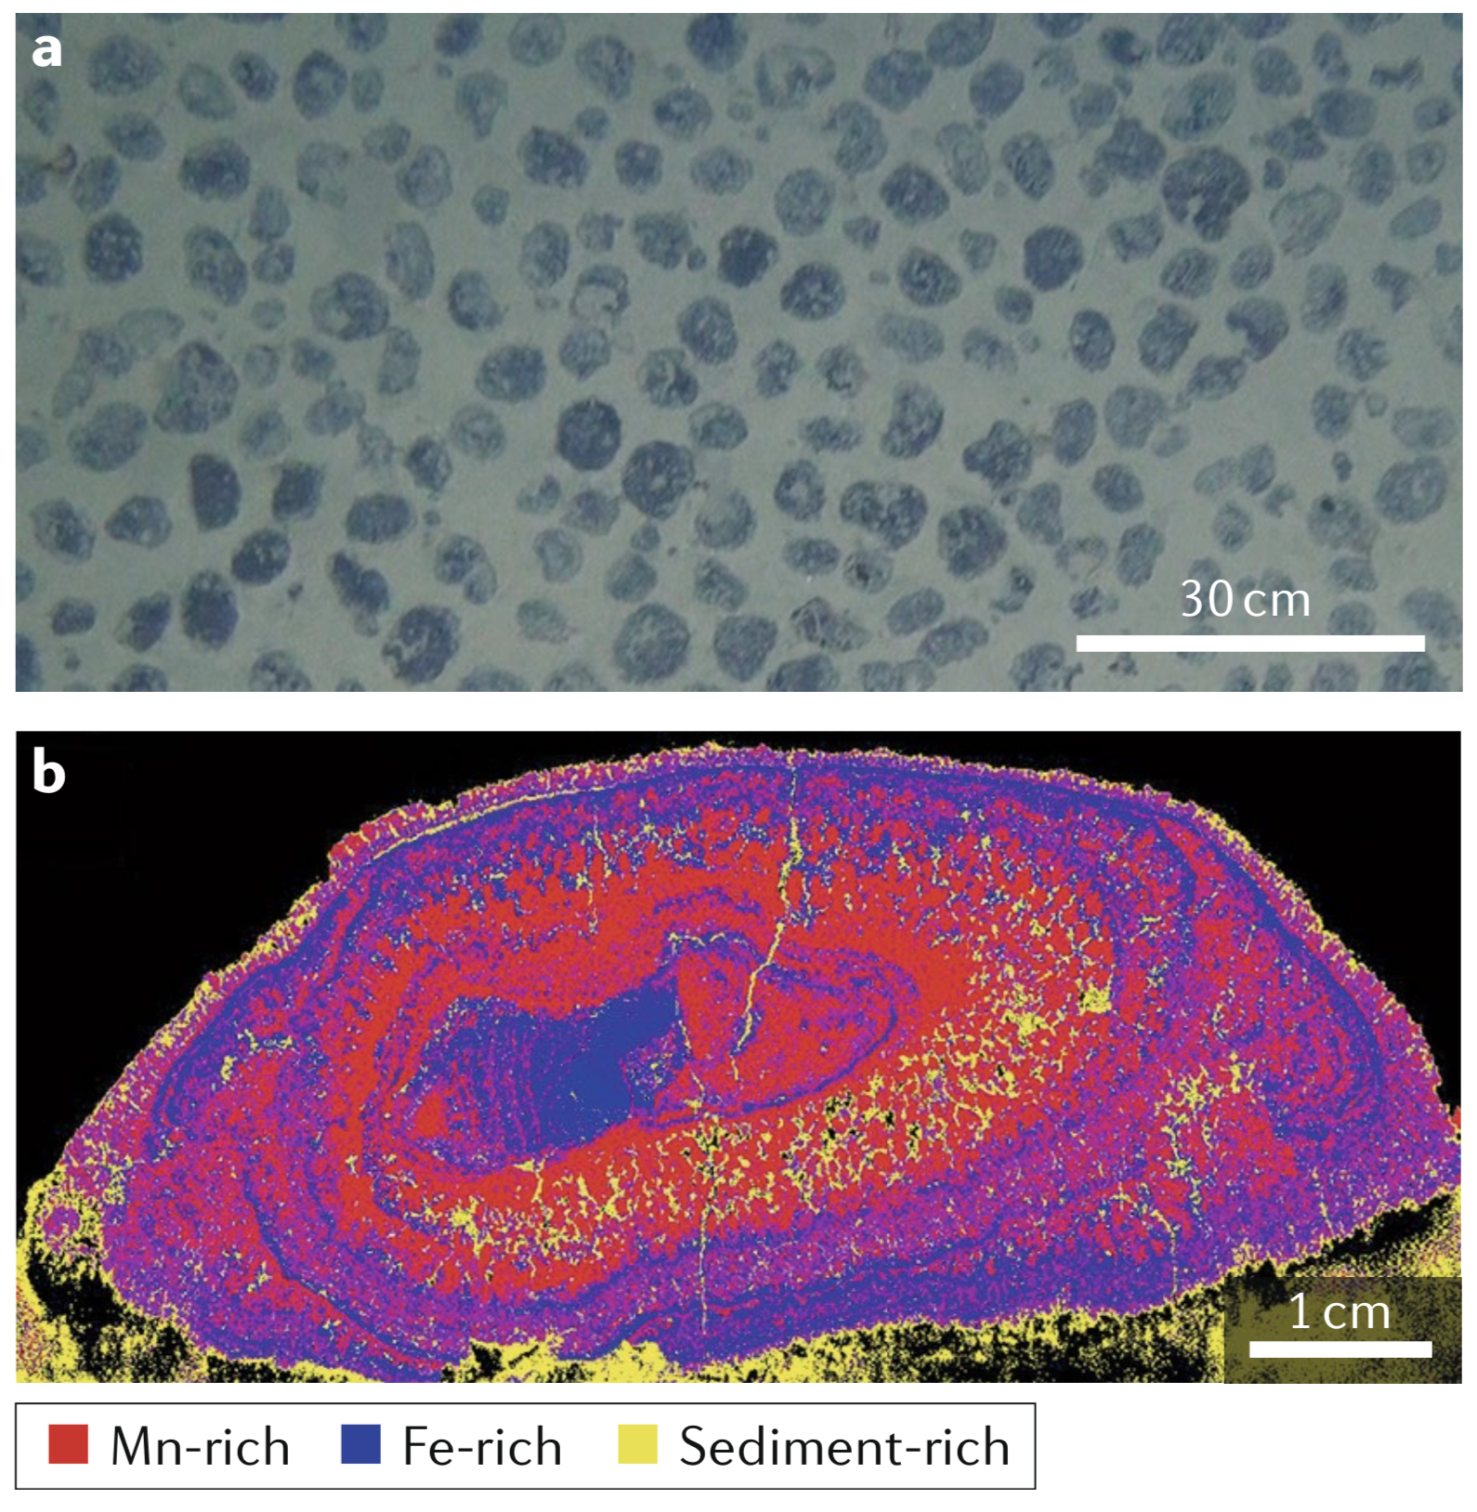
Polymetallic nodules
Form on the sediment-covered floor of the ocean at depths of 3500-6500 m
Composed of alternating micrometer-scale Fe-rich and Mn-rich laminae
Nodule density ~20 kg m⁻²
Fig. 2 | Small-scale distribution and structure of polymetallic nodules.
a | Plan view of the seafloor in the central Clarion–Clipperton Zone at 4,900 m water depth with even coverage of about 20 kg m⁻² (dry weight) of medium-sized nodules.
b | X-ray scan of a nodule cross section from the Clarion–Clipperton Zone with typical alternation of Mn-rich and Fe-rich layers. Sediment within the nodules is an indication of their high porosity.
J. R. Hein, A. Koschinsky, T. Kuhn. Deep-ocean polymetallic nodules as a resource for critical materials. Nat. Rev. Earth Environ. 2020, 1, 158-169.

Slide 13
Polymetallic nodule formation
Hydrogenetic precipitation
Driven by oxidation of dissolved Mn²⁺ and Fe²⁺ in oxygen-rich ocean waters
Mn⁴⁺ and Fe³⁺ oxide colloids accrete around a nucleus
Hydrogenetic layers form at rates of a few millimeters per million years
Requires negligible sedimentation and oxic conditions on the ocean floor and in the underlying sediment
Diagenetic precipitation
Within pore space of deep-ocean sediments; requires slightly higher sedimentation rates than hydrogenetic precipitation
Oxidation of organic matter results in reduction and dissolution of Mn oxides and release of associated elements (Ni, Cu, Li, others)
Concentration gradients cause metals to diffuse upwards
On contact with oxygen-rich ocean water, metals are re-oxidized and precipitate
Form at rates of a few tens of millimeters per million years
J. R. Hein, A. Koschinsky, T. Kuhn. Deep-ocean polymetallic nodules as a resource for critical materials. Nat. Rev. Earth Environ. 2020, 1, 158-169.

Slide 14
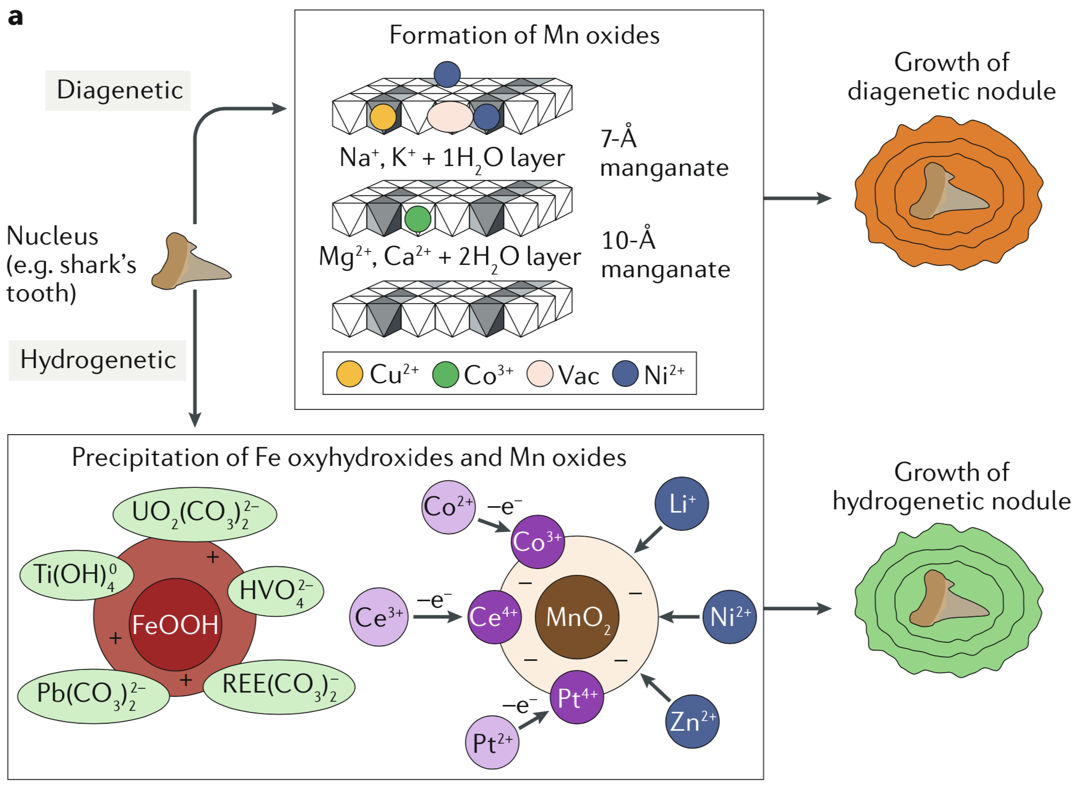
Polymetallic nodule formation
“Polymetallic nodules primarily consist of precipitated iron oxyhydroxides and manganese oxides, onto which metals such as nickel, cobalt, copper, titanium and rare earth elements sorb.”
Fig. 3 | Formation mechanisms and environments for polymetallic nodules.
a | Schematic showing the formation of δ-MnO₂ and ferrihydrite (bottom) and phyllo- manganates (top), which precipitate around a nucleus to form hydrogenetic and diagenetic nodule layers, respectively. In addition to those shown here, many other anions and neutral complexes sorb onto the ferrihydrite and cations sorb onto the δ-MnO₂ and other phyllomanganates.
J. R. Hein, A. Koschinsky, T. Kuhn. Deep-ocean polymetallic nodules as a resource for critical materials. Nat. Rev. Earth Environ. 2020, 1, 158-169.

Slide 15
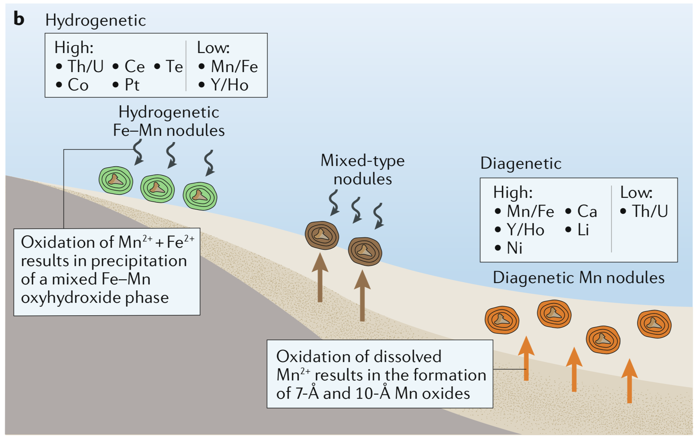
Polymetallic nodule formation
“Polymetallic nodules primarily consist of precipitated iron oxyhydroxides and manganese oxides, onto which metals such as nickel, cobalt, copper, titanium and rare earth elements sorb.”
Nodule formation is feasible in areas with sedimentation rates <10 mm per 1,000 years, a source of material for nucleation (e.g. particles of rock debris, indurated sediment, nodule fragments, shark teeth), surface waters that have moderate to low productivity and small-scale ocean floor topography.
Fig. 3 | Formation mechanisms and environments for polymetallic nodules.
b | Schematic showing the formation of hydrogenetic, mixed- type and diagenetic nodules, with variations in chemistry shown.
J. R. Hein, A. Koschinsky, T. Kuhn. Deep-ocean polymetallic nodules as a resource for critical materials. Nat. Rev. Earth Environ. 2020, 1, 158-169.

Slide 16
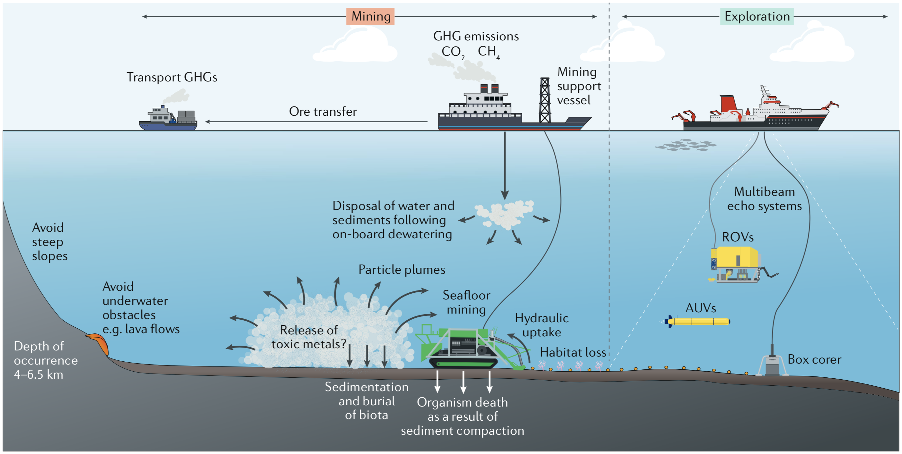
Polymetallic nodule mining: exploration
Multibeam, hydroacoustic mapping with a system mounted on the hull of a vessel provide information about the ocean-floor topography and water depth (bathymetry), and the characteristics of the ocean floor (hard rock, sediments, nodules).
Deep-towed systems and autonomous underwater vehicles (AUVs) can get closer to the ocean floor and, thus, provide a higher resolution (smaller footprint).
Box corer collects samples, allows estimate of nodule density and evaluation of nodule composition
ROV - remotely operated underwater vehicle
Economic deposits selected based on
nodule abundance (min ~10 dry kg m⁻²)
metal content (min ~2 wt.% Ni+Cu+Co for the CCZ)
J. R. Hein, A. Koschinsky, T. Kuhn. Deep-ocean polymetallic nodules as a resource for critical materials. Nat. Rev. Earth Environ. 2020, 1, 158-169.

Slide 17
Polymetallic nodule mining
The components of a polymetallic-nodule-mining project:
the collector on the seafloor
the vertical riser system
the surface mining vessel
bulk carriers
the processing plant on land
J. R. Hein, A. Koschinsky, T. Kuhn. Deep-ocean polymetallic nodules as a resource for critical materials. Nat. Rev. Earth Environ. 2020, 1, 158-169.

Slide 18
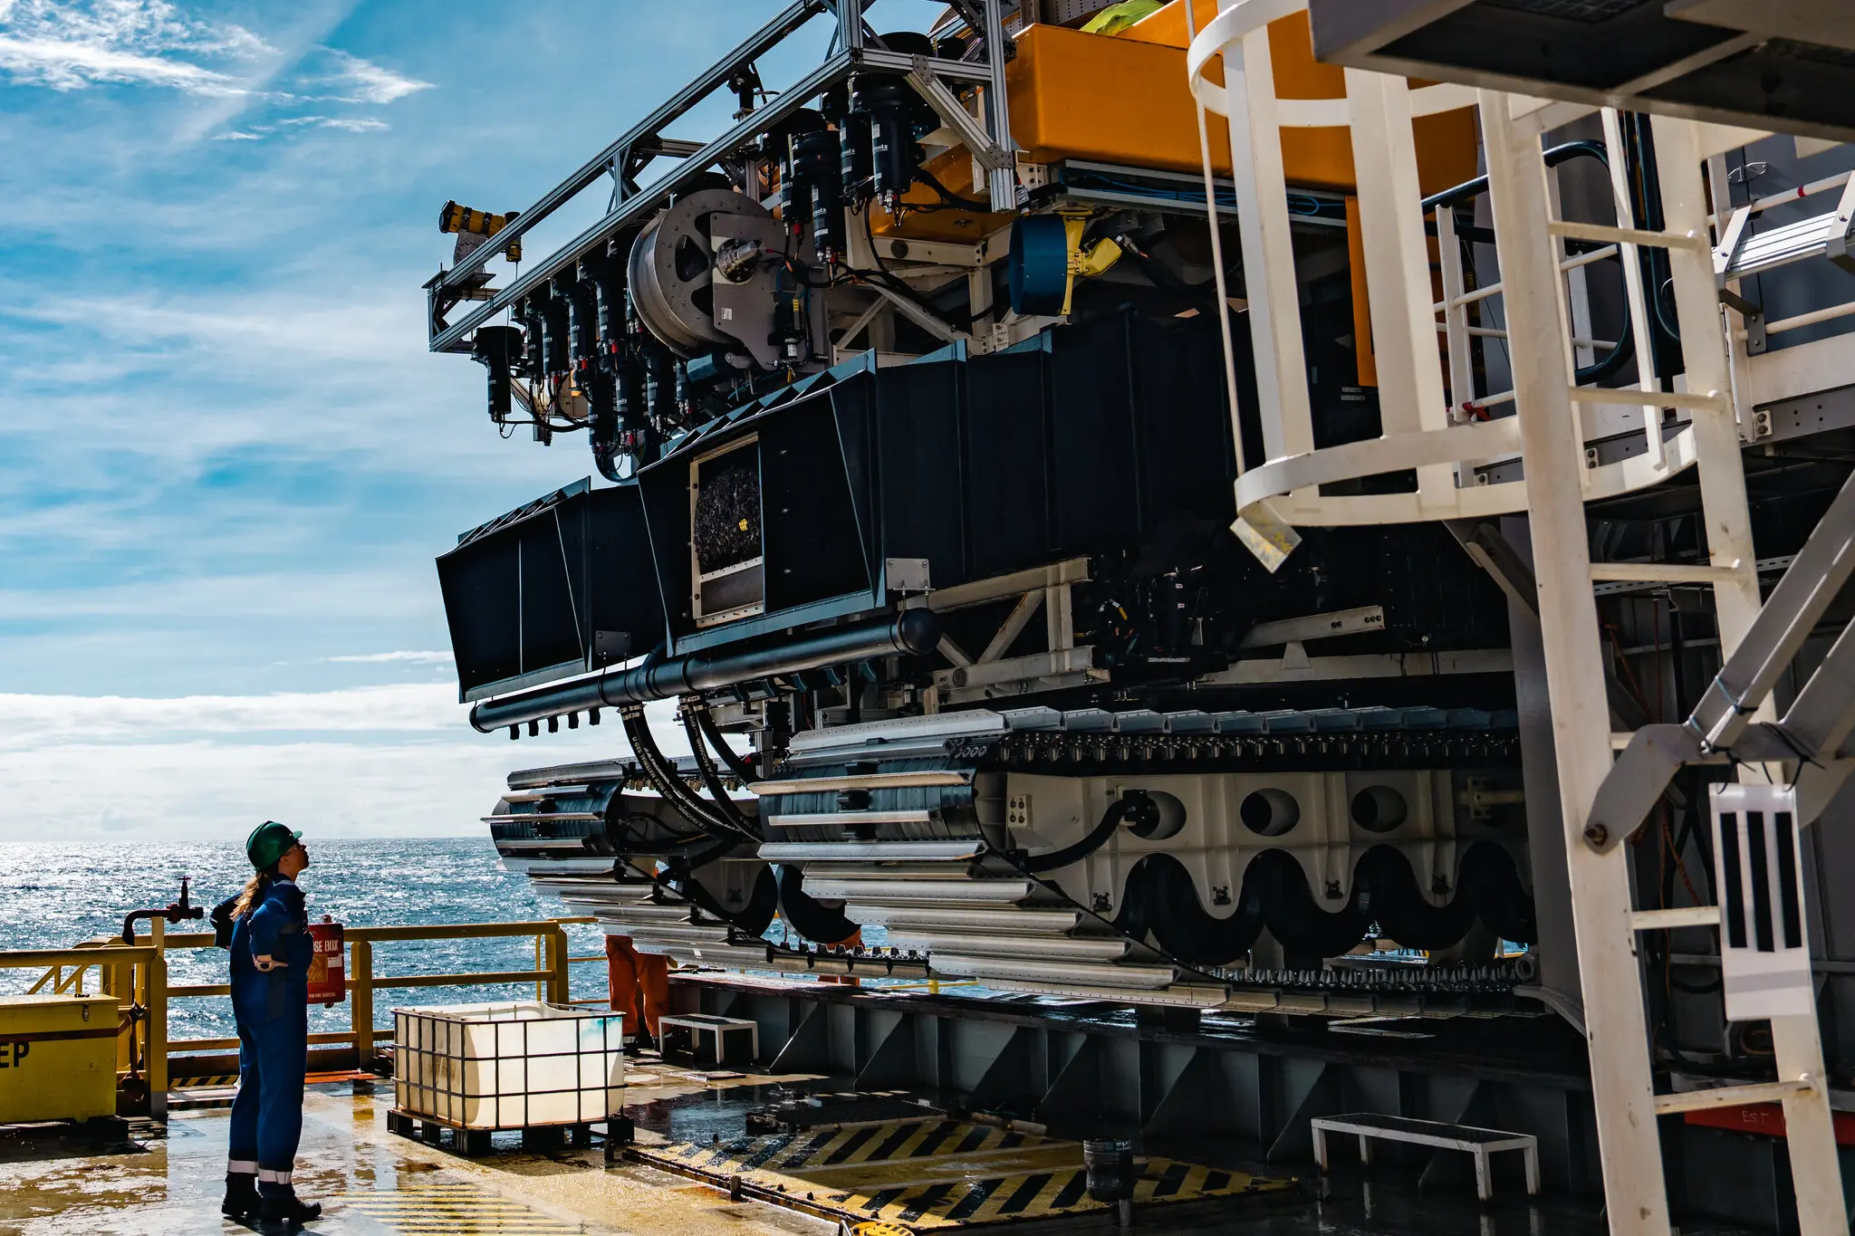
Nodule collectors
Nodule collectors use caterpillar track systems
Nodules are collected by either a mechanical or hydraulic uptake mechanism
Sediment is cleaned away, and nodules are crushed then pumped to a buffer chamber at the lower end of the vertical riser system
Vertical riser systems use centrifugal pumps or air lift; must have a capacity of 300-500 tons of ore per hour
An image provided by the Metals Company shows an engineer inspecting a nodule collector in September.
Richard Baron/The Metals Company
J. R. Hein, A. Koschinsky, T. Kuhn. Deep-ocean polymetallic nodules as a resource for critical materials. Nat. Rev. Earth Environ. 2020, 1, 158-169.

Slide 19
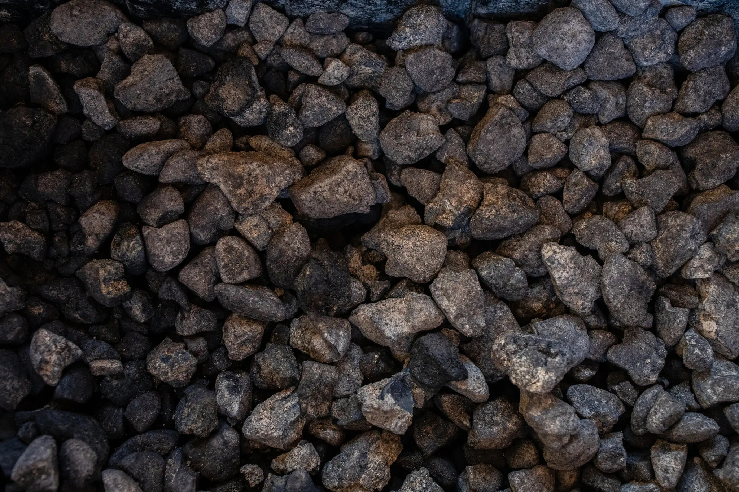
Nodule processing
Polymetallic nodules are a unique type of oxide deposit – there are no terrestrial analogues
New (and green) metallurgical processing methods must be developed
The nodule matrix must be completely destroyed to release the metals; options include:
Pyrometallurgy (smelting in electric arc furnace at 1400-1500 ˚C, separate Mn-Fe-Si slag to steel industry / Cu-Ni-Mo alloy to hydrometallurgical separation)
Hydrometallurgy (chemical dissolution into sulfuric or hydrochloric acid or in ammonium sulfate and carbonate solutions)
Dissolution by microorganisms (lab-scale only)
Polymetallic nodules collected by the Metals Company from the Clarion-Clipperton Zone in the Pacific.
Tamir Kalifa for The New York Times
J. R. Hein, A. Koschinsky, T. Kuhn. Deep-ocean polymetallic nodules as a resource for critical materials. Nat. Rev. Earth Environ. 2020, 1, 158-169.

Slide 20
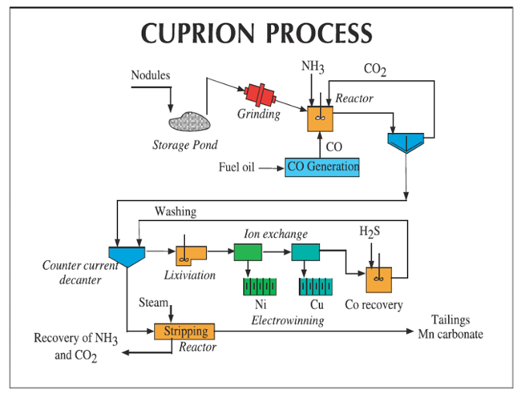
Hydrometallurgical nodule processing
Hydrometallurgy (chemical dissolution into sulfuric or hydrochloric acid or in ammonium sulfate and carbonate solutions)
Cuprion process – uses CO as reducing agent in the presence of ammonium as lixiviant
Caron process – reduction roasting at 500-750 ˚C followed by leaching with ammonium carbonate solution
High-pressure acid leaching or HCl-MgCl₂ leaching – widely used to process nickel laterites already
https://www.omlus.com/ocean-minerals-llc-technology/
J. R. Hein, A. Koschinsky, T. Kuhn. Deep-ocean polymetallic nodules as a resource for critical materials. Nat. Rev. Earth Environ. 2020, 1, 158-169.

Slide 21
Proposed advantages of deep-sea mining
Do not require infrastructure needed for terrestrial mines (roads, ocean-floor ore-transport systems, water-transportation or electrical-transport systems, buildings, waste dumps)
No overburden needs to be removed
Viable mining sites contain 3+ metals of economic interest
Selective mining of small deposits is simple (move mining vessel to the location), no need to process intervening low-grade material (less ore required for same amount of metal)
No acid mine drainage, river or soil contamination, town relocation, deforestation, large-scale lowering of the groundwater table
J. R. Hein, A. Koschinsky, T. Kuhn. Deep-ocean polymetallic nodules as a resource for critical materials. Nat. Rev. Earth Environ. 2020, 1, 158-169.

Slide 22
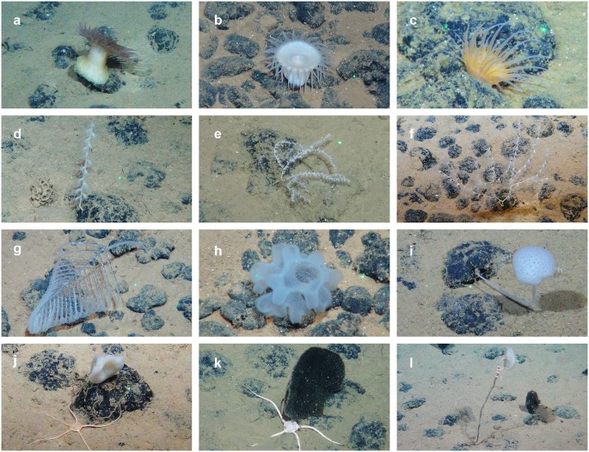
Environmental concerns around deep-sea mining
Nodule extraction will cause habitat degradation:
Nodules serve as a hard substrate for a variety of sessile organisms (sponges, corals)
Octopods have been known to brood clutches of eggs on the stalks of dead sponges attached to nodules
The nodule collector will crush organisms and compact the sediment
May cause short-term release of potentially toxic metals into the water column
J. R. Hein, A. Koschinsky, T. Kuhn. Deep-ocean polymetallic nodules as a resource for critical materials. Nat. Rev. Earth Environ. 2020, 1, 158-169.
A. Vanreusel et al. Threatened by mining, polymetallic nodules are required to preserve abyssal epifauna. Sci. Rep. 2016, 6, 26808.

Slide 23
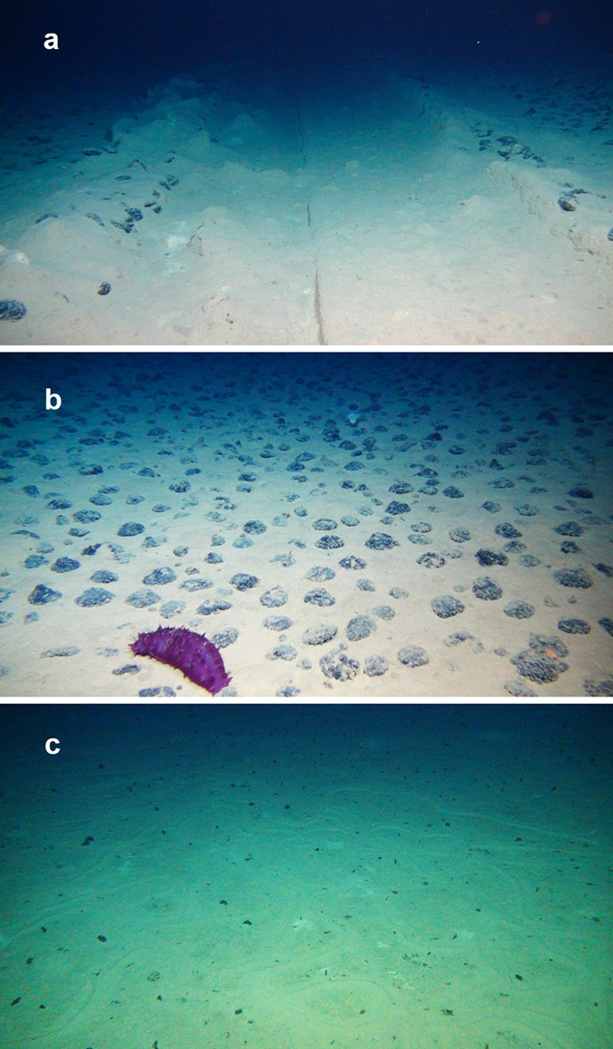
Environmental concerns around deep-sea mining
Examples of seafloor morphology:
(a) 37-year old OMCO track
(b) Nodule landscape
(c) Nodule-free landscape
”Surveys conducted along tracks from trawling or experimental mining simulations up to 37 years old, suggest that the removal of epifauna is almost complete and that its full recovery is slow”
A. Vanreusel et al. Threatened by mining, polymetallic nodules are required to preserve abyssal epifauna. Sci. Rep. 2016, 6, 26808.
(Image Copyright: ROV Kiel 6000 Team/GEOMAR Kiel.)

Slide 24
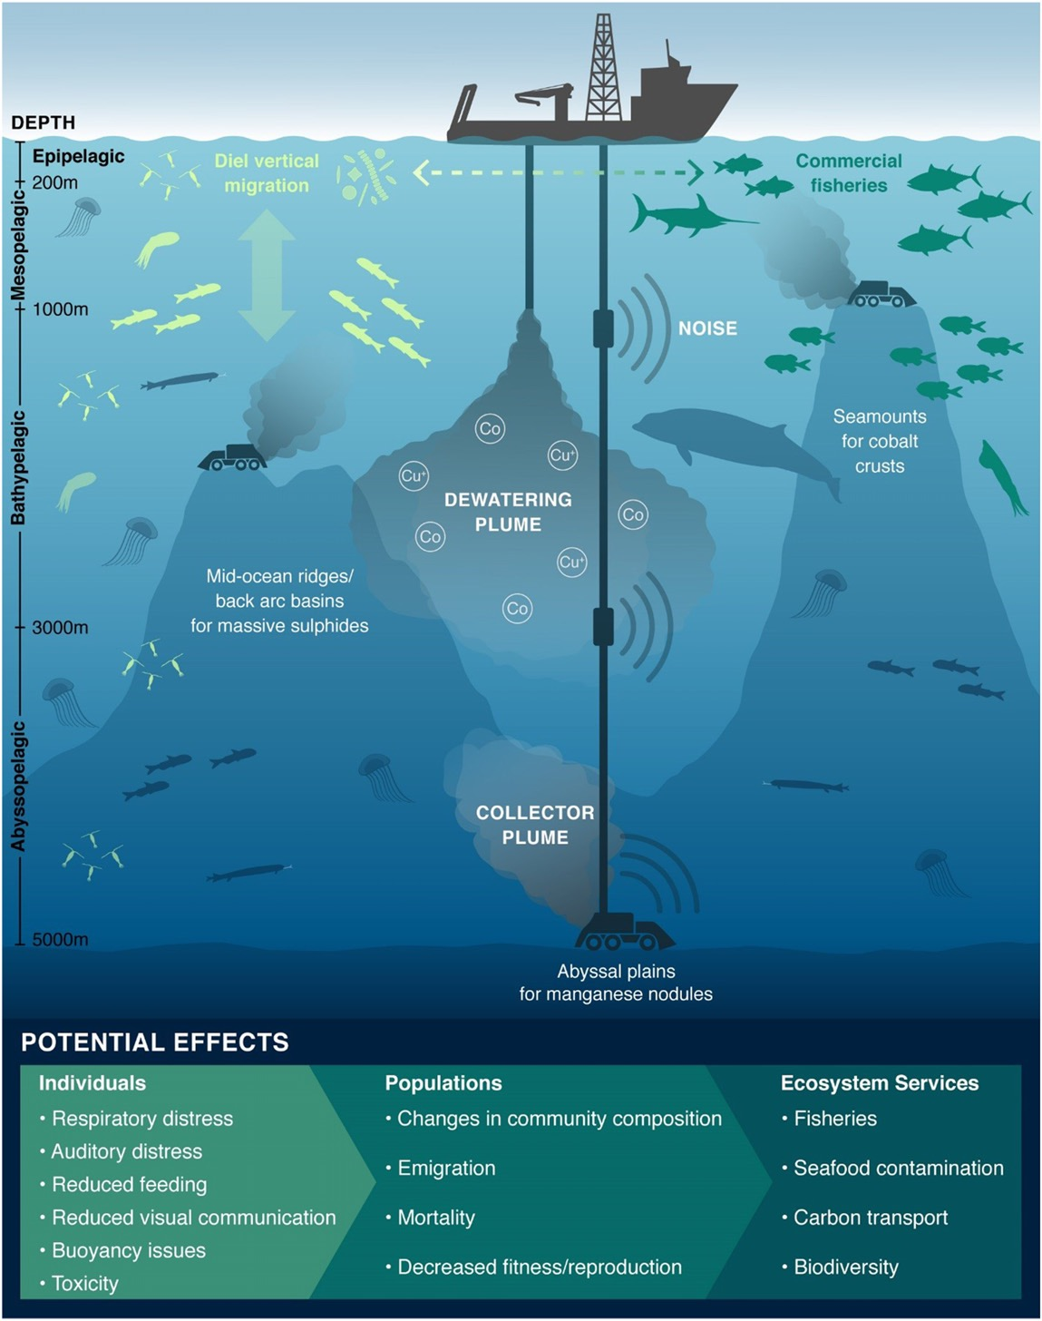
Sediment plumes
Collectors create sediment plumes
Sediment and unwanted nodules piped up to the ship are returned to the ocean, creating a discharge plume
Plumes may clog filter feeding structures, bury organisms, and expose organisms to toxic metals
J. C. Drazen et al. PNAS, 2020, 117 (30), 17455-17460.
C. Muñoz-Royo et al. Sci. Adv. 2022, 8, eabn1219.
Notes:
See also https://news.mit.edu/2019/understanding-impact-deep-sea-mining-1206

Slide 25
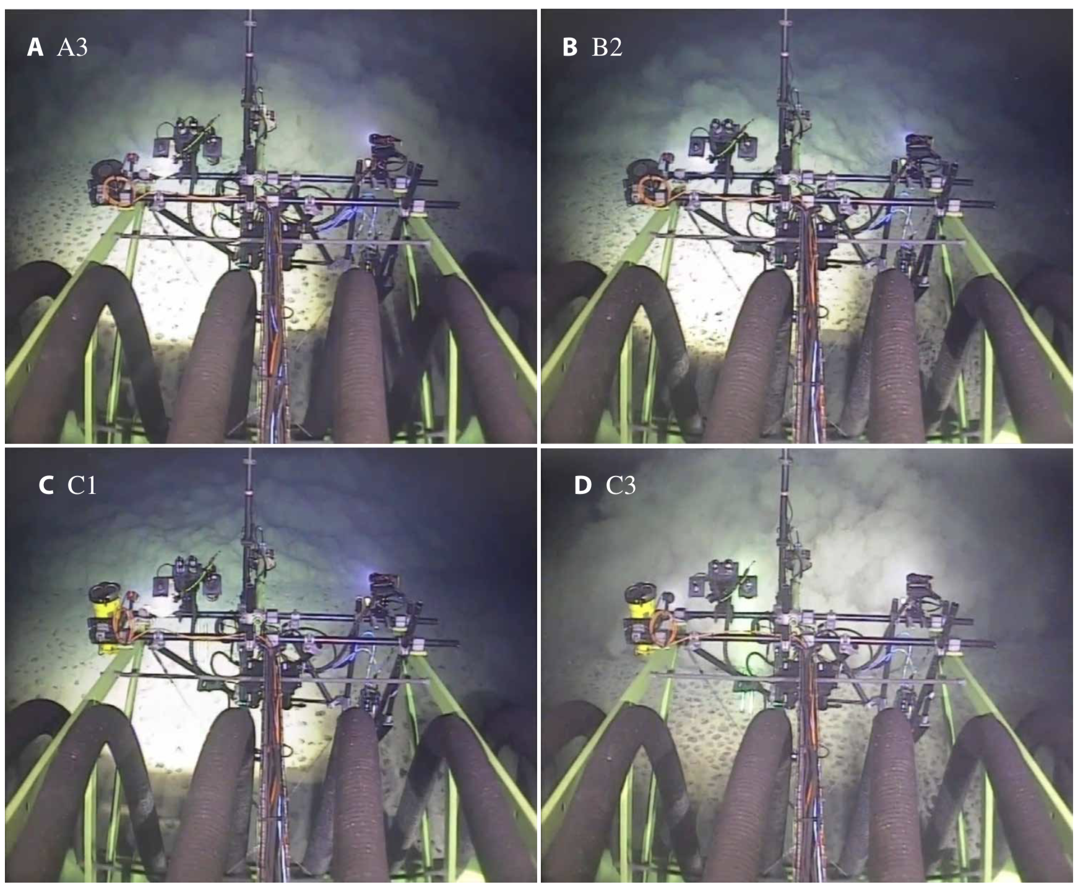
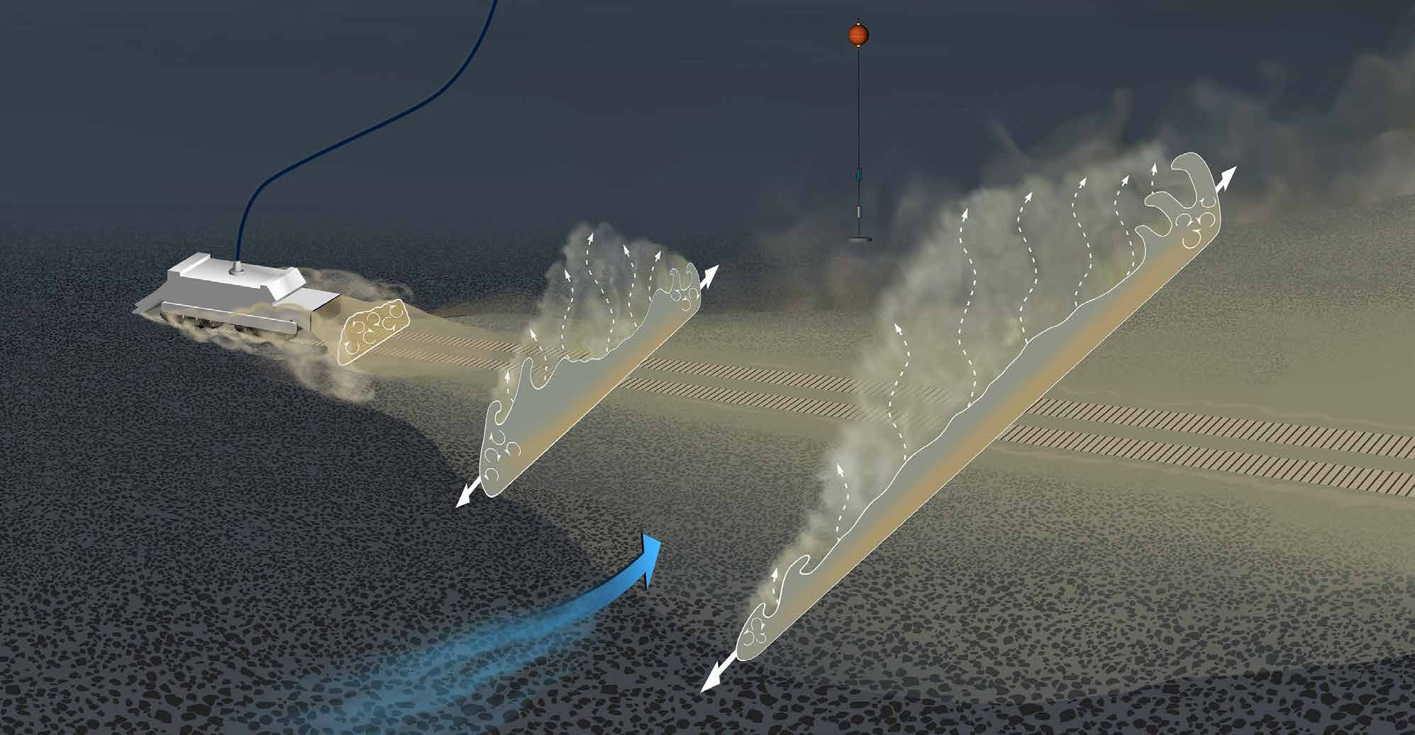
Illustration of the plume spreading behind a collector vehicle as it picks up nodules
“Our results suggest that turbidity current dynamics sets the fraction of sediment remaining suspended and the scale of the subsequent ambient sediment plume. The implications of this process, which is characteristically overlooked in previous modeling efforts, are substantial for plume modeling that will lie at the heart of environmental impact statements for regulatory consideration.”
C. Muñoz-Royo et al. Sci. Adv. 2022, 8, eabn1219.

Slide 26
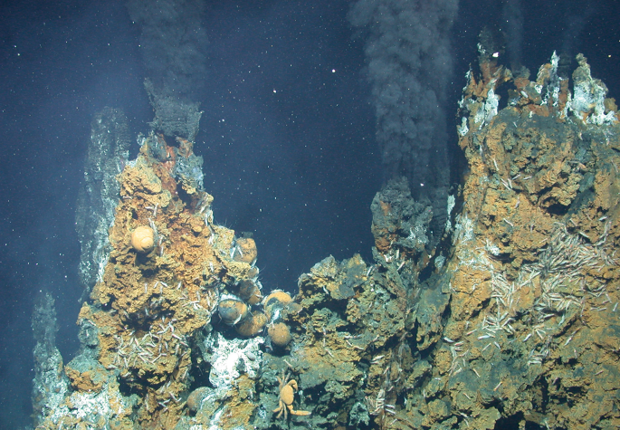
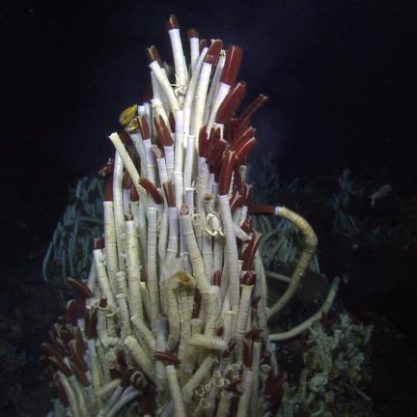
Massive sulfide deposits
>350 sites of high-temperature hydrothermal vents and ~200 sites of significant massive sulfide accumulation have been identified
Mostly associated with the mid-ocean ridges, backarc environments, submarine volcanic arcs, and in basins near volcanic arcs
Total accumulation estimated to be 10⁸ tonnes, containing ~3 x 10⁷ tonnes of Cu and Zn
Unique ecosystems at hydrothermal vents (giant tube worms)
International Seabed Authority (ISA) website
M. O. Anderson Nature Geosci. 2018, 11, 706.
Notes:
Tube worm photo: https://nautiluslive.org/album/2015/06/20/life-extremes-tube-worms

Slide 27
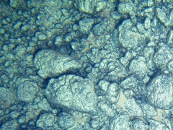
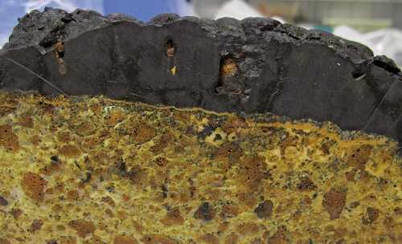
Cobalt crusts
Cobalt-rich ferromanganese crusts
Depths between ~400 – 5000 m
Areas of significant volcanic activity
Grown on hard-rock substrates of volcanic origin via precipitation of metals dissolved in seawater
Up to 2% Co, 0.0001% Pt, plus rare earth elements
Cross section of black cobalt crust, several cm thick, atop light-colored volcanic rock
From the Louisville seamount chain in the southwest Pacific
International Seabed Authority (ISA) website
World Ocean Reviews 3, Marine Resources - Opportunities and Risks (2014).

Slide 28
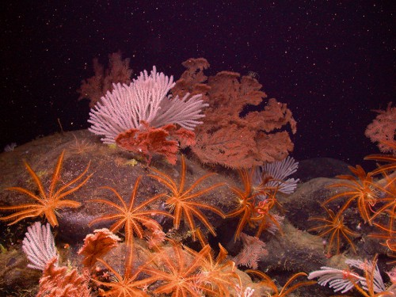
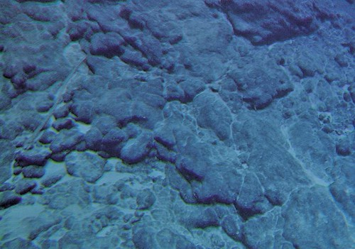
Cobalt crusts
Unlike polymetallic nodules, most cobalt crusts are located within Exclusive Economic Zones – not overseen by the International Seabed Authority
Environmental concerns similar to those of nodules
International Seabed Authority (ISA) website
World Ocean Reviews 3, Marine Resources - Opportunities and Risks (2014).

Slide 29
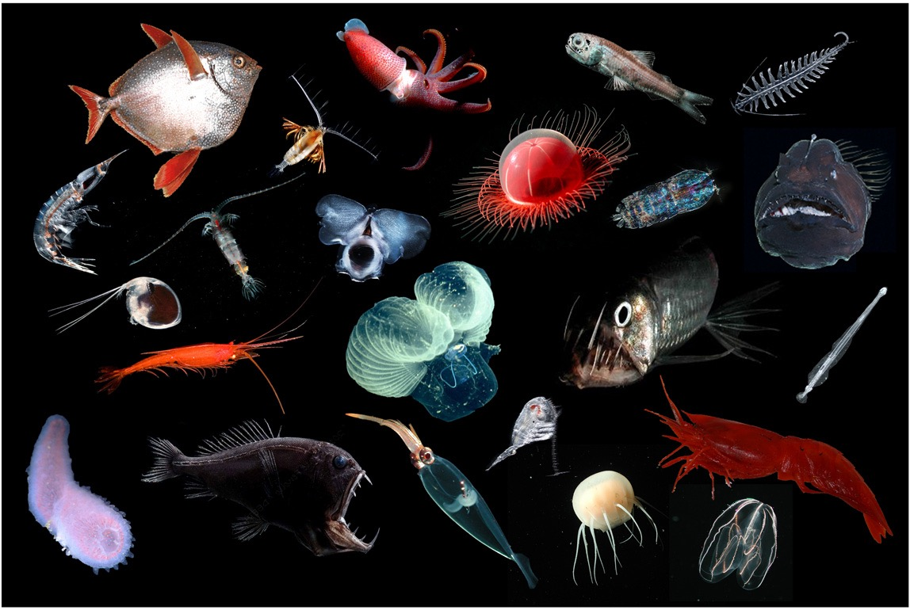
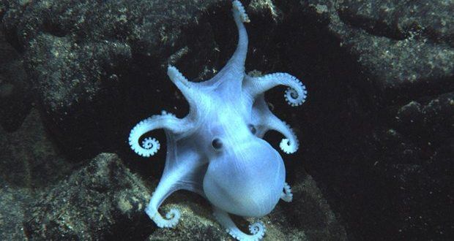
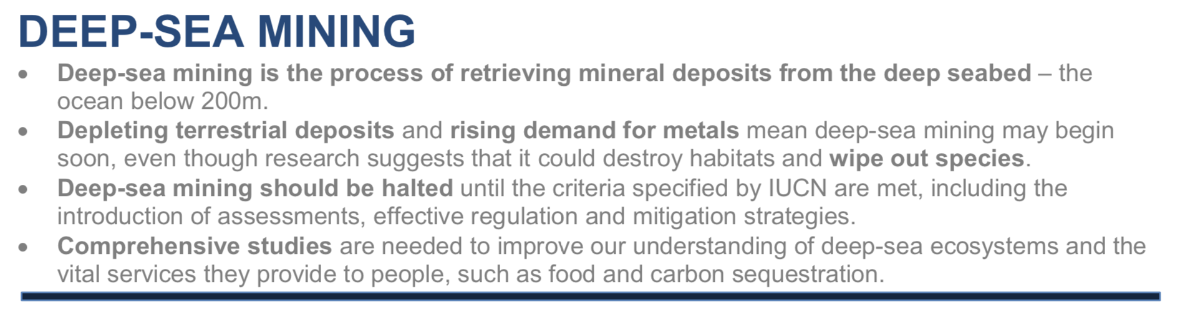
Environmental concerns around deep-sea mining
International Union for Conservation of Nature and Natural Resources (IUCN), Deep-Sea Mining Issues Brief, May 2022.
Notes:
Octopus image: https://manoa.hawaii.edu/kaunana/manganese-nodules-as-breeding-ground-for-deep-sea-octopods/
Other image: J. C. Drazen et al. PNAS, 2020, 117 (30), 17455-17460.

Slide 30
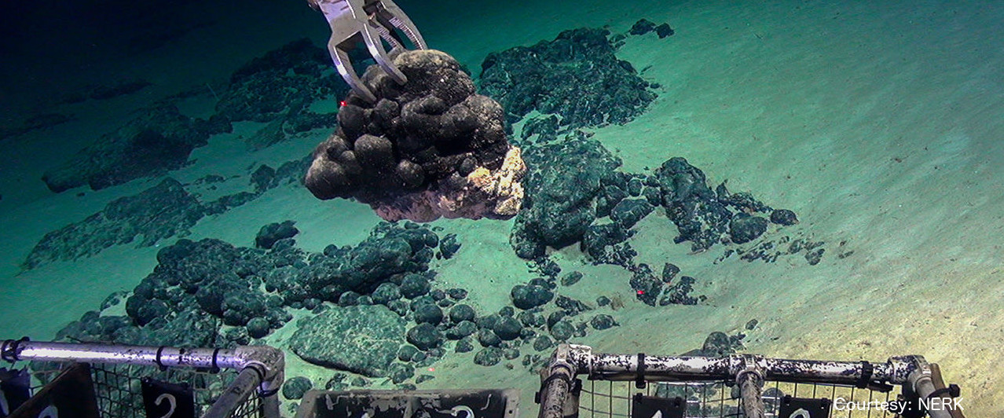

Regulation of deep-sea mining
“The ‘Mining Code’ refers to the whole of the comprehensive set of rules, regulations and procedures issued by ISA to regulate prospecting, exploration and exploitation of marine minerals in the international seabed Area, or the "Area" (defined as the seabed and ocean floor and subsoil thereof beyond the limits of national jurisdiction).”
International Seabed Authority (ISA) website

Slide 31
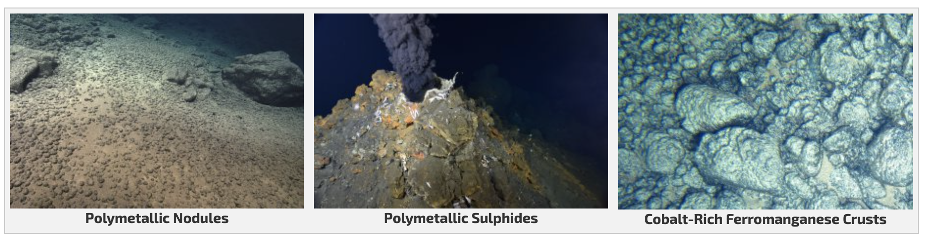
Regulation of deep-sea mining
ISA has entered into 15-year contracts for exploration for polymetallic nodules, polymetallic sulfides and cobalt-rich ferromanganese crusts in the deep seabed with 22 contractors.
19 exploration contracts
Companies/agencies based in Jamaica, China, Cook Islands, UK, Singapore, Kiribati, Belgium, Tonga, Nauru, Germany, India, France, Japan, South Korea, Russia, Bulgaria, Cuba, Czech Republic, Poland, Slovakia
7 exploration contracts
Companies/agencies based in China, France, Germany, Russia, South Korea, India, Poland
5 exploration contracts
Companies/agencies based in Japan, China, Russia, South Korea, Brazil
International Seabed Authority (ISA) website

Slide 32
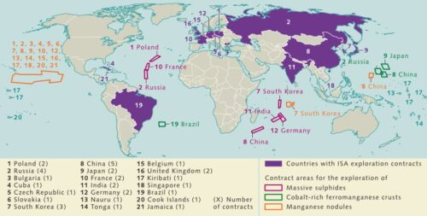
Regulation of deep-sea mining
ISA has issued 15-year contracts for exploration for polymetallic nodules, polymetallic sulfides and cobalt-rich ferromanganese crusts in the deep seabed with 22 contractors.
Exploration contracts
Polymetallic nodules: 19
Polymetallic sulfides: 7
Cobalt crusts: 5
International Seabed Authority (ISA) website
World Ocean Reviews 7, The Ocean, Guarantor of Life – Sustainable Use, Effective Protection (2021).

Slide 33
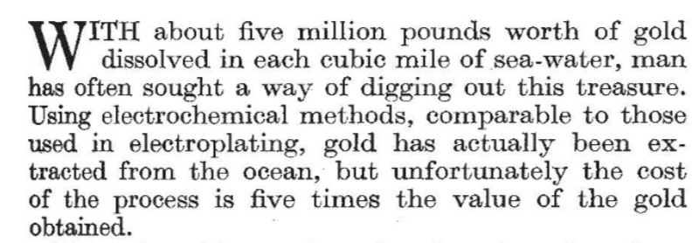
Extraction of minerals from seawater?
Screening of minerals that can be economically extracted from seawater based on current market prices and seawater concentrations of the minerals
Nature 1941, 148, 171.
P. Loganathan, G. Naidu, S. Vigneswaran. Environ. Sci.: Water Res. Technol. 2017, 3, 37.

Slide 34
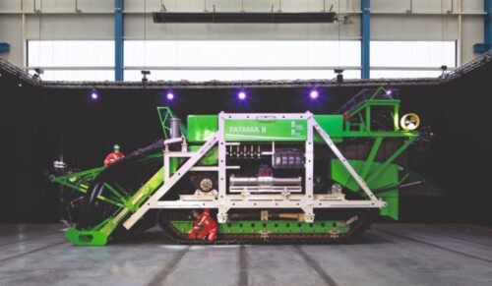
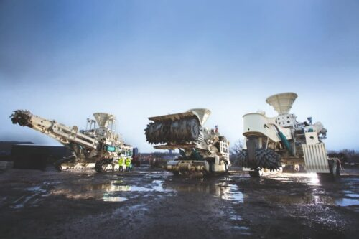
Questions?
Notes:
Green guy: https://www.greencarcongress.com/2021/04/20210429-get.html
Three mining machines: https://www.theguardian.com/environment/2017/jun/04/is-deep-sea-mining-vital-for-greener-future-even-if-it-means-destroying-precious-ecosystems

Slide 35
References
Deep-sea mining
IEA (2021), The Role of Critical Minerals in Clean Energy Transitions, IEA, Paris https://www.iea.org/reports/the-role-of-critical-minerals-in-clean-energy-transitions, License: CC BY 4.0.
J. R. Hein, A. Koschinsky, T. Kuhn. Deep-ocean polymetallic nodules as a resource for critical materials. Nat. Rev. Earth Environ. 2020, 1, 158-169. DOI: 10.1038/s43017-020-0027-0
International Seabed Authority (ISA) website https://www.isa.org.jm/
International Union for Conservation of Nature and Natural Resources (IUCN), Deep-Sea Mining Issues Brief, May 2022. https://www.iucn.org/resources/issues-brief/deep-sea-mining
J. C. Drazen et al. Opinion: Midwater ecosystems must be considered when evaluating environmental risks of deep-sea mining. PNAS, 2020, 117 (30), 17455-17460. DOI: 10.1073/pnas.2011914117
E. Lipton, The New York Times, “Battle Over Deep-Sea Mining Takes on New Urgency as Trial Run Winds Down”, Nov. 3 2022. https://www.nytimes.com/2022/11/03/world/deep-sea-mining.html
T. Peacock and M. A. Alford. The Race Is on to Mine and Protect the Deep Seafloor. Scientific American, 2018, 318 (5), 72-77. DOI: 10.1038/scientificamerican0518-72
A. Gillespie, NPR, “Your Next Car May Be Built With Ocean Rocks. Scientists Can’t Agree If That’s Good”, Sept. 3, 2021. https://www.npr.org/2021/09/03/1031434711/your-next-car-may-be-built-with-ocean-rocks-scientists-cant-agree-if-thats-good
U.S. Government Accountability Office, “Deep-Sea Mining Could Help Meet Demand for Critical Minerals, But Also Comes with Serious Obstacles”, Dec. 16, 2021. https://www.gao.gov/blog/deep-sea-mining-could-help-meet-demand-critical-minerals%2C-also-comes-serious-obstacles
A. Vanreusel et al. Threatened by mining, polymetallic nodules are required to preserve abyssal epifauna. Sci. Rep. 2016, 6, 26808. DOI: 10.1038/srep26808
C. Muñoz-Royo T. Peacock et al. An in situ study of abyssal turbidity-current sediment plumes generated by a deep seabed polymetallic nodule mining preprototype collector vehicle, Sci. Adv. 2022, 8, eabn1219. DOI: 10.1126/sciadv.abn1219
Some helpful MIT news articles: (1) https://news.mit.edu/2019/understanding-impact-deep-sea-mining-1206, (2) https://news.mit.edu/2021/deep-sea-mining-sediment-plumes-0727, (3) https://news.mit.edu/2022/sediment-deep-sea-mining-0921
M. O. Anderson, Deep-sea ore deposits, Nature Geosci. 2018, 11, 706. DOI: 10.1038/s41561-018-0237-y
World Ocean Reviews 3, Marine Resources - Opportunities and Risks (2014). https://worldoceanreview.com/en/wor-3/mineral-resources/cobalt-crusts/
Extraction from seawater
Nature 1941, 148, 171. DOI: 10.1038/148171b0
P. Loganathan, G. Naidu, S. Vigneswaran. Mining valuable minerals from seawater: a critical review. Environ. Sci.: Water Res. Technol. 2017, 3, 37. DOI: 10.1039/c6ew00268d
B. A. Sharkh et al. Seawater desalination-–a new frontier for sustainable mining of valuable minerals. npj Clean Water 2022, 5, 9. DOI: 10.1038/s41545-022-00153-6

