Slide 1
Monitoring Carbon in Forest Ecosystems
HEJC Fall 2022
Lisa Wang
Notes:
Mapping the world’s carbon stores is essential for taking stock of the climate crisis. It informs our climate solutions, the emissions targets that countries set and so - it goes without saying - the figures need to be as accurate as possible.

Slide 2
Contents
Carbon budget and natural carbon cycle
Remote sensing technologies
  Spectroscopy
  Airborne Lidar
  Space-borne: optical and radar sensors, SAR satellites
  Ground-based sensors
Forest carbon stocks
  Allometric equations
Case studies
Notes:
why remote technologies are key to monitoring carbon sequestration and preserving natural sinks

Slide 3
When will we exceed our carbon budget?

Slide 4
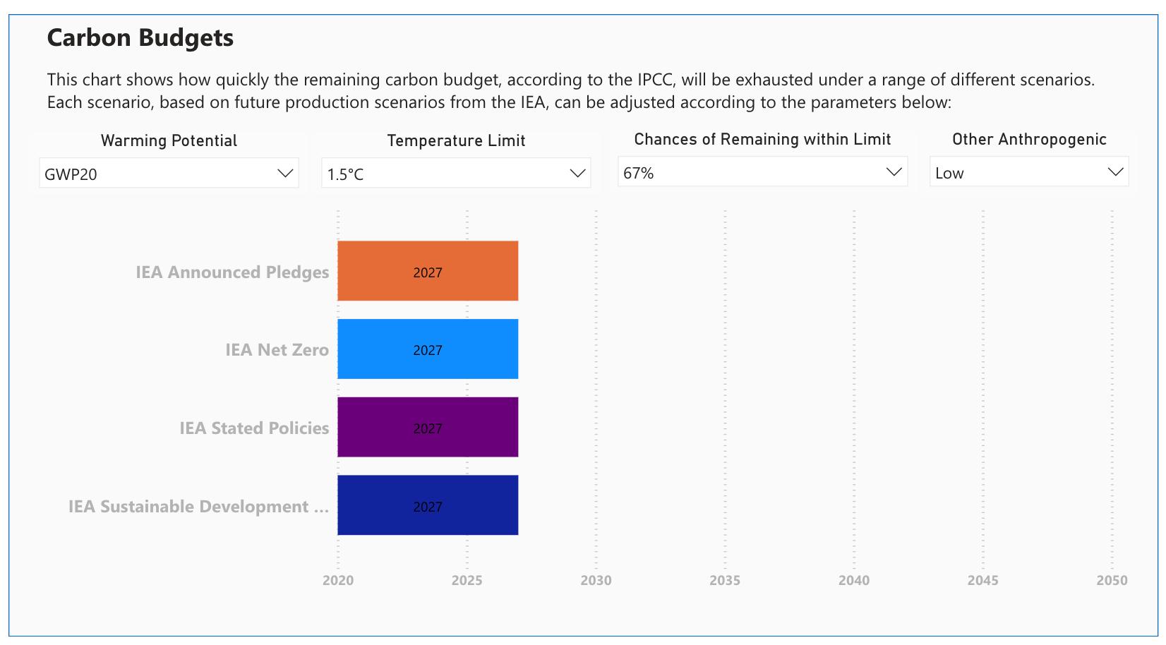
Our remaining carbon budget will be exhausted by 2027 to under a 1.5C limit scenario.
Source: FossilFuelRegistry.org
Notes:
A carbon budget is "the maximum amount of cumulative net global anthropogenic carbon dioxide emissions that would result in limiting global warming to a given level with a given probability, taking into account the effect of other anthropogenic climate forcers”

Slide 5
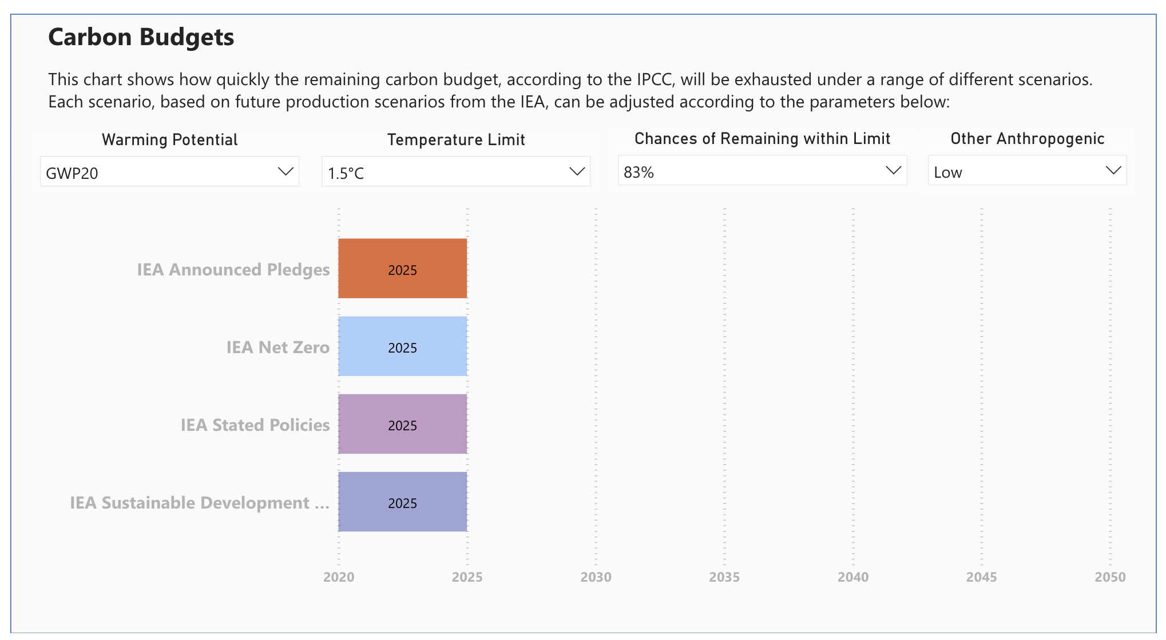
Our remaining carbon budget will be exhausted by 2025 to under a 1.5C limit scenario, with a likelihood of 83%.
Source: FossilFuelRegistry.org
Notes:
In greater likelihood, that year is more like 2025. What does this mean? We need to dramatically reduce emissions while also drawing carbon down that is already in the atmosphere.

Slide 6
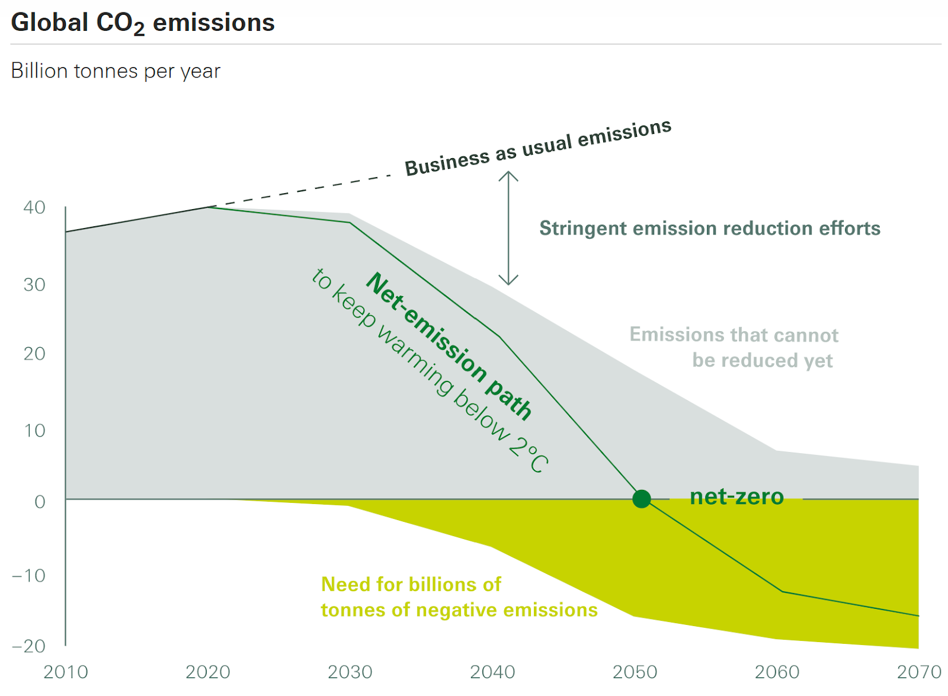
Source: Swiss Re, based on IPCC data
To meet IPCC targets, we’ll need to remove one billion metric tons of carbon annually by 2030 and five to ten billion metric tons annually by 2050.

Slide 7
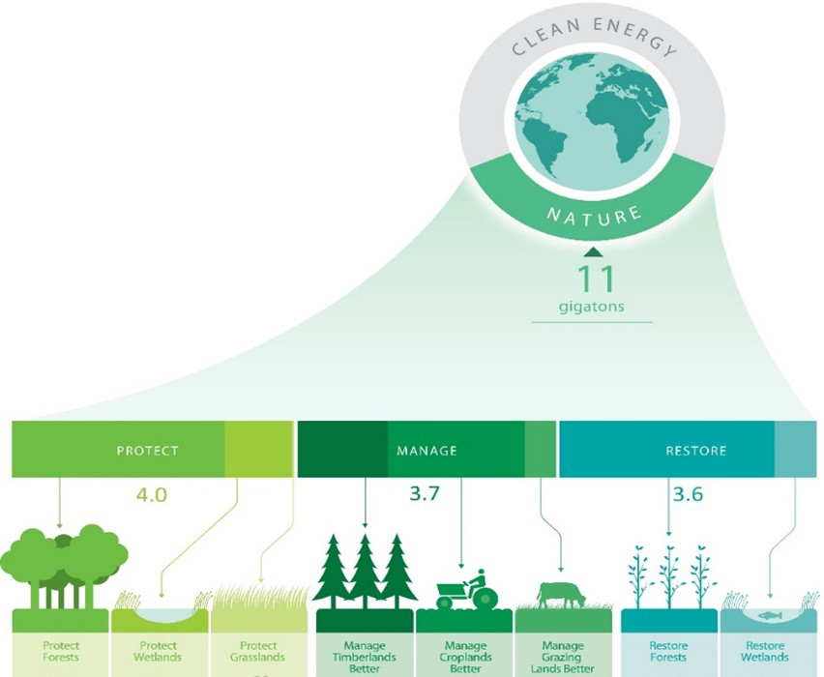
Natural Climate Solutions (NCS)
NCS enable avoidance/reduction of emissions and CO2 sequestration
conservation, restoration and improved land management
Can provide 30% of climate mitigation to reach 1.5° degree pathway (WBCSD)
No substitute for rapid, direct decarbonization, but critical part of the net-zero transition
Source: World Business Council for Sustainable Development
Notes:
Climate change is driven by increased concentrations of CO2 and other ghgs in the atmosphere. The Earth’s forests, soils, and natural systems can help slow the accumulation of atmospheric carbon.
In addition to the climate and carbon sequestration benefits, nature-based solutions are important to mitigate biodiversity loss and adaptation for resilience in a changing climate.
reducing emissions also means reducing land use change emissions
preserving natural sinks
Studies have shown that natural climate solutions (NCS) can provide around 30% of the emissions reductions needed to limit the worst impacts of global warming by 2030. As well as mitigating climate change, NCS can also provide other important solutions, such as the protection of ecosystems and biodiversity, restoration of degraded lands and the support of sustainable livelihoods.
On slide:
NCS enable
the avoidance/reduction of emissions
the removal/sequestration of CO2 from the atmosphere
through conservation, restoration and improved land management.
Can provide one third (7 Gt CO2) of climate mitigation to reach 1.5- degree pathway **
NCS are no substitute for rapid, direct decarbonization, but are a critical part of the net-zero transition.

Slide 8
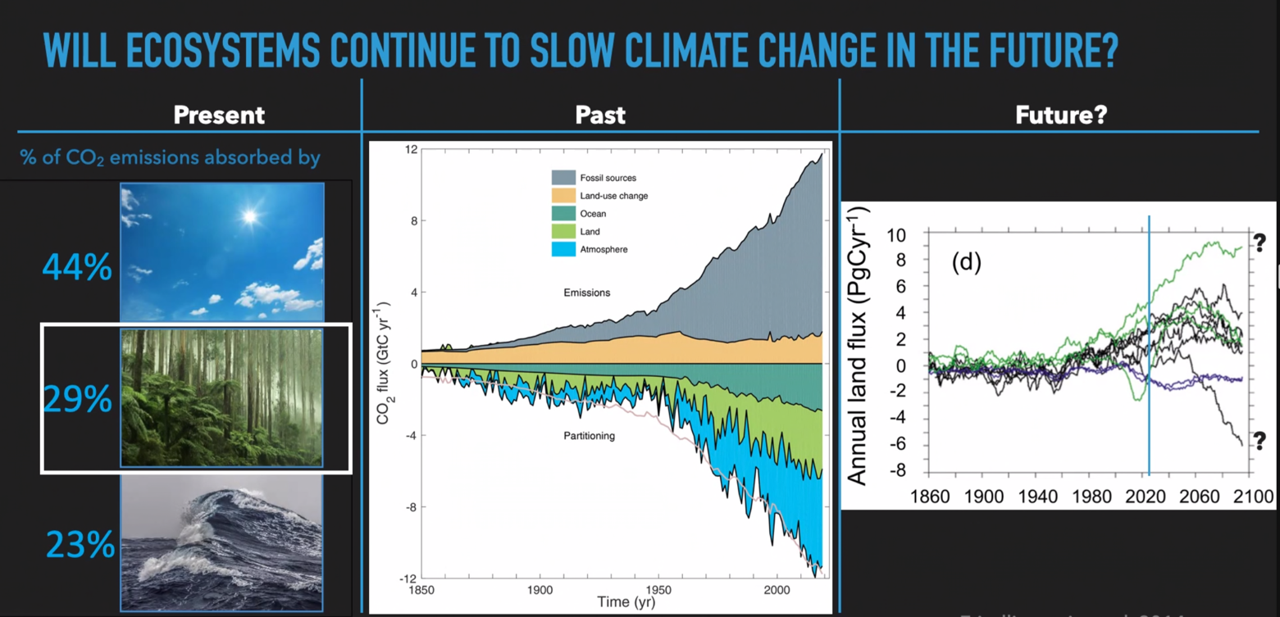
Source: Terrer, MIT1.076 Carbon Management. Global Carbon Budget, Friedlingstein et al.
Our natural carbon sinks will change under a changing climate.
Notes:
Forests currently sequester: …
These sinks, however, will be affected by climate change. in fact, the land could become a source rather than a sink. Land use change: deforestation leads to net increase in atmospheric CO2.
How are we measuring these changes? Might we be able to identify where the greatest changes are happening to preserve our natural carbon sinks.
In addition, deforestation is leading to a significant rise in emissions. When trees are cut down, they release immense amounts of stored carbon and lose their long-term ability to sequester carbon.
Put simply, it will be nearly impossible to mitigate without reversing tropical deforestation.

Slide 9
Where in the world is carbon stored??

Slide 10
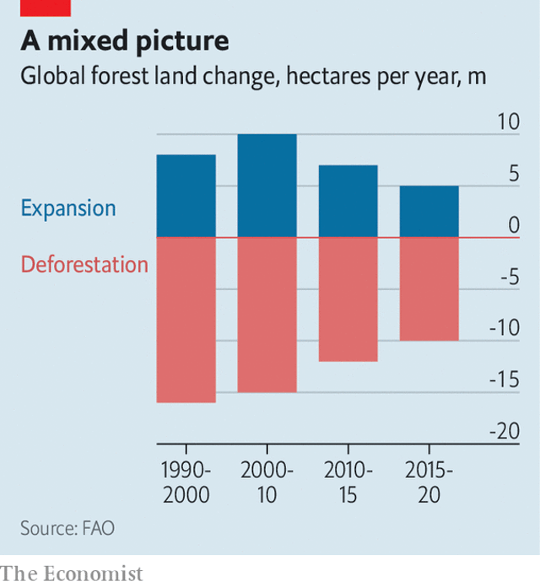
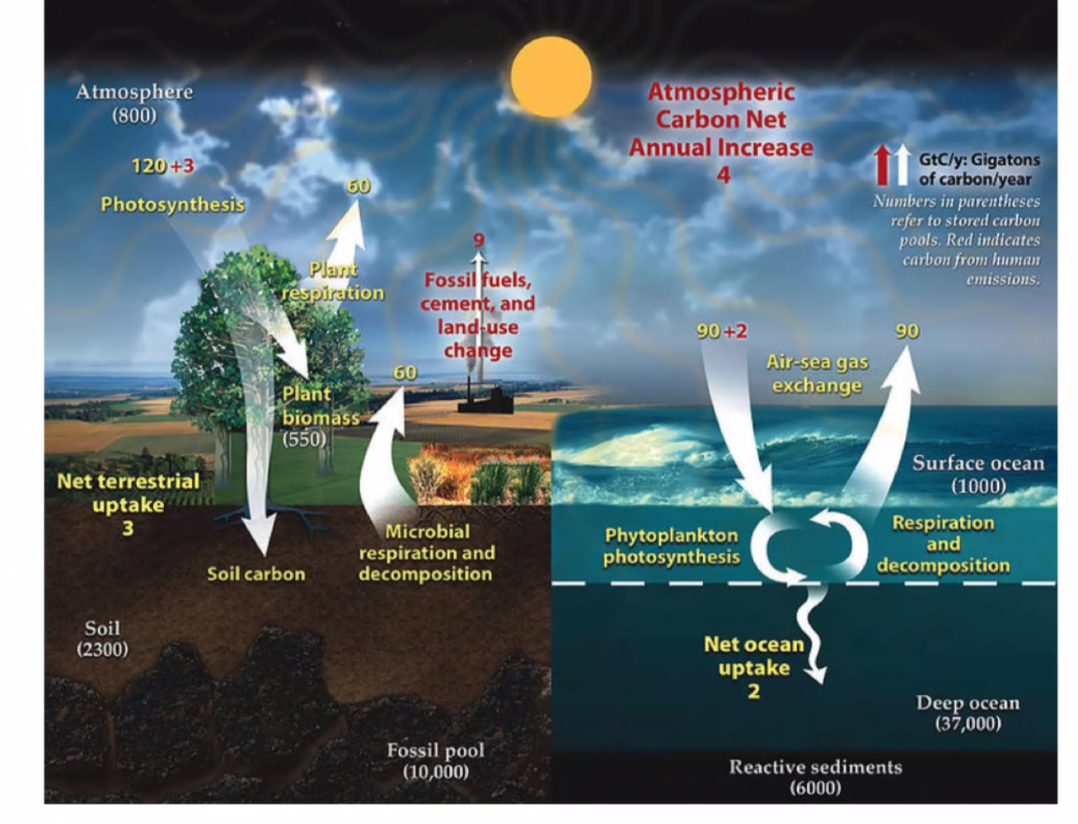
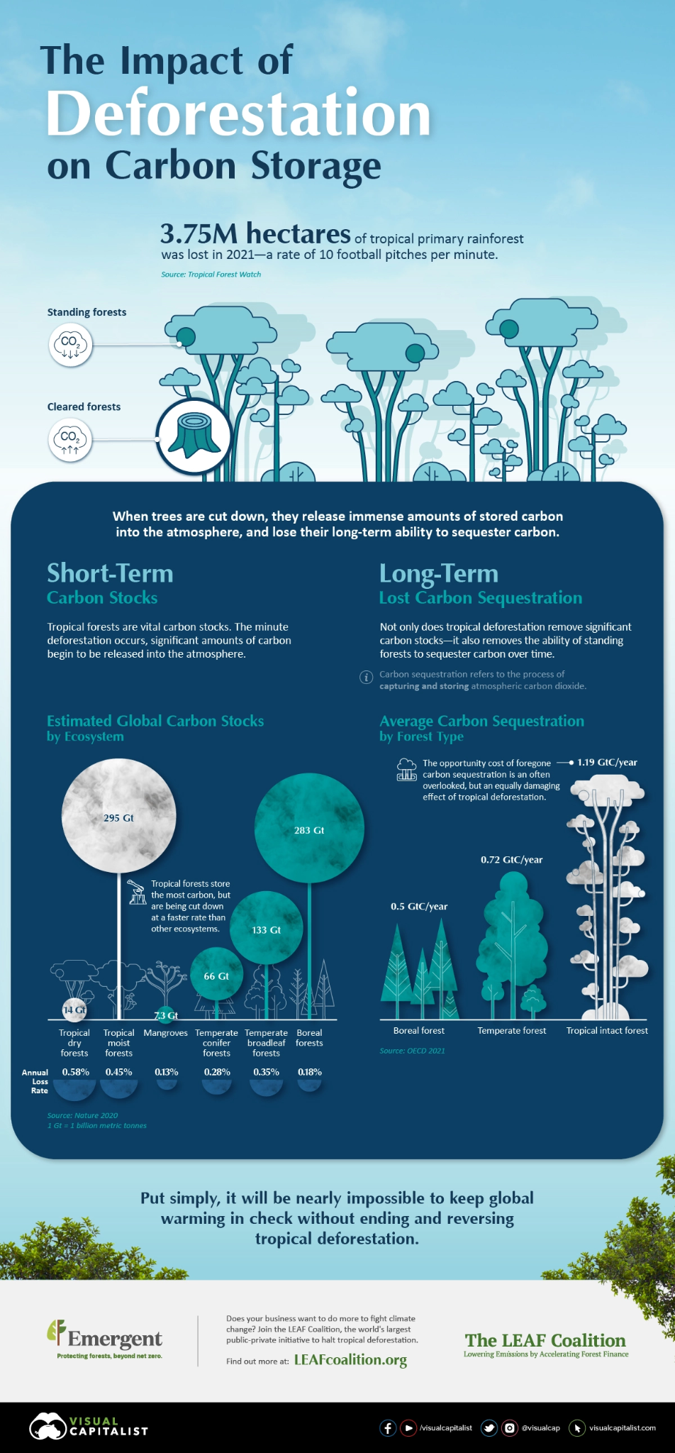
Anthropogenic activity and climate change cause imbalance in sources and sinks of carbon.
Natural Carbon Cycle
Terrestrial ecosystems play an important role in sequestering carbon.
Notes:
Explain left chart:
yellow - fluxes
white - pools
red - net increase from human activities
Forests play a significant role in the planet’s carbon cycle.
Terrestrial ecosystems directly impact local and global climate through its biogeophysical effects and as carbon sinks, sequestering and storing carbon through photosynthesis.
A carbon stock, or carbon pool, is a system that has the capacity to store or release carbon. A carbon flux refers to the amount of carbon exchanged between carbon stocks over a specified time. 1. In simple terms, it is the movement of carbon between land, oceans, atmosphere, and living things. 2.L
At the heart of the issue is that the natural carbon cycle in which trees and other plants play an ancient role is being thrown out of whack by human activity. The cycle is normally slow and self-regulating. Trees soak up CO2 from the atmosphere, then return some of it when they decompose or burn in natural wildfires. Over time, that CO2 cycles back into new plants. In the absence of human intervention, sources and sinks of carbon achieve balance.
So let’s figure out how to better quantify the carbon stored in natural ecosystems, beginning with terrestrial carbon stocks.

Slide 11
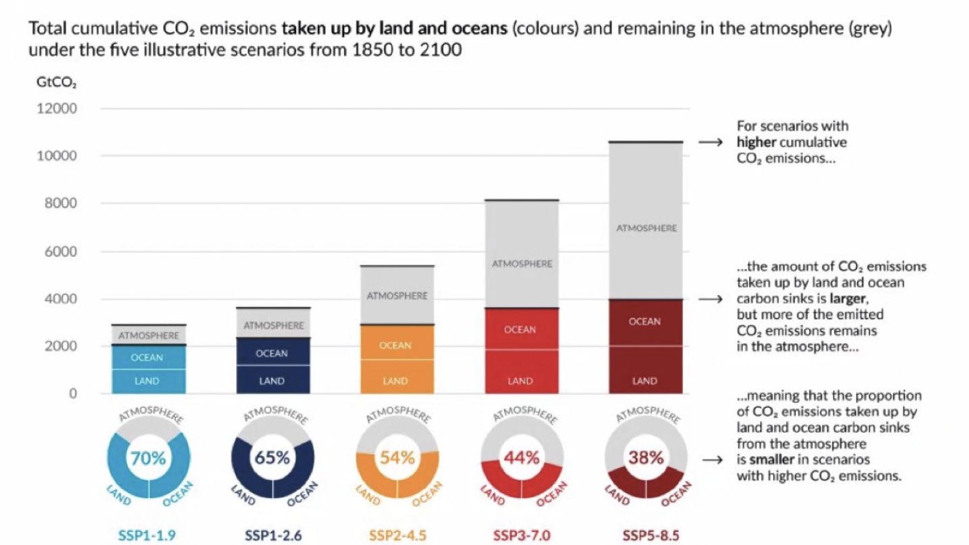
The portion of CO2 emissions taken up by natural sinks is smaller under scenarios with higher cumulative CO2 emissions.
Notes:
The portion of CO2 emissions taken up by natural sinks is smaller under scenarios with higher cumulative CO2 emissions.

Slide 12
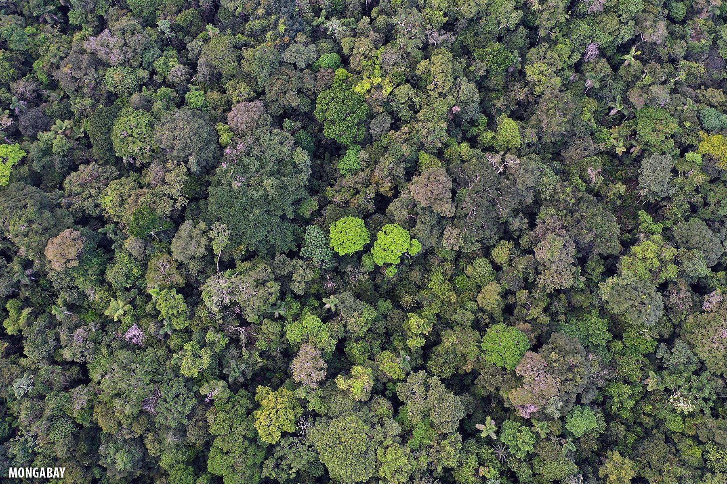
82.5%
of terrestrial carbon stocks are stored in forests

Slide 13
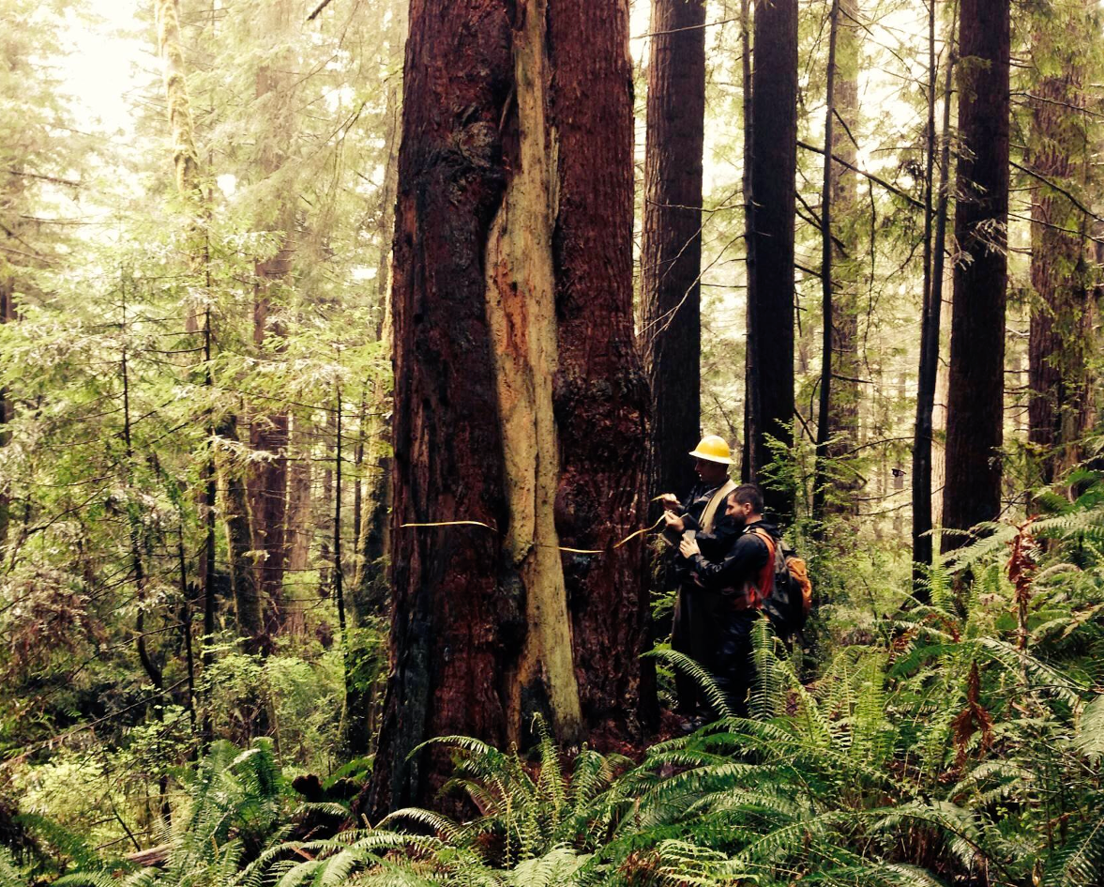
How is forest carbon measured today?
Carbon inventories by hand:
Measure trees in plots randomly sited throughout the project
Tree’s carbon estimated from height and
diameter at breast height (DBH)
Challenges: labor and cost-intensive, difficult to scale
Source: Pachama
Notes:
Project developers send crews to the field to conduct carbon inventories by hand:
Measure the height and diameter of trees in plots randomly sited throughout the project
Each tree’s carbon is then estimated based on its height and diameter.
We’ll come back to these exact calculations later.
These inventories are labor-intensive and ultimately cannot scale at the speed the planet demands. Projects are often located in remote areas of the world, or even areas with armed conflict.
It can take weeks or months to measure trees across just 30 plots for a single project and cost tens to hundreds of thousands of dollars.
And they must be repeated every five to ten years over the project’s lifetime.
So let’s dive into some technologies that are being used to monitor carbon!

Slide 14
Remote Sensing of Forest Carbon
Notes:
Added benefits of taking stock: Improve deforestation and afforestation estimates, and therefore GHG emissions and removals through satellite-based AGB measurements, and information about the associated uncertainty (World Bank)

Slide 15
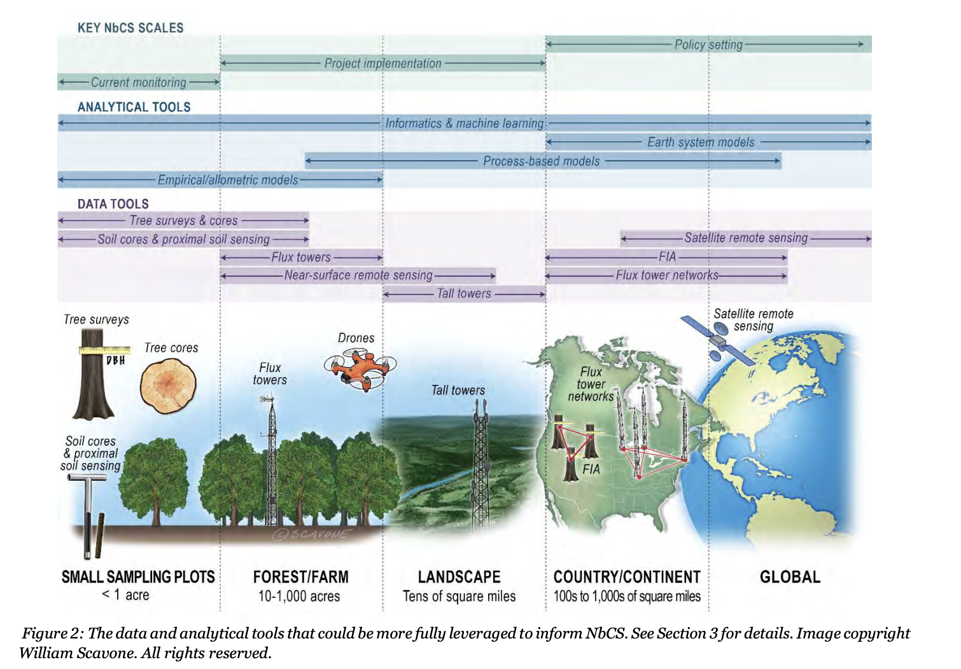
Data and Tools to inform Natural Climate Solutions
Source: The science needed for robust, scalable, and credible nature-based climate solutions for the United States
Notes:
Over the past decade, operational, near-real time observations of carbon cycle pools and fluxes have been enabled by:

Slide 16
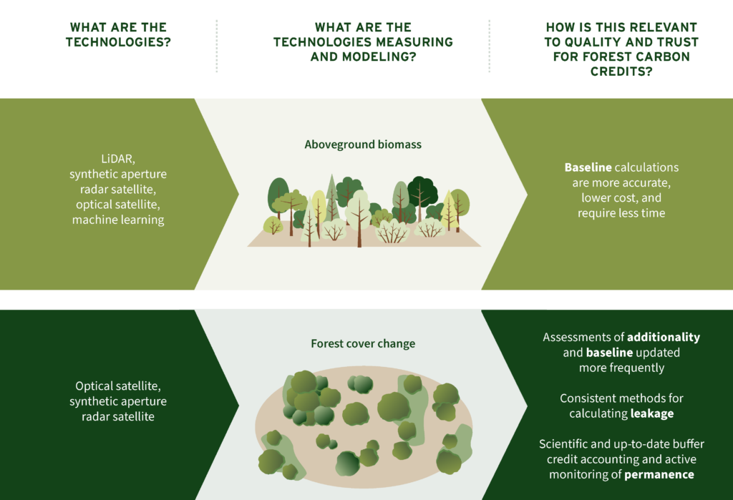
Source: RMI
Notes:
There are innovations in developing technologies.
It can be difficult to measure SOC using field or lab techniques.

Slide 17
Overview of Technologies
1) Space-borne: passive sensors including optic satellites and active sensors such as SAR and LiDAR
2) Air-borne: LiDAR attached to planes and drones, near surface sensing
3) Ground-based sensors: used to collect forest inventory data
Tree surveys, soil cores, flux towers
Notes:
There are three categories of data acquisition technologies: 1) space-borne, including passive sensors including optic satellites and active sensors such as SAR and LiDAR, 2) air-borne, including LiDAR attached to planes and drones, and 3) on-the-ground sensors used to collect forest inventory data.
LiDAR, synthetic-aperture radar satellite, and on-the-ground sensors (often coupled with machine learning) are being used to model above-ground biomass of forests, which will reduce the time and costs to provide more accurate baseline calculations.

Slide 18
Remote Sensing
Notes:
SAR

Slide 19
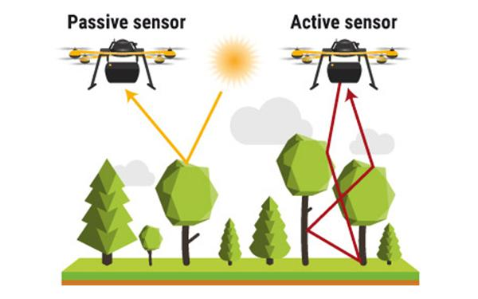
Remote Sensing
The science of obtaining information about objects or areas from a distance, ie. from aircraft or satellites. Remote sensors passively or actively capture radiation reflected or emitted by objects near or on Earth’s surface.
Spectroscopy: Study of interactions between a substance and the
natural absorption and radiation of light.
Passive sensors: use light that is readily available
(ie. solar radiation)
Active sensors: provide their own energy source
Notes:
Remote sensors passively capture the radiation reflected or emitted by objects near/on Earth’s surface. Aka detect energy reflected from Earth.
Sensors are often mounted on aircraft or satellites - unmanned aircraft systems can improve hyperspectral capabilities
https://www.yellowscan-lidar.com/knowledge/how-lidar-works/

Slide 20
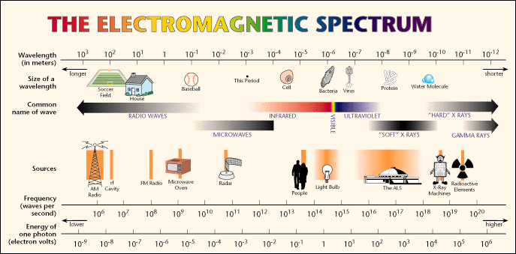
Notes:
Spectroscopy is the study of interactions between a substance and the natural absorption and radiation of light.
Most satellites work using spectroscopy.

Slide 21
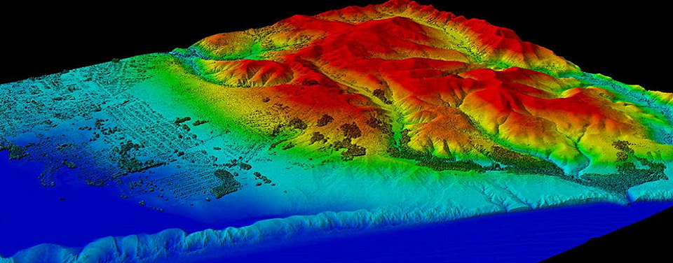
Airborne LiDAR
A Lidar (Light Detection and Ranging) image created with data collected by NOAA's National Geodetic Survey. (NOAA)
Notes:
Planet quote: we have so many more satellites than previously to observe our planet.
The notion of the little blue dot.

Slide 22
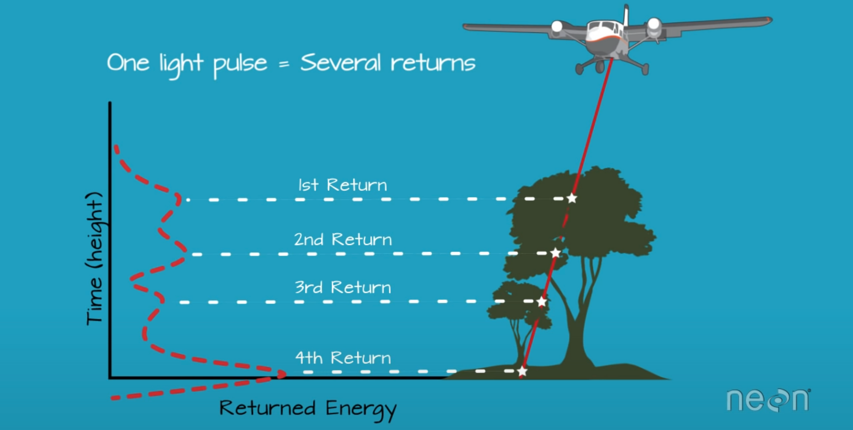
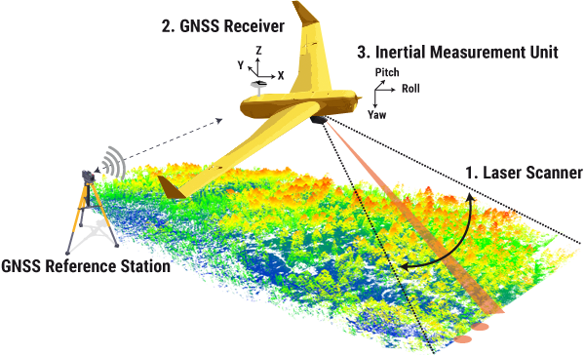
Lidar: Light Detection and Ranging
Uses emission of light and reflection from the ground or near earth objects:
1. Pulses of light emitted as laser scan
2. Reflected light from surface is recorded by the sensor
3. Time taken by light to travel to ground and back is recorded to
calculate distance to ground
Distance = (Speed of Light x Time of Flight) / 2
Source
Notes:
LiDAR systems are active sensors, and use the emission of light and reflection from the ground, or near earth object.
1. pulses: laser scans actively emit light energy in bursts
2. reflected light energy from objects near the earth’s surface returns and is recorded by the sensor.
3. The time it takes for the light to travel to the ground and back, is used to calculate the distance of the system to the ground.
- The GPS in the liar unit will determine its position on the ground. The IMU (intertial measurement unit) tracks plane position and tilt in the sky; for accurate elevation measurement.
The pulses of light can travel through the tree canopy, like how sunlight streams through branches, to the ground. This ability to travel through forests can tell us about the forest structure. LiDAR can record a dense array of distance return values, assembled into highly detailed 3D reconstruction.
which you will see on the next page

Slide 23
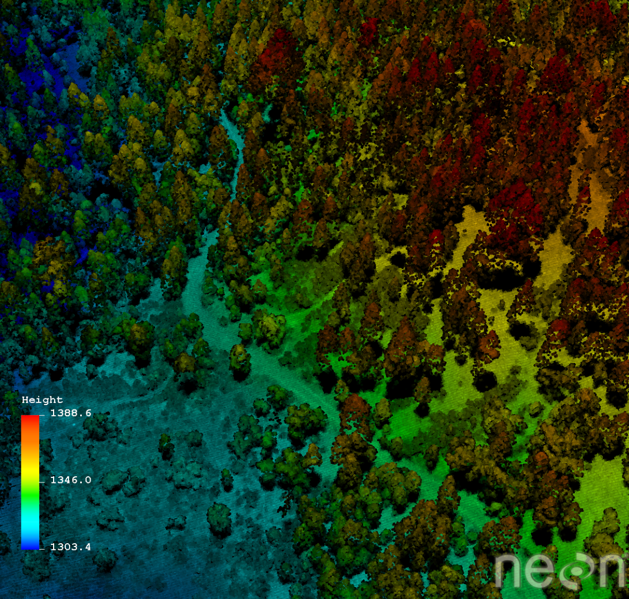
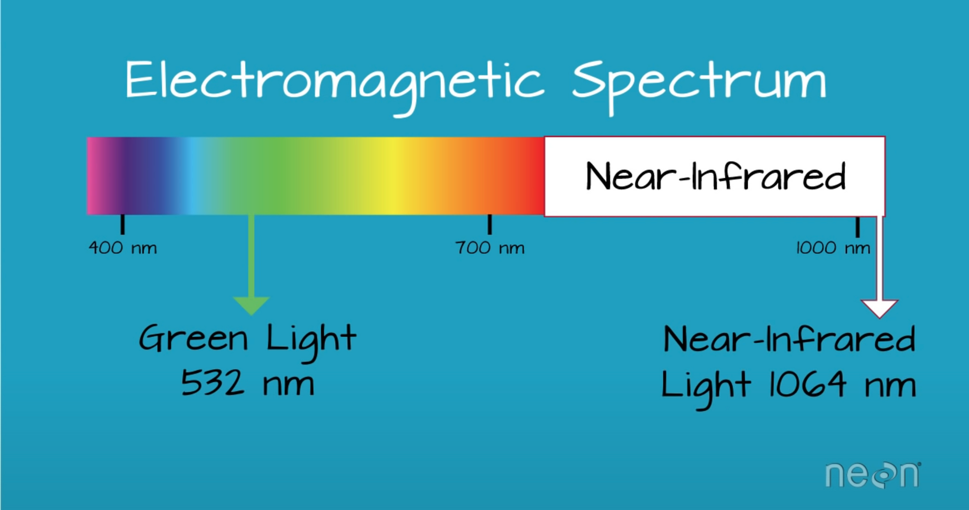
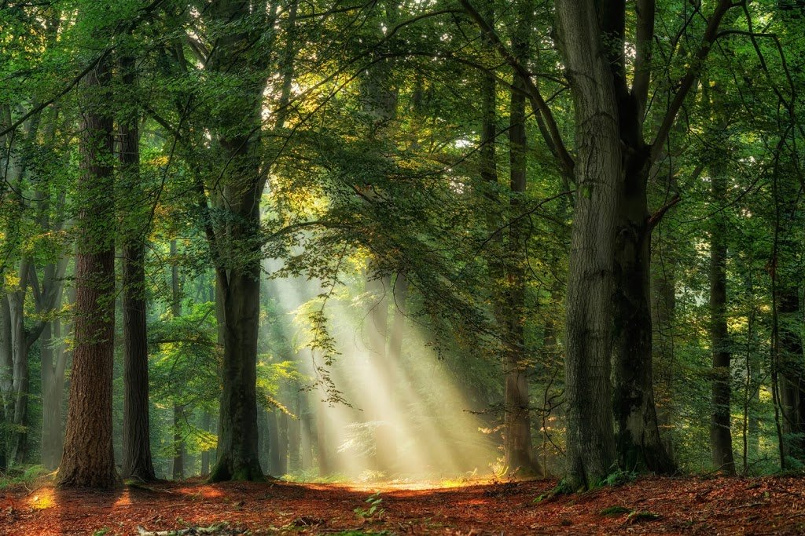
Lidar
Emitted green or near infrared light reflect strongly off vegetation
Vegetation structure information:
  canopy cover
  canopy height
  leaf area index
  vertical forest structure species ID
High resolution elevation data and 3D reconstructions
LiDAR data collected at the Soaproot Saddle site by the National Ecological Observatory Network's Airborne Observation Platform (NEON AOP).
Source: NEON
Notes:
The LiDar laser system uses green or near infrared light because these wavelengths reflect strongly off of vegetation. In other words, forests will reflect the green light emitted by the laser.
LiDAR data have also been used to derive information about vegetation structure including Canopy Height, Canopy Cover, Leaf Area Index, Vertical Forest Structure Species identification (if a less dense forests with high point density LiDAR)
LiDAR data have historically been used to generate high resolution elevation datasets.
A Full Waveform LiDAR System records a distribution of returned light energy. Full waveform LiDAR data are thus more complex to process however they can often capture more information compared to discrete return LiDAR systems. (Source: NEON)

Slide 24
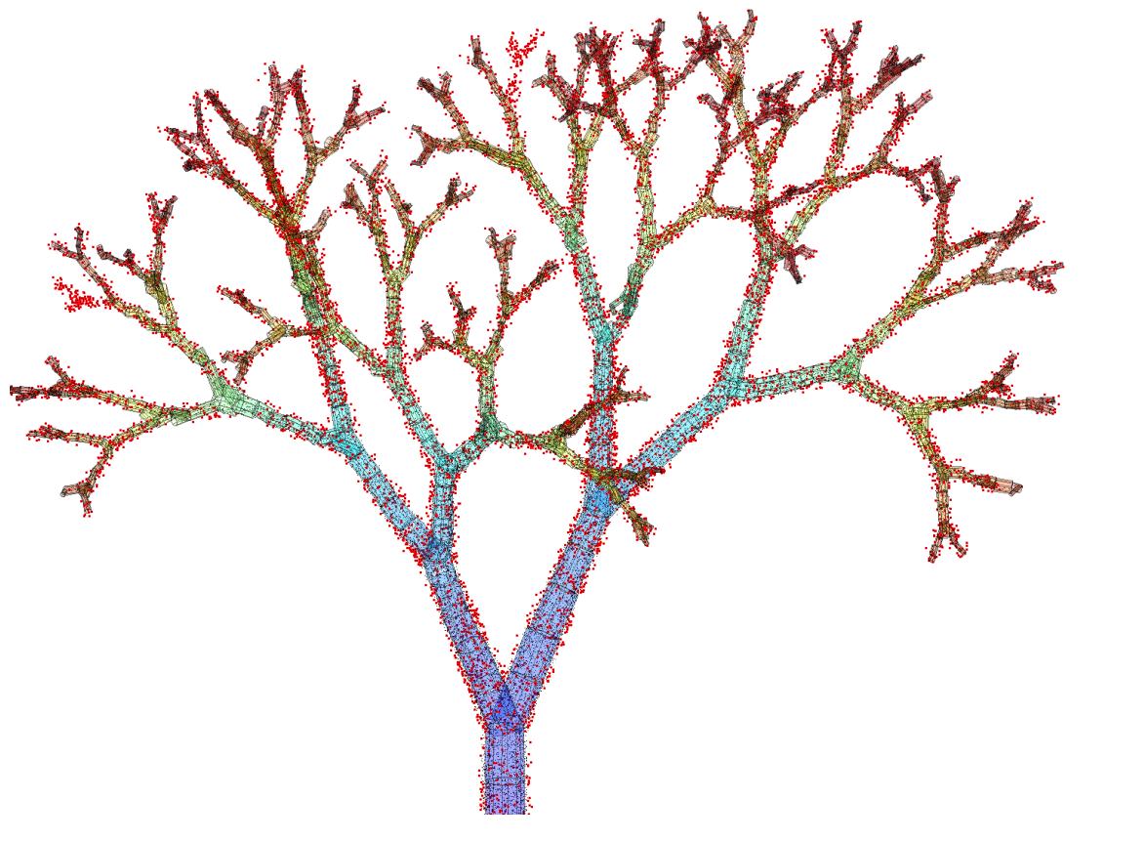
ForestScanner app demo!

Slide 25
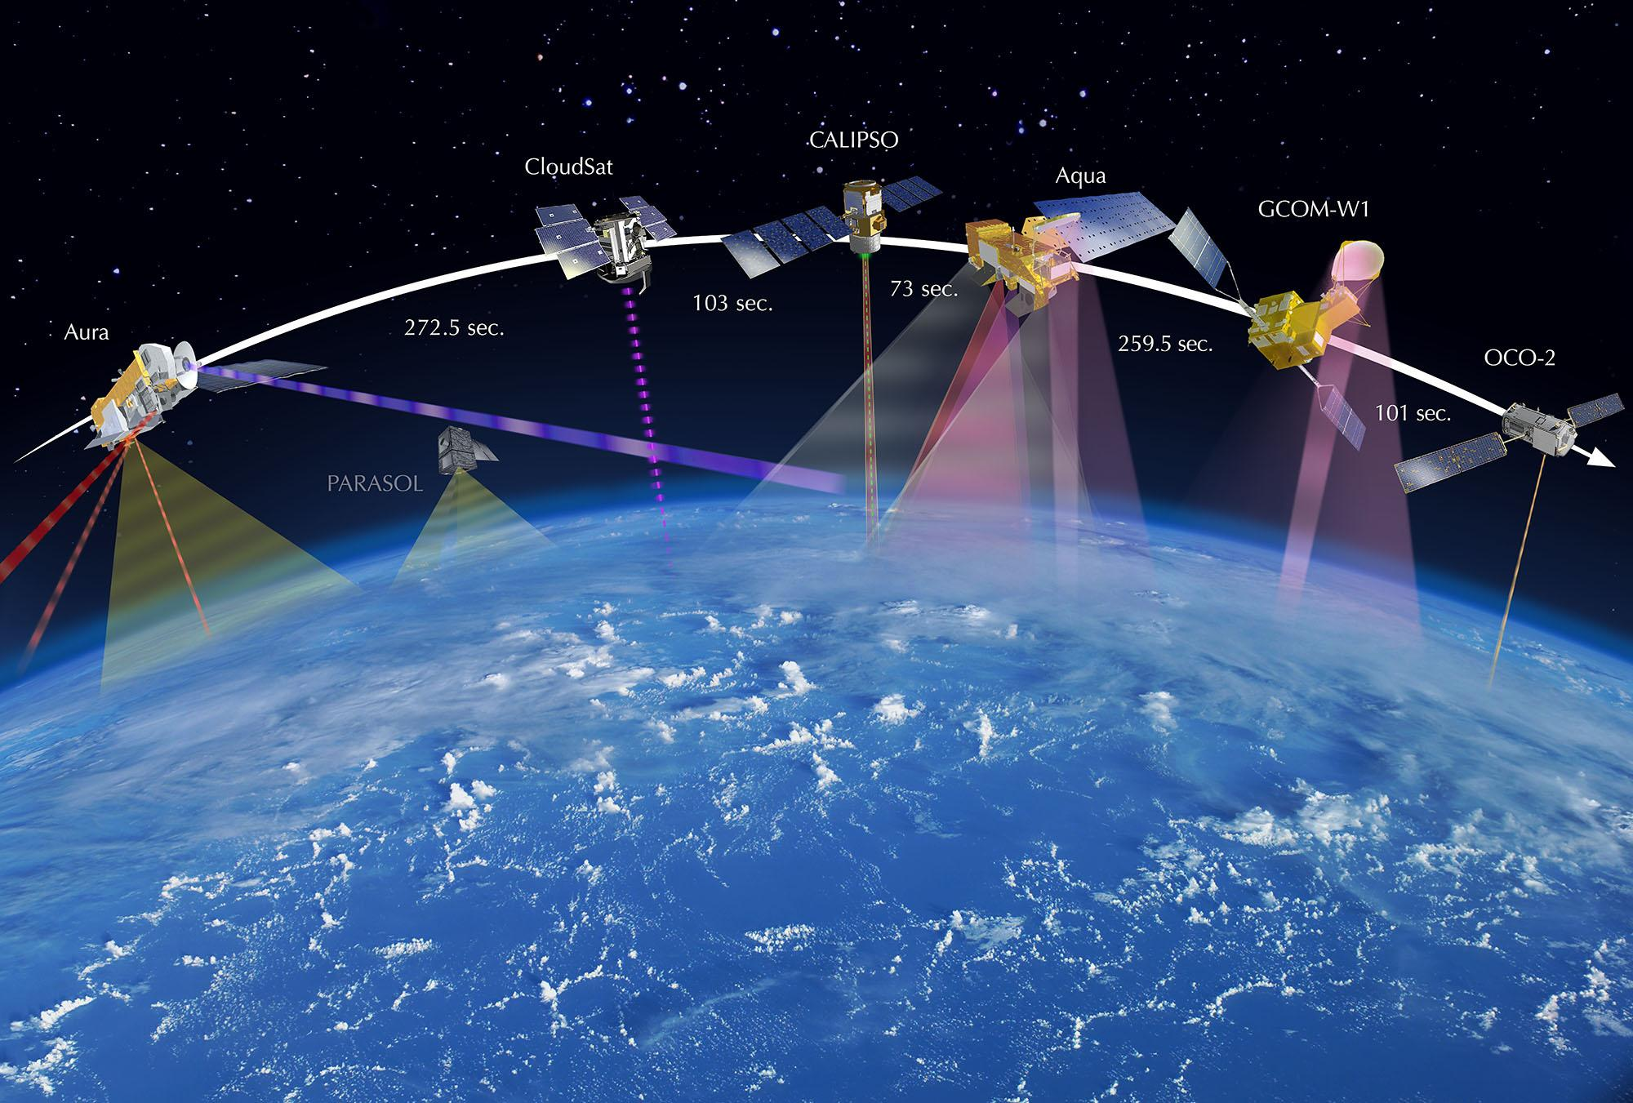
Satellite Imagery

Slide 26
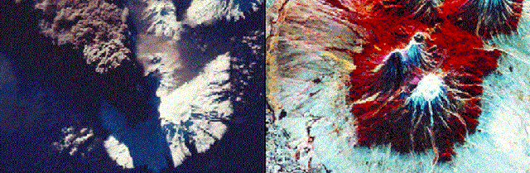
Optical Sensors
Use the Sun’s radiation as illumination to capture wavelengths in the near infrared/shortwave infrared spectral regions; only function during daytime.
Optical image of Kliuchevskoi volcano on the left, with a radar image on the right (Credit: Michigan Tech Volcanology). The optical image does not penetrate the clouds. Source.
Notes:
Optical
Optical sensor use Sun’s radiation as illumination to capture wavelengths in the near infrared/shortwave infrared spectral regions. Optical sensors measure reflected solar light: thus only function in the daytime and can't penetrate through clouds.
optical satellites use sun’s energy reflecting off Earth’s source, much like a camera
Radar
Radar sensors on the other hand, can image at both day and night and in almost all weather conditions. Microwaves can penetrate clouds and vegetation, to operate in day/night conditions.
Radar is an “active” sensing device in that it has its own source of illumination, a transmitter, for locating targets. It typically operates in the microwave region of the electromagnetic spectrum
Radar is a detection system that uses radio waves to determine the distance, angle, and radial velocity of objects relative to the site.
radiowaves are longer wavelength
can penetrate through clouds and tree canopy
What makes SAR unique is its ability to penetrate atmospheric conditions, providing near real-time visibility in cloud covered areas, both day and night.
\what makes this important

Slide 27
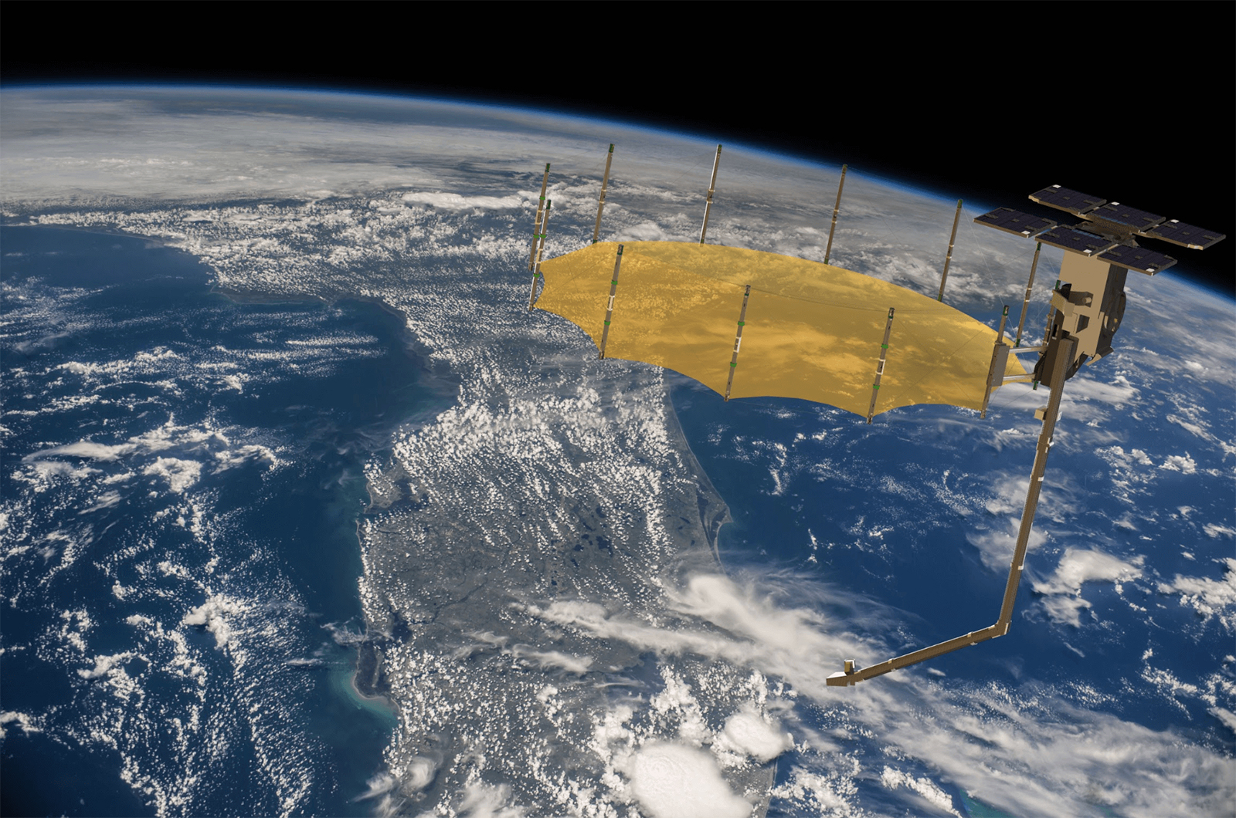
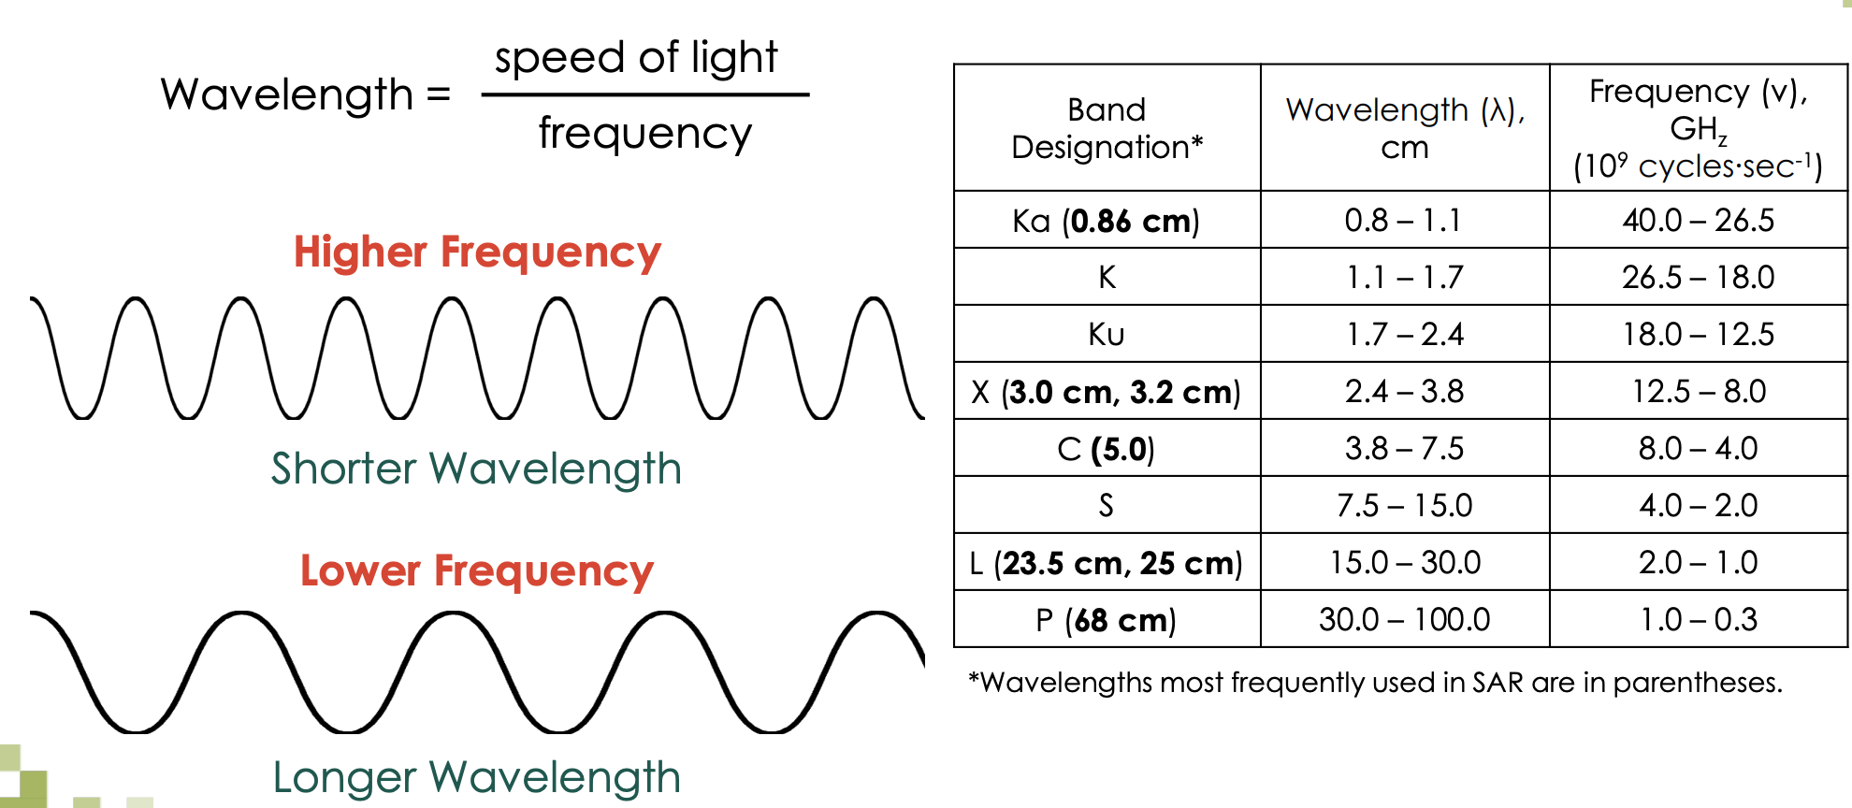
Radar
Radar: detection system using radio waves to determine the distance, angle, and radial velocity of objects relative to the site. Active sensor with its own source of illumination; longer wavelengths able to penetrate clouds and vegetation.
Notes:
As opposed to using the sun’s radiation, radar emits its own source of energy
Capella’s constellation of synthetic aperture radar (SAR) satellites provides 24-hour all-weather Earth observation. https://www.capellaspace.com/data/why-sar/
wavelengths are an important parameter.
Left: https://appliedsciences.nasa.gov/sites/default/files/2020-11/SAR_Part1.pdf

Slide 28
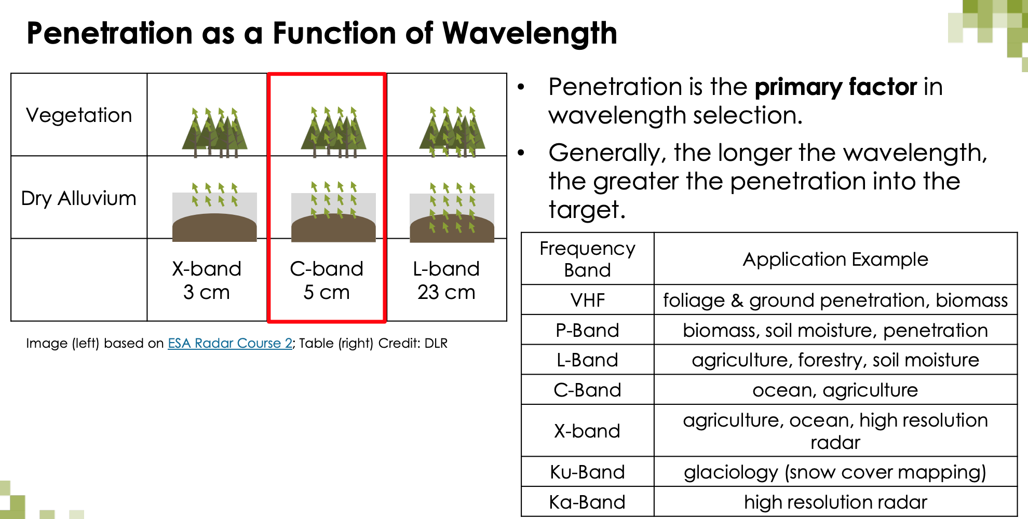
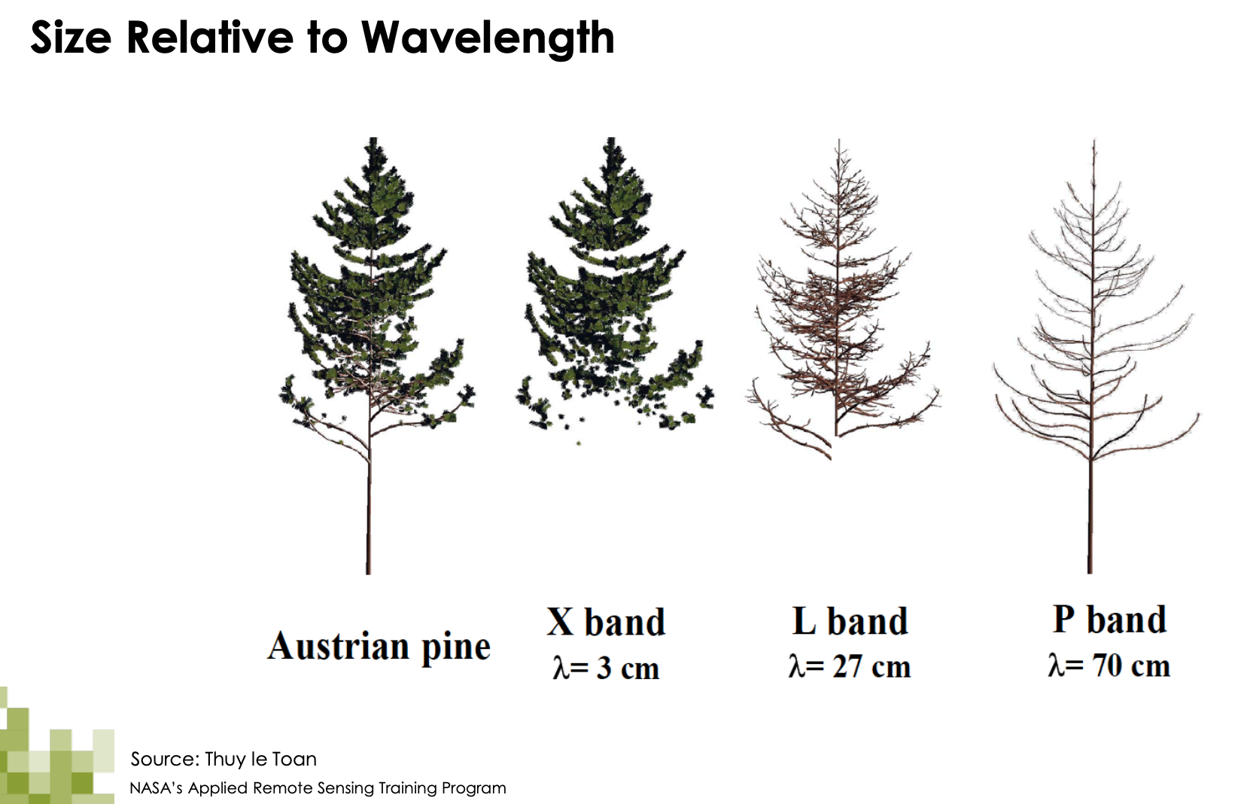
Source: NASA
Notes:
https://appliedsciences.nasa.gov/sites/default/files/2020-11/SAR_Part1.pdf
This is particularly useful in areas of persistent cloud cover. L-band will see larger branches but shorter wavelgnths from X- and C-band radar signal can see the leaves and twigs.
X-band SAR data can be acquired at a spatial resolution better than 5 metres, which allows more detailed characterisation of forest canopy structure and although still regarded as research, has potential to provide information about forest degradation.
detection of changes in forest cover, and has potential for use for early warning of forest clearing

Slide 29
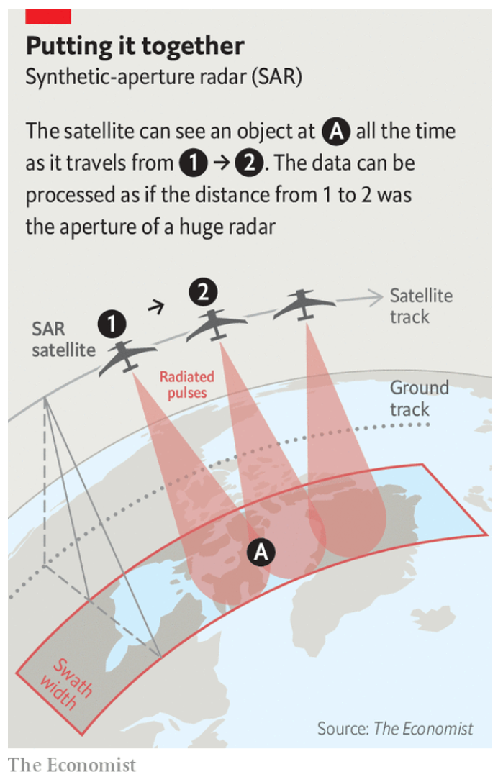
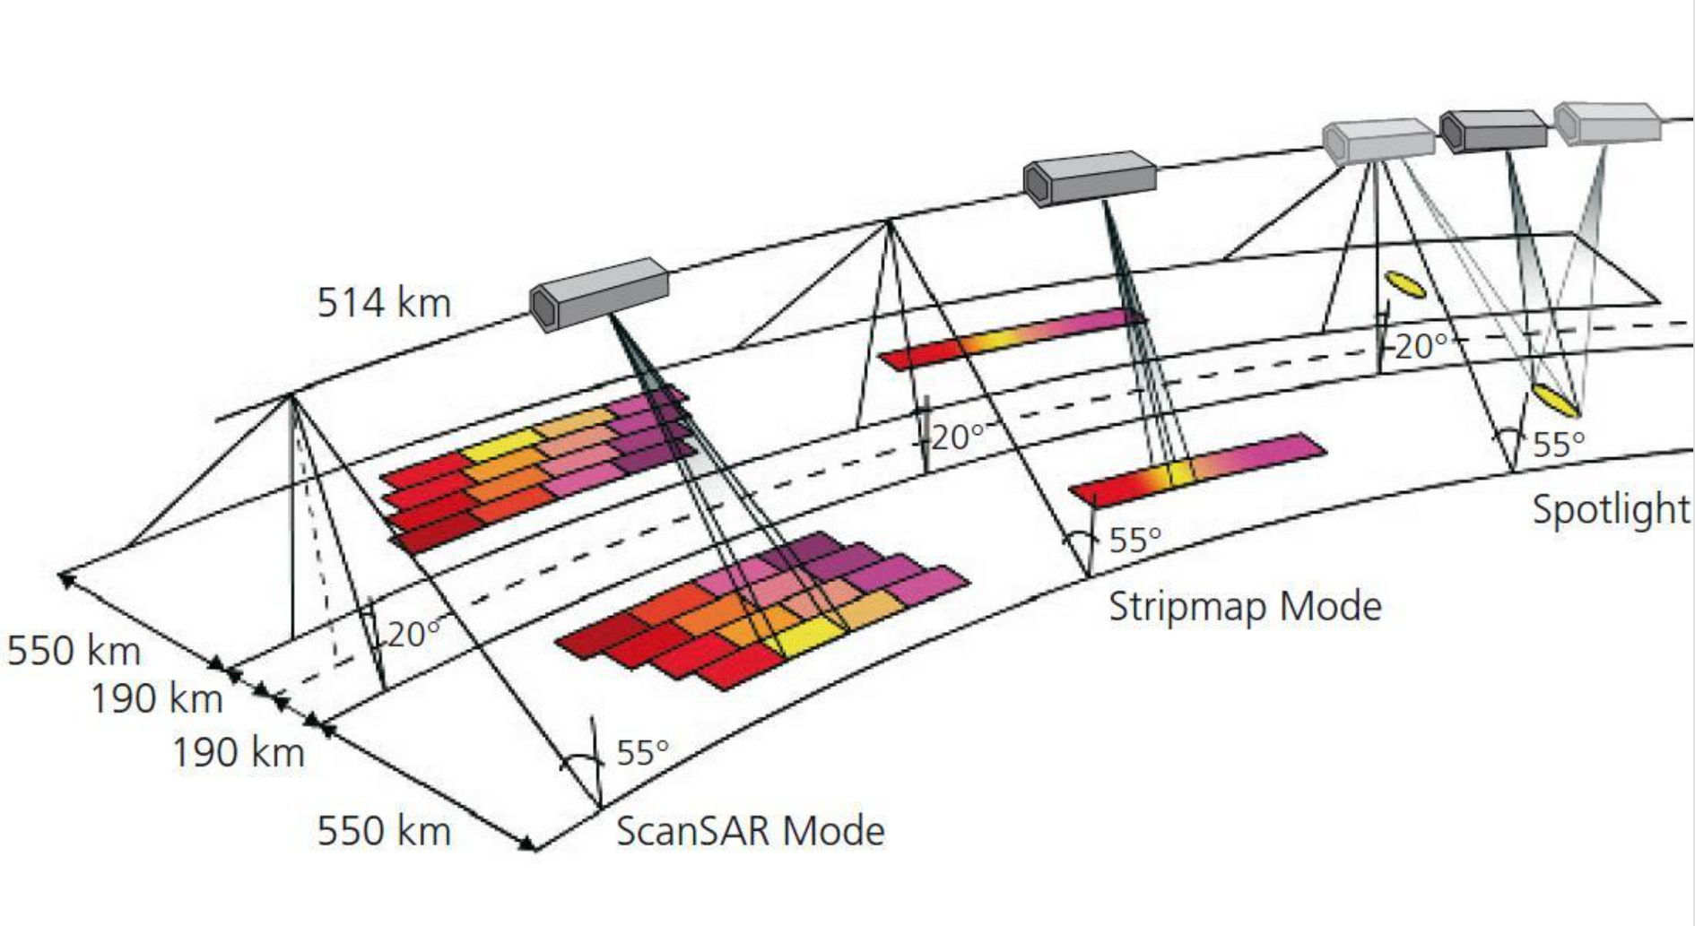
Synthetic-aperture-radar (SAR)
Creates 2D or 3D images. Motion of radar antenna over target regions provides finder spatial resolution.
Much smaller device can be deployed in space.
Angular resolution = wavelength / size of aperture
Notes:
Synthetic-aperture (SAR) radar is a form of radar that is used to create two-dimensional images or three-dimensional reconstructions of objects, such as landscapes. SAR uses the motion of the radar antenna over a target region to provide finer spatial resolution than conventional stationary beam-scanning radars.
able to shrink this down, able to put a much smaller satellite on a rocket , and deploy structure
traditionally require a large antenna/aperture -> which would also require a much larger antenna
angular resolution = wavelength / size of aperture.
longer wavelengths also require longer aperture
SAR helps improve resolution; moving a small antenna over long distances → combine multiple viewpoints
SAR techniques take advantage of the fact that the radar is moving in orbit to synthesize a virtual 10-km-long antenna from the physical 10-m antenna in the direction of flight. As the radar moves along its path, it sweeps the antenna’s footprint across the ground while continuously transmitting pulses – short signal bursts separated by time – and receiving the echoes of the returned pulses.
This is particularly useful in areas of persistent cloud cover. L-band will see larger branches but shorter wavelgnths from X- and C-band radar signal can see the leaves and twigs.

Slide 30
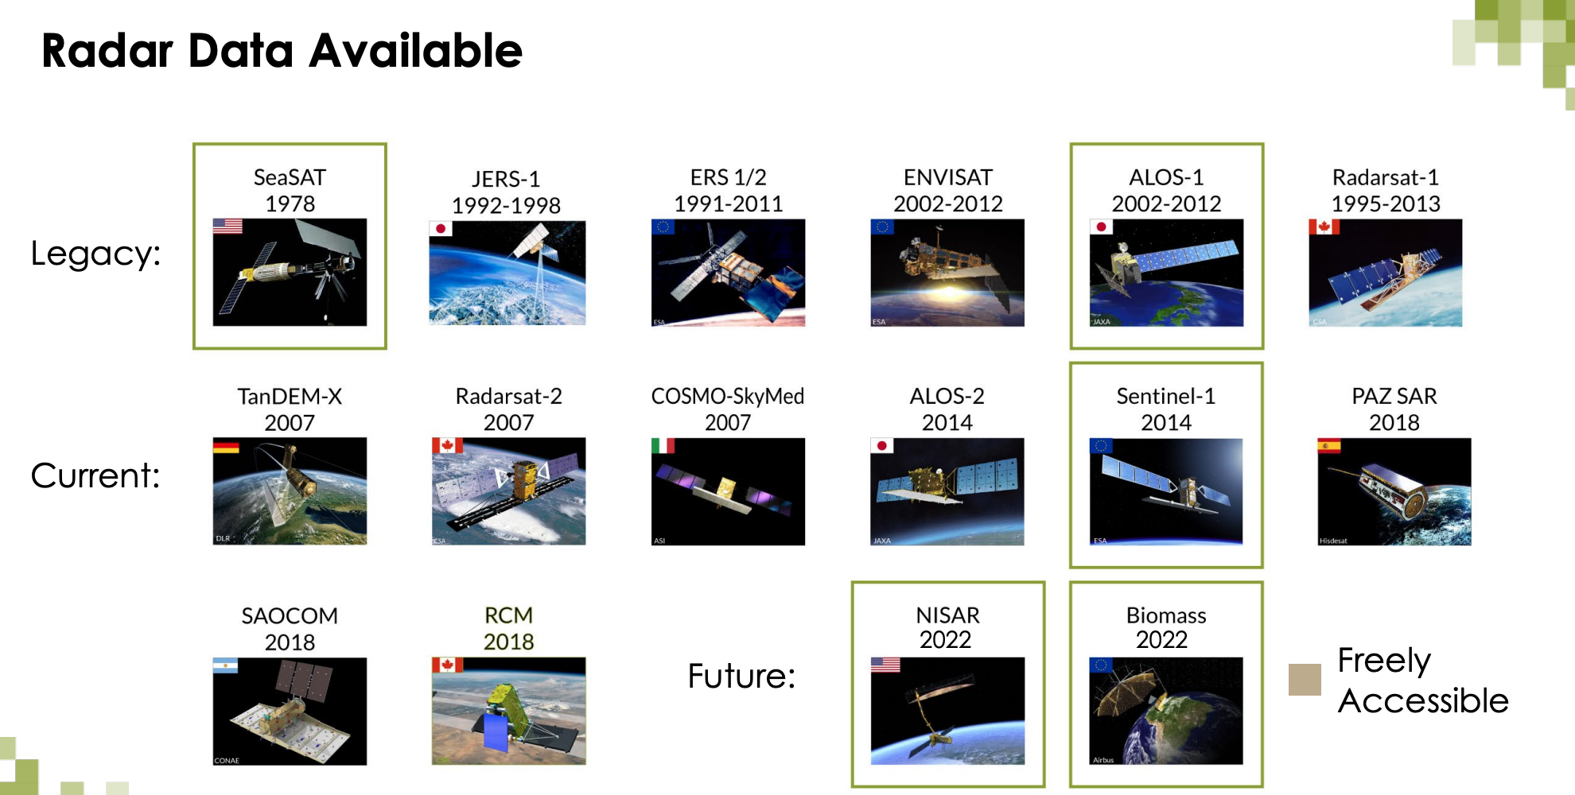
Source: NASA

Slide 31
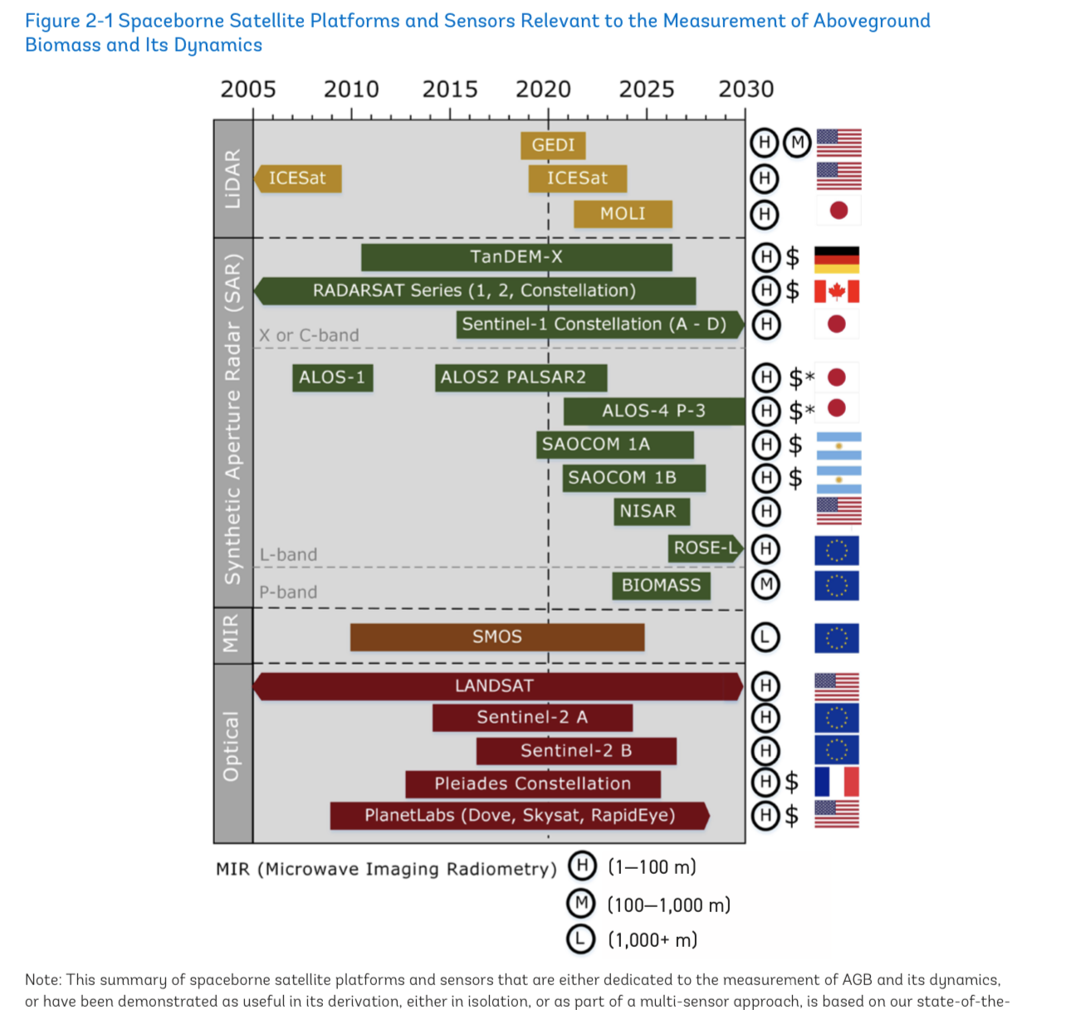
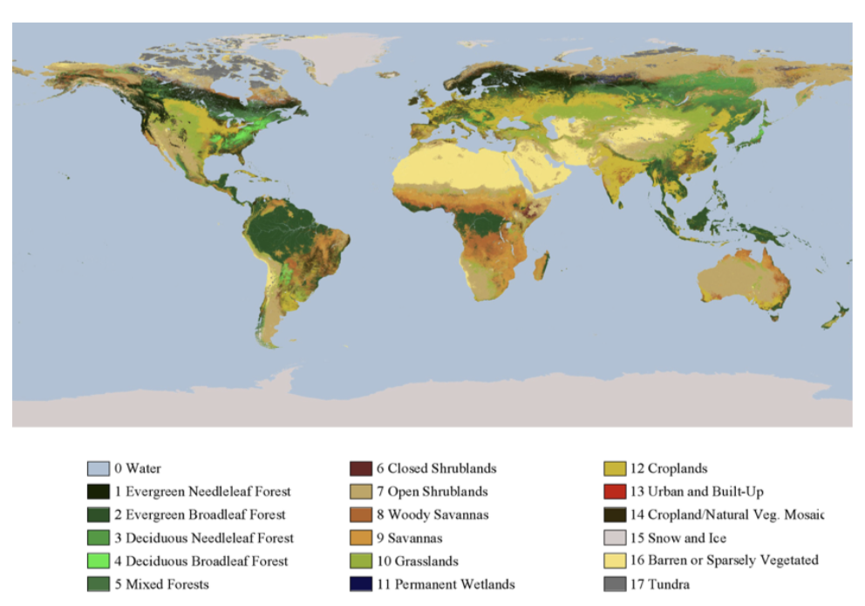
Satellite data!
Sources of optical satellite imagery relevant to ecosystem AGB::
NASA’s LandSAT and MODIS satellites
European Space Agency’s (ESA) Sentinel-2 and PROBA-V satellites
Japanese Space Agency’s (JAXA) ALOS-PALSAR radar
NASA’s GEDI (Global Ecosystem Dynamics Investigation) lidar
MODIS International Geosphere Biosphere Program global vegetation classification scheme; yearly 500m product
Source: World Bank
Notes:
The NASA/USGS Landsat Program provides the longest continuous space-based record of Earth's land in existence. https://landsat.gsfc.nasa.gov/data/
Landsat sensors record reflected and emitted energy from Earth in various wavelengths of the electromagnetic spectrum.
Landsats 8 and 9 “see” and record blue, green, and red light in the visible spectrum as well as near-infrared, shortwave-infrared, and thermal-infrared light that human eyes cannot perceive (although we can feel the thermal-infrared as heat).

Slide 32
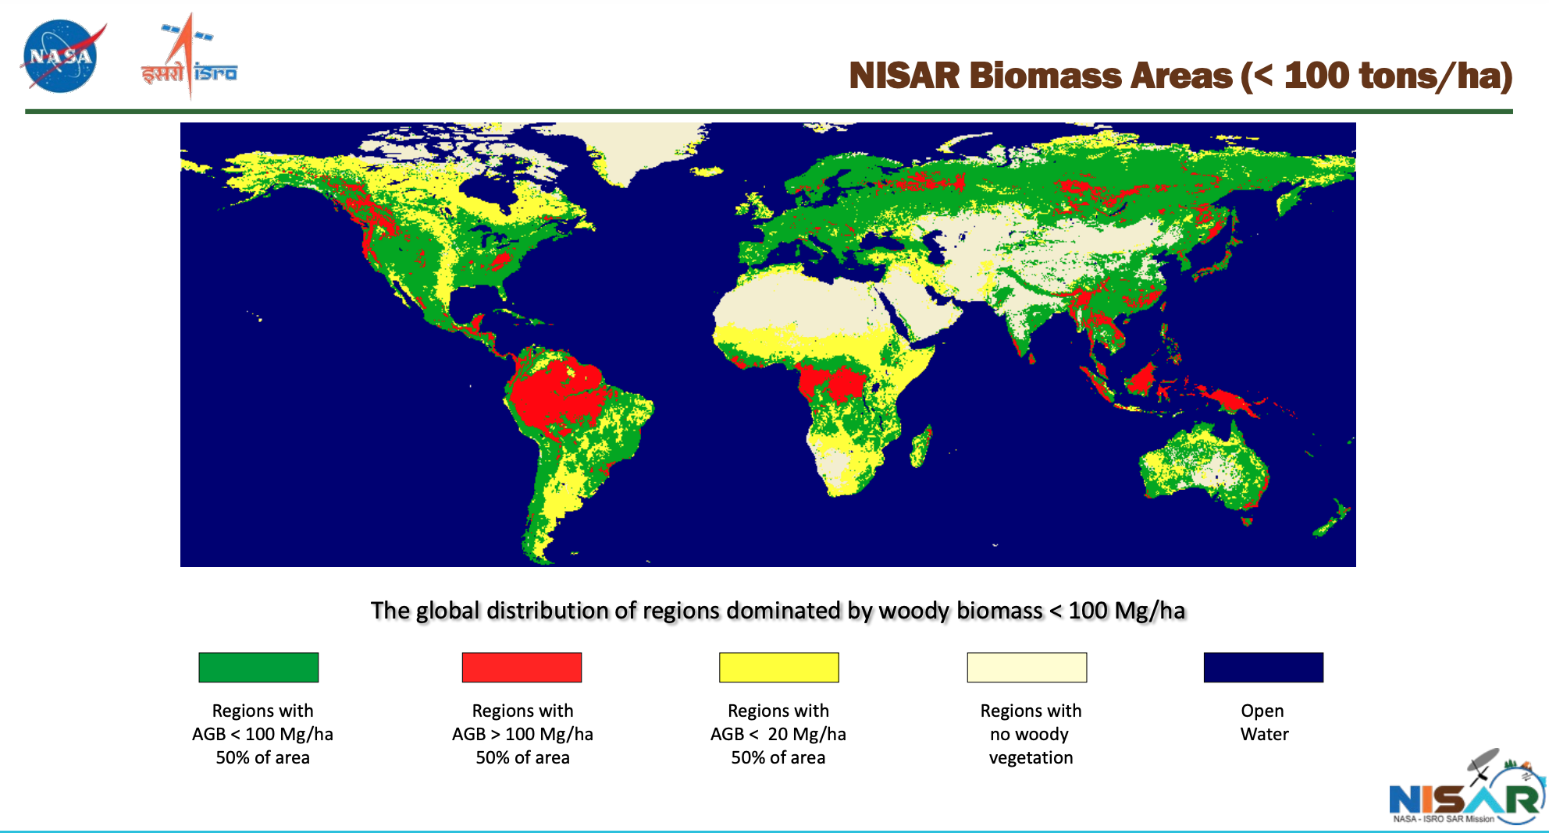
Aboveground Biomass (AGB) Models
Forest carbon storage accounts for 82.5% of terrestrial vegetation carbon storage (Cusack et al, 2014)

Slide 33
Ground-based Measurements
Notes:
Prior studies demonstrate that carbon maps using only satellite imagery are no better than simply using the average carbon of the plots used to train the mapping algorithm (8). In other words, imagery-only carbon mapping is not an improvement over manual plot inventories.

Slide 34
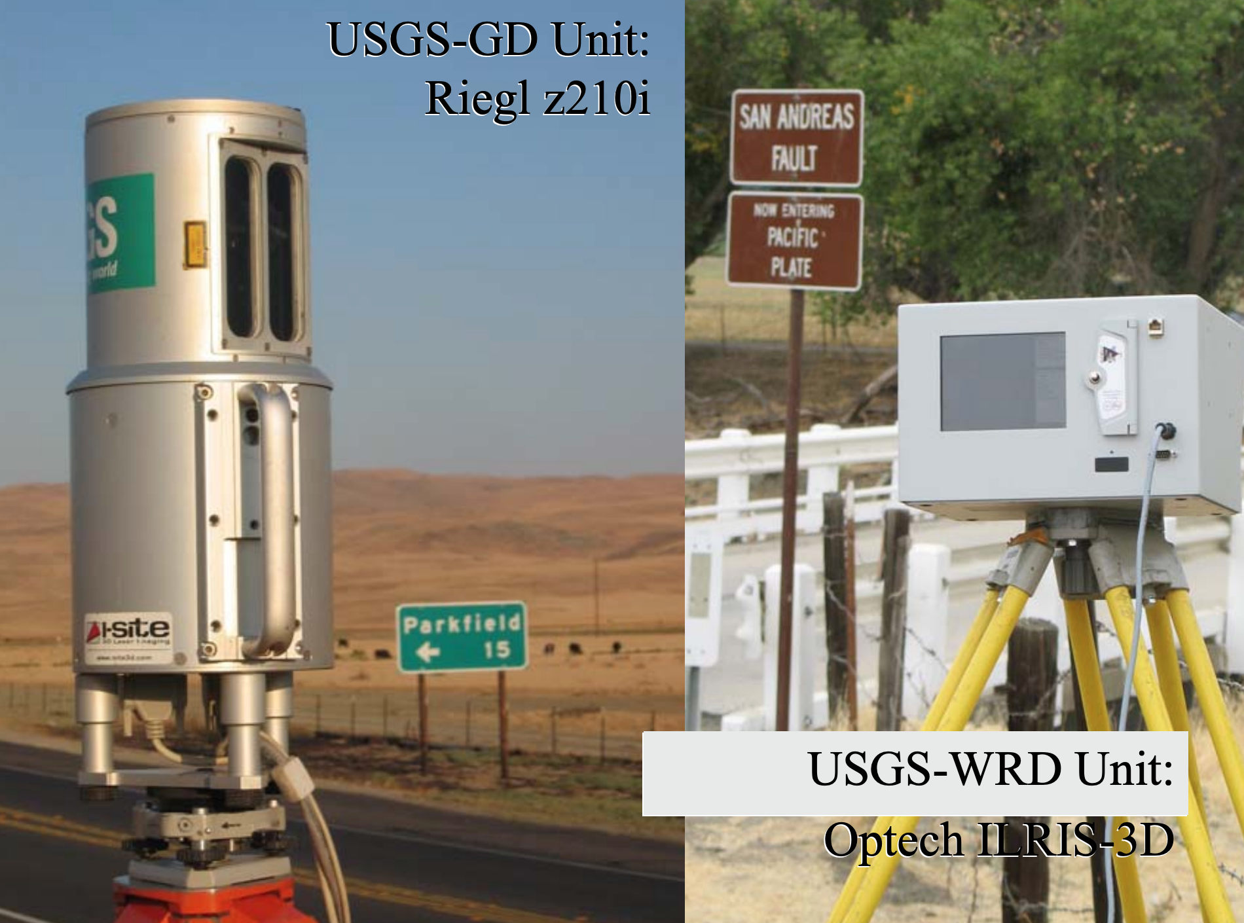
Ground-based/Terrestrial Lidar, Forest Inventories

Slide 35
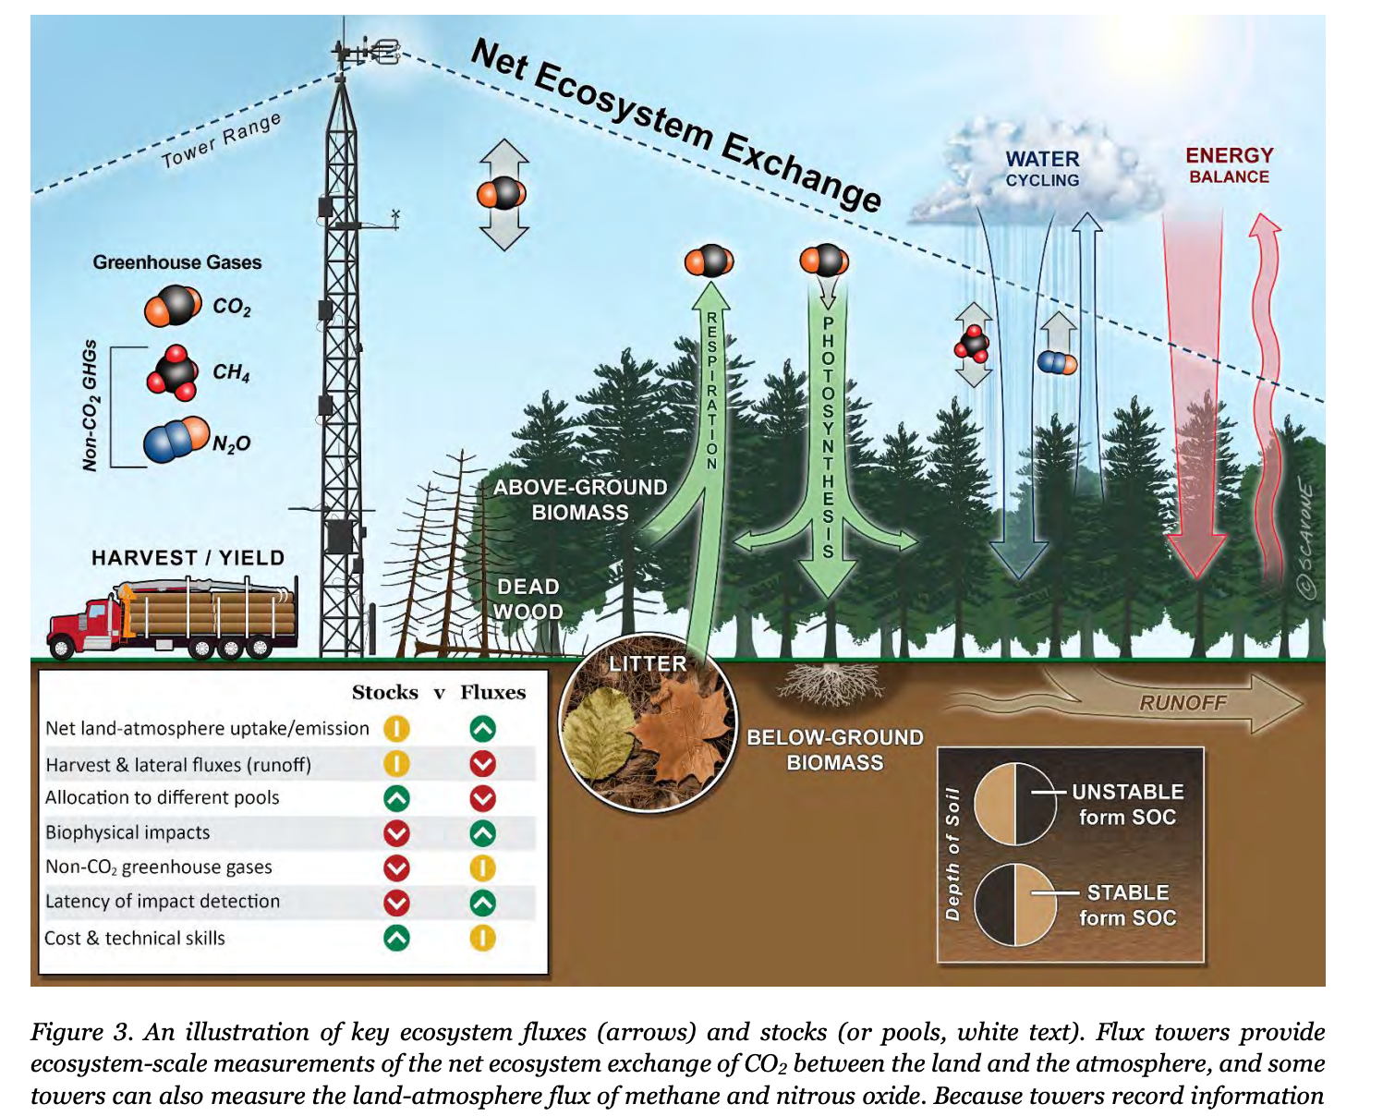
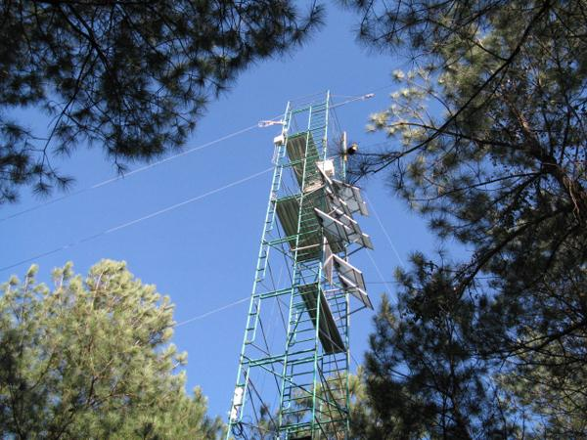
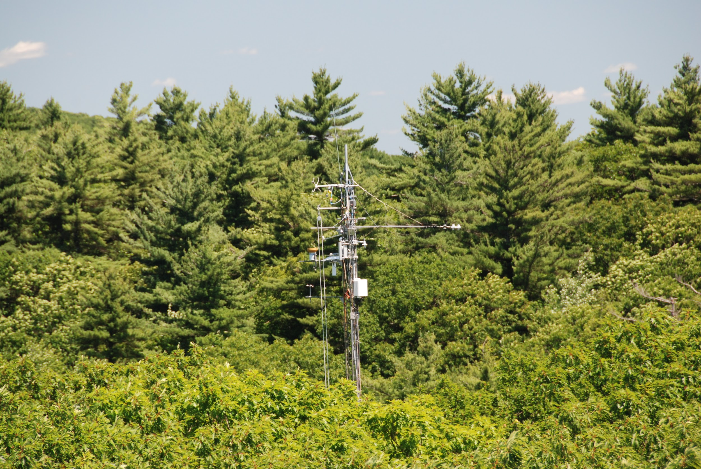
Carbon flux and stock information are complementary
Harvard Forest Flux Tower
Notes:
Net ecosystem exchange, including water, energy, ghgs between forests and atmosphere.
Flux Towers are micrometeorological tower sites that use eddy covariance methods to measure the exchanges of carbon dioxide, water vapor, and energy between the biosphere and atmosphere

Slide 36
Forest Carbon Stocks
Notes:
It is difficult to calculate the exact amount of CO2 sequestered by a tree per year due to the complex biological and climatic variables involved in tree growth.

Slide 37
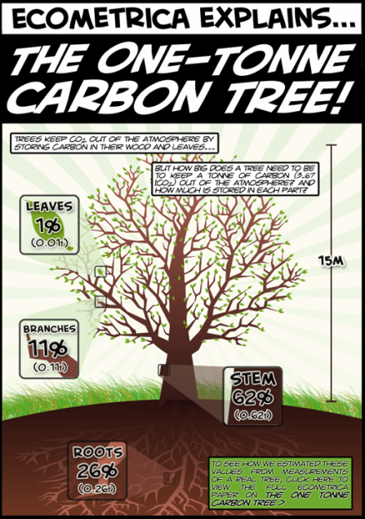
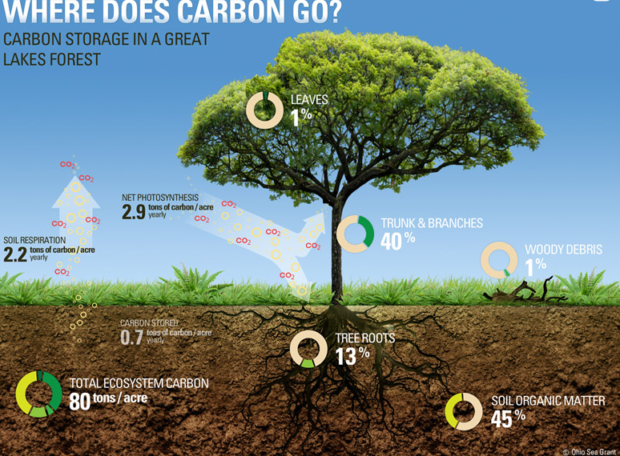
Tree Carbon Content
Source
Notes:
Very roughly speaking, a tree absorbs up to 20 kg CO2 per year = about 1 tonne of carbon by age 40. However, these figures vary a lot between species and locations. Add the enormous amount of carbon stored in forest soils to that of the trees, and forests are major carbon storage reservoirs.

Slide 38
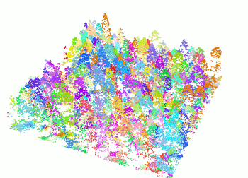
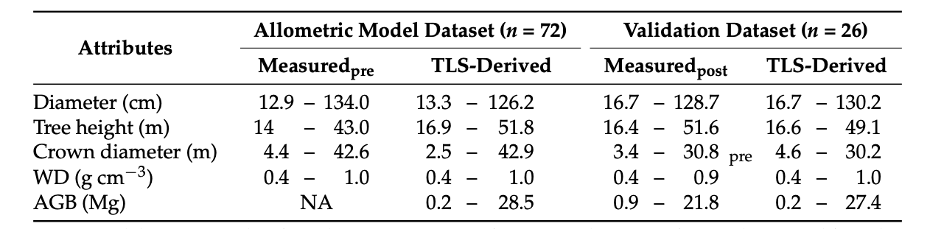
Estimating Biomass Using Lidar Data
Tree attributes obtained from terrestrial laser scanning (TLS) point clouds
  Diameter, height, crown diameter, wood density
  Tree volume and aboveground biomass
Biomass models from field-sampled data * conversion factor_carbon concentration = carbon stock
Source: Lau et al.
Source
Notes:
Paper: https://www.cifor.org/publications/pdf_files/articles/ALau1901.pdf
A common practice for estimating tree carbon stocks is that tree biomass (total and components) models are first developed based on field-sampled data, and then carbon stock is calculated by multiplying the model-predicted biomass by a conversion factor of carbon concentration.Dec 14, 2015

Slide 39
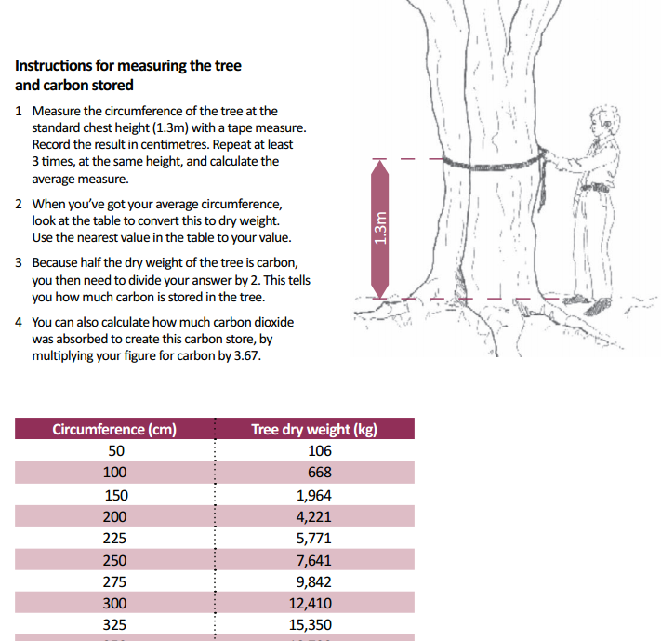
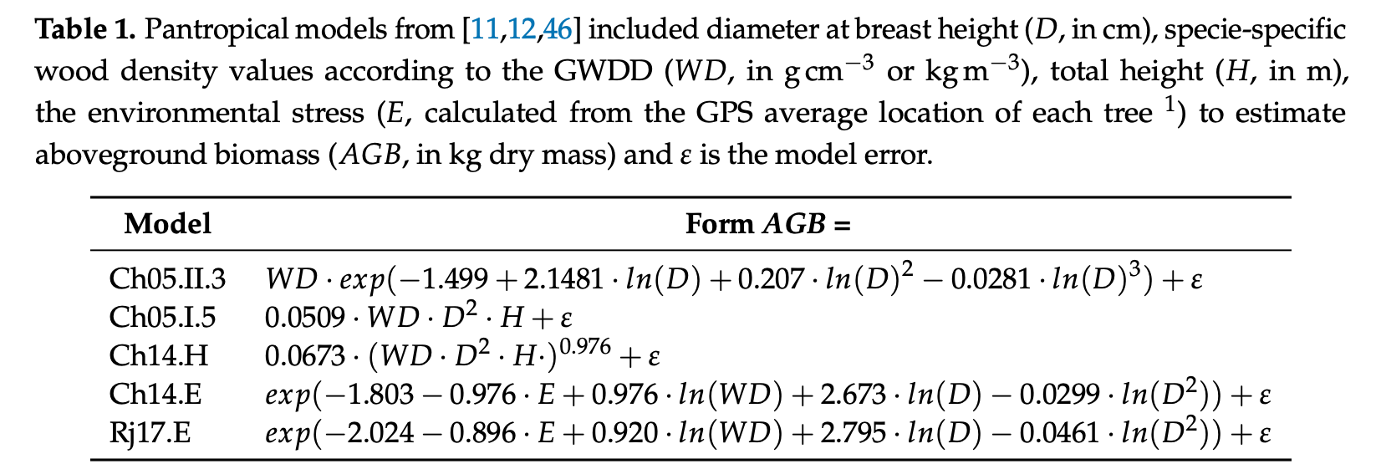
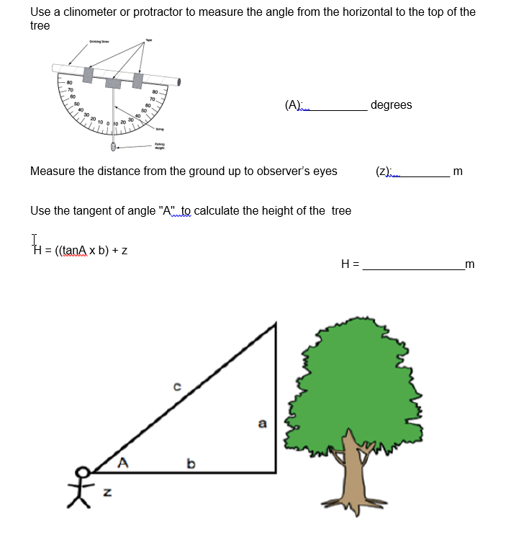
Allometric Equations
Allometric equations provide biomass estimates from tree measurements such as diameter at breast height (DBH), height, and/or wood density.
These Equations capture the scaling relationships between tree form and function to predict total and component (ie. branch, needle, bark, root) biomass. (Vorster et al.)
Estimate height of tree using the angle from the observer’s eyes to the top of the tree. (Source)
Notes:
Key figure of carbon content is the SIZE of the tree. Bigger trees are usually older and have captured more carbon dioxide from the atmosphere during their life. Therefore, contain more carbon.
Equations differ based on the type of forest, ie. these are widely used for moist forests
Trees grow at different rates depending on the species, soil, drainage, slope aspect, climate, etc.

Slide 40
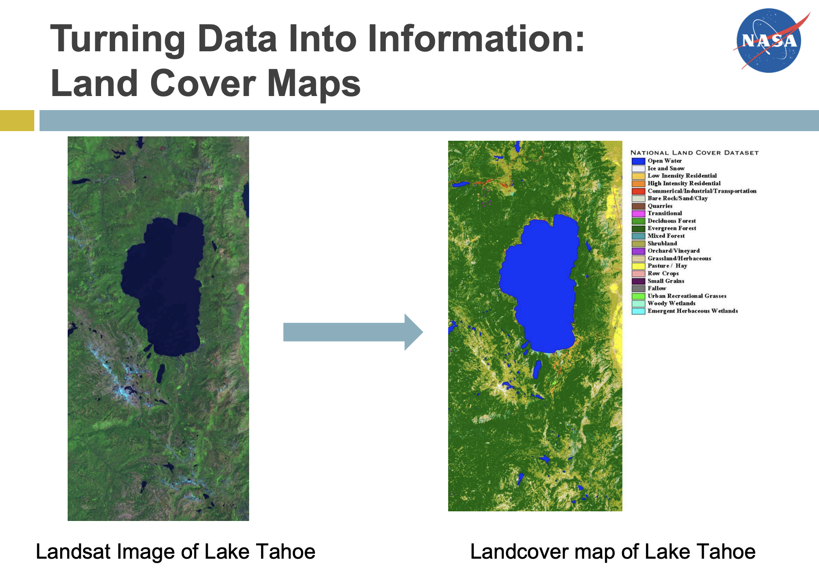
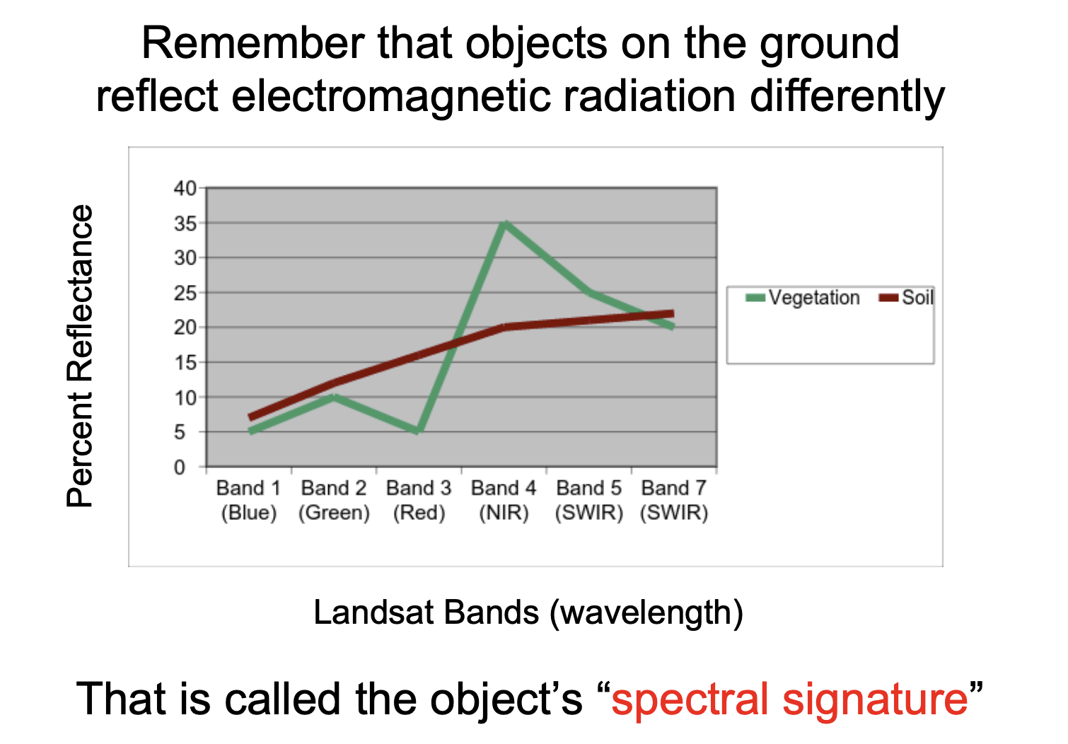
Mapping Land Cover
Source: NASA

Slide 41
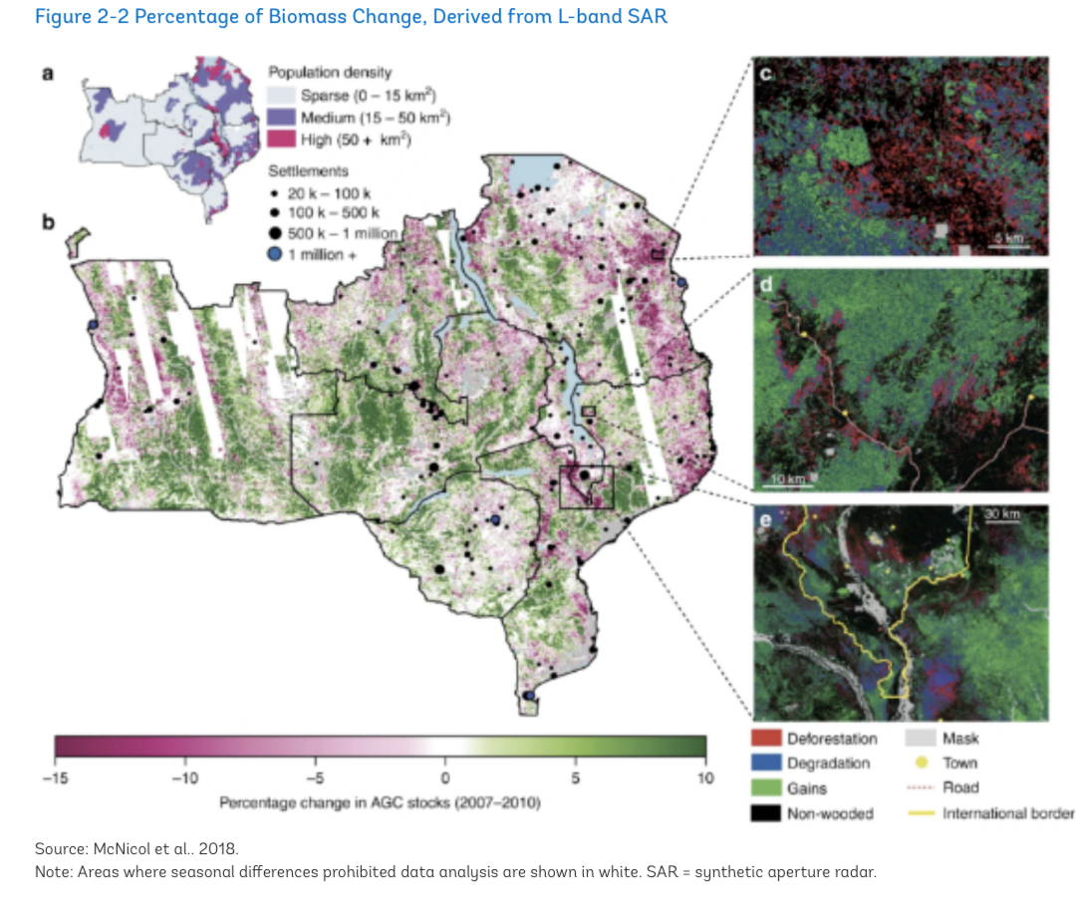

Mapping Land Changes
Source: World Bank
Notes:
https://youtu.be/gBTlIaf12-4?t=70

Slide 42
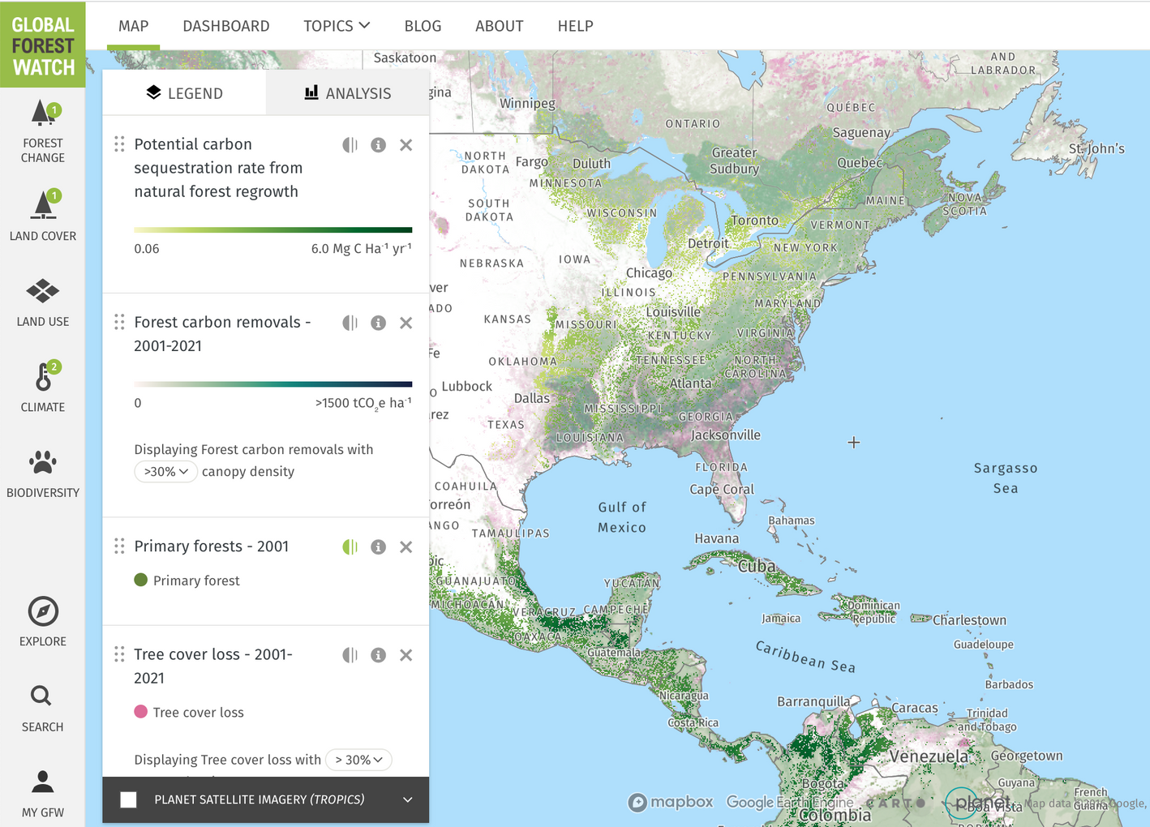
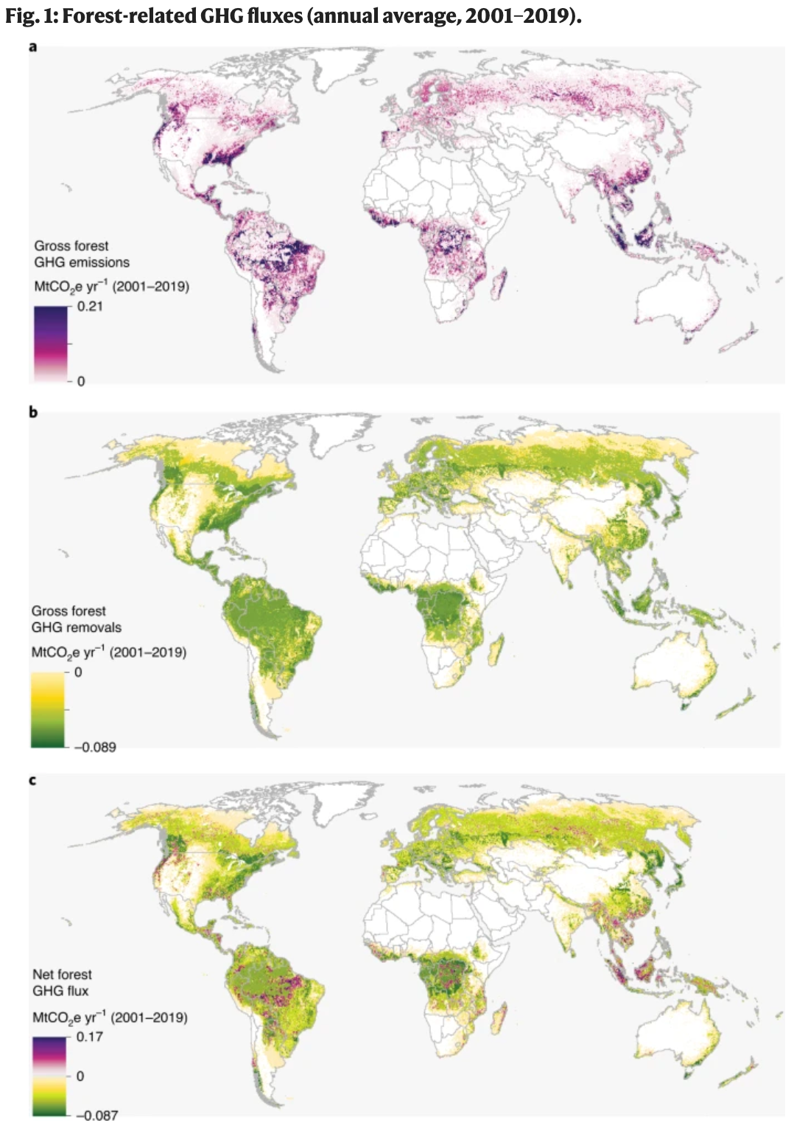
Global Forest Watch: Carbon Sequestration
Source: Global Forest Watch
Notes:
removals include carbon stored above and below ground

Slide 43

Global Forest Watch: Carbon Sequestration
Source: Global Forest Watch
Notes:
removals include carbon stored above and below ground

Slide 44
Case Studies and Companies

Slide 45



Source: Lau et al.
Notes:
Models

Slide 46



Carbon Mapping Tools and Companies
Chloris Geospatial: directly measures carbon stocks, and their losses and gains, with quantified uncertainty at the pixel level.
Kanop: We use the most precise satellite images available and train our AI with ground data from thousands of forests
Europe's vegetation has removed over 3.4 Gt CO2e in the period 2003-2019, almost the entire emissions of the year 2019 for the 27-countries block. (Source: Chloris Geospatial)

Slide 47



Gaia.AI
Source: Gaia.AI

Slide 48

Pachama: Sample Forest Height Maps
Source: Pachama
Using plot inventories and airborne lidar to train and validate algorithms in new regions.
Notes:
map forest height as well as the height of different canopy layers in the forest

Slide 49
Data and Tools to inform Natural Climate Solutions
Source: The science needed for robust, scalable, and credible nature-based climate solutions for the United States
Notes:
Over the past decade, operational, near-real time observations of carbon cycle pools and fluxes have been enabled by:
multiple active NASA science missions have relevance to NbCS
airborne campaigns providing ‘snapshots’ of both natural and anthropogenic fluxes at the landscape scal

Slide 50
Takeaways
Mapping the world’s carbon stores is essential for taking stock of the climate crisis
Data can inform our solutions and decision-making for forestry practices, land management, and resource allocation
Natural climate solutions are important and projects should be monitored
Remote sensing technologies can accurately, cheaply measure at scale
Remotely sensed and ground-truth data should be used in conjunction

Slide 51
Thank you for listening and for caring about our climate!
Notes:
Thank you all so much for the work you do and for learning more. It can be hard, but it really is up to all of us to help our planet and people.

Slide 52
Additional Sources
Catanzaro P., D’Amato A. (2019) Forest Carbon: An essential natural solution for climate change. University of Massachusetts Amherst, University of Vermont. https://masswoods.org/sites/masswoods.org/files/Forest-Carbon-web_1.pdf
Cook-Patton, S.C., S.M. Leavitt, D. Gibbs, N.L. Harris, K. Lister, K.J. Anderson-Teixeira, R.D. Briggs, R.L. Chazdon, T.W. Crowther, P.W. Ellis, H.P. Griscom, V. Herrmann, K.D. Holl, R.A. Houghton, C. Larrosa, G. Lomax, R. Lucas, P. Madsen, Y. Malhi, A. Paquette, J.D. Parker, K. Paul, D. Routh, S. Roxburgh, S. Saatchi, J. van den Hoogen, W.S. Walker, C. E. Wheeler, S. A. Wood, L. Xu, & B. W. Griscom (2020) Mapping Potential Carbon Capture from Global Natural Forest Regrowth. Nature, in press.
Hao H, Li W, Zhao X, Chang Q, Zhao P. Estimating the Aboveground Carbon Density of Coniferous Forests by Combining Airborne LiDAR and Allometry Models at Plot Level. Front Plant Sci. 2019 Jul 10;10:917. doi: 10.3389/fpls.2019.00917. PMID: 31354780; PMCID: PMC6636660.
Lau A, Calders K, Bartholomeus H, Martius C, Raumonen P, Herold M, Vicari M, Sukhdeo H, Singh J, Goodman RC. Tree Biomass Equations from Terrestrial LiDAR: A Case Study in Guyana. Forests. 2019; 10(6):527. https://doi.org/10.3390/f10060527

Slide 53
Where we go now is up to us.

Slide 54
Appendix
Notes:
TO DO
optical infrared finish

Slide 55
Satellite Observations
Optical Infrared
Radar
Lidar

Slide 56

Source
To meet IPCC targets, we’ll need to remove one billion metric tons of carbon annually by 2030 and five to ten billion metric tons annually by 2050.

Slide 57


Slide 58


Notes:
Satellite carbon estimation

Slide 59
Proxies for Soil Carbon
Moisture, land use,
For wetlands: tidal inundation frequency and height, vegetation species, and soil algal biomass could improve remote-sensing-based tidal wetland SOC studies.

Slide 60
Abbreviation | Description
TCH | Top of canopy height of plot
h25…h95 | Height percentiles
d25…d95 | Density percentiles
CC | Canopy closure
AvgH | Average height of plot
LorH | Lorey’s height of plot
BA | Base area of plot
Notes:
https://cran.r-project.org/web/packages/lidR/readme/README.html
possibly include point cloud video

