Slide 1
Petrochemical: Current Status and Future
Abdul Alfaraidi

Slide 2

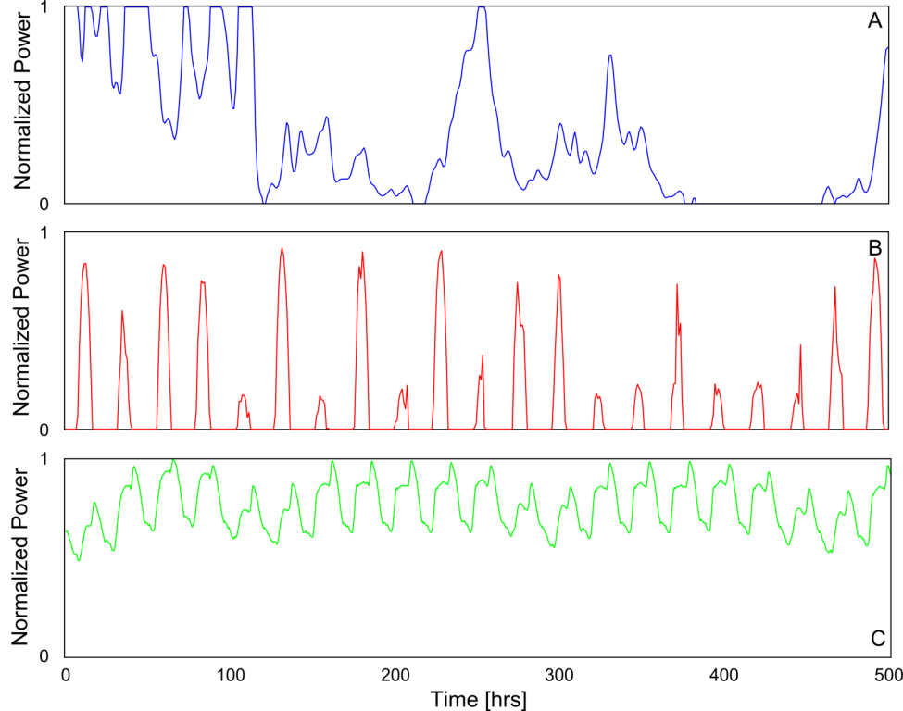
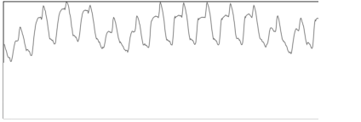
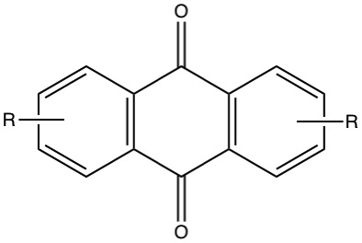
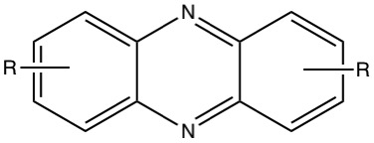
wind production
Power
3 weeks
PV production
Power
grid demand
We must also find alternative ways to make the feedstock clean

Slide 3
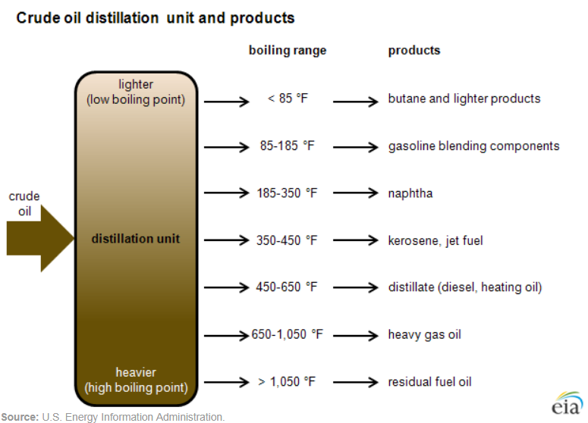
Petrochemicals (sometimes abbreviated as petchems) are the chemical products obtained from petroleum by refining.
Steam cracking is a petrochemical process in which saturated hydrocarbons are broken down into smaller, often unsaturated, hydrocarbons.

Slide 4
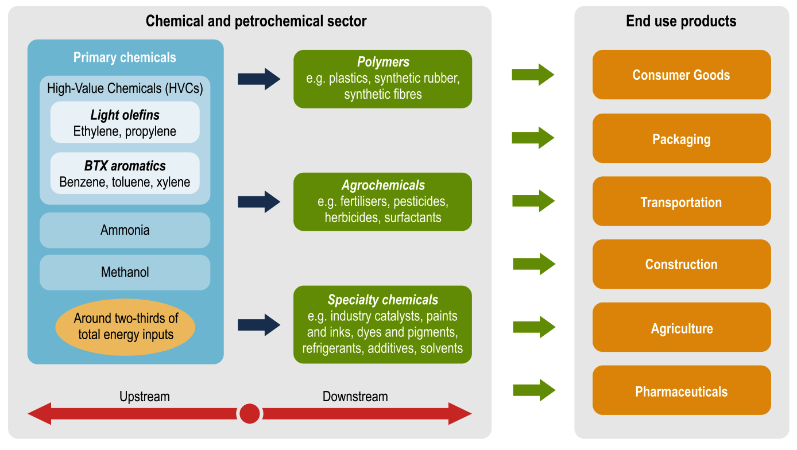

Slide 5
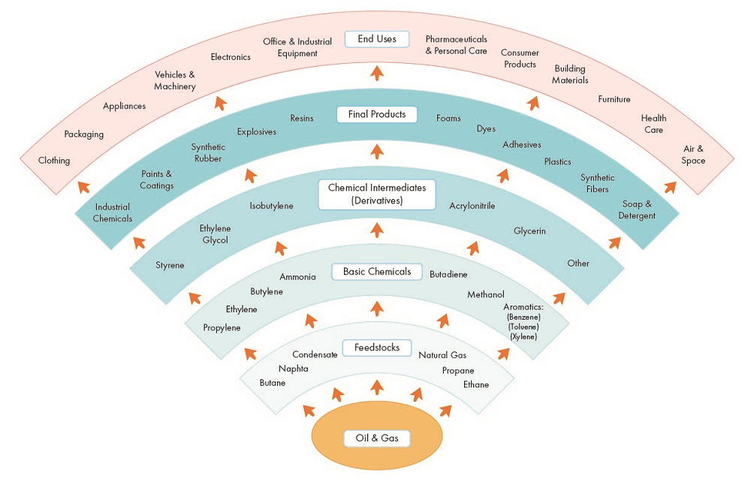
Fact: Pharmaceuticals represent about 3% of petrochemical use but almost 99% of pharmaceuticals contain petrochemicals.
Am J Public Health. 2011 September; 101(9): 1568–1579.

Slide 6
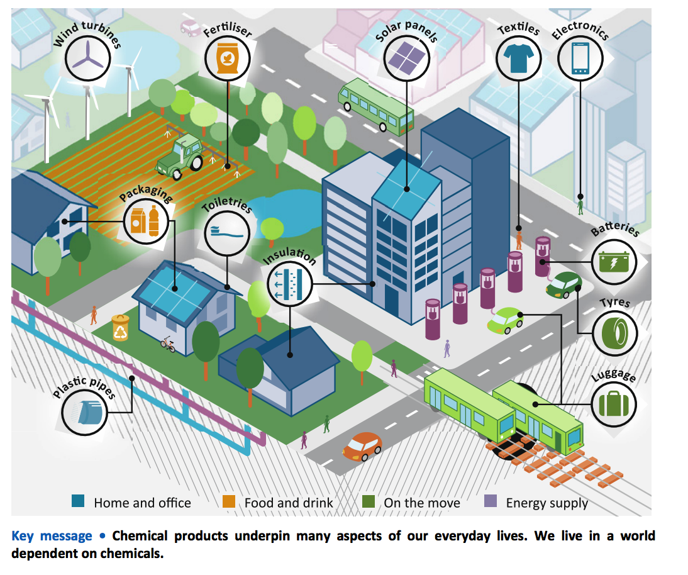

Slide 7
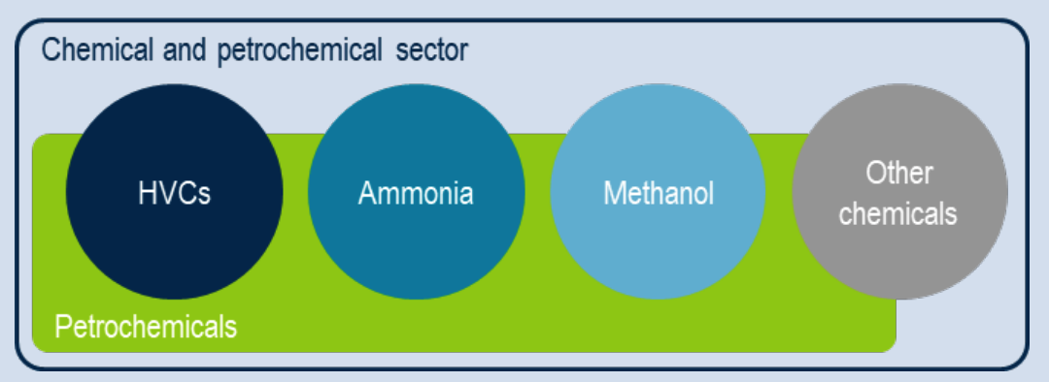
The production of “primary chemicals” (the collective term for HVCs, ammonia, and methanol together), accounts for around -two-thirds of total energy demand in the chemical sector.
What drives chemical consumption?? Ex:food
-Fertilisers and agrochemicals are used extensively to promote crop growth and provide protection against harmful organisms and pathogens.
-Plastic packaging (the single largest source of plastic demand) plays an instrumental role in delivering food from the pasture to the plate.
Notes:
Chemicals such as light olefins (ethylene and propylene) and aromatics (benzene, toluene and mixed xylenes [BTX]), typically called “high-value chemicals” (HVCs), are often co-produced in a process such as steam cracking

Slide 8
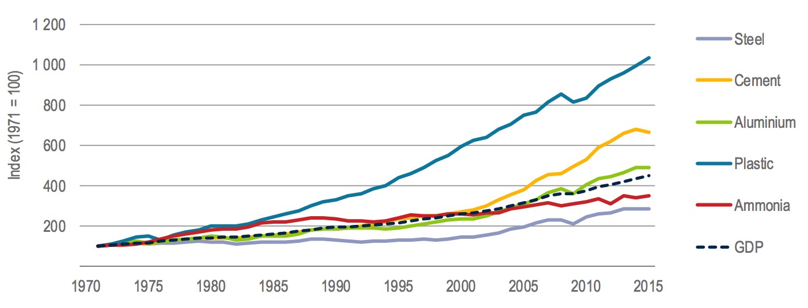
Production growth for selected bulk materials and GDP
- Regional consumption patterns for several important plastics and fertilisers show that as wealth (measured in GDP per capita) increases, so does the consumption of these products.
However, in regions with high income per capita, demand saturation appears to emerge for some products
For example: in Japan, the United States, and parts of Western Europe, annual demand for key nitrogen fertilisers has stabilised at around 85-135 kilogrammes per capita (kg/capita)
In lower-income and rapidly developing regions such as India, China and Africa, demand for these products is still on the increase (1-2% annual growth rates are not uncommon), and current consumption ranges from as low as 12 kg/capita to around 60 kg/capita.
Notes:
Regional consumption patterns for several important plastics and fertilisers show that as wealth (measured in GDP per capita) increases, so does the consumption of these products. However, in regions with high income per capita, demand saturation appears to emerge for some products, especially fertilisers. In high-income countries such as Japan, the United States, and parts of Western Europe, annual demand for key nitrogen fertilisers has stabilised at around 85-135 kilogrammes per capita (kg/capita), with limited growth per capita having occurred over the last 15-20 years. In lower-income and rapidly developing regions such as India, China and Africa, demand for these products is still on the increase (1-2% annual growth rates are not uncommon), and current consumption ranges from as low as 12 kg/capita to around 60 kg/capita.

Slide 9
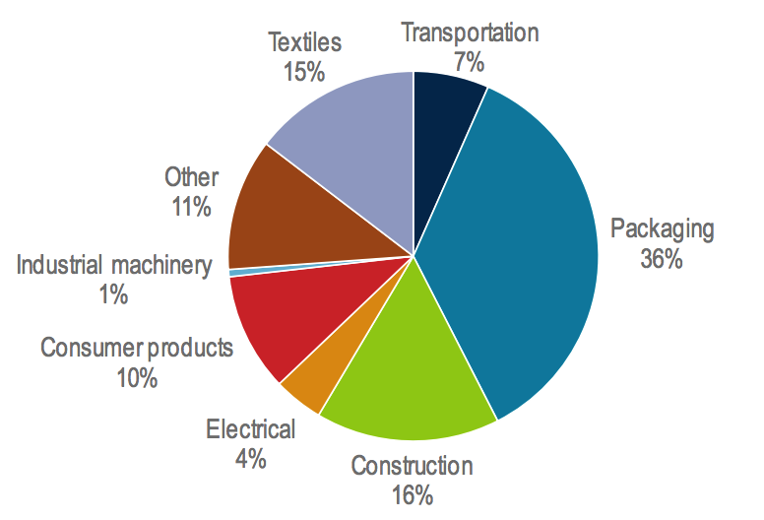
Estimated consumption of plastic by end-use sector
-Packaging, the largest end-use segment, accounts for 36% of global plastic demand.
-The construction industry is the second most important non-textile market, accounting for 16% of global consumption, an important plastic for the construction industry being polyvinyl chloride (PVC), which is used for window and door frames, and underground pipes, due to its stiffness and durability
Notes:
. The construction industry is the second most important non-textile market, accounting for 16% of global consumption, an important plastic for the construction industry being polyvinyl chloride (PVC), which is used for window and door frames, and underground pipes, due to its stiffness and durability

Slide 10
Can chemicals be used more efficiently?
Re-using products. For example, using a plastic bottle twice halves the amount of material demanded relative to the purchase of a new bottle. This is an especially important strategy for products with a short lifetime, as multiple tranches of savings can be achieved rapidly.
Using products more intensively. Structural materials, such as reinforced composites (e.g. for wind turbine blades), can be designed to a tighter specification, thereby reducing the amount of material required relative to thicker or over-designed components.
Recycling. Providing secondary input materials, so consuming less virgin material and less energy. Plastic recycling is the key example in the chemical sector, but other pockets of recycling exist, such as recovery and recycling of the solvent, acetic acid.
For several bulk materials in other sectors, recycling rates are already high: steel and aluminium around 80% and paper around 60%. The rate of plastic recycling is much lower ~18%

Slide 11
Today there are two main categories of plastic recycling: mechanical and chemical recycling, with the former being much more widespread.
1- Mechanical, or “back to polymer”, recycling offers a simpler and generally lower cost source of secondary plastic production, in which the chemical structure of the polymers remains intact. Collected and sorted plastic waste is the feed material, which is then cleaned, cut up into chips, and re-melted ready for moulding.
https://www.youtube.com/watch?v=I_fUpP-hq3A or tour the Harvard recycling facility
2-Chemical, or “back to monomer”, recycling describes a group of processes in which the plastic waste is converted back to the chemical building blocks that produced the original virgin material.
https://www.science.org/doi/10.1126/science.abo4626

Slide 12
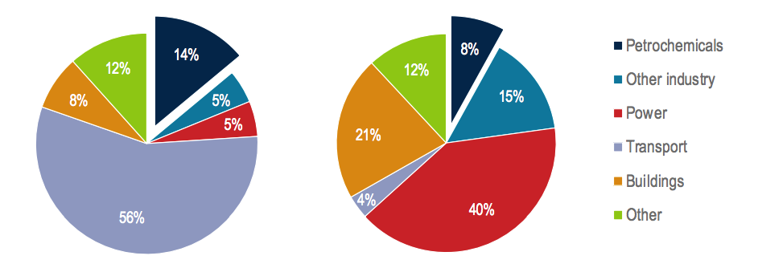
Chemicals and the energy system:
As in society, chemicals play an important role in the energy system. The chemical sector is the largest industrial energy consumer, ahead of iron and steel, and cement. It accounts for approximately 10% of total final energy consumption and almost 30% of industrial final energy consumption
Primary oil (left) and natural gas (right) demand in 2017 by sector
Petrochemicals account for 14% and 8% of total primary demand for oil and gas respectively.

Slide 13
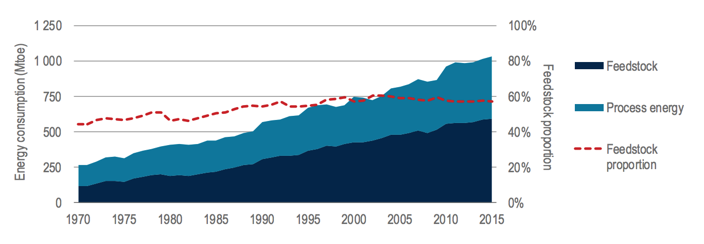
Fuels are consumed in two ways in the chemical sector:
1- As energy to drive processes: fuels are consumed to provide direct heat, steam and electricity to drive the sector’s processes, equipment and facilities
2- As “feedstock”, which describes the use of various fuels as a material input. Akin to iron ore inputs to the iron and steel industry or alumina inputs to the aluminium industry, chemical feedstock is the source of the carbon and hydrogen used physically to constitute chemical products
So how energy goes to 1 Vs 2?
Key: feedstock accounts for just over half of the sector’s energy inputs.

Slide 14
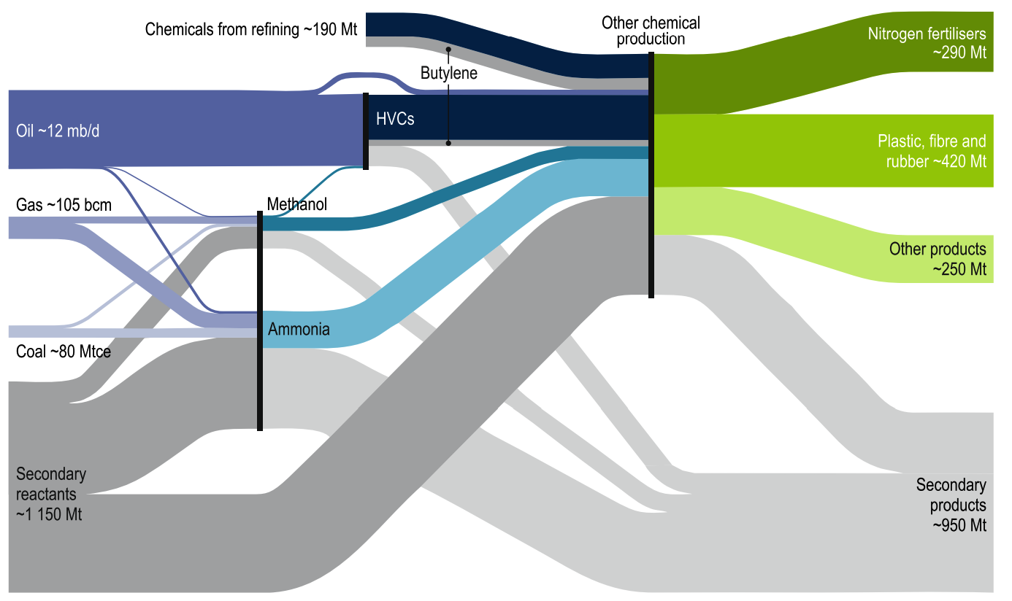
Passage of fossil fuel feedstock through the chemical industry in 2017
Secondary reactants and products are the compounds specified within chemical reactions that do not form part of the feedstock or main products. Key examples include water, CO2, oxygen, nitrogen and chlorine.
More than 500 million tonnes of oil-equivalent (Mtoe) of feedstock is consumed per year to make nearly 1 billion tonnes of chemical products. Oil is the dominant feedstock for HVCs, whereas gas and coal are used for ammonia and methanol.

Slide 15
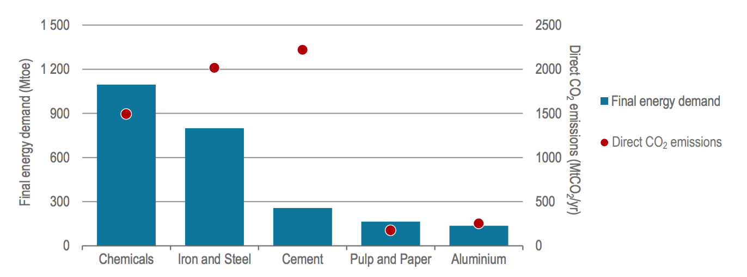
Global final energy demand and direct CO2 emissions by sector in 2017
CO2 emissions from the chemical sector are approximately 1.5 gigatonnes of carbon dioxide (GtCO2) per year globally, or 18% of industrial CO2 emissions.
The chemical sector is the largest industrial energy consumer, and ranks third among industrial CO2 emitters.

Slide 16
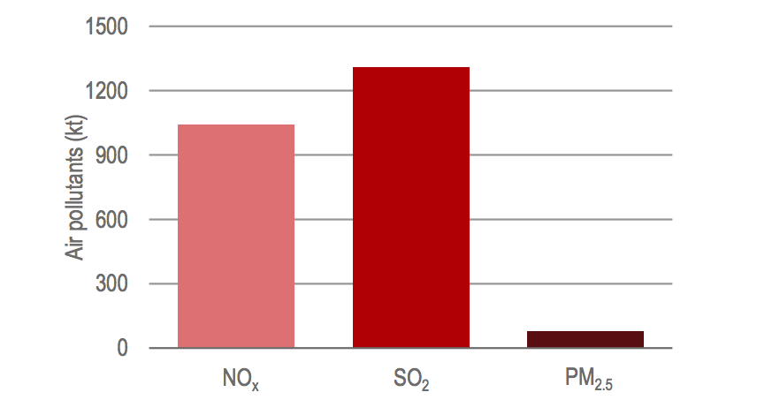
Air pollutants from primary chemical production
Air pollution is a public health crisis and the fourth-largest overall risk factor for human health worldwide, after high blood pressure, dietary risks, and smoking (IEA, 2016a).
Among industrial activities, the chemical sector is the second largest source of SO2 (about one-third) and of NOx (almost 20%), behind the iron and steel sector. It also contributes to PM2.5 (20%). Like most heavy industry, chemical sector activity tends to take place outside urban centres, but emissions from this activity can still have a significant impact on human health.

Slide 17
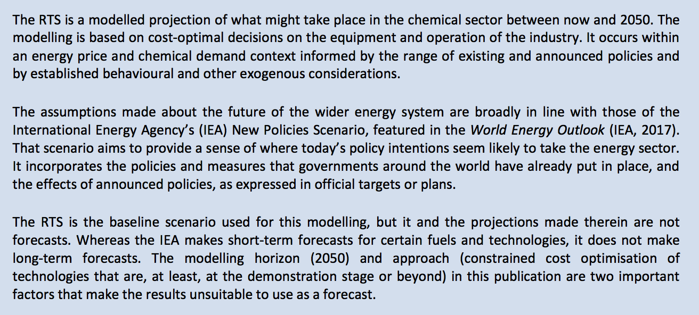
What is the current trajectory for petrochemicals?
Results are taken from the Reference Technology Scenario (RTS) by IEA

Slide 18
This worse case scenario is shaped by the projection of the current trajectory, shaped by existing and announced policies
On the current trajectory, demand for primary chemicals is set to increase by around 30% by 2030 and almost 60% by 2050
Production of methanol in the RTS is the highest area of global growth among primary chemicals, with output increasing by more than 50% by 2030 and almost doubling by 2050.
China was already responsible for more than 50% of global methanol production (USING COAL) in 2017, a figure that remains relatively consistent throughout the period to 2050.
Demand for HVCs grows by around 60% by 2050 (relative to 2017), the second-fastest rate among primary chemicals, with plastics are expected to remain the key driver of demand for HVCs
Ammonia grows at the slowest rate among primary chemicals (saturation taking hold in developed economies.)

Slide 19
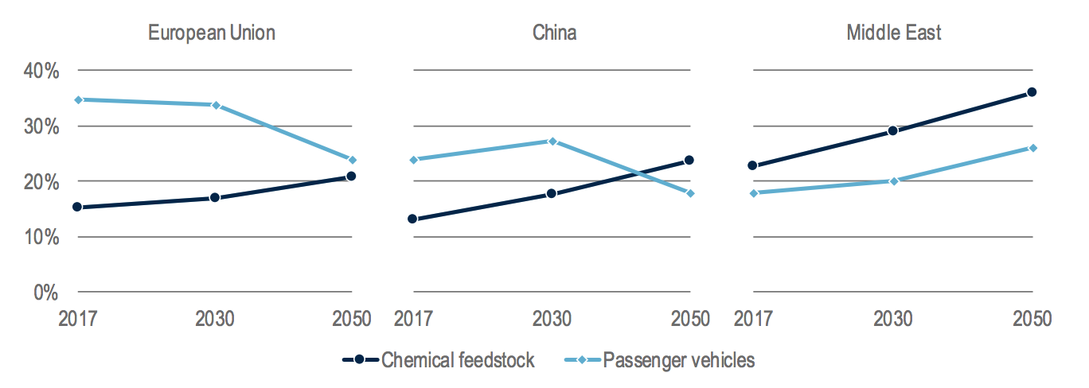
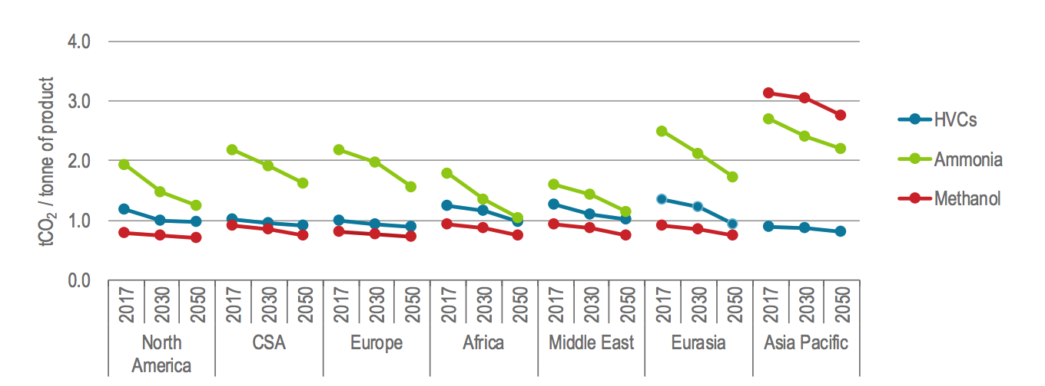
Shares of oil demand for chemical feedstock and passenger vehicles in the RTS
The growing share of chemical feedstock in total oil demand surpasses that of passenger vehicles in certain regions.
CO2 emission intensities in the RTS
Gentle declines in CO2 emissions intensity take place for all chemicals across all regions, mainly due to integration of CCS

Slide 20
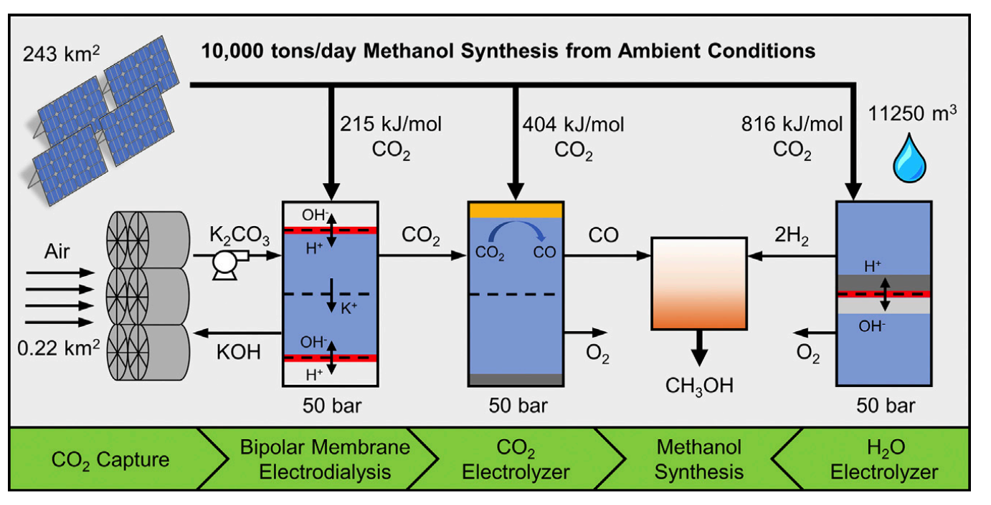
These results are alarming so what are some alternatives to fossil fuels-derived feedstock?
1-CO2 utilization for producing methanol via electrolysis:
Joule 3, 1822–1834, August 21, 2019 .

Slide 21
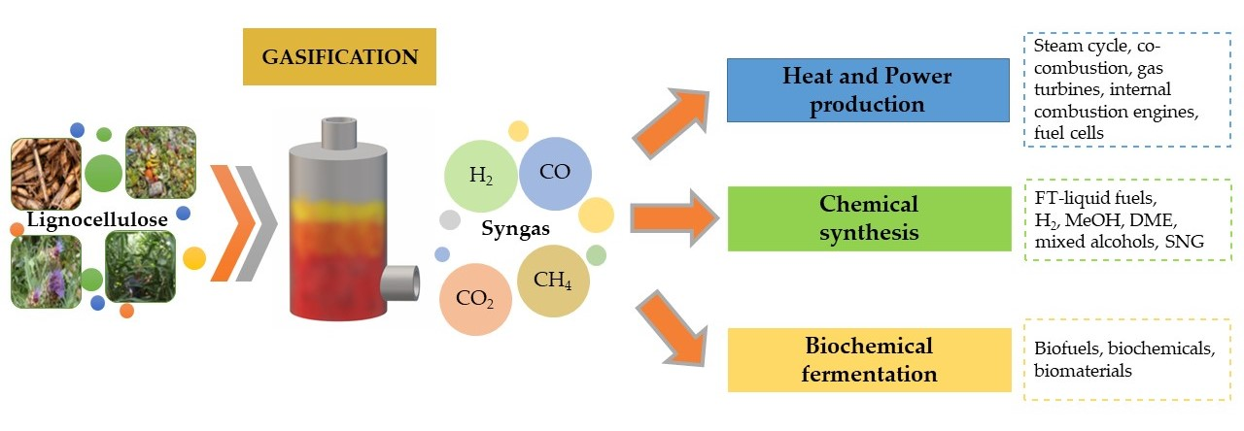
2-Biomass Gasification:
Biomass, a renewable organic resource, includes agriculture crop residues (such as corn stover or wheat straw), forest residues, special crops grown specifically for energy use (such as switchgrass or willow trees), organic municipal solid waste, and animal wastes.
Gasification is a process that converts organic or fossil-based carbonaceous materials at high temperatures with a controlled amount of oxygen and/or steam into carbon monoxide, hydrogen, and carbon dioxide.
widely available
Mature process
carbon neutral
Less garbage in landfills
reduces the overreliance of fossil fuels
not as efficient as fossil fuels
not entirely clean
Deforestation
Notes:
the use of animal and human waste escalates the amount of methane gases, which are also damaging to the environment. Additionally, the pollution created from burning wood and other natural materials can be considered just as bad as that resulting from burning coal and other types of energy resources.
Some biofuels, like Ethanol, is relatively inefficient as compared to gasoline. In fact, it has to be fortified with fossil fuels to increase its efficiency.
Since wood is one of the most used source of biomass energy, vast amounts of wood and other waste products have to be burned to produce the desired amount of power. While currently there is enough wood waste already, there is a risk of deforestation in the future.

Slide 22
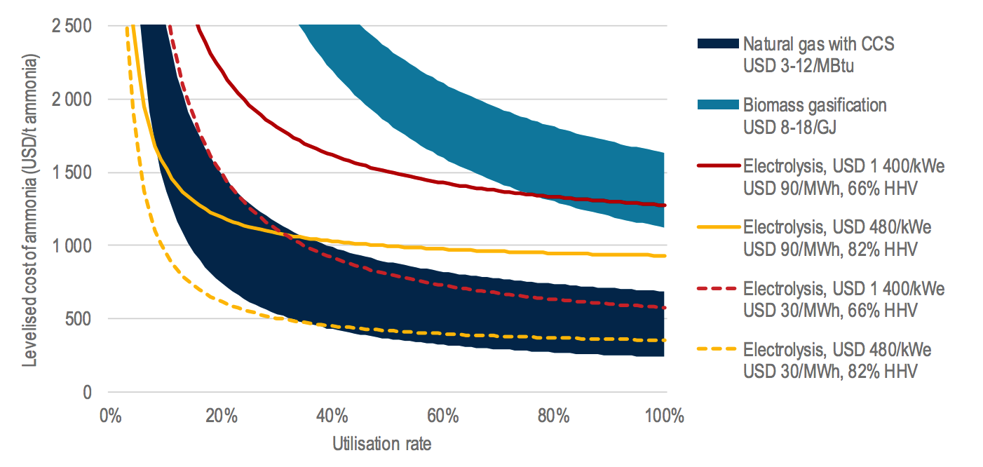
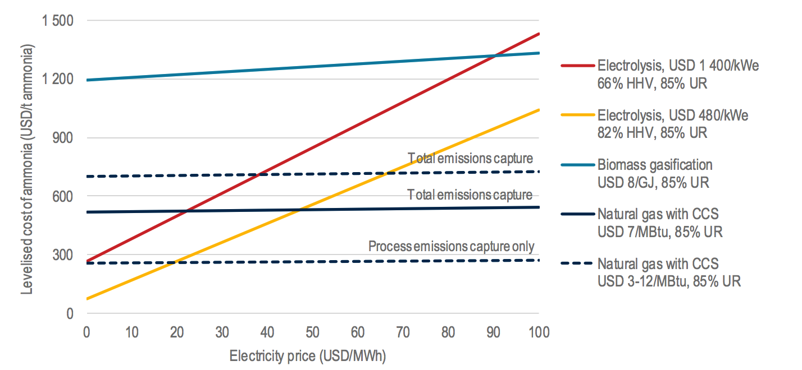
Simplified levelised cost of ammonia via various pathways
Biomass efficiency is lacking, making it expensive.
Given a natural gas price of USD 7/MBtu, electrolysis competes with gas-based production equipped with CCS at electricity prices between USD 20-45/MWh, depending on electrolyser efficiency and cost.

Slide 23
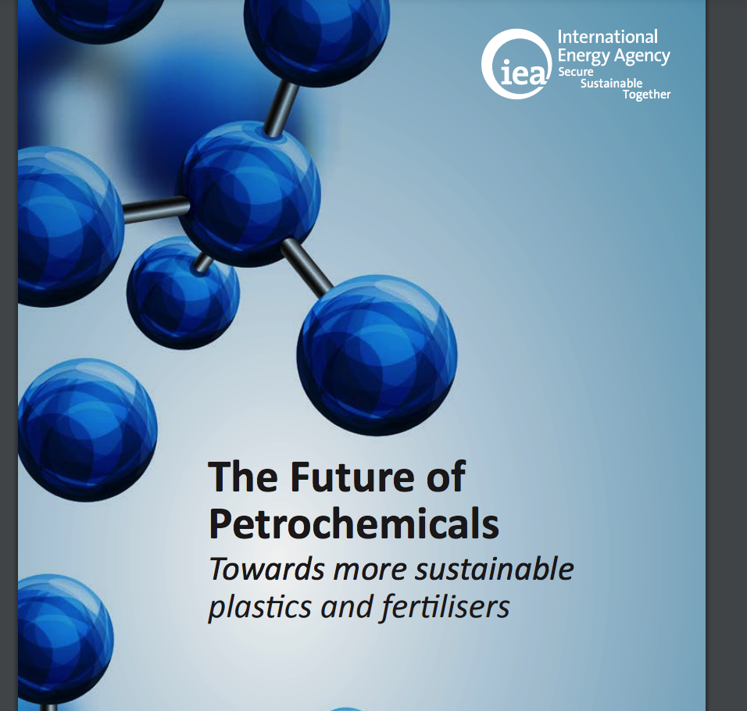
Thank you
https://www.iea.org/reports/the-future-of-petrochemicals

