Slide 1
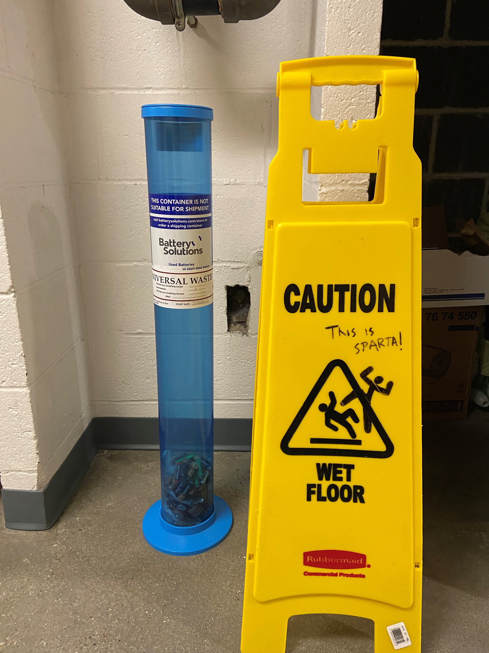
Enlightening Battery Recycling
The truth of post-use can be frightening
Jordan D. Sosa
Harvard Energy Journal Club
November 18th, 2022
Notes:
Battery industry growth
Motivations for recycling
How are batteries recycled now
Issues in recycling
Innovations in recycling
What’s the plan?

Slide 2
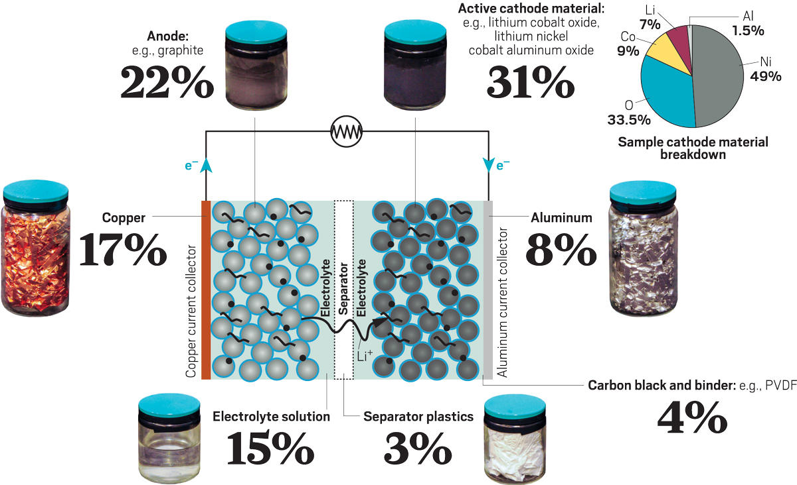
What goes into a Lithium ion battery?
https://cen.acs.org/materials/energy-storage/time-serious-recycling-lithium/97/i28
Notes:
The pie chart resembles a lithium nickel cobalt aluminum oxide cathode
Cathdoe: source of lithium ions, determines capacity and average voltage of battery
Anode: stores and releases lithium ions
Electrolyte: medium for movement of ions
Separation: prevents cathode/anode contact so there are no short circuits

Slide 3
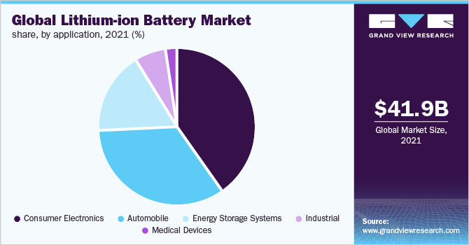
Battery Market: Lithium Ion
https://www.grandviewresearch.com/industry-analysis/lithium-ion-battery-market
Notes:
The consumer electronics segment held the largest revenue share of over 40.0% in 2021. Portable batteries are incorporated in portable devices and consumer electronic products. The applications of portable batteries include mobile phones, laptops, computers, tablets, torches or flashlights, LED lighting, vacuum cleaners, digital cameras, wristwatches, calculators, hearing aids, and other wearable devices. The electric and hybrid electric vehicle market is projected to witness lucrative growth over the forecast period. Growing awareness regarding the benefits of battery-operated vehicles and increasing fossil fuel prices, particularly in Asia Pacific, Europe, and North America, are projected to favor the growth.
Lithium-ion batteries are also utilized for providing backup power supply for commercial buildings, data centers, and institutions. In addition, lithium-ion battery is preferred for energy storage in residential solar PV systems. These factors will boost the growth of the energy storage systems application segment in the forecast period. Lithium-ion batteries are used in numerous industrial applications such as power tools, cordless tools, marine equipment and machinery, agricultural machinery, industrial automation systems, aviation, military and defense, electronics, civil infrastructure, and oil and gas

Slide 4
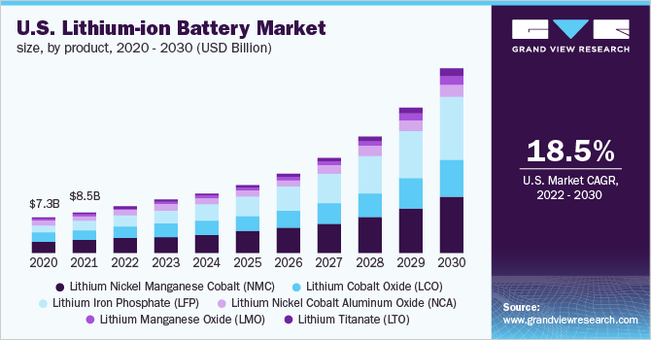
Battery Market: Lithium Ion
https://www.grandviewresearch.com/industry-analysis/lithium-ion-battery-market
Notes:
CAGR: compound annual growth rate

Slide 5
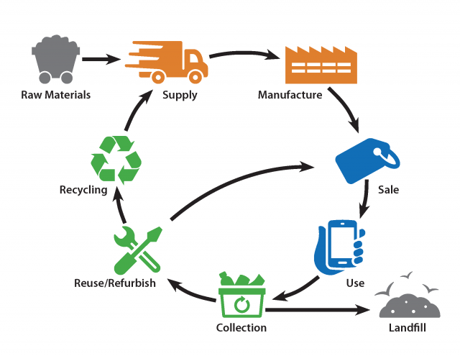
Life Cycle of Batteries
https://www.epa.gov/recycle/used-lithium-ion-batteries Accessed Nov 16th, 2022
Notes:
Li-ion batteries are made of materials such as cobalt, graphite and lithium which are considered critical minerals. Critical minerals are raw materials that are economically and strategically important to the U.S., have a high risk of their supply being disrupted and for which there are no easy substitutes. When these batteries are disposed of in the trash, we lose these critical resources outright.

Slide 6
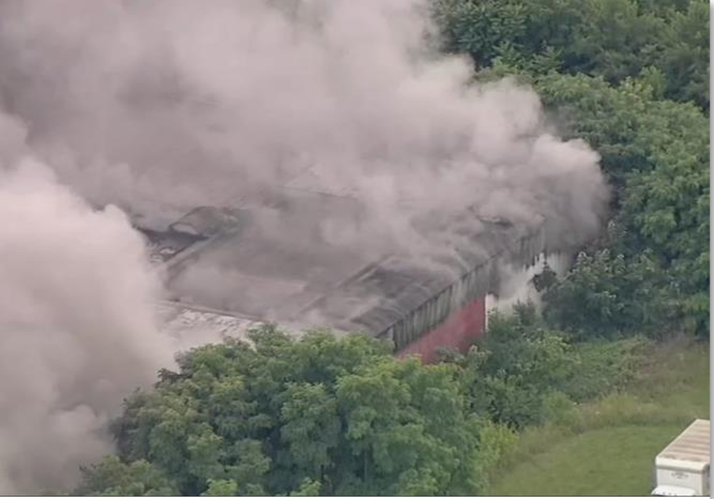

Issue: Improper handling of materials
By 2030, estimated at least 2,619,000 metric tons of lithium-ion batteries will need to be recycled
Examples of recycling in 2019
  Australia: 2-3% of Li+ batteries collected and recycled
  EU and US: Less than 5% (~4k tons for US)
It is estimated that the US and Canada have incurred losses worth more than $1.2 billion because of lithium-ion battery fires.
EPA Lithium-Ion Battery Disposal and Recycling Stakeholder Workshop Summary Report | October 5 & 19, 2021
https://www.popsci.com/energy/lithium-ion-batteries-recycling-fire/ accessed Nov 17, 2022
https://cen.acs.org/materials/energy-storage/time-serious-recycling-lithium/97/i28
Notes:
The core problem takes place in end-of-life old lithium-ion batteries which end up in the trash or recycling bins. During collecting and recycling processes, these batteries can go undetected in piles of garbage. They can get crushed after getting compressed in a truck, accidentally run over by a loader, or jostled around on conveyor belts in waste facilities.
When the barrier between the cathode and the anode of a lithium-ion battery ruptures, it causes a breakaway thermal reaction from the lithium molecules. These molecules can then reach extremely high temperatures within a short time and ignite or explode.
Other reasons for recycling:
Recovered materials can be used to make new batteries
Possibly lowering manufacturing costs (active materials are half the battery cost in 2019)
Allows for less dependence on a few countries
Less energy-intensive mining if can reuse materials

Slide 7
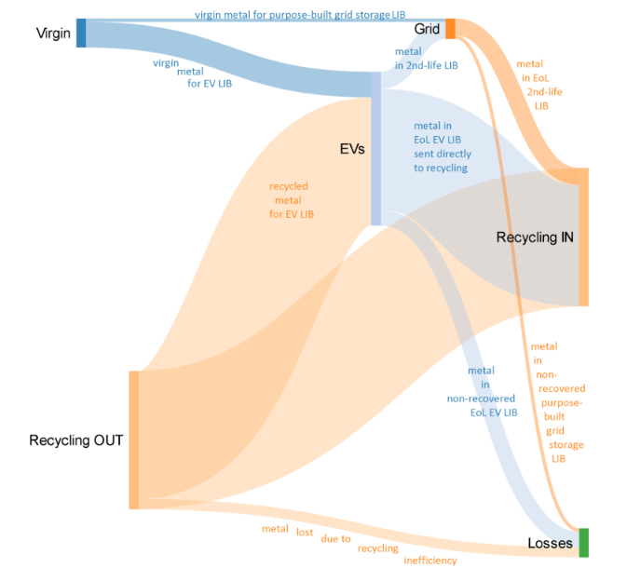
Sankey diagram of recycling
Notes:
2nd life batteries, article from Intercalation Station in July or June:
Based on research from ReJoule, the cost of refurbishing EV batteries is around $160/kWh, while the cost of repurposing is approximately 25% cheaper at about $120/kWh.

Slide 8
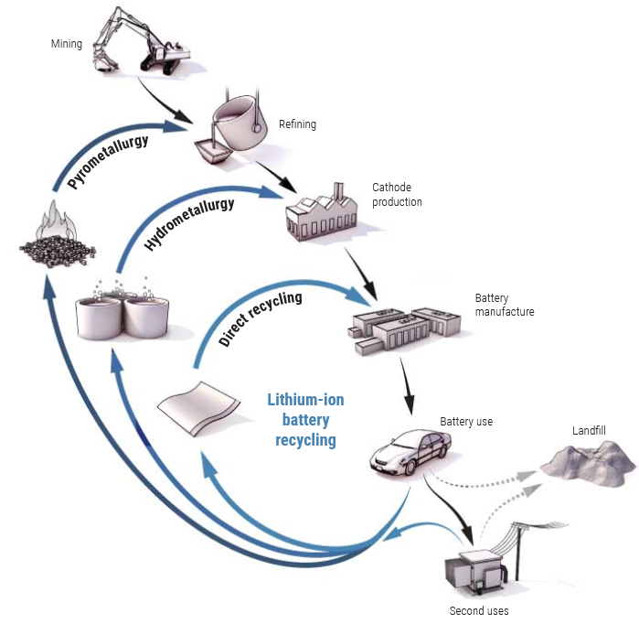
Opportunities for recycling
Notes:
Pyrometallurgy (at 1500 C) to recover cobalt, nickel, and copper but not lithium, Al, or organic compounds
Hydrometallurgy (chemical leaching): Less energy-intensive and lower capital costs; run below 100 C and can also recover Li and Cu
However, requires caustic reagents like strong acids

Slide 9
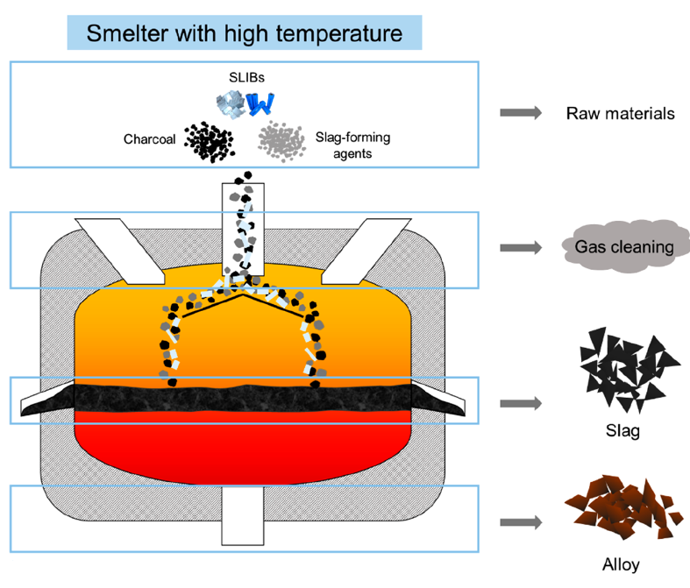
Pyrometallurgy
ACS EST Engg. 2021, 1, 1369−1382
Notes:
Pyrometallurgy: process using elevated temperature to extract metals or other compounds from spent lithium ion batteries
Few requirements for raw materials and produces little liquid waste (gas?). It’s already used in several companies.

Slide 10
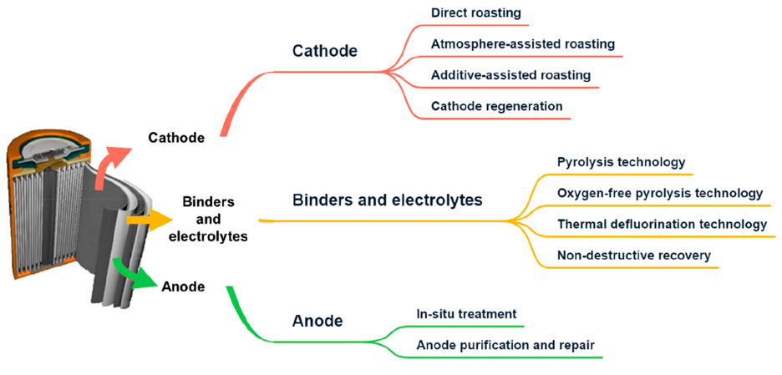
Pyrometallurgy
ACS EST Engg. 2021, 1, 1369−1382
Notes:
Direct roasting: reduce the cathode active material chemically at a high temperature (1400 C), then get the metallic alloy as the product. This process is nice because the Al and organic electrolytes can be used as fuel for this process. Then, oxides are added to segregate the metals. However, this can only recover cobalt and nickel usually. This process takes hours. Also, lots of toxic gases are exhumed. Plus the lithium is usually lost.
Atmopshere-assisted roasting: oxygen-free environment to shift equilibrium of this process and perform it at lower temperatures (650-1000 C). However, this process requires more pretreatment to separate the materials or a post-treatment in solutions is needed.
Additive assisted roasting: basically the thermal treatment followed up with an inorganic salt or acid. This process cuts down on waste from the Spent LIB because much more of the lithium gets captured in the recovery. This process includes sulfation roasting, chlorination roasting, and nitration roasting
~~~~~~~~~~~~~~~~~~~~~~~~~~~~~~~~~
Cathode regeneration: high-temperature phase transformation tech to extract metals from the SLIB and ovnert them to precursors for high-value products. This process is meant to heal the failure of SLIBS due to structure distorture from loss of Li+ and phase transformations
Solid-state reactions: compensate spent cathode materials with related elements to reach the desired proportions, then mix the materials with ball milling and then chemically process to get the original phase
Spray pyrolysis: high-temperature pyrolysis furnace as a sprayed solution, then a solid-phase powder precipitates. Apparently this can be done at 600-800 C with some post processing with calcination
~~~~~~~~~~~~~~~~~~~~~~~~~~~~~~~~~~~~~~~~

Slide 11
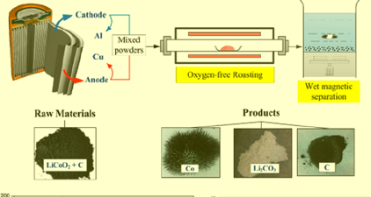
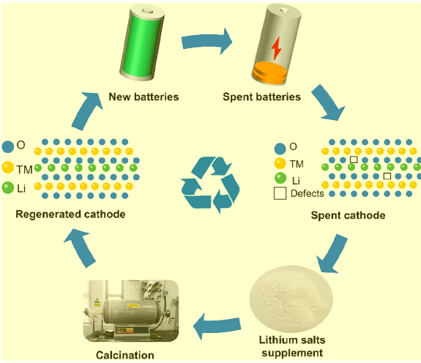
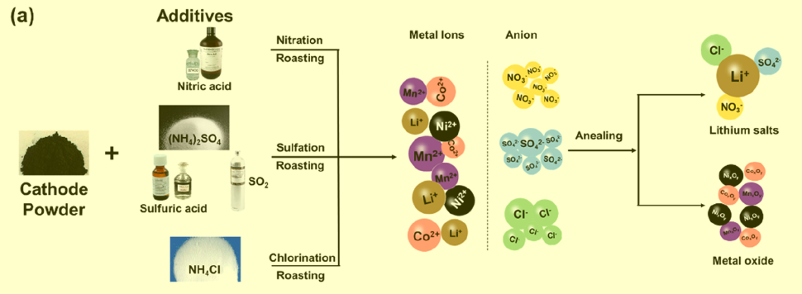
Atmosphere-assisted roasting
ACS EST Engg. 2021, 1, 1369−1382
Cathode Regeneration
Additive-assisted roasting
Notes:
Direct roasting: reduce the cathode active material chemically at a high temperature (1400 C), then get the metallic alloy as the product. This process is nice because the Al and organic electrolytes can be used as fuel for this process. Then, oxides are added to segregate the metals. However, this can only recover cobalt and nickel usually. This process takes hours. Also, lots of toxic gases are exhumed. Plus the lithium is usually lost.
Atmopshere-assisted roasting: oxygen-free environment to shift equilibrium of this process and perform it at lower temperatures (650-1000 C). However, this process requires more pretreatment to separate the materials or a post-treatment in solutions is needed.
Additive assisted roasting: basically the thermal treatment followed up with an inorganic salt or acid. This process cuts down on waste from the Spent LIB because much more of the lithium gets captured in the recovery. This process includes sulfation roasting, chlorination roasting, and nitration roasting
Cathode regeneration: high-temperature phase transformation tech to extract metals from the SLIB and ovnert them to precursors for high-value products. This process is meant to heal the failure of SLIBS due to structure distorture from loss of Li+ and phase transformations
Solid-state reactions: compensate spent cathode materials with related elements to reach the desired proportions, then mix the materials with ball milling and then chemically process to get the original phase
Spray pyrolysis: high-temperature pyrolysis furnace as a sprayed solution, then a solid-phase powder precipitates. Apparently this can be done at 600-800 C with some post processing with calcination

Slide 12
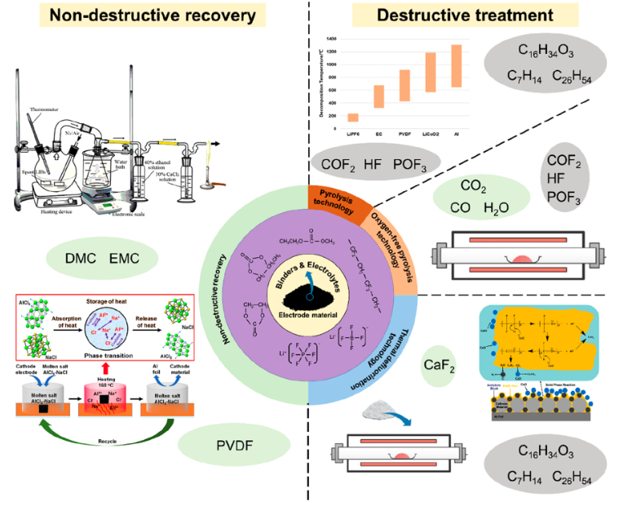
Pyrometallurgy:
Binders and electrolytes
ACS EST Engg. 2021, 1, 1369−1382
Notes:
Binders and electrolytes: must be treated before any other processing of the cell because evaporation of these materials would be extremely toxic and also hurt performance of the other processes
Solvents have been costly and not eco-friendly for this research so far.
Pyrolysis: Calcinate material in a furnace under air to remove binder and organic matter. The temperature must e carefully selected so the cathode and attached organic matter can adequately separate. Also need to decompose the organic matter without melting the Al foil or decomposing cathode materials. This process still requires heating and also dangerous gas emissions
Oxygen-free pyrolysis: basically provides closed environment for this process and protects metals from oxidation. However, corrosion to equipment is inevitable
Thermal defluorination: 300 C, use calcium oxide as thermal defluorinating agent which also helps catch generated HF. It takes less energy and costs less money, but the final products are less pure.
Nondestructive recovery:
Low-temperature volatilization tech: recover solution components at “low temps” according to their boiling points. It doesn’t cause structure damage, but it requires more equipment and energy and post-processing
Molten salt: melt PVDF and separate out cathode material

Slide 13
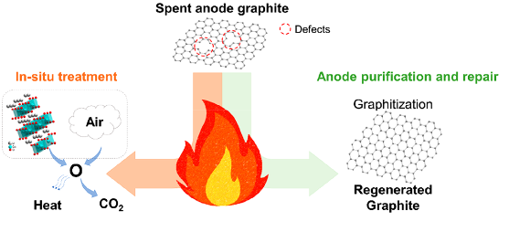
Pyrometallurgy: Anodes
ACS EST Engg. 2021, 1, 1369−1382
Notes:
Anodes: 12 to 21 wt% of SLIBS and take about 10-15% of cost of battery
In situ treatment:
Graphite removed as impurity
Graphite used as reducing agent (as mentioned for cathode treatment), but then quality may go down
Anode purification and repair: high energy consumption for it, but smelting away the current collector. Also have carbon-thermal reduction to repair the graphite structure with an acid treatment plus carbon-thermal reduction

Slide 14
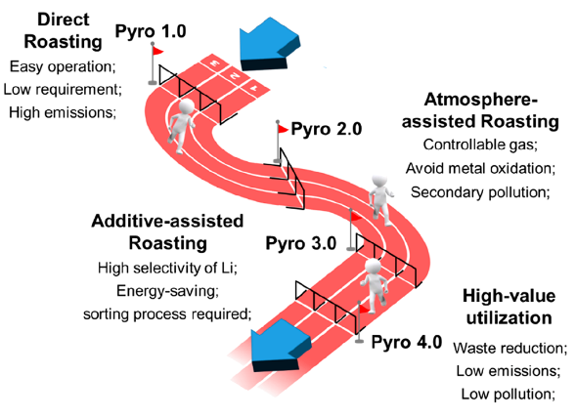
Pyrometallurgy: Pathway
Challenges
Noise and waste gas pollution
Cathode materials still at Pyro 1.0
High energy inputs
ACS EST Engg. 2021, 1, 1369−1382
Notes:
yro 1.0 is the initial version,
imitating the process of mineral smelting; the battery is directly
burned in the furnace. The decomposed gas product may cause
serious environmental problems, and the final products have
many impurities. Pyro 2.0 is based on Pyro 1.0, which adds some
kinds of the atmosphere in the calcination process of waste
batteries such as CO2 , N 2, Ar, vacuum, etc.; this can effectively
decrease the reaction temperature and make the exhaust gas
treatment controllable. The key to pyro 3.0 is to recover lithium
in a targeted manner and reduce the reaction temperature as
Figure 9. Typical pyrometallurgical treatment of SLIBs anode.
Figure 10. Schematic diagram of the evolution of pyrometallurgy in the
field of SLIBs.
ACS ES&T Engineering pubs.acs.org/estengg Review
https://doi.org/10.1021/acsestengg.1c00067
ACS EST Engg. 2021, 1, 1369−1382
1378
much as possible. By roasting with a specific additive such as
chlorides, sulfates, or nitrates, the lithium element can be
preferentially recovered. Pyro 4.0 is related to a pyrometallur-
gical high-value utilization, and it tends to make the overall
utilization of various parts of SLIBs. At this stage, this technology
mainly includes the regeneration of SLIB electrodes or the
nondestructive recovery of electrolytes and binders

Slide 15
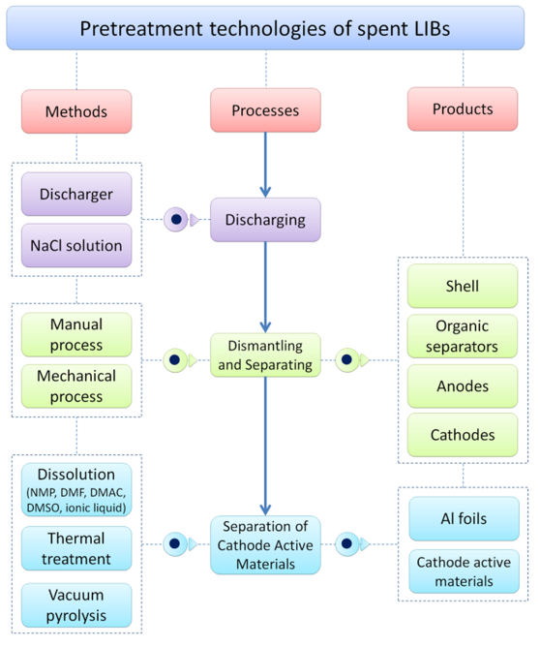
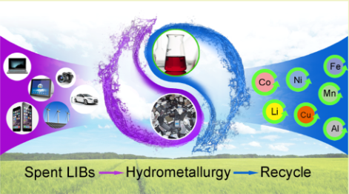
Hydrometallurgy:
Pretreatment
Benefits:
  High recovery rates, high product purity, low energy, minimal emissions
ACS Sustainable Chem. Eng. 2018, 6, 13611−13627
Notes:
Hydrometallurgy: Obtain metals by treatment with aqueous solutions
Discharge: discard remaining capacity to prevent short circuit and self-ignition dangers
10 wt % NaCl solution can achieve an ideal
discharge efficiency in a reasonable time and lower cost
(71.96% discharge efficiency at 358 min)
because of the huge amount and small size of
traditional consumer LIBs, manual operation is not feasible for
the large-scale recycling process, whereas mechanical treatment
shows an advantage in the economic and industrial
perspective. Generally, a mechanical process involves
crushing, sieving, magnetic separation, and classification,
which were carried out to get the particles rich in cathode active material
mechanical separation process also has some disadvantages. For example, in the
complicated LIBs structure, several metals, organic and
inorganic substances penetrate into each other; therefore, it
is difficult to separate them from each other completely by
mechanical separation processes.
For separating cathode active materials that are held to current collectors with binders (usually PVDF), NMP is used to separate the materials from the Al foils. By dissolving in solution and doing an ultrasonic treatment, the separation is done faster and with more efficiency. Disadvantages include the fact that organic solvents can’t remove all impurities and the recovered active material needs further processing to burn off residual carbon and PVDDF. They’re also expensive and not suitable for scale-up recycling. Also, one solvent doesn’t work for all binders. An alternative is thermal treatment. First the cathode is shredded and then put in a furnace to burn off carbon and organic components. It’s very simple, but the toxic gases and smoke emissions are environmentally dangerous, so extra purification is required. If done in vacuum pyrolysis, then the organic materials evaporate or decompose and the active materials can be easily separated.

Slide 16
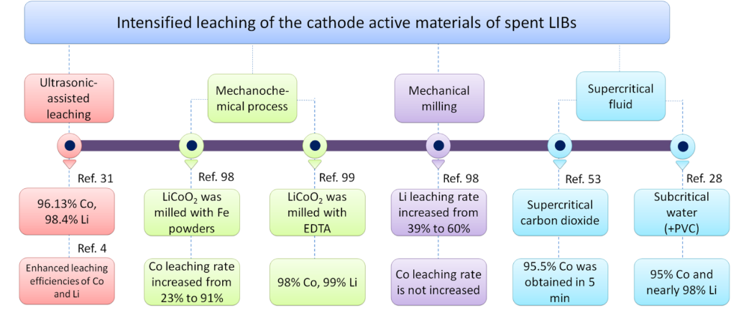
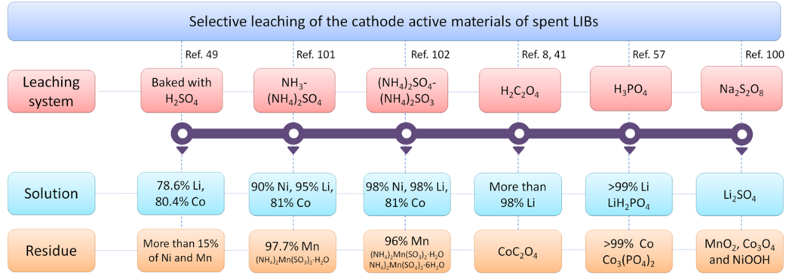
Hydrometallurgy:
Leaching
Convert metals in cathode active materials from pretreatment to ions in a solution
Common types:
Inorganic acid leaching
Organic acid leaching
Bioleaching
ACS Sustainable Chem. Eng. 2018, 6, 13611−13627
Notes:
Aim: convert metals from the cathode separation treatment into ions in a solution
How it’s done: inorganic, organic acid, alkali or bacteria solution, sometimes assisted with ultrasonic wave and mechanical chemistry
More environmentally friendly: Bioleaching
Inorganic acid leaching: issues with gas emissions, so need extra equipment. This process at different stages is limited by reaction rates or reactions + diffusion, so the processing times can be dependent on the materials. 99% of material can be recovered in some cases. However, don’t forget the toxic emissions and possible post-processing because of the pH of these processes
Organic acid leaching: Easy degradation, recyclability of materials, seldom secondary pollution. Examples: citric acid to leach lithium cobalt oxide at 90 C, got to 99% efficiency. Oxalic acid used as leaching reagenet and precipitant so could precipitate the cobalt and dissolve the lithium. However, organic acids are more expensive, and the processing time is longer, and you need much more acid because they’re weaker acids
Bioleaching: environmentally friendly, low cost, less demanding in industry. Use bacteria that feed on powders and produce metabolites that dissolve cobalt and lithium. Example: lithium cobalt oxide bioleached with varying pH and iron powder. However, these reactions are extremely slow, so catalysts are needed. One copper catalyst boosted 43% efficiency in 10 days to 99.9% in 6 days. Alternatively, fungi can be used and have a stronger toxic tolerance and faster leaching, but seemingly lower efficiencies for high value metals. Drawback: slower speeds, difficulty in incubating microbes correctly, and must leach metals into small concentrations or else the cells die
Alkaline leaching: Hydroxide ions interacting with metals instead of hydrogen ions. Simple NaOH at 50 C in 1 hour removed all Co and most Li. Ammonia also used and could control the pH to control what metals will form complexes
Intensified leaching: See figure. Ultrasonic waves promote convective motion and materials interchanges, but lots of energy is released at the interface because of cavitation effect. However, hot cavities from the waves can enhance the chemical reactions for leaching. For Ref 99, lithium cobalt oxide was first cogrinded with EDTA to form water-soluble metal chelates Li-EDTA and Co-EDTA. And then, the Co and Li were leached out easily from the milled products with water
Selective leaching: make separation and recovery of materials easier. Add an oxidant or reductant to leaching solution to pick out individual precipitants

Slide 17
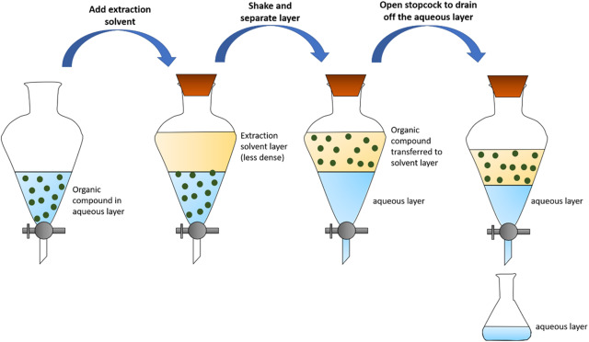
Hydrometallurgy:
Materials Recovery: Solvent extraction
Kasevem Santhiya-Nair, ... Sreenivasan Sasidharan, in Herbal Biomolecules in Healthcare Applications, 2022
Notes:
Aim: Separate valuable metals from the complex solutions
Solvent extraction: High selectivity. Add another solvent to the solution that will dissolve in all the desired product because it’s more soluble in that solvent, then separate that solution and precipitate the material. Looks like it’s been done with high 90% efficiencies with various organic materials

Slide 18
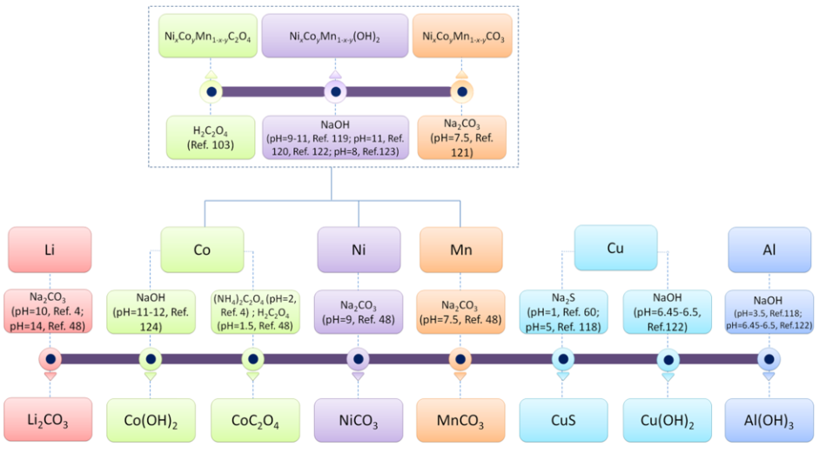
Hydrometallurgy:
Materials Recovery: Chemical precipitation
ACS Sustainable Chem. Eng. 2018, 6, 13611−13627
Notes:
Metal cations will bond with different anions in leached solution and then precipitate out. Different metals will have different solubilities so use that to pick the products. However, this process only works with leaching solutions with simple components, which is often not the case. Therefore, several precipitation steps are often required. If couple with solvent extraction, then less steps are needed and can maintain very high purity of products. Unfortunately, these processes also work better at higher temperatures (90 C), thus taking more energy

Slide 19
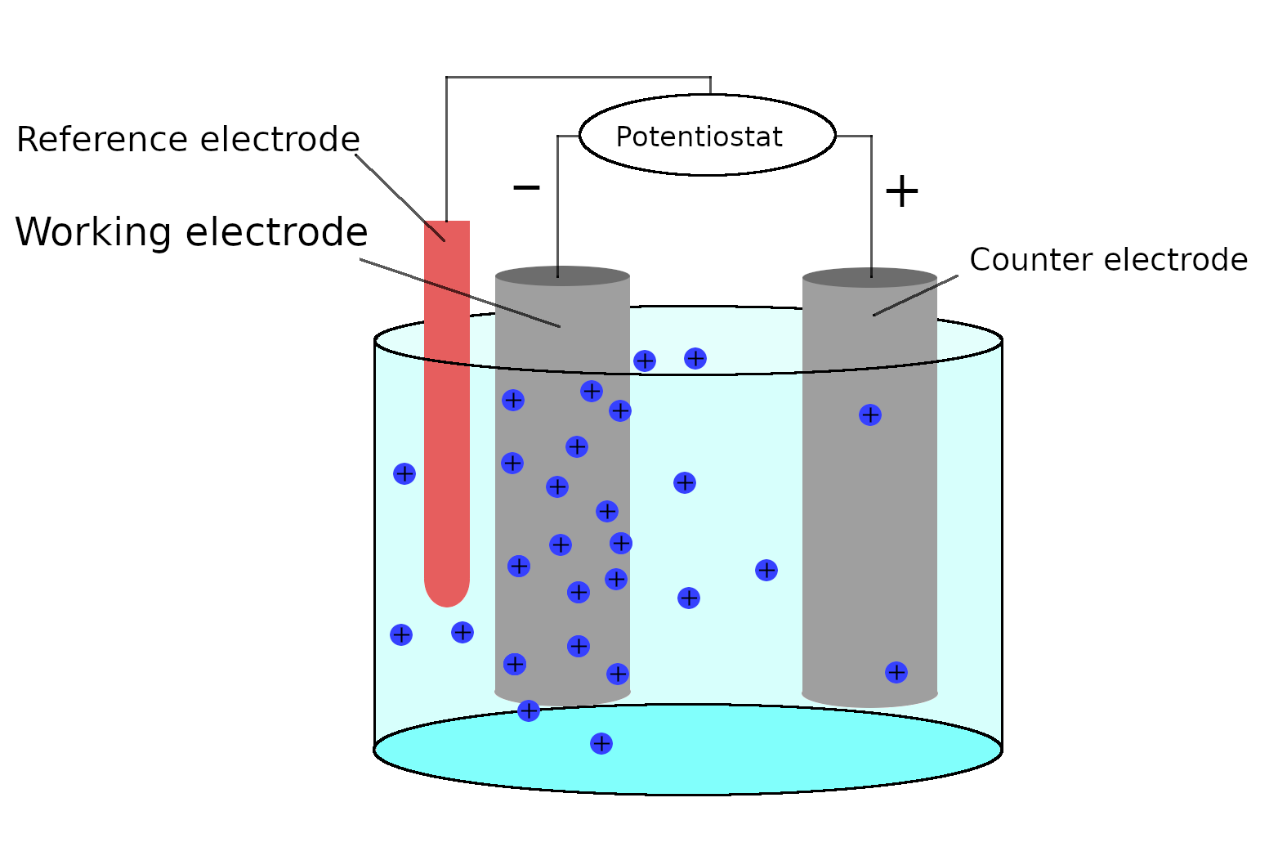
Hydrometallurgy:
Materials Recovery: Electrodeposition
Species of interest
+
https://wiki.aalto.fi/display/SSC/Electrochemical+deposition Accessed Nov 17, 2022
Notes:
Electrodeposition: Selectively separate materials in a solution by their differences in reduction potentials.
Example: lithium cobalt oxide recovered with nitric acid solution with LiOH.
Issue: can be limited by water stability window . Also, if potentials of materials are very close, can’t select for one of them. (issue for nickel and cobalt). Also, variation in pH and ion concentrations can make the process different for different solutions.

Slide 20

Recap:
Pyrometallurgy: High temperature treatments for recovering materials in cathode, anode, binder and electrolyte
  Different processes for each part of the battery
Hydrometallurgy: Less toxic, less energy-intensive way to recover materials, usually for cathode materials
  Consists of discharging, separating cell components, leaching, and materials recovery

Slide 21
What does Harvard do?
Complete Battery Solutions
Shipped to Georgia
60-70% materials recovery
Notes:
So CRS receives the batteries and sorts them into like chemistries. All terminals are taped to prevent short circuiting and then packed into DOT approved containers for shipment to our R2 certified downstream vendor, BRME out of Cartersville, GA. The batteries are shredded and/or processed in Hammermill. The bi product commodities are then sold as product. As far as the percentages of material recovered they do not have specifics as it can change by type. The estimate is 60-70% recovery of commodities

Slide 22
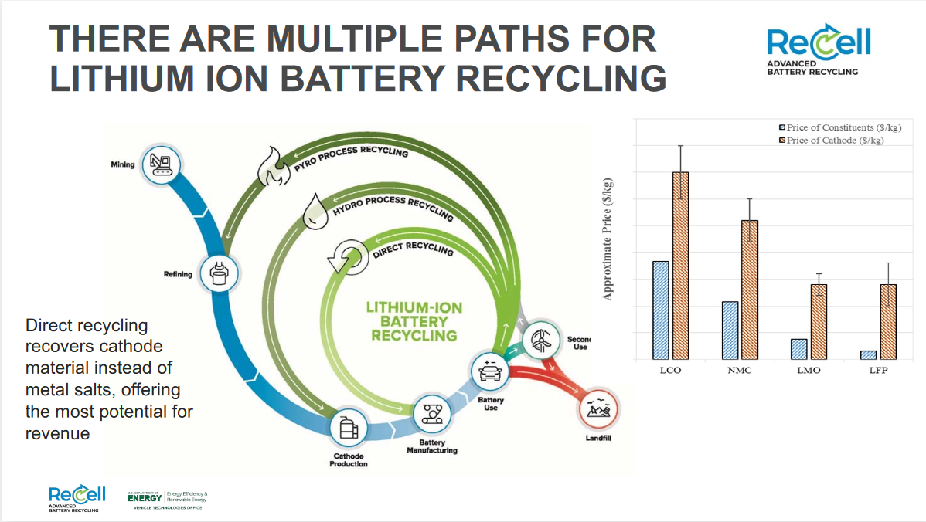
Notes:
DOE’s battery recycling R&D center
Direct recycling is the recovery, regeneration, and reuse of battery components directly without breaking down the chemical structure. The resulting material—often called black mass—is ideal for recovery, regeneration, and reuse in battery designs. However, the shredding process may introduce metallic impurities into the recycled electrodes. The resulting contaminants pose a challenge for recyclers, inhibiting the performance of the recycled batteries. To pinpoint these impurities, NREL and ANL combined electrochemical analysis with isothermal microcalorimetry to identify characteristic "fingerprints" for each metallic contaminant, including iron, aluminum, copper, silicon, and magnesium. This synergistic approach allows researchers to confirm the presence of contaminants and assess the impact of each metallic impurity on the overall performance of the recycled electrodes.
By maintaining the process value in the original battery components, a lower-cost re-constituted material can be supplied to battery manufacturers

Slide 23
Challenges in scaling recycling
Current hydrometallurgy and pyrometallurgy recover specific metals and in forms that are low value to manufacturers
Large fluctuations in prices of materials cast uncertainty on economics of recycling
If new energy storage type emerges (like Li air battery or fuel cells), recycling might quickly become obsolete
With different types of batteries already in market, different types of recycling processes are needed, increasing complications and raising costs
https://cen.acs.org/materials/energy-storage/time-serious-recycling-lithium/97/i28
https://recellcenter.org/

Slide 24
New organizations for advanced recycling
ReLib: Collaboration at Faraday Institute using AI and robotics
RecycLiCo: Company focused on recovering cathode materials
Battery Resourcers: Largest battery recycling facility in North America, processing 30k tons of Li+ batteries
ReCell: DOE battery recycling R&D center, focused on direct recycling among other processes
American Manganese uses sulfur dioxide for leaching without acids or peroxides
Notes:
RecycLiCo is building a hydrometallurgy demonstration plant right now. It has installed 500 kg/day capacity with a 99% leach extraction efficiency
DOE’s ReCell: Direct recycling without costly processing by removing electrolyte with supercritical carbon dioxide, then crushing the cell and separating components physically by density differences, for example

Slide 25
Pt 2: Trains & Trams, what’s the plan?
Spring 2023

Slide 26
Pt 2, really:
What’s the plan?

Slide 27
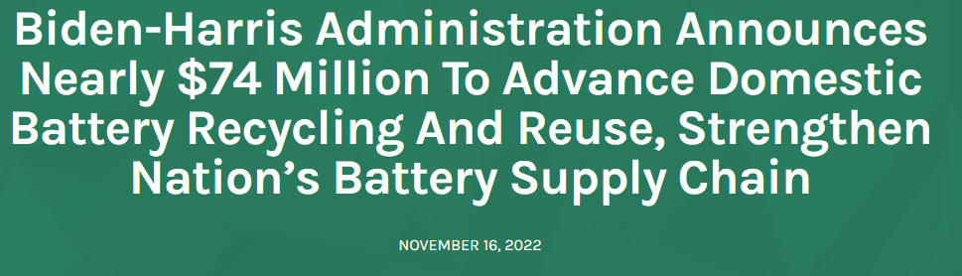
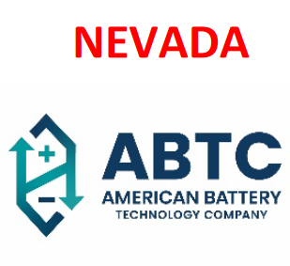

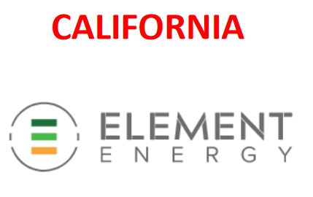

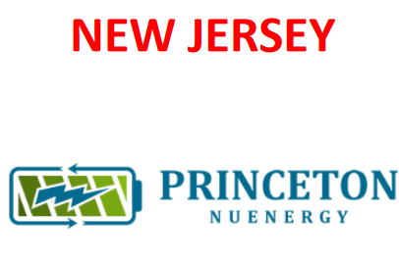
Battery materials cost expected to rise 4,000 %
Goal: EVs = ½ of all vehicles sales in America by 2030.
Notes:
Since President Biden took office, more than 1.2 million EVs have been sold in America—more than triple the number of EVs on the road before he took office
1.
American Battery Technology Company (ABTC) and its partners will
validate, test, and deploy at pre-commercial scale three disruptive
advanced separation and processing technologies to its existing
lithium-ion battery recycling facility to further enhance economic
competitiveness, reduce environmental impact, and re-integrate an
even greater percentage of the constituent components to the
domestic battery manufacturing market. ABTC will work in partnership with
Novonix Group, University of Nevada, Reno (UNR), University of Utah (U of U), North Carolina State University
(NCSU), National Renewable Energy Laboratory (NREL), Argonne National Laboratory (ANL), and Idaho National
Laboratory (INL), and with downstream material validation and offtake by Dainen Material, Novonix Group, and
iM3NY. Through this proposed project, ABTC and its
partners will validate and optimize each of these advanced technologies at the bench scale, then manufacture
qualification batches of these products for evaluation and testing by downstream partners, followed by the
scale-up of these advanced systems for integration into ABTC’s existing pre-commercial scale lithium-ion battery
recycling facility
The initial plant capacity will be able to process 20,000 metric tons per year of end-of-life batteries and
battery manufacturing waste, scaling up to 100,000 metric tons per year.
~~~~~~~~~~~~~~~~~~~~~~~~~~~~~~~~~~
2.
Cirba Solutions (formerly known as Retriev), will develop a process for
recycling critical materials from end of life (EOL) EV batteries for use
in the manufacture of new EV cells at its lithium-ion battery (LIB)
recycling facility in Lancaster, Ohio
irba plans to modify its current commercial hydrometallurgical line
at its Lancaster facility to convert black mass from EOL LIBs to an intermediate mixed-metal sulfate solution and
then to purified mixed-metal hydroxides. This conversion utilizes a new patented process for recovering purified
mixed nickel, cobalt, and manganese hydroxides. Cirba has partnered with Momentum Technologies, the
licensee of a scalable, energy-efficient, low-cost, and closed-loop Membrane Solvent Extraction (MSX) process
developed by scientists at Oak Ridge National Laboratory (ORNL), to separate the intermediate mixed-metal
sulfate solution into pure, battery-grade nitrate salts. Cirba is also partnering with 6K Inc., a leader in
transforming engineered materials into products that advance industries across additive manufacturing, to
produce virgin cathode active material (CAM) for LIBs. Lastly, Cirba will partner with a DOE National Laboratory
such as ORNL to use these CAMs to manufacture and validate functional LIBs as efficient as those made from
virgin materials.
The unique combination of these new, individually demonstrated technologies has the potential to reduce
overall purification costs and eliminate complexity of EOL LIB recycling. A successful demonstration of this
energy-efficient, cost-effective process will enable the recovery of high-purity products acceptable to OEMs.
OEM acceptance of LIBs produced through the project will close the loop for maintaining critical battery
materials within the U.S. LIB industry and retain these critical materials for expected LIB growth domestically. By
weaving MSX technology into a closed-loop battery recycling and manufacturing process, Cirba is catalyzing a
domestic supply chain for recycled critical materials that will help meet the expected increase in demand for
LIBs and the elements critical to LIB manufacturing.
~~~~~~~~~~~~~~~~~~~~~~~~~~~~~~~~~~~~~~~~~~~~~~~~~~~~~~~~~~~~~~~~~~~~~~~~~~~~~~
3
This one isn’t really recycling. Element’s unique hardware and software approach to battery management can help overcome the challenges in
scaling the second-life battery market. Proprietary technology replaces a traditional power conversion system
with a distributed power conversion approach for a more granular level of control. Instead of controlling a
Megawatt hour- (MWh) scale battery as a single element with thousands of cells all subjected to the same use
profile, Element’s technology independently controls the power flowing in and out of each module (tens of
cells).
Element Energy and NextEra Energy Resources (NEER) are jointly pursuing a commercial scale pilot facility at one
of NEER’s wind generating facilities in West Texas. This provides an opportunity for Element’s technology to be
deployed in a real-world application on the grid, which is key to validating the viability and value proposition
provided by Element’s unique technology.
~~~~~~~~~~~~~~~~~~~~~~~~~~~~~~~~~~~~~~~~~~~~~~~~~~~~~~~~~~~~
4
PROJECT NAME: Supplying Refined Battery Materials
into the United States Electric Vehicle Battery Supply
Chain by Synergizing Lithium-ion Battery Recycling
with Mine Waste Reclamation
This project addresses several economic and technical challenges in
the lithium-ion battery recycling industry, including, 1) low payable
metals, 2) difficulty in achieving specifications for battery-grade
lithium from mixed secondary feedstock, 3) high operational costs and
environmental impact of the state-of-the-art recycling practices. The
project will develop and demonstrate an innovative synergized battery recycling and metal refining technology
and accelerate its commercialization to achieve product demonstration and process validation. The pilot-scale
facility (Q3 2023 start) aims to process 5-20 kilowatt hour (kWh) of battery cells and modules per day, producing
both intermediate lithium and nickel products as well as battery-grade lithium carbonate (Li2CO3) and nickel
sulfate (NiSO4)
Potential project impacts include:
• Reducing total energy use and total greenhouse gas (GHG) emission by at least 25% per nickel unit
produced compared to the state-of-the-art recycling practice.
• Establishing a profitable U.S. battery recycling business regardless of the types of cathode chemistry.
• Supplying additional nickel and cobalt minerals from unconventional resources. If further successful, an
additional 56 million lbs. of nickel and 2 million lbs. of cobalt from Eagle’s Humboldt Tailing Disposal
Facility (HTDF) will be recoverable
~~~~~~~~~~~~~~~~~~~~~~~~~~~~~~~~~~~~~~~~~~~~~~~~~~~~~~~~~~~~~~~~~
5
PROJECT NAME: An Environmentally Sustainable
Solution to Completely Recycle and Upcycle
Lithium-Ion Battery Components
The LIB recycling methods currently used are hydrometallurgical
and pyrometallurgical processes. Though effective, these processes only enable the recovery of specific metals
and in material forms that are of low value to LIB manufacturers. To make LIB recycling profitable and to
encourage industry growth without charging disposal fees to consumers, new recycling methods such as direct
recycling need to be developed. Direct recycling is the recovery, regeneration, and reuse of LIB components
directly without breaking down the chemical structure.

Slide 28

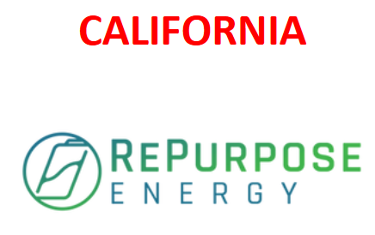



Notes:
PROJECT NAME: Second Life Battery Microgrid
Demonstration Enabled by Advanced State of Health
Tracking
This project involves the development, third-party validation, and high-impact demonstration of technology to
cost-effectively estimate and monitor the SoH of used EV batteries. Using this technology. the initial SoH of used
EV batteries will be estimated in less than two minutes using electrical pulse testing and artificial intelligence.
This initial SoH information will be used to optimize reassembly of the batteries and as an input to an equivalent
circuit model embedded in a battery management system to track battery SoH throughout second life.
~~~~~~~~~~~~~~~~~~~~~~~~~~~~~~~~~~~~~~~~~~~~~~~~~~~~~~~~~~~~~~~~~~~~~~
2.
PROJECT NAME: Low-Cost and Scalable Second Use
Battery Demonstration in Central California for
Equitable Domestic Manufacturing and Job Growth
Smartville’s scaled solution will help capture a growing percentage of the estimated 100 GWh/year of used EV
batteries by 2030 by maximizing their remaining useful life while lowering the overall greenhouse gas emissions
associated with both energy storage deployment and end-of-life battery recycling. Smartville’s battery
repurposing facilities will improve efficiencies and generate much needed added-value to the lithium-ion battery
industry, support U.S. strategic interests and battery material supply chain security, and spur job creation in the
power and manufacturing sectors
~~~~~~~~~~~~~~~~~~~~~~~~~~~~~~~~~~
3
PROJECT NAME: Second-life Battery in Mobile EV
Charging Application for Rural Transportation (SMART
Mobile charging stations (MCSs) play a critical role in removing the
charging deserts in rural areas and alleviating range anxiety, as they
can be transported to desired locations for EV charging with fewer
concerns about power infrastructure and locational constraints. While
rural America will potentially need many MCSs to eliminate charging
deserts, the high investment cost due to large and new battery energy
storage systems (BESS) and low utilization rate are barriers to
adoption at a large scale. The requirement of large and new BESS in
MCSs also
burdens the U.S. battery supply chain.
This project aims to address the urgent need to develop affordable MCSs that can be deployed in rural America
on a large scale by utilizing second-life batteries retired from EVs. The project objectives are to 1) design,
develop, demonstrate, and validate four types of cost-effective MCSs to reduce upfront investment costs; 2)
create and demonstrate first-of-the-kind affordable, resilient, and sustainable rural EV infrastructure in a multi-
state region (TN, OH, VA, KY, WV, KS, and TX) by seamlessly integrating affordable MCSs into the existing
charging network to support electrification in underserved rural communities; 3) collect and analyze the first-
hand data of second-life-battery-integrated MCSs to assess the potential market and benefits; 4) create
outreach, training, and education opportunities to help a broad range of EV stakeholders make informed
decisions in adopting second-life-battery-powered MCSs and develop economically viable charging stations.
The project team consists of one major EV original equipment manufacturer (Nissan North America), two MCS
suppliers (BoxPower and FreeWire), one second-life BESS diagnostic company (ReJoule), one battery material
recycling company (Princeton NuEnergy), four academic institutions (Tennessee Technological University,
University of Texas-Austin, University of Kansas, and University of Memphis), Pacific Northwest National
Laboratory, and two DOE Clean Cities coalitions (East Tennessee Clean Fuels Coalition and Virginia Clean Cities),
three State Energy Offices (Tennessee Department of Environment and Conservation, Kentucky Office of Energy
Policy, Texas State Energy Conservation Office), a top-ranked engineering, procurement, construction provider
(Black & Veatch), and Twinify Technologies.
~~~~~~~~~~~~~~~~~~~~~~~~~~~~~~~~~~~~~~~~~~~~~~~~~~~~~
4
PROJECT NAME: Development and Scaling Up of the
Purification and Regeneration Integrated Materials
Engineering ("PRIME") Process for Cathodes Direct
Recycling and Upcycling
Lithium-ion batteries (LIBs) prosper with the rapid emergence of
electrification of the whole world. The increased adoption of Electric
vehicles (EV), energy storage stations (ESS), and Internet of Things
(IoT) devices will require a vast quantity of LIBs with disparate metrics
within ten years. Ensuring a domestic supply of lithium batteries and
accelerating the development of a robust and secure domestic
industrial base become a critical need for the U.S. EV and energy
industry (U.S. National Blueprint Lithium Batteries 2021).
Recycling LIBs not only reduces constraints imposed by materials scarcity and enhances
environmental sustainability, but also supports a more secure and resilient domestic supply chain that is circular
in nature. Currently, pyrometallurgy and hydrometallurgy methods dominate the industrial level battery
recycling, mainly focused on cobalt (Co) and nickel (Ni) recovery, which suffer low yield, low profit, high
environmental impact, and high energy consumption.
In this project, the team will develop and scale up a novel technology for recycling lithium-based batteries by
implementing a Purification-Regeneration Integrated Materials Engineering (“PRIME”) process for recycling and
upcycling, which can more effectively regenerate critical cathode materials from both manufacturing scraps and
spent batteries.
The energy consumption and the cost of the whole process are expected to be only 20% of traditional recycling
methods due to successful integration of several key processing steps. The PRIME process merges the
advantages of direct cathode recycling techniques with the novel purification strategy to improve the quality of
recovered cathode materials with significantly reduced unit operation steps, which can be scaled up to an
industrial level and solve the issue of limited domestic cathode supply. In this project, the team will fully develop
this technology and build a working pilot to demonstrate a ton-level high-quality cathode production.
~~~~~~~~~~~~~~~~~~~~~~~~~~~~~~~~~~~~~~~~~~~~~~~~~~~~~~~~~~~~~~~~~~~~
5
Adaptive Second-Use Battery
Utilization with Different Degradation Levels for
EV Charging Stations and Power Grid Support
and Resiliency
The objective of this project is to develop and demonstrate an
economically viable end-of-life advanced lithium-ion battery (LIB)
system to enable second uses for batteries in stationary electric
vehicle (EV) charging stations, which reduces power grid demands,
provides environmental benefits, and serves as a backup power
source for EV charging when grid power is not available. Such as system also provides potential for energy
reduction and cost savings in the lifecycle of EV batteries. Additionally, the utilization of the second-use
batteries in EV charger applications makes EV chargers ready for the integration of renewable energy sources in
EV charging stations. Second-use batteries that are retired from use in EVs can continue to serve EVs in
stationary applications.
The proposed technology development and demonstration project, which involves both a multi-state utility
power company (Southern Company Services) and EV manufacturer (Mercedes Benz US International Inc.,) in
addition to the academic institution (UA), will demonstrate a module-level adaptive system architecture and
health-aware control technology in which retired EV batteries support EV chargers at adaptive rates/magnitudes
that are a function of their varying state-of-health values (during both charging and discharging), temperature
values, and capacity values. The system is scalable, adaptable, and will be able to operate with battery modules
with different chemistries, capacities, and voltage ranges.
The number of chargers and their use in the U.S. and around the world continues to increase. The power
availability from these chargers is expected to become increasingly critical for EV customers with increased load
impact on the power grid, especially during peak power demand hours. It is estimated that there will be more
than 460,000 public EV charging stations in the U.S. by 2027. This rapid growth will undoubtedly bring the
proposed technology to scale, which will further enhance the potential positive environmental impacts and
improve quality of life

Slide 29
Thank you!!!
Contact me at
Jsosa@g.Harvard.edu
Find out where to recycle your batteries here:
Used Lithium-Ion Batteries | US EPA
Or at https://www.epa.gov/recycle/used-lithium-ion-batteries

Slide 30
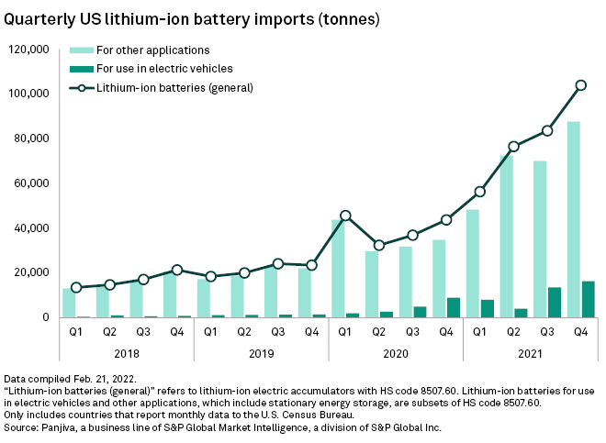
Supplemental for mass calculation of imported battery materials
https://www.spglobal.com/marketintelligence/en/news-insights/latest-news-headlines/us-lithium-ion-battery-imports-surge-as-auto-energy-sectors-race-to-meet-demand-69048550 Accessed Nov 17th, 2022

