Slide 1

ESG Investing: Buzzwords or propellant for energy transition?
Mandy Liu
HEJC
2022/03/11

Slide 2
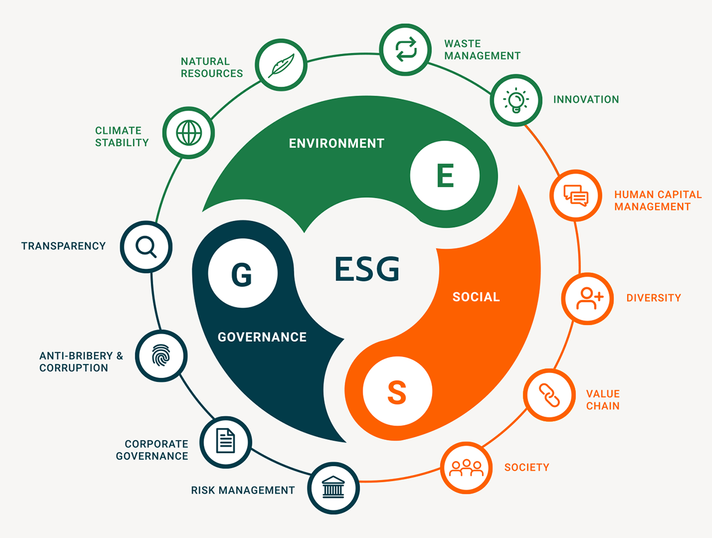
What is ESG Investing?
Usually use interchangeably with sustainable investing
It is a criteria, in additional to conventional financial parameters, used to evaluate a firm in the investment decision-making process.
It is typically a score based on data reported by the company.

Slide 3
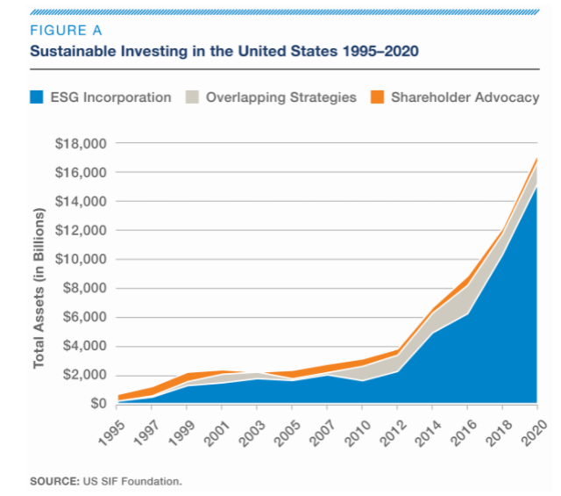
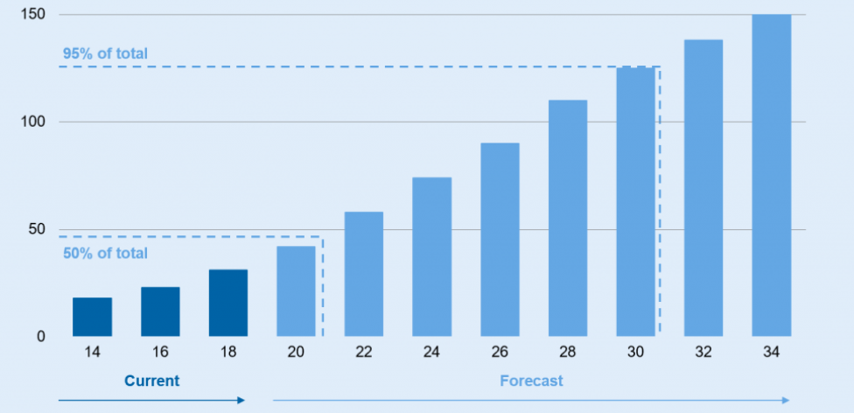
Increasing popularity of ESG
Total assets under management that factored in ESG principles
$ trillion
Significant, rapid growth in ESG in terms of total assets in both United States and around the world.
https://www.bankinghub.eu/banking/research-markets/esg-investments-current-trends
https://www.ussif.org/sribasics

Slide 4
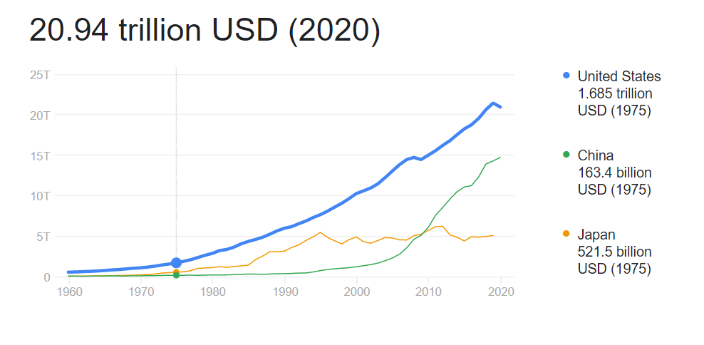
Increasing popularity of ESG
Total assets under management that factored in ESG principles
US GDP
$ trillion
Significant, rapid growth in ESG in terms of total assets in both United States and around the world.
https://www.bankinghub.eu/banking/research-markets/esg-investments-current-trends
https://www.ussif.org/sribasics

Slide 5
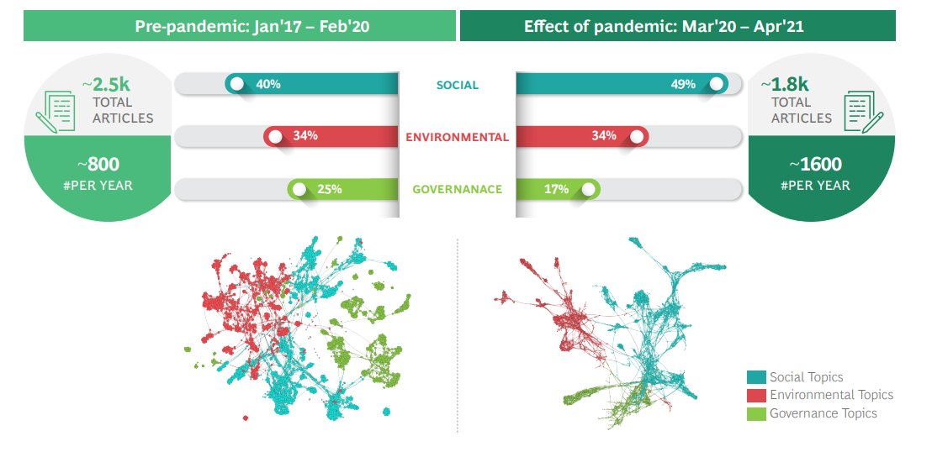
Increasing popularity of ESG
, which is corroborated by soaring media attention as well.
BCG ‘The Next Big Leap’ report

Slide 6
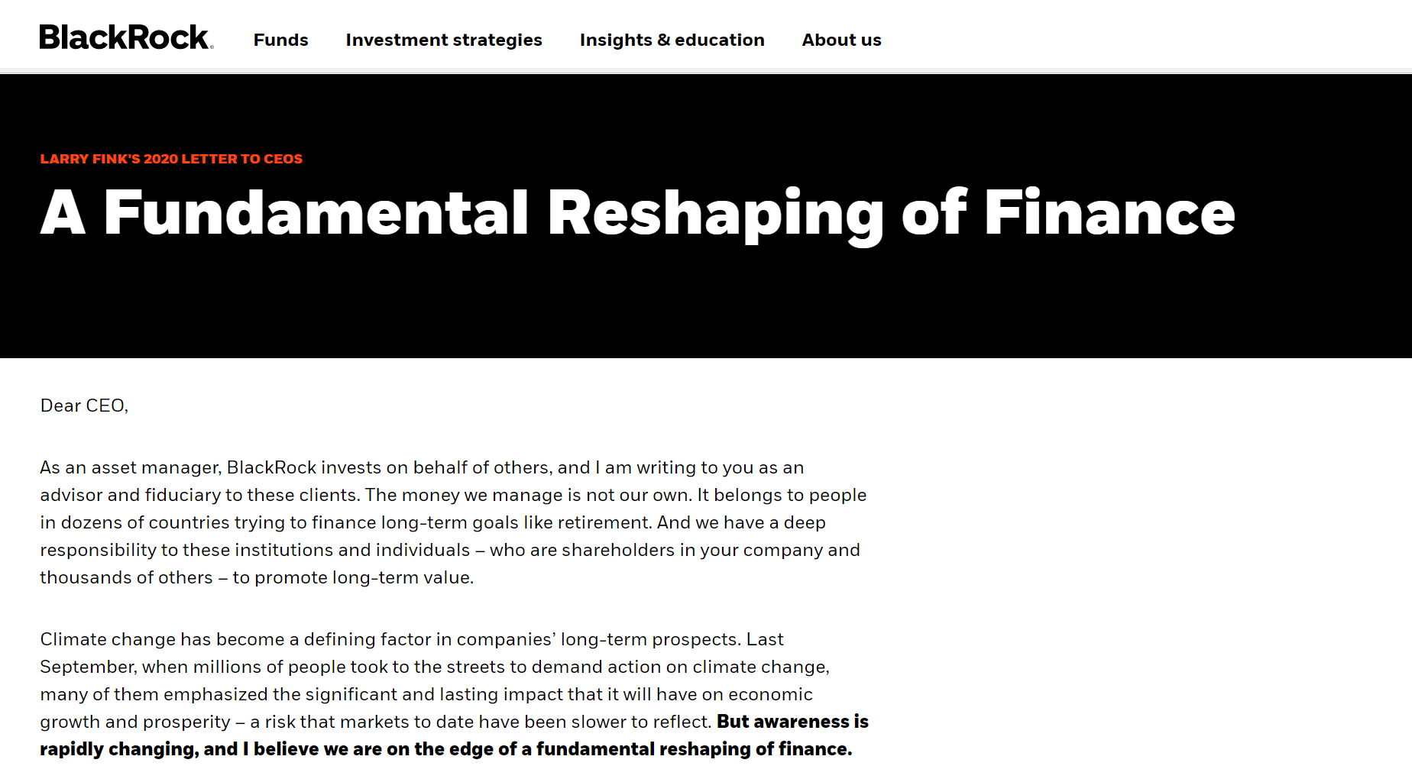
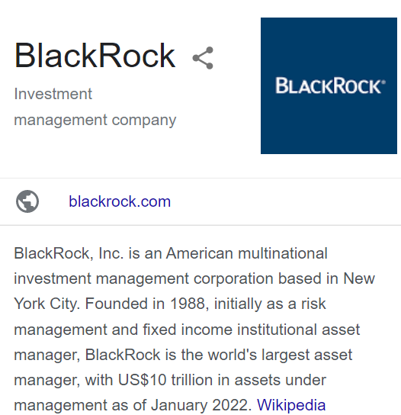
Main Drivers
Investors – Asset Management firms
Asset management invests pooled funds from clients, putting the capital to work through different investments including stocks, bonds, real estate, and more.
April 2021, BlackRock, Vanguard, State Street, and 84 other fund managers had committed $37 trillion of assets to the Net Zero Asset Managers Initiative, calling for net-zero GHG emissions by 2050.
https://www.blackrock.com/americas-offshore/en/larry-fink-ceo-letter#:~:text=Dear%20CEO%2C,long%2Dterm%20goals%20like%20retirement.

Slide 7
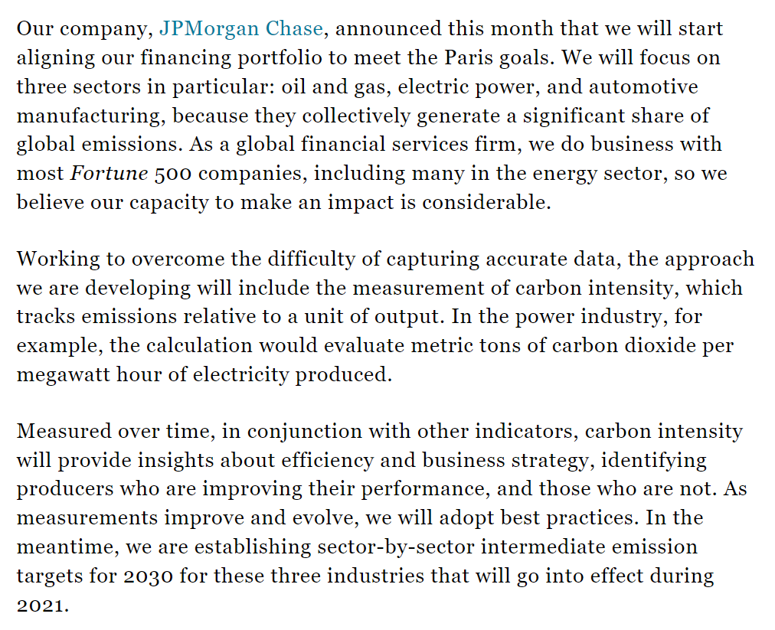
Main Drivers
Investors – banks and other financial Institutions
JPMorgan Chase has announced plans to make business decisions based in part on the “carbon intensity” of its customers‘ activities.
https://fortune.com/2020/10/16/jpmorgan-chase-climate-change-carbon-emissions-paris-agreement/

Slide 8
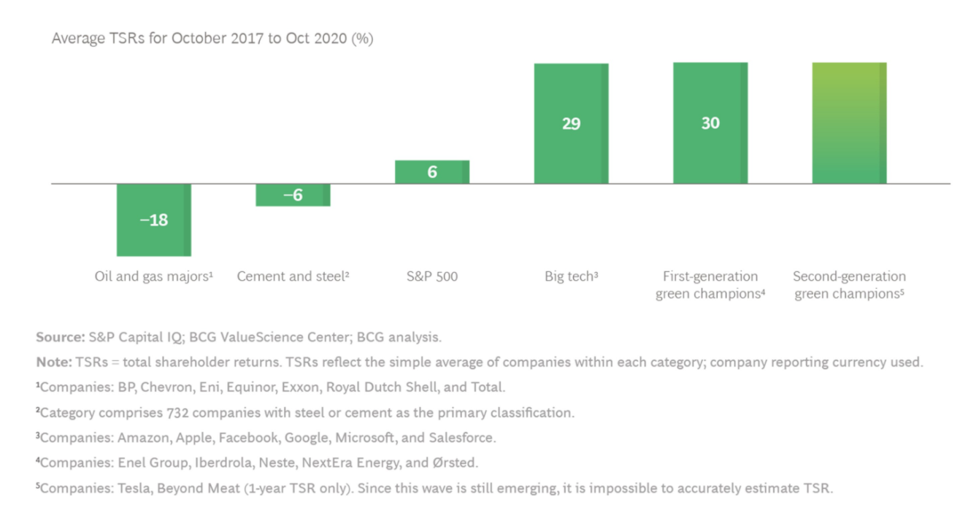
Main Drivers
Shareholder returns
While traditionally sustainable investing has been assumed to have lower return compared to the market average.
But this is no longer true. First-generation green champion performing at Big Tech level
https://www.bcg.com/en-us/publications/2021/next-generation-climate-innovation

Slide 9
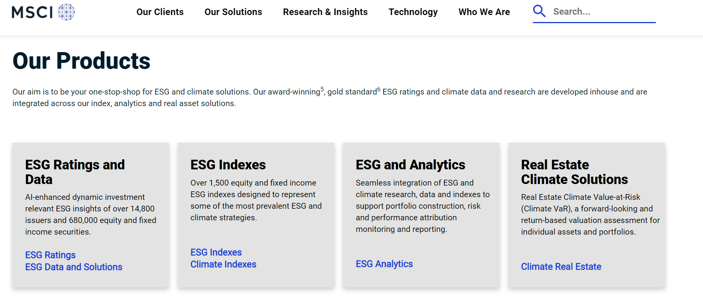
Evaluating ESG
Leading ESG rating agency
https://www.bcg.com/en-us/publications/2021/next-generation-climate-innovation

Slide 10
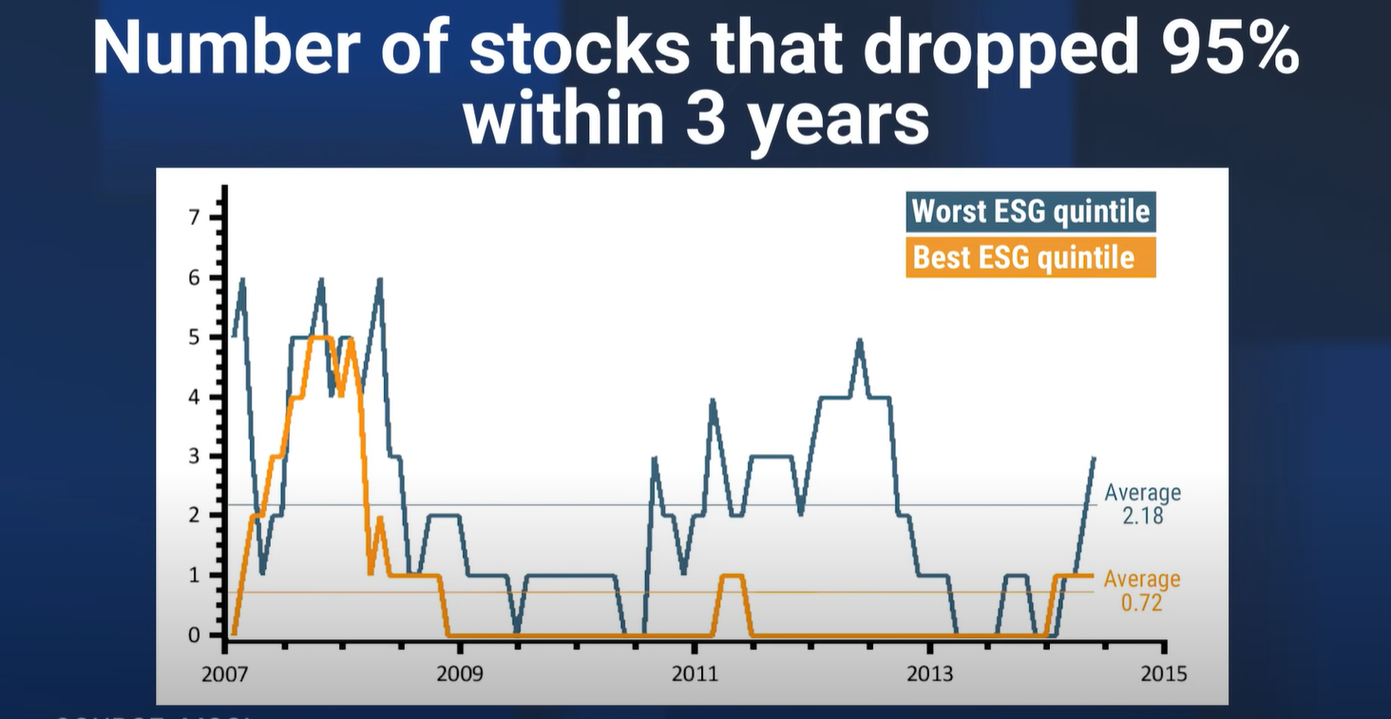
Types of ESG Investing
ESG stocks
ESG funds
Individual companies
ESG as a risk reduction parameter
https://www.youtube.com/watch?v=4LPRQaG83Ls

Slide 11
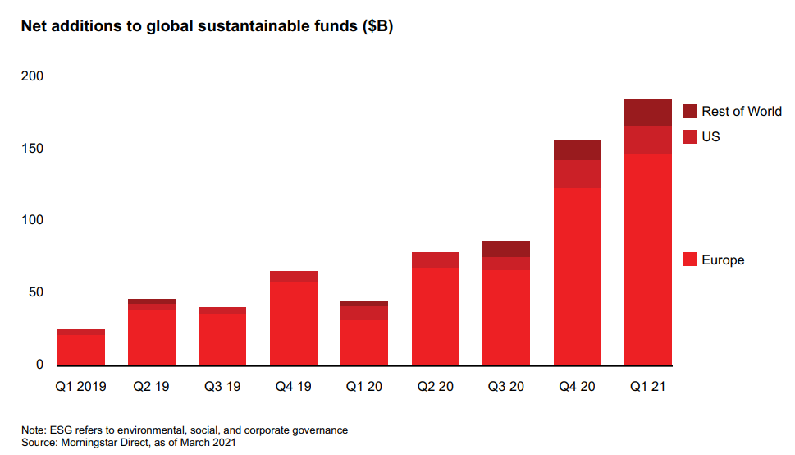
Types of ESG Investing
ESG funds
Investor money
Asset management
Alternative investment funds
Registered investment funds
Private Equity
Venture Capital
Hedge Fund
Mutual Fund
ETF (exchange-traded funds, can be traded as stocks)
https://www.bain.com/insights/topics/energy-and-natural-resources-report/

Slide 12
What ESG Investing is Not:
Alignment: does high ESG score mean better performance at CET?
ESG Investing
(investment taking environmental, social, and governing factors into considerations)
Investing in Clean Energy Transition (CET)
(direct investment in cutting emissions from fossil fuels)
Are companies utilizing CET technologies and services to cut emissions and improve ESG score?

Slide 13
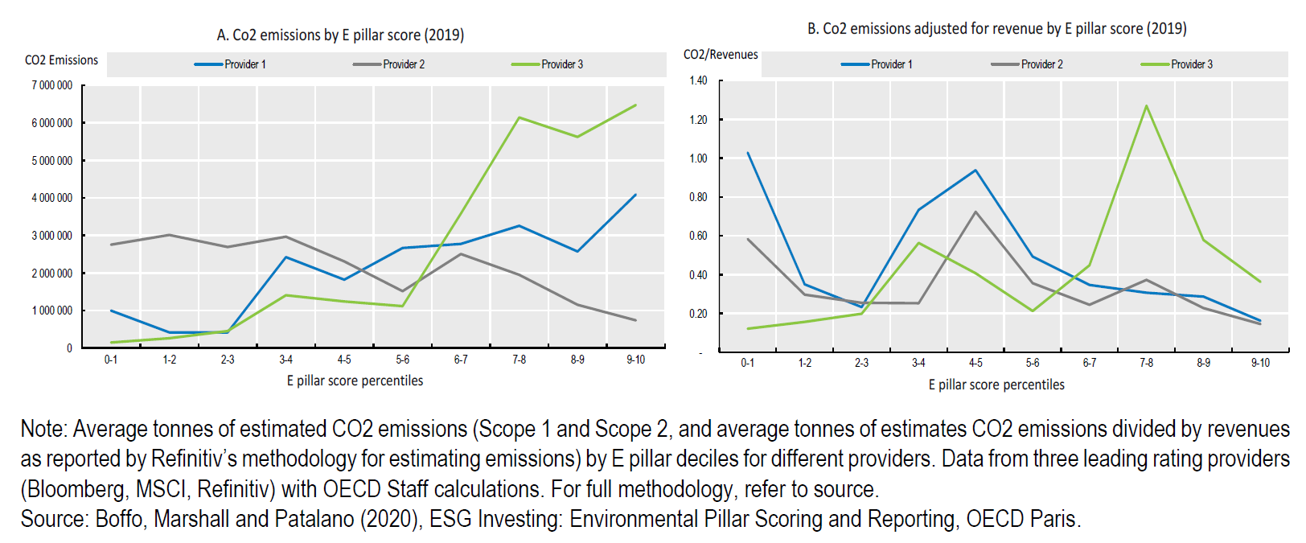
Alignment of ESG with clean energy transition
In cases, high ESG score actually correlate with higher CO₂ emission and higher revenue adjusted CO₂ emission.
OECD: ESG investing and climate transition report
Notes:
Organisation for Economic Co-operation and Development

Slide 14
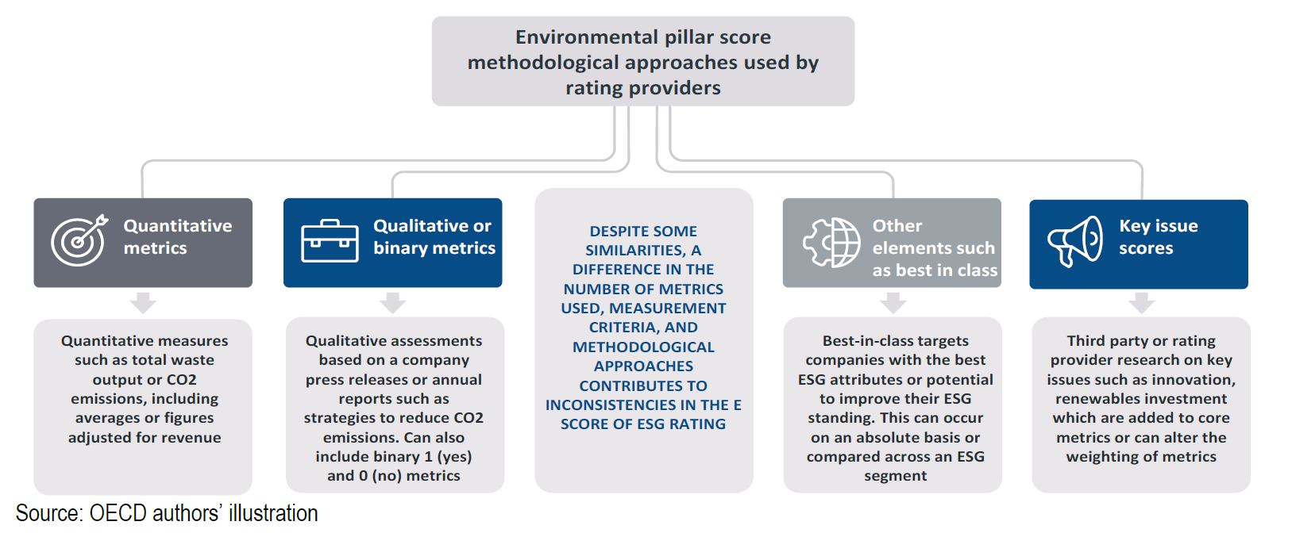
Alignment of ESG with clean energy transition
Environmental score in ESG methodologies vary by rating provider, using a mix of approaches
OECD: ESG investing and climate transition report

Slide 15
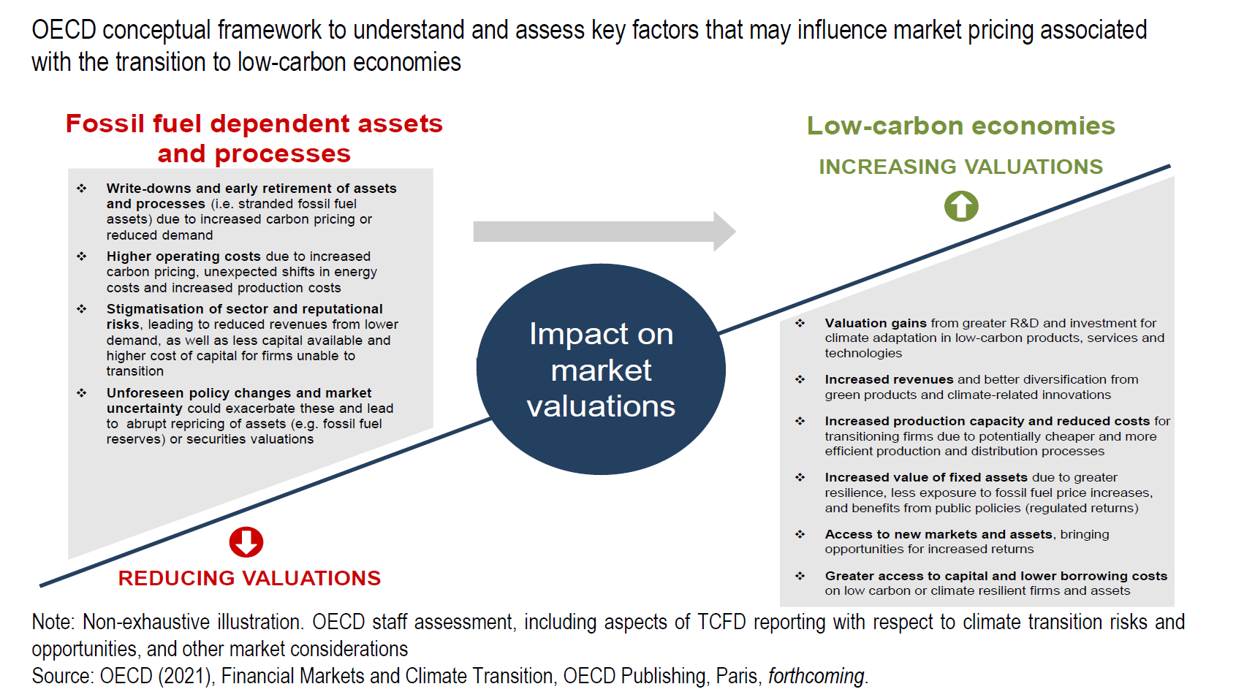
Alignment of ESG with clean energy transition
Framework to capture the various material climate disclosure factors on market valuations related to a low-carbon transition.
OECD: ESG investing and climate transition report

Slide 16
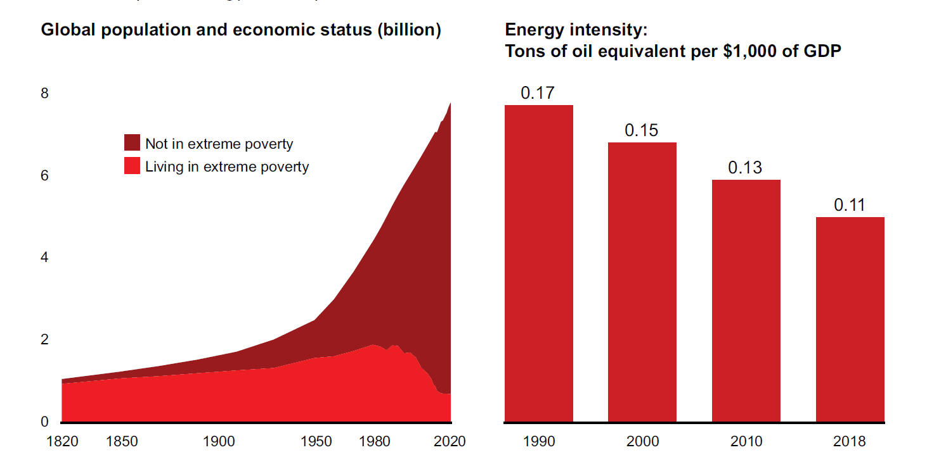
Energy & Natural Resources companies (Oil & Gas)
The global population has grown to nearly 8 billion, while living standards have improved dramatically and energy intensity has decreased
Bain & Co: Global Energy and Natural Resources Report 2021

Slide 17
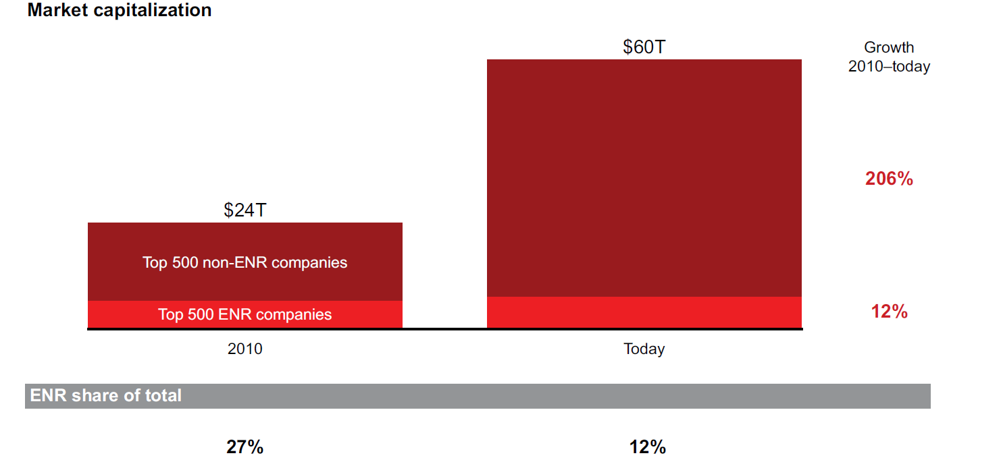
Energy & Natural Resources companies (Oil & Gas)
Energy and natural resources companies has grown more slowly than other industries
Bain & Co: Global Energy and Natural Resources Report 2021

Slide 18
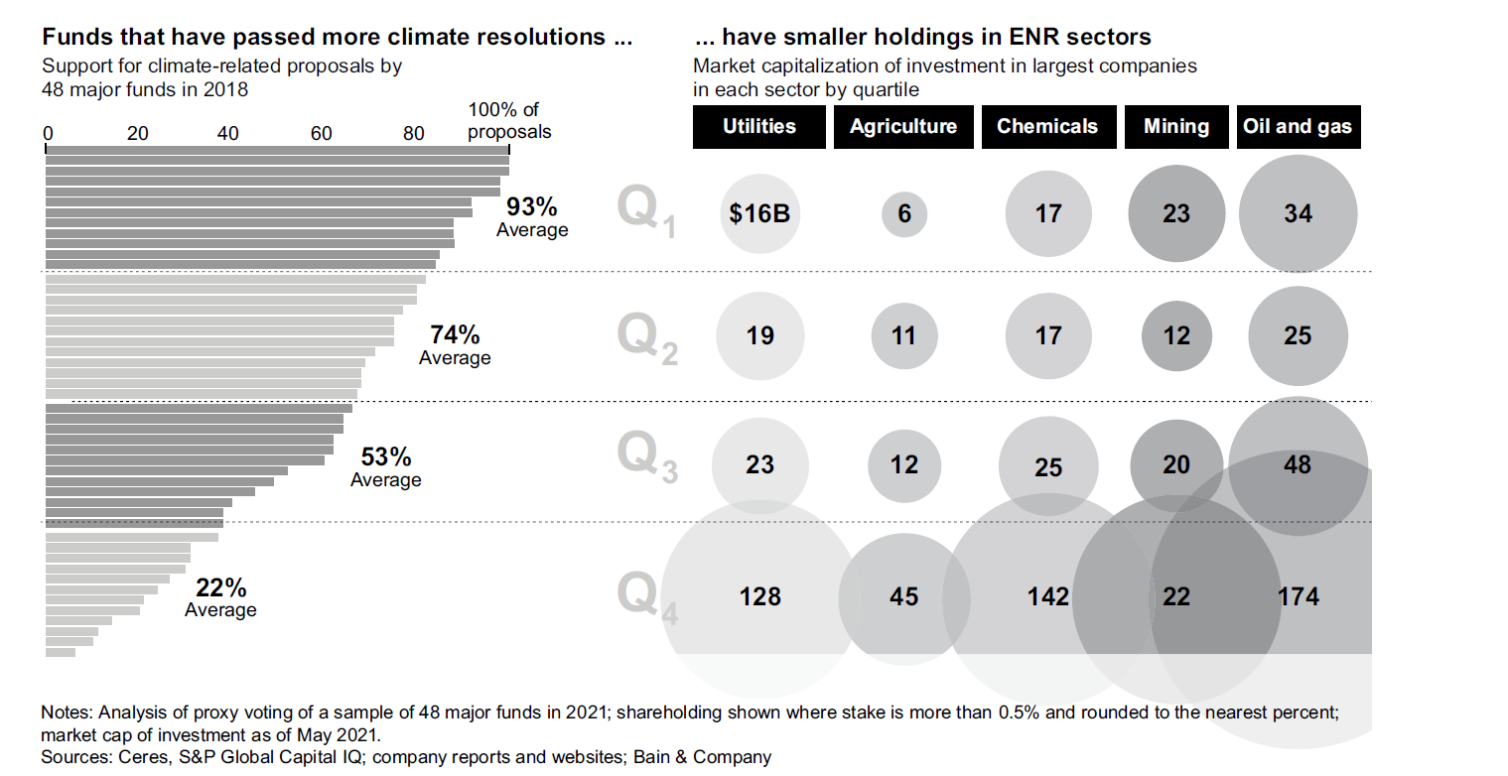
Energy & Natural Resources companies (Oil & Gas)
Call for increased investment to support energy transitions of oil & gas companies
Bain & Co: Global Energy and Natural Resources Report 2021

Slide 19
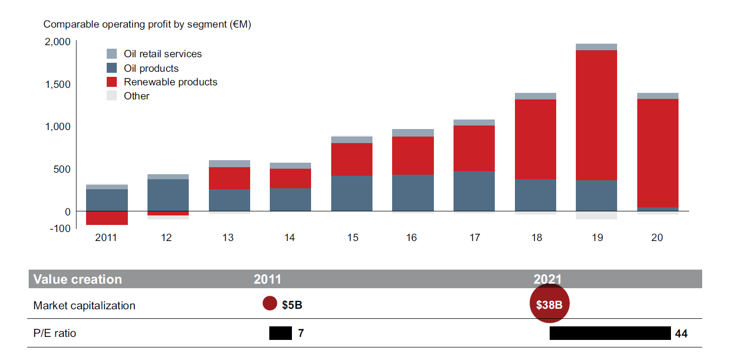
Energy & Natural Resources companies - Neste
Profit streams of Neste, Finland oil & chemical company
Main renewable product: Neste renewable diesel
Low-carbon biofuel with the same chemical composition as fossil fuel
Neste: a successful transition story
Bain & Co: Global Energy and Natural Resources Report 2021
Notes:
vegetable oil refining fuel production process

Slide 20
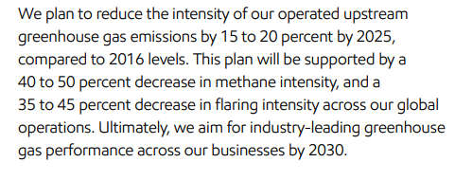
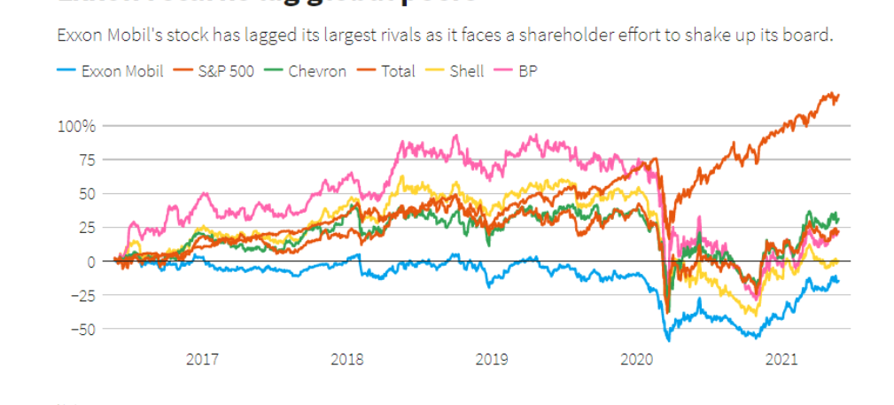
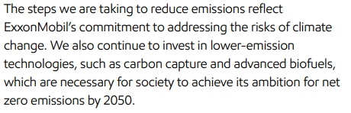

Energy & Natural Resources companies – ExxonMobil
A less successful story: ExxonMobil
Large emphasis on carbon capture & storage
https://www.reuters.com/business/sustainable-business/shareholder-activism-reaches-milestone-exxon-board-vote-nears-end-2021-05-26/

Slide 21
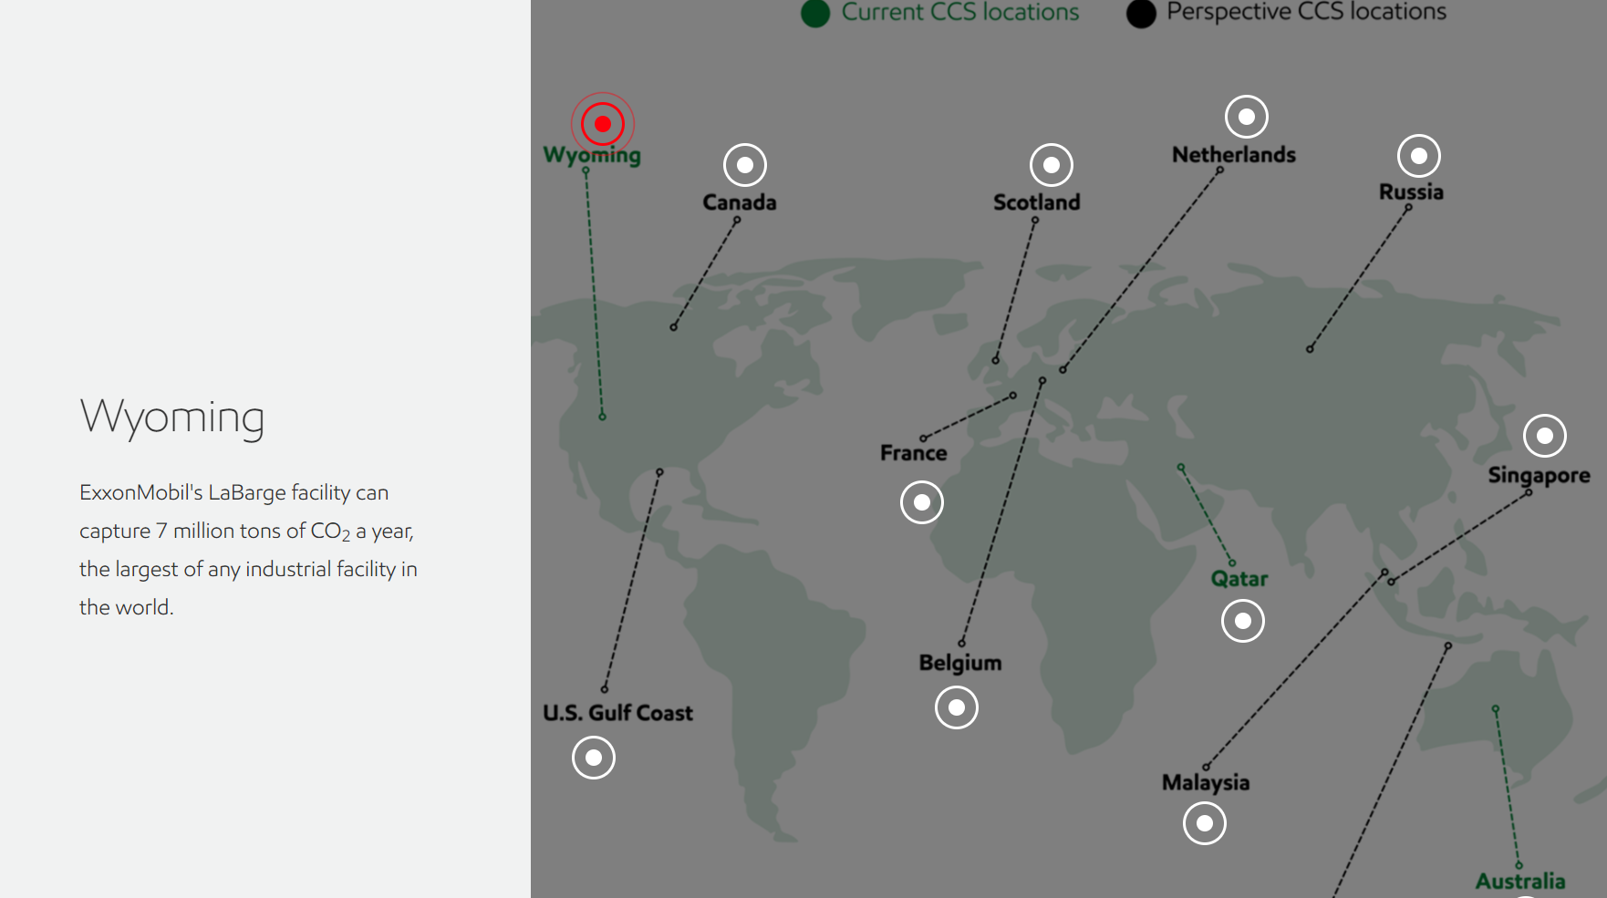
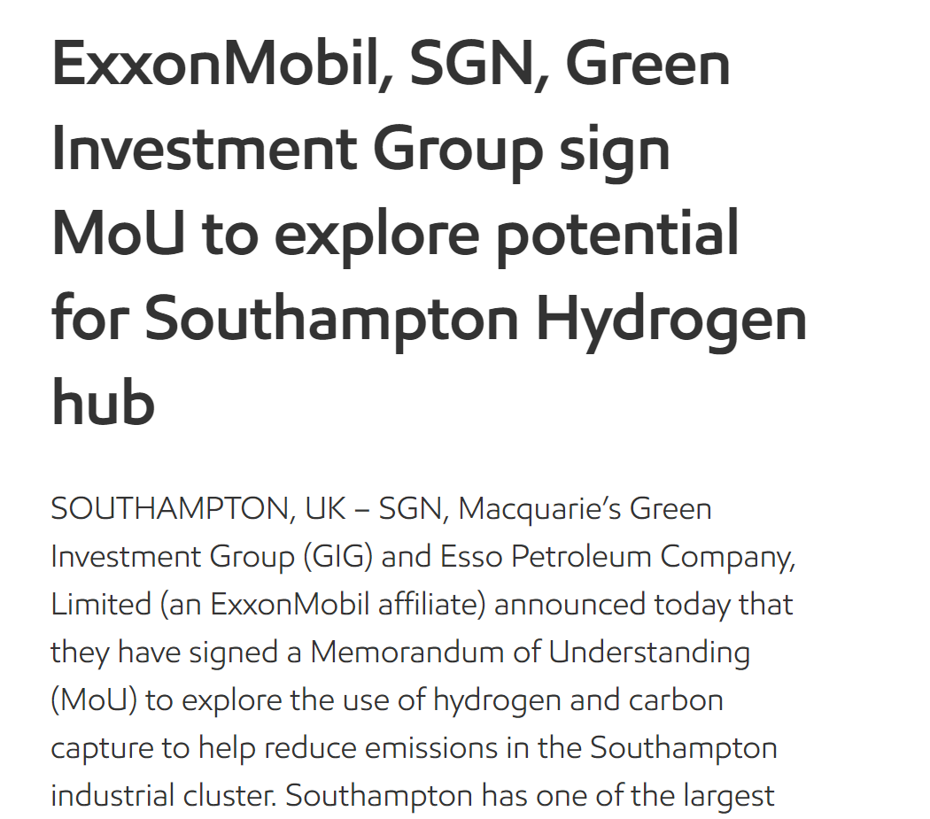
Energy & Natural Resources companies – ExxonMobil
https://corporate.exxonmobil.com/Climate-solutions/CCS-in-action
https://corporate.exxonmobil.com/News/Newsroom/News-releases/2021/1208_ExxonMobil_SGN_Green-Investment-sign-MoU-for-Southampton-hydrogen-hub

Slide 22
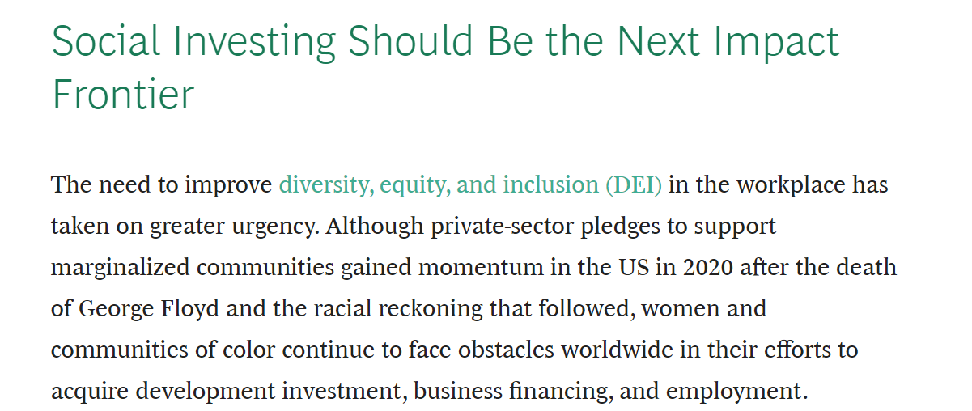
The ESG buzzwords?
https://www.bcg.com/en-us/publications/2022/institutional-investors-should-embrace-social-impact-investment

Slide 23


Takeaway from Sloan Conference: ESG in Asian market
Heavy focus on agriculture
Scaling challenge, examples:
  Compliance on the small holders/farmers level
  Cosmetics with renewable containers not profitabl

Slide 24

Thank you! Questions?

