Slide 1
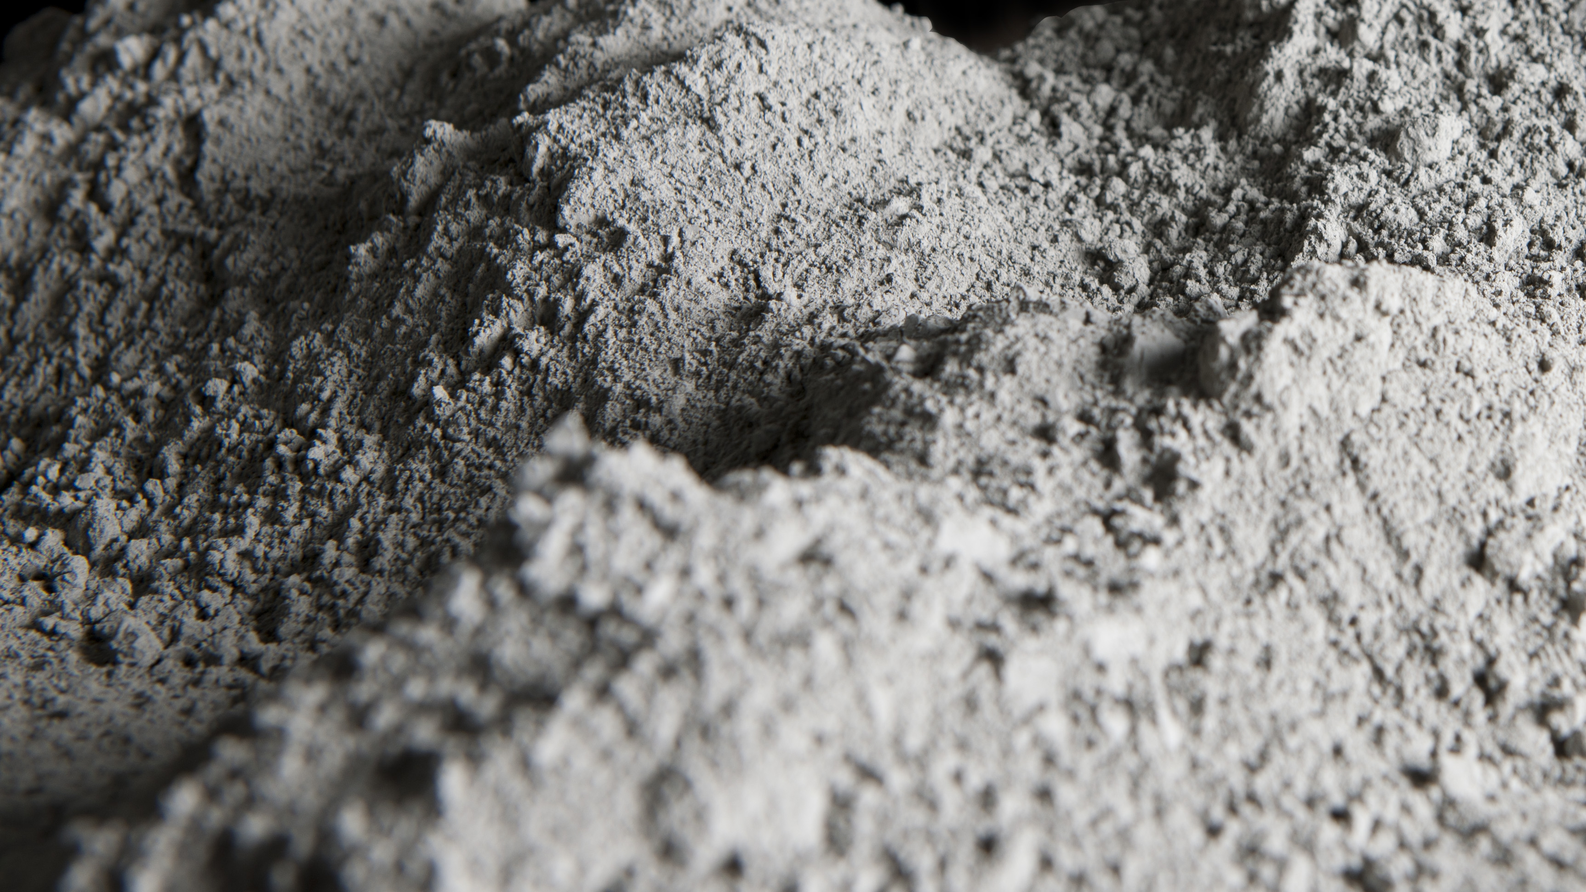
Cement Industry Decarbonization:
The Path to …Concrete… Change
Eliza Spear
HEJC
Feb. 25, 2022
Notes:
Blurb: “The cement industry is responsible for at least 5% of global greenhouse gas emissions, accounting for nearly a third of industry-related emissions. By volume, cement is the most-used manufactured substance globally, with about 4.3 Gt produced in 2020 and demand increasing every year. Over 60% of cement-related carbon dioxide emissions come directly from chemical reactions necessary to the production of cement. The remainder come from energy use, with the majority of thermal energy supplied by fossil fuels. This talk will provide an overview of the current state of the cement industry and explore pathways and challenges to achieving net zero emissions by 2050.”
Cover photo source: https://www.heidelbergcement.com/en/cement

Slide 2
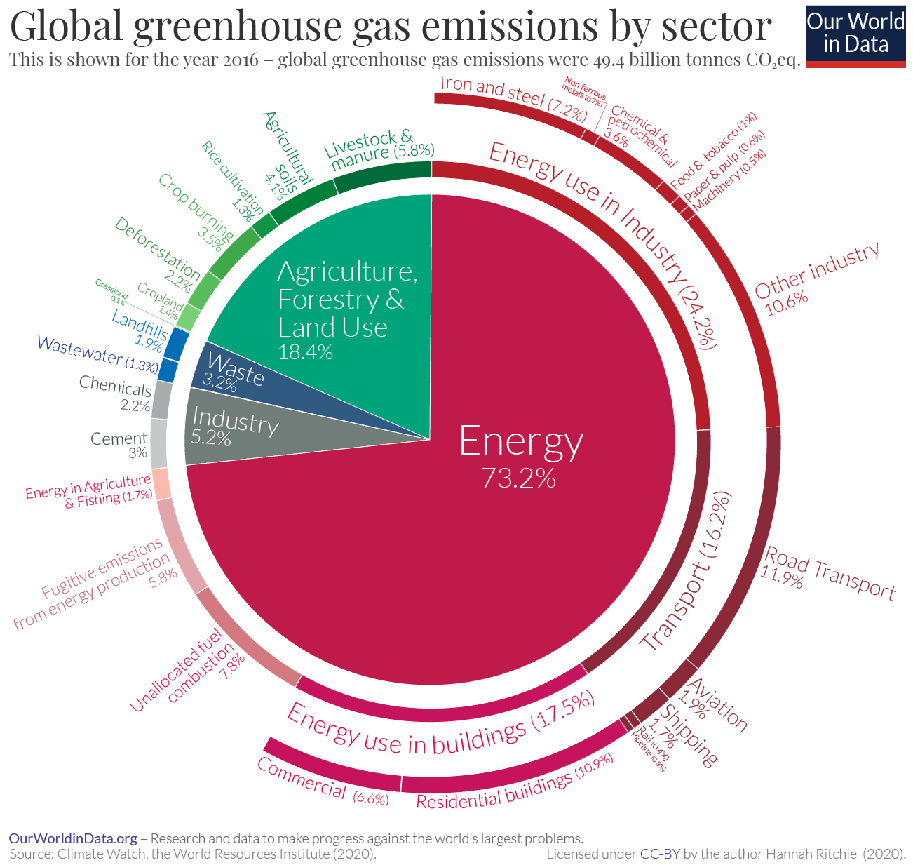
Cement accounted at least 5% of global GHG emissions in 2016
Total emissions: 49.4 billion tonnes CO₂eq
60-70% of cement emissions
3% (~1.5 billion tCO₂eq) directly emitted from conversion of limestone to lime: CaCO₃ → CaO + CO₂
remaining 30-40% of cement emissions
~1.3-2% total global emissions come from energy use in cement production
And some sources estimate that cement is responsible for up to 8% of GHG emissions!

Slide 3
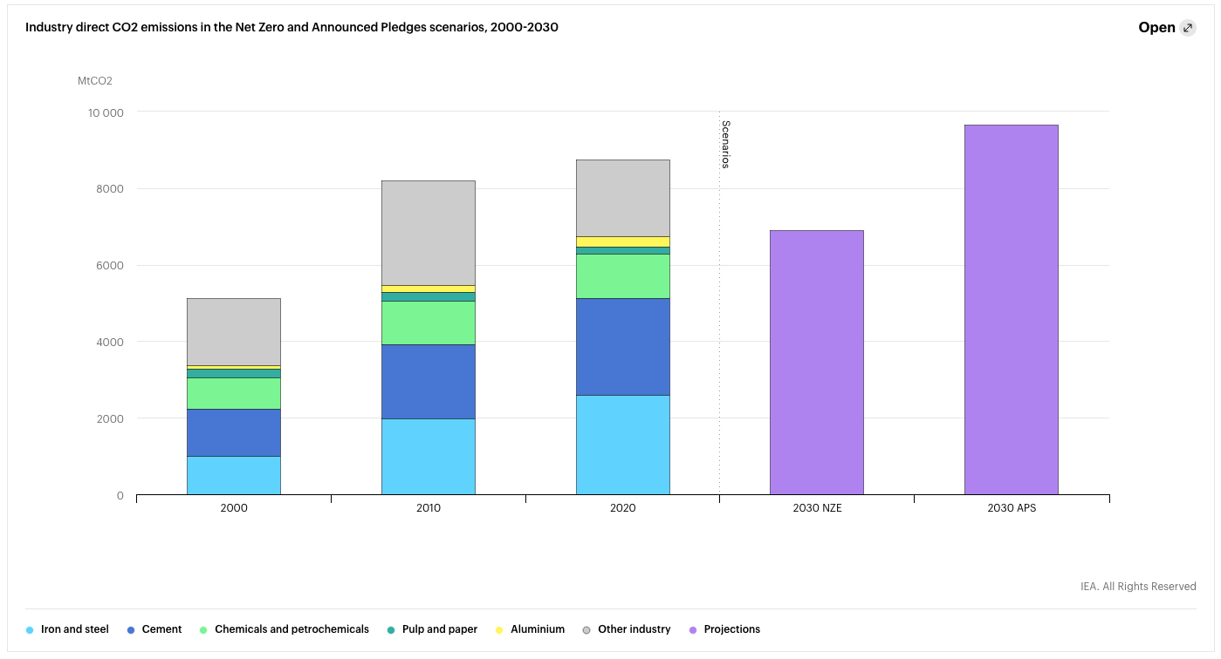
Industry direct CO₂ emissions in the Net Zero and Announced Pledges scenarios, 2000-2030
Direct CO₂ emissions from cement:
~2.5 GtCO₂ in 2020
Cement accounted for 29% of direct CO₂ emissions from industry in 2020
Direct industrial CO₂ emissions, including process emissions, declined 1.6% in 2020 largely because of slowdown in industrial activity due to COVID-19
IEA’s net zero by 2050 scenario requires a 2.3% decline annually to 6.9 GtCO₂ total direct industrial emissions by 2030, despite expected industrial production growth
NZE = Net Zero Emissions Scenario. APS = Announced Pledges Scenario. Direct CO₂ emissions encompass energy and process emissions. “Other industry” includes non-energy-intensive industries such as food and beverages, mining, and textiles. Values for 2020 are estimates.
IEA (2021), Tracking Industry 2021, IEA, Paris https://www.iea.org/reports/tracking-industry-2021

Slide 4

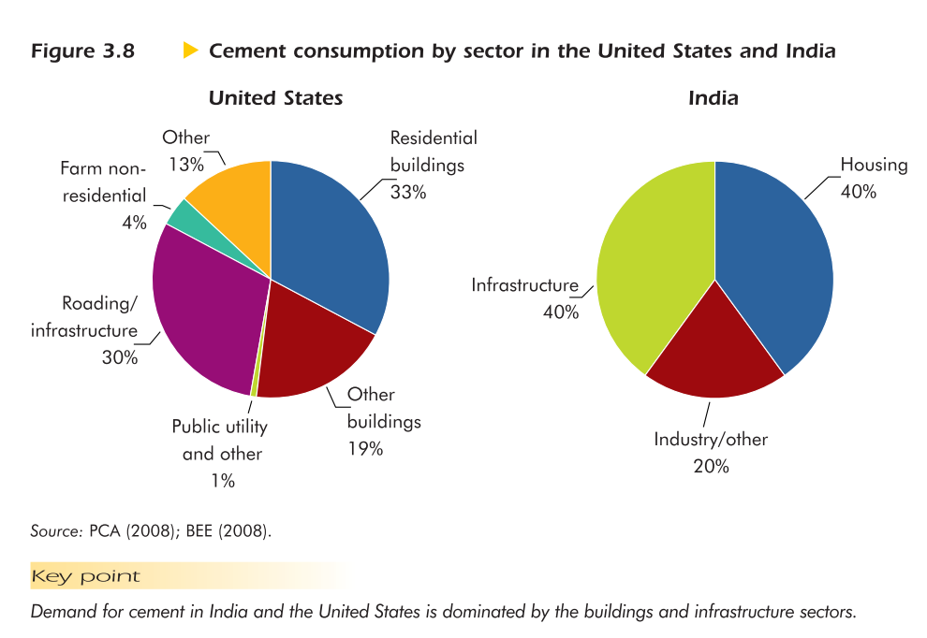
How much cement do we use, and what do we use it for?
Demand for cement in the construction industry drives production
An estimated 4.3 Gt of cement were produced globally in 2020, vs 4.2 Gt in 2019
China is the largest cement producer (~55% global production), followed by India (~8%)
Strategies to reduce demand for cement
Optimize the use of cement in concrete mixes
Use concrete more efficiently
Minimize waste in construction
Maximize the design life of buildings and infrastructure
IEA (2021), Cement, IEA, Paris https://www.iea.org/reports/cement
International Energy Agency, & Organisation for Economic Co-operation Development. (2009).
Energy Technology Transitions for Industry :Strategies for the Next Industrial Revolution. OECD Publishing.

Slide 5
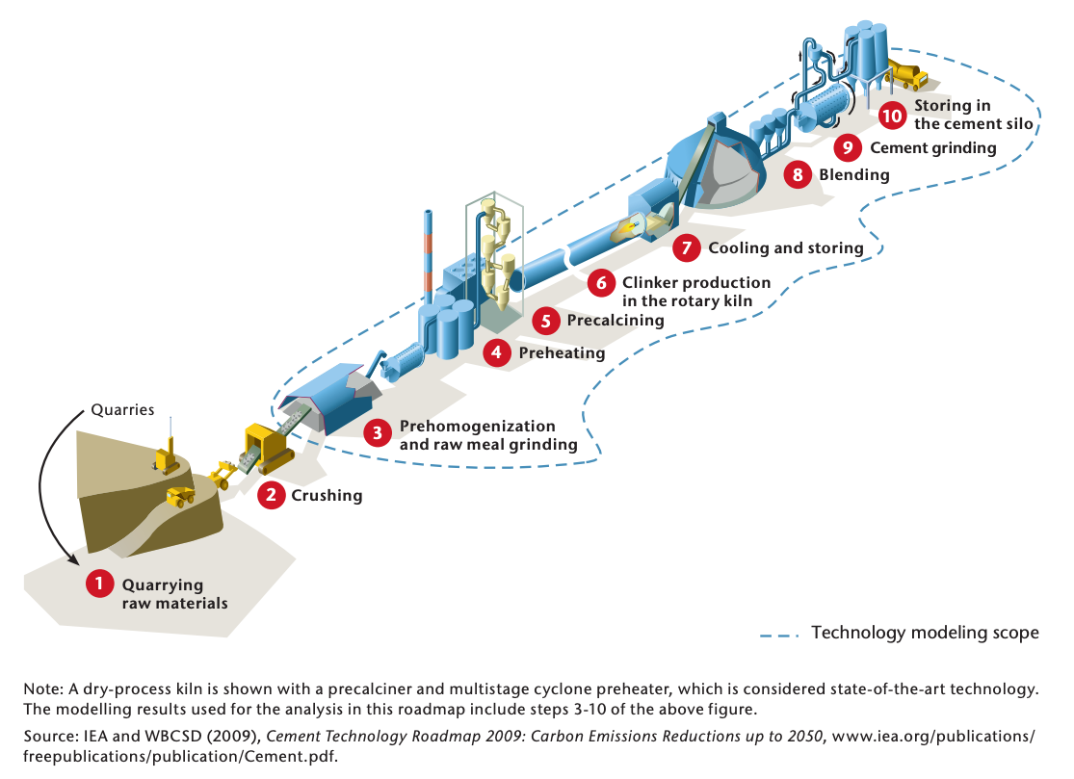
Cement manufacturing
Three-stage process:
Raw materials preparation
Clinker production
Clinker grinding with other components to produce cement
IEA (2018), Technology Roadmap - Low-Carbon Transition in the Cement Industry, IEA, Paris https://www.iea.org/reports/technology-roadmap-low-carbon-transition-in-the-cement-industry

Slide 6
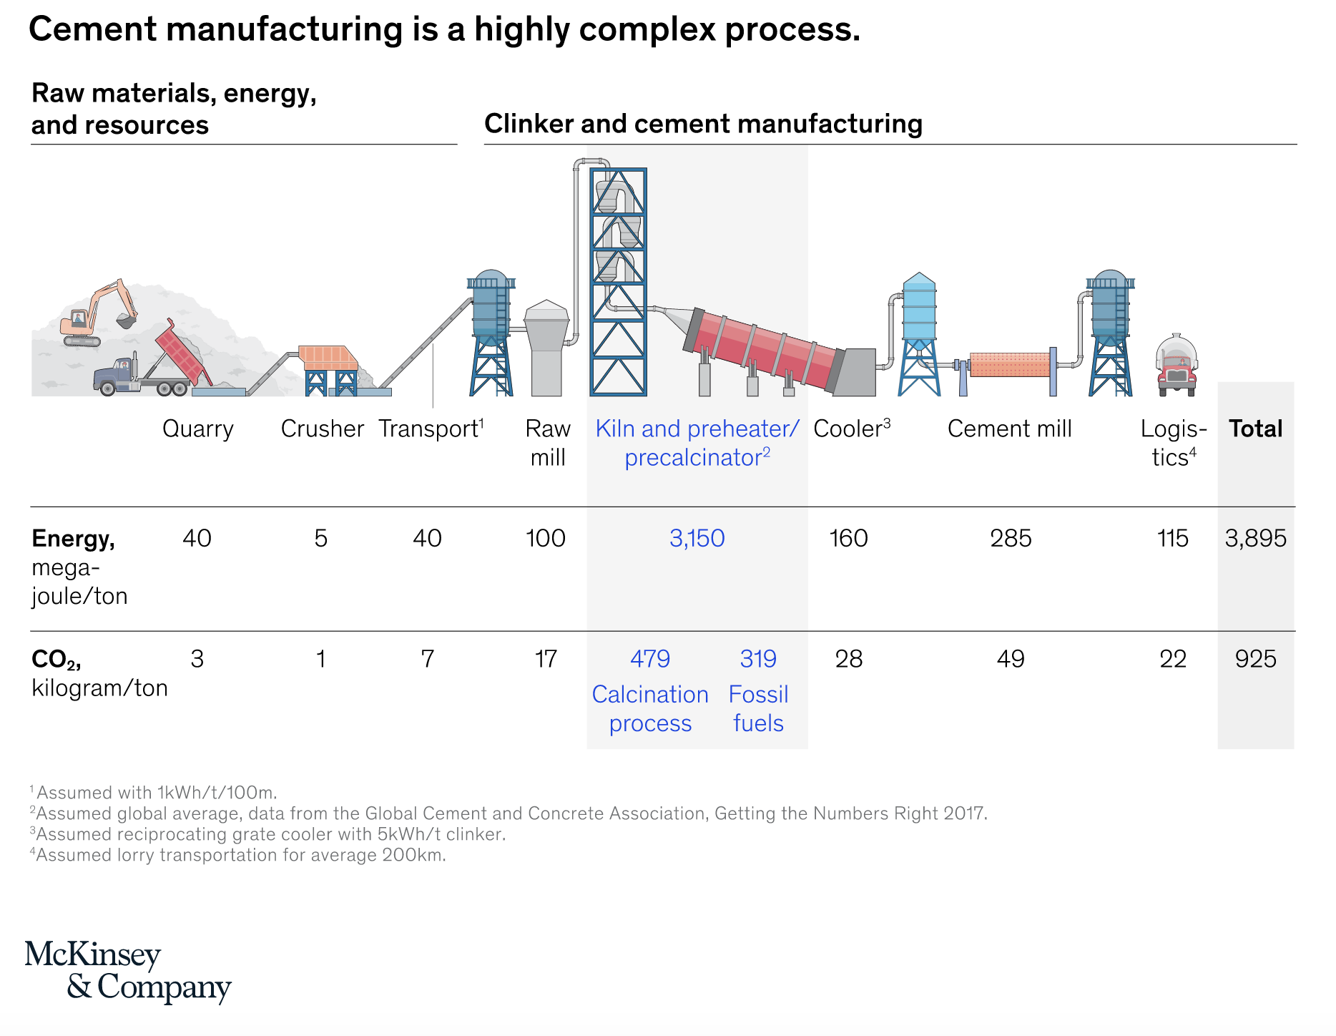

IEA (2018), Technology Roadmap - Low-Carbon Transition in the Cement Industry, IEA, Paris
https://www.iea.org/reports/technology-roadmap-low-carbon-transition-in-the-cement-industry
https://www.mckinsey.com/industries/chemicals/our-insights/laying-the-foundation-for-zero-carbon-cement (May 14, 2020)

Slide 7
Quarrying raw materials
Naturally occurring calcareous deposits (limestone, marl, chalk) provide calcium carbonate (CaCO₃)
These materials are extracted from quarries that are often near the cement plant
Small amounts of other materials (iron ore, bauxite, shale, clay, sand) provide extra iron oxide, alumina, and silica needed to meet process and product performance requirements
Crushing
Quarried materials are crushed to <10 cm in size and transported to the cement plant
IEA (2018), Technology Roadmap - Low-Carbon Transition in the Cement Industry, IEA, Paris
https://www.iea.org/reports/technology-roadmap-low-carbon-transition-in-the-cement-industry
https://www.mckinsey.com/industries/chemicals/our-insights/laying-the-foundation-for-zero-carbon-cement (May 14, 2020)

Slide 8
Preparing raw material
In prehomogenisation, raw materials are mixed to achieve the desired chemical composition
Crushed material is milled to produce a fine powder called “raw meal”
Chemistry of the raw meal is monitored and controlled to ensure consistent and high-quality cement
IEA (2018), Technology Roadmap - Low-Carbon Transition in the Cement Industry, IEA, Paris
https://www.iea.org/reports/technology-roadmap-low-carbon-transition-in-the-cement-industry
https://www.mckinsey.com/industries/chemicals/our-insights/laying-the-foundation-for-zero-carbon-cement (May 14, 2020)

Slide 9
Clinker production
Homogenized raw materials are converted to clinker in high-temperature kilns
This step is the source of direct CO₂ emissions
1/3 of direct emissions come from combustion of fuels
Remaining 2/3 come from chemical reactions involved in converting limestone to calcium oxide, which is a precursor to formation of the calcium silicates that give cement its strength
Two basic types of clinker production: “wet” and “dry”, depending on the moisture content of the raw materials and different kiln designs
(wet consumes more energy than dry)
IEA (2018), Technology Roadmap - Low-Carbon Transition in the Cement Industry, IEA, Paris
https://www.iea.org/reports/technology-roadmap-low-carbon-transition-in-the-cement-industry
https://www.mckinsey.com/industries/chemicals/our-insights/laying-the-foundation-for-zero-carbon-cement (May 14, 2020)

Slide 10
Clinker grinding with other components to produce cement
Clinker is inter-ground with gypsum (CaSO₄·2H₂O) to produce cement
Depending on the required properties of the cement, other components may be added (e.g. fly ash, ground granulated blast furnace slag, fine limestone)
This step may occur at the kiln site, or at separate griding or blending plants
Cement may then be used to make concrete
(~12% cement by volume)
IEA (2018), Technology Roadmap - Low-Carbon Transition in the Cement Industry, IEA, Paris
https://www.iea.org/reports/technology-roadmap-low-carbon-transition-in-the-cement-industry
https://www.mckinsey.com/industries/chemicals/our-insights/laying-the-foundation-for-zero-carbon-cement (May 14, 2020)

Slide 11
Kiln and calcination:
81% of energy
86% of CO₂
52% calcination, 34% fossil fuels
IEA (2018), Technology Roadmap - Low-Carbon Transition in the Cement Industry, IEA, Paris
https://www.iea.org/reports/technology-roadmap-low-carbon-transition-in-the-cement-industry
https://www.mckinsey.com/industries/chemicals/our-insights/laying-the-foundation-for-zero-carbon-cement (May 14, 2020)

Slide 12
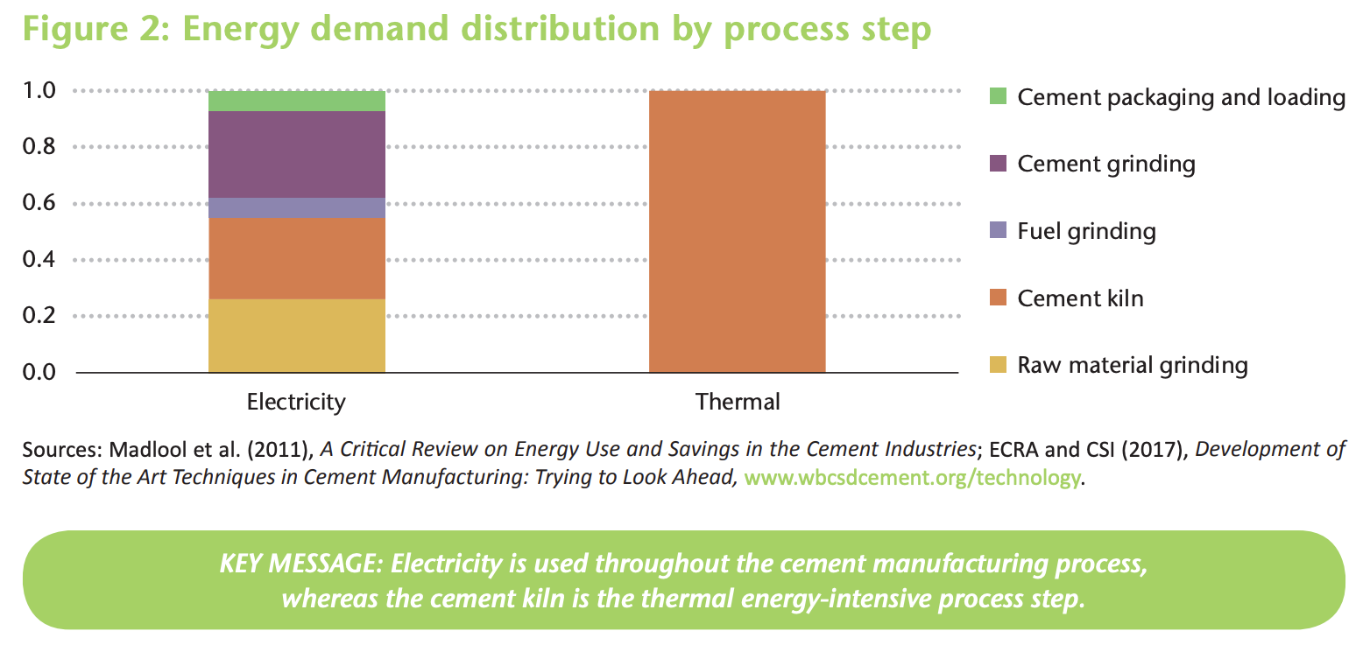
IEA (2018), Technology Roadmap - Low-Carbon Transition in the Cement Industry, IEA, Paris https://www.iea.org/reports/technology-roadmap-low-carbon-transition-in-the-cement-industry

Slide 13
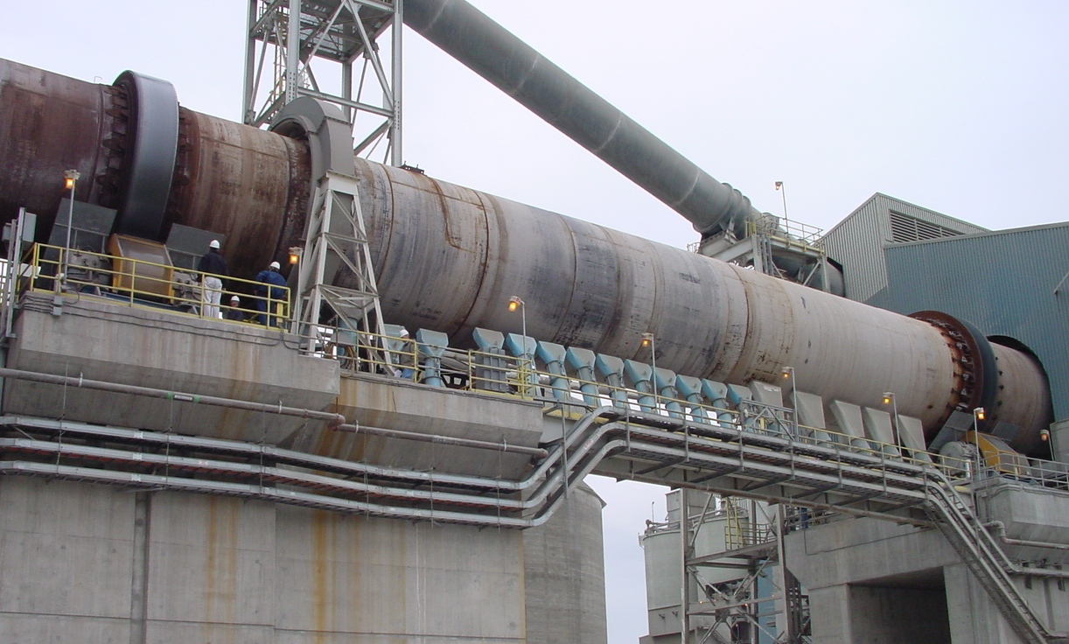
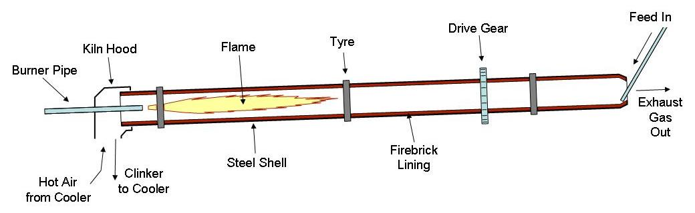
Cement production: the kiln
Feedstock: limestone, clay, sand
Key ingredients: lime, silica, alumina, iron
The kiln is a horizontally sloped steel cylinder lined with firebrick that turns at 1-3 rpm
  Kilns can be >100 m long, 6 m diameter
Fuels (e.g. coal, natural gas, fuel oils, petroleum) are burned so that the flame reaches 2000 ˚C, heating the materials to 1500 ˚C so that they are partially molten
The kiln converts calcium and silicon oxides into calcium silicates, the main component of cement
  At 900 ˚C, limestone undergoes calcination: CaCO₃ → CaO + CO₂
International Energy Agency, & Organisation for Economic Co-operation Development. (2009). Energy Technology Transitions for Industry :Strategies for the Next Industrial Revolution. OECD Publishing.
images: https://en.wikipedia.org/wiki/Cement_kiln

Slide 14
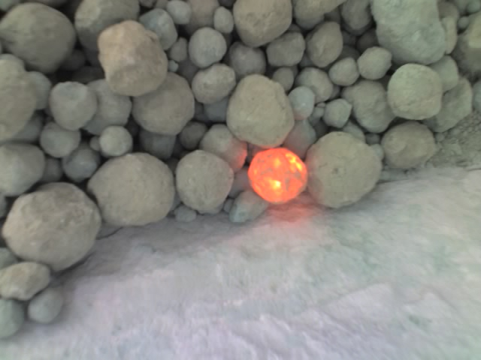
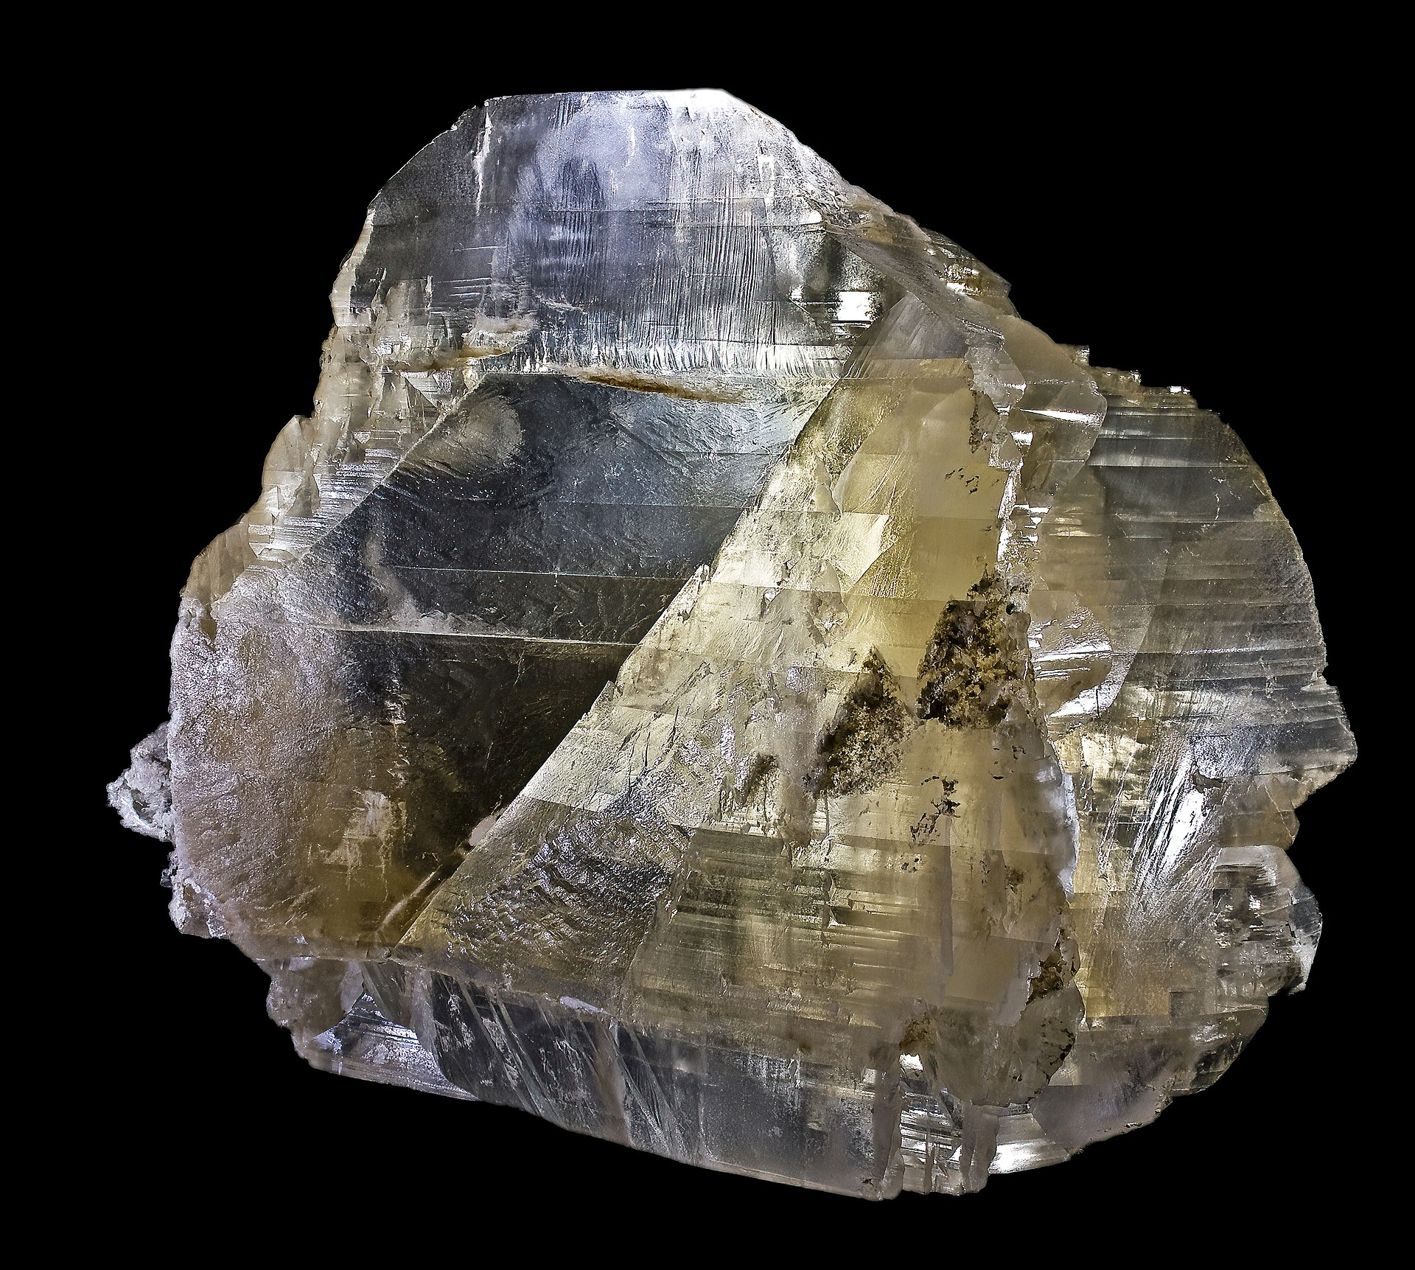
Clinker and cement
Feedstock: limestone, clay, sand
Key ingredients: lime, silica, alumina, iron
Main minerals:
  C₃S: alite (3CaO·SiO₂)
  C₂S: belite (2CaO·SiO₂)
  C₃A: tricalcium aluminate (3CaO·Al₂O₃) – also called celite
  C₄AF: brownmillerite (4CaO·Al₂O₃·Fe₂O₃)
These materials are produced by heating the raw materials up to their sintering temperature of ~1450 ˚C
The silicates provide cement’s desirable mechanical properties
Aluminum and iron oxides act as flux to reduce the sintering temperature
Tricalcium aluminate is the most reactive mineral in the clinker; it can undergo an exothermic hydration reaction resulting in flash setting of the cement (hydrated form Ca₂AlO₃(OH)·nH₂O)
Gypsum (CaSO₄·2H₂O, <5 wt%) is added to prevent flash setting of the C₃A (better control of cement setting)
  Sulfate ions passivate the tricalcium aluminate by forming an insoluble layer of ettringite (3CaO·Al₂O₃·3CaSO₄·32H₂O) over the surface of the calcium aluminate crystals
Portland cement is a hydraulic cement: it sets when the components undergo hydration reactions
clinker
gypsum
(CaSO₄·2H₂O)
https://en.wikipedia.org/wiki/Cement
https://en.wikipedia.org/wiki/Cement_clinker
https://en.wikipedia.org/wiki/Gypsum

Slide 15
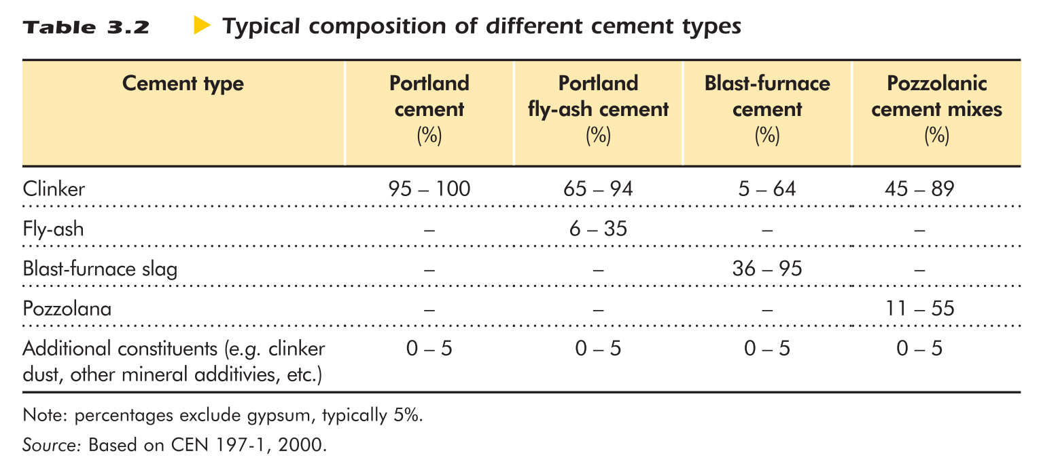
Clinker substitutes
clinker
The most widely-used type of cement is Portland (95% clinker)
Mixing clinker substitutes into Portland cement is one strategy to reduce emissions and cost
International Energy Agency, & Organisation for Economic Co-operation Development. (2009). Energy Technology Transitions for Industry :Strategies for the Next Industrial Revolution. OECD Publishing.
Image: https://en.wikipedia.org/wiki/Cement_clinker

Slide 16
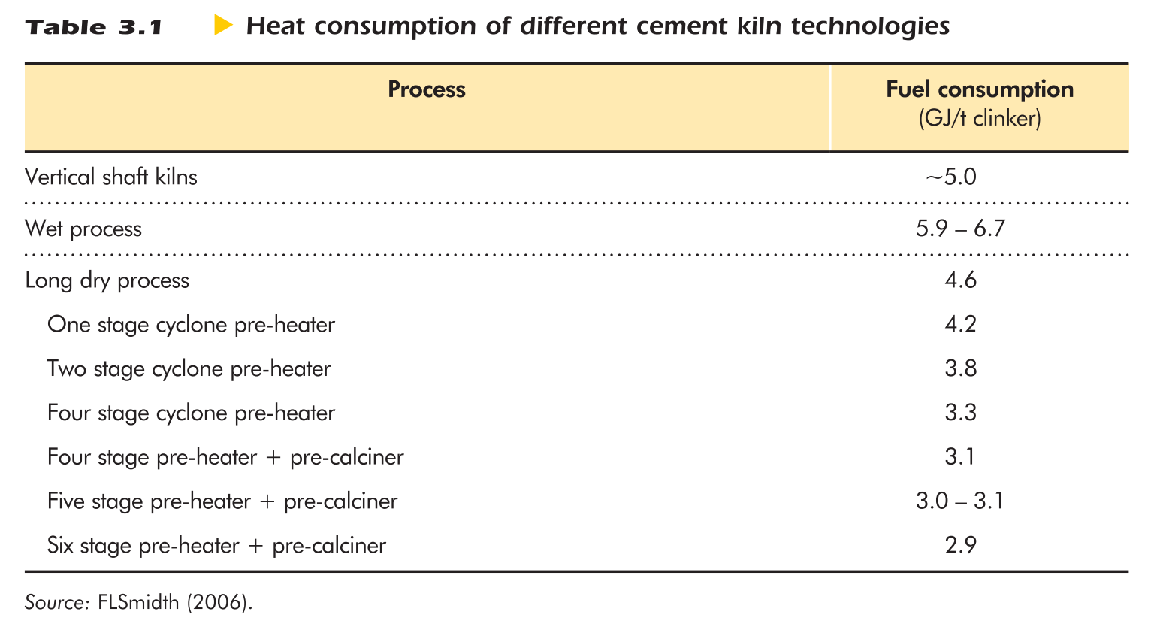
Wet vs dry process
Wet process
Pre-ground with water to create a slurry
higher water content in starting material (40-45%)
easier control of chemistry
consumes more energy to evaporate the water before calcination
Dry process
Dry-ground powder
more efficient (avoids water evaporation)
International Energy Agency, & Organisation for Economic Co-operation Development. (2009). Energy Technology Transitions for Industry :Strategies for the Next Industrial Revolution. OECD Publishing.
https://en.wikipedia.org/wiki/Cement_kiln

Slide 17
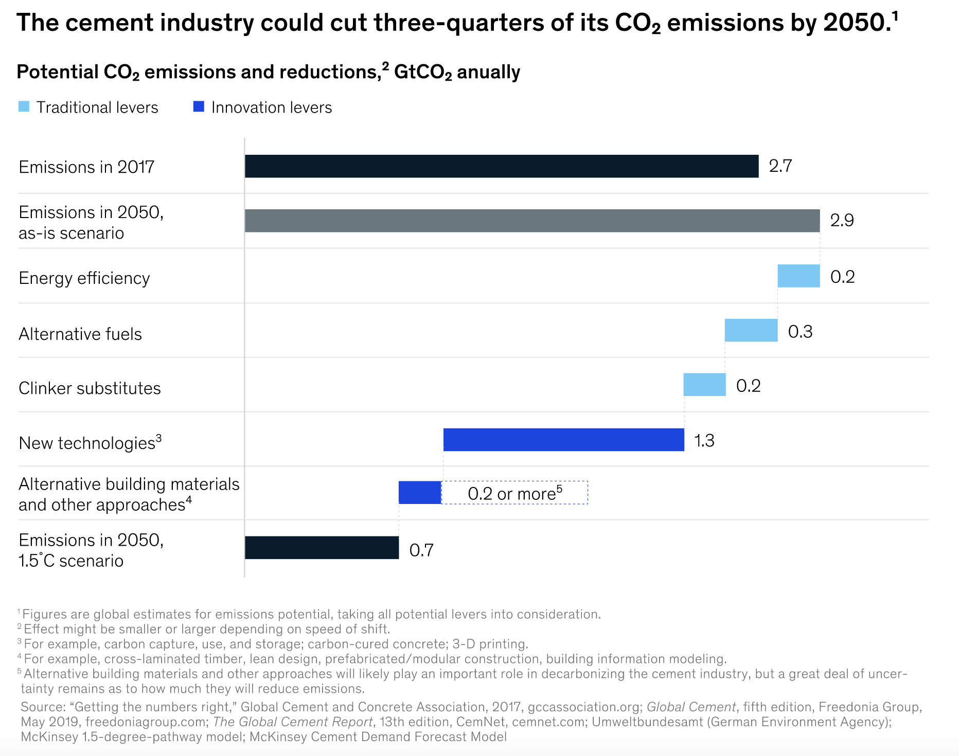
Plans for decarbonization of the cement industry rely heavily on new tech
Only ~20% of emissions reduction is expected to be achieved through operational advances (light blue)
Energy efficiency updates mostly already implemented
Alternative fuels and clinker substitutes are limited by input material availability
New tech and alternative building materials are critical in further reducing the carbon footprint of cement
New tech options are still in very early stages
https://www.mckinsey.com/industries/chemicals/our-insights/laying-the-foundation-for-zero-carbon-cement (May 14, 2020)

Slide 18
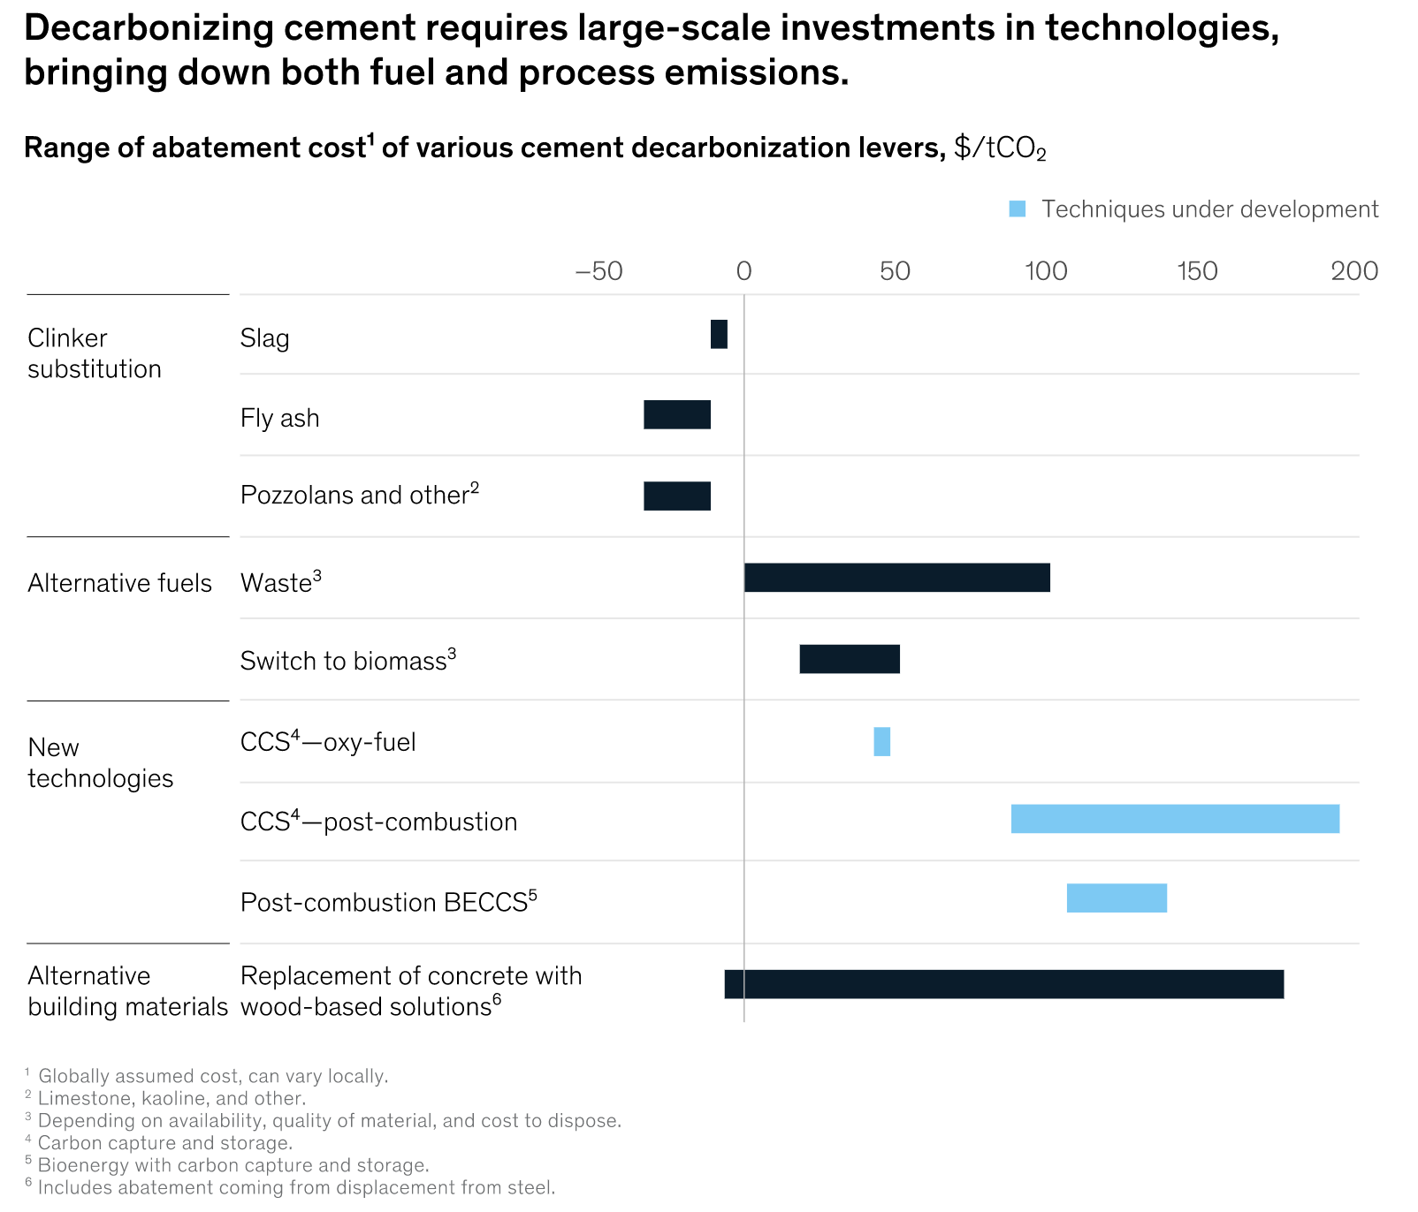
Estimated abatement costs in $/tCO₂
A negative abatement cost indicates that the lever benefits the manufacturer
Abatement costs are shown as ranges with depend upon future availability of various materials, e.g.:
the availability of fly ash and slag will decrease as the steel and energy sectors work on decarbonization
demand for biomass will increase across various industries
https://www.mckinsey.com/industries/chemicals/our-insights/laying-the-foundation-for-zero-carbon-cement (May 14, 2020)

Slide 19
Manufacturer dilemma
If the abatement cost of a lever is higher than the price of CO₂…
“There is pressure from the public and financial investors to abate quickly, even though there is no economic rationale to do so.”
https://www.mckinsey.com/industries/chemicals/our-insights/laying-the-foundation-for-zero-carbon-cement (May 14, 2020)

Slide 20
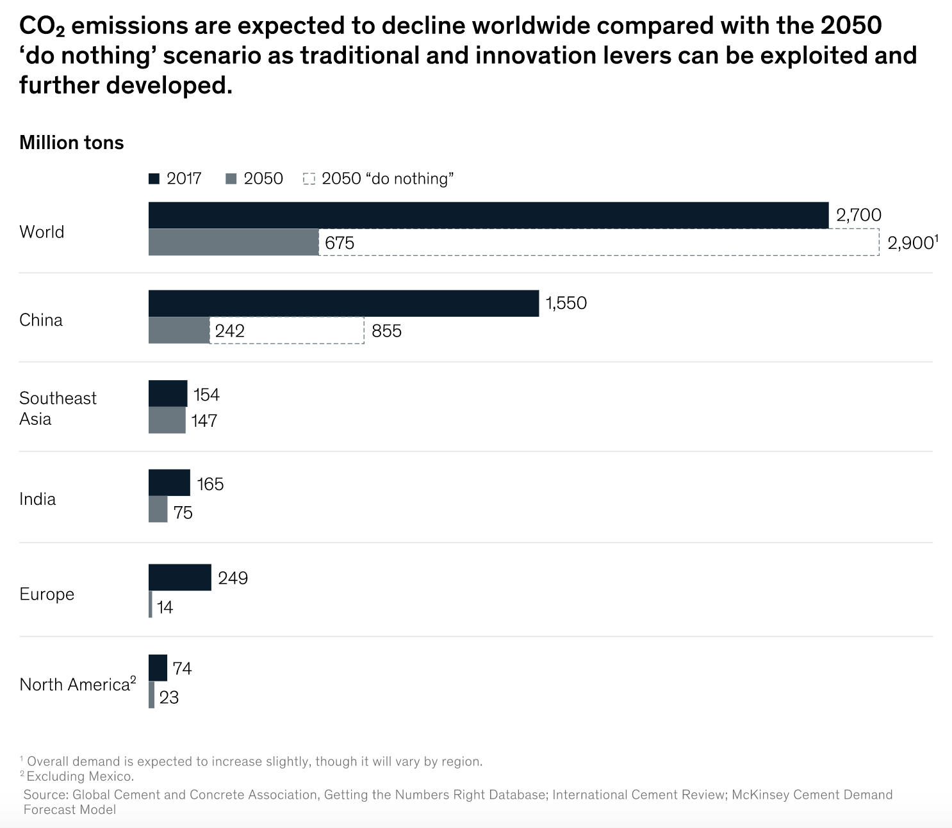
Varying regulatory approaches in different countries will yield differing levels of CO₂ reduction
China:
expect ~45% decline in demand
will deploy operational advances and tech innovation
Southeast Asia and India:
have started developing policies to promote decarbonization efforts
however, urbanization and economic development will lead to increased demand
Europe and North America:
high investor scrutiny and regulatory pressure to decarbonize
https://www.mckinsey.com/industries/chemicals/our-insights/laying-the-foundation-for-zero-carbon-cement (May 14, 2020)
Notes:
Why will China have 45% decline in cement demand? Have not seen this elsewhere.

Slide 21
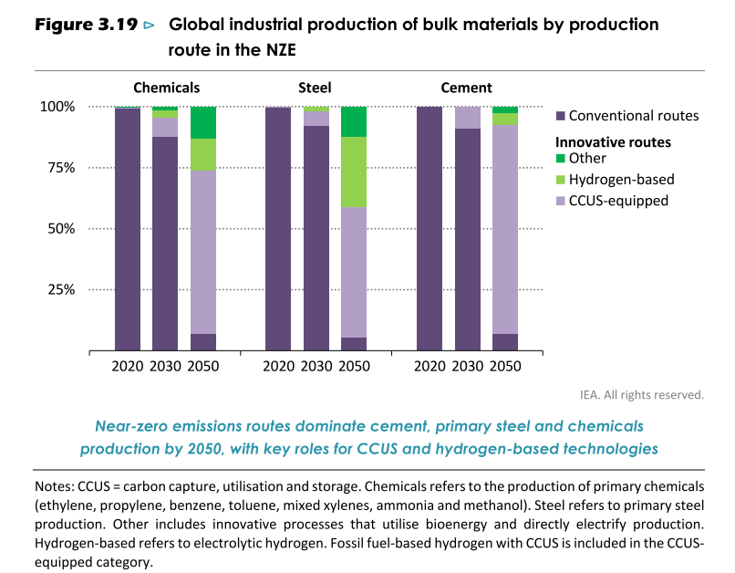
What is decarbonization going to look like for the cement industry?
IEA (2021), Net Zero by 2050, IEA, Paris https://www.iea.org/reports/net-zero-by-2050

Slide 22
Operational advances
Clinker substitutes
  Fly ash (from coal-fired powerplants) and slag (from steel blast furnaces) will have declining availability
  Natural pozzolans (e.g. volcanic rock and ash) haven’t been assessed at large scale
Reduce energy intensity through better plant utilization
Increasing equipment effectiveness
Recovering waste heat to provide carbon-free energy
Alternative fuels (waste, biomass)
  Availability varies regionally; expect increasing demand
  However, could reduce emissions by ~10% by 2050
Advanced analytics
  a European cement producer created self-learning models of a kiln’s heat profile and optimized the shape and intensity of the kiln flame; yielded 6% fuel savings
https://www.mckinsey.com/industries/chemicals/our-insights/laying-the-foundation-for-zero-carbon-cement (May 14, 2020)

Slide 23
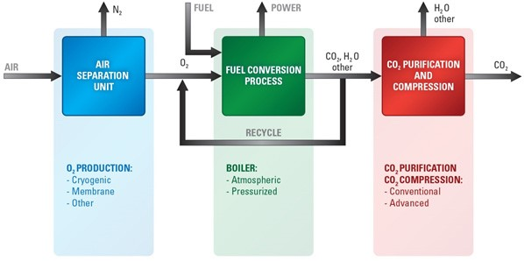
Technological innovation: CCUS
Carbon capture, utilization, and storage (CCUS)
  Current status: CCUS is costly, better suited for higher-value products e.g. steel
  By 2050: may be able to cut cement emissions in half
  Options include post-combustion carbon capture, and oxyfuel combustion (promising but expensive) which yields high concentrations of CO₂ in flue gas, enabling capture of nearly all CO₂
Oxyfuel combustion
https://www.mckinsey.com/industries/chemicals/our-insights/laying-the-foundation-for-zero-carbon-cement (May 14, 2020)
Image: https://netl.doe.gov/node/7477

Slide 24
Low-carbon innovation for CCUS
CCUS is especially necessary for reducing emissions released during limestone calcination
To reach 2050 targets, capture technologies in cement production need to be commercialized by 2030
Some current efforts:
Commercial-scale CCS facilities
  In Texas, a facility began operating in 2014; captures 15% of emissions using chemical absorption
  A pilot project at an Anhui Conch plant in China; began operating in 2018; captures 50 ktCO₂/year (“closer to full capture rates” than Texas’ 15% -- what’s the rate though?)
  Other plants are in the works in Norway, Canada, and India
CLEANKER project, using calcium looping carbon capture (Italy)
Semi-industrial oxyfuel test facility (Germany)
CO2ment project, completed 2nd phase trials in early 2021 (Canada), capturing 1 tonne CO₂ per day using novel physical adsorption technology
Direct separation (captures CO₂ emissions by applying indirect heating in the calciner); successfully piloted by the LEILAC project (Belgium, 2019); large-scale demo plant design underway for 2025 (Germany)
IEA (2021), Cement, IEA, Paris https://www.iea.org/reports/cement

Slide 25


Electrification of cement production
Electrification is at an earlier stage of development than CCUS
CemZero project (Sweden)
  Collaboration between cement producer Cementa and energy producer Vattenfall, working to electrify cement production
  Feasibility study was completed in early 2019; indicated that electrified cement production is technically possible and “likely” cost-competitive with other options to substantially reduce emissions (in experimental study, only 2x cost)
  Current status: investigating how a pilot plant can be built
ELSE project (Norway):
  Investigating kiln electrification
Mineral Products Association (UK):
  Trialing fueling kilns with a blend of biomass, hydrogen, and electrical plasma
IEA (2021), Cement, IEA, Paris https://www.iea.org/reports/cement

Slide 26

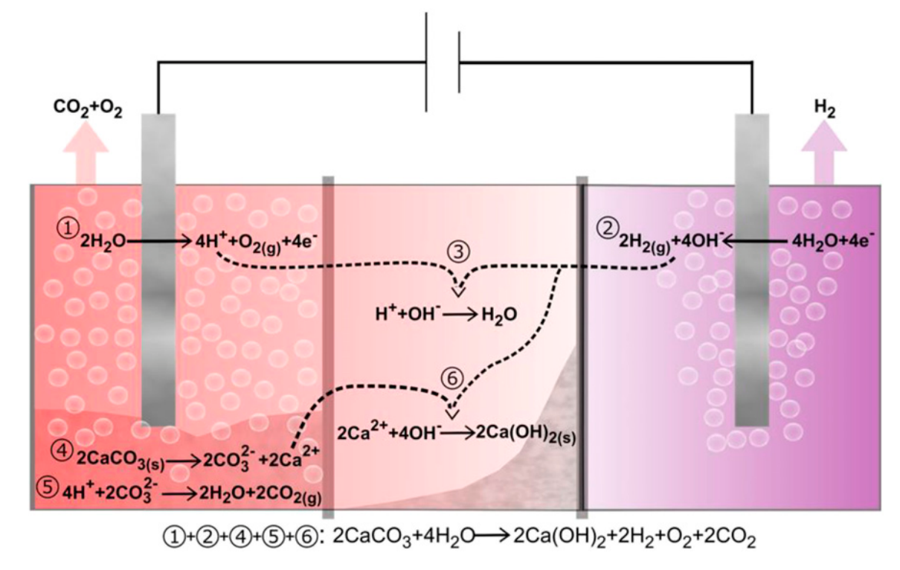
Electrification of cement production: Sublime Systems
Founded by Dr. Leah Ellis and Yet-Ming Chiang (MIT)
Producing “electrochemical cement”
Convert limestone to lime at room temperature
Makes the CO₂ produced easier to capture
Reduces overall energy consumption
Currently producing at a rate of kg/h, and working on scaling to tons/h
Sublime Systems is at the Engine, and they’re hiring in Somerville now!
https://sublime-systems.com/
https://www.engine.xyz/founders/sublime-systems/
Ellis, L. D.; Badel, A. F.; Chiang, M. L.; Park, R. J.-Y.; Chiang, Y.-M. PNAS 2020, 117 (23), 12584. DOI: ﻿10.1073/pnas.1821673116

Slide 27

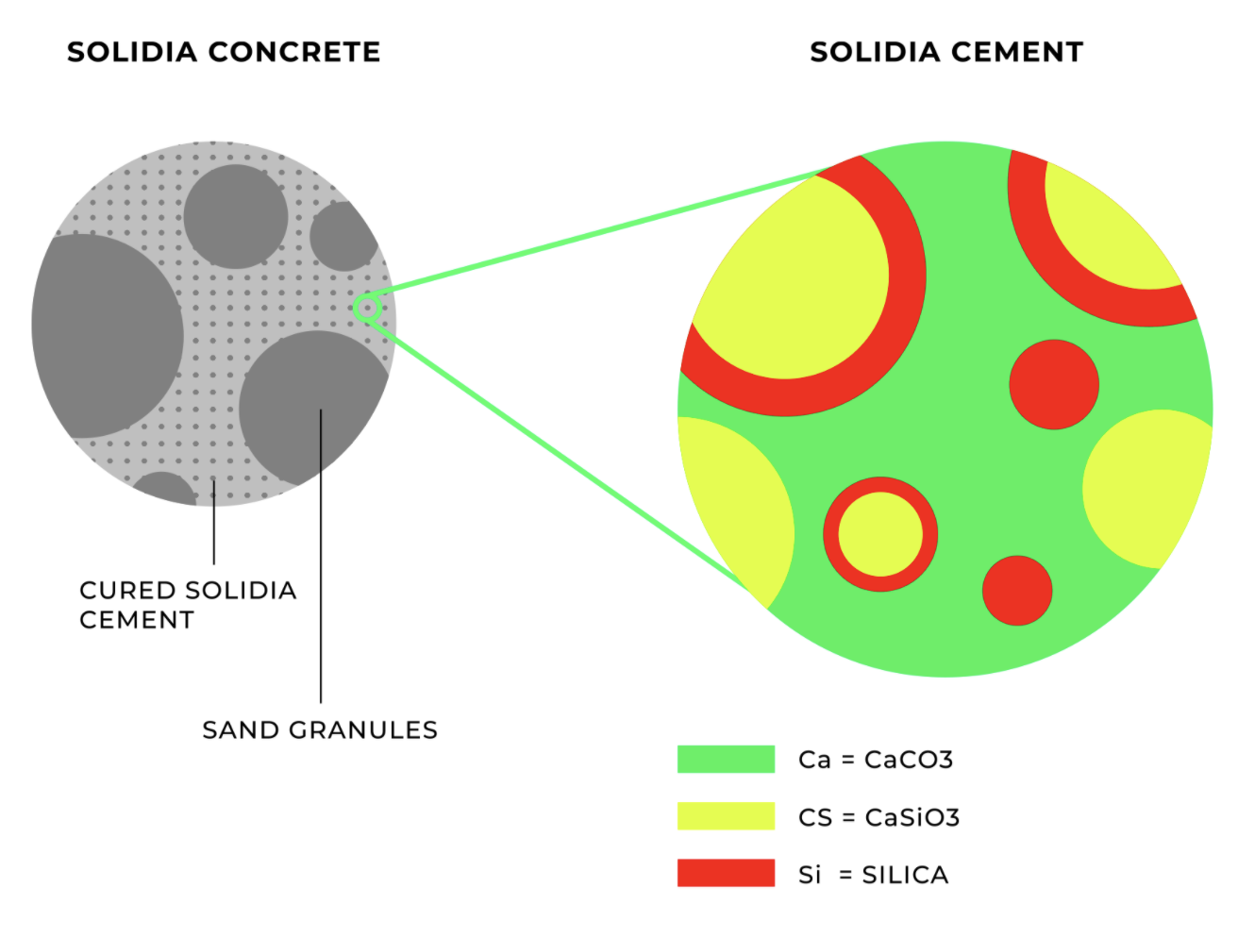
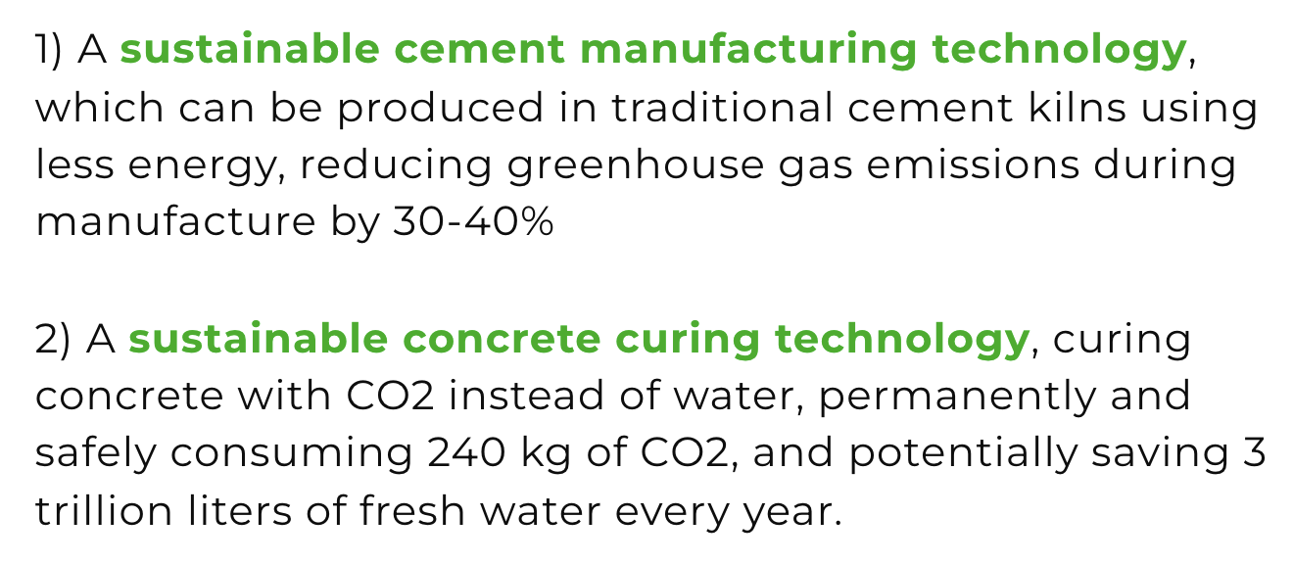
Alternative binding materials: Solidia Technologies
Niche but commercially available
Carbonation of calcium silicates; launched a commercial venture in 2019
IEA (2021), Cement, IEA, Paris https://www.iea.org/reports/cement
https://www.solidiatech.com/
Notes:
“application is limited to precast products” – not sure what this means

Slide 28
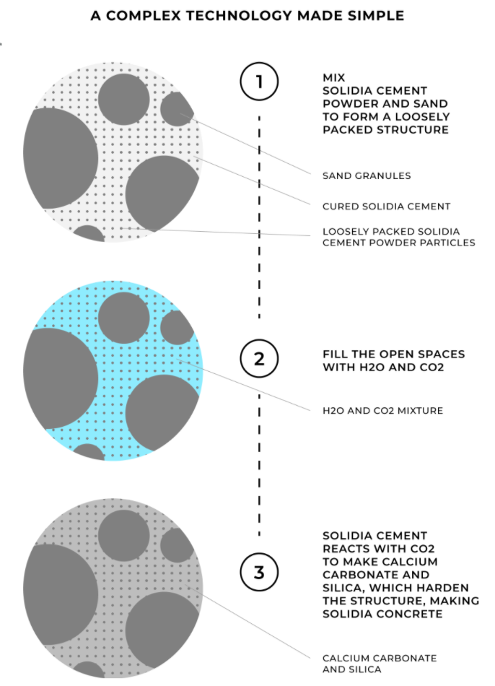
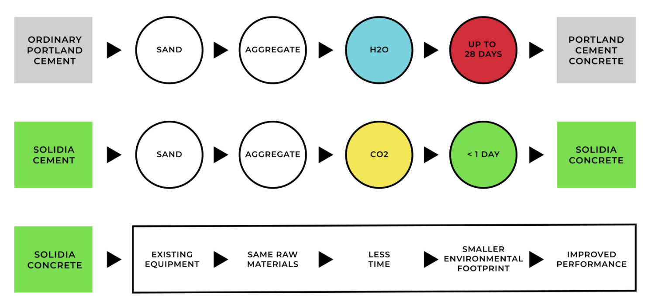
IEA (2021), Cement, IEA, Paris https://www.iea.org/reports/cement
https://www.solidiatech.com/
Notes:
“application is limited to precast products” – not sure what this means

Slide 29
New growth horizons
In general, this means new business models, partnerships, and construction approaches
Recycling: in the UK, increasingly using recycled materials from construction and demolition to replace the aggregates in concrete
Alternate cement production techniques: Energetically Modified Cement (EMC), which releases less CO₂ and requires less energy to produce; some EMC is being used in Texas
  Instead of thermal, uses mechanochemical process: high energy ball milling
Alternate building materials: cross-laminated timber (CLT) is a possible replacement for cement/concrete; replacing 10% of cement with CLT could eliminate 2% of global emissions
https://www.mckinsey.com/industries/chemicals/our-insights/laying-the-foundation-for-zero-carbon-cement (May 14, 2020)
https://en.wikipedia.org/wiki/Energetically_modified_cement

Slide 30

“The Global Cement and Concrete Association aims for carbon neutrality by 2050, but greater policy ambition is needed to make this vision a reality”
In September 2020, the Global Cement and Concrete Association (40 member companies representing ~40% of global cement production) announced its commitment to deliver carbon-neutral concrete production by 2050
  Cement is the first industry subsector to have a global association set a net zero commitment
  The association launched a 2050 Net Zero Roadmap in October 2021
The IEA report states that “governments need to create a policy environment that helps cement producers pursue ambitious CO₂ emissions reductions”
IEA (2021), Cement, IEA, Paris https://www.iea.org/reports/cement
https://gccassociation.org/

Slide 31
What’s the plan?
“Decarbonization of the cement subsector is challenging because relatively few technology options are currently market ready for deep emission reductions and economic incentives to reduce emissions are limited in the absence of strong carbon pricing policies”
Key strategies to cut carbon emissions in cement production
  Improving energy efficiency
  Switching to lower-carbon fuels
  *Promoting material efficiency (to reduce the clinker-to-cement ratio and total demand)
  *Advancing process and technology innovations such as CCUS
* #3 and #4 contribute the most to direct emissions reductions in the Net Zero Emissions by 2050 Scenario
IEA Report: Recommended Actions
  Accelerate energy and material efficiency
  Increase uptake of alternative fuels
  Accelerate innovation and deployment of low-carbon technologies
  Adopt mandatory CO₂ emissions policies
  Improve data collection
IEA (2021), Cement, IEA, Paris https://www.iea.org/reports/cement

Slide 32
Questions?

Slide 33
1. Accelerate energy and material efficiency
Recommend collaborative efforts among industry, public sector, and research partners to
  share best practices on state-of-the-art technologies, and
  develop plant-level action plans that would increase the speed and scale of technology deployment
To guarantee optimal energy performance:
  ensure efficient equipment operations and maintenance
  use energy management systems
Opportunities for industrial symbiosis
  use waste or by-products from one process to produce another product of value
  e.g. use steel blast-furnace slag in cement production, use waste from other industries as alternative fuels for cement production
IEA (2021), Cement, IEA, Paris https://www.iea.org/reports/cement

Slide 34
2. Increase uptake of alternative fuels
Facilitate uptake of alternative fuels by
  redirecting waste from landfills to the cement industry
  coordinating the supply of sustainably sourced biomass across sectors to enable cost-competitive access for cement production
IEA (2021), Cement, IEA, Paris https://www.iea.org/reports/cement

Slide 35
3. Accelerate innovation and deployment of low-carbon technologies
Focus on CCUS and alternative binding materials
Governments and financial investors need to increase support for RD&D, particularly to advance the large-scale demonstration and deployment of technologies that have already shown promise
Governments may need to develop or modify regulations to facilitate technology uptake
  e.g. shifting from prescriptive to performance-based design standards would stimulate uptake of lower-carbon blended cements and cements that include alternative binding materials
Begin planning and developing infrastructure for the eventual deployment of innovative processes (e.g. CCUS pipeline networks to transport CO₂ for use or storage)
  Gaining social acceptance for building this infrastructure, particularly CO₂ transport and storage facilities, will also be necessary
IEA (2021), Cement, IEA, Paris https://www.iea.org/reports/cement

Slide 36
4. Adopt mandatory CO₂ emissions policies
Policymakers can promote CO₂ emissions reduction efforts by adopting mandatory reduction policies, e.g.
  a gradually rising carbon price
  tradeable industry performance standards that require average CO₂ intensity for production of each key material to decline across the economy and permit regulated entities to trade compliance credits
Adopting such policies at lower stringencies in the short term (next 3-5 years) will
  provide an early market signal, enabling industries to prepare and adapt as stringency increases over time
  reduce the costs of low-carbon production methods, softening the impact on cement prices in the long term
Complementary measures: differential market requirements (e.g. a government-mandated minimum proportion of low-emission cement in targeted products)
”A considerable proportion of cement production is not exposed to cross-border competition”, but coordinated efforts may be needed to ”ensure a level global playing field”
IEA (2021), Cement, IEA, Paris https://www.iea.org/reports/cement

Slide 37
5. Improve data collection
Collection, transparency, and accessibility of cement subsector energy performance and CO₂ emissions statistics to facilitate research, regulatory and monitoring efforts (e.g. multi-country performance benchmarking assessments).
Consistently reported data covering a larger share of global production is especially needed, as reporting for some key regions is currently limited.
Industry participation and government coordination are both important to improve data collection and reporting.
IEA (2021), Cement, IEA, Paris https://www.iea.org/reports/cement

Slide 38
Carbon pricing systems that cover / may cover the cement subsector
EU
Cement production is covered by the EU emissions trading system
Prices were >60 Euro (70 USD) in late 2021
Korea
ETS
Canada
Output-based carbon pricing system
China
Emissions trading system put in place in February 2021 covers the power sector; plan to include several industry subsectors; cement may be included in 2022 (uncertain)
India
PAT (Perform, Achieve, Trade) scheme includes cement
Market-based mechanism to improve energy efficiency, since 2012; first 3 cycles are complete: included ~200 cement companies, and saved ~13 Mt CO₂ emissions
13 Mt CO₂ emissions = nearly 20% of one year’s cement sector fuel combustion emissions in India
IEA (2021), Cement, IEA, Paris https://www.iea.org/reports/cement

Slide 39
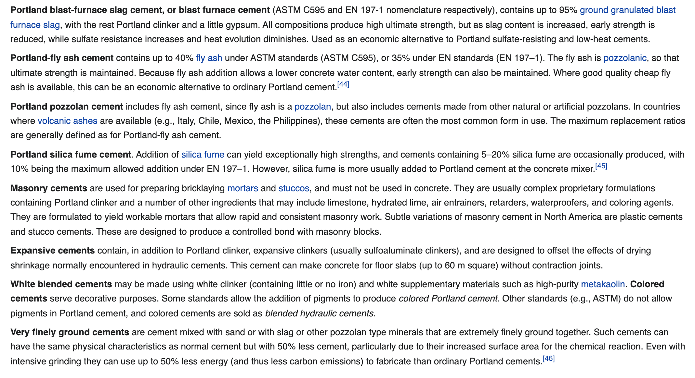
Details about various types of cement
https://en.wikipedia.org/wiki/Cement

