Slide 1
Renewable Energy:
Land Use and Social Issues
Harvard Energy Journal Club - Feb. 18, 2022

Slide 2
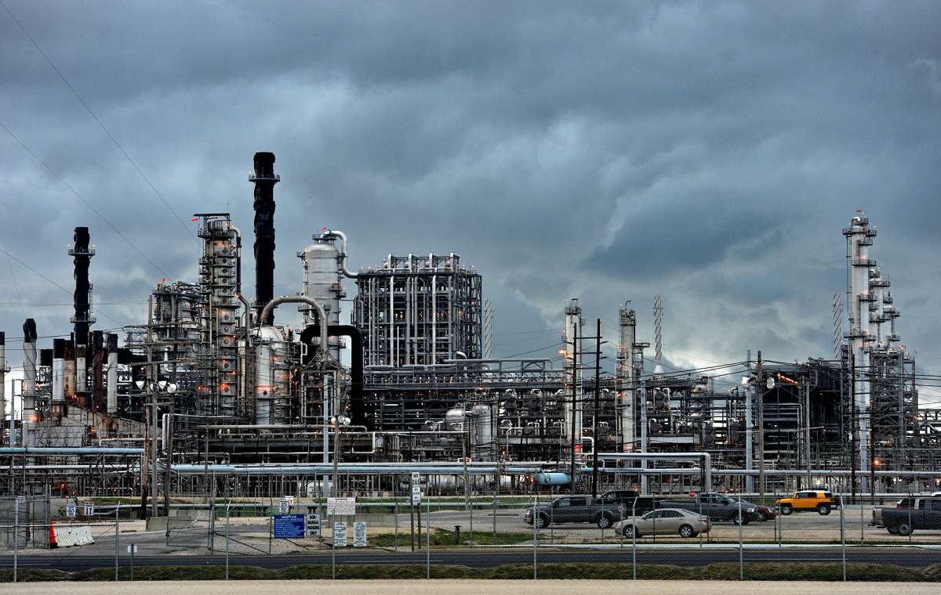
Benchmark: Motiva Refinery
Largest oil refinery in North America
4,000 acre site in Port Arthur, TX
Owned by Saudi Aramco
603,000 barrels/day capacity ¹
770 employees ²
“Processes heavy sour crude oil and other feedstocks…”
Numerous environmental justice issues
Motiva Refinery
1. https://www.usatoday.com/story/money/markets/2016/03/19/largest-us-refinery-now-belongs-saudi-arabia/81974062/
2. https://www.valero.com/about/locations/port-arthur-refinery
Image: https://s.hdnux.com/photos/57/55/33/12506817/5/1200x0.jpg
Notes:
Hard to compare oil refineries to renewables- outputs serve totally different purposes. Ex. one of outputs of Motiva is jet fuel.
Energy density comparisons mostly meaningless.
Wikipedia: Harvard Cambridge campus ~200 acres

Slide 3
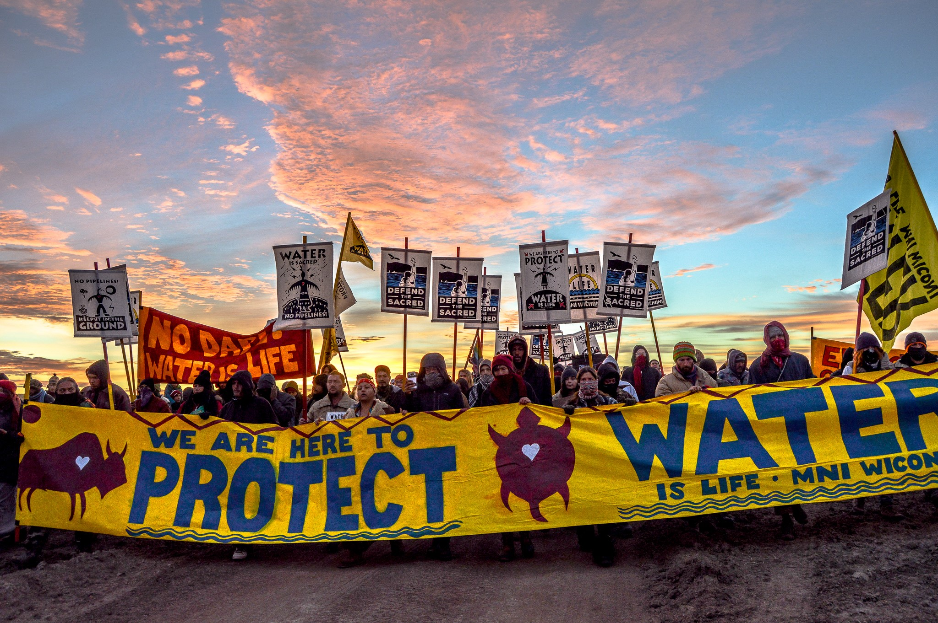
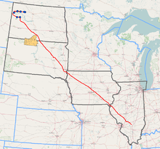
Dakota Access Pipeline protests, North Dakota ca. 2016
Notes:
Sioux Tribe members protested Dakota Access Pipeline, planned for construction near Standing Rock Reservation in North Dakota. Planned to carry shale oil from North Dakota to an oil terminal in Illinois

Slide 4
Challenges of a renewable energy transition
Land Use (competition for resources, energy density)
Intermittency/storage
Resource use (batteries, rare metals, etc.)
Transmission
Lifecycle (recycling of used materials)

Slide 5
Challenges of a renewable energy transition
Land Use (competition for resources, energy density)
Intermittency/storage
Resource use (batteries, rare metals, etc.)
Transmission
Lifecycle (recycling of used materials)

Slide 6
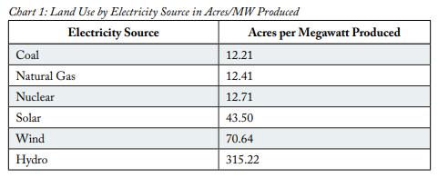
Land Use Efficiency by Energy Source
Hydro is least efficient in terms of land use by clear margin
Nuclear on par with fossil fuels, plus >92% capacity factor
Wind: ~32% capacity factor
Solar PV: ~26% capacity factor
Solar for all of US would cover MD + DE (or WV + RI)
Land use by energy source from Stata Policy
“If hydroelectric produced at 100 percent capacity, and if both existing and potential hydropower sources were producing in the US, hydropower would generate 178,000 megawatts. If the US produced 178,000 megawatts, hydropower alone would account for over 47 percent of all US electricity demand.”
1. https://docs.wind-watch.org/US-footprints-Strata-2017.pdf
Image: https://docs.wind-watch.org/US-footprints-Strata-2017.pdf
Notes:
Hard to compare oil refineries to renewables- outputs serve totally different purposes. Ex. one of outputs of Motiva is jet fuel.
Energy density comparisons mostly meaningless.
Wikipedia: Harvard Cambridge campus ~200 acres

Slide 7
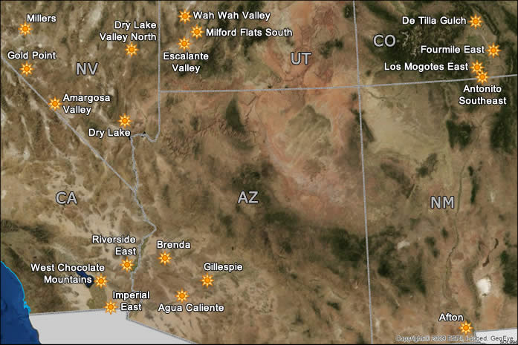
Recent Policy Changes
Nevada: 50% renewable by 2030
Hawaii: 100% by 2045
Energy Act of 2020: 25,000 MW of solar capacity by 2025 on public lands ¹
Biden exec. order: double offshore wind by 2030 ²
Map of Bureau of Land Management “Solar Energy Zones”
1. https://www.blm.gov/blms-national-renewable-energy-strategy-0
2. https://www.whitehouse.gov/briefing-room/presidential-actions/2021/01/27/executive-order-on-tackling-the-climate-crisis-at-home-and-abroad/
Image: https://blmsolar.anl.gov/sez/

Slide 8
From the Bureau of Land Management website:
BLM manages roughly 245 million acres of public lands which have substantial solar, wind, and geothermal energy potential… To remove unnecessary barriers, ineffective planning or procedures, and other impediments to timely permitting of renewable energy projects, the BLM is considering revisions to its regulations related to wind and solar energy permitting and linear rights-of-way on public lands. As part of this process, the agency has been soliciting preliminary input from the public on relevant areas, with an aim to publish a proposed rule in the Federal Register by early 2022.
1. https://www.blm.gov/blms-national-renewable-energy-strategy-0

Slide 9
Solar Energy Zone Assessment Process
Relatively large
Economically and technically feasible
Potential connections to transmission
“Generally low resource conflict”
Map of Bureau of Land Management “Solar Energy Zones”
1. https://blmsolar.anl.gov/sez/identification/
Image: https://blmsolar.anl.gov/sez/

Slide 10
Environmental/Cultural Screening Criteria
Mechanically altered
Idle industrial sites
Areas invaded by nonnative grasses
Colocation with other energy dev.
Map of Bureau of Land Management “Solar Energy Zones”
1. https://blmsolar.anl.gov/sez/identification/
Image: https://blmsolar.anl.gov/sez/

Slide 11
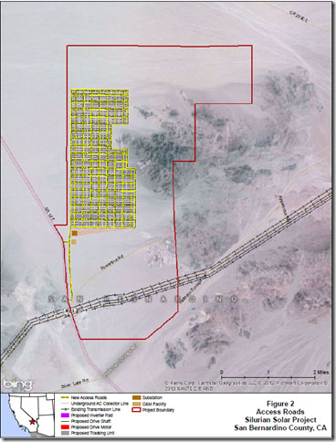
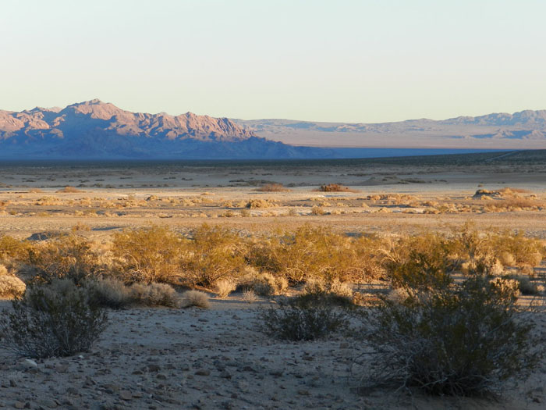
Silurian Wind and Solar ¹
Status: Rejected by BLM in 2014
Combined solar (200MW) and wind project
9,000 acres of solar
15,000 acres of wind
Proposed area of Silurian Solar Project in San Bernardino County, CA
1. https://www.sbsun.com/2014/03/23/silurian-valley-solarwind-project-up-for-public-discussion-in-barstow/
Images: https://www.basinandrangewatch.org/Silurian-Wind.html

Slide 12
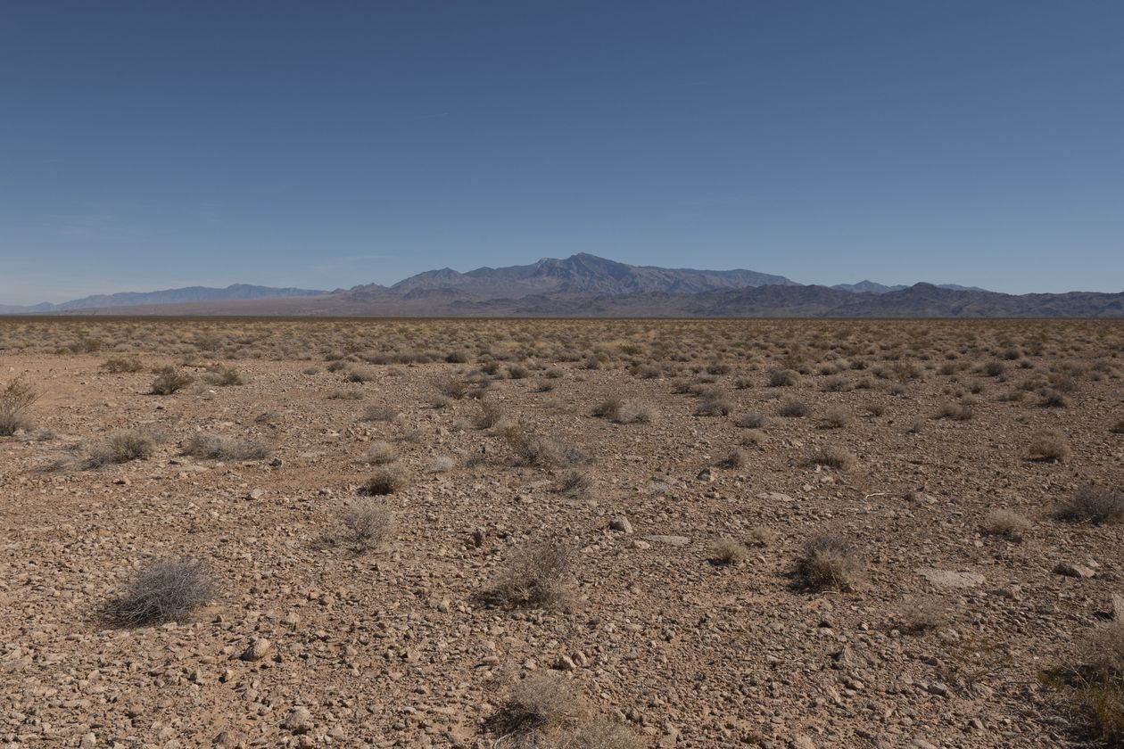
Battle Born Solar Project ¹
Status: Cancelled in 2021
Would-be largest solar project in US
14 sq. miles near Las Vegas, NV
850 MW capacity
Faced opposition from community:
  Dust
  “Keep the land unspoiled”
  Endangered species (tortoise)
  “Views would not be as beautiful”
Mormon Mesa, NV, the planned site for the Battle Born Solar Project
1. https://www.wsj.com/articles/solar-powers-land-grab-hits-a-snag-environmentalists-11622816381
Image: https://www.wsj.com/articles/solar-powers-land-grab-hits-a-snag-environmentalists-11622816381

Slide 13
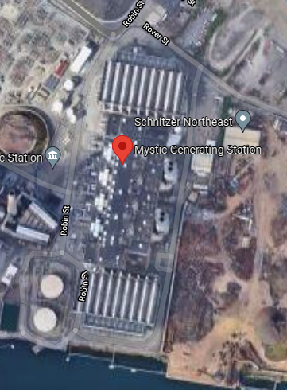
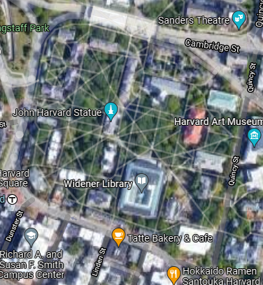
Mystic Generating Station
North of Boston in Everett, MA
Two 700+ MW natural gas turbines ¹
Similar land area to Harvard Yard
Harvard Yard and Mystic Generating Station
(same scale)
1. https://www.constellationenergy.com/our-company/locations/location-sites/mystic-generating-station.html
Image: Google Maps
Notes:
Hard to compare oil refineries to renewables- outputs serve totally different purposes. Ex. one of outputs of Motiva is jet fuel.
Energy density comparisons mostly meaningless.
Wikipedia: Harvard Cambridge campus ~200 acres

Slide 14
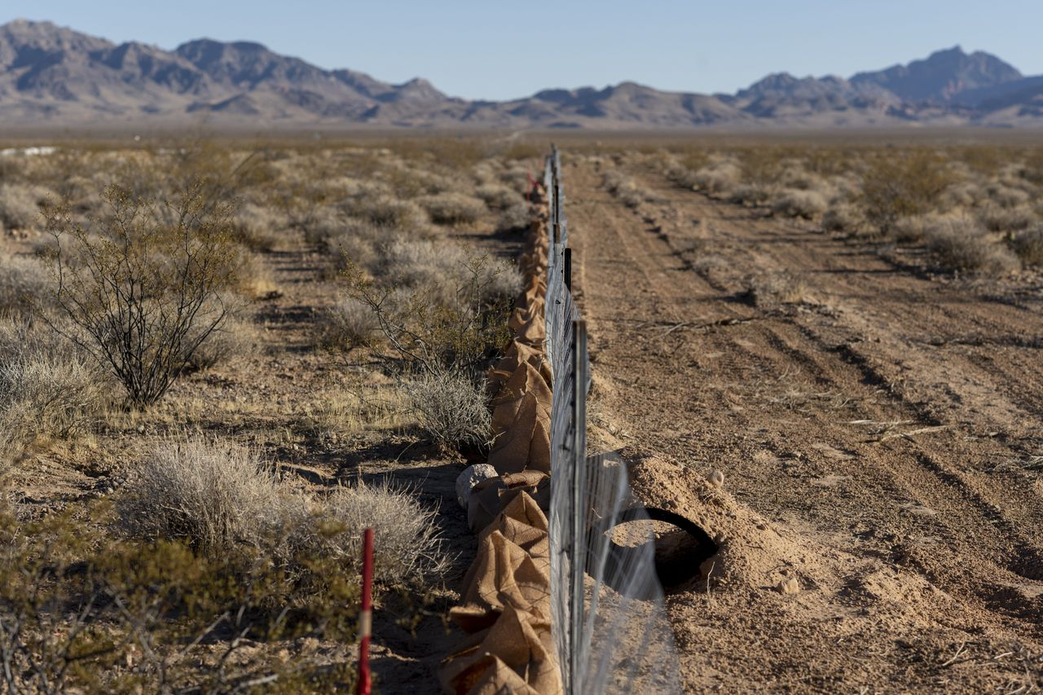
Gemini Solar Project ¹
Status: In construction (2023)
690 MW capacity
Built on public lands near Las Vegas
Threatens habitat for 1,000 endangered desert tortoises
Tortoises moved before construction, will be returned after completion
Tortoise fence near the Gemini Solar Project site in Nevada
1. https://www.usgs.gov/centers/southwest-biological-science-center/science/gemini-solar-project
Image: https://www.wsj.com/articles/solar-powers-land-grab-hits-a-snag-environmentalists-11622816381

Slide 15
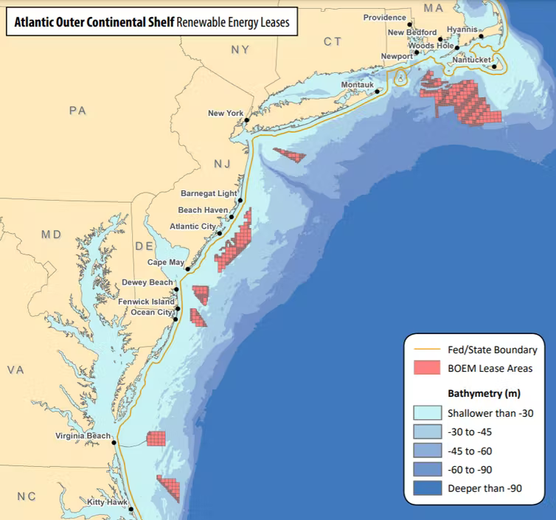
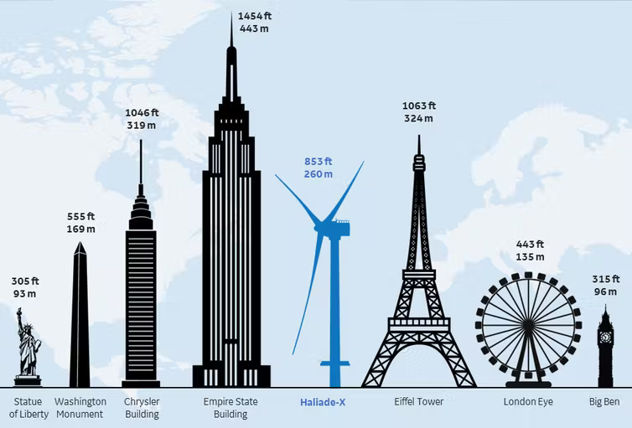
Vineyard Wind ¹
Status: In construction (2023)
800 MW capacity
62 260m tall turbines
14 mi. from Martha’s Vineyard
Existing Bureau of Ocean Energy Management wind leases
1.https://theconversation.com/us-approves-its-first-big-offshore-wind-farm-near-marthas-vineyard-its-a-breakthrough-for-the-industry-160747
Image: https://theconversation.com/us-approves-its-first-big-offshore-wind-farm-near-marthas-vineyard-its-a-breakthrough-for-the-industry-160747

Slide 16
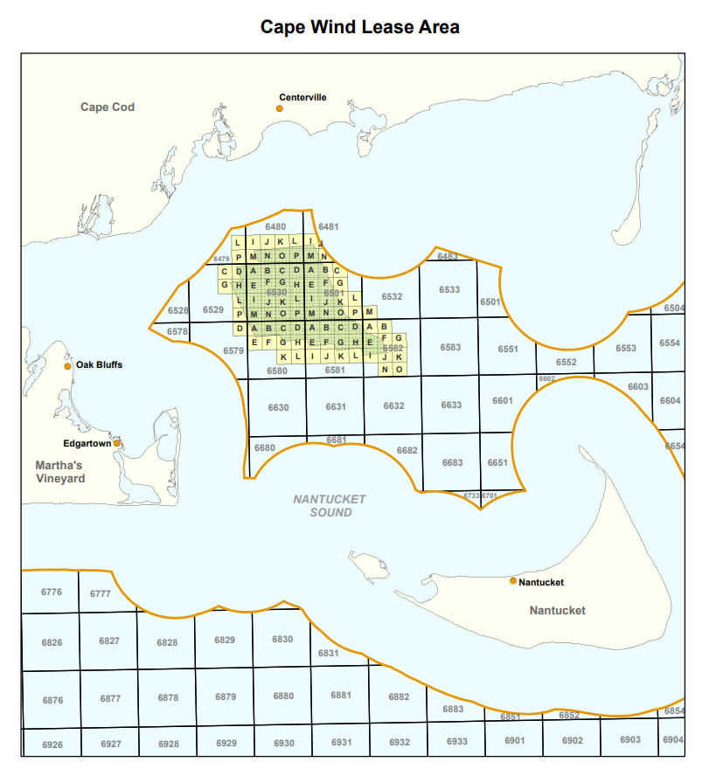
Cape Wind ¹
Status: Cancelled (2019)
<5 mi. from land (visible)
Opposed for 16 years by “a coalition of business and political leaders, Cape Cod and Island communities, Native Americans and fishermen, pilots and environmental advocates”
and also Bill Koch
Planned Cape Wind Lease Area
1. https://www.masslive.com/news/2017/12/cape_wind_opposed_by_bill_koch.html
Image: https://www.boem.gov/sites/default/files/uploadedFiles/BOEM/Renewable_Energy_Program/Studies/Lease%20Area.pdf

Slide 17
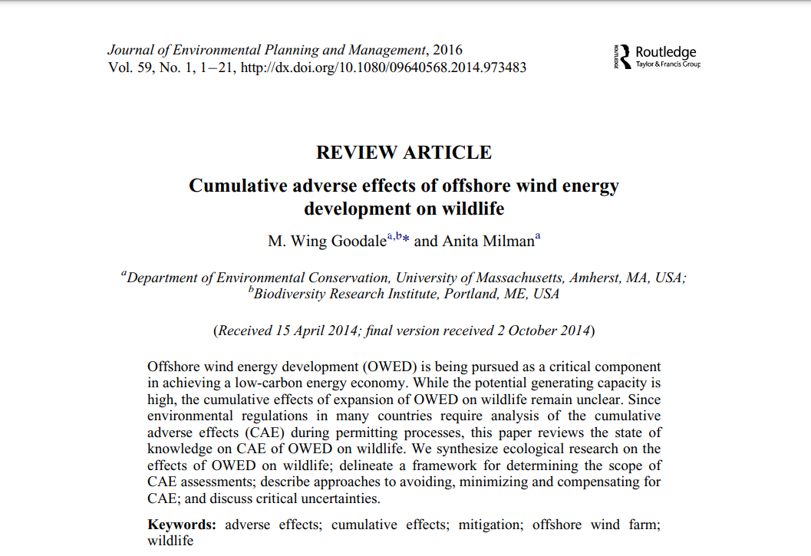
Dakota Access Pipeline protests, North Dakota ca. 2016

Slide 18
Compromise?
Dakota Access Pipeline protests, North Dakota ca. 2016

Slide 19
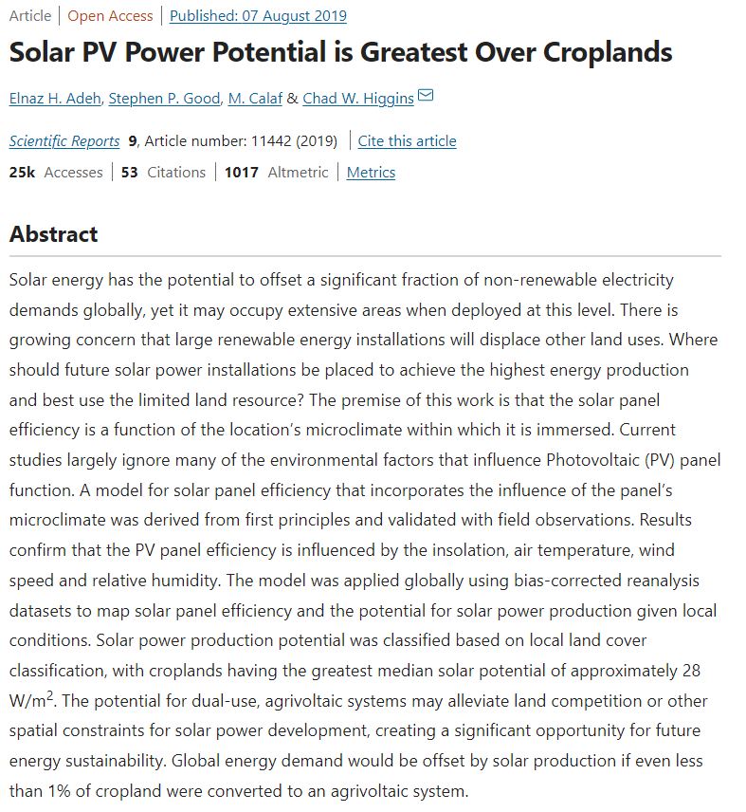
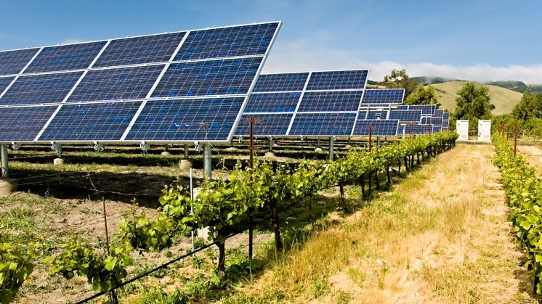
Dakota Access Pipeline protests, North Dakota ca. 2016

Slide 20
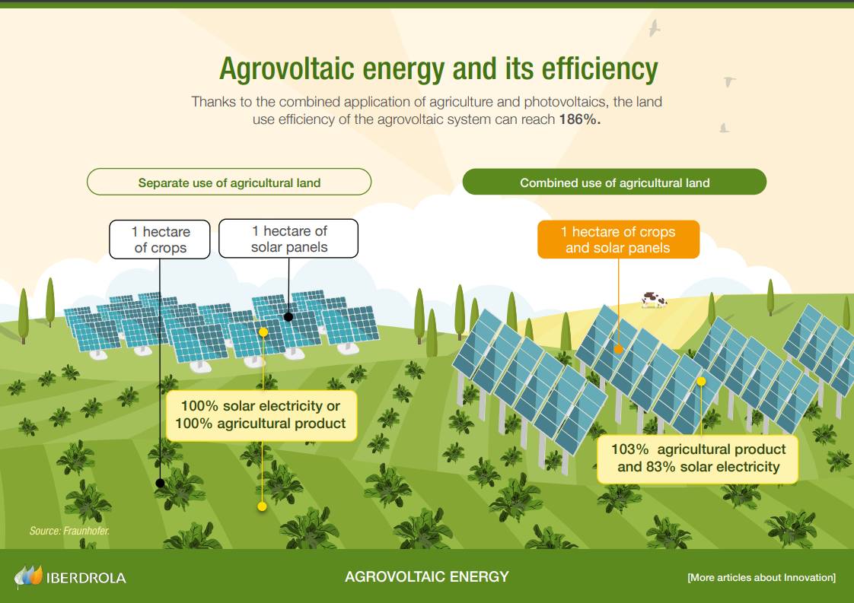
Sus Math
Image: https://www.iberdrola.com/documents/20125/1259808/Infographic_Agrovoltaics.pdf/4d70451f-06e0-ca4c-f6b5-eae842b28545?t=1639484268118

Slide 21
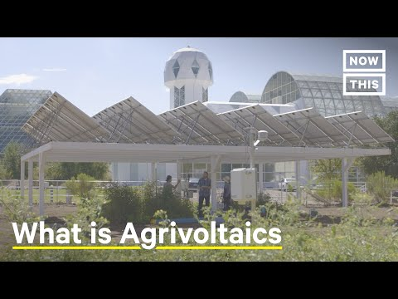

Slide 22
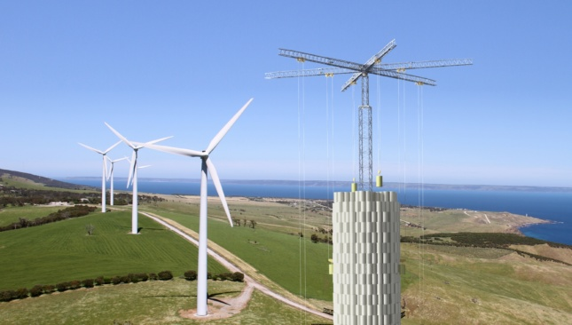
Notes:
Gravity storage for wind intermittency, except speeds where wind turbines can generate are unsafe for crane operation so fundamental flaws

Slide 23
In summary
No one-size-fits-all approach will work
Tension between conservation / energy / aesthetics will continue
Local ecology vs. global climate
No great examples of compromise

