Slide 1
(Real)
Fake
Meat:
Environmental Impacts of Food and
the Outlook for Meat Substitutes
HEJC 12/10/2021
Tommy George

Slide 2
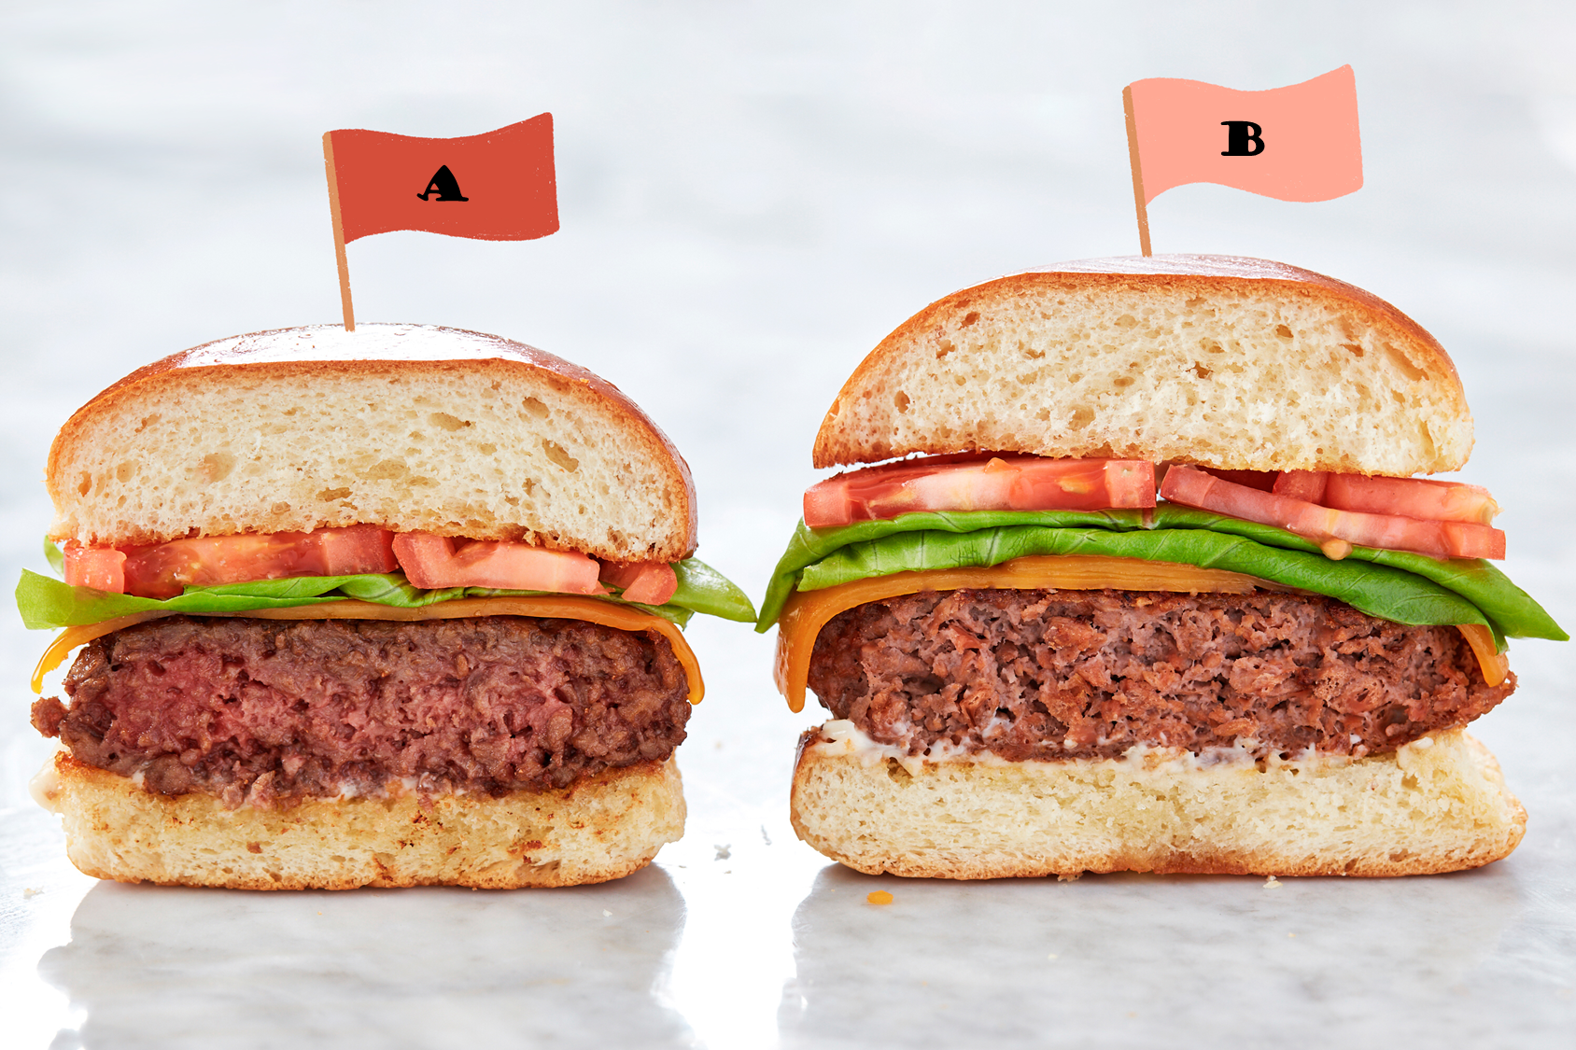
Outline
Food, CO₂ emissions, and the environment
Fake meat
  What is plant-based meat?
  Case study: life cycle of a Beyond burger
(Real) Fake meat
  “Fake meat” vs. “(real) fake meat”
  The science of “cultured meat”
  Challenges ahead
1
https://cdn.apartmenttherapy.info/image/upload/v1579208930/k/Design/2020-01/alt-meat.jpg

Slide 3
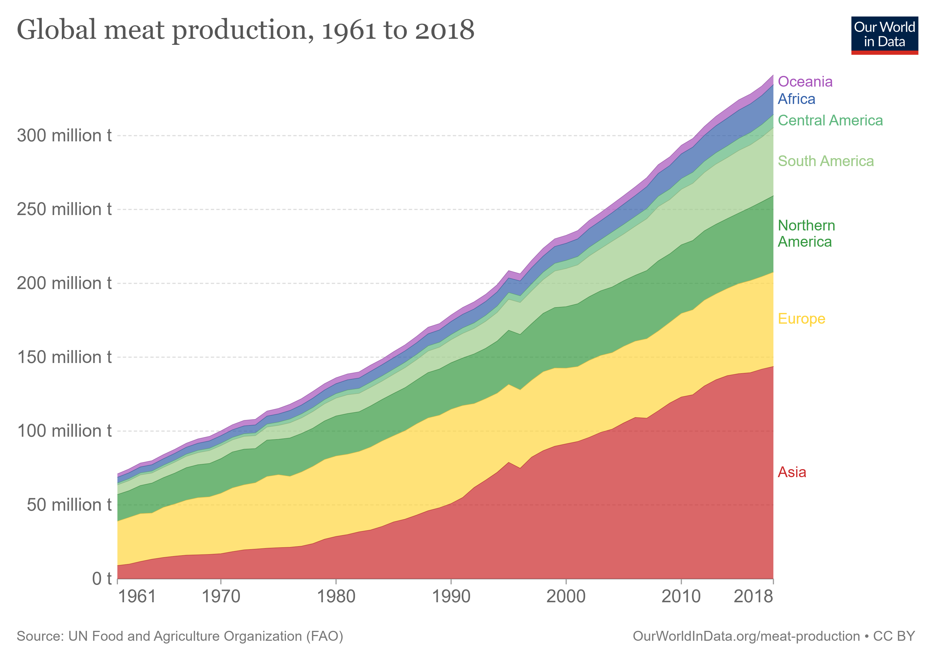
Meat production is on the rise
Quick math:
There are approx.
1 trillion pounds
of humans on Earth,
or ~450 million t
2

Slide 4
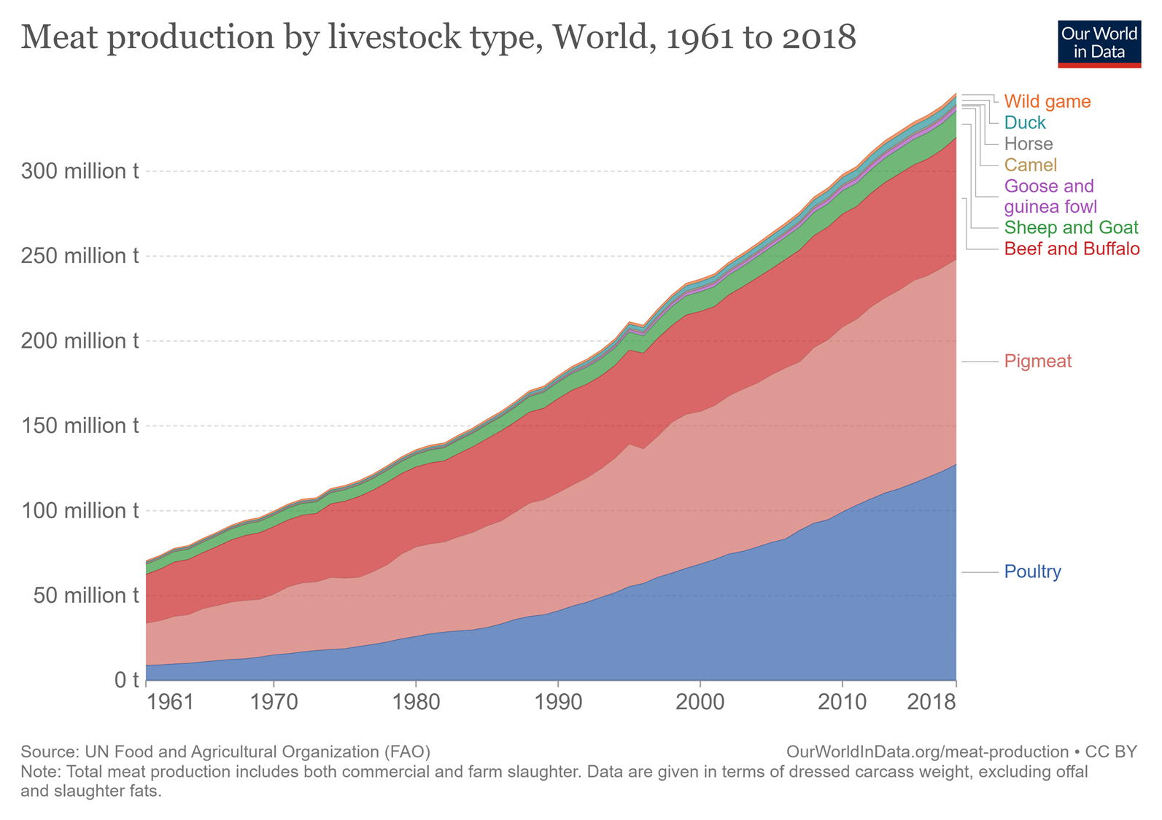
Meat production breakdown by meat type
3

Slide 5
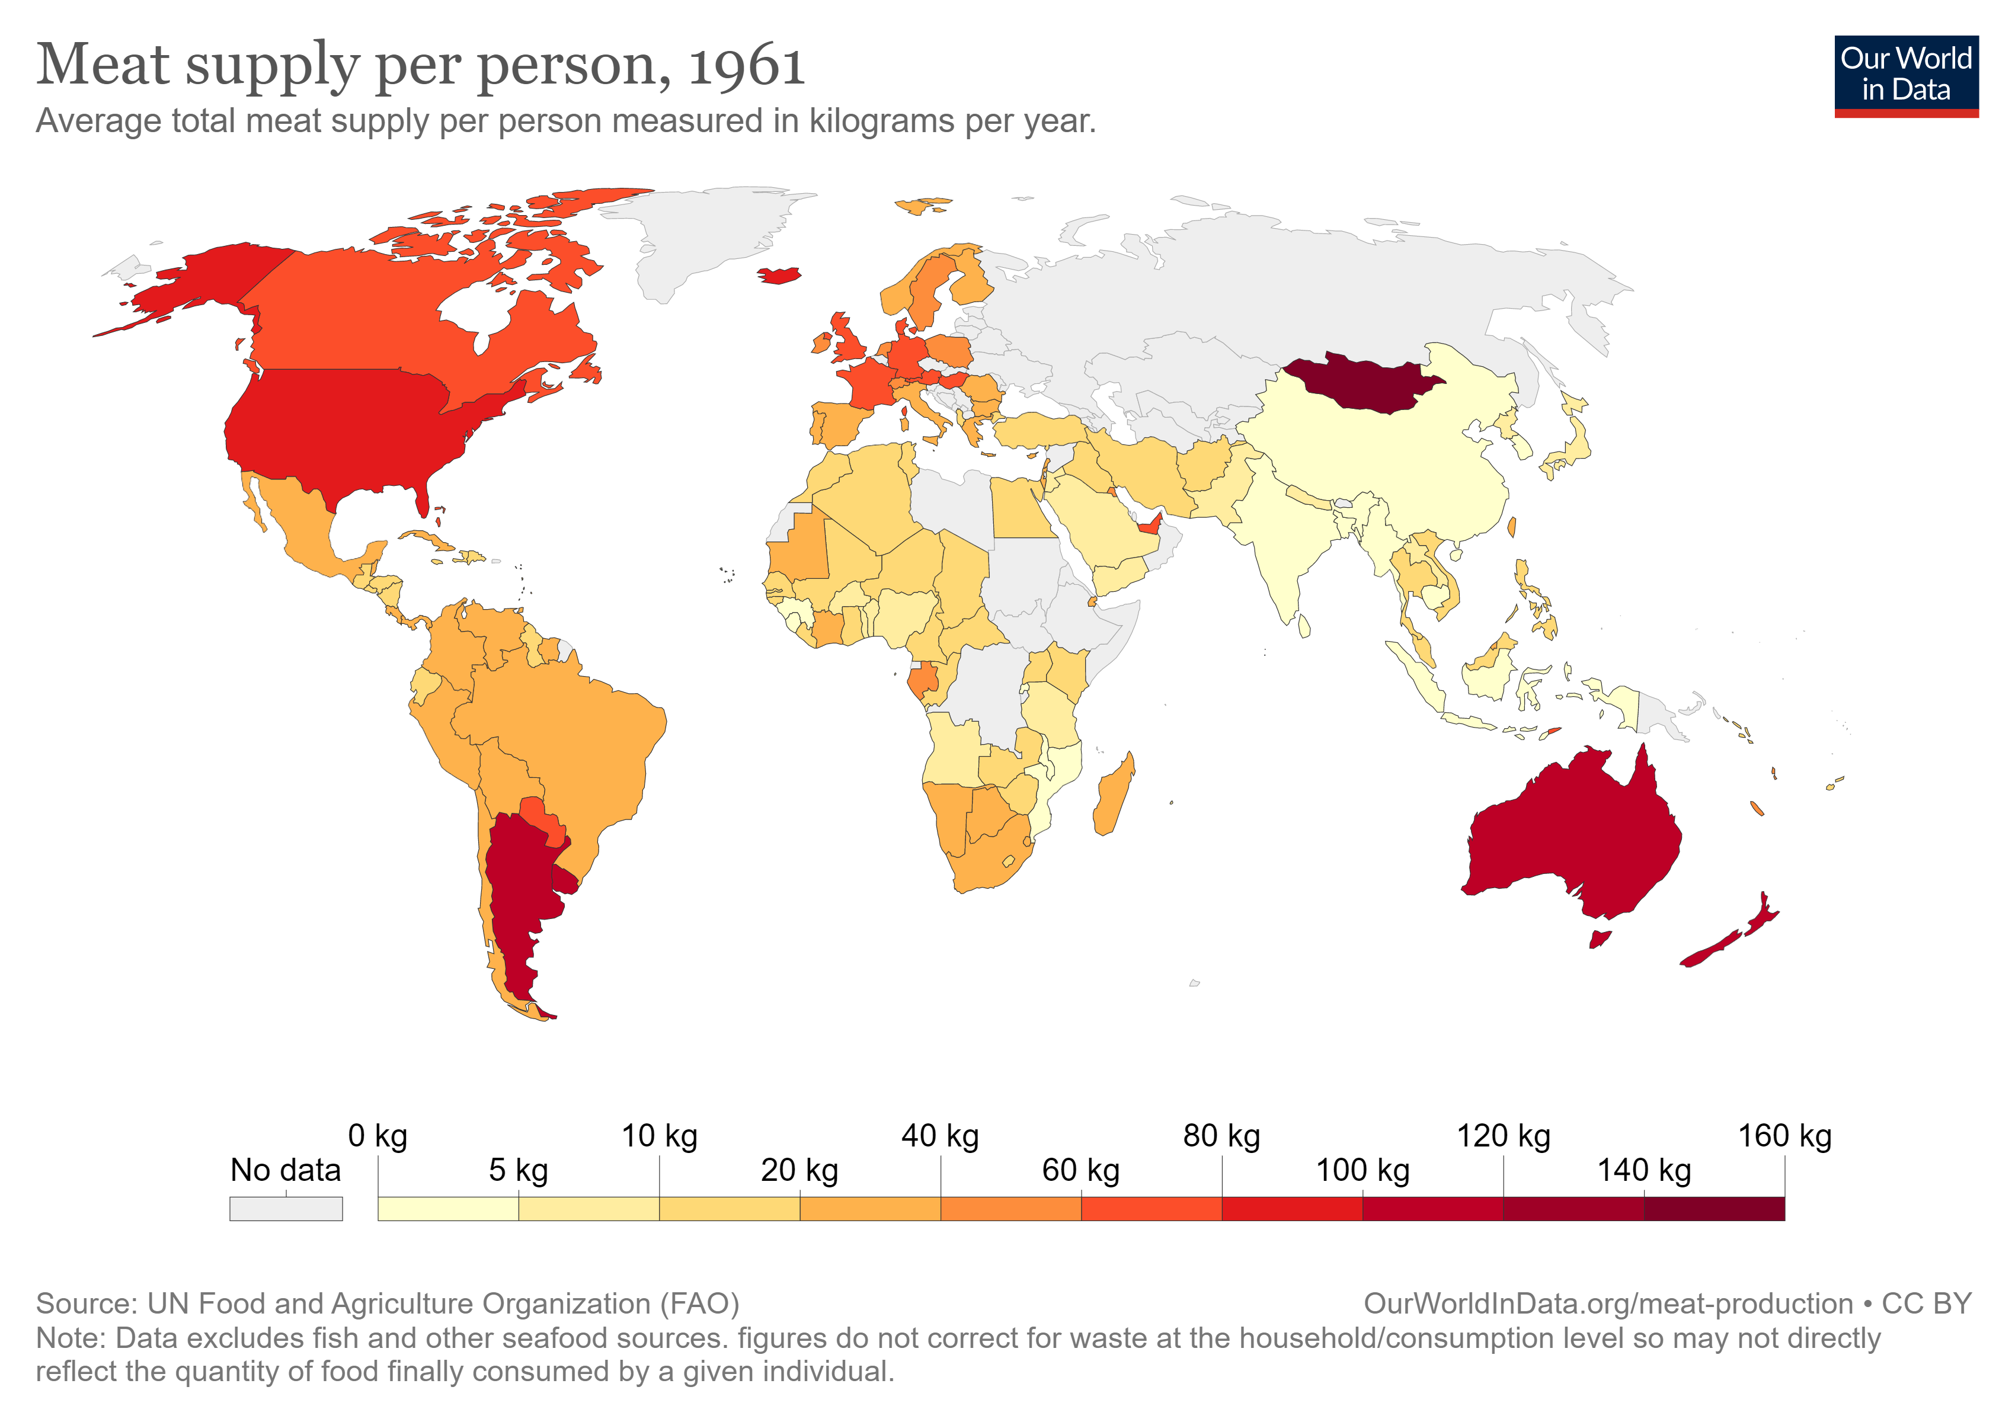
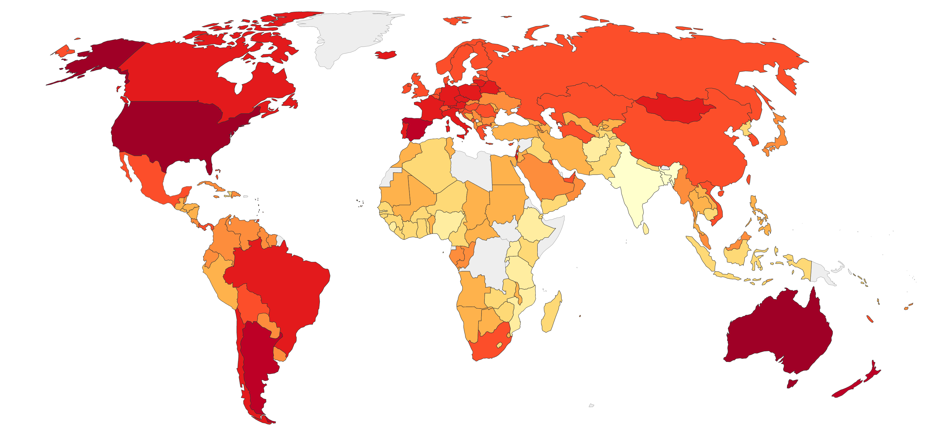
Who is eating all that meat?!
1961
2017
4

Slide 6
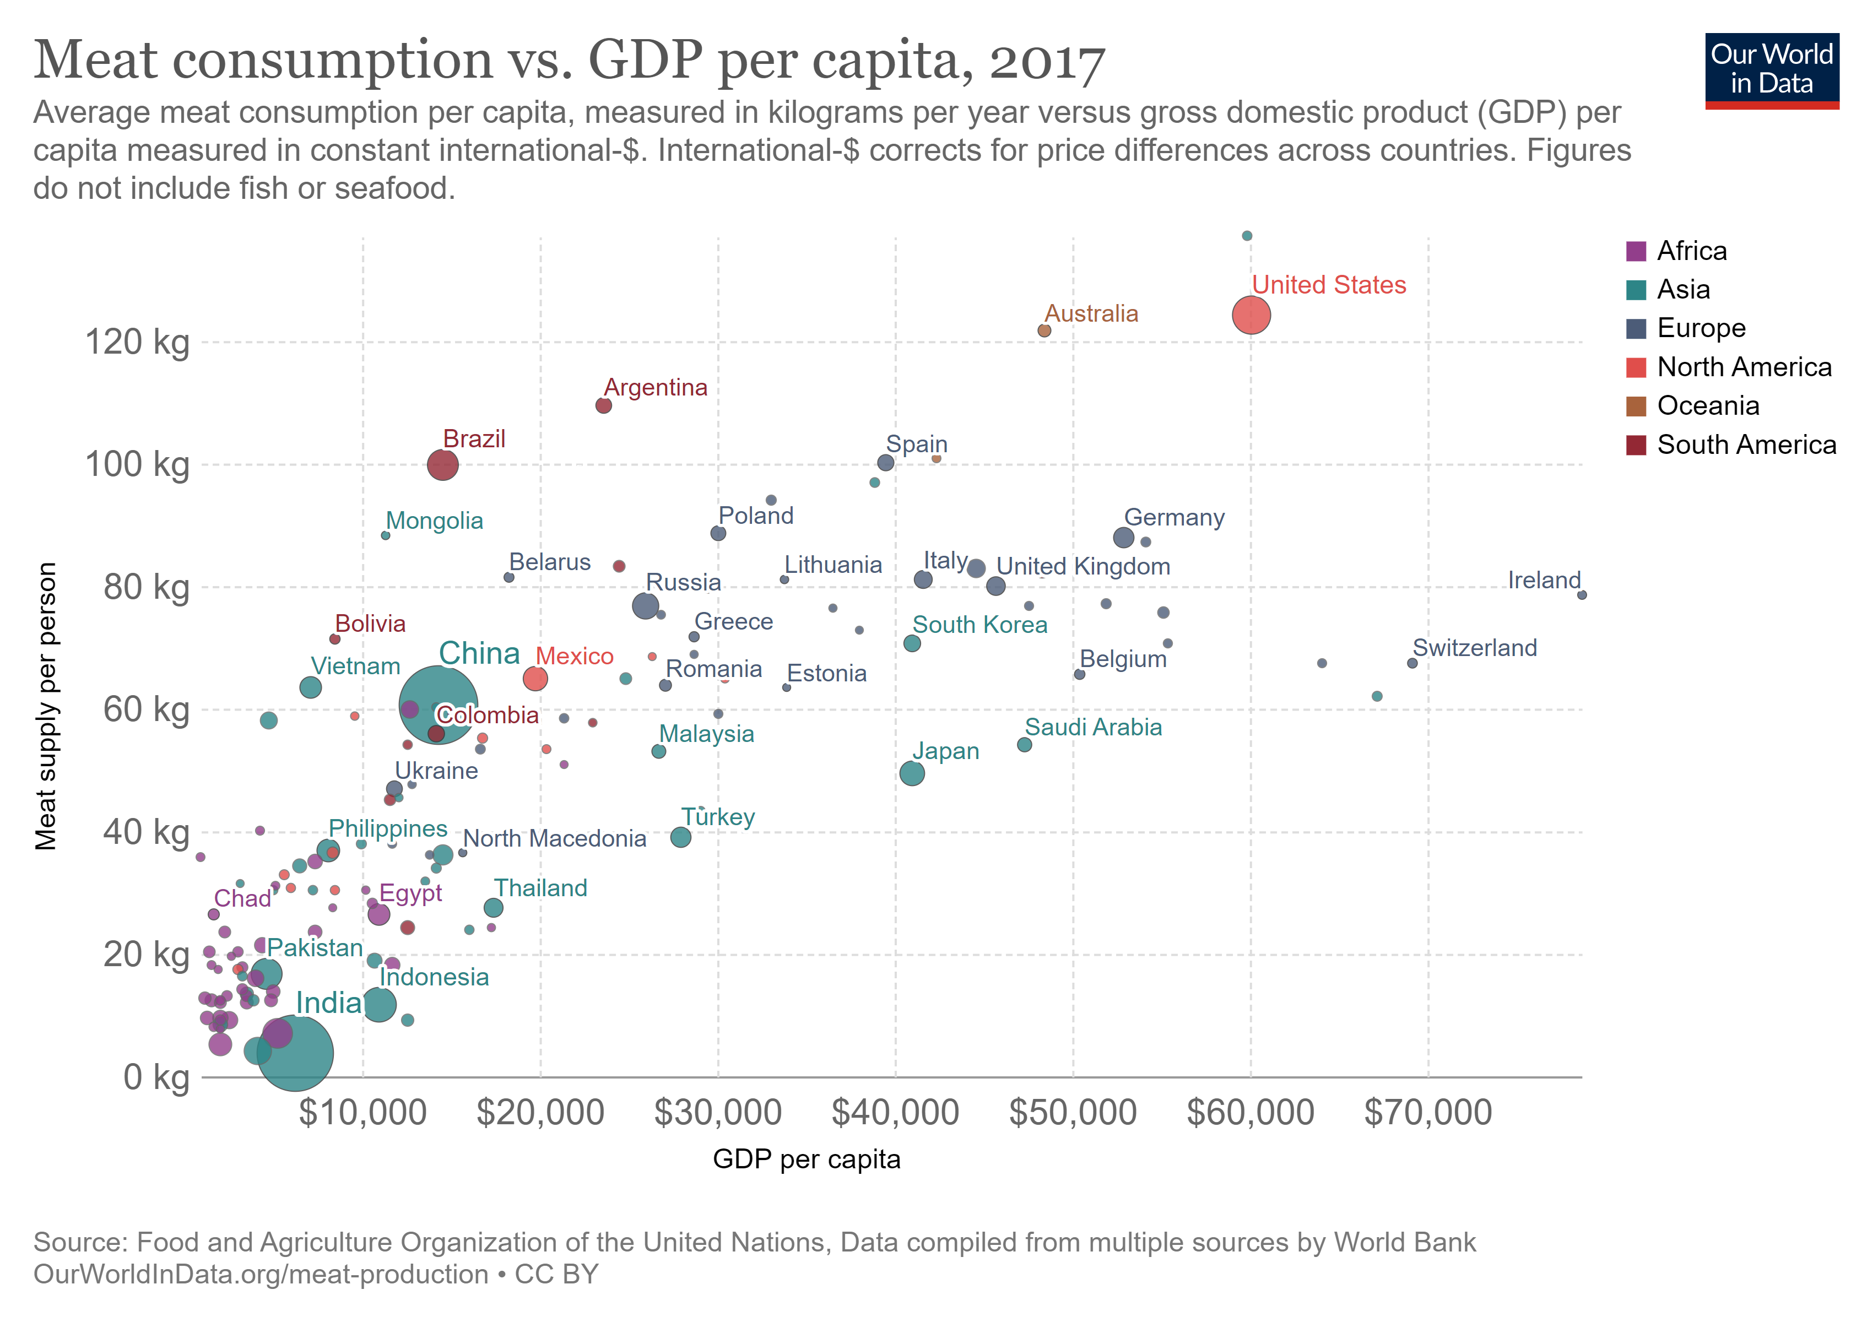
More money, more meat
5

Slide 7
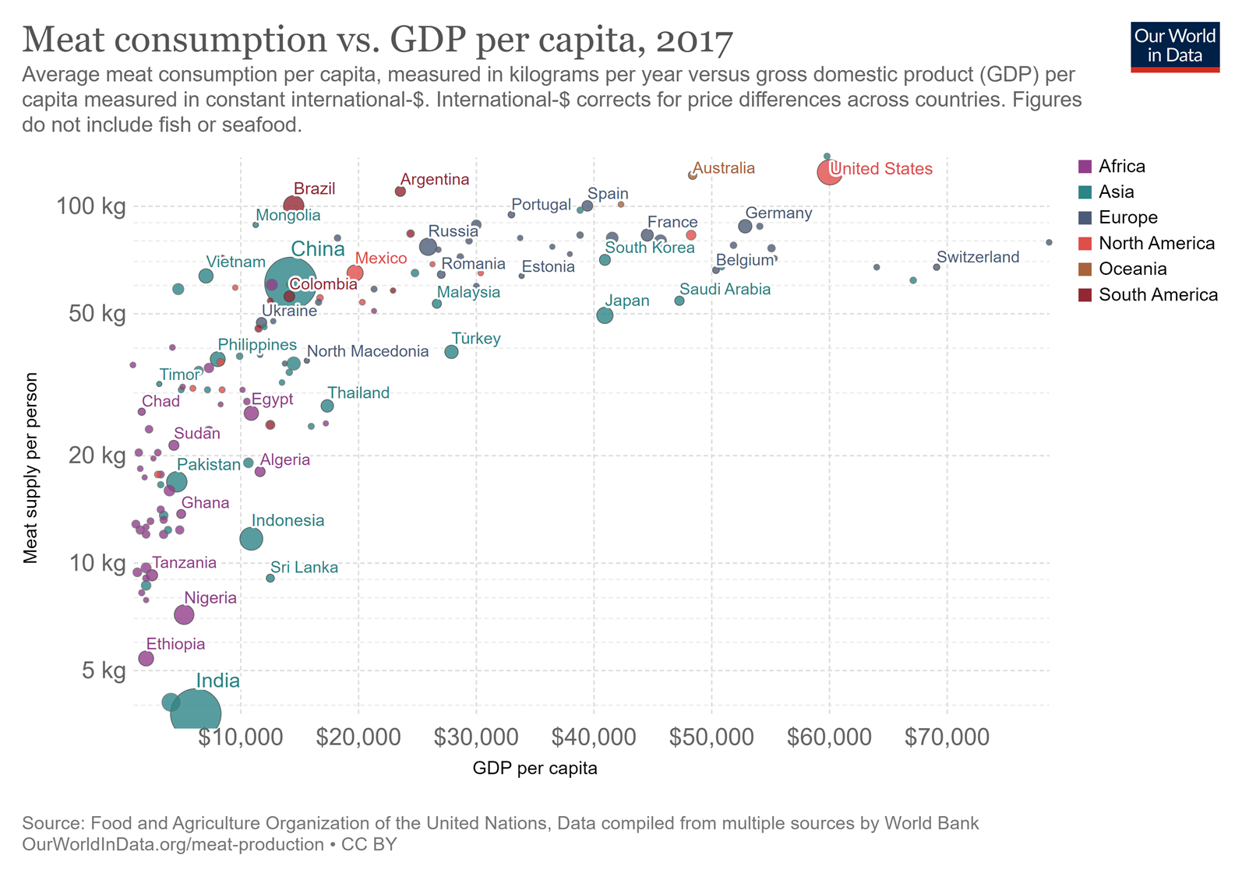
More money, more meat (log scale)
6

Slide 8
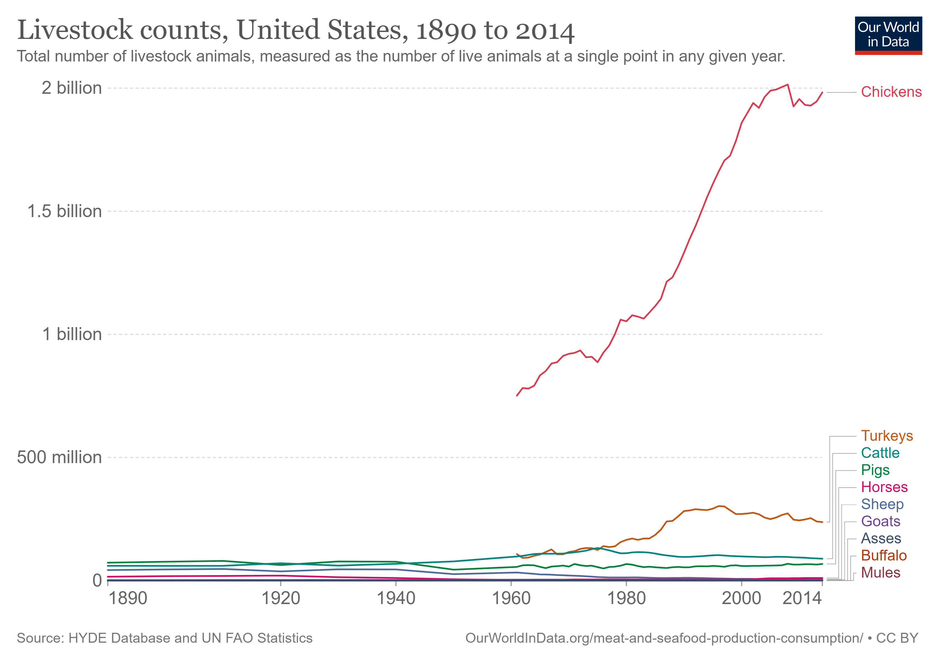
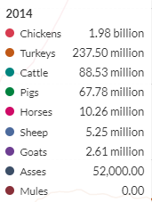
We are outnumbered
7

Slide 9
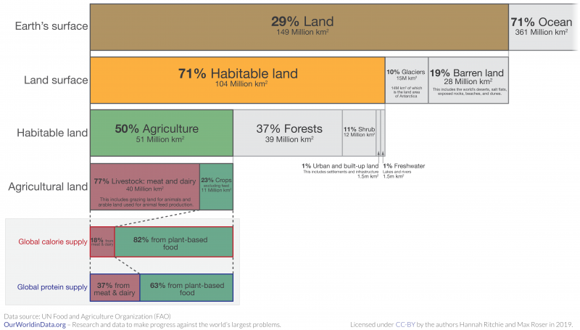
Global land use for food production
8

Slide 10
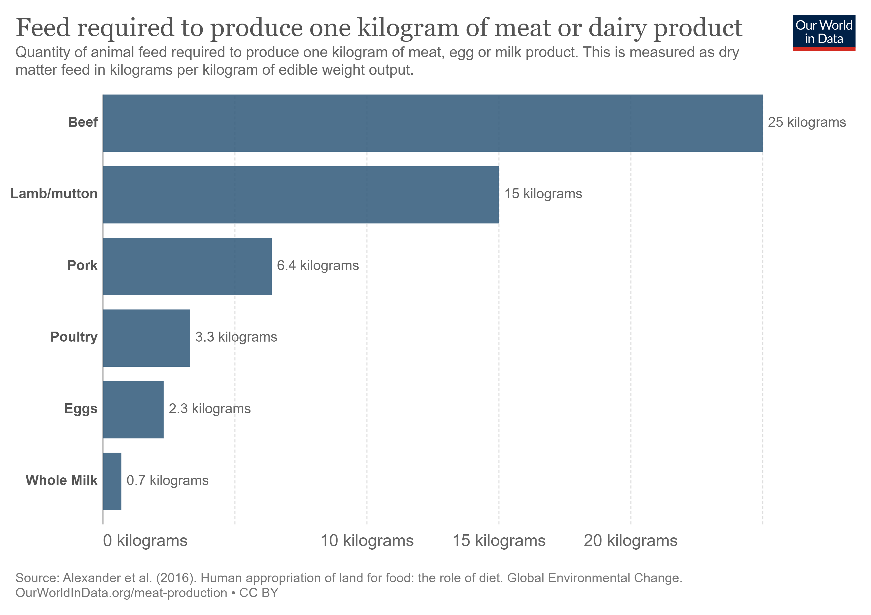



Feed conversion ratio
9

Slide 11
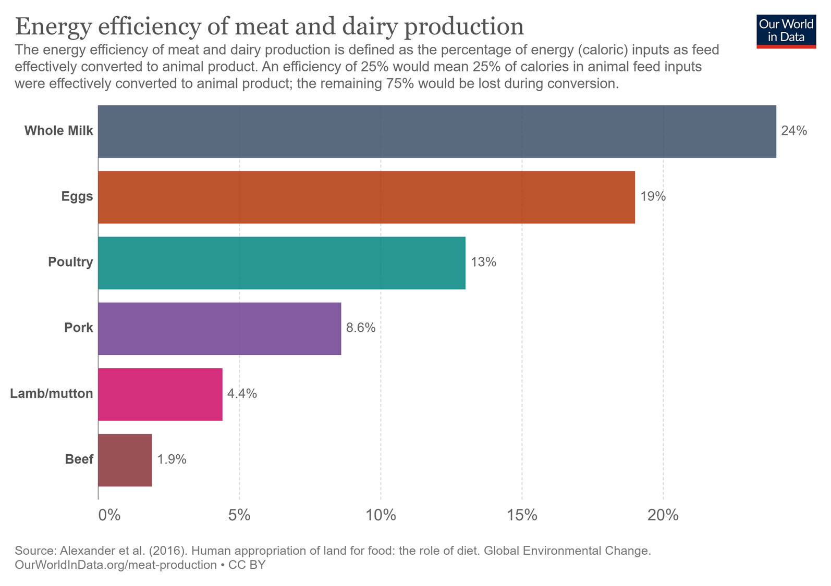
Energy efficiency (food calories)
10

Slide 12
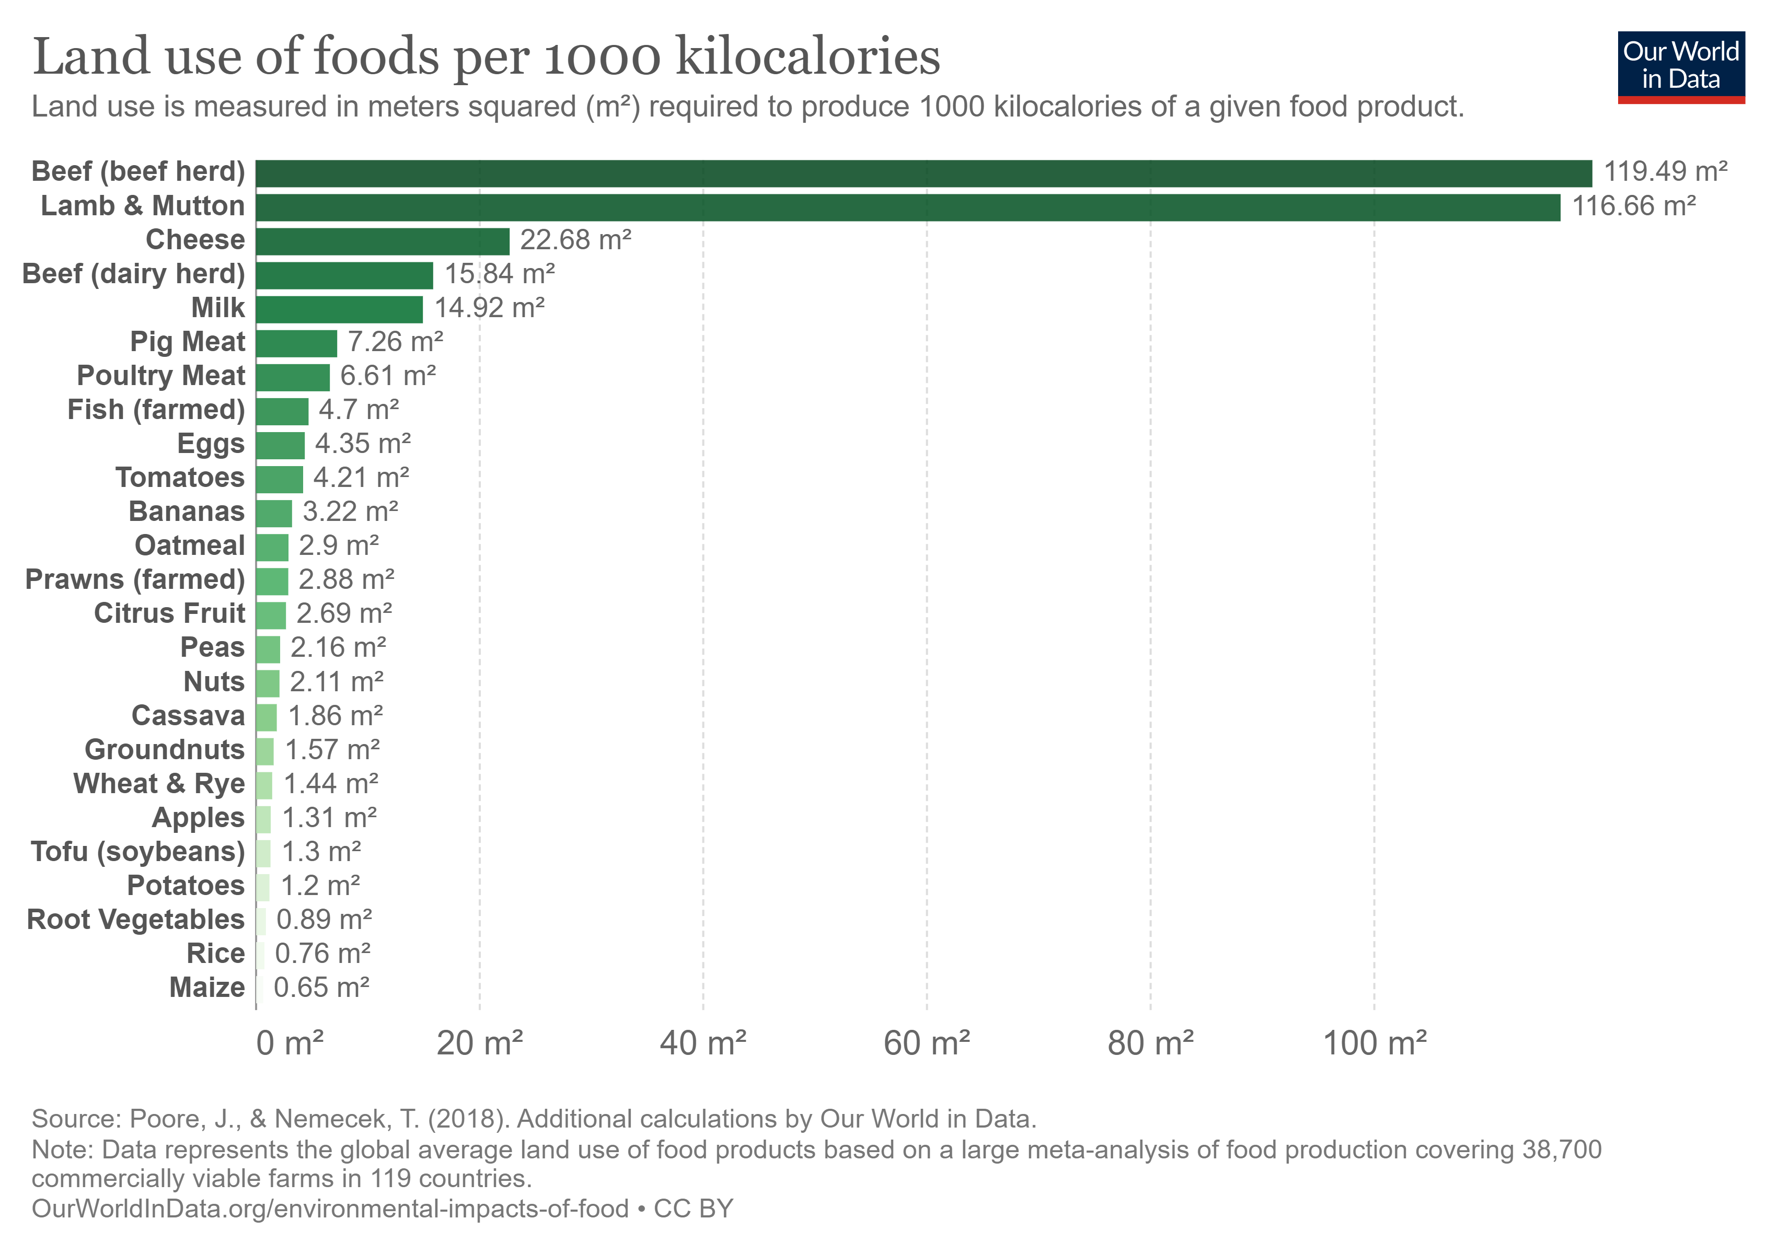
Land use per 1000 kcal by food type
11

Slide 13
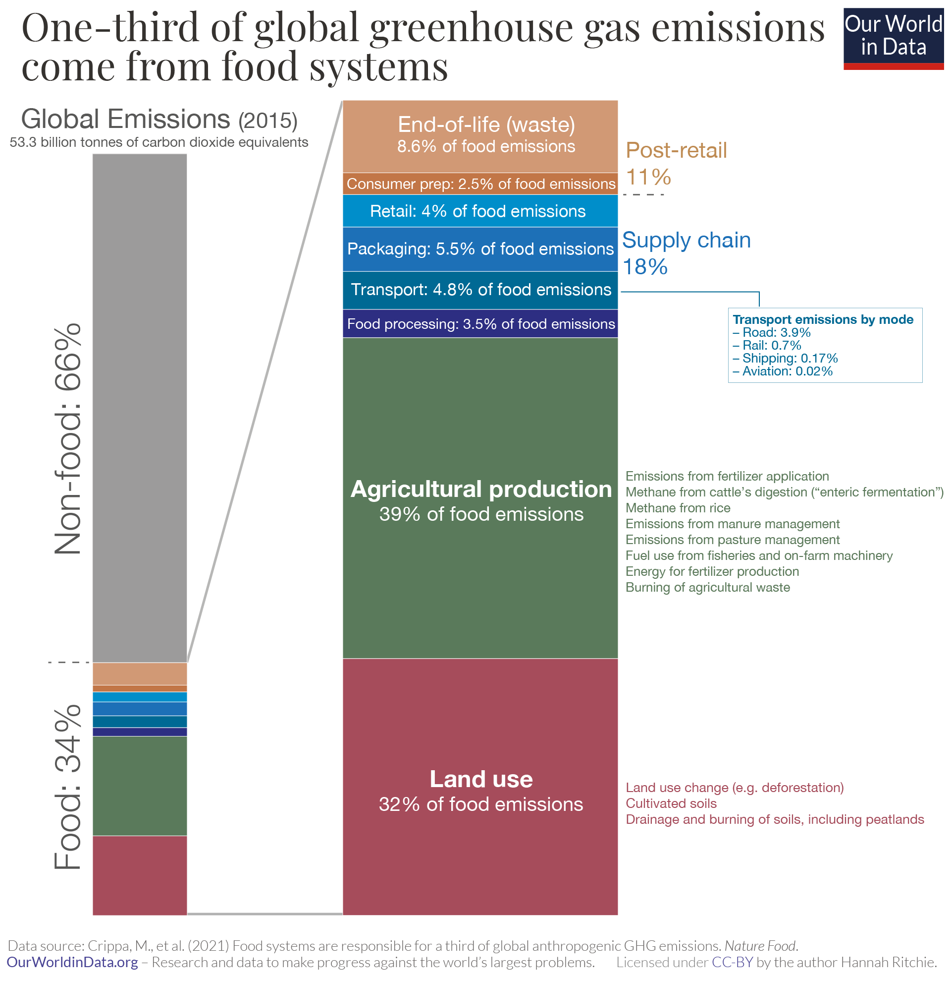
Greenhouse gas emissions
12

Slide 14
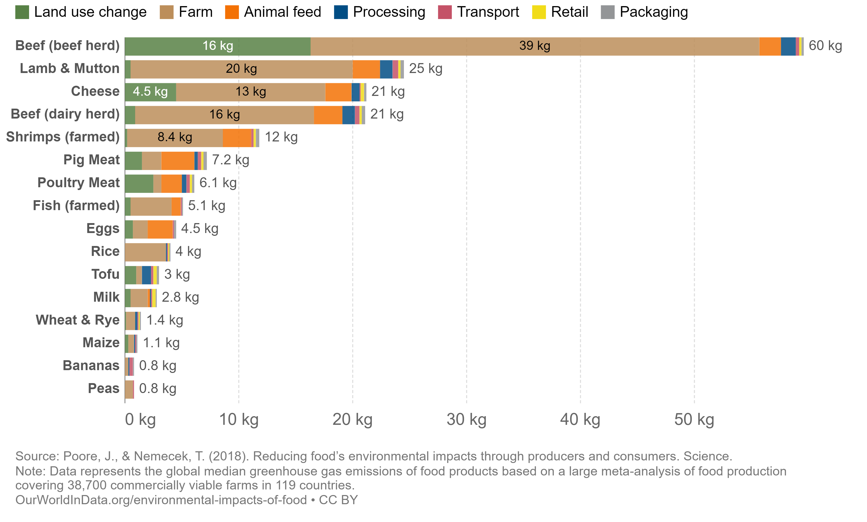
Greenhouse gas emissions by food
13

Slide 15
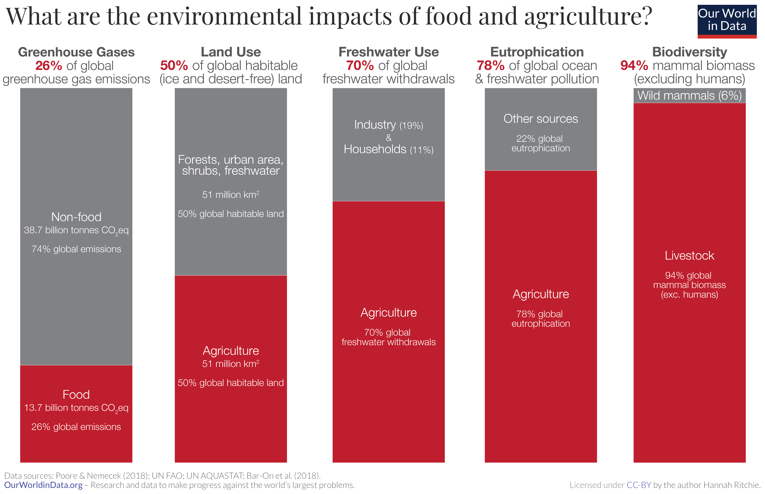
Other environmental impacts
14

Slide 16
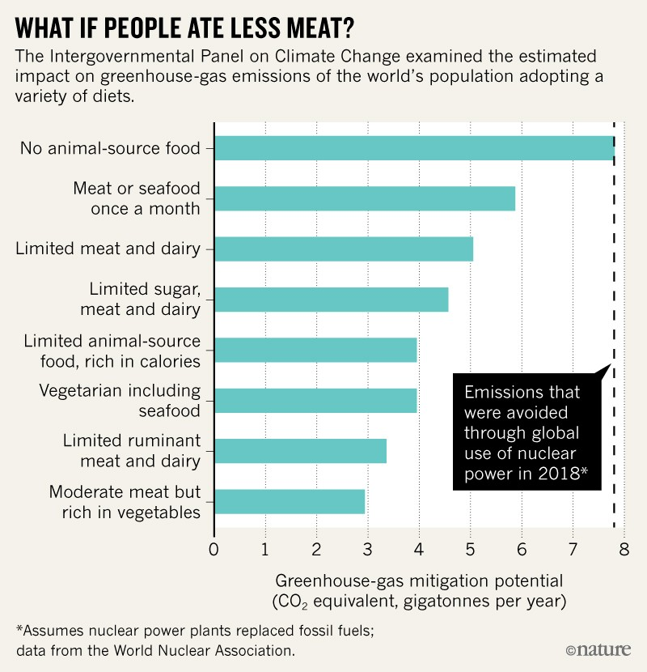
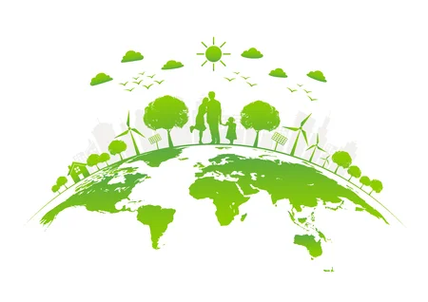
Less meat = climate mitigation
This is nice and all
but I miss burgers
15

Slide 17
Less meat = climate mitigation
This is nice and all
but I miss burgers
Can we substitute meat with a close imitation?
Or… can we just make (real) meat with SCIENCE?!
15

Slide 18
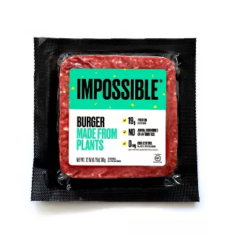
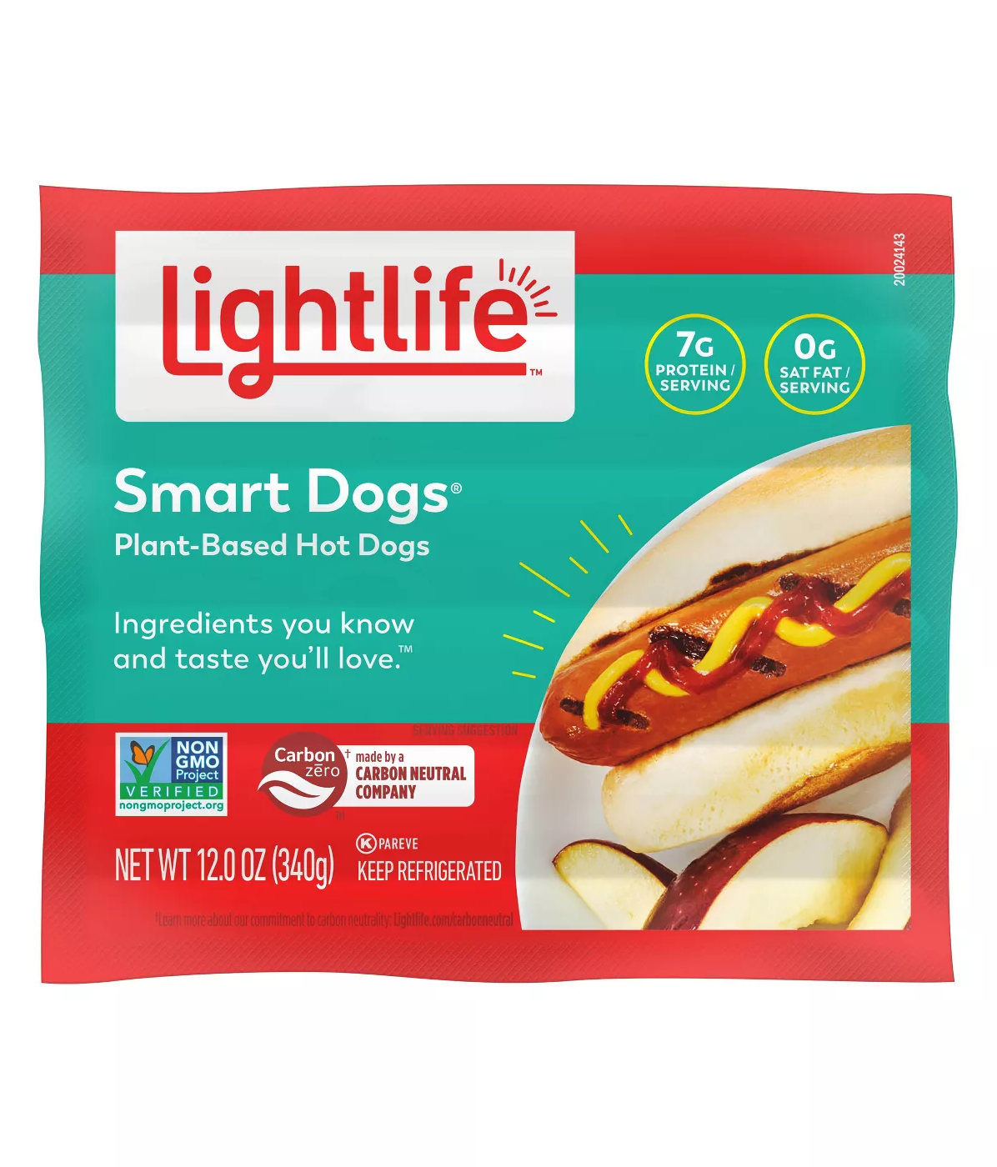
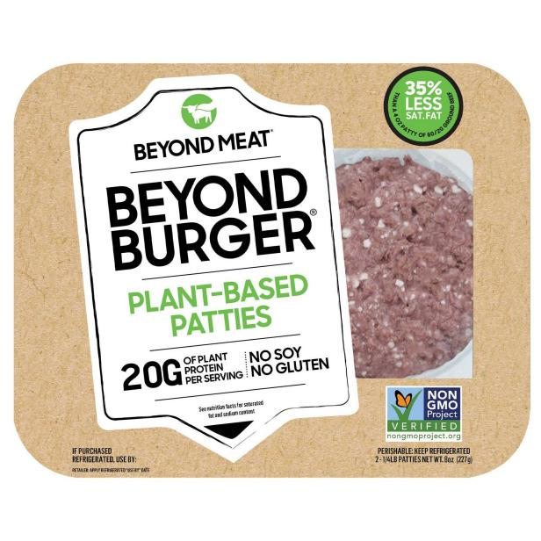
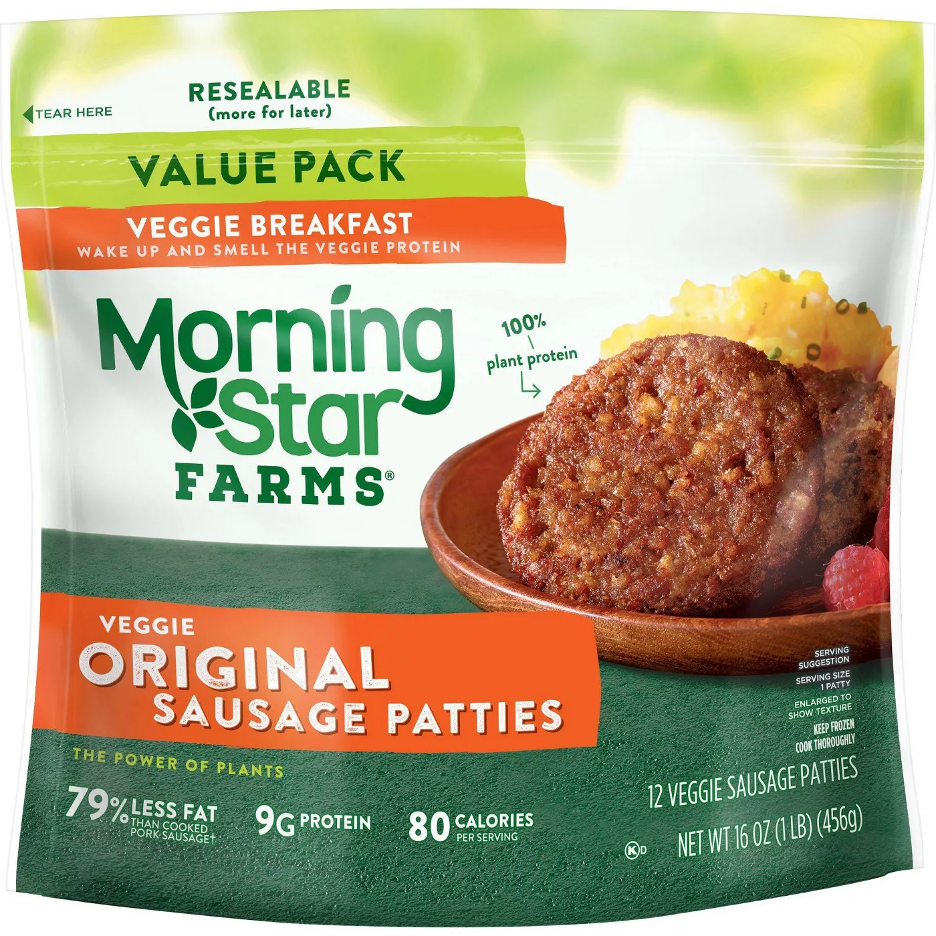
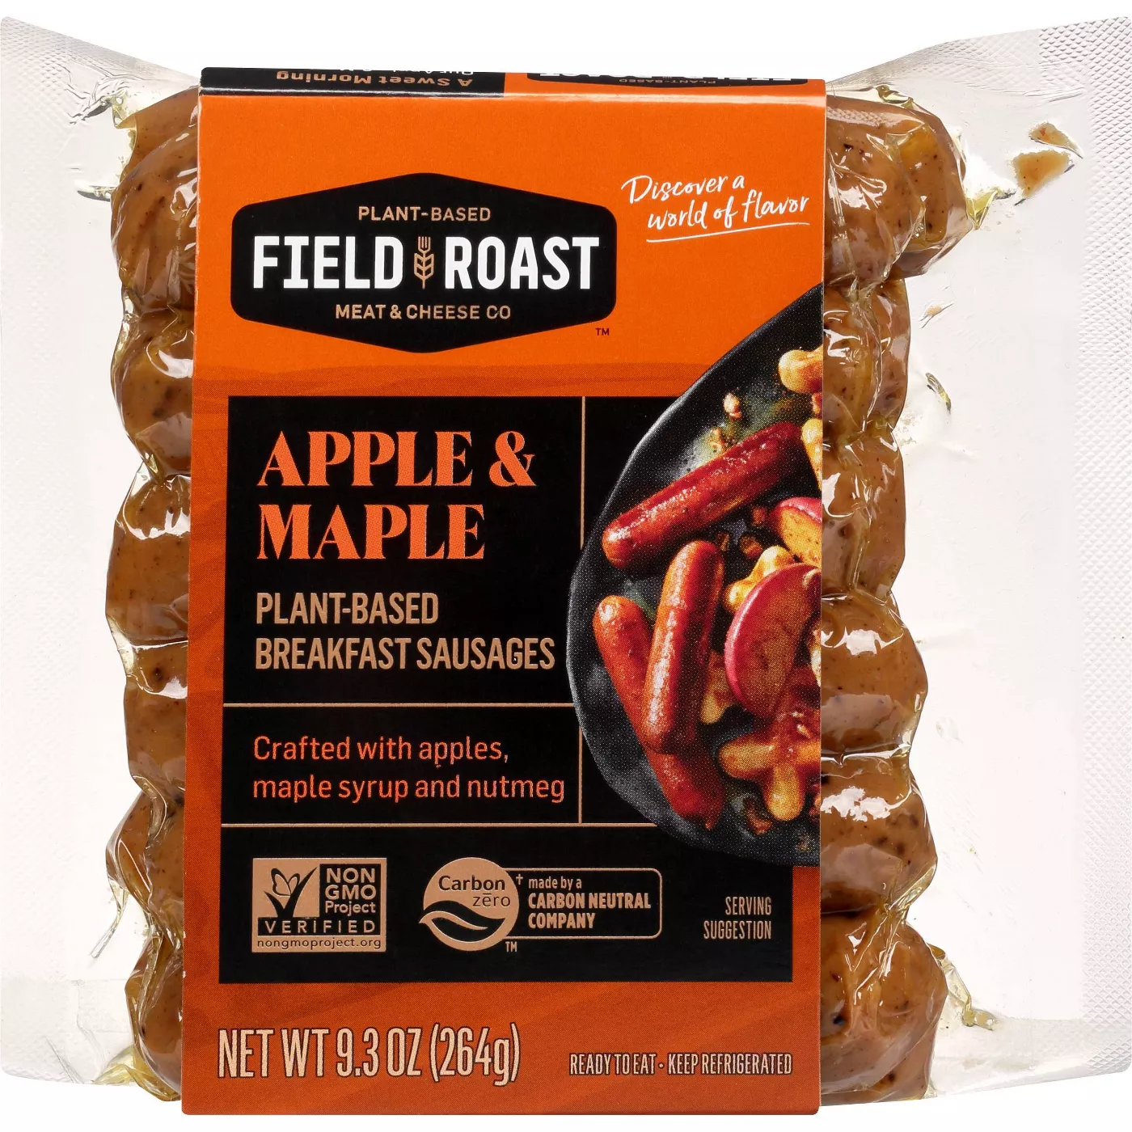
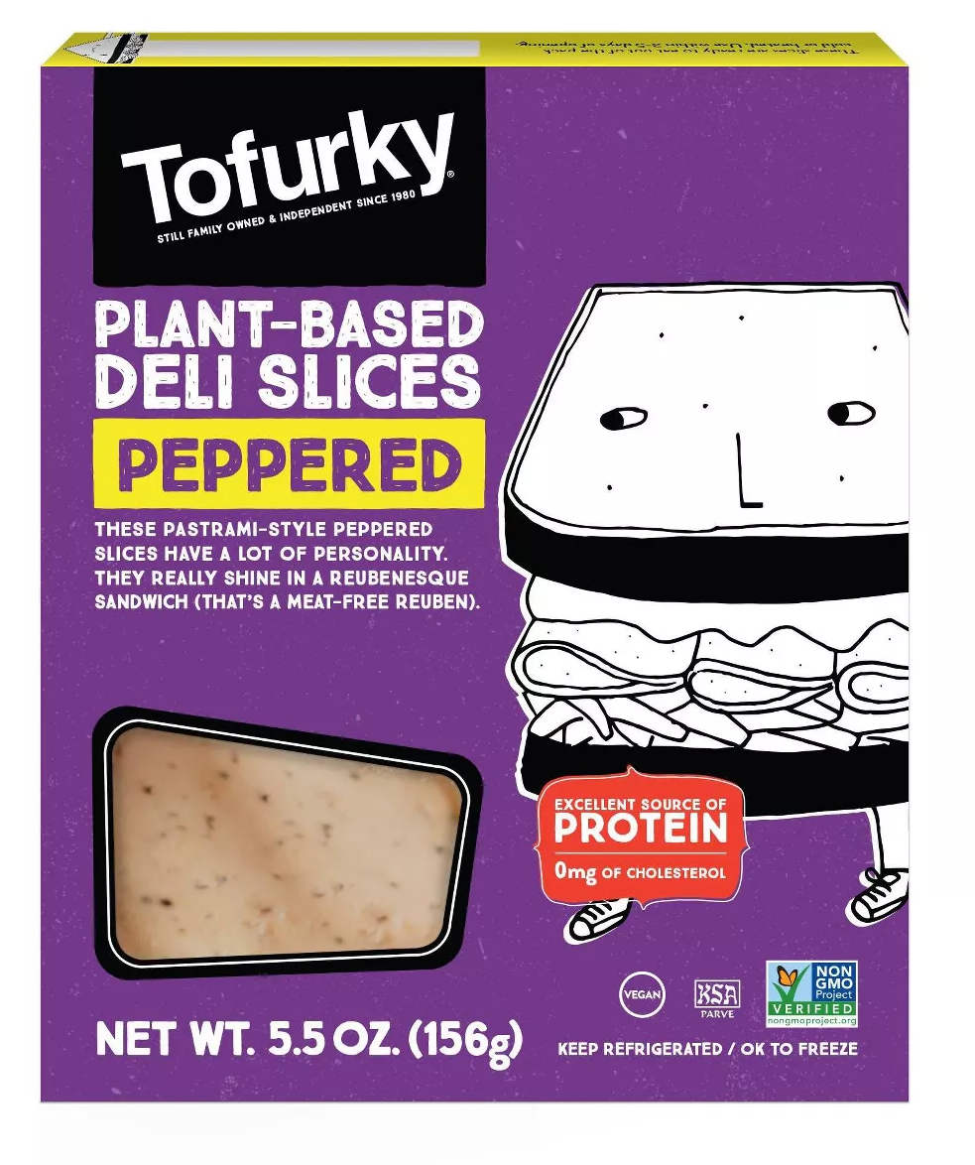
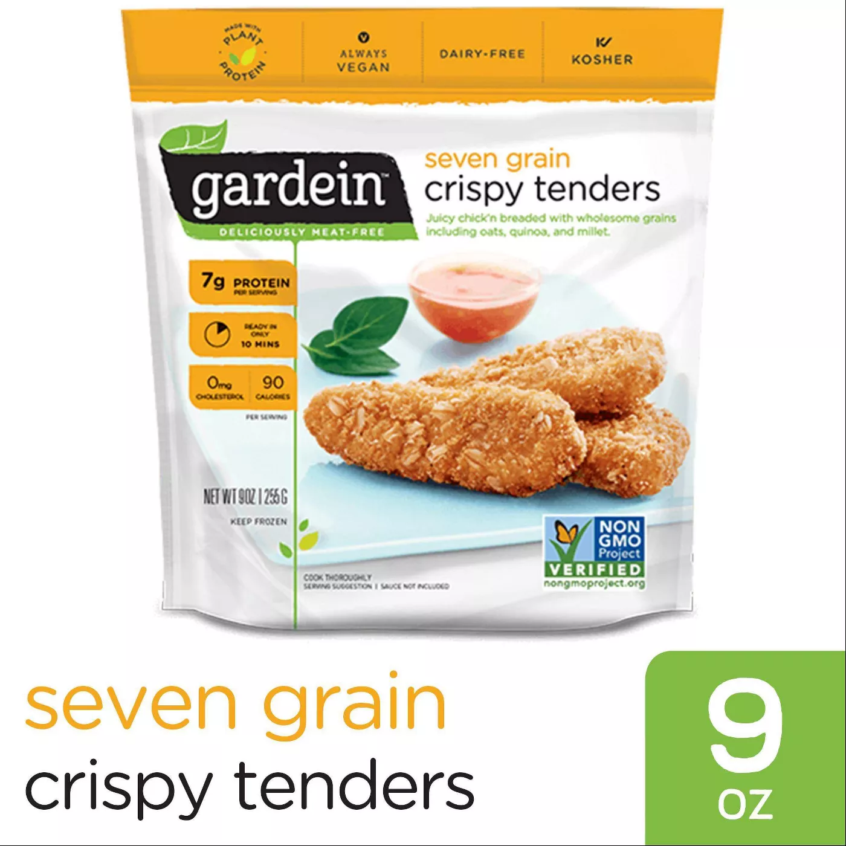
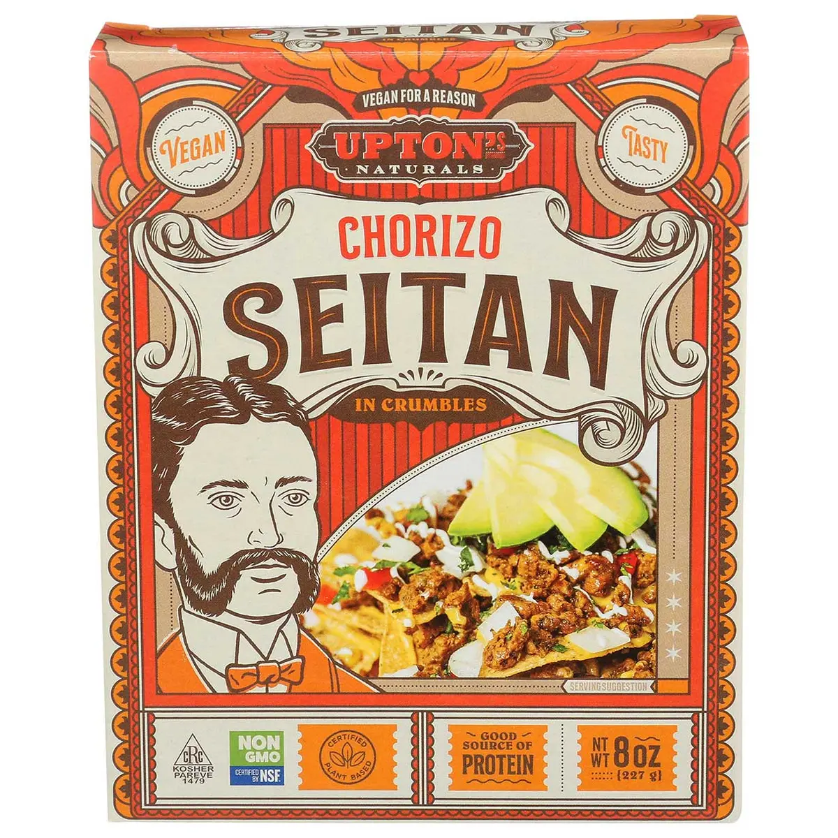
Plant based substitutes: fake meat
16

Slide 19
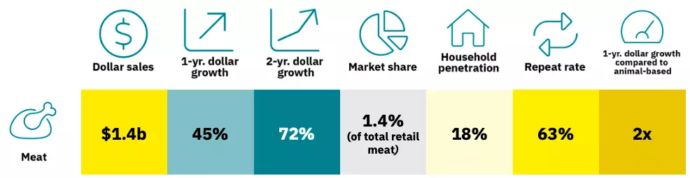
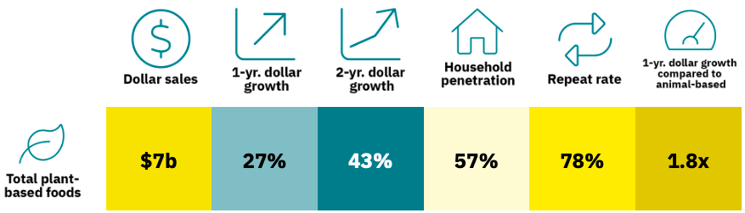
Plant based substitutes are a growing market (U.S.)
“In the U.S., 98 percent of people who buy plant-based meat also purchase conventional meat.”
17
https://gfi.org/marketresearch/

Slide 20
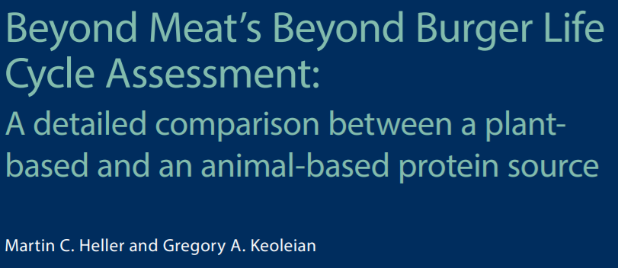

18

Slide 21
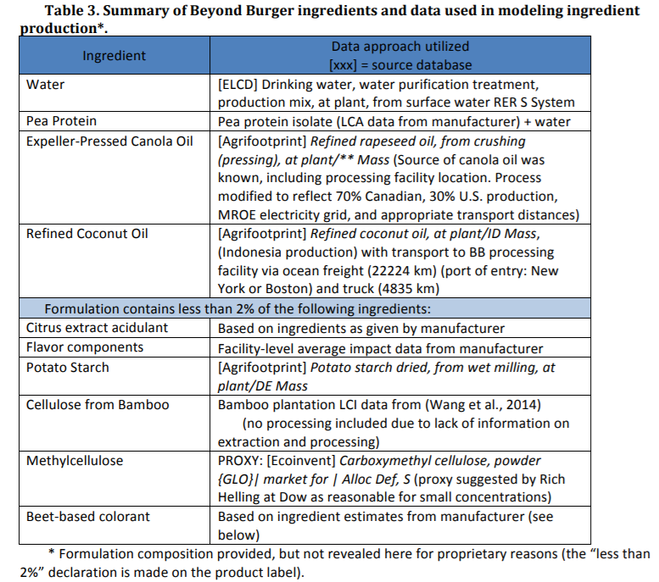
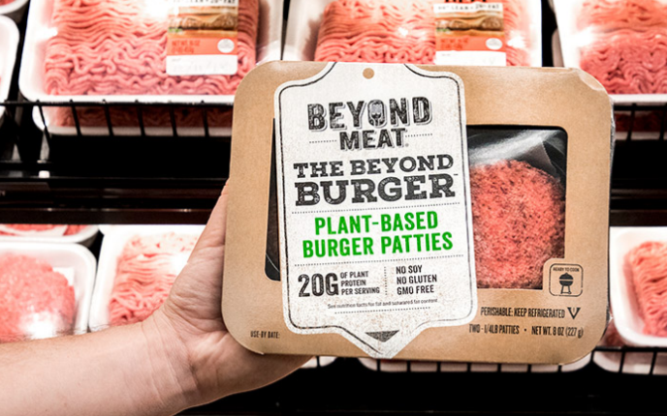
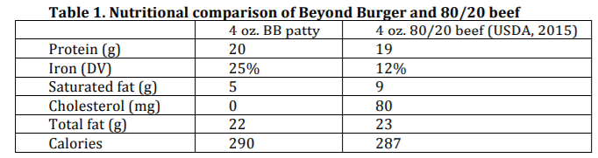
Beyond Burger ingredients
19

Slide 22
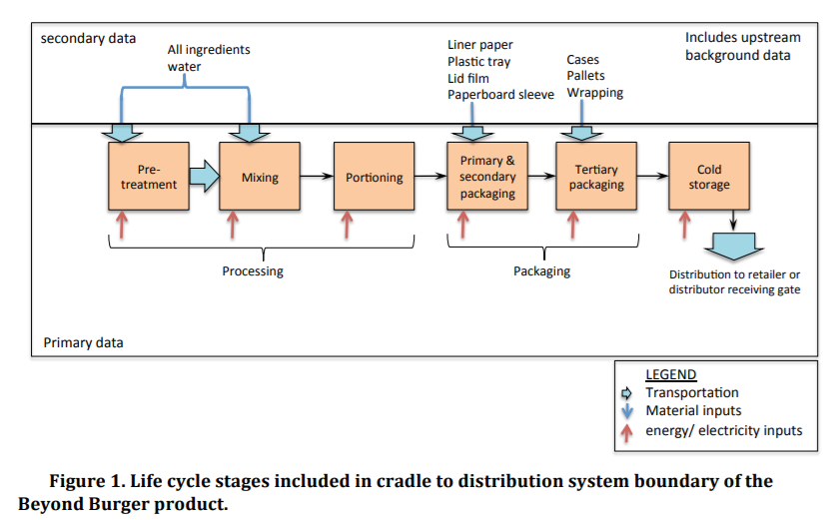
Beyond Burger cradle-to-distribution life cycle
20

Slide 23
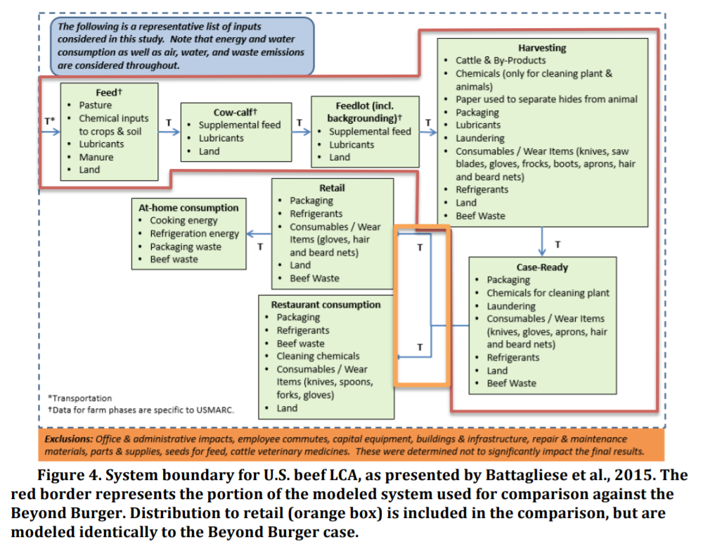
Beef burger cradle-to-distribution life cycle
21

Slide 24
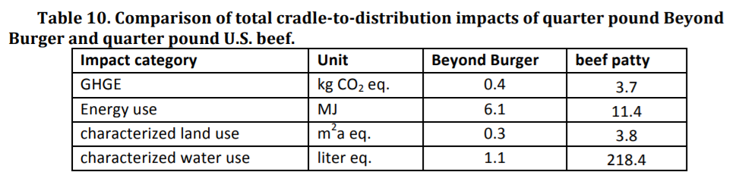
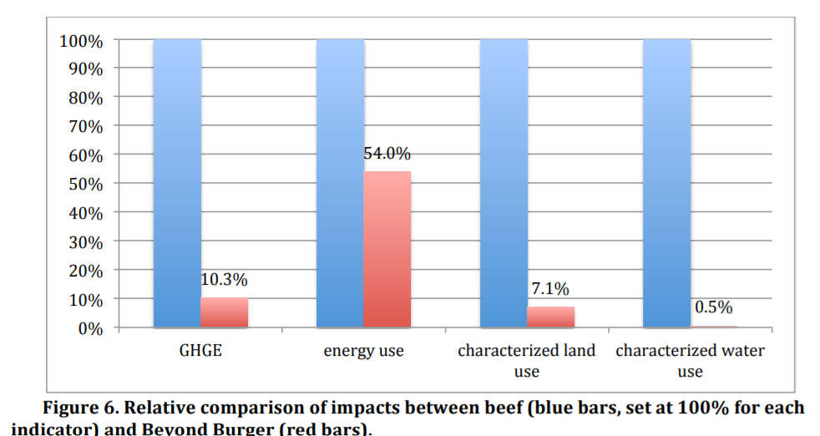
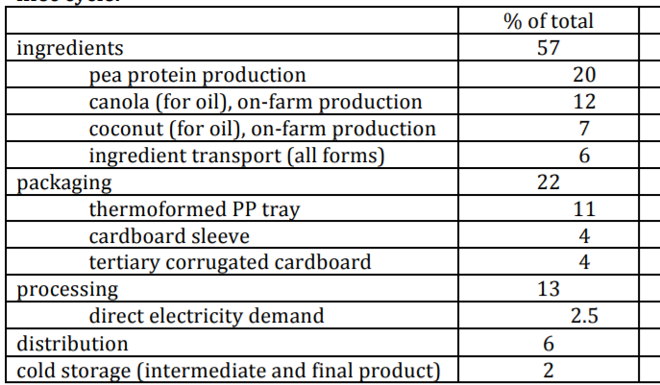
Battle of the burgers
Contributions to BB emissions
22

Slide 25
Another option: (real) fake meat
Wah, my burger
tastes like peas ☹
23

Slide 26
Another option: (real) fake meat
Wah, my burger
tastes like peas ☹
SCIENCE
23

Slide 27
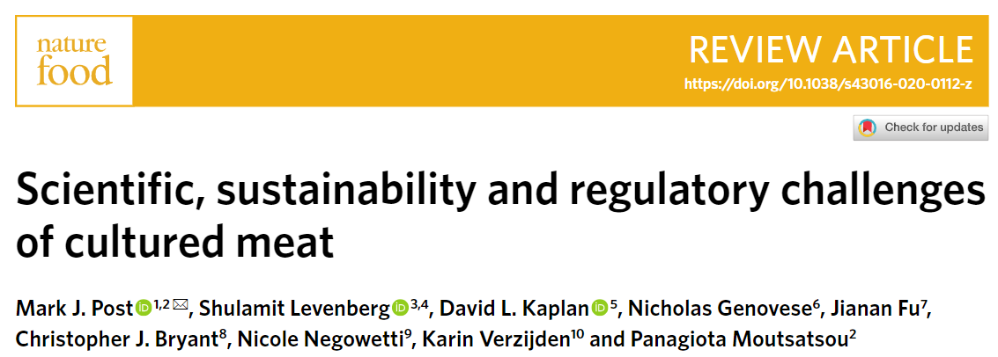
Meat, meet science
24

Slide 28
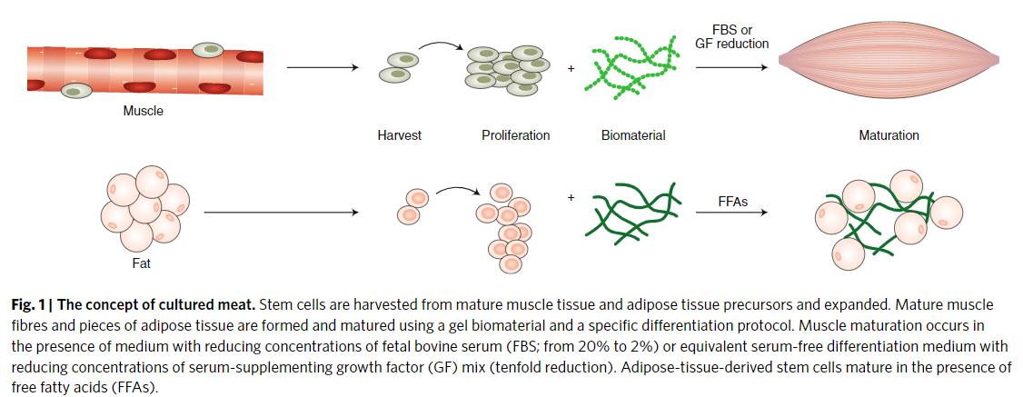
The concept of cultured meat
biopsy from animal
proliferate
add scaffold
mature
add medium
25

Slide 29
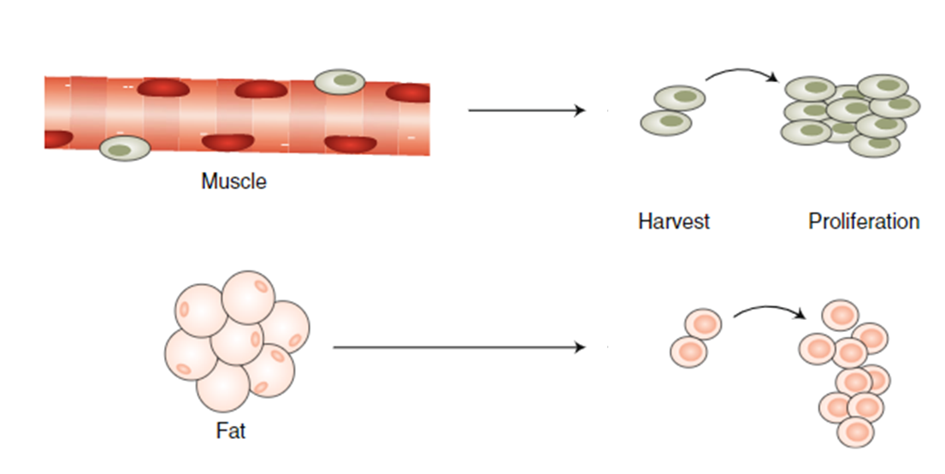
Stem cells make cultured meat possible
Stem cells are unspecified cells that can self-renew and can also differentiate into cells with specified functions
Stem cell options
Adult (tissue-specific) stem cell: A cell found in a tissue that can renew itself but can only yield specialized cell types from the tissue from which it originated. For example, a skin stem cell can not give rise to brain tissue. (shown here)
Pluripotent stem cell: A stem cell that can give rise to nearly all tissue types that are associated with different organs. Embryonic stem cells from the inner cell mass cells of the blastocyst, are pluripotent.
Induced pluripotent stem cells (iPS): Pluripotent stem cells derived from adult tissues by pushing them back in their development (“reprogramming”) to acquire properties of human embryonic stem cells
Stem cell info courtesy of Shannon Geary,
science communicator extraordinaire
26
Notes:
Tissue specific requires optimization of cell culture to have more proliferative capacity (finite potential to renew)
ESC and iPS still at early stages for relevant animals. ESCs face regulatory hurdles.

Slide 30
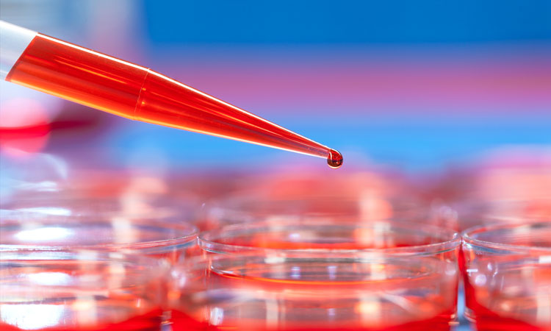
Cell culture details
Medium matters
Different media needed for proliferation and differentiation
Fetal bovine serum (FBS) = animal consumption, also relatively scarce and costly; will need to
innovate on commercially viable, sustainable growth factors to replace FBS.
Environmental footprint depends on major components: amino acids, glucose. Biomass from bacteria
and/or algae could be more sustainable
Recycling may be possible
Metabolic engineering can help
27
https://www.drugtargetreview.com/article/93060/making-cell-culture-models-more-physiologically-relevant/
Notes:
This is based on hydrolysis of a raw mate-rial such as starch, which is naturally produced by plants through photosynthesis and therefore requires the use of land and water.

Slide 31
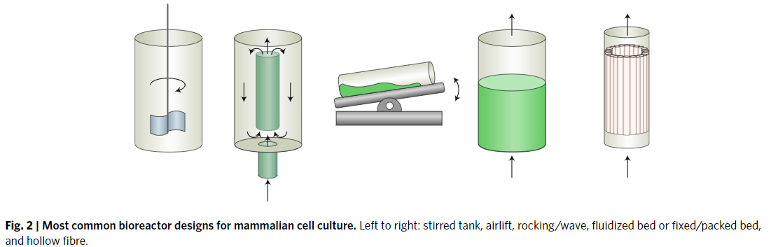
Scale it up: bioreactors
Stirred tank and rocking bioreactor most common
Too much agitation can shear the cells; hollow fibre helps but is more expensive
Packed/fixed bed faces mass transport limitations
28
Notes:
This is based on hydrolysis of a raw mate-rial such as starch, which is naturally produced by plants through photosynthesis and therefore requires the use of land and water.
In general scale up helps with cost and reactors help w process controll

Slide 32
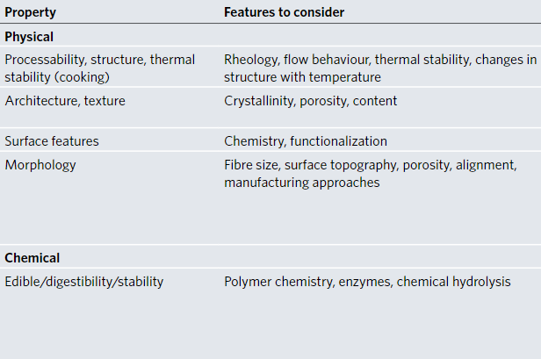
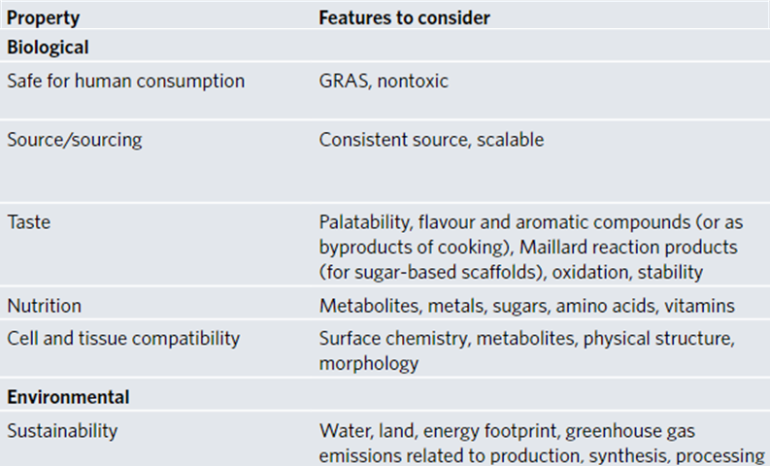
Scaffolds: cheap, edible, palatable, and sustainable
29
Notes:
This is based on hydrolysis of a raw mate-rial such as starch, which is naturally produced by plants through photosynthesis and therefore requires the use of land and water.
In general scale up helps with cost and reactors help w process controll

Slide 33
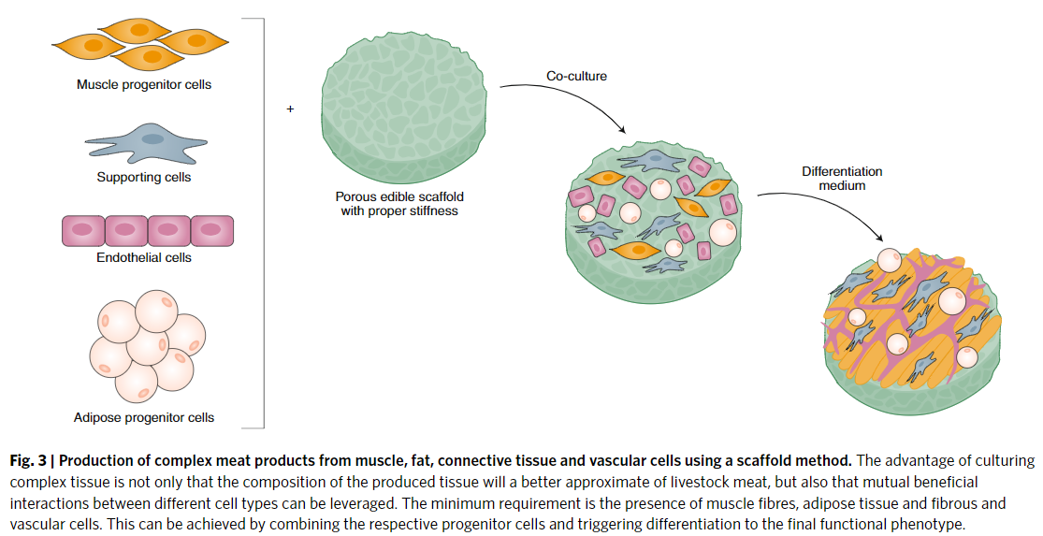
Meat is complicated
30
Notes:
1 cm beyond oxygen diffusion but that’s how thick we’d want meat
Perfusion system
Or printed blood vessels

Slide 34
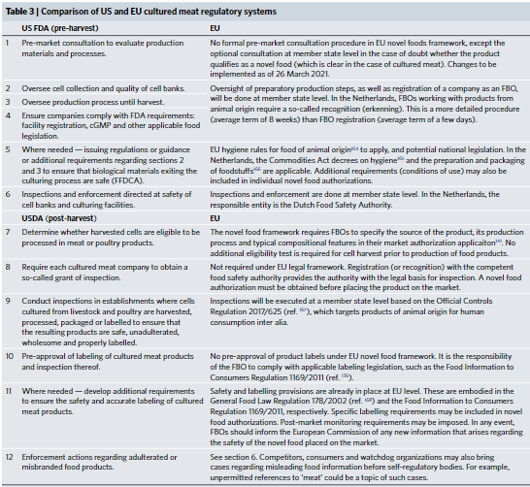
Regulation is complicated
31
Notes:
1 cm beyond oxygen diffusion but that’s how thick we’d want meat
Perfusion system
Or printed blood vessels

Slide 35
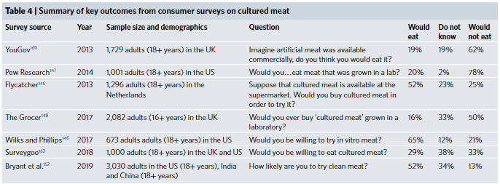
Would people try cultured meat?
32
Notes:
1 cm beyond oxygen diffusion but that’s how thick we’d want meat
Perfusion system
Or printed blood vessels

Slide 36

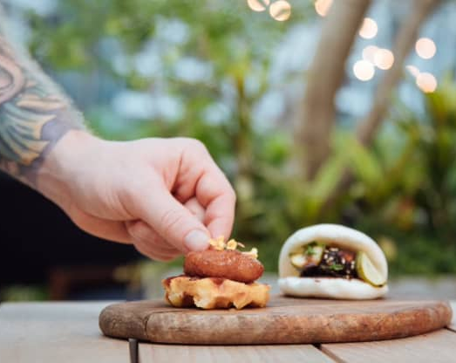
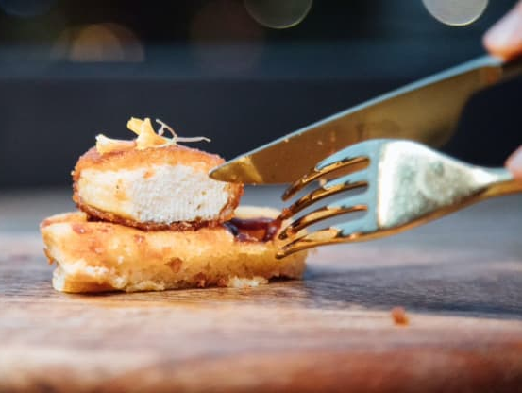
First lab grown chicken sold!
Served at 1880 Restaurant in Singapore…
“bao bun with crispy sesame cultured chicken and spring onion; phyllo puff pastry with cultured chicken and black bean puree; and a crispy maple waffle with cultured chicken with spices and hot sauce.”
33
https://www.cnbc.com/2020/12/18/singapore-restaurant-first-ever-to-serve-eat-just-lab-grown-chicken.html
Notes:
Took 2 yrs for approval in Singapore
Sold at $23 a plate but not at a profit
Dec 2020

