Slide 1
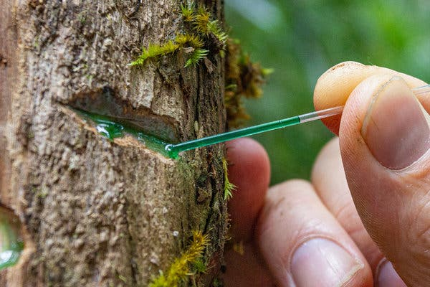
Phytomining
Eliza Spear
December 3, 2021
Harvard Energy Journal Club
Notes:
Image source: https://www.nytimes.com/2020/02/26/science/metal-plants-farm.html

Slide 2
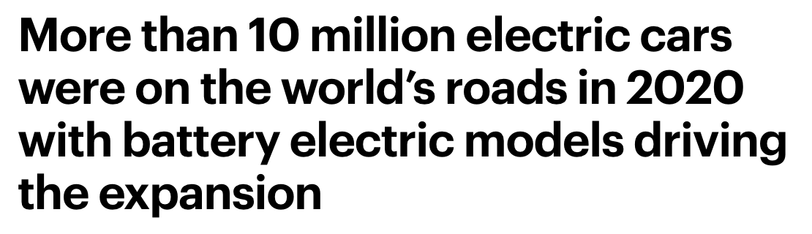
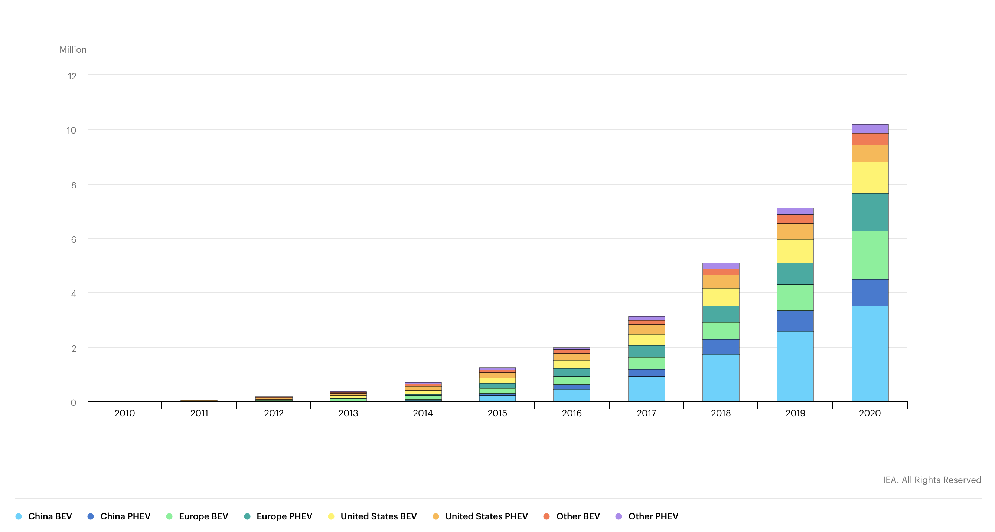
EVs account for about 1% of cars on the road globally
https://www.iea.org/reports/global-ev-outlook-2021/trends-and-developments-in-electric-vehicle-markets

Slide 3
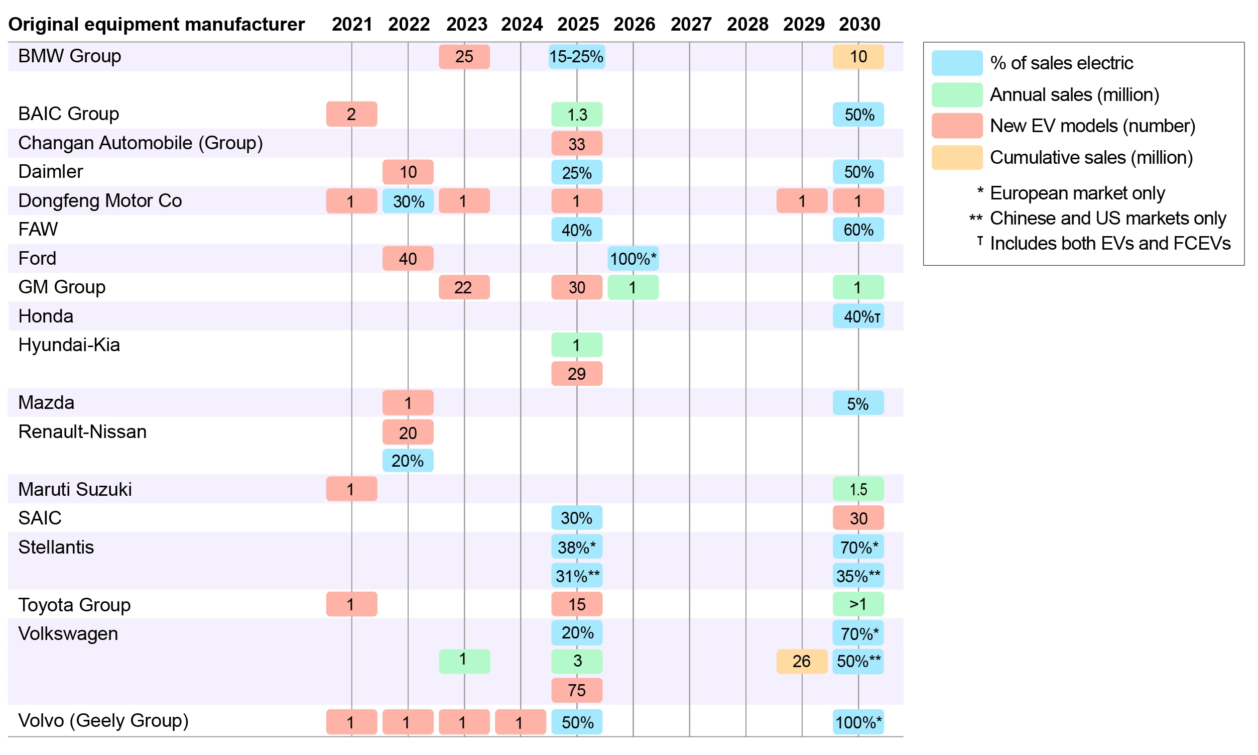
OEM’s announced goals translate to estimated cumulative light duty electric vehicle sales of 55-72 million by 2025 globally
OEM announcements in the first trimester of 2021:
Volvo will only sell electric cars from 2030
Ford will only sell electric cars in Europe from 2030
Volkswagen wants 70% electric car sales in Europe, and 50% in China and the U.S. by 2030
Stellantis aims for 70% electric car sales in Europe and 35% in the U.S.
…and Biden’s Infrastructure Investment and Jobs Act includes a $7.5 billion investment ”to build out the first-ever national network of EV chargers in the United States” to accelerate EV adoption in the U.S.
https://www.iea.org/reports/global-ev-outlook-2021/trends-and-developments-in-electric-vehicle-markets
https://www.whitehouse.gov/briefing-room/statements-releases/2021/08/02/updated-fact-sheet-bipartisan-infrastructure-investment-and-jobs-act/

Slide 4
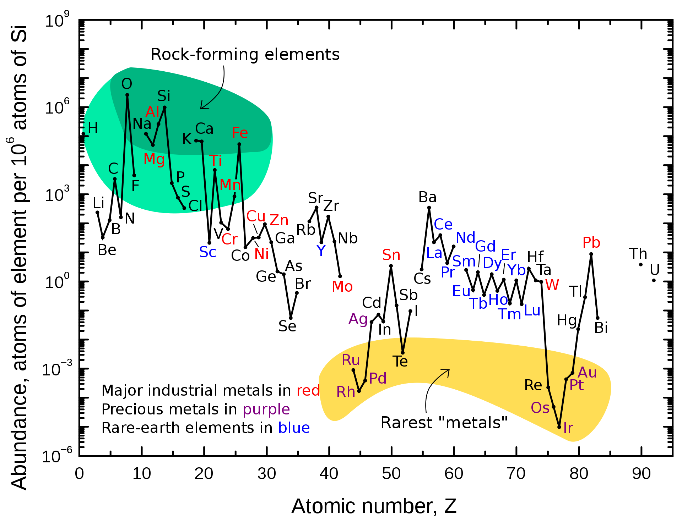
As EV production ramps up, sourcing the elements required for EV batteries is becoming increasingly difficult
Most EVs use NMC batteries (LiNi_{x}Mn_{y}Co_{z}O₂ cathode); Tesla uses NCA batteries (LiNi_{x}Co_{y}Al_{z}O₂ cathode)
Both NMC and NCA batteries require Ni and Co, which are relatively expensive
In October of this year, Tesla announced that it will be switching to LFP batteries (LiFePO₄ cathode) for all standard-range EVs
Element | Price (USD/kg)
Lithium | 81.4 - 85.6
Aluminum | 1.79
Manganese | 1.82
Cobalt | 32.81
Nickel | 13.9
Iron | 0.424
Phosphorus | 2.69
4%
6%
19%
Kramer, D. Physics Today 2021, 5, 20. DOI: ﻿10.1063/PT.3.4745
https://en.wikipedia.org/wiki/Prices_of_chemical_elements
https://www.iea.org/reports/global-ev-outlook-2021/trends-and-developments-in-electric-vehicle-markets

Slide 5
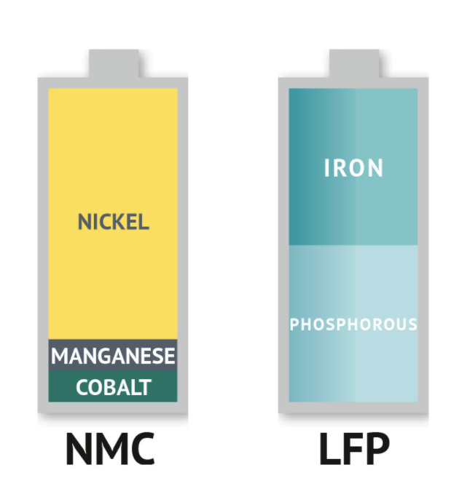
In NMC and NCA lithium ion batteries, more cobalt means higher stability:¹
“in nickel-rich NMC compositions, thermal stability, which is crucial for avoiding catastrophic failures, as well as cycle stability drastically dropped in comparison to equal nickel-cobalt fractions”
“The NMC systems with progressively higher nickel content from NMC 111, 532, 622, 811 (where 111 represent 1 part nickel, 1 part manganese, and 1 part cobalt mass composition, respectively) follow a steady trend in decreasing cycle stability and safety”
LFP cathode material is 43% less expensive per kWh than NMC811
LFP energy density is 65-70% of that of NMC811
An LFP-powered Tesla Model 3 would have only 66% of the range of an NCA-powered Model 3
In switching from NCA to LFP batteries, Tesla is sacrificing energy density for cost:²
Li, M. and Lu, J. Cobalt in lithium-ion batteries. Science 2020, 367, 6481. DOI: ﻿10.1126/science.aba9168
https://nickelinstitute.org/blog/2020/june/battle-of-the-batteries-cost-versus-performance/

Slide 6
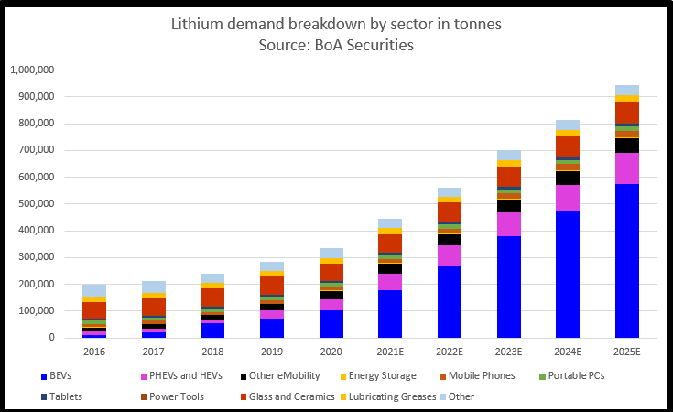
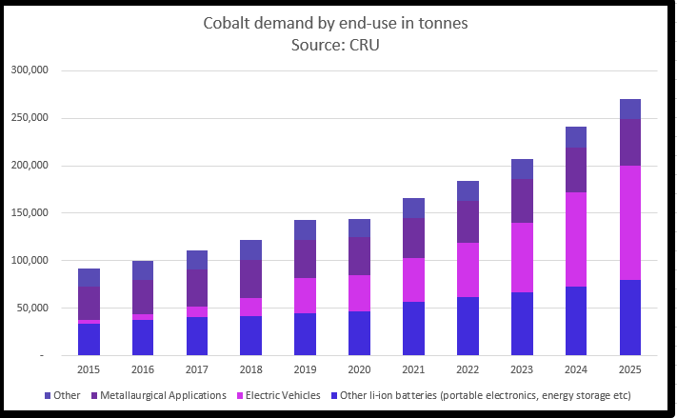
Demand for cobalt is expected to continue rising as the BEV market grows
https://www.reuters.com/business/energy/shortages-flagged-ev-materials-lithium-cobalt-2021-07-01/

Slide 7
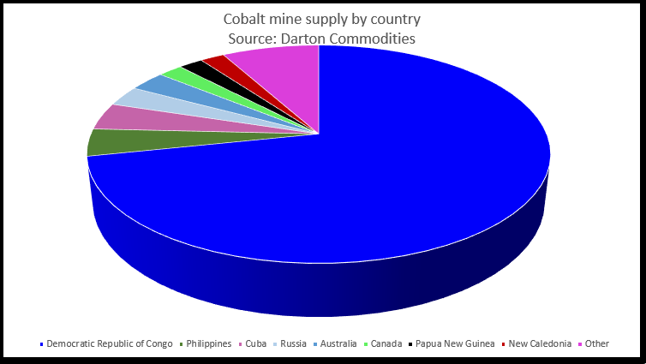
The vast majority of Co is mined in the Democratic Republic of the Congo
Mining conditions in the Democratic Republic of Congo are rife with human rights violations including child labor, causing some to dub cobalt ”the blood diamond of batteries”
https://www.reuters.com/business/energy/shortages-flagged-ev-materials-lithium-cobalt-2021-07-01/ (chart)
https://www.nytimes.com/2021/11/29/world/congo-cobalt-albert-yuma-mulimbi.html?auth=linked-google

Slide 8
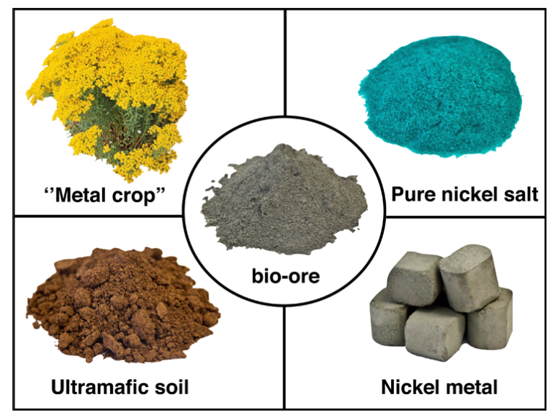
Phytomining could be an alternative source of Co and Ni
(3) The plants are harvested and incinerated to yield bio-ore
(2) Hyperaccumulator plants are grown on ultramafic soil.
These plants accumulate large quantities of metal.
(4) Pure nickel salt is extracted from the bio-ore
(1) Ultramafic soils containing high concentrations of Ni, Co
(5) Nickel metal is produced from the nickel salt
van der Ent et al. Environ. Sci. Technol. 2015, 49, 4773. DOI: ﻿10.1021/es506031u

Slide 9
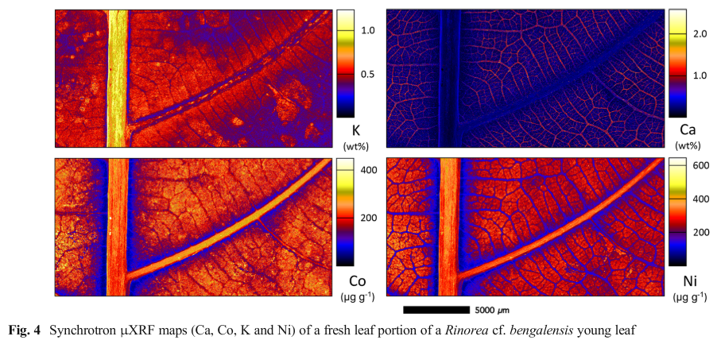
Hyperaccumulator plants take up large quantities of metals from the soil
A hyperaccumulator contains a significant quantity of metal (wt % metal in the dried leaves; >0.03 wt % Co, >0.1 wt % Ni)
The most broadly accepted hypothesis for why hyperaccumulation evolved is “elemental defense” (herbivory protection functions)
van der Ent et al. Environ. Sci. Technol. 2015, 49, 4773. DOI: ﻿10.1021/es506031u
Paul, A. L. D. et al. Plant and Soil 2020, 455, 289. DOI: ﻿10.1007/s11104-020-04629-7

Slide 10
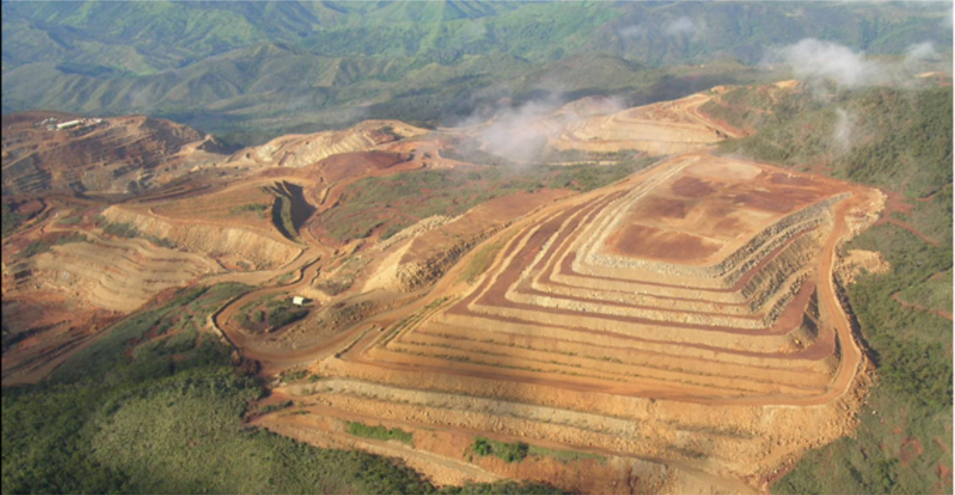
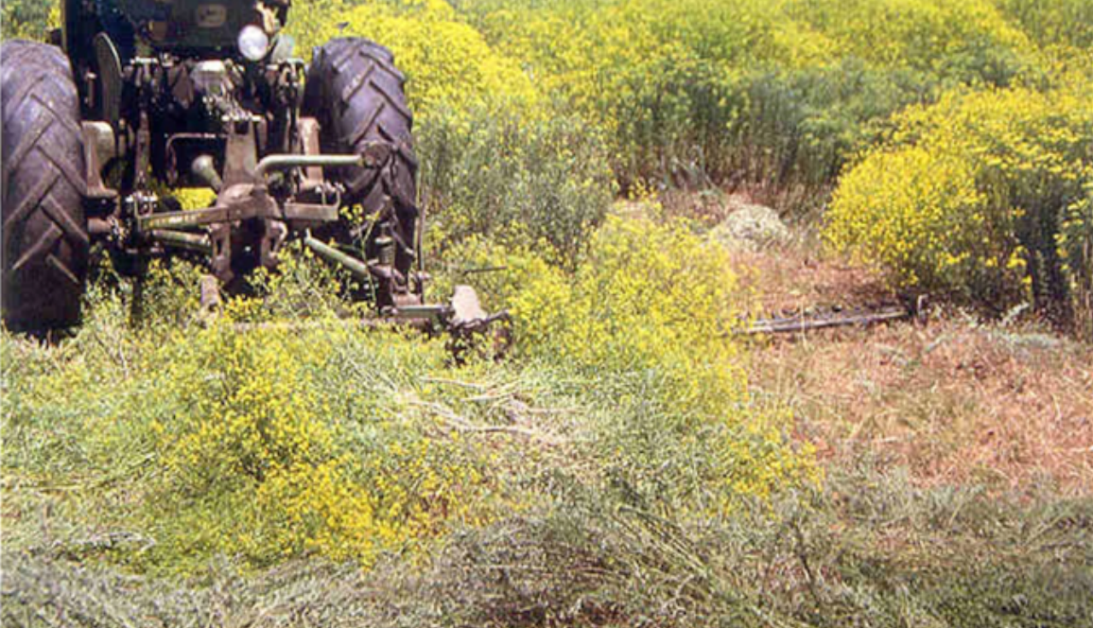
Hyperaccumulator plants take up large quantities of metals from the soil
Possible uses of hyperaccumulators include:
  Prospecting (locating ore-bodies)
  Phytoextraction (soil clean up)
  Phytomining (commercially producing metals, metal products, or catalysts)
  Agromining (a variant of phytomining in which phytomining is conceived to be part of an integrated agricultural chain)
For example, bio-ore can contain 10-25 wt % Ni, a higher percentage than in lateritic ores (<1.5%) which are mined for Ni
Bio-ore lacks the Fe and Mg silicates found in the soil, which could make nickel extraction from bio-ore cheaper than from soil
van der Ent et al. Environ. Sci. Technol. 2015, 49, 4773. DOI: ﻿10.1021/es506031u

Slide 11
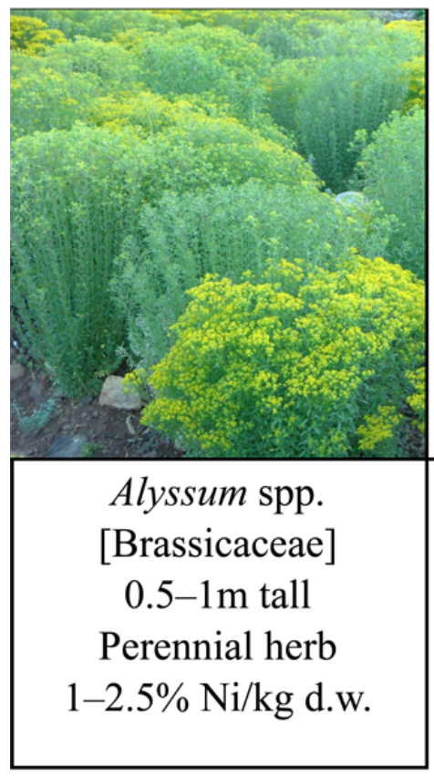
Nickel hyperaccumulator plants are particularly well-explored
The first nickel hyperaccumulator was reported in 1948
More hyperaccumulators of nickel are known than of any other metal, largely because naturally-occurring Ni-enriched ultramafic soils cover >3% of the Earth’s surface
As of 2020, about 700 hyperaccumulators were known, with about 70% hyperaccumulating Ni including:
  >100 species in Cuba
  >50 species in New Caledonia
  >50 species in Turkey
Criteria for possible commercial relevance:
  Must contain >1% Ni in dried leaves (only ~10% of Ni hyperaccumulators)
  Must have sufficient annual harvestable biomass
  High-Ni tissue must make up a large proportion of the harvestable biomass
van der Ent et al. Environ. Sci. Technol. 2015, 49, 4773. DOI: ﻿10.1021/es506031u
Chaney R.L., Baker A.J.M., Morel J.L. (2018) The Long Road to Developing Agromining/Phytomining. In: Van der Ent A., Echevarria G., Baker A., Morel J. (eds) Agromining: Farming for Metals. Mineral Resource Reviews. Springer, Cham. https://doi.org/10.1007/978-3-319-61899-9_1
Paul, A. L. D. et al. Plant and Soil 2020, 455, 289. DOI: ﻿10.1007/s11104-020-04629-7
Nkrumah, P. J. of Geochem. Explor. 2019, 198, 114. DOI: ﻿10.1016/j.gexplo.2018.12.003

Slide 12
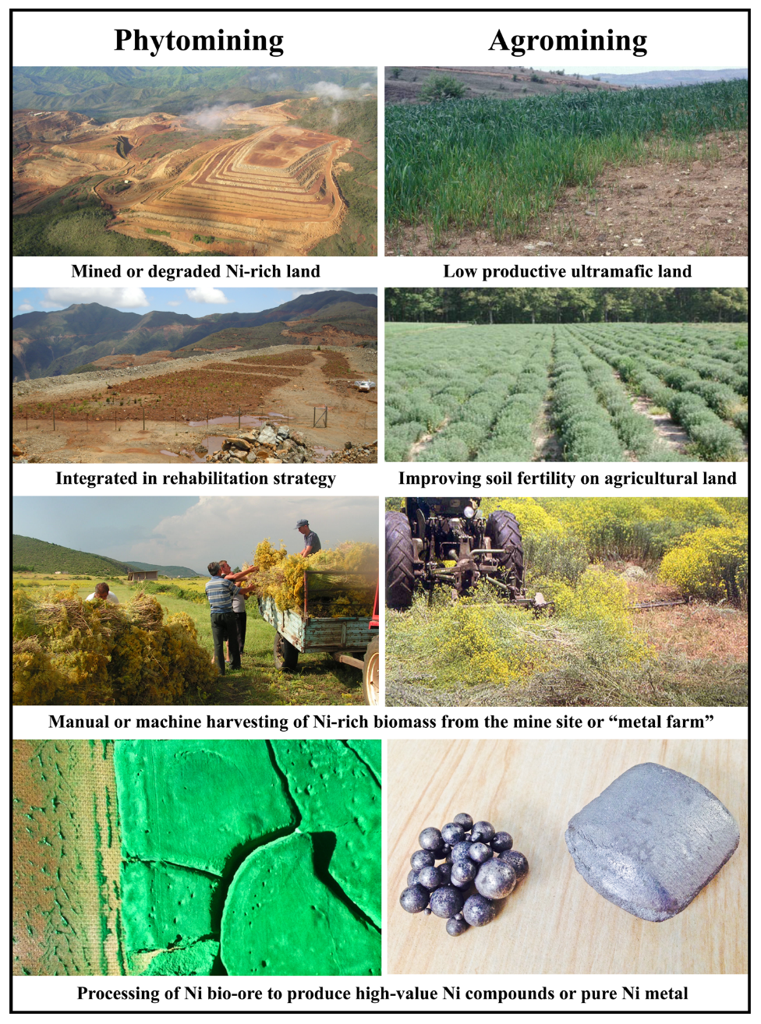
Proposed uses of phytomining / agromining
Phytomining on degraded or mined land (left):
  Rehabilitation strategy for Ni laterite mines, smelter contaminated land, or beneficiation tailings, or otherwise degraded metal-rich land
  Could act as a first stage in the development of lateritic mining projects, and continue as part of a rehabilitation plan (use phytomining to generate cash flow as project is developed, before underlying minerals are extracted)
Agromining on low-productivity agricultural soils (right):
  Target large, relatively flat ultramafic areas that have low food production productivity
  Agromining should be used when it can generate better economic returns to farmers than would other agricultural activities
  Co-cropping is possible (e.g. in Greece, olive plantations could be intercropped with a nickel hyperaccumulator Alyssum; in Malaysia, palm oil estates could be intercropped with Phyllanthus)
van der Ent et al. Environ. Sci. Technol. 2015, 49, 4773. DOI: ﻿10.1021/es506031u

Slide 13
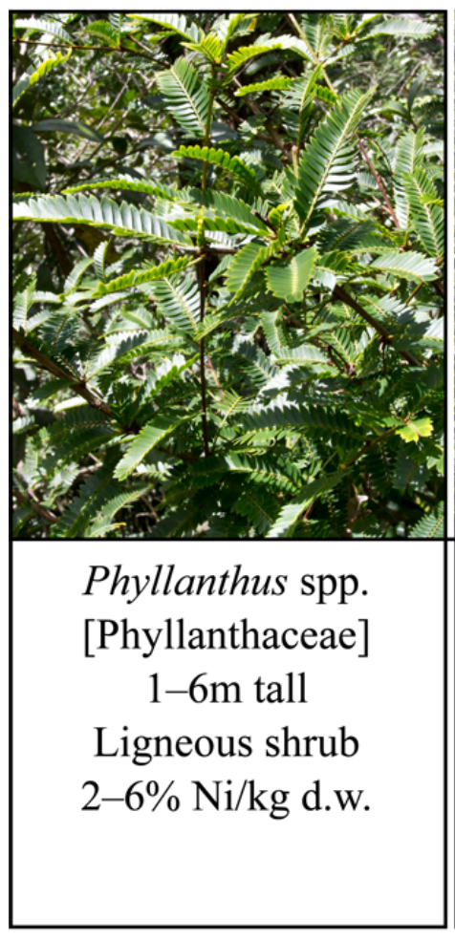
Economics of agromining
Hyperaccumulators are known for As, Se, Cd, Co, La, Mn, Ni, Pb, Tl, and Zn
Cu, Co, La, and Pb have poor accumulation characteristics and, as of 2015, were not under consideration for commercial agromining
Economic feasibility depends on element market price, annual yield per unit area, and availability of surface areas enriched in the desired element
(as of January 2020: Ni $13.90/kg, Co $32.8/kg)
Field trials with several Ni hyperaccumulators yielded 5-10 t of dry matter per hectare, containing 2% Ni, for a total of 100-200 kg Ni per hectare (Alyssum murale, A. corsicum)
Other trials:
  Albania, A. murale, 105 kg Ni ha⁻¹ (agricultural conditions)
  California, Streptanthus polygaloides, 100 kg Ni ha⁻¹ (smaller scale)
  Italy, A. bertolonii, 72 kg Ni ha⁻¹ (smaller scale)
  South Africa, Berkheya coddii, 100 kg Ni ha⁻¹ (smaller scale)
van der Ent et al. Environ. Sci. Technol. 2015, 49, 4773. DOI: ﻿10.1021/es506031u
https://en.wikipedia.org/wiki/Prices_of_chemical_elements

Slide 14
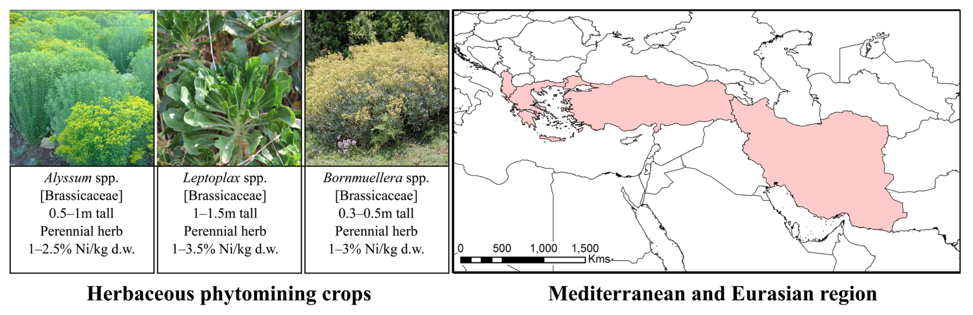
Economics of agromining
Can agromining be economically feasible?
With yields >100 kg Ni ha⁻¹ and a market cost of around $15/kg (2015), agromining could provide more income than most food crops
Comparison:
      A premium rice crop on fertile “normal” soils yields $850 per hectare per year in Indonesia
      Ni phytomining on local ultramafic soils could yield up to $1000 per hectare per year
Also worth noting, Ni-rich ultramafic soils are inherently infertile and have low economic returns if used for food crops
High biomass yield is critical, and ideally uses perennial species that rapidly regenerate above-ground biomass after harvesting
van der Ent et al. Environ. Sci. Technol. 2015, 49, 4773. DOI: ﻿10.1021/es506031u

Slide 15
Economics of agromining
Long-term planning
Unlike the competition between food crops and biofuels for fertile soils, agromining does not replace food crop production; instead, it is a relatively temporary use of low-quality land that can improve soil quality, potentially enough to later enable food crop production after the metal resource has been extracted
How long can it last?
Back-of-the-envelope calculation by van der Ent:
For 1 ha with an average of 2000 mg kg⁻¹ Ni to 1 m depth
  Total Ni resource: 30 t
  Crops with 5 t ha⁻¹ dry weight plant material, containing 2 wt % Ni, would yield 100 kg Ni ha⁻¹ (1/300 of the total Ni resource)
  Not all Ni is available to plants; van der Ent assumes 10-20% Ni is plant-available (3-6 t ha⁻¹ Ni total)
  If this available Ni pool is “buffered” by mineral phases, agromining could persist for 30-60 years
van der Ent et al. Environ. Sci. Technol. 2015, 49, 4773. DOI: ﻿10.1021/es506031u
Notes:
1 hectare = 2.471 acres or 10,000 square meters

Slide 16
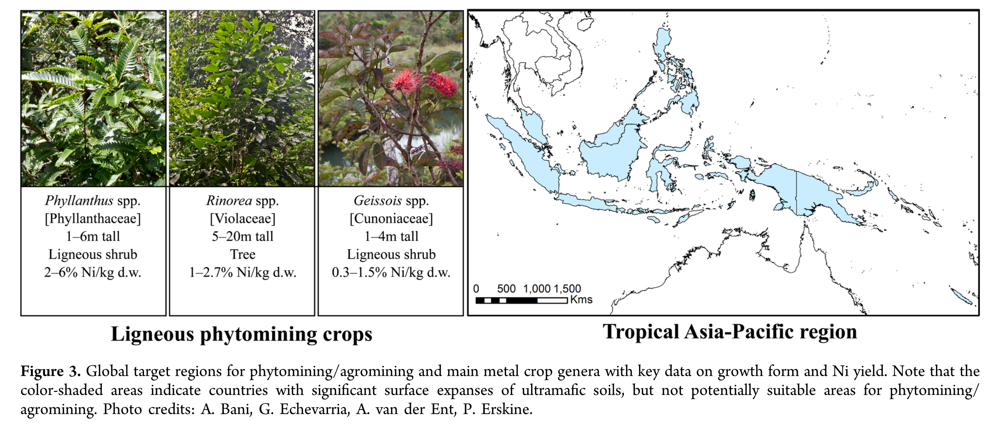
Summary of economic feasibility considerations
Total development and optimization costs through trial stages to full operation
Predicted annual costs, including labor, machinery, fertilization, irrigation, plant protection, and harvesting
Land costs
Current and predicted price of the metal or its compounds on world markets
The value of alternative land uses
To minimize harm, native plant species are preferred.
van der Ent et al. Environ. Sci. Technol. 2015, 49, 4773. DOI: ﻿10.1021/es506031u

Slide 17
Proposed regions for practical implementation of Ni phytomining
Asia-Pacific region (Malaysia, Indonesia, the Philippines, Papua New Guinea, New Caledonia)
  Large area of ultramafic laterite soils rich in Ni
  Large-scale Ni strip-mining occurs in these regions, but much of the ultramafic soils contain <1% Ni and are not suitable for strip-mining
  Hyperaccumulators have been shown to accumulate significant Ni in soils with as little as 0.1% Ni
  Hyperaccumulators will also deplete other elements that are already lacking in ultramafic soil (Ca, P, N, K) and may require fertilization
  Other soil properties can be tuned to improve yield (e.g. Alyssum species accumulate more Ni in soils with low pH)
  Following strip-mining, rehabilitation (soil stabilization) is accomplished by planting various native species; replacement of these plants with local hyperaccumulators would provide additional revenue
Mediterranean and Eurasian regions (Turkey, Albania, Greece, Iran)
  Also significant areas of ultramafic land, used for food crops but with poor productivity due to soil quality
  Agromining in this region with the end-goal of yielding more fertile land that can be used for more productive food crops
  Propose use of phytomining to subsidize enhancement of soil fertility
Reports in 2021 indicate that phytomining of Ni is underway in Albania and Indonesia
van der Ent et al. Environ. Sci. Technol. 2015, 49, 4773. DOI: ﻿10.1021/es506031u
Kramer, D. Physics Today 2021, 74, 24. DOI: ﻿10.1063/PT.3.4791

Slide 18
Global target regions for phytomining/agromining Ni (1/2)
van der Ent et al. Environ. Sci. Technol. 2015, 49, 4773. DOI: ﻿10.1021/es506031u

Slide 19
Global target regions for phytomining/agromining Ni (2/2)
van der Ent et al. Environ. Sci. Technol. 2015, 49, 4773. DOI: ﻿10.1021/es506031u

Slide 20
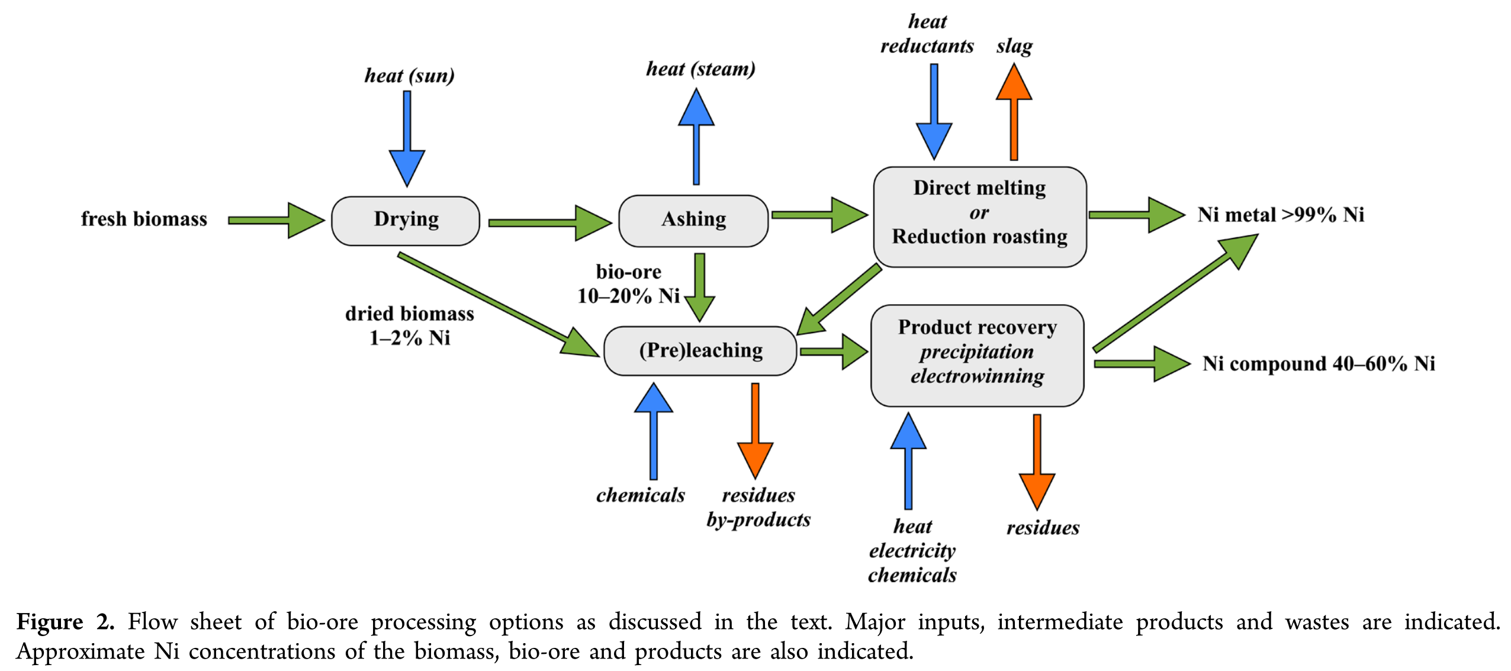
Bio-ore processing options
Dried biomass can be ashed then smelted (pyrometallurgical), leached followed by Ni recovery (hydrometallurgical), or ashed then leached (pyro-hydro combination)
van der Ent et al. Environ. Sci. Technol. 2015, 49, 4773. DOI: ﻿10.1021/es506031u

Slide 21
Bio-ore processing option details
Ashing
Ashed biomass is typically about 20 wt % Ni, primarily as NiO; also contains K, Ca, Mg as carbonates and oxides
Can still be carbon neutral (CO₂ released will be recaptured as more plants grow)
Smelting
Thermo-chemical treatment of bio-ore
Requires heat input, a chemical reductant, and flux to control the slag properties
Ferro-nickel or nickel pig-iron from laterite ore is economically feasible for grades containing >1.5 wt % Ni
Dried biomass could be integrated into the feed of existing Ni smelters, although one advantage of hyperaccumulators is that they separate Ni from Fe (Ni:Fe mass ratio of 1:100 in soil vs 40:1 in plant matter)
Leaching
Extraction of Ni with an aqueous leaching solution (for Ni, typically using sulfuric acid or ammonium hydroxide / carbonate / sulfate)
Often utilizes elevated pressure and temperature
Product recovery
From hydrometallurgical processing, Ni can be recovered in various forms (metallic via electrochemical reduction, or as a compound by chemical or evaporative precipitation)
Byproducts of hydrometallurgical processes (e.g. K₂CO₃) can be recycled to the phytomined area to replenish necessary macronutrients
van der Ent et al. Environ. Sci. Technol. 2015, 49, 4773. DOI: ﻿10.1021/es506031u

Slide 22
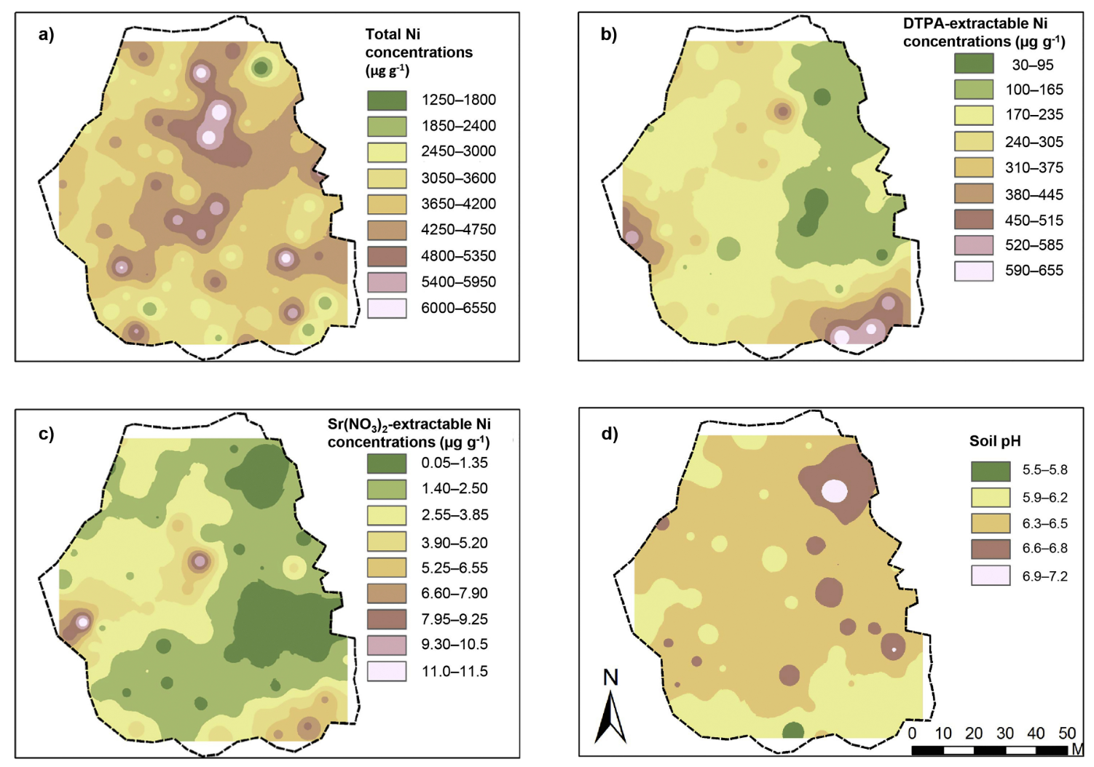
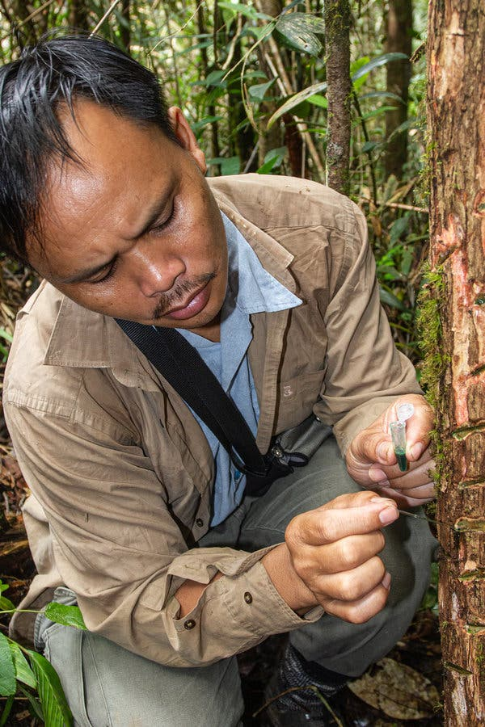
Ni phytomining field-trial in Malaysia
Study Details:
>90% of the soil on the 1 ha farm site contained >2000 μg g⁻¹ of Ni
High phytoavailable Ni concentrations
Average soil pH 6.4, ideal for maximum Ni uptake in the local candidate species
Low concentrations of Ca, K, and P in the soil, indicating the need for improved fertilization for sustainable agromining
Nickel-rich sap being taken from a tree in Malaysia.Credit...Antony van der Ent
Nkrumah, P. J. of Geochem. Explor. 2019, 198, 114. DOI: ﻿10.1016/j.gexplo.2018.12.003
https://www.nytimes.com/2020/02/26/science/metal-plants-farm.html
Sukaibin Sumail retrieved nickel sap from a hyperaccumulator tree in Malaysia.Credit...Antony van der Ent
Notes:
1 hectare = 2.471 acres or 10,000 square meters

Slide 23
Pilot-scale phytomining operation in Malaysia
Phyllanthus rufuscheneyi: up to 2.5 wt % Ni in shoots, and 1.23 wt % in leaves; mean 1.8 wt % in seeds and 8830 mg L⁻¹ in phloem sap
Nickel-rich sap being taken from a tree in Malaysia.
Sukaibin Sumail retrieved nickel sap from a hyperaccumulator tree in Malaysia.
Nkrumah, P. J. of Geochem. Explor. 2019, 198, 114. DOI: ﻿10.1016/j.gexplo.2018.12.003
https://www.nytimes.com/2020/02/26/science/metal-plants-farm.html

Slide 24
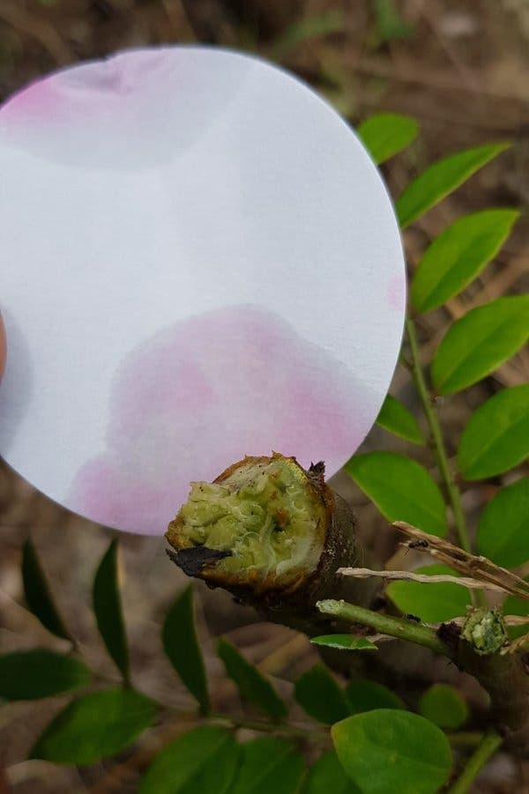
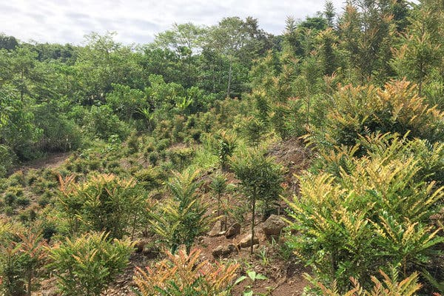
Pilot-scale phytomining operation in Malaysia
Vegetation on a small plot of land in Sabah, Malaysia, can yield hundreds of pounds of nickel citrate every 6-12 months. The researchers are now testing a larger plot of land.
A plant’s sap turned testing paper a reddish color, indicating high nickel content.
Nickel-rich sap being taken from a tree in Malaysia.Credit...Antony van der Ent
Nkrumah, P. J. of Geochem. Explor. 2019, 198, 114. DOI: ﻿10.1016/j.gexplo.2018.12.003
https://www.nytimes.com/2020/02/26/science/metal-plants-farm.html
Sukaibin Sumail retrieved nickel sap from a hyperaccumulator tree in Malaysia.Credit...Antony van der Ent

Slide 25
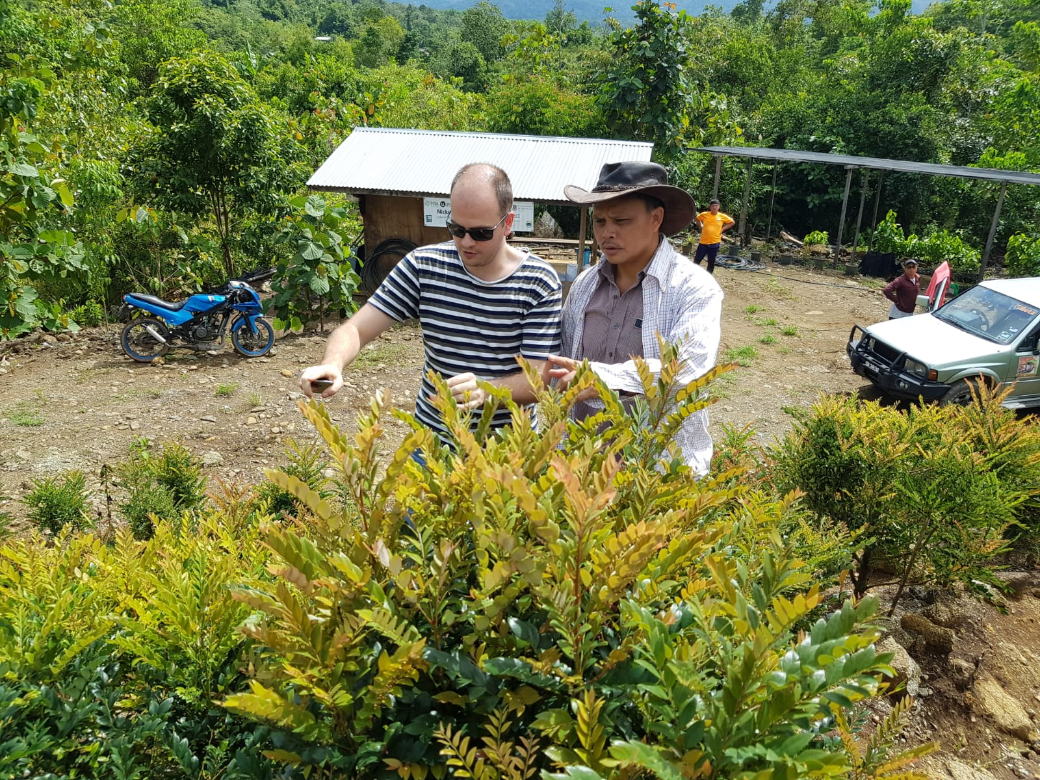
Pilot-scale phytomining operation in Malaysia
As of August 2021, the phytomining operation in Malaysia was yielding 150 - 250 kg (170 - 280 lbs) of Ni per hectare per year
Farmers net about $3800 per acre, which van der Ent says is “on par with some of the best-performing agricultural crops on fertile soils, while operating costs are similar” (compare to palm oil, $2710 per acre)
Van der Ent’s team has recently formed partnerships in the mining industry who plan to implement Ni phytomining trials in Indonesia (on hold due to COVID as of August 2021)
He has said ”It’s only uptake by industry that is holding up translation of phytoming to large-scale application”
Antony van der Ent, left, and his colleague Sukaibin Sumail, a local field researcher, examine a P. rufuschaneyi at the test plot in Kinabalu Park.
Nickel-rich sap being taken from a tree in Malaysia.Credit...Antony van der Ent
https://grist.org/science/phytomining-nickel-kinabalu-park-malaysia/
Sukaibin Sumail retrieved nickel sap from a hyperaccumulator tree in Malaysia.Credit...Antony van der Ent

Slide 26
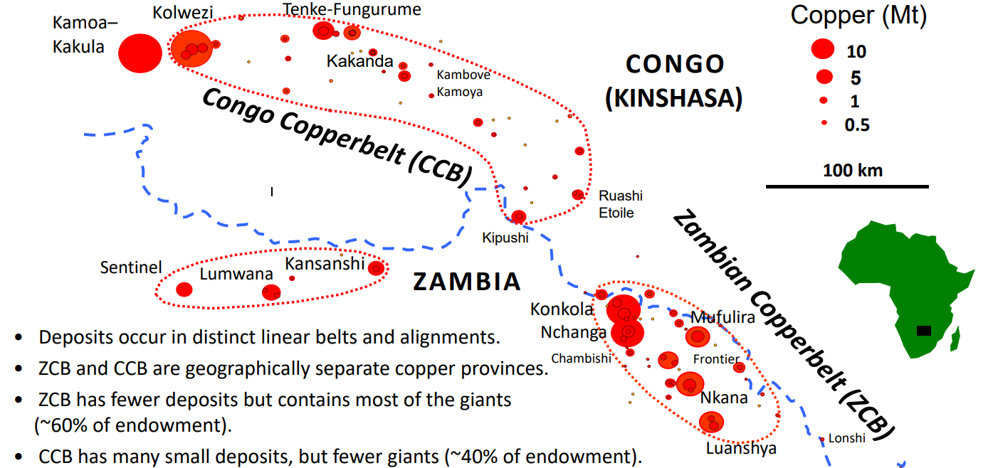
What about cobalt?
Co is not essential for plants and is not involved in any metabolic processes for higher plants
In contrast, Ni is essential for nitrogen assimilation (in the enzyme urease)
Excess Co disrupts photosynthesis, and induces Fe deficiency and production of reactive oxidative species leading to leaf yellowing (chlorosis) and stunted growth
Co hyperaccumulation is rare (~40 species known, 2020), and has mostly been found in Cu-Co outcrops of the Copperbelt
Paul, A. L. D. et al. Plant and Soil 2020, 455, 289. DOI: ﻿10.1007/s11104-020-04629-7
Hitzman, M.W., Bookstrom, A.A., Slack, J.F., and Zientek, M.L. - Cobalt—Styles of deposits and the search for primary deposits: U.S. Geological Survey Open-File Report 2017–1155, https://pubs.usgs.gov/of/2017/1155/ofr20171155.pdf (image)

Slide 27
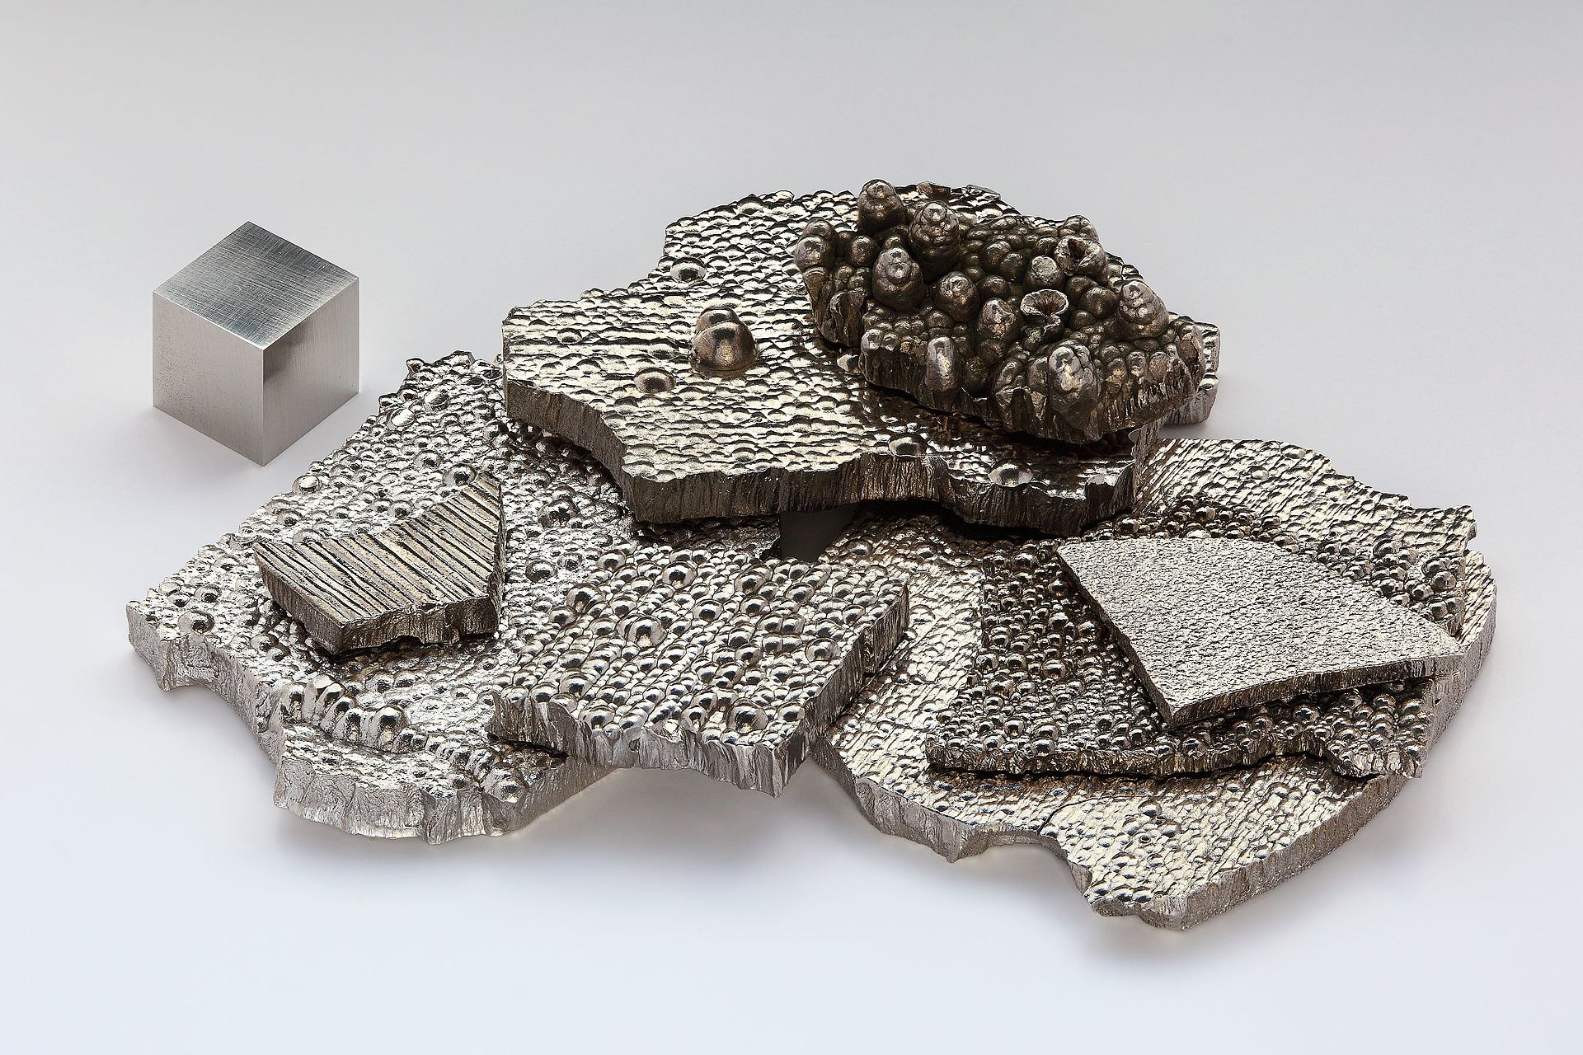
Feasibility of cobalt phytomining?
Southeast Asian Rinorea species have been reported to accumulate up to 670 μg g⁻¹ Co
  This is only 0.067 wt % Co, whereas earlier economic viability calculations for nickel assumed 1-2 wt % Ni
  Co only costs about 2.3x as much as Ni; this doesn’t look so economically viable!
Paul, A. L. D. et al. Plant and Soil 2020, 455, 289. DOI: ﻿10.1007/s11104-020-04629-7
Kramer, D. Physics Today 2021, 74, 24. DOI: ﻿10.1063/PT.3.4791
Notes:
Image source: https://en.wikipedia.org/wiki/Cobalt

Slide 28
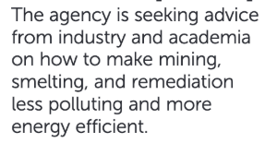
Feasibility of cobalt phytomining?
Southeast Asian Rinorea species have been reported to accumulate up to 670 μg g⁻¹ Co
  This is only 0.067 wt % Co, whereas earlier economic viability calculations for nickel assumed 1-2 wt % Ni
  Co only costs about 2.3x as much as Ni; this doesn’t look so economically viable!
A fellow at ARPA-E, Dr. Elizabeth Troein, is exploring phytomining as a domestic source of metals to reduce the need for carbon-intensive hard-rock mining.
Dr. Antony van der Ent (University of Queensland) says little R&D has gone into cobalt phytomining, and that it should be centered in central Africa (Copperbelt) where cobalt-enriched soils and mine waste exist. He also says that any Ni hyperaccumulator will also accumulate some Co, but the metals will compete and Ni will typically be more abundant.
Dr. Rufus Chaney (retired Dept. of Agriculture scientist) suggests using bioengineering to convert a Ni/Co hyperaccumulator into a Co-only hyperaccumulator that ignores Ni.
(Bio-engineer Co hyperaccumulators that accumulate >1 wt % Co?)
Paul, A. L. D. et al. Plant and Soil 2020, 455, 289. DOI: ﻿10.1007/s11104-020-04629-7
Kramer, D. Physics Today 2021, 74, 24. DOI: ﻿10.1063/PT.3.4791
Notes:
Image source: https://en.wikipedia.org/wiki/Cobalt

