Slide 1
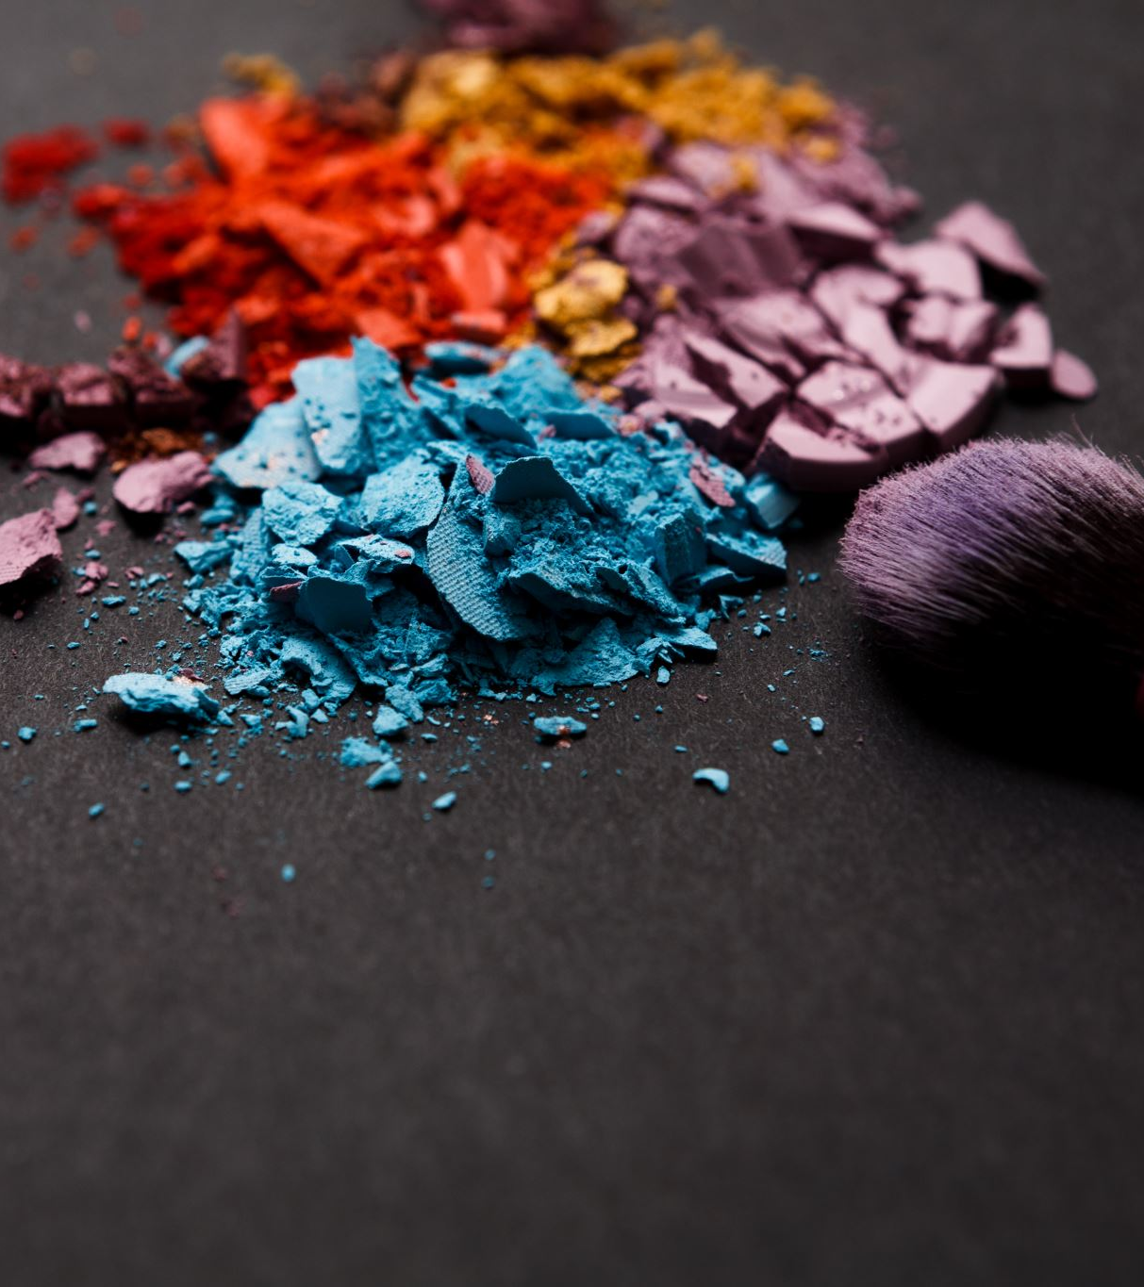
The Beauty and the Ugly
—Towards a Greener Future of the Beauty Industry
Mandy Liu
HEJC
2021/11/19
Notes:
Blurb:
Title: The Beauty and the Ugly: Towards a Greener Future of the Beauty Industry
Currently a $80 billion industry in the U.S. and $500 billion industry worldwide with steady market growth, the beauty business has shaped numerous aspects of our modern lifestyle. To what extent it has and will shape the world’s energy landscape, however, is a harder question to answer. Is it truly an epitome of excessive consumerism, with an appalling ugly side of waste and pollution? Or is it a sector with great potential to contribute to a greener society given its giant volume and far-reaching influence? In this talk we will examine the value chain of the beaty industry, including—listed from upstream to downstream—raw material, production, packaging & distribution, and costumer behavior, and discuss existing problems as well as effective/promising practices to promote clean energy and reduce pollution at these stages.

Slide 2
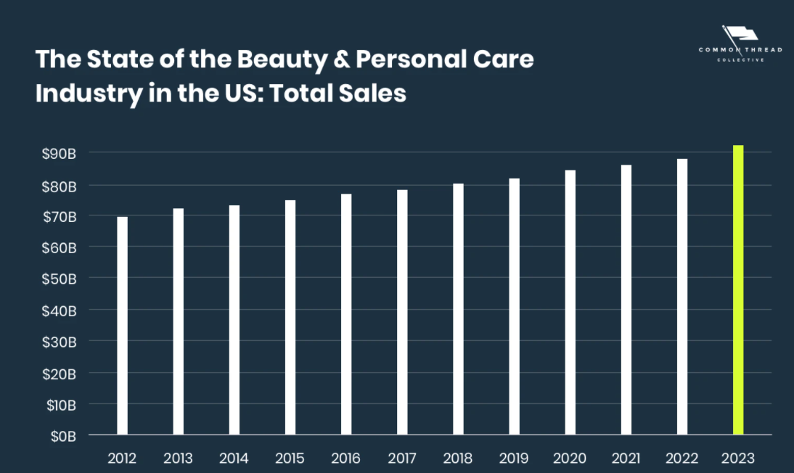
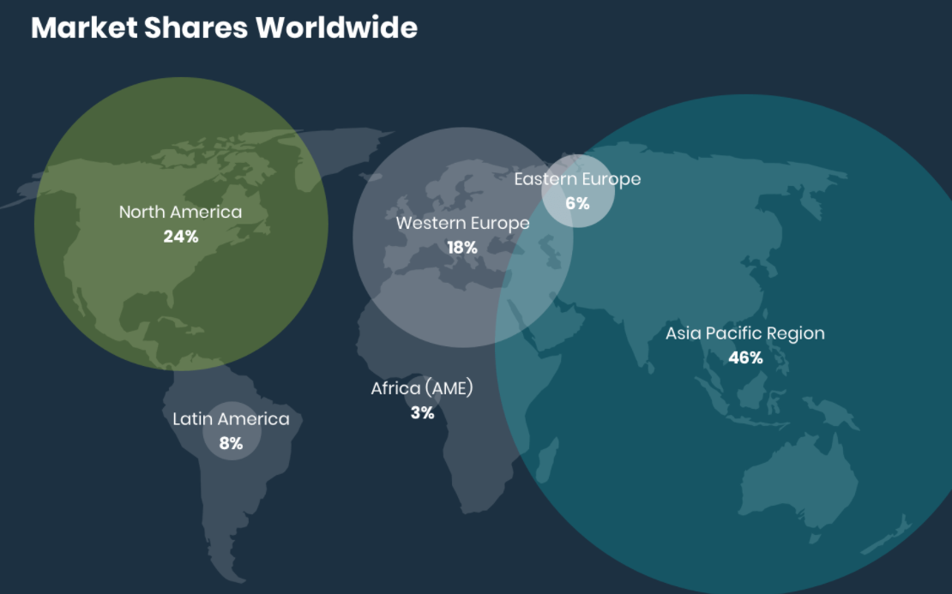
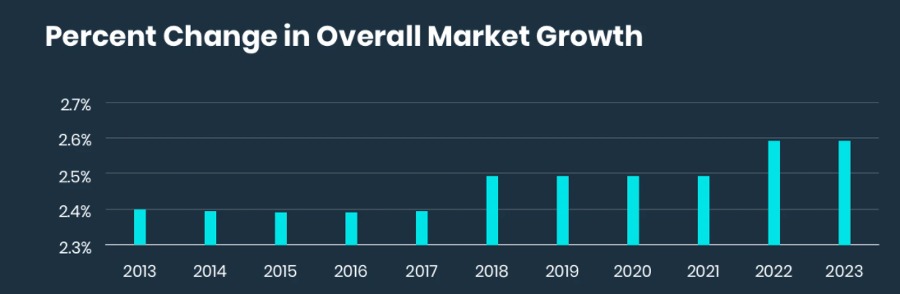
What Do We Mean by “Beauty/Cosmetics Industry”: Market Statistics
Commonthread Collective, Sources: Reports Global (2021), L’Oreal (2020) & Statista (2021)
It’s a $80B industry in the US and $500B industry worldwide that sees steady market growth.

Slide 3
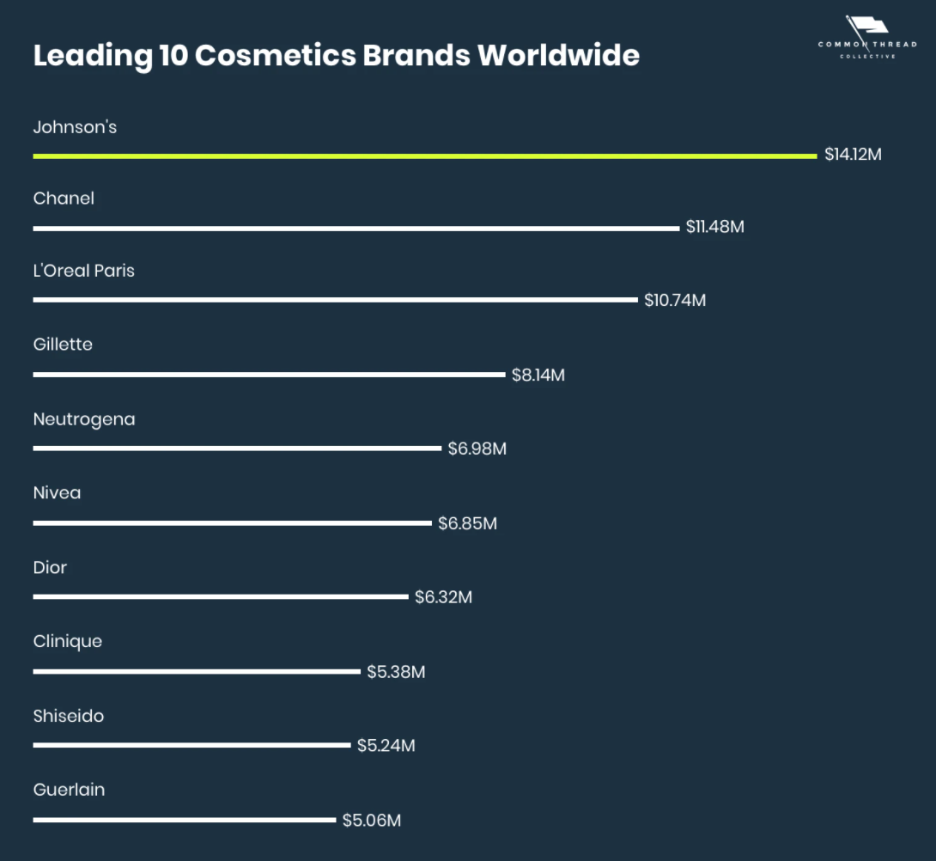
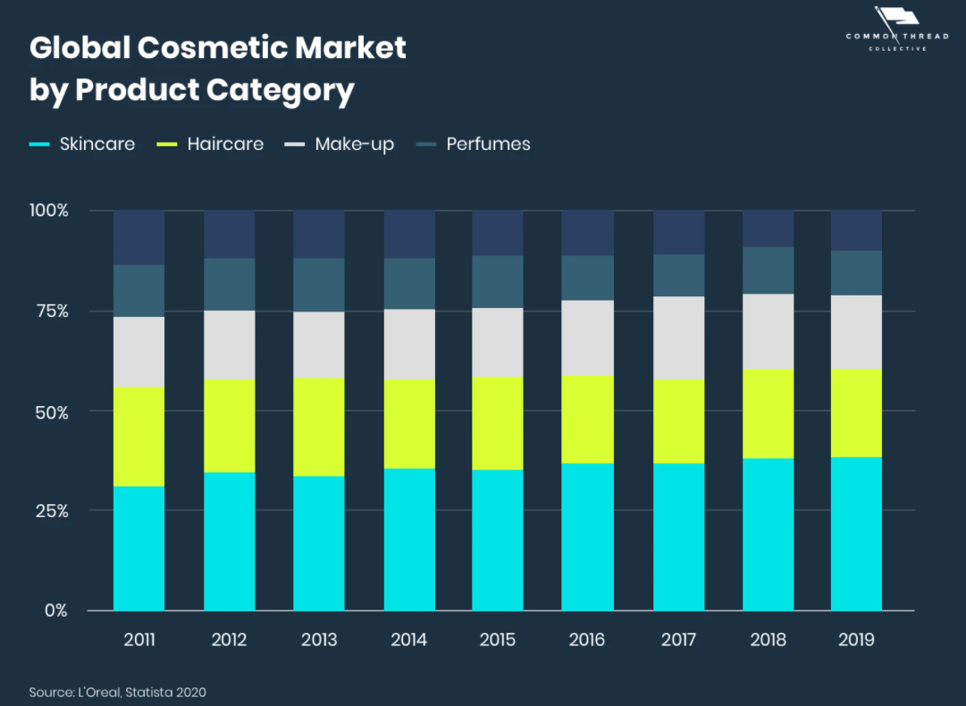
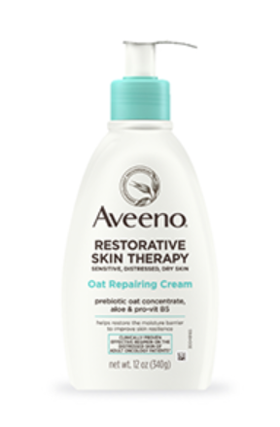

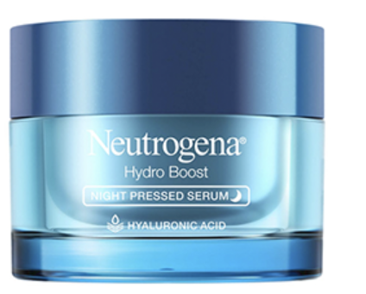
What Do We Mean by “Beauty/Cosmetics Industry”: Market Statistics
I use Dabao everyday
It’s more relevant to your everyday life than you have probably realized.
Commonthread Collective, Sources: L’Oreal (2020) & Statista (2021), Brand Finance (2019)

Slide 4
Value Chain
Raw Material
Production:
Chemistry & Formulation
Packaging & Distribution
Customer Behavior
Land & Water & Energy Use
Clean Energy Finance Forum

Slide 5
Value Chain
Raw Material
Production:
Chemistry & Formulation
Packaging & Distribution
Customer Behavior
Land & Water & Energy Use
Majority of the carbon footprint
Clean Energy Finance Forum

Slide 6

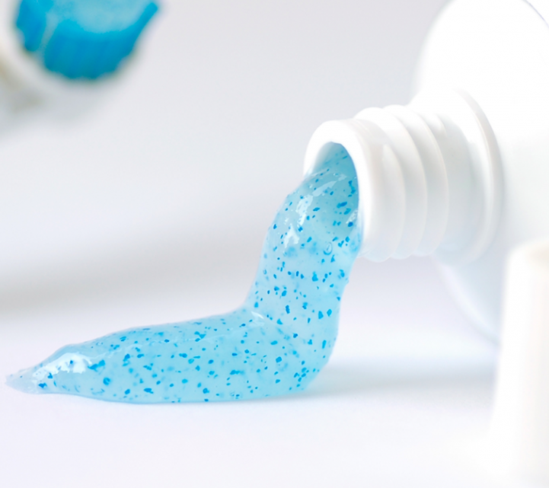

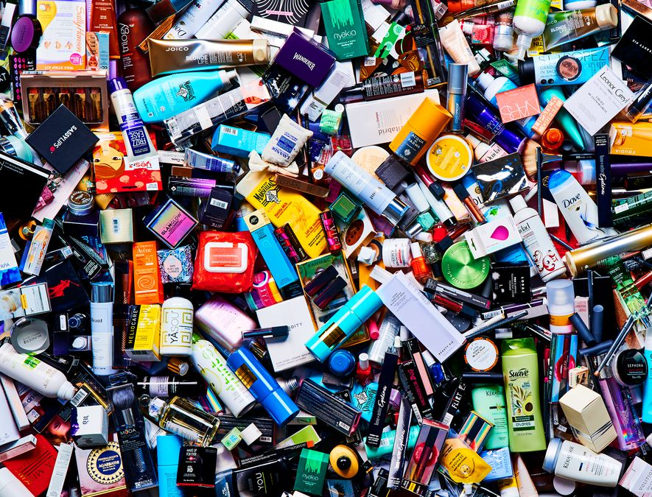

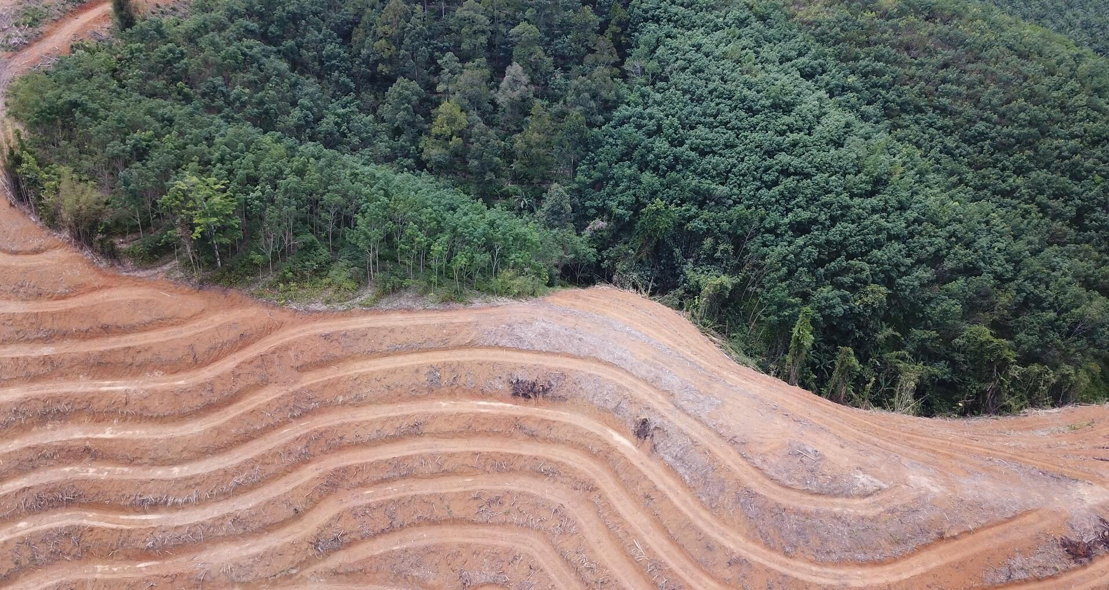
“The Ugly Side”
plastic waste
(what people typically think of)
the less talked about
“messy” waste that’s hard to recycle
major source of microplastic
VOC from hair spray contributing to smog
palm oil & deforestation

Slide 7
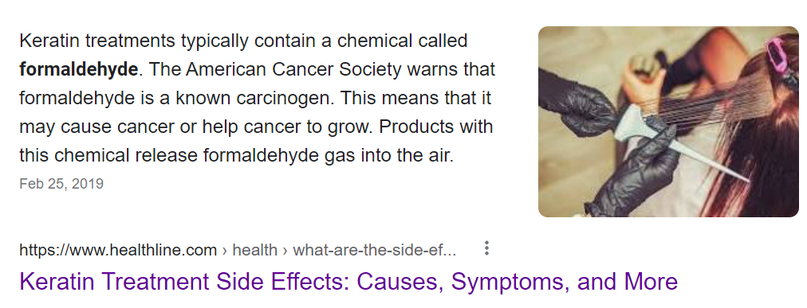
“The Ugly Side”
The less talked about
“messy” waste that’s hard to recycle
major source of microplastic
toxic chemicals
VOC from hair spray contributing to smog
palm oil & deforestation

Slide 8
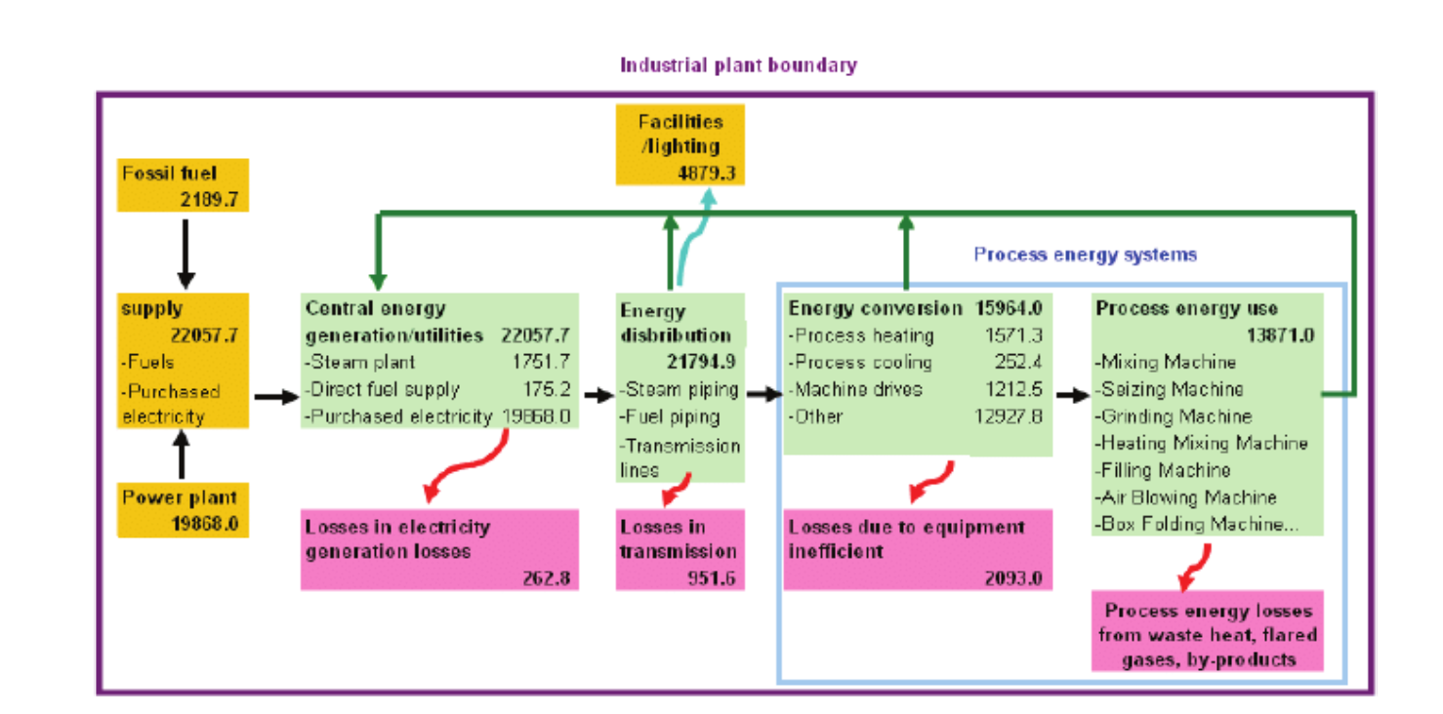
Energy Use in Production
Case study 1: energy flow profile of Taiwan cosmetics industry
Unit: GJ
Su, Leet, Hong. Environ. Eng. Manag. 2014, 13, 2971.

Slide 9
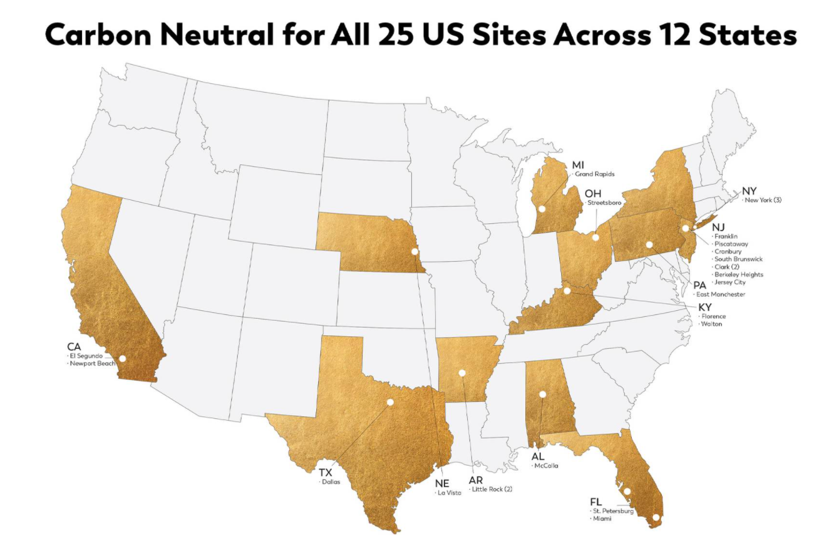
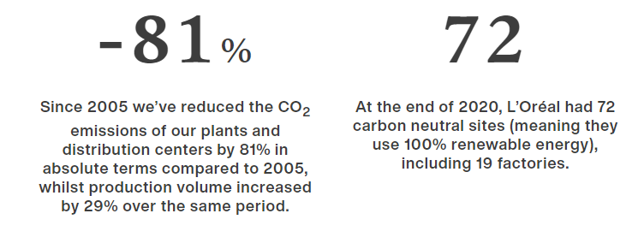
Energy Use in Production
Case study 2: L’Oreal reaching carbon neutrality in U.S.
Energy optimization
Reduce energy consumption in manufacturing facilities
  LED lighting
  High-efficiency air compressors and vacuum pumps
DOE Better Building, Better Plants program
Source: L’Oreal

Slide 10
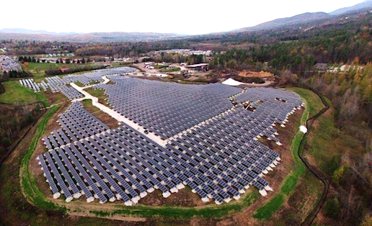
Energy Use in Production
Case study 2: L’Oreal reaching carbon neutrality in U.S.
Energy optimization
Reduce energy consumption in manufacturing facilities
  LED lighting
  High-efficiency air compressors and vacuum pumps
DOE Better Building, Better Plants program
Direct renewable energy projects
Largest commercial solar array in Kentucky
  4140 solar panels, 686000 sq ft.
Renewable energy in administrative offices
Locally Sources Renewable Energy Certificates
Renewable Natural Gas (RNG)
RNG from landfill gas projects in Texas & New York that capture and convert methane produced from natural decomposition of organic materials
Onsite gas for space and water heating
Source: L’Oreal
Notes:
Solar star, biggest solar farm in the world/US. 1.7 million solar panels over 13 square kilometers in LA, California

Slide 11
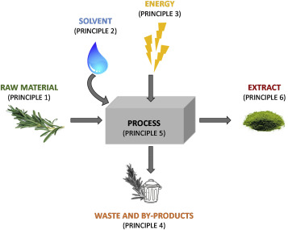
Chemistry & Formulation
Is natural product the answer: principles of green extraction of natural products
Use of alternative solvents and principally water or agro-solvents
Reduction of energy consumption by energy recovery and using innovative technologies
Aim for green extract with green values and non-denatured and biodegradable extract without contaminants
Innovation by selection of varieties and use of renewable plant resources
Reduction of unit operations number and development of safe, robust and controlled process
Production of co-products instead of waste towards bio-refinery concepts
Chemat et al. Trends in Analyt. Chem. 2019, 10.1016/j.trac.2019.05.037.

Slide 12
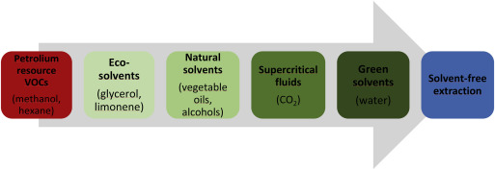
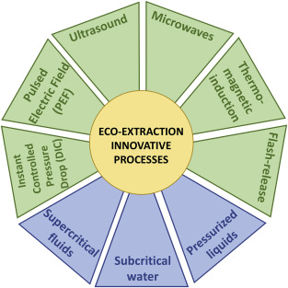
Chemistry & Formulation
Chemat et al. Trends in Analyt. Chem. 2019, 10.1016/j.trac.2019.05.037.

Slide 13
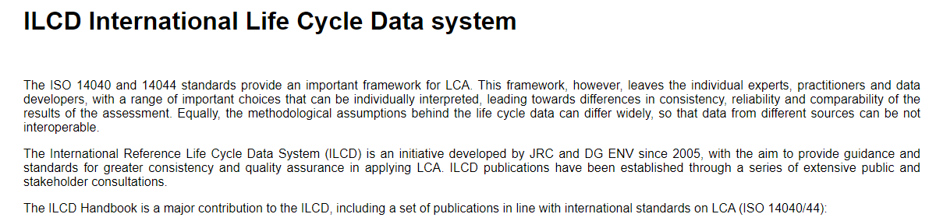
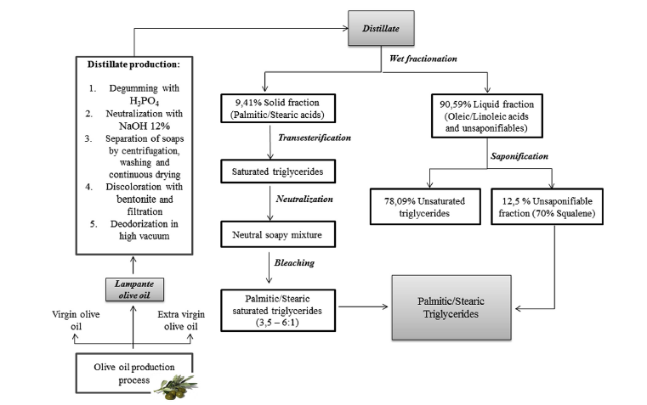
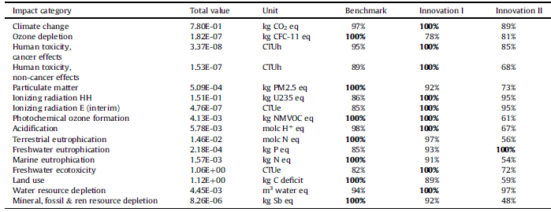
Chemistry & Formulation
Case study: life cycle analysis
use naturally extracted triglycerides to replace synthetic ingredients
Synthetic ingredient (benchmark) still does better in many impact categories (<100%)
Secchi et al. Trends in J. Clean. Prod. 2016, 129, 269..

Slide 14
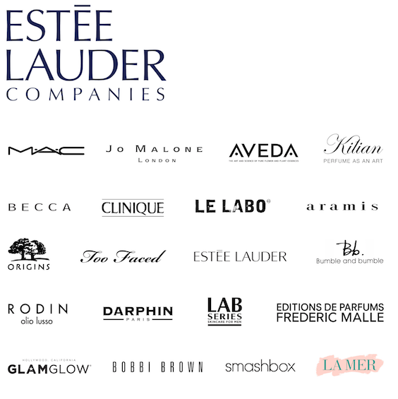
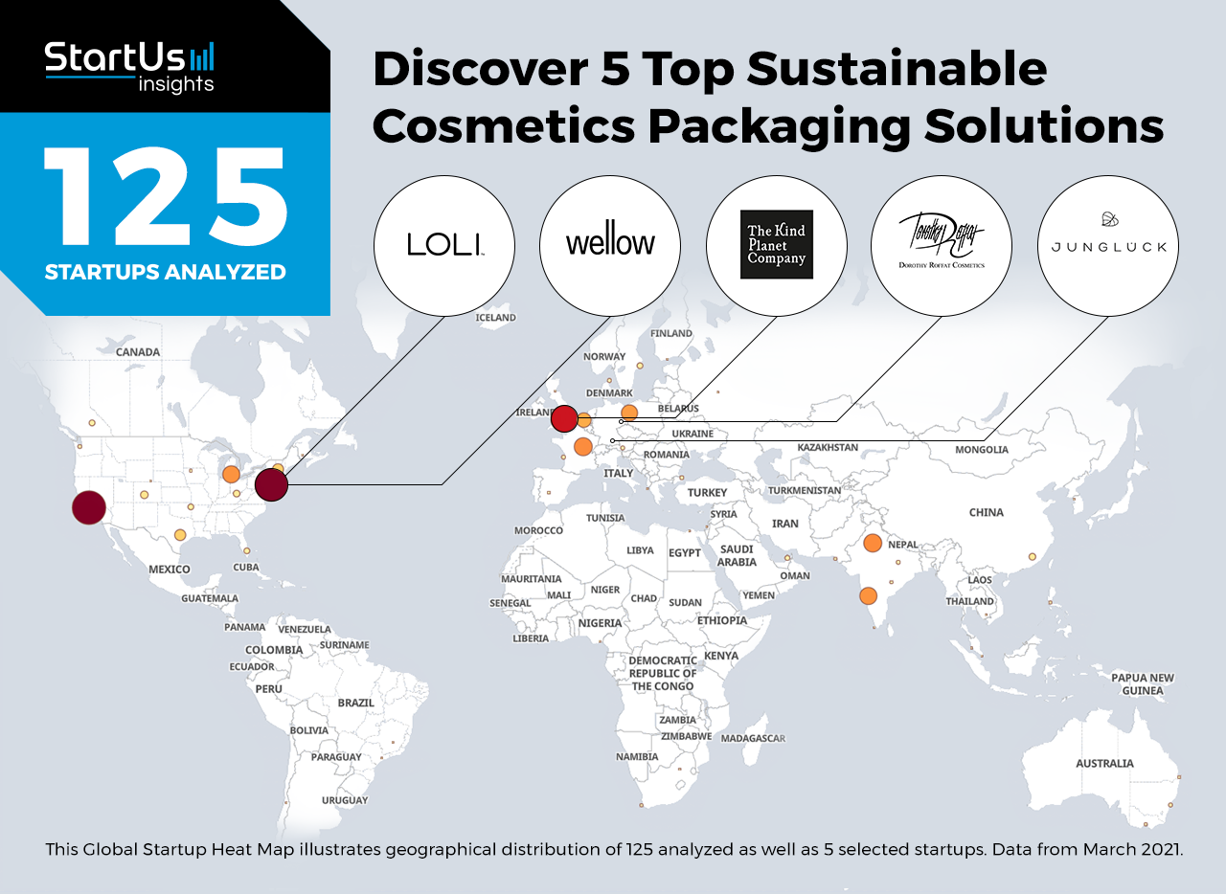
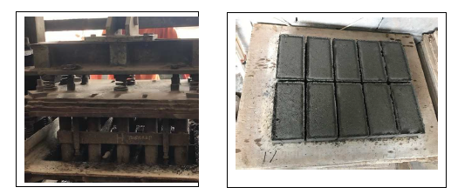
Packaging & Distribution
corporate actions
packaging startup
waste treatment/repurposing
Non-hazardous waste:
  Product reject, plastic bags, cardboard, paper
Hazardous waste:
  Chemical packaging drum
  Paint sludge: for pavement blocks
By 2025:
75-100% of packaging:
  Recyclable/recycled
  Refillable
  Reusable
  Recoverable
Returnable
Biodegradable/plant-based
Amber glass/direct printing
Compostable
Compostable
Source: Mint, StartUs
Purwanto, Permana-Citra. J. Phys. Conf. Ser. 2019, 012042.
Notes:
Lightweight construction materials

Slide 15
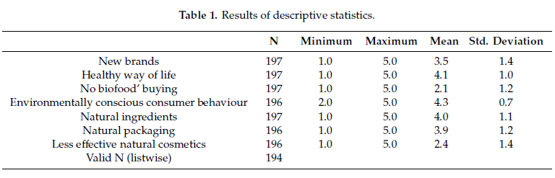
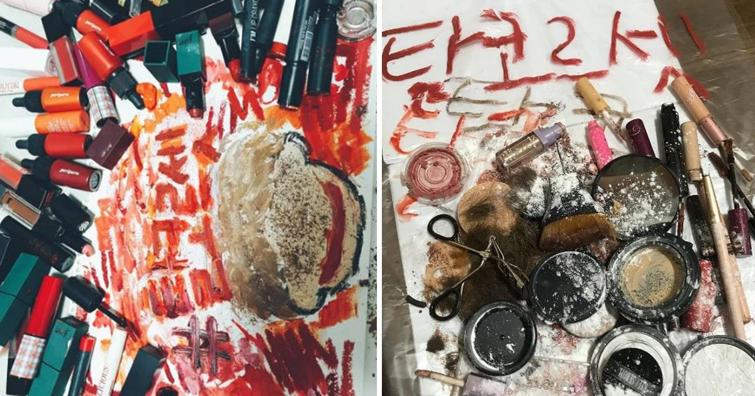
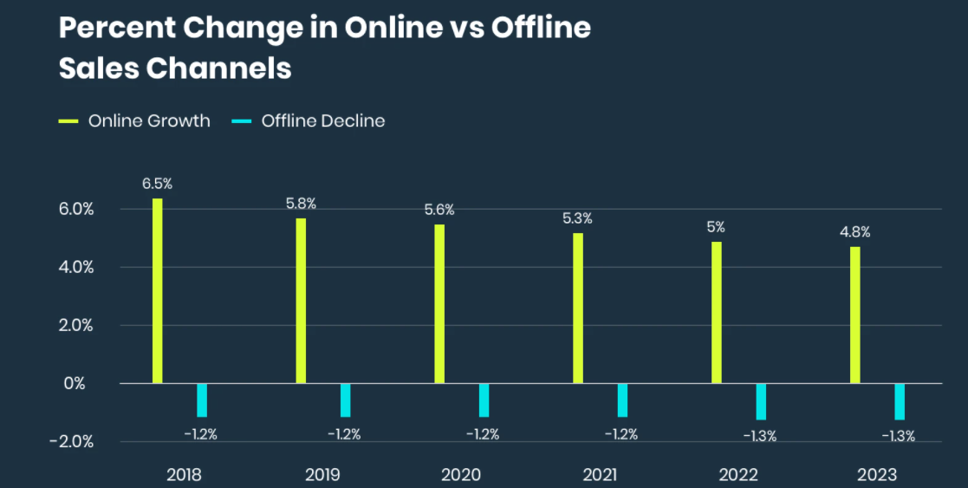

Customer Behavior
How much are costumers willing to pay/do?
Feminism movements in Asia
Increasing online sales
Amberg, Fogarassy. Resources 2019, 8, 137.
Source: Statista
Notes:
Return rate is low

Slide 16

Questions?
Thank you!

