Slide 1
Recent Developments In Nuclear Fusion
Harvard Energy Journal Club – 10/8
Robert Newman

Slide 2
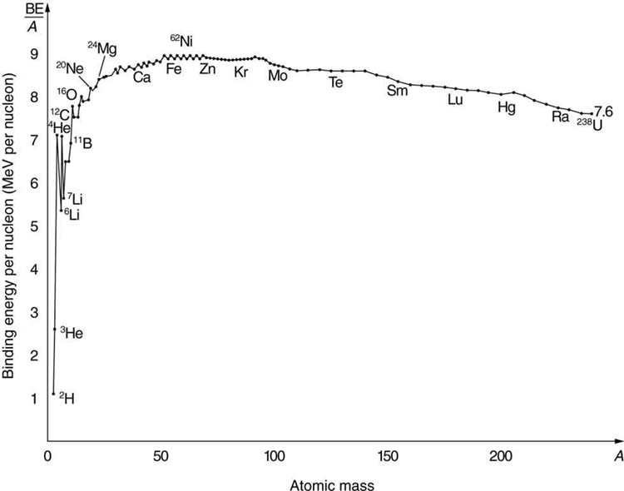
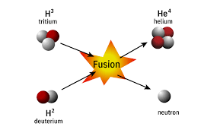

Slide 3
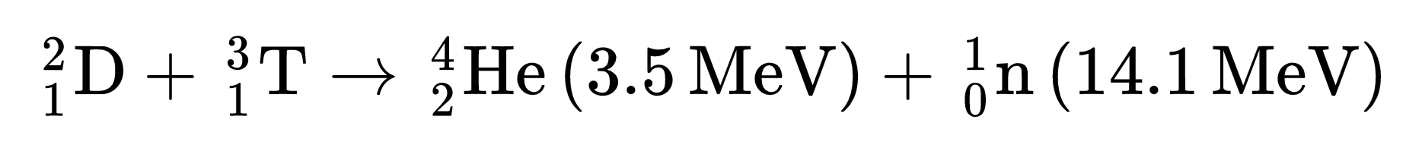
Advantages of Fusion
High energy density
Minimal radioactive waste
“Sustainable” fuel
Meltdowns are not self-sustaining

Slide 4
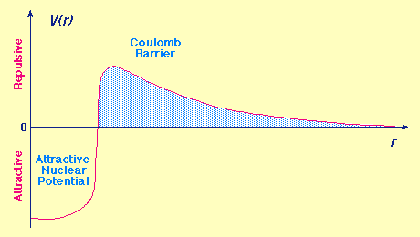

Slide 5
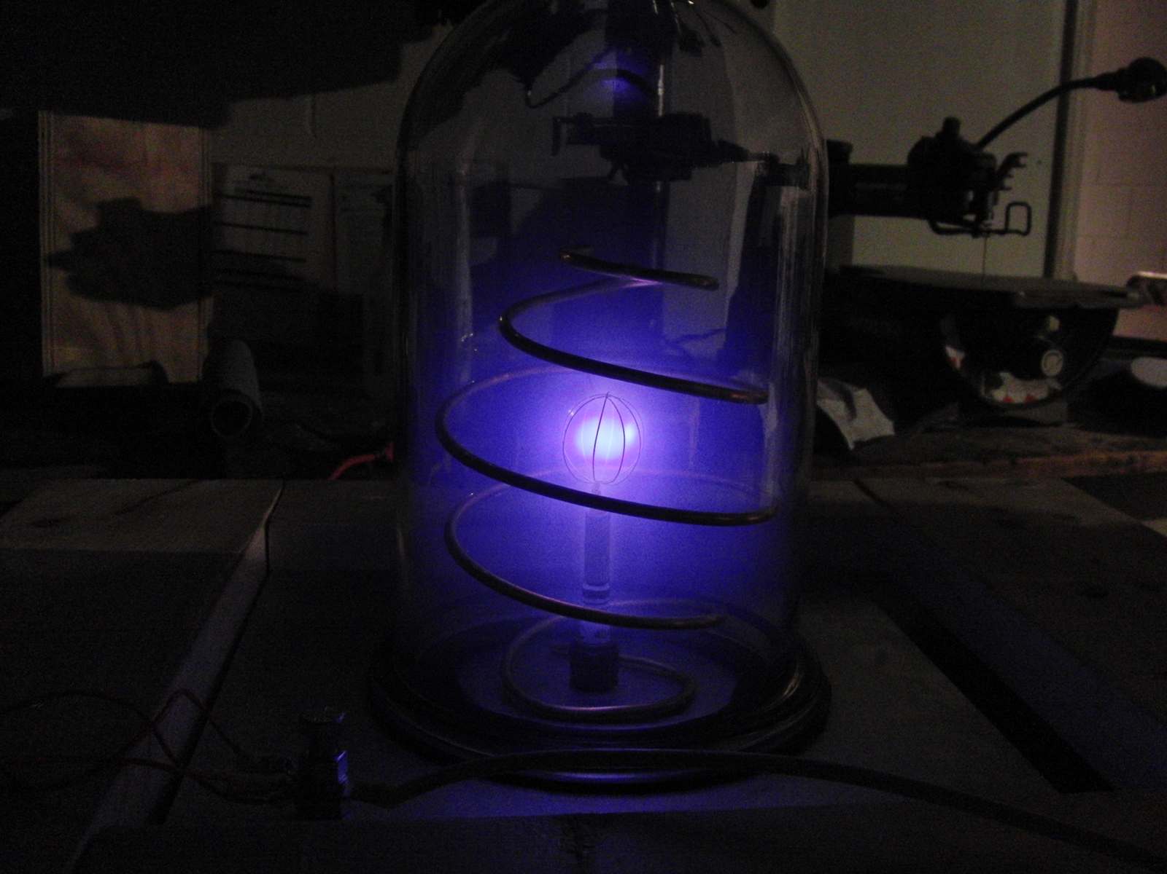
Fusion Is Easy

Slide 6
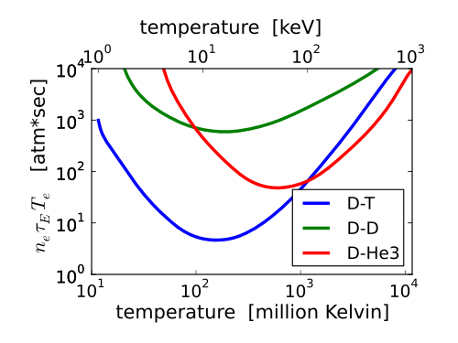
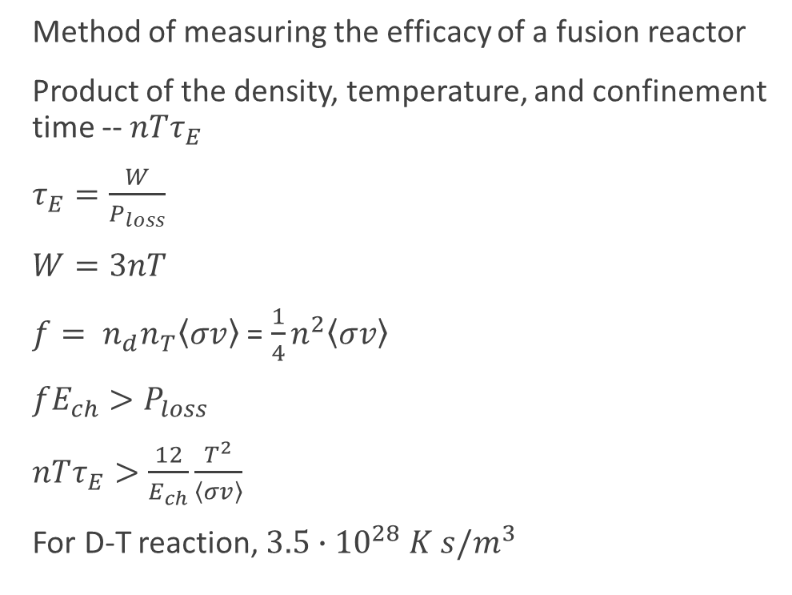
Fusion Triple Product
Method of measuring the efficacy of a fusion reactor
Product of the density, temperature, and confinement time -- $nTτ_{E}$
$τ_{E}=\frac{W}{P_{loss}}$
$W=3nT$
$f= n_{d}n_{T}\left\langle σv\right\rangle$ = $\frac{1}{4}n^{2}\left\langle σv\right\rangle$
$fE_{ch}>P_{loss}$
$nTτ_{E}>\frac{12}{E_{ch}}\frac{T^{2}}{\left\langle σv\right\rangle }$
For D-T reaction, $3.5∙{10}^{28} K s/m^{3}$

Slide 7
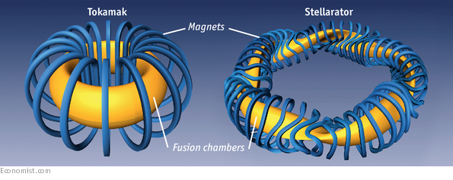
Magnetic Confinement Fusion

Slide 8
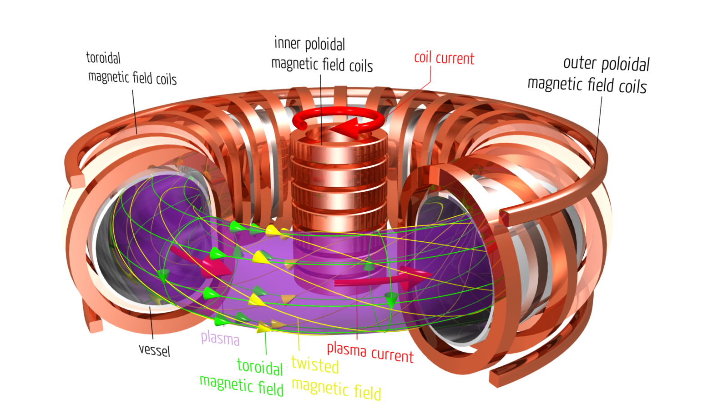
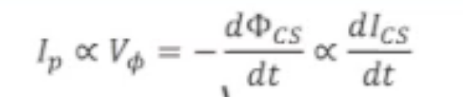
Tokamak
Induce current in the plasma:
Use central solenoid
Bootstrap current
Radio Frequency
Neutral Beam Injection

Slide 9
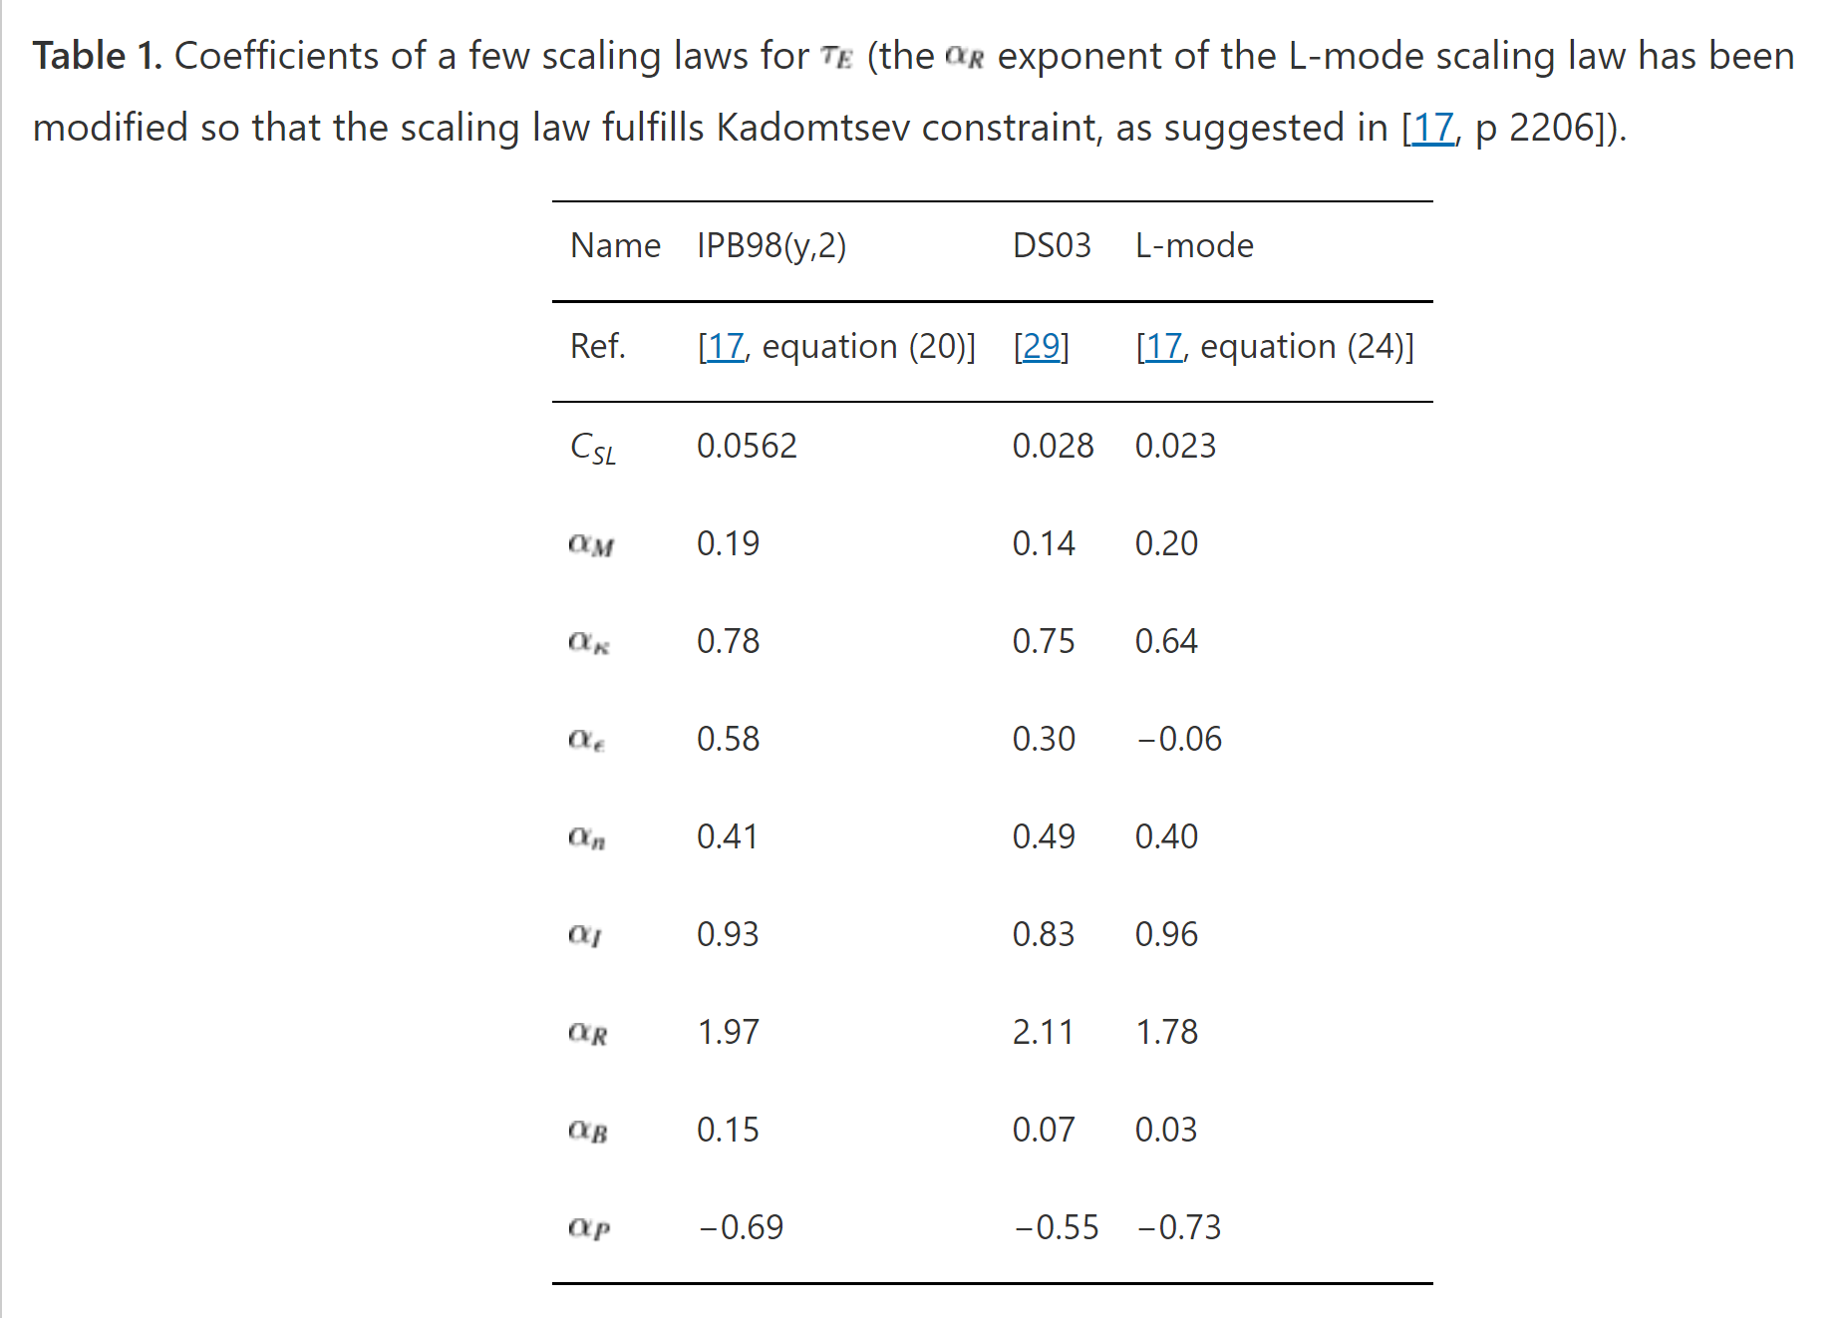
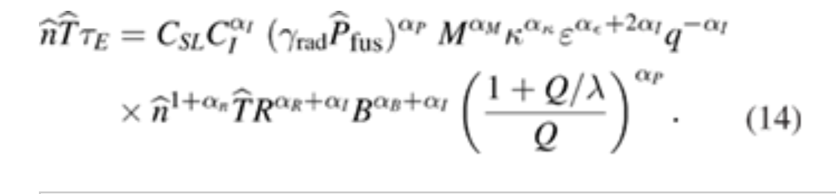
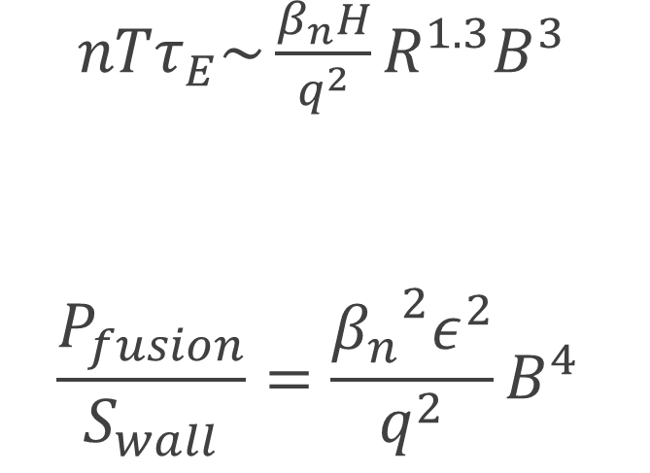
Magnetic Scaling
$nTτ_{E}\sim \frac{β_{n}H}{q^{2}}R^{1.3}B^{3}$
$$\frac{P_{fusion}}{S_{wall}}=\frac{{β_{n}}^{2}ε^{2}}{q^{2}}B^{4}$$

Slide 10
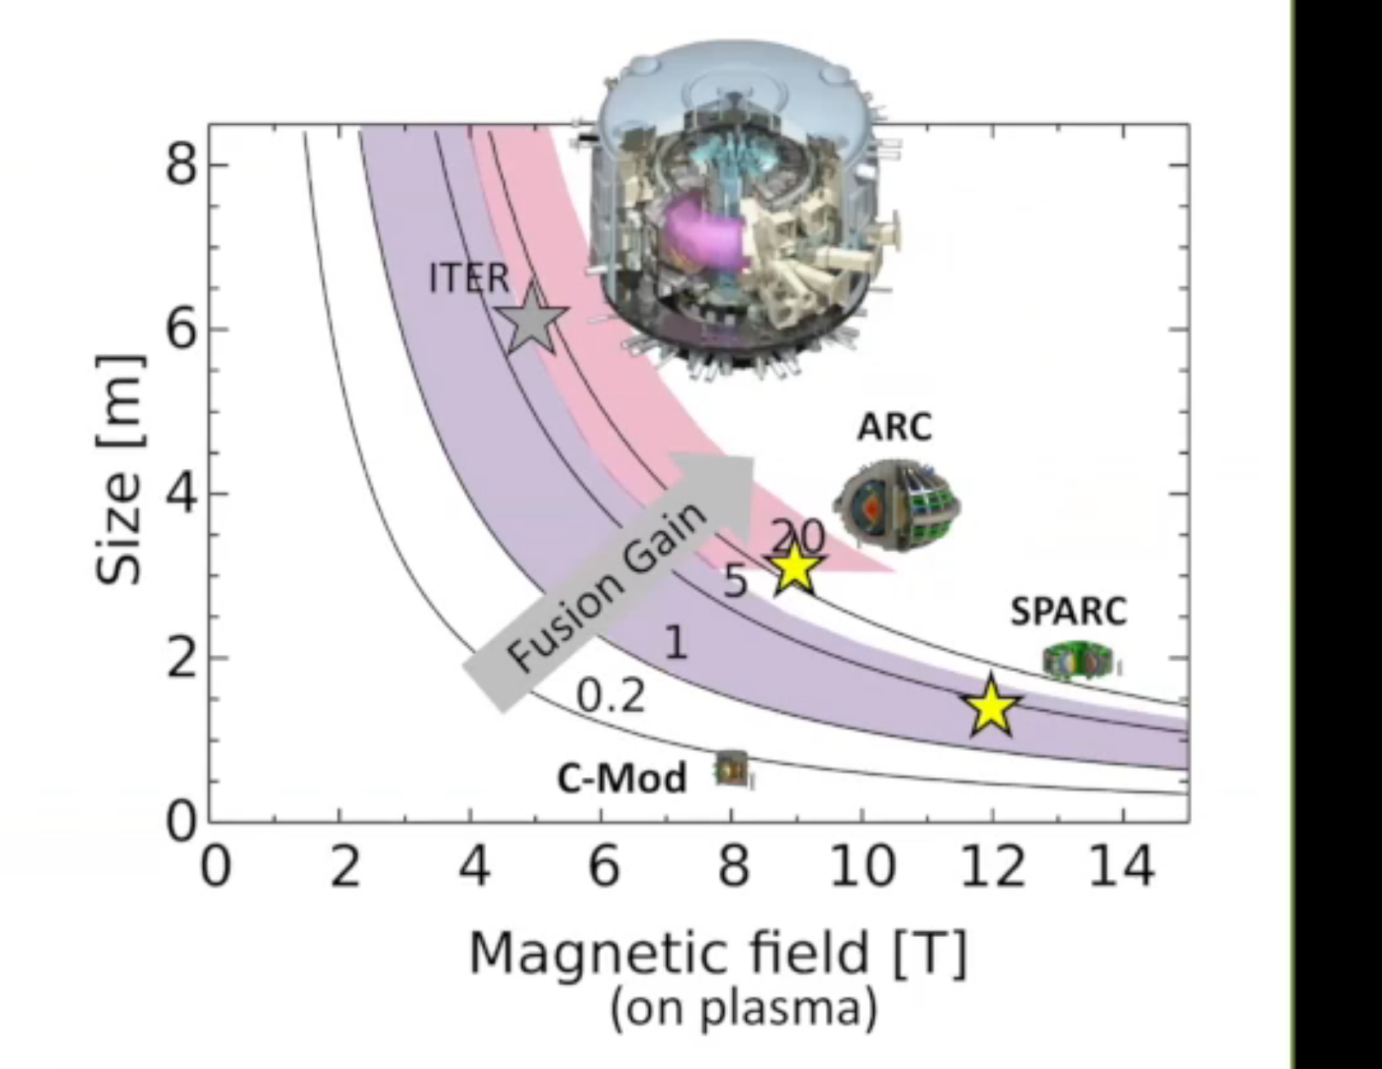
Radius Vs Magnetic Field

Slide 11
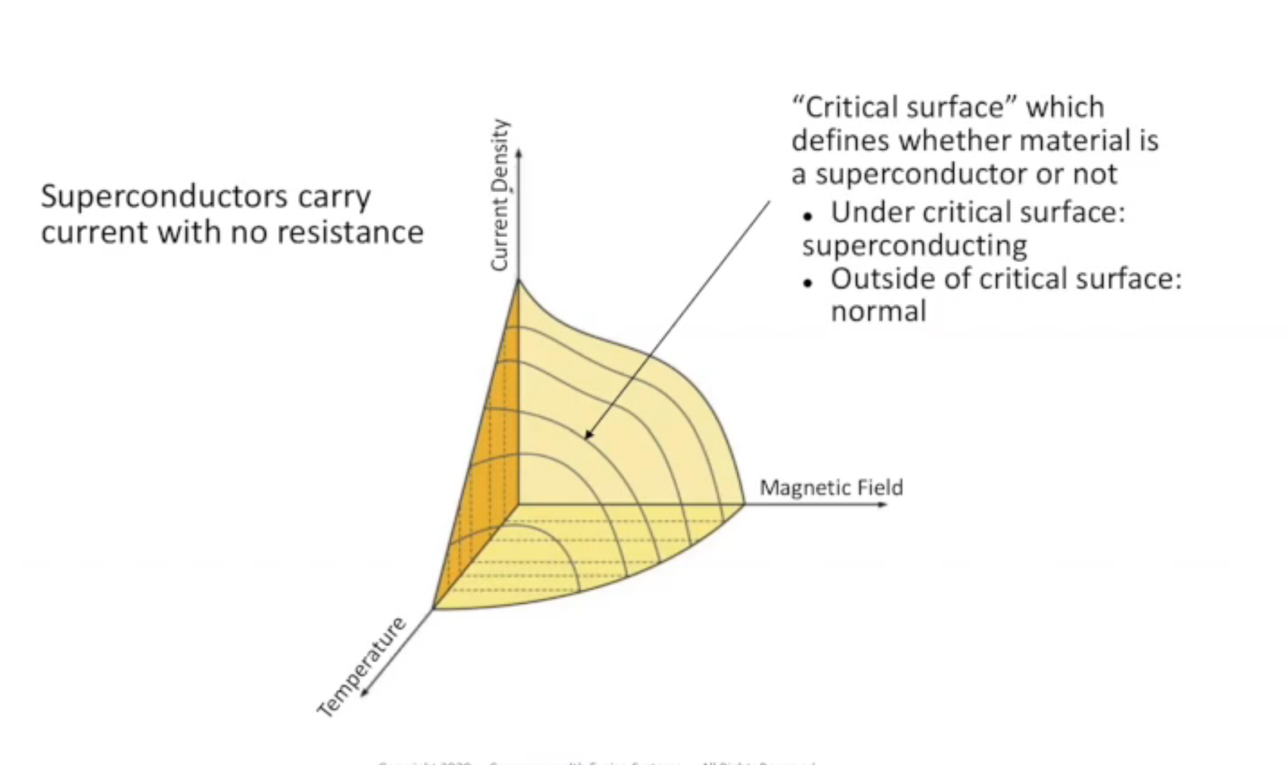

Slide 12
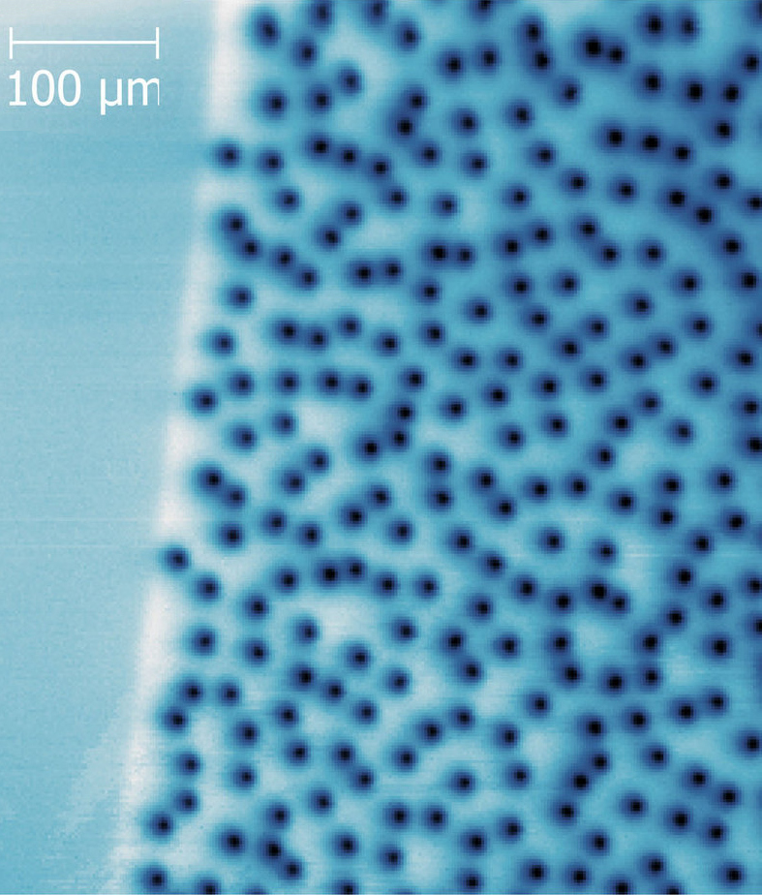
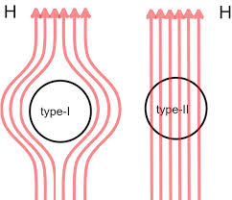
Type I vs Type II Superconductors

Slide 13
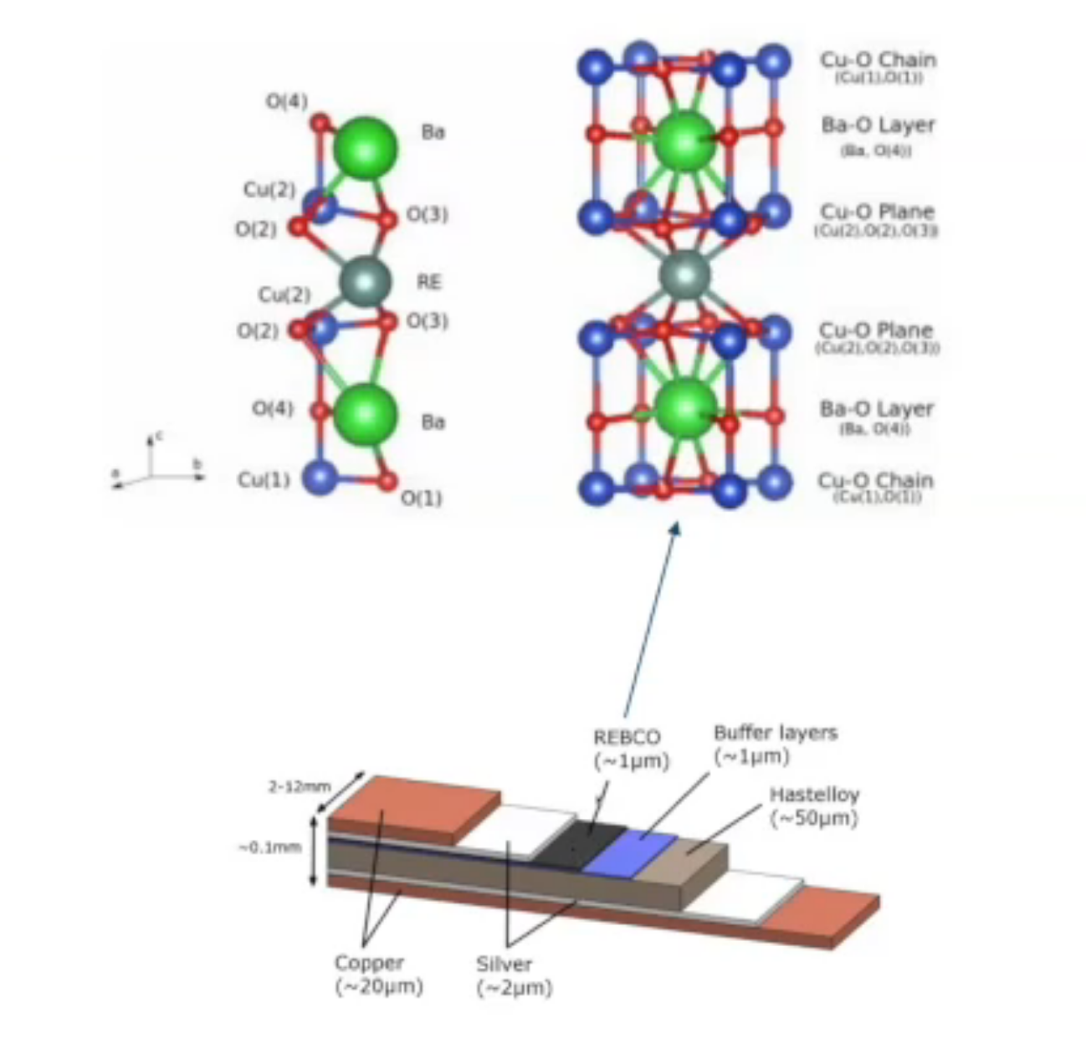
REBCO Super Conductors

Slide 14
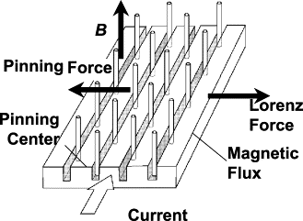
Flux Pinning

Slide 15
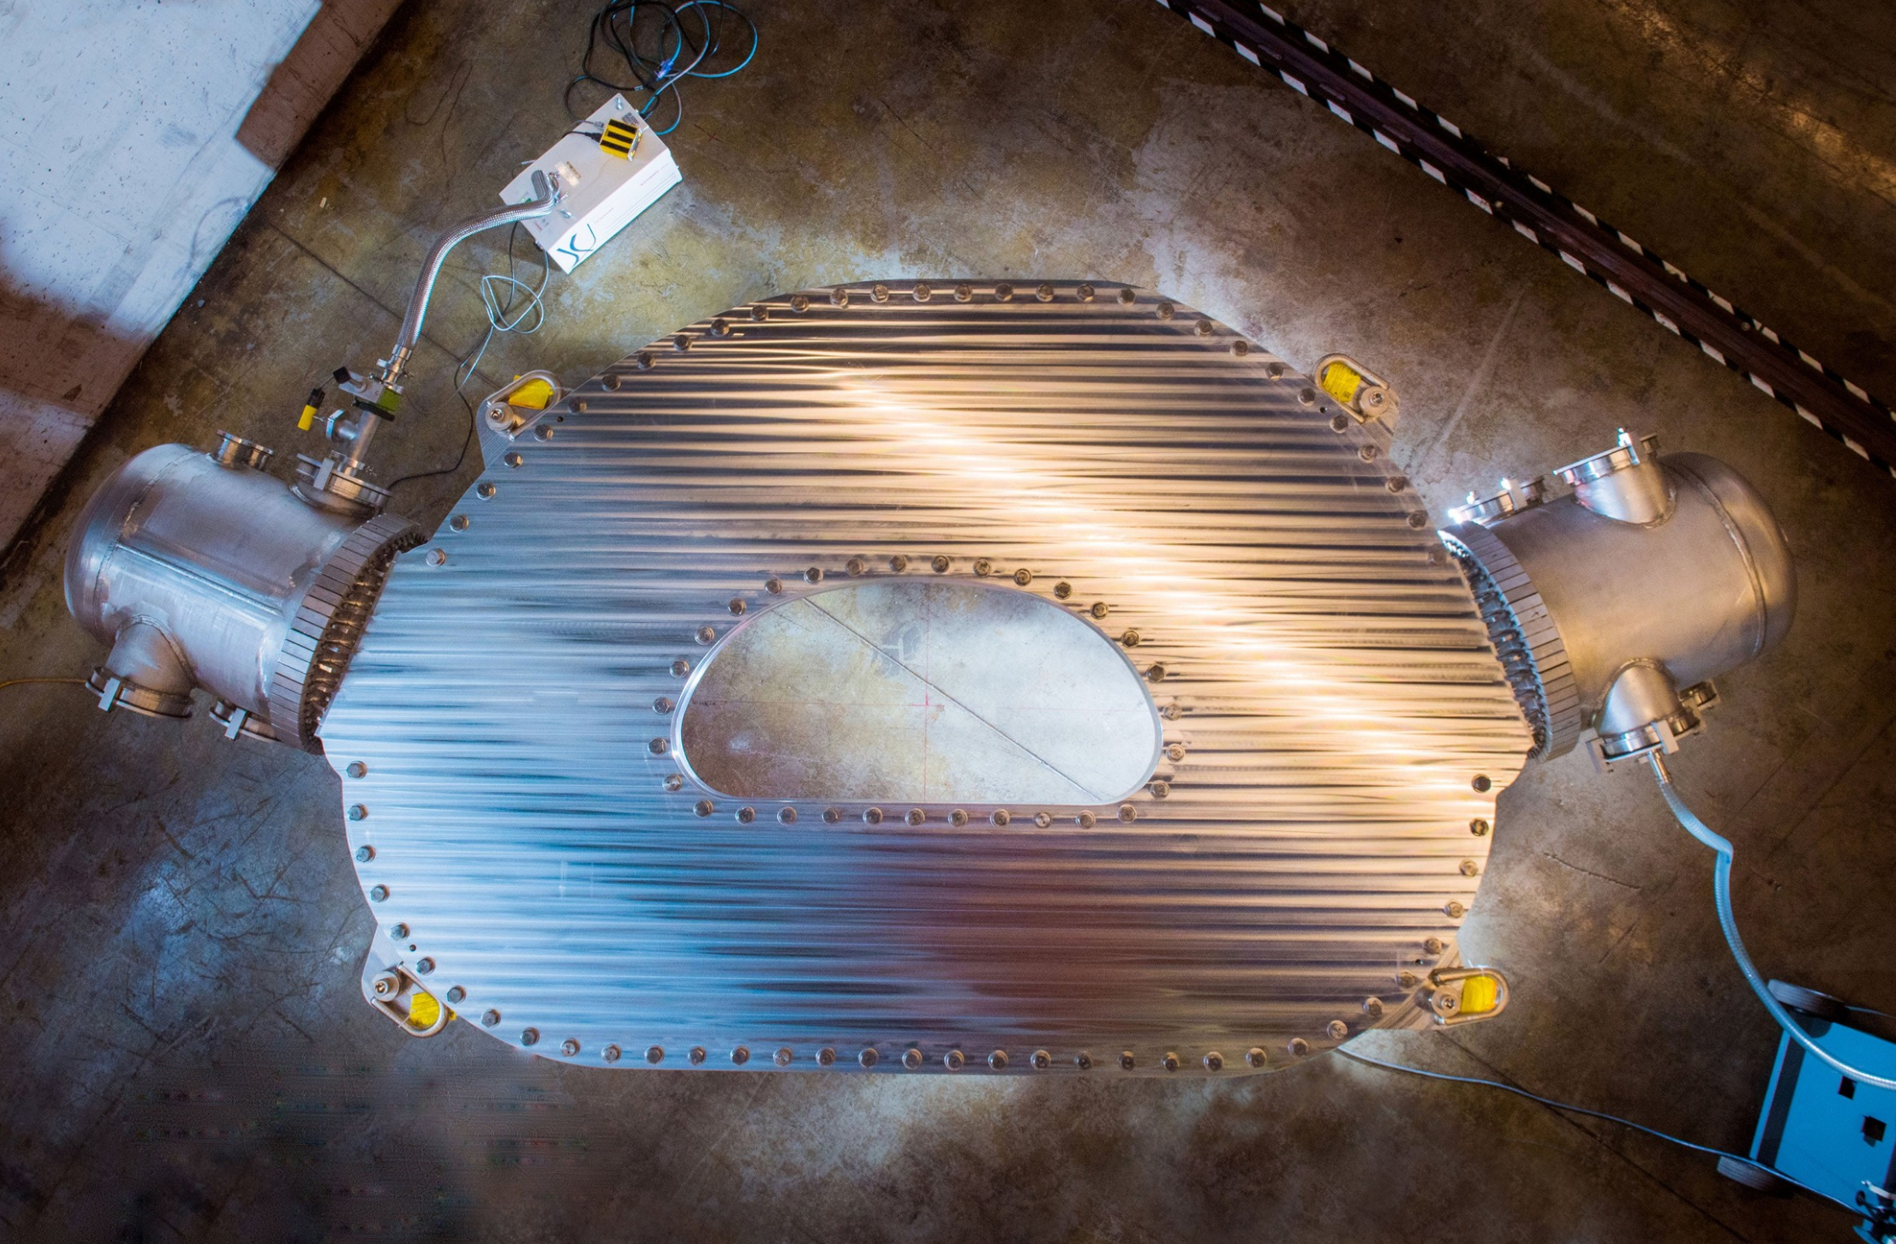
CFS 20T Magnet

Slide 16
What Happened and Ramifications
Engineering feat of being able to build magnet
  Removing impurities and defects during manufacturing
  Testing and collecting data for refinement
  Increasing manufacturing capacity for REBCO
Previous papers proved the efficacy of the SPARC reactor contingent on the high field magnets
Extremely compact and powerful magnets could be used in other applications

Slide 17
Problems Yet to be Solved
Appropriate materials for plasma contact
Sufficient methods of plasma
Blanket design and tritium breeding
  Lithium blankets are required to make tritium

Slide 18
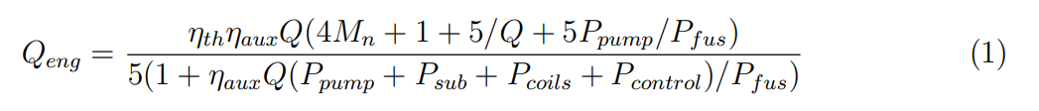
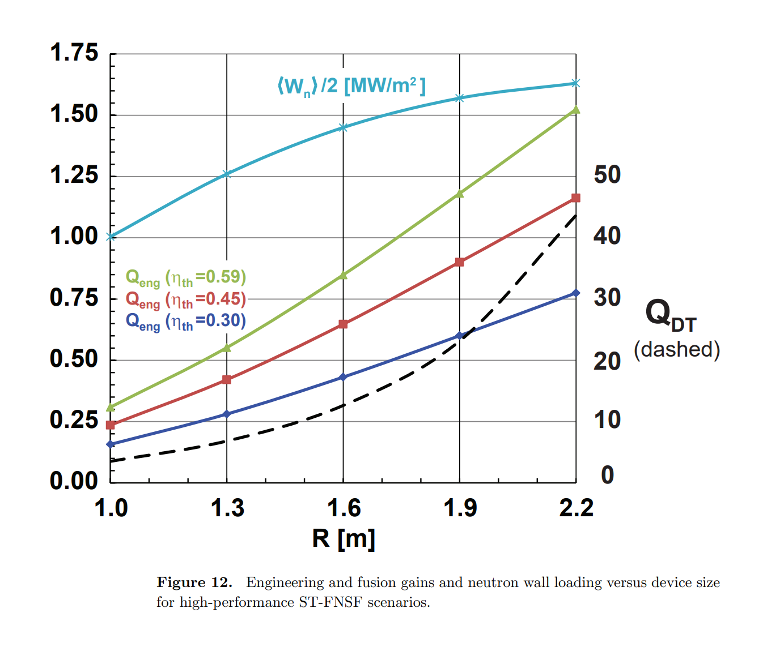

Slide 19
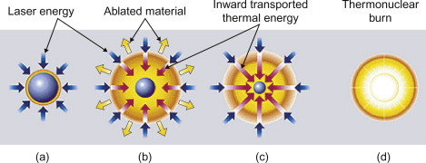
Inertial Confinement Fusion

Slide 20
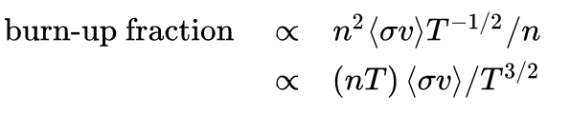

Ignition
Heating from alpha particles is sufficient to continue the reaction
$v_{th}= \sqrt{\frac{k_{B}T}{m_{i}}}$
$τ_{E}= \frac{R}{v_{th}}=R$ $\sqrt{\frac{m_{i}}{k_{B}T}}$
$nR>\frac{{(k_{B}T)}^{3/2}}{\left\langle σv\right\rangle }$ > 1 g/cm^2

Slide 21
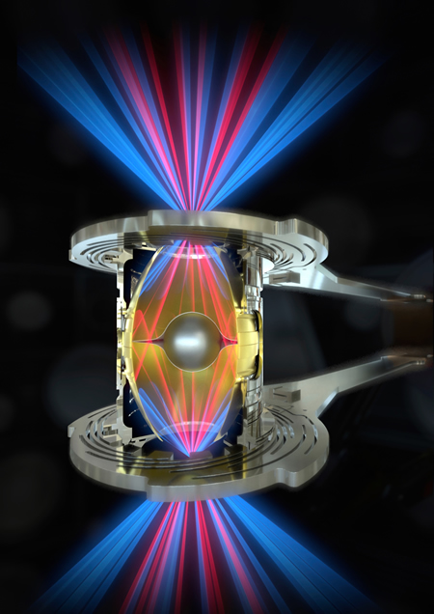
Direct vs Indirect
Direct drive absorbs laser light, ablating spherical shell
Minor instabilities can cause leakages (Rayleigh-Taylor instabilities)
Indirect uses a hohlraum to produce an even distribution of x-rays to be absorbed by the fuel
  More similar to thermonuclear warheads

Slide 22
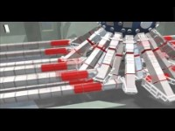
National Ignition Facility

Slide 23
Achievement
On Aug 8, produced 70% of required energy to initiate nuclear reaction
Produced about 10 quadrillion Watts for 100 trillionths of a second
Highest Q in a fusion experiment ever
Parameters responsible for the jump unknown?

Slide 24
Inertial Confinement Problems
Low energy efficiency in laser amplification (1 to 1.5%)
  Requires Q=350 for electricity break even
Flash lamps to be replaced with laser diodes
Fast Ignition?
Fuel costs

Slide 25
Sources
R. Betti, P. Y. Chang, B. K. Spears, K. S. Anderson, J. Edwards, M. Fatenejad, J. D. Lindl, R. L. Mccrory, R. Nora, and D. Shvarts, “Thermonuclear ignition in inertial confinement fusion and comparison with magnetic confinement,” Physics of Plasmas, vol. 17, no. 5, p. 058102, 2010.
“Bootstrap current,” Wikipedia, 23-Feb-2021. [Online]. Available: https://en.wikipedia.org/wiki/Bootstrap_current. [Accessed: 11-Oct-2021].
David Chandler | MIT News Office, “MIT-designed project achieves major advance toward fusion energy,” MIT News | Massachusetts Institute of Technology. [Online]. Available: https://news.mit.edu/2021/MIT-CFS-major-advance-toward-fusion-energy-0908. [Accessed: 11-Oct-2021].
“Fusion ignition,” Wikipedia, 30-Aug-2021. [Online]. Available: https://en.wikipedia.org/wiki/Fusion_ignition. [Accessed: 11-Oct-2021].
“Fusion power,” Wikipedia, 10-Oct-2021. [Online]. Available: https://en.wikipedia.org/wiki/Fusion_power. [Accessed: 11-Oct-2021].
How NIF Works. [Online]. Available: https://lasers.llnl.gov/about/how-nif-works. [Accessed: 11-Oct-2021].
“HTS Magnets,” Commonwealth Fusion Systems. [Online]. Available: https://cfs.energy/technology/hts-magnets. [Accessed: 11-Oct-2021].
“Inertial confinement fusion,” Wikipedia, 09-Oct-2021. [Online]. Available: https://en.wikipedia.org/wiki/Inertial_confinement_fusion. [Accessed: 11-Oct-2021].
“Lawson criterion,” Wikipedia, 22-Sep-2021. [Online]. Available: https://en.wikipedia.org/wiki/Lawson_criterion. [Accessed: 11-Oct-2021].
J. Menard, T. Brown, L. El-Guebaly, M. Boyer, J. Canik, B. Colling, R. Raman, Z. Wang, Y. Zhai, P. Buxton, B. Covele, C. D’Angelo, A. Davis, S. Gerhardt, M. Gryaznevich, M. Harb, T. Hender, S. Kaye, D. Kingham, M. Kotschenreuther, S. Mahajan, R. Maingi, E. Marriott, E. Meier, L. Mynsberge, C. Neumeyer, M. Ono, J.-K. Park, S. Sabbagh, V. Soukhanovskii, P. Valanju, and R. Woolley, “Fusion nuclear science facilities and pilot plants based on the spherical tokamak,” Nuclear Fusion, vol. 56, no. 10, p. 106023, 2016.

Slide 26
Sources
“National Ignition Facility experiment achieves record-breaking yield,” ANS. [Online]. Available: https://www.ans.org/news/article-3169/national-ignition-facility-experiment-achieves-recordbreaking-yield/. [Accessed: 11-Oct-2021].
“National Ignition Facility experiment puts researchers at threshold of fusion ignition,” LLNL. [Online]. Available: https://www.llnl.gov/news/national-ignition-facility-experiment-puts-researchers-threshold-fusion-ignition. [Accessed: 11-Oct-2021].
“Nuclear fusion,” Wikipedia, 29-Sep-2021. [Online]. Available: https://en.wikipedia.org/wiki/Nuclear_fusion. [Accessed: 11-Oct-2021].
“SULI19Jun2020_BSorbom - Princeton University Media Central,” Princeton University. [Online]. Available: https://mediacentral.princeton.edu/media/SULI19Jun2020_BSorbom/1_82x9z7d7/13468191. [Accessed: 11-Oct-2021].
“SULI_18Jun20_BBattaglia - Princeton University Media Central,” Princeton University. [Online]. Available: https://mediacentral.princeton.edu/media/SULI_18Jun20_BBattaglia/1_r5hr9brn/13468191. [Accessed: 11-Oct-2021].
“Welcome to the 2020 Introduction to Fusion Energy and Plasma Physics Course,” 2020 Intro Course. [Online]. Available: https://suli.pppl.gov/2020/course/. [Accessed: 11-Oct-2021].
Menard JE. Compact steady-state tokamak performance dependence on magnet and core physics limits. Philos Trans A Math Phys Eng Sci. 2019;377(2141):20170440. doi:10.1098/rsta.2017.0440
S.-I. Itoh and K. Itoh 1989 Nucl. Fusion 29 1031
Y. Sarazin et al 2020 Nucl. Fusion 60 016010
Zohm Hartmut 2019 On the size of tokamak fusion power plants Phil. Trans. R. Soc. A. 3772017043720170437 https://doi.org/10.1098/rsta.2017.0437

