Slide 1
Adaptive Buildings and Energy-Efficient Living
Mandy Liu
HEJC
04/09/2021

Slide 2


Conventional buildings and their energy costs
Sheltering and protection as the central function of buildings, achieved by creating solid, static boundaries between the indoor environment and the surroundings.
However, to satisfy comfort requirements, more efforts are needed.
HVAC, lighting
Comfort energy consumption
HVAC: heating, ventilation, air-conditioning
Loonen, Cóstola, Hensen, Renew. Sustain. Energy Rev. 2013, 25, 483.

Slide 3
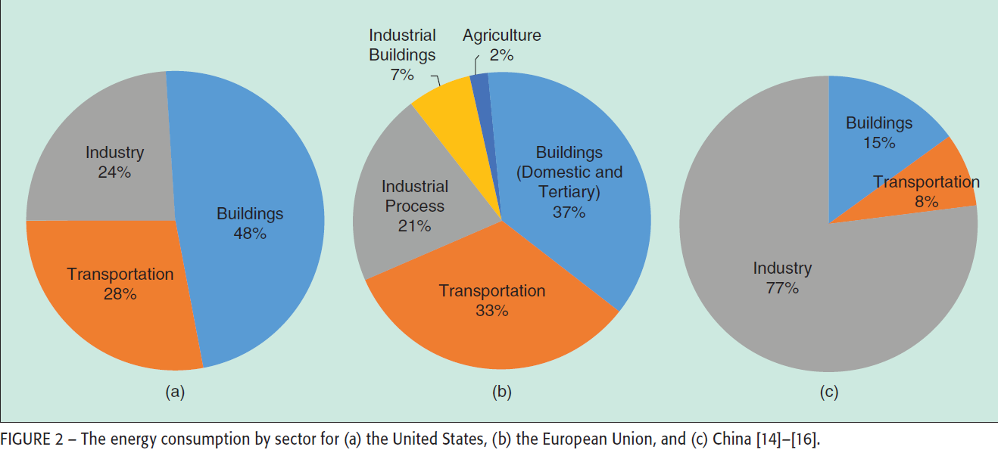
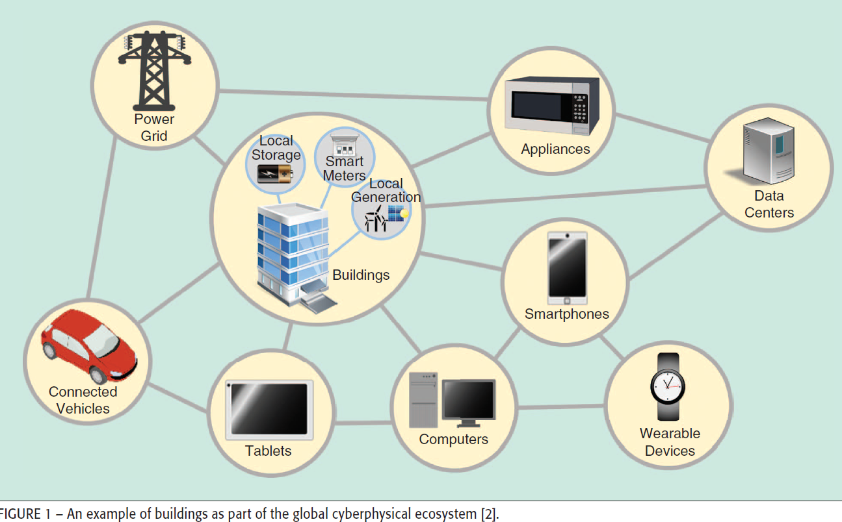
Energy consumption of buildings
United States
European Union
China
Building at the center of modern lifestyle
Manic, Wijayasekara, Amarasinghe, Rodriguez-Andina, Ind. Electron. Mag. 2016, 1932

Slide 4


Adaptive building: scope of discussion
real-time environmental conditions/climate
user activity
living systems with natural responsiveness
dynamic responsiveness in adaptive buildings

Slide 5
Scope of discussion
adaptive building shell
responsive technology (sensing/control/actuation)
building control system/building energy management systems: control HVAC and lighting
distinction from zero-energy building:
net zero energy consumption
adaptive building:
improving energy consumption efficiency/reduce consumption (20-40%) while improving user comfort and interactivity

Slide 6
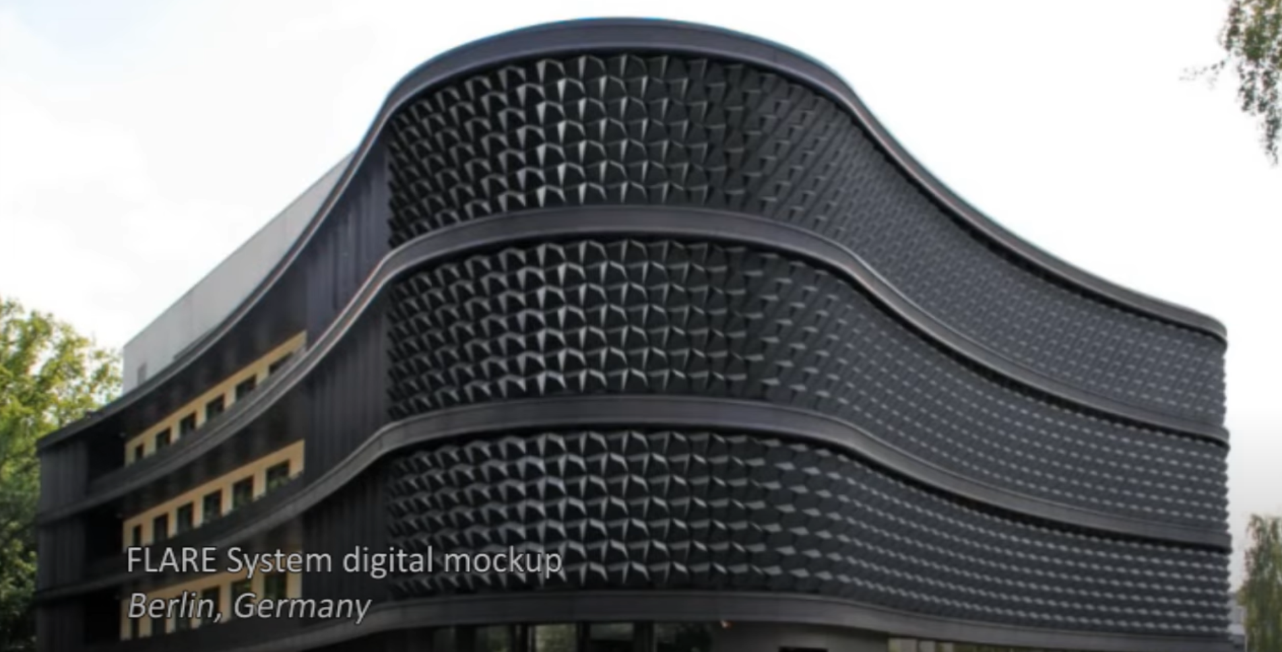
Climate-adaptive building shell (CABS)
“A climate adaptive building has the ability to repeatedly and reversibly change some of its functions, features or behavior over time in response to changing performance requirements and variable boundary conditions, and does this with the aim of improving overall building performance”
Often with an emphasis on energy performance
Building shell: construction element that divide inside and outside air.
https://youtu.be/6XPzQgOH3pE
Loonen, Cóstola, Hensen, Renew. Sustain. Energy Rev. 2013, 25, 483.

Slide 7
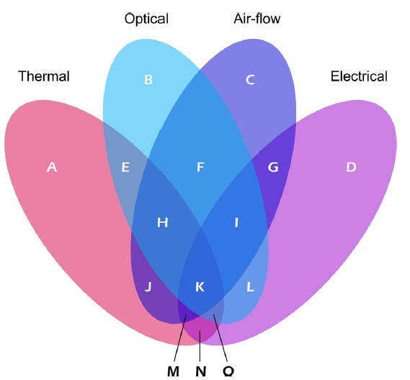
Categories of CABS
relevant physics
time-frame
Seconds, fluctuations that are stochastic in nature
Minutes, cloud cover and daylight availability
Hours, angular movements of the sun
Diurnal, day-night cycles, ambient air temperature and solar radiation
Seasons, most “elegant” application area, etc. “thermal diode”
Loonen, Cóstola, Hensen, Renew. Sustain. Energy Rev. 2013, 25, 483.

Slide 8
Categories of CABS
Scale of changes
Macro
  Presence of observable movements
  Changes in the building shell’s configuration via moving parts
Micro
  Changes directly affect the internal structure of a material
  Etc. smart windows, light transmitting properties based on external stimuli
Control types
Extrinsic: feedback based
  Compare current with desired state
  Sensors, processors, actuators
  Either distributed or centralized
Intrinsic: environmental stimuli based
  Automatically triggered by environmental conditions: humidity, temperature, wind speed
  No hardware for control units/processors are necessary
  Limitation: sensitive to disturbances deviating from design conditions
Loonen, Cóstola, Hensen, Renew. Sustain. Energy Rev. 2013, 25, 483.

Slide 9
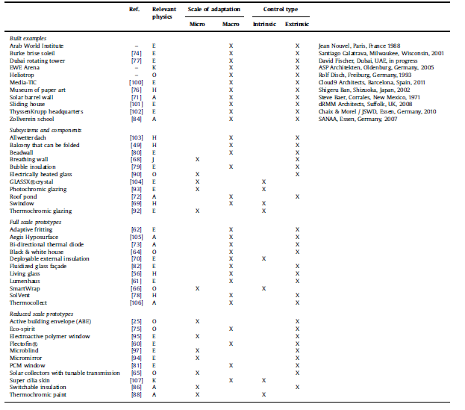
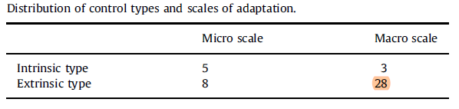
CABS: Summary of State of Art
Loonen, Cóstola, Hensen, Renew. Sustain. Energy Rev. 2013, 25, 483.

Slide 10
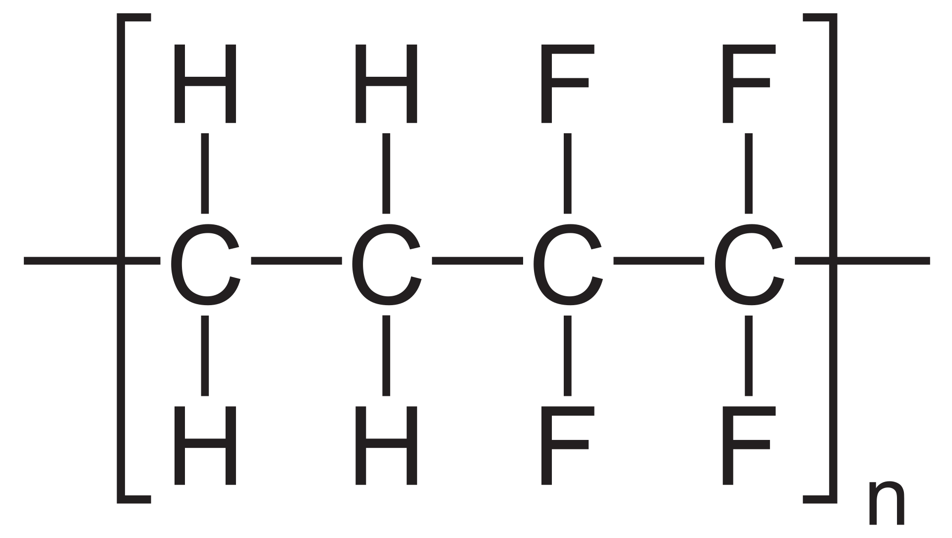
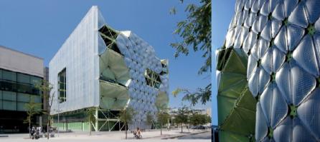
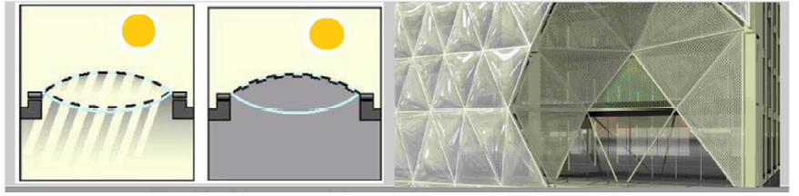
Case study of CABS
Media-ICT building in Barcelona
Core technology:
“ETFE Diaphragm”
ETFE: ethylene tetrafluoroethylene polymer
Light meter sensors
Actuate inflation and deflation
Façade transparent or opaque
Adjust penetration of light and heat
Results:
20% less in energy consumption
42/57 score on environmental standard/energy efficiency
Decrease solar factor (transmittance)from 0.45 to 0.10
Transparent layer
reverse pattern
Shahin, Renew. Alex. Eng. J. 2019, 58, 352.

Slide 11
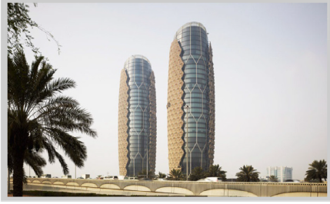
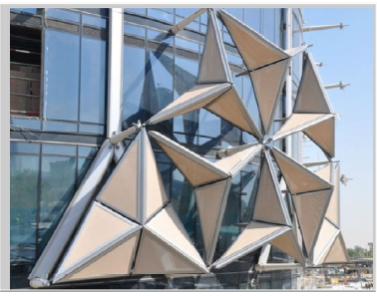
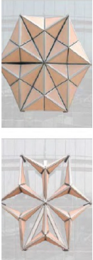
Case study of CABS
Al Bahar Tower, Abu Dhabi, UAE
Core technology:
Shading screen
Managed by computer
Each triangle enclosed in micro-perforated glass fiber and adjusted automatically respond to the motion of the sun
Decrease solar gain and glare
Shielded by sensors in cases where conditions are altered
Results:
Restrains solar glare by 50%
Decrease use of AC
Decrease the need of artificial lighting by using glasses with natural tints
Shahin, Renew. Alex. Eng. J. 2019, 58, 352.

Slide 12
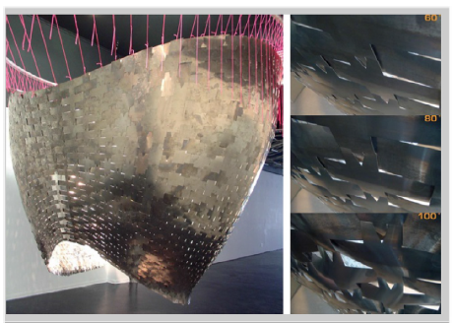
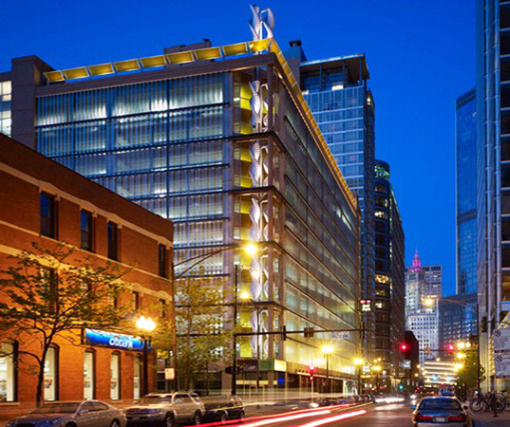
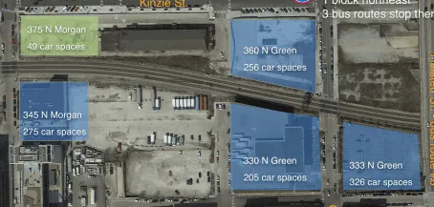
Other examples of CABS
Thermal bimetal self-ventilating system
Breathing wall based on metals with different thermal expansion coefficients
Air-flow responsive system, Greenway self-park, Chicago
Integrated wind turbine
Criticized for being “lipstick on a pig”
Shahin, Renew. Alex. Eng. J. 2019, 58, 352.
https://chi.streetsblog.org/2018/12/07/lipstick-on-a-pig-an-arty-kinetic-facade-wont-redeem-a-too-large-garage/
Notes:
How to integrate with the existing city infrastructure (lipstick on a pig)

Slide 13
Status & Challenges
Motivation: dynamism
Status
  Conceptual buildings
  Difficulty of integration
  Single purpose/monofunctional
Challenges
  Higher operational and maintenance requirement
    Engineering/designing a process instead of a product
  Compromised robustness
  Lack of control
  Conversion of old/energy intensive buildings

Slide 14
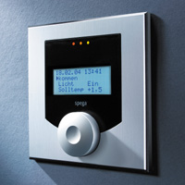
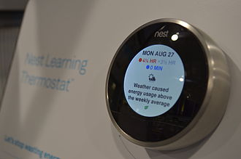
Building and home automation
BAS: building automation systems
BEMS: building energy management systems: software + hardware, HVAC, electrical, and lighting
Thermostat
Control UI
Electric device communication

Slide 15
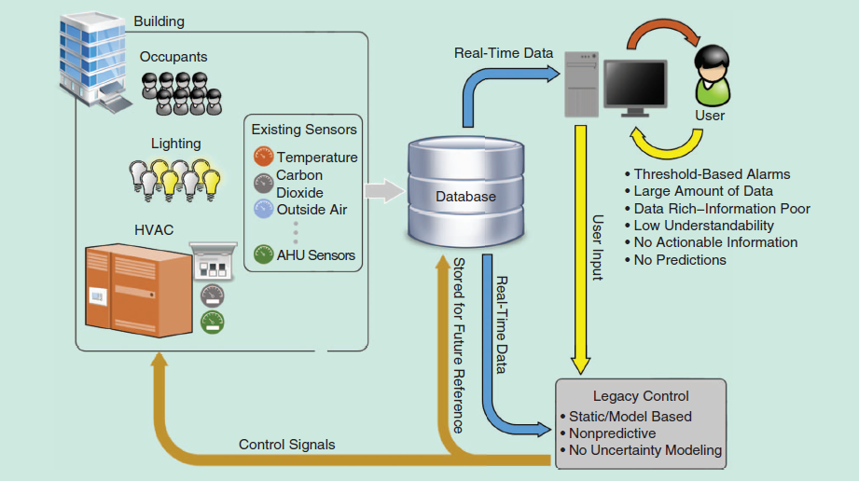
Typical BEMS architecture
Manic, Wijayasekara, Amarasinghe, Rodriguez-Andina, Ind. Electron. Mag. 2016, 1932

Slide 16
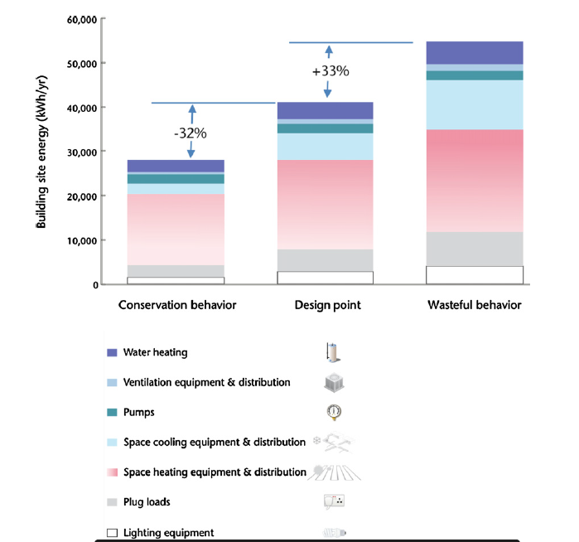
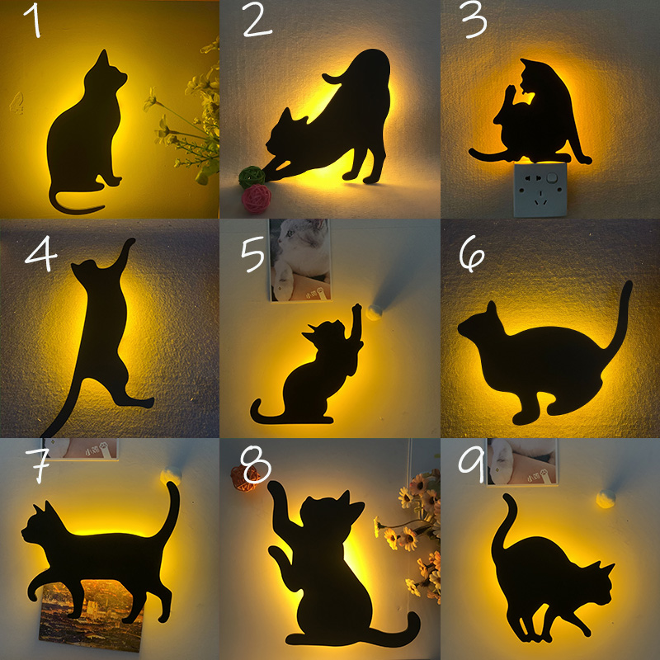
Intelligent BMS: User presence & behavior
sound/motion activated lighting
Nguyen, Atello. Energ. Buildings 2013, 56, 244
Notes:
Worker tracking/idle device

Slide 17
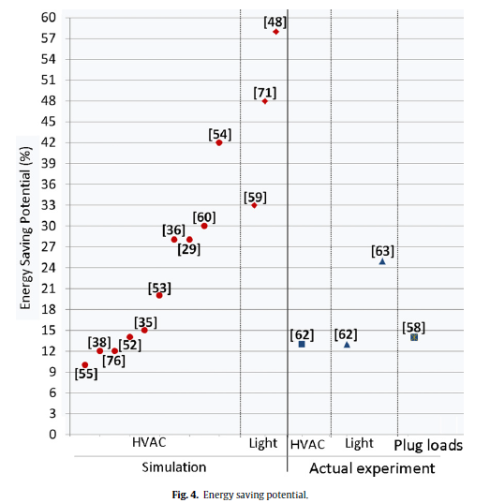
Adaptive BMS based on user behavior
Real-time occupancy information
Personal preference sensing
You and your lab mates have different office lighting, temperature, humidity, etc.
Prediction of occupancy patterns
Thermostats based on occupants in/away/wake/asleep
Nguyen, Atello. Energ. Buildings 2013, 56, 244

Slide 18
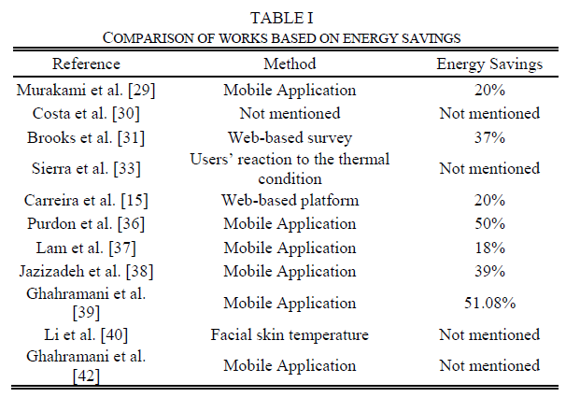
Study on user feedback – Comfort level of occupants
Highest user satisfaction among all studies: 95%
Highest energy saving among all studies: 51%
Data on thermal comfort:
  42% of people do not feel comfortable on “neutral” temperature-Study A
  70.14% accuracy in determining the thermal comfort of occupants-Study B
Direct feedback is no longer necessary to understand user comfort
Poor, Javid. Int. J. Innov. Res. Sci. Eng. Technol. 2020, 14, 375
Notes:
privacy

Slide 19
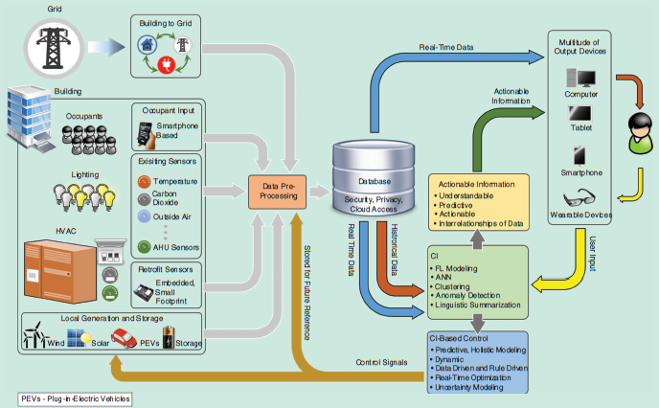
CI (computational intelligence) in BEMS
Handling large amount of heterogenous data
Predictive modeling, optimization, and artificial intelligence (learning from the data)
CI-based algorithms:
ANN- artificial neural networks
(generalizing overall system behavior)
FL- fuzzy logic modeling
(quantifying uncertainties)
EA-evolutionary algorithms
(converge on near-optimal results)
Manic, Wijayasekara, Amarasinghe, Rodriguez-Andina, Ind. Electron. Mag. 2016, 1932

Slide 20
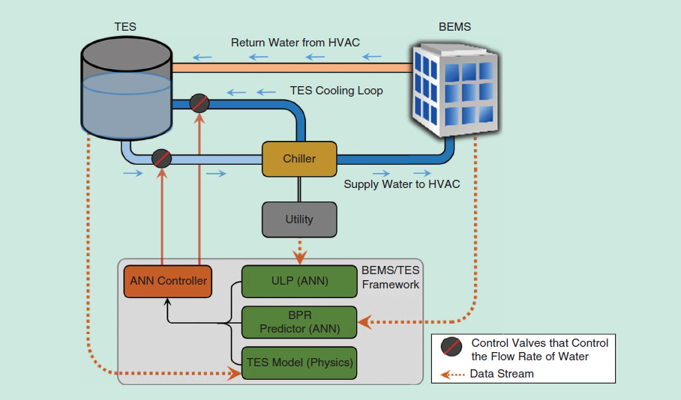
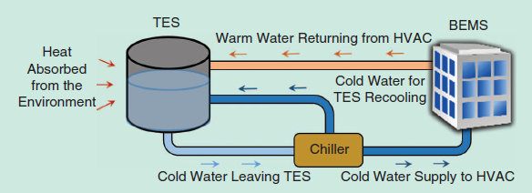
Case study: Thermal energy management
dynamic communication
Utility load prediction
Building` power requirement
Heat from building (stored)
Cooling by chiller
(peak shaving and cost saving)
Other factors: hour of day, day of week, current T (outside/inside)
H
BPR: prediction based on historical data/sensor
ULP: predict load for the following hours
T
Manic, Wijayasekara, Amarasinghe, Rodriguez-Andina, Ind. Electron. Mag. 2016, 1932

Slide 21
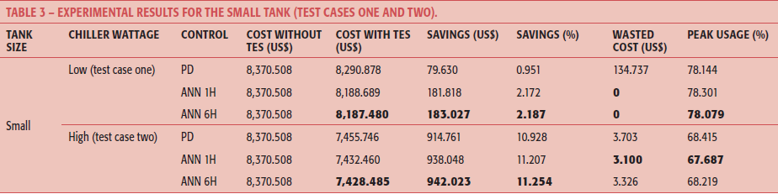
Case study: Thermal energy management
H
warming building at night by releasing heat
H
Performance improvement sensitive to tank size and chiller power. How easy the algorithm is to interface with new technology?
T
T
phase-change materials TES
Manic, Wijayasekara, Amarasinghe, Rodriguez-Andina, Ind. Electron. Mag. 2016, 1932

Slide 22
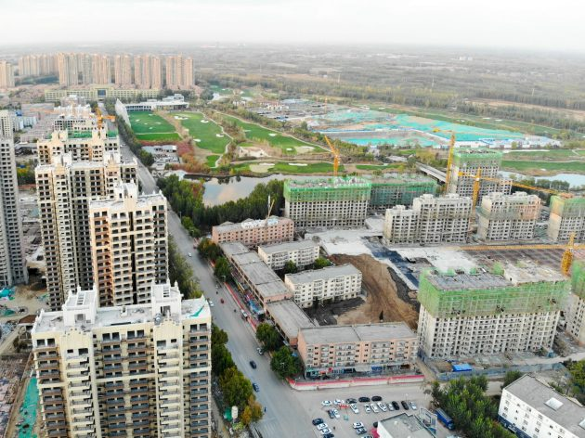

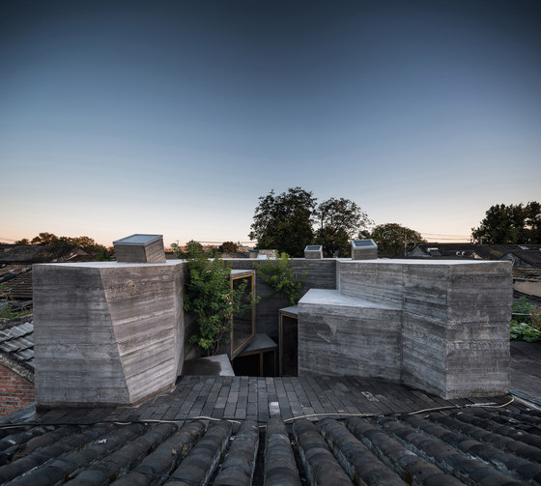

Energy Intense = comfort?
United States
Natural lighting: building facing enclosed building unit
Line drying of clothes
China
Natural ventilation
If you leave heat on when no one’s home…
Manic, Wijayasekara, Amarasinghe, Rodriguez-Andina, Ind. Electron. Mag. 2016, 1932

Slide 23
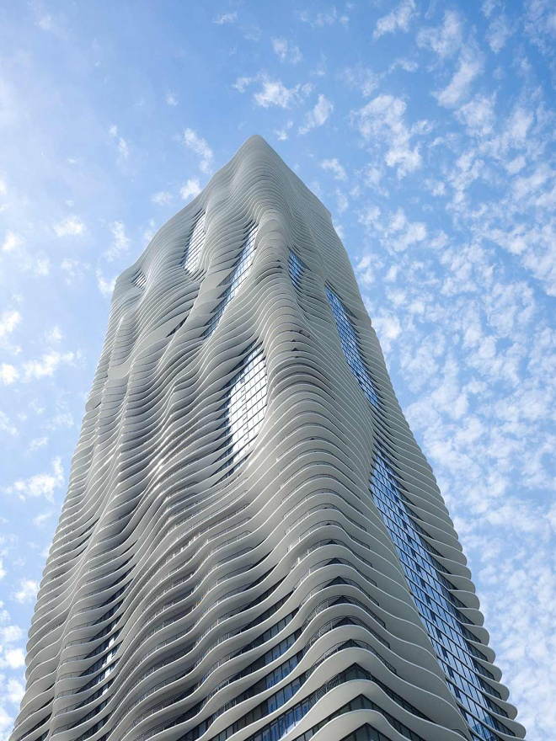
(Blind) Belief in technology advancement
Technology inventions with fluidity and perceptiveness have an artistic appeal.
Yet, “our reverence for technology blinded us to more holistic solutions: ‘We got to the moon, invented the Internet. We can do anything. It’s inconceivable to think there are problems that don’t have a technological solution. To go from “I can do anything” to “I deserve everything” is very quick.”
--Dreamland, The true tale of America’s opiate epidemic
“发展的问题只能用发展来解决”
Problems created by development/advancement could only be solved by development/advancement
As those problems are often irreversible
Aqua Tower, Chicago

Slide 24

Thank you!

