Slide 1

Greener Garments: The environmental impacts of the textile industry and possible paths forward

Slide 2
How big is the global apparel industry?
“In 2010, the global apparel industry produced more than 150 billion garments, enough to provide more than twenty new articles of clothing to every person on the planet. At that scale, it is not surprising that the market for textiles is critical to the world economy. In fact, it is estimated that in 2010 the textiles and apparel market had revenues in excess of $1.8 trillion dollars (AM Mindpower 2010). “
Sustainable Apparel Materials, 2015
Notes:
https://matteroftrust.org/wp-content/uploads/2015/10/SustainableApparelMaterials.pdf

Slide 3
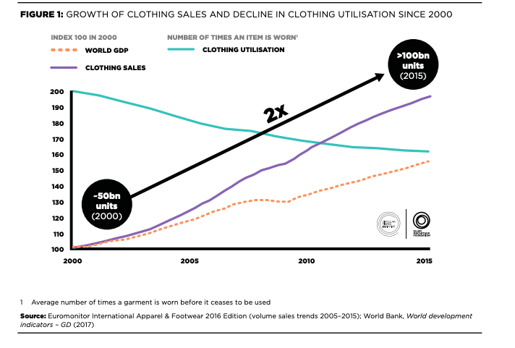
Clothing sales are rising and clothing utilization is decreasing
A New Textiles Economy 2016
Notes:
https://www.ellenmacarthurfoundation.org/assets/downloads/publications/A-New-Textiles-Economy_Full-Report_Updated_1-12-17.pdf

Slide 4
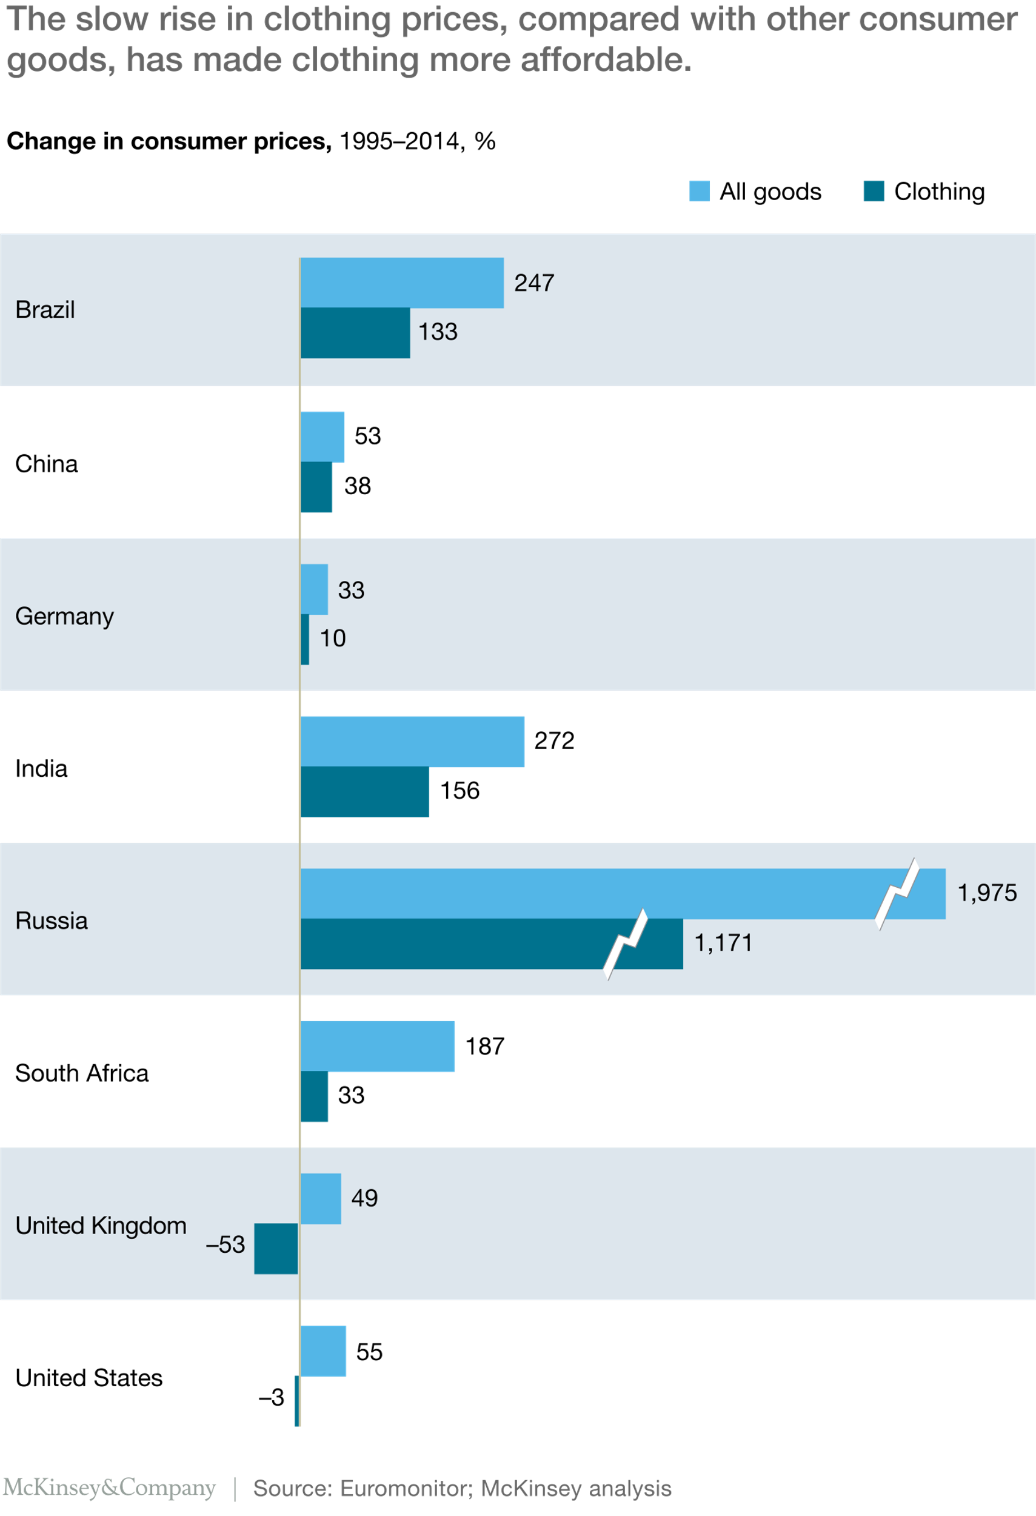
This is driven in part by the relatively slow growth in the cost of clothing
Style that’s sustainable a new fast fashion formula
Notes:
https://www.mckinsey.com/business-functions/sustainability/our-insights/style-thats-sustainable-a-new-fast-fashion-formula#

Slide 5
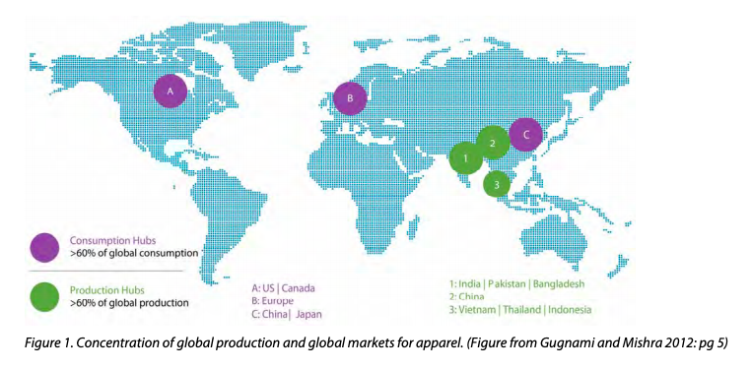
Who makes and who buys textiles?
Sustainable Apparel Materials, 2015

Slide 6
The economic impacts of the textile industry are complicated
“The low barriers to entry that make textile and apparel production so pervasive also make scoping and quantifying its full social impact nearly impossible. However, even conservative estimates suggest that this industry directly employs more than 40 million people worldwide. In some developing countries, the textiles 4 and apparel industries are a particularly important source of manufacturing employment, which is often associated with lifting individuals out of poverty. Key examples of this include Cambodia (80.1%), Mauritius (72.8%), Sri Lanka (49.2%), Bangladesh (35%), Pakistan (42.9%), and Madagascar (45%). (McNamara 2008) The derivative effects of this scale of employment are clearly immense. The government of India has estimated that every direct textile industry job means another 1.2 jobs in allied industries (e.g., machinery, design, transport). (Gugnami and Mishra 2012) “
Sustainable Apparel Materials, 2015

Slide 7
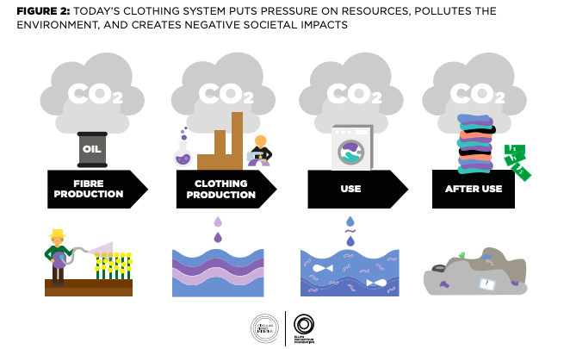
Where are environmental impacts in the clothing system?
A New Textiles Economy 2016

Slide 8
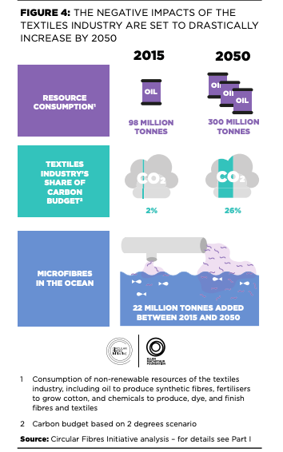
What non-carbon factors matter when thinking about textiles?
A New Textiles Economy 2016

Slide 9
The environmental impacts are not evenly distributed
“Textiles production (including cotton farming) uses around 93 billion cubic metres of water annually, representing 4% of global freshwater withdrawal. Clothing accounts for over two thirds of this water use. At present, many of the key cotton-producing countries are under high water stress, including China, India, the US, Pakistan, and Turkey. In China, 80% to 90% of fabric, yarn, and plastic-based fibres are made in water-scarce or water-stressed regions. Beyond production, washing clothing using washing machines is estimated to require an additional 20 billion cubic metres of water per year globally”
A New Textiles Economy 2016
Notes:
https://www.ellenmacarthurfoundation.org/assets/downloads/publications/A-New-Textiles-Economy_Full-Report_Updated_1-12-17.pdf

Slide 10
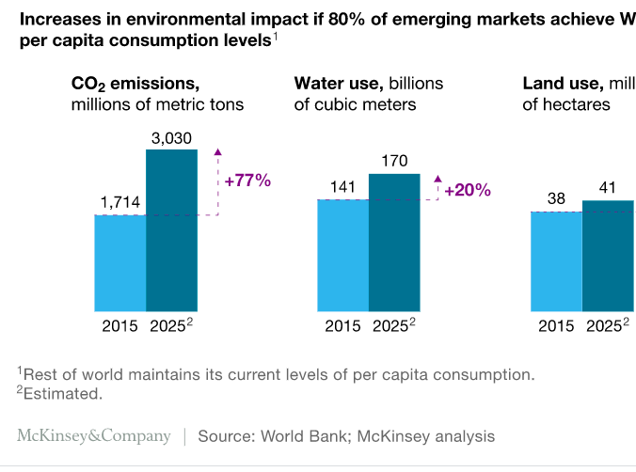
How do we expect resource use to change in the future?
Style that’s sustainable, a new fast fashion formula
Notes:
https://www.mckinsey.com/business-functions/sustainability/our-insights/style-thats-sustainable-a-new-fast-fashion-formula#

Slide 11
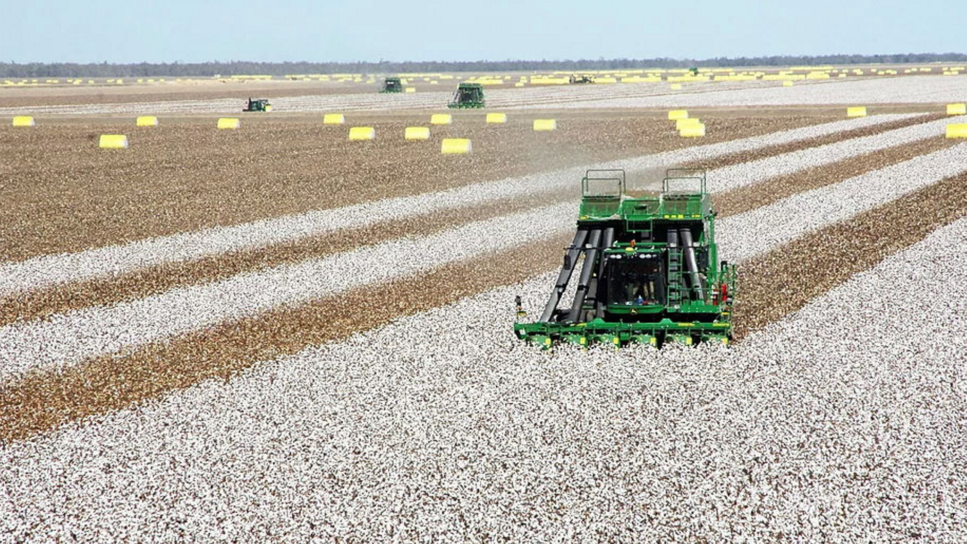
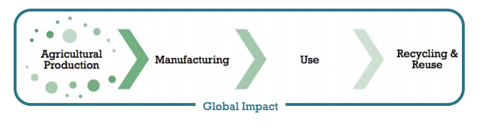
Cotton
Sustainable Apparel Materials, 2015
Financial times, Chinese company forced to sell stake in Australian cotton farm

Slide 12
How much cotton do we produce?
“By 2015, the global apparel industry is expected to produce more than 400 billion square meters of fabric per year, representing nearly enough material to cover the state of California annually. These fabrics will be produced from nearly 100 million tonnes of fiber and filament yarns, about 40% of which are agriculturally derived (i.e., cotton, wool, …) and 60% synthetic (i.e., polyester, nylon, …). (Gugnami and Mishra 2012)"
Sustainable Apparel Materials, 2015

Slide 13
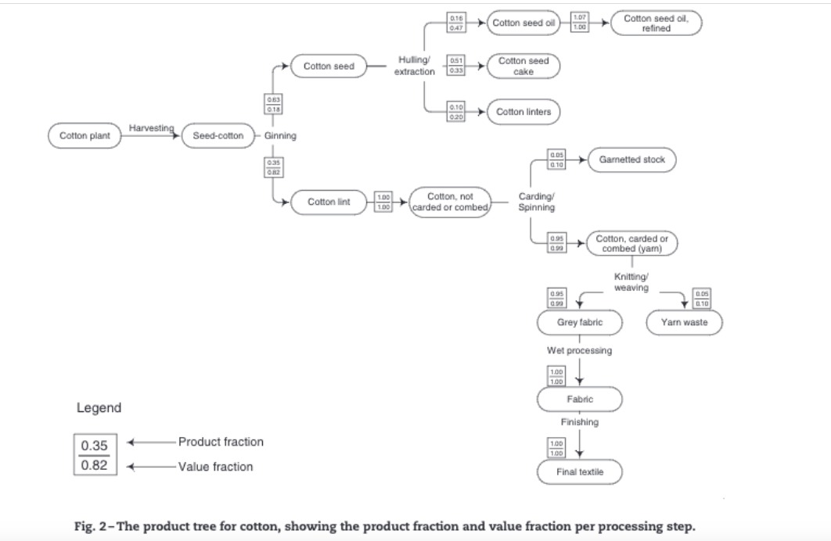
How are cotton fabrics produced?
The water footprint of cotton consumption: An assessment of the impact of worldwide consumption of cotton products on the water resources in the cotton producing countries
Notes:
https://reader.elsevier.com/reader/sd/pii/S0921800905005574?token=75F91E0B371CEAE69E24BDD201591184821578E2375D9C4F4C83AAAFFF85AF7B1F097BFA35B74AD73BF8C0B8C5231856&originRegion=us-east-1&originCreation=20210401125815

Slide 14
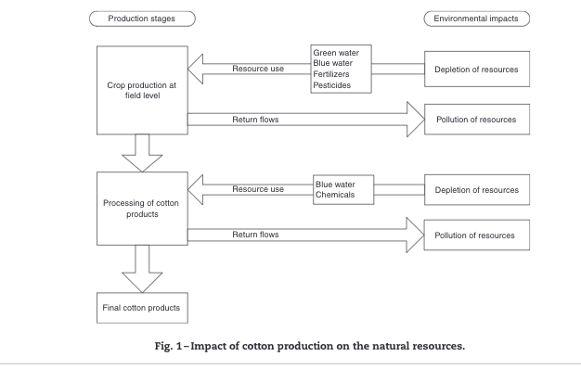
What are the environmental interactions relevant for cotton production production
The water footprint of cotton consumption: An assessment of the impact of worldwide consumption of cotton products on the water resources in the cotton producing countries
Notes:
https://reader.elsevier.com/reader/sd/pii/S0921800905005574?token=75F91E0B371CEAE69E24BDD201591184821578E2375D9C4F4C83AAAFFF85AF7B1F097BFA35B74AD73BF8C0B8C5231856&originRegion=us-east-1&originCreation=20210401125815

Slide 15
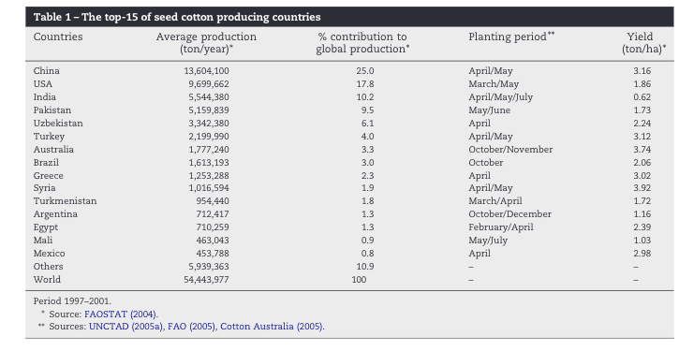
Where is cotton produced?
The water footprint of cotton consumption: An assessment of the impact of worldwide consumption of cotton products on the water resources in the cotton producing countries
Notes:
https://reader.elsevier.com/reader/sd/pii/S0921800905005574?token=75F91E0B371CEAE69E24BDD201591184821578E2375D9C4F4C83AAAFFF85AF7B1F097BFA35B74AD73BF8C0B8C5231856&originRegion=us-east-1&originCreation=20210401125815

Slide 16
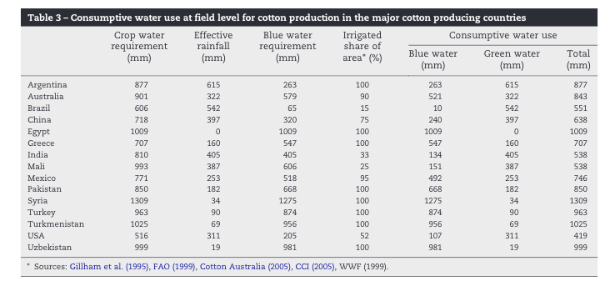
What are the environmental impacts of cotton production?
The water footprint of cotton consumption: An assessment of the impact of worldwide consumption of cotton products on the water resources in the cotton producing countries
Notes:
https://reader.elsevier.com/reader/sd/pii/S0921800905005574?token=75F91E0B371CEAE69E24BDD201591184821578E2375D9C4F4C83AAAFFF85AF7B1F097BFA35B74AD73BF8C0B8C5231856&originRegion=us-east-1&originCreation=20210401125815

Slide 17
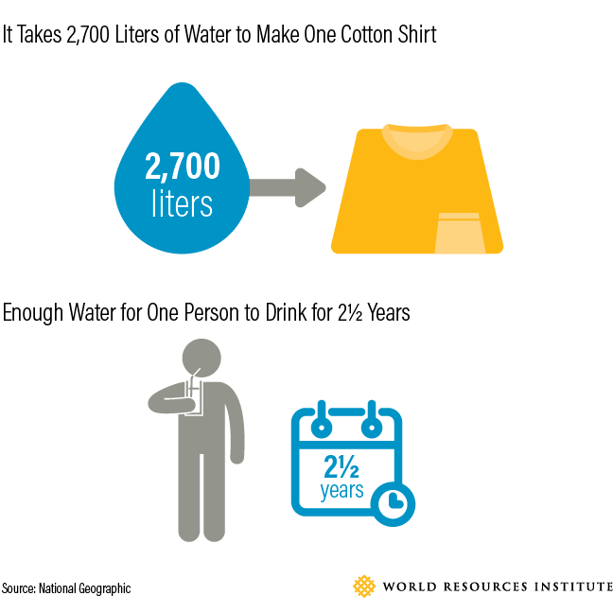
How much water is needed after processing
Apparel Industry’s enviormental impact in 6 graphics
Notes:
https://www.wri.org/blog/2017/07/apparel-industrys-environmental-impact-6-graphics

Slide 18
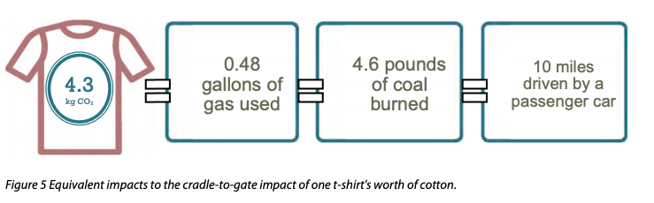
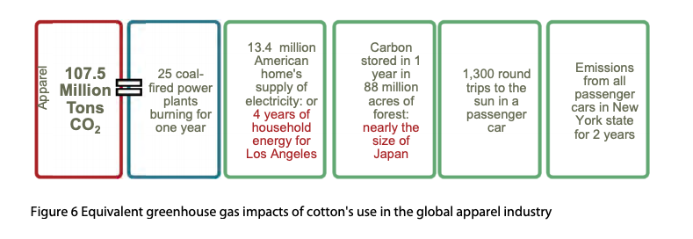
Sustainable Apparel Materials, 2015

Slide 19
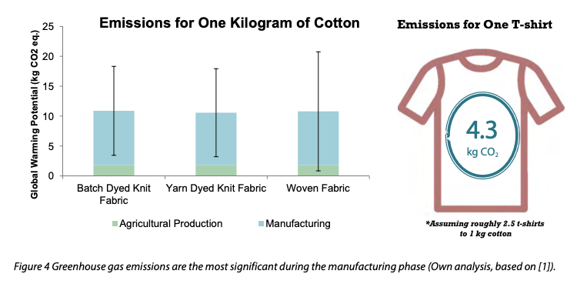
For cotton, woven v knit fabric have similar emissions
Sustainable Apparel Materials, 2015

Slide 20
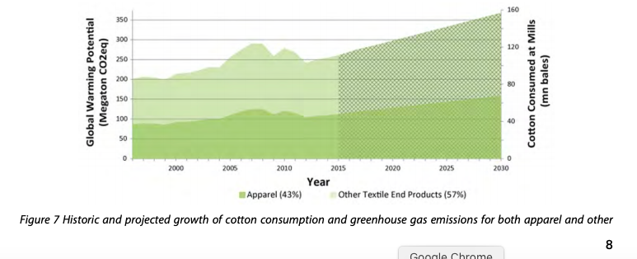
Projected future emissions and consumption from cotton production
Sustainable Apparel Materials, 2015

Slide 21
Reccomendations for decreasing cotton emissions
“Transition to low-input organic management system cotton farms “
“Partner with Organizations such as Better Cotton Initiative and Textile Exchange”
“Use coarser yarns “
Sustainable Apparel Materials, 2015

Slide 22
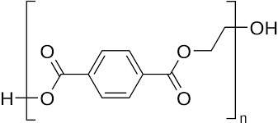
Polyester

Slide 23
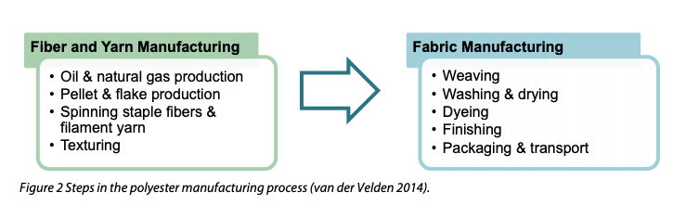
How is polyester produced?
“In 2007, 8% of the world’s polyester production was sourced from recycled PET (Shen 2011). While there is room for growth in PET collection for recycling in most countries, this also demonstrates how much polyester will continue to be manufactured from virgin (or, “first use”) PET because of growth in demand.”
Sustainable Apparel Materials, 2015

Slide 24
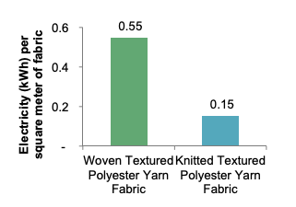
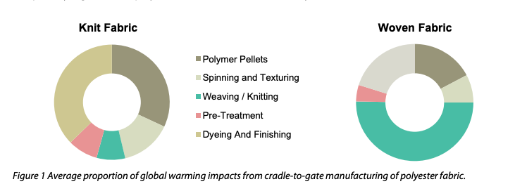
“The average polyester t-shirt has a global warming impact of 3.8 to 7.1 kilograms of CO2e, depending on whether it’s knit or woven”
Sustainable Apparel Materials, 2015

Slide 25
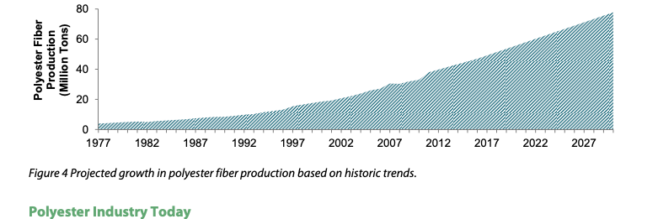
Producted polyester growth over time
Sustainable Apparel Materials, 2015

Slide 26
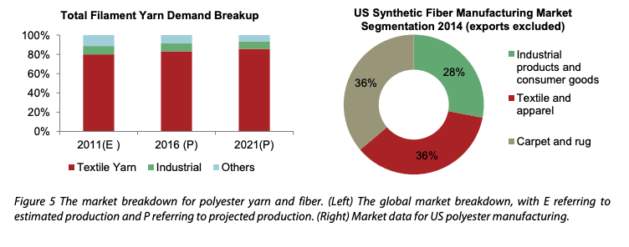
Much of global polyester production does not end up in clothing
Sustainable Apparel Materials, 2015

Slide 27
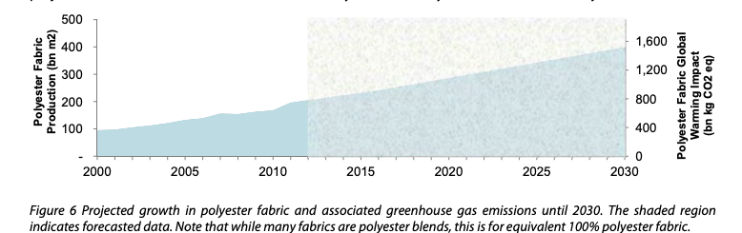
Estimated growth of polyester fabric
Sustainable Apparel Materials, 2015

Slide 28
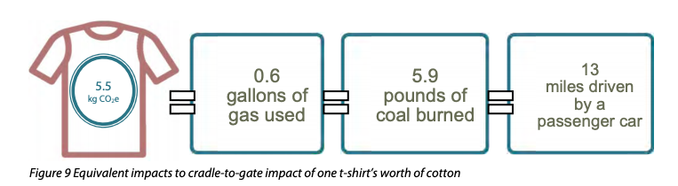
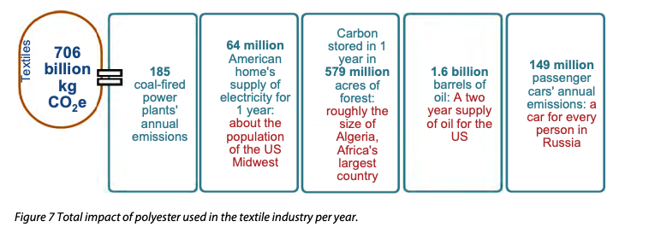
Cardon emissions of polyester production in textile industry
Sustainable Apparel Materials, 2015

Slide 29
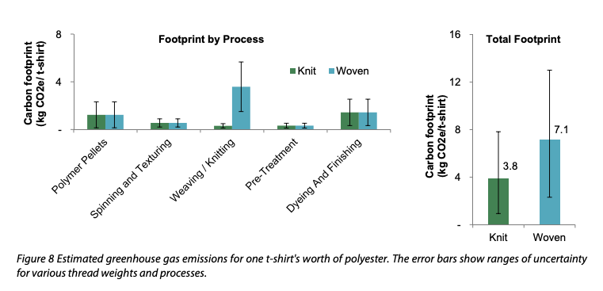
Much of the emissions of polymer comes from actual garment construction when weaving
Sustainable Apparel Materials, 2015

Slide 30
Pollution impacts of polyester production
“Of course, there are impacts in polyester production beyond GHGs. For example, the production of PET is linked to potential water pollutants, in particular, antimony trioxide. Antimony trioxide is used as a catalyst in polyester production, and can be released during dyeing, distillation and other processes that require heat (Victor Innovatex 2003). The antimony ends up in wastewater, which may or may not be adequately treated, depending on the production location and local water quality guidelines. In the US, there is a limit on antimony levels in surface and drinking water supplies. “
Sustainable Apparel Materials, 2015

Slide 31
Reccomendation for lower emission polyester
“Locate manufacturing facilities in areas with lower emission electricity grids, or facilitate lower emissions in existing locations. Polyester is produced in factories, thus grid emissions are the majority of the impact. Cleaner grids equals lower carbon footprint. “
“Use more knit fabrics. Knit fabrics require significantly less energy to produce. “
“Use lighter weight fabrics which require less energy to produce per area. x Use all of the recycled PET available, an effort that could include expanding PET collection. x Encourage PET recyclers to use processes that minimize electricity use (Shen 2011).”
Sustainable Apparel Materials, 2015

Slide 32
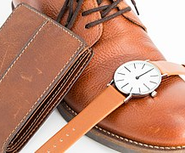
Leather
Ivan Radic, wikicommons

Slide 33

How much leather is produced?
“Over 22 billion square feet of leather is manufactured each year, an area roughly the size of Maryland or Luxembourg, over 50% of which is used in footwear. The total global annual impact of the leather worldwide is estimated around 130 MT CO2e, about the same as the emissions from 30 million passenger vehicles used in one year”
Sustainable Apparel Materials, 2015
Kamran.nef, wikicommons

Slide 34
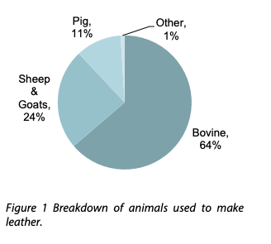
Where do we get leather
Sustainable Apparel Materials, 2015

Slide 35
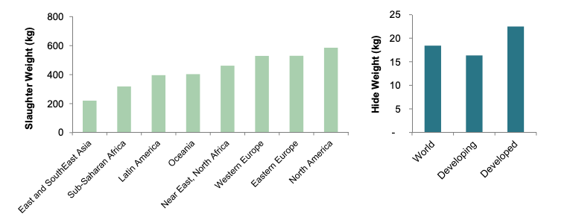
The emissions associated with leather production depends somewhat on where the animal was raised
Sustainable Apparel Materials, 2015

Slide 36
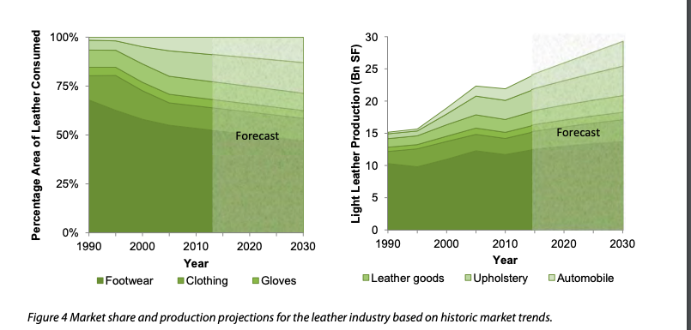
Uses of leather in the coming years are expected to change
Sustainable Apparel Materials, 2015

Slide 37
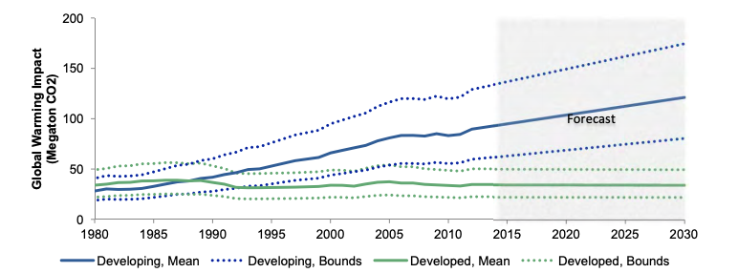
Global warming impact of leather production projections
Sustainable Apparel Materials, 2015

Slide 38
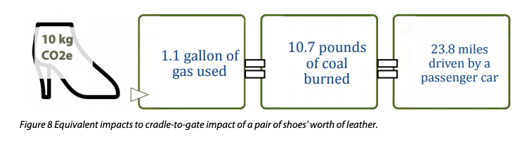
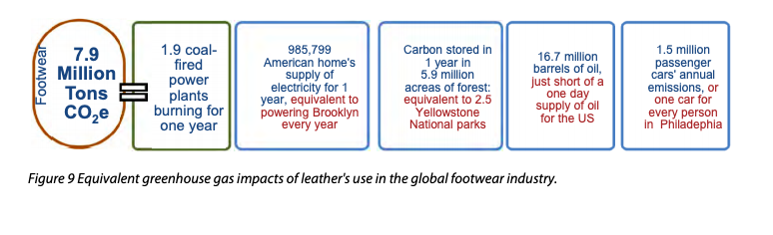
Emissions from leather production
Sustainable Apparel Materials, 2015

Slide 39
Recommendations for lowering leather-related emission
“Better feed conversion at the system level”
“Use of feeds that increase soil carbon sequestration versus carbon emission”
“Ensure that the manure produced substitutes for synthetic fertilizer, and use manure for bio-energy production. “
“Improve practices in developing countries in order to increase the size of cattle.”
“Increase share of leather originating from goats.”
“Discourage agricultural practices that involve slash and burn practices and/or the clearing of tropical forests.”
“Encourage manure management in accordance with local best practices. “
Sustainable Apparel Materials, 2015

Slide 40

Synthetic Rubber

Slide 41
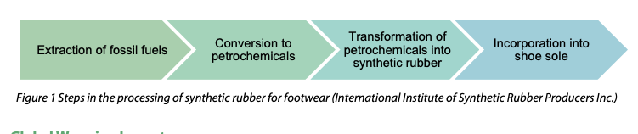
How does synthetic rubber come to be in apparel?
“The chief type is styrene‐butadiene rubber (SBR), along with polybutadiene (BR), nitryl (NBR), polychloroprene (CR), plastics (TR) and various other forms of latex (International Institute of Synthetic Rubber Producers Inc.).”
Sustainable Apparel Materials, 2015

Slide 42
Other pollutants to consider in synthetic rubber conditions
“Considering the production of synthetic rubber, fossil fuels are not sustainable resources and their use as petrochemical ingredients in products reduces the amount available for energy production. Additionally, air pollutants such as volatile organic compounds (VOCs), hazardous air pollutants (HAP) and particulate matter (PM) are released during rubber manufacturing (US EPA 2009). “
Sustainable Apparel Materials, 2015

Slide 43
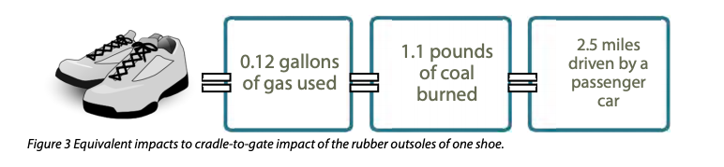
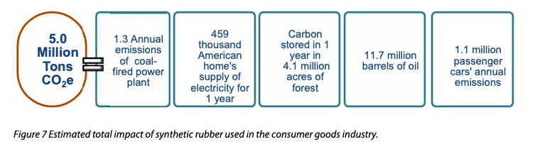
Emissions from synthetic rubber
Sustainable Apparel Materials, 2015

Slide 44
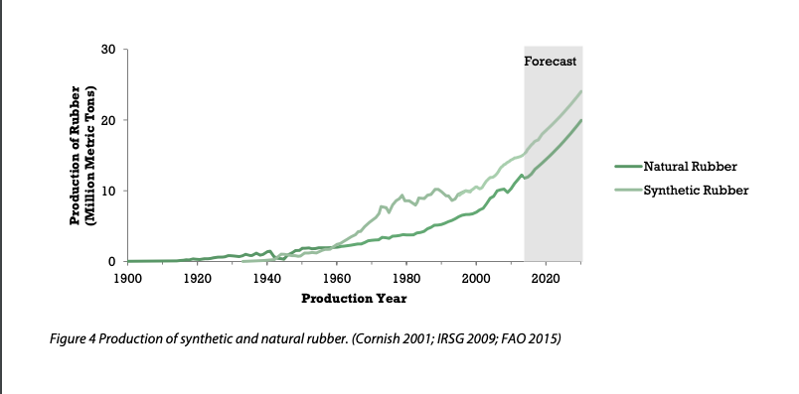
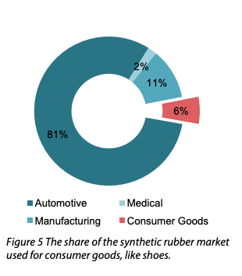
Projections for rubber prodcution
Sustainable Apparel Materials, 2015

Slide 45
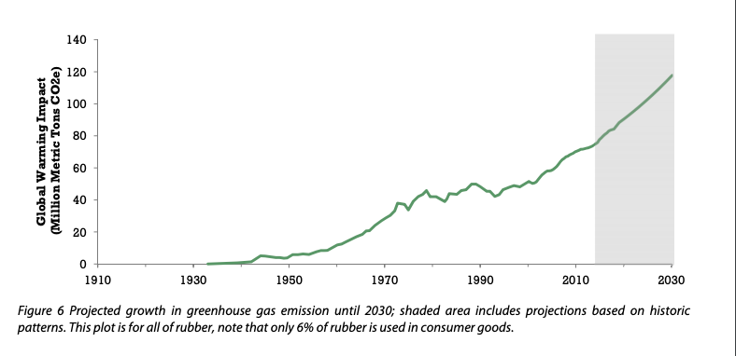
Projections for emissions from rubber
Sustainable Apparel Materials, 2015

Slide 46
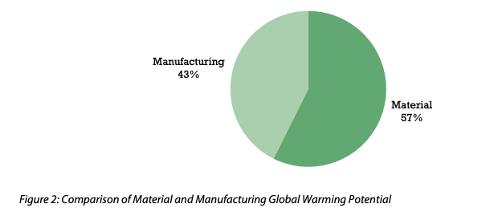
Both the material and the manufacturing contribute to emissions
Sustainable Apparel Materials, 2015

Slide 47
Rubber Recommendations
Compare the life cycle impact of synthetic rubber to natural rubber, which is a renewable resource, and if it is deemed environmentally preferable, consider whether natural rubber would be a suitable alternative in some products.
“In terms of the manufacturing phase, finding cleaner alternatives for heating, pursuing energy efficiency improvements related to the sole production […], and reducing machinery idle time would help cut the GWP of the product
Sustainable Apparel Materials, 2015

Slide 48

Problems and Solutions

Slide 49
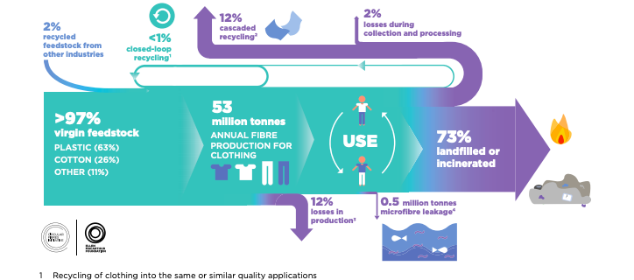
Very little clothing is recycled into new clothing
A New Textiles Economy
Notes:
https://www.ellenmacarthurfoundation.org/assets/downloads/publications/A-New-Textiles-Economy_Full-Report_Updated_1-12-17.pdf

Slide 50
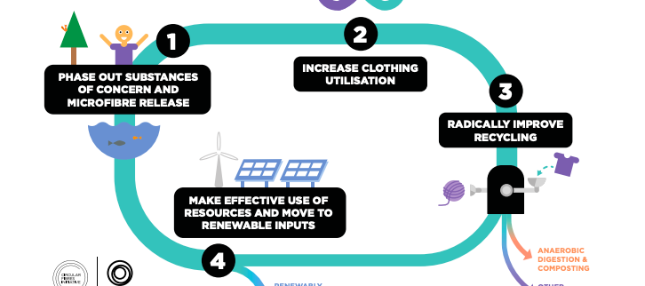
A new textile economy
A New Textiles Economy
Notes:
https://www.ellenmacarthurfoundation.org/assets/downloads/publications/A-New-Textiles-Economy_Full-Report_Updated_1-12-17.pdf

Slide 51
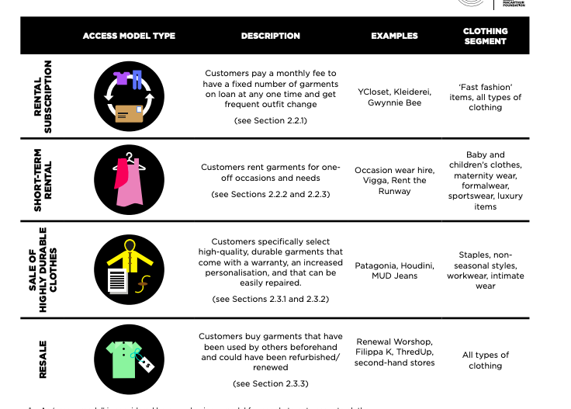
Alternative clothing business models
A New Textiles Economy

Slide 52
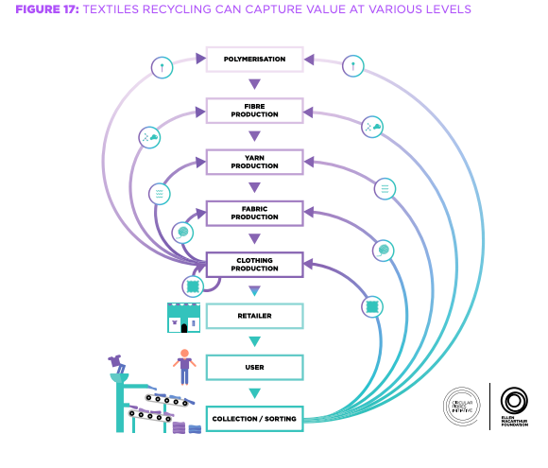
Recycling throught the production and use cycle
A New Textiles Economy
Notes:
https://www.ellenmacarthurfoundation.org/assets/downloads/publications/A-New-Textiles-Economy_Full-Report_Updated_1-12-17.pdf

Slide 53
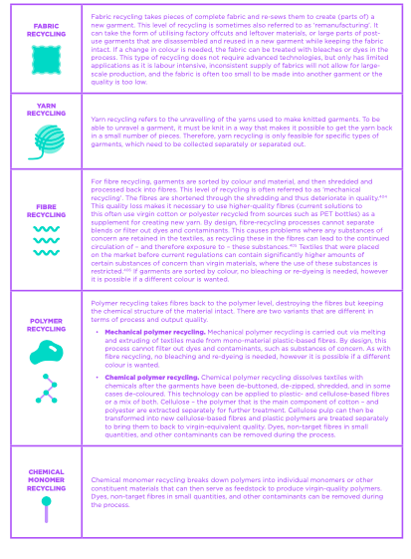
Types of recycling
A New Textiles Economy
Notes:
https://www.ellenmacarthurfoundation.org/assets/downloads/publications/A-New-Textiles-Economy_Full-Report_Updated_1-12-17.pdf

Slide 54
Thanks for listening

