Slide 1
The case for public ownership of energy and climate infrastructure:
A study of electric utilities in the U.S
Toly Rinberg
HEJC
3/26/21
Notes:
This will be a patchy discussion – in my research, I didn’t find a lot of synthesized claims, just lots of case studies
I urge you to differentiate GOVERNANCE from FINANCING
Please interrupt and ask questions, almost every fact I learned, I also saw something that was an exception
Not going to spend a lot of time motivating the broader context around climate change, other than to say that while climate change poses a massive challenge that presents immense future harm, responding to it is also an opporuntity to reduce inequality and redistribute wealth to the poorest populations

Slide 2
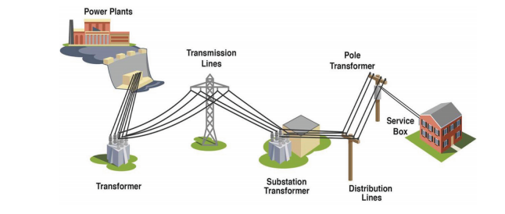
The components of our electricity system
Distribution
Generation
Transmission
https://www.publicpower.org/system/files/documents/municipalization-what_is_public_power.pdf
Notes:
what is a utility: an organization that maintains the infrastructure for a public service. Public utilities are subject to forms of public control and a regulation
Electric utilities are natural monopolies - an industry in which high infrastructural costs and other barriers to entry relative to the size of the market give the largest supplier in an industry, often the first supplier in a market, an overwhelming advantage over potential competitors.
But monopolies are illegal, right? To compensate for their special treatment, state utility commissions are appointed to regulate electric rates and other aspects of the business model

Slide 3
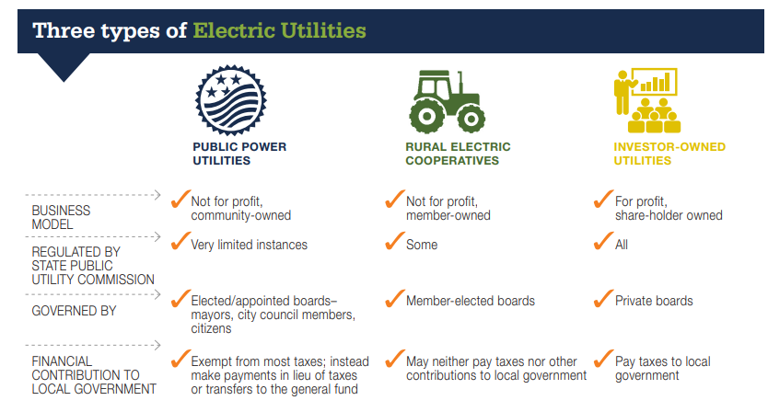
municipally owned
Financing through tax-free bonds
Budget: Break even with recovery of costs through rates
Financing through a combination of shareholders, bonds, bank borrowing
Budget: Shareholders’ required rate of return under regulations
https://www.publicpower.org/system/files/documents/municipalization-what_is_public_power.pdf
https://thenextsystem.org/sites/default/files/2019-03/EnergyDemocracy-2-star-Final.pdf
Notes:
Most public power utilities are distribution-only, meaning they do not own and operate their own power plants and bulk transmission. Instead, these utilities purchase power and transmission services at wholesale to distribute to their customers. Many distribution-only utilities purchase power and transmission from joint action agencies.

Slide 4
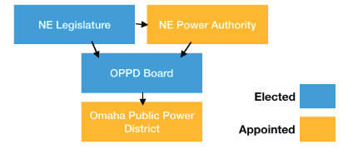
Example: Nebraska’s Omaha Public Power District Governance Structure
https://thenextsystem.org/sites/default/files/2019-03/EnergyDemocracy-2-star-Final.pdf
Notes:
IOUs: Compare this to shareholders, board of directors, executives

Slide 5
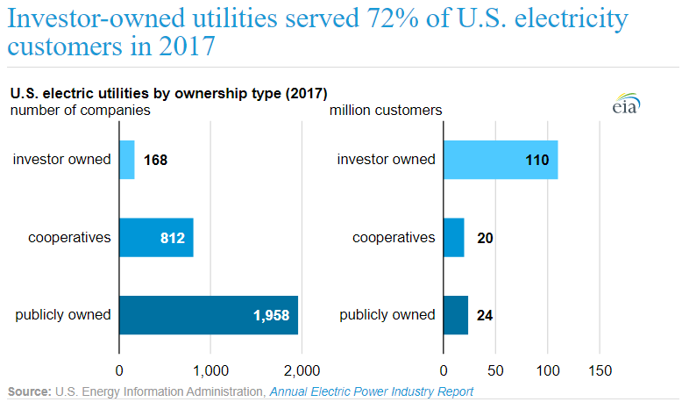
https://www.eia.gov/todayinenergy/detail.php?id=40913

Slide 6
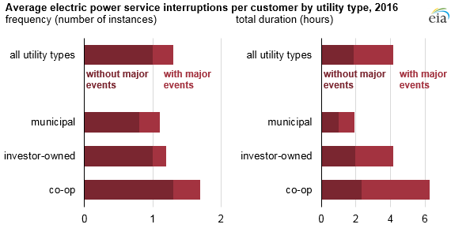
Notes:
Outage frequency and duration values are reported to EIA for any interruption lasting longer than five minutes. Utilities may designate if these outages occurred during major events, which can include snowstorms, hurricanes, floods, or heatwaves. Utilities can also designate periods of outages that differ greatly from its five-year history as a major event.
- An analysis of EIA data by the Citizens’ Utility Board of Michigan (CUB), an intervenor in rate cases, found the state’s publicly owned utilities as a whole performed better than investor-owned utilities — municipal and investor-owned utilities respectively averaged 136 minutes and 613 to restore power after an outage.

Slide 7
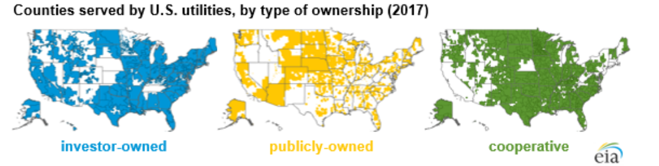

Slide 8
Investment-owned utilities are incentivized to build stuff
By law, IOUs have to sell power to ratepayers without any markup
Cost of Service Regulation (COSR) rewards utilities for infrastructure investments
  Investment money is needed to build out new substations, transformers, meters, and power lines
  Utility shares — a safe and predictable rate of return on investment
  “Prudence reviews“ set return rate - enforced by public utility commissions
Alternatives to utility building infrastructure
  non-infrastructure solutions: software, data analytics, and small-scale distributed energy resources (DERs) like solar panels and batteries;
  non-utility-owned solutions, which include third parties like private aggregators who link together dozens or hundreds of DERs.
Notes:
NOTE: information asymmetry (utilities know more than PUCs or outside advocacy groups)
IOUs have more incentive to build stuff. In fact, since it is their legal obligation to act in the interests of shareholders. And PUCs have limited ability to restrain them.
To put it more bluntly: utilities’ strong preference for capital investments puts them intrinsically at odds with smarter grids and privately owned DERs

Slide 9
Whirlwind history of the emergence of electric utilities in the U.S.

Slide 10
Early 20th century
Turn of the century: electric utilities were emerging as vertically integrated monopolies (mostly in cities)
By 1914: 43 states establish regulatory policies governing electric utilities
1920s: explosion of holding companies to avoid regulation
  10 utility systems controlled three-fourths of the United States' electric power business by end of 1920s
1928: the Federal Trade Commission begins a six-year investigation into the market manipulations of the holding companies
https://www.pbs.org/wgbh/pages/frontline/shows/blackout/regulation/timeline.html
Notes:
Pearl Street Station, built by the Edison Illuminating Company, which was led by Thomas Edison, was the first electric distribution utility in the nation. It began operating in Lower Manhattan, New York, in 1882 - https://www.eia.gov/todayinenergy/detail.php?id=40913
Holding companies: pyramiding holding company on top of holding company, sometimes such that a holding company was as many as ten times removed from the operating company each holding company could issue fresh stocks and bonds without state oversight

Slide 11
FDR fought for federal regulation of utilities
All in 1935:
FDR calls holding companies "evil" in his State-of-the-Union address
Congress passed the Public Utility Holding Company Act
Congress passed the Federal Power Act of 1935, which gave the Federal Power Commission (FPC) regulatory power over interstate and wholesale transactions and transmission of electric power
https://www.pbs.org/wgbh/pages/frontline/shows/blackout/regulation/timeline.html
Notes:
PUHCA
PUHCA outlawed the pyramidal structure of interstate utility holding companies, determining that they could be no more than twice removed from their operating subsidiaries.
It required holding companies which owned 10 percent or more of a public utility to register with the Securities and Exchange Commission (SEC)
Between 1938 and 1958 the number of holding companies declined from 216 to 18

Slide 12
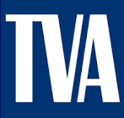
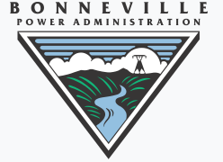
Creation of federal agencies to distribute power
Tennessee Valley Authority (TVA) in 1933 - To provide navigation, flood control, electricity generation, fertilizer manufacturing, and economic development
Rural Electrification Association (REA) in 1935 - To create and finance rural utility companies
Bonneville Power Administration in 1937 - operate electric systems and sell the electrical output of federally owned and operated hydroelectric dams
Notes:
In the mid-1930s, only 10% of homes in the rural United States had electricity. The Rural Electrification Act of 1936 was a federal loan program that provided electricity to rural populations. Farmer cooperatives quickly started forming to bring electricity to communities not covered by IOUs or municipal utilities. Co-ops are still most prevalent in rural areas today.
REA crews traveled through the American countryside, bringing teams of electricians along with them. The electricians added wiring to houses and barns to utilize the newly available power provided by the line crews. A standard REA installation in a house (post World War II) consisted of:
A 60 amp, 230 volt fuse panel, with:
A 60 amp range circuit
A 20 amp kitchen circuit
Two or three 15 amp lighting circuits

Slide 13
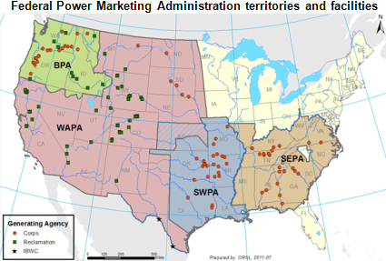
Bonneville Power Administration (1937)
Southwestern Power Administration (1943)
Southeastern Power Administration (1950)
Western Area Power Administration (1977)
Notes:
A PMA’s – which is a federal agency - primary purpose is to market wholesale power, and it usually plays a role in transmission and electric power systems as well.
Buying power mostly from hydro plants owned by the army corps of engineers
PMAs also play a large role in transmission, both as transmission owners and transmission operators
With some exceptions, the PMAs generally do not own electric generating plants.
By federal statute, PMAs sell power primarily to preference customers, which largely consist of publicly-owned and cooperative-owned utilities

Slide 14
A few case studies

Slide 15
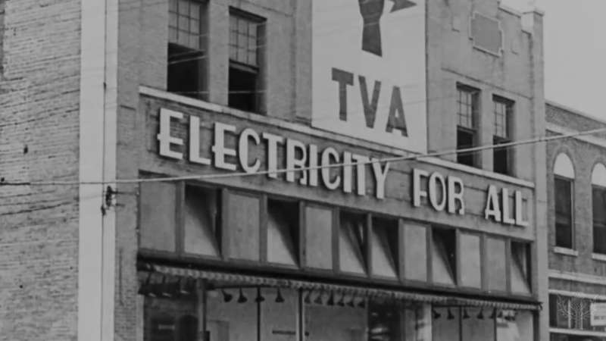
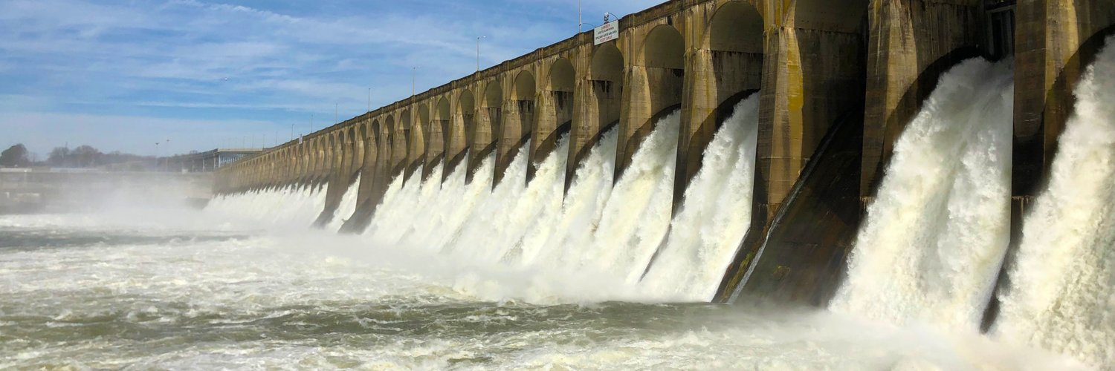
Case study #1:
Tennessee Valley Authority
Notes:
Economic
The average income in the rural area was $639 per year, with some families surviving on as little as $100 per year. Much of the land had been exhausted by poor farming practices, and the soil was eroded and depleted. Crop yields had fallen, reducing farm incomes. The best timber had been cut, and 10% of forests were lost to fires each year

Slide 16
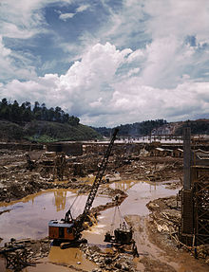
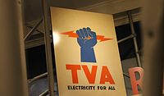
Case study #1: Tennessee Valley Authority
Created in 1933 by Congressional charter to provide navigation, flood control, electricity generation, fertilizer manufacturing, and economic development
Current generating capacity ~35 GW – from hydro, nuclear, coal, etc.
Governance:
  Board of directors: 9 people, 5 year terms. Nominated by POTUS and approved by Senate
  Executives: 6
  Regional Energy Resource Council
  Regional Resource Stewardship Council
Financing:
  Originally financed through bonds and federal funds
  Currently fully self-financing through electricity sales and power system bond financing
Notes:
Regional Energy Resource Council - Comprising members of regional government, customers, academia and advocacy groups, the Regional Energy Resource Council provides guidance on how TVA manages its energy resources against competing objectives and values.
Regional Resource Stewardship Council - Comprised of members of regional government, customers, academia and advocacy groups, the Regional Resource Stewardship Council helps advise TVA in its efforts to manage the Tennessee River system against competing priorities and still provide maximum recreational benefit for all the residents of the Tennessee Valley.
-----
Economic
30 percent of the population was affected by malaria. The average income in the rural area was $639 per year, with some families surviving on as little as $100 per year. Much of the land had been exhausted by poor farming practices, and the soil was eroded and depleted. Crop yields had fallen, reducing farm incomes. The best timber had been cut, and 10% of forests were lost to fires each year
How is TVA funded:
In fiscal year 2018, TVA's operating revenue was $11.2 billion. TVA receives no public tax dollars; instead, it finances all of its programs, including those for environmental protection, integrated river management, and economic development, almost entirely through power sales and power program financings.
TVA is now fully self-financing, funding virtually all operations through electricity sales and power system bond financing. TVA sets rates as low as feasible and reinvests net income from power sales into power system improvements and economic development initiatives. TVA makes no profit and receives no tax money [ref]
TVA issues bonds - federal 10 year treasury was 2.45% in March 2017; TVA was 2.9% in Feb 2017. I.e. very low risk even though the bonds aren’t backed by federal government(?).
What does TVA do with profits or losses?
“As a wholly-owned government corporation, income from TVA’s operating activities is invested back into its power system. TVA invested almost $3 billion in the power system during 2016 while only raising debt by less than $100 million.” (ref)
----
Recent changes: It cut operating costs by nearly $950 million a year, reduced its workforce by more than half, increased the generating capacity of its plants, and developed a plan to meet the energy needs of the Tennessee Valley through the year 2020.

Slide 17
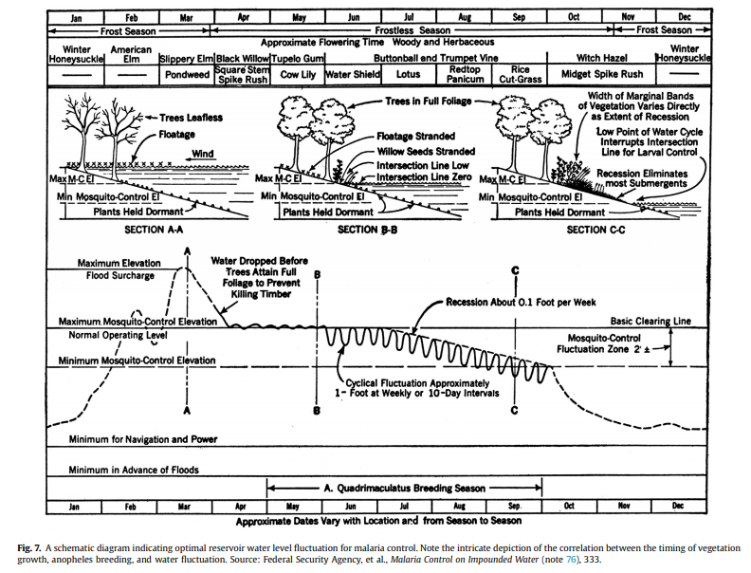
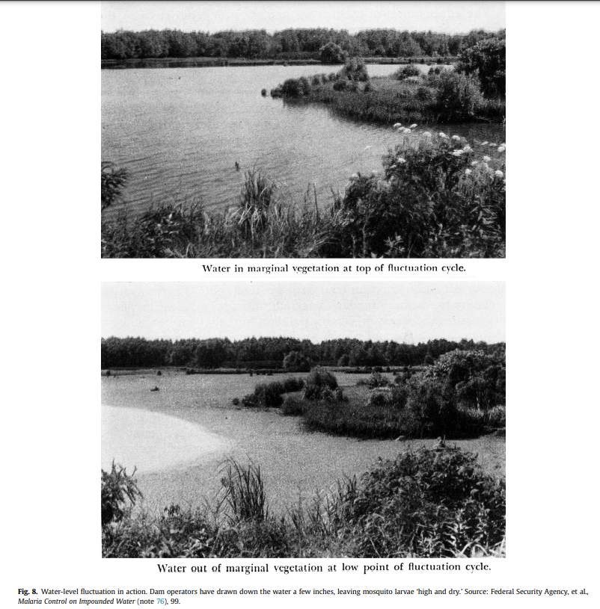
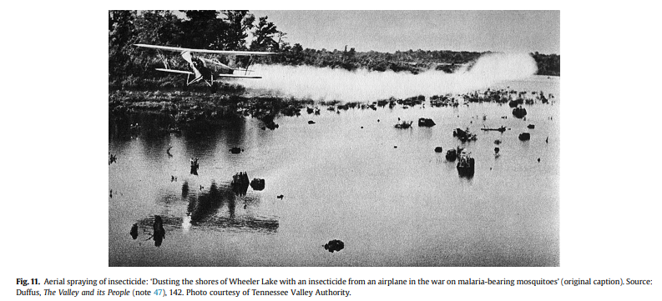
Case study #1: Tennessee Valley Authority
https://www.sciencedirect.com/science/article/abs/pii/S030574881300100X
Notes:
30% of population affected by malaria – from the anopheles mosquitoes

Slide 18
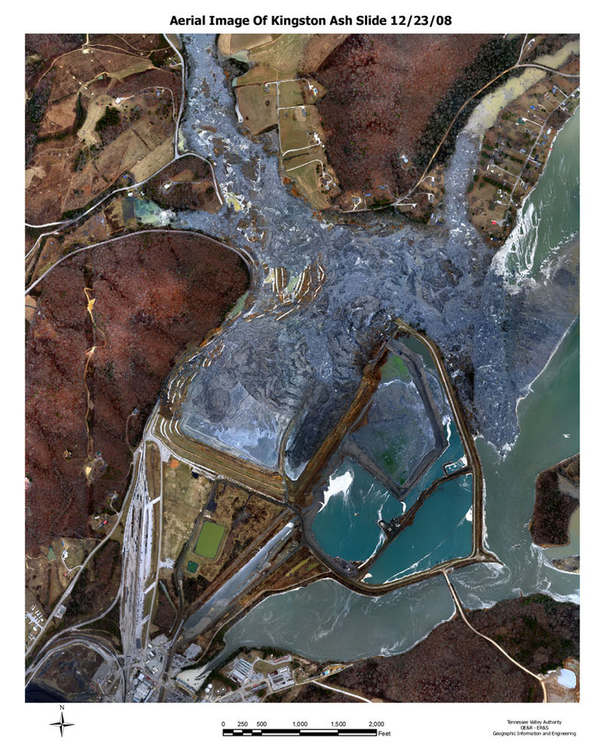
Case study #1: Tennessee Valley Authority
Kingston Fossil Plant coal fly ash slurry spill (2008) – which released 1.1 billion gallons of coal fly ash slurry
TVA found liable: A court ruling found that TVA did not build the holding ponds according to the initial plan and failed to train its employees on how to properly inspect the dikes surrounding the ash ponds, leading ultimately to a failure to maintain the facility to prevent a rupture of the dikes.
Notes:
More recently:
- It cut operating costs by nearly $950 million a year, reduced its workforce by more than half, increased the generating capacity of its plants, and developed a plan to meet the energy needs of the Tennessee Valley through the year 2020.
- Shut down some coal plants

Slide 19
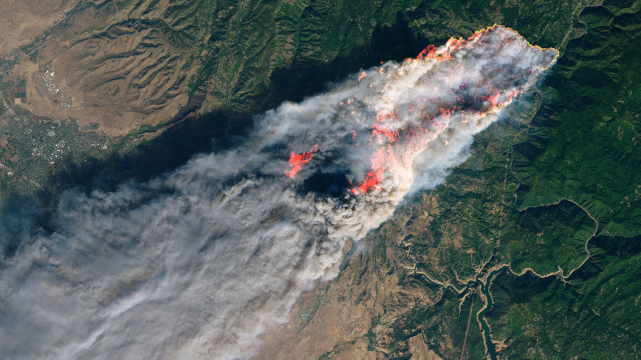
Case study #2: PG&E and the 2018 Camp Fire
Notes:
One of the largest and deadliest fires in history – started by a

Slide 20
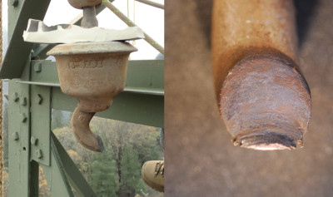
Case study #2: PG&E and the 2018 Camp Fire
Nearly 100 year old transmission line (transmission tower life expectancy = 65 years)
153,335 acres burned (approximately size of Chicago)
+18,000 buildings destroyed (mostly residences)
$16.5 billion in damage (+ $150 million in fire suppression costs)
85 people dead
Criminal fines: $3.5 million
PG&E filed for bankruptcy shortly after the fire
  Part of the restructuring plan is that they must provide $13.5 billion to wildfire victims
The C hook is responsible for supporting an insulator, which holds the high-voltage jumper conductor in position. When the C hook broke, the jumper conductor fell, striking the tower, with the resulting short circuit throwing sparks into the vegetation below, starting the Camp Fire.
https://hackaday.com/2020/09/17/closely-examining-how-a-pge-transmission-line-claimed-85-lives-in-the-2018-camp-fire/
https://www.pbs.org/wgbh/frontline/article/camp-fire-by-the-numbers/

Slide 21
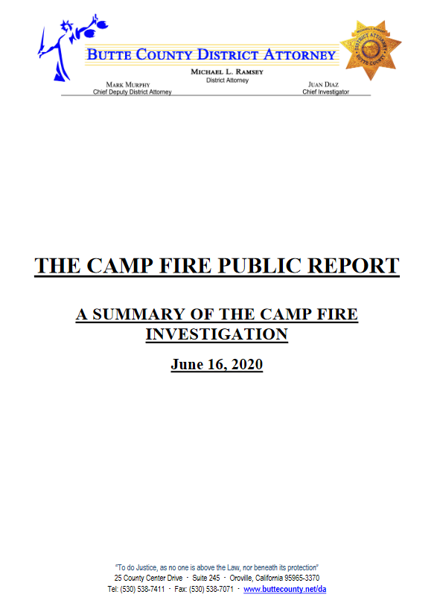
B. The Facts:
Based upon the forensic analysis of the failed “C” hook from the suspect tower, it was the opinion of the experts consulted that the wear which caused the hook to break occurred gradually over almost 100 years. It is our belief the wear had been visible for at least 50 years. Over the past 50 years scores of PG&E employees should have been in a position to observe the wear. However, none of the employees documented the wear. Since nobody apparently noticed the wear, it would be impossible to prove any single person was negligent. Additionally PG&E culture made decision-making “by committee” a standard, virtually eliminating individual responsibility. A “silo mentality” also pervaded the company in which departments and management groups did not share information, goals, tools, priorities and processes with each other. (E.g. The PG&E Tower Division took responsibility for maintenance of the steel tower structures. The PG&E Line Division took responsibility for the maintenance of the power lines. The “C” hooks seemed to fall between their two responsibilities – i.e. neither took responsibility for the hooks, assuming the other division was responsible, which left the hooks as orphan equipment.)
Notes:
LIABILITY/ACCOUNTABILITY:
A federal judge found the company increased investor dividends instead of removing trees that could pull down wires
an audit found the company diverted $123 million earmarked for burying lines underground over the last 10 years.
80s/90s got rid of training program for (“troublemen”) people who would inspect 5% of the lines each year - people were just trained by the manager which eroded training/accountability
Copy and pasting: “Recall the six steel towers numbered 22/187 through 23/192 ceased to exist in December 2012 due to the catastrophic failure and were replaced by a “Shoe Fly” consisting of 15 wood poles in January 2013 until the towers were permanently replaced in 2016. However, according to this 2014 report, those missing towers were physically inspected in August 2014, including a previously documented issue on tower 22/188. The previously documented issue on Tower 22/188 was the replacement of the parallel groove connectors identified during the 2009 Detailed Ground Inspection. “
No liabilities because no one’s been officially trained – no base level of competence, then it’s no one’s fault
INCENTIVE system:
Jumps out: management/staffers were getting renumeration/rewards based on how far under budget they come – don’t look for issues – don’t train staff to look for issues
“Although several PG&E transmission line employees referred to the ETPM as “The Bible” and asserted strict compliance with the standards and policies of the ETPM, the totality of the evidence shows that on the Caribou-Palermo line, the ETPM was not followed.”
The evidence clearly established that on the Caribou-Palermo line, PG&E interpreted the mandate of “require” as discretionary.
“One former troubleman admitted he did not like flying the Feather River Canyon transmission lines and, whenever possible, assigned an available lineman to complete the routine air patrols. According to the former troubleman, after the lineman completed the air patrol the troubleman would use the lineman’s notes to complete the patrol report and submit the report as if the former troubleman had personally completed the patrol. “ (pg 40)
-----
COMPARISON to Silicon Valley Power
SVP - 86 minutes to reconnect after outage
PGE – 288 minutes
(last year)

Slide 22
Electric utilities pushing to delay climate action
Ohio: passed HB 6 - subsidizing dirty, decades-old coal plants and gutting the state’s clean energy programs
  “Utilities gave $320K to Ohio House members who voted for bailout bill”
  “FirstEnergy Solutions has spent millions of dollars on outside lobbying and public relations firms”
Florida (ahem, “Sunshine State”): lobbying against clean bills and delays in solar hook ups
  From 2014 through the end of May, Florida’s four largest investor-owned utilities together spent more than $57 million on campaign contributions
Louisiana: Entergy actually paid actors to show up at a New Orleans city council meeting to secure approval for a new natural gas plant.
Arizona: the state’s largest electric utility – Arizona Public Service (which is investor owned!)– has put more than $50m into elections, including for its own regulator, often lying about its involvement. Once its favored politicians took office, the utility succeeded in rolling back solar policies.
https://www.theguardian.com/commentisfree/2019/jul/28/planet-overheats-ohios-coal-industry-gets-a-bailout
Notes:
ST. PETERSBURG, Fla. — Florida calls itself the Sunshine State. But when it comes to the use of solar power, it trails 19 states, including not-so-sunny Massachusetts, New Jersey, New York and Maryland.

Slide 23
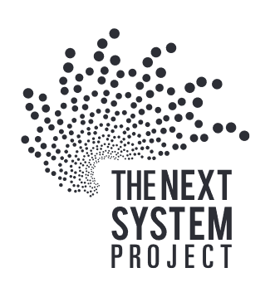
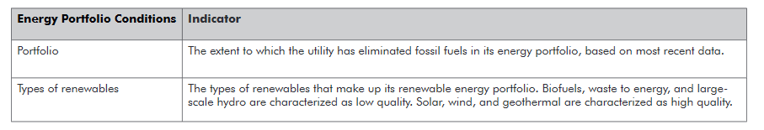
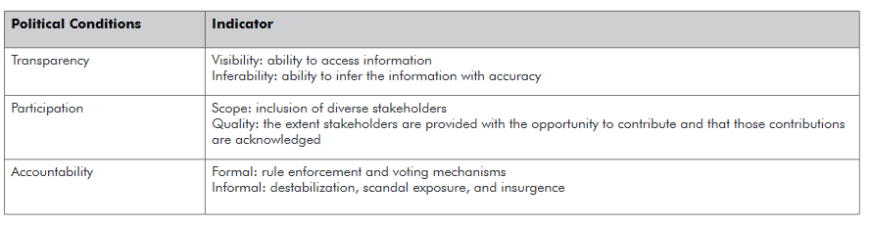
Energy Democracy

Slide 24
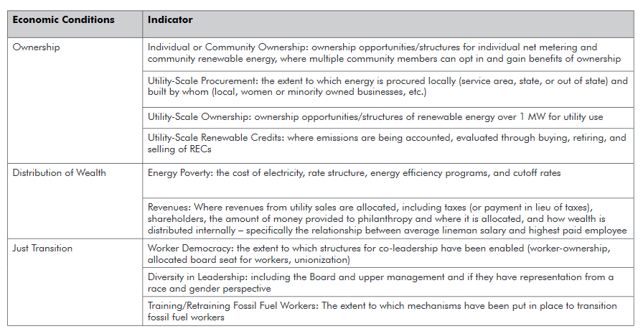
Energy Democracy

Slide 25
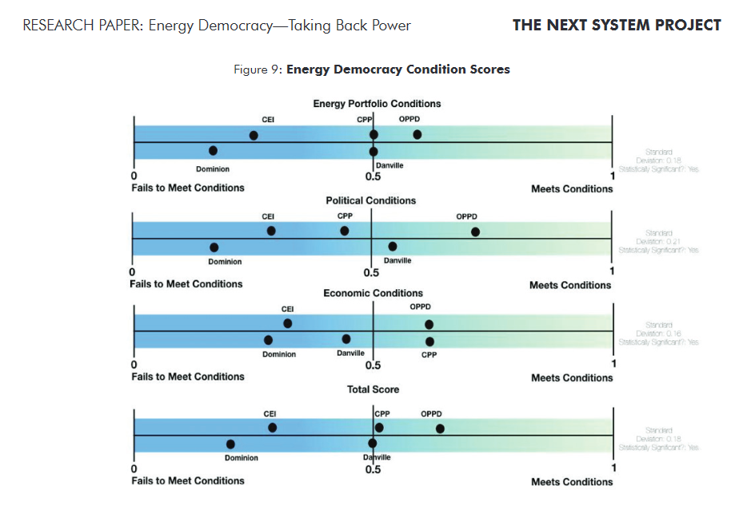
Public:
Danville
CPP
OPPD

Slide 26
Has anyone proposed anything concrete?

Slide 27
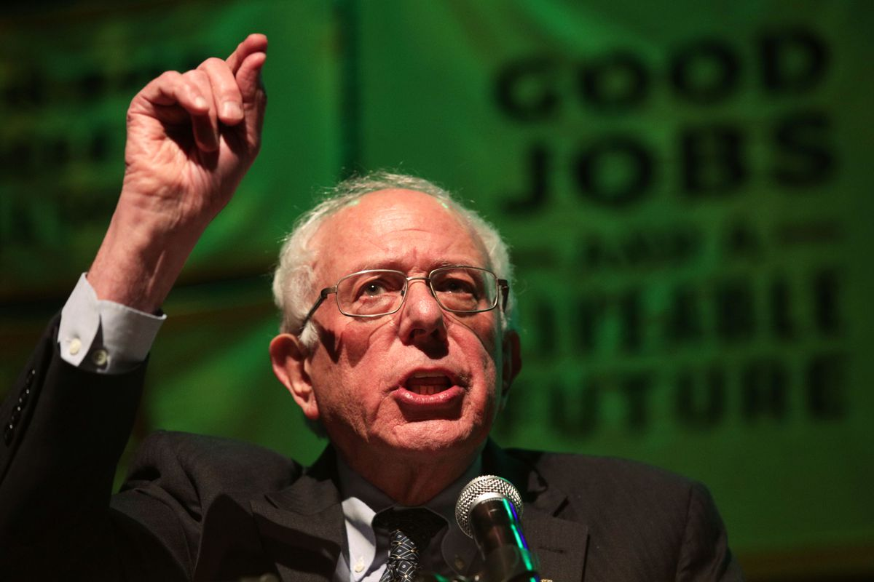
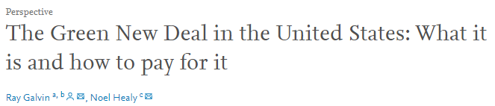
Sanders’ Green New Deal
$16.3 trillion in total from federal dollars
But how will we pay for it?
  $6.4 trillion in revenue from selling energy via power marketing authorities
  $2.3 trillion from income taxes from the new jobs created under the plan
  $1.2 trillion from reducing military expenses related to protecting oil shipping routes
How will it be spent?
  $1.52 trillion to deploy renewable energy and $852 billion for energy storage
  $526 billion for an underground high-voltage direct current power transmission network
  $200 billion for the United Nations Green Climate Fund to help other countries reduce their emissions
  $40 billion for a climate justice resiliency fund for under-resourced groups like Native Americans, people with disabilities, and the elderly to prepare for climate change
https://www.vox.com/2019/8/22/20827396/bernie-sanders-2020-climate-policy-green-new-deal
Notes:
The proposal aims to pay for itself over 15 years. And according to Sanders, the price tag is a bargain compared to the business-as-usual climate trajectory. “Economists estimate that if we do not take action, we will lose $34.5 trillion in economic activity by the end of the century,” according to the plan.
It also allocates $1.3 trillion for workers currently in the fossil fuel and carbon intensive industries to find work with strong benefits and a living wage.
From Bernie’s plan: https://berniesanders.com/issues/green-new-deal/
We will end greed in our energy system. The renewable energy generated by the Green New Deal will be publicly owned, managed by the Federal Power Marketing Administrations, the Bureau of Reclamation and the Tennessee Valley Authority and sold to distribution utilities with a preference for public power districts, municipally- and cooperatively-owned utilities with democratic, public ownership, and other existing utilities that demonstrate a commitment to the public interest. The Department of Energy will provide technical assistance to states and municipalities that would like to establish publicly owned distribution utilities or community choice aggregation programs in their communities. Electricity will be sold at current rates to keep the cost of electricity stable during this transition.

Slide 28

“Gosh, I’m not sure that’s what gets you to the solution”
Notes:
During CNN’s climate town hall, Elizabeth Warren was asked if she would advocate for the public ownership of energy utilities.

Slide 29
High-level incentive analysis
Advantages of public ownership governance
  Positive:
    Maintenance can be more easily incentivized (e.g. SVE vs. PG&E)
    Increases accountability and transparency to local community (e.g. TVA)
    Allows balancing environmental stewardship, jobs, economic growth (e.g. TVA, PMAs)
  Removing negative:
    Removes regulatory complexity (e.g. TVA, PG&E)
    Removes perverse lobbying incentives (e.g. Ohio HB 6)
    Removes incentive to just build infrastructure as a financing tool (e.g. COSR)
Sufficient financing incentives are key (e.g. Sanders’ GND)
Notes:
It’s not that public utilities don’t have faults, it’s just that they are better than current privately owned systems
Financing models are a NEGATIVE across the board
We need RAPID transformation today
One question I’d pose: Do we really need a system to pay for itself? If, for example, it can avoid future harm

Slide 30

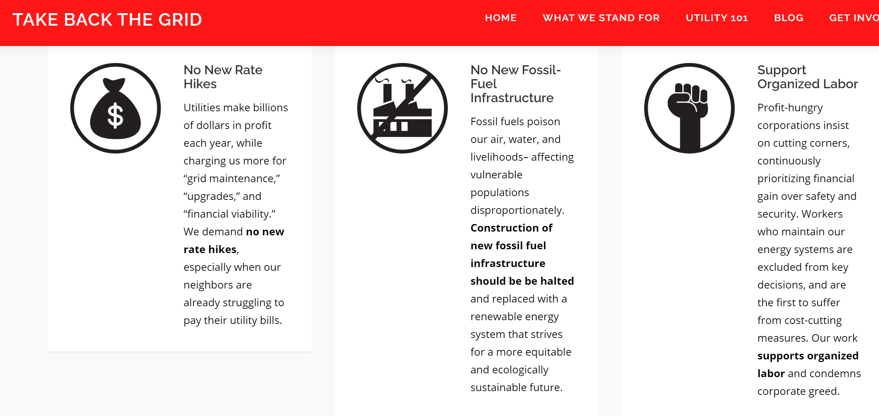
Local action you can get involved with:
Take Back the Grid
Democratic
Socialists of
America
https://www.takebackthegrid.org/

