Slide 1
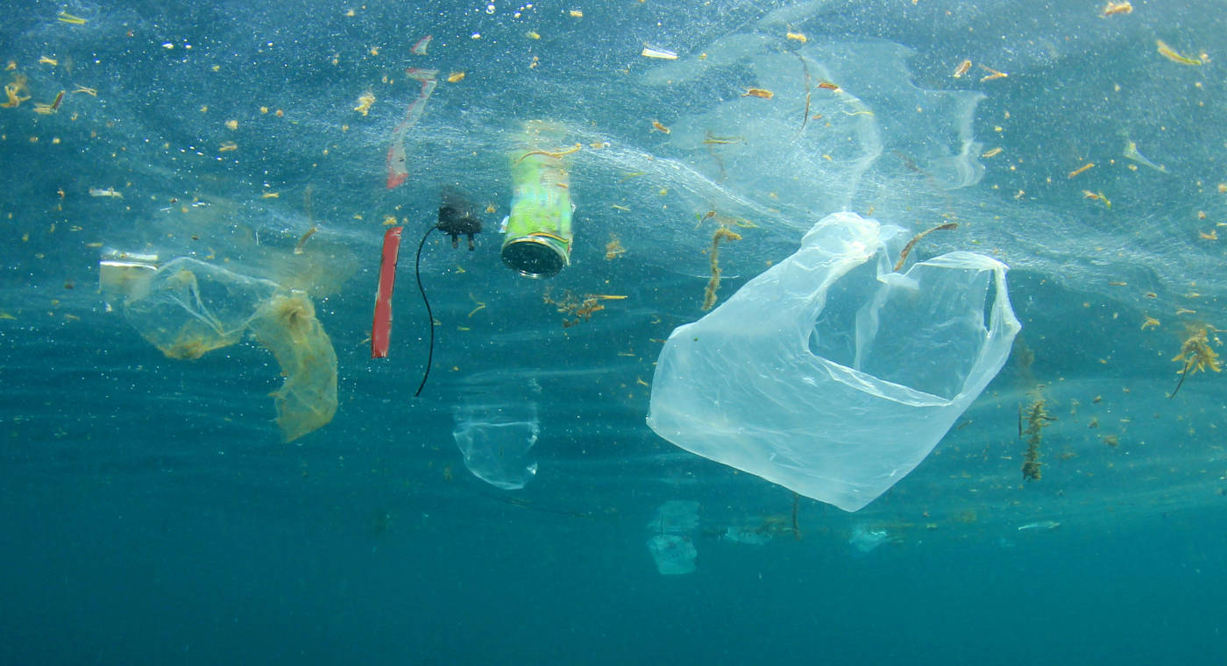
Plastic Pollution
Amos Meeks
3/5/21

Slide 2
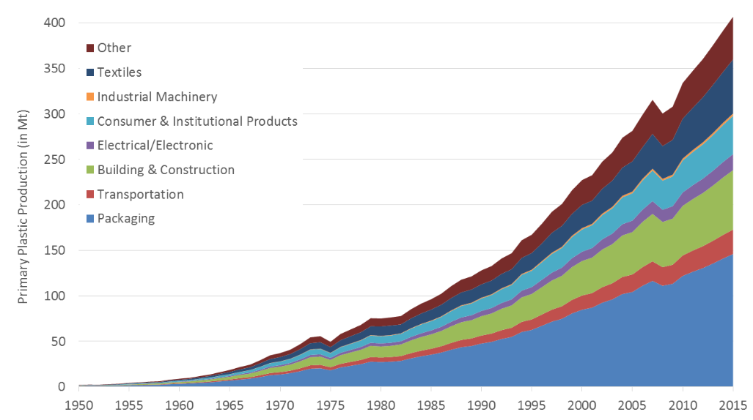
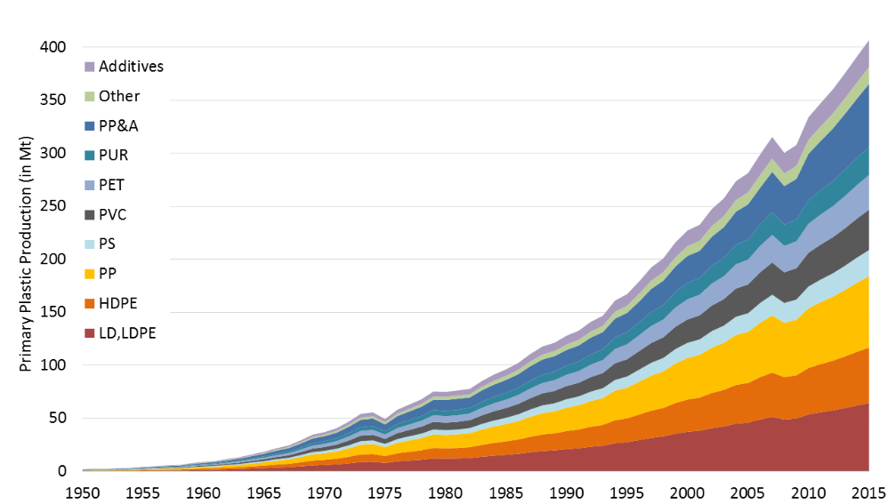
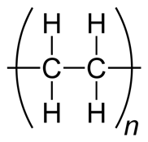
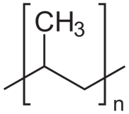
Plastic production is growing exponentially, mostly PE and PP
Production by Use
Production by Type
Historical 4 to 8% annual growth rate
polyethylene:
polypropylene:
Geyer, R., Jambeck, J. R. & Law, K. L. Production, use, and fate of all plastics ever made. Sci. Adv. 3, e1700782 (2017).

Slide 3
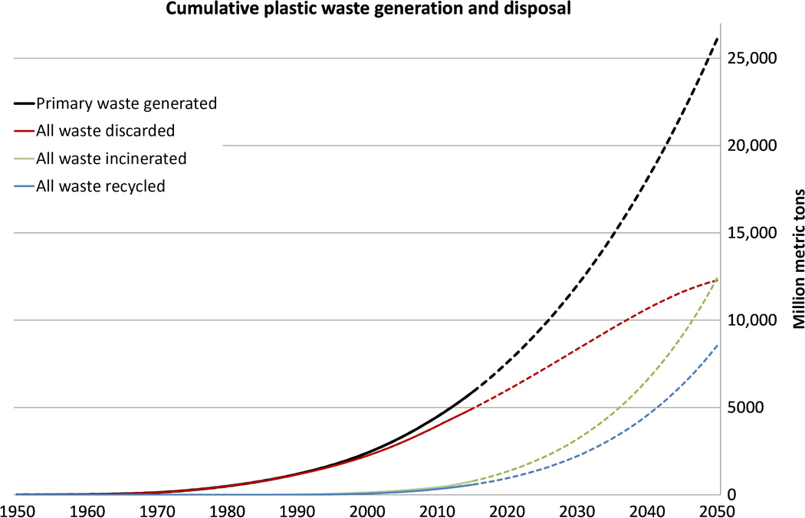
Waste generation is also growing exponentially
Lots of CO2 emissions
Mostly to landfills
You are here
Only delays environmental sequestration or CO2 release
Geyer, R., Jambeck, J. R. & Law, K. L. Production, use, and fate of all plastics ever made. Sci. Adv. 3, e1700782 (2017).
Notes:
Exponential growth
Corresponding energy consumption

Slide 4
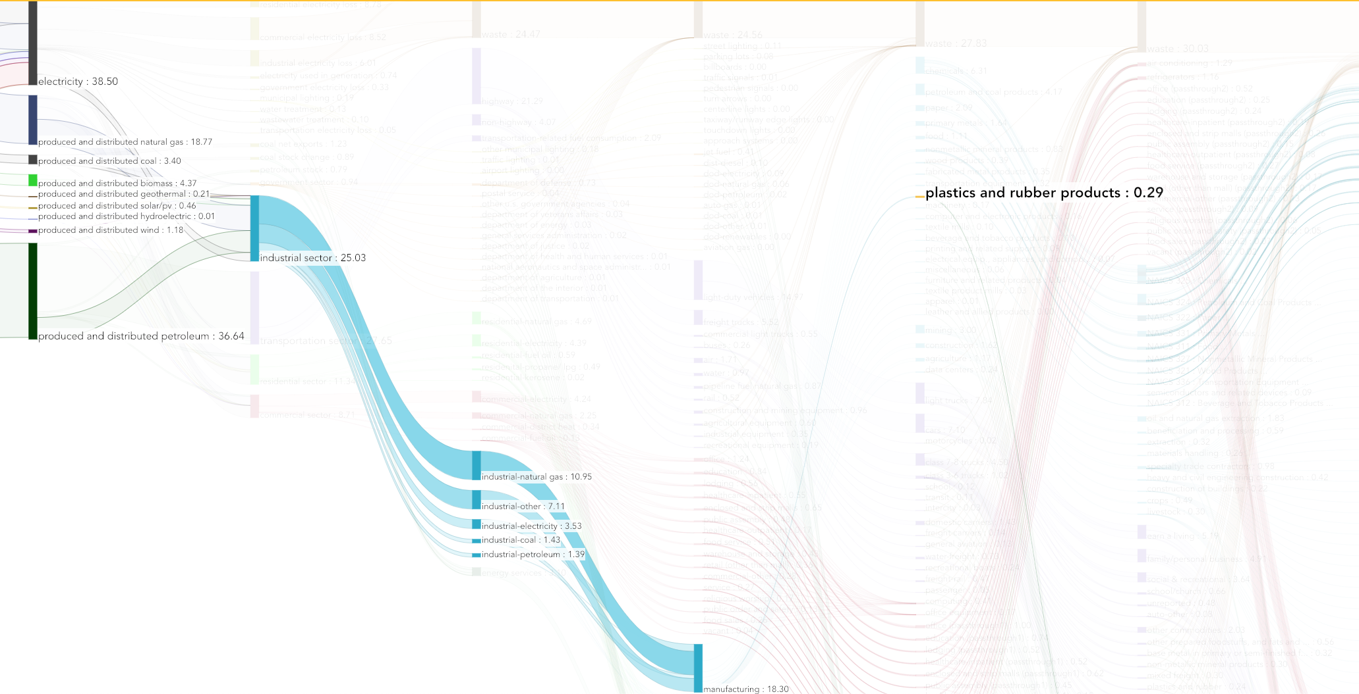
Plastic products represent a small fraction of total US energy consumption*
http://departmentof.energy/
Notes:
*Consider that we likely import a lot of plastic products manufactured elsewhere.

Slide 5




Creation of plastics from fossil carbon only delays CO₂ emissions
Incineration
Fossil hydrocarbons
CO₂
Aerobic degradation
Plastics
Atmospheric oxidation
CH₄
Anaerobic degradation

Slide 6
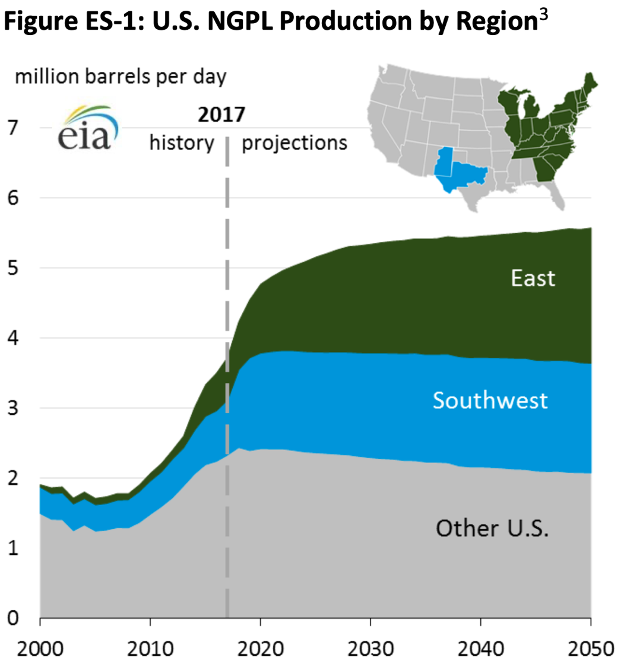
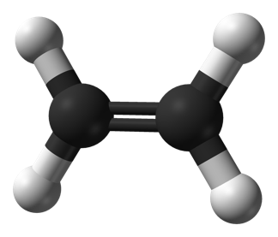
Co-production of Natural Gas Plant Liquids (NGPL) is driving up ethylene supply
U.S. Energy Information Administration, "Annual Energy Outlook 2018," 2018, https://www.eia.gov/outlooks/aeo/.

Slide 7
Current life-cycle GHG emissions driven primarily by resin production and conversion
Total 2014 emissions were about 36 GtCO2
Zheng, J. & Suh, S. Strategies to reduce the global carbon footprint of plastics. Nature Climate Change 9, 374–378 (2019).
Notes:
PP&A= polyester, polyamide, and acrylic

Slide 8
Reaching zero emissions by 2050 will be extremely difficult
4% growth, current energy mix
4% growth, decarbonize energy by 2050
2% growth, current energy mix
2% growth, decarbonize energy by 2050
Zheng, J. & Suh, S. Strategies to reduce the global carbon footprint of plastics. Nature Climate Change 9, 374–378 (2019).
Notes:
a, Plastics demand grows at 4% yr⁻¹ under the current energy mix. b, Plastics demand grows at 4% yr⁻¹, and the energy mix decarbonizes by 2050. c, Plastics demand grows at 2% yr⁻¹ under the current energy mix. d, Plastics demand grows at 2% yr⁻¹, and the energy mix decarbonizes by 2050. Solid lines represent the projected EoL-management mix (Supplementary Table 10); whereas shaded areas represent ranges due to EoL options. The bars on the right side of each panel represent ranges due to different EoL options in 2050.

Slide 9
Even with 100% renewables bio-based plastics have significant emissions
Current Energy Mix
100% Renewables
Zheng, J. & Suh, S. Strategies to reduce the global carbon footprint of plastics. Nature Climate Change 9, 374–378 (2019).
Notes:
a, GHG emissions under the current energy-mix scenario in 2050. b, GHG emissions under a 100%-renewable-energy scenario in 2050. Emissions results are based on the scenario with a 4% yr^{–1} growth rate for plastics demand and the projected EoL-management mix (Supplementary Table 10). Carbon credits generated by recycling are considered.
Carbon credit from atmosphere was subtracted from the production phase of bio based plastics

Slide 10
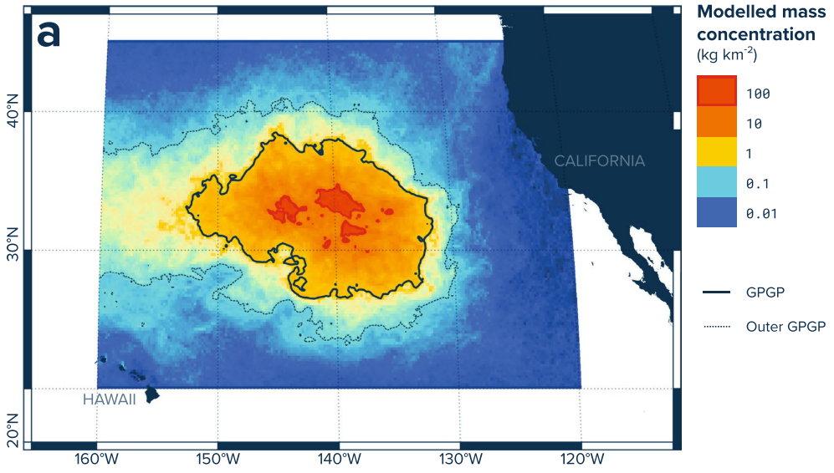
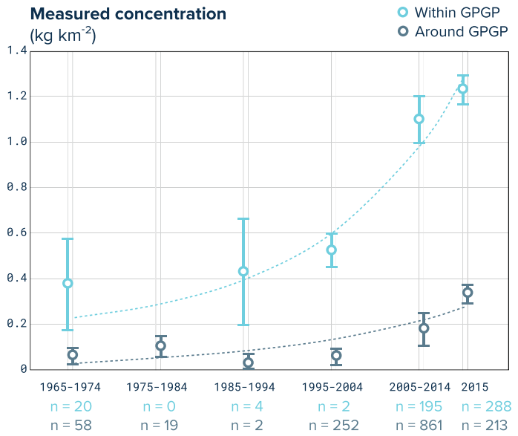
Plastic waste accumulation in the ocean is growing exponentially
2010
plastic waste generation
~275 Mt
plastic waste generation in coastal regions
~99.5 Mt
Mismanaged plastic waste generation in coastal regions
~31.9 Mt
Plastic waste entering the ocean
4.8 (1.7%) – 12.7 (4.6%) Mt
Lebreton, L. et al. Evidence that the Great Pacific Garbage Patch is rapidly accumulating plastic. Sci. Rep. 8, 1–15 (2018).
Jambeck, J. R. et al. Plastic waste inputs from land into the ocean. Science (80-. ). 347, 768–771 (2015).
Notes:
Estimated difference of about 2 orders of magnitude between what is observed and what is estimated to be emitted.

Slide 11
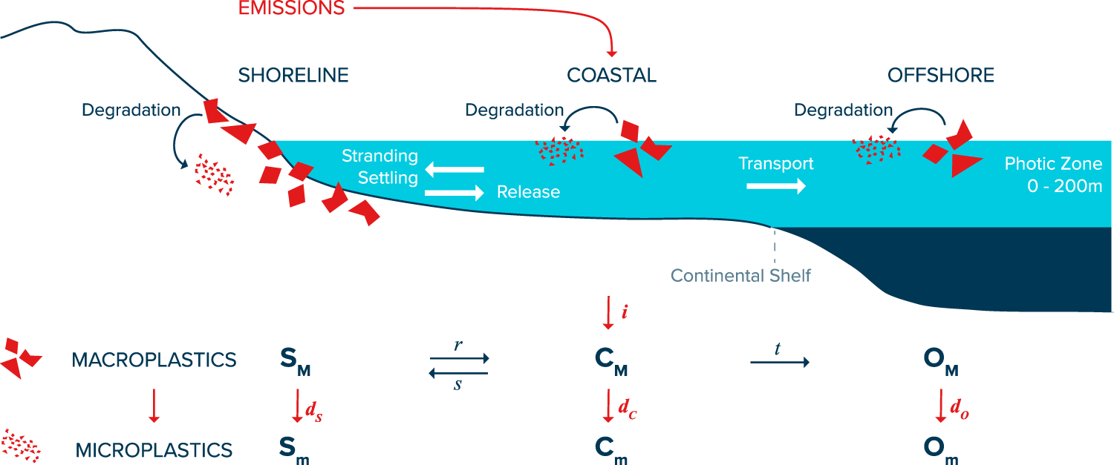
97% of plastic emitted into the ocean becomes stranded or buried in coastal waters
1.7-4.6%
1%
33%
3%/year, half life=23 years
97%
Lebreton, L., Egger, M. & Slat, B. A global mass budget for positively buoyant macroplastic debris in the ocean. Sci. Rep. 9, 1–10 (2019).
Notes:
They assumed the degradation rates to all be equal, but actually probably just a measurement of the ocean deg rates. Degradation of buried plastic is probably much much lower.
t=33% applies to non-beaching particles.

Slide 12
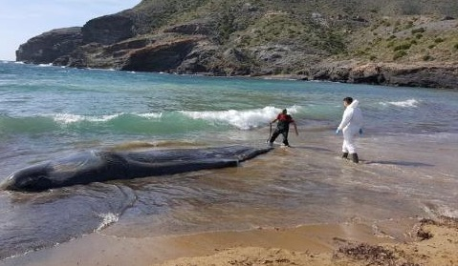
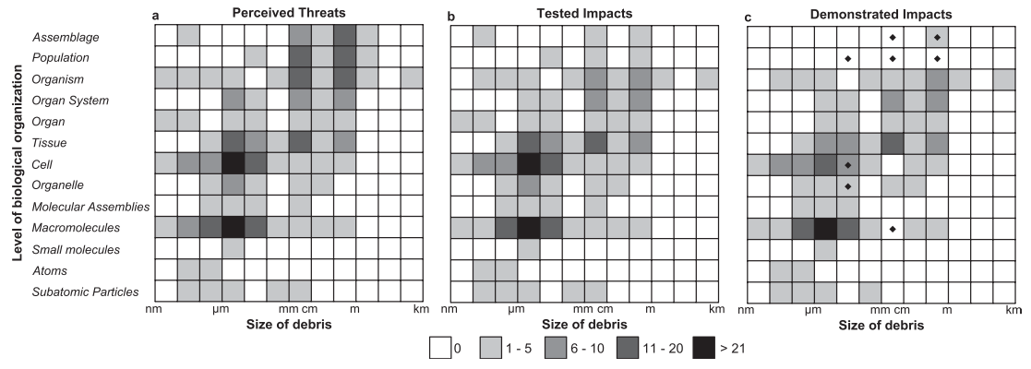
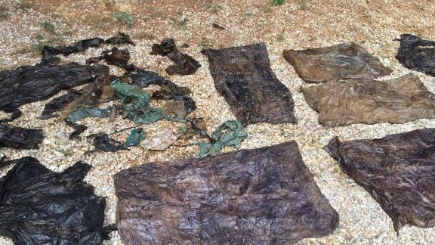
Plastic pollution has an unknown environmental impact
Rochman, C. M. et al. The ecological impacts of marine debris: unraveling the demonstrated evidence from what is perceived. Ecology 97, 302–312 (2016).
https://www.cnn.com/2018/04/11/health/sperm-whale-plastic-waste-trnd/index.html
Notes:
64 lbs of plastic waste in its stomach.
Most significant impact appears to be impact on metabolism and fecundity due to taking space in the stomach
Fig. 2. Perceived, tested, and demonstrated impacts of debris. Rows in each matrix represent different levels of biological organization from subatomic particles, atoms, small molecules, macromolecules, molecular assemblies, organelle, cell, tissue, organ, organ system, organism, and population to assemblage. Columns represent order- of- magnitude sizes of debris from smallest (left) to largest (right). Shading in the individual cells of the matrix represent the magnitude of (a) perceived, (b) tested, and (c) demonstrated impacts of debris in peer- reviewed literature identified using the search terms plastic debris and marine debris. Shading represents the number of impacts. Diamonds in the matrix in panel (c) correspond to cells where at least one impact has been demonstrated by correlative evidence. All impacts described at multiple size ranges and levels of biological organization are represented such that there are more impacts than there are papers.

Slide 13
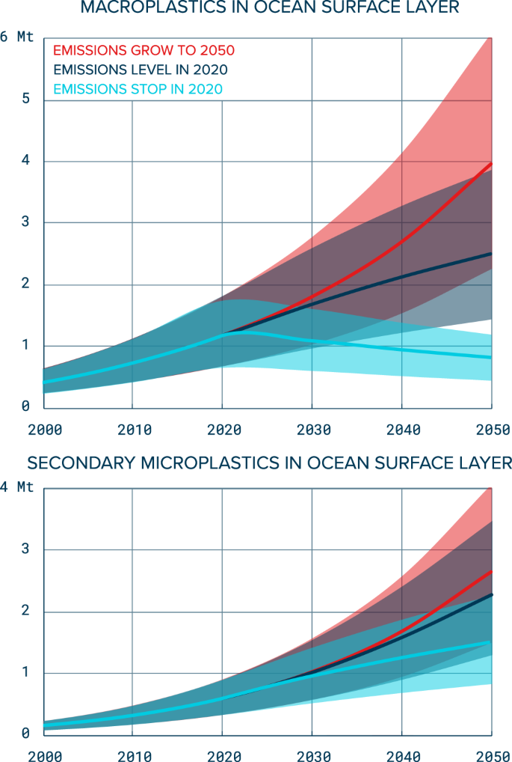
All of this add up to a similar type of problem as climate change
﻿”The same properties that make plastics so versatile in innumerable applications—durability and resistance to degradation—make these materials difficult or impossible for nature to assimilate. Thus, without a well-designed and tailor-made management strategy for end-of-life plastics, humans are conducting a singular uncontrolled experiment on a global scale, in which billions of metric tons of material will accumulate across all major terrestrial and aquatic ecosystems on the planet.”
Geyer, R., Jambeck, J. R. & Law, K. L. Production, use, and fate of all plastics ever made. Sci. Adv. 3, e1700782 (2017).
Lebreton, L., Egger, M. & Slat, B. A global mass budget for positively buoyant macroplastic debris in the ocean. Sci. Rep. 9, 1–10 (2019).
Notes:
An experiment with unknown effects and a significant delay in stock response to policy actions

Slide 14
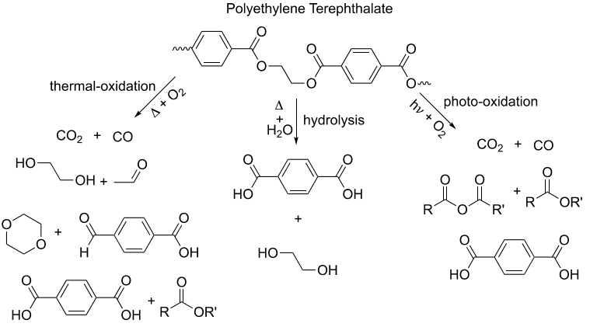
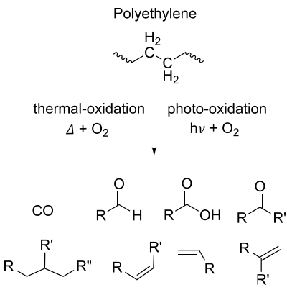
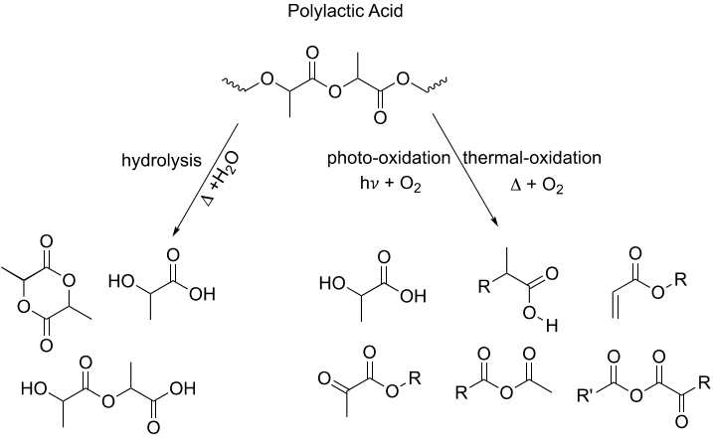
Materials science can be used to make more easily degraded plastic, but at a performance cost
Chamas, A. et al. Degradation Rates of Plastics in the Environment. ACS Sustain. Chem. Eng. 8, 3494–3511 (2020).
Notes:
Details of degradation are complicated, but if you remember one thing remember this: ester groups allows for hydrolysis, are often able to be biologically broken down as well.
Temperature plays an important role, PLA especially requires elevated temperatures for speedy hydrolysis.

Slide 15
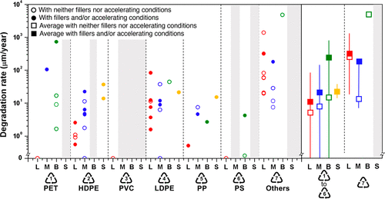

Even biodegradable plastics can be extremely long-lived in the environment
Chamas, A. et al. Degradation Rates of Plastics in the Environment. ACS Sustain. Chem. Eng. 8, 3494–3511 (2020).
Notes:
Note that this is degradation into smaller bits. Not the end of the story, possible bioplastics can be more easily broken down by microbes into CO2

