Slide 1
Electric Vehicle Market
Harvard Energy Journal Club
December 11th, 2020
Jordan Sosa

Slide 2
Outline
Vehicle definitions
Why electric vehicles important?
History of electric vehicles
Current standing in markets and technology
Projected growths, challenges, and advantages

Slide 3
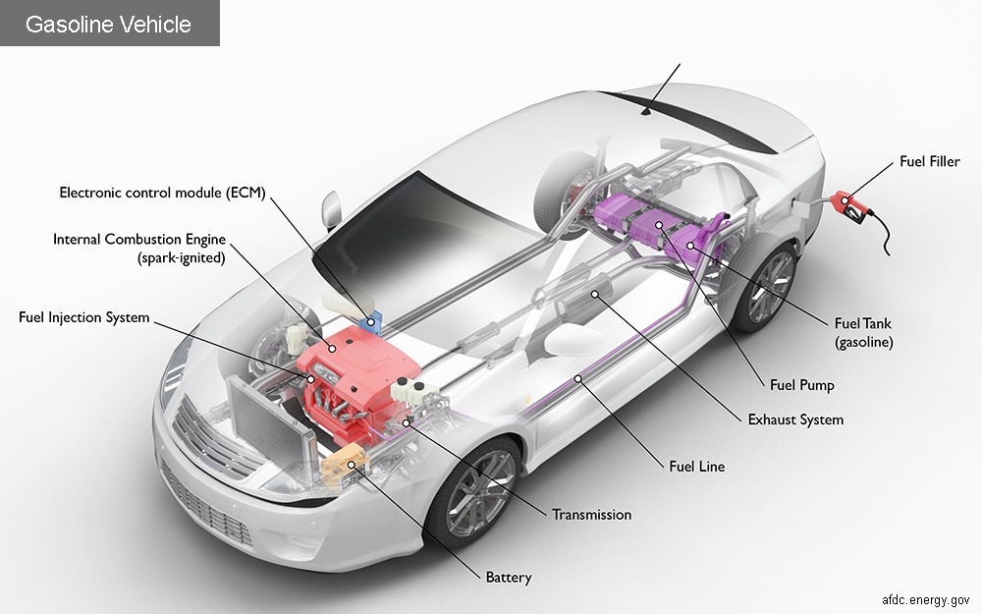
Insert chemical energy!
Notes:
Types of emissions from transport
Direct emissions: from operating the vehicle; smog-forming pollutants, air health pollutants, and greenhouse gases (GHGs))
Life cycle emissions: fuel and vehicle production, processing, distribution, use, and post-use (recycling/disposal)
Types of cars
GHG powered vehicles
Hybrid electric vehicles (HEVs)
Plug-in HEVs (few direct emissions)
Hydrogen fuel vehicles (not discussed today☹)
Electric vehicles (0 direct emissions, fewer life cycle emissions, but dependent on electricity source)
You can check your electricity emission rates! https://afdc.energy.gov/vehicles/electric_emissions.html

Slide 4
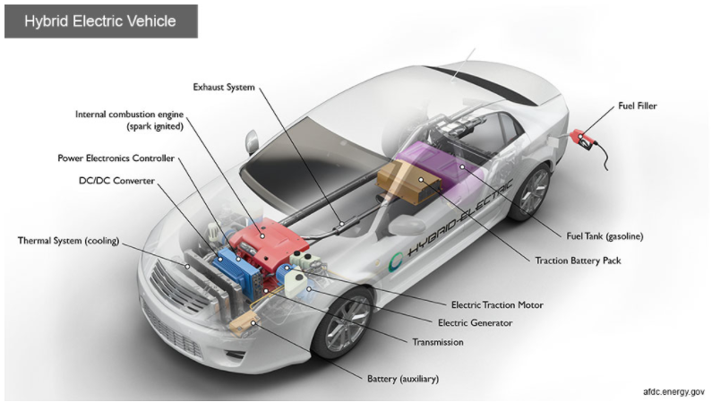
Chemical energy
Electrochemical energy
(chemical to/from electrical)

Slide 5
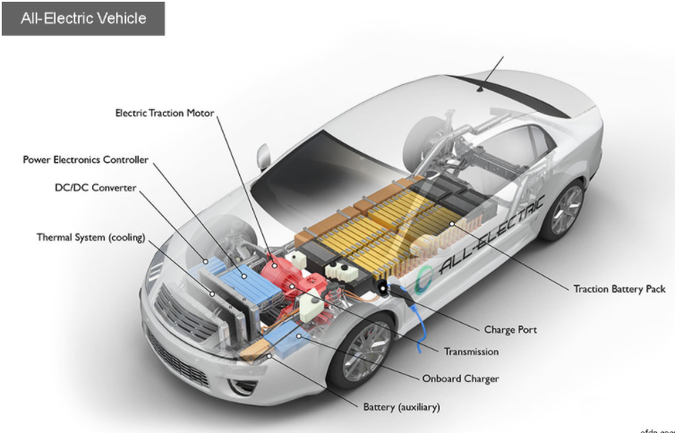
    You can check your electricity emission rates! https://afdc.energy.gov/vehicles/electric_emissions.html
Electrochemical energy!

Slide 6
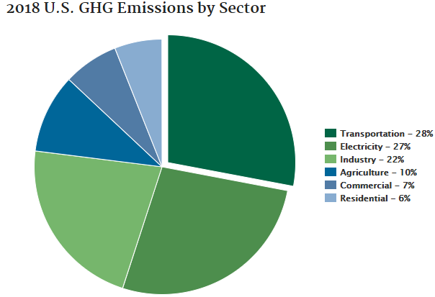
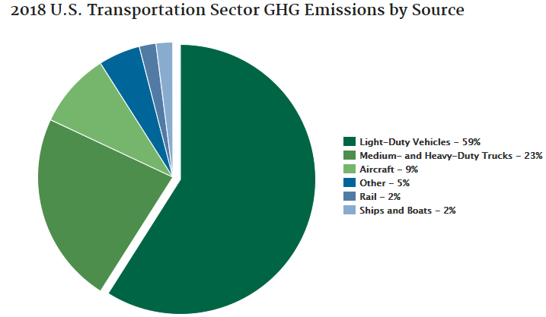
Energy and Climate Change
Up from 14% in 2014
(https://www.epa.gov/ghgemissions/global-greenhouse-gas-emissions-data#Sector)
Expected increase +20% by 2030, +50 % by 2050
https://www.epa.gov/greenvehicles/fast-facts-transportation-greenhouse-gas-emissions
https://www.epa.gov/greenvehicles/fast-facts-transportation-greenhouse-gas-emissions
Notes:
Transport contribution to greenhouse gases (HGH) expected to rise by 20% by 2030 and to 50 % by 2050
To combat: Need global rail transport electrification and at least 20% of road transport vehicles to be EVs by 2030 (Paris electro mobility declaration)
https://www.epa.gov/greenvehicles/fast-facts-transportation-greenhouse-gas-emissions

Slide 7
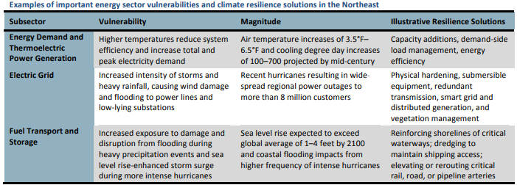
Energy and Climate Change
  https://www.energy.gov/science-innovation/climate-change
Notes:
https://www.energy.gov/science-innovation/climate-change

Slide 8
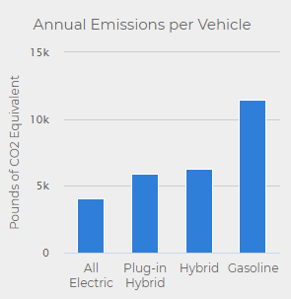
Why electric vehicles?
Renewable energy sources
Less fuel transportation waste
Possible higher energy conversion of fuel in industrial reactors
https://afdc.energy.gov/vehicles/electric_emissions.html
Notes:
With EV’s, can recharge by renewable energy sources like solar, wind, geothermal, nuclear, etc
Also, less energy for transportation of fuel
Higher energy conversion if fuel converted in industrial reactors instead of in small car engines
https://afdc.energy.gov/vehicles/electric_emissions.html

Slide 9
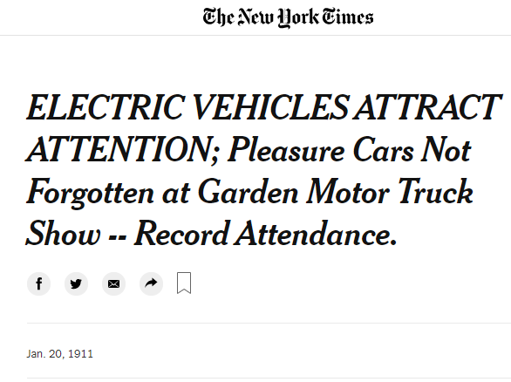
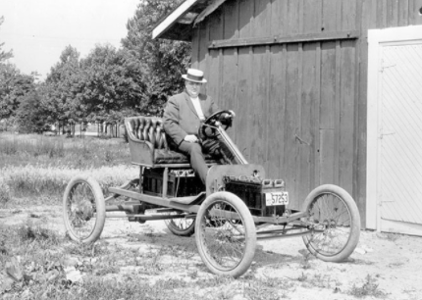
History of EVs in USA
1890: William Morrison’s electric wagon
1900: 1/3 of NYC vehicles were Evs
Many historic inventors and businessman considered designs
Setback: weight of batteries
1935: no more Evs ☹
https://www.energy.gov/articles/history-electric-car
https://www.caranddriver.com/features/g15378765/worth-the-watt-a-brief-history-of-the-electric-car-1830-to-present/
Notes:
1890: William Morrison: electric wagon in Iowa to travel 14 mph (first one from Robert Anderson 1832-39, got destroyed from rail workers)
Through 1900, electric cars accounted for 1/3 of vehicles in NYC
Many historic inventors and businessman investigated EV’s
Henry Ford and Thomas Edison
Ferdinand Porsche
Setback: Weight of batteries, not solved until Li+
By 1935, all EV’s disappeared due to long-range travel from new highways and cheap fuel discovered in Texas and Oklahoma

Slide 10
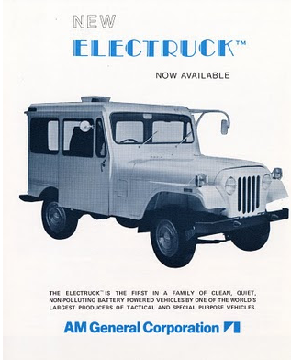
History of EVs in USA
1970’s initiated US’s concern over dependence on oil
  Government-funded EV/HEV research
GM developed EV for EPA’s 1st symposium on Low Pollution Power Systems Development of same year
American Motor Company made E jeeps for USPS in ’75 tests
NASA used electric Lunar rover in ’71
Problem: Still limited speeds and ranges
  Image:
  https://www.hagerty.com/media/automotive-history/decades-before-gm-ev1-these-postal-electruck-jeeps-delivered-the-goods/
Notes:
1970’s initiated US’s concern over dependence on oil
Electric and Hybrid Vehicle R,D, & Demonstration Act of 1976 for DOE to research E & HV’s. Goals were to design changes in road-design, utilities, tax policies; incentivize inventions by guaranteeing a purchase of 2500-5000 vehicles, and make sure no biases in industry
Image: https://www.hagerty.com/media/automotive-history/decades-before-gm-ev1-these-postal-electruck-jeeps-delivered-the-goods/

Slide 11
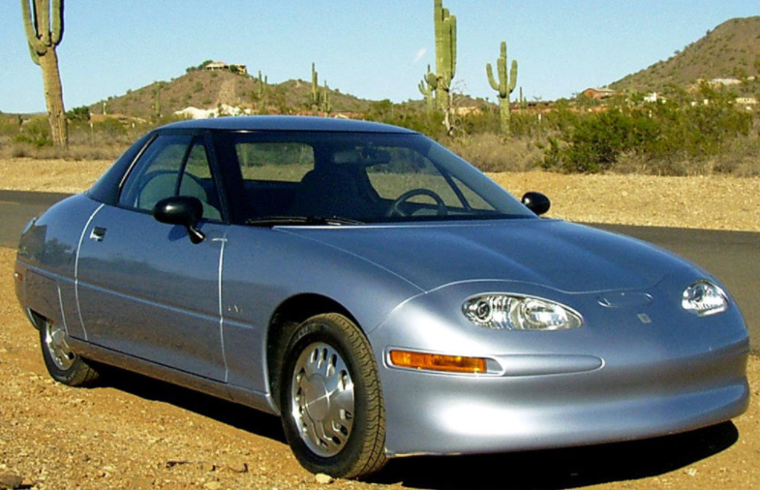
History of EVs in USA
1990’s: Government programs renewed EV interest
  Energy & Air Acts
Speeds closer to gas vehicles, driving ranges ~ 60 miles;
  The Impact set land speed record for EVs at 183 mph. Scrapped it.
  GM EV1 first mass produced EV (initially lead-acid with 55 mile range, then with Ni-metal hydride, 100-140 miles))
Image: https://en.wikipedia.org/wiki/General_Motors_EV1#:~:text=The%20General%20Motors%20EV1%20was,electric%20vehicle%20from%20the%20outset.
GM EV1
Notes:
1990’s: Renewed interest in EV’s from government policies: 1990 Clean Air Act Amendment, ‘92 Energy Policy Act, and California 0 emission vehicle mandate
https://en.wikipedia.org/wiki/General_Motors_EV1#:~:text=The%20General%20Motors%20EV1%20was,electric%20vehicle%20from%20the%20outset.

Slide 12
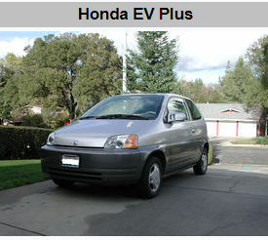
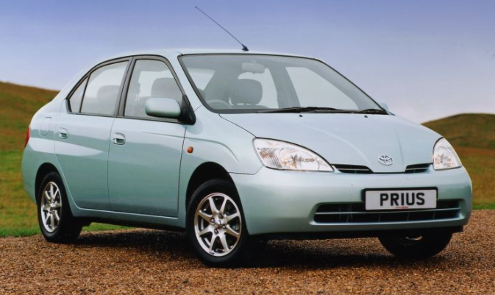
History of EVs in USA (1990’s continued)
Honda EV: 1st EV without lead acid batteries (80 mph, 8-35 h charge time); replaced with hybrid Honda Insight after 340 different models
1997: Toyota Prius first mass-produced hybrid (worldwide in 2000)
Image: https://en.wikipedia.org/wiki/Honda_EV_Plus
Image:
https://blog.toyota.co.uk/history-toyota-prius#:~:text=The%20Toyota%20Prius%20was%20the,%2C%20low%2Demission%20family%20vehicle.
Notes:
https://en.wikipedia.org/wiki/Honda_EV_Plus
https://blog.toyota.co.uk/history-toyota-prius#:~:text=The%20Toyota%20Prius%20was%20the,%2C%20low%2Demission%20family%20vehicle.

Slide 13
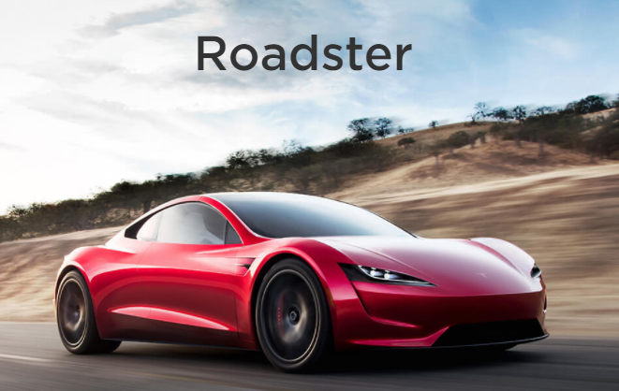
Recent History of EVs
2006: Tesla Motors
2007: Chevy Volt
2010: DOE loans $465 million to Tesla (repaid in 9 years) for manufacturing facility, which became the largest auto industry employer in CA
Chevy Volt and Nissan LEAF
Image:
https://www.tesla.com/roadster
Notes:
Tesla Motors starts producing luxury E sports cars w/ 200+ miles on one charge (Li+ batteries)

Slide 14
Electric Vehicles Now
Where can we charge???
  2009 Recovery & Reinvestment Act
2012 EV Everywhere Grand Challenge: $ of EV = $ of gas vehicle by 2022
2014: 23 electric and 36 hybrids options; 234k EVs and 3.3 mill hybrids
https://www.energy.gov/eere/articles/ev-everywhere-america-s-plug-electric-vehicle-market-charges-forward#:~:text=In%202012%2C%20the%20Energy%20Department,within%20the%20next%2010%20years.
https://www.energy.gov/recovery-act
Notes:
“Through the Recovery Act, the Energy Department invested more than $31 billion to support a wide range of clean energy projects across the nation -- from investing in the smart grid and developing alternative fuel vehicles to helping homeowners and businesses reduce their energy costs with energy efficiency upgrades and deploying carbon capture and storage technologies. ” energy.gov/recovery-act
Where can we charge??? Recovery Act allocation $115 mill for charging infrastructure for 18l residential, commercial, and public chargers (8k locations & 20k outlets in 2014)
2012 EV Everywhere grand challenge for gas vehicles to be same price as EV in 2022 (see Argonne National Lab E Storage and ARPA-E)
reference

Slide 15
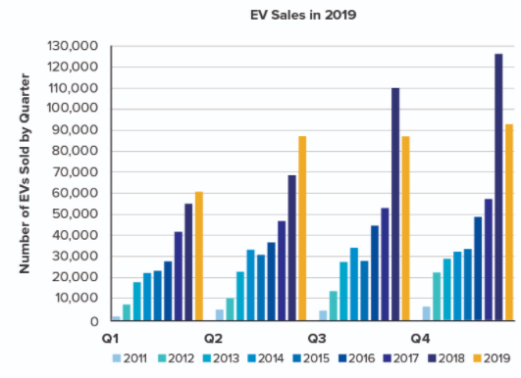
Current EV growth
EV market to hit almost 27 million units by 2030
  (that’d be 10% of the cars in the US in 2018)
  Growth from 3.3 million in 2019
  Still small amount considering 70 million cars made worldwide in 2016
    In 2018, 2.2% of cars sold were EVs
2019, 36% of market requires strict clear air standards
In 2020, more new EV models than gas car models
2022, over 500 EV models
See end of slides for References
Notes:
over 175% growth over ~1 decade ($21.2 compound annual growth rate)
CAGR = (ending value/ Beginning value)^(1/# years) -1
https://www.sciencedirect.com/science/article/abs/pii/S2214629620303200
https://www.marketsandmarkets.com/Market-Reports/electric-vehicle-market-209371461.html#:~:text=The%20Electric%20Vehicles%20Market%20is,is%20from%202019%20to%202030.
https://cleanenergy.org/blog/electric-vehicles-will-kick-gas/#:~:text=2019%20saw%2010%25%20year%2Dover,Tesla%20Model%203%20deliveries%20surged.
https://cleanenergy.org/blog/electric-vehicles-will-kick-gas/#:~:text=2019%20saw%2010%25%20year%2Dover,Tesla%20Model%203%20deliveries%20surged.
Figure
Source based on 2018 reports

Slide 16


Current competitors
https://wattev2buy.com/ev-buy-electric-car-list/
Variety of countries making Evs
Range of products/services
  Purchase
  lease/”subscribe”
  Battery renting
Notes:
United States
Tesla (shares up 409%) , has new manufacturing plant in Austin, TX and plans for more gigafactories; had first quarter of profits last year
Ford’s electric F-150 and Mustang; bought Rivian startup to accelerate tech, as well as partnering with Volkswagen, etc
Canada
Facedrive acquired Steer for EV “subscription”
Germany
BMW, Volkswaggen
Other: Volvo plans to make a new model EV every year for five years; goal of 50% of global sales to be Evs by 2025
Japan
Nissan (eight new EV models from 2019 to 2023) will also partner with Nissan, Mitsubishi to work juntos, Honda, Toyota, etc
China
Li Auto, Xpeng, Nio (shares up 1100%), BYD
Nio leases batteries
Some companies have PHEV specialization to navigate sparse charging infrastructure. Since 2019, sold 10k units
https://en.wikipedia.org/wiki/Li_Auto

Slide 17
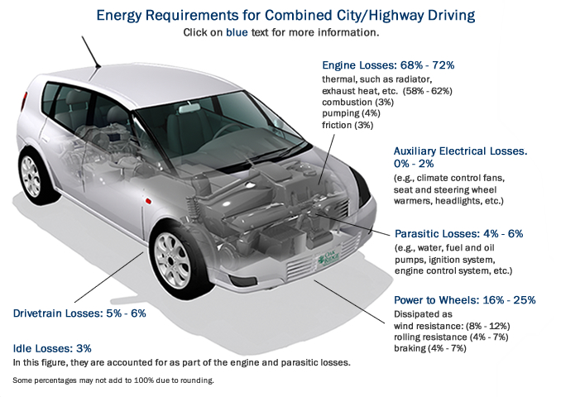
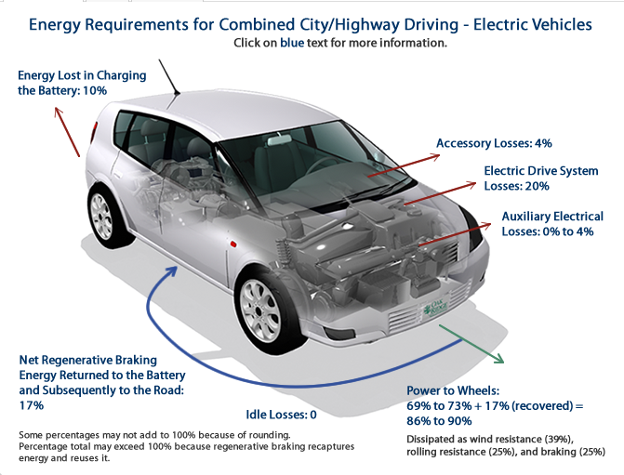
64-75% of energy lost for gas-powered cars
15-20% of energy lost for EVs
https://www.fueleconomy.gov/feg/atv-ev.shtml

Slide 18
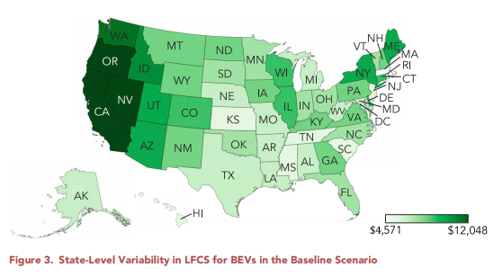
Advantages to EVs
Lifetime Fuel Cost Savings (LFCS)
No gas station stops
At least comparable performance
New tech
Cost of operation is generally lower
5/6 of Americans live in areas where EVs reduce or compare to best gas hybrid vehicles
Macroscopically, energy diversity good for economic stability
Looking to buy a car and compare energy source effects?
  https://www.fueleconomy.gov/feg/findacar.shtml
  https://www.energy.gov/maps/egallon (see this one for operation costs)
Notes:
With home or work charging, no gas station stops
Higher torque, faster accelerations, etc
Better tech (mechanical and general)
Cost of operating a new gasoline vehicles in US ($1509-993, average 1117) much higher than for electric vehicle (485 average, 1106 to 367). Per location, always cheaper for EV
For gas vehicles, gas mileage must be at least 57.6 mpg on average to be less expensive
5/6 of Americans live in areas where EVs reduce or compare to best gas hybrid vehicles
Macroscopically, energy diversity good for economic stability
Image: cell.com/joule/pdfExtended/S2542-4351(20)30231-2

Slide 19


Challenges to EV growth
Price ($19k+ more on average initially)
Range
Rare earth metals as electrode materials
  International Economic Impact Concerns
  Environmental Damage
Charging stations
Car dealers! (made 74% of car deals in Switzerland survey)
  Limited profit for dealers from EV sales or no car dealers at all
    Also frequently less knowledgeable on Evs
Understanding (people don’t like change!)
Image: https://twitter.com/hdebeaufort/status/1257316175773437953?s=27
Notes:
Price ($19k+ more on average initially); however, for small EVs, parity expected by 2025; medium and large sized expected around 2030 for parity.
https://www-sciencedirect-com.ezp-prod1.hul.harvard.edu/science/article/pii/S0301421520307345
Solutions to rare earth metals concerns:
1. better predict their deposits so the mining is not as destructive. Need more geologist!
2. Better recycling of battery materials
3. Other battery materials that are easier to harvest and more abundant (sodium, carbon, etc)
https://web.mit.edu/12.000/www/m2016/finalwebsite/solutions/recycling.html
https://twitter.com/hdebeaufort/status/1257316175773437953?s=27

Slide 20
EV Goals
Ford electric F-150 to halve cost of ownership by 2022
Tesla Battery Day 2020 Announced goals
  Battery pack prices down to $60/kWh by 2025 (from $135/kWh 2020)
  Cobalt-free cathodes
  3 TWh capacity for factories by 2023
ZETA (Zero Emission Transportation Association) goal of only EVs sold in US by 2030
  28 car manufacturers, infrastructure providers, and service companies collaborating
US Government: 550,000 new charging stations in Biden Administration

Slide 21
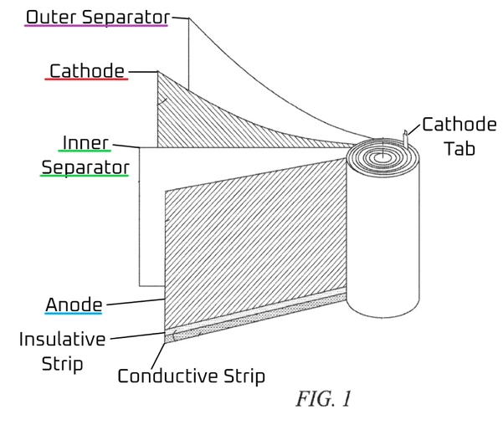

Emerging Technologies: Cell Design
Notes:
Larger diameter and taller cells with more active material (less deadweight) that’s cheaper to manufacture while maintaining supercharging and thermal control.
These cells also add more structural integrity to the cars, since they’re aligned along the bottom of the car.
Also, they got rid of tabs
Deep Dive Into Tesla Tabless Electrode Patent Before Battery Day (tesmanian.com)
Getting rid of these tabs apparently allows for a lot better power distribution and somehow allows charge/discharge at each plane in the coil.
It also eliminates production steps and better manages heating concerns.

Slide 22
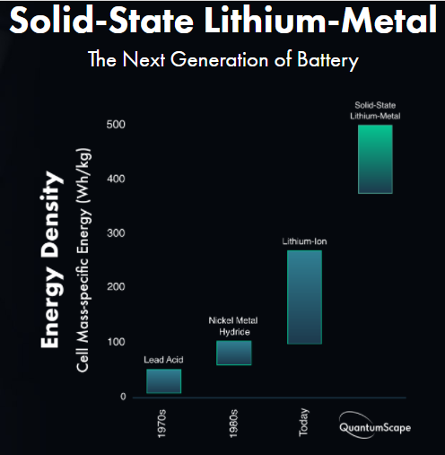
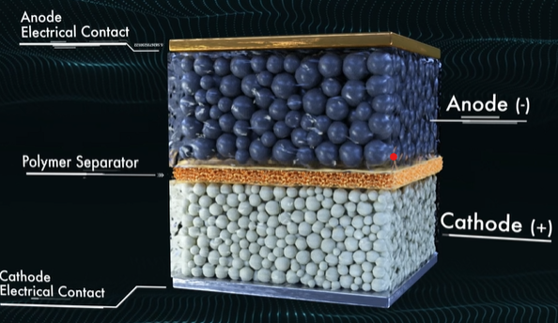
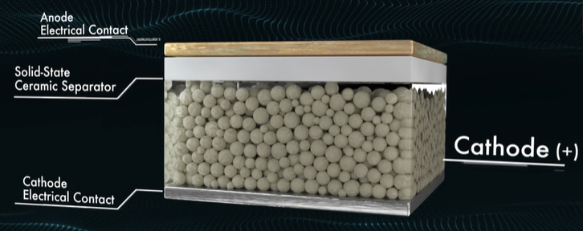
Emerging Technologies
https://www.quantumscape.com/
Notes:
silver-carbon instead of lithium metal in a prototype pouch yields a battery with a higher capacity, lengthens the cycle life, and makes the battery safer.
Samsung predicts 500 mile range with more than 1000 recharges (500k miles). However, no year prediction.
QuantumScape predicts we’ll see their batteries in four years. Issues it faces are that lithium ion batteries are already widely used, and their performance and cost are only expected to drop while this technology is still in its R&D phase.
https://www.quantumscape.com/
Solid state batteries (Samsung, QuantumScape)
Improved energy density, power density, safety,
Replacing dendritic lithium with silver-carbon

Slide 23
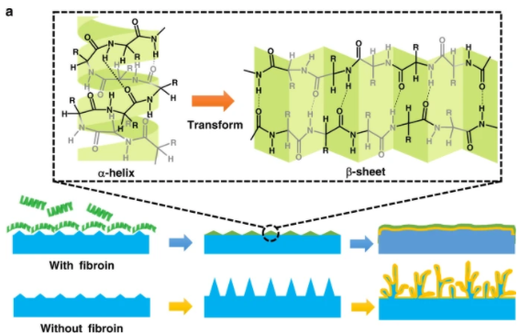
Emerging Technologies: Protein battery enhancement
Wang, T., Li, Y., Zhang, J. et al. Immunizing lithium metal anodes against dendrite growth using protein molecules to achieve high energy batteries. Nat Commun 11, 5429 (2020). https://doi.org/10.1038/s41467-020-19246-2
Notes:
certain protein could efficiently prevent and eliminate the growth of wispy lithium dendrites, leading to long cycle life and high Coulombic efficiency of lithium metal anodes. Protein acts like a natural, immunization mechanism for self-defense against the growing dendrites. These proteins can be added into electrolyte, and then adsorb onto lithium metal surface. This changes the electric field distribution, causing a plating and stripping of the electrode. So still lose electrode material, but won’t have failure to dendrites which short circuits batteries relatively quickly.
Proteins: https://www.nature.com/articles/s41467-020-19246-2

Slide 24

Emerging Technologies: Combustion
For gasoline powered vehicles:
Low-temperature combustion (+20% efficiency)
Diluted gasoline combustion (+35%)
Clean diesel
https://www.energy.gov/eere/vehicles/advanced-combustion-strategies
Notes:
The left-hand side of the video shows real-time video footage of conventional diesel combustion, where the fuel injector (center) sprays 8 jets of liquid fuel into combustion chamber. The right-hand side of the video shows real-time video footage of Homogeneous Charge Compression Ignition (HCCI), an advanced combustion process where fuel is vaporized and premixed with air prior to compression.
For gasoline powered vehicles, researchers are looking at low-temperature combustion, diluted gasoline combustion, clean diesel,

Slide 25
Summary of EVs in the market
Have existed for awhile
Have notable economic and performance advantages
  Current goals can unite these
Need to grow charging infrastructure
Essential to combatting climate change
In mean time
  Improve gasoline technologies
  Advance mining techniques of battery materials
  Diversify battery technologies
  Need policies (Clear Car Standards) to keep pushing

Slide 26
Thank you!
Please email me or check the HEJC website for links.
Congratulations to everyone on finishing 2020.
Jordan Sosa
Jossa@g.Harvard.edu

Slide 27
References from slide 15
Slide 15
  Jana Plananska, Touchpoints for electric mobility: Investigating the purchase process for promoting sales of electric vehicles in Switzerland, Energy Research & Social Science, Volume 69, 2020,101745, ISSN 2214-6296, https://doi.org/10.1016/j.erss.2020.101745.
  https://www.marketsandmarkets.com/Market-Reports/electric-vehicle-market-209371461.html#:~:text=The%20Electric%20Vehicles%20Market%20is,is%20from%202019%20to%202030.
  https://www.marketsandmarkets.com/Market-Reports/electric-vehicle-market-209371461.html#:~:text=The%20Electric%20Vehicles%20Market%20is,is%20from%202019%20to%202030.
  https://cleanenergy.org/blog/electric-vehicles-will-kick-gas/#:~:text=2019%20saw%2010%25%20year%2Dover,Tesla%20Model%203%20deliveries%20surged.

