Slide 1

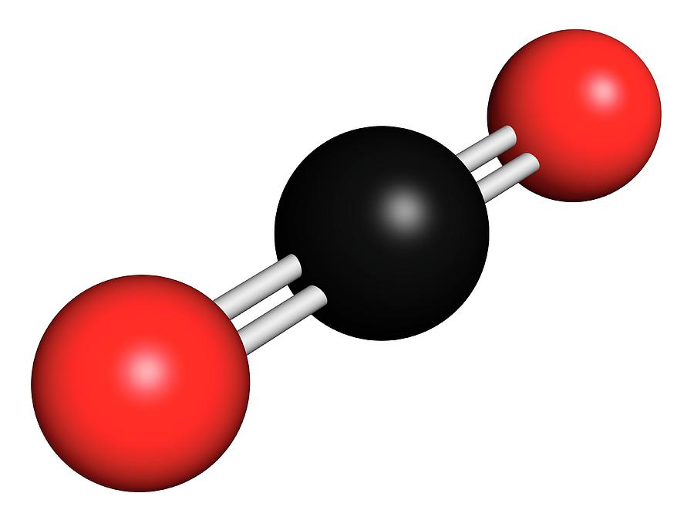

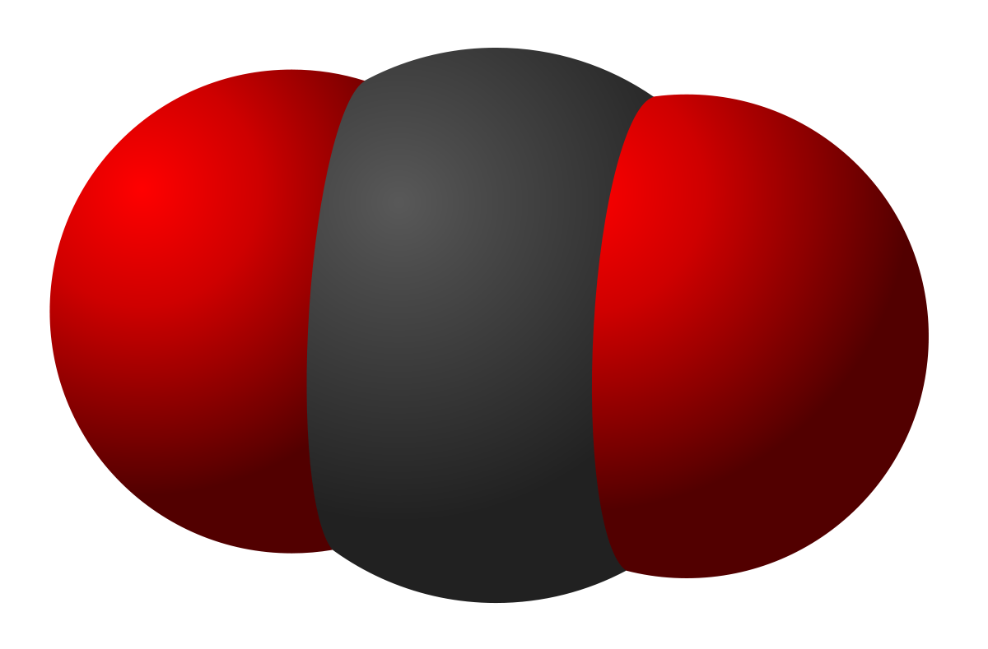
Counting Carbon
HECJ 10/30/20
Amos Meeks

Slide 2

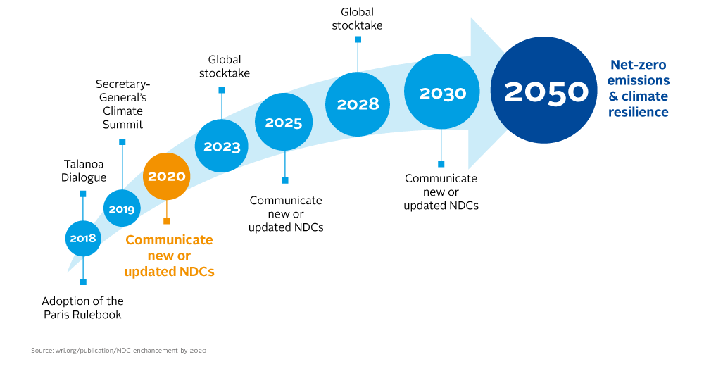
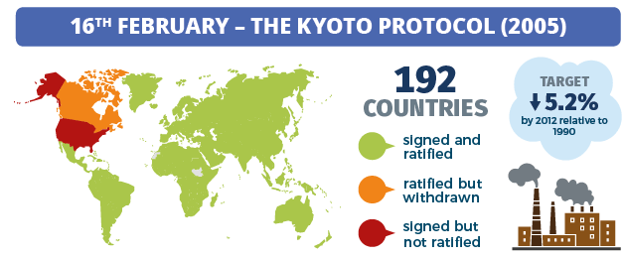
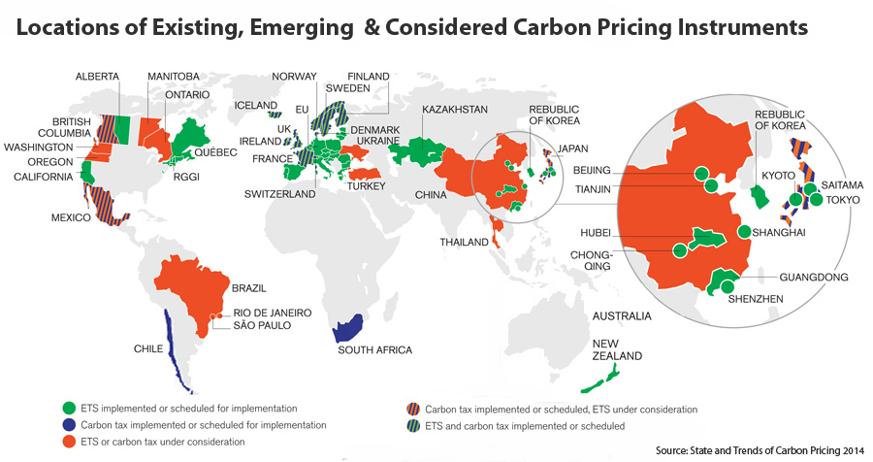
Climate policy requires measuring carbon
International Treaties:
Carbon Pricing:
Notes:
https://en.wikipedia.org/wiki/Paris_Agreement
https://en.wikipedia.org/wiki/Kyoto_Protocol
Paris
Countries make nonbinding NDCs. Goal is to make these more ambitious over time.
Global stocktake every 5 years.
Kyoto
Countries commit to (weakly) binding emissions targets
Provides for international emissions trading as a way to meet targets
Carbon pricing (cap and trade or tax)
Most carbon accounting is done through bottom-up methods and self-reported. Bottom up methods can miss a lot, and what we care about is the total amount of CO2 in the atmosphere. How can we measure what we care about and also verify the accuracy of these methods?

Slide 3
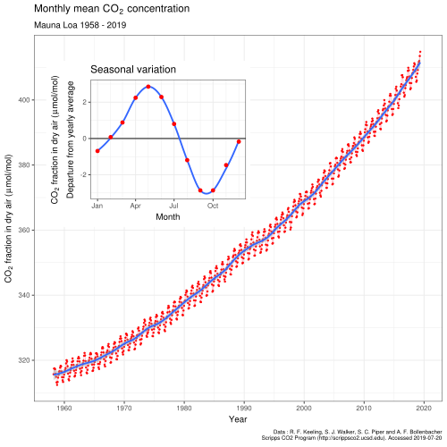
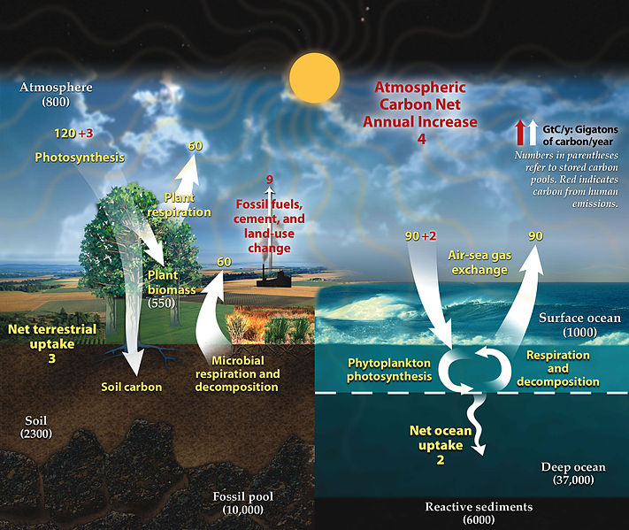
Measure what you care about: CO2 in the atmosphere
But the relationship between emissions and atmospheric CO2 is complex:

Slide 4
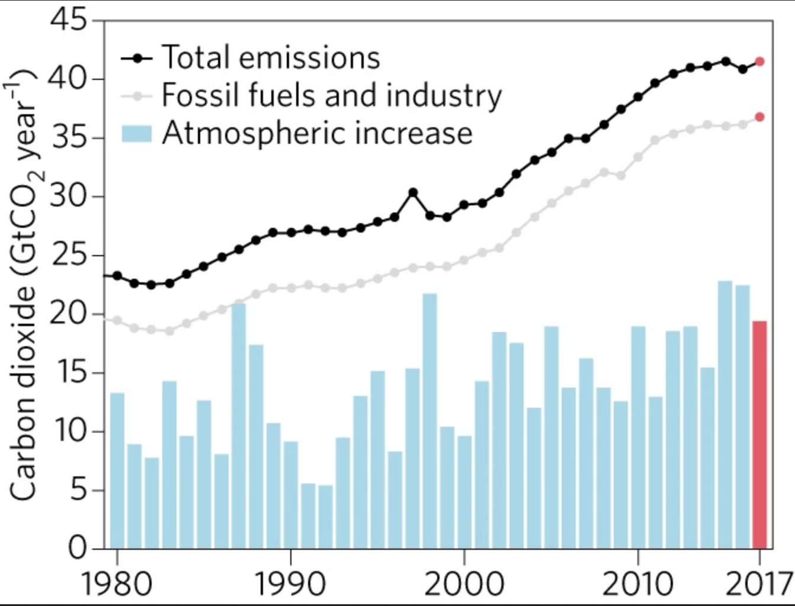
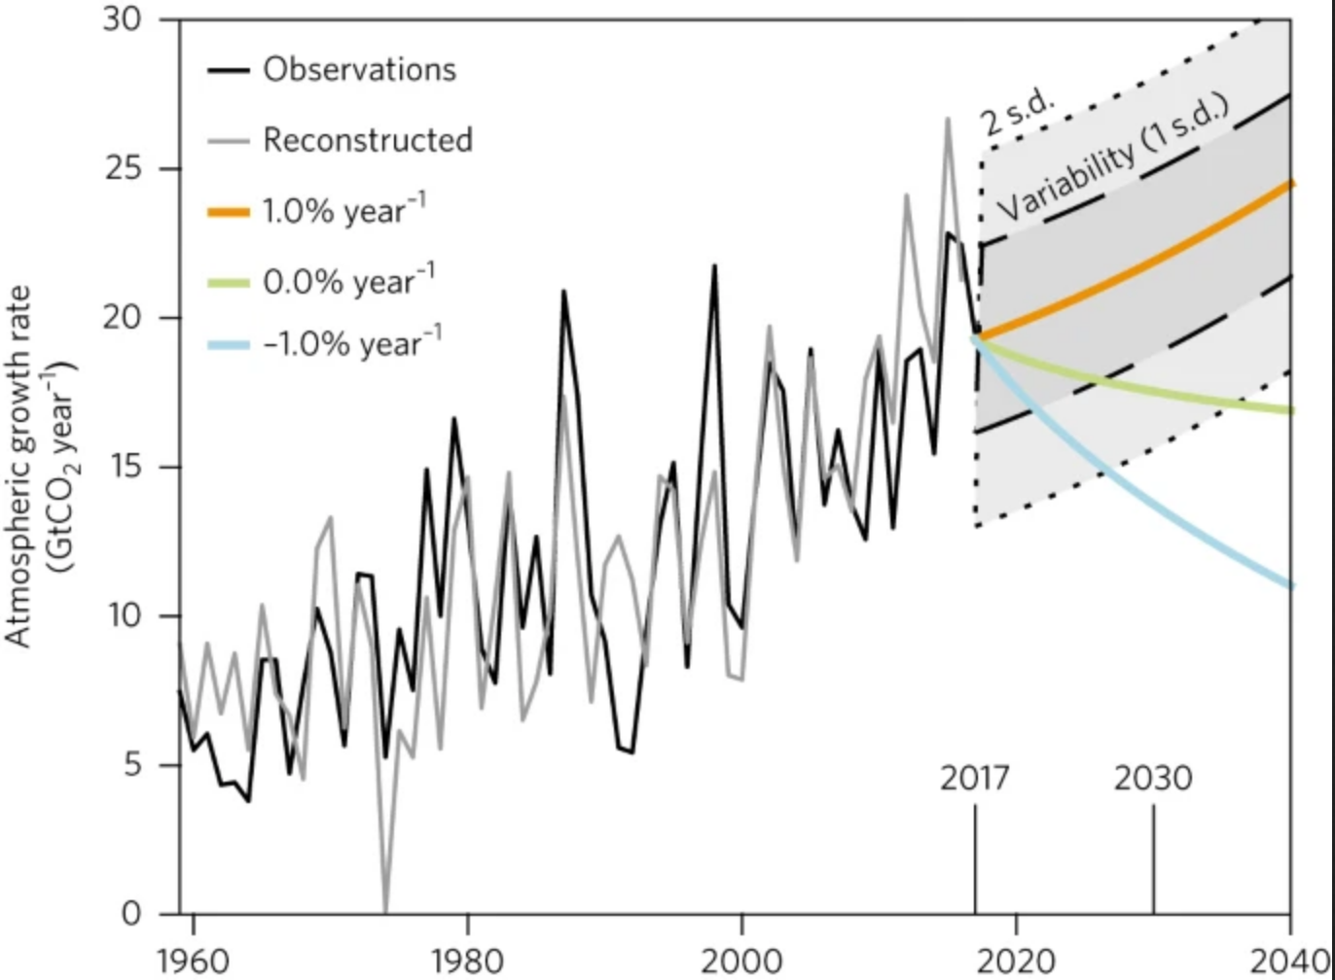
Accurate top-down emissions measurements are hard, usually only 5-15% accuracy
Peters, G. P. et al. Towards real-time verification of CO2 emissions. Nature Climate Change 7, 848–850 (2017).

Slide 5
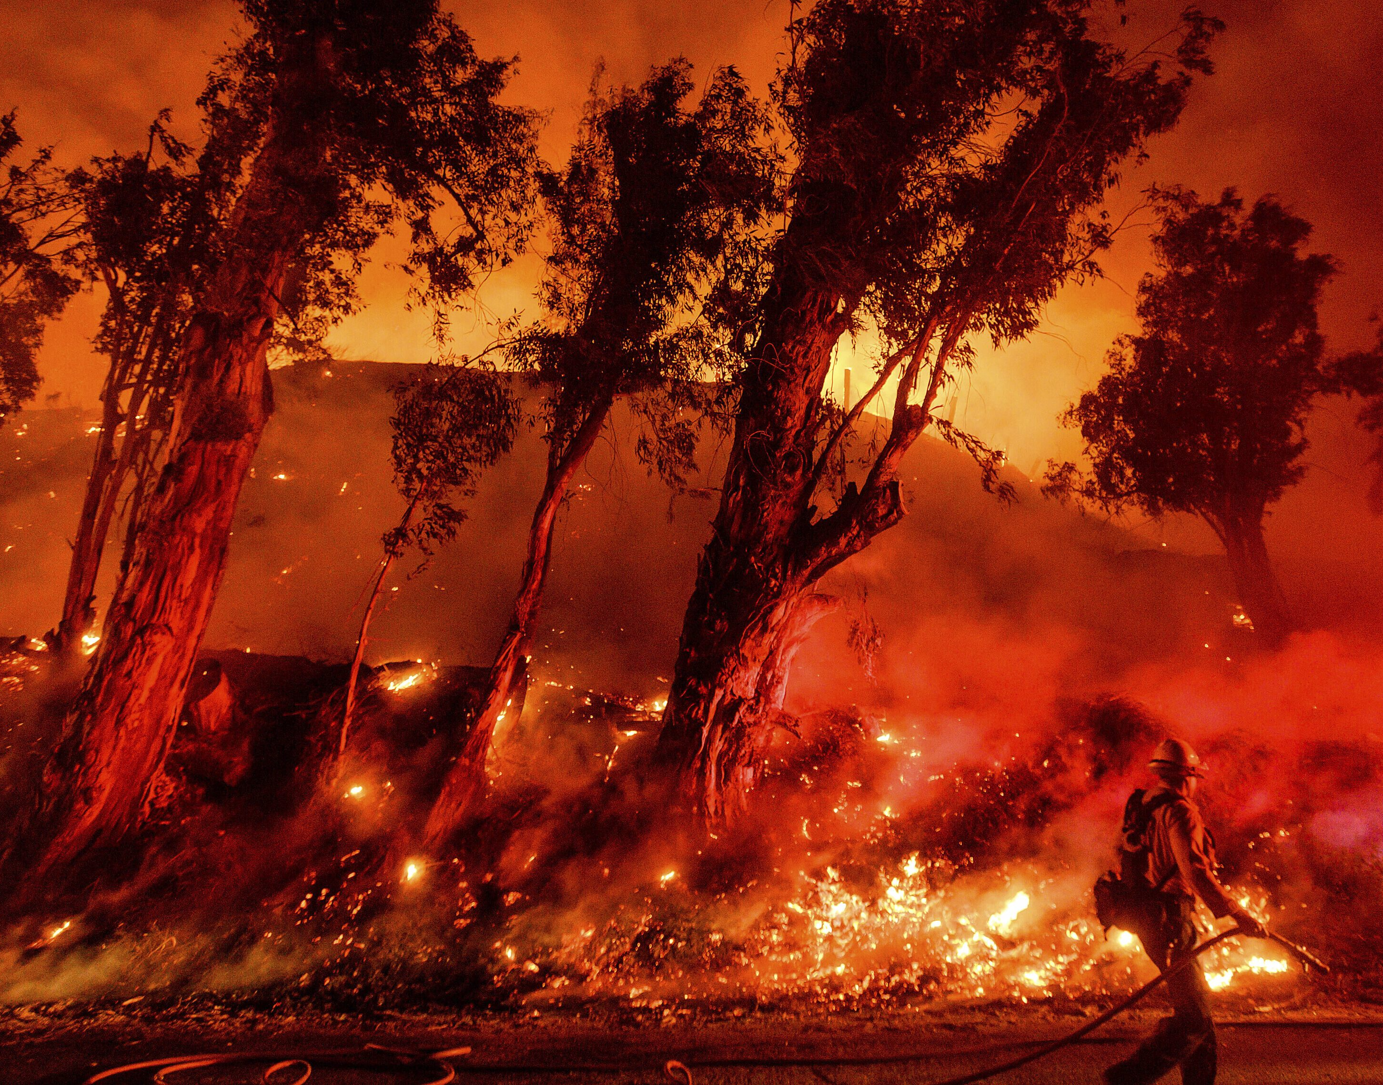
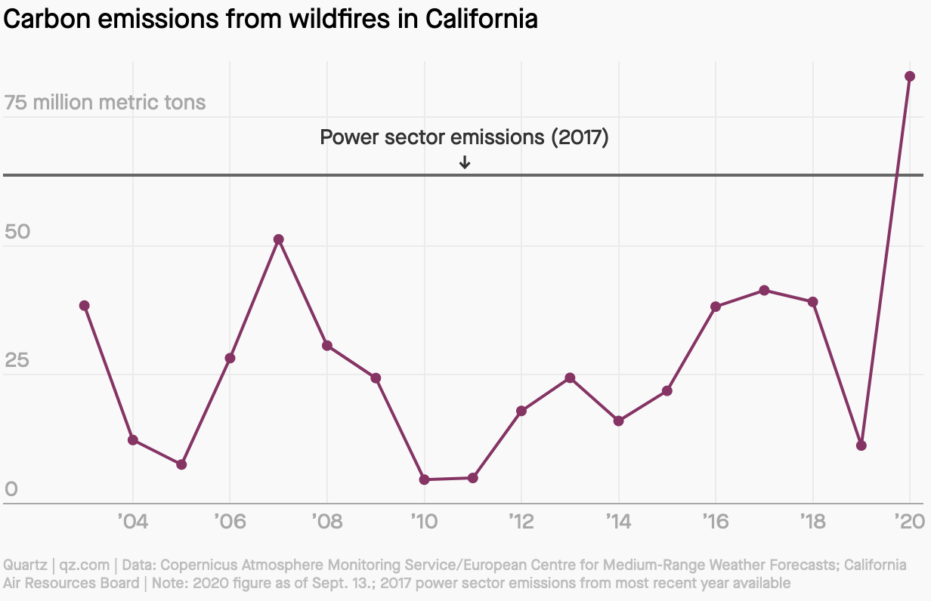
Example: 2020 Wildfire emissions in CA surpass annual power sector emissions

Slide 6
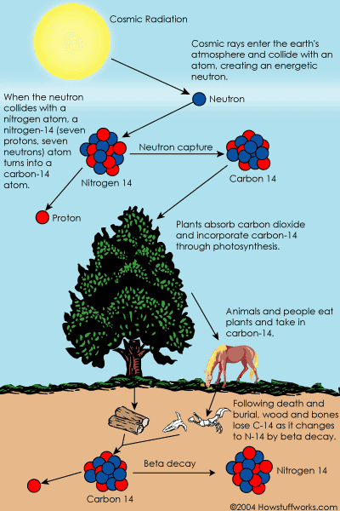
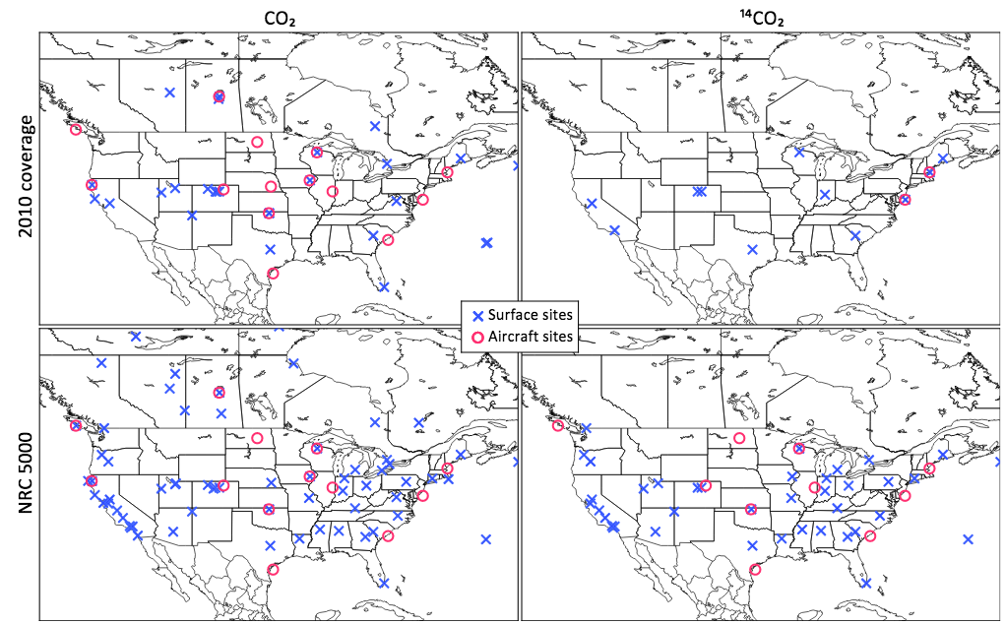
A network of ¹⁴CO₂ sensors offer promise of better emissions measurement
Modeled CO2 Monitoring Locations:

Slide 7
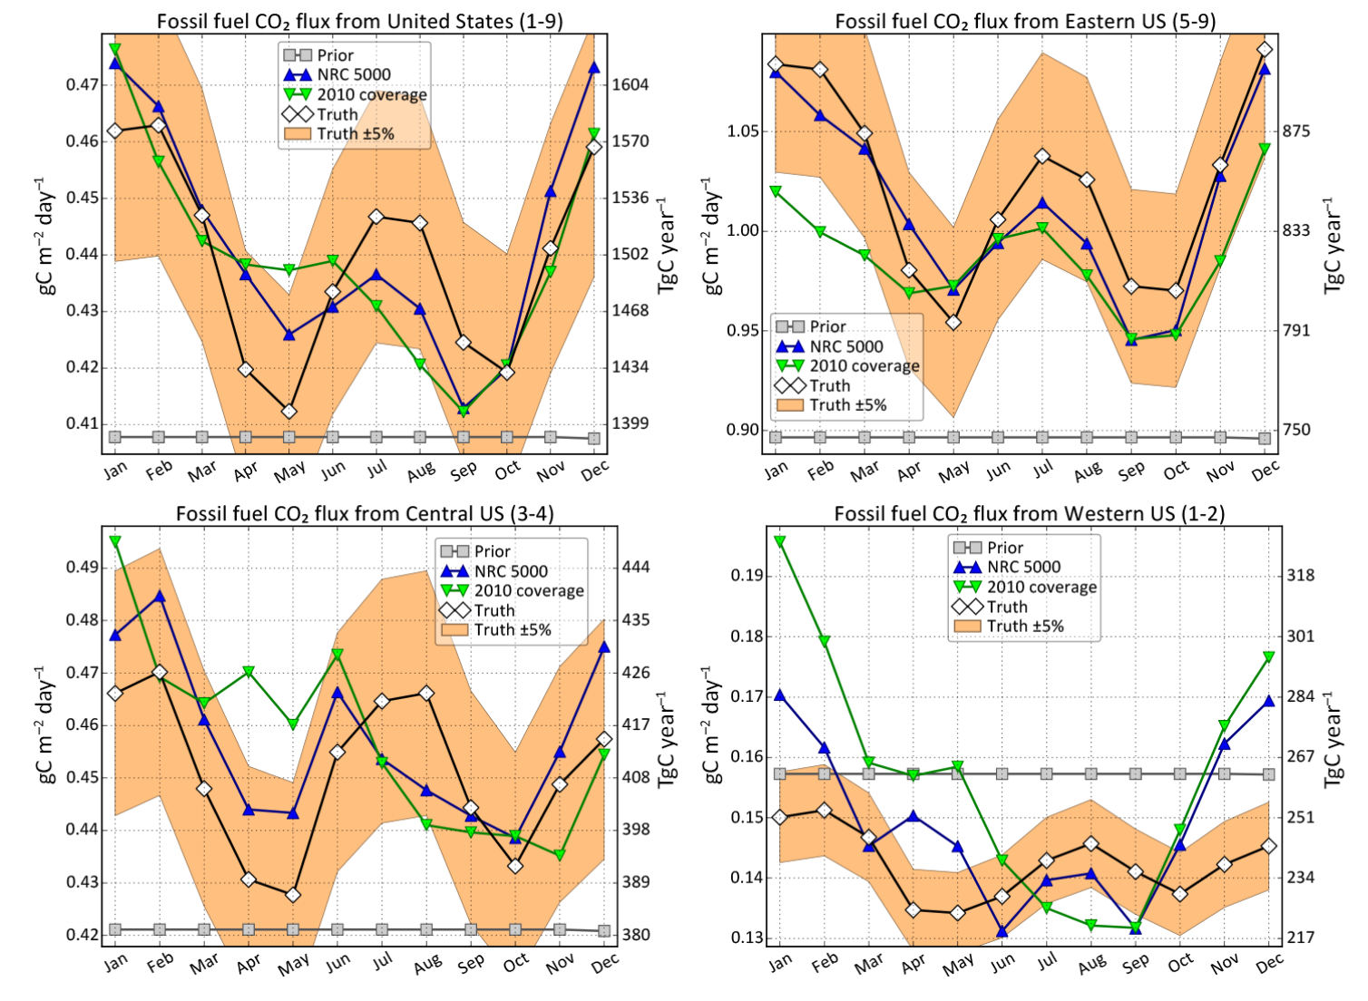
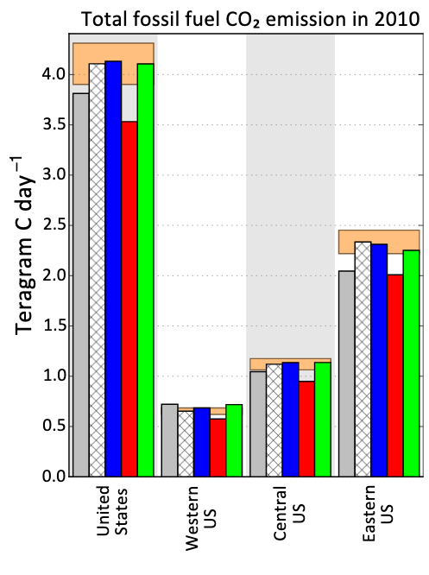
This network can measure CO2 emissions to ~1% accuracy annually
Basu, S., Miller, J. B. & Lehman, S. Separation of biospheric and fossil fuel fluxes of CO2 by atmospheric inversion of CO2 and 14CO2 measurements: Observation System Simulations. Atmos. Chem. Phys. 16, 5665–5683 (2016).

Slide 8
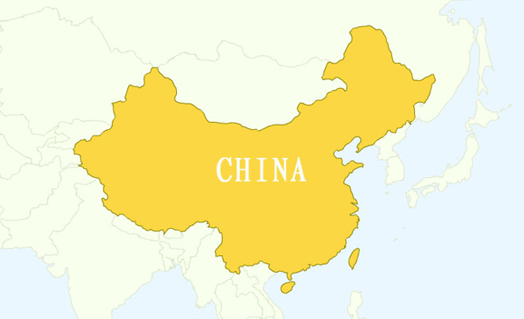

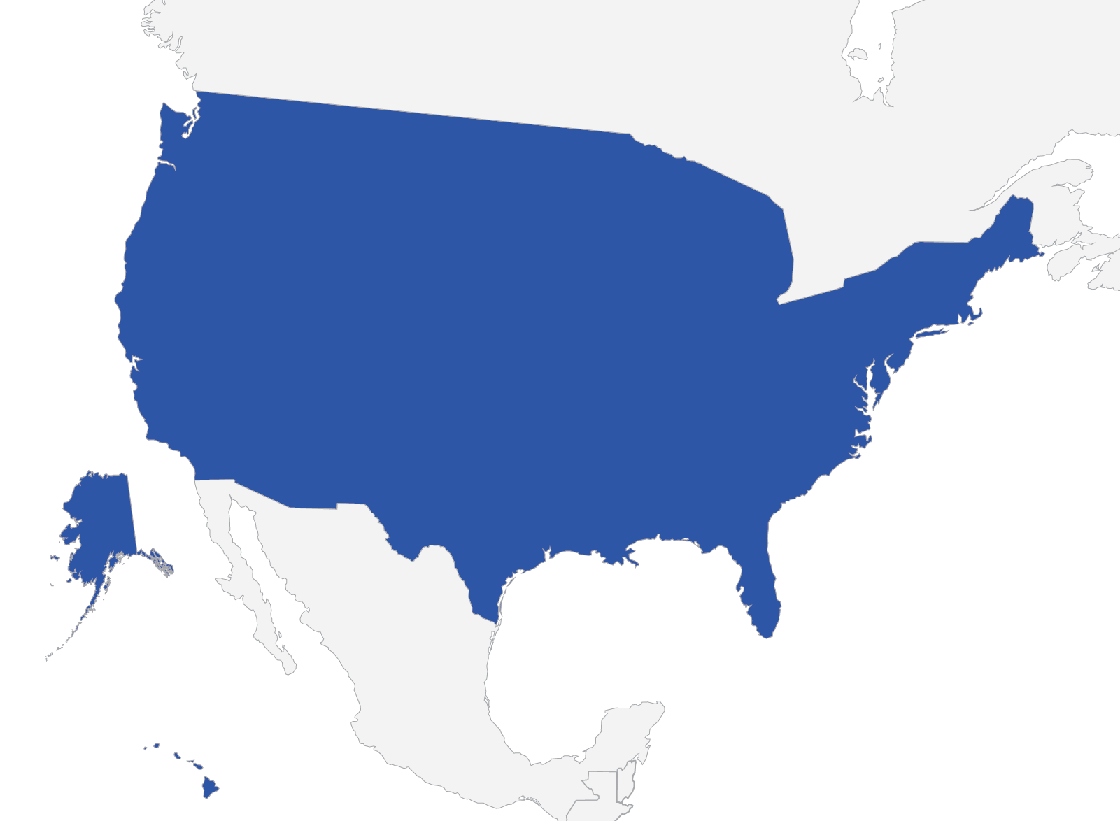




Bottom-up accounting is hard for other reasons
Notes:
Car is made in china. China counts the factory emissions.
Car is shipped across the ocean. Who counts the emissions in international waters?
Car is then driven in the US, and the US counts those tailpipe emissions.
But accounting this way means that countries like the US can push a bunch of emissions onto countries like China, even though the demand is ultimately in the US, artificially deflating a country’s true emissions.
If you try the opposite though, then the carbon accountant in the US would need to know all of the details about he shipping and the factory in China. That information is not always available. What if the factory in china has trade secrets?

Slide 9
Bottom up accounting: production vs. consumption
Criteria | Production-based NEI | Consumption-based NEI
Emissions covered | Administered territory | Global
Allocation | Domestic production | Domestic consumption
Allocation of trade | Includes exports, not imports | Includes imports, not exports
Mitigation focus | Domestic activities including exports | Domestic activities and imports (exports excluded)
Comparability | Consistent with GDP | Consistent with national consumption
Consistent with trade policy | No | Yes
Annex I emissions coverage | Lower | Higher
Complexity | Low | High
Transparency | High | Low
Uncertainty | Lower | Higher
Current country coverage | Relatively high | Low with current data
Mitigation analysis | Domestic mitigation only | Global mitigation
Notes:
International treaties use production based inventories, while literature prefers consumption based. Why do you think this might be?
How to handle carbon outside of national boundaries? How to handle trade? Production vs. consumption accounting.
E.g. if we inject CO2 in national waters, but it leaks back into the atmosphere in international waters, how is that accounted for nationally?
What if an aquifer is shared by many countries? What if it then leaks?
https://en.wikipedia.org/wiki/Greenhouse_gas_emissions_accounting

Slide 10
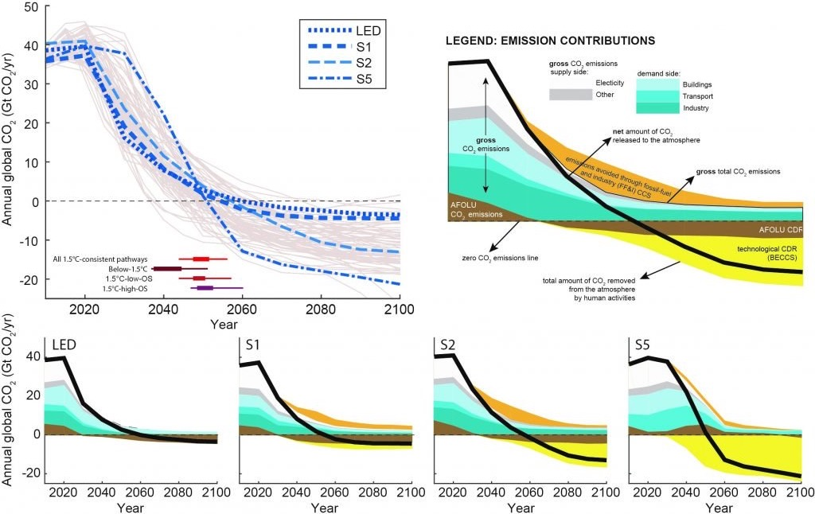
Negative emissions are necessary to reach Paris goals
Rogelj, J., et al. 2018: Mitigation Pathways Compatible with 1.5°C in the Context of Sustainable Development [Masson-Delmotte, V., et al. (eds.)].
Otherwise, how do you know it’s actually a negative emission?
Notes:
AFOLU=Agriculture, forestry, and other land use
S1 is a sustainability oriented scenario, S2 is a middle-of-the-road scenario, and S5 is a fossil-fuel intensive and high energy demand scenario. LED is a scenario with particularly low energy demand.

Slide 11
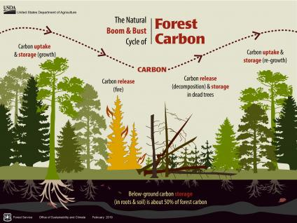
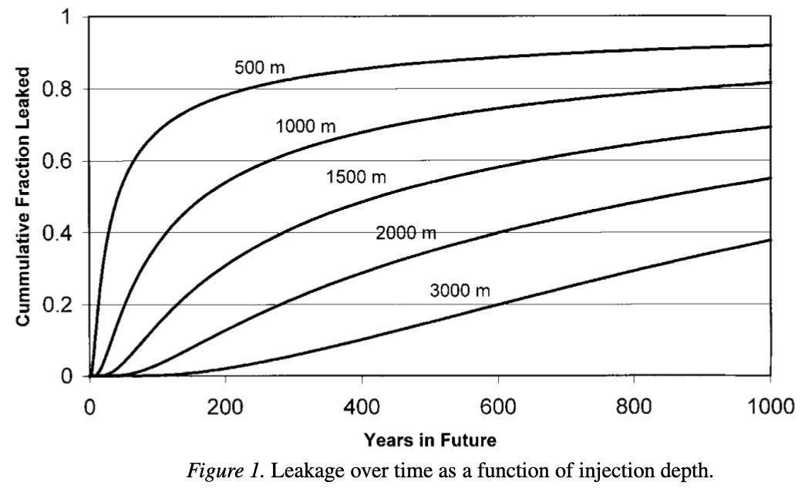
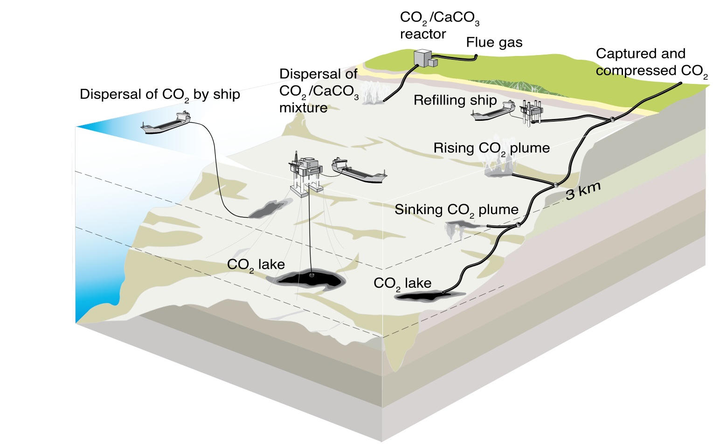
Forestation and ocean injection are impermanent forms of sequestration
Forestation
Ocean injection

Slide 12
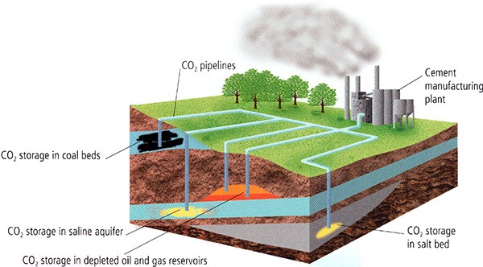
Ground injection is more permanent but still has risks of release
Injecting pure supercritical CO2
Injecting dissolved CO2 in water
Snæbjörnsdóttir, S.Ó., Sigfússon, B., Marieni, C. et al. Carbon dioxide storage through mineral carbonation. Nat Rev Earth Environ 1, 90–102 (2020).
Notes:
Terrestrial biosphere – Decades
Ocean injection - Centuries
Underground reservoirs – Millenia
Mineralization – Millenia to millions of years?
https://www.ipcc.ch/site/assets/uploads/2018/03/srccs_wholereport-1.pdf

Slide 13
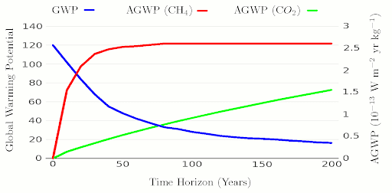
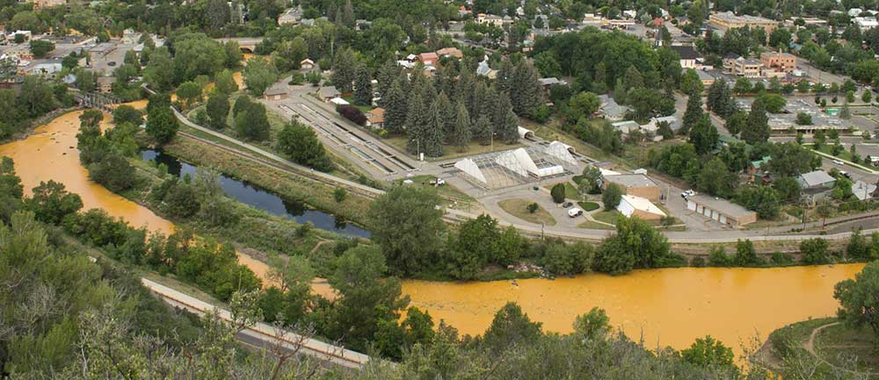
Possibilities to account for storage time
Carbon price
Carbon price
Value
Value
Time
t₀=“Permanent” storage
credit for storage
debit for release
Time
Animas River
Aug. 6 2015
Notes:
Credits, liabilities, discounting, etc.
Ton year accounting
How long should be considered permanent storage?
Completely determines value of temporary storage on a ton year accounting approach.
Similar to thinking about a 100 year GWP of greenhouse gasses.
Make sequestration and emission different events
If you are responsible for a ton of emissions, you have to buy a credit at the going price when it happens
If you are responsible for a ton of sequestration, you sell a credit at the going price when it happens.
If you sequester, then it leaks, you gain for the initial sequestration and then must buy credits to cover the leaks
Difficulty is in tracking leaking back to an individual. Also what happens after the individual has moved on. See mine cleaning.
Can these institutions be maintained hundreds to thousands of years in the future? Example: abandoned mine cleanup
The Environmental Protection Agency’s efforts to clean up an abandoned mine near Silverton, Colorado, backfired. While using heavy machinery to enter Gold King Mine, crews sprang a leak, sending three million gallons of mining wastewater into the Animas River. The river turned mustard yellow as it carried the contaminants south through Colorado, Utah, and New Mexico.
Note that all of this applies to avoided emissions also.

Slide 14
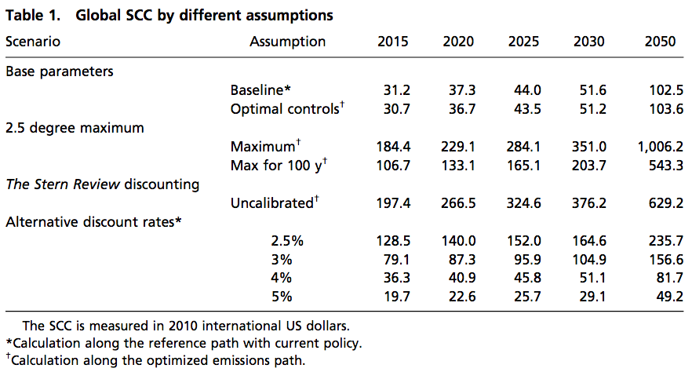
Current Integrated Assessment Models predict a social cost of carbon that increases with time
Price grows, but slower than discount rate
Nordhaus, 2017. PNAS.
Notes:
If carbon price increases more slowly than the discount rate then it can still be profitable to do temporary storage
Find paper showing carbon price change over time compared to possible discount rates?
Problem is, that if emissions continue, the value of marginal emissions increases

Slide 15
A future backstop technology can make temporary storage more valuable
Direct air capture and storage price
Carbon price
Value
How long until $_{SCC} = $_{DAC}? 10 years? 100? 1,000?
t_{backstop}
Time
Herzog, H., Caldeira, K. & Reilly, J. An issue of permanence: Assessing the effectiveness of temporary carbon storage. Clim. Change 59, 293–310 (2003).

Slide 16
Regulation through performance standards
Economists traditionally view market mechanisms as the most efficient way to manage emissions
However, these issues of verification, time, and leakage may not have an efficient market-based solution
This means that other regulations, such as “best available technology” or performance standards, may also play a substantial role.

Slide 17

Thought Experiment #1
A certain country does ocean injection of CO2 on coastal waters. This country signed a treaty regulating CO2 using annual production-based emissions inventories. Injected CO2 will equilibrate with the atmosphere over the next few hundred years, pretty much entirely in international waters. How much credit, if any, should the country get for this injection?
Notes:
Example 1: Country gets full credit, several hundred years is considered permanent storage and ignored. -> Potentially unrealistic, may lead to less sequestration than necessary
Example 2: Country gets full credit at time of injection, then a debit every year based on how much of the estimated CO2 is lost. This liability is tradeable, and varies year to year based on observations, weather, etc. -> High overhead and uncertainty, may lead to less sequestration than necessary.
Example 3: Country must abide by certain technical standards, and credit is issued assuming these standards and estimated leaked. ->Lower overhead, less likely to miss estimations.

Slide 18
Thought Experiment #2
A private company injected CO2 into a depleted oil reservoir and sells the negative emissions for a credit. When the reservoir is full, the company goes out of business. However, they improperly capped the wellhead, and much of the sequestered CO2 is released over the next 100 years. When and how would this leak be detected, if ever? Once detected, who is liable to fix it and pay for the released CO2?
What if the leak is elsewhere and caused due to an earthquake? What if that other location is over a border into another country, or offshore in international waters?

Slide 19
Summary

