Slide 1
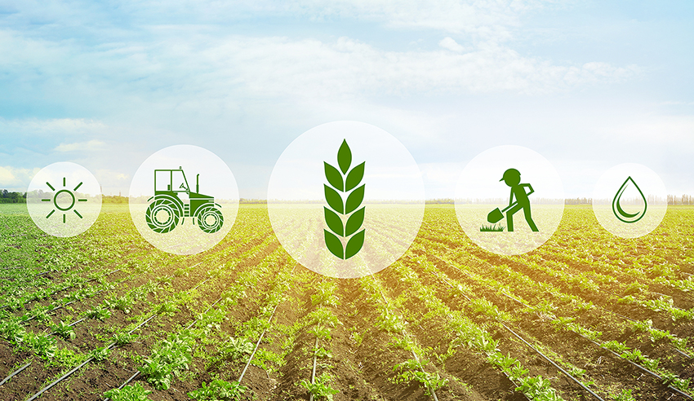
Waste and Agriculture
Harvard Energy Journal Club
By Robert Newman

Slide 2
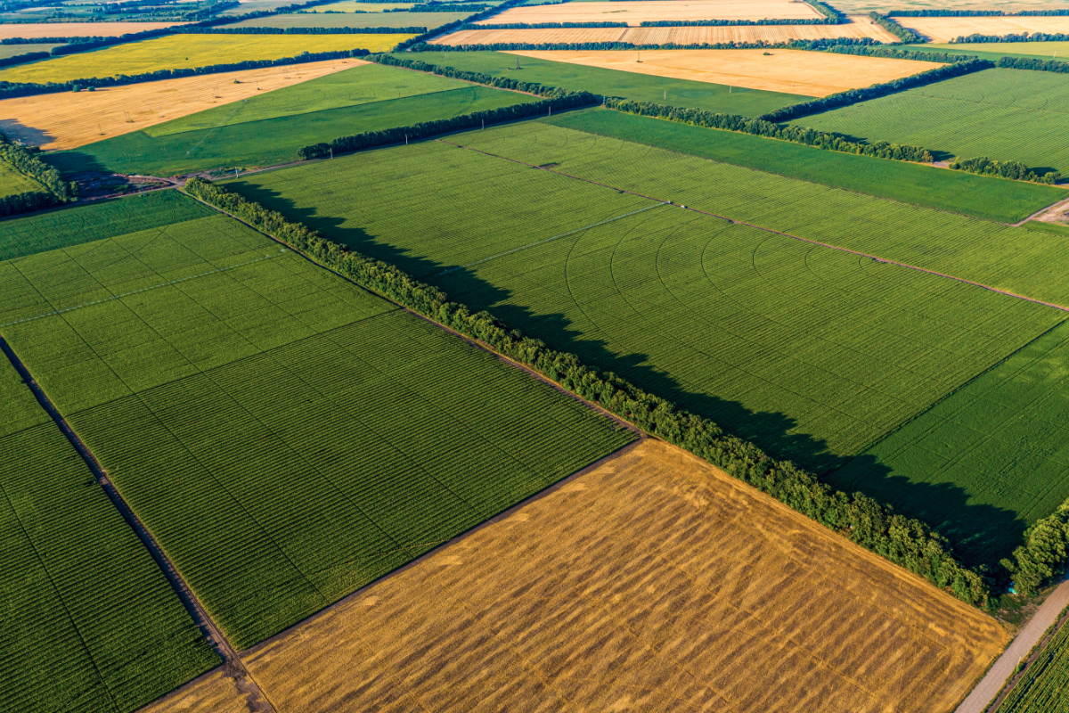
Agriculture in The United States
Net exporter
Average farm size is 418 acres
  Less than a 10th of Harvard’s Campus
4% of Farms make over $1M
These farms yield 2/3 of all total out
Accounts for about 1% of GDP
Accounts for about 2% of energy usage

Slide 3
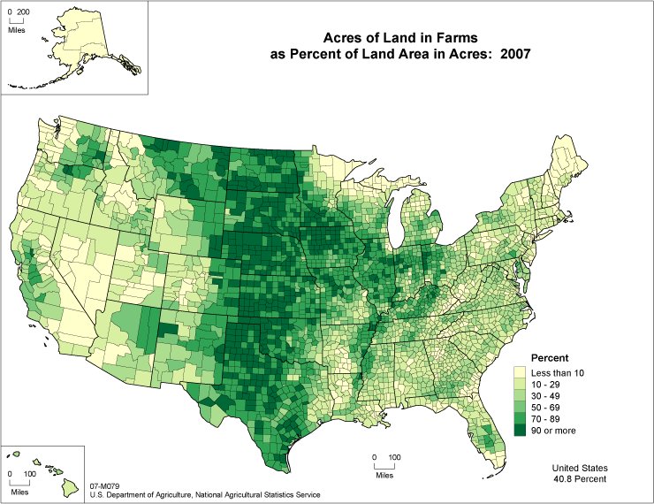
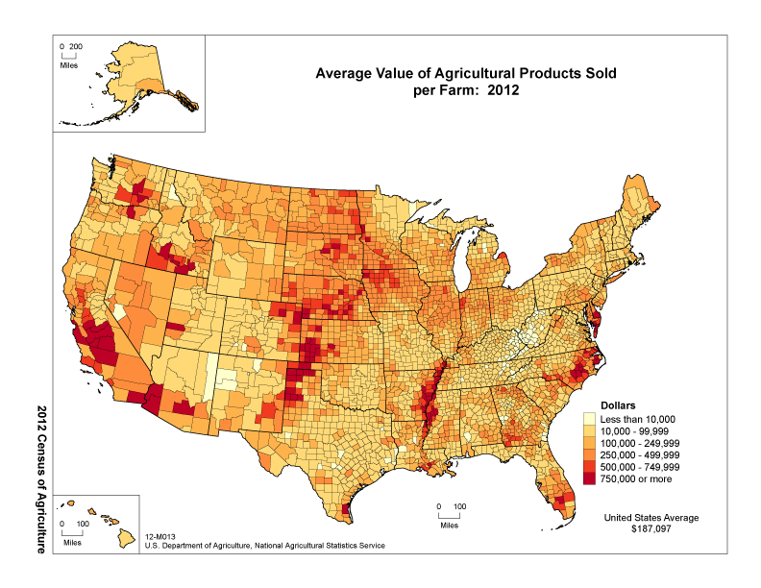
Where

Slide 4
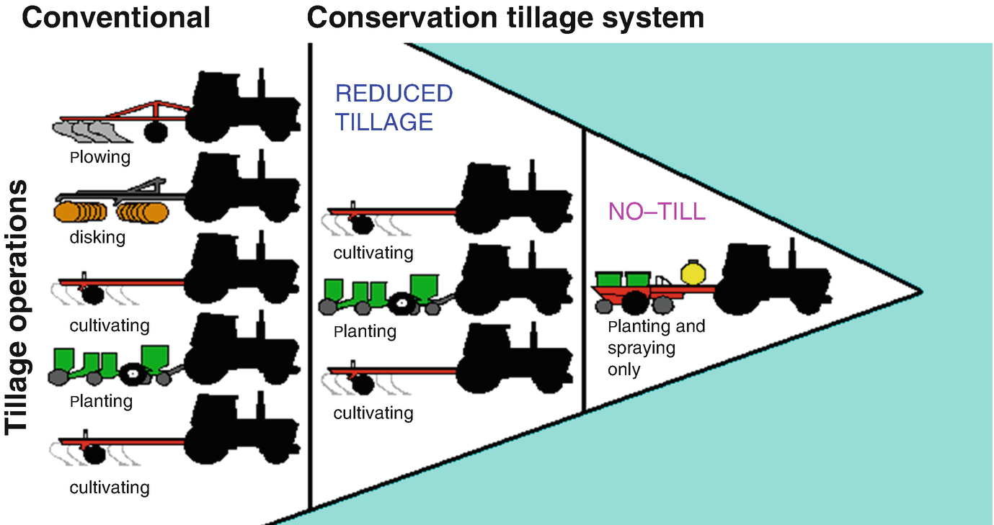
Tilling the soil

Slide 5
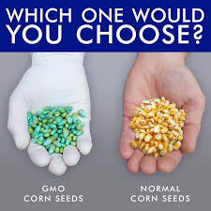
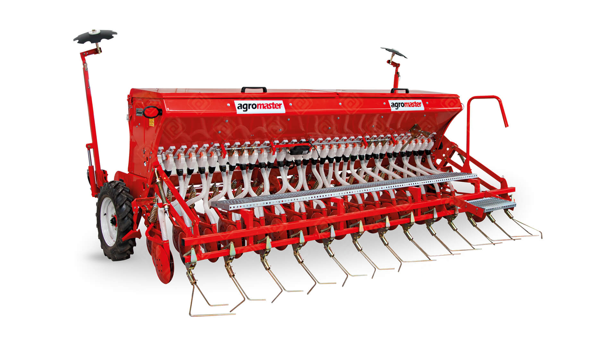
Planting Seeds

Slide 6
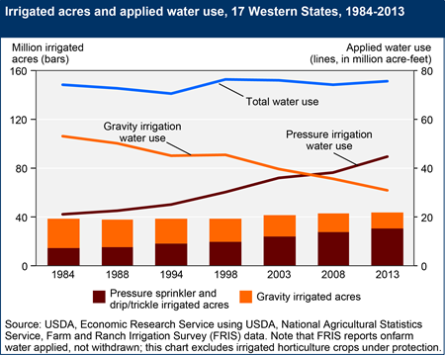
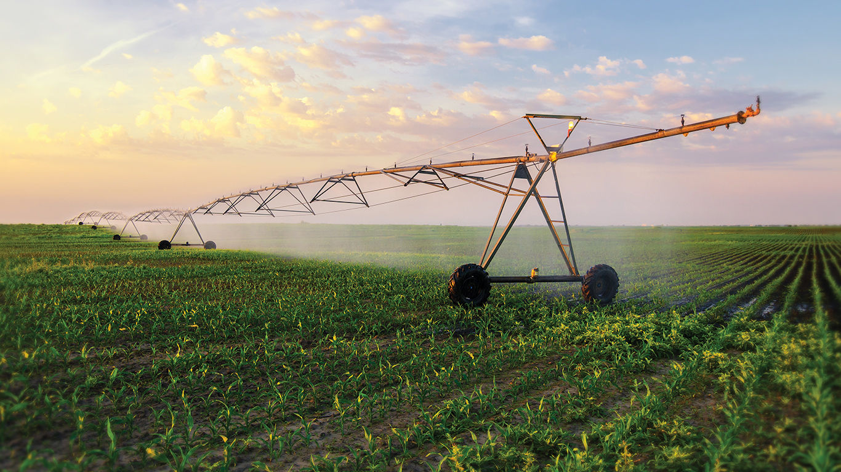
Irrigation
80%-90% of all US water use
Only 1/3 of farms are irrigated

Slide 7
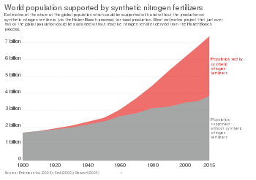
Fertilizers and Pesticides
Fertilizers provide nitrogen, phosphate and potassium
Herbicides, insecticides, fungicides

Slide 8
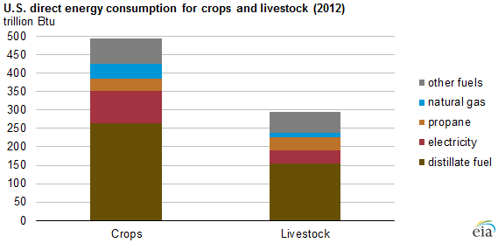
Energy Consumption
2% of US Energy is used in growing food
50% is fertilizer and pesticides
50% operation of equipment and irrigation
Around 13 percent of all US energy is used for other food related processing and transport

Slide 9
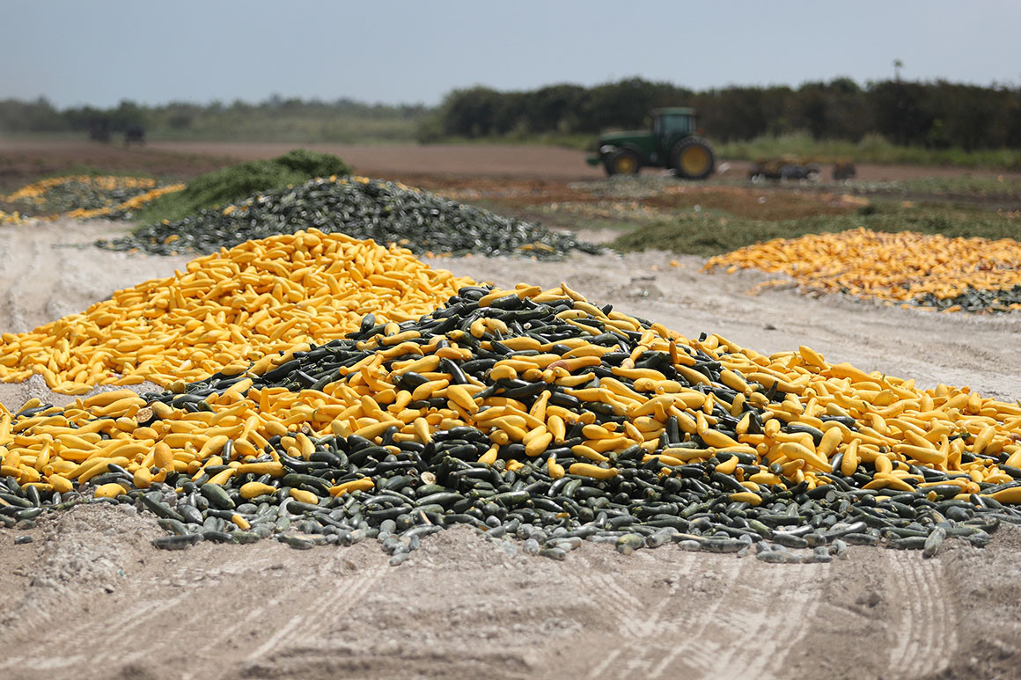
Food Waste- Production
Overproduction and Dumping
Cosmetic defects
Labor shortages
Public hysteria
Trimmings

Slide 10
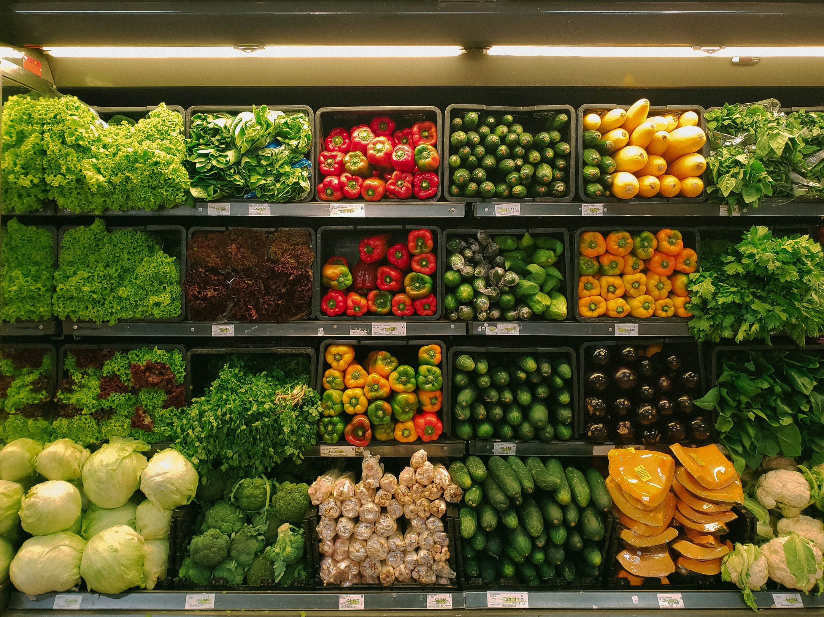
Food Waste- Consumption
Retail waste- perishables - $15B
  Overstocking
  Sell by dates
  Liability concerns
Restaurants
  Portion size
  Pre-preparation
Households
  Spoiling

Slide 11
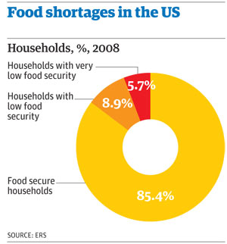
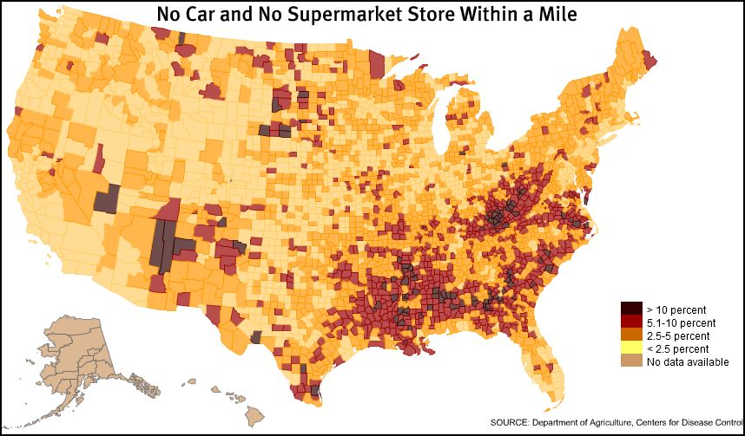
Access to Food

Slide 12
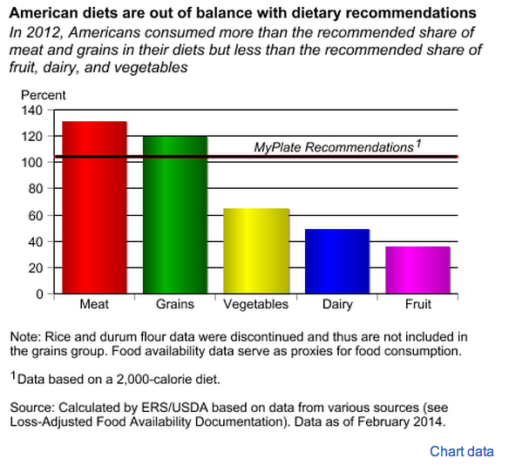
Nutrition

Slide 13
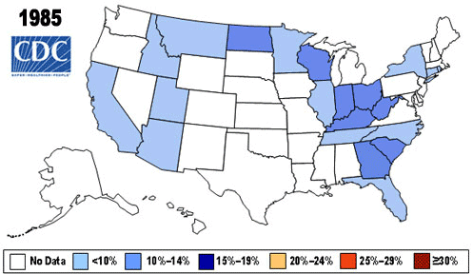
Obesity

Slide 14
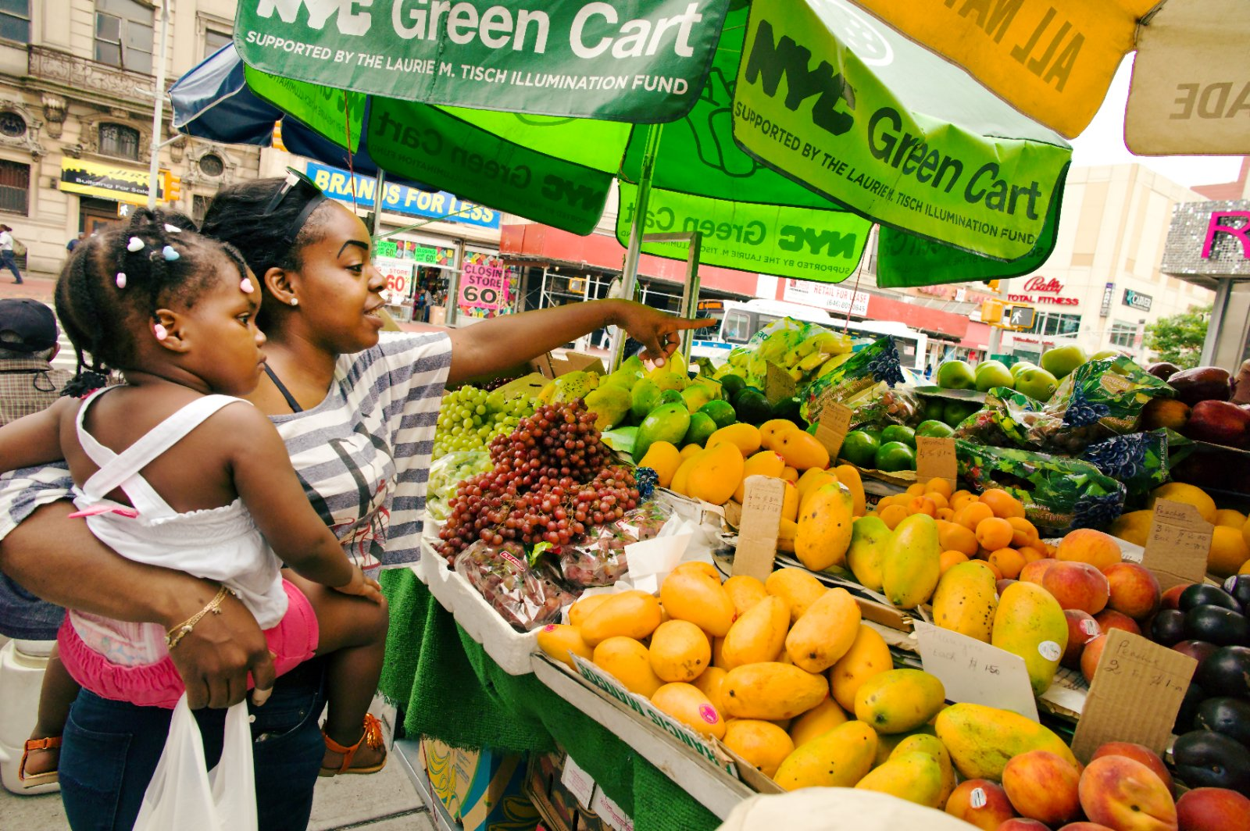
Food Allocation
Produce carts
Zoning laws
Education
Public transportation
Distributed production
Food Taxes
Packaging and Labeling
Demand prediction
Source: Smart Growth America

Slide 15
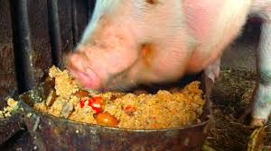
Food Waste Usage- Animal Feed
Heat treated and dehydrated
Mostly already being done
Requires transportation

Slide 16
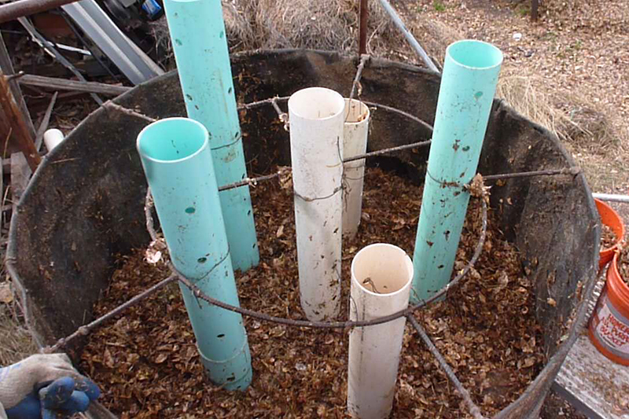
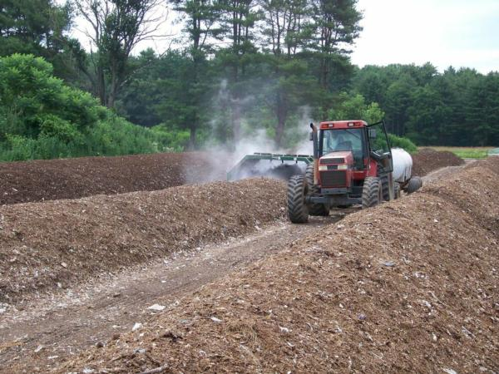
Composting
Various methods
  Turning windrows
  Aerated Static Pile
Hard to compete with synthetic fertilizer
Large time scales
Require maintenance and treatment
Produces small amounts of heat
Produces waste gases

Slide 17
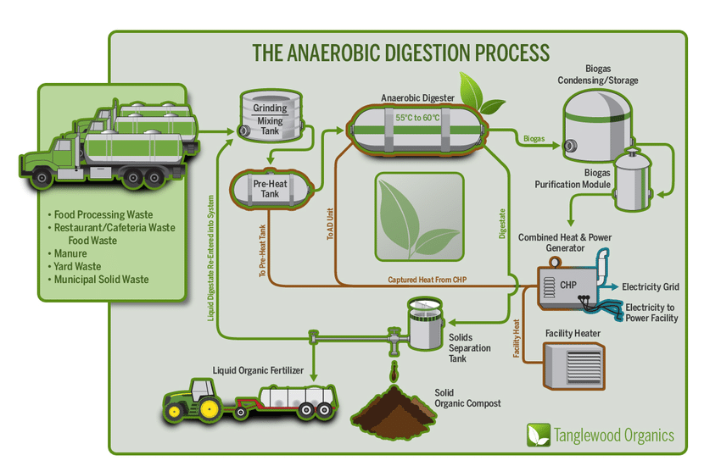
Anaerobic Decomposition

Slide 18
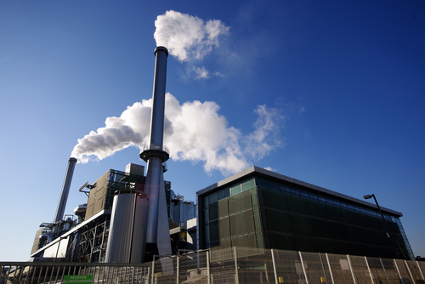
Burning
Torrefaction
Charcoal Briquettes
Expensive due to its high water content
Reduces landfill usage

Slide 19
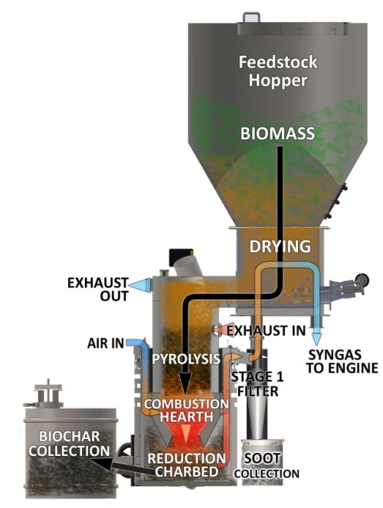
Pyrolysis
Biomass is heated in the absence of oxygen
Produces a pyrolysis oil, biochar, and syngas
Heat can make steam or use thermocouples to generate energy

Slide 20
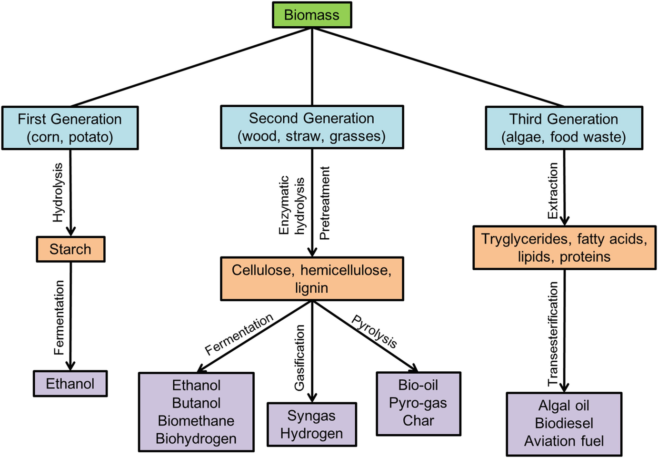
Biofuels
Fermentation of biomass leads to the production of ethanol
Biodiesel can be made mixing ethanol with various oils
Requires significant amounts of purification and processing
Also done with hydrothermal liquefaction

Slide 21
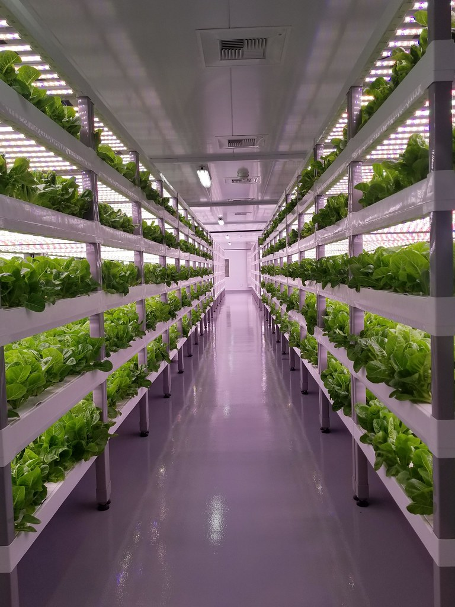
Other Farming Strategies
Vertical Farming
Hydroponics
Aquaponics
Two-crop/cover crop systems
Agroforestry

